Slide 1
2025-2026
Special Education December Count
Reports Training
^{January 28, 2026}
^{Lindsey Heitman}

Slide 2
Special Education December Count
Contact Information and Resource Links
Contact Information:
Lindsey Heitman – SpedDecCount@cde.state.co.us 720-456-2033
  Special Education December Count Snapshot submission
  Includes IEP Interchange and December Count SPED staff/SAM questions
Hannah Prokop – Prokop_H@cde.state.co.us 720-284-8144
  Special Education staff qualifications
  Special Education monitoring and compliance
Please include your AU #, District # and error code # or cognos report name (if applicable) in emails
Resource Webpages
  Special Education IEP Interchange
  Staff Interchange
  Special Ed December Count Snapshot
  ESSU Data Management System

Slide 3
Why do we have reports?
The U.S. Department of Education (Department) requires CDE to ensure the timeliness and accuracy of data reported by the State under Sections 616 and 618 of the Individuals with Disabilities Education Act (IDEA).
Timely and accurate data submission is one element of an AU’s Determination issued annually as required under Section 616 (D) of the Individuals with Disabilities Education Act Part B
The reports are evidence that the Special Education Director has reviewed the data and certified that the data are accurate, valid, and reliable.

Slide 4
Timeline Clarification
Friday, January 30 – complete error free snapshot
All Sped IEP and Staff Interchange errors resolved
All December Count Snapshot errors resolved
January 30 – February 6 – Initial Report Review
Friday February 6 is a statewide deadline
Review December Count Staff and Student Cognos reports
No need to sign reports or submit anything to CDE until the final report review week
February 9 – 10 - CDE to run duplicate and other data validity checks on student data
  Email will be sent by Wednesday, 2/11 with instructions for AUs
February 11 – 17 - Administrative Units research and make file changes to resolve duplicate and data validity issues.
Wednesday, February 18 (STATE DEADLINE) - all duplicates resolved and snapshot complete and error-error
  Email will be sent once all duplicates are resolved and it is ok to start submitting your final snapshot
February 18 - 20 Final Report Review and Submission to CDE.
  Approve final Special Education December Count Snapshot in the Data Pipeline by clicking “Submit to CDE” button
  Upload 16 signed reports and Flag Explanation document (if necessary) to the DMS
  Signed reports are uploaded to the Data Management System under the ESSU DMS Documents tab. Please tag the file with the corresponding data collection name

Slide 5
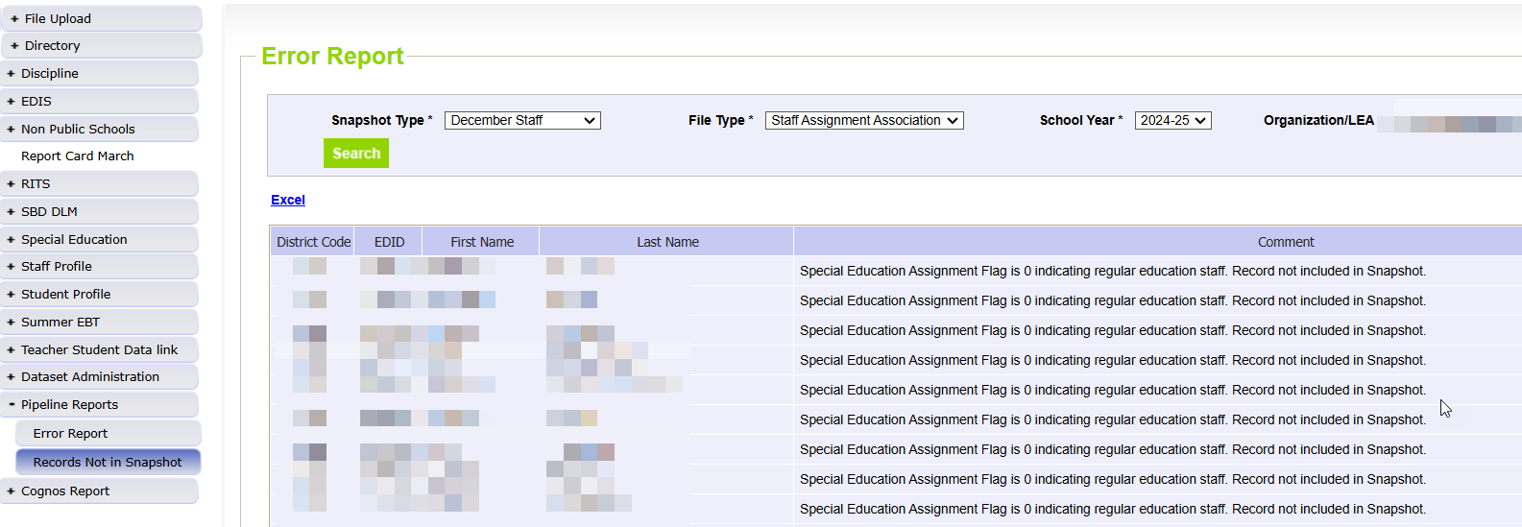
Special Education December Count:
Helpful Report to find why staff EDIDS are missing from your Dec Count Snapshot
Records potentially missing from your snapshot may be found in this report.
Pipeline Reports → Records Not in Snapshot
Filter on Snapshot Type ‘December Staff’ and each file type
Records listed in this report do not meet the snapshot criteria (see reasons below right) but they are not errors
Use this report to find why a staff or student interchange record is missing from your snapshot
AUs please use this report to locate why a Staff record is missing (to help your staff respondent)
Record may have error in the Staff Interchange files
Record may not be included in one of the Staff Interchange files
Record may not be marked with Sped Assignment Flag = 1
Record may have an End Date of Assignment prior to 12/01/25

Slide 6
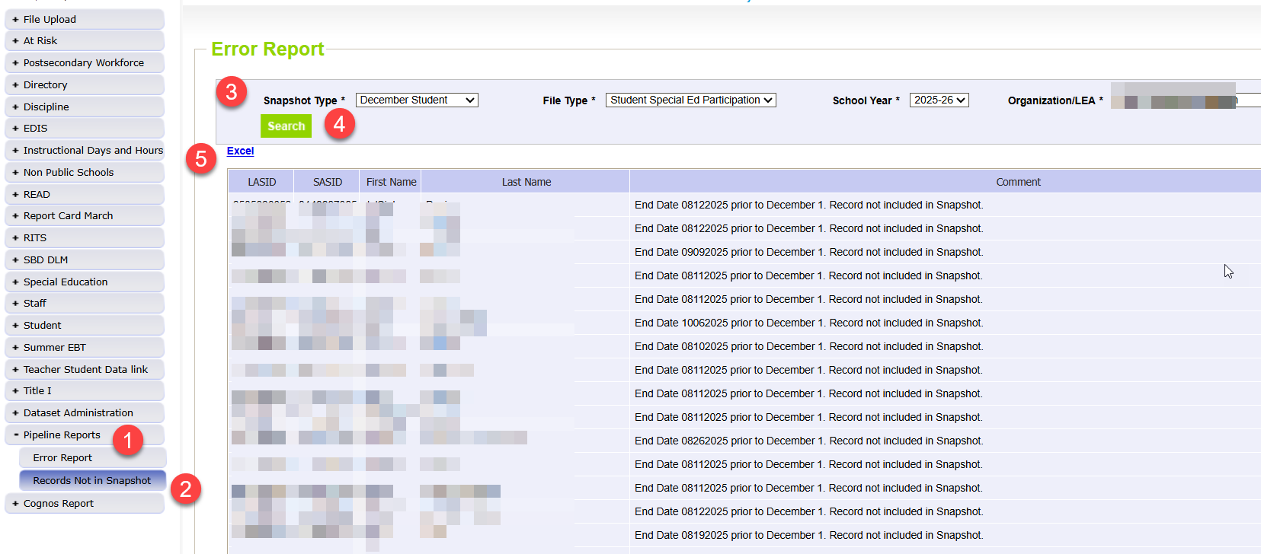
Pipeline Reports → Records Not in Snapshot
MUST CHECK this report so you don’t inadvertently miss records from snapshot that are due funding
Keep in mind not all records on this report should be in your snapshot.
  Records are correctly excluded if they have a Start Date or Exit Date that doesn’t overlap 12/01 or no Start Date at all.
You will want to fix any SASID or LASID mismatches, missing records from one file, or records with interchange errors (that should be in your snapshot).
Missing records = missed funding! Check for records that were receiving SPED services as of 12/01/25.

Slide 7
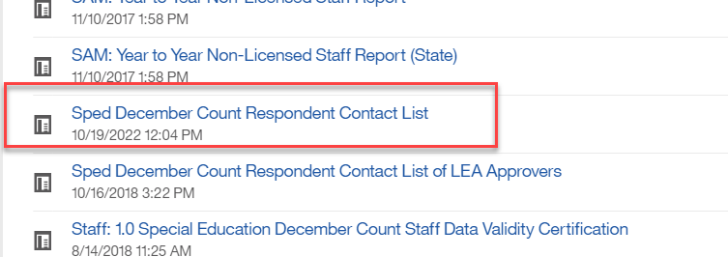
Special Education December Count: Student Warnings
DC158: The following SASIDs are included in the December Count Student Snapshot, but no record was found in the Student interchange- Untagged or DEC tagged file. This may be accurate for students in Non-Public Schools or Approved Facility Schools, however, if any of these students are in a Public School, please check with your Student Interchange contact to see why they are not reporting the student.
DC260 - This student was exited from your AU on the prior Sped EOY. Please verify whether they should be reported in December count and adjust the data if necessary.
Duplicate Records between AUs – check for these December Student warnings
  DC154: Another AU is also claiming a Funding Status of 50 for this student. Please verify attendance and enrollment records for December 1st. If your record is correct, you may leave it the same.
  DC214: Another AU is reporting that this student is attending in their AU. Please verify attendance and enrollment records for December 1st. If your record is correct, you may leave it the same and ignore this warning.
    The other reporting AU is included in the far right column of the error report
    Reference ‘Pupils Attendance Information Codes’ document from December Count Snapshot webpage under Additional Links for help with PAI and Funding Status Codes.
    Contact List found in Cognos→Special Education December folder
To find the other AU contact info, export the entire report to Excel and search the Admin Unit # column for the AU#. Be sure to email all contacts listed to ensure you catch the right person, sometimes there are several people listed for an AU.

Slide 8
PAI Codes:
A-Side and B-Side Codes
PAI Codes A-Side | A – Side District of Attendance PAI Code Descriptions | PAI Codes B –Side | B-Side District of Residence PAI Code Descriptions
01 | Resident, Designated School | n/a | n/a
02 | Resident, Open Enrollment | n/a | n/a
03 | Resident, Non-District Site | n/a | n/a
08 | Resident, Non-Choice | n/a | n/a
04 | Non-Resident, Choice | n/a | n/a
n/a |  | 22 | Licensed Eligible Facility Attending On-Grounds School (Approved Facility School)
05 | Non-Resident, Non-Choice | 23 | Licensed Facility, Attending Public School
11 | Non-Resident, Detention Center | 24 | Court-Mandated Juvenile Detention
n/a | n/a | 27 | Non-Public School (Contractual Agreement)
n/a | n/a | 28 | Outside of CO, Public Education Agency
n/a | n/a | 29 | Outside of CO, Non-Public School
n/a | n/a | 30 | CO Public Agency (Contractual Agreement)
12 | Non-Resident Administrative Unit Placement | 31 | Administrative Unit (Contractual Agreement)
14 | Resident, Served at District Site | n/a
15 | Non-Resident, Served at District Site | n/a
16 | Resident, Non-District Site | n/a
17 | Non-Resident, Non-District Site | n/a
19 | State Operated Program | 32 | State Operated Program (AU of residence reporting is optional)
These codes differ from the Student Interchange PAI Code options!

Slide 9
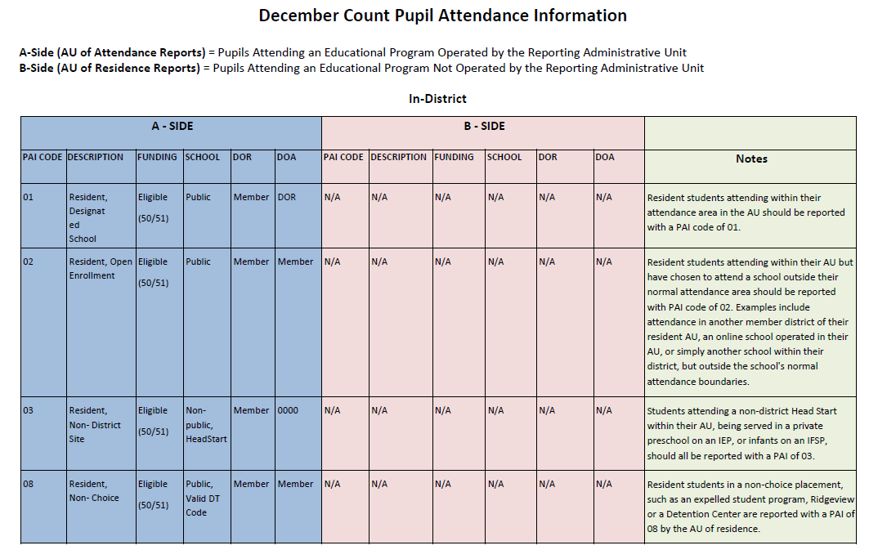
SPED PAI Codes Document– Please Print for PAI Coding Help
Special Education December Count Snapshot
SPED PAI coding chart with notes about each code found under Additional Resources section
Information on how to report these fields so they all align with the student’s placement:
  School Code
  PAI Code
  Funding Status
  District of Attendance
  District of Residence

Slide 10
SAM Warning Notes
DC208, DC209, DC210, DC211
SAM Warnings are found in your Special Education December Staff Warning Reports (view in either Pipeline error reports or Cognos error reports)
SAM Warnings should be investigated - some may be resolved by correction of data:
  incorrect SSN
  job code miscoding
  student disability caseload discrepancy
    Note about a system limitation: someone with an early childhood special education endorsement (only) will trigger SAM warnings 209/210 if they have a third grader on their student caseload
Snapshot errors should be resolved before you review SAM Warnings DC209/DC210
Both DC209/DC210 generate for special education teachers (202) and speech-language pathologists (238) who do not satisfy SAM approval criteria

Slide 11
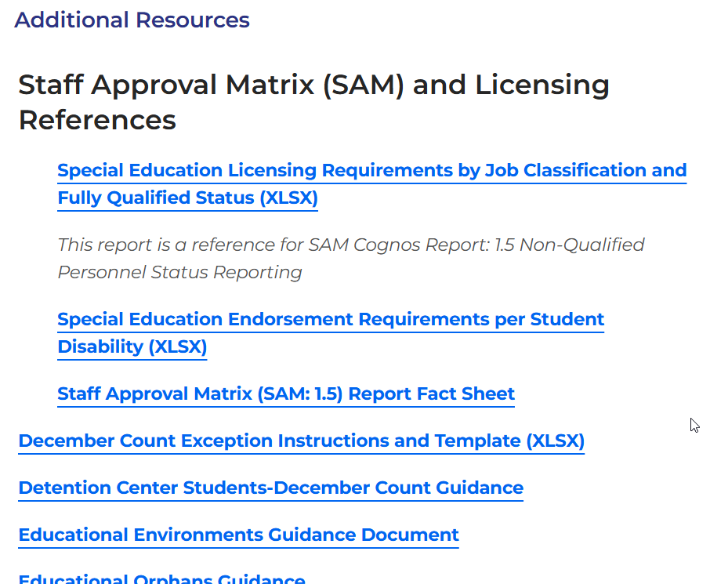
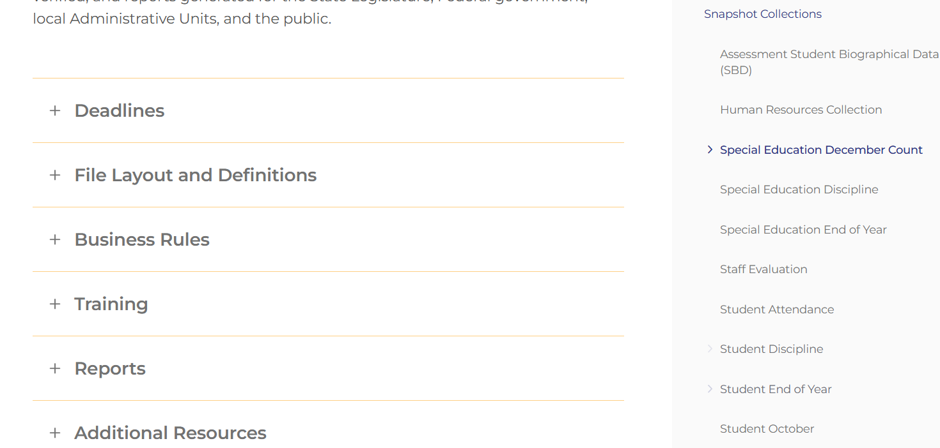
December Count
Snapshot Resources Webpage
Special Education December Count Snapshot Webpage

Slide 12
SAM/Staff Qualifications
Online Reference Documents
Refer to documents posted in the Additional Resources section of the
Special Education December Count Snapshot webpage
Use Staff Approval Matrix (SAM) and Licensing Reference documents to assist in proper job coding, allowable license types and appropriate special education endorsements
  Special Education Licensing Requirements by Job Classification and Fully Qualified Status
    displays allowable license/endorsement types for job codes requiring a CDE license
  Special Education Endorsement Requirements per Student Disability
    displays allowable endorsements for the placement of special education teachers (202) for the 50% student disability caseload match

Slide 13
SAM Warnings
SAM Warning DC208 – Staff did not hold a valid license on 12/01
Remind staff to renew their license
SAM Warning DC209 – Staff does not hold an appropriate endorsement for the assignment
Check to be sure you are reporting the correct job code
Remind staff to apply for the correct license for their job role
SAM Warning DC210 – Staff does not hold an appropriate endorsement for the caseload
Check to be sure the primary providers/job codes are correct (i.e. students with disability type 08 or 11 must have a primary provider with a 238 job code)
SAM Warning DC211 – Staff does not hold a valid license
Check to be sure SSN is correct in COOL system and on your Staff Assignment file and in EDIS system

Slide 14
Special Service Provider Job Codes and SAM Warning DC209
Occupational Therapist = JCC 234
Physical Therapist = JCC 235
** these positions are often classified as “motor services” at the AU level with job codes interchanged during data reporting
Counselor = JCC 211
Psychologist = JCC 236
Social Worker = JCC 237
** these positions are often classified as “mental health services” at the AU level with job codes interchanged during data reporting
Another job often miscoded:
  Behavioral Specialist = 220 vs. Board Certified Behavioral Analyst (BCBA) = 224
    There is a specific BCBA endorsement type and code 224 is the correct job code for that role
Verify staff license type and endorsement prior to coding
Ensure that staff positions are coded correctly in your Human Resources systems and are in alignment with job codes posted in the CDE Staff Interchange – Staff Assignment document and CDE Chart of Accounts
Job code miscoding results in SAM Warning (DC209)

Slide 15
SAM Cognos Reports
SAM cognos reports are available to help you validate your data/find coding issues
  SAM: 1.5 Non-Qualified Personnel Status
    displays staff by job code with each generated SAM Warning type
  SAM: ALL Certified Staff Report
    displays staff in assignments that require a CDE license
  SAM: Caseload Student Detail (DC210 Detail)
    displays special education teachers and SLPs with individual primary and secondary students
  SAM: Caseload Summary (DC210 Summary)
    displays special education teachers and SLPs with the number of primary students in each disability category

Slide 16
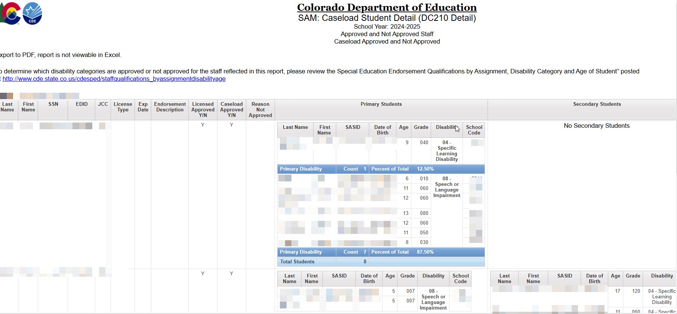
SAM: Caseload Student Detail (DC210 Detail) Report

Slide 17
Special Education December Count:
Unresolved SAM Warnings
December Staff Snapshot Warnings DC208, DC209, DC210, DC211
SAM Warnings will NOT prevent you from finalizing your December Count staff data.
If SAM Warnings remain unresolved at collection close, staff will display in the final SAM: 1.5 Non-Qualified Personnel Status report.
All non-qualified staff are included in the post December Count Correction Tracker accountability process.

Slide 18
Post December Count Collection
Staff Tracker Process
If SAM Warnings remain unresolved at collection close, staff will display in the final SAM:1.5 Non-Qualified Personnel Status report. These staff are considered non-qualified for one of the reasons we talked about today.
The Tracker is an accountability process between CDE and the AU documenting how the non-compliant issue is either resolved, or how it will be resolved.
AU Responsibility:
During December Count collection and post collection
Upon review of the SAM: 1.5 Non-Qualified Personnel Status report, the AU Special Education Director signs the report verifying the contained data is valid and accurate. Report is uploaded to the DMS.
CDE Responsibility:
SAM: 1.5 report data for each administrative unit is reviewed to validate SAM results.
If clarification is needed, Special Education Directors will be contacted by the ESSU’s General Supervision and Monitoring team.
Post collection Process:
A Personnel Status Correction Tracker form is completed for each administrative unit listing all staff contained in the SAM: 1.5 report. Director documents how the non-compliant issue will be resolved.
AU must work within CDE timelines to resolve the issue, and the AU remains in noncompliance status until the issue is fully resolved. If the issue is not timely resolved, the AU may be subject to corrective actions.

Slide 19
Special Education December Count - Student and Staff Signature Reports – Due by February 20th
Cognos Reports→ Special Education December Folder (reports are listed on the validity certification reports):
December Student Cognos Validation Reports: 2.0 Student Data Validity Certification 2.1 Significant Year to Year Report by Age Group and Disability
2.2 Significant Year to Year Report by Age Group and Race/Ethnicity
2.3 Significant Year to Year Report by Age Group and Educational Environment
2.4 Significant Year-to-Year Educational Orphan Report
2.5 Indicator 5: Number of Students Aged 6-21 by Educational Environment
2.6 Indicator 6: Number of Students Aged 3-5 by Educational Environment
2.7 Number of Reported Students by Special Education Funding Status by Administrative Unit and Disability
2.8 Number of Reported Students Parentally Placed in a Private School by Disability and Type of Service
2.9 Indicator 9: Disproportionate Representation of Racial and Ethnic Groups in Special Education Ages 3-21
2.10 Indicator 10: Disproportionate Representation of Racial and Ethnic Groups in Specific Disability Categories in Ages 3-21
*Please review Student Warnings
December Staff Cognos Validation Reports:
1.0 Staff Data Validity Certification
1.1 Summary of Special Education Staff by Administrative Unit, District & Job Classification Category
1.2 Summary of Job Classification by District Purchased Service Staff
1.4 Special Education Directors & Child Find Coordinators
SAM 1.5 Non-Qualified Personnel Status
*Please review Staff SAM Warnings DC208, DC209, DC210, DC211

Slide 20
December Count Student Reports
11 +1 STUDENT Reports to be Uploaded to the Data Management System
Year to Year
Data Summary Reports
    2.7 Number of Reported Students by Special Education Funding Status by AU and Disability
    2.8 Number of Reported Students Parentally Placed in a Private School By Disability and Type of Service
    2.5 Indicator 5
    2.6 Indicator 6
    2.9 Indicator 9
    2.10 Indicator 10
  Year-to-Year Reports:
    2.0 Student Data Validity Certification
    2.1 By Age Group and Disability
    2.2 By Age Group and Race/Ethnicity
    2.3 By Age Group and Ed. Environment
    2.4 Educational Orphan
  December Count Flag Explanations if you have flags on any of the above Year-to-Year.
Indicators

Slide 21
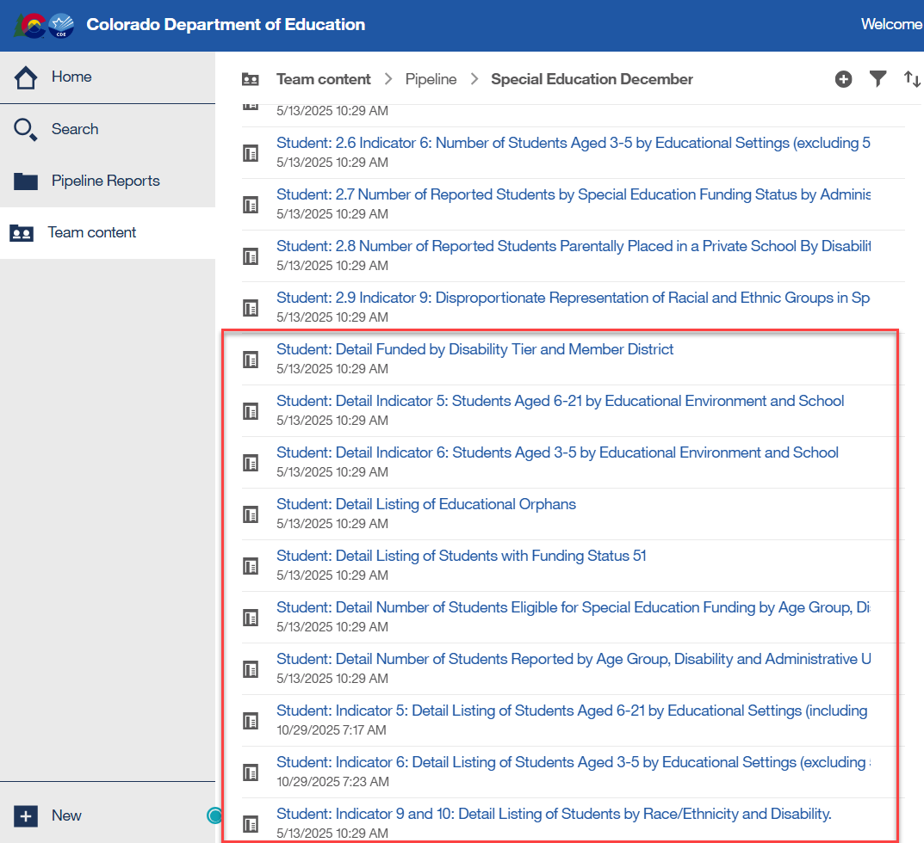
Student Detail Reports
Detail reports for your Information

Slide 22
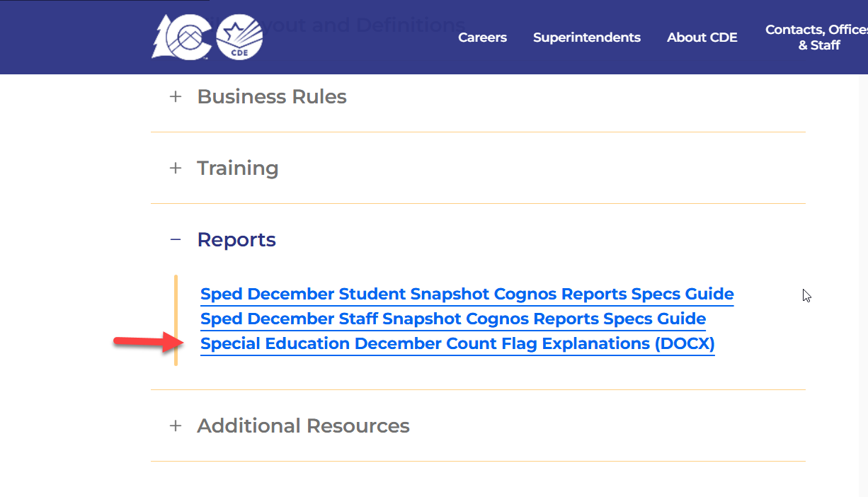
Special Education December Count
Flag Explanation Template
AUs are required to submit an explanation for each A flag on the 2.1, 2.2, 2.3, or 2.4 year-to-year reports.
Use the flag explanation template found on the Special Education December Count Snapshot webpage under the Reports section.

Slide 23
December Count Staff Report Lists
Reports for Your Information
District/AU Activity Report
SAM: ALL Certified Staff Report
SAM: Caseload Student Detail (DC210 Detail)
SAM: Caseload Summary (DC210 Summary)
SAM: Percentage of Not-approved Staff
SAM: Staff Licensed after December 1st
SAM: Temporary Educator Eligibility (TEE)
SAM: Year to Year Non-Licensed Staff Report
Detail: Mode Contract Days and Hours Per Day by JCC
Detail: SPED BOCES Staff Reported
Detail: SPED List by JCC
Detail: Teachers with License Info
Staff with FTE below 0.01 or higher than 1.7
5 Reports to be Uploaded
1.0 Staff Data Validity Certification
1.1 Summary of Special Education Staff by AU, District & Job Classification Category
1.2 Summary of Job Classification Category by District and AU Purchased Service Staff
1.4 Special Education Directors & Child Find Coordinators
SAM 1.5 Non-Qualified Personnel Status

Slide 24
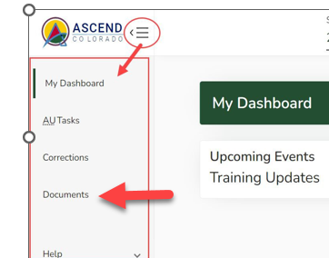
Special Education December Count – Reports Due for Upload to the Data Management System
By February 20, 2026
  Upload Required Reports to the Data Management System
    Staff Report #’s: 1.0, 1.1,1.2, 1.4, SAM 1.5
    Student Report #’s: 2.0, 2.1, 2.2, 2.3, 2.4, 2.5, 2.6, 2.7, 2.8, 2.9, 2.10
    Please upload these signed reports to the DMS under the Documents section (same location as the Discipline and EOY Reports).
If you have questions on uploading reports to the DMS or would like confirmation of your upload, please email Josh Fails at Fails_J@cde.state.co.us

Slide 25
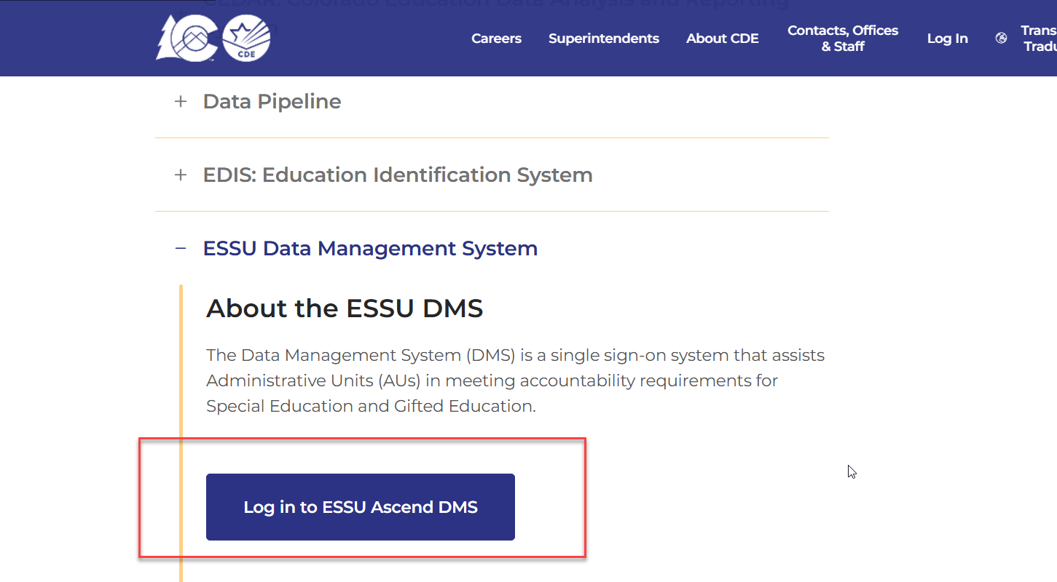
Uploading Reports to the
ESSU Data Management System
From the Idm homepage, click ESSU Data Management System log in button

Slide 26
Reports Submission Steps
Download the 16 numbered reports from Pipeline (export to PDF) and make sure all the reported numbers are accurate.
Sign the reports and scan them into one PDF.
Download the “Year-to-Year Flag Explanation Document” found under the Reports section (if necessary).
Explain the A flagged count differences using the templates in the flag document (2nd page).
Upload the following to Documents in the Data Management System:
  Signed and scanned reports (in one single pdf)
  Filled out year to year explanation template (separate Word document)

Slide 27
Special Education December Count:
Staff and Student Snapshot Timeline
Date | Event | Event Description
10/31/2025 | Interim Deadline | IEP and Staff Files have been uploaded at least once by this date
11/03/2025 | Open | Special Education December Count Snapshot Open – AUs may begin creating snapshots in Data Pipeline.
12/01/2025 | Other Date | Official December Count Date
12/19/2025 | Interim Deadline | IEP and Staff Interchange files error free and at least 1 December Count Snapshot created by this date
01/30/2026 | Interim Deadline | Date for AUs to have a complete and error-free December Count Snapshot
02/02/2026 to 02/06/2026 | Report Review | Report Review – Review Student, Staff, and SAM reports found in cognos
02/06/2026 | Deadline | Date for AUs to have a complete and error-free December Count Snapshot
02/10/2026 to 02/17/2026 | Other Date | AUs work together to resolve duplicates
02/18/2026 | Deadline | All duplicates resolved and complete error-free snapshot
02/18/2026 to 02/20/2026 | Final Report Review | Final opportunity to review reports and make any last-minute changes needed
02/20/2026 | Final Deadline | Final submission due to CDE

Slide 28
Thank you for listening today!

