Slide 1
Short Bytes
PTECH
Notes:
Reagan

Slide 2
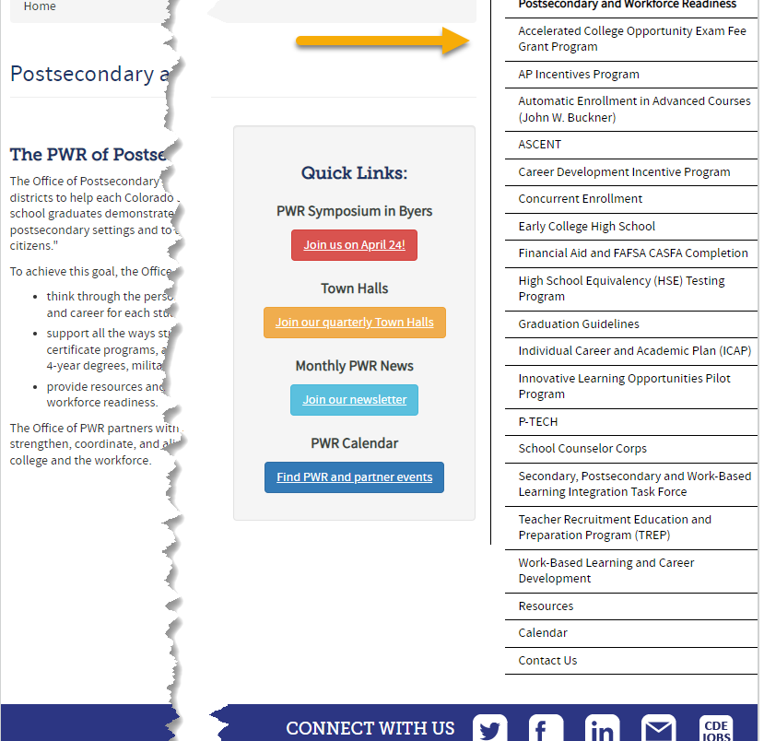
What are Postsecondary Programs?
Provide opportunities for high school students to demonstrate the knowledge and skills (competencies) needed to succeed in postsecondary settings and to advance in career pathways as lifelong learners and contributing citizens.
Support all the ways students can enter into postsecondary education – including certificate programs, apprenticeships and other work-based learning experiences, 2- and 4-year degrees, military, and career training.
Notes:
Erica

Slide 3
Postsecondary at CDE
Data Services
Postsecondary and Workforce Readiness
Manages student data collection processes
  Main point of contact for districts for collection
  Coding pattern questions
  Provide training, build guidance, forms, etc.
Produce reports, summary information, and manage data requests
Support LEAs in understanding and implementing Postsecondary programs
Support all the ways students can enter postsecondary education
Compile resources on effective strategies for addressing program implementation
Notes:
Erica

Slide 4
General Information:
Types of Postsecondary Programs
Years 1-4
Years 5-6
Concurrent Enrollment
Early College
  Participating schools only
Dropout Recovery at a Community College
  Students Age 16 to 21
P-TECH Years 1-4
  Participating schools only
ASCENT (year 5 only)
  Slot allocation removed in 2022-2023
P-TECH (years 5 & 6)
  Student must have been coded as PTECH in year 4
  Participating schools only
TREP (years 5 & 6)
  New in 2022-2023
  Slot allocation
Note: Number of years in High School is determined by the student’s Anticipated Year of Graduation (AYG). Only students with an AYG indicating they are in their 5th year are eligible for ASCENT. Only students in their 5th or 6th year per AYG are eligible for the applicable years of P-TECH or TREP.
Notes:
Erica

Slide 5
P-TECH Program Overview
More information on P-TECH
Site: P-TECH Program Website
Site: P-TECH Students and Parents Website
Pathways in Technology Early College High Schools in CO
An innovative partnership between a school district, a community college(s), and one or more local high growth industry employer(s).
Students begin in 9th grade and go through 14th grade (high school and two equivalent years of college) for a total of 6 years.
Students graduate with both a high school diploma and an industry-recognized associate degree, in addition to gaining relevant workplace skills.
The associate degree is in a Science, Technology, Engineering or Math (STEM) focused high-growth industry.
P-TECH can be a school, or a program within a school.
Approved P-TECH Programs/Schools
Notes:
Erica

Slide 6
Postsecondary
Annual Coding Cycle
End of Year
October
Monitor for Status Changes
Monitor postsecondary program enrollment changes for students from OCT to SEY
Is the student actively participating in the postsecondary program?
Did the student participate in the postsecondary program at any point in the school year?
Coding remains the same as October unless and enrollment change occurred
Identify students that will be participating in PTECH years 5-6 during Fall semester (retention code 2)
Reminder: Districts should verify student meets postsecondary requirements
Site: CDE Postsecondary and Workforce Readiness
Site: CDE Audit Resource Guide
Site: Student Interchange File Layout and Definitions-Student School Association
Student October
Is the postsecondary status of the student as of October 1st (Count Date)
Student End of Year
PS code is the summation of the current school year
PS code is not the status of the student for next year
Retention code 2 is the anticipated status for next year
Notes:
Reagan

Slide 7
Counting for Graduation Rates vs Received Diploma
Colorado Graduation Rates
Diploma Issued
Students who return to participate in ASCENT, TREP, or P-TECH years 5-6 may be counted as a graduate for graduation rate purposes at the end of their 4th year if they have met local and state graduation requirements.
Prevents students participating in these programs from negatively effecting the 4-year on time graduation rate for the district/school.
Students participating in ASCENT, TREP, and P-TECH years 5-6 programs receive their high school diplomas at the end of their corresponding program.
Diplomas & Transcripts reflect a student’s final exit from K-12 education as the graduation date.
Notes:
Reagan

Slide 8
P-TECH: Coding Pattern
Counted as Graduate in 4th year
Counted as Graduate in 6th Year
Years in HS (per AYG) | 3rd | 4th | 5th | 6th
Grade Level | 110 | 120 | 120 | 120
Postsecondary Program | 15 | 15 | 16 | 16
School Entry Type | *02 | 02 | 90 | 90
School Exit Type | 00 | 90 | 23 | 24 or 23
Retention Code | 0 | 2 | 2 | 0
Years in HS (per AYG) | 3rd | 4th | 5th | 6th
Grade Level | 110 | 120 | 120 | 120
Postsecondary Program | 15 | 15 | 16 | 16
School Entry Type | *02 | 02 | 02 | 02
School Exit Type | 00 | 00 | 00 | 96
Retention Code | 0 | 2 | 2 | 0
Notes:
*Entry type in 3rd year may be any applicable code
Exit 24 – Previous graduate who completed their P-TECH 6th year.
Exit 23 – Previous graduate who completed their P-TECH 5th year and will return for a 6th year or left P-TECH program in the middle of their 5th/6th year.
Diploma/Transcripts reflect exit date in the 6th year as the student’s graduation date (or point left program in middle of 5th/6th year without returning).
Student is expected to be enrolled in P-TECH for the entirety of the school year (both OCT and SEY)
Notes:
Reagan

Slide 9
General Business Rule Checks
Postsecondary Program Enrollment code must be a valid code and is required
  2-digit numeric code only, use ’00’ if student is not participating in a postsecondary program
Grade Level checks to ensure student is in the grade level outlined in the restrictions (e.g.,Grade 120 for ASCENT/P-TECH/TREP, Grade 9-12 for CE, etc.)
Students marked as ASCENT/P-TECH years 5-6/TREP in Student October (OCT) are also marked ASCENT/P-TECH years 5-6/TREP in Student End of Year (SEY) within the same year since these are year long programs
ASCENT/P-TECH years 5-6/TREP Students included in the subsequent OCT who do not have retention code 2 in the current year SEY
  Example:
    If 2023-2024 OCT postsecondary code indicating ASCENT/P-TECH years 5-6/TREP
    Then 2022-2023 SEY must have Retention Code 2
Notes:
Reagan

Slide 10
P-TECH: Types of Business Rule Checks
Students in P-Tech programs must be attending an approved P-TECH school code
Students in P-TECH years 5-6 should have been in a P-TECH program in the prior year
Students in P-TECH must be funded full-time
Exit type for P-TECH years 5-6 students should be 00, 96, 23, or 24
  Exit Type 96 or 00 cannot be used if Exit Type 90 was used in a prior year
  Exit Type 23 or 24 cannot be used unless the student had Exit Type 90 in a prior year
Entry Type 90 is required for students with Exit Type 90 in a prior year
12th grade students in P-TECH Years 1-4 program without retention code 2
  Warning to help districts ensure any student continuing into years 5-6 have the appropriate retention code
District Code in the current year for P-TECH years 5-6 students must match their last district of attendance in the prior year
Student in P-TECH years 5-6 must be in the 5th or 6th year of HS per AYG
Student October (OCT) collection also includes checks to ensure P-TECH students utilize correct funding code patterns per OCT collection guidelines
Notes:
Reagan

Slide 11
For more information, please reach out to the Student Interchange Leads or Postsecondary Unit.
Notes:
Reagan

