Slide 1
Short Bytes
Other Postsecondary Programs
Notes:
Hello and welcome to this short byte. Today we will review Other Postsecondary Programs in conjunction with our Postsecondary Unit. Let’s get started.

Slide 2
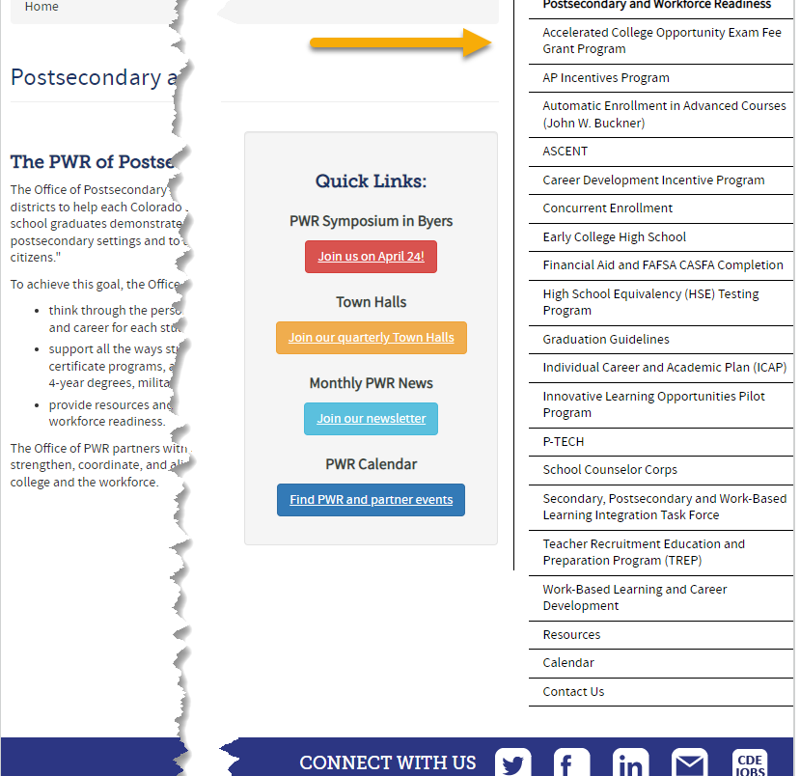
What are Postsecondary Programs?
Provide opportunities for high school students to demonstrate the knowledge and skills (competencies) needed to succeed in postsecondary settings and to advance in career pathways as lifelong learners and contributing citizens.
Support all the ways students can enter into postsecondary education – including certificate programs, apprenticeships and other work-based learning experiences, 2- and 4-year degrees, military, and career training.
Notes:
Erica

Slide 3
Postsecondary at CDE
Data Services
Postsecondary and Workforce Readiness
Manages student data collection processes
  Main point of contact for districts for collection
  Coding pattern questions
  Provide training, build guidance, forms, etc.
Produce reports, summary information, and manage data requests
Support LEAs in understanding and implementing Postsecondary programs
Support all the ways students can enter postsecondary education
Compile resources on effective strategies for addressing program implementation
Notes:
Erica

Slide 4
General Information:
Types of Postsecondary Programs
Years 1-4
Years 5-6
Concurrent Enrollment
Early College
  Participating schools only
Dropout Recovery at a Community College
  Students Age 16 to 21
P-TECH Years 1-4
  Participating schools only
ASCENT (year 5 only)
  Slot allocation removed in 2022-2023
P-TECH (years 5 & 6)
  Student must have been coded as PTECH in year 4
  Participating schools only
TREP (years 5 & 6)
  New in 2022-2023
  Slot allocation
Note: Number of years in High School is determined by the student’s Anticipated Year of Graduation (AYG). Only students with an AYG indicating they are in their 5th year are eligible for ASCENT. Only students in their 5th or 6th year per AYG are eligible for the applicable years of P-TECH or TREP.
Notes:
Erica

Slide 5
Concurrent Enrollment
More information on CE
Site: Concurrent Enrollment
Site: Student and Parent
A program which allows the simultaneous enrollment of a qualified student in a local education provider and in one or more postsecondary courses, including academic or career and technical education courses, at an institution of higher education at no tuition cost to the student.
Postsecondary Program Code = 02
Student October: Use postsecondary program code ‘02’ to indicate a student who is actively participating in CE courses as of October 1st (Count Date). This will be indicated in the student’s enrollment record (SSA).
Student End of Year: Use postsecondary program code ‘02’ to indicate a student who participated in CE courses at any point during the school year. This will be corresponding to the student’s enrollment record (SSA).
  Example: Student participated in CE courses in Fall but not in Spring – code the student as ’02’ in the Student End of Year (SEY) collection in one of the student’s enrollment records.
*Student’s Postsecondary Program should not change from OCT to SEY. If the Postsecondary Program status does change, more than 1 enrollment record will be needed to reflect status change.
Notes:
We will now step into each postsecondary program with the first being Concurrent Enrollment. Concurrent Enrollment is a program that allows the simultaneous enrollment of a qualified student in a LEP and in one or more postsecondary courses including academic or career and technical education courses at an institution of higher education (IHE) at no tuition cost to the student. To indicate a student is a Concurrent Enrollment student, you will need to indicate the student with a Postsecondary Program Code of 02. During the Student October Collection, you will use postsecondary program code 02 to indicate a student who is actively participating in CE courses as of October 1st or your district’s adoptive count date. This will be indicated in the student’s enrollment record in the Student School Association file. For our Student End of Year Collection, continue to code the student with 02 to indicate a student who participated in CE courses at any point during the school year. The indication corresponds to the student’s enrollment record. For example, a student participated in CE courses in Fall but not in Spring – you will need to code the student as 02 in the Student End of Year collection in one of the student’s enrollment records, specifically the Fall record. The student’s Postsecondary Program should not change from OCT to SEY. If the Postsecondary Program status does change, more than 1 enrollment record will be needed to reflect status change. More information on Concurrent Enrollment can be found on the Concurrent Enrollment website or the Student and Parent Website. On the Student and Parent website, there are videos from students, parents and counselors about the benefit of Concurrent Enrollment programs. You can also learn about how credits will transfer and how to apply for admission as a Concurrent Enrollment student.

Slide 6
Early College
More information on Early College
Site: Early College for Practitioners
Site: Early College for Students and Parents
An Early College, as defined by C.R.S. 22-35-103(10)(a), is a secondary school that provides only a curriculum that requires each student to enroll in and complete secondary and postsecondary courses while enrolled in the four years of high school such that, upon successful completion of the curriculum, the student will have completed the requirements of a high school diploma and an associate's degree or other postsecondary credential or at least sixty credits toward the completion of a postsecondary credential. The curriculum must be designed to be completed within four years.
State Approved Early College List
Postsecondary Program Code = 07
Student October: Use postsecondary program code ‘07’ to indicate a student who is actively participating in Early College as of October 1st (Count Date). This will be indicated in the student’s enrollment record (SSA).
Student End of Year: Use postsecondary program code ‘07’ to indicate a student who participated in Early College at any point during the school year. This will be corresponding to the student’s enrollment record (SSA).
  Example: Student participated in EC in Fall but not in Spring – code the student as ’07’ in the Student End of Year (SEY) collection in one of the student’s enrollment records.
*Student’s Postsecondary Program should not change from OCT to SEY. If the Postsecondary Program status does change, more than 1 enrollment record will be needed to reflect status change.
Notes:
Moving on to Early College.. Early College is a secondary school that provides only a curriculum that requires each student to enroll in and complete secondary and postsecondary courses while enrolled in the four years of high school such that, upon successful completion of the curriculum, the student will have completed the requirements of a high school diploma and an associate’s degree or other postsecondary credential or at least sixty credits toward the completion of a postsecondary credential. The curriculum must be designed to be completed within 4 years. There is a list of approved Early College school codes that are able to enroll Early College students. To indicate a student is enrolled in an early college program, LEAs will need to code the student with Postsecondary Code of 07. During the Student October Collection, you will use postsecondary program code 07 to indicate a student who is actively participating in Early College as of October 1st or your district’s adoptive count date. This will be indicated in the student’s enrollment record in the Student School Association file. For our Student End of Year Collection, continue to code the student with 07 to indicate a student who participated in Early College at any point during the school year. The indication corresponds to the student’s enrollment record. For example, a student participated in Early College in Fall but not in Spring – you will need to code the student as 07 in the Student End of Year collection in one of the student’s enrollment records, specifically the Fall record. Again, the student’s Postsecondary Program should not change from OCT to SEY. If the Postsecondary Program status does change, more than 1 enrollment record will be needed to reflect status change. More information on Early College can be found on the Early College for Practitioners website or the Student and Parent Website.

Slide 7
Dropout Recovery at Community College
A dropout recovery program allowing a student who has dropped out of high school, or a student who is at-risk of dropping out of high school, to complete their high school graduation requirements exclusively at the community college. Any individual age 16 to 21 who has dropped out of school may participate with the permission of the school district.
Postsecondary Program Code = 08
Student October: Use postsecondary program code ‘08’ to indicate a student who is actively participating in Early College as of October 1st (Count Date). This will be indicated in the student’s enrollment record (SSA).
Student End of Year: Use postsecondary program code ‘08’ to indicate a student who participated in Early College at any point during the school year. This will be corresponding to the student’s enrollment record (SSA).
  Example: Student participated in EC in Fall but not in Spring – code the student as ’08’ in the Student End of Year (SEY) collection in one of the student’s enrollment records.
*Student’s Postsecondary Program should not change from OCT to SEY. If the Postsecondary Program status does change, more than 1 enrollment record will be needed to reflect status change.
Notes:
Finally getting into Dropout Recovery at a Community College.. A dropout recovery program allowing a student who has dropped out of high school, or a student who is at-risk of dropping out of high school, to complete their high school graduation requirements exclusively at the community college. Any individual age 16 to 21 who has dropped out of school may participate with the permission of the school district. To indicate a student is enrolled in a dropout recovery program, LEAs will need to code the student with Postsecondary Code of 08. During the Student October Collection, you will use postsecondary program code 08 to indicate a student who is actively participating in dropout recovery as of October 1st or your district’s adoptive count date. This will be indicated in the student’s enrollment record in the Student School Association file. For our Student End of Year Collection, continue to code the student with 08 to indicate a student who participated in dropout recovery at any point during the school year. The indication corresponds to the student’s enrollment record. For example, a student participated in dropout recovery in Fall but not in Spring – you will need to code the student as 08 in the Student End of Year collection in one of the student’s enrollment records, specifically the Fall record. Again, the student’s Postsecondary Program should not change from OCT to SEY. If the Postsecondary Program status does change, more than 1 enrollment record will be needed to reflect status change.

Slide 8
General Business Rule Checks
Postsecondary Program Enrollment code must be a valid code and is required
  2-digit numeric code only, use ’00’ if student is not participating in a postsecondary program
Grade Level checks to ensure student is in the grade level outlined in the restrictions (e.g., Grade 9-12 for CE and EC, etc.)
Students in dropout recovery programs must be at least 16 years old
Students in Early College programs must be enrolled in an approved Early College school code
Students in Dropout Recovery programs must have a Pupil Attendance Information Code = ’03’ (Resident, Non-District Site) with a school of accountability
Students with postsecondary codes 02, 07, or 08 cannot be returning to a school after being a graduate in a prior school year. (school exit type 90 in a prior year, school entry type 90 in the current year)
Notes:
We have a couple of business rule checks for these programs (not all are listed but let’s review a few). The first being a general check for all Postsecondary Program Enrollment codes indicating that they must be a valid code and is required 2-digit numeric code only, use ’00’ if student is not participating in a postsecondary program. We also have grade level and age level checks to verify the student is enrolled in the right grade for the corresponding postsecondary program or is in the right age range for the program. Students in Early College programs must be enrolled in an approved Early College school code. This is a school code list that is provided from the Postsecondary Unit to verify that only certain schools can enroll Early College students. And finally, students in Dropout Recovery programs must have a Pupil Attendance Information Code = ’03’ (Resident, Non-District Site) with a school of accountability. Students with postsecondary codes 02, 07, or 08 cannot be returning to a school after being a graduate in a prior school year. (school exit type 90 in a prior year, school entry type 90 in the current year). If a student does not meet these different requirements, errors will flag.

Slide 9
For more information, please reach out to the Student Interchange Leads or Postsecondary Unit.
Notes:
Reagan

