Slide 1
2020 – 2021 Student End of Year Snapshot: Regular Collection/Clean Up (Phase 1)
Jesse Cooper
cooper_j@cde.state.co.us

Slide 2
Agenda
Collection Schedule
Regular Phase: Student Interchange
Uploads
Common errors
Exceptions
FAQs
Regular Phase: End of Year Snapshot
Creating a snapshot
Common errors
Exceptions
Submission
FAQs
Looking ahead…What comes next?
Resources

Slide 3
End of Year Collection Schedule

Slide 4
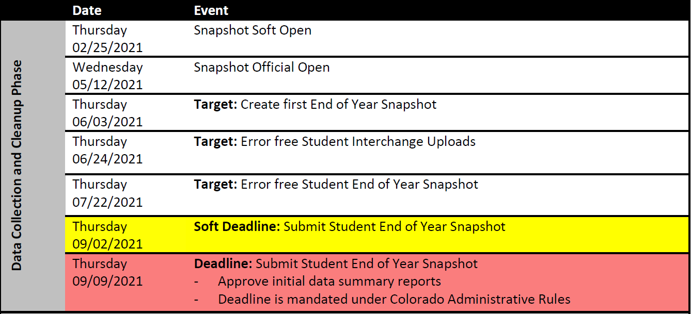
Collection Schedule: Regular Phase

Slide 5
Regular Phase: Student Interchange

Slide 6
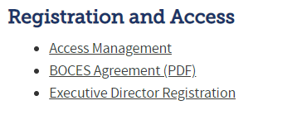
CDE Identity Management
1
http://www.cde.state.co.us/idm
Application | Collection | Role
Pipeline | Student Interchange | LEA USER OR APPROVER
Pipeline | Student End of Year | LEA USER OR APPROVER
2
3

Slide 7
CDE Identity Management
Application | Collection | Role | Access Level
Pipeline | Student Interchange | LEA User | Upload and Edit Records for the Student Demographic, School Association, and Graduation Guidelines files
Pipeline | Student End of Year | LEA User | Create Snapshot - cannot submit
Pipeline | Student End of Year | LEAAPPROVER | Create Snapshot and submit
Pipeline | Any | LEA Viewer | View Cognos reports – cannot edit
Pipeline | Title I Interchange | LEA User | Upload and Edit Records
You can only have one role for each Collection.
An LEAAPPROVER can do all the things an LEA User can do.
Link to full instructions: http://www.cde.state.co.us/datapipeline/assigneoyroles

Slide 8
Student Interchange Preparation
Get SASIDs for your new students
Through RITS or Data Pipeline
Resources on getting SASIDs can be found here:
http://www.cde.state.co.us/datapipeline/yr_rits
Create Extracts from your Student Information System
Pull data for the Student Demographic/Profile file and Student School Association
Data Pipeline accepts .csv, .xls, .xlsx formats
.xls is the recommended format
If opening file in Excel, please make sure you don’t lose leading zeros
CDE has a guide to keeping leading zeros on Student Interchange website
CDE recommends using a file naming convention:
Example: 0110_DEM_EOY_10112020.xls
Spaces in the file name are not allowed

Slide 9
Student Interchange: Uploads

Slide 10
Student Interchange Preparation
Upload interchange files
Wait for a Confirmation Email from the Pipeline System
The email will show you the number of errors in your upload
Check your error reports
Resolve ALL errors in your interchange files
Update your Interchange files to address the errors
Update in SIS → Extract → Upload to Pipeline
Edit Record Tool (Data Pipeline)
Upload Student Demographic File
Upload Student School Association File
Upload Graduation Guidelines File
One record per student
One or more record per student (depends on enrollment)
At least two records per student (one with Guideline Type = 0 and one with Guideline Type = 1)

Slide 11
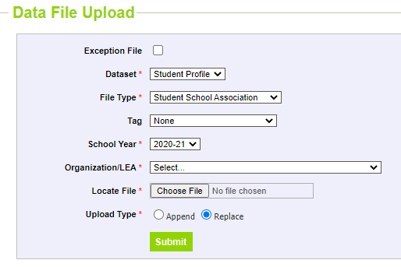
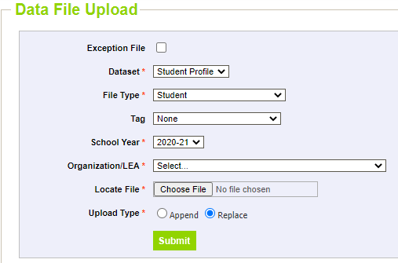
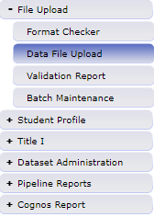
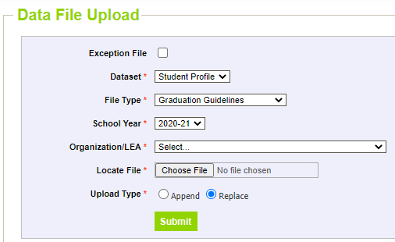
Data File Upload

Slide 12
Student Interchange: Common Errors

Slide 13
Pipeline Reports: Error Report
Select file type:
Student (demographic)
Student School Association
Graduation Guidelines
This will show you the entire record for the student flagging the error/warning

Slide 14
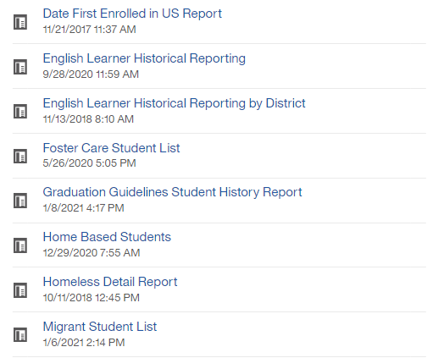
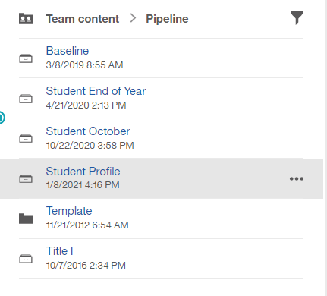
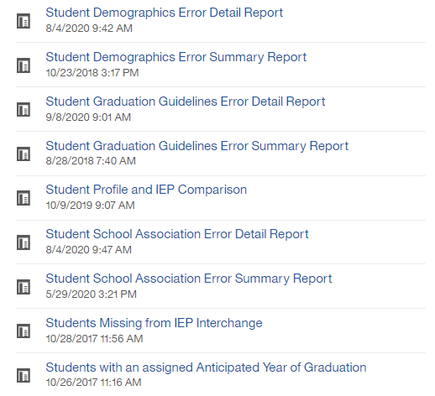
Student Interchange: Cognos Reports

Slide 15
Common Student Demographic Errors
Language Proficiency – A student's English language proficiency is described by his or her ability to speak, listen, read, and write in English.
English Learners (EL): (1) NEP Non-English Proficient (2) LEP Limited English Proficient (6) FEP Fluent English Proficient Monitor Year 1 (7) FEP Fluent English Proficient Monitor Year 2 (8) FEP Fluent English Proficient Exited Year 1 (9) FEP Fluent English Proficient Exited Year 2
Non-EL students must be coded as (0) NA or (4) PHOLTE Primary or Home Language Other Than English
Former English Learners are coded as (5) FELL- Former EL
*Student should have the same language proficiency as coded in Student October*

Slide 16
Common Student School Association Errors
Date First Enrolled in the United States
Districts may zero-fill this field and CDE will calculate the date of first enrollment based upon the date a student first had an entry date in a CDE student interchange data collection.
Student’s date of first enrollment will be calculated based on the earliest entry date in Kindergarten and greater.
If a date has been entered for a student, CDE will not override that field with a calculated value, though the entered value may not be more recent than the date CDE calculates.

Slide 17
Common Graduation Guidelines Errors
Invalid score values
i.e., if Guideline name is AP score must be between 1 and 5
Guideline names that must use specific guideline type
i.e., if Guideline Name is QAS, Guideline Type must be math
Accommodation errors
A student may only be IEP Accommodation = 1 if the student has a record in the SPED interchange.
A student may only be EL Accommodation = 1 if the student is IPST_COHORT_LEP = 1 in Student End of Year.
A student may only be GT Accommodation = 1 if the student is IPST_COHORT_GT = 1 in Student End of Year.

Slide 18
Student Interchange: Exceptions

Slide 19
Exceptions
“Exceptions” refer to overriding Data Pipeline errors.
CDE occasionally overrides these business rule errors because although the errors are legitimate, the case needs to be corrected to reflect what happened with the student.
The cases are typically either unusual or they are correcting an error from the prior year.
Error Exceptions are used when you have an error that will not clear in your Error Report in Pipeline even though you are coding the student correctly.

Slide 20
Exception
Download the correct exception template on the Student End of Year webpage, under Business Rules and Exceptions:
This document should be an Excel Document.
The first sheet will contain the directions and the second sheet is where you will fill out these exceptions.
Copy and paste all information directly from your Error Detail Report in Cognos or Pipeline.
This will ensure that you have the correct SASID, Error Code, School Code, and Grade Level for your exception.
IMPORTANT: If you do not have the correct information, the exception will not process.
Each error will have their own row in the exception request. You can have as many exceptions as you want on one sheet.

Slide 21
Exception
Please keep exception “types” separate
We recommend that you put all ELL exceptions in a separate document, all other DEM exceptions in a separate document, all SSA exceptions in a separate document
School Code and Grade Level are only required for school level errors. You can level them blank for Demographic (DEM) errors
Please make sure the “Reason for Exception” is short but explains the reason behind the exception
Leading zeros must be kept with the exception request

Slide 22
Exceptions
Save exception request to computer to upload to Syncplicity.
Upload Exception Request in Student Syncplicity Folder
Some districts have their own folder organization process, but most use the “Requested Exception” folder to upload exceptions. The Student Syncplicity folder is used by both Student October and Student End of Year Data Owners
Email the Collection Lead (cooper_j@cde.state.co.us) that the document has been uploaded to Syncplicity. The collection lead will then either grant the exception or let you know how to code the student correctly to clear the error.
Exception template
Step by step directions here

Slide 23
Student Interchange: Frequently Asked Questions

Slide 24
Special Education Transition Coding
Before the 2020-2021 school year, Local Education Agencies (LEAs) were not able to mark a special education student as both meeting graduation requirements (exit type code 90) and have the student receive transition services in the subsequent school year(s).
H.B. 19-1066 allows students to both
(1) be marked as a graduate when the student meets all local and state graduation requirements, and
(2) receive special education transition services (and funding) in subsequent year(s).
More information here

Slide 25
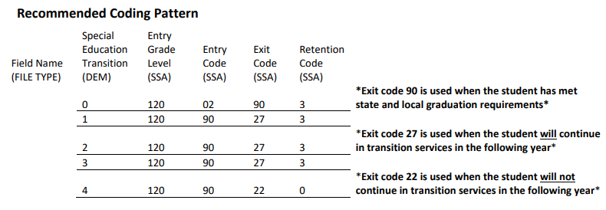
Special Education Transition Coding

Slide 26
Special Education Transition Coding
Diploma Dates
For the purpose of HB 19-1066, students must be counted in the high school’s graduation rate the year in which the student completes the graduation requirements. This is the date the district should report for state accountability purposes. HB 19-1066 makes clear that nothing within the legislation limits the right of a student who has met the local LEP’s graduation requirements to continue access to a free and appropriate public education (FAPE) as provided by the Individuals with Disabilities Education Act (IDEA), the Exceptional Children’s Educational Act (ECEA), or any other federal or state law or rule. The date on the diploma should reflect the year in which the student’s IEP team determined the student met all the requirements of FAPE or the year in which the student ages out.
Students in Transition Programs Prior to 2020-2021
Students who were in a transition program prior to 2020-2021 and have met graduation requirements in a prior year should use the new coding pattern. In short, any student who has met graduation requirements and will continue in a transition program in the following year will be coded with exit type code 90 and retention code 3 for 2020-2021. This will lead to a sudden, but expected, increase in the number of graduates in 2020-2021. Students who were in a transition program prior to 2020-2021 but have not met graduation requirements should only use exit type code 90 upon meeting graduation requirements.

Slide 27
Graduation Guidelines
Will accountability be linked to GG for 2021? No. Graduation Guidelines data will not be used for any official accountability purposes or decision-making in 2021.
What is the last date by which a student may complete graduation requirements to be considered a graduate of the class of 2021? In order to count as a graduate in the class of 2021, students must meet local graduation requirements by August 31, 2021. Students may complete graduation requirements over the summer, if necessary. Consider counting summer courses, online courses, jobs, internships, apprenticeships, earned industry certificates, or other assessments/opportunities.
Can students receive an exception to Graduation Guidelines in 2020-2021? No. Exceptions to Graduation Guidelines are not permitted for the 2020-2021 school year. Any student who has exit type code ‘90’ should have met local graduation requirements (in the definition for ‘90’ exit type code). Therefor, all students qualify to use Local Measure (LM) as their Guideline measure, negating the need for exceptions.

Slide 28
Graduation Guidelines
Are students with disabilities, English learners, and students in gifted and talented programs required to meet Graduation Guidelines?
All students (regardless of IEP, EL, or GT status) must meet Graduation Guidelines to graduate with a regular diploma (and be exited with exit code ‘90’). The accommodation fields indicate that the student received an accommodation to meet the specific Graduation Guideline. More information here.
What if a student transfers from out of state in 12th grade and is graduating?
Any student who receives a diploma from a Colorado Local Education Provider (LEP) is required to meet Graduation Guidelines, regardless of their state/country of origin.
How are ASCENT students expected to report GG?
Any and all students who use exit type code 90 (graduate with regular diploma) in Student End of Year are required to have met Graduation Guidelines in both English and math. However, according to ASCENT law, students do not have to meet graduation requirements to continue in their ASCENT program for their 5th year. This is a district decision. Further, districts may count ASCENT students in their 4-year graduation rate if they have met local graduation requirements and GG prior to their ASCENT year.

Slide 29
Regular Phase: End of Year Snapshot

Slide 30
What is the End of Year Snapshot?
The purpose of the Student End of Year Snapshot is to summarize the annual educational history for students throughout the school year.
The data from this collection is used to derive the graduation, completion, dropout, mobility, and stability rates.

Slide 31
To be included in the End of Year Snapshot
Criteria
Pull all error-free records from the student school association file where PRIMARY_SCHOOL = 1
And school code is a valid public school code
And Pupils Attendance Information between 01 and 08
And school entry type <> 04
The records selected will be joined with data from the Student Demographic, Student School Association, and Graduation Guidelines files

Slide 32
End of Year Snapshot: Creating a Snapshot

Slide 33
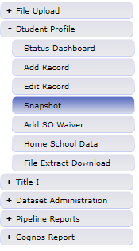
Creating a Snapshot
Snapshot creation confirmed

Slide 34
Creating a Snapshot
Do not create a snapshot until you have error free interchange files
All three files must be error free (SSA, DEM, GG)
Students with errors in SSA, DEM, or GG will not be included in snapshot
SE401: A PK-12 grade student has errors at the interchange level (SSA).
SE405: A PK-12 grade student has errors at the interchange level (DEM).
You will get new errors after creating a snapshot
Each time a snapshot is created, the old one is deleted

Slide 35
End of Year Snapshot: Common Errors

Slide 36
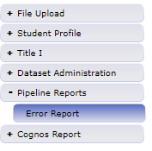
Snapshot Pipeline Reports - Errors
You can view your errors through Data Pipeline
Select warnings and/or errors
Click “view details” to see which students are flagging errors

Slide 37
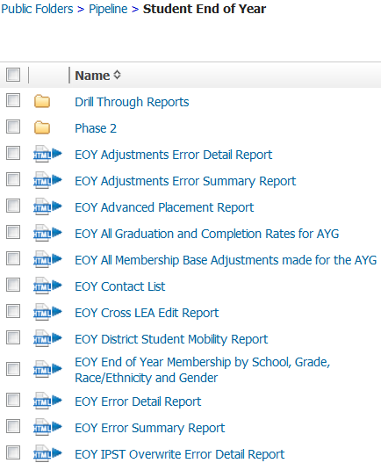
Snapshot Cognos Reports
These are the Snapshot Error Reports

Slide 38
Common Snapshot Errors
All Snapshot level errors are posted in the Student End of Year Business Rules file.
You can find the file on the Student End of Year website

Slide 39
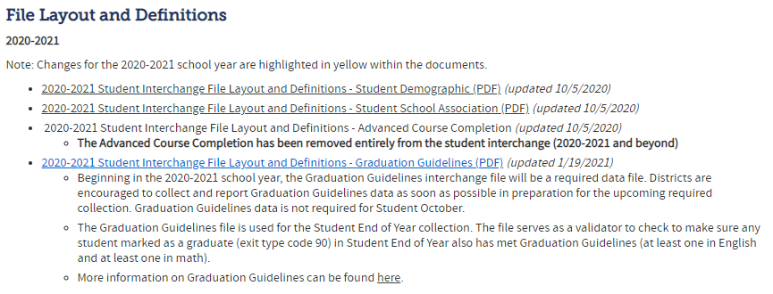
Entry and Exit Types
Entry and exit types and dates are used to track an overview of a student’s enrollment throughout the year.
A full list of the possible Entry and Exit types are available in the Student School Association (SSA) file format:
On the Student Interchange website

Slide 40
Why do we use entry and exit types?
Entry Type – Indicates how a student entered the school or district
02 – Continuous in same school (start of year)
05 – Transfer from out of country
11 – Transfer from school in same district
13 - Transfer from another district
14 – Transfer from out of state
70 – Return to school after transferring to a GED program

Slide 41
Why do we use entry and exit types?
Exit Type – Indicates how a student exits the school or district
11 – Transfer to school in same district
13 – Transfer to another district
40 – Drop out
90 – Graduate
00 – Student finished the year at the school

Slide 42
Why do we use entry and exit types?
Student returns from prior year (Entry Type 02)
Student exits to transfer to another district (Exit Type 13)
Later in the year student comes back from another district (Entry Type 13)
Student exits for the summer (Exit Type 00)
District | SASID | Entry Date | Entry Type | Exit Date | Exit Type
0180 | 1234567890 | 08212016 | 02 | 10022016 | 13
0180 | 1234567890 | 12102016 | 13 | 00000000 | 00

Slide 43
Common Errors
SE049 | If a student was reported in Student October in grade K-12 with Attendance Code 01-08 they must have at least 1 record in EOY. Note: Pre-K students who did not complete the school year in your district do not have to be reported on the Student End of Year
SE091 | Students with Exit Type Code 11 should be followed by record with Entry Type Code 11 or 12.
SE109 | Entry Type may be 11 (Transfer from a public school in the same district) for the first detail record, only if the student finished the prior year at a different School Building Code with Exit Type Code = 00.
SE102 | Entry Type may be 02 (Continuous in same school with no interruption of schooling) for the first detail record only if the student was reported in the prior year as finishing at the same School Building Code with Exit Type Code = 00.
SE104 | If a grade K-12 student was reported last year with Exit Type=00 in the last detail record, they must be reported this year with an Entry Type = 00, 02, 03, 10, 11, 90 or 91, in the first detail record.
 | Exit Type cannot be 00 if Entry Grade Level = 120 and Retention Code = 0
SE171 | Errors will be resolved once you’ve recorded the graduation of seniors. Seniors have until August 31st to graduate during the 2020-2021 school year. Please record seniors who graduate after summer school with an exit date of the graduation with the rest of their class.

Slide 44
Common errors
SE400s: Records not getting into snapshot
Please make sure primary school flag is set correctly in student school association file. The primary school flag must be set to 1 for the student to appear
Check to see if the record is in error in student interchange file
Validate the pupil's attendance code is correct
SE060 Student reported on Student October not in Student End of Year
If a student was reported on Student October, system expects record for student on October 1st in Student End of Year
Use Syncplicity to request an exception

Slide 45
SE404 One-Day Records
SE404 errors trigger when a student exited the previous year with a 00 exit type
Over the summer, the student left and never attended during the 2020-2021 school year
The student will still need a record indicating where they are attending school
For example:
District | SASID | Entry Date | Entry Type | Exit Date | Exit Type
0180 | 1234567890 | 08212020 | 02 | 08212020 | 14
Same entry and exit date

Slide 46
Common Error
NEW in 2020-2021
SE301
This student was reported with an exit type of 90 (graduating with a regular diploma). However, this student does not have a record of meeting graduation guidelines in English and/or math in the Graduation Guidelines file (GG). Please add this student to your Graduation Guidelines file or change the school exit type.
Data Checks:
Any student with exit type code 90
Who has an AYG ≥ 2020-2021
Who has not met GG in English and math
Is not an ASCENT student
*NO EXCEPTIONS WILL BE GRANTED FOR SE301*

Slide 47
End of Year Snapshot: Exceptions

Slide 48
Exception
Snapshot-level exceptions (SExxx) follows the same process as interchange-level exceptions (SPxxx or SGxxx)
Download the correct exception template on the Student End of Year webpage, under Business Rules and Exceptions
Copy and paste all information directly from your Error Detail Report in Cognos or Pipeline.
Save exception request to computer to upload to Syncplicity.
Upload Exception Request in Student Syncplicity Folder
Email the Collection Lead that the document has been uploaded to Syncplicity – cooper_j@cde.state.co.us

Slide 49
End of Year Snapshot: Submission

Slide 50
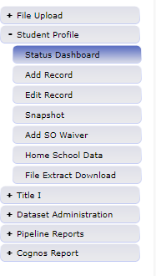
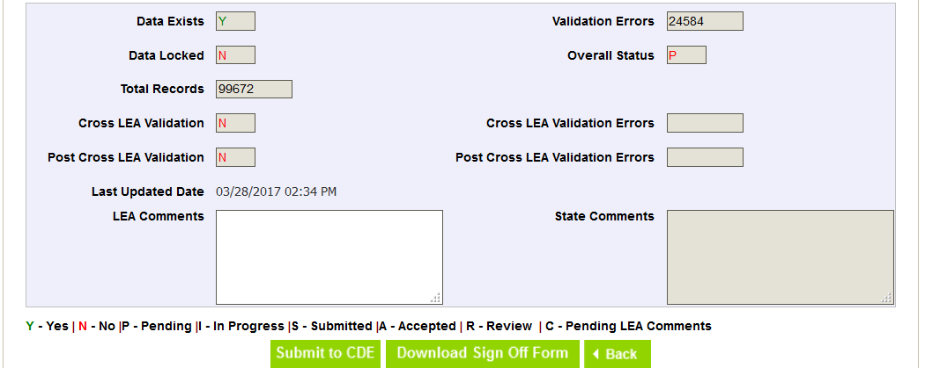
Submitting a Snapshot
Once you’ve completed resolving your snapshot errors, you will want to submit your snapshot.
Deadline is Thursday, September 9th
(Soft Deadline is Thursday, September 2nd)
Submit your snapshot through the status dashboard
*Do NOT download your sign off form until after the post-cross phase*

Slide 51
End of Year Snapshot: Frequently Asked Questions

Slide 52
End of Year FAQs
You can review the full FAQ document here
Why do I have to code a student as returning in the current year even though the student never attended a school in our district in the current year?
Students who were reported in the prior year with an exit type 00 and a grade level of 7th -12th are required to have a record in the current year. CDE requires this record in order to see the student’s progression into the next school year. The enrollment record can have an entry date any date after July 1st for the school year and the exit type needs to indicate where the student went after leaving your district.
Which students should be reported in the End of Year report?
For grades PK-12 we need at least one detail record for every student that was counted in membership at any time between July 1 and June 30 of the reported school year – including those that left your school/district during that period.

Slide 53
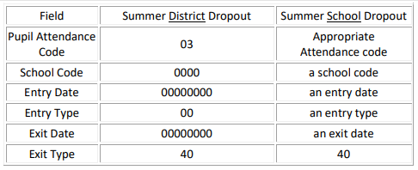
End of Year FAQs
What happens when an 8th grade student drops out over the summer? Are they included in a cohort graduation rate?
In this case, you need to code the student as a summer district drop out. These students should be entered in the next school year as follows:
NOTE: Districts that code a student to the school they were anticipated to attend, but never did, will be included in that school’s rate information. CDE allows the above coding as to not penalize the anticipated school. If you receive transfer documentation for this student after coding them as a summer dropout, please update their record to show a one-day enrollment at an appropriate high school in your district. This will not impact the high schools’ rates in any way.

Slide 54
End of Year FAQs
How should I code a 12th grade student who had been retained in a grade to participate in PTECH or ASCENT?
If a student is retained for a post-secondary program, a ‘2’ should be entered in the ‘Retention Code’ field of the student’s detail file in the collection year during which the initially completed 12th grade. If the student is participating in PTECH or ASCENT and has completed the district’s standard high school graduation requirements prior to being retained for a 5th year, they should be coded as graduating (90) on the final day of that school year. If the student has not yet completed their high school graduation requirements or is participating in some other kind of post-secondary program (Early College) they should be coded with a ‘00’ exit type and a zero filled exit date.
When should I use exit type code ‘00’? How does CDE define this exit code?
Entering an Exit Type Code of ‘00’ for a student indicates that the student completed the school year in a given grade and school within your district. Exit Type ‘00’ should be used for every student who completes the school year in your district – regardless of his or her anticipated enrollment status at the beginning of the next year. The students described in each of the following scenarios would be assigned an exit code of ‘00’:
“Jimmy finished the school year with us, but I know for certain his family is moving to California over the summer.”
“Kate finished middle school this year and will be starting at our high school next year.”
“Tom is a high school senior who will need to repeat 12th grade next year.” (retention code should be ‘1’)

Slide 55
Looking ahead… What comes next?

Slide 56
Collection Schedule: Cross LEA and Post Cross LEA Phases

Slide 57
Cross LEA and Post Cross LEA
Cross LEA Phase (Training on Friday, September 17th)
CDE runs a process in Data Pipeline that compares transfer information across districts throughout the state.
Post Cross LEA Phase (Training on Wednesday, October 20th)
Districts receive a new set of warnings and errors to resolve.
Districts review the new warnings and errors, make modifications to student records as necessary, and resubmit their snapshots.
Post-Cross LEA validation is the final step in the End of Year collection
Errors are created based on Student’s Exit types using data from across the state
Districts can only update their snapshot’s exit types during this phase of the collection
Identifies students that:
Were listed as transfers but were not recovered by other districts, or
Were dropouts who were recovered by other districts

Slide 58
Resources

Slide 59
End of Year Resources
Student Interchange (file layouts, edits, templates)
Student End of Year (file layouts, edits, training materials)
Graduation Guidelines (policy and practices)
Adequate Documentation of Transfer
Exit Types that Comprise Graduation Rates

Slide 60
Who to Contact at CDE
Question about…? | Contact | Email
Student End of Year | Jesse Cooper | Cooper_j@cde.state.co.us
Graduation Guidelines | Robin Russel Andy Tucker | Russel_r@cde.state.co.us Tucker_a@cde.state.co.us
Student October | Brooke Wenzel | Wenzel_b@cde.state.co.us
Homeless Students (McKinney-Vento) | Kerry Wrenick | Wrenick_k@cde.state.co.us
RITS/EDIS | Debbie Puccetti | Puccetti_d@cde.state.co.us
Dropout Prevention | Ashley Idrees | Idrees_a@cde.state.co.us
English Learners | Morgan Cox | Cox_m@cde.state.co.us
Postsecondary Programs | Michelle Romero | Romero_m@cde.state.co.us

Slide 61
Questions?
Jesse Cooper cooper_j@cde.state.co.us

