Slide 1
Student End of Year:
Collection Overview
2024-2025

Slide 2
Agenda
Collection Purpose & Data Use
Collection Timeline
2025 SEY Changes
File Layout and Data Sources
  What is a Snapshot?
  SEY File Layout
  Student Interchange Files
  Other Data Sources and Internal Flags
Data Pipeline Process
  Prepare
  Collection Steps by Phase
  File Upload
  Create/Update Snapshot
  Business Rules
  Status Dashboard & Submitting Snapshot
Reviewing/Validating Data
(CEDAR/COGNOS Reports)
Exceptions and Data Change Requests
  Regular Phase & Cross LEA
  Post-Cross LEA Phase
Suggested Monthly Checklists
Additional Information
  Adequate Documentation of Transfer
  Exit Type 00 & One-Day Records
  Instances of Mobility
  Retention Codes
  Handling SASID Merges
  Anticipated Year of Graduation (AYG)
Contact & Resources

Slide 3
Collection Purpose & Data Use

Slide 4
Purpose
The purpose of the Student End of Year (SEY) snapshot is to collect enrollment and outcome information for students during a school year. This includes demographic information and student’s entry and exit from public schools within a district.
The SEY collection includes all students in grades PK-12 who were counted in membership in a Local Education Agency (LEA) at any point during the school year.
  This includes at minimum a one-day record indicating the exit (transfer) circumstances for students who completed the 2023-2024 school year (School Exit Type 00) and then transferred out of the LEA/district before the start of the 2024-2025 school year.
  Academic Reporting Year: July 1, 2024, through June 30, 2025
    Summer Graduates/Completers may be counted through August 31, 2025

Slide 5
Uses
Primary Use
Additional Use
Public reporting of graduation, completion, dropout, mobility, and stability rates
State Accountability Frameworks
  Graduation
  Grades 9-12 Dropout
  Military Enlisted
Federal Reporting (EdFacts)
  Annual graduate and dropout counts
  Federal cohort graduation rates, 4- and 7- cohorts
  Other required student counts such as homeless, migrant, title 1, etc.
Dropout Prevention
Legislative reports
Civil Rights Data Collection (CRDC)
Media

Slide 6
Rates
Graduation/Completion
Dropout
Mobility/Stability
  Cohort Based Calculation
    Reflect students in given Anticipated Year of Graduation (AYG) cohort
  Student Groups
    Student Instructional Program/Service Type (IP/ST) groups include students who had a qualifying IP/ST status at some point during 9-12th grade
    Student groups for gender and race/ethnicity are based upon a student's reported status in the current year (or most recent reported year)
  Education Statistics Site: Graduation/ Completion
  Annual calculation
    Reflect students in grades 7-12
    Accountability Frameworks only include rates for students in grades 9-12
  Student Groups
    Annual IP/ST Status
    Gender and Race/Ethnicity based upon reported school year
  Education Statistics Site: Dropout
  Annual calculation
    Reflects students in grades K-12
    Calculation based upon membership and movement as of October 1, 2024, through end of year
  Student Groups
    Annual IP/ST Status
    Gender and Race/Ethnicity based upon reported school year
  Education Statistics Site: Mobility/ Stability
Data Privacy Guidelines
All publicly posted data utilizes privacy guidelines.
Individual district CEDAR/COGNOS reports available to users with SEY access in IdM do not utilize privacy guidelines to allow LEAs to review their data in complete detail.
Education Statistics Site privacy methods include blurring of cohort/membership base sizes with small populations (all students & subgroups), top & bottom masking of rates, and limited suppression
  More Information: Graduation, Dropout Mobility Rates – Aggregate Data Privacy Guidelines Site

Slide 7
Data Release Process
Collection closes December 2, 2025
  Data locked; no changes to data are made after this point
  Superintendent verification form due
December through January Release CDE internal processes to prepare data for public release
Education statistics based upon the 2024-2025 SEY data are embargoed until the public data release in January 2026
  District data available through COGNOS/CEDAR reports
Districts receive a preview of the public data files a few days prior to the public data release
  Sent to SEY Data Respondents from the SEY Collection Lead
  SEY Data Respondents should share with applicable administrative staff within their district
  (i.e. superintendent, accountability contact, etc.)
CDE sends out a media release and notifications through their communication department when this data is publicly released
  SEY Data Collection lead will send an email to data respondents when the embargo has lifted and data has been publicly released

Slide 8
Collection Timeline

Slide 9
SEY Collection Cycle
March 31 to April 23
Begin creating snapshot *Optional*
SEY training begins
May 1 to September 4
Primary collection phase
Many interim deadlines throughout the phase
September 18 to October 16
Data validated across state records
October 23 to November 18
Limited changes allowed
Data validated across state records and compared to October 2025-2026 records
November 21 to November 25 Final report review
December 2 Superintendent Verification Due
January 2026
Data Release
Soft Open
Regular Phase
Cross LEA Phase
Post-Cross LEA Phase
Final Dates
Note: The SEY data collection overlaps with many student data collections throughout the cycle. Data respondents who are responsible for multiple collections are encouraged to review the Data Pipeline Collection Dates document posted on the Data Pipeline Resources page to plan accordingly.

Slide 10
Key Dates: Soft Open Phase
Date | Event | Event Description
03/31/2025 | Open | Districts may begin creating snapshots.
04/02/2025 9:00-11:00am | Training Event | *Critical Training* Collection Overview Training 1 of 2: Collection Overview 1 of 2 Registration
04/10/2025 | Other Date | Suggestion: Upload Graduation Guidelines (GG) interchange file and review CEDAR/COGNOS reports. Students expected to graduate in 2024-2025 must have met both English and Math minimum requirements.
4/22/2025 1:00-2:00pm | Training Event | Special Education 18-21 Transition Services: Secondary Transition Collaborative Webinar Registration Collaborative webinar designed for SEY data and SPED program staff
04/24/2025 to 4/30/2025 | Closed | Soft open phase ends and snapshots are closed until the next phase.
4/29/2025 1:00-3:00pm | Training Event | *Critical Training* Collection Overview Training 2 of 2: Collection Overview 2 of 2 Registration
Notes:
Creating snapshots during this phase is optional.
Business rules and documentation will continue to be updated throughout this phase.
Districts are encouraged to upload a graduation guidelines file during this phase.

Slide 11
Key Dates: Regular Phase
Date | Event | Event Description
5/1/2025 | Open | Collection officially opens. Districts may create snapshots Adjustment (ADJ) interchange file opens.
5/9/2025 | Interim Deadline | Upload the initial end of year interchange files – DEM, SSA, GG, TT1 (targeted assistance schools only) Districts are expected to have an upload date 04/01/2025 or later to meet this interim deadline.
5/13/2025 10:30-11:30am | Training Event | May SEY Office Hours: May SEY Office Hours Registration On demand topics
5/29/2025 | Interim Deadline | Create initial SEY snapshot
6/10/2025 10:30-11:30am | Training Event | June SEY Office Hours: June SEY Office Hours Registration On demand topics
6/11/2025 | Interim Deadline | Error free interchange files – DEM, SSA, GG, TT1
7/15/2025 10:30-11:30am | Training Event | July SEY Office Hours: July SEY Office Hours Registration On demand topics
7/31/2025 | Interim Deadline | Submit any necessary reporting exceptions for review
8/12/2025 10:30-11:30am | Training Event | August SEY Office Hours: August SEY Office Hours Registration Topic—Reviewing Reports and Data Validation
8/14/2025 | Interim Deadline | Error free SEY snapshot
8/14/2025 to 9/4/2025 | Report Review | Validate SEY data using CEDAR/COGNOS reports. Submit snapshot as soon as review is complete.
9/4/2025 | State Deadline | Submit SEY snapshot
9/5/2025 to 9/17/2025 | Closed | SEY Snapshot is closed until the start of the Cross LEA phase

Slide 12
Key Dates: Cross LEA Phase
Date | Event | Event Description
9/16/2025 10:30-11:30am | Training Event | *Critical Training* September SEY Office Hours: September SEY Office Hours Registration Topic—Cross LEA Phase
09/18/2025 | Open | Districts may begin creating snapshots as soon as they receive a ‘snapshot unlocked’ notification from data pipeline; typically mid-day.
10/6/2025 | Interim Deadline | Error free Cross LEA Student End of Year snapshot.
10/6/2025 to 10/16/2025 | Report Review | Validate Student End of Year data using CEDAR/COGNOS reports. Submit snapshot as soon as review is complete.
10/16/2025 | Deadline | Resubmit Student End of Year snapshot.
10/17/2025 to 10/22/2025 | Closed | SEY Snapshot is closed until the start of the Post-Cross LEA phase. 2024-2025 Title 1 Interchange closes 2024-2025 Special Education IEP Interchange closed upon completion of SPED EOY collection
CDE runs a process to cross validate data across all school districts/BOCES.
  Cross references student educational history across school districts; focused on transfer students
  SE700 series errors/warnings
Ensures validity of education statistics
  Students may only count as a graduate/completer in one district and one year
  Students who dropout are attributed to their final district of attendance during the school year.
  Students who left a district and were recovered by another district or completed a HSED are reconciled
All data fields may be corrected during this phase.
All districts must create at least one SEY snapshot during this phase and resubmit an error-free snapshot.

Slide 13
Key Dates: Post-Cross LEA Phase
Date | Event | Event Description
10/23/2024 | Training Event | *Critical Training* October SEY Office Hours: October SEY Office Hours Registration Topic—Post-Cross LEA Phase
10/23/2025 | Open | Districts may begin updating their snapshot to address post-cross LEA business rules. Note: Only records receiving SE900 series errors may be updated without an approved post-cross change request or exception request.
11/10/2025 | Interim Deadline | Error free Student End of Year snapshot and responses provided to any request for adequate documentation by another district/BOCES.
11/12/2025 | Other Date | LEAs may begin submitting Superintendent Verification (sign-off) forms. Forms will not be accepted prior to this date.
11/12/2025 to 11/18/2025 | Report Review | Validate Student End of Year data using CEDAR/COGNOS reports. Note, there is no submit button at the end of this phase.
11/18/2025 (noon) | Deadline | Post-cross phase ends. Districts must have error free Student End of Year snapshots and have addressed any necessary post-cross change.
11/19/2025 | Closed | SEY Snapshot is closed. Only LEAs with approved changes during the report review window will be able to make any additional updates.
CDE runs a process to cross validate data across all school districts/BOCES and compared to October 2025-2026 data.
  SE900 series errors/warnings
  AYG Reconciliation occurs
Final opportunity for districts to validate their SEY data.
Districts can only update select data for select students based upon SE900 series errors/warnings.
During this phase, snapshots are not unlocked, only ‘updated’.
  All districts must ‘update’ their snapshot at least once during this phase, even if no SE900 business rules were triggered.

Slide 14
Key Dates: Final Dates
Date | Event | Event Description
11/21/2025 to 11/25/2025 (noon) | Report Review | Final review of graduation/completion, dropout, and mobility/stability rates. Reconcile any issues found in CDE’s final review process. SEY Collection lead will notify impacted districts/BOCES directly. Reminder: Any changes will require a new Superintendent Verification Form.
12/2/2025 | Deadline | Superintendent Verification (Sign-Off) form due. Data remains embargoed until the official release in January.
12/3/2025 | Closed | Collection is closed. Absolutely no data changes can be made at this point.
1/13/2026 Tentative | Data Release | Official data release and embargo lifts. Graduation/completion, dropout, and mobility rates posted on the CDE website and released to the public.
Superintendent Verification Form:
Download from data pipeline ‘status dashboard’ screen
Signed by Superintendent
  Certifies SEY and Graduation Guidelines data is accurate and complete
  Acknowledgment that this data is used in district/school accountability frameworks
Dated after the last updated date of your SEY snapshot as shown on the SEY status dashboard
Scan and email to SEY Collection lead
Final Data:
Embargoed until the official release in January 2026
Districts may use COGNOS/CEDAR reports internally, but may not share graduation/dropout/mobility rates publicly

Slide 15
SEY 2025 Changes

Slide 16
2024-2025
SEY Changes
No data field changes
Internal Flag refinement from 2024 LEA feedback
  Migrant internal flag – ensure it isn’t causing FRL errors during the Post-Cross
  SPED Student internal flag – ensure indicating ‘Yes’ for students reported attending SPED Programs on the IEP Interchange
Business Rule Refinement
  Gifted and Talented checks (prior SEY to current SEY), (OCT to SEY)
  Prior Graduates entry/exit checks related SPED 18-21 Transition
  Expanded use of ‘error details’ for cross collection checks
  Expand change threshold to +/- 15% for FRL school level errors (SE181, SE182, SE813)
CEDAR/COGNOS Report Refinement
  Dropout: District and School – add district level categories for ‘alternative schools only’ and ‘excluding alternative schools’
  SEY Error Summary and Details – Remove dropdown menu for phases, prevents accidentally excluded rules and mirrors functionality of pipeline
  Other updates as needed

Slide 17
File Layout and Data Sources

Slide 18
What is a Snapshot?

Slide 19
Snapshot (collection): Source Files
A data snapshot begins with uploading the corresponding interchange files. These interchange files become the source of information, or source file for specific data fields on a snapshot.
Source File A
Contains multiple columns of data/information as outlined on the file layout for this source file.
Source File B
Contains multiple columns of data/information as outlined on the file layout for this source file.
File A: Element 1
File A: Element 2
File B: Element 1
File B: Element 2
File A: Element 4
File A: Element 3
File A: Element 5
File B: Element 3
File B: Element 4

Slide 20
Snapshot (collection): Creation
When a snapshot is triggered, it pulls needed information from the source (interchange) files into a new file called the snapshot.
Source File A
Source File B
File A: Element 1
File A: Element 4
File B: Element 1
File B: Element 4
File A: Element 2
File A: Element 3
File A: Element 5
File B: Element 2
File B: Element 3
Snapshot

Slide 21
Snapshot (collection): Internal Flags
Snapshots typically won’t use every data element on a source file.
Snapshots often pull in information called “internal flags.” These are calculated pieces of data from information provided on the interchange files or from other internal data in data pipeline.
Source File A
Source File B
Internal Flags
File A: Element 2
File A: Element 5
File B: Element 3
Internal Flag: 1
Internal Flag: 2
Internal Flag: 3
Snapshot
File A: Element 1
File B: Element 1
File A: Element 3
File A: Element 4
File B: Element 2
File B: Element 4

Slide 22
SEY File Layout

Slide 23
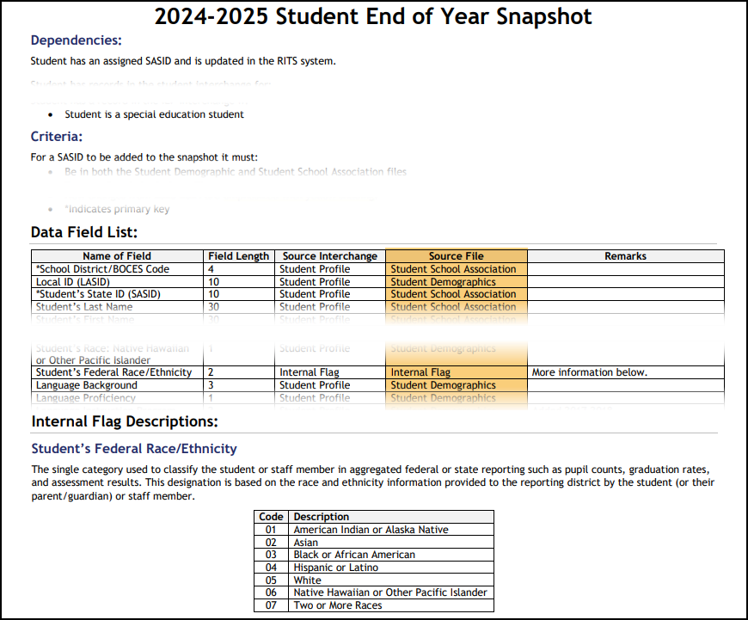
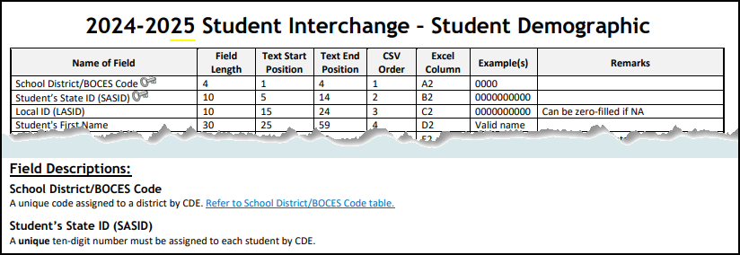
File Layout Example
Snapshot File Layout
Dependencies: List of source interchange files needed for the snapshot
Criteria: Rules regarding the types of records pulled from a source file into a snapshot
Data Fields: Includes a list of specific source files for each data field or indicates the field is an internal flag.
Internal Flag Definitions: Provides detailed descriptions of each internal flag data field and codes.
Interchange File Layout
Provides a list of each data field included on an interchange (source) file with detailed descriptions and codes.

Slide 24
SEY Snapshot Dependencies
Student has been assigned a SASID and updated in the RITS system
Student has a record in the student interchange for:
  Student Demographics
  Student School Association (may have multiple records)
  Graduation Guidelines (only required for graduating students)
  Adjustment File (only required if adjusting prior year data)
Student has a record in the Title 1 interchange if:
Internal Flag
  Student has received Targeted Assisted Services/Funding (as of Oct. 1)
Student has a record in the IEP interchange if:
Internal Flag
  Student is a special education student

Slide 25
SEY Snapshot Criteria
Error free interchange records
Enrollment records on the Student School Association file where…
  Primary School = 1 (Yes)
  School Code is a valid public school
  Pupil Attendance Information is between 01 and 08 (Group A records only)
  Grade Level is not ‘002’ infant
Matched records from other source files
  Student Demographic (SASID, District Code, School Year)
  Graduation Guidelines (SASID)
  Other data sources such as Title I Interchange, SPED Interchange, & internal lists (SASID, School Year)

Slide 26
Records Excluded from the Snapshot due to Criteria
At times, LEAs may have records in their SIS used for other data collections or for internal LEA purposes but are not records indicating a student is actively attending a school in the LEA where a SEY record is required
Possible examples:
Student enrolled in more than one school in the LEA
  Only one school can be listed as the ‘primary school’, sometimes called ‘school of accountability’
Contractual education scenario: Student is a resident of the LEA, but LEA has contracted with entity to provide educational services for the student
  See the resource Contract Agreement Students: Impacts of Pupil Attendance Information (PDF) on the Student Interchange website for more information
Non-attending student where the LEA has a process in their SIS to track absences for truancy or other LEA purposes
Non-attending student that is accountable to the LEA for the graduation cohort
  LEAs are encouraged to follow-up regarding the student’s educational outcomes in case an adjustment or record is needed in the SEY collection
Special Education reporting situation
Other
COGNOS/CEDAR Report Highlight
Report Name
Student List: Records Excluded from SEY Snapshot Due to Criteria
Report Category
Student End of Year
Report Purpose
Lists student records that are not part of the snapshot due to one of the following reasons
  DEM record only
  Group B PAI Code
  Primary School = 0 (no)
  Grade Level = 002 (infant)
  Errors on DEM and/or SSA file

Slide 27
Student Interchange Files

Slide 28
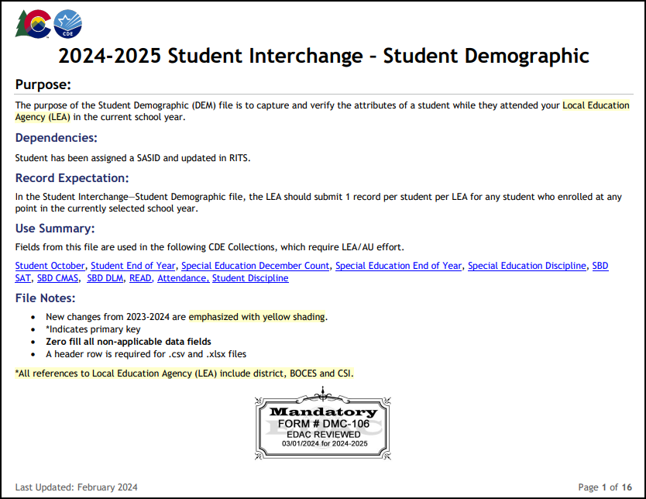
Student Demographic File (DEM)
Untagged file only
Upload this file first
One record per student
Most data fields found on this file are used in the SEY snapshot
Captures attributes of a student
  Point in Time: Attribute as of extract date
    Examples: Gender, Race/Ethnicity, Military Enlisted, Alternate Assessment Participant
  Cumulative: Once true, the attribute remains true entire school year but may change the following year if student no longer qualifies for the service (Additive, but not subtractive).
    Examples: Homeless Status, FRL Status, English Learner, Military Connected, SPED Transition

Slide 29
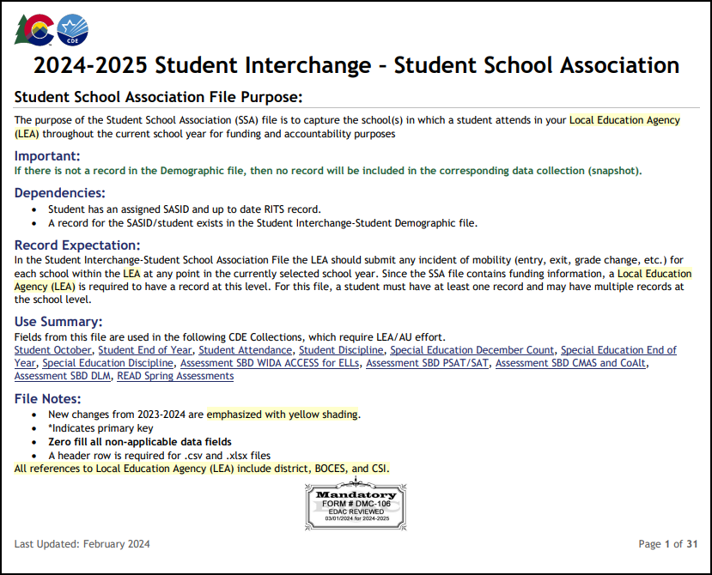
Student School Association File (SSA)
Untagged file only
May include multiple records per student
SEY is focused on SSA records that capture the timeframe a student was actively attending a school within the LEA.
  One-day records are the exception.
Only records meeting the snapshot criteria will pull into SEY.
  Primary School = 1 (yes)
  Grade is PK-12 (infant excluded)
  PAI code is 01-08 (Group A Records)
Data fields for gifted and talented status and date first enrolled in US should be treated like demographic information, matching across all SSA records
SEY is the only student collection that utilizes the data fields ‘school entry type’ and ‘school exit type’
SEY does not use data fields connected to attendance counts, funding status, or alternative instruction courses.

Slide 30
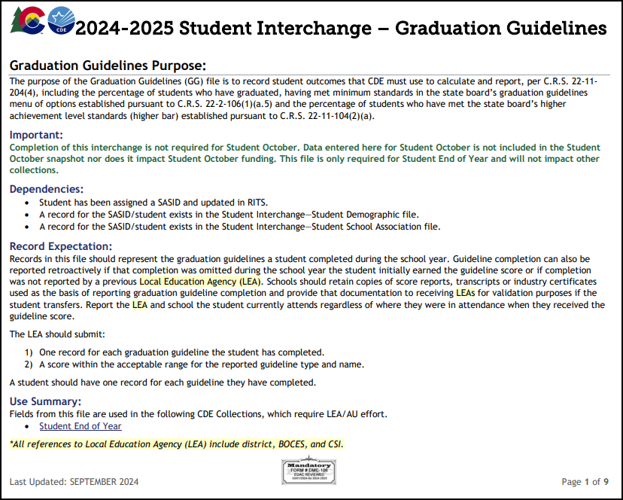
Graduation Guidelines File (GG)
Secondary students only
Expect multiple records per student
No data field from this file is directly pulled into the SEY snapshot, rather the data from this file is used for the business rule SE301 which checks that graduating students have reported GG measures.
LEA Options/Considerations:
  Minimum Reporting: At least one English and one Math measure meeting the benchmark per graduating student
  Optional: Any attempted GG measure, regardless of planned graduation status during the year
    Allows LEAs to monitor GG with the related COGNOS reports
    GG measures travel with student across CO schools
Note: If a measure was reported in a prior school year but the student did not graduate, it does not need to be reported again in the current year since this data is already stored in pipeline

Slide 31
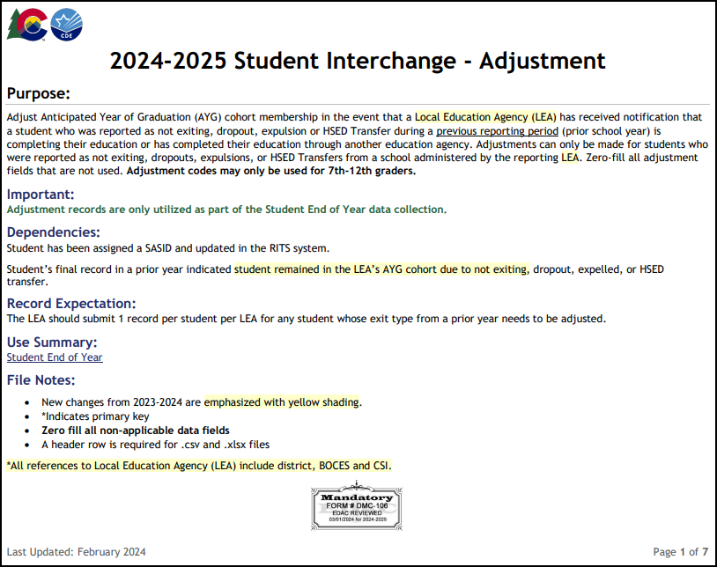
Adjustment File (ADJ)
As needed for SEY Collection
7th-12th grade students only
Not extracted from SIS
  Build file manually using posted template
Adjusts the final exit type for a student in a prior school year who did not attend your district in the current year.
Only used to adjust students with very specific exit scenarios
  Dropout (Exit 40)
  Expulsion (Exit 50)
  HSED transfer (Exit 70)
  Did not Exit (Exit 00)
  Other special circumstance (Exits 18, 19, 21, 26, 30)
Record is loaded in the current year using an adjustment file
Student does not have a record on your DEM or SSA file in the current year

Slide 32
Interchange Preparation
Get SASIDs for your new students
  Through RITS or Data Pipeline
  Visit the RITS Website for resources and instructions regarding SASIDs
Extract files from your Student Information System (DEM, SSA, GG)
  Recommended format is .xls or .xlsx (excel)
    Data Pipeline also accepts .csv
  All data fields must be zero filled or include an applicable code matching the specified field length
  Leading zeros are required for all data fields to maintain the specified field length
    Be careful when opening .csv format in excel to not lose leading zeros
      The newest version of excel has a pop-up asking if you want to keep leading zeros
      CDE has a guide to keeping leading zeros on Student Interchange website
Pro Tip: Use a file naming convention as you will likely extract files multiple times
  Example: 0110_DEM_EOY_04052024.xls
    Spaces in the file name are not allowed

Slide 33
Other Data Sources and Internal Flags

Slide 34
Additional Interchanges
Title 1 Interchange (TT1)
SpED IEP Interchange
Only required for LEAs operating Title 1 Targeted Assistance Programs/Schools
Cumulative student status
  Students indicated as receiving TT1 Targeted Assistance in OCT should remain on this list
  Add any students newly receiving TT1 Targeted Assistance after OCT through the end of the year
Schoolwide programs are automatically indicated and do not require this interchange file
Title 1 Student Internal Flag
  0—No
  2—Yes, Schoolwide (SW)
  3—Yes, Targeted Assistance (TA)
Reflects all students with an IEP
Records needed on the following files:
  SpED Child File
  SpED Participation File
Special Education Student Internal Flag
  0—No
  1—Yes
    SASID indicated in SpED interchange as eligible for services during the current school year
    District of Attendance or District of Residence match SEY Reporting District
Note: Partner with the person responsible for these files in your LEA as these files are often overseen by someone other than the SEY data respondent in a LEA.

Slide 35
Internal Flags
CDE Supporting Data Source
Calculated Fields
CDE receives list of students (by SASID) from another state data source which is used to indicate the student’s status
  0—No
  1—Yes
Data Fields:
  Foster
  Migrant
  CTE
  CTE Nontraditional
  Title 1 Schoolwide
Calculated value based upon current or prior year reported data
Data Fields:
  Student’s Federal Race/Ethnicity
  Gifted and Talented (Y/N)
  English Learner Y/N
  Anticipated Year of Graduation Fields
  IP/ST Cohort Fields
  IP/ST Yearly Flags
  Entry Sequence Flags
  Last Record Flags
  Date First Enrolled in US
    When LEA zero fills field to utilize CDE’s auto calculated date

Slide 36
Data Pipeline Process

Slide 37
Prepare

Slide 38
Checklist
Ensure you have access/logins for following systems
  Your LEA’s Student Information System (SIS)
    Must have ability to extract state reporting files and edit student records for related data fields
  Data Pipeline & COGNOS/CEDAR
  RITS (at least viewing permissions)
  Syncplicity Student Folder
    District Code – District Name – Student
Bookmark important CDE websites & review supporting documentation – slide #43
Sign up for data pipeline TH emails if you don’t already receive them
Plan to maintain data privacy for Personally Identifiable Information (PII)
  What are your internal processes?
  Utilize Syncplicity when communicating with CDE
Gather/Save Critical Contact Information
  CDE: Reagan Ward, StudentEndOfYear@cde.state.co.us, 720-484-9057
  Check your contact information on the COGNOS report SEY Respondent Contact List for accuracy
  Internal:
    Ensure know which colleagues support/oversee which programs such as—English Learners, Homeless, Foster, SpED including SpED Transition, Title 1, Gifted & Talented, Postsecondary Programs such as ASCENT/TREP/PTECH, Free/Reduced Lunch, Graduation Guidelines, school staff to validate adequate documentation of transfer for school exit types
    Do you have colleagues who will support data validation such as district accountability staff?
    Who needs to be notified of preliminary data?

Slide 39
SEY Identity Management (IdM) Roles
Bookmark: Identity Management Site
District Local Access Manager (LAM) assigns account/privileges
Provides access to the various CDE tools
Data Pipeline permissions are needed to complete data collections
A user can only have one role for each Collection
IdM user roles are used by CDE to create email lists & grant collection specific access
  COGNOS/CEDAR access mirrors pipeline access
  Collection emails – typically only LEA Approvers and LEA Users
  Data Pipeline Town
    Manually added, can subscribe via email
  Syncplicity access
    Manually added, monitored by collection leads
Application | Collection | User Role | Access & Notes
Pipeline | Student Interchange | LEA User | Required for SEY data respondents. Upload and edit records for DEM, SSA, & GG files.
Pipeline | Student End of Year | LEA Approver | At least one required per LEA. Create snapshot, submit snapshot, download sign-off form.
Pipeline | Student End of Year | LEA User | Additional support for SEY within the LEA. Create snapshot.
Pipeline | Any | LEA Viewer | View CEDAR/COGNOS reports related to the assigned collection but cannot edit data. Useful role for district support staff who help validate data but do not actively complete the collection.

Slide 40


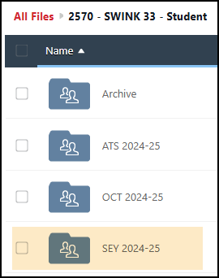
PII and Syncplicity
Personally Identifiable Information (PII)
PII is defined by state and federal laws as information that alone, or in combination, personally identifies an individual
  Includes direct identifiers (SASID, student name)
  Includes information when combined is identifiable
Colorado’s Student Data Transparency and Security Act outlines requirements for how Student PII is collected, used and shared
  See CDE’s data security and privacy site for more information
Communicating PII must be done through secure methods. DO NOT EMAIL PII
  Data Pipeline file upload & COGNOS/CEDAR
  Syncplicity secure file transfer
  Phone call is secure method; 720-484-9057
    Please do not leave PII in voicemail but rather request a return call to discuss PII
Syncplicity
Secure file transfer site
  Syncplicity Login Page
Collection specific folders
  Student End of Year, October, Attendance share a primary folder with subfolders by collection
    Primary Syncplicity Folder:
    District Code – DISTRICT NAME – Student
    Subfolder: SEY 2024-25
Does not notify users of file upload
  Email SEY Inbox if file is ready for review

Slide 41
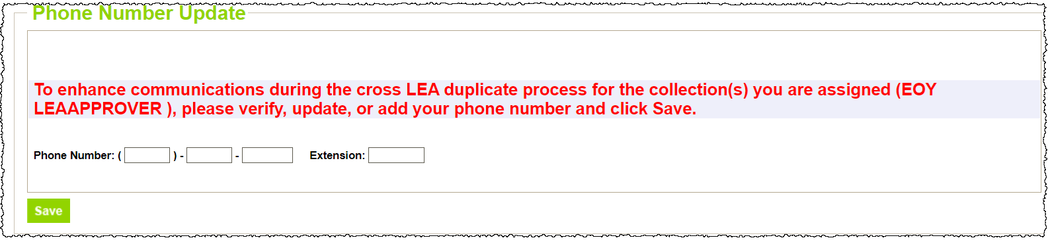
Data Respondent Phone Numbers
Data respondents are asked to maintain current phone numbers in Data Pipeline.
  On-screen prompt when login to pipeline if no phone number has been entered.
  Check existing phone number using CEDAR/COGNOS report EOY Contact List.
    Email StudentEndofYear@cde.state.co.us if phone number is incorrect on the SEY Respondent Contact List but no prompt shows on the data pipeline screen when you login.

Slide 42
Data Pipeline Weekly Maintenance
Data Pipeline has a weekly maintenance window on Tuesday afternoons, during which time users may not be able to access file uploads and snapshots.
What does this mean for you?
  Avoid taking a SEY Snapshot on Tuesdays between 4pm-8pm.
  If you are attempting to do a file upload and are locked out of pipeline, try again in about an hour.

Slide 43
Bookmark List
Site Name/Link | Information/Uses
Data Pipeline Home Page | Starting point for all pipeline collections, training, and resources
 Student End of Year | Primary site for SEY Collection information Contains file layouts, templates, business rules, training materials, and resources
 SEY Adequate Documentation | List of required adequate documentation for each exit type Sample forms/templates
 Student Interchange | Contains file layouts, templates, business rules, training materials, and resources
 SpED IEP Interchange | Contains file layouts, templates, business rules, training materials, and resources
 Title 1 Interchange | Title 1 Targeted Assistance Schools/Programs
 Identity Management (IdM) | This is the landing page with login links to the various CDE data platforms. Data Pipeline, COGNOS/CEDAR Reporting, RITS, etc.
 Frequently Requested Codes and Resources | Includes list of school codes, facility schools, detention centers, etc.
 Trainings | Subpages for Town Hall presentations and general respondent training resources
Syncplicity | Secure file transfer site used to communicate personally identifiable information with CDE if you have questions on specific students during reporting or have exception requests.
Education Statistics | Landing page for all Colorado Education Statistics. From here, navigate to graduation/completion, dropout, or mobility/stability statistics.
Graduation Guidelines | Information for program staff regarding the graduation guidelines menu of options.

Slide 44
Collection Steps by Phase

Slide 45

Regular Phase Steps
Upload interchange files (DEM, SSA, GG)
  Title 1 and/or IEP interchange files as needed
  Adjustment file as needed
Resolve interchange errors
  Update student information system
  Extract and upload new interchange files
Create SEY Snapshot
Resolve SEY Snapshot Errors
  SE001-SE500 series
  Update student information system
  Extract and upload new interchange files
  Request exceptions if needed (Interim Deadline: July 31, 2025)
  Create SEY Snapshot (repeating steps 1 to 4 as needed)
Validate data
  Graduation/Completion/Dropout/Mobility/Stability
Submit error-free snapshot
  SEY~LEAApprover role in IdM required

Slide 46
Cross LEA Phase Steps
Review Cross LEA Errors & Warnings
  SE700 series
  Any SE001-SE500 series errors that arise
Resolve SEY Snapshot Errors
  Update student information system
  Extract and upload new interchange files
  Load adjustment records if needed
    Used to correct prior year exits
  Request exceptions if needed
Create SEY Snapshot (repeating steps 1 to 3 as needed)
  Also ensures all internal flags associate with the snapshot
Validate data
  Graduation/Completion/Dropout/Mobility/Stability
Resubmit error-free snapshot
  SEY~LEAApprover role in IdM required

Slide 47
Post-Cross LEA Phase Steps
Review post-cross validation errors and warnings
  SE900s
  Any SE001-SE700 series errors that arise
Edit student records in pipeline as needed to address business rules
  Data Pipeline → Edit Record
  Request exceptions as needed
  Request post-cross data changes as needed
Update SEY Snapshot (repeating steps 1 to 3 as needed)
Validate data
  Graduation/Completion/Dropout/Mobility/Stability
Submit Superintendent Sign-Off form to CDE
  SEY~LEAApprover role in IdM required to download form
  Email completed forms to StudentEndOfYear@cde.state.co.us
  Nov. 12 through Dec. 2

Slide 48
File Upload

Slide 49
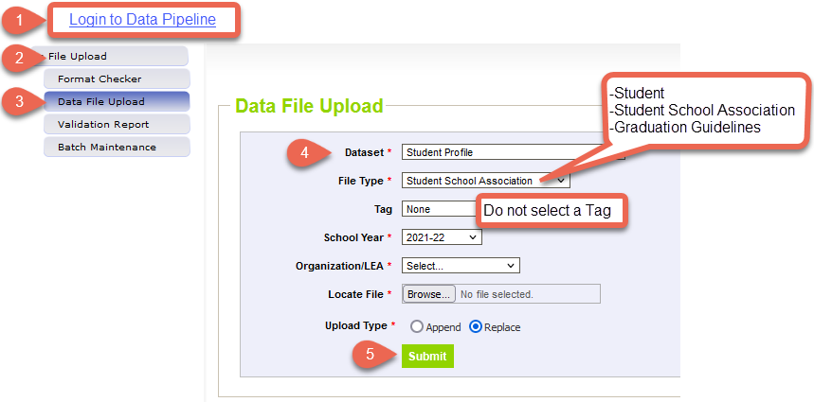
Data File Upload
Update your Interchange files to address errors
  Preferred: Update in SIS → Extract → Upload to Pipeline
  Alternate Method: Edit Record Tool (Data Pipeline)
    Not encouraged during the Regular Phase or Cross LEA Phase
    This method is required for the Post-Cross LEA Phase
Wait for a Confirmation Email from the Pipeline System
  The email will show you the number of errors in your upload
  Use Pipeline or CEDAR reports to review errors and warnings

Slide 50
Create/Update Snapshot

Slide 51
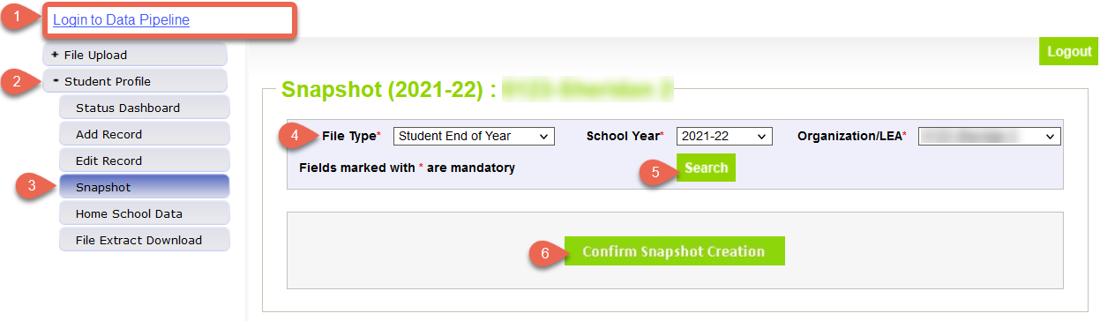
Create Snapshot: Regular Phase & Cross LEA Phase
The message “Snapshot creation triggered and processing. A notification email will be sent upon completion” will appear at the top of the screen after you press the confirm snapshot creation button
Wait for the notification email before reviewing errors/warnings
Creating a new snapshot will replace all the records from your previous snapshot

Slide 52
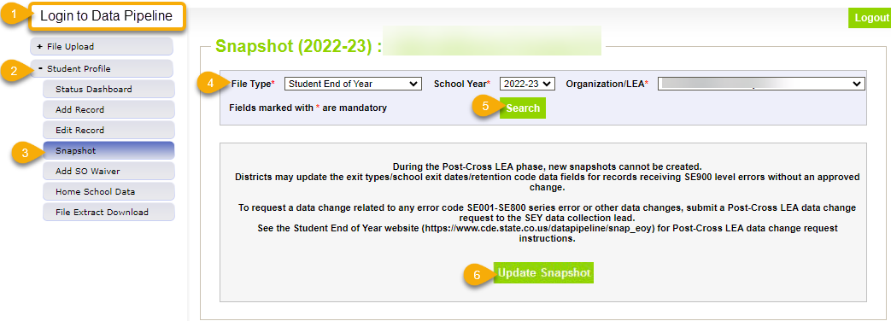
Update Snapshot: Post-Cross LEA Phase
The message “Snapshot creation triggered and processing. A notification email will be sent upon completion” will appear at the top of the screen after you press the confirm snapshot creation button
Data is only updated for records with SE900 series errors or approved data change request
Clears errors for approved exception requests
All districts should ‘update’ their snapshot at least once during the Post-Cross LEA phase even if they do not make any changes to student records

Slide 53
Business Rules

Slide 54
Overview
Business Rules are the list of errors and warnings that are checked when an interchange file is uploaded, or snapshot is created
Available on the SEY Website
  Note: Business Rules will continue to be updated through the official open on May 1st
Kinds of information checked:
  Demographic information (some fields typically do not change from Student October to Student End of Year)
  Valid student entry/exit types, internally and across districts
  Graduating/completing/dropout student coding to ensure accuracy of reporting
    Cohort groups
    Student movement between districts
    Students retained (academic, postsecondary programs, transition programs)
    Identify dropouts from prior years showing up in other districts
    Identify students for whom an HSED certificate has been reported

Slide 55
Errors/Warnings: Overview
Errors
Warnings
Must be addressed
  Update data fields to clear
  Request reporting exception if student data is accurate but does not follow the typical coding pattern as indicated by the error message
Snapshot cannot be submitted if there are any errors
Indicate possible data inconsistencies/coding issues
Some SEY warnings indicate issues that will turn into errors in the post collection phases if not addressed
Snapshot can be submitted even if warnings are present
Pro Tip: Review warnings to look for patterns/areas where district data could be documented in a more accurate manner

Slide 56
Interchange vs Snapshot Business Rules
Interchange
Snapshot
Address data inconsistencies that apply to multiple data collections (snapshots)
Errors on the student demographics and student school association interchange files prevent the student from being included on the SEY snapshot
Errors on the graduation guidelines file prevent that measure from being associated with a graduating student’s SASID
Business Rules: Student Interchange Website
Address data inconsistencies that apply to SEY data collection specifically
Focused on the student’s educational history to ensuring accuracy when deriving graduation, dropout, mobility, and stability rates
Business Rules: Student End of Year Website

Slide 57
Addressing Snapshot Errors/Warnings
Data fields must be updated on the corresponding student interchange file
  Regular Phase & Cross LEA Phase: Upload a new interchange file
    Student Demographic
    Student School Association
    Graduation Guidelines
    Adjustments
  Post-Cross Phase: Manually edit the interchange file in data pipeline
    Student Demographic
    Student School Association
Must create a new snapshot to clear snapshot level errors
  Snapshot creation causes pipeline to run the data through the business rules again

Slide 58
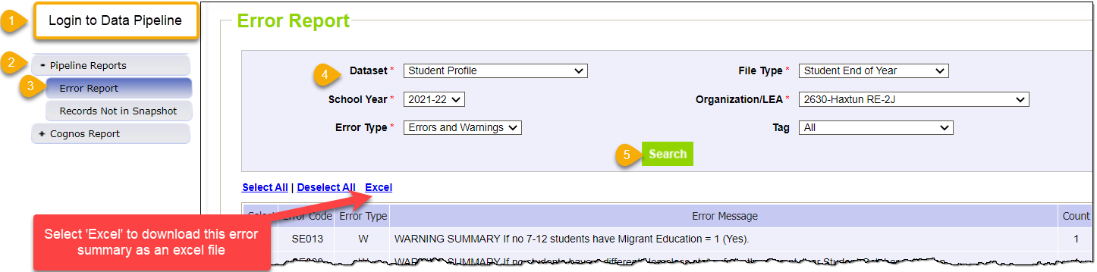
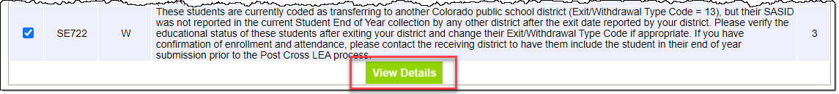
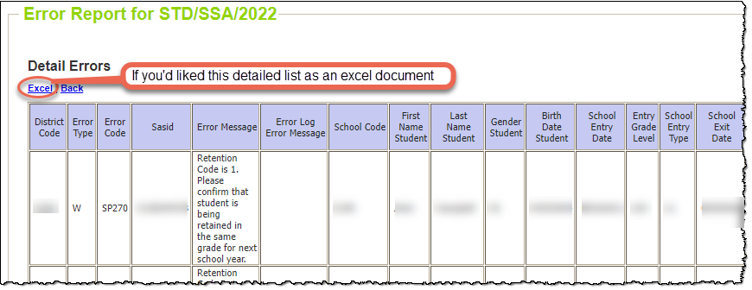
Checking Errors/Warnings: Pipeline Error Report
Preferred method for checking errors/warnings
Some errors and warnings are being updated to use the ‘error log error message’ column that used to be blank on this report
Pro Tip: Use check boxes to select a specific error/warning code before reviewing error details as it may be simpler to focus on one business rule topic at a time
To view specific student records that are triggering an error/warning,
select View Details at the bottom of the screen.

Slide 59
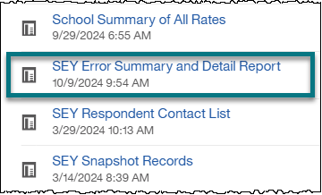
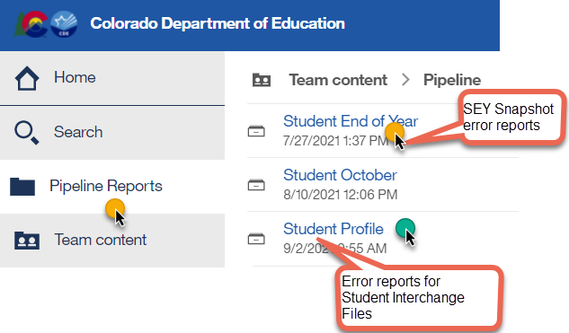
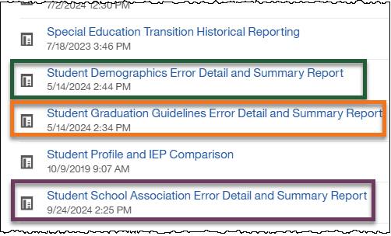
Checking Errors/Warnings: COGNOS/CEDAR
Alternative method for checking errors/warnings
  Login to COGNOS/CEDAR using the link in Data Pipeline or the IdM webpage
Use when reviewing 1,000+ individual error detail records
Some errors and warnings are being updated to use the ‘error log error message’ column that used to be blank on this report
COGNOS/CEDAR is best used to validate data using the various topic specific reports

Slide 60
Business Rules by Phase
Regular Phase
SE001 through SE500 series rules
Focused on checking LEA data against itself for the current year and prior year
  October to SEY
  Assessment to SEY
  Prior SEY to Current SEY
Some warnings indicate potential issues in Cross/Post-Cross phases or even October 2025-2026
  SE137 exit type 13 after May 1
  SE138 exit type 00 multiple LEAs
  SE287 Language Proficiency in OCT does not match SEY for transfer student
  SE275 exit type 13 without another LEA claiming student in grade K-6
  SE722 exit type 13 without another LEA claiming student in grade K-6
Cross LEA
SE700 series
Checks data across CO LEAs
  Current year errors corrected on SSA record
  Prior year errors may be corrected with adjustment file or with a one-day record in current year SEY
Some warnings indicate issues that become errors in Post-Cross Phase if not addressed
Post-Cross LEA
SE900 series
Checks data across CO LEAs
  Current and prior SEY,
  Subsequent OCT (2025-2026)
AYG Warnings
  AYG Reconciliation run as part of CDE process to begin phase, re-runs each time snapshot is updated

Slide 61
SE500 Custom Business Rule
This rule can only be cleared by submitting a request to the SEY Collection lead
View the ‘error log error message’ column on the error detail report for a custom message regarding the specific data issue to resolve
  SASID included if needed
Must communicate with SEY Collection lead to resolve
  Exception Request, Post-Cross Data Change Request, Phone Call to discuss situation, etc.
Used when issue found through manual checks
Used in SASID merge situations
Most common in Cross LEA and Post-Cross LEA

Slide 62
Status Dashboard & Submitting Snapshot

Slide 63
Status Dashboard Information
Allows you to review the status of a submitted interchange file or snapshot
  Quantity of errors
  Data Exists ‘Y’ means successful snapshot creation
  Data Locked ‘Y’ means snapshot creation is not available
    Post-Cross LEA updates can be completed in this status
  Overall Status
    ‘P’ Pending
    ‘S’ Submitted
  Last Updated Date
    This date/time should be more recent on your SEY snapshot than on the related student interchange files
Used to submit snapshot to CDE
Used to download the superintendent verification (sign-off) form during the final phase of data collection
  Last Updated Date on the status dashboard must be prior to the date on the sign-off form for the form to be accepted

Slide 64
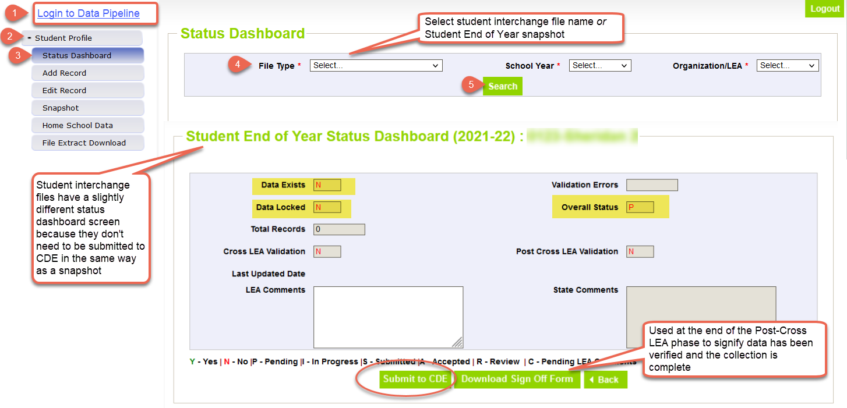
Status Dashboard Screen

Slide 65
Reviewing/Validating Data
(COGNOS/CEDAR Reports)

Slide 66
CEDAR/COGNOS Reports Overview
The Colorado Education Data Analysis and Reporting system (CEDAR) is a private, secure system which provides student level data to authorized users. Access to student-level data is limited to educators who have need for such data.
Reports in CEDAR/COGNOS have multiple purposes. Some are used as operational reports to assist data respondents in looking up specific information on students, file/snapshot errors, and students missing from a snapshot due to profile errors. Other reports are used to validate data when finalizing a data collection. Many reports also provide districts with a preview of data that will be published based upon specific data collections. (i.e., graduation statistics)
SEY CEDAR/COGNOS Reports Guide
Notes:
Often CEDAR is referred to as COGNOS since COGNOS is the software currently powering the Colorado Education Data Analysis and Reporting system (CEDAR).

Slide 67
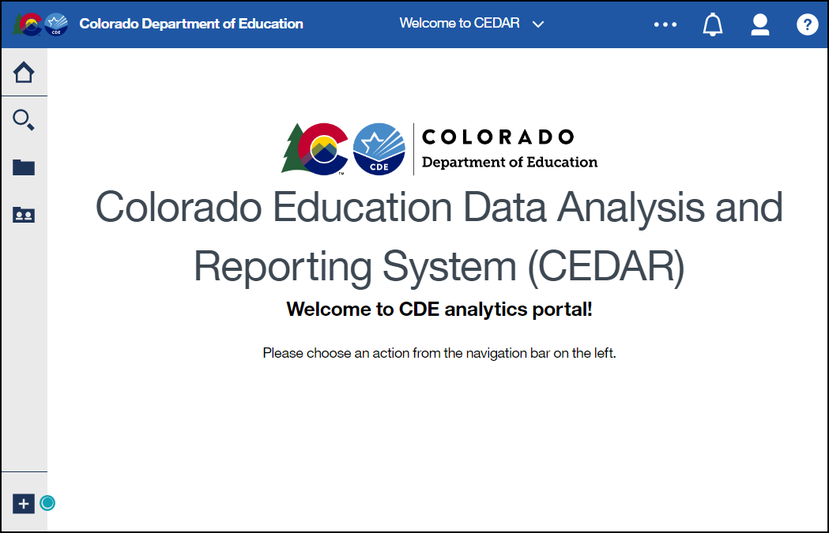
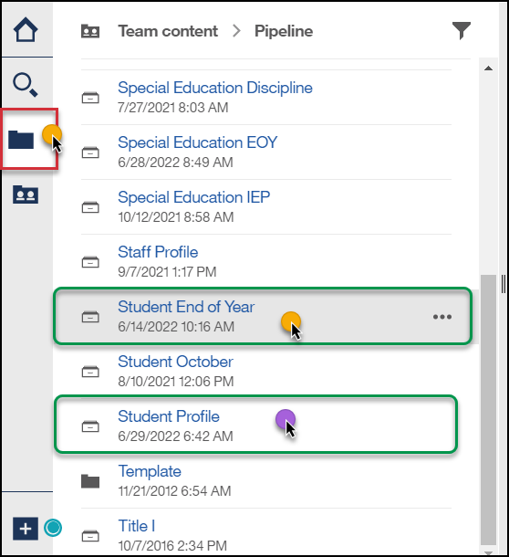
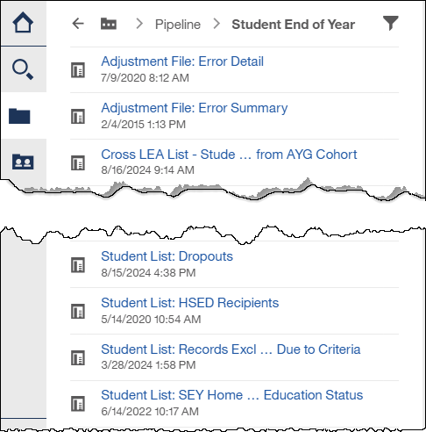
Accessing Reports
Identity Management Landing Page → CEDAR Link
Data Pipeline →

Slide 68
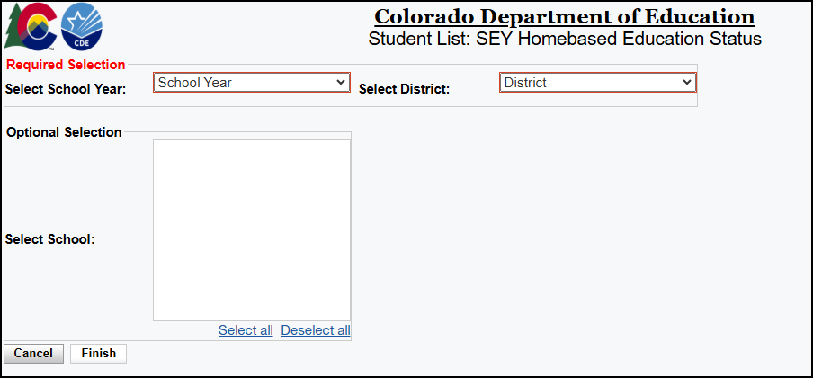
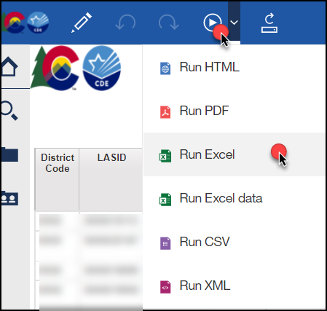
Report Screen & Download
Use dropdown menus to select desired information
Reports can be downloaded as an excel file for easier sorting/filtering of information.

Slide 69
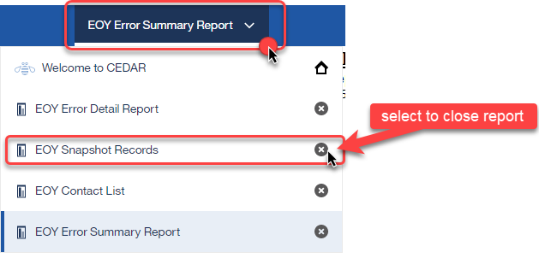
Moving between reports
Toggle between reports using the recent reports dropdown
Close an open report using the recent reports dropdown

Slide 70
Student Profile Reports
Individuals with permissions to the Student Interchange in IdM have access to student profile reports
  STD~LEAVIEWER
  STD~LEAUSER
These reports are operation in nature, assisting districts with reporting accurate data on these fields and providing historical information when helpful
They are connected to information from the student interchange files:
  Student Demographics
  Student School Association
  Graduation Guidelines

Slide 71
Student End of Year Reports
Available to individuals with permissions to Student End of Year in IdM
  SEY~LEAVIEWER
  SEY~LEAUSER
  SEY~LEAAPPROVER
Some reports are operational in nature, designed to assist with the data collection
  Tip: Student lists are a great tool when asking other colleagues to assist with data validation for dropout and AYG Cohort (graduate) status
Some reports are designed to provide districts with a preview of their education statistics data prior to the public release of data in January
  Graduation/Completion Rates
  Dropout Rates
  Mobility/Stability Rates
See the SEY CEDAR/COGNOS report guide (PDF) for information regarding each available report

Slide 72
Exceptions and Data Change Requests

Slide 73
When are reporting exceptions needed?
Reporting exceptions are used to clear the associated errors (without changing the data) in unique circumstances where a student’s record has accurate information, but their educational history does not follow the anticipated coding patterns outlined in the business rules for an interchange file or snapshot
Data respondents must work with the data collection lead for a given file/snapshot to request an exception be granted
Some reporting exceptions require additional supporting documentation and may be reviewed by other CDE staff

Slide 74
Regular Phase and Cross LEA Phase

Slide 75
Reporting Exception Process
Complete exception request template
  Available on SEY Website
Upload exception request template to your district’s Syncplicity student folder
  Folder: 1234 – DISTRICT NAME – Student
  Subfolder: SEY 2024-25
Notify the SEY collection lead that you’ve uploaded a document for review
  StudentEndofYear@cde.state.co.us
  Suggestion: Include the date in name of your exception request file as you may upload more than one exception during the collection cycle
Collection lead will review your request and notify you of the outcome
  Approved requests – reupload interchange file and/or create a new SEY snapshot
  Denied requests – collection lead will provide next steps for clearing the error
  Additional information needed – collection lead will request information

Slide 76
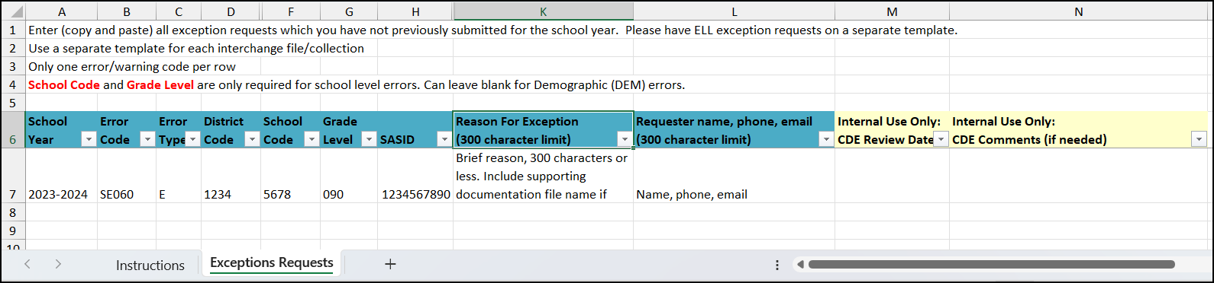
Exception Request Template
Required for all reporting exceptions, even when additional documentation is also being provided
Uploaded to Syncplicity for Review
  Pro Tip: Include district code, date, and file type in the file name 1234_5.23.25_SEY_exceptions
Do not combine requests for different interchange files or SEY snapshot into one form
Do not delete tabs or columns from this form.
  Hidden columns exist on the exception request tab required for accurate processing.
  Instructions tab includes information that the exceptions request tab validates against.
Submit a new exception request form when additional exceptions are needed
  CDE Collection Lead inputs date request is reviewed to let you know it has been processed. After this point a new form is needed for new requests.

Slide 77
What types of exceptions might need additional information?
If the reason given for the exception doesn’t make sense with the coding pattern, clarification may be requested
SASID merge situations
  Work with the RITS coordinator (RITS@cde.state.co.us) to resolve
  Once merge is complete, then any follow-up SEY errors are cleared with an exception
English Learners whose status changed mid-year
  Students with > 2 years of English Learner history in the same district whose status is changing mid-year (3 OCT, 2 SEY collections)
  Mid-Year English Learner Change Form
Post-Cross LEA SE903 errors
  Proof of adequate documentation required for student to remain coded as Exit 13 (transfer to a public school in another CO district)

Slide 78
Post-Cross LEA Phase

Slide 79





Post-Cross Phase:
Exception Requests & Data Change Requests
Post-Cross Error or Data issue
SEY Data Incorrect and must be updated
SEY Data is Accurate as Reported
Submit a Post-Cross LEA Data Change Request
Submit an Exception Request

Slide 80
What is a Post-Cross data change request?
Unique to Post-Cross LEA phase of SEY Collection
Used to request a change to a student’s record under the following circumstances:
  Updating data to clear any regular phase or Cross-LEA business rule (SE001-SE800s)
  Updating exit type/date/retention code to clear a SE900 series warning
  Adding a missing student record to resolve a SE400 error or as directed by SEY collection lead.
  If instructed to update records due to a SASID merge. When SASID merges occur during the Post-Cross phase, email the SEY Collection lead BEFORE making any changes to your data.
Update data in pipeline using the edit record screen
  School Exit Type
  School Exit Date
  Retention Code
  Other data fields in rare circumstances
Complete a data change request form
Submit form to Syncplicity using the same folder as exception requests
Notify StudentEndOfYear@cde.state.co.us that a request has been placed in Syncplicity for review
Collection lead will review the request and notify you of the outcome or any next steps

Slide 81
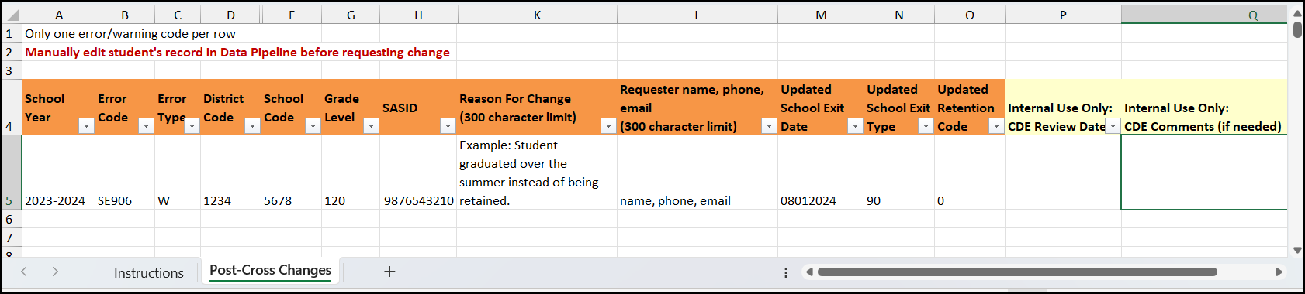
Post-Cross Data Change Request Template
Required for any post-cross data change outside of the SE900 series errors
Must include the new school exit date, school exit type, and retention code
  If other data field changes are requested, include this information in the reason for change request
Do not delete tabs or columns from this form.
  Hidden columns exist on the post-cross changes tab required for accurate processing.
  Instructions tab includes information that the post-cross changes request tab validates against.
Submit a new change request form when additional changes are needed
  CDE Collection Lead inputs date request is reviewed to let you know it has been processed. After this point a new form is needed for new requests.

Slide 82
Suggested Monthly Checklists

Slide 83
April/May
April (Soft Open Phase)
May (Regular Phase)
Prepare for SEY Collection
  Access/Logins
  Review Resources
  Gather Contacts
Attend Collection Overview Training and Register for remaining Trainings
  4/2 and 4/29 Training: Collection Overview (two options)
  4/22 Training: SPED 18-21 Transition
4/10 Upload DEM/SSA/GG files to monitor GG with COGNOS/CEDAR Reports
Optional: Create SEY Snapshot as part of Soft Open Phase (3/31 to 4/23)
5/1 Collection officially opens, may begin submitting exception requests and adjustment files
5/9 Interim Deadline: Upload interchange files
5/29 Interim Deadline: Create SEY Snapshot
5/13 Training: May Office Hours
Review errors and collaborate with colleagues who may be unavailable over the summer (EL, GG, Homeless, FRL, etc)
Remind staff in charge of exit types/dates to use exit type 00 for students who finish the year within 3 weeks to your LEA’s last day of school
  Create one-day records in 2025-2026 school year when adequate documentation is available and exit status is known for summer transfers

Slide 84
June/July
June
July
6/11 Interim Deadline: Error Free Interchange Files
6/10 Training: June SEY Office Hours
Update exit status for graduating students, create snapshot to look for SE301 missing GG errors
Begin resolving SEY errors
Begin submitting exception requests
Create one-day records in 2025-2026 school year when adequate documentation is available and exit status is known for summer transfers
7/31 Interim Deadline: Submit all exception requests for review
7/15 Training: July SEY Office Hours
SEY snapshot should almost be error free
  Types of remaining errors:
    Pending exception requests
    Exit type/retention for potential summer graduates/completers being monitored through summer school
    Pending input from additional colleagues
Review and address SEY warnings

Slide 85
August/September (Regular Phase)
August
September
8/14 Interim Deadline: Error free snapshot
8/12 Training: Aug SEY office hours
Report Review/Data Validation
  Student List: Dropouts
  Student List: AYG Cohort
  Other COGNOS/CEDAR reports
Ensure accurate retention codes
  Check SEY 2025 grade and retention code compared to 2026 grade level for students at beginning of year
Verify coding for SPED Transition and Postsecondary Program students
9/4 State Deadline: Submit error-free SEY Snapshot

Slide 86
September/October (Cross LEA Phase)
September
October
9/16 Training: September SEY Office Hours
9/18 Cross LEA begins
Begin resolving Cross LEA errors
Begin research of SE722 warnings
  Address as many of these as possible during Cross LEA, especially potential SASID merges
  Use COGNOS/CEDAR report ‘SEY Respondent Contact List’ to reach out to other LEAs
Review SE275 warnings,
  Check documentation and update school exit types
  Use school exit type 06 if exit status is unknown
Pro Tip: Use time between SEY phases to work on resolving 2026 DEM and SSA errors in preparation for October 2026 collection
10/6 Interim Deadline: Error free Snapshot
10/16 Deadline: Submit error free snapshot
  Pro Tip: Create initial October 2025-2026 snapshot by this date to ensure first review of Post-Cross errors and warnings reflects both SEY 2025 and OCT 2026 data
Create at least one SEY snapshot even if no errors exist
Final opportunity to correct demographic issues, clear SE001-SE600 warnings, update title 1 targeted assistance status
Review COGNOS/CEDAR reports, especially rates to look for reasonableness

Slide 87
October/November (Post-Cross Phase)
October
November
10/21 Training: October SEY Office Hours
10/23 Post-Cross Phase begins
Check SEY retention codes compared to OCT 2026 coding for SPED Transition and Postsecondary Program students
  SEY warnings and OCT errors support process
Begin resolving SEY Errors
  Change exit type and update snapshot
  Request Exception
  Post-Cross Data Change Request
11/10 Interim Deadline: Error free snapshot
  If errors remain, they should be related to pending exception requests and post-cross data changes already submitted for review
Update snapshot at least once even if no errors or changes needed
Review/Validate data, especially rates
  11/12 May begin submitting sign-off forms if data is validated and accurate
11/18 Deadline: Error free snapshot
  Hard deadline, no data changes past this date unless required due to CDE’s final data review
If receive notice of required changes during CDE’s final review window, respond promptly (11/21 to 11/25)

Slide 88
December/January (Final Dates)
December
January
12/2 Superintendent Verification (Sign-Off) Form Due
  Collection closed, no data changes may occur
Follow internal district processes to prepare for public data release next month
  Data is embargoed until the public release, but may be used internally
  COGNOS/CEDAR reports show unsuppressed data
  Quick summary for school administrators may be created using COGNOS/CEDAR report School Summary of All Rates
CDE Public Data Release (date TBD)
  Share embargoed statewide data with applicable internal staff (approximately 1 week prior to public data release)
  Forward notification of public release to applicable data staff

Slide 89
Additional Information

Slide 90
Adequate Documentation of Transfer

Slide 91
Adequate Documentation Overview
Adequate documentation is the documentation maintained by districts/schools when students transfer out of their district
  Documentation necessary to avoid incorrectly coding students as dropouts.
  Documentation supports selecting the appropriate exit type for ‘verified transfers out’ of your AYG graduation cohort
Adequate documentation is maintained year-round and should be readily available upon request by SEY collection
  Reviewed by SEY collection lead on a case-by-case basis
  Typically used when addressing SE903 errors in the Post-Cross LEA Phase

Slide 92
1-CCR-301 Highlights/Reminders
When a student withdraws, districts are authorized to request information from the parent or guardian about the specific type of educational enviornment that a student is transferring to in order to monitor compliance with the School Attendance Law. [section 22-33-104 (1), C.R.S.]
Colorado Public Schools and local education agencies are required to send transcripts or to confirm attendance when requested from another Colorado Public School or local education agency within two weeks of receiving the request with the exception of students in out of-home placements whose records must be transferred within five (5) days pursuant to sections 22-32-138(2)(a)(II) and (3)(a), C.R.S

Slide 93
SEY Adequate Documentation Website
SEY Adequate Documentation Site
  Sample forms and templates
  List of documentation required for each school exit type
All documentation should include the student’s SASID and full name
Types of documentation
  Written records request
  Confirmation of enrollment and attendance
    Provided by receiving district when student has begun attending the receiving school
    Must include date of enrollment and date of attendance
  Certificate of enrollment
  Signed parent/guardian letter
  Written confirmation from school administrator

Slide 94
Exit 13 – Transfer to a public school in a different CO District
Documentation Required:
Confirmation of enrollment and attendance
  Provided by receiving district when student has begun attending the receiving school
  Must include date of enrollment and date of attendance
  Must include student’s SASID and full name
  If a SASID merge has taken place or student is found to have two different SASIDs, include both SASIDs on the form
No other documentation is accepted
  RITS system is not adequate because a student may have enrolled but never attended
Sending district should request this form if they lack documentation
Districts must respond to records requests within two weeks
  Records requests for out of home placements must be responded to within 5 days

Slide 95
One-Day Records

Slide 96
School Exit Type 00
School Exit Type 00 = did not exit
Used for any student who completes the school year, regardless of their anticipated enrollment the next year
  Per the Colorado Code of Regulations (1-CCR-301-1), “students shall be counted as completing (finishing) the school year if they leave school within three weeks of the last day of school…”
Must be paired with school exit date ‘00000000’
Students with school exit type 00 in the prior year (2023-2024) must have a record in the current year (2024-2025)

Slide 97
One-Day Record
Used to reconcile student enrollment records
  Transfer out of the district over the summer
  Summer dropouts
  Grade reassignments
Typically occur in the summer before the start of a LEA’s school calendar
  Best practice: 07/01 entry and exit date
  Could be sequential days (07/01 entry, 07/02 exit) if your LEA’s student information system does not allow the use of an entry/exit on the exact same day
Occasionally used at the end of the school year to reconcile a student in the AYG cohort who has an updated final exit status from an LEA
  Best practice: 06/30 entry and exit date
Must have a valid school code
  Matriculating students who transfer out of the district: Use the school code for the school the student would have attended unless a dropout. Then, use the summer district dropout coding pattern.
Grade Level reflects the grade the student would have been in if enrolled in the current year
Language Proficiency reflects the EL proficiency a student would have if enrolled in the current year. Moving the student along the EL progression if needed.

Slide 98
Instances of Mobility

Slide 99
Mobility Calculation
Mobility Instance: each time a student experiences an unanticipated movement within the academic year such as entering or leaving a school or district.
Mobility rates are based upon movement occurring after October 1st
  Entry/exit from a school (school instance of mobility)
  Entry/exit from a LEA (district instance of mobility)
  Oct. 1st date means the one-day records at the beginning of the year to show summer transfers out of a school/LEA do not negatively impact mobility rates
Students must have a gap in attendance of 10 days or more for a move to be considered mobile
  Allows students to have enrollment ‘status’ changes that require multiple enrollment records at the same school code without impacting mobility (e.g., postsecondary program enrollment, home based education, etc.)

Slide 100
Instances of Mobility: Reporting extended absences
Per state board rule, districts should indicate an instance of mobility for a student after ten consecutive days of absence as part of the Student End of Year (SEY) collection.
  Instances of mobility capture extended timeframe of non-attendance
Used to calculate mobility rates
Requires multiple attendance records (PAI 01-08, Primary School 1)
  School Exit/Entry 25 used if student’s absence is 10+ days to 6 weeks
  School Exit/Entry 45 used if student’s absence is 6+ weeks
  School exit date indicates last date of attendance
  School entry date indicates date student began attending district again
LEAs should follow local policies and procedures used to track steps taken to attempt to reengage student/pursue truancy/etc. during timeframe where student is not attending the LEA (mobility instance)
  This may or may not include records in the LEA’s SIS that do not meet criteria for inclusion in SEY or Attendance collection
Implications for Attendance collection
  Impacts total days possible, attended, excused, and unexcused
  Time frame between enrollment records (instance of mobility) not part of attendance data, impacting chronic absenteeism rate
Attendance Record | School Code | School Entry Date | School Entry Type | School Exit Date | School Exit Type
#1: Mobility instance | 1234 | 08152024 | 02 | 02012025 | 25
#2: Return to school | 1234 | 04012025 | 25 | 00000000 | 00

Slide 101
Retention Codes

Slide 102
General Information
Retention Code always indicates the expected grade level for the student in the following school year.
  A retention code in 2024-2025 SEY indicates the student will be in the same grade level again in 2025-2026.
Retention Code = 1 may be used for any student K-12
  Must have school exit type 00 with school exit date 00000000
Retention Codes 2 and 3 are reserved for 12th grade students with special circumstances only
Code | Definition
0 | No/Not Applicable
1 | Yes – student will repeat this grade the next school year
2 | Yes – 12th grader who will return to participate in an approved postsecondary program in the next year (i.e. ASCENT, P-TECH, and TREP).
3 | Yes – 12th grader with an IEP who will return to participate in 18-21 transition services in the next year.

Slide 103
Retention Codes: 12th graders
1
2
3
Also known as an Academic Retention
Postsecondary Program
  ASCENT
  PTECH years 5-6
  TREP
SPED 18-21 Transition Services
School Exit Type 00
See coding guides in section 5 of the SEY collection manual
See coding guides in section 5 of the SEY collection manual
Record required in following year
Record expected in following year
Record required in following year

Slide 104
Handling SASID Merges

Slide 105
SASID Merge Overview
When a single student is found to have multiple assigned SASIDs in the RITS system, a SASID merge is need.
Why does this happen?
  Student transferred between LEAs and the receiving LEA requested a new SASID rather than claiming the existing RITS record
    Most often found during the Cross LEA & Post-Cross LEA phases of the SEY collection
  Typos in student’s name, date of birth, or gender data in RITS leading to a LEA to accidentally request a new SASID rather than claiming the existing RITS record
  Student with hyphenated middle or last names
How is it corrected?
  Reach out to the RITS Coordinator at RITS@cde.state.co.us to request a merge. Additional documentation supporting the SASID merge may be requested via Syncplicity.
    Note: The RITS Coordinator has their own Syncplicity folders and does not use the same folder as the SEY collection

Slide 106
SASID Merge resolution
Regular & Cross LEA Phases
Post-Cross LEA Phase
Update all interchange files to reflect the correct SASID, name, date of birth, and gender for the student
  SASID indicated by RITS coordinator
Reupload the interchange files
Create a SEY snapshot
Verify student included in the SEY collection with the correct SASID using the CEDAR/COGNOS report EOY and OCT (prior, current, subsequent year) – SASID lookup
Resource: Handling SASID merges in Regular and Cross LEA Phases (PDF)
Email SEY Collection lead for additional directions BEFORE making any changes to your data
  Special handling is required during this phase and is handled on a case-by-case basis
Verify student included in the SEY collection with the correct SASID using the CEDAR/COGNOS report EOY and OCT (prior, current, subsequent year) – SASID lookup
Resource: Handling SASID merges in Post-Cross LEA Phase (PDF)

Slide 107
Anticipated Year of Graduation (AYG)

Slide 108
AYG Assignment Logic
Assigned in the school year a student is first reported as entering high school in Colorado through the Student End of Year collection (grades 9-12)
  AYG is automatically assigned during the SEY collection process
  Once assigned, AYG does not change
  Based upon the student’s highest grade level as of October 1st
If reported in multiple districts, will base AYG on the highest grade level as of 10/1
  EXAMPLE:
    District A reports 10th grade with an exit date on/after October 1st
    District B reports 9th grade with an exit date on/after October 1st
    Student’s AYG will be calculated based on the 10th grade record in District A
  Post-Cross Phase includes mechanics to reconcile AYG across districts
The following data fields are all set in the year that a student’s AYG is assigned
  Starting Year for Graduation Cohort
  Starting Grade for Graduation Cohort
  Starting District for Graduation Cohort
  Anticipated Year of Graduation
Grade Level | AYG Calculation | Example (Current Year 2024-2025)
9th | Current Year + 3 | AYG 2028
10th | Current Year + 2 | AYG 2027
11th | Current Year + 1 | AYG 2026
12th | Current Year | AYG 2025
Notes:
Verified Transfer Out: School Exit Types 02, 05, 13, 14, 15, 16
Exit Types that Comprise the AYG Cohort: 00, 01, 40, 12, 26, 18, 19, 21, 30, 50, 70, 90, 92, 93, 94, 95, 96

Slide 109
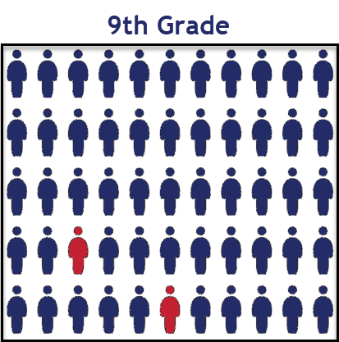
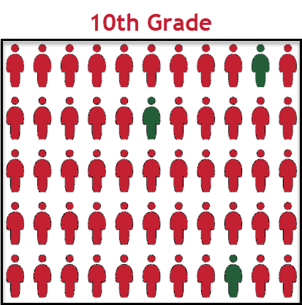
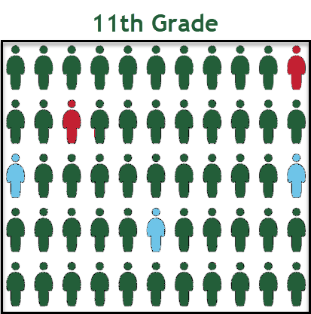
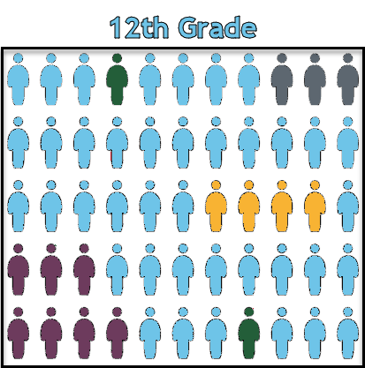
AYG represented in a High School Population
9th grade example:
Mostly AYG 2028
Few AYG 2027 who experienced a retention
10th grade example:
Mostly AYG 2027
Few AYG 2026 who experienced a retention
11th grade example:
Mostly AYG 2026
AYG 2025 if experienced a retention
AYG 2027 if experienced grade acceleration
12th grade example:
Mostly AYG 2025,
AYG 2024, 2023, 2022 if experienced a retention, are participating in SPED Transition, or a Postsecondary Program
AYG 2026 or AYG 2027 if experienced grade acceleration
Notes:
Once a student is assigned an AYG, that AYG remains constant.
Students who experience grade reassignments (acceleration or retention) remain in their original AYG cohort.

Slide 110
AYG Q&A
Q: A student is transferring into the LEA from out of state or out of country whose age does not align with their number of transferrable high school credits. What grade level should they be placed in?
A: LEAs determine appropriate grade level based upon their local policies. LEAs are encouraged to consider the following:
  Student’s current transfer credits and instructional needs
  If placed in (blank) grade, can they reach 12th grade before they reach the maximum age for educational services?
  AYG is based upon the first record for a student in a CO high school.
    The grade level of that record will determine the AYG.
    Once set, AYG does not change.
  Some postsecondary programs have restrictions related to AYG (ASCENT, PTECH, TREP)
Q: What is the AYG Reconciliation Process?
A: In the reporting year a student first enters a CO high school, a process is run during the Post-Cross phase to reconcile the student’s AYG if they have multiple enrollment records (in an LEA or across CO) at different grade levels. Student’s AYG is set based upon the highest grade level as of Oct. 1st.

Slide 111
Contact & Resources

Slide 112
SEY Collection Lead
Here to answer questions and assist where possible
  Student End of Year collection
  Student Interchange 2024-2025 questions
Don’t get frustrated, reach out!
To best assist you, please help me with the following
  Include your 4-digit district code in emails and voicemails
  Leave voicemails or send follow-up emails if I miss your call
  Ensure your phone number is accurate in IdM (ask your LAM to help if it needs to be updated)
Email: StudentEndofYear@cde.state.co.us
Phone: 720-484-9057

Slide 113
Bookmark/Resource List
Site Name/Link | Information/Uses
Data Pipeline Home Page | Starting point for all pipeline collections, training, and resources
 Student End of Year | Primary site for SEY Collection information Contains file layouts, templates, business rules, training materials, and resources
 SEY Adequate Documentation | List of required adequate documentation for each exit type Sample forms/templates
 Student Interchange | Contains file layouts, templates, business rules, training materials, and resources
 SpED IEP Interchange | Contains file layouts, templates, business rules, training materials, and resources
 Title 1 Interchange | Title 1 Targeted Assistance Schools/Programs
 Identity Management (IdM) | This is the landing page with login links to the various CDE data platforms. Data Pipeline, COGNOS/CEDAR Reporting, RITS, etc.
 Frequently Requested Codes and Resources | Includes list of school codes, facility schools, detention centers, etc.
 Trainings | Subpages for Town Hall presentations and general respondent training resources
Syncplicity | Secure file transfer site used to communicate personally identifiable information with CDE if you have questions on specific students during reporting or have exception requests.
Education Statistics | Landing page for all Colorado Education Statistics. From here, navigate to graduation/completion, dropout, or mobility/stability statistics.
Graduation Guidelines | Information for program staff regarding the graduation guidelines menu of options.

