Slide 1
Short Bytes
Anticipated Year of Graduation (AYG)

Slide 2
Overview
Anticipated Year of Graduation (AYG) is the year a student is anticipated to graduate high school
  4 years after they enter 9th grade for the first time
AYG is automatically assigned during the SEY collection process
Once assigned, AYG does not change
Students with the same AYG in a school/district are placed into a graduation cohort based upon that AYG that is used when calculating graduation and completion rates
Colorado’s process to assign an AYG to a student is based on US Dept. of Ed. Regulation & Guidance

Slide 3
Assigning AYG
Assigned in the school year a student is first reported as entering high school in Colorado through the Student End of Year collection (grades 9-12)
Based upon the student’s grade level as of October 1st of the current year
Grade Level | AYG Calculation | Example (Current Year 2022-2023)
9th | Current Year + 3 | AYG 2026
10th | Current Year + 2 | AYG 2025
11th | Current Year + 1 | AYG 2024
12th | Current Year | AYG 2023
If reported in multiple districts, will base AYG on the highest grade level as of 10/1
  EXAMPLE:
    District A reports 10th grade with an exit date on/after October 1st
    District B reports 9th grade with an exit date on/after October 1st
    Student’s AYG will be calculated based on the 10th grade record in District A

Slide 4
AYG Data Fields
The following data fields are all set in the year that a student’s AYG is assigned
  Starting Year for Graduation Cohort
  Starting Grade for Graduation Cohort
  Starting District for Graduation Cohort
  Anticipated Year of Graduation
Accessing AYG information using CEDAR reports
  Available data respondents with Student End of Year access in Identity Management (LEA Approver, User, Viewer)
    Student End of Year – EOY Student List – Students from Current AYG
    Student End of Year – EOY AYG lookup by SASID
    Student End of Year – EOY Snapshot Records
  Available to data respondents with Student Interchange access in Identity Management (LEA User or Viewer)
    Student Profile – Students with an Assigned Anticipated Year of Graduation
    Student Profile – Graduation Guidelines: List of Students - Summary

Slide 5
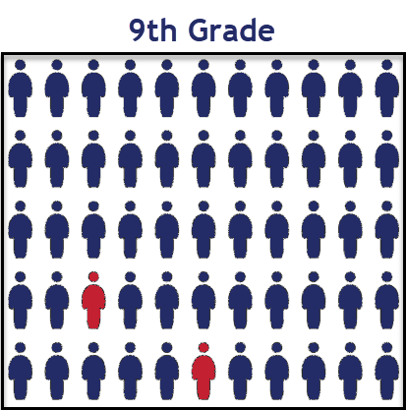
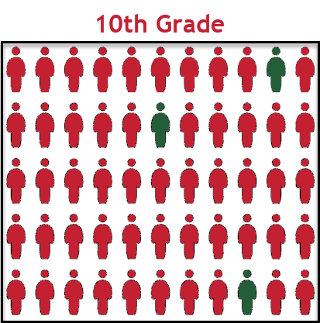
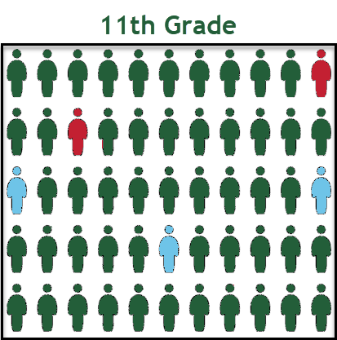
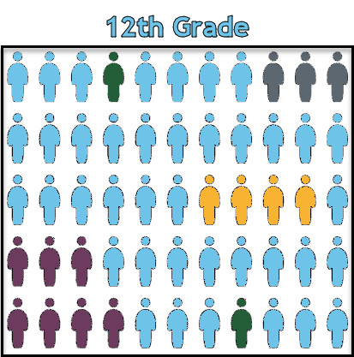
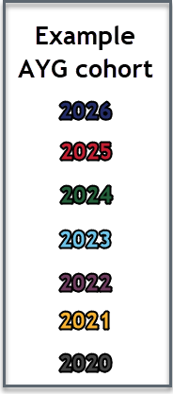
AYG represented in a High School Population
Once a student is assigned an AYG, that AYG remains constant.
Students who experience grade reassignments (acceleration or retention) remain in their original AYG cohort.

Slide 6
Graduation Cohort Base a.k.a. AYG Cohort
The graduation base represents all students with the same AYG assignment in a given calculation group (state/district/school)
AYG Cohort initially built based upon students entering 9th grade
  Transfers in are added to the AYG cohort
  Verified transfers out are removed from the AYG Cohort
Graduation & Completion rates use the AYG cohort as the denominator when calculating rates for a given group (state/district/school)
Verified Transfer Out: A Student who has left your district and transferred to another educational enviornment that is providing educational services that lead to a regular high school diploma
Requires adequate documentation
Exit Types:
  02 – Death
  05 – Transfer to another country
  13 – Transfer to another Colorado district
    Student enters the AYG cohort for their new district/school
  14 – Transfer to another state
  15 – Transfer to a non-public school
  16 – Transfer to home-based education (homeschool)

Slide 7
Exit Types that Comprise the AYG Graduation Cohort Base
Code | School Exit Type Description
00 | Student did not exit
01 | Reached maximum age for services
40 | Dropped Out
12 | Transfer to a detention center within district
26 | Transfer to a detention center (out of district)
18 | Transfer to a Career and Technical (vocational) Education program not administered by a CO district/BOCES
19 | Transfer to a Licensed Eligible Approved Facility School or State Operated Program
21 | Transfer to a facility operated by the Colorado Department or Division of Youth Corrections
30 | Illness/Injury
50 | Expulsion (not receiving educational services and did not return before end of the reported year)
70 | HSED Transfer
Code | School Exit Type Description
90 | Graduated with a regular high school diploma
92 | Other Completer (non-diploma certificate)
93 | High School Equivalency Diploma (HSED)
94 | Transferred to non-district HSED program AND received HSED certificate
95 | Received regular diploma in the current year after being reported as a HSED recipient by the reporting district in a prior year
96 | Graduated and completed a Postsecondary Program (ASCENT, P-TECH, TREP)
Resources:
  Student School Association file layout on the Student Interchange website
  Exit Types that Comprise the AYG Graduation Cohort on the Student End of Year website

Slide 8
More Information:
Student End of Year Website

