Slide 1
SEY Office Hours
August 2025

Slide 2
Agenda
Timeline Review
  Monthly Tasks
  Completing Regular Phase: Submitting Snapshot
  Looking ahead to the Cross LEA Phase
CEDAR/COGNOS Basics
Summary Report
Mobility/Stability Reports
Dropout Reports
Graduation/Completion Reports
Report Review Checklist
Questions

Slide 3
Regular Phase Timeline
Date | Event | Event Description | Notes
8/14/2025 | Interim Deadline | Error free SEY Snapshot | Critical date as the SEY collection is time intensive.
8/14/2025 to 9/4/2025 | Report Review | • Validate Student End of Year data using CEDAR/COGNOS reports. • Submit snapshot as soon as review is complete | Collaborate with schools to review student lists. Student List: Dropouts Student List: AYG Cohort Student List: District and School Mobility Review initial rates. Graduation: 3-,4-,5-,6-,7-year rates by School Year Dropout: District and School Rates Mobility: District and School Rates School Summary of All Rates
9/4/2025 | State Deadline | Submit SEY snapshot | Only users with the LEA Approver role for the SEY collection can submit the snapshot.
Reminder: This collection has multiple phases requiring action by SEY Data Respondents
Cross LEA Phase: 9/18/2025 to 10/16/2025
Post-Cross LEA Phase: 10/23/2025 to 11/18/2025
Final Deadline (Superintendent Verification Form): 12/2/2025
Data Release: January 2026

Slide 4
Suggested Monthly Checklist: August/September
August
September
8/12 Training: Aug SEY office hours
8/14 Interim Deadline: Error free snapshot
8/14 to 9/4 Report Review
  Student List: Dropouts
  Student List: AYG Cohort
  Other COGNOS/CEDAR reports
Ensure accurate retention codes
  Check SEY 2025 grade and retention code compared to 2026 grade level for students at beginning of year
Verify coding for SPED Transition and Postsecondary Program students
9/4 State Deadline: Submit error-free SEY Snapshot
9/16 Training: September SEY Office Hours
9/18 Cross LEA begins
Begin resolving Cross LEA errors
Begin research of SE722 warnings
  Address as many of these as possible during Cross LEA, especially potential SASID merges
  Use COGNOS/CEDAR report ‘SEY Respondent Contact List’ to reach out to other LEAs
Review SE275 warnings,
  Check documentation and update school exit types
  Use school exit type 06 if exit status is unknown
Pro Tip: Use time between SEY phases to work on resolving 2026 DEM and SSA errors in preparation for October 2026 collection

Slide 5
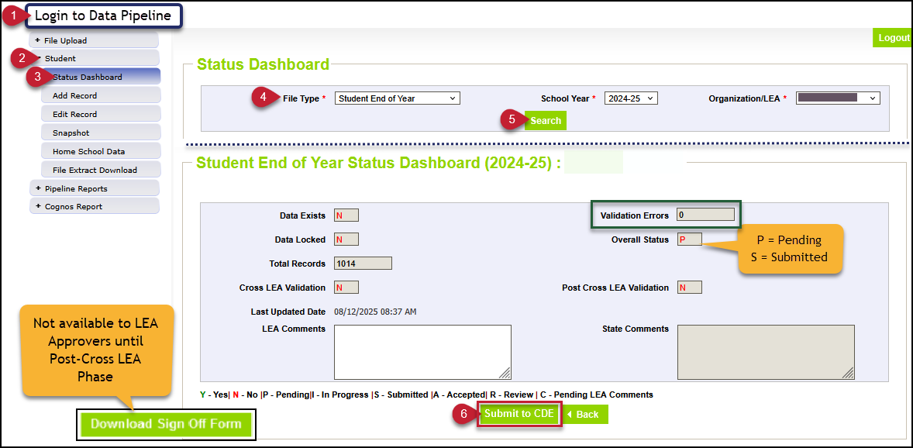
Completing the Regular Phase: Submitting Snapshot
Submission Checklist
*LEA Approvers*
Error Free
Reconciled summer graduate/completers
(updated exit types)
Checked retention codes
  If grade level in 2025-2026 = 2024-2025 then, retention code 2024-2025 cannot be zero
Checked 2024-2025 exit coding for students participating in SPED Transition or ASCENT/PTECH 5-6/TREP in 2025-2026
Validated data
  Reviewed rates
  Reviewed lists
  (dropout, AYG cohort)
Note: Download Sign Off Form not available until Post-Cross LEA Phase

Slide 6
Looking ahead to the Cross-LEA Phase
Purpose
Required LEA Tasks
Second phase of SEY collection
CDE runs a process to cross validate student educational history across all school districts/BOCES
  SE700 series errors/warnings are triggered
    Not all LEAs will have SE700 errors or warnings, but all LEAs should review any SE001-SE500 errors and warnings as well
Ensures accuracy of education statistics
  Graduate/completers
  Dropouts
  Exit one district and recovered by another
  Completed HSED
Final opportunity to correct demographic data
Review errors/warnings
Create at least one SEY snapshot
  Even if the LEA’s snapshot was error free on 9/18 when the phase began
Review data, making updates as needed
  All data fields may be corrected during this phase
  Last chance to correct any miscoded student demographic information
Resubmit by October 16, 2025
Notes:
Some districts will receive new errors/warnings to address
SE700/SE800 series are the primary focus
Any SE001-SE400 series error that arises must also be addressed
Districts with errors/warnings to address make modifications to student records as needed

Slide 7
CEDAR/COGNOS Basics

Slide 8

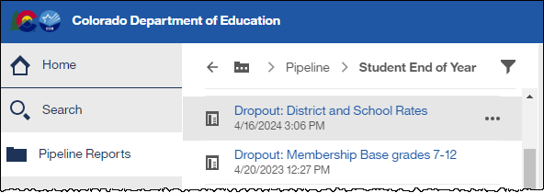
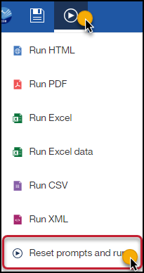
CEDAR/COGNOS
CEDAR: Colorado Education Data Analysis and Reporting system
  Secure data report portal based upon IdM permissions, aligned to data pipeline roles
  Also known as COGNOS
Access via link on IdM website or from the cognos report link on the bottom of your left menu bar when logged into Data Pipeline
Navigate reports using the left menu bar while in CEDAR
  Pipeline Reports Folder
  Select desired reports category
    Student Interchange
    Student End of Year
  Select desired report
Tip: download reports to excel

Slide 9
Summary Report

Slide 10
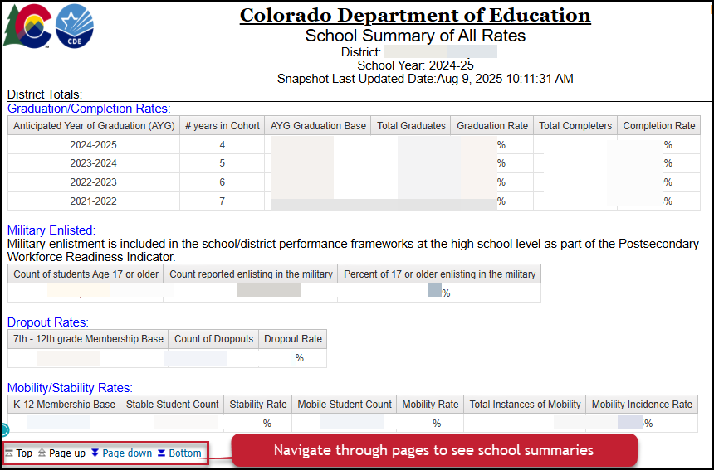
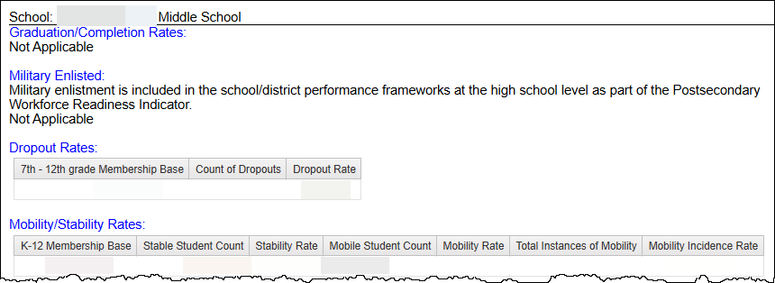
School Summary of All Rates
UNSUPPRESSED
  Includes specific counts for numerator of rates, which is not part of publicly posted data
Designed to mirror sign-off form
Includes school level and district level
  Shows ‘not applicable’ when a specific type of rate does not apply to a school due to grade range

Slide 11
Mobility/Stability Reports

Slide 12
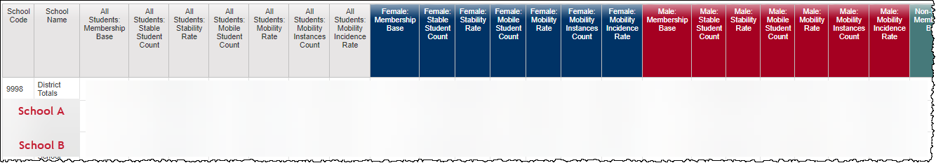
Mobility: District and School Rates
UNSUPPRESSED preview of rates that will be publicly posted on Mobility/Stability Statistics site in January 2026
  Note: All publicly posted rates will have data privacy applied
Student Groups
  All students
  Gender
  Race/Ethnicity
  IPST category
Former Report Name:
  EOY Mobility Rates by School, Grade, Race/Ethnicity, Gender, and IPST

Slide 13
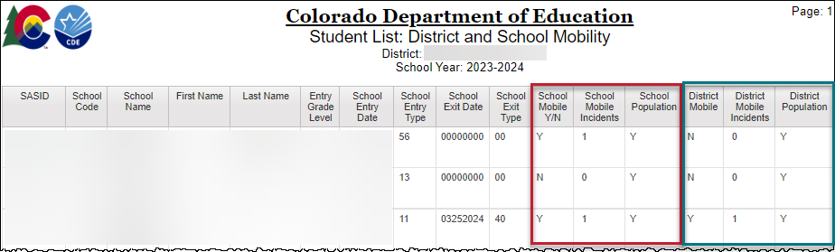
Student List: District and School Mobility Instances
Lists all students with their mobility status at the district and school level
  One record per school attended during the year
  Includes count of mobility incidents
School Mobility: movement in/out of a school with a gap of 10+ days after 10/1
District Mobility: movement in/out of the LEA with a gap of 10+ days after 10/1

Slide 14
Dropout Reports

Slide 15
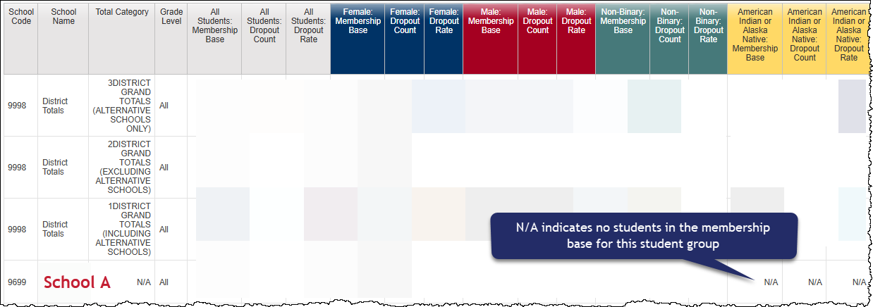
Dropout: District and School Rates
UNSUPPRESSED preview of rates that will be publicly posted on Dropout Statistics site in January 2026
  Note: All publicly posted rates will have data privacy applied
Student Groups
  All students
  Gender
  Race/Ethnicity
  IPST category
Grade level
  ‘All’ publicly posted
  All others are for
  internal use only
District level categories
  Alternative Schools Only
    LEAs indicate this status as part of school directory
    Not necessarily the same as AECs
  Excluding Alternative Schools
  Including Alternative School = all schools in LEA
Former Report Names:
  EOY Students Dropout Rates by School and IPST
  EOY Student Dropout Counts by School and Grade

Slide 16
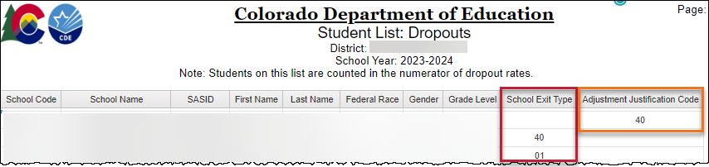
Student List: Dropouts
List of students counted as dropouts for the given school year
  Students with the summer district dropout coding pattern listed under school code ‘0000’
School Exit Type (40 or 01)
Adjustment Justification Code (40)

Slide 17
Graduation/Completion Reports

Slide 18
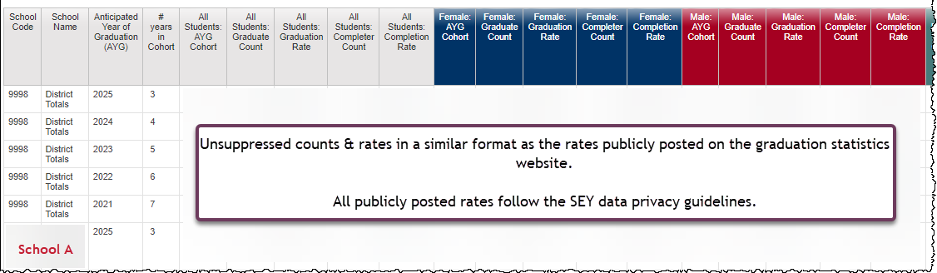
Graduation: 3-,4-,5-,6-,7- year Rates by School Year
UNSUPPRESSED preview of rates that will be publicly posted on Graduation/Completion Statistics site in January 2026
  Notes:
    All publicly posted rates will have data privacy applied
    3-year rates are not publicly posted
All applicable AYG cohorts for given school year in one report
District and School Level
Student Groups
  All students
  Gender
  Race/Ethnicity
  IPST category
Former Report Names:
  EOY On-Time Graduation and Completion Rates
  EOY On-Time Graduation Rate by IPST Category for the Current AYG
  EOY On-Time Graduation Rates by Race/Ethnicity and Gender or the Current AYG
  EOY On-Time High School Graduates and Other Completers by Race/Ethnicity and Gender for the Current AYG

Slide 19
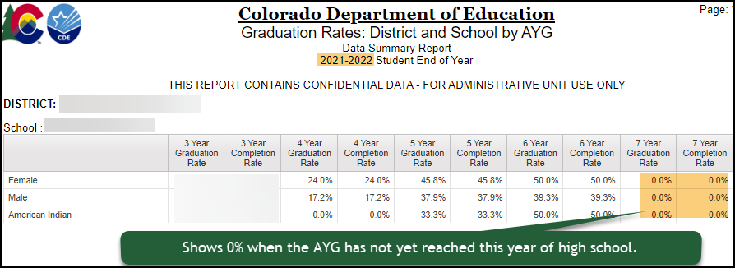
Graduation Rates: District and School by AYG
Review graduation rates for a specific AYG
Shows data over time
0.0% shown when an AYG cohort has not yet reached this year in high school or if the student group has no members
Former Report Name:
  EOY All Graduation and Completion Rates for AYG
UNSUPPRESSED
  Note: All publicly posted rates will have data privacy applied
Student Groups
  All students
  Gender
  Race/Ethnicity
  IPST category

Slide 20
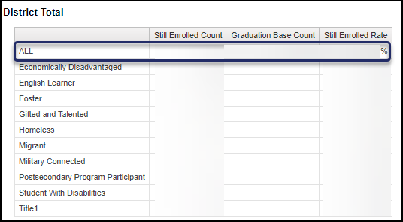
Still Enrolled Rates: District and School by AYG
Only 4-year still enrolled rates
(AYG 2025) will be publicly available on the Graduation/Completion Statistics site in January 2026
Former Report Name:
  EOY Students Still Enrolled in Current AYG Cohort Group
Number of students with Exit Type 00 divided by AYG cohort size
Student Groups
  All students
  Gender
  Race/Ethnicity
  IPST category

Slide 21
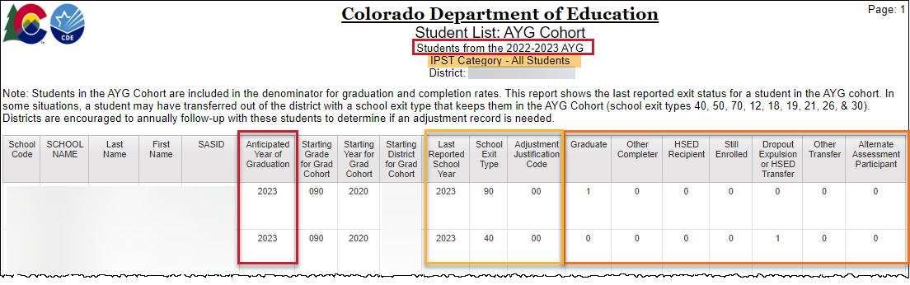
Student List: AYG Cohort
Lists all students in an AYG Cohort (Graduation Base) for a given AYG and IPST category
Applicable lists for SEY 2025
  AYG 2026, 3 years in cohort
  AYG 2025, 4 years in cohort
  AYG 2024, 5 years in cohort
  AYG 2023, 6 years in cohort
  AYG 2022, 7 years in cohort
Last Reported School Year
School Exit Type/Adjustment Justification Code
Status (Graduate, HSED Recipient, Other Transfer, etc.)
  Reminder: Students indicated as alternate assessment participants who are also shown as graduates on this report are counted as completers for FEDERAL graduation rate purposes

Slide 22
Exit Types that remain in the AYG Cohort
Code | School Exit Type Description
00 | Student did not exit
01 | Reached maximum age for services
40 | Dropped Out
12 | Transfer to a detention center within district
26 | Transfer to a detention center (out of district)
18 | Transfer to a Career and Technical (vocational) Education program not administered by a CO district/BOCES
19 | Transfer to a Licensed Eligible Approved Facility School or State Operated Program
21 | Transfer to a facility operated by the Colorado Department or Division of Youth Corrections
30 | Illness/Injury
50 | Expulsion (not receiving educational services and did not return before end of the reported year)
70 | HSED Transfer
Code | School Exit Type Description
90 | Graduated with a regular high school diploma
92 | Other Completer (non-diploma certificate)
93 | High School Equivalency Diploma (HSED)
94 | Transferred to non-district HSED program AND received HSED certificate
95 | Received regular diploma in the current year after being reported as a HSED recipient by the reporting district in a prior year
96 | Graduated and completed a Postsecondary Program (ASCENT, P-TECH, TREP)
Notes:
The graduation base represents all students with the same AYG assignment in a given calculation group (state/district/school)
AYG Cohort initially built based upon students entering 9th grade
Transfers in are added to the AYG cohort
Verified transfers out are removed from the AYG Cohort
Graduation & Completion rates use the AYG cohort as the denominator when calculating rates for a given group (state/district/school)
Verified Transfer Out: A Student who has left your district and transferred to another educational enviornment that is providing educational services that lead to a regular high school diploma
Requires adequate documentation
Exit Types:
02 – Death
05 – Transfer to another country
13 – Transfer to another Colorado district
Student enters the AYG cohort for their new district/school
14 – Transfer to another state
15 – Transfer to a non-public school
16 – Transfer to home-based education (homeschool)

Slide 23
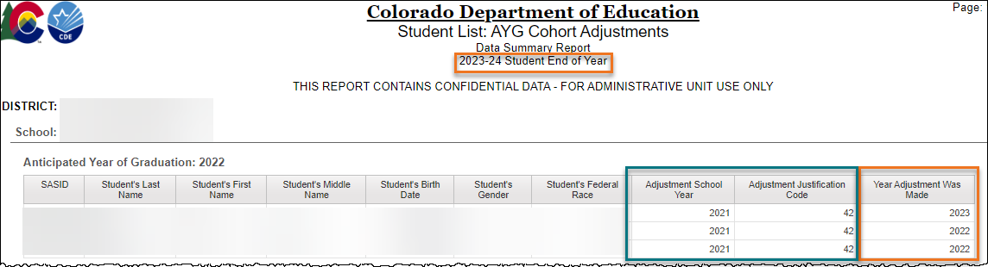
Student List: AYG Cohort Adjustments
List students with an adjustment record for in the selected school year
  Only LEAs who have uploaded an Adjustment file will have data in this report
AYG cohort impacted
Adjustment School Year
Adjustment Justification Code
Year Adjustment Made (reported)

Slide 24
Adjustment Justification Codes
Code | Short Description | Impact to AYG Cohort
40 | Dropout: No documentation of reenrollment | Remain in AYG cohort
41 | Prior Dropout: Requests for transcripts received | Removed from AYG cohort
42 | Prior Dropout: Received HSED | Remain in AYG cohort, counted as completer
51 | Prior Expulsion: Requests for transcripts received | Removed from AYG cohort
52 | Prior Expulsion: Received HSED | Remain in AYG cohort, counted as completer
71 | Prior HSED Transfer: Request for transcripts received | Removed from AYG cohort
77 | Prior HSED Transfer: Received HSED | Remain in AYG cohort, counted as completer
90 | *Misreported Graduate | Remain in AYG cohort, counted as graduate
96 | *Misreported Graduate Postsecondary Program | Remain in AYG cohort, counted as graduate
*It is better (and easier) to include a one-day record to count a student as a graduate than use the adjustment file to handle misreported graduates because of the graduation guidelines error checks.

Slide 25
Report Review Checklist

Slide 26
Validating Data: Report Checklist
School Summary of All Rates
Mobility: District and School Rates
  Dig Deeper?
    Student List: District and School Mobility Instances
Dropout: District and School Rates
  Dig Deeper?
    Student List: Dropout
Graduation: 3-,4-,5-,6-,7- year Rates by School Year
  Dig Deeper?
    Graduation Rates: District and School by AYG
    Still Enrolled Rates: District and School by AYG
    Student List: AYG Cohort
    Student List: AYG Cohort Adjustments

Slide 27
Questions?

