Slide 1
Report Card March
2025-2026 School Year Training

Slide 2
Report Card March Agenda
What is Report Card March?
IdM Role
Updates to RCM 2025-2026
RCM Timeline
FAQs
Step by Step Instructions for Submitting Data
Final Thoughts
Contact

Slide 3
What is Report Card March?
The Report Card March is a mandatory collection that contains school descriptors such as a school’s course offerings, health and wellness information, and programs offered.
A mandatory collection is defined by the Education Data Advisory Committee (EDAC) as a statutorily required collection to be completed by all appropriate agencies. Funding or services may be withheld if not submitted.
Legislation: Performance reports – contents – rules, 22-11-503, C.R.S.; Courses and 1 CCR 301-1 11.05(5)(G) – (G)Professional Development Days, 22-32-109 Safe Schools Reporting Requirements, 22-93-101 School Bullying Prevention

Slide 4
IdM Role
To submit Report Card March data, a district data respondent must be assigned a role in the CDE Identity Management System (IdM) for Report Card March.
Identity Management groups are available
  Acronym is RCM
  Examples:
MOFFAT_2 PIPELINE-2800-RCM~LEAVIEWER Read-Only Role
SILVERTON_1 PIPELINE-2820-RCM~LEAUSER Submit and Modify Role
CENTER_26_JT PIPELINE-2810-RCM~LEAAPPROVER Approver Role
Work with your LAM to get the role assigned before the collection opens.
Only one role can be assigned.

Slide 5
Updates to RCM 2025-2026
Please visit the Report Card March web page for an updated and finalized 2025-2026 file layout.
2 fields had verbiage updates.
  Comprehensive Health Education
  School Health Team or School Wellness Committee
Form submission was removed as an option for data input.

Slide 6
Report Card Timeline
Wednesday, February 25th, 2026, through Tuesday, April 10th, 2026
Data must be submitted in Data Pipeline (click the Submit to CDE button) by the 10th

Slide 7
Report Card FAQs and Tips
To report professional development days, use only whole numbers or for half days use .5 as the system will not allow any other decimals. This year the number of professional days reported can be up to 21 before a warning message is generated.
Reportable professional days for the 2025-2026 School Year are any days between July 1, 2025, until June 30, 2026.
The Report Card March data is reported on CDE’s School View Web page in Data Center. This data collection is mandated by state statute and is used by parents, policymakers, advocacy organizations, and the media.
In the text fields avoid using apostrophes as this causes errors when uploading the file.
Remember that when you upload a file, the file name should not contain spaces.
Don’t forget to finalize the data and submit the superintendent sign-off sheet.

Slide 8
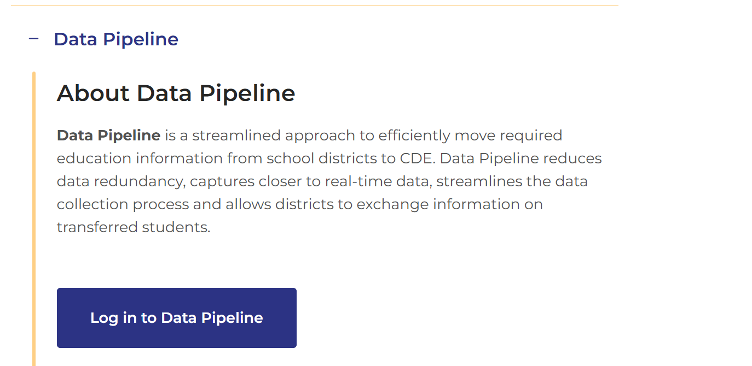
Step by Step Instructions for Submitting Data
Go to Data Pipeline through the IDM single sign on link.

Slide 9
Step by Step Instructions for Submitting Data – File Saving
You can do any of the following:
  Download the spreadsheet of the prior years’ data and make any needed changes and then re-upload; or
  Download the file extract your vendor has established; or
  Use the file upload template on the Report Card March Web page
Save the file using any name but file name should not contain spaces.

Slide 10
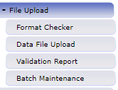
Step by Step Instructions for Submitting Data – Upload File
To upload the Report Card March file into Data Pipeline, first go to the File Upload link located on the left top of the screen and click on it.

Slide 11
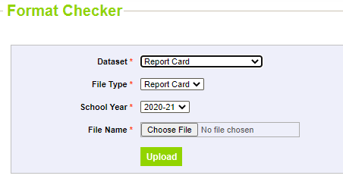
Step by Step Instructions for Submitting Data – Format Checker
Check file in Format Checker using the Format Checker under the File Upload menu.
All rows will indicate “pass” in green if the file passes the check.
  If there is a row with an error marked in red, go back and redo the file layout.
  Format Checker only checks the first row.
Format Checker just checks the first line of your spreadsheet to ensure the formatting is correct.
  Select the following:
Dataset - Report Card
File Type - Report Card
School Year - Select the current school year
File Name - Locate file by using the Choose File button at the bottom of the blue box.

Slide 12
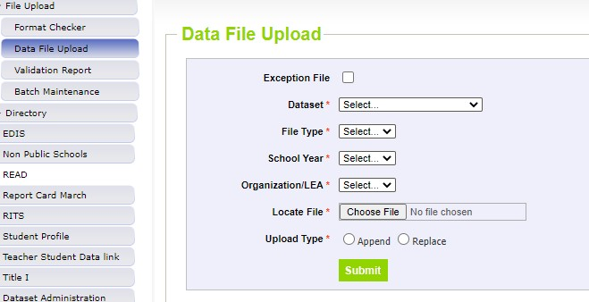
Step by Step Instructions for Submitting Data – Data File Upload
Next click on the Data File Upload button and select the following:
Dataset - Report Card
File Type - Report Card
School Year - Select the current school year
Organization/LEA - Select your LEA
Locate file by using the browse button and attach. Then press the green submit button at the bottom of the blue box.

Slide 13
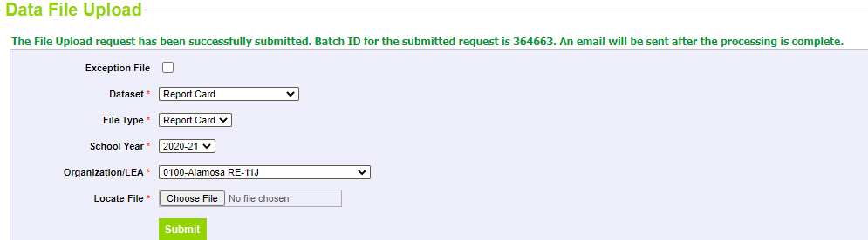
Step by Step Instructions for Submitting Data – Batch Number
Once the file is successfully uploaded you will receive a message saying so, as well as you’ll receive a batch number. You will also receive an email.

Slide 14
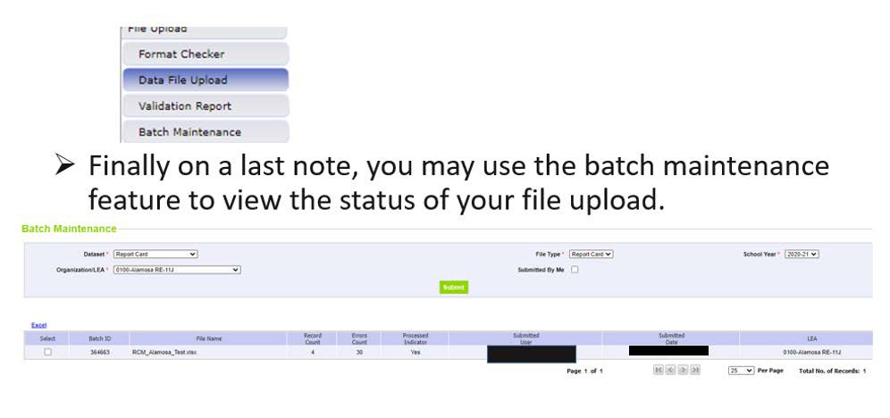
Step by Step Instructions for Submitting Data – Error Report
You may use the Batch Maintenance screen to view the status of your file upload. Batch Maintenance menu item is located right under Validation Report in the File Upload sub menu.

Slide 15
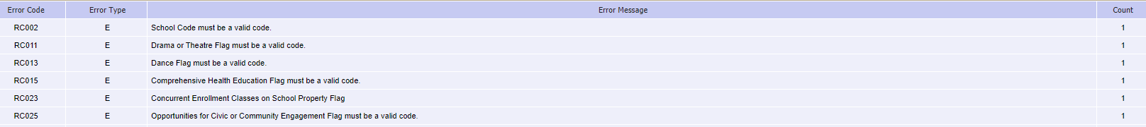
Step by Step Instructions for Submitting Data – Batch Maintenance Screen
The Data Pipeline Error Report will allow you to see error codes, messages and the error count by each type of error.

Slide 16
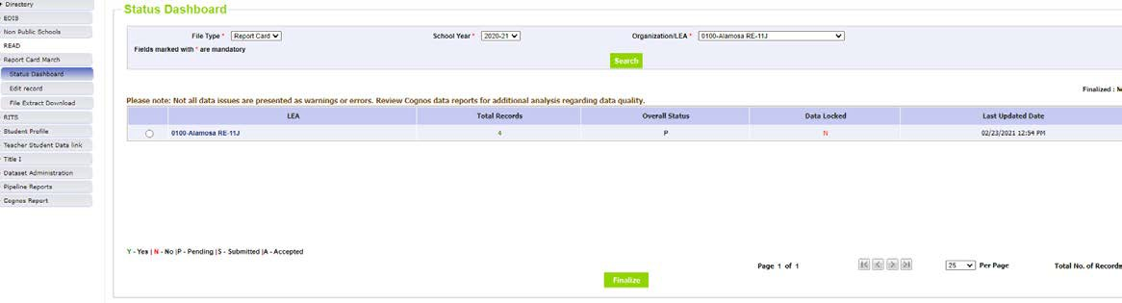
Step by Step Instructions for Submitting Data – Status Dashboard
Once all the data is correct, go to the Status Dashboard (located on the main Data Pipeline page on the left side under the Report Card March link) and press approve/finalize button.

Slide 17
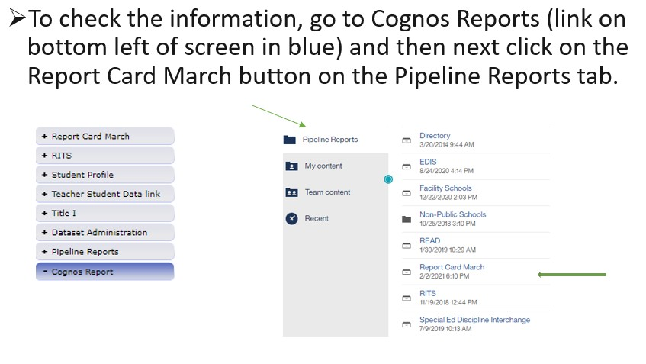
Step by Step Instructions for Submitting Data – Cognos Reports
To check the information, go to Cognos Reports (this will open a new tab) and then click on the Report Card March button under the Pipeline Reports tab

Slide 18
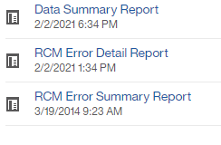
Step by Step Instructions for Submitting Data – Cognos Reports Continued
There are three reports you may review:
  Data Summary Report
  RCM Error Detail Report
  RCM Error Summary Report
These reports are helpful in locating and correcting any errors. It’s highly recommended that you refer to these reports before submitting any finalized data and throughout the collection.

Slide 19
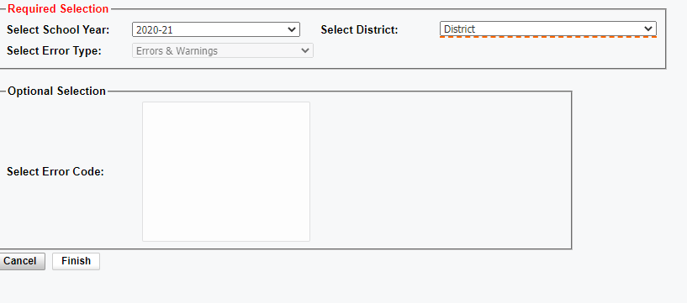
Step by Step Instructions for Submitting Data – Cognos Reports Continued Steps
To review the Cognos Reports, do the following:
  Click on desired report
  Fill in boxes as previously done
  Click the “finish button”
Please note that warnings won’t prohibit the data from being submitted but you may still want to look the warnings over in addition to correcting the errors. Warnings act as another tool for data validation.

Slide 20
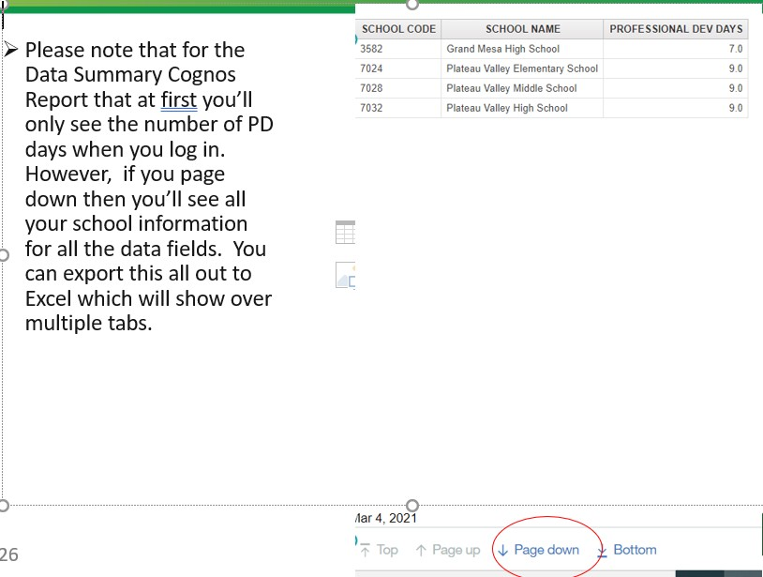
Step by Step Instructions for Submitting Data – Cognos Reports Continued Viewing Cognos Reports
Please note that for the Data Summary Cognos Report, you will only see the number of PD days when you run the report initially. However, if you page down, you will view all your school information for all data fields. You can export this out to Excel.

Slide 21
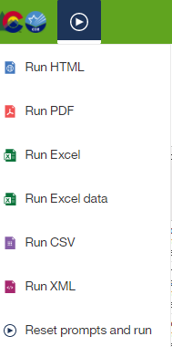
Step by Step Instructions for Submitting Data – Cognos Reports Continued Exporting Data
You can view any of the Cognos reports in Excel (or other formats). Simply press the arrow button on the top left-hand side of your screen next to the State/CDE logos and select the format wanted.

Slide 22
Step by Step Instructions for Submitting Data – Signoff Form
After all the data is submitted, have your district’s superintendent sign off on the superintendent letter and email it back to CDE following the instructions that will come with the letter.
Below is what is being certified:
  The summary reports provided by CDE should be reviewed carefully for completeness and accuracy. The reports will include the data necessary to verify your data for each school.
  All school systems must submit a verification form, signed by the local superintendent of schools that certifies agreement with the summary data report.

Slide 23
Step by Step Instructions for Submitting Data – Final Thoughts
The key to success is submitting data early!
The last day to submit data before the collection closes is April 10th!
This is one of the quicker and easier data collections to complete.
If you discover that you need to make any corrections and need to have your data unlocked, please email Jessica Tribbett at ReportCard@cde.state.co.us who can unlock your data for you to re-submit however, this all must be done by Friday, April 10th!

Slide 24
Contact and Thank You
Jessica Tribbett
ReportCard@cde.state.co.us

