Slide 1
READ Training Data Collection
Tara Rhodes
READActData@cde.state.co.us
July 15, 2025

Slide 2

Topics in Today’s Webinar
Part 1: Background Information and Updates for 25-26
Data Privacy & Security
Purpose of the READ Training Data Collection
Timeline
2025-26 File Layout and Definitions
Website Updates
Q&A
Part 2: Step-by-Step Process in Pipeline
Pipeline Walkthrough
Resolving Errors
Common Problems
Q&A
Part 3: Manual Review Process
Purpose of Manual Review
How to Access the Smartsheet Form
Procedure for Submission
Common Problems
Q&A

Slide 3
Data Privacy and Security

Slide 4
PII Definitions and Requirements
Personally Identifiable Information (PII) is defined by state and federal laws as information that, alone or in combination, personally identifies an individual
  This includes direct identifiers (i.e. name, EDID, etc.)
  Includes information that when combined is identifiable
CDE has prepared guidance on how to comply with this and other privacy laws which can be found here: http://www.cde.state.co.us/dataprivacyandsecurity

Slide 5
Data Sharing Processes
Check local policies for restrictions, requirements, etc.
Ensure that you are following local policies when transmitting PII to any third party
Use secure methods to transfer any PII to CDE
  Contact Data Collection Lead with questions about how to transmit PII securely
  Use Syncplicity to encrypt emails to CDE
Avoid sending PII via unencrypted emails or to unsecured faxes when sharing data between or within districts
Do not use PII in trainings, presentations, etc.
Do not share PII with unauthorized individuals
Do not share passwords

Slide 6
Purpose of the READ Training Data Collection

Slide 7
READ Act Reporting Requirements for Districts
Teachers
SB 19-199 Colorado READ Act
Training Reporting Requirements
22-7-1210.5. Per-pupil intervention money - uses - distribution - monitoring - repeal.
(3) (a) At the beginning of each budget year, the department shall distribute to a local education provider that meets the requirements specified in subsection (3)(b) of this section the amount of per-pupil intervention money calculated for the local education provider pursuant to subsection (1) of this section for the applicable budget year.
(b) To receive per-pupil intervention money in a budget year, a local education provider must meet the following requirements: … (II) For the 2022-23 budget year and budget years thereafter, the local education provider must submit evidence that it is in compliance with the teacher training requirements specified in section 22-7-1208 (6); (II.5)
22-7-1208
(6) (a) By the beginning of the 2022-23 school year and continuing for each school year thereafter, each local education provider that receives per-pupil intervention money or a grant through the early literacy grant program in any budget year starting with the 2019-20 budget year shall ensure that each teacher employed to teach kindergarten or any of grades one through three successfully completes or has successfully completed evidence-based training in teaching reading. To comply with this subsection (6)(a), a local education provider must submit evidence, as described in subsection (6)(b) of this section, that each teacher employed to teach kindergarten or any of grades one through three has successfully completed evidence-based training in teaching reading…To comply with this subsection (6.5)(a), a local education provider shall submit evidence that each principal and administrator described in this subsection

Slide 8
READ Act Reporting Requirements for Districts
Administrators and 4th-12th Grade Reading Interventionists
(6.5) (a) By the beginning of the 2024-25 school year and continuing for each school year thereafter, each local education provider that receives per-pupil intervention money or a grant through the early literacy grant program in any budget year starting with the 2023-24 budget year shall ensure that each principal in a school that serves kindergarten or any of grades one through three and each administrator with responsibility that pertains to programs in kindergarten or any of grades one through three successfully completes or has successfully completed evidence-based training designed for school administrators in the science of reading
(6.7) (a) By the beginning of the 2024-25 school year and continuing for each school year thereafter, each local education provider that receives per-pupil intervention money or a grant through the early literacy grant program in any budget year starting with the 2023-24 budget year shall ensure that each reading interventionist employed to teach students in any of grades four through twelve successfully completes or has successfully completed evidence-based training in teaching reading as described for teachers in subsection (6) of this section. To comply with this subsection (6.7)(a), a local education provider shall submit evidence that each reading interventionist employed to teach students in any of grades four through twelve has passed an end-of-course assessment of learning at the completion of the evidence-based training.

Slide 9
READ Act Reporting Requirements for Districts
Summary
Though specific roles are defined in READ Act statute, the definitions are open ended as they relate to job function. This makes it difficult to provide standardized answers as to who is required to take the training from the state’s perspective. Determination of the job function must be made locally.
This means that districts should review job functions of their staff and determine if that meets the respective training requirements in statute regarding who is required to take the training.
For the collection more specifically, districts should report anyone who they deem required to take either the K-12 READ Teacher training or the K-3 READ Principal/Admin training per the definitions in the Colorado READ Act and functions of the jobs.

Slide 10
Data Components of the READ Act
Data Components of the READ Act
Components Collected through Data Pipeline
Spring READ Assessment
(Spring)
READ Literacy Programs and Assessment
(Spring)
Components Collected through GAINS
READ Budgets
(Spring/Summer)
READ Training
(Fall)

Slide 11
Reminders to Ensure Data Accuracy
Reporting accurate data is the primary goal of the collection
How to ensure your data is accurate?
  Complete the basics of the collection early!
    Get files error free by mid August
    An error free file does not guarantee accurately reported data
    Thoroughly review your data
    Ask district READ leads or other content area experts to assist in verifying data
Do not report inaccurate data to avoid errors
  If an educator is generating errors, please call the data collection lead to find out how to properly code the educator

Slide 12
READ Training Data Collection Timeline

Slide 13
READ Training Data Collection Timeline
Date | Event | Event Description
7/15/2025 | Training Event | This training event will cover changes for the 25-26 READ Training collection. This is a live event from 1-2pm and will be recorded.
8/1/2025 | Open | The 25-26 READ Training collection opens in Data Pipeline.
8/15/2025 | Other Date | This is the date by which teachers, principals, and administrators should have their respective READ training designations added to their COOL accounts.
8/19/2025 | Other Date | This is the target upload date for the collection. Please complete an upload by this date.
8/26/2025 | Other Date | This is the target date for an error-free submission for the collection. Please resolve errors by this date.
8/30/2025 | Deadline | The 25-26 READ Training collection closes in Data Pipeline and sign-off forms are due.
9/8/2025 | Other Date | CDE prepares preliminary State Board of Education documents for any extension requests.
10/8/2025 | Other Date | State Board of Education hears extension requests and provides the final decision around the approval of any extension requests.

Slide 14
25-26 File Layout and Definitions

Slide 15
Changes to the 25-26 READ Training File Layout
Removed the Staff’s Teacher Training Not Complete Status Code column and the Staff’s Administrator Training Not Complete Status column.
While these two columns were removed, the information was not. Additional codes were added to the Staff’s Teacher Training Status Code column and the Staff’s Administrator Training Status Code column to capture the reasons for non-completion.
Added a “No Report of Training” screen in Data Pipeline for districts that are either: 1. declining READ funds, or 2. have already reported all staff as having completed the appropriate training.
Updated the sign-off form to include non-completion counts for codes 14-17 as well as updated language if the district is declining READ funds.

Slide 16
READ Training Data Collection Elements (1 of 2)
Name of Field | Field Length | Text Start Position | Text End Position | CSV Order | Excel Column | Example(s) | Remarks
School District/BOCES Code* | 4 | 1 | 4 | 1 | A | 1111
School Code* | 4 | 5 | 8 | 2 | B | 2222
EDID* | 8 | 9 | 16 | 4 | C | 12345678 | Must match in EDIS
Staff's First Name* | 30 | 17 | 46 | 5 | D | valid name | First name must match in EDIS
Staff's Last Name* | 30 | 47 | 76 | 6 | E | valid name | Last Name must match in EDIS

Slide 17
READ Training Data Collection Elements (2 of 2)
Name of Field | Field Length | Text Start Position | Text End Position | CSV Order | Excel Column | Example | Remarks
Staff's Gender* | 2 | 77 | 78 | 7 | F | 01 | Gender must match in EDIS
Staff's Date of Birth* | 8 | 79 | 86 | 8 | G | 01011980 | MMDDYYYY Format DOB must match in EDIS
Staff’s Primary Grade Level or Role* | 3 | 87 | 89 | 9 | H | 010 | Grade primarily served by the educator (most classes/class time).
Staff’s Teacher Training Status Code* | 2 | 90 | 91 | 10 | I | 10 | Teacher Training completion status
Staff’s Teacher Training Not Complete Status Code | 2 | 92 | 93 | 11 | J | 01 | Only required if a teacher training status code of 13 is entered
Staff’s Administrator Training Status Code* | 2 | 94 | 95 | 12 | K | 10 | Administrator Training Completion Status
Staff’s Administrator Training Not Complete Status Code | 2 | 96 | 97 | 13 | L | 01 | Only required if an administrator training status code of 13 is entered

Slide 18
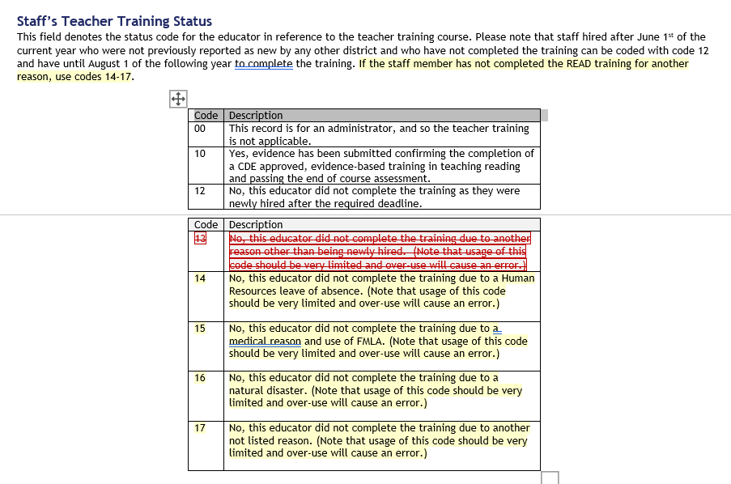
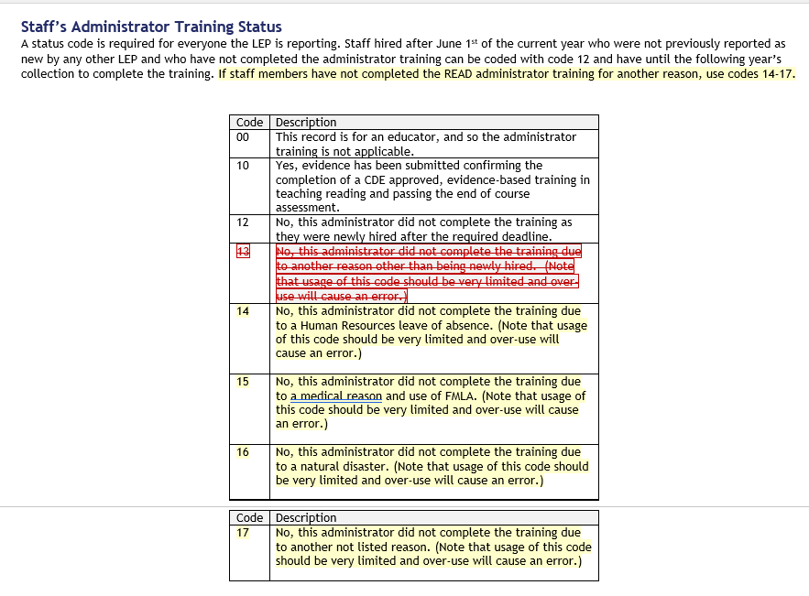
Additional Information on Training Status Columns

Slide 19
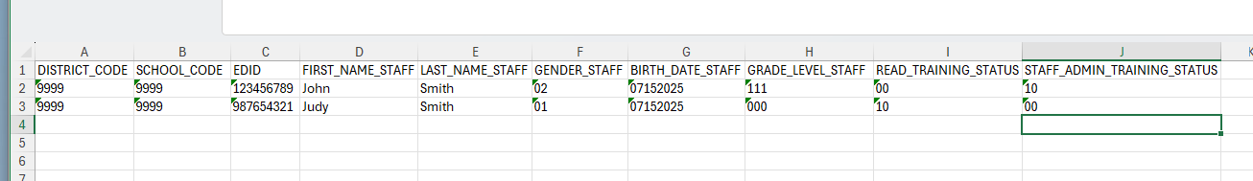
25-26 READ Training File Template

Slide 20
Website Review and Updates

Slide 21
Website Updates
If you’re the data respondent for more than just the READ Training data collection, you’ll notice that all of the READ data collection websites have been updated to follow the standard Data Pipeline website layout.
On the website, you can find:
  The file layout
  The collection manual (coming soon)
  The business rules
  Recordings of trainings and other resources
Here’s the link to the READ Training Data Collection webpage.

Slide 22
Questions on Background?

Slide 23
Step-by-Step Guide in Data Pipeline

Slide 24
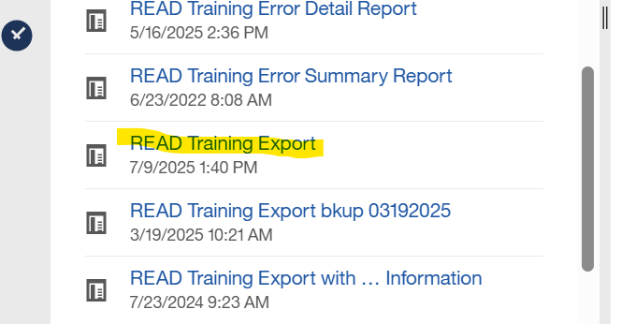
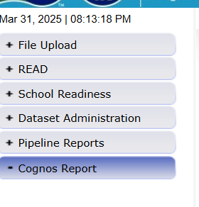
Step 1: Download the READ Training Export Report
As one possible starting point, districts can download the READ Training Export report out of Cognos. The report is pulled from the prior year’s HR file, and it will need customized before submitting for the current school year READ Training data collection.

Slide 25
Step 2: Customize the READ Training Export Report
Districts will need to:
Add any new staff hired after June 1st of the current year who are required to take the training.
Add any staff who may have changed into a position that requires the READ teacher training, such as a 5th grade teacher moving to 3rd grade.
Add any 4-12 reading interventionists and other staff who are required to take the teacher training.
Add any permanent substitutes, special educators, non-licensed staff, and/or additional staff who are required to take the teacher training as determined by the function of their positions.
Add K-3 administrators, principals, and others required to take the Principal/Admin training as determined by licenses and the function of their position(s).
Add any staff required who took the READ Principal/Admin training, regardless of their license.
Remove any individuals who appeared on the export who are not required to take either training based on their position and statute definition.
Remove any teachers who are currently no longer working for your district.

Slide 26
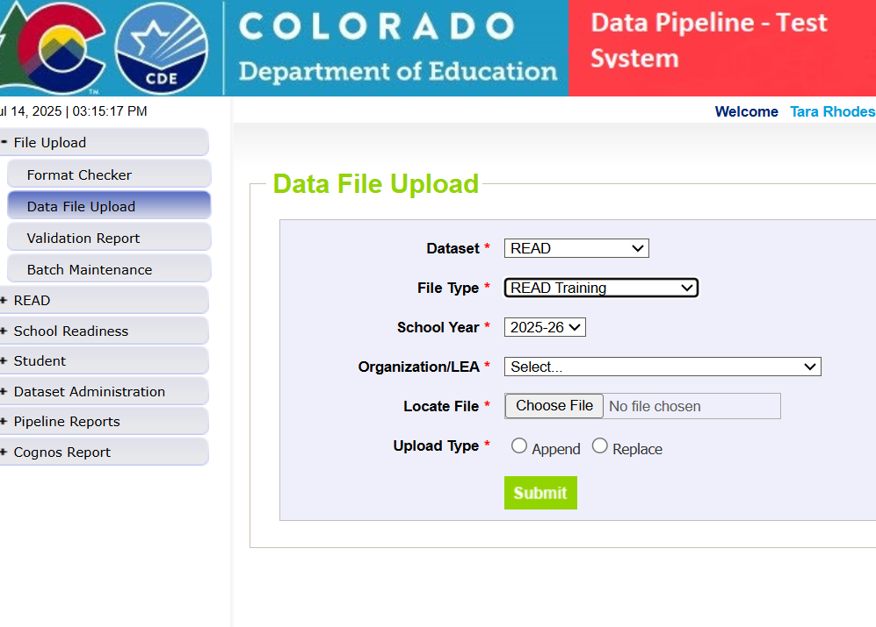
Step 3: Upload Data
After customizing the READ Training Export report, please complete an upload. Please also ensure that all of your staff have EDIDs assigned to them prior to upload.

Slide 27
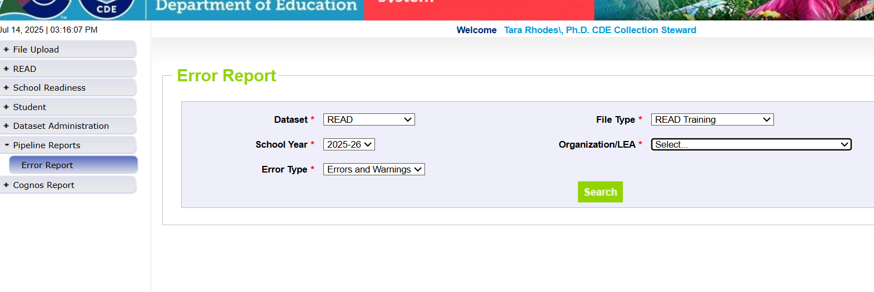
Step 4: Check Pipeline Error Report
After uploading, Pipeline will send an automated email that will tell you how many errors exist in your file.
After receiving this email, you can check your error report in Pipeline through using the options shown in the screenshot.

Slide 28
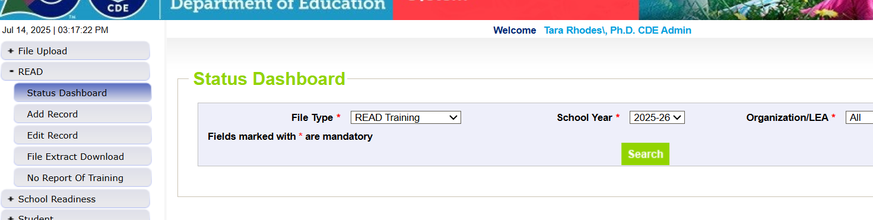
Step 5: Correct Errors and Reupload
Please continue this process of uploading and checking your error report until you reach zero errors. To confirm that you have zero errors, please use the Status Dashboard as shown below.

Slide 29
Resolving Errors
Why do we get errors? Errors are edits that are in place to assist with providing most accurate information to CDE which is published, analyzed and reviewed by legislators, stakeholders, researchers, etc
Errors must be corrected in the file before finalizing the data
Error message should provide adequate information to assist you with determining the corrections needed
Each error message will list the data field(s) that is an issue
Find the data field(s) in the data file upload and make appropriate adjustment
Upload fixed data file again into Data Pipeline and run error reports

Slide 30
READ Training Collection: Error TR026
Message for TR026: The CDE has no record that this educator has completed the READ Teacher training. Please confirm with the staff members that they've acquired the READ training and submit their EOC accordingly.
TR026 Solution: Ensure PII information is correct for this individual. Confirm with the individual they have taken the training and have applied for their respective designation in COOL. If they are unable to add their designation in COOL due to licensure issues (no license or not the specific principal/admin licenses), resolve all other errors on your file before initiating a Manual Review Request with the CDE.

Slide 31
READ Training Collection: Error TR035
Message for TR035: The CDE has no record that this individual added the READ Admin Designation in COOL or that they have completed the READ Admin Training.
TR035 Solution: Determine if this individual holds one of the correct licenses that enables them to add the READ Admin designation in COOL. If yes, ask them to add the READ Admin designation in COOL. If they do not have the correct license but have completed the training, collect their EOC and initiate a Manual Review Request with the CDE.
  Licenses that can add the READ Administrator Designation in COOL:
    Principal or Administrator license
    Principal Authorization
    Emergency Authorization with either a Principal or Administrator Endorsement
    Interim Authorization with either Principal or Administrator Endorsement

Slide 32
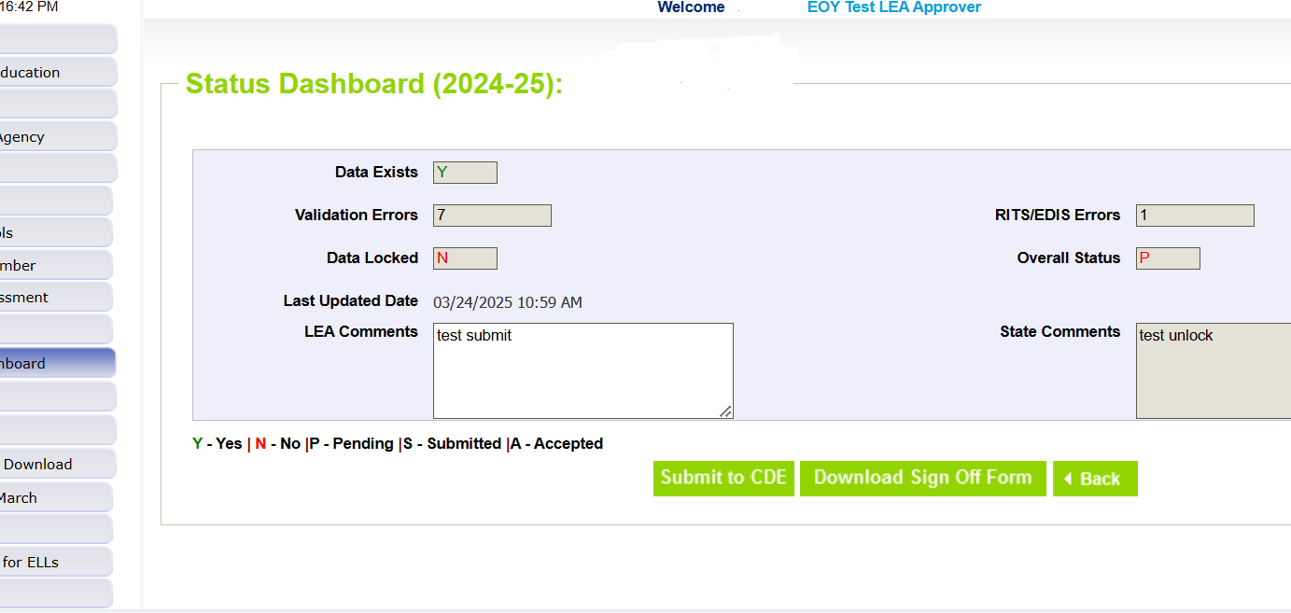
Step 6: Lock Your Submission
After you have reached zero errors and have reviewed your data for accuracy, please lock your submission in Data Pipeline. This will ensure that no further changes are made to your file.

Slide 33
Step 7: Download and Submit Sign-Off Form
Once you have cleared all errors and locked your data, please verify the count of non-completers on the sign-off form and then submit that to the READ Act Data email at READActData@cde.state.co.us by 8/30/2025.

Slide 34
Alternate Path: No Report of Training Screen
Context
Background: The No Report of Training screen was new in the 24-25 collection, but was only used by districts that were declining READ funds.
Purpose: The No Report of Training screen should only be used by districts for two reasons: 1. The district is choosing to decline READ funds for that school year; or 2. All staff (including administrators) have already been trained and reported to CDE in a previous collection year.

Slide 35
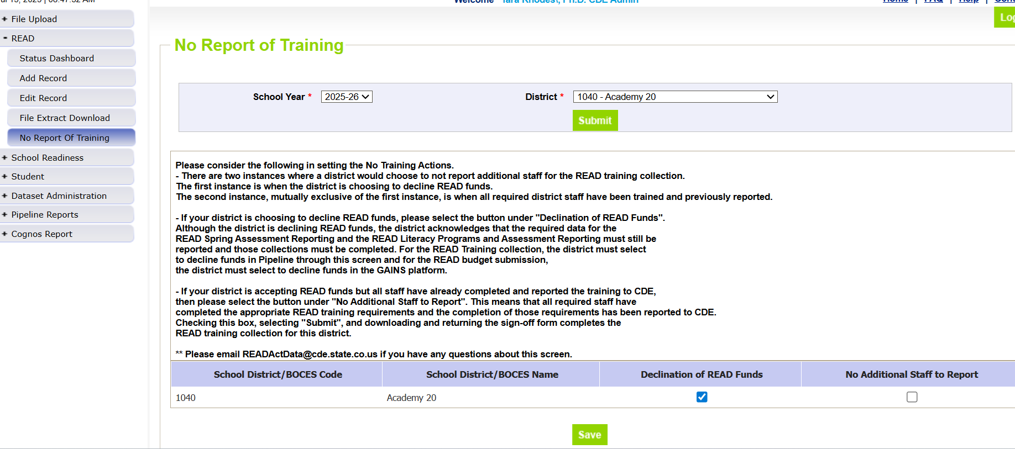
Alternate Path: No Report of Training Screen
Procedure
Steps:
Click on the READ gray box in Data Pipeline and then click on the “No Report of Training” gray box in the submenu.
Click on “Submit” to load the main screen.
Make your selection of “Declination of READ Funds” or “No Additional Staff to Report”.
Click on “Save”. This selection should get saved to the Status Dashboard so that then you can go and lock your submission.
2
1
3
4
Notes:
This selection should get saved to the Status Dashboard so that you can then go and lock your data.

Slide 36
Questions on Data Pipeline?

Slide 37
Manual Review Process

Slide 38
Manual Review Process
Background and Purpose
It is important to understand that not all staff who have completed the training will be able to add their respective designations using COOL, as there are limitations based on licenses. These circumstances are detailed below:
  Unlicensed teachers, as they cannot have a COOL account; and
  The READ Administrator Training is tied to a specific type of license in COOL. Only individuals who hold the following active, specific licenses are able to add the READ Admin Designation in COOL:
    Principal or Administrator license
    Principal Authorization
    Emergency Authorization with either a Principal or Administrator Endorsement
    Interim Authorization with either Principal or Administrator Endorsement
However, districts may have required individuals to complete the READ Admin/Principal Training who fall outside of the above license perimeters. These individuals should still be reported on the READ Training Export Report and districts should then initiate a Manual Review Request so they can receive credit for completing the training.
The Manual Review Request Process was developed to overcome these barriers, and it is reserved only for circumstances in which the district must submit evidence of completion (EOC) on behalf of their staff when COOL cannot be used.

Slide 39
Manual Review Process
Procedure
Steps:
Report all individuals on the READ Training Export Report, even those that may require a manual review.
Resolve all errors on your READ Training Export Report that are not related to the manual review process. Before initiating the Manual Review Request, you should ensure the only errors left are TR026 and TR035 errors that cannot be resolved by the individual adding their designation in COOL.
Send an email to READActData@cde.state.co.us with Manual Review Request – District Name and Code in the subject, i.e. Manual Review Request [District Name] [District Code]
The CDE data team will first confirm all errors other than TR026 and TR035 errors related to COOL licensure conflicts have been resolved. The team will send a link for you to complete a Smartsheet Form in which you will need to add your Evidence of Completion (EOC) files for each error line on your READ Training Export Report.
Once the manual data review has been completed by CDE staff, you will receive a follow-up email that informs you that the EOC has been manually validated and to reupload your file. After you receive this email, you will need to submit and finalize your report in Data Pipeline.

Slide 40
Manual Review Process
Common Problems
Common Problems:
  Identifying information on certificate does not match identifying information in Data Pipeline
    Solution: Please make sure that the correct names are used in the Data Pipeline file upload submission. If there is a name change, please notify us prior to manual review.
  Certificate does not match the training noted as completed in Data Pipeline (i.e., the administrator training will be marked as completed, but the certificate is for the teacher training)
    Solution: Please double-check your coding in your file submission.
  The evidence of completion (EOC) submitted is not an accepted or approved form of EOC.
    Solution: Please check the linked Google doc on the Smartsheet form that holds the approved forms of EOC for the different pathways

Slide 41
Questions on Manual Review Process?

Slide 42
READ Collection Resources
READ Collection resources can be found at:
https://www.cde.state.co.us/coloradoliteracy/readdatapipeline
Webinar recordings
Timeline
Additional resources such as guidance documents
Questions?
Contact Tara Rhodes, READ Data Collection Lead
Email: READActData@cde.state.co.us
Cell: 720-601-4125

