Slide 1
Student October:
Multilingual Learner
Progression & Overview
Office of Data Services and CLDE
SY2025-2026
Notes:
Collin - Submit questions in the chat – we will answer as soon as each presenter finishes their slides

Slide 2
Disclosures
Attendees may not use Artificial Intelligence (AI) software or services to capture the content of the event. CDE reserves the right to remove any attendee employing such services. By participating in this meeting, attendees agree that they will not record, capture, share, or publicly post its contents without expressed permission.
Districts and schools are required to adhere to Personally Identifiable Information (PII) information laws regarding student privacy. Always use secure methods to transfer any PII. Contact CDE Data Collection leads with questions about how to transmit PII securely through Syncplicity. Avoid sending PII via unencrypted email or unsecured faxes when sharing data between/within districts or with CDE.
Notes:
Collin - A few disclosures before we get started
We acknowledge that we are living in a time of great advances in technology and that many of these tools are helpful in the workplace. We value your thoughts, contributions and privacy as colleagues when sharing information about your district or students and families. Additionally, we want to create a safe space to ask questions, and problem solve together, and we are still uncertain about how those conversations would be captured and how that data would be shared. So, at this time, we will be removing any AI assistants (like chat bots) that attend a meeting in place of the human counterpart. We will be posting these slides on the student interchange website.
As we walk through ML Enrollment updates today, please keep in mind 99.9% of the time this guidance will apply to your students. There are always unique situations that come up each year so please feel free to reach out to the CLDE and Data Services about things that don’t always fit your understanding or discuss how designation and coding should occur to comply with state identification and reporting requirements. Please feel free to ask general questions in the chat as we present, but a gently reminder to not use PII when asking questions today or when you send us an email after today.

Slide 3
Federal & State Requirements
Every Student Succeeds Act (ESSA), §§1112(e); 3116(b)
Lau Remedies, 1975 (Case law, Civil Rights Act 1964)
Specifies approved approaches, methods, and procedures for: Identifying and evaluating national origin minority students’ English language skills
English Language Proficiency Act, CRS 22-24-105
Requires districts to identify and report the number of MLs in the district to the Colorado Department of Education
Senate Bill 109, CRS 22-24-106
One common assessment, Screener (Kindergarten or Grades 1-12) as the state mandated placement assessment must be used as one indicator to determine English Language Proficiency (ELP) and if student is in fact ML.
Requires recipients of Titles I and III to identify MLs and notify parents of the Language Instruction Educational Program (LIEP) available to students
Notes:
Doris – MLs comprise nearly 11 percent of the student population nationwide. They account for a highly diverse group of students who bring with them valuable cultural and linguistic assets, including their home languages. Yet despite these many assets, MLs face significant opportunity and academic achievement gaps compared to their non-MLs.
To ensure that MLs can meaningfully participate educational programs and services there are Federal and State laws that require districts and schools to identify MLs in order to provide appropriate language services and scaffolds to enable access to core content instruction. Titles I and III in the Every Student Succeeds Act, the reauthorized ESEA, require recipients of Titles I and/or III to identify MLs in a timely manner and notify parents of the language instruction educational programs available to their students.
The Lau Remedies of 1975 specify approved approaches, methods and procedures for identifying and evaluating a student’s English language skills.
In Colorado, the English Language Proficiency Act, or ELPA, requires all Colorado districts, Charter School Institute, and facility schools to identify MLs.
ELPA also requires
Districts to provide a report of MLs through the Student October Count, including proficiency levels and number of MLs who have exited from the program
ELPA requires Schools & districts to administer and provide evidence-based ELD programs to all identified MLs and
To provide professional development to all staff members supporting MLs.
Finally, Colorado Senate Bill 109, CRS 22-24-106 requires us to use one common assessment to identify MLs. Colorado has selected the WIDA Screeners as the state mandated placement assessment which must be used as one indicator to determine English language proficiency and if a student is a multilingual learner.

Slide 4
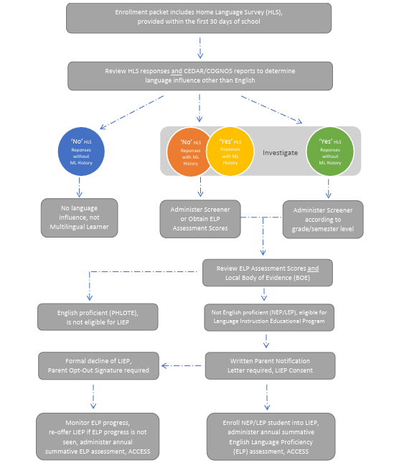
Standardized Identification Procedures
Provide an enrollment packet which includes HLS for parents and families to complete and return to the enrolling district and/or school.
Identification including screening, evaluating scores and local evidence, parent notification and enrollment into an LIEP occurs within 30 days when student enrolls before October and 2 weeks when student enrolls after October.
Notes:
States are directed by US department of education to create and implement “standardized, statewide entrance procedures” for MLs. It is one of the most critical “affirmative steps” and “appropriate action[s]” that school districts must take to open instructional programs to ML students and to address their English proficiency. At the time of student enrollment, districts and schools must promptly identify ML students who are in need of language assistance instruction in a systematic and sustainable manner.
So how does a student become identified as multilingual learner? On this slide you will see an updated visual to describe Colorado’s standardized identification procedures. Based on state and federal laws, and with input from stakeholders last school year, Colorado has outlined the following procedures for districts to follow when identifying MLs. To ensure consistent, objective and timely identification processes using data, all potential ML students follow the same process.
We will review procedures in four sections. Beginning at the top … Provide an enrollment packet which includes HLS for parents and families to complete and return to the enrolling district and/or school. Identification including screening, evaluating scores and local evidence, parent notification and enrollment into an LIEP occurs within 30 days when student enrolls before October and 2 weeks when student enrolls after October.
(More details and information can be found in the Standardized Identification Guidance document (graphic on page 4). https://www.cde.state.co.us/cde_english/elstandardizedidentificationandfaqs)

Slide 5
Enrollment
The district’s enrollment packet should include the Home Language Survey (HLS). It is provided to and completed by families and parents as part of the registration process:
  What questions are asked on the HLS (language(s) used in the home, spoken by student and first acquired)? How is the HLS disseminated, made available, or administered in the district?
Responses indicated on the HLS does not determine ML eligibility:
  What are the guidelines for interpreting HLS responses? Which responses indicate that a student will take an ELP placement test? How should responses be interpreted as a whole? What are the next steps if responses are unclear or contradictory?
  Review responses alongside CEDAR/COGNOS reports to determine if further investigation into student’s English Language Proficiency (ELP) level should be taken.
More details and information can be found in the Standardized Identification Guidance document (graphic on page 4).
Notes:
What is the purpose of the HLS? And What should districts be asking on the HLS? Most districts and schools use a home language survey (HLS) at the time of enrollment to gather information about a student’s language background. It should elicit information about the student’s current English abilities. Questions should be clear and understandable to those who administer the HLS. It should also be translated into the home languages of students, parents and guardians when possible. (Asking language questions at the time of enrollment is considered (minimally) compliant under the federal and state law).
Districts have flexibility to reword the questions or add more than three questions to figure out which students may have a language other than English influence, exposure or background. But questions must not be asked in such a way that they violate students’ civil rights or ask about US citizenship.
It’s really important to know that responses indicated on the HLS does not determine ML eligibility but used to ensure that MLs are not missed, and guard against inaccurate reporting of the student’s English abilities. District and schools must establish clear processes for evaluating responses provided by parents and families, criteria used to determine when potential MLs should move onto screening, and how to evaluate inconsistent responses or what happens when responses don’t align with student’s language abilities seen in the classroom. (There are three Office for Civil Rights and Department of Justice approved questions: 1) What is the primary language used in the home, regardless of the language spoken by the student? 2) What is the language most often spoken by the student? 3) What is the language that the student first acquired)
Beginning this school year, CDE has added ACCESS Overall and Literacy scores into ML data reports so that districts and schools can review HLS responses alongside CEDAR/COGNOS reports to determine how to further investigate student’s English Language Proficiency (ELP) level. We will talk more about data reports soon.

Slide 6
Review Responses and Reports
Notes:
Let’s take a look at the next section, focusing on the blue circle. It represents no other language influence/exposure/background indicated on the HLS and student does not have ML history; student is not considered a potential ML, so no further investigation into student’s ELP level is required, student is reported or coded to CDE as English Only
Moving to times when districts and schools should investigate student’s ELP. The green circle, represents there is another language influence/exposure/background reported by family/parent on the HLS; student is considered a potential ML so further investigation into student’s ELP level should be conducted; administering Screener is appropriate here
Districts and schools should also investigate student’s ELP when the student has ML history in data pipeline represented as the orange and yellow circles, however screening may not be necessary when student has current year ACCESS Overall and Literacy proficiency scores which are provided in ML historical data reports in CEDAR/COGNOS, or if the enrolling district can obtain scores through student records when they transfer into the district from another CO district or another WIDA state. I will explain the ways investigation of ELP assessment data occurs on the next slide…
(I am going to pause for a minute and talk about situations when parents answer ‘no’ to any of the HLS questions. Sometimes parents respond ‘no’ due to lack of understanding to the questions like when questions are presented in a language parents cannot read, or they are choosing to not disclose information due to perceived actions that might negatively impact their child in the classroom. When you notice responses don’t match how the student is accessing grade level content… you have the authority to screen student’s English proficiency in order to ensure you are not missing students who could benefit from LIEPs. Remind yourselves the HLS is a tool to help you investigate your student’s proficiency, but it is not what is used to determine ML designation or eligiblity for LIEPs. The Screener scores, the student BOE and your professional judgement as an educator are used to determine ELP level and how to code students).

Slide 7
Investigate English Language Proficiency (ELP)
Assess potential ML students with the State’s mandated assessments, Screener for Grades 1-12 or Screener for Kindergarten. Refer to grade level cluster guidance prior to test administration.
  Screener score reports must remain on file in the district and should be easily accessible to school and staff and available during CDE audits and reviews.
Data Pipeline, CEDAR/COGNOS reports are used to verify if student has been previous designated as ML and/or if ELD instruction through a Language Instruction Educational Program (LIEP) has been provided and supports accurate reporting of student’s ELP level each school year.
  ACCESS Overall and Literacy proficiency level scores from the current test year will be added to ML Historical reports (Multilingual Learner Historical Reporting: SASID Lookup (single student by state id number) and Multilingual Learner Historical Reporting: District List (entire list of students by the reporting district) beginning SY25-26.
Notes:
Screener is given any time of the school year, upon student enrollment and is available as paper or computer assessment which are dependent on student’s grade and/or educational needs. When screening students, please pay close attention to grade and semester of the student. After screening, score reports must remain on file in the district and should be easily accessible to school and staff as well as available during CDE audits or reviews.
I mentioned very briefly earlier but here is more detail about ELP assessment scores in data reports. Each year multilingual learners designated and coded as NEP and LEP students, take a summative ELP assessment between Jan and Feb. Overall and Literacy scores from that assessment called ACCESS have been added to ML reports to assist districts in meeting the civil rights and educational needs for students, and to provide accurate reporting of student’s language proficiency level.
ACCESS Overall and Literacy scores from the current test year have been added to ML reports to assist districts in meeting the civil rights and educational needs for students, and to provide accurate reporting of student’s language proficiency level. For students who have prior school experience in Colorado, the district and school should extract/pull, and review ML Historical reports found in Data Pipeline (CEDAR/COGNOS) to verify if student has been previously designated as ML and/or if ELD instruction has been provided, use this data to support ELP level designation and data coding decisions upon enrollment. There are two reports to extract/pull … SASID and District List, access to view these reports are decided by districts, how many educators who can view this data is requested by your district through the data pipeline office at CDE.
(Colorado Education Data Analysis and Reporting System (CEDAR) … COGNOS a system used to run the data in CEDAR)

Slide 8
Evaluate ELP Scores and Evidence
District investigates language proficiency
District determines
language proficiency
Notes:
After districts and school assess student or review scores provided by CDE, they need to make a decision!
The area between red and purple lines is very important. Here districts and schools have investigated language proficiency and now must determine if student is English proficient based on an ELP assessment they administered or through scores obtained in data pipeline reports (received from other CO districts or WIDA states ok too so long as within the current test year).
In addition to evaluating ELP assessment scores, a local body of evidence is used to determine if the student has demonstrated English proficiency and ready for FEP or would the student benefit from ongoing ELD instruction programs or services. Let’s take a closer look at BOE next.

Slide 9
Evaluate ELP Assessment Scores and Body of Evidence (BOE)
Scores
Family Interviews
Student Academic Records
Local school or district assessments
Informal assessments
SpED, MTSS other teams
Use ELP assessment scores and BOE to make English Language Proficiency (ELP) level designation and coding decisions
Districts and schools should:
have a clearly articulated process to evaluate ELP scores and BOE (scoring rubrics or expectations)
follow ECEA Rules and the Transcript and Records Checklist
maintain records and documentation related to annual ELL Funding Factor audit
Notes:
To recap the standardized identification procedures instructs districts and schools to use two components when making designation and coding decisions: ELP assessment scores and collecting local bodies of evidence. Examples of evidence include but not limited to:
Family Interviews
Student Academic Records
Local school or district assessments or
Informal assessments
Professional judgments from the SpEd, MTSS or other teams
Districts and schools have lots of flexibility here, they can decide what evidence to collect, how many pieces of student work to examine but should have a clearly articulated process to evaluate ELP test scores and BOE for ELP level decisions.
Specifically, there should be criteria for assessments, classroom observations, or analysis of student work to demonstrate ML students meet district and school expectations for grade level success responsibilities of personnel involved in gathering data to make this decision should be well defined (i.e., ELD educators providing access to grade-level content, assessment and/or data personnel, and district and school leadership)
Student’s body of evidence collected must be well-documented and kept in the student’s records so that if students transfer out of the district, the assessment data and identification checklist or decision tree will follow them.
The Exceptional Children’s Educational Act (ECEA) Rules and the Transcript and Records Checklist remind districts that good recording keeping is really important and will be benefit your district or school should it be audited during the annual ELL Funding Factor audit that occurs each year.
(For various reasons, including personal beliefs on the best ways to learn English, the current political climate, or lack of understanding of the form, families may indicate that there is no influence other than English. That is where it is up to the Body of Evidence and professional judgment of the staff in the building to determine if further testing may be helpful in identifying a language influence other than English. If the district is using an online enrollment process, the district should build in some processes to communicate the results of the HLS with school-based staff who may be collecting the supporting body of evidence).

Slide 10
Notify Parents
Consent to enroll student into language instruction educational program (LIEP) is not given by parents.
Parent opt out form must be signed by parent. Student is not enrolled into LIEP.
NEP/LEP students who opt out of language instruction take ACCESS each year until they meet redesignation criteria established by CDE.
Consent to enroll student into language instruction educational program (LIEP) is given by parents.
District can choose program model to provide.
NEP/LEP students take ACCESS each year until they meet redesignation criteria established by CDE.
Notes:
Parents must be informed of the district's identification decision before enrolling students into an LIEP!
We are at the bottom of the identification visual, looking at the right side - after reviewing Overall and Literacy ACCESS scores found in ML history reports, and/or after screening and evaluating scores and evidence, districts and schools must notify parents in writing and document the informed consent for placement into language instruction educational program (LIEP) in other words letting parents know student is eligible for language instruction, what requirements students must meet in order to exit the ELD program. And the parent notification must include how ELD instruction will be coordinated with and meet the goals of IEP services, when applicable. District must also provide a description of the language model (SIOP, Sheltered, pull in, push out etc) that will be used to help the student acquire English.
Unless the district has a consent decree agreement with OCR and DOJ, districts have flexibility to choose what curriculum to use, which LIEP model to implement as well as how much time to provide instruction each day or each week.
Because NEP and LEP are not yet English proficient in English, they continue to take ACCESS until they demonstrate English proficiency in reading speaking listening and writing. CDE released ACCESS scores to districts and schools in late April/beginning May. We ask that ACCESS scores are shared with parents before summer break. We also recommend between March and May as a time to collect local evidence so that as soon as scores are received, the district can quickly make ELP decisions in June/July.
Moving to the left side - Sometimes after we inform parents that their child is eligible for language instruction, they do not consent to enrollment into an LIEP. That is ok. Parents have the full legal right to exercise language instruction opt out. They must sign a formal opt out form which the district must keep on file in its SIS. Opt out students retain their ML code and are expected to take ACCESS each year until they meet redesignation cut score criteria. Parents are opting out of language services but can’t opt out of annual summative ELP testing.

Slide 11
Parent Right to Opt-Out of Services
Parents have the legal right to Opt-Out students from ELD services and instruction. Parent Opt-Out signature is required and secure related documentation at the district. Communicate with parents in a meaningful way, in a language parents can understand and provide free translation services when necessary
Requirement to monitor ELP and academic progress of students who Opt-Out of EL programs and services. Obligation to provide meaningful access to the general curriculum to meet the language and academic needs of identified MLs
Opt-Out of ELD student retains coding in local & state data (Language Background not ‘ENG’, Language Proficiency = NEP/LEP, Language Instruction = 98)
All Opt-Out students (NEP/LEP) take annual ELP assessment, ACCESS, until they achieve proficiency in reading, writing, listening, and speaking and evaluated for Redesignation (scores and evidence)
When Opt-Out student does not demonstrate appropriate growth in ELP or maintain appropriate academic levels, district should inform the parents in a language they understand and re-offer LIEP annually
Parents cannot opt-out of ML designation, or the annual summative English Language Proficiency (ELP) assessment designed for students with a language proficiency designation of NEP (1) or LEP (2)
Notes:
MLs are linguistically diverse and identified as having a level of English Language Proficiency (ELP) that requires language support to achieve standards in grade-level content in English. Districts may not recommend, encourage or promote parents to opt their child out of language instruction or services for any reason but parents have the full and legal right to opt-out students from ML services/instruction.
If a parent voluntarily decides to opt his or her child out of ML programs or particular ML services, document this and always communicate to parents and families in a meaningful way, in a language parents can understand and provide free translation services as needed or when requested.
Districts and schools must continue to monitor the English language proficiency (ELP) and academic progress of students who opt out of ML programs and services. When parents decline LIP for their child, it does not release the district from its responsibility for providing ML access to a meaningful education. The district must support the academic learning of all identified multilingual learners whether they are enrolled in LIEP or not.
If an opt-out student does not demonstrate appropriate linguistic growth or maintain appropriate academic levels, districts and schools should inform the parents in a language they understand and re-offer ML services each year.
Again while there is a formal process to opt-out of language services and instruction, there is no formal option to opt-out of annual ELP testing, which means all NEPs and LEPs not receiving ELD services are required to take ACCESS/Alt. ACCESS each year until they are Redesignated based on scores and BOE following the same state guidelines as all other students who are receiving ELD services and instruction. In other words the student still retains status as an ML in local and state data as NEP or LEP, and their language instruction code will be 98 indicating parent opt out.

Slide 12
State Language Proficiency Progression
FEP Monitor Year 1
FEP Monitor Year 2
FEP Exited Year 1
NEP / LEP
FEP Exited Year 2
Former ML
Redesignation (ACCESS & BOE)
Identification
(Screener & BOE)
Re-Entry (Screener & BOE)
All identified NEPs & LEPs take annual ELP assessment, ACCESS, until the criteria for redesignation (i.e., evaluate ACCESS scores and local evidence) is met, demonstrating English proficient in all four language domains.
Notes:
Let’s take a minute to look at everything we have discussed so far in relationship to the language proficiency progression or sequence. It starts with identification seen in gray box on the left side, after screening, students are identified following an evaluation of ELP scores and local evidence as Non-English Proficient NEP or Limited English Proficient or LEP. These students are eligible for English language development instruction and would be enrolled into programs and services to help them acquire English once parent consent is given.
Students can be coded as NEP/LEP for multiple years represented in the magenta box until the District (ML coordinator or team) makes a Redesignation decision. The yellow arrow indicates Redesignation which must be a review of WIDA ACCESS scores and a collection of local evidence that demonstrate a student is FEP or Fluent English Proficient. Meaning FEP students can transition successfully to classrooms, with minimal or no language support because met the state’s minimum cut score requirement (4/4 or 3/3). They are redesignated and will be coded FEP monitor year 1. Each year the student will continue along the progression indicated in the purple/blue boxes before coded as Former multilingual learner or Former ML after 2 years of monitoring and 2 years as exited.
If FEP student is not progressing academically and linguistically as expected, and there is a persistent and developing language need, reconsiders re-evaluating the student’s ELP level by administering Screener and collecting new evidence before making the decision to re-enroll student into ELD. While uncommon, re-enter into ELD services might occur during FEP years, which means the student moves back into programming, NEP/LEP status and the progression sequence starts again.
Very important to note here: FEP students do not take annual ELP assessment, but all identified NEPs/LEPs take annual tests to measure how English language instruction and supports are helping them attain English. FEP are monitored for two full school years for monitoring, before moving to Exited status for two years
Former ML refers to students who were once identified as MLs, received ELD instruction, and have completed FEP years
(Every Students Succeeds Act or ESSA states parents/families can formally opt-out of services/instruction/program by not giving consent for their child to participate in a LIP (indicated as a language instruction program code of 98), but they cannot formally opt out of the district’s decision to designate or identify their child as ML. As such if the district has identified students as ML through following the State’s standardized identification procedures, students will retain their ML designation and be coded with a language proficiency code 1 or 2. To reintegrate, although Opt out students are not enrolled in an language instruction educational program, they are still expected to take ACCESS or Alternate ACCESS each year until a review of scores and a collection of evidence indicate they should be redesignated and coded as Fluent English Proficient (FEP)). ​
Student who’s ELP assessment scores show they are proficient in English are designated as PHLOTE
PHLOTE students do not appear on the state proficiency progression … they are proficient in English and are not enrolled in ELD services/programs and don’t take annual summative assessments, ACCESS
Coding change to student’s ELP is done at the beginning of each school year, after July!
Do not change EOY student report in May after you get ACCESS scores – October count coding and EOY needs to match!
FEP students must be monitored for linguistic and academic progress for two years
If FEP student is not progressing as expected, and there is a persistent and developing language need, reconsiders re-evaluating the student’s ELP level
Re-enter into ELD services might need to occur during FEP years
Re-entry moves the student back into programming, NEP/LEP status

Slide 13
Keep in Mind
Screener Domain and Score Resets, never send PII via email. Pease email to schedule a time to meet over the phone
Alternate Screener a new WIDA assessment will be available next year for CO districts and schools to use
ACCESS Overall and Literacy proficiency scores are found on ML Historical Reports (SSAID Lookup or District List, select school year field 25-26)
Notes:
From time to time, the test administrator enters the wrong domain score, or something happened during testing with technology, and the domain needs to be given again… email me and we can set up a time to reset scoring or regenerate the domain over the phone. Don’t send me PII over email!
An alternate Screener is not available this school year. This will be a new assessment for potential MLs who have been identified with the most significant cognitive disabilities, receive instruction under the Extended Evidence Outcome (EEOs = alternate academic achievement standards (AAAS) for students with the most significant cognitive disabilities), and currently participate in the alternate state content assessments. – keep your eye out for more information from CLDE in the 2026. For now, email me if you need help screening a student with a sensory or severe cognitive disability.
I have mentioned several times that current year ACCESS scores have been added to ML historical reports in data pipeline. Let’s go through that a bit more now…

Slide 14
ML Students with Current ELP Scores
NEP/LEP Students with ELP scores* from the current year enrolls, district will determine:
If student in fact meets the state criteria for redesignation, following the standardized Redesignation procedures, the enrolling district must gather a local Body of Evidence (BOE) in order to move to student from NEP/LEP to FEP M1.
If student does not meet state criteria for redesignation, following the Standardized Redesignation procedures, the enrolling district must not redesignate the student, must provide language instruction, continue to designate NEP/LEP, and administer the annual English Language Proficiency (ELP) assessment until the student meets the criteria for redesignation.
*Multilingual Learner Historical Reporting: SASID Lookup (single student by state id number) and Multilingual Learner Historical Reporting: District List (entire list of students by the reporting district), select school year field 25-26.
Notes:
If ACCESS scores are from the current year, and aligns state criteria for redesignation, enrolling district collect evidence and makes ELP designation and coding decision

Slide 15
ML Students without Current ELP Scores
If NEP/LEP students ACCESS/Screener scores are missing, unobtainable, beyond the current year, and/or does not align with local evidence, the enrolling district must determine ELP level through Screener administration and collecting local BOE before making an ELP decision and determining the student’s location in the language progression sequence for Data Pipeline coding.
PHLOTE/FEP/Former ML enrolls without ACCESS/Screener scores from the current year, the enrolling district must collect local BOE following the Standardized Redesignation procedures, prior to making an ELP level decision and determining the student’s location in the language progression sequence for Data Pipeline coding. When local evidence indicates students is no longer English proficient, the enrolling district must administer the appropriate Screener and follow the Identification procedures before making ELP decisions.
Notes:
If NEP/LEP students ACCESS/Screener scores are missing, unobtainable, beyond the current year, and/or does not align with local evidence, the enrolling district must determine ELP level through Screener administration and collecting local BOE before making an ELP decision and determining the student’s location in the language progression sequence for Data Pipeline coding.
PHLOTE/FEP/ Former ML students often enroll without ELP scores or scores are older than the current test year. Enrolling district must collect evidence (reading and writing). If the evidence confirms the student is continuing to progress academically and linguistically without English Language Development (ELD) instruction ie they are doing great without active ELD instruction, keep student designated and coded as PHLOTE/FEP/Former ML. If the evidence shows the student’s English language proficiency has slipped or below the district’s expectations, screening is warranted to determine if student should re-enter ELD instruction and programming.

Slide 16
Students Re-enrolling or Transferring Back to District
Student Enrolls
Evaluate ELP scores found in ML Historical Data Reports
Determine language designation and coding location in the language progression sequence *
HLS Responses & CDE Data Pipeline (CEDAR/ COGNOS)
Collect a local Body of Evidence (BOE)
*Enrolling district remain obligated to make ELP decisions following federal and state identification procedures to provide written parent notification and adhere to timeline requirement (30 days/2 weeks) upon student enrollment.
Notes:
We hope updates to ML Enrollment improves district and school processes and systems at the time of enrollment which should include reviewing HLS responses and also pulling or extracting ML reports. It continues to be important to evaluate ELP scores found on ML reports or provided by the prior reporting district and school in conjunction with a collection of local evidence when determining designation and coding decisions for students enrolling during SY25-26.
Now enrolling districts and schools have valuable information to make ELP decisions quickly and more accurately.
If student took ACCESS during the current school year, enrolling district can use scores and local evidence to determine ELP
If student didn’t take ACCESS during the current school year (absent, sick, traveling), enrolling district must keep them in program i.e. can't redesignate!
Civil Rights Obligations remains the foundation of the legal rights of MLs, the requirements and timeline to complete ML Identification has not been changed or extended with ML enrollment updates, it remains to be 30 days if the student enrolls prior to October and 2 weeks if enrolling after October.

Slide 17
Cross Departmental Efforts
ELD Team
Review HLS Response
Data Team
Extract ML reports CEDAR/COGNOS
Evaluates ELP Scores
Collects a Body of Evidence
Verify Student Coding
Submit Reporting & Exceptions
Notes:
Taking affirmative steps to ensure that the ML students can meaningfully participate, so that they can fully benefit from district and school ELD programs should be an ongoing, cross departmental effort through the school year.
As you implement procedures and updated guidance this year, please also consider essential collaborations among ELD and Data teams. Strengthening processes and systems will require teams to not only understand how to use this guidance but to also understand how each team will contribute to creating robust standardized procedures that more accurately determines designation and coding for enrolling students who are acquiring English.

Slide 18
Student October Deadline Dates
Date​ | Event​ | Event Description​
07/14/2025 | Open​ | Districts may begin uploading Student Interchange Files (Student Demographic and Student School Association).​
08/29/2025 | Open​ | Districts may begin creating snapshots. Student October Snapshot dependencies are the Student Demographic File, Student School Association File, Title I File (if applicable) and At-Risk File.​
09/02/2025​ | Training Event​ | Data Pipeline Training 10-11 a.m.​ Registration Link
09/04/2025 | Training Event​ | New Respondent Training 1-2 p.m.​ Registration Link
09/10/2025 | Training Event​ | Multilingual Learner (English Learner) Training 11-12 p.m.​ Registration Link
09/16/2025 | Training Event​ | Veteran Respondent Training 11:30-12:30 p.m.​ Registration Link
09/17/2025 | Training Event​ | Postsecondary Program Coding Training 11-12 p.m.​ Registration Link
10/01/2025 | Other Date​ | Official Count Day for 2025
10/02/2025 | Interim Deadline​ | Upload Student Demographic and Student School Association Files. Upload Title I Interchange File (if applicable). Upload At-Risk Interchange File.​
10/09/2025 | Interim Deadline​ | Error-free Student Interchange File Uploads (DEM and SSA)
10/14/2025 | Training Event​ | Mid-Collection Office Hours 1-2 p.m. Registration Link
10/14/2025 | Interim Deadline​ | Create an initial Student October Snapshot​
10/27/2025 | Interim Deadline​ | Submit any necessary reporting exceptions for review.
10/27/2025 | Interim Deadline​ | Error free Student October Snapshot​
10/28/2025 | Training Event​ | Data Validation, Transfer Enrollment Exceptions and Cognos Reports 1-2 p.m.​ Registration Link
10/30/2025 | Training Event​ | Data Pipeline Duplicate Process and Submission 11-12 pm Registration Link
11/03/2025 | Report Review​ | Review Student October Cognos Reports for data validation. Submit Student October Snapshot data as soon as review is complete.​
11/10/2025, 12:00 p.m.​ | State Deadline​ | Submit Student October Snapshot data​
Notes:
Collin -

Slide 19
3 Data Elements Collected about MLs in Student Demographic File
Language Background
Language Proficiency
ML Data
Language Instruction Program
Notes:
Local Control – allow d/s to code students where they see fit
Corrections to EOY reports – seek Exceptions Requests
Window to correct coding is very small (by November 10 – Snapshot needs to be error free!)

Slide 20
Student Demographic Data Fields
Language Background
Students who are NEP, LEP, FEP, FELL, or PHLOTE must have a language background other than English (ENG)
Language Proficiency
Indicates student’s English language proficiency (ability to speak, listen, read, and write in English)
Language Instruction Program (LIP)
Indicates the type of English language instructional program used in the district
Not an English Learner | English Learner
0 – Not Applicable 4 – PHLOTE, English Proficient (Primary Home Language Other Than English) | 1 – NEP, Non-English Proficient 2 – LEP, Limited English Proficient 5 – FELL, Former EL 6 – FEP, Monitor Year 1 7 – FEP, Monitor Year 2 8 – FEP, Exited Year 1 9 – FEP, Exited Year 2

Slide 21
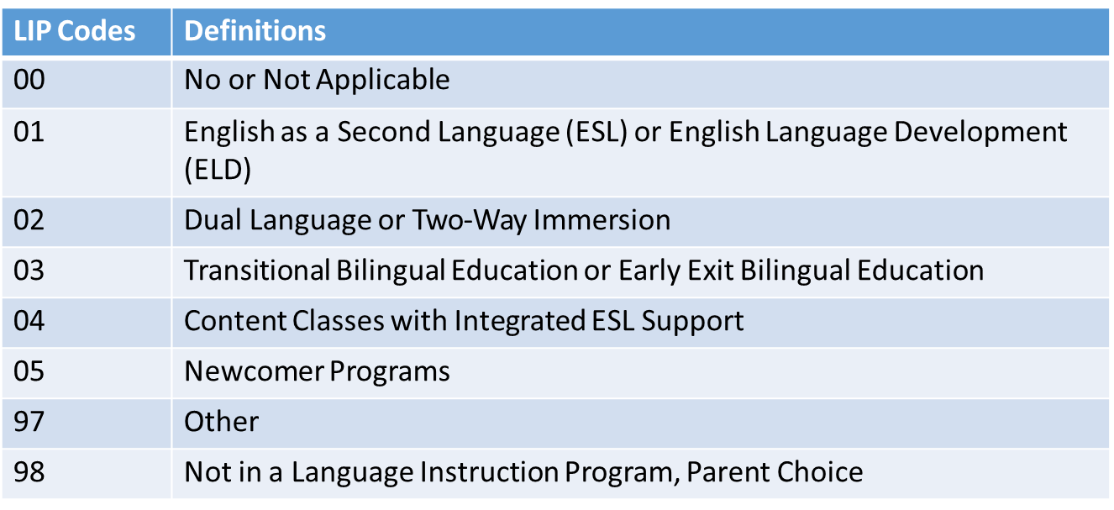
Coding Tips for Data Fields
Language Background | Language Proficiency | Language Instruction
ENG | 0 | 00
Not ENG | NEP – LEP - FEP M1 – FEP M2 | Not 00
Not ENG | PHLOTE - Former ML | 00
Not ENG | FEP E1 – FEP E2 | Any Code (use table below)
Notes:
When thinking through the coding pattern for a student, it is best to first ask yourself, “what is the student’s language background?” If the student’s language background is English, they must have a language proficiency code of zero (or not applicable) and a language instruction program 00 (not applicable). This essentially means that students who speak English should not be enrolled in an English Learning program. On the flip side, if the student’s language background is something other than English (Not ENG), the student must have a valid language proficiency code of something other than 0. The language instruction program is dependent on the language proficiency code described below.
As mentioned before, if a student has a Language Background of English, their LIP must be ‘00’. Otherwise, there are specific instructions for Language Proficiency Codes other than ‘00’. NEP, LEP, FEP Monitor Year 1 and Monitor year 2 Language Proficiency Codes must have a LIP of anything other than ‘00’. PHLOTE or FELL students must have an LIP of ‘00’ since they have demonstrated proficiency in English. FEP exited Year 1 and year 2 can have any of the below codes. If you are concerned that your program is not included in any of the defined programs, please call the Office of CLDE for help in selecting the most appropriate program type.

Slide 22
Annual Data Reporting Cycle
Student October
Language Proficiency identifies students’ ML status based standardized identification procedures
New coding begins 7/1 for students moving along ML Progression
During the Year
ACCESS: Testing window occurs each winter (Jan-Feb)
Note: Language proficiency is expected to still match Student October
End of the Year
Language proficiency coding remains same as October through 6/30
Note: all Spring student level data collections expected to reflect the same coding as Student End of Year
Summer
Plan for next school year using CO’s standardized redesignation procedures and cut score guidance
New coding begins 7/1 for students moving along ML Progression
Notes:
Example
2024-2025 LEP with exit date 06/30/2025 for services
2025-2026 FEP MY1 with start date 07/01/2025 for services, ending 06/30/2026

Slide 23
Data Checks (Errors and Warnings)
Demographic File
Student End of Year
Errors
Warnings
2025-2026: Consolidated many errors and warnings into fewer codes
Compares language proficiency from current file to prior October
Compares language proficiency in current OCT to current SEY
Student’s coding does not follow expected sequence and must be addressed
Possible issues, encouraged for review
Custom ‘error details’ to the error report to show the language proficiency and district code in the prior year for comparison to the current year

Slide 24
New SP570 Student Demographic (DEM) Error
Prior Year: OCT Language Proficiency | Current DEM: Expected Language Proficiency (no error) | Current DEM: SP570 Error—Language Proficiency Out Of Sequence | Current DEM: Allowable Language Proficiency (warning)
1—NEP | 1, 2, 6 | 0, 7, 8, 9, 5, 4 | No other options available
2—LEP | 1, 2, 6 | 0, 7, 8, 9, 5, 4 | No other options available
6—FEP MY1 | 7 | 0, 6, 8, 9, 5, 4 | 1, 2 (SP566 warning)
7—FEP MY2 | 8 | 0, 6, 7, 9, 5, 4 | 1, 2 (SP566 warning)
8—FEP Exit 1 | 9 | 0, 6, 7, 8, 5, 4 | 1, 2 (SP566 warning)
9—FEP Exit 2 | 5 | 0, 6, 7, 8, 9, 4 | 1, 2 (SP566 warning)
5—Former ML | 5 | 0, 6, 7, 8, 9, 4 | 1, 2 (SP566 warning)
4—PHLOTE | 4 | 0, 6, 7, 8, 9, 4 | 1, 2 (SP566 warning)
0—N/A | 0 | 6, 7, 8, 9, 5 | 1, 2 (no warning) 4 (SP178 warning)

Slide 25
Common Errors for Exception Requests:
Student does not follow logical language proficiency sequence
Current Year | Prior Year | Error | Sequence
FEP M2 (7) | NEP (1) or LEP (2) | Missing FEP M1 (6) year | Student must complete a full year of M1 prior to being coded M2
FEP (6,7,8,9) | NA (0) | Missing NEP (1) or LEP (2) or PHLOTE (4) year | Requires ML reporting prior to being coded FEP
NA (0) | NEP/ LEP/FEP/Former ML/PHLOTE (1-9) | Changes to English Only | Review ID guidance
NEP> LEP> FEP M1> FEP M2> FEP Exit1> FEP Exit 2> Former ML
Notes:
Now let’s talk through some common errors that you may encounter when reporting ML information within our Student October Collection. These errors will flag at the Student Interchange level, specifically our Student Demographic File when a student does not follow the typical language proficiency progression. I will just review a few.
(SP183)Student is currently coded FEP Monitor Year 2 (Language Proficiency = 7). Last October the student was coded as NEP (1) or LEP (2). Students who are redesignated to FEP must have a full year as Monitor Year 1 (6) prior to being Monitor Year 2. This error will flag when a student falls out of sequence NEP>LEP> FEP M1>FEP M2>FEP Exit1> FEP Exit 2>Former ML. The system is expecting to code the student as FEP M1 this year.
(SP166) Student is currently coded as Language Proficiency = 0 (N/A). Prior year Student October your district reported this student as an ML student with a Language Proficiency code that was NOT zero (Previous October Language Proficiency = 1, 2, 3, 4, 5, 6, 7, 8, or 9). This error is flagging because the student was identified as ML last year. Please review district identification for current ML determination and reach out to our CLDE office with questions.

Slide 26
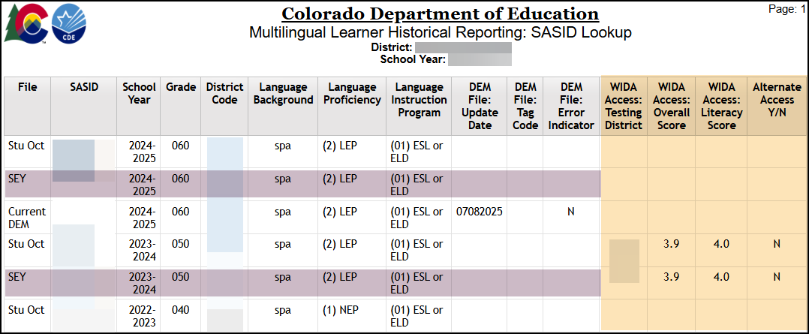
COGNOS/CEDAR
Multilingual Learner Historical Reporting: SASID Lookup
New report published 7/14, old report ‘English Learner Historical Reporting by SASID’ is no longer available
WIDA ACCESS scores for prior year (if available) now included in this report
Student End of Year (SEY) rows appear when there is an active SEY collection to allow LEAs to see approved sequence changes occurring mid-year
Report now includes most recent school year at the top, then reflects prior school years in descending order
Data User IdM Role = Student Interchange, LEA User
Optional Viewing Only IdM Role = Student Interchange, LEA Viewer
Notes:
Pick current SY = 25-26 man!

Slide 27
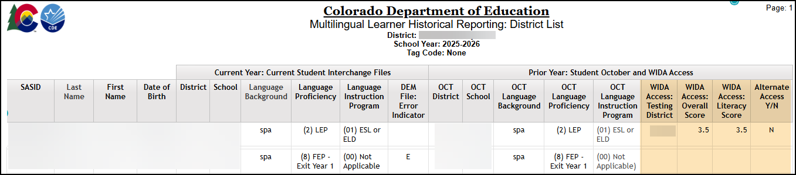
COGNOS/CEDAR
Multilingual Learner Historical Reporting: District List
New report published 7/30, old report ‘English Learner Historical Reporting by District’ is no longer available
Must upload both a Student Demographic and a Student School Association file before this report will reflect data
Includes prior year Student October and WIDA ACCESS data for students in your current student interchange files
Includes ALL students with Student Interchange records, including students whose language background is ‘ENG’ in the current year and prior year.
Tip: Use the ‘extract excel data’ download option to download an excel spreadsheet that can be sorted/filtered
Data User IdM Role = Student Interchange, LEA User
Optional Viewing Only IdM Role = Student Interchange, LEA Viewer
Notes:
Pick current SY = 25-26

Slide 28
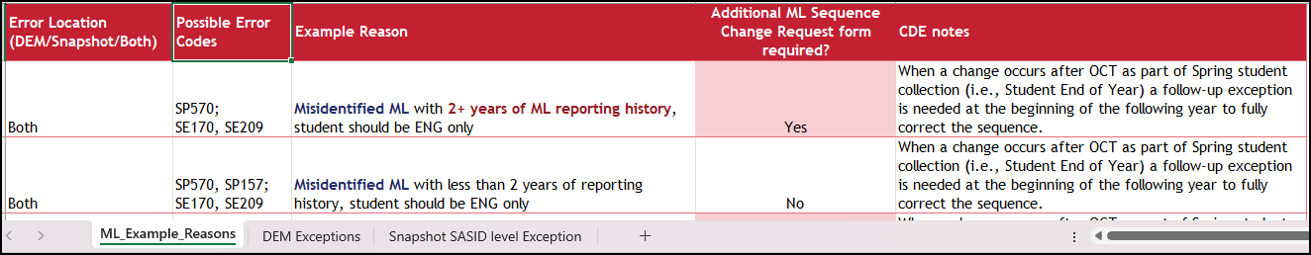
Reporting Exceptions
Submitted by student data respondent to request an error is cleared for a specific student coding scenario
  May need input from ELD Team to complete template or ML Change Request Form
  Directions and template available on Student Interchange website
2025-2026 Updates
  ML specific template that includes tab with sample ‘reasons’ for requests
  ML sequence change request form updated for use throughout the year instead of just mid-year changes
    Use when student has 2+ years of ML history as additional documentation to support the template
Notes:
Reason bank is new this year
Once you have done your research on various errors that flag for EL students, it may be time to request an exception. Exceptions are used when a student is accurately coded but is still flagging an error within Data Pipeline. Let's look at the regular exception collection template. The regular exception template is the template used for the majority of exceptions in the student data collections, not just English learner exceptions. It's imperative that the information on this form is accurate. The error code, error type, District code, and SASID must be accurate. Otherwise, the exception does not process correctly. Data respondents are encouraged to copy this information directly from the corresponding error detail report. Once you have completed it exception template, it is now time to save it and upload to Syncplicity. After uploading the document to Syncplicity (again we use this because the exception request will contain PII), you will email the Student October data collection lead. The Student October Collection lead will guide you to the next steps in the exception process. The exception request form can be found on the Student Interchange website. Exceptions are only used, again, for students who are coded accurately and continue to flag errors within the Data Pipeline System. Please reach out to the Student October Collection lead if you have any questions on errors flagging, whether or not an exception is needed and coding patterns.

Slide 29
Common Exception Examples
Student does not speak a language other than English or student is not ML
  Consider providing: District has mis-identified the student. District's robust documentation and body of evidence demonstrates this recently identified ML student (2 reporting years or less) is not eligible for language instruction.
Student incorrectly identified as ML student, code student as PHLOTE
  Consider providing: Student was screened in the district on ‘date’. Documented screener scores and body of evidence indicated student is fully proficient in English. Student should have been coded as PHLOTE to begin with and was never provided ML services.
Student's Language Proficiency is FEPM2 (7) (skipped FEP M1 in progression in records - coding)
  Consider providing: Student took ACCESS/ALT ACCESS during ‘school year’. Conference with ELD Team/Dept, documented scores and body of evidence indicated should have been redesignated to FEP M1 last school year. Code as FEP M2 now. Student had mid-year exception approved in Student End of Year Collection.
Student was LEP last year but after October Count so was not reported in October Count with a language. This year, they moved to FEP Monitor 1 (6)
  Student was LEP last year but after October Count so was not reported in October Count as a LEP student. Student was screened upon enrollment after report deadline (Student October). Screener and body of evidence indicated student is fully proficient in English. This year, they moved to Monitor 1 (6). Student had mid-year exception approved in Student End of Year Collection.
Notes:
Student does not speak a language other than English or student is not ML.
Consider providing: District has mis-identified the student. District's robust documentation and body of evidence demonstrates this recently identified EL student (2 reporting years or less) is not eligible for language instruction.
Student incorrectly identified as ML student, code student as PHLOTE
Consider providing: Student was screened in the district on ‘date’. Documented screener scores and body of evidence indicated student is fully proficient in English. Student should have been coded as PHLOTE to begin with and was never provided EL services.
Student's Language Proficiency is FEPM2 (7) (skipped FEP M1 in progression in records - coding)
Consider providing: Student took ACCESS/ALT ACCESS during ‘school year’. Conference with ELD Team/Dept, documented scores and body of evidence indicated should have been redesignated to FEP M1 last school year. Code as FEP M2 now. Student had mid-year exception approved in Student End of Year Collection.
Student was LEP last year but after October Count so was not reported in October Count with a language. This year, they moved to FEP Monitor 1 (6).
Student was LEP last year but after October Count so was not reported in October Count as a LEP student. Student was screened upon enrollment after report deadline (Student October). Screener and body of evidence indicated student is fully proficient in English. This year, they moved to Monitor 1 (6). Student had mid-year exception approved in Student End of Year Collection.

Slide 30

Personally Identifiable Information (PII)
Personally Identifiable Information (PII) is defined by state and federal laws as information that alone, or in combination, personally identifies an individual
  Includes direct identifiers (i.e. SASID, student names)
  Includes information when combined is identifiable
Colorado’s Student Data Transparency and Security Act outlines requirements for how Student PII is collected, used and shared
  See CDE’s data security and privacy site for more information
Syncplicity
  Secure file transfer site used to communicate PII with CDE collection leads
  Each collection lead maintains their own Syncplicity folder and can assign rights to that folder
    Student End of Year, Student October, and Attendance all utilize the same primary folder with subfolders to organize the collections
    Primary Syncplicity Folder: District Code – DISTRICT NAME – Student
Notes:
Before we look at our exception request form, we need to talk about Personally Identifiable information. Personally identifiable information is defined by state and federal laws as information that alone or in combination personally identifies an individual. So, in this instance we're talking about students. It would be direct identifiers such as SASID, student names, date of births or other information that when you combine it together would identify a student. Because of Colorado's student data transparency and Security Act we really need to think about the requirements for how we communicate student PII and how it is used and shared. So, this is data that we do need to keep secure and we do need to keep private. That means that when communicating with CDE staff or communicating amongst one another, it's important to know that e-mail is not considered secure. If personal identifiable information must be sent to CDE staff, we use a system called Syncplicity. This is a secure file transfer site used to communicate student information with collection leads. For Student End of Year, Student October or the Attendance collections, please use the primary Syncplicity folder indicated by District Code – District Name – Student to send student information securely to data collection leads. All exception requests will go through this safe process.

Slide 31
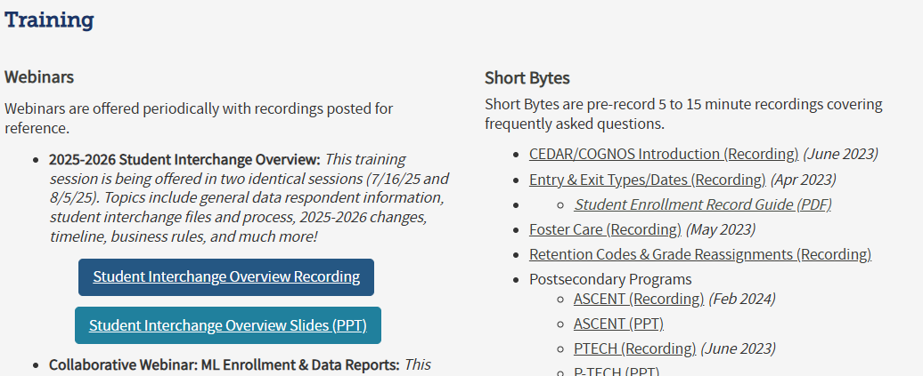
Trainings (webinars, slides, short bytes)
Student Interchange Website
Notes:
I know both Doris and I went through a ton of information today, but you are in luck, we not only record this presentation and post the PPT, we also have recorded webinars that pertain to English Language Learners already posted on the web as well as Short Bytes and they are meant to focus in on one subject at a time. These can be found on the Student Interchange website.

Slide 32
CDE Contacts & Offices
CLDE Office Website (Identification, Redesignation, Screener, Programming)
  Contact Doris Nguyen at brock-Nguyen_d@cde.state.co.us or 720-626-6175
  CLDE List Serv Emails, contact Janet Turnmeyer at turnmeyer_j@cde.state.co.us
Data Pipeline Website
  Student Interchange Website
  Student October and Student End of Year Sites
  Contact Collin Slutzky at StudentOctober@cde.state.co.us or 720-760-3569
  Contact Regan Ward at StudentEndOfYear@cde.state.co.us
Assessment Office Website (WIDA ACCESS)
    Contact Heather Villalobos Pavia at Villalobos-Pavia_H@cde.state.co.us

