Slide 1
Instructional Days and Hours
Building the upload file and field calculations

Slide 2
Instructional Days and Hours:
Timeline and Submission Requirements
Collection Timeline
OPEN: Wednesday, September 17th
CLOSE: Friday, December 19th
Required to Submit​
Districts,​
BOCES operating schools,​
and the Charter School Institute ​
will need to submit data for all public schools serving grades K-12 (006-120).​
​
Do NOT submit data for:​
Pre-k​
Public schools serving only grades 004-004​
100% Home Options Schools (school system code 10)
Instructional Days and Hours
DirectoryData@cde.state.co.us

Slide 3
Instructional Days and Hours Training Resources
Instructional Days and Hours Resources
Instructional Days and Hours File Upload Template
Instructional Days and Hours File Layout
Training District: 0250 Springfield RE-4
Springfield School District 2025-2026 Calendar
Springfield School District 2025-2026 Student Handbook
Instructional Days and Hours
DirectoryData@cde.state.co.us

Slide 4
Instructional Days and Hours: IDM Roles
IDM role | Example | Permissions
IDH Viewer | PIPELINE-xxxx-IDH~LEAVIEWER | Can review data through the File Extract Download and Cognos Reports.
IDH User | PIPELINE-xxxx-IDH~LEAUSER | Same as IDH Viewer plus file uploads, add, edit, delete records, view and download error reports.
IDH Approver | PIPELINE-xxxx-IDH~LEAAPPROVER | Same as IDH user plus permissions to submit final data to CDE.
Instructional Days and Hours
DirectoryData@cde.state.co.us

Slide 5
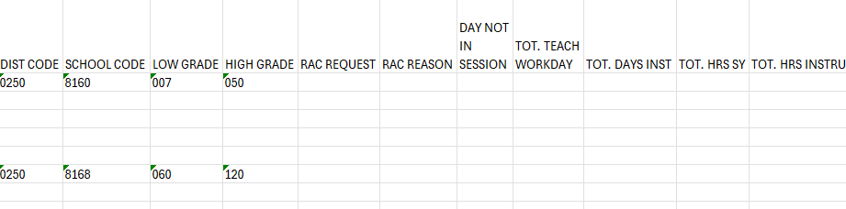
Step 1: Determine schools and grades to be reported
Training District: 0250 Springfield RE-4
The school district has two schools serving pre-k through 12th grades:
  Springfield Elementary School (8160) – serving grades pre-k through 5th
  Springfield Junior/Senior High School (8168) – serving grades 6th through 12th
^{Starting point}
Instructional Days and Hours File Upload Template
Instructional Days and Hours
DirectoryData@cde.state.co.us

Slide 6
Step 2: The low hanging fruit – Reduced Academic Calendar Fields
Reduced Academic Calendar fields CAN be zero-filled
Reduced Academic Calendar Request: Y/N
^{Reason for RAC Request}
WHY: Reduced Academic Calendar requests for the 25-26 school year have already been approved and districts notified. If you know you are on a reduced academic calendar you are welcome to accurately complete these two data fields, but there are no validation checks on our end.
Instructional Days and Hours
DirectoryData@cde.state.co.us

Slide 7
Step 2: The low hanging fruit – Day Not in Session & Calendar Adopted
Four Day School Week is not the same as a Reduced Academic Calendar
Day Not in Session – if not consistent, use the code that is representative of the majority of the school year.
Date Calendar Adopted by School Board – MMDDYYYY
  Warning - Date Calendar Adopted must be within one year of the reporting school year. For example 25-26 school year calendars cannot be adopted prior to 01/01/2024.
Code | Description
0 | N/A
1 | Monday
5 | Friday
Instructional Days and Hours
DirectoryData@cde.state.co.us

Slide 8
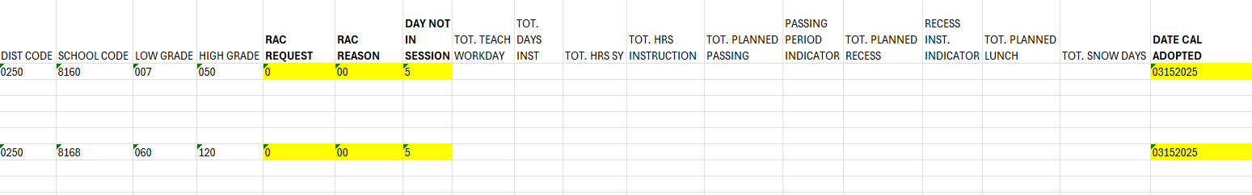
Step 2: The low hanging fruit – Results
^{RAC Request – 0 (NO)}
RAC Reason – 00 (N/A – not applicable)
Day Not in Session – 5 (Friday)
Date Calendar Adopted by School Board - 03152025
Instructional Days and Hours
DirectoryData@cde.state.co.us

Slide 9
Step 3: Fields requiring calculation
^{Total Teacher Workdays}
^{Total Days of Instruction}
Total Hours for the School Year
^{Total Hours of Instruction}
^{Total Planned Passing}
^{Total Planned Recess}
^{Total Planned Lunch}
^{Total Planned Snow Days}
Instructional Days and Hours
DirectoryData@cde.state.co.us

Slide 10
Step 3: Calculate Total Days of Instruction/Student Contact
To calculate:
For each grade review the school calendar and count the number of full and partial mandatory attendance days.
File expectations:
If the total number of school days varies by grade level, a new record must be submitted for that grade level.
Must be between 100.0 and 250.0. Use .5 decimal if counting half days.
Notes
A partial day of instruction can be counted as a whole or half-day of instructional time.
Do not include: Student non-attendance days or optional attendance days.
Do include: Testing days.
Instructional Days and Hours
DirectoryData@cde.state.co.us

Slide 11
Step 4: Calculating Total Teacher Workdays
To calculate:
Use full-time, full school year average of teacher contract days or add count PD days for the school year and add to the Total Days of Instruction Calculation.
File expectations:
Must be between 100.0 and 260.0. Use .5 decimal for half days.
Notes:
Includes student-contact and non-student contact days.
Total Teacher Workdays are teacher contract days.
Do not include: Training or orientation days specific to new teachers.
Do include: Professional development, data-review, teacher-in-service, or parent-teacher conference days.
Instructional Days and Hours
DirectoryData@cde.state.co.us

Slide 12
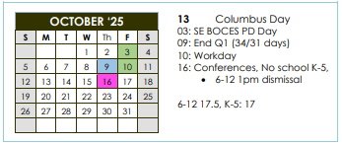
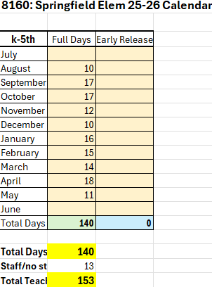
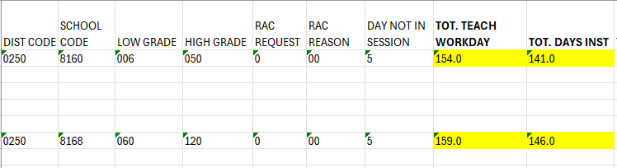
0250 Springfield RE-4 – Total Days of Instruction & Total Teacher Workdays Calculation
School District Calendar
Instructional Days and Hours
DirectoryData@cde.state.co.us

Slide 13
Step 5: Calculating Total Hours for the School Year
To calculate:
  Determine the hours of a full school day.
    The start of the instructional day is the time at which the first scheduled period of the day begins.
    The end of the instructional day is the time at which the last scheduled period of the day ends.
    If a school has periods that begin before, or end after, scheduled bus routes for the school, these periods should not be considered as part of the instructional day.
  For each grade, multiply the full-day hours by the number of full, mandatory attendance days scheduled for the school year for that grade.
  Determine the hours for a half school day.
  For each grade, multiply the half-day hours by the number of half-days scheduled for the school year for that grade.
  For each grade, add the full- and half-day totals and divide by 60.
File expectations:
If the total number of school days varies by grade level, and new record must be submitted for that grade level.
Must be between 0990.0 and 2000.0.
Notes
Do not include: Any hours from non-student contact days, full or partial.
Do include: All instructional and non-instructional time that fall between first and last bell or first and last scheduled bus route.
Instructional Days and Hours
DirectoryData@cde.state.co.us

Slide 14
0250 Springfield RE-4 – Total Hours for the School Year
2025-2026 Student Handbook p. 7
The School Day
Kindergarten through 5th grade classes begin at 8:00 a.m. Doors will open at 7:30 a.m. Students arriving before 7:45 a.m. will go directly to the Commons Area for breakfast, even if they do not plan to eat breakfast. Students arriving between 7:45 a.m. and 8:00 a.m. may either go to breakfast or to their classrooms. Elementary students arriving after 8 a.m. must check in at the front office.
Classes for grades 6 through 12 will begin at 7:45 a.m. Doors will open at 7:30 a.m. Students should report directly to their first hour classes.
School dismisses for all K-5th grade students at 4:00 p.m. School dismisses for all 6th-12th grade students at 4:10 p.m.
Instructional Days and Hours
DirectoryData@cde.state.co.us

Slide 15
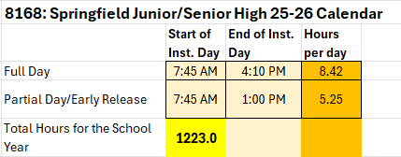
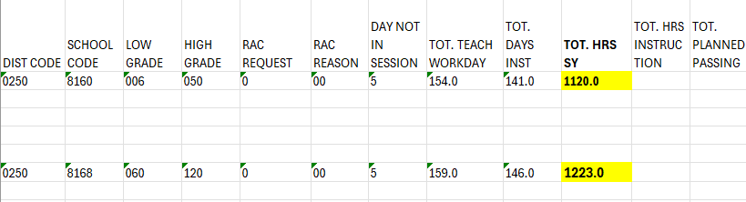
0250 Springfield RE-4 – Total Hours for the School Year
2025-2026 Student Handbook p. 7
# of full days of instruction | # of partial days of instruction
144 | 2
(Hours per full day * # of full days of instruction) + (Hours per partial day * # of partial days of instruction)
(8.42 * 144) + (5.25 * 2) → 1212.5 + 10.5 = 1223.0
Instructional Days and Hours
DirectoryData@cde.state.co.us

Slide 16
Step 6: Calculate Lunch (and other meal breaks)
To calculate:
For each grade, find the duration of lunch break. This is the difference in minutes from the start of the lunch break to the start of the next bell signaling class has begun.
File expectations:
If the total number of lunch and meal breaks varies by grade level, a new record must be submitted for that grade level.
Notes:
If one grade range has several bell schedules with varying durations of lunch, you may either calculate the lunch duration for each bell schedule or simply use the lunch duration that is most common.
Lunch and meal breaks may be shortened for partial/early release days. Be sure to calculate these accordingly.
Do include: Passing out of lunch. Passing out of lunch should be included in your lunch hour total.
(Duration of meal break + minutes until next start of class) * Total Days of Instruction full and partial
Instructional Days and Hours
DirectoryData@cde.state.co.us

Slide 17
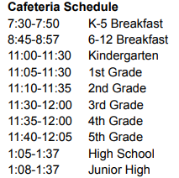
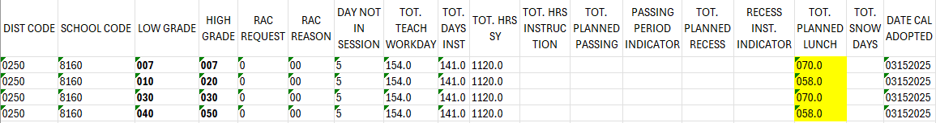
0250 Springfield RE-4 – Total Lunch Hours for the School Year
Springfield Elementary (8160)
Springfield Elementary (8160) 25-26 SY Lunch
Break Schedule | Lunch Start | Lunch End | Lunch Duration | Total Lunch Hours for the SY
007 | 11:00 AM | 11:30 AM | 0.50 | 70
010 | 11:05 AM | 11:30 AM | 0.42 | 58
020 | 11:10 AM | 11:35 AM | 0.42 | 58
030 | 11:30 AM | 12:00 PM | 0.50 | 70
040 | 11:35 AM | 12:00 PM | 0.42 | 58
050 | 11:40 AM | 12:05 PM | 0.42 | 58
Instructional Days and Hours
DirectoryData@cde.state.co.us

Slide 18
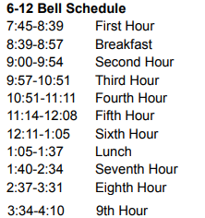
0250 Springfield RE-4 – Total Lunch Hours for the School Year
Springfield Junior/Senior High (8168)
Springfield Junior/Senior High (8168) 25-26 SY Meals
Break Schedule | Lunch Start | Lunch End | Lunch Duration | Total Lunch/Meals Hours for the SY
Breakfast 060-120 | 8:45 AM | 9:00 AM | 0.25 | 36.0
060 | 1:08 PM | 1:40 PM | 0.53 | 76.8
070 | 1:08 PM | 1:40 PM | 0.53 | 76.8
080 | 1:08 PM | 1:40 PM | 0.53 | 76.8
090 | 1:05 PM | 1:40 PM | 0.58 | 84.0
100 | 1:05 PM | 1:40 PM | 0.58 | 84.0
110 | 1:05 PM | 1:40 PM | 0.58 | 84.0
120 | 1:05 PM | 1:40 PM | 0.58 | 84.0
Instructional Days and Hours
DirectoryData@cde.state.co.us

Slide 19
Step 7: Calculate Total Hours of Passing
To calculate…
Add the total number of passing minutes for each grade’s bell schedule and multiply by the number of days that bell schedule is followed.
File expectations:
If the total number of passing hours varies by grade level, a new record must be submitted for that grade level.
Notes:
Since some districts may have a policy that some passing time can be counted as instructional for funding purposes, passing may be counted twice. In both Total Instructional Hours and Total Hours of Passing.
Do not include: Passing out of lunch. Passing out of lunch should be included in your lunch hour total.
Instructional Days and Hours
DirectoryData@cde.state.co.us

Slide 20
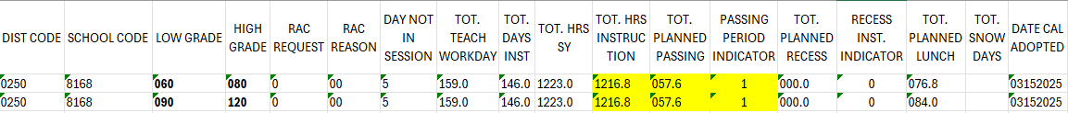
0250 Springfield RE-4 – Total Passing and Instructional Hours for the School Year
Springfield Junior/Senior High (8168) 25-26 SY Bell Schedule
Hour | Start | End | Class Duration | Pass Duration
1st hour | 7:45 AM | 8:39 AM | 0.90 | 0.10
6th-12th breakfast | 8:45 AM | 8:57 AM | 0.20
2nd hour | 9:00 AM | 9:54 AM | 0.90 | 0.05
3rd hour | 9:57 AM | 10:51 AM | 0.90 | 0.00
4th hour | 10:51 AM | 11:11 AM | 0.33 | 0.05
5th hour | 11:14 AM | 12:08 PM | 0.90 | 0.05
6th hour | 12:11 PM | 1:05 PM | 0.90
6th-8th lunch | 1:08 PM | 1:37 PM | 0.48
9th-12th lunch | 1:05 PM | 1:37 PM | 0.53 | 0.05
7th hour | 1:40 PM | 2:34 PM | 0.90 | 0.05
8th hour | 2:37 PM | 3:31 PM | 0.90 | 0.05
9th hour | 3:34 PM | 4:10 PM | 0.60
TOTALS |  |  | 1216.80 | 57.60
Instructional Days and Hours
DirectoryData@cde.state.co.us

Slide 21
Step 8: Calculate Total Hours of Recess
To calculate…
For each grade, add the total recess minutes in a day and multiply by the number of student contact days.
File expectations:
If the total number of recess time varies by grade level, a new record must be submitted for that grade level.
Notes:
It is likely that recess will be counted as instructional time which may be reflected in both the Total Instructional Hours and Total Hours of Recess fields.
May or may not include: Recess out of lunch. Depending on your policy and schedule recess out of lunch may or may not be instructional. If recess out of lunch is NOT considered instructional, please count this in the lunch total.
Instructional Days and Hours
DirectoryData@cde.state.co.us

Slide 22
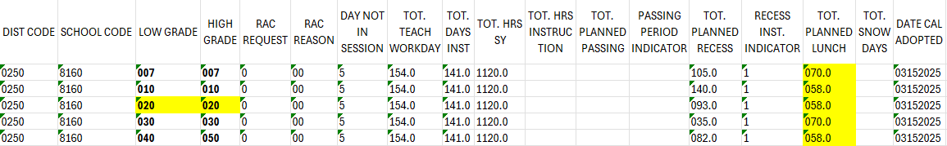
0250 Springfield RE-4 – Total Recess Hours for the School Year
Springfield Elementary (8160) 25-26 SY Recess
Grade | Start AM | End AM | Duration AM | Start PM | End PM | Duration PM | Total for SY
007 | 9:30 AM | 10:00 AM | 0.50 | 2:00 AM | 2:15 AM | 0.25 | 105.0
010 | 8:45 AM | 9:15 AM | 0.50 | 2:05 AM | 2:35 AM | 0.50 | 140.0
020 | 10:30 AM | 10:45 AM | 0.25 | 11:10 AM | 11:35 AM | 0.42 | 093.0
030 |  |  | 0.00 | 2:20 PM | 2:35 PM | 0.25 | 035.0
040 | 11:00 AM | 11:15 AM | 0.25 | 2:45 PM | 3:05 PM | 0.33 | 082.0
050 | 9:40 AM | 9:55 AM | 0.25 | 2:45 PM | 3:05 PM | 0.33 | 082.0
Instructional Days and Hours
DirectoryData@cde.state.co.us

Slide 23
Step 9: Calculating Total Hours of Instruction
To calculate…
Add the total number of in-class minutes for each grade’s bell schedule and multiply by the number of days that bell schedule is followed.
File expectations:
If the total number of in-class hours varies by grade level, a new record must be submitted for that grade level.
Notes:
Since most districts have a policy that passing and recess can be counted as instructional it is allowable that Total Hours of Instructions can include these totals.
Do not include: Lunch and passing out of lunch.
May include: Passing and recess if District School Board policy allows.
Instructional Days and Hours
DirectoryData@cde.state.co.us

Slide 24
0250 Springfield RE-4 – Total Passing and Instructional Hours for the School Year
Springfield Junior/Senior High (8168) 25-26 SY Bell Schedule
Hour | Start | End | Class Duration | Pass Duration
1st hour | 7:45 AM | 8:39 AM | 0.90 | 0.10
6th-12th breakfast | 8:45 AM | 8:57 AM | 0.20
2nd hour | 9:00 AM | 9:54 AM | 0.90 | 0.05
3rd hour | 9:57 AM | 10:51 AM | 0.90 | 0.00
4th hour | 10:51 AM | 11:11 AM | 0.33 | 0.05
5th hour | 11:14 AM | 12:08 PM | 0.90 | 0.05
6th hour | 12:11 PM | 1:05 PM | 0.90
6th-8th lunch | 1:08 PM | 1:37 PM | 0.48
9th-12th lunch | 1:05 PM | 1:37 PM | 0.53 | 0.05
7th hour | 1:40 PM | 2:34 PM | 0.90 | 0.05
8th hour | 2:37 PM | 3:31 PM | 0.90 | 0.05
9th hour | 3:34 PM | 4:10 PM | 0.60
TOTALS |  |  | 1216.80 | 57.60
Instructional Days and Hours
DirectoryData@cde.state.co.us

Slide 25
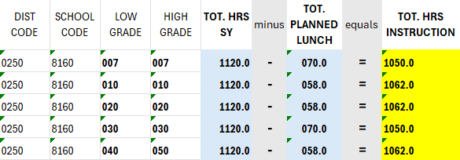
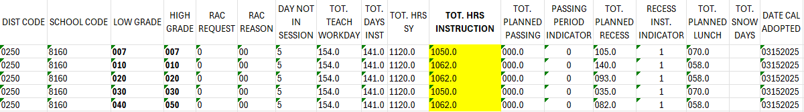
0250 Springfield RE-4 – Total Recess Hours for the School Year
Springfield Elementary (8160)
Total Hours for School Year – Total Planned Lunch Hours
Instructional Days and Hours
DirectoryData@cde.state.co.us

Slide 26
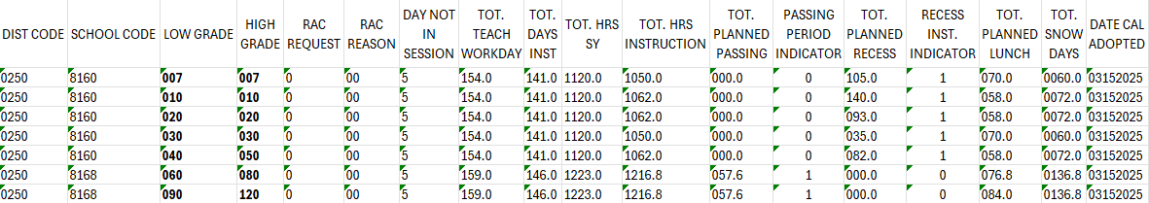
Step 10: Calculating Planned Hours for Snow Days/Emergency Closures
To calculate…
For elementary grades (k-5/6): Subtract 968 from the Total Hours of Instruction. If Total Hours of Instruction is less than 990, Total Planned Hours for Snow Days/ Emergency Closures can be 0000.0.
For secondary grades (6-12): Subtract 1056 from the Total Hours of Instruction. If Total Hours of Instruction is less than 1080, Total Planned Hours for Snow Days/ Emergency Closures can be 0000.0.
Instructional Days and Hours
DirectoryData@cde.state.co.us

