Slide 1
Short Bytes
Home Based Students

Slide 2
What are Home Based (Home School) Students?
As defined in the Audit Resource Guide: A home-school student is a pupil receiving education under a non-public, home-based educational program where the parent or guardian (not the district) has taken on the primary responsibility for providing the student’s education in a home setting.
2 Types
  Home based students not receiving educational services from reporting LEA
  Home based students receiving some educational services from reporting LEA
Different reporting requirements for each type

Slide 3
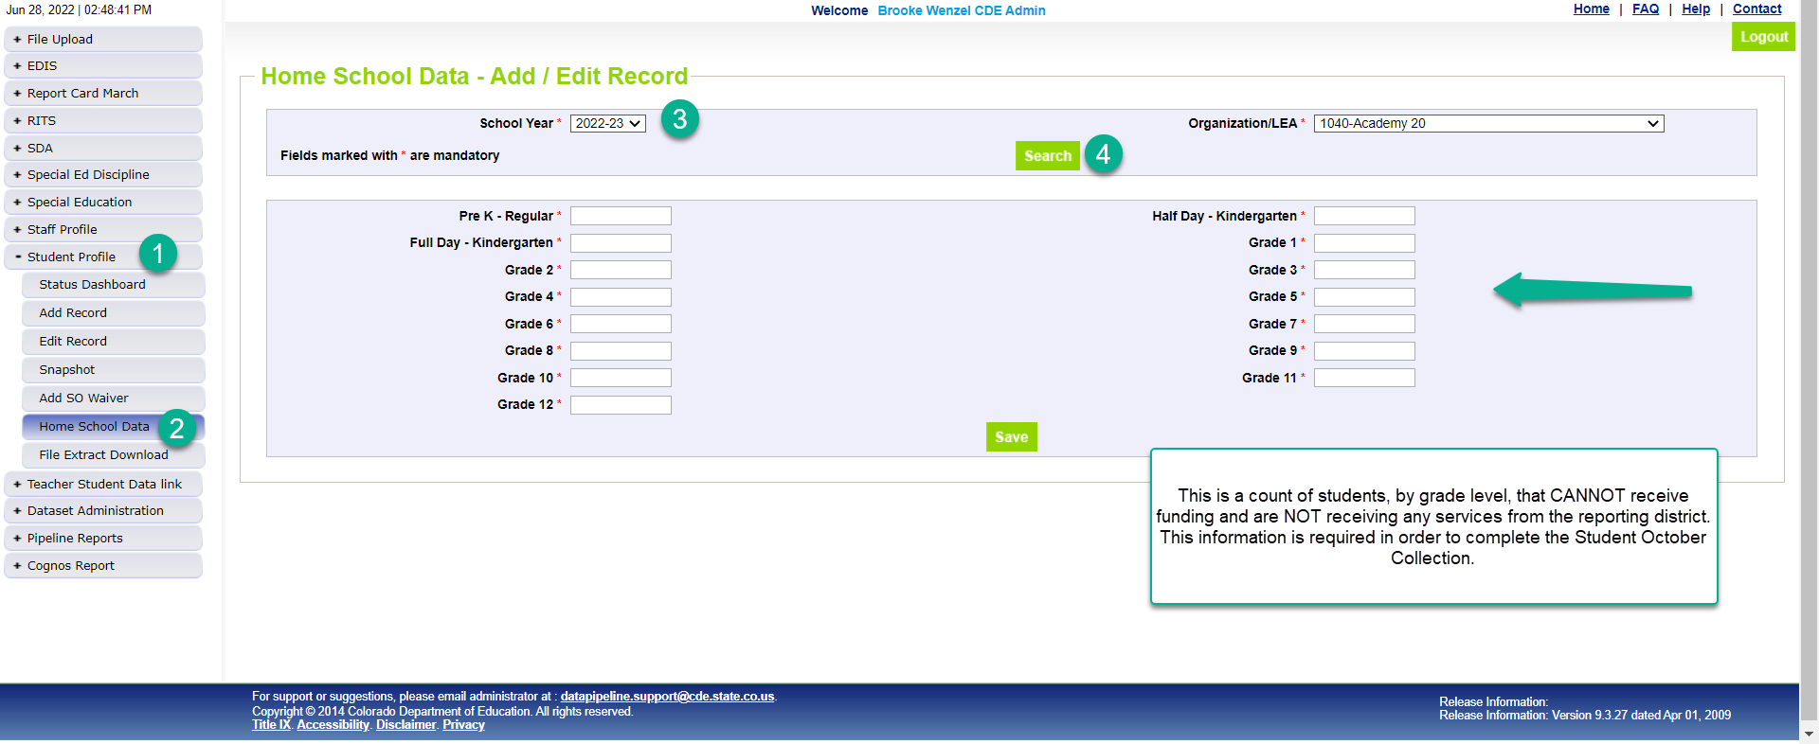
Home School Students Not Receiving Educational Services from LEA
Submit through Home School Data screen
Count by grade level
Submit information before close of Student October Collection (November 10th)
Students receiving only a home-based education are not eligible for funding.

Slide 4
Home School Students receiving LEA educational services
Home-school students are eligible for a maximum of part-time funding statewide.
If a home-school student is receiving part-time services from multiple districts, the student may only be submitted for part-time funding by one district.
Part-time funding will be determined based on the type of courses or services the student is receiving
Include these students in your Student Interchange Files (DEM, SSA) to ultimately be pulled into Student October Snapshot
Home Based = ‘1’
Home Based | Public School Finance Funding Status
‘1’ | Brick and Mortar: ’85’, ’86’, or ’87’
‘1’ | Online: ’94’, ’95’, or ’96’
For a reminder on Funding Status Codes, visit our Student Interchange Website (specifically the Student School Association File)

Slide 5
Home Based Students Outside of School Grade Range
Sometimes schools offer home school programs outside of designated grade range
Home Based Students Receiving Educational Services can be enrolled in a grade level outside of the school’s designated grade range
  Students must be indicated with Home Based = ‘1’ for error check to clear
Example: School 1234 serves grade levels K-5 (007 through 050) but provides a home school program to 6th (060) graders.
  Students can be enrolled as 6th graders in school 1234 if they have home based = ‘1’. Otherwise, these students will receive an error. (SP23: Grade Level does not contain a valid code for the specified school. Only students coded as Home Based Education = 1 are permitted to have grade levels outside of the school's designated range.)

Slide 6
Home Based Error Checks
Home Based Students Not Receiving Educational Services:
  Error: Student October Data for LEA 1234 cannot be submitted until Home School Data is entered.
  Resolution: Navigate to Home School Data screen and fill in appropriate counts per grade level.
Home Based Students Receiving Educational Services:
  Error OC107: If the Home-Based Education flag is set to 1 (Yes), then funding code must be 85, 86, 87, 94, 95, or 96.
  Resolution: Change student’s Home-Based Education status to ‘0’ if the student is not Home Based or change the student’s Public School Finance Funding Status to any of the codes listed.
  Error OC114: Students with funding status of 85 must have Home Based Education marked as 1.
  Resolution: Change Home Based status to ‘1’ or change student’s Public School Finance Funding Status if the student is not Home Based.

Slide 7
For more information, reach out to the Student October Collection Lead.

