Slide 1
Short Bytes
Exceptions (Error/Warning, Transfer Enrollment, Alternative Count Date)

Slide 2
What are Exceptions?
Overriding Data Pipeline information without changing data
  Errors or warnings
  Count Date for individual students (Transfer Enrollment) or entire districts/schools (Alternate Count Date)
Process typically occurs between the district data respondent and the Student October Collection lead
4 Types of Exceptions in Student October
  Error Exceptions
  Warning Exceptions
  Transfer Enrollment Exceptions
  Alternative Count Date Exceptions

Slide 3
Error/Warning Exceptions
Business rules flag errors or warnings (English Language Learners Warnings only)
Student’s data accurately represents the student’s situation, but an error or warning is still flagging with the student
  Interchange or Snapshot level
Used to clear errors and warnings without changing the data
Standard Exception Request Template (found on the Student October webpage)
Use a separate spreadsheet for each interchange file/collection
Only one error/warning per row

Slide 4
Error/Warning Exceptions Examples
Interchange Level Exception
Student October Snapshot Exception
English Language Learner Errors
Language Proficiency Progression does not match with the prior year’s information for the student
Sometimes we see students fall out of progression when moving in and out of districts, the state or even the country.
OC101 error will flag if an entire school is missing from the district’s Student October data and is not found in your Student School Association Interchange file data.
In some cases, we see that some schools are not closed in time of the Student October Collection due to lack of enrollment, for example.
An exception would be needed to clear up this error since there are no students enrolled at the school.

Slide 5
Transfer Enrollment Exceptions
In order to be eligible for funding, students must have established attendance with the district on or before the pupil enrollment count date unless they meet one of the transfer enrollment exceptions allowing for students to establish attendance after the pupil enrollment count date, but before the end of the 11-day count period.
  Includes in-state and out-of-state transfer students
  Will need to provide additional documentation to show that the student met one of the enrollment exception requirements for funding purposes.
  Must meet criteria outlined in the Student October Count Audit Resource Guide section on Transfer Enrollment Exceptions
  You must fill out Transfer Date Exception template to have student counted
  IMPORTANT: Please verify the student’s Entry/Exit Dates overlap with the Transfer Enrollment Exception Date

Slide 6
Transfer Enrollment Exceptions Examples
Within-District
Within-State
Out-of-State
Student withdraws from a district school prior to the pupil enrollment count date (September 29th) and enrolls in another school within the same district after the count date. (within 30 days following the pupil enrollment count date)
Student transferred from another Colorado district, XXXX, but does not qualify for October Count in their former district and established attendance prior to the end of the count window.
Student transferred from out of state (Wyoming) on October 6th within the 11-day count period.

Slide 7
Alternative Count Date Exceptions
A district may request an alternative count date for a school or program to allow maximum flexibility in the operation and scheduling of alternative program school calendars and year-round calendars, or for other reasons as authorized in statute
Technically an “exception” but it is automatically processed between the School Auditing Office and the Student October Collection Lead
Alternative Count Date requests are submitted through the Executive Director of School District Operations
  Outline the reason for the request
  Copy of the corresponding calendar (district, school or program)

Slide 8
Exception Steps – Filling out the Exception
Download the correct exception template on the Student October webpage, under Templates.
  This document should be an Excel Document.
  The first sheet will contain the directions and the second sheet is where you will fill out these exceptions.
Fill out the exception template.
  IMPORTANT: If you do not have the correct information, the exception will not process.
  Each student will have their own row in the exception request. You can have as many exceptions as you want on one sheet.
  Please keep exception “types” separate.
  Please make sure the “Reason for Exception” is short but explains the reason behind the exception.
  Leading zeros must be kept with the exception request.

Slide 9
Exception Steps – Sending it to CDE
Save exception request to computer to upload to Syncplicity.
Upload Exception Request in Student Syncplicity Folder, shown below. The Student Syncplicity folder is used by both Student October and Student End of Year Data Owners.
  If you do not have access to the Student Syncplicity folder, please contact the Student October Collection Lead.
Email the Student October Collection Lead that the document has been uploaded to Syncplicity. The collection lead will then either grant the exception or provide further instructions.

Slide 10
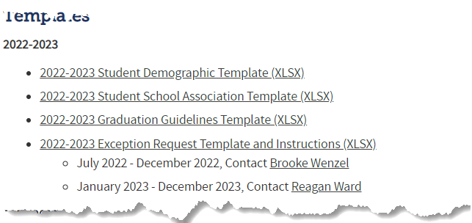

Exception Steps Overview
Complete exception request template
Upload exception request template to your district’s Syncplicity student folder
Folder: 1234 – DISTRICT NAME – Student
Notify the OCT collection lead (wenzel_b@cde.state.co.us) that you’ve uploaded a document for review
Collection lead will review your request and notify you of the outcome
Approved requests – reupload interchange file and/or create a new OCT snapshot
Denied requests – collection lead will provide next steps for clearing the error
Additional information needed – collection lead will request information
Available on Student October or Student
Pro Tip: Include the date in name of your exception request file as you may upload more than one exception during the collection cycle
Interchange Website

Slide 11
For more information, reach out to the Student October Collection Lead.

