Slide 1
April 25, 2024 Data Pipeline Town Hall
The goal of the webinar is to provide updates on the Data Pipeline, current, and upcoming data collections. These webinars also provide a forum for districts, BOCES, and Administrative Units to have questions answered about Data Pipeline.

Slide 2
Colorado Department of Education Identity Management (IdM)
Identity Management Site
Frequently Asked Questions
How do I add myself or others to the email listserv for town hall emails and/or a specific collection?
Email lists are dependent on a person’s access rights in IdM. Contact your LAM to get an account or be assigned to a specific collection.
Where can I find the IdM role mappings for Data Pipeline and other applications?
Role Mapping (XLS)
I am a LAM. How do I update the user permissions for someone in my district?
Follow the steps outlined in the IdM Quick Guide for Access Management (DOCX)
Important: Users are not automatically removed from IdM when their email address is no longer active in your district. The LAM must deactivate their IdM account to ensure only designated staff can access CDE’s data reporting system.

Slide 3
What is PII?
Student Personally Identifiable Information (PII) is defined by state and federal laws as information that, alone or in combination, personally identifies an individual
This includes direct identifiers (i.e. student and staff names, SASID, EDID, etc.)
Includes information that when combined is identifiable
Colorado’s Student Data Transparency and Security Act outlines requirements for how Student PII is collected, used and shared
See the Data Privacy and Security website for prepared guidance on how to comply with this and other privacy laws.

Slide 4
Sharing Data
Use secure methods to transfer any PII to CDE
Contact Data Collection leads with questions about how to transmit PII securely
Each Data Collection leads maintains their own Syncplicity folders for specific collections, reach out to the collection lead for access
Use Syncplicity to encrypt emails to CDE
Avoid sending PII via unencrypted email or to unsecured faxes when sharing data between or within districts
Use Syncplicity to encrypt emails to CDE
Check local policies for restrictions, requirements, etc. regarding PII
Do not use PII in trainings, presentations, etc.
Do not share PII with unauthorized individuals
Do not share passwords
Follow local policies when transmitting PII to any third party

Slide 5
Today’s Agenda
Agenda Topic | Presenter
Open Data Collections and Upcoming Deadlines in Data Pipeline
Career Development Incentive Program (CDIP) | Eivi Colmenero
READ Spring Assessment Reporting | Tara Rhodes
K-3 Literacy Programs & Assessment Reporting | Tara Rhodes
SAT, CMAS, and DLM SBDs | Tara Rhodes
Summer EBT | Madeleine Breza
Special Education Discipline | Lindsey Heitman
Special Education EOY and Medically Necessary Services | Lindsey Heitman
Student End of Year | Reagan Ward
2024-2025 Student Interchange | Brooke Wenzel
Attendance | Brooke Wenzel

Slide 6
Open Collections and Upcoming Deadlines in Data Pipeline

Slide 7
Open Collections and Upcoming Dates
Name | Category | Status | Key Dates
RITS | Year Round | Open
EDIS | Year Round | Open
Directory | Year Round | Open | Reduced Academic Calendar Applications 3/6/2024 to 5/10/2024 School Code Change Requests 2/5/2024 to 6/28/2024
Student | Interchange | Open | Interim Deadline: 5/9/2024 Initial upload DEM & SSA files for Spring reporting (Attendance, Discipline, Student End of Year)
Title I | Interchange | Open
Special Education IEP | Interchange | Open
Staff | Interchange | Open
TSDL | Interchange | Open
Discipline | Interchange | Open
Data Pipeline Resources: Data Pipeline Collection Dates (XLS)

Slide 8
Open Collections and Upcoming Dates cont.
Name | Category | Status | Final Deadline Date | Deadline Milestone | Looking Ahead
TSDL | Snapshot | Open | Aug. 30, 2024
Attendance | Snapshot | Open | July 12, 2024 |  | Training Event 5/8/24
Student Discipline | Snapshot | Coming Soon | July 31, 2024 |  | Interchange open
Student End of Year | Snapshot | Soft Open | Nov. 19, 2024 | Training Event: 4/29/24 SEY Collection Overview (Session 2 of 2) | Collection “Regular Phase” Opens: 5/2/24
S-EBT | Periodic | Open | Apr. 30, 2024
Special Education Discipline | Snapshot | Coming Soon | August 29, 2024 |  | Snapshot officially opens 5/1/2024
Special Education End of Year | Snapshot | Soft Open | September 27, 2024 |  | Snapshot in soft open - officially opens 5/1/2024
Data Pipeline Resources: Data Pipeline Collection Dates (XLS)

Slide 9
Career Development Incentive Program (CDIP)
Eivi Colmenero

Slide 10
CDIP: Introduction
What is CDIP?
The Career Development Incentive Program (CDIP), or Career Development Success Program, provides financial incentives for school districts and charter schools that encourage high school students, grades 9-12, to complete:
Tier 1: qualified industry credential programs, pre-apprenticeships and apprenticeships;
Tier 2: Workplace training programs (internships); or
Tier 3: Computer Science Advanced Placement (AP) courses, with a score of 3 or higher.
Participating districts, charter schools or BOCES could receive up to $1,000 for each pupil who completes a program, and 120% of the per-pupil amount for each pupil who is eligible for free or reduced-price lunch, distributed in tiered order.
CDIP
colmenero_e@cde.state.co.us

Slide 11
CDIP Timeline
CDIP Reporting
March: Intent to Participate opens
April 15: Pipeline opens
April 15—June 30: Office Hours/Reporting Window
June 30: DEADLINE
July: CDE Cleans data and prepares funding
September—October: Funds are sent out!
CDIP
colmenero_e@cde.state.co.us

Slide 12
Questions & Resources: CDIP
Email: Eivi Colmenero
CDIP Collection Website

Slide 13
READ Spring Assessment Reporting
Tara Rhodes

Slide 14
READ Data Collections Overview
The READ Act provides per-pupil intervention funds to assist LEPs in providing intervention support to students identified as having significant reading deficiencies (SRDs).
For the 2023-24 reporting window, there are three file uploads required in Data Pipeline in order for a district to successfully complete the READ data collection:
2023-24 Spring READ Assessment Data (DUE 6/14/24)
2024-25 Literacy Programs & Assessment Data (DUE 6/28/24)
2024-25 Teacher Training Completion Data (DUE 8/30/24)
READ Act Data Collections – Spring Assessment Data
Readactdata@cde.state.co.us

Slide 15
READ Data Collections Purpose and Criteria
Purpose: Districts must annually report the data necessary to determine the prevalence of SRDs among K-3 students. This data determines the per-pupil funding for districts by dividing the amount of money available by the total number of K-3 students identified as having an SRD in the preceding budget year. Districts must also report whether students in grades 4-12th grade remain on a READ plan or not.
Criteria: Districts are required to report student level READ Act administered interim assessments along with the student’s score, READ plan status, intervention supports, and demographic data. All K-3 students enrolled in the district at the time of data submission are required to be reported. In addition, all 4-12th grade students who exited 3rd grade on a READ plan.
Link to view the READ data collections website
READ Act Data Collections – Spring Assessment Data
Readactdata@cde.state.co.us

Slide 16
READ Data Collections Purpose and Criteria Cont.
Spring READ Assessment reporting window is scheduled to open April 10, 2024 and is scheduled to close June 14, 2024.
Timeline:
• April 10, 2024: Data collection opens, and files may be uploaded in Data Pipeline
• June 14, 2024: Date by which district must have error free and locked file in the Status Dashboard
• June 21, 2024: CDE conducts cross LEA validation process and districts will work with each other to remove duplicate SASIDS
• June 28, 2024: Date by which district must have file resubmitted with duplicate SASIDs removed
• July 25, 2024: CDE sends emails to data respondents with final SRD numbers through Data Pipeline for district confirmation
• July 29, 2024: CDE sends emails to superintendents with final SRD numbers
READ Act Data Collections – Spring Assessment Data
Readactdata@cde.state.co.us

Slide 17
READ Data Collections Changes for 23-24 Collection
There were no changes to the file layout for the Spring READ assessment data reporting for the 23-24 collection.
However, there have been updates to cut scores as well as approved programs.
Please review the updates on the READ Act Approved Assessments webpage.
READ Act Data Collections – Spring Assessment Data
Readactdata@cde.state.co.us

Slide 18
Questions & Resources: READ Spring Assessments
Email: ReadActData@cde.state.co.us
READ Collections Website

Slide 19
K-3 Literacy Programs & Assessment Reporting
Tara Rhodes

Slide 20
Literacy Programs & Assessment Reporting Purpose and Criteria
Purpose: The 2019 updates to the READ Act (SB19-199) require that districts report their K-3 instructional literacy programs and READ Act interim and diagnostic assessments by school and grade level (K-3). In addition, districts that use READ Act money and/or Early Literacy Grant funding for teacher professional development must provide information on how their professional development plan aligns to scientific and evidence-based literacy instruction. This requirement is annual, regardless of whether districts are eligible for biennial UIP flexibility.
Criteria: For the 24-25 school year, districts are required to report the READ Act administered interim and diagnostic assessments along with their core, supplemental, and intervention instructional literacy programs for grades K-3 for each school in their district (including charter schools)
Link to view the READ data collections website
READ Act Data Collections – Literacy Programs
ReadActData@cde.state.co.us

Slide 21
Literacy Programs & Assessment Reporting Timeline
Literacy Programs & Assessment reporting window is scheduled to open on April 24, 2024 and close June 28, 2024.
Timeline:
• April 24, 2024: Data collection opens, and files may be uploaded in Data Pipeline
• June 28, 2024: Date by which district must have error free and locked file in the Status Dashboard
READ Act Data Collections – Literacy Programs
ReadActData@cde.state.co.us

Slide 22
Literacy Programs & Assessment Reporting Changes for 24-25 Collection
There were no changes to the ordering or inclusion of fields in the file layout for the literacy programs and assessment data reporting for the 24-25 collection.
However, a few field lengths were adjusted for the core, supplemental, and intervention programming code fields.
Additionally, updates have been made to the advisory list for the instructional programming.
Please review the updates on the Advisory List of Instructional Programming Webpage.
READ Act Data Collections – Literacy Programs
ReadActData@cde.state.co.us

Slide 23
READ Data Collections Preparation for Collection Openings
Steps to Take to Prepare for the Collection Opening:
For Spring READ Assessment Data Reporting:
• Begin having conversations with the READ leads in your district to see if any programming changes are planned for next year.
• The interim and diagnostic lists have been updated for the 2024-25 school year. Please reference this link to see which assessments will no longer be available for the 24-25 school year and which ones are new.
For Literacy Programs and Assessment:
• Extract your data file from the last reporting cycle to see what has been reported historically.
READ Act Data Collections – Spring Assessment Data
Readactdata@cde.state.co.us

Slide 24
Questions & Resources: K-3 Literacy Programs & Assessments
Email: ReadActData@cde.state.co.us
READ Collections Website

Slide 25
SAT, CMAS, and DLM SBDs
Tara Rhodes

Slide 26
Upcoming Trainings
This year, the Assessment Division will be hosting two trainings for the SBD collections:
SAT SBD Training Webinar
Occurred on 4/23 from 11:30am – 12:30pm
The webinar session was recorded and will be posted to the SAT SBD webpage shortly
CMAS and DLM SBD Training Webinar
4/30 at 11:30am – 12:30pm
Microsoft Teams Link
The CMAS and DLM webinar will be recorded and posted to the appropriate SBD websites as soon as possible after the training has concluded.
Assessment SBDs
Sbdsupport@cde.state.co.us

Slide 27
Questions and Resources: SBD Collections
Email: SBDSupport@cde.state.co.us
SAT SBD Webpage
CMAS SBD Webpage
DLM SBD Webpage

Slide 28
Summer-EBT Program

Slide 29
Summer EBT Data Collection
Collection currently open, closing on April 30
All districts required to submit student level data by due date
If data is not received by April 30, the district will be out of compliance with federal regulations and a formal letter of noncompliance and required corrective action will be sent
Summer EBT
s-ebt@cde.state.co.us
Notes:
I want to remind everyone that this is a new program and with that comes updated USDA guidance
Giving districts and charter institutions more flexibility
However, I want to emphasize that our preference, is that you upload all your data as the goal is to capture all eligible students

Slide 30
S-EBT File Layout
 | Name of Field | Field Length | Text Start Position | Text End Position | CSV Order | Excel Column | Examples | Remarks
1 | School District Code* | 4 | 1 | 4 | 1 | A2 | 0000
2 | School Code* | 4 | 5 | 8 | 2 | B2 | 0000
3 | Entry Date* | 8 | 9 | 16 | 3 | C2 | 08152021 | Format is MMDDYYYY
4 | Exit Withdraw Date* | 8 | 17 | 24 | 4 | D2 | 10152021 | Format is MMDDYYYY; 0 fill if N/A
5 | Student’s State ID (SASID)* | 10 | 25 | 34 | 5 | E2 | 0000000000
6 | Local ID (LASID)* | 10 | 35 | 44 | 6 | F2 | 0000000000
7 | Student’s First Name* | 30 | 45 | 74 | 7 | G2 | Valid Name
8 | Student’s Middle Name* | 30 | 75 | 104 | 8 | H2 | Valid Name | NMN if none
9 | Student’s Last Name* | 30 | 105 | 134 | 9 | I2 | Valid Name
10 | Student’s Gender* | 2 | 135 | 136 | 10 | J2 | 01, 02
11 | Student’s Date of Birth* | 8 | 137 | 144 | 11 | K2 | 08152008 | Format is MMDDYYYY
12 | Student’s Grade Level* | 3 | 145 | 147 | 12 | L2 | 060
13 | Student’s Language Background | 3 | 148 | 150 | 13 | M2 | ENG
14 | Primary Parent/Guardian First Name* | 30 | 151 | 180 | 14 | N2 | Valid Name
15 | Primary Parent/Guardian Last Name* | 30 | 181 | 210 | 15 | O2 | Valid Name
16 | Primary Parent/Guardian Telephone Number | 10 | 211 | 220 | 16 | P2 | 5551231234; None
17 | Student’s Primary Mailing Address 1* | 44 | 221 | 264 | 17 | Q2 | 123 Star Quarry Road
18 | Student’s Primary Mailing Address 2 | 42 | 265 | 306 | 18 | R2 | Apt. 2 | Try to avoid special characters, i.e., #, &, @, etc.
19 | Student’s Primary Mailing City* | 50 | 307 | 356 | 19 | S2 | Nowhere
20 | Student’s Primary Mailing State* | 2 | 357 | 358 | 20 | T2 | CO
21 | Student’s Primary Mailing Postal Code* | 10 | 359 | 368 | 21 | U2 | 99999-0000, 99999
22 | Free/Reduced Lunch Price Eligible* | 2 | 369 | 370 | 22 | V2 | 00, 01, 02
23 | FRPL Eligibility Date | 8 | 371 | 378 | 23 | W2 | 10152021 | Format is MMDDYYYY
Summer EBT
s-ebt@cde.state.co.us

Slide 31
Submissions
*104/184 districts have submitted their final data

Slide 32
Questions & Resources: Summer EBT
S-EBT General Email
Data Collection FAQ
School Nutrition Summer-EBT webpage
Data Pipeline S-EBT webpage
Office Hours Sign-up

Slide 33
Special Education Discipline
Lindsey Heitman

Slide 34
Special Education Discipline Snapshot
Data pulls from these Interchanges to make up the snapshot:
Special Education Discipline Snapshot
Discipline Interchange:
Discipline Action File
Student Interchange:
Student Demographic File
Student School Association File
Special Education IEP Interchange:
Child File
Participation File
AU Responsibility
District(s) Responsibility
*An Interchange is the data holding place where your data files may be uploaded and validated throughout the school year
*A snapshot is a point in time “picture” of your data extracted from the Interchange files
Special Education Discipline – Lindsey Heitman
SpedDiscipline@cde.state.co.us

Slide 35
Special Education Discipline Snapshot: Soft Open
Special Education Discipline Snapshot 2023-2024 will open by next Wednesday 5/1
2023-2024 Special Education Discipline Timeline
Date | Description of What is Due
May 1, 2024 | SpEd Discipline Snapshot official open
May 23, 2024 | All Interchange files that feed into snapshot uploaded at least once
June 27, 2024 | Interchange errors resolved – Discipline Action File, Child File, Participation File
August 15, 2024 | All Exception requests submitted to CDE processing
August 22, 2024 | Snapshot error-free
Aug. 22 – Aug. 29, 2024 | Report Review
August 29, 2024 | Final Submission approval in Data Pipeline and reports uploaded to DMS.
Keep in mind:
July 31st, 2024 Student Discipline Snapshot due by this date!
Special Education Discipline – Lindsey Heitman
SpedDiscipline@cde.state.co.us

Slide 36
Special Education Discipline Snapshot Annual Training
Upcoming Webinars
Special Education Discipline Annual Snapshot Training
Thursday May 9th 1:00 – 2:30
Who should attend?
AU respondents (SPI role) – create the snapshots/approve and sign off on the final dataset
District respondents (DIS role) – upload the files and resolve file errors
Microsoft Teams meeting
Join the meeting now
Meeting ID: 285 851 980 245
Passcode: n3mJaT
Dial-in by phone
+1 929-341-4269 448449212#
Special Education Discipline Office Hours
Thursday May 23rd 1:00 – 2:00
Reminders, Q & A
Microsoft Teams meeting
Join the meeting now
Meeting ID: 277 993 473 781
Passcode: 4ACq9q
Dial-in by phone
+1 929-341-4269 642811665#
Special Education Discipline – Lindsey Heitman
SpedDiscipline@cde.state.co.us

Slide 37
Questions & Resources: SpEd Discipline
Discipline Interchange
Special Education Discipline Snapshot
SpedDiscipline@cde.state.co.us
Collection Lead:
Lindsey Heitman Heitman_l@cde.state.co.us

Slide 38
Special Education End of Year/Medically Necessary Services
Lindsey Heitman

Slide 39
Special Education End of Year: Soft Open
The Special Education EOY Snapshot 2023-2024 is in SOFT OPEN
2023-2024 Special Education End of Year Timeline
Date | Description of What is Due
May 1, 2024 | Sped EOY Snapshot official open
June 27, 2024 | IEP Interchange errors resolved and at least 1 Sped EOY Snapshot created
August 29, 2024 | Exception requests submitted to CDE by this date
September 5, 2024 | Snapshot and Interchange errors resolved
Sept. 5 – Sept. 13, 2024 | Initial Report Review
Sept. 16 – Sept. 20, 2024 | Resolving duplicates
Sept. 23 – Sept. 27, 2024 | Final Report Review
September 27, 2024 | Final Submission approval in Data Pipeline and reports uploaded to DMS.
Annual Training Dates:
Tuesday May 7 2:00 – 3:30
Join the meeting now
Tuesday May 14 10:00- 11:30 *content repeated
Join the meeting now
Special Education EOY – Lindsey Heitman
SpedEndofYear@cde.state.co.us

Slide 40
Medically Necessary Services: Required by all AUs in 23-24
Access to Students for Medically Necessary Services
NEW reporting requirement started in 2023-2024 school year – House Bill 22-1260
AUs must report # of requests for access to students for medically necessary services
Beginning 7/01/2024, the AU must report to CDE the number of requests during the 23-24 school year for access to a student by a private healthcare specialist and whether the access was authorized or denied.
Starting in January 2025, CDE must make this information available online.
Each AU must report to CDE the total counts for the following (no student level information is needed):
# of requests for access to a student for medically necessary services
# of those requests authorized
# of those requests denied
These counts will be collected in a new input screen within the Data Pipeline under the IEP Interchange. ‘SPE User Role’ access. (see next slide for steps)
AU will not be able to approve final SpEd EOY Snapshot until counts have been entered and saved in the Data Pipeline
Counts will not be included in your SpEd EOY Snapshot though
Special Education End of Year – Lindsey Heitman
SpedEndofYear@cde.state.co.us

Slide 41
Medically Necessary Services: Steps to Submit Counts to Data Pipeline
Notes:
Counts must reflect all districts within AU from July 1, 2023 – June 30, 2024
Must be completed by the time Sped EOY is approved – by 9/27/24
AUs are able to modify counts until their final Sped EOY is locked/approved
pop up message will ensure each box is populated with a number
pop up message will ensure total # box (1st box) is the sum of those authorized and denied
Steps
1. Click Special Education tab
2. Click Medically Necessary Services tab
3. Select School Year/AU and click Search button
4. Enter a number in all 3 boxes
5. Click Save button
# Requests Authorized
# Requests Denied
Total # of Requests
Special Education End of Year – Lindsey Heitman
SpedEndofYear@cde.state.co.us

Slide 42
Questions & Resources: Special Education End of Year
Special Education IEP Interchange
Special Education End of Year Snapshot
SpedEndofYear@cde.state.co.us
Collection Lead:
Lindsey Heitman Heitman_l@cde.state.co.us

Slide 43
Student End of Year
Reagan Ward

Slide 44
SEY Collection Timeline: Upcoming Events
Date | Event | Event Description
04/26/2024 | Closed | Soft open phase ends and snapshots are closed until the next phase.
04/29/2024 9:00-10:30am | Training Event | Collection Overview Training 2 of 2 This training covers all elements of the Student End of Year collection. It is being offered in two identical sessions to provide the opportunity for all SEY data respondents to attend a live session. Click here to register for this training event.
05/02/2024 | Open | Collection officially opens. Districts may create snapshots. Adjustment (ADJ) interchange file opens.
05/09/2024 | Interim Deadline | Upload the remaining initial end of year interchange files. Student Demographic (DEM) Student School Association (SSA) Title 1 (Targeted Assistance schools only) Graduation Guidelines (if district missed April 11th interim deadline) Districts are expected to have an upload date 04/01/2024 or later to meet this interim deadline.
05/15/2024 | Training Event | May SEY Office Hours
05/30/2024 | Interim Deadline | Create initial SEY snapshot
06/12/2024 | Interim Deadline | Error free interchange files. Student Demographic (DEM) Student School Association (SSA) Graduation Guidelines (GG) Title 1 (Targeted Assistance schools only)
Visit the SEY Website to download the complete SEY Collection Timeline with Training Dates
Student End of Year – Reagan Ward
StudentEndOfYear@cde.state.co.us

Slide 45
SEY Snapshot Dependencies
Student has been assigned a SASID and updated in the RITS system
Student has a record in the student interchange for:
Student Demographics
Student School Association (may have multiple records)
Graduation Guidelines (only required for graduating students)
Adjustment File (only required if adjusting prior year data)
Student has a record in the Title 1 interchange if:
Internal Flag
Student has received Targeted Assisted Services/Funding (as of Oct. 1)
Student has a record in the IEP interchange if:
Internal Flag
Student is a special education student
Student End of Year – Reagan Ward
StudentEndOfYear@cde.state.co.us

Slide 46
SEY Snapshot Criteria
Error free interchange records
Enrollment records on the Student School Association file where…
Primary School = 1 (Yes)
School Code is a valid public school
Pupil Attendance Information is between 01 and 08 (Group A records only)
Grade Level is not ‘002’ infant
Matched records from other source files
Student Demographic (SASID, District Code, School Year)
Graduation Guidelines (SASID)
Other data sources such as Title I Interchange, SPED Interchange, & internal lists (SASID)
All students in grades PK-12 counted in membership at any time between July 1 and June 30 of the reported school year including students who left the LEA during that time or attended a non-school program (i.e., BOCES Program, Institute of Higher Education)
Student End of Year – Reagan Ward
StudentEndOfYear@cde.state.co.us

Slide 47
*New* 2023-2024 Data Fields
Innovative Learning Opportunities Pilot (ILOP)
From SSA file
Pulled in to mirror Student October fields for analysis by CDE program staff
Last Record School Internal
Existing internal flag that identifies the final enrollment record for a student in a given school
Newly visible to districts on snapshot extract
Complete file layout available on SEY Website
Student End of Year – Reagan Ward
StudentEndOfYear@cde.state.co.us

Slide 48
*New* 2023-2024: Cross Collection Business Rules
New
Updated
Students who took WIDA Access must be coded with Language Proficiency 1 or 2 (NEP/LEP)
SASID level Assessment to SEY
Date First Enrolled in US
Assessment to SEY
Homeless status check by SASID
October to SEY
Assessment to SEY
Title 1 Targeted Assistance by SASID
October to SEY
Free Lunch by SASID (Warning)
October to SEY
Post-Cross: SPED Transition in next October without retention 3 in SEY (Warning)
Military Connected (SE026)
October to SEY
Language Proficiency (SE209)
October to SEY
FRL % Change from OCT to SEY
Moved from District to School Level
SE181, SE182, SE183
Missing record PK Student (SE057)
Reported in OCT with PAI 01-08
No record in SEY
Student End of Year – Reagan Ward
StudentEndOfYear@cde.state.co.us

Slide 49
On-Going Upgrades: CEDAR/COGNOS
New Planned Reports
Planned Upgrades
Student List: Students excluded due to snapshot criteria
Use in place of some SE400 warnings
Cross LEA List: Students Removed from AYG Cohort
Use in place of some SE800 and SE700 warnings
Cross LEA List: Students with SE700 errors or warnings
Improve workflow of Cross LEA phase
School Summary of All Rates
Mirrors sign-off form but at the school level
Deactivate outdated reports
Update or consolidate existing graduation rate reports to increase ease of use
Rename reports to help differentiate between operational reports and reports designed to mirror posted rates
Student End of Year – Reagan Ward
StudentEndOfYear@cde.state.co.us

Slide 50
Questions & Resources: Student End of Year
Reagan Ward
StudentEndOfYear@cde.state.co.us
720-484-9057
Student End of Year Webpage Student Interchange Webpage Graduation Guidelines Webpage

Slide 51
2024-2025 Student Interchange
Brooke Wenzel

Slide 52
2024-2025 Student Interchange Information
Opens on July 15, 2024!
Be mindful when uploading Student Interchange Files as we will have two years (2023-2024 and 2024-2025) open at the same time over the summer
Should have received an email (same email was sent to our SIS vendors) on April 4th
Please read over all File Layouts on the Student Interchange Website
Student Demographic
Student School Association
Graduation Guidelines
Adjustment (only for Student End of Year – will open when SEY opens)
Few Updates – Definitions, New Data Elements, etc. (yellow highlighting and redlines)
Met with stakeholders at CDE (Special Education Team, Postsecondary Unit, etc.)
All files had a format update (accessibility purposes)
“District/BOCES” replaced with “Local Education Agency (LEA)” where we saw fit
2024-2025 Student Interchange – Brooke Wenzel
StudentOctober@cde.state.co.us

Slide 53
2024-2025 Student Demographic
Definition Updates
2024-2025 Student Interchange – Brooke Wenzel
StudentOctober@cde.state.co.us

Slide 54
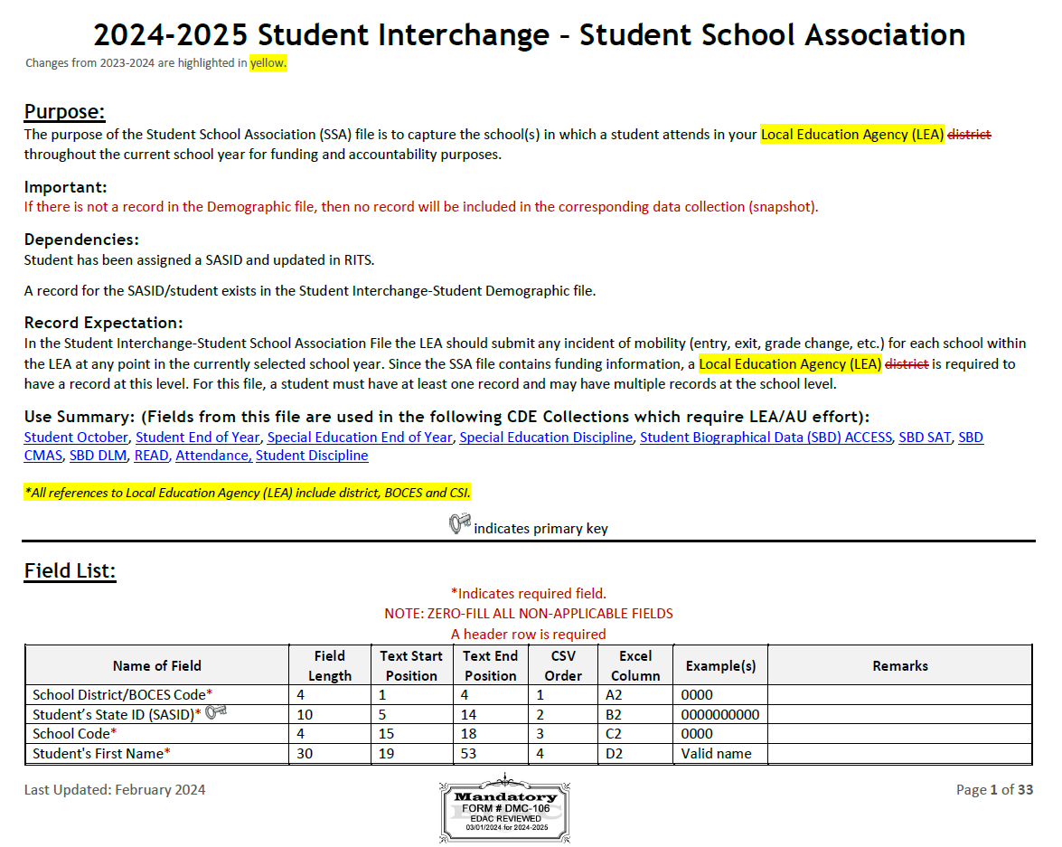
2024-2025 Student School Association
Definition Updates
Added 4 new yes/no fields for Alternative Instruction Courses (in response to PSF Act 1 CCR 301-39)
Independent Study Course
Work-Based Learning Opportunity Course
Blended Learning Course
Supplemental Online Course
2024-2025 Student Interchange – Brooke Wenzel
StudentOctober@cde.state.co.us

Slide 55
2024-2025 Graduation Guidelines and 2024-2025 Adjustment
Graduation Guidelines
Used during Student End of Year
Adjustment
Only used in specific circumstances during the Student End of Year Collection
Opens in May with the start of the Student End of Year Collection
2024-2025 Student Interchange – Brooke Wenzel
StudentOctober@cde.state.co.us

Slide 56
Student Interchange Timeline Document
Recommended Timeline under “Deadlines” on Student Interchange Website
Broad overview of the Student Interchange and how it is utilized throughout the year for data collections.
Has each month listed with prior year collection information (2023-2024) and current year collection information (2024-2025)
July shown as example:
2024-2025 Student Interchange – Brooke Wenzel
StudentOctober@cde.state.co.us

Slide 57
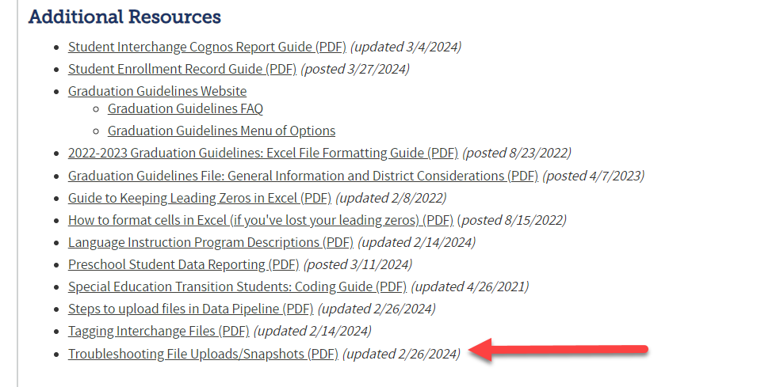
Troubleshooting File Uploads/Snapshots Document
Document posted under “Additional Resources” on Student Interchange Website
Goes through how to troubleshoot a file that fails to upload or a snapshot that fails to process
This process is close to what Collection Leads do when troubleshooting failed uploads!
Tons of screenshots of Data Pipeline emails and what to look for
2024-2025 Student Interchange – Brooke Wenzel
StudentOctober@cde.state.co.us

Slide 58
Student Interchange Summer Office Hours
Two identical Office Hours
July 24th, 10:00 – 11:30 a.m.
August 15th, 1:00 – 2:30 p.m.
Registration Links can be found on the Student Interchange Website under “Training”
Target Audience: New Respondents/Those who want a better understanding
Student Interchange Overview/Introduction
Resources
Fields
Errors at Interchange level
Year-round Uploads
What collections pull from Interchange
Data Pipeline
SIS Extraction
Uploading
Error Checking
Re-Uploading Interchange Files
2024-2025 Student Interchange – Brooke Wenzel
StudentOctober@cde.state.co.us

Slide 59
Questions & Resources: 2024-2025 Student Interchange
Brooke Wenzel
StudentOctober@cde.state.co.us
720-441-7963
Student Interchange Webpage

Slide 60
Attendance
Brooke Wenzel

Slide 61
Attendance Timeline
Date | Event | Event Description
04/17/2024 | Open | Districts may begin creating snapshots. Attendance Snapshot dependencies are the Student Demographic File and Student School Association File.
05/08/2024 10:30-12:00 p.m. | Training Event | Collection Overview Training
05/09/2024 | Interim Deadline | Upload Student Demographic and Student School Association Files
05/28/2024 | Interim Deadline | Create an initial Attendance Snapshot
06/12/2024 | Interim Deadline | Error free Student Interchange file uploads
06/26/2024 | Interim Deadline | Error free Attendance Snapshot
07/05/2024 | Report Review | Review Attendance Cognos Reports for data validation. Submit Attendance Snapshot data as soon as review is complete.
07/12/2024 | Deadline | Submit Attendance Snapshot data.
07/26/2024 | Deadline | Collection closes Superintendent Verification (sign-off) form due. Data remains embargoed until the official release in August.
08/16/2024 | Data Release | Official data release
See the Attendance website for collection timeline
Attendance – Brooke Wenzel
Attendance@cde.state.co.us

Slide 62
Quick Guide for Attendance Reporting
All attendance student-level data will be reported in the Student Interchange: Student School Association File
You need the STD~LEA User role to make any updates to the Student files OR
You will need to work with the Student Interchange respondent to make updates during the Attendance snapshot process
IDM Roles – Can be assigned by your LAM (Local Access Manager)
ATS roles have automatically been assigned to those that had SDA roles
You will need at least 1 person in your district assigned to LEAPPROVER
Application | Collection | Role | Internal Name
Pipeline | Student Interchange | LEA USER | -STD~LEAUSER
Pipeline | Attendance | LEA USER or APPROVER | -ATS~LEAUSER -ATS~LEAAPPROVER
Attendance – Brooke Wenzel
Attendance@cde.state.co.us

Slide 63
Creating Attendance Snapshot
Attendance Snapshot is now located under Student Profile!
Select Student Profile then Snapshot
Fill out prompts for Attendance (File Type: Attendance, School Year: 2023-24, Organization/LEA should auto-fill)
Attendance – Brooke Wenzel
Attendance@cde.state.co.us

Slide 64
AS020 – Issue Resolved!
You can use the Cognos Error Report or Pipeline Error Report if you are receiving this error.
Please reach out to me if you run into any other issues – big move from SDA to STD and we could have missed something!
Attendance – Brooke Wenzel
Attendance@cde.state.co.us

Slide 65
Attendance Training
2023-2024 Collection Overview
May 8th, 2024
10:30-12:00 p.m.
Login information is posted on the Attendance Website under Training
Attendance – Brooke Wenzel
Attendance@cde.state.co.us

Slide 66
Questions & Resources: Attendance
Brooke Wenzel
Attendance@cde.state.co.us
720-441-7963
Attendance Webpage
Student Interchange Webpage

Slide 67
Thank you for joining today!
Next Town Hall will be May 2nd
Missed a town hall?
Check out the Archived Town Hall Presentation site.
Archived agendas, presentations, and recordings posted for the last three months.

Slide 68
Collection Email Addresses
Additional support has been added to help manage emails for the CDE Team
Some emails may be signed as "Technical Help Support"
The data collection leads you know, and trust are:
Still responding and signing their names as needed
Training & assisting the Technical Help Support staff
Note: These email addresses are also posted on the Data Pipeline website and Contact list for reference
Data Collection | Email Addresses
Attendance | Attendance@cde.state.co.us
Directory | DirectoryData@cde.state.co.us
EDIS | EDIS@cde.state.co.us
Human Resources | HumanResourcesData@cde.state.co.us
READ Collections | ReadActData@cde.state.co.us
Report Card March | ReportCard@cde.state.co.us
RITS | RITS@cde.state.co.us
Special Ed December Count | SpedDecCount@cde.state.co.us
Special Ed Discipline | SpedDiscipline@cde.state.co.us
Special Ed End of Year | SpedEndOfYear@cde.state.co.us
Staff Evaluation | StaffEvaluation@cde.state.co.us
Student Discipline Snapshot | StudentDiscipline@cde.state.co.us
Student End of Year | StudentEndOfYear@cde.state.co.us
Student October Count | StudentOctober@cde.state.co.us
Teacher Student Data Link | TeacherStudentDataLink@cde.state.co.us

