Slide 1
March 13, 2025
Data Pipeline Town Hall
The goal of the webinar is to provide updates on the Data Pipeline, current, and upcoming data collections. These webinars also provide a forum for districts, BOCES, and Administrative Units to have questions answered about Data Pipeline.

Slide 2
Colorado Department of Education
Identity Management (IdM)
Identity Management Site
Frequently Asked Questions
How do I add myself or others to the email listserv for town hall emails and/or a specific collection?
  Email lists are dependent on a person’s access rights in IdM. Contact your LAM to get an account or be assigned to a specific collection.
Where can I find the IdM role mappings for Data Pipeline and other applications?
  Role Mapping (XLS)
I am a LAM. How do I update the user permissions for someone in my district?
  Follow the steps outlined in the IdM Quick Guide for Access Management (DOCX)
Important: Users are not automatically removed from IdM when their email address is no longer active in your district. The LAM must deactivate their IdM account to ensure only designated staff can access CDE’s data reporting system.
Notes:
LAMs, please check the IdM roles for your district. Remove permissions for users who have retired, left your district, or are no longer assigned to a collection. Add roles for new hires and newly assigned respondents for specific collections.

Slide 3

What is PII?
Student and Staff Personally Identifiable Information (PII) is defined by state and federal laws as information that, alone or in combination, personally identifies an individual
  This includes direct identifiers
  (i.e. student and staff names, SASID, EDID, etc.)
  Includes information that when combined is identifiable
Colorado’s Student Data Transparency and Security Act outlines requirements for how Student PII is collected, used and shared
See the Data Privacy and Security website for prepared guidance on how to comply with this and other privacy laws.

Slide 4

Sharing Data
Use secure methods to transfer any PII to CDE
  Contact Data Collection leads with questions about how to transmit PII securely
    Each Data Collection leads maintains their own Syncplicity folders for specific collections, reach out to the collection lead for access
  Use Syncplicity to encrypt emails to CDE
Avoid sending PII via unencrypted email or to unsecured faxes when sharing data between or within districts
  Use Syncplicity to encrypt emails to CDE
Check local policies for restrictions, requirements, etc. regarding PII
  Do not use PII in trainings, presentations, etc.
  Do not share PII with unauthorized individuals
  Do not share passwords
  Follow local policies when transmitting PII to any third party

Slide 5
Today’s Agenda
Agenda Topic | Presenter
Open Data Collections and Upcoming Deadlines in Data Pipeline | Host: Dawna Gudka
SBD Collections | Leon Merker
Teacher Student Data Link | Peter Hoffman
Reduced Academic Calendar | Jessica Tribbett
Report Card March | Jessica Tribbett
School Code Review Committee | Jessica Tribbett
RITS Web Update | Jessica Tribbett
Student Discipline | Dawna Gudka
Student End of Year | Reagan Ward

Slide 6
Open Collections and
Upcoming Deadlines in
Data Pipeline

Slide 7
Open Collections and Upcoming Dates:
Year-Round & Interchanges
Name | Category | Status | Key Dates
RITS | Year Round | Open | N/A
EDIS | Year Round | Open | N/A
Directory | Year Round | Open | Reduced Academic Calendar: 2/5/2025 to 5/9/2025 School Code Change Requests: 2/5/2025 to 6/30/2025
Student | Interchange | Open | March Recommendation: Update DEM & SSA files, load GG file
At-Risk | Interchange | Closed | N/A
Title I | Interchange | Open | May 2025: Update file in preparation for SEY and ATS reporting
Special Education IEP | Interchange | Open | Special Education EOY Snapshot opens by 5/1/2025
Staff | Interchange | Open
Discipline Action | Interchange | Open | This interchange file is needed for Student Discipline Snapshot and Special Education Discipline Snapshot Collections
Teacher Student Data Link | Interchange | Open | Upload an interchange file at least once by 5/16/2025
Data Pipeline Resources: Data Pipeline Collection Dates (XLS)

Slide 8
Open Collections and Upcoming Dates:
Snapshots
Name | Category | Status | Final Deadline Date | Next Milestone | Looking Ahead
Human Resources | Snapshot | Closed | Feb. 21, 2025
Teacher Student Data Link | Snapshot | Open | Aug. 29, 2025 | Upload an interchange file at least once: 5/16/2025
Student End of Year | Snapshot | Coming Soon | Dec. 2, 2025 | Soft Open (Optional Phase): 3/31/2025 to 4/24/2025 | Training Event: Collection Overview Training—option 1 of 2 4/2/2025, 9:00-11:00am
Special Education Discipline | Snapshot | Coming Soon | Aug. 1, 2025 |  | Snapshot Opens: 5/1/2025
Special Education EOY | Snapshot | Coming Soon | Oct. 3, 2025 |  | Snapshot Opens: 5/1/2025
Data Pipeline Resources: Data Pipeline Collection Dates (XLS)

Slide 9
Open Collections and Upcoming Dates:
Periodic
Name | Category | Status | Final Deadline Date | Next Milestone | Looking Ahead
Summer EBT | Periodic | Closed | Feb. 28, 2025 | Collection Closes: 2/28/2025 LEAs must submit an error-free file | Corrections Period: 5/9/2025 to 9/3/2025
SBD WIDA ACCESS for ELLs | Periodic | Coming Soon | Mar. 26, 2025, 5pm | Collection Opens: 3/17/2025 | Training: 3/1/2025, 1pm
Report Card March | Periodic | Open | Apr. 11, 2025 | Collection Opens: 3/5/2025
Alternative Education Campus | Periodic | Coming Soon | Jun. 27, 2025 | Application/Renewal File: 3/19/25 to 4/25/25 Planned Measures File: 3/19/2025 to 6/27/2025 | Actual Measures File: 5/19/25 to 6/27/25
Data Pipeline Resources: Data Pipeline Collection Dates (XLS)

Slide 10
SBD Collections
Leon Merker

Slide 11
Introductions
Leon Merker
  SBD Collection Lead, Primary SBD support
  Merker_l@cde.state.co.us
Jasmine Carey
  Back up SBD Collection Lead, SBD support
  Carey_j@cde.state.co.us
SBD Collections
sbdsupport@cde.state.co.us

Slide 12
Student Biographical Data (SBD) Timeline
SBD Collections
  There are four collections, one for each assessment vendor
  Details are in the Periodic Collections on the Data Pipeline page
    Documents are currently available for WIDA ACCESS SBD
    Timelines are subject to change; please make sure you have users in each collection group to receive emails about the specific collection
 | Assessment | Data Pipeline Group | SBD Review Window
1 | ACCESS for ELLs® ACCESS for ELLs Alternate | ACC | March 17 – 26, 2025
2 | Colorado PSAT/SAT | SAT | May 13 – 21, 2025
3 | Colorado Measures of Academic Success (CMAS): Mathematics, ELA, CSLA, Science and Social Studies Colorado Alternate (CoAlt): Science and Social Studies | CMS | May 15 – 28, 2025
4 | Colorado Alternate (CoAlt): English Language Arts and Mathematics (Dynamic Learning Maps) | DLM | May 28 – June 4, 2025
SBD Collections
sbdsupport@cde.state.co.us

Slide 13
WIDA ACCESS For ELLs SBD
WIDA ACCESS for ELLs is the English Language Proficiency assessment.
Students classified as Non-English Proficient (NEP) or Limited English Proficient (LEP) are required to take WIDA ACCESS. No other students take this assessment.
The assessment is offered in all grades, K-12.
There is an alternate version (Alt-ACCESS) used for students with significant cognitive disabilities.
The testing window starts in January, so the data clean up is earlier than other state assessments.
SBD Collections
sbdsupport@cde.state.co.us

Slide 14
Preparing for WIDA ACCESS SBD
  Download and review all of the documentation on the Data Pipeline Collection Page
      File Layout
      SBD Manual – if you have never done an SBD review please review the manual before you start working on the collection
      Business Rules
      Failsafe Template (if needed to move a student to another district)
  Review the training powerpoint, or watch the training webinar
  Make sure you have the ACC group in IDM and have at least one district data respondent with the LEA Approver role
    Remove users who are no longer with your district
SBD Collections
sbdsupport@cde.state.co.us

Slide 15
Changes to the collection for 2025
Additional Valid Value for the Did Not Test Reason code
  Valid values are:
    00 – Absent: Used only for students who were absent for the entire testing window but did not withdraw from the school
    03 – Withdrew Before Testing: The student left the district before they started testing.
    04 – Student Refusal: The student refused to begin testing all domains when the opportunity was provided.
    07 – Medical Exemption
    08 – Part-time Home School Student: New for 24-25, CDE was instructed to include home options school students
    10 – Did Not Attend: The student was not absent but did not attend a scheduled/rescheduled test session for any domain
    11 – Data Error: There was an error in the data submitted at October Count and the student is not NEP or LEP.
  Reminder: There is no participation component in Accountability for WIDA ACCESS. Parent Opt-out is not allowed by law.
SBD Collections
sbdsupport@cde.state.co.us

Slide 16
Contact Information
Contact SBD Support with any questions:
Email: sbdsupport@cde.state.co.us
Phone: 720.696.0185
Please do not use the general CDE Help Desk!
Remember not to send PII by email or on voicemail because an email will be autogenerated.
WIDA SBD Website
SBD Collections
sbdsupport@cde.state.co.us

Slide 17
Questions & Resources:
SBD Collections
sbdsupport@cde.state.co.us
SBD WIDA ACCESS for ELLs
SBD PSAT9, PSAT10, and SAT
SBD CMAS and CoAlt
SBD Dynamic Learning Maps

Slide 18
Teacher Student Data Link
Peter Hoffmann

Slide 19
2024-2025 TSDL Timeline
Date | Event | Event Description
Friday, May 16, 2025 | Interim Deadline | TARGET: Date by which you should have uploaded the TSDL Upload interchange file at least once
Friday, June 13, 2025 | Interim Deadline | TARGET: Date by which the TSDL Upload interchange should be uploaded and error free.
Friday, June 27, 2025 | Interim Deadline | TARGET: Date by which the TSDL snapshot should be created at least once.
Friday, August 22, 2025 | Interim Deadline | TARGET: Date by which you should have a complete Teacher Student Data Link Snapshot. Complete Teacher Student Data Link Snapshot means: All TSDL interchange errors are resolved All TSDL snapshot errors are resolved If you anticipate that you will not be able to meet this deadline, please contact CDE at TeacherStudentDataLink@cde.state.co.us
Monday, August 25, 2025 – Thursday, August 28, 2025 | Report Review | Final Snapshot Report Review – This is your opportunity to review reports in detail and make any data corrections you deem necessary to make sure you are reporting valid and reliable data. All data corrections must be completed during this time.
Friday, August 29, 2025 | Deadline | Required to have TSDL snapshot error free and finalized before or on this date. TSDL closed and final report is signed and provided to CDE via email TeacherStudentDataLink@cde.state.co.us
Teacher Student Data Link
TeacherStudentDataLink@cde.state.co.us

Slide 20
TSDL IdM Roles
TSDL Snapshot Now Open
Teacher Student Data Link Interchange Roles:
  TSL~ LEAUSER – upload and modify TSDL interchange files OR
  TSL~LEAVIEWER – view (only) TSDL interchange data
Teacher Student Data Link Snapshot Roles:
  TLS~LEAAPPROVER – Approves, creates, views Snapshot OR
  TLS~LEAUSER - creates, views Snapshot OR
  TLS~LEAVIEWER- views snapshot
Please note the swapped letters in the prefix TLS vs TSL
  Often, users are given 2 roles with the TLS prefix in error which does block access
  “S” at the end is for “Snapshot”
Teacher Student Data Link
TeacherStudentDataLink@cde.state.co.us

Slide 21
TSDL Snapshot Updates 2024-2025
2024-2025 TSDL data will be utilized as a part of 9th grade success reporting. Please ensure that your course completion status field is being calculated / populated correctly.
  Link to Colorado Legislature HB24-1282
Various Demographic Information Pulled in from Student Interchange for 9th Grade Success Reporting – Race/Ethnicity, ELL, Special Education, and Foster Status
New field – Second grade 9th grader. If SASID is present in previous years TSDL with 090 grade, this will flag as yes (1).
Teacher Student Data Link
TeacherStudentDataLink@cde.state.co.us

Slide 22
Tips for 2024-2025
Common Errors:
  Local Course Title Field (column D2) is where we see the most common error that prevents an upload into pipeline. If there are commas in your local course title this will cause a shift in data.
  TD087 – Course Completion Status must be valid
    This may be flagging for courses that are still in progress
    Double check what semester the error is flagging for – if it is for the first half of the year corrections may be needed. If it is for current classes, it may resolve once the school year ends.
Teacher Student Data Link
TeacherStudentDataLink@cde.state.co.us

Slide 23
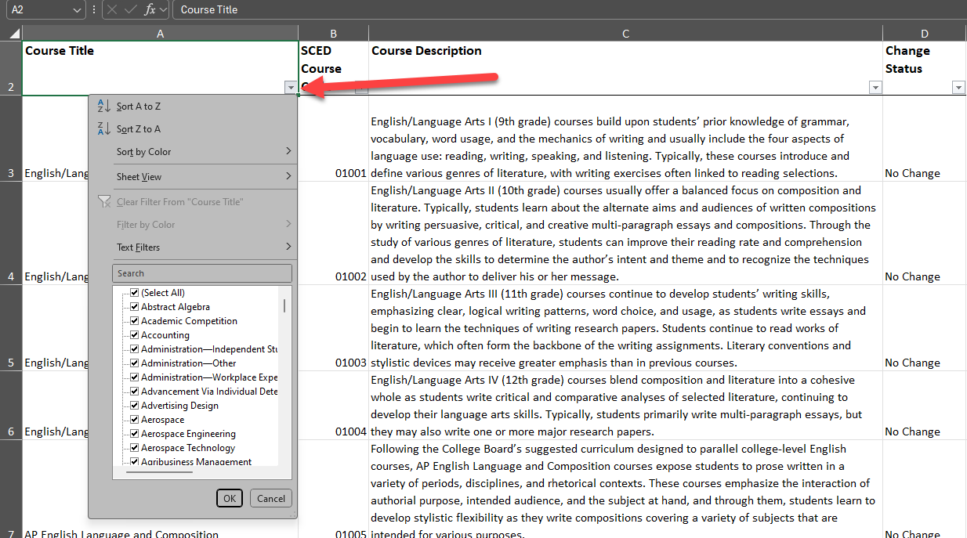
Tips for 2024-2025 – SCED Codes
Update courses in your SIS with accurate SCED Codes, latest SCED code file can be found at the NCES SCED website.
Utilize the course title dropdown to find a course title that is similar to your local course title.
Broader / more generic searches will give more options - ex. “Algebra” or “Computer Science”
Teacher Student Data Link
TeacherStudentDataLink@cde.state.co.us

Slide 24
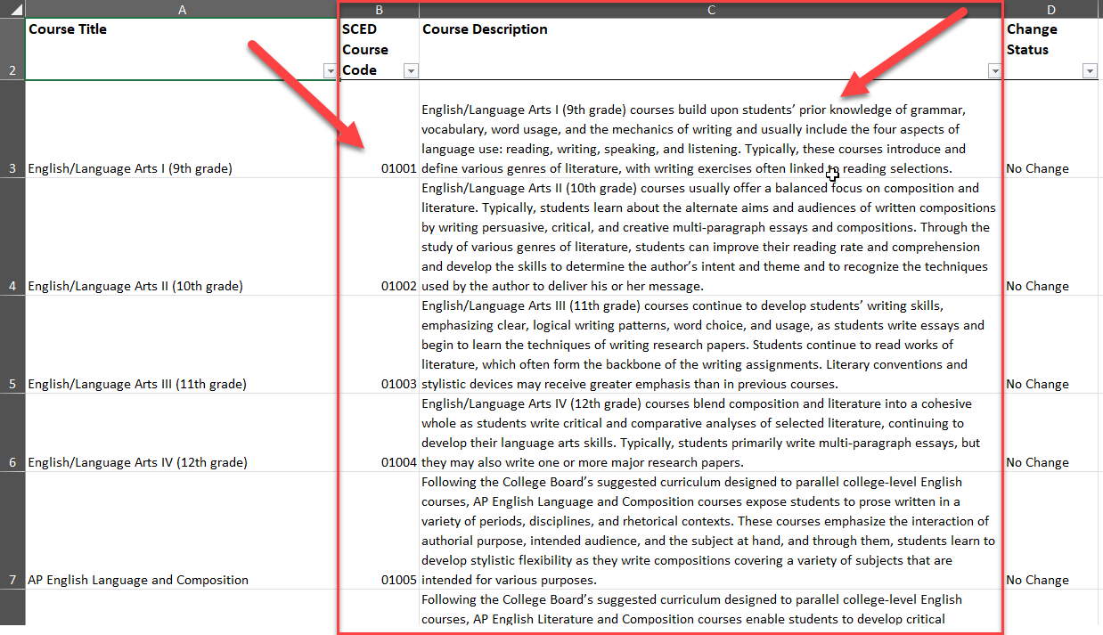
Tips for 2024-2025 – SCED Codes Continued
Update courses in your SIS with accurate SCED Codes, latest SCED code file can be found at the NCES SCED website.
Once you have narrowed down the choices, use the course description that most closely matches your districts local course description and use that SCED course code.
Teacher Student Data Link
TeacherStudentDataLink@cde.state.co.us

Slide 25
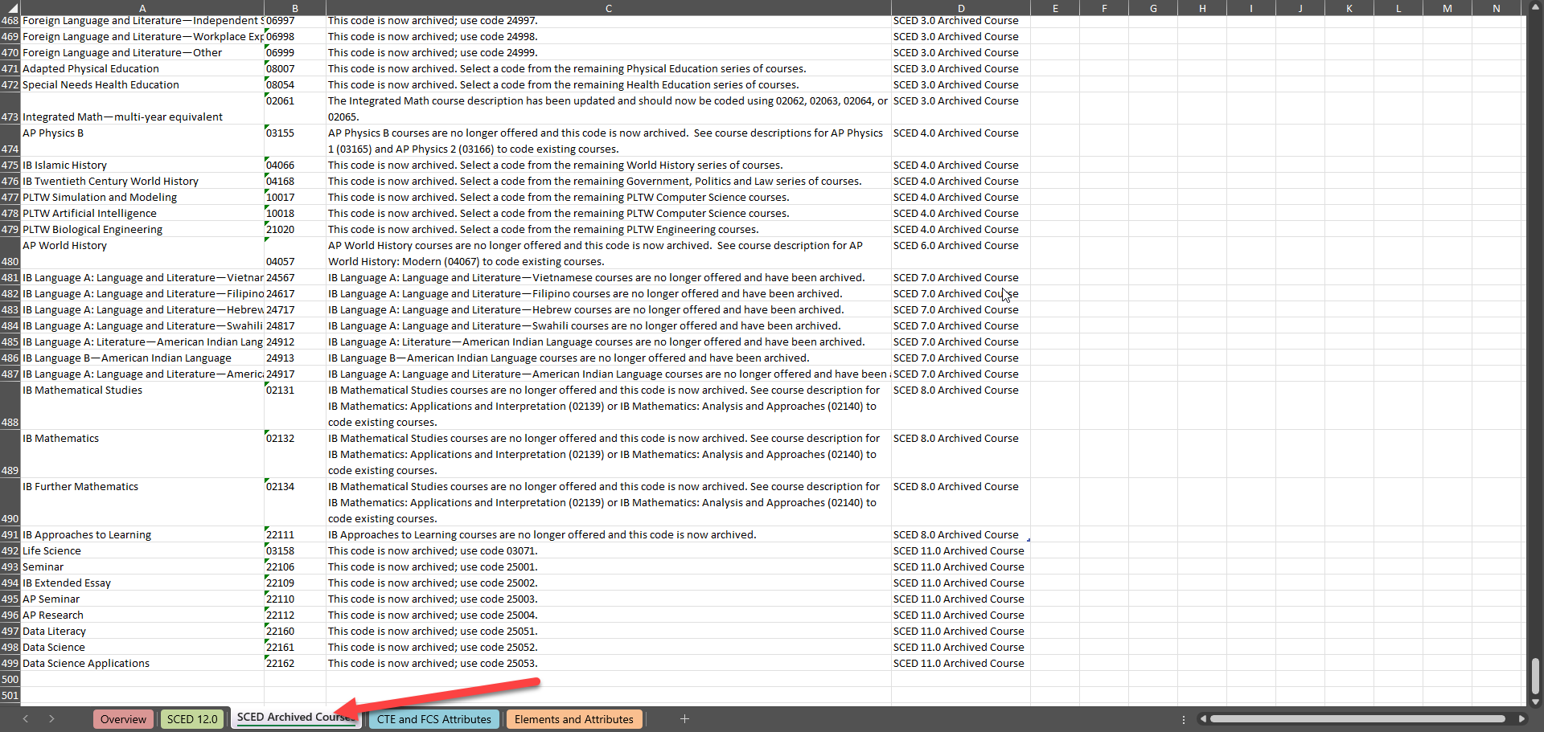
Tips for 2024-2025 – Archived SCED Codes
Update courses in your SIS with accurate SCED Codes, latest SCED code file can be found at the NCES SCED website.
If you are getting errors on SCED codes that you think are valid, double check the archived courses tab to see if the code has be replace with a newer one.
Teacher Student Data Link
TeacherStudentDataLink@cde.state.co.us

Slide 26
Questions & Resources: TSDL
Peter Hoffman
720-925-8611
Email for the Teacher Student Data Link

Slide 27
Reduced Academic Calendar formally 4 Day School Week
Jessica Tribbett

Slide 28
Reduced Academic Calendar
Reduced Academic Calendar Requests*
*formally 4 Day School Week
Fewer than 160 contact days
2/6/2025 – 5/9/2025
Complete Reduced Academic Calendar Request form in Data Pipeline.
If your district is on a district wide improvement plan, you will need to extra documentation to field services via this webform.
Field services and the commissioner will approve by 6/30/2025 and districts will be notified.
Reduced Academic Calendar
DirectoryData@cde.state.co.us

Slide 29
Questions & Resources:
Reduced Academic Calendar
DirectoryData@cde.state.co.us
Reduced Academic Calendar Website

Slide 30
Report Card March
Jessica Tribbett

Slide 31
Report Card March – Now Open
Report Card March
NOW OPEN!!
Wednesday, March 5th through Friday, April 11th.
IDM Roles Needed
RCM~LEAUSER – Submit and Modify Role
RCM~LEAAPPROVER – Approver Role
New Fields
HB 22-1376
              1.District Wide Climate Survey
              2. Climate Survey Results Posted Publicly
              3. If Posted (Specify)
Report Card March
reportcard@cde.state.co.us

Slide 32
Questions & Resources:
Report Card March
Email:
reportcard@cde.state.co.us
Website:
Report Card March Collection Website

Slide 33
School Code Changes
Jessica Tribbett

Slide 34
School Code Changes - Overview
OPEN!! School Code Changes for 2025-2026
now thru
Monday, June 23rd, 2025
25-26 school year begins Tuesday, July 1st
School Code Changes considered are:
New School Code
School Name Change
School Grade Change
Request for Closing/Merging Schools
School Code Change Requests
tribbett_jessica@cde.state.co.us

Slide 35
Questions & Resources:
School Code Changes
Website:
School Code Change Request Website
Forms:
School Code Change Request Form
Email:
Tribbett_Jessica@cde.state.co.us

Slide 36
RITS Web Update
Jessica Tribbett

Slide 37
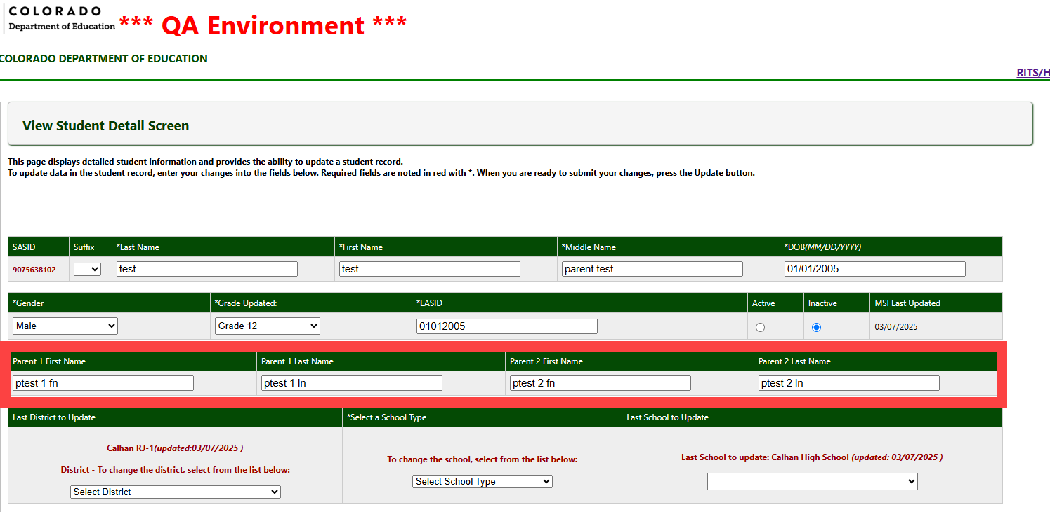
RITS Web Update-
RITS Web
Tribbett_Jessica@cde.state.co.us

Slide 38
Questions & Resources:
RITS Web Updates
Tribbett_Jessica@cde.state.co.us

Slide 39
Student Discipline
Dawna Gudka

Slide 40
Student Discipline
Collection Timeline
Date | Event | Event Description
3/15/2025 | Open | Discipline Action Interchange Open
5/06/2025 | Open | Student Discipline Snapshot Open
5/06/2025 | Interim Deadline | Upload Student Discipline Interchange file at least once
5/09/2025 | Interim Deadline | Update and upload Student Interchange files: Student Demographics and Student School Association Districts are expected to have an upload date of 4/1/25 or later to meet this interim deadline
5/09/2025 | Interim Deadline | Upload Student Discipline Interchange file at least once
6/11/2025 | Interim Deadline | Error free Student Demographics and Student School Association Interchange files
6/21/2025 | Interim Deadline | Create at least one student discipline snapshot
7/08-07/26/2025 | Report Review | Student Discipline Snapshot records error free
7/31/2025 | State Deadline | LEAs should use this time to review reports prior to the deadline. Typically, one week prior to the deadline.
8/9/2025 | State Deadline | Signature page emailed to Student Discipline Snapshot
8/31/2025 | Data Release | Data published
StudentDiscipline@cde.state.co.us

Slide 41
Discipline Action file Example
One Incident resulted in the student being physically restrained and place in seclusion
New Behavior code of 00
Use Discipline Action code of 00
Student Discipline Snapshot
StudentDiscipline@cde.state.co.us

Slide 42
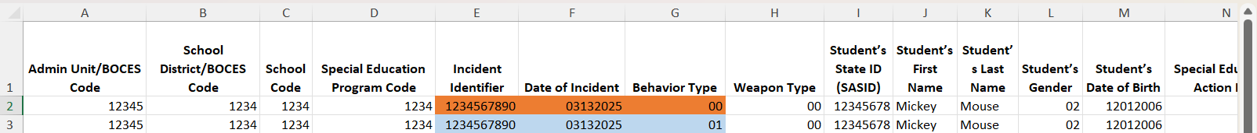
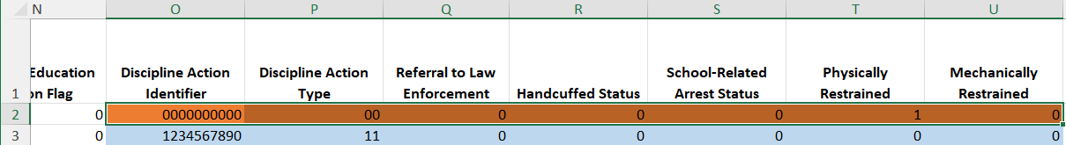
Discipline Action file Example
One Incident student violated a behavior and received in school suspension and student was physically restrained
Two records are required
One record reporting the incident that violated the behavior
One record reporting the student was physically restrained
Student Discipline Snapshot
StudentDiscipline@cde.state.co.us

Slide 43

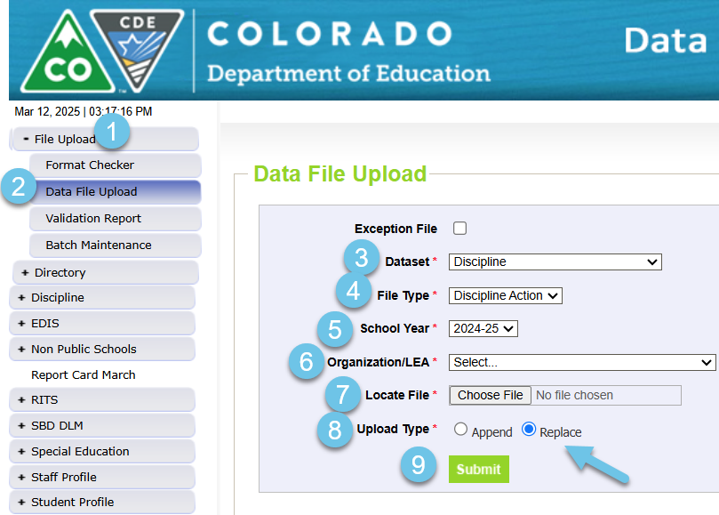
Interchange is now open
Student Discipline Snapshot
StudentDiscipline@cde.state.co.us

Slide 44
Questions & Resources:
Student Discipline Snapshot Collection
Student Discipline Snapshot Collection
Student Discipline Interchange Website
Discipline Action File Layout
Student Discipline Snapshot Timeline
StudentDiscipline@cde.state.co.us
Dawna Gudka-Collection lead
(303) 598-7901

Slide 45
Student End of Year
Reagan Ward

Slide 46
SEY Training
Critical Training
Additional Support
Collection Overview
  Primary training for SEY collection
  Offered in two identical sessions
    4/2, 9-11am
    4/28, 1-3pm
Link: SEY Collection Manual (PDF)
Link: SEY CEDAR/COGNOS Report Guide (PDF)
Sept. & Oct. Office Hours
  9/16 Focus: Cross LEA Phase
  10/21 Focus: Post-Cross LEA Phase
Collaborative Webinar
  Designed for program staff and data staff to attend together
  Special Education 18-21 Transition
    4/22, 1-2pm
Wednesday Office Hours
  Ongoing support
  Select Wednesdays 10:30-11:30am
    5/13, 6/10, 7/15, 8/12, 9/16, 10/21
Short Byte Videos
  Pre-recorded topic-based videos
  Approximately 5 to 15 minutes long
Registration Links and Detailed Training Schedule available on SEY Website
Student End of Year – Reagan Ward
StudentEndofYear@cde.state.co.us

Slide 47
SEY Soft Open Phase
Collection Timeline
Date | Event | Event Description
3/31/2025 | Open | Soft Open Phase Begins: Districts may begin creating snapshots
4/2/2025 | Training Event | Collection Overview Training 1 of 2: This training covers all elements of the Student End of Year collection. This training is being offered in two identical sessions to provide the opportunity for all SEY data respondents to attend a live session. Collection Overview 1 of 2 Registration
4/10/2025 | Other Date | Suggestion: Upload Graduation Guidelines (GG) interchange file and review CEDAR/COGNOS reports. Students expected to graduate in 2024-2025 must have met both English and Math minimum requirements.
4/22/2025 | Training Event | Special Education 18-21 Transition Services This webinar is designed for data respondents and district special education staff who support 18-21 transition services. Secondary Transition Collaborative Webinar Registration
4/24/2025 to 4/30/2025 | Closed | Soft open phase ends and snapshots are closed until the next phase.
4/29/2025 | Training Event | Collection Overview Training 2 of 2: This training covers all elements of the Student End of Year collection. This training is being offered in two identical sessions to provide the opportunity for all SEY data respondents to attend a live session. Collection Overview 2 of 2 Registration
5/1/2025 | Open | Regular Phase Begins: Collection officially opens. Adjustment (ADJ) interchange file opens.
Student End of Year – Reagan Ward
StudentEndOfYear@cde.state.co.us

Slide 48
Soft Open Phase Overview
Optional Phase
Allows districts the chance to get a head-start on student end of year reporting
  Once a snapshot is created, SEY COGNOS reports begin to function for 2024-2025
Some business rules may be updated or created during this phase.
  2024-2025 has a few planned rule refinements, but not many planned changes for business rules
Great time to look for issues where you’ll need input from other colleagues in your district to address the errors
May begin to prepare exception requests, but they won’t be loaded until 5/1/2025 when the regular phase begins
Expect some errors will remain until you complete the year and input final exit types and/or retention codes for students.
Student End of Year – Reagan Ward
StudentEndOfYear@cde.state.co.us

Slide 49
Soft Open Phase: Leveraging Existing Business Rules
Missing Graduation Guidelines: SE301
  Leverage student interchange graduation guidelines reports (summary and completion list) to look for students missing GG records for students not yet indicated as graduates
Missing Student Record: SE049, SE057, SE064, SE292, SE293, SE401, SE404, SE405
October + SEY Enrollment Date Issues: SE060, SE300
October + SEY Demographic/Program Disagreement: SE026, SE163, SE284, SE307
FRL School Level change threshold: SE181, SE182, SE183
  Warnings for individual students: SE234, SE235
Grade Progression: SE090, SE113, SE117, SE242, SE243
English Learner Errors: SE170, SE209, SE309
FRL + Migrant or Foster: SE234, SE235
Many rules focus on Exit/Entry Type agreement in a district
  SEY 2024 exit against SEY 2025 entry
  Exit and entry across multiple enrollment records in 2025
COGNOS/CEDAR report to investigate issues
SASID Lookup: SEY and OCT Prior, Current, Subsequent Year
Student End of Year – Reagan Ward
StudentEndOfYear@cde.state.co.us
Notes:
SE301 pro tip – temporarily mark grade 12 students you expect will be graduates in 2024-2025 as exit type 90 with an exit date, then create a SEY snapshot. Pull a list of all students triggering SE301 to begin communicating with schools regarding missing graduation guidelines data. Then, reupload a SSA file with the current exit date/type for the student to ensure clean interchange data.

Slide 50
Questions & Resources:
Student End of Year
StudentEndOfYear@cde.state.co.us
720-484-9057
  Student End of Year Collection Website
  Student Interchange Website
  Graduation Guidelines (Program) Website

Slide 51
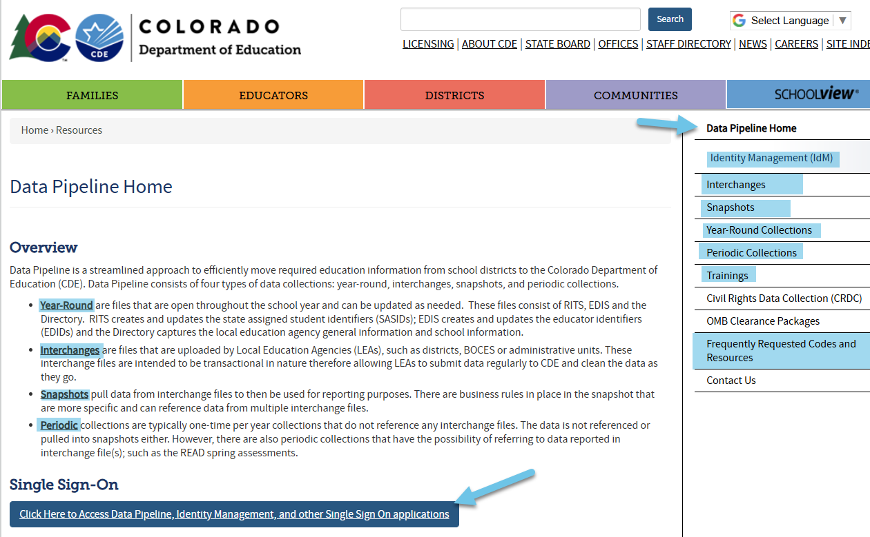
Thank you for Joining Today!
Reminder: Data Pipeline Home Website is a great page to bookmark!
Next Town Hall March 20th

