Slide 1
March 6, 2025
Data Pipeline Town Hall
The goal of the webinar is to provide updates on the Data Pipeline, current, and upcoming data collections. These webinars also provide a forum for districts, BOCES, and Administrative Units to have questions answered about Data Pipeline.

Slide 2
Colorado Department of Education
Identity Management (IdM)
Identity Management Site
Frequently Asked Questions
How do I add myself or others to the email listserv for town hall emails and/or a specific collection?
  Email lists are dependent on a person’s access rights in IdM. Contact your LAM to get an account or be assigned to a specific collection.
Where can I find the IdM role mappings for Data Pipeline and other applications?
  Role Mapping (XLS)
I am a LAM. How do I update the user permissions for someone in my district?
  Follow the steps outlined in the IdM Quick Guide for Access Management (DOCX)
Important: Users are not automatically removed from IdM when their email address is no longer active in your district. The LAM must deactivate their IdM account to ensure only designated staff can access CDE’s data reporting system.
Notes:
LAMs, please check the IdM roles for your district. Remove permissions for users who have retired, left your district, or are no longer assigned to a collection. Add roles for new hires and newly assigned respondents for specific collections.

Slide 3

What is PII?
Student and Staff Personally Identifiable Information (PII) is defined by state and federal laws as information that, alone or in combination, personally identifies an individual
  This includes direct identifiers
  (i.e. student and staff names, SASID, EDID, etc.)
  Includes information that when combined is identifiable
Colorado’s Student Data Transparency and Security Act outlines requirements for how Student PII is collected, used and shared
See the Data Privacy and Security website for prepared guidance on how to comply with this and other privacy laws.

Slide 4

Sharing Data
Use secure methods to transfer any PII to CDE
  Contact Data Collection leads with questions about how to transmit PII securely
    Each Data Collection leads maintains their own Syncplicity folders for specific collections, reach out to the collection lead for access
  Use Syncplicity to encrypt emails to CDE
Avoid sending PII via unencrypted email or to unsecured faxes when sharing data between or within districts
  Use Syncplicity to encrypt emails to CDE
Check local policies for restrictions, requirements, etc. regarding PII
  Do not use PII in trainings, presentations, etc.
  Do not share PII with unauthorized individuals
  Do not share passwords
  Follow local policies when transmitting PII to any third party

Slide 5
Today’s Agenda
Agenda Topic | Presenter
Open Data Collections and Upcoming Deadlines in Data Pipeline | Host: Jessica Tribbett
Civil Rights Data Collection (CRDC) | Annette Severson
SBD Collections | Jasmine Carey/Leon Merker
Reduced Academic Calendar | Jessica Tribbett
Report Card March | Jessica Tribbett
School Code Review Committee | Jessica Tribbett

Slide 6
Open Collections and
Upcoming Deadlines in
Data Pipeline

Slide 7
Open Collections and Upcoming Dates:
Year-Round & Interchanges
Name | Category | Status | Key Dates
RITS | Year Round | Open | N/A
EDIS | Year Round | Open | N/A
Directory | Year Round | Open | Reduced Academic Calendar: 2/5/2025 to 5/9/2025 School Code Change Requests: 2/5/2025 to 6/30/2025
Student | Interchange | Open | February Recommendation: Update DEM & SSA files
At-Risk | Interchange | Closed | N/A
Title I | Interchange | Open | May 2025: Update file in preparation for SEY and ATS reporting
Special Education IEP | Interchange | Open | Special Education EOY Snapshot opens by 5/1/2025
Staff | Interchange | Open
Discipline Action | Interchange | Opening soon | This interchange file is needed for Student Discipline Snapshot and Special Education Discipline Snapshot Collections
Teacher Student Data Link | Interchange | Open
Data Pipeline Resources: Data Pipeline Collection Dates (XLS)

Slide 8
Open Collections and Upcoming Dates:
Snapshots
Name | Category | Status | Final Deadline Date | Next Milestone | Looking Ahead
Human Resources | Snapshot | Closed | Feb. 21, 2025
Teacher Student Data Link | Snapshot | Open | Aug. 29, 2025 | Interchange Opened: 12/11/2024 | Snapshot Open
Student End of Year | Snapshot | Coming Soon | Dec. 2, 2025 | Soft Open (Optional Phase): 3/31/2025 to 4/24/2025 | Training Event: Collection Overview Training—option 1 of 2 4/2/2025, 9:00-11:00am
Special Education Discipline | Snapshot | Coming Soon | Aug. 1, 2025 |  | Snapshot Opens: 5/1/2025
Special Education EOY | Snapshot | Coming Soon | Oct. 3, 2025 |  | Snapshot Opens: 5/1/2025
Data Pipeline Resources: Data Pipeline Collection Dates (XLS)

Slide 9
Open Collections and Upcoming Dates:
Periodic
Name | Category | Status | Final Deadline Date | Next Milestone | Looking Ahead
Summer EBT | Periodic | Closed | Feb. 28, 2025 | Collection Closes: 2/28/2025 LEAs must submit an error-free file | Corrections Period: 5/9/2025 to 9/3/2025
SBD WIDA ACCESS for ELLs | Periodic | Coming Soon | Mar. 26, 2025, 5pm | Collection Opens: 3/17/2025 | Training: 3/1/2025, 1pm
Report Card March | Periodic | Open | Apr. 11, 2025 | Collection Opens: 3/5/2025
Alternative Education Campus | Periodic | Coming Soon | Jun. 27, 2025 | Application/Renewal File: 3/19/25 to 4/25/25 Planned Measures File: 3/19/2025 to 6/27/2025 | Actual Measures File: 5/19/25 to 6/27/25
Data Pipeline Resources: Data Pipeline Collection Dates (XLS)

Slide 10
Civil Rights Data Collection (CRDC)
Annette Severson

Slide 11
Updates from The Office of Civil Rights (OCR)
Notification letters were sent last week by OCR with status for each district.
OCR has extended the reporting period for submitting and certifying the required CRDC data.
The new and final deadline is now Monday, April 7, 2025.
Civil Rights Data Collection
severson_a@cde.state.co.us

Slide 12
Questions & Resources: CRDC
Visit our new Data Submission Resource Center:
For fastest responses, always use the PSC Contact Us form
Please only reach out once. Follow-up outreach will delay response times.
Need special accommodations? Please call us at: (855) 255-6901

Slide 13
SBD Collections
Jasmine Carey
Leon Merker

Slide 14
Introductions
Jasmine Carey
  Back up SBD Collection Lead, SBD support
  Carey_j@cde.state.co.us
Leon Merker
  SBD Collection Lead, Primary SBD support
  Merker_l@cde.state.co.us
SBD Collections
Merker_L@cde.state.co.us

Slide 15
What is the SBD Review?
SBD reviews provide districts with a final opportunity to verify the accuracy of student level demographic and testing administration data for all grades 3-11 state administered assessments prior to public reporting and accountability calculations.
The data being reviewed during SBD comes from the systems of the vendors who administer the assessment. SBD review gives a final opportunity to review the data within the CDE Data Pipeline system and provides additional checks such as State Student Identifier validation.
Once the review is complete, the data for districts that completed their review are updated and loaded back into the vendor system. The updated data are then used in the final data files and reports, as well as in public reporting and accountability calculations.
SBD Collections
Merker_L@cde.state.co.us

Slide 16
Student Biographical Data (SBD) Timeline
SBD Collections
  There are four collections, one for each assessment vendor
  Details are in the Periodic Collections on the Data Pipeline page
    Documents are currently available for WIDA ACCESS SBD
    Timelines are subject to change; please make sure you have users in each collection group to receive emails about the specific collection
 | Assessment | Data Pipeline Group | SBD Review Window
1 | ACCESS for ELLs® ACCESS for ELLs Alternate | ACC | March 17 – 26, 2025
2 | Colorado PSAT/SAT | SAT | May 13 – 21, 2025
3 | Colorado Measures of Academic Success (CMAS): Mathematics, ELA, CSLA, Science and Social Studies Colorado Alternate (CoAlt): Science and Social Studies | CMS | May 15 – 28, 2025
4 | Colorado Alternate (CoAlt): English Language Arts and Mathematics (Dynamic Learning Maps) | DLM | May 28 – June 4, 2025
SBD Collections
Merker_L@cde.state.co.us

Slide 17
Trainings
WIDA ACCESS for ELLs training webinar was held this week
  The powerpoint and a recording of the training will posted on the collection webpage soon
Trainings for the other SBD collections will be held in the first week of May
Assessment will continue to attend Townhall and provide updates when documents are available
SBD Collections
Merker_L@cde.state.co.us

Slide 18
Questions & Resources:
SBD Collections
sbdsupport@cde.state.co.us
SBD WIDA ACCESS for ELLs
SBD PSAT9, PSAT10, and SAT
SBD CMAS and CoAlt
SBD Dynamic Learning Maps

Slide 19
Reduced Academic Calendar formally 4 Day School Week
Jessica Tribbett

Slide 20
Reduced Academic Calendar
Reduced Academic Calendar Requests*
*formally 4 Day School Week
Fewer than 160 contact days
2/6/2025 – 5/9/2025
Complete Reduced Academic Calendar Request form in Data Pipeline.
If your district is on a district wide improvement plan, you will need to extra documentation to field services via this webform.
Field services and the commissioner will approve by 6/30/2025 and districts will be notified.
Reduced Academic Calendar
DirectoryData@cde.state.co.us

Slide 21
Questions & Resources:
Reduced Academic Calendar
DirectoryData@cde.state.co.us
Reduced Academic Calendar Website

Slide 22
Report Card March
Jessica Tribbett

Slide 23
Report Card March – Now Open
Report Card March
NOW OPEN!!
Wednesday, March 5th through Friday, April 11th.
IDM Roles Needed
RCM~LEAUSER – Submit and Modify Role
RCM~LEAAPPROVER – Approver Role
New Fields
HB 22-1376
              1.District Wide Climate Survey
              2. Climate Survey Results Posted Publicly
              3. If Posted (Specify)
Report Card March
reportcard@cde.state.co.us

Slide 24
Report Card March – New Fields
District Wide Climate Survey 1 – yes, 0 - no
Climate Survey Results Posted Publicly 1 – yes, 0-no
If Posted (Specify) – Text Field
The climate survey is for students and parents only and does not include teaching conditions surveys.
This can include any survey asking about wellbeing, engagement, satisfaction, emotional / physical safety, sense of belonging.
Report Card March
reportcard@cde.state.co.us

Slide 25
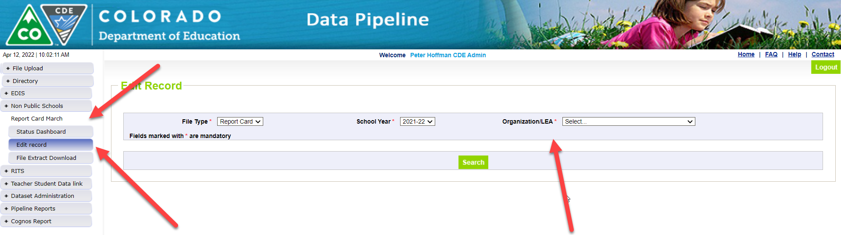
Report Card March – Form Submission
Log in to the Data Pipeline Report Card March Collection
  Click Edit Record tab and select the below fields:
    File Type: Report Card
    School Year: Select current school year
    Organization/LEA: Your LEA should be auto-populated
    School Code: Select 'All Schools' or a specific school code
Report Card March
reportcard@cde.state.co.us

Slide 26
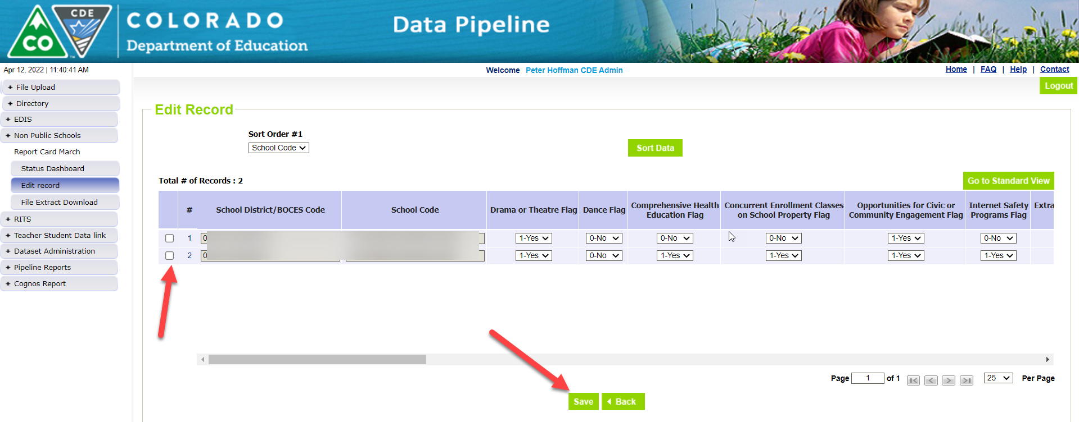
Report Card March – Form Submission Continued – Data Fields
Data Fields for Form Submission
  Select Y/N for all applicable fields.
  Type number of professional development days and COVID Remote Response days in the fields that requests that information, and text in the other fields if applicable
  Be sure to enter information into the new school climate survey fields
Report Card March
reportcard@cde.state.co.us

Slide 27
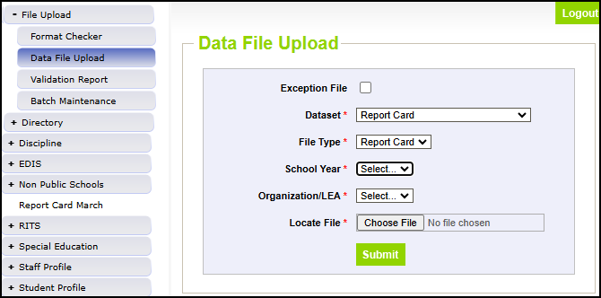
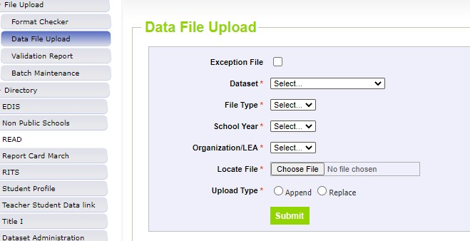
Report Card March – File Submission
Data Pipeline File Upload
You can do any of the following:
1) download the spreadsheet of the prior years’ data and make any needed changes and then re-upload or 2) download the file extract your vendor has established; or 3) use the file upload template on the Report Card March website.
  File extract will have the 3 new climate survey fields 0 filled.
File name should not contain spaces and remember to use the file format checker!
NOTE: If you start out submitting by file you may not change and submit by form. This may result in errors.
Report Card March
reportcard@cde.state.co.us

Slide 28
Additional Notes
Pick one method to submit – either form or file upload
If you start by submitting a file upload and then submit by form, you may encounter errors.
Avoid apostrophes in text fields as it can cause an error with saving / submitting.
For professional development days and COVID remote response days, use only whole or half day numbers.
For half days use .5
For file uploads, use 1 for yes and 0 for no.
Report Card
reportcard@cde.state.co.us

Slide 29
Questions & Resources:
Report Card March
Email:
reportcard@cde.state.co.us
Website:
Report Card March Collection Website

Slide 30
School Code Changes
Jessica Tribbett

Slide 31
School Code Changes - Overview
OPEN!! School Code Changes for 2025-2026
now thru
Monday, June 23rd, 2025
25-26 school year begins Tuesday, July 1st
School Code Changes considered are:
New School Code
School Name Change
School Grade Change
Request for Closing/Merging Schools
School Code Change Requests
tribbett_jessica@cde.state.co.us

Slide 32
School Code Request Process
Review the School Code Change Request website to review information.
Complete the correct School Code Change Request Form.
  Note: More than one request may be needed.
    Example: Grade change may be accompanited by a name change.
Print the confirmaion page and email to your district's superintendent to sign.
Send me the superintendent signed confirmation sheet. This needs to be done for your request to be considered complete and be reviewed by the school code review committee.
School Code Review Committee reviews request. They will either have some follow up questios, alternative scenarios for your district to consider, or approve the request.
I'll contact you with follow up questions or a formal CDE letter of approval for the change.
School Code Change Requests
tribbett_jessica@cde.state.co.us

Slide 33
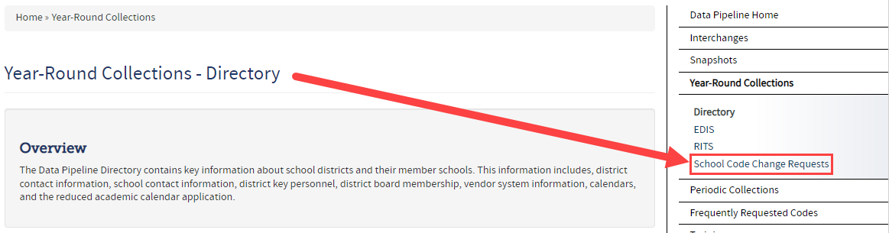
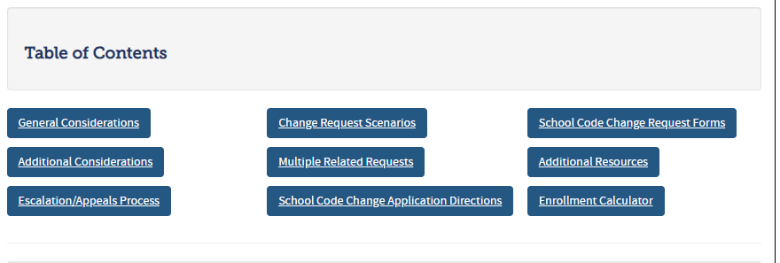
School Code Request Website and Information
School Code Change Request Website
School Code Change Requests
tribbett_jessica@cde.state.co.us

Slide 34
Questions & Resources:
School Code Changes
Website:
School Code Change Request Website
Forms:
School Code Change Request Form
Email:
Tribbett_Jessica@cde.state.co.us

Slide 35
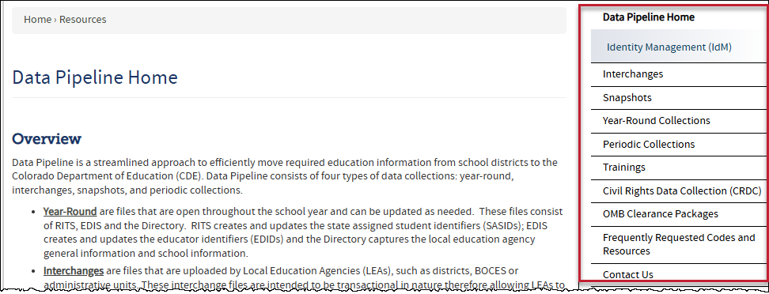
Thank you for joining today!
Next Town Hall will be March 13th
Reminder:
Each data collection has a more detailed timeline, file layout and other helpful resources posted on their corresponding webpage.
Visit the Data Pipeline Homepage to access collection pages.
The navigation menu has been updated too. Check out the new Town Hall page in the Trainings section!

