Slide 1
Student Discipline Collection Overview
2025-2026

Slide 2

Agenda
Collection Purpose & Data Use
Collection Timeline
2025-2026 File Layouts
Data Sources
  What is a Snapshot?
  Interchange Files
Data Pipeline Process
  Prepare
  Collection Steps
  No Discipline Actions
  File Upload
  Create/Update Snapshot
  Business Rules
  Status Dashboard & Submitting Snapshot
Reviewing/Validating Data (CEDAR/COGNOS Reports)
Exceptions
Contact & Resources

Slide 3
Collection Purpose & Data Use

Slide 4
Purpose
The purpose of the Student Discipline (STU) snapshot is to collect behavior and discipline information for students during a school year. This includes demographic information. This data can also be utilized to pre-populate data in the Civil Rights Data Collection file.
The Student Discipline Snapshot includes all students in grades PK-12 who violated a reportable behavior and were disciplined in a Local Education Agency (LEA) at any point during the school year.
Academic Reporting Year: July 1, 2025, through June 30, 2026

Slide 5
Data Uses
Primary Use
Public reporting of behaviors, discipline actions, student counts, demographic breakdowns. (Profile Reports)
Federal Reporting (EdFacts)
  Expulsions with or without services
  Firearms
  Other required student counts such as SPED, race/ethnicity, etc.
Additional Use
  Dropout Prevention
  Legislative reports
  Civil Rights Data Collection (CRDC)
Data Privacy Guidelines
All publicly posted data utilizes privacy guidelines.
Education Statistics Site privacy methods include blurring of cohort/membership base sizes with small populations (all students & subgroups), and limited suppression.
Individual district CEDAR/COGNOS reports available to users with STU access in IdM do not utilize privacy guidelines to allow LEAs to review their data in complete detail.

Slide 6
Data Release Process
Collection closes July 7, 2026
  Data locked; no changes to data are made after this point
  Superintendent verification form due
July through August - CDE internal processes to prepare data for public release
Education statistics based upon the 2025-2026 STU data are embargoed until the public data release in September 2026
  District data available through COGNOS/CEDAR reports
Districts receive a preview of the public data files a few days prior to the public data release
  Sent to STU Data Respondents from the STU Collection Lead
  STU Data Respondents should share with applicable administrative staff within their district
CDE sends out notifications through their communication department when this data is publicly released
  STU Data Collection lead will send an email to data respondents when the embargo has lifted, and data has been publicly released

Slide 7
Collection Timeline

Slide 8
Timeline Overview
November 17 to January 15
Begin uploading discipline action file *Optional*
STU training begins
January 15 to April 8
Discipline Interchange open
Interim deadlines
April 9 to June 11
Student Discipline Snapshot open
Interim deadlines
June 11 to June 30
Report Review
Snapshot submission
July 7
Superintendent Verification Due
September 2026
Data Release
Soft Open
Open
Final Dates
Note: The STU data collection overlaps with many student data collections throughout the cycle. Data respondents who are responsible for multiple collections are encouraged to review the Data Pipeline Collection Dates document posted on the Data Pipeline Resources page to plan accordingly.

Slide 9
Key Dates
Date | Event | Event Description
01/15/2026 | Open | Discipline Interchange opens
01/29/2026 | Other Date | Suggestion: Upload Discipline Action interchange file and review CEDAR/COGNOS reports.
02/24/2026 | Training Event | Student Discipline Collection Training Afternoon Session
03/12/2026 | Interim Deadline | Upload interchange files: Student Demographic (DEM) Student School Association (SSA) These files are expected to have an upload date 03/01/2026 or later to meet this interim deadline
03/12/2026 | Other Date | Suggestion: Coordinate with AU to upload the following interchange files: Special Education Child File (includes EOY data) Special Education Participation File (includes EOY data)
03/19/2026 | Interim Deadline | Upload the initial Discipline Action File
04/09/2026 | Open | Student Discipline Snapshot opens LEAs may create snapshots
04/23/2026 | Interim Deadline | Create initial Student Discipline Snapshot
05/28/2026 | Interim Deadline | Error free interchange files: Student Demographic (DEM) Student School Association (SSA) Discipline Action File These files are expected to have an upload date 05/01/2026 or later to meet this interim deadline
05/28/2026 | Other Date | Suggestion: Coordinate with AU for the following interchange files: Special Education Child File (Error free for students with discipline actions) Special Education Participation File (Error free for students with discipline actions)
06/04/2026 | Other Date | Exception request deadline
06/11/2026 | Interim Deadline | Error free Student Discipline snapshot
06/11/2026 to 06/30/2026 | Report Review | LEAs validate Student Discipline data using CEDAR/COGNOS reports and submit the snapshot
06/30/2026 | State Deadline | Submit Student Discipline snapshot.
07/07/2026 | State Deadline | Superintendent Verification (Sign-Off) form due. Note: Student Discipline snapshot date must be on or after last discipline action file upload and signed verifications must display a printed date on or after the final student discipline snapshot
07/15/2026 | Closed | Collection is no longer available for LEA.
09/2026 | Data Release | Education statistics based upon this collection are publicly released and the embargo is lifted for this dataset.

Slide 10
2025-2026 File Layouts

Slide 11
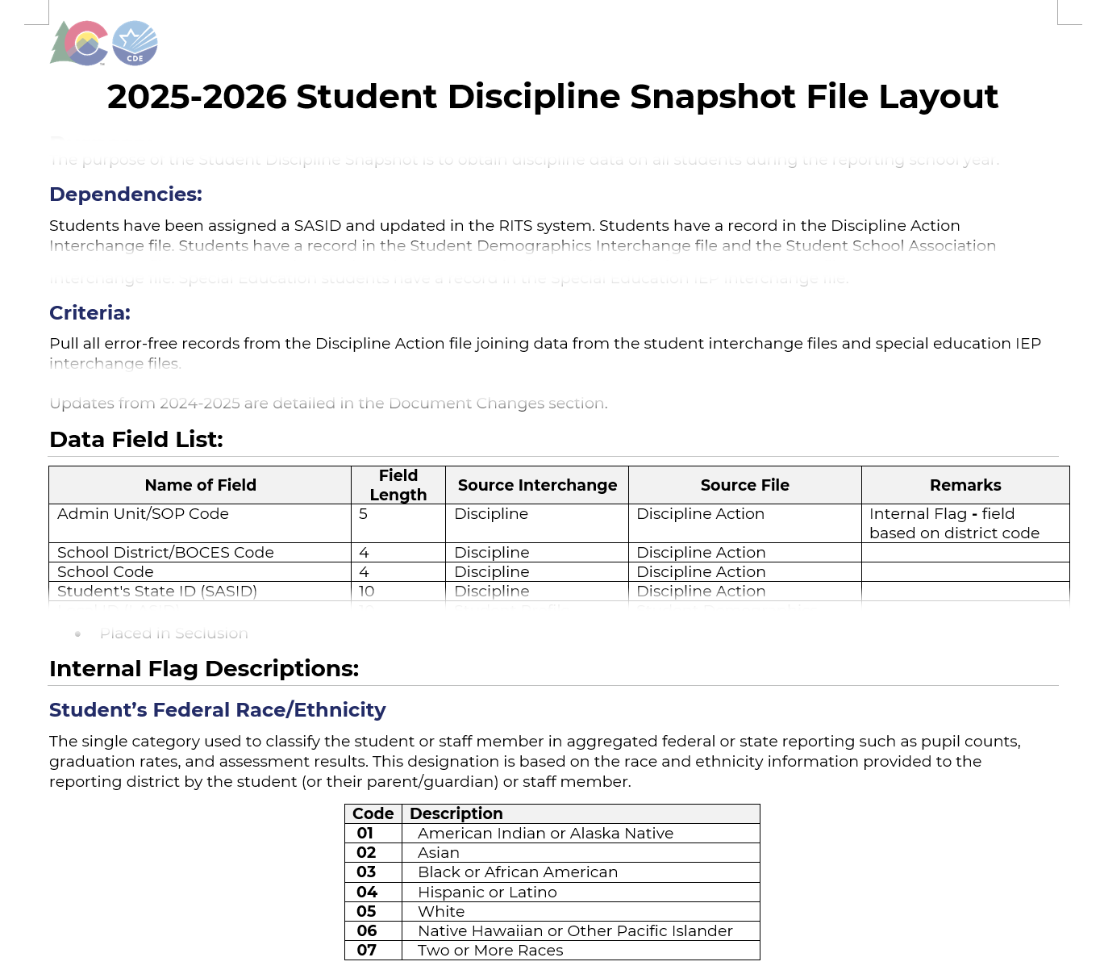
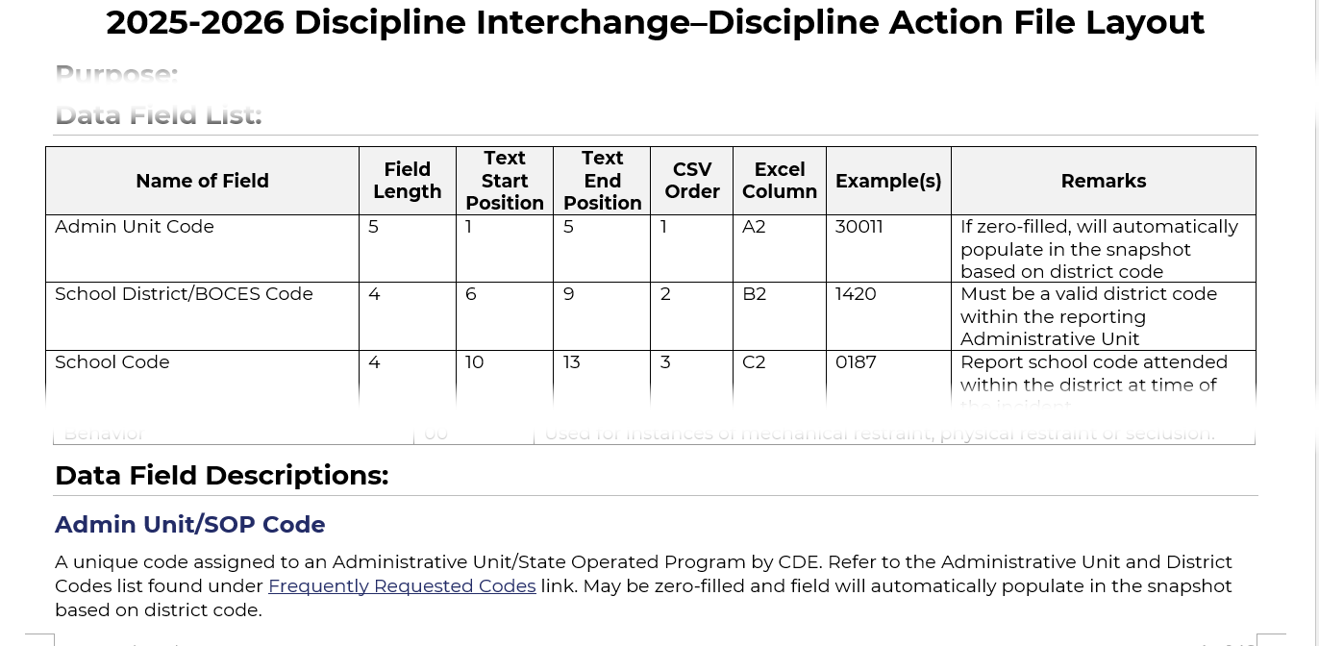
File Layout Example
Interchange File Layout
Provides a list of each data field included on an interchange (source) file with detailed descriptions and codes.
Snapshot File Layout
Dependencies: List of source interchange files needed for the snapshot
Criteria: Rules regarding the types of records pulled from a source file into a snapshot
Data Fields: Includes a list of specific source files for each data field or indicates the field is an internal flag.
Internal Flag Definitions: Provides detailed descriptions of each internal flag data field and codes.

Slide 12
STU Snapshot Dependencies
Student has been assigned a SASID and updated in the RITS system
Student has a record in the discipline interchange
Student has a record in the student interchange for:
  Student Demographics
  Student School Association (may have multiple records)
Student has a record in the IEP interchange if:
  Student is a special education student

Slide 13
STU Snapshot Criteria
Error free interchange records
Enrollment records on the Student School Association file where…
  School Code is a valid public school
Matched records from other source files
  Student Demographic (SASID, District Code, School Year)
  Student School Association
  Special Education IEP Interchange
  Internal lists (SASID, School Year)

Slide 14
2025-2026
Discipline Action File Changes
Data field changes
  Removed
    Physical Restraint
    Mechanical Restraint
    Placed in Seclusion
  Added
    Off Campus Behavior Flag
  Updated
    Discipline Start Date required for all records with a non-zero discipline action type.
    Discipline Action Type must be 00 for CRDC records
Removed Behavior Type Code 00
Updated Record Expectation (clarification)
  Each record represents a student, a behavior and a discipline action.
    An incident is a behavior that leads to discipline action.
    If multiple behaviors are associated with an incident, only the most serious behavior type is reported.
    If multiple discipline actions are associated with an incident, each discipline action is reported.
    Each incident may have multiple records (with a duplicate incident identifier) if more than one student was involved.
    A student may have multiple records if they are involved in multiple incidents or have multiple discipline actions associated with an incident.
Business Rule Refinement
  Moved rules from the Snapshot to the Interchange
    Allows for more timely error correction
  Discipline Action Length and Discipline Start Date checks
  Behavior Type and Discipline Action Type checks
  Additional record requirements for CRDC behaviors

Slide 15
2025-2026
Student Discipline Snapshot Changes
Data field changes
  Removed
    Physical Restraint
    Mechanical Restraint
    Placed in Seclusion
  Added
    Off Campus Behavior Flag
    Free and Reduced Lunch Price Eligible
    Homeless
    Admin Unit/SOP code
    Discipline Start Date
    Special Education Program Code
    Primary Disability
    Date of Entry to Special Education
    Date of Exit from Special Education
Business Rule Refinement
  Added SPED Discipline Snapshot business rules
  Changed SD007 from an Error to a Warning
    No longer requires an exception

Slide 16
Data Sources

Slide 17
What is a Snapshot?

Slide 18
Snapshot (collection): Source Files
A data snapshot begins with uploading the corresponding interchange files. These interchange files become the source of information, or source file for specific data fields on a snapshot.
Source File A
Contains multiple columns of data/information as outlined on the file layout for this source file.
Source File B
Contains multiple columns of data/information as outlined on the file layout for this source file.
File A: Element 1
File A: Element 2
File B: Element 1
File B: Element 2
File A: Element 4
File A: Element 3
File A: Element 5
File B: Element 3
File B: Element 4

Slide 19
Snapshot (collection): Creation
When a snapshot is triggered, it pulls needed information from the source (interchange) files into a new file called the snapshot.
Source File A
Source File B
File A: Element 1
File A: Element 4
File B: Element 1
File B: Element 4
File A: Element 2
File A: Element 3
File A: Element 5
File B: Element 2
File B: Element 3
Snapshot

Slide 20
Snapshot (collection): Internal Flags
Snapshots typically won’t use every data element on a source file.
Snapshots often pull in information called “internal flags.” These are pieces of data from information provided on the interchange files or from other internal data in data pipeline.
Source File A
Source File B
Internal Flags
File A: Element 2
File A: Element 5
File B: Element 3
Internal Flag: 1
Internal Flag: 2
Internal Flag: 3
Snapshot
File A: Element 1
File B: Element 1
File A: Element 3
File A: Element 4
File B: Element 2
File B: Element 4

Slide 21
Interchange Files

Slide 22
Interchange Preparation
Get SASIDs for your new students
  Through RITS or Data Pipeline
  Visit the RITS Website for resources and instructions regarding SASIDs
Extract files from your Student Information System (DIS, DEM, SSA)
  Recommended format is .xls or .xlsx (excel)
    Data Pipeline also accepts .csv
  All data fields must be zero filled or include an applicable code matching the specified field length
  Leading zeros are required for all data fields to maintain the specified field length
    Be careful when opening .csv format in excel to not lose leading zeros
      The newest version of excel has a pop-up asking if you want to keep leading zeros
      CDE has a guide to keeping leading zeros
  Spaces in the file name are not allowed
  Pro Tip: Use a file naming convention as you will likely extract files multiple times. Example: 0110_DIS_04052025.xls

Slide 23
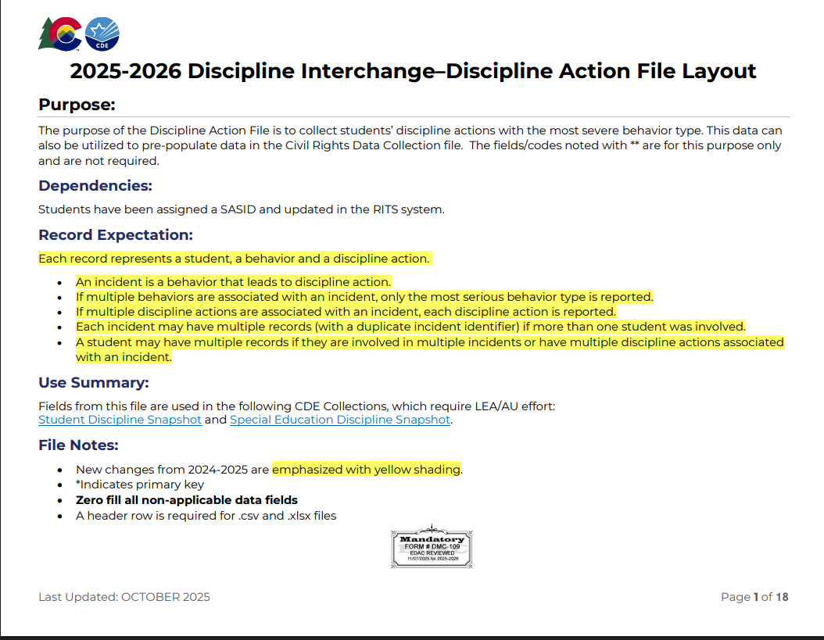
Discipline Action File (DIS)
All data fields in this file are used in the STU snapshot.

Slide 24
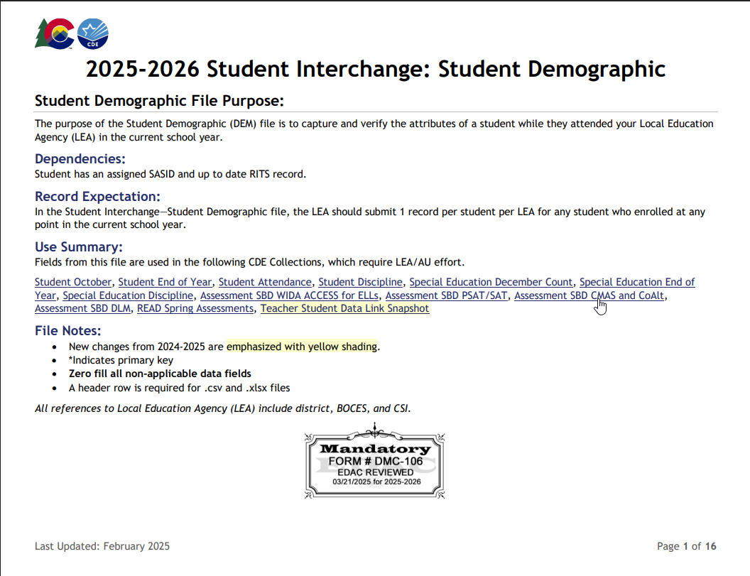
Student Demographic File (DEM)
Many data fields in this file are used in the STU snapshot
One record per student
Captures attributes of a student
  Point in Time: Attribute as of extract date
    Gender
    Race/Ethnicity
    Section 504 Status
  Cumulative: Once true, the attribute remains true entire school year but may change the following year if student no longer qualifies for the service (Additive, but not subtractive).
    Homeless Status
    FRL Status
    Multilingual Learner

Slide 25
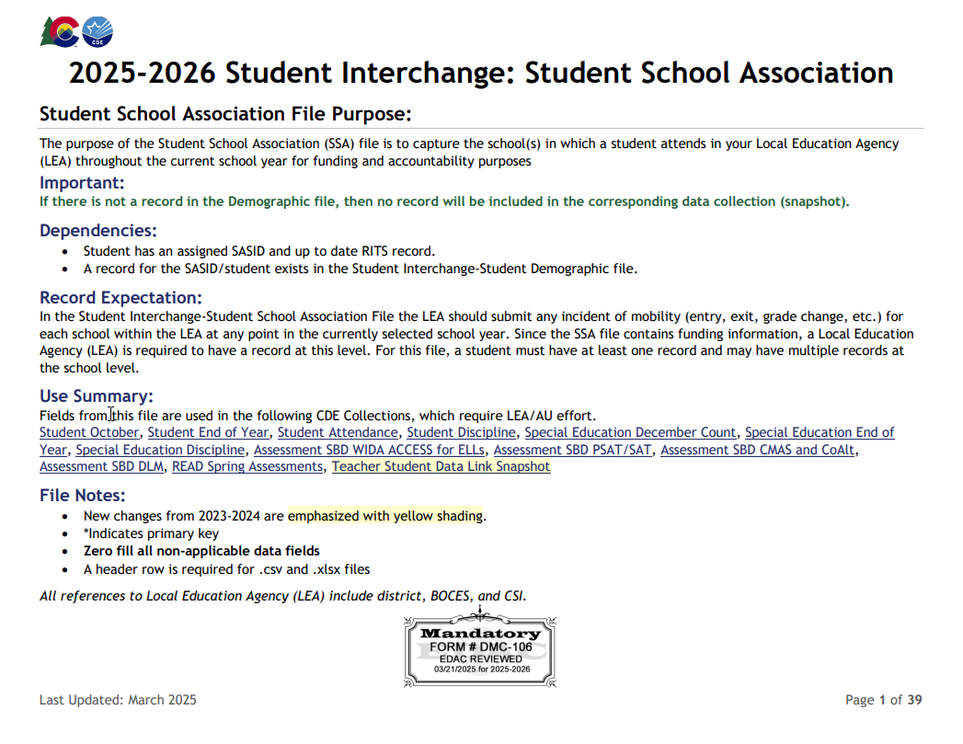
Student School Association File (SSA)
May include multiple records per student
STU is focused on SSA records that capture the timeframe a student was actively attending a school within the LEA.

Slide 26
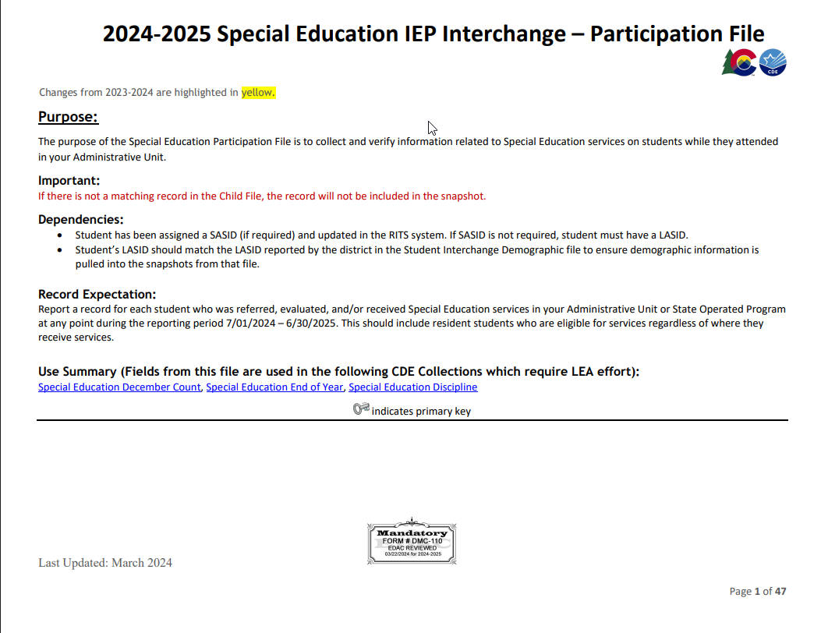
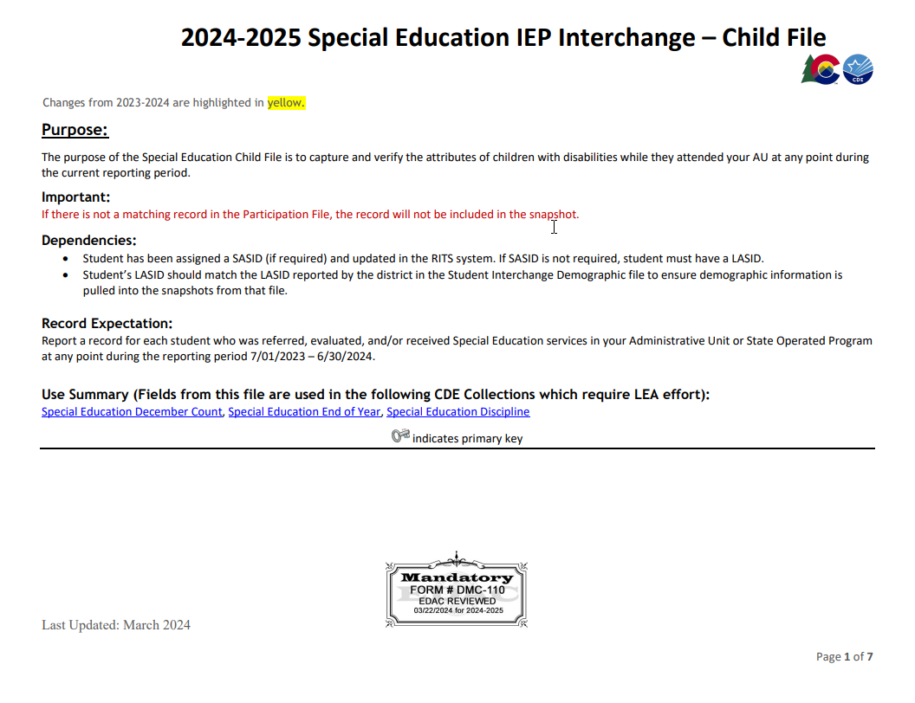
Special Education IEP Interchange (IEP)
Reflects all students with an IEP
Records needed on the following files:
  SPED Participation File
    Primary Disability
    Date of Entry to Special Education
    Date of Exit from Special Education
  SPED Child File

Slide 27

Teamwork
Partner with the individuals responsible for these files in your LEA, they are often overseen by someone other than the student discipline data respondent.

Slide 28
Data Pipeline Process

Slide 29
Prepare

Slide 30
Checklist
Ensure you have access/logins for following systems
  Your LEA’s Student Information System (SIS)
    Must have ability to extract state reporting files and edit student records for related data fields
  Data Pipeline & COGNOS/CEDAR
  RITS (at least viewing permissions)
  Syncplicity Student Folder
    District Code _ Discipline
Bookmark important CDE websites & review supporting documentation – Bookmark List
Sign up for data pipeline TH emails if you don’t already receive them
Plan to maintain data privacy for Personally Identifiable Information (PII)
  What are your internal processes?
  Utilize Syncplicity when communicating with CDE
Gather/Save Critical Contact Information
  CDE: Carrie Martin, StudentDiscipline@cde.state.co.us, 720-665-4456
  Internal:
    Know which colleagues support/oversee which programs such as—Multilingual Learners, Homeless, SPED, Free/Reduced Lunch
    Do you have colleagues who will support data validation?
    Who needs to be notified of preliminary data?

Slide 31
STU Identity Management (IdM) Roles
Bookmark: Identity Management Site
District Local Access Manager (LAM) assigns account/privileges
Provides access to the various CDE tools
Data Pipeline permissions are needed to complete data collections
A user can only have one role for each Collection
IdM user roles are used by CDE to create email lists & grant collection specific access
  COGNOS/CEDAR access mirrors pipeline access
  Collection emails – typically only LEA Approvers and LEA Users
  Data Pipeline Town
    Manually added, can subscribe via email
  Syncplicity access
    Manually added, monitored by collection leads
Application | Collection | User Role | Access & Notes
Pipeline | Discipline Interchange | LEA User | Required for STU data respondents. Upload and edit records for DEM, SSA, & GG files.
Pipeline | Student Discipline | LEA Approver | At least one required per LEA. Create snapshot, submit snapshot, download sign-off form.
Pipeline | Student Interchange | LEA User | Required for data respondents. Upload and edit records for DEM & SSA.
Pipeline | Any | LEA Viewer | View CEDAR/COGNOS reports related to the assigned collection but cannot edit data. Useful role for district support staff who help validate data but do not actively complete the collection.

Slide 32
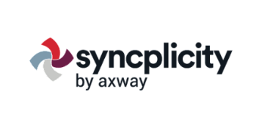
PII and Syncplicity
Personally Identifiable Information (PII)
PII is defined by state and federal laws as information that alone, or in combination, personally identifies an individual
  Includes direct identifiers (SASID, student name)
  Includes information when combined is identifiable
Colorado’s Student Data Transparency and Security Act outlines requirements for how Student PII is collected, used and shared
  See CDE’s data security and privacy site for more information
Communicating PII must be done through secure methods. DO NOT EMAIL PII
  Data Pipeline file upload & COGNOS/CEDAR
  Syncplicity secure file transfer
  Phone call is secure method; 720-665-4456
    Please do not leave PII in voicemail but rather request a return call to discuss PII
Syncplicity
Secure file transfer site
  Syncplicity Login Page
Collection specific folders
  Primary Syncplicity Folder:
  District _ Discipline
Does not notify users of file upload
  Email STU Inbox if file is ready for review

Slide 33
Data Pipeline Weekly Maintenance
Data Pipeline has a weekly maintenance window on Tuesday afternoons, during which time users may not be able to access file uploads and snapshots.
What does this mean for you?
  Avoid taking a STU Snapshot on Tuesdays between 4pm-8pm.
  If you are attempting to do a file upload and are locked out of pipeline, try again in about an hour.

Slide 34
Collection Steps

Slide 35

Steps
Upload interchange files (DIS, DEM, SSA)
  IEP interchange file as needed
Resolve interchange errors
  Update student information system
  Extract and upload new interchange files
Create STU Snapshot
Resolve STU Snapshot Errors
  Update student information system
  Extract and upload new interchange files
  Request exceptions if needed (Deadline: June 11, 2026)
  Create STU Snapshot (repeating steps 1 to 4 as needed)
Validate data
Submit error-free snapshot
  STU~LEAApprover role in IdM required
Submit Superintendent Sign-Off form to CDE
  STU~LEAApprover role in IdM required to download form
  Email completed forms to StudentDiscipline@cde.state.co.us by July 7, 2026

Slide 36
No Discipline Actions

Slide 37
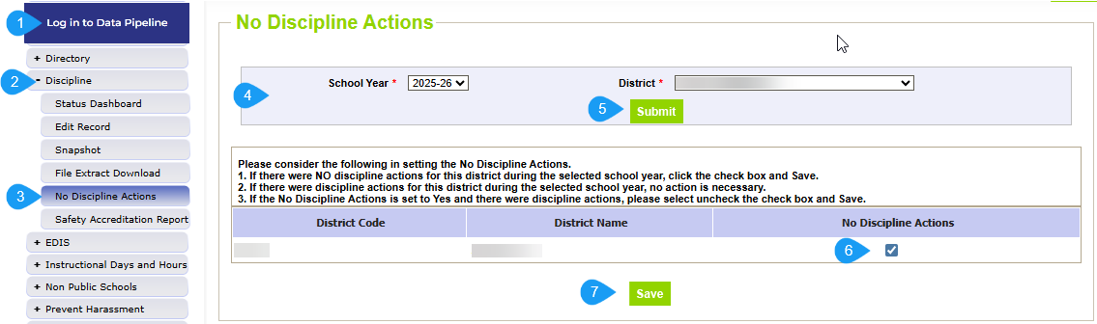
No Discipline Actions Steps
THIS IS ONLY NEEDED IF YOUR DISTRICT HAS NO DISCIPLINE DATA TO REPORT

Slide 38
File Upload

Slide 39
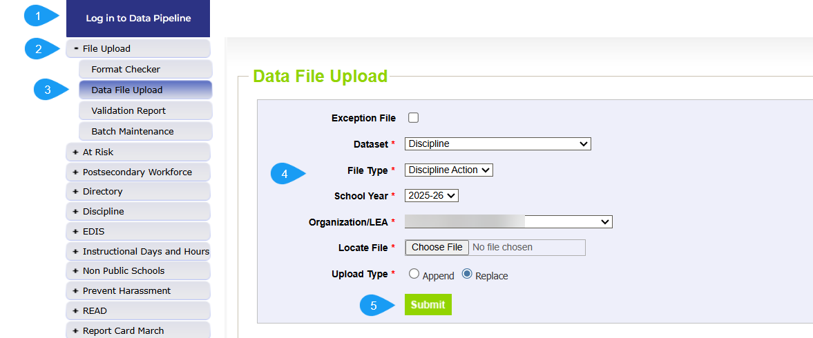
Data File Upload
Update Interchange files to address errors
  Preferred: Update in SIS → Extract → Upload to Pipeline
  Alternate Method: Edit Record Tool (Data Pipeline)
    Not encouraged
Wait for a Confirmation Email from the Pipeline System
  The email will show the number of errors in the file upload
  Use Pipeline or CEDAR reports to review errors and warnings

Slide 40
Create/Update Snapshot

Slide 41
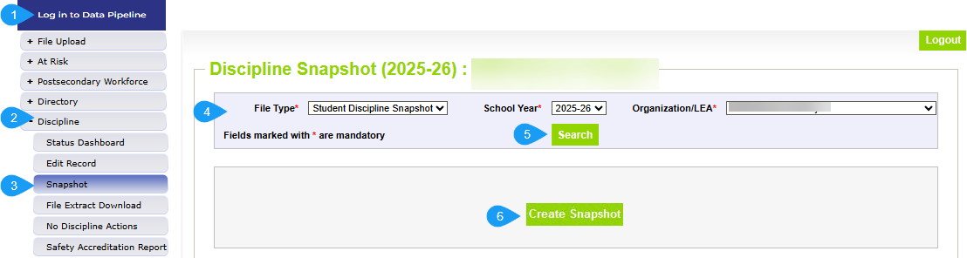
Create Snapshot
The message “Snapshot creation triggered and processing. A notification email will be sent upon completion” will appear at the top of the screen after selecting the create snapshot button
Wait for the notification email before reviewing errors/warnings
Creating a new snapshot will replace all the records from the previous snapshot

Slide 42
Business Rules

Slide 43
Overview
Business Rules are the list of errors and warnings that are checked when an interchange file is uploaded, or snapshot is created
Available on the Student DisciplineWebsite and the Discipline Interchange Website
Types of information checked:
  File Layout expectations
  Demographic information
  Student entry and exit dates/types

Slide 44
Errors/Warnings: Overview
Errors
Warnings
Must be addressed
  Update data fields to clear
  Request reporting exception if discipline data is accurate but does not follow the typical coding pattern as indicated by the error message
Snapshot cannot be submitted if there are any errors
Indicate possible data inconsistencies/coding issues
Snapshot can be submitted even if warnings are present
Pro Tip: Review warnings to look for patterns/areas where district data could be documented in a more accurate manner

Slide 45
Interchange vs Snapshot Business Rules
Interchange
Snapshot
Address data inconsistencies that apply to multiple data collections (snapshots)
Errors on the discipline interchange file prevent the records from being included on the STU snapshot
Business Rules: Discipline Interchange Website
Address data inconsistencies that apply to STU data collection specifically
Business Rules: Student Discipline Website

Slide 46
Addressing Snapshot Errors/Warnings
Data fields must be updated on the corresponding interchange file
Must create a new snapshot to clear snapshot level errors
  Snapshot creation causes pipeline to run the data through the business rules again

Slide 47
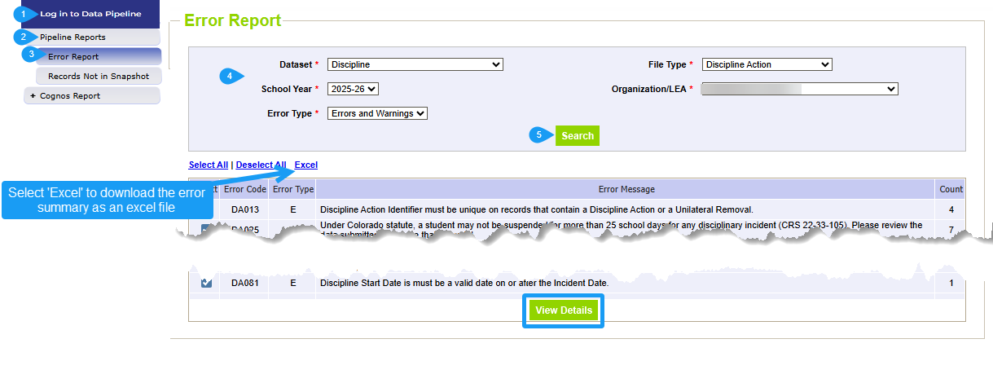
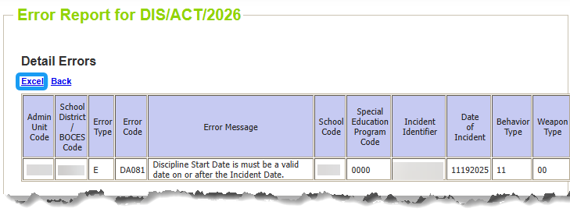
Checking Errors/Warnings: Pipeline Error Report
Preferred method for checking errors/warnings
Some errors and warnings are being updated to use the ‘error log error message’ column that used to be blank on this report
Pro Tip: Use check boxes to select a specific error/warning code before reviewing error details as it may be simpler to focus on one business rule topic at a time
To view specific student records that are triggering an error/warning,
select View Details at the bottom of the screen.

Slide 48
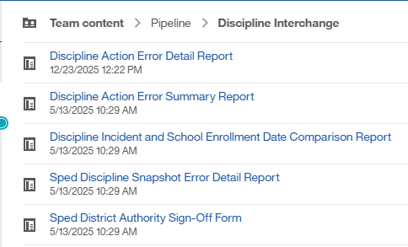
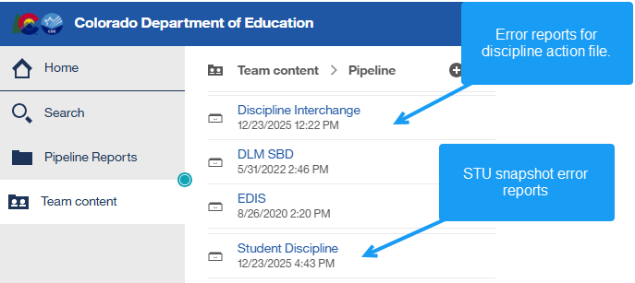
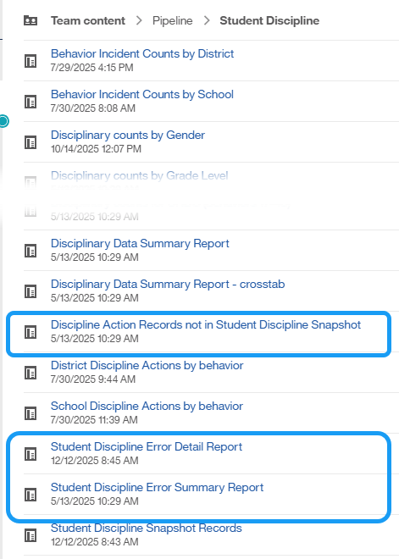
Checking Errors/Warnings: COGNOS/CEDAR
Alternative method for checking errors/warnings
  Login to COGNOS/CEDAR using the link in Data Pipeline or the IdM webpage
Use when reviewing 1,000+ individual error detail records
COGNOS/CEDAR is best used to validate data using the various topic specific reports

Slide 49
Status Dashboard & Submitting Snapshot

Slide 50
Status Dashboard Information
Allows you to review the status of a submitted interchange file or snapshot
  Total Records
  Quantity of errors
  Data Locked ‘Y’ means snapshot creation is not available
  Overall Status
    ‘P’ Pending
    ‘S’ Submitted
  Updated Date- This date/time should be more recent on your STU snapshot than on the related interchange files
  Updated By-email of the user
Used to submit snapshot to CDE
Used to download the superintendent verification (sign-off) form during the final phase of data collection
  Last Updated Date on the status dashboard must be prior to the date on the sign-off form for the form to be accepted

Slide 51
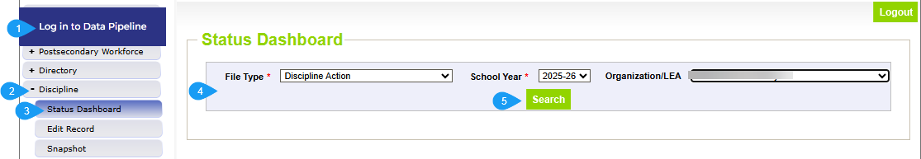
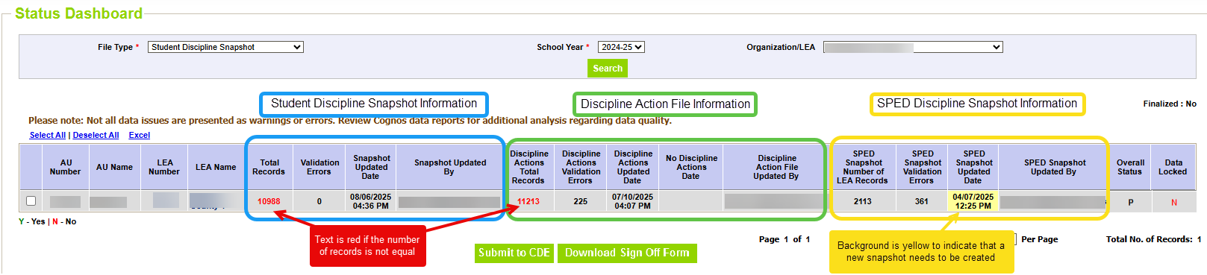
Status Dashboard Screen

Slide 52
Reviewing/Validating Data
(COGNOS/CEDAR Reports)

Slide 53
CEDAR/COGNOS Reports Overview
The Colorado Education Data Analysis and Reporting system (CEDAR) is a private, secure system which provides student level data to authorized users. Access to student-level data is limited to educators who have need for such data.
Reports in CEDAR/COGNOS have multiple purposes. Some are used as operational reports to assist data respondents in looking up specific information on students, file/snapshot errors, and students missing from a snapshot due to profile errors. Other reports are used to validate data when finalizing a data collection. Many reports also provide districts with a preview of data that will be published based upon specific data collections.
Notes:
Often CEDAR is referred to as COGNOS since COGNOS is the software currently powering the Colorado Education Data Analysis and Reporting system (CEDAR).

Slide 54
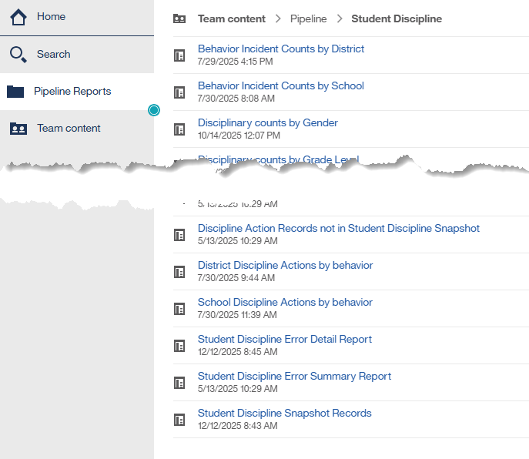
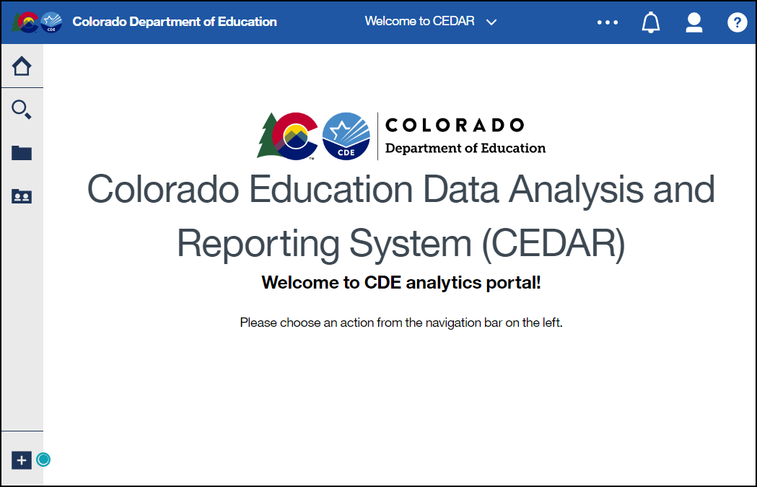
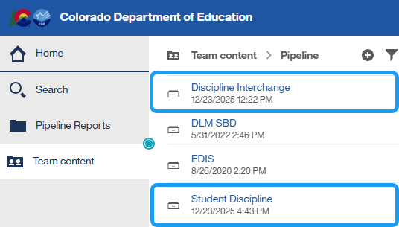
Accessing Reports
Identity Management Landing Page → CEDAR Link
Data Pipeline →

Slide 55
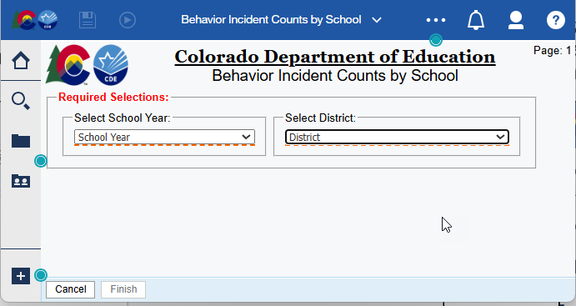
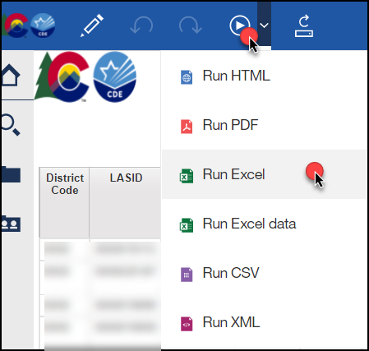
Report Screen & Download
Use dropdown menus to select desired information
Reports can be downloaded as an excel file for easier sorting/filtering of information.

Slide 56
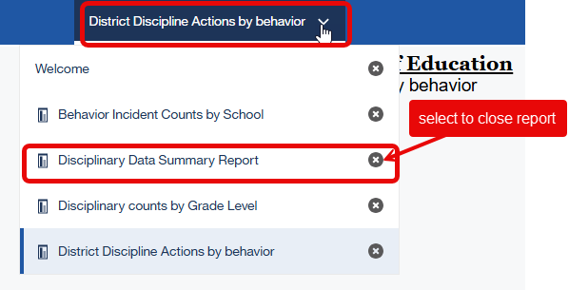
Moving between reports
Toggle between reports using the recent reports dropdown
Close an open report using the recent reports dropdown

Slide 57
Discipline Interchange Reports
Individuals with permissions to the Discipline Interchange in IdM have access to student profile reports
  DIS~LEAVIEWER
  DIS~LEAUSER
These reports are operational in nature, assisting districts with reporting accurate data on these fields and providing historical information when helpful
They are connected to information from the discipline interchange file.

Slide 58
Student Discipline Reports
Available to individuals with permissions to Student Discipline in IdM
  STU~LEAVIEWER
  STU~LEAUSER
  STU~LEAAPPROVER
Some reports are operational in nature, designed to assist with the data collection
Some reports are designed to provide districts with a preview of their education statistics data prior to the public release of data in September
  District Discipline Actions by Behavior
  Behavior Incident Counts by District
  Disciplinary counts by Grade Level

Slide 59
Exceptions

Slide 60
When are reporting exceptions needed?
Reporting exceptions are used to clear the associated errors (without changing the data) in unique circumstances where a student’s record has accurate information, but their discipline record does not follow the anticipated coding patterns outlined in the business rules for an interchange file or snapshot
Data respondents must work with the data collection lead for a given file/snapshot to request an exception be granted
Some reporting exceptions require additional supporting documentation and may be reviewed by other CDE staff

Slide 61
Reporting Exception Process
Complete exception request template
    Available on STU Website
Upload exception request template to the district’s Syncplicity student folder
    Folder: 1234 _ Discipline
Notify the STU collection lead that a document has been uploaded for review
    StudentDiscipline@cde.state.co.us
    Pro Tip: Include the date in name of your exception request file as more than one exception may be uploaded during the collection cycle
Collection lead will review the request and notify you of the outcome
    Approved requests – reupload interchange file and/or create a new STU snapshot
    Denied requests – collection lead will provide next steps for clearing the error
    Additional information needed – collection lead will request information

Slide 62
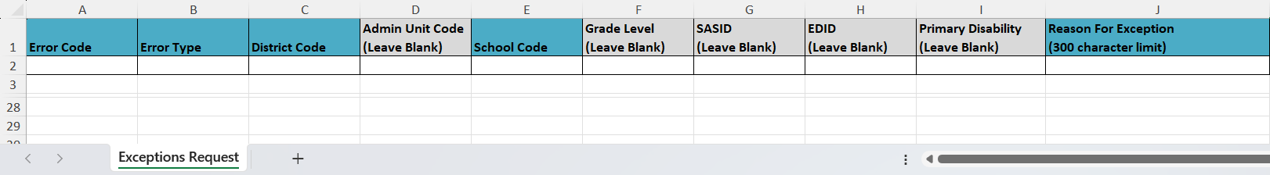
Exception Request Template
Required for all reporting exceptions, even when additional documentation is also being provided
Uploaded to Syncplicity for Review
  Pro Tip: Include district code, date, and file type in the file name 1234_5.23.25_STU_exceptions
Do not combine requests for different interchange files or STU snapshot into one form
Do not delete tabs or columns from this form.
  Hidden columns exist on the exception request tab required for accurate processing.
  Instructions tab includes information that the exceptions request tab validates against.
Submit a new exception request form when additional exceptions are needed

Slide 63
Contact & Resources

Slide 64
STU Collection Lead
Here to answer questions and assist where possible
  Student Discipline collection
  Discipline Interchange 2025-2026 questions
Don’t get frustrated, reach out!
  Book a time to meet with me that works with your schedule
To best assist you, please help me with the following
  Include your 4-digit district code in emails and voicemails
  Leave voicemails or send follow-up emails if I miss your call
  Ensure your phone number is accurate in IdM (ask your LAM to help if it needs to be updated)
Email: StudentDiscipline@cde.state.co.us
Phone: 720-665-4456

Slide 65
Bookmark List
Site Name/Link | Information/Uses
Data Pipeline Home Page | Starting point for all pipeline collections, training, and resources
 Student Discipline | Primary site for STU Collection information Contains file layouts, templates, business rules, training materials, and resources
 Discipline Interchange | Contains file layouts, templates, business rules, training materials, and resources
 Student Interchange | Contains file layouts, templates, business rules, training materials, and resources
 Special Education IEP Interchange | Contains file layouts, templates, business rules, training materials, and resources
 Identity Management (IdM) | This is the landing page with login links to the various CDE data platforms.
 Frequently Requested Codes and Resources | Includes list of school codes, facility schools, detention centers, etc.
 Trainings | Town Hall presentations and general respondent training resources.
Syncplicity | Secure file transfer site used to communicate personally identifiable information with CDE if you have questions on specific students during reporting or have exception requests.
Education Statistics | Landing page for all Colorado Education Statistics.

Slide 66

Thank you

