Slide 1
Special Education December Count 2019-2020
December Count Report Webinar
January 2020

Slide 2
Special Education December Count
Welcome to the Special Education December Count Recorded Report Webinar
Special Education Team contact information
Orla Bolger – bolger_o@cde.state.co.us 303-866-6896
Alyssa Ohleyer – ohleyer_a@cde.state.co.us 303-866-6308
Lauren Rossini – Rossini_l@cde.state.co.us 303-866-6688

Slide 3
Why do we have reports?
Reports are tools to help AUs validate data
The CDE assumes that Admin Units have used the reports to validate data, and in fact, the data submitted are valid
Reports help you determine your AU’s compliance with Indicators 5, 6, 9 and 10 (required by OSEP), fiscal allocations, and other compliance related material
Authorized Reports provide federal and state assurances data is valid and reliable

Slide 4
DEADLINES WHAT’s DUE & WHEN
January 30, 2020
Staff Data Validity Certification Report 1.0
Student Data Validity Certification Report 2.0
February 20, 2020
Upload Required Reports to the Data Management System (all other “numbered” reports)
Reports are to be uploaded to the Data Management System under the Profile Tab (Same location as the Discipline and EOY Reports)
.

Slide 5
When do reports become available?
Special Education December Count Reports become available once interchange data have been successfully uploaded and a snapshot has been created.
Only pipeline users with the DEC role can see the Special Education December Count Reports.
You can still see the reports when you have errors at the interchange, but data related to those errors won’t be included in the report.
You can still see the report when you have errors at the Snapshot, but the reports won’t be complete.

Slide 6
Data Collection Process Flow
Upload interchange files
Become error-free at the interchange level
Take a snapshot
Re-take snapshot
Become error-free at the snapshot level
Examine the reports

Slide 7
How do I view the reports?
From the Data Pipeline website, click on +Cognos Report
In COGNOS choose Special Education December
The following types of reports are available
Included – Staff and Student
Excluded – Staff and Student
Error Reports – Summary and Detail for Staff and Student
Staff Summary and Detail Reports
Student Summary and Detail Reports
Staff and Student Data Validity Certification Reports
SAM Reports
Educational Orphan (New)

Slide 8
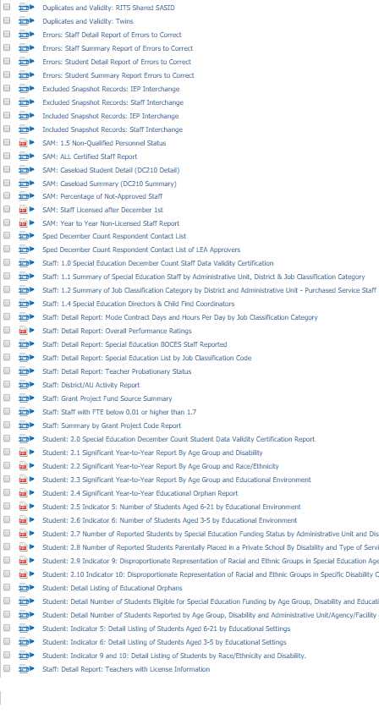
Kinds of reports: Both Staff and Student
Error Reports
Included and Excluded Reports
Data Summary Reports
Indicator Reports
Data Validity Certifications
Detail Reports

Slide 9
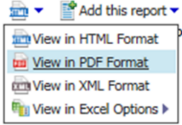
Important Note
When you are ready to create a hard copy of a “signature” report for your Director’s Signature, ALWAYS view the report in PDF Format.
This will ensure:
The best layout of the report for a printed page (no columns will be cut off).
Informative headers and footers will appear on every page, including the time and date the report was generated.
Pages will be automatically numbered.
You will see ALL the pages including the Signature Page.
Selecting the right format for your Report
This applies to Staff Reports 1.1 through 1.4 and the Validity Certificates 1.0 and 2.0. GOOD NEWS – The rest of the reports have been formatted to automatically populate as a PDF!

Slide 10
Preparing for January 30, 2020 Validity Reports

Slide 11
Report Checklist
https://www.cde.state.co.us/datapipeline/decembercountreportchecklist

Slide 12
To view Student or Staff Reports, go to Pipeline Reports
Tip
+Pipeline Reports>Error Reports
It is important to review Warnings!
Dataset: Special Education IEP Interchange
File Type:
Sp. Ed December Count Staff
Sp. Ed December Count Student
If you see ERRORS -> These must be resolved before your final snapshot submission to CDE.
If you see WARNINGS -> These records will make it into snapshot, but there is something unusual with the records. Please check before proceeding.

Slide 13
Student Error Reports in COGNOS
>Cognos Report
>Pipeline
>Special Education December
The Error Reports themselves are not submitted, but your Administrator will be asked to sign off that Error Report Warnings have been reviewed.
Notes:
Grey heading indicate that the report should be reviewed, but should not be included in the packet of reports uploaded to the CDE.

Slide 14
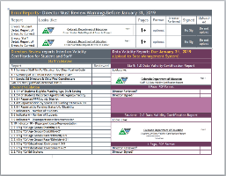
STAFF DATA VALIDITY Certification Report
* Note 1.3 has been removed
Report slides are color coded to match Checklist!
Your Director must certify that they have reviewed all these reports. Report Numbers 1, 2, 4 and 5 will be uploaded to the DMS in February, after the CDE had reviewed state data for duplicates.

Slide 15
Student Data Validity Certification Report
☑
Your Director must certify that they have reviewed all these reports in January. Report Numbers 2.1-2.10 will be uploaded to the DMS in February, after the CDE had reviewed state data for duplicates.
Notes:
Before the January due date your director must review the Error Reports for Warnings. Your director must also review the other reports listed and they may want to review “detail” reports that are tied to these.

Slide 16
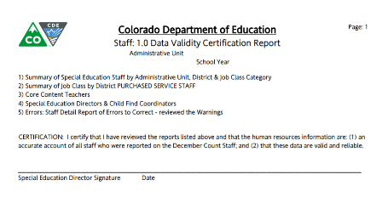
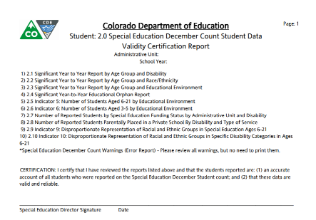
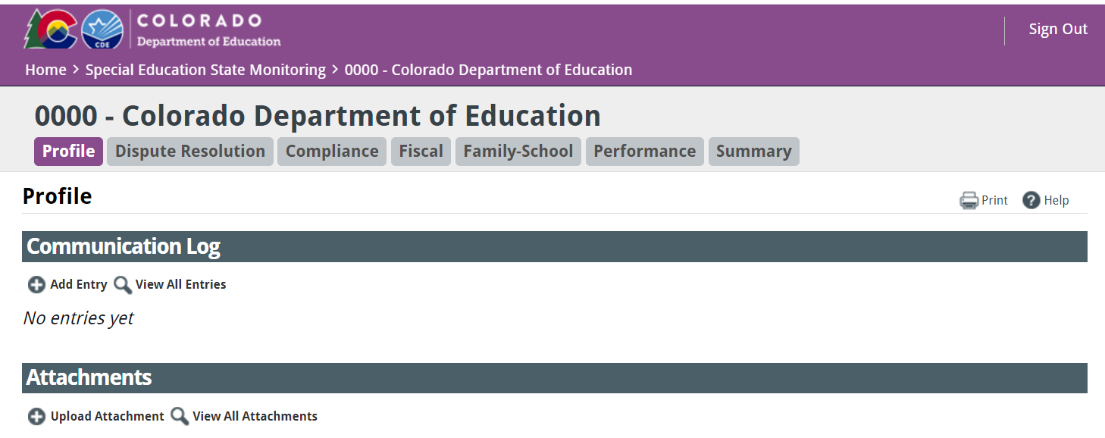
Submitting Data Certification Reports (2 reports)
Staff and Student Data Certification Reports are due on Thursday, January 30, 2020
Reports require a wet signature by the Special Education Director along with the date the reports were signed.
Scan both signed documents into a PDF
Upload the PDF to the Data Management System/Profile Tab

Slide 17
STAFF REPORTS
Special Education December Count Reports

Slide 18
February 20, 2020
These are the same reports that your director reviewed prior to Validity Certification Authorization
These reports are run again after the CDE has reviewed all data submitted to the state for duplicates and duplicates have been resolved.
These reports must be signed by your director.

Slide 19
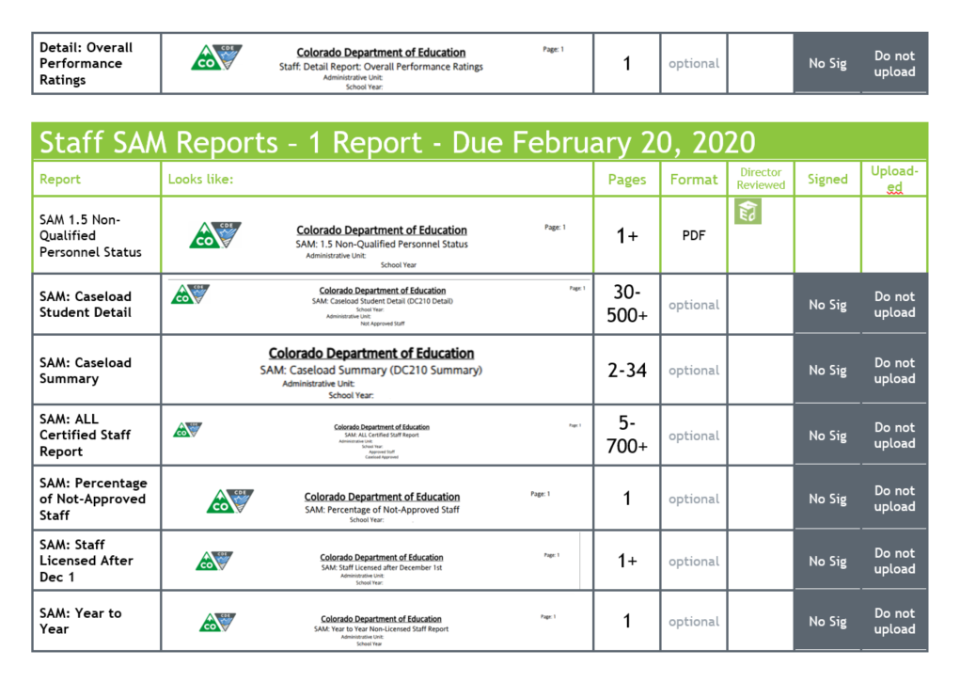
Staff Report Checklist Pages

Slide 20
Staff Report Lists
4 Reports to be Uploaded
Reports for Your Director’s Information
SAM: Caseload Student Detail (DC210 Detail)
SAM: Caseload Summary (DC210 Summary)
SAM: ALL Certified Staff Report
SAM: Percentage of Not-approved Staff
SAM: Staff Licensed after December 1st
SAM: Year to Year Non-Licensed Staff Report
Detail: Mode Contract Days and Hours Per Day by JCC
Detail: Overall Performance Rating
Detail: SPED BOCES Staff Reported
Detail: SPED List by JCC
Detail: Teacher Probationary Status
Detail: Teachers with License Info
District/AU Activity Report
Grant Project Fund Source Summary
Staff with FTE below 0.01 or higher than 1.7
Summary by Grant Project Code
1.1 Summary of Special Education Staff by AU, District & Job Classification Category
1.2 Summary of Job Classification Category by District and AU Purchased Service Staff
1.4 Special Education Directors & Child Find Coordinators
SAM 1.5 Non-Qualified Personnel Status
Notes:
The SAM report is new! It is supported by a number of additional detail reports.

Slide 21
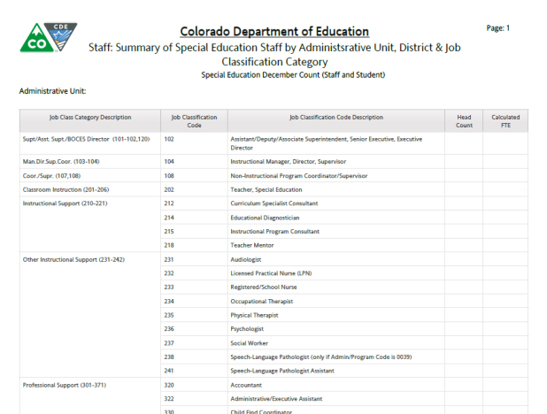
Staff: 1.1 Summary of Special Education Staff by Administration Unit, District & Job Classification Category

Slide 22
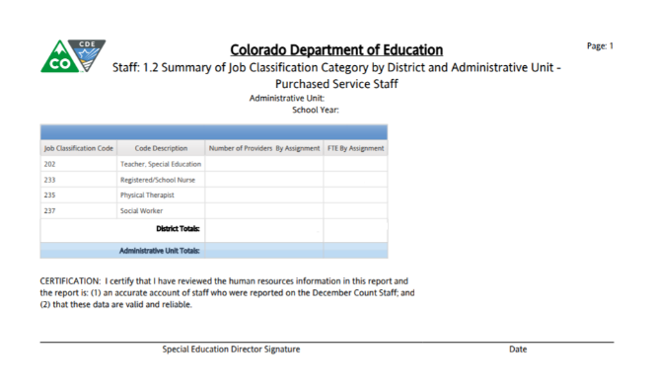
Staff: 1.2 Summary of Job Classification Category by District and Administrative Unit Purchased Service Staff
Select Criteria: Employment Status Code = 23
Average Daily Rate = summed base salary (calculated base salary for hourly employees) divided by mode contract days for job class code divided by the summed FTE
Average Hourly Rate = summed base salary (calculated base salary for hourly employees) divided by the sum of (contract days * hours per day)

Slide 23
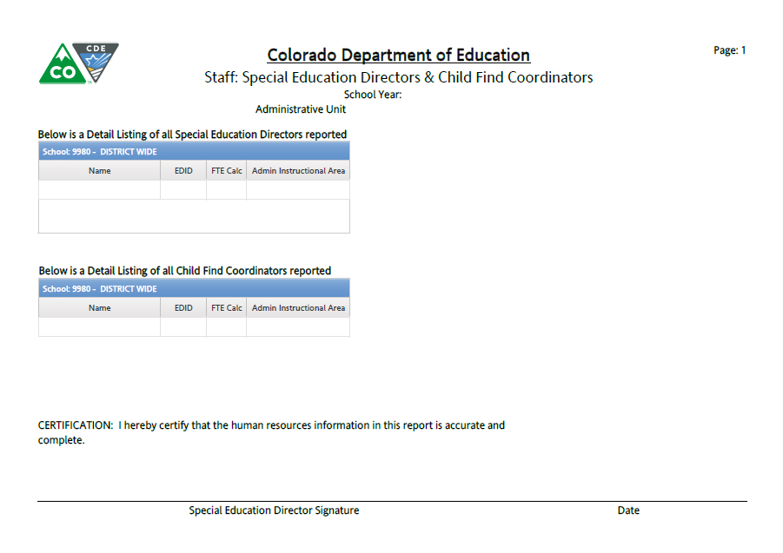
Staff: 1.4 Special Education Directors & Child Find Coordinators
Job Classification Codes 102 and 330

Slide 24
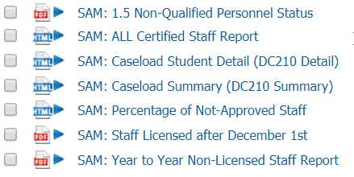
SAM Reports
Staff
Signature
SAM 1.5 Non-Qualified Personnel Status
Detail
SAM: Caseload Student Detail (DC210 Detail)
SAM: Caseload Summary (DC210 Summary)
SAM: ALL Certified Staff Report
SAM: Percentage of Not-approved Staff
SAM: Staff Licensed after December 1st
SAM: Year to Year Non-Licensed Staff Report

Slide 25
SAM: 1.5 Non-Qualified Personnel Status
This report will automatically generate as a PDF
This report has multiple sections:
Staff with expired licenses
Staff with no licenses
Staff with caseload discrepancies
Staff with an inappropriate license for their position (broken out by position)
Notes:
In previous years this report was compiled by hand. Last year, this report was uploaded to the DMS and directors were contacted by their AU Partner to review the issues. This year the report is generated along with December Count Reports and the report requires a signature.

Slide 26
Example of one of the new SAM Detail Reports
This report gives a detailed description of staff who have had licensing issues longer than one year

Slide 27
Special Education December Count Reports
Student Reports

Slide 28
Checklist Symbols

Slide 29
Student Reports
10 +1 STUDENT Reports to be Uploaded to the Data Management System
Year to Year
Year-to-Year:
2.1 By Age Group and Disability
2.2 By Age Group and Race/Ethnicity
2.3 By Age Group and Ed.Environment
2.4 Educational Orphan
December Count Flag Explanations if you have flags on any of the above Year-to-Year.
Data Summary Reports
2.7 Number of Reported Students by Special Education Funding Status by AU and Disability
2.8 Number of Reported Students Parentally Placed in a Private School By Disability and Type of Service
2.5 Indicator 5
2.6 Indicator 6
2.9 Indicator 9
2.10 Indicator 10
Indicators

Slide 30
Student Reports (continued)
3 Reports for Your Director’s Information (Please don’t upload)
Reports for Reference Only
Indicator 5: Detail Listing of Students Aged 6-21 by Educational Settings
Indicator 6: Detail Listing of Students Aged 3-5 by Educational Settings
Indicator 9 & 10: Detail Listing of Students by Race/Ethnicity and Disability
Student: Detail Listing of Educational Orphans
Student: Detail Number of Students Eligible for Special Education Funding by Age Group, Disability and Educational Environment
Student: Detail Number of Students Reported by Age Group, Disability and Administrative Unit/Agency/Facility of Attendance

Slide 31
Data Summary Checklist Page

Slide 32
5 Data Summary Reports
Data Summary Reports have been reduced from 5 reports down to 2. “Number of Students Eligible for Special Education Funding by Age Group, Disability and Educational Environment” and “Number of Students Reported by Age Group, Disability and Administrative Unit/Agency/Facility of Attendance” are still available as detail reports.
2.7 Number of Reported Students by Special Education Funding Status by AU and Disability
2.8 Number of Reported Students Parentally Placed in a Private School By Disability and Type of Service

Slide 33
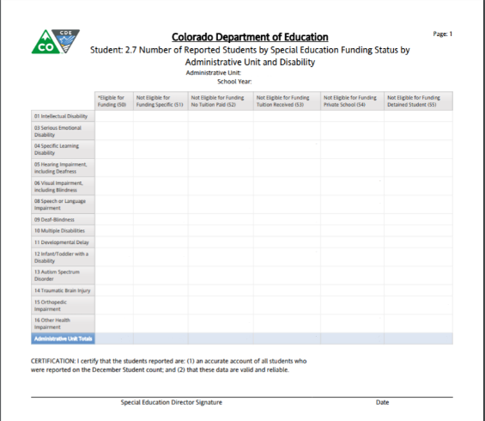
Student 2.7 Number of Reported Students by Special Education Funding Status by Administrative Unit and Disability
$
This report will automatically generate as a PDF
This report includes all records with a valid disability code
This report is 1 Page

Slide 34
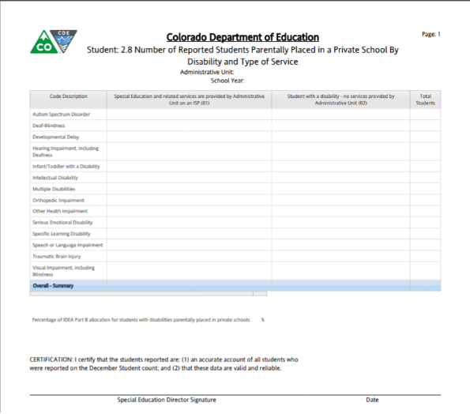
Student: 2.8 Number of Reported Students Parentally Placed in a Private School by Disability and Type of Service
$ MOE
This report will automatically generate as a PDF
Select criteria: Parentally Placed in a Private School = 01 or 02 and Disability is not zero filled
This report is 1 Page

Slide 35
Year-to-Year Checklist Page

Slide 36
4 Significant Year-to-year Reports (Plus Flag Explanations)
2.1 Significant Year-to-Year Change Report by Age Group and Disability
2.2 Significant Year-to-Year Change Report by Race/ Ethnicity
2.3 Significant Year-to-Year Change Report by Age Group and Educational Environment
2.4 Significant Year-to-Year Ed Orphan Change Report
Flag Explanations
The number of Year-to-Year reports have been reduced by including the age groups 3-5 and 6-21 onto one report for each report category. Now we only have 4 Year-to-Year reports instead of 7.

Slide 37
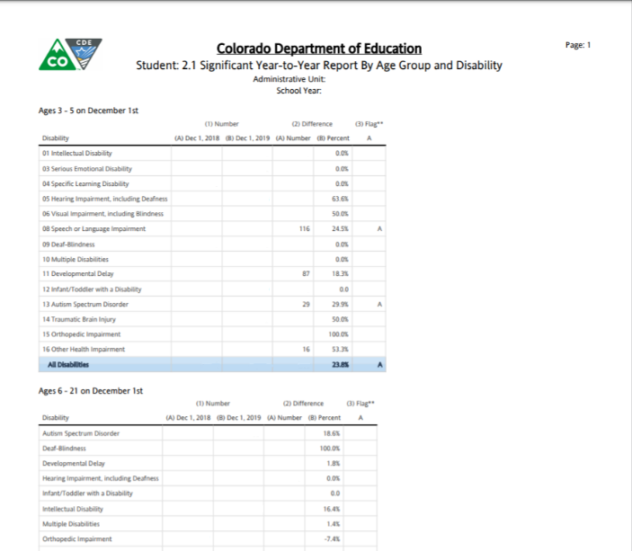
2.1 Significant Year-to-Year Change Report By Age Group and Disability
Example of flags to explain on the Flag Explanation form
This report will automatically generate as a PDF
Select Criteria: Funding Status = 50.
Calculated Age as of December 1

Slide 38
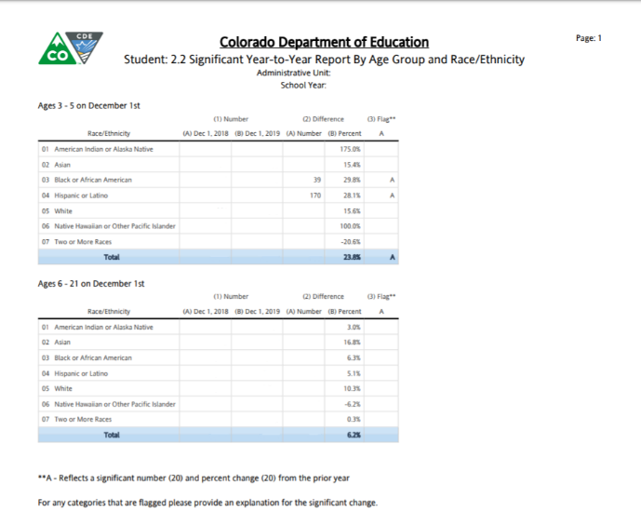
2.2 Significant Year-to-Year Change Report By Age Group and Race/ Ethnicity
This report will automatically generate as a PDF
Select Criteria: Funding Status = 50.
Calculated Age as of December 1

Slide 39
2.3 Significant Year-to-Year Change Report by Age Group and Educational Environment
This report will automatically generate as a PDF
Select Criteria: Funding Status = 50.
Calculated Age as of December 1

Slide 40
$
2.4Significant Year-to-Year Ed Orphan Change Report
This report will automatically generate as a PDF
Select Criteria: Number of Educational Orphans reported by year

Slide 41
Flag Explanations
Complete Flag Explanations for any flags in the 4 Year-to-Year Comparison Reports. These can be included on the same form when the name of the report is included in the Category Flagged field.
Flag Explanation Report can be found Here: Flag Explanations (.docx)
When you go to upload this, please upload it as a Word Document. All comments are compiled into a master file and it is easier to copy/paste than type it in!
Notes:
If you find yourself copy/pasting an explanation, stop and just add the category flagged and count data to the top three boxes.

Slide 42
Indicator Report Checklist Page

Slide 43
4 Student Indicator Reports
📈
☑
2.5 Indicator 5:
Number of Students Aged 6-21 by Educational Settings
2.6 Indicator 6:
Number of Students Aged 3-5 by Educational Settings
2.9 Indicator 9:
Disproportionate Representation of Racial and Ethnic Groups in Special Education
2.10 Indicator 10:
Disproportionate Representation of Racial and Ethnic Groups in Specific Disability Categories


Slide 44
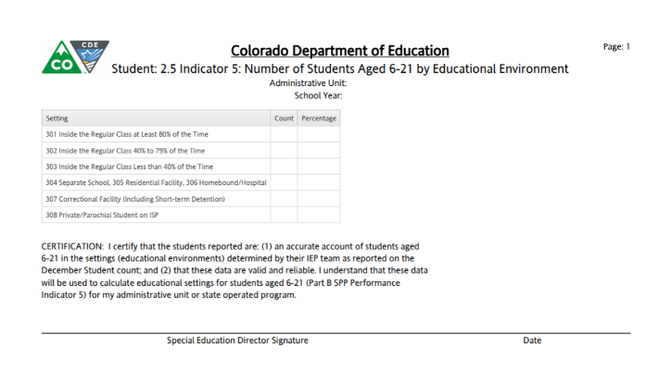
2.5 Indicator 5 Number of Students Aged 6-21 by Educational Settings
📈

This report is 1 page
This report will automatically generate as a PDF
Remember there are two Indicator 5 reports available. Your director must review both - this report of the count and the Detail Report, but you should only upload THIS report to the CDE.

Slide 45
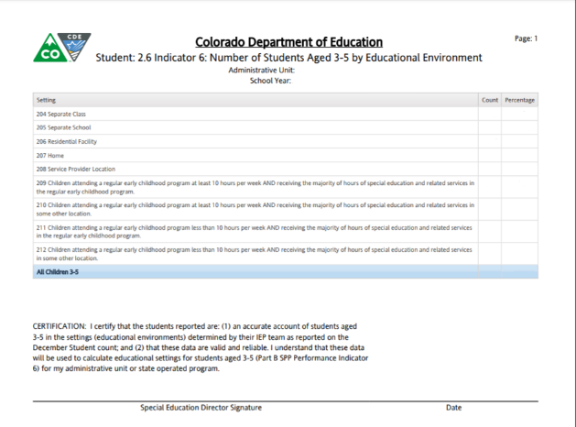
2.6 Indicator 6 Number of Students Aged 3-5 by Educational Settings
Select Criteria: Educational settings = 204-212
PAI 01 02 03 04 05 08 11 12 14 15 16 17 19 22 27 28 29 30
📈

This report is 1 page
This report will automatically generate as a PDF
Remember there are two Indicator 6 reports available. Your director should review both - this report of the count and the Detail Report, but you should only upload THIS report to the CDE.

Slide 46
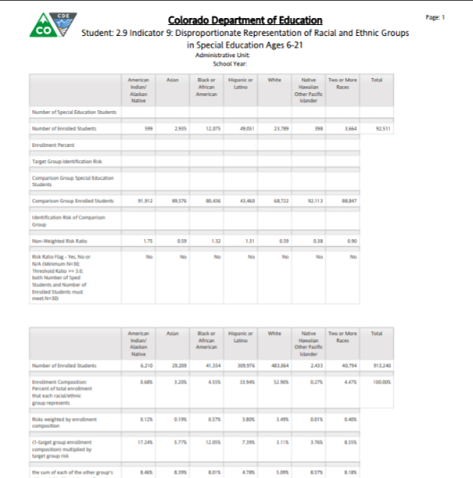
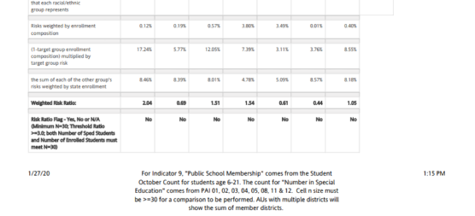
2.9 Indicator 9 Dispropor-tionate Representation of Racial and Ethnic Groups in Special Education
☑

This report is a 2 page Report
Weighted Risk Ratio and Flag at the bottom of the page are the key info on this report
This report will automatically generate as a PDF

Slide 47
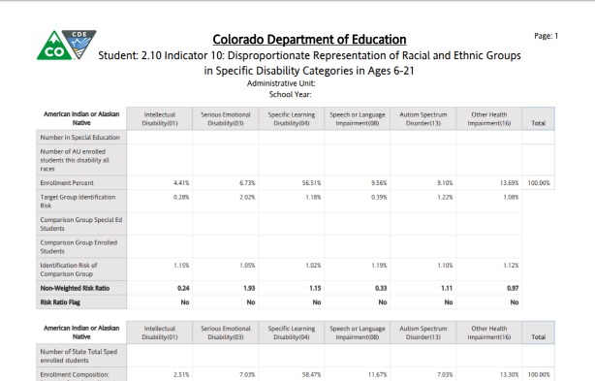
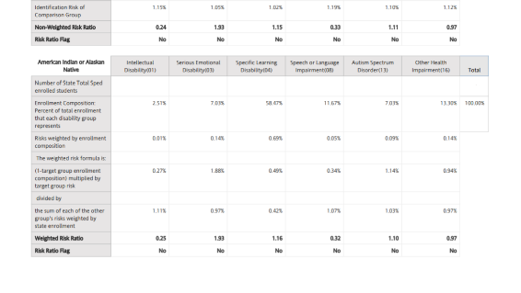
2.10 Indicator 10 Dispropor-tionate Representa-tion of Racial and Ethnic Groups in Specific Disability Categories
☑

This report, as well as the previous report, (I9) are very complex. The “Weighted Risk Ratio,” second line from the bottom of the second half of the chart, is the key number. When at least 30 students are in the group and this number is below 3.0, the ratio will not flag. It will not flag if the group is less than 30.
This report will automatically generate as a PDF

Slide 48
Submitting Final Reports (20 to 21 Reports)
All Final Reports should be signed and submitted by Thursday, February 20, 2020
10 Student Signature Reports (+ Flag Report)
4 Staff Report
Scan signed documents into a PDF or multiple PDFs
Upload the PDF to the Data Management System/Profile Tab
Please upload Flag Explanations separately as a Word File

Slide 49
Special Education December Count Contact Information
Orla Bolger bolger_o@cde.state.co.us 303-866-6896
Alyssa Ohleyer ohleyer_a@cde.state.co.us 303-866-6308
Lauren Rossini rossini_l@cde.state.co.us 303-866-6688
Thank You!

