Slide 1
Special Education Discipline 2024-2025
Reports Training
July 2025

Slide 2
AGENDA
Deadlines – slides 3-5
Signature Reports – slides 6, 10, 14-18
Where to Find Validation Reports – slide 7
Cognos Reports Available to Help Resolve Errors – slide 8
SPED Snapshot Records – slide 9
Detail Reports – slides 10-13
Flag Explanations – slides 19-20
Final Submission to DMS- slides 21-25
Final Approval in Data Pipeline – slide 26

Slide 3
Purpose & Content Reminder
20 U.S.C. 1416(a)(3)(A); 1412(a)(22) of IDEA requires that states report to the federal government the number of children with disabilities by race, ethnicity, and disability category who are removed to an interim alternative educational setting or are subject to long-term suspensions or expulsion.
EDFacts – U.S. Department of Education federal requirements
State Performance Plan Indicators 4A and 4B which report the disproportionate rates of suspensions and expulsions greater than 10 school days in a school year for children with IEP’s
Research requests
Monitoring
Consultant analysis to support technical assistance needs in the state
Special Education Fiscal Advisory Council (SEFAC)
Reporting Period: July 1, 2024 – June 30, 2025

Slide 4
Remaining Timeline
Thursday July 24th - all exceptions requests submitted to CDE for processing
Friday July 25th Complete Snapshot – Error Free:
  Date for AUs to have a complete Special Education Discipline Snapshot dataset by passing all interchange and snapshot validations in preparation for report review
Friday July 25 August 1^{st -} Report Review Week:
  Director and data respondent review validation reports in detail and make any data corrections necessary to ensure data is valid and reliable
Friday August 1st:
    Final snapshot approval due within the Data Pipeline system and signed reports uploaded to ESSU Data Management System.
      *It is okay to do this as soon as you’ve reviewed your reports and signed off on your data!

Slide 5
Special Education Discipline
Final Deadline – Friday, August 1, 2025
Administrative Unit data respondent is responsible for completing the following steps to meet the deadline:
  Electronically SUBMIT the data to CDE via the Data Pipeline
  Upload the two required signed reports to the ESSU Data Management System
      SPED Discipline Data Summary Report (exported to PDF – all 10 pages)
      SPED Discipline Year-to-Year Comparison Type of Disciplines Report (exported to PDF-1 page)
        Flag explanation document required if ‘A’ flags trigger on year-to-year report. Template found on the Special Education Discipline Snapshot webpage under the Reports section.
      Please upload the Data Summary Report and Year-to-Year Report together in one PDF. The Flag Explanations document should be uploaded separately in a word document.

Slide 6

Signature Reports
ADMINISTRATIVE UNIT
Reports to upload to the DMS:
SPED Discipline Data Summary Report (10 Pages)
SPED Discipline Year-to-Year Comparison Type of Disciplines Report (1 Page)
  Year-to-Year Flag Explanation Document (Word) if applicable
DISTRICT
Report to send to AU:
District Authority Sign-Off Form
  (requested by Special Education Directors for data assurance purposes and found in the Discipline Interchange cognos folder)
  *No need to send to CDE – for your records

Slide 7
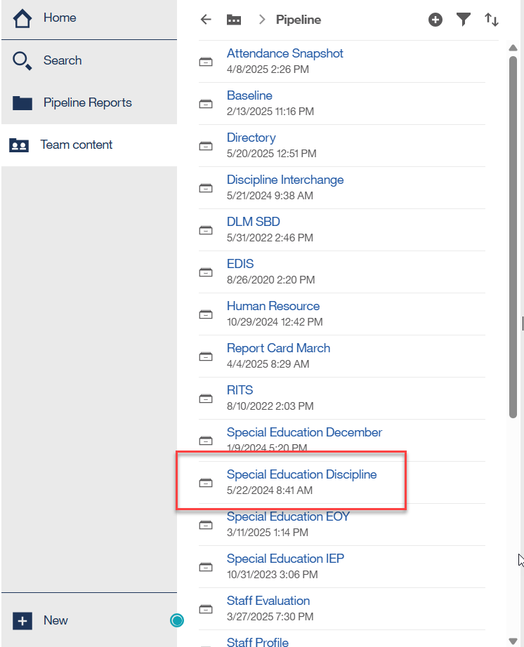
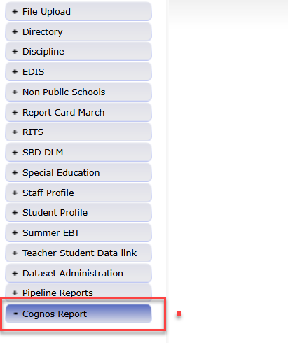
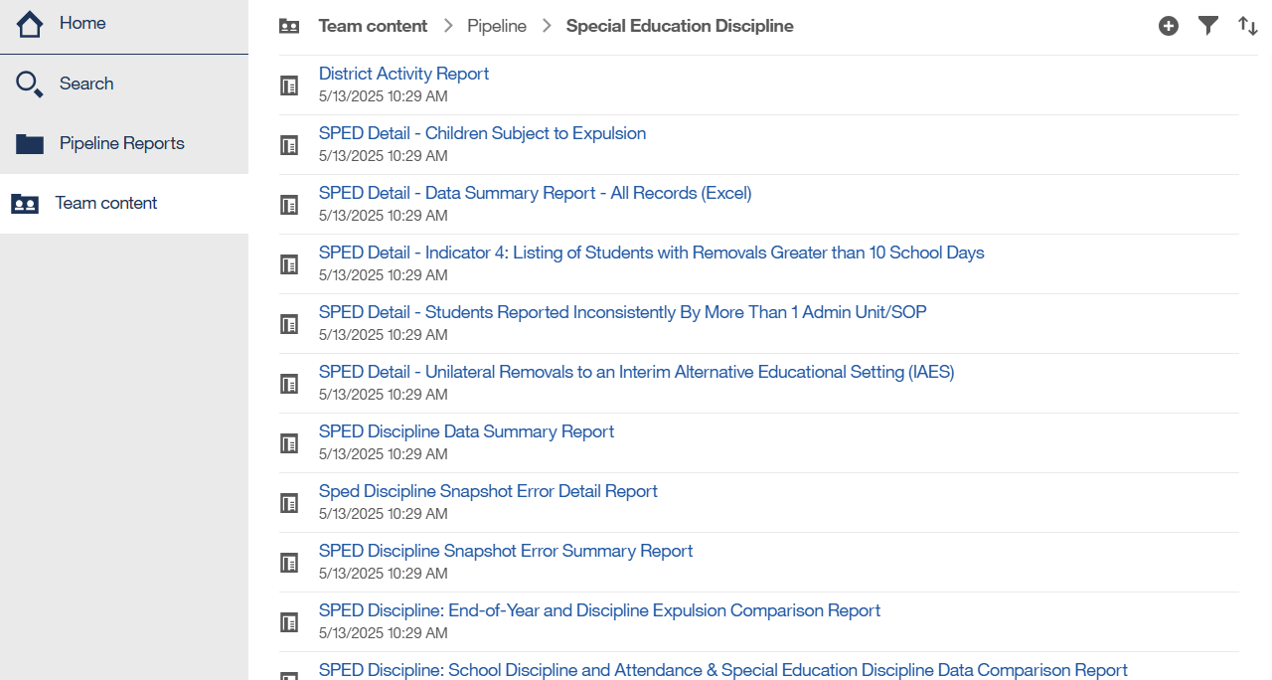
Where to Find SPED Discipline Validation Reports
In Date Pipeline, click Cognos Reports and then the Special Education Discipline folder.
Expand to see the full report names and scroll down to see the full list of reports available.

Slide 8
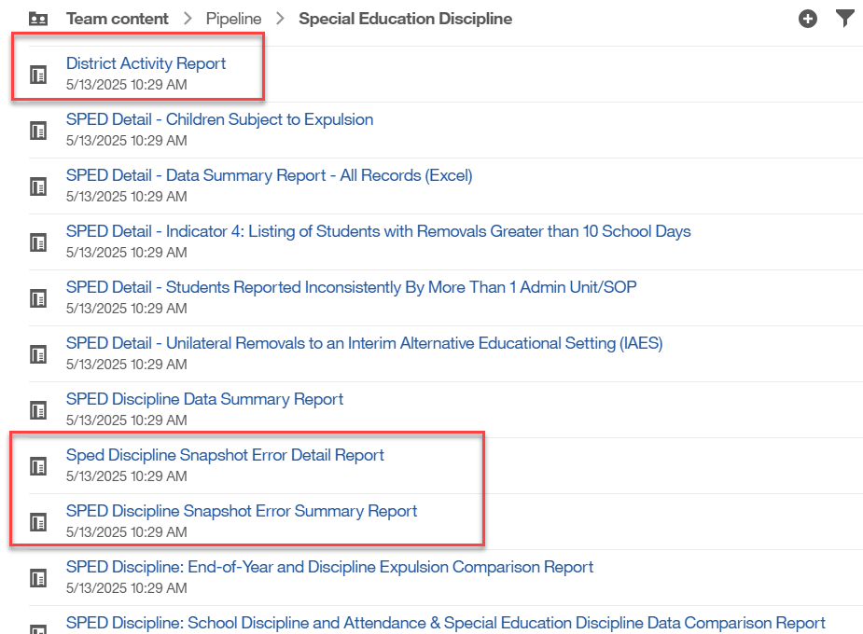
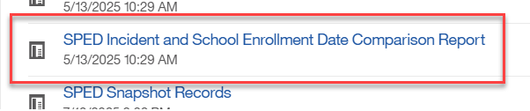
Cognos Reports Available to Help Resolve Errors
District Activity
Snapshot Error Detail
Snapshot Error Summary
Incident Date and School Enrollment Comparison (Error SD017)

Slide 9
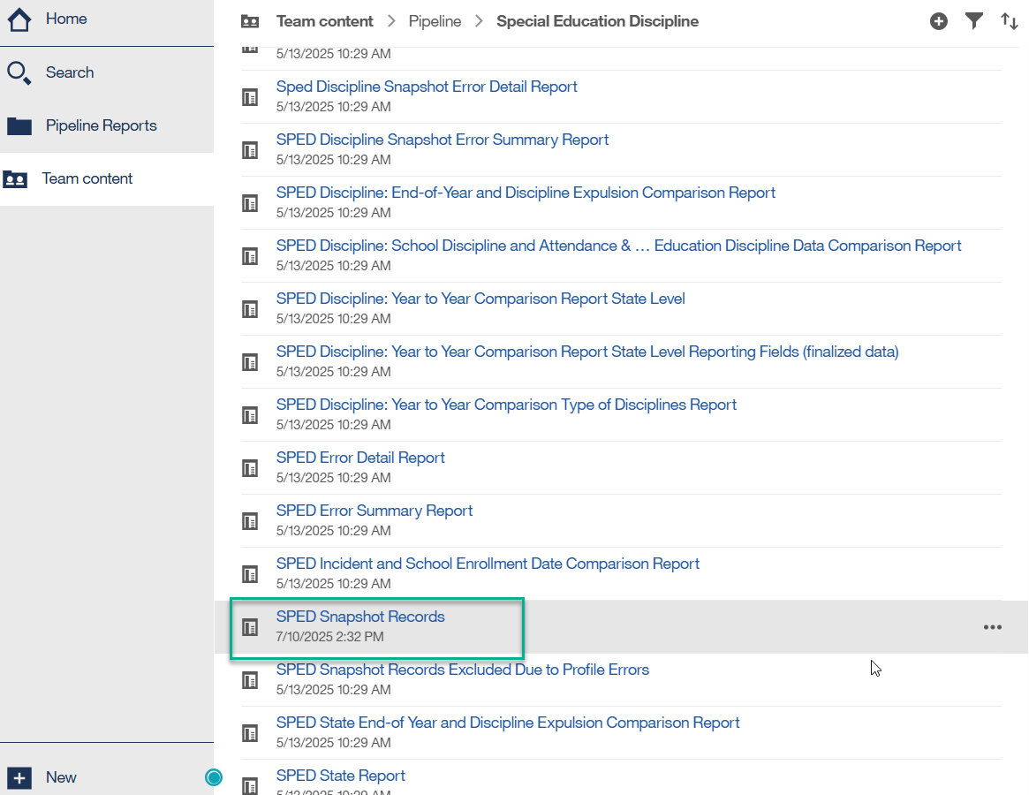
Cognos Report-SPED Snapshot Records
These are all the records in your SPED Discipline Snapshot
You can use this as a reference when questions arise from other reports
This report is available in the Data Pipeline/Special Education Discipline cognos folder for each collection year

Slide 10
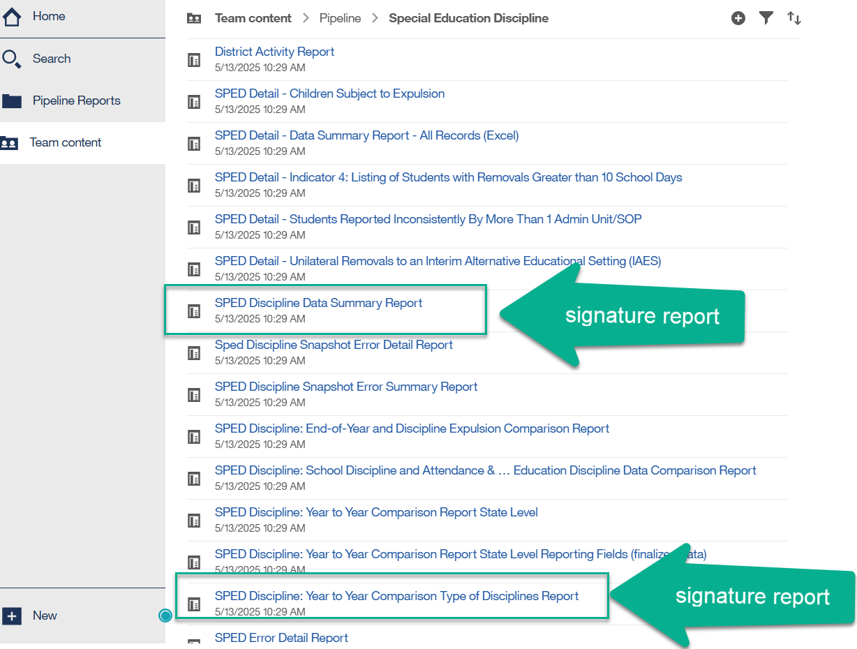
Signature and Detail Reports
2 signature reports required to be uploaded in full to the DMS
The rest of the reports are detail reports for your information
Detail Reports are there to assist Administrative Units in validating the Data Summary and Year-to-Year Comparison Reports

Slide 11

SPED Detail – Indicator 4: Listing of Students with Removals Greater than 10 School Days
  This report is a listing of all student records that appear in the count for Indicator 4 - Disproportionate Representation in Discipline.
  CDE does not collect this report as a signed report, it is for your information.
  Refer to the SPED Discipline Data Summary Report. Find the Table “Federal Race/Ethnicity Reporting Category” (pp. 3-4) and pay special attention to the column titled “Out-of-School Suspensions/Expulsions > 10 Days Count of Students.”
    The totals for this column are used to determine your Indicator 4A compliance
    The racial/ethnic data in this column are used to determine Indicator 4B compliance

Slide 12
SPED Detail - Students Reported Inconsistently by More Than 1 Administrative Unit
This report will provide data that is inconsistent between AUs.
The “errors” appearing here may be legitimate entries.
  For example, a student’s disability identification may have changed at a mid-year staffing
  A student’s parents may choose to report race differently when they move to a new district (for example: a student is identified “Hispanic,” then “2 or More Races”)
Please investigate things that don’t make sense.

Slide 13
More Detail Reports
SPED Detail - Children Subject to Expulsion
  Details on children subject to expulsion
  Student and school level detail
    Disability type, gender, race, number of days removed
SPED Detail – Data Summary Report All Records (Excel)
  Student level details on all removals – a tab for each of these disciplinary removal types:
    Children Subject to Expulsion
    Unilateral Removals to IAES
    School Suspensions and Expulsions
    Disciplinary Removals – all types
SPED Detail - Unilateral Removals to an Interim Alternative Educational Setting (IAES)
  Details on students who had a unilateral removal to an IEAS for 45 days or less

Slide 14
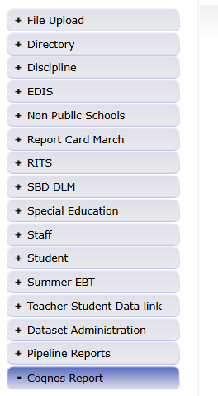
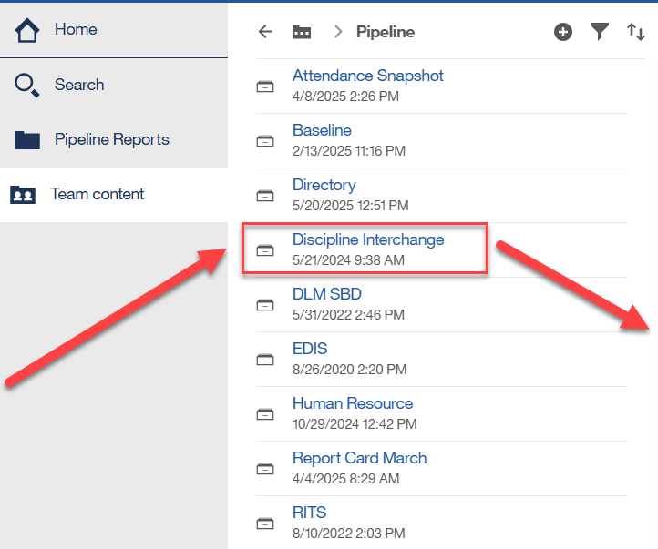
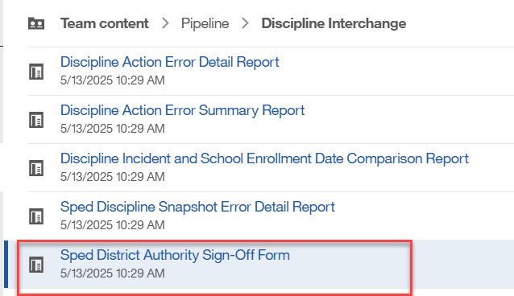
District Authority Sign-Off Form
District responsibility (DIS role) to send to AU team (no need to send this report to CDE)
Found under Cognos Reports/Discipline Interchange

Slide 15
District Authority Sign-Off Form
Report Contains the following data:
Unilateral Removals to an Interim Alternative Educational Setting by School Personnel
  (A) Number of Children (B) Drugs (C) Weapons (D)Serious Bodily Injury
Removals to an Interim Alternative Educational Setting Based on a Hearing Officer Determination Regarding Likely Injury
Out-of-School Suspensions or Expulsions
  (A) Number of Children with Out-of-School Suspensions/Expulsions Totaling 10 Days or Less
  (B) Number of Children with Out-of-School Suspensions/Expulsions Totaling Greater than 10 Days
In-School Suspensions
  (A) Number of Children with In-School Suspensions Totaling 10 Days or Less
  (B) Number of Children with In-School Suspensions Totaling Greater than 10 Days
Disciplinary Removals
  (A) Total Disciplinary Removals
  (B) Number of Children with Disciplinary Removals Totaling 1 Day or Less
  (C) Number of Children with Disciplinary Removals Totaling 2-10 Days
  (D) Number of Children with Disciplinary Removals Totaling Greater than 10 Days
Children Subject to Expulsion
  (A) Received Educational Services During Expulsion
  (B) Did Not Receive Education Services During Expulsion
Superintendents confirm district numbers with this form. This form is for AU directors' information and record keeping.

Slide 16
SPED Discipline Data Summary Report
This report is 10 pages and has 5 sections. Each section breaks down the data into demographic categories: Disability, Grade Range, Race/Ethnicity, Gender, and EL Status. Please export to PDF to print.
  Count of Discipline Action Events and Students (pp. 1-2)
  In-School and Out-of-School Suspensions/Expulsions (pp. 3-4)
  Removal Length (pp. 5-6)
  Expulsions (pp. 7-8)
  Unilateral Removal to Interim Alternative Educational Setting (pp. 9-10)
Report Notes:
Students with more than one ISS/OSS/Expulsion will be counted for each type of action received. The counts are per action per SASID, not per SASID.
Counts will be higher on this report than the year to year comparison report when a student has more than one type of action.

Slide 17
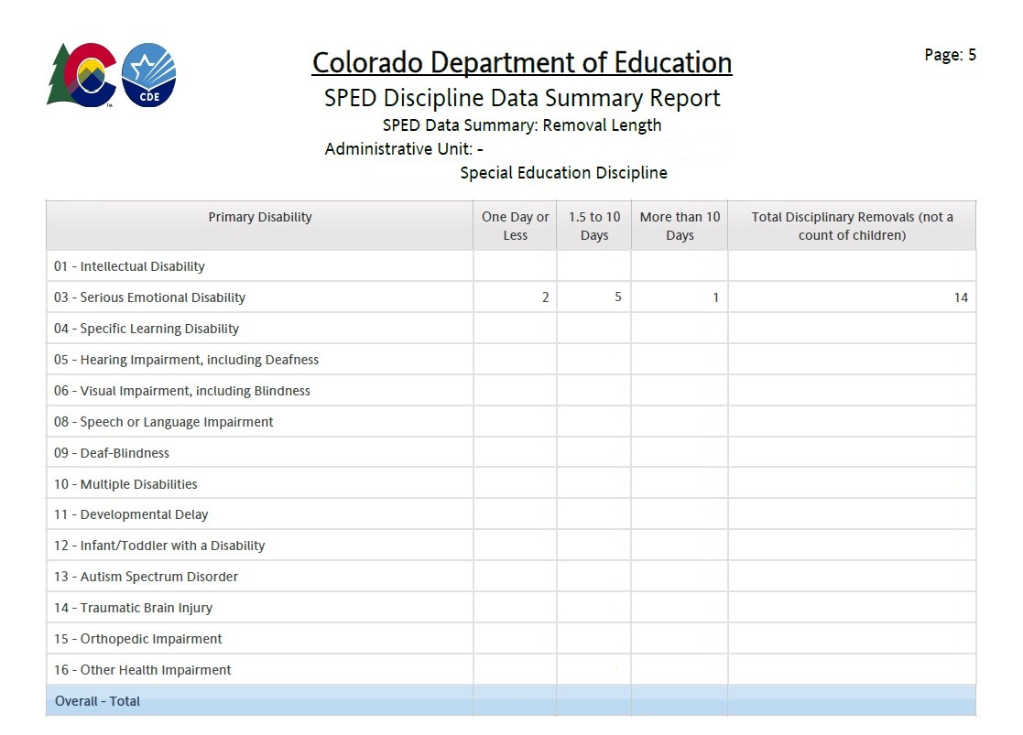
SPED Discipline Data Summary Report:
Removal Length Section
This section breaks down the data for each demographic group by Students and removals into:
One Day or Less – count of students
1.5 to 10 days – count of students
More than 10 Days – count of students
Total Disciplinary Removals- count of removals
Note: total sum of student counts does not equal the total count of removals

Slide 18
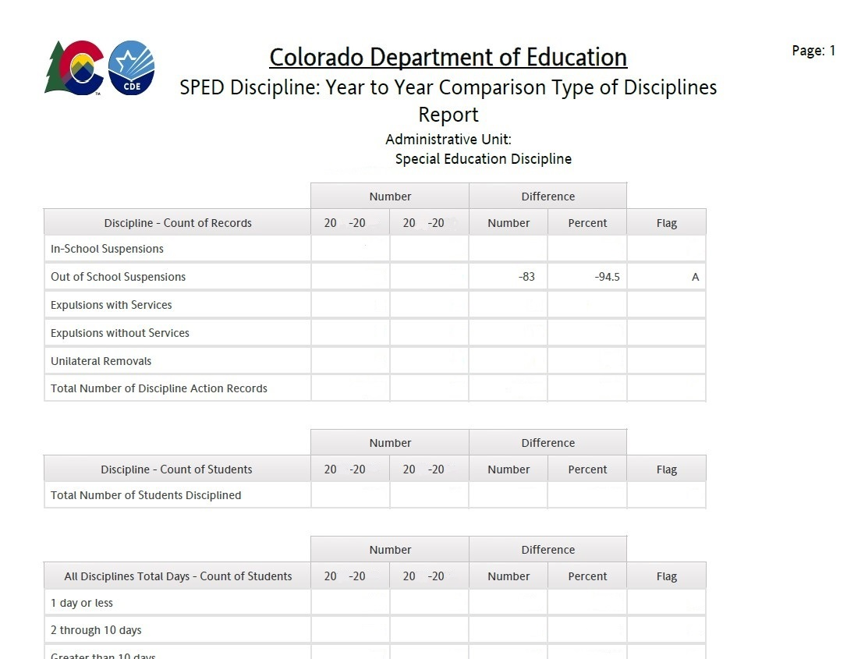
Year-to-Year Comparison Report example
SPED Discipline Year to Year Comparison Type of Disciplines Report
This is the year-to-year comparison of the count of disciplinary removal types and the count of students.
This is a signature report that may require a flag explanation in a separate word document.
You will only see flags - “A” – if both the number of the change is over 20 students AND the Percent of the Change is over 20%
These are the only data points that require explanation on the Flag Explanations sheet
18

Slide 19
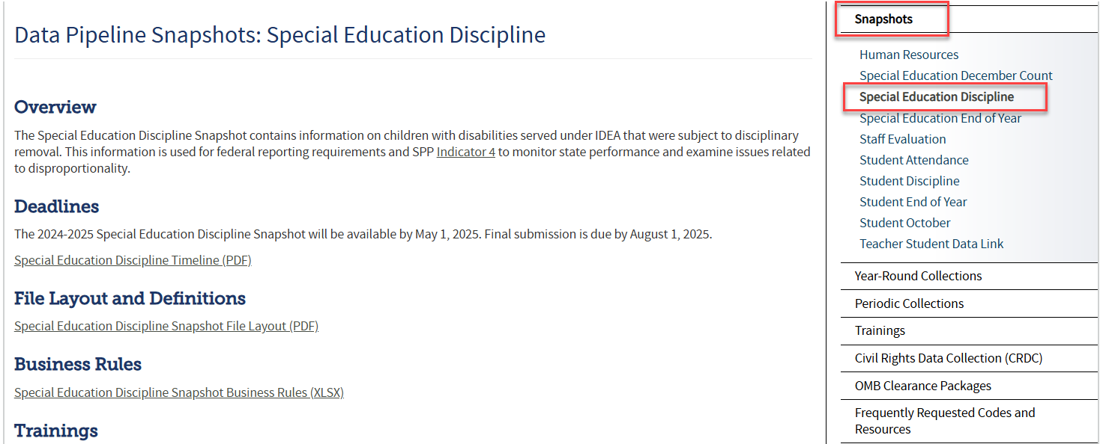
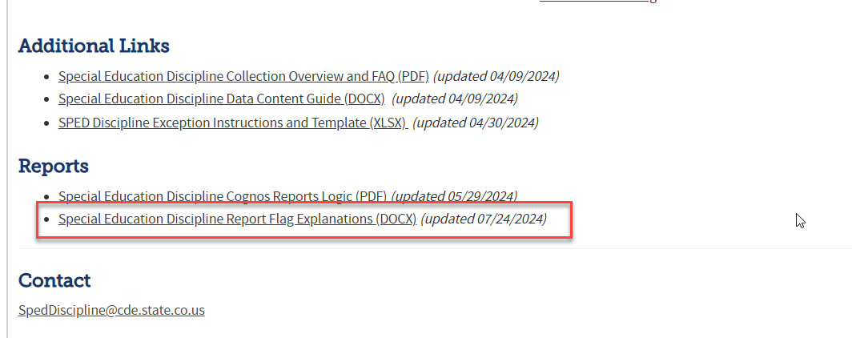
Flag Explanations Document:
Located on the Special Education Discipline Snapshot webpage under Reports section
Special Education Discipline Snapshot

Slide 20
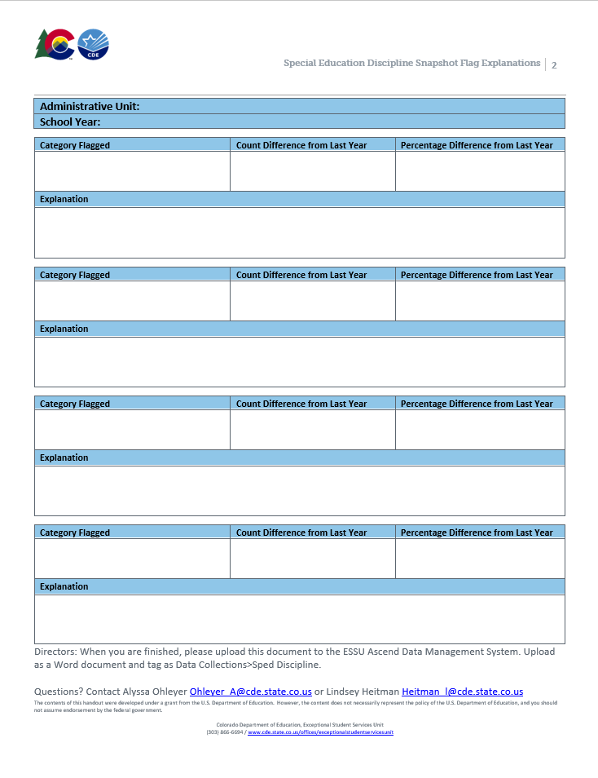
Completing Flag Explanations
Use the second page of the document to provide explanations for each flag.
The CDE needs AUs’ explanations to:
  Identify the best practices and support needs in the field
  To report the year-to-year differences to OSEP
We appreciate explanations with:
  Great details
  Cause and effect (e.g., program implementation, unusual mobility)
Copy and paste the template on a new page as needed.
Upload this page to the Data Management System as a Word file, separate from the signed reports.

Slide 21
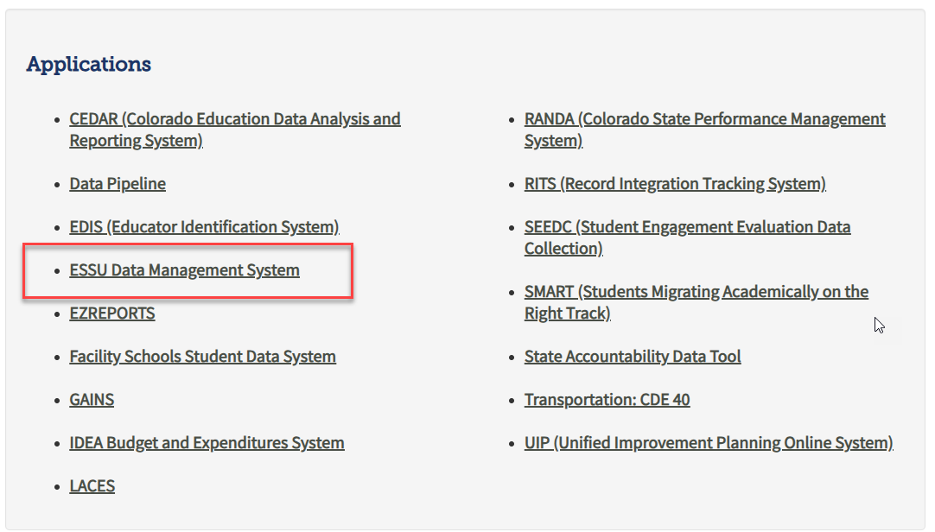
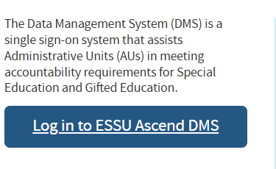
Uploading Reports to the ESSU Data Management System
SPED Director or AU respondent
From IdM homepage log into the ESSU Data Management System
  Click ‘ESSU Data Management System’
  Click ‘Log in to ESSU Ascend DMS’
  Questions on the DMS steps? Contact Josh Fails Fails_j@cde.state.co.us

Slide 22
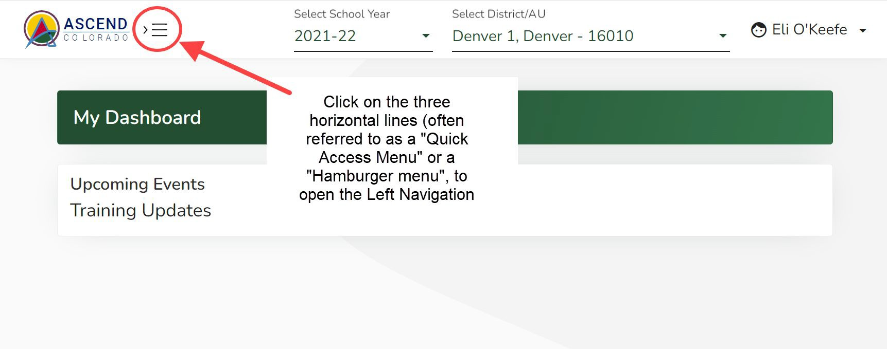
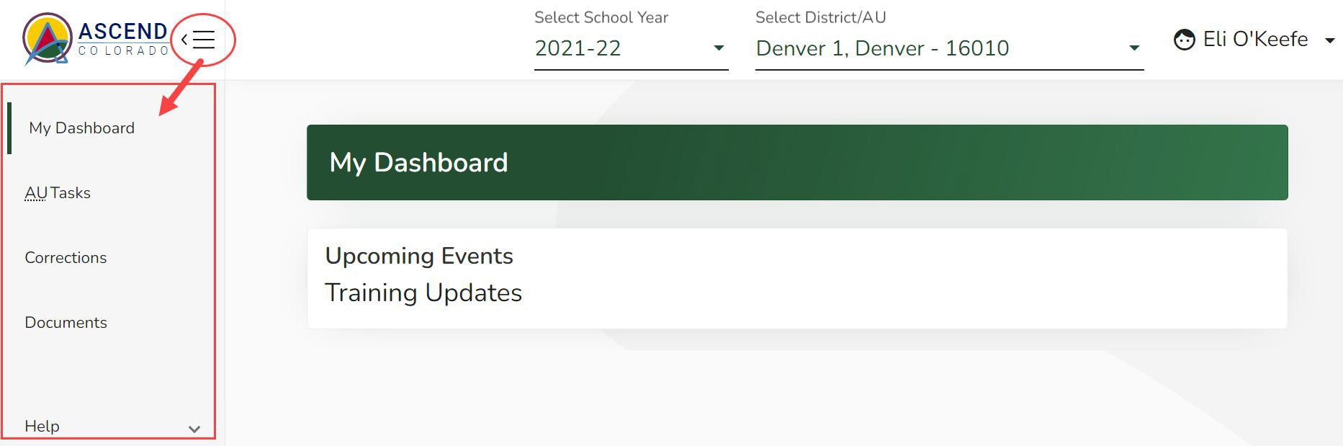
Ascend DMS Left Navigation Pane
Ascend may open with the left navigation pane closed. The left navigation pane contains the links to the various module pages such as AU Tasks, Corrections, Documents, and Help.
To open the left navigation pane:
Click on the Quick Access menu (3 horizontal lines icon) located to the right of the ASCEND logo located in the upper left corner of the screen.
To upload your Discipline Reports, select Documents from the menu

Slide 23
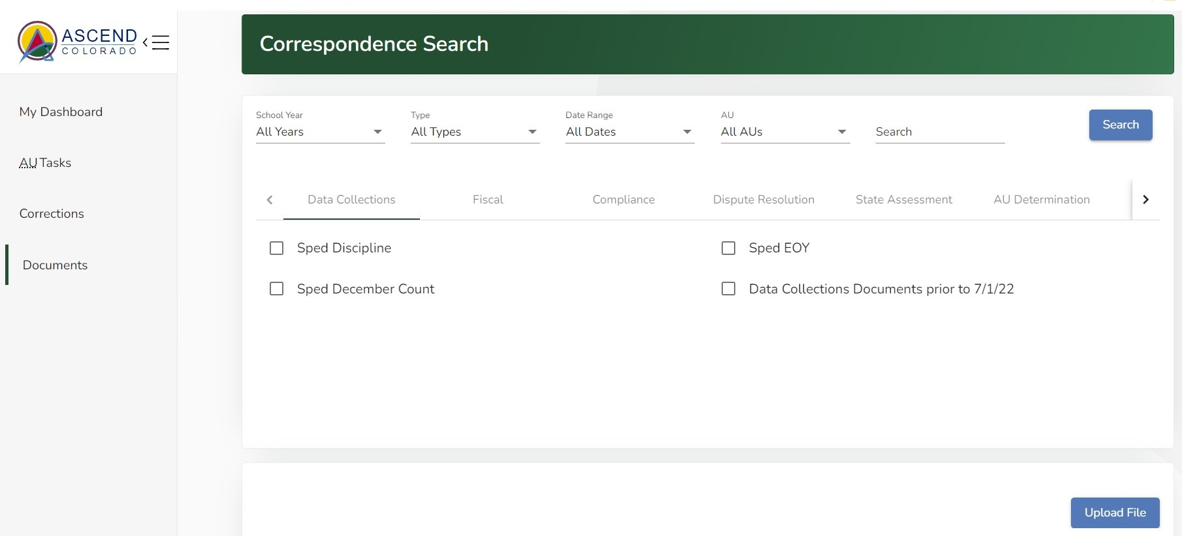
To Upload Documents
Click on “Upload File” button on this Documents Dashboard

Slide 24
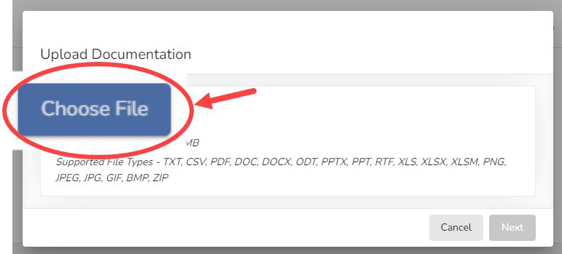
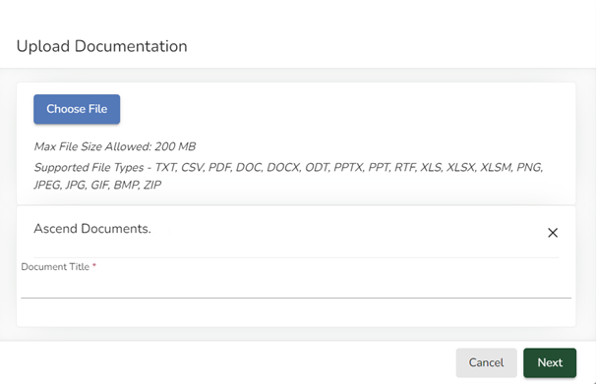
Uploading Discipline Report Documents
To upload documents:
  Choose the file(s) from your computer
  Type in the Document Title using the exact examples below.
“2024-25 Discipline Signature Reports” for the PDFs
“2024-25 Discipline Flag Explanations” for the Flag Explanations Word file
2024-25 Discipline Signature Reports

Slide 25
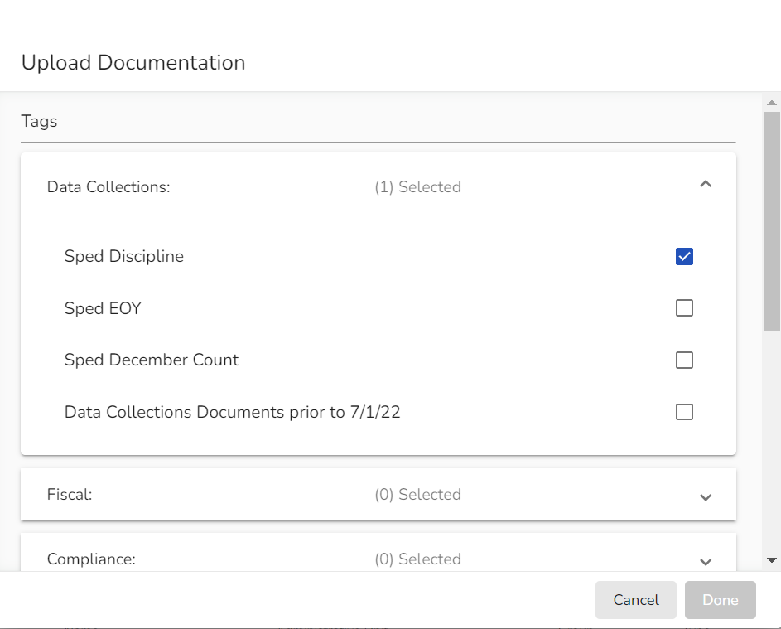
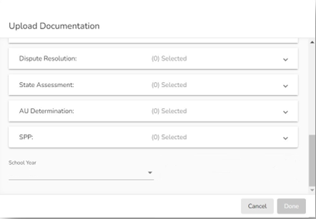

Tagging your Document
Use the carets on the right side of the Upload Documentation box to open Tag selection field for Data Collections
Select Sped Discipline
Scroll down
Select 2024-25 for the School Year
Click the “Done” button when it turns green (if it has not turned green, you have missed required info)

Slide 26
Final Snapshot Approval Steps within Pipeline
*required by August 1, 2025
Within Data Pipeline
1. Click Discipline on the left menu
2. Click Status Dashboard
3. Use the drop downs to select the appropriate values
  File Type: SPED Discipline Snapshot
  School Year: 2024-25
  Organization/LEA: defaults to your AU
Notice the Data Locked value on this screen is set to N
Notice the Overall Status is set to P (pending) indicating the data has not been submitted to CDE.
Check the box next to the Admin Unit name and number and then click on your Admin Unit name to get to the screen which contains the submit button.
Click the Submit to CDE button (Only SPI-APPROVERS will have this ability) (must have 0 errors)
Click OK
  A green message should display above the File Type box indicating the data was submitted
  The Data Locked value should change to Y
  The Overall Status should change to S

Slide 27

Assistance Needed?
For questions or support with the Special Education Discipline Data Collection, please contact:
Lindsey Heitman heitman_l@cde.state.co.us Collection Lead
Josh Fails Fails_j@cde.state.co.us Data Management System, Document uploads

