Slide 1
Short Bytes
ASCENT

Slide 2
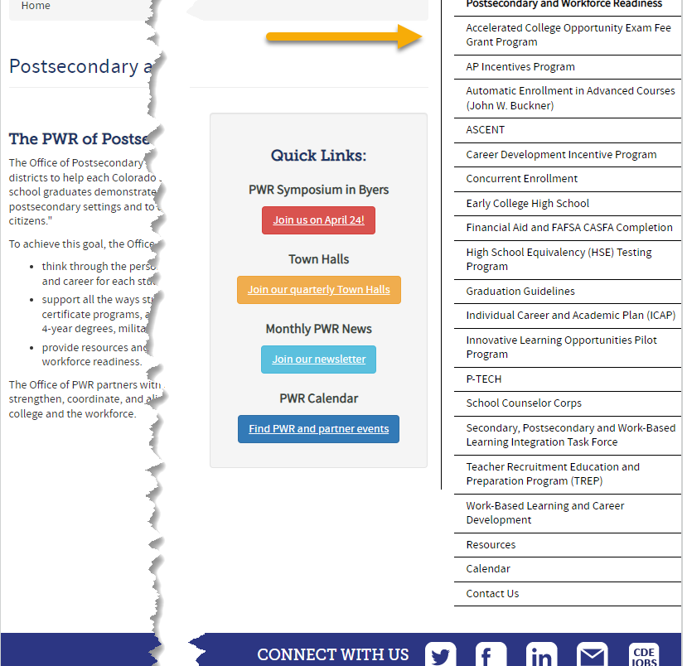
What are Postsecondary Programs?
Provide opportunities for high school students to demonstrate the knowledge and skills (competencies) needed to succeed in postsecondary settings and to advance in career pathways as lifelong learners and contributing citizens.
Support all the ways students can enter into postsecondary education – including certificate programs, apprenticeships and other work-based learning experiences, 2- and 4-year degrees, military, and career training.

Slide 3
General Information:
Types of Postsecondary Programs
Years 1-4
Years 5-6
Concurrent Enrollment
Early College
  Participating schools only
Dropout Recovery at a Community College
  Students Age 16 to 21
P-TECH Years 1-4
  Participating schools only
ASCENT (year 5 only)
P-TECH (years 5 & 6)
  Student must have been coded as PTECH in year 4
  Participating schools only
TREP (years 5 & 6)
  Slot allocation
Note: Number of years in High School is determined by the student’s Anticipated Year of Graduation (AYG). Only students with an AYG indicating they are in their 5th year are eligible for ASCENT. Only students in their 5th or 6th year per AYG are eligible for the applicable years of P-TECH or TREP.

Slide 4
ASCENT Program Overview
Accelerating Students through Concurrent Enrollment (ASCENT) is a fifth-year high school program that allows students to participate in concurrent enrollment the year after 12th grade, to enroll in postsecondary courses and earn college credit at no tuition cost to them or their families.
Additional costs, such as textbooks, fees, and transportation, are not required by the district to cover.
Students need 9 postsecondary credits to qualify.
ASCENT students are identified to CDE during Student October.

Slide 5
Postsecondary
Annual Coding Cycle
End of Year
October
Monitor for Status Changes
Monitor postsecondary program enrollment changes for students from OCT to SEY
Is the student actively participating in the postsecondary program?
Did the student participate in the postsecondary program at any point in the school year?
Coding remains the same as October unless and enrollment change occurred
Identify students that will be participating in ASCENT year 5 during Fall semester (retention code 2)
Reminder: Districts should verify student meets postsecondary requirements
Site: CDE Postsecondary and Workforce Readiness
Site: CDE Audit Resource Guide
Site: Student Interchange File Layout and Definitions-Student School Association
Student October
Is the postsecondary status of the student as of October 1st (Count Date)
Student End of Year
PS code is the summation of the current school year
PS code is not the status of the student for next year
Retention code 2 is the anticipated status for next year
Notes:
Reagan
Each school year, we have a typical cycle in order to monitor a student’s postsecondary status throughout the school year. Starting at the top left of our cycle with the Student October Collection. Each LEA should verify that every actively participating postsecondary (or ASCENT) student is coded as such. These students should be actively participating in this program as of October 1st of that school year. After the closing of the Student October collection, moving to the next section, please monitor these students throughout the school year for status changes. We expect that postsecondary statuses do not change from the beginning to the end of the year, but that doesn’t necessarily mean that it can’t happen. Moving on to Student End of Year. During our Student End of Year Collection, LEAs will not only need to monitor ASCENT students in the current school year, but also gather a list of those students that plan to participate in the following school year. Coding should remain the same as October unless an enrollment change occurred during the same school year. The Postsecondary code of the student is the summation of the current school year. A helpful question you can ask yourself is “Did the student participate in the postsecondary program at any point in the school year?” Moving on to our second group of students: Students that plan to participate in the following school year. During this collection, LEAs need to identify students that will participate in ASCENT in the following school year. Using a retention code 2 let’s us know that the student plans to return the following year for ASCENT.
Please visit the links on this slide if you have questions about postsecondary programs.

Slide 6
Counting for Graduation Rates vs Received Diploma
Colorado Graduation Rates
Diploma Issued
Students who return to participate in ASCENT, TREP, or P-TECH years 5-6 may be counted as a graduate for graduation rate purposes at the end of their 4th year if they have met local and state graduation requirements.
Prevents students participating in these programs from negatively effecting the 4-year on time graduation rate for the district/school.
Students participating in ASCENT, TREP, and P-TECH years 5-6 programs receive their high school diplomas at the end of their corresponding program.
Diplomas & Transcripts reflect a student’s final exit from K-12 education as the graduation date.
Notes:
Some notes on counting ASCENT students for graduation rates vs. when the student receives their diploma. Students who return to participate in ASCENT, TREP, or P-TECH years 5-6 may be counted as a graduate for graduation rate purposes at the end of their 4th year if they have met local and state graduation requirements. This prevents students participating in these programs from negatively effecting district’s 4-year on time graduation rate. When we talk about the issuance of the diploma for students that participate in our years 5 and 6 programs, they should be provided at the end of their corresponding program. For ASCENT students, this would more than likely be at the end of their 5th year due to the program. Both the diploma and the transcript will reflect the student’s final exit from K-12 education as the graduation date.

Slide 7
ASCENT: Coding Pattern
Counted as Graduate in 4th Year
Counted as Graduate in 5th Year
Years in HS (per AYG) | 4th | 5th
Grade Level | 120 | 120
Postsecondary Program | 00 or 02 | 01
School Entry Type | 02* | 90
School Exit Type | 90 | 24 or 23
Retention Code | 2 | 0
OCT Funding | 80** | FT, PT, N/A
Years in HS (per AYG) | 4th | 5th
Grade Level | 120 | 120
Postsecondary Program | 00 or 02 | 01
School Entry Type | 02* | 02 or 11
School Exit Type | 00 | 96
Retention Code | 2 | 0
OCT Funding | 80** | FT, PT, N/A
Notes:
*Entry Type in 4th year may be any applicable code
Exit 24 – Previous graduate who completed their ASCENT 5th year.
Exit 23 – Previous graduate who did not complete their ASCENT 5th year.
Diploma/Transcripts reflect exit date in the 5th year as the student’s graduation date.
**October funding in 4th year may be any applicable code
Notes:
Let’s review two different coding patterns we have for ASCENT students: students that were counted as a graduate in the 4th year and students that were counted as a graduate in the 5th year. For this presentation’s purpose, we will just review the 4th year graduate to show how to read these charts. Just a reminder, students participating in an ASCENT programs receive their high school diplomas at the end of their corresponding program (year 5).
Students that were counted as a graduate in the 4th year will have the following coding pattern if they anticipate returning as an ASCENT student in their 5th year. These students will be indicated in 12th grade (120). Their postsecondary program in that year will reflect either not in a postsecondary program 00 or 02 which means concurrent enrollment. The school entry type for these students will be any applicable code for that year and the student’s funding status is also any applicable code for that school year (in this case, we have a full-time student – 80). For this example, we are using 02 which means the student continued on as normal from the prior year. The student’s School exit type will need to reflect the student meeting graduation requirements – 90 and marked as retention code 2 meaning that the student plans on returning as a postsecondary student. When the student is in their 5th year, the School Entry Type will be 90 since the student is returning after being counted as a graduate. The funding code of the student will be dependent on the allocation slot the student is utilizing. The School Exit Type is depending on if the student completed the ASCENT program or not. If the student completed the program, you will use code 24. If the student did not complete the program, a code 23 will be used. The Retention code will change from 2 to 0 because the student will not return the next school year and again the funding status will be related to the allocation slot.
For our students that graduate in their 5th year, please use the coding pattern shown in the blue chart as it differs slightly to our other kiddos.

Slide 8
ASCENT: Types of Business Rule Checks
Exit type for ASCENT students should be 96, 23, or 24
  Exit Type 96 cannot be used if Exit Type 90 was used in a prior year
  Exit Type 23 or 24 cannot be used unless the student had Exit Type 90 in a prior year
ASCENT students included in the subsequent OCT who do not have retention code 2 in the current year SEY
  Example:
    If 2023-2024 OCT postsecondary code indicating ASCENT
    Then 2022-2023 SEY must have Retention Code 2
Students in ASCENT should have Non-School Program code 04 (Third Party Program) because they are taking their courses through the IHE
District Code in the current year for ASCENT students must match their last district of attendance in the prior year
Student in ASCENT must be in the 5th year of HS per AYG
Students in ASCENT should not have retention code 2 at the end of their 5th year
Student October (OCT) collection also includes checks to ensure ASCENT students utilize correct funding codes per OCT collection guidelines
Notes:
There are a handful of business rule checks for ASCENT, some of which are listed here. Students should have exit type 96, 23, or 24 at the end of their ASCENT program. (Exception exit type 16 for homebased education). ASCENT students included in the subsequent October Count who do not have retention code 2 in the current year SEY collection will flag an error. For example, if 2023-2024 OCT postsecondary code indicates ASCENT, then 2022-2023 SEY record must have retention 2 for that student. Students are also checked to ensure their last district of attendance in the prior year matches the current year and that the student is in their 5th year of HS per AYG. It is important to note that the OCT collection also includes checks to ensure ASCENT students utilize correct funding codes per OCT collection guidelines.

Slide 9
For more information, please reach out to the Student Interchange Leads or Postsecondary Unit.
Notes:
Reagan
Thank you for listening on this short byte regarding ASCENT students. For more information, please reach out to the Student Interchange Leads or Postsecondary Unit.

