Slide 1
Reporting Graduation Guidelines: (Student Interchange) File Overview April 6, 2022
Reagan Ward Data Service Unit: Data Analyst/Statistician ward_r@cde.state.co.us

Slide 2
Agenda
Graduation Guidelines Overview
Reporting Overview
Special Considerations
Data Reporting Details
File Upload: Step-by-Step Directions
GG File: Error Checking
SEY Errors & Reporting Exceptions
COGNOS/CEDAR Reports
Resources & Contacts

Slide 3
Graduation Guidelines Overview

Slide 4
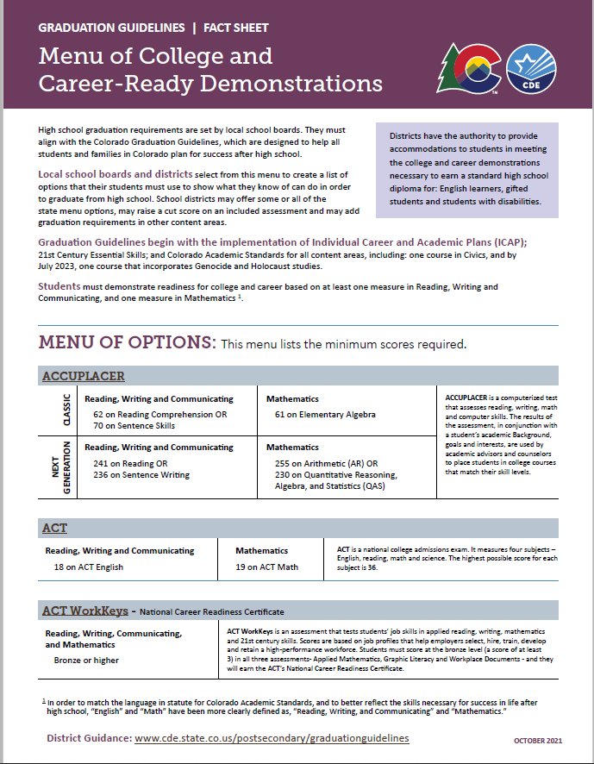
What are Graduation Guidelines?
A student’s demonstration of Postsecondary and Workforce Readiness (PWR) in Reading, Writing, and Communicating (RWC) and Mathematics.
In order to graduate from high school, students choose measures from a Menu of Options – adopted at the local school board level – that show their proficiency in RWC/Math.

Slide 5
What is on the Menu of Options?
Traditional Measures
Performance Assessments
District Capstone
Industry Certificates
Performance Assessments
Collaboratively-developed, standards-based
ACCUPLACER
ACT
ACT WorkKeys
Advanced Placement
ASVAB
Concurrent Enrollment
International Baccalaureate
SAT

Slide 6
Graduation Guidelines 2021-2022
Full implementation of Graduation Guidelines goes into effect for students graduating in the 21-22 school year and beyond.
YES
5th, 6th, and 7th year seniors from AYG 2021; and
All students who have an Anticipated Year of Graduation (AYG) of 2022 or beyond, including 3-year graduates
NO
Students from AYG 2020 and prior
6th year (AYG 2020)
7th year (AYG 2019)

Slide 7
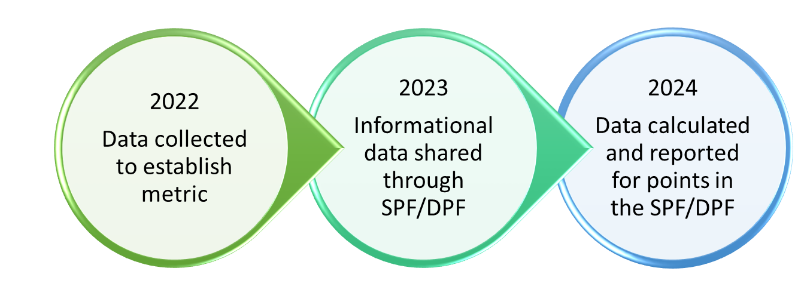
Graduation Guidelines Data Usage
Graduation Rate
Graduates (Exit Codes 90, 95, 96) require reported GG measures in English (RWC) and Math
*New* PWR Measure
“Higher Bar” metric
More information available on Accountability Site
NOTE: Accountability is on pause for 2021-22 due to COVID-19
Please see the accountability site for more information.
Notes:
Legislation:
C.R.S. 22-2-106
C.R.S. 22-11-204
C.R.S. 22-11-501
C.R.S. 22-11-504
S.B. 17-272
RWC = reading, writing, communicating
Math = Mathematics

Slide 8
Reporting Overview

Slide 9
How do districts report Graduation Guidelines?
Graduation Guidelines is a file in the Student Interchange
File layout, business rules, and template available on student interchange website
Matches with the Student School Association File and Student Demographic file based on SASID.
Graduation Guidelines is incorporated into the Student End of Year Collection as a validation check for Exit Type = 90, 95, or 96.
Any graduating student must have at least two records (i.e. rows) in the Graduation Guidelines file
At least one English (Guideline Type = 0)
At least one Math (Guideline Type = 1)
Student may have multiple English or Math records
Districts may report measures on any student

Slide 10
Who at the district is involved in reporting?
Program/Policy staff & Data Respondents must work together to report GG accurately and effectively.
Best Practice Suggestion
Data Respondent: pull a list of students who are likely to graduate in the current school year
Use information from Student Information Systems
COGNOS contains helpful reports as well, more information in
Program/policy staff: check which students have met GG with which guideline name from the menu of options
Data Respondent: Upload Graduation Guidelines file to data pipeline with GG data provided by Program/Policy staff
Repeat as needed

Slide 11
When do districts report this data?
Graduation Guidelines is a required file for the 2021-22 Student End of Year (SEY) data collection.
SEY data collection officially opens May 5, 2022.
SEY is currently in a ‘soft open’ phase
As with all Student Interchange files, this file can be uploaded multiple times throughout the school year.
This assists with sharing information on transfer students between districts.
This allows districts to keep the data up-to-date, simplifying the end of year data collection.
Allows data respondents and program/policy staff the ability to work on this file throughout the year before the summer break.

Slide 12
What’s new in 2021-2022 Reporting?
ACCUPLACER
Addition of guideline name Advanced Algebra and Functions ‘AAF’
ACT WorkKeys
Addition of ‘7’ as a valid score due to updated guidance from ACT WorkKeys
Industry Certificate
Updated Guideline Name Code acronym from ‘CRT’ to ‘IC’
Local Measure ‘LM’ guideline removed
Per the state board of education, LM was only provided as a graduation guidelines option for the class of 2021
Accommodations Fields can be zero-filled
IEP Accommodation
EL Accommodation
GT Accommodation
Not a required field
Removed entirely in 2022 - 2023
Zero-fill option available for 2021-2022

Slide 13
Are there any changes planned for 2022-2023 Reporting?
Updated score ranges
Align with vendor files
Act WorkKeys score range 1-7, 3 remains the benchmark
ASVAB score range 1-99, 31 remains the benchmark
Clarified Guideline Type Language
English is synonymous with Reading, Writing, Communicating (RWC)
Math is synonymous with Mathematics
Fields Removed
IEP Accommodation
EL Accommodation
GT Accommodation
District of Completion
2022-2023 GG File Layout is available on the Student Interchange site
Notes:
Note: Although the ‘district of completion’ field was removed, districts may still report graduation guidelines measures completed by a student in a prior district/state per a local district’s policies.

Slide 14
Special Considerations

Slide 15
Students with AYG Prior to 2021
Students with an Anticipated Year of Graduation (AYG) prior to 2020-2021 are not required to meet Colorado’s Graduation Guidelines.
Students with AYG 2020 and AYG 2019 should not trigger an error in data pipeline. Contact the SEY collection lead if an error does arise.

Slide 16
ASCENT Students
According to ASCENT law:
Students do not have to meet graduation requirements to continue in their ASCENT program for their 5th year.
This is a district decision.
Districts may count ASCENT students in their 4-year graduation rate if they have met local graduation requirements and GG prior to their ASCENT year.

Slide 17
Charter, Online, and Facility Schools
Charter schools must meet the local graduation requirements of their authorizers unless they seek waivers of those requirements by their authorizers.
Online schools are also held to the same Guidelines as spelled out in the legislation from 2008.
If they seek a waiver of the local requirements, charter or online schools would still need to adopt graduation requirements that meet or exceed the state’s guidelines and report on graduation guidelines.
All students in facility schools must meet the requirements and graduate through the Facilities School program at CDE. These Facility Schools Graduation Requirements are aligned with the state’s graduation guidelines.

Slide 18
Special Education Transition Students
Students do not have to meet graduation requirements to move into transition services.
However, if the student completes district graduation requirements and has ongoing transition needs (and will access 18-21 transition services), the district may count them (for state accountability purposes) as a 4-year graduate.
If the student is graduating with exit type code 90, the student must meet Graduation Guidelines in both English and math
If the student will not be using exit type 90, the student does not need to meet Graduation Guidelines.
More information regarding coding for Special Education Transition Students can be found on the Student Interchange website.

Slide 19
Data Reporting Details

Slide 20
Graduation Guidelines - Reporting
Minimum: All graduating students must have at least one GG met in English and at least one GG met in math.
Best Practice: A student’s GG records should capture any and all GGs attempted
REPORTING_SCHOOL_DISTRICT/ BOCES_CODE | SASID | SCHOOL_CODE | STUDENT_FIRST_NAME | STUDENT_LAST_NAME | STUDENT_GENDER | STUDENT_DATE_OF_BIRTH
1234 | 123456789 | 1234 | Test | Test |  | 01012000
1234 | 123456789 | 1234 | Test | Test |  | 01012000
This is YOUR district’s code
This is the reporting school
GUIDELINE_TYPE | GUIDELINE_NAME | GUIDELINE_SCORE | SCHOOL_YEAR_OF_COMPLETION | IEP_ACCOMMODATION | EL_ACCOMMODATION | GT_ACCOMMODATION | DISTRICT_OF_COMPLETION
0 |  |  | 20212022 | 0 | 0 | 0 | 1234
1 |  |  | 20202021 | 0 | 0 | 0 | 1234
Every student must have one GG reported in English (0) and math (1)
Based on GG menu of options – more examples on following slide
The year the student met a GG – not necessarily the reporting school year
Where student met GG
– not necessarily your district
– Can be zero filled ‘0000’
2021-2022 Graduation Guidelines Template

Slide 21
Accepted Guideline Scores vs. Benchmark Scores
Graduation Guidelines File Layout
Graduation Guidelines Menu of Options
Guideline Name and Description | Guideline Name Code | Accepted Guideline Score Values | Benchmark Scores
SAT The SAT is a college entrance exam that is accepted or required at nearly all four-year colleges and universities in the U.S. The current SAT includes sections on reading, writing, and math. The highest possible score for each section is 800. | SAT | 200-800 | Benchmark English: 470 Benchmark Math: 500
These are all the possible score values for students who take the SAT
*You can use any of these score values without getting an error in Pipeline*
This is the score a student must meet or exceed to use SAT as their English/math GG requirement
*A student with exit code 90 and SAT for GG must have at least a 470 reported in English and 500 reported in math to pass SEY error checking*

Slide 22
GG Case Studies
A student meets one English and one math requirement
A student attempts, and passes, more than the required one GG in math and one GG in English.
GUIDELINE_TYPE | GUIDELINE_NAME | GUIDELINE_SCORE
0 | SAT | 480
1 | AP | 4
GUIDELINE_TYPE | GUIDELINE_NAME | GUIDELINE_SCORE
0 | ACT | 21
1 | ACT | 24
0 | COL | 1
1 | AP | 5

Slide 23
GG Case Studies
A student attempts multiple GGs but did not meet any benchmark guideline scores.
A student attempts multiple GGs and did not meet on some guideline scores but does pass others.
GUIDELINE_TYPE | GUIDELINE_NAME | GUIDELINE_SCORE
0 | SAT | 390
0 | ASVAB | 18
1 | SAT | 450
1 | ASVAB | 18
GUIDELINE_TYPE | GUIDELINE_NAME | GUIDELINE_SCORE
0 | SAT | 390
1 | SAT | 450
0 | ASVAB | 18
1 | ASVAB | 18
0 | CAP | 1
1 | IC | 1

Slide 24
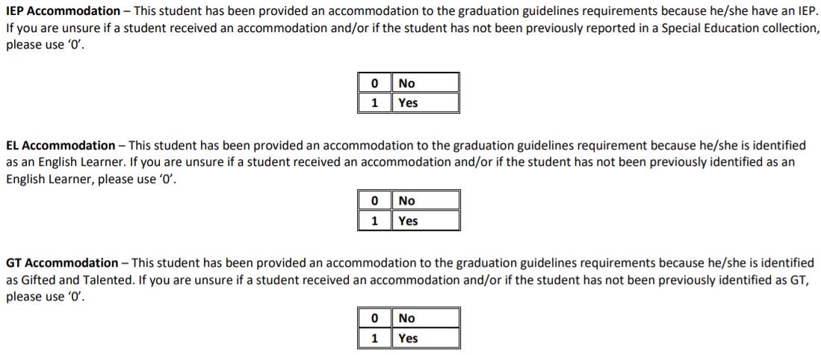
Students with Accommodations
NOTE: These fields can be zero filled ‘0’ for all student in 2021-2022. These fields will be removed from the file layout in 2022-23
There are 3 types of accommodation for GG:
English Learners (EL)
Gifted Students
Students with Disabilities
Student must have record in SPED Interchange to use this accommodation.
Student must be in IPST_COHORT_LEP (in Student End of Year) to use this accommodation.
Student must be in IPST_COHORT_GT (in Student End of Year) to use this accommodation.

Slide 25
File Upload Step-By-Step Directions

Slide 26
File Upload

Slide 27
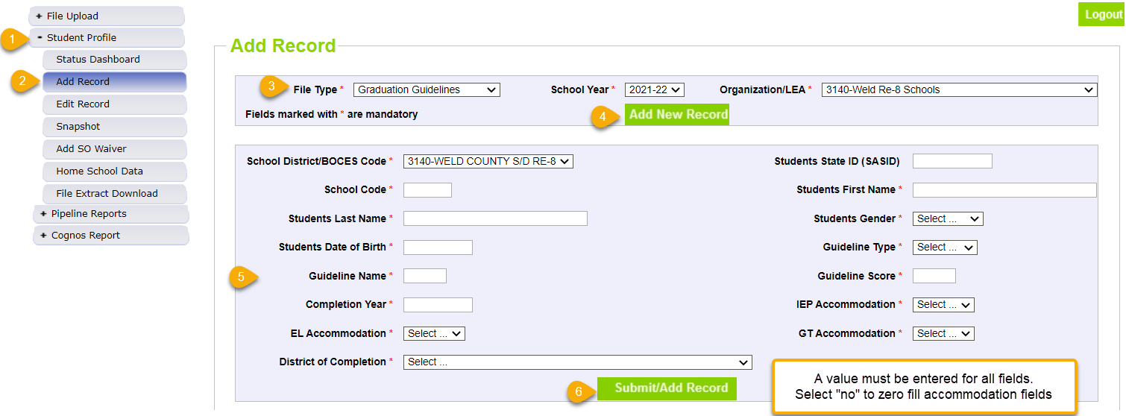
Add Record directly in Data Pipeline
Important Note: A file upload will overwrite any data that has manually been entered into data pipeline.

Slide 28
GG File: Error Checking

Slide 29
Business Rules and Overview
2021-2022 Graduation Guidelines Business Rules (updated 03/23/2022)
Two levels of Errors:
Interchange
SGxxx
Snapshot
SE301
Errors flagged after uploading GG interchange file
Error flagged after Student End of Year snapshot is taken

Slide 30
Graduation Guidelines File: Error Checking
Invalid score values
Guideline names that must use specific guideline type
Accommodation errors
Note: Accommodation fields may = 0 for all students
Notes:
Invalid score values
i.e., if Guideline name is AP score must be between 1 and 5
Guideline names that must use specific guideline type
i.e., if Guideline Name is QAS, Guideline Type must be math
Accommodation errors
A student may only be IEP Accommodation = 1 if the student has a record in the SPED interchange.
A student may only be EL Accommodation = 1 if the student is IPST_COHORT_LEP = 1 in Student End of Year
A student may only be GT Accommodation = 1 if the student is IPST_COHORT_GT = 1 in Student End of Year
Note: Accommodation fields may = 0 for all students

Slide 31
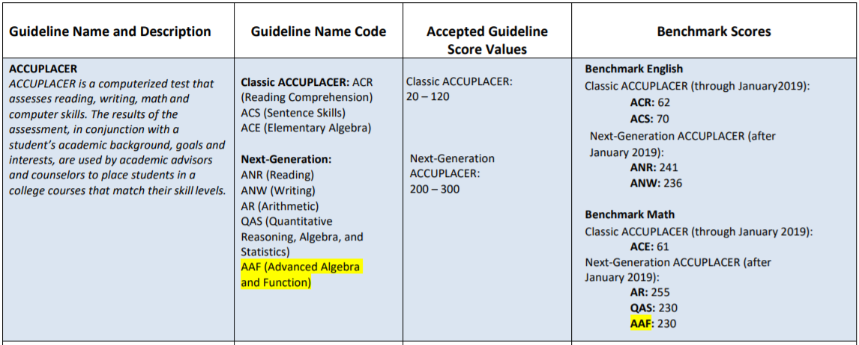
Common Errors: GUIDELINE_NAME
ACCUPLACER Guideline Name Codes are dependent on Guideline Type
Guideline Type = 0 (English)
Guideline Type = 1 (Math)
ACR, ACS, ANR, ANW
ACE, AR, QAS, AAF
ACE, AR, QAS, AAF
ACR, ACS, ANR, ANW
*Note: Guideline Name Codes are case sensitive, use UPPER CASE only*
Notes:
Pay attention to character length and guideline score range (i.e., SAT cannot do 3 digits below 200)
Guideline Name must be in all caps

Slide 32
Common Errors: GUIDELINE_SCORE
Accepted Guideline Scores change based on the Guideline Name
On the file layout, it says field length = 3
0, 8, 37, 67, 99
000, 067, 099, 100
0, 1
00, 001, 2, 3
200, 470, 500, 785
20, 150, 080, 999
*Note: Guideline Score does not accept leading zeros*
Notes:
The file layout is referencing the max field length (i.e., used for SAT and some other guideline names).
This does not mean all fields must be 3 – unique to other data fields (i.e., birthdate must always be 8) in that regard. There are never leading zeros for guideline score – just enter the actual score (i.e., ASVAB 74 not 074).

Slide 33
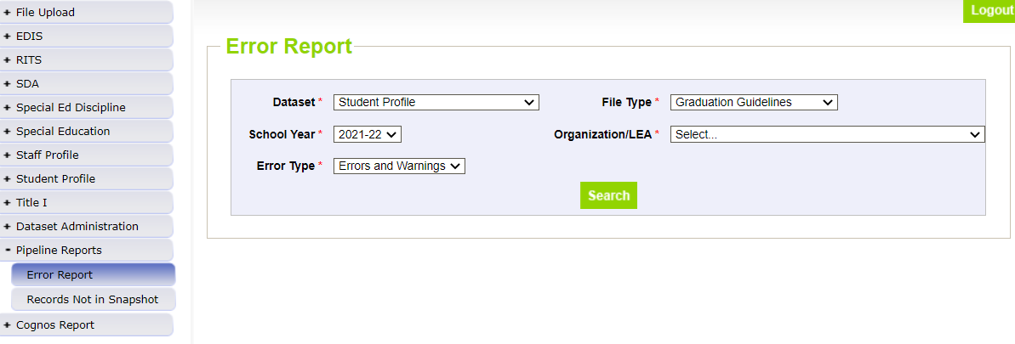
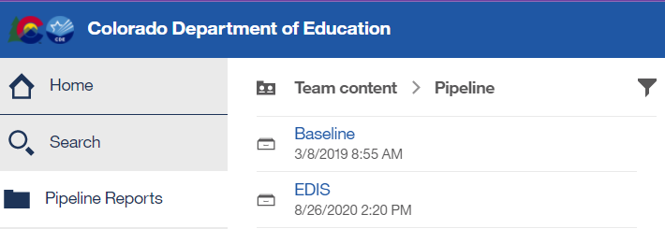
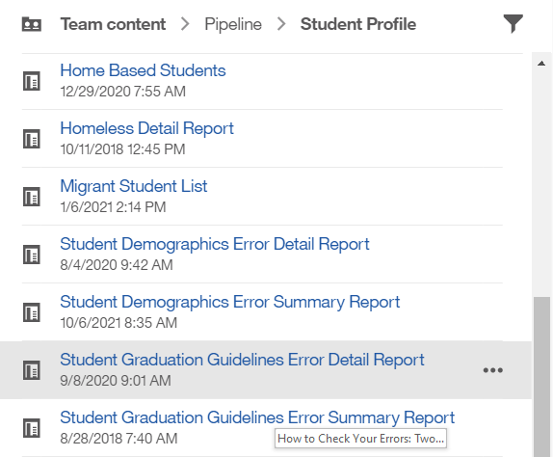
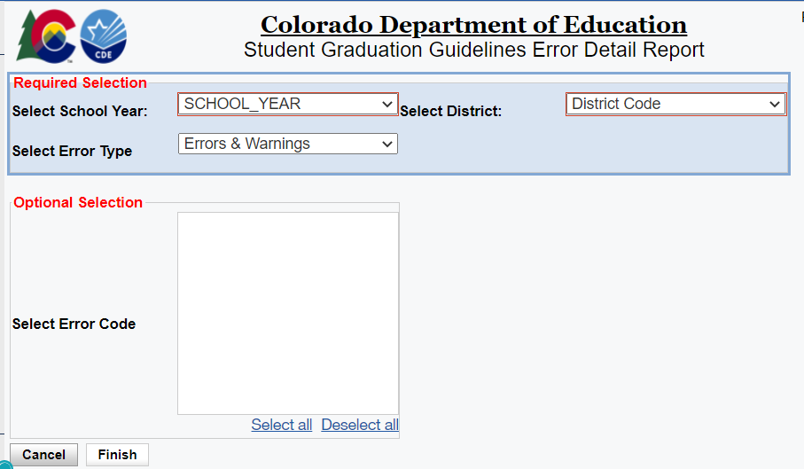
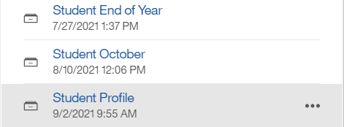
How to Check Your Errors: Two Methods
Method 1: Data Pipeline
Method 2: CEDAR/COGNOS Reports
This will show you the entire record for the student flagging the error/warning

Slide 34
SEY Errors & Reporting Exceptions

Slide 35
Business Rules and Overview
2021-2022 Student End of Year Business Rules (updated 03/14/2022)
SEY Business rules will not be finalized until May 5, 2022
Two levels of Errors:
Interchange
SGxxx
Snapshot
SE301
Errors flagged after uploading GG interchange file
Error flagged after Student End of Year snapshot is taken

Slide 36
SE301 Error Logic Graduation Guidelines + Student End of Year
If student’s exit type indicates graduate (exit 90, 95, 96)
And student’s AYG is >= 2021
Search for matching Graduation Guidelines records in data pipeline, matched on SASID
At least one matching English at/above minimum benchmark
At least one matching Math at/above minimum benchmark
Corresponding GG records found; no error triggered
Missing a GG record for English and/or Math; error triggered

Slide 37
Student End of Year: SE301 Errors
Error Message: “This student was reported with an exit type of 90 (graduating with a regular diploma) or 95 or 96. However, this student does not have a record of meeting graduation guidelines in English and/or math in the Graduation Guidelines file (GG). Please add this student to your Graduation Guidelines file or change the school exit type.”
Resolutions:
Add missing GG record(s) for this student to your GG interchange file
Change the student’s exit type to something other than a graduate (Exits 90, 95, 96)
Contact SEY data collection lead for possible reporting exception
Notes:
Exit 90 = graduated with regular diploma
Exit 95 = graduated with regular diploma in current year after being reported as a HSED recipient by the reporting district in a prior year
Exit 96 = graduated and completed a postsecondary program

Slide 38
When are reporting exception used?
Used if the student’s educational history is coded accurately (within the parameters of the collection), but their data doesn’t fall within the expected values identified in the business rules for a given collection.
These are unique circumstances and apply to few students
Reporting exceptions are used to clear the errors associated with a student’s record without changing the data.
Data respondents must work with the data collection lead for a given file/snapshot to request an exception be granted
Notes:
Student End of Year data collection is focused on accurately reporting a student’s educational history for the purpose of calculating graduation/completion, dropout, and mobility/stability rates.

Slide 39
Reporting Exception Process
Complete exception request template
Upload exception request template to your district’s Syncplicity student folder
Folder: 1234 – DISTRICT NAME – Student
Notify the SEY collection lead (ward_r@cde.state.co.us) that you’ve uploaded a document for review
Subfolder: SEY 2021-22
Collection lead will review your request and notify you of the outcome
Approved requests – reupload interchange file and/or create a new SEY snapshot
Denied requests – collection lead will provide next steps for clearing the error
Additional information needed – collection lead will request information
Available on SEY Website
Pro Tip: Include the date in name of your exception request file as you may upload more than one exception during the collection cycle

Slide 40
SE301 Exceptions
May be reviewed by other CDE departments
Submit to SEY Collection lead via syncplicity
Allow additional time for review
Possible reasons for an exception
Missing or incorrect information
Military compact (late transfer from another district/state)
Documentation delays (i.e. test results delayed)
Late transfer (senior year) from another state or country

Slide 41
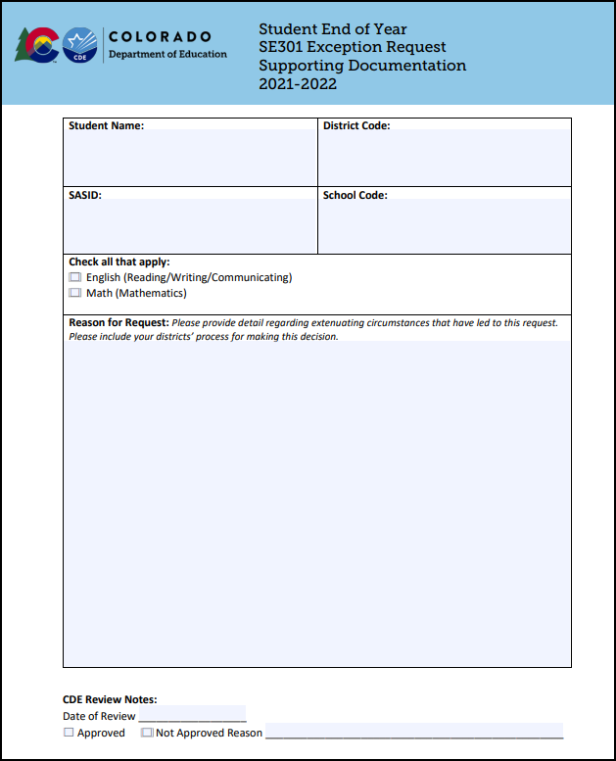
Supporting Documentation
Reason for Request: “Please provide detail regarding extenuating circumstances that have led to this request. Please include your districts’ process for making this decision.”

Slide 42
COGNOS/CEDAR Reports

Slide 43
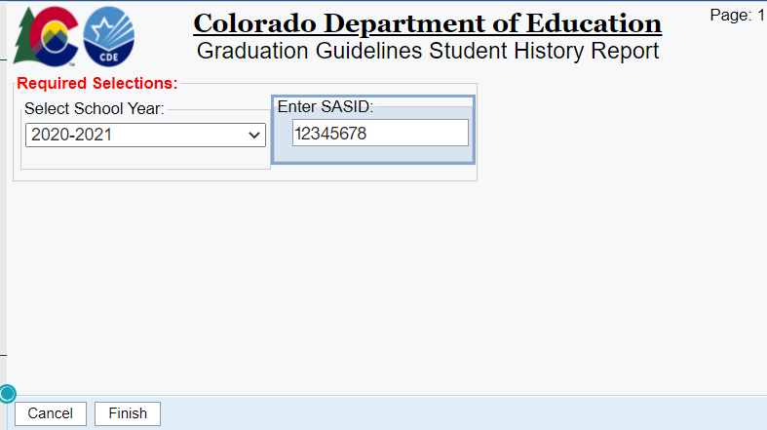
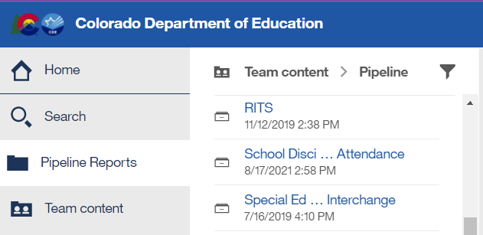
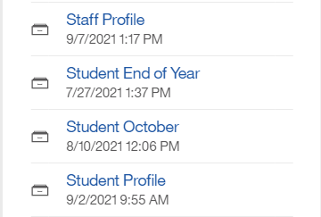
Graduation Guidelines Student History Report
Student Profile
This report reflects information for a given SASID that has been reported by a CO district
Reflects data for any student grades 9-12 that has been reported by any CO district
One tool to assist in determining GG measures for transfer students
It is best practice to upload/update your GG file frequently throughout the school year

Slide 44
Graduation Guidelines: Student Completion List
Student Profile
List of any completed measures for all students in district
If the student does not have any reported measures, they are excluded from the list
Student list based upon current SSA file
Graduation Guidelines measures based upon any reported measures (all years/districts) found in data pipeline
Matched on SASID
Includes ‘Met Benchmark Y/N’ field
Can be exported to excel

Slide 45
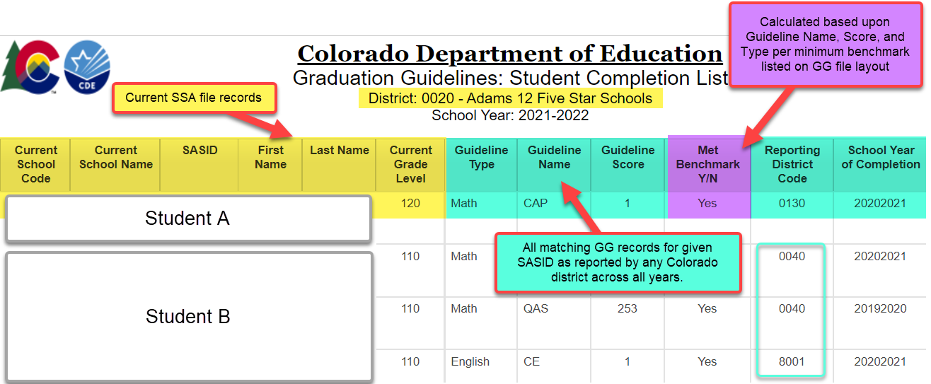
Graduation Guidelines: Student Completion List
Student Profile
Notes:
Report updates with SSA file upload and GG file upload
Only reflects reported measures. A student may have completed a measure in a prior district that has not been reported to CDE.

Slide 46
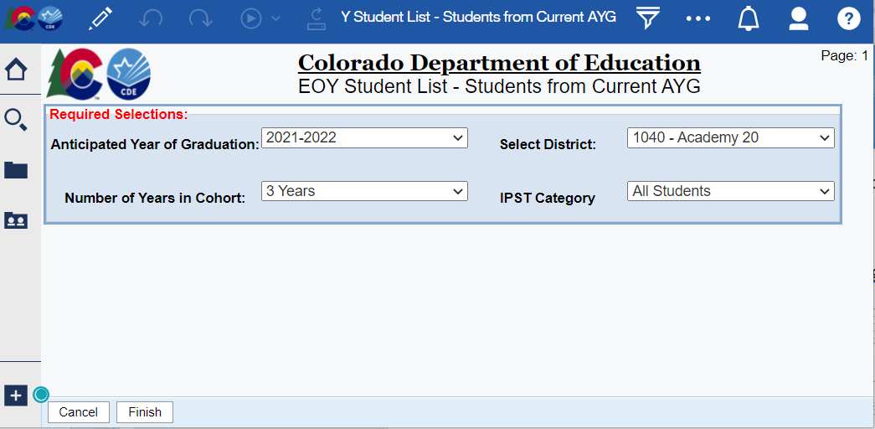
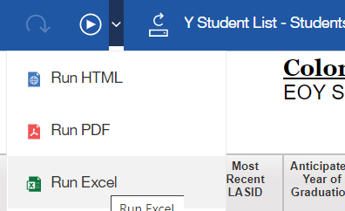
EOY Student List – Students from Current AYG
Student End of Year
Provides list of student names by AYG
Can be exported to excel
Notes:
Once the student end of year data collection has opened, select ‘4 years in cohort’ when select current AYG year.

Slide 47
Resources & Contacts

Slide 48
Resources
Reporting Resources
General Information
Student Interchange Website
GG File Layout and Definitions
GG Business Rules
GG Template
Student End of Year Website
GG training resources
Graduation Guidelines website
Menu of Options webpage
Guidance for English Learners, Gifted Students, and Students with Disabilities
Graduation Guidelines Promising Practices
Graduation Guidelines FAQs

Slide 49
Contacts
Name | Area of Expertise | Contact Info
Reagan Ward | Student End of Year Graduation Guidelines Reporting | Ward_r@cde.state.co.us 303.866.6970
Brooke Wenzel | Student Interchange Graduation Guidelines Backup | Wenzel_b@cde.state.co.us
Robin Russel | Graduation Guidelines Manager | Russel_r@cde.state.co.us
Andy Tucker | Director Postsecondary and Workforces Readiness | Tucker_a@cde.state.co.us

