Slide 1
DATA PIPELINE NEW COLLECTION- STAFF EVALUATION OFFICE HOURS

Slide 2
Office Hours Agenda
HB 22-070
Process of collection
Staff Profile
Staff Assignment
Staff Evaluation-NEW FILE
Timeline
What job codes are reported
Staff Evaluation file
Staff Evaluation Snapshot
Process
Questions

Slide 3
How can we narrow the gap between collection and analysis/reporting?
HB 22-070
How Evaluations have been collected in Human Resource collection? What has changed?
Evaluations conducted in Spring of each academic year
Reported the following year as part of the Spring HR collection
i.e.; Spring 2019 evaluation data wasn’t available until Spring/Summer 2020, a full calendar year later
Dashboards and reporting are always at least one year out of date
Insights are no longer useful
Dashboards are not meaningful 1+ years later
Evaluations for staff who have left the district are missing and, therefore, the data are incomplete

Slide 4
SB 22-070
Creation of a new data collection for districts/BOCES to report evaluation ratings annually to CDE by October 15th
These are the same fields contained in the current interchange that CDE is collecting now, but they will be collected (1) earlier and (2) separately.

Slide 5
Reporting 2022-2023 Evaluation Data
Staff Profile
May 2023 – October 2023
Staff Evaluation Snapshot
Staff Assignment
Staff Evaluation

Slide 6
Identity Management Roles
Staff Interchange Roles (both 4-digit LEAs and 5 digit AUs):
STF~ LEAUSER – upload and modify staff interchange files OR
STF~LEAVIEWER – view (only) staff interchange data
Human Resources Snapshot Roles (only 4-digit LEA codes):
HRD~LEAAPPROVER – Approves, creates, views Snapshot OR
HRD~LEAUSER - creates, views Snapshot OR
HRD~LEAVIEWER- views snapshot

Slide 7
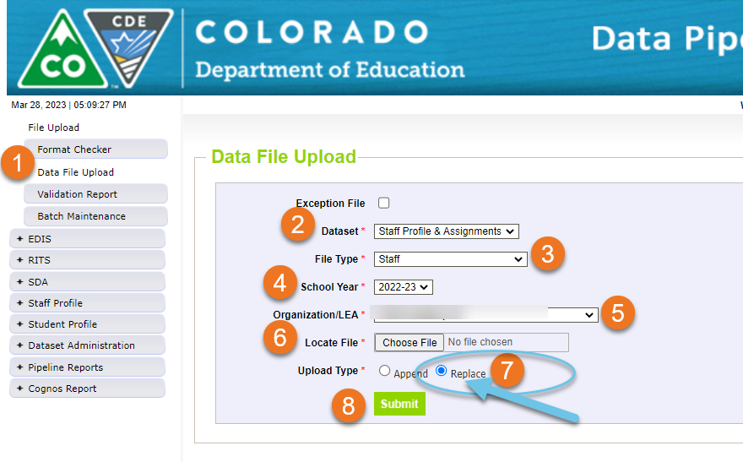
STAFF PROFILE FILE
Staff Profile Resources
Staff Interchange Website
Staff Profile file layout
Staff Profile Template
Staff Profile Business Rules
First upload an updated Error Free Staff Profile file
Upload an updated Staff Profile file

Slide 8
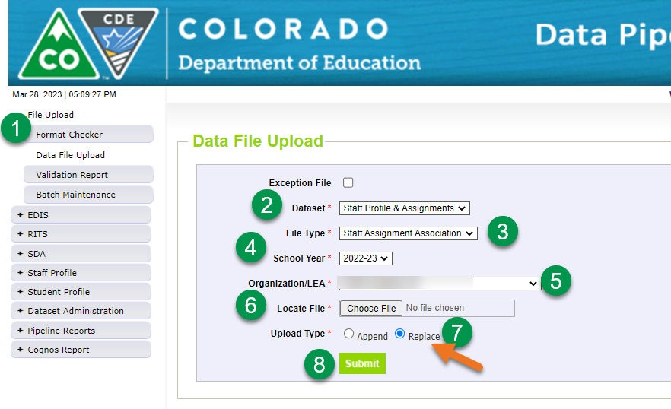
STAFF ASSIGNMENT FILE
Staff Assignment Resources
Staff Interchange Website
Staff Assignment file layout
Staff Assignment Template
Staff Assignment Business Rules
Second upload an updated Error Free Staff Assignment file
Upload an updated Staff Assignment file

Slide 9
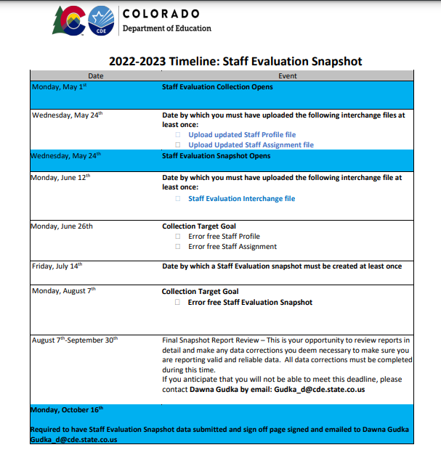
Staff Evaluation Collection Timeline
Opens May 1st
Can upload updated Staff Profile, and Staff Assignment file before May 1st
Staff Evaluation file can be uploaded
Collection Target Goals
Timeline Goals help districts meet the final deadline
Collection Final Deadline
Data is Due October 16th

Slide 10
Questions?
NEW COLLECTION, WHY?
RANDA AND OTHER VENDORS
SETTING UP A 1:1 Team meetings
My job is to help you navigate through this collection
ANY QUESTIONS ABOUT THE COLLECTION, THE PROCESS
PLEASE REACH OUT!!!

Slide 11
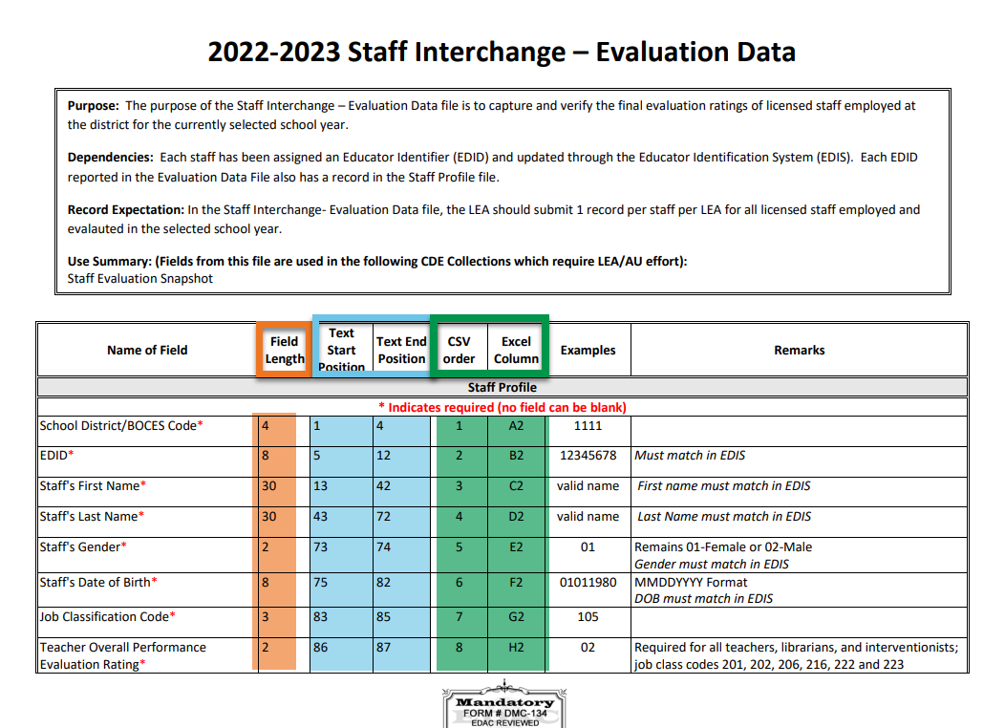
Staff Evaluation File

Slide 12
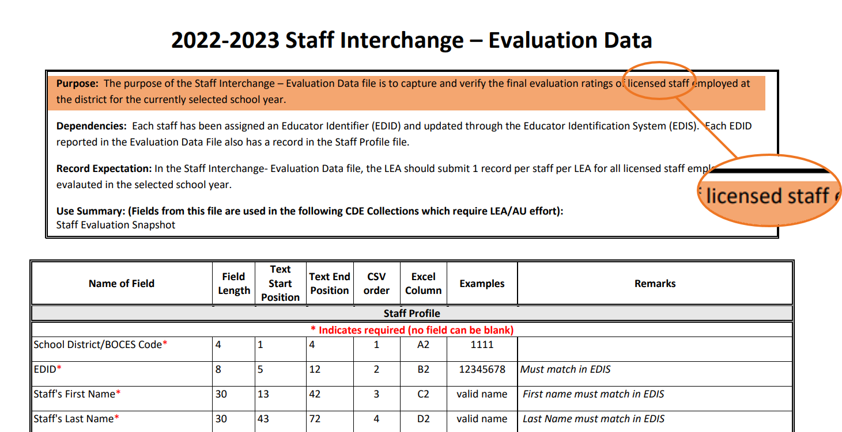
Licensed Staff
2022-2023 Evaluation Data
Staff Evaluation File Layout

Slide 13
Job Codes
Teachers, Librarians, and Interventionist
2022-2023 Evaluation Ratings
201 Teacher, Regular
202 Teacher, Special Education
206 Teacher, Title 1
216 Librarian/Media Consultant
222 Reaching Interventionist
223 Math Interventionist
Teacher Overall Performance Evaluation Rating
Teacher Quality Standard 1: Know Content
Teacher Quality Standard 2: Establish Environment
Teacher Quality Standard 3: Facilitate Learning
Teacher Quality Standard 4: Professionalism
Teacher Measures of Student Learning
2022-2023 Evaluation Data

Slide 14
Special Services Provider
Job Codes
2022-2023 Evaluation Ratings
211 Counselors
231 Audiologist
233 School Nurse, Registered Nurse
234 Occupational Therapist
235 Physical Therapist
236 Psychologist
237 Social Worker
238 Speech Language Pathologist
242 School Orientation and Mobility Specialist
Special Services Provider (SSP) Overall Performance Evaluation Rating
Special Services Provider (SSP) Quality Standard 1: Professional Expertise
Special Services Provider (SSP) Quality Standard 2: Learning Environment
Special Services Provider (SSP) Quality Standard 3: High Quality Delivery
Special Services Provider (SSP) Quality Standard 4: Professionalism
Special Services Provider (SSP) Measures of Student Outcomes
2022-2023 Evaluation Data

Slide 15
Principals
Job Codes
2022-2023 Evaluation Ratings
105 Principals
106 Assistant/Deputy/ Associate Principal
Principal Overall Performance Evaluation Rating
Principal Quality Standard 1: Strategy
Principal Quality Standard 2: Culture
Principal Quality Standard 3: Instruction
Principal Quality Standard 4: Professionalism
Principal Measures of Student Learning
2022-2023 Evaluation Data

Slide 16
Vendors
Vendors have been notified of the Staff Evaluation file layout
Its always a good idea to reach out to your vendor and find out if they are creating an extract for you to use to upload into Data Pipeline and if they are unaware of the new file, send them the file layout.
2022-2023 Staff Evaluation File Layout

Slide 17
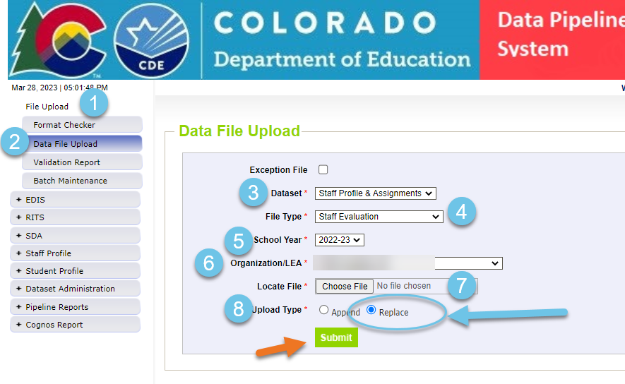
STAFF EVALUATION
Third Staff Evaluation File Upload
Staff Evaluation Resources
Staff Evaluation Website
Staff Evaluation file layout
Staff Evaluation Template
Staff Evaluation Snapshot file layout
Staff Evaluation Business Rules
Staff Evaluation Snapshot Business Rules
Staff Evaluation Timeline
Training
Senate Bill 22-070

Slide 18
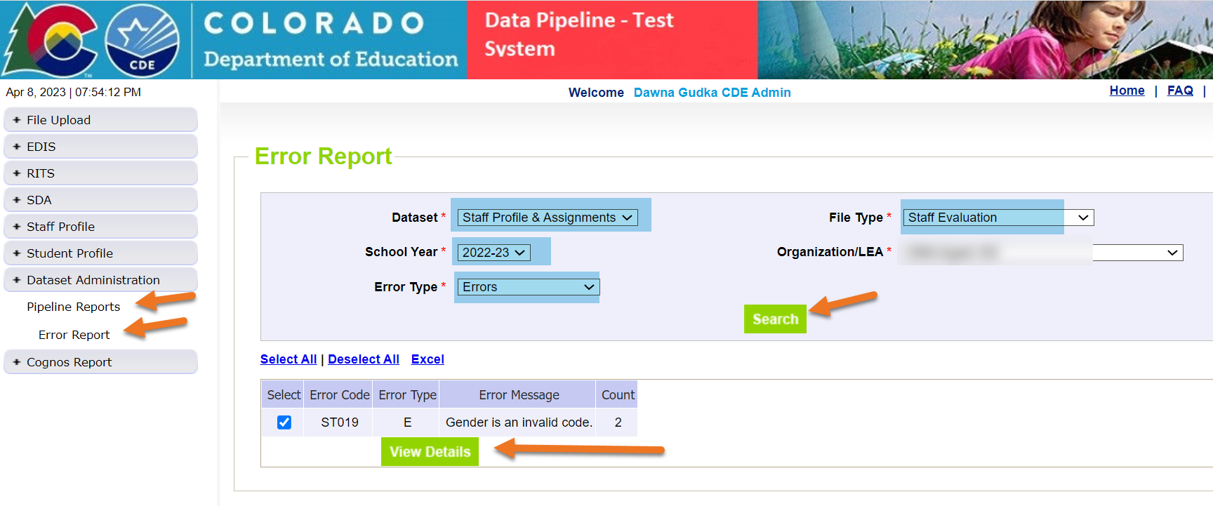
Error Report

Slide 19
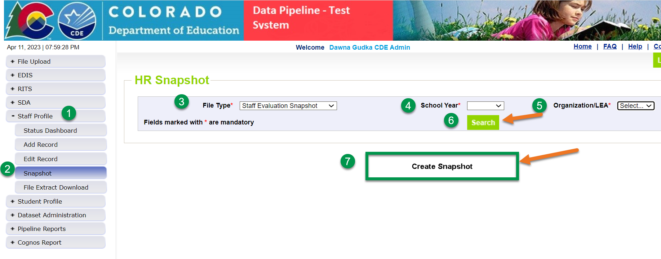
Staff Evaluation Snapshot
Staff Profile~Snapshot~
File Type: Staff Evaluation Snapshot~School Year 2022-23~LEA~Search~Create Snapshot

Slide 20
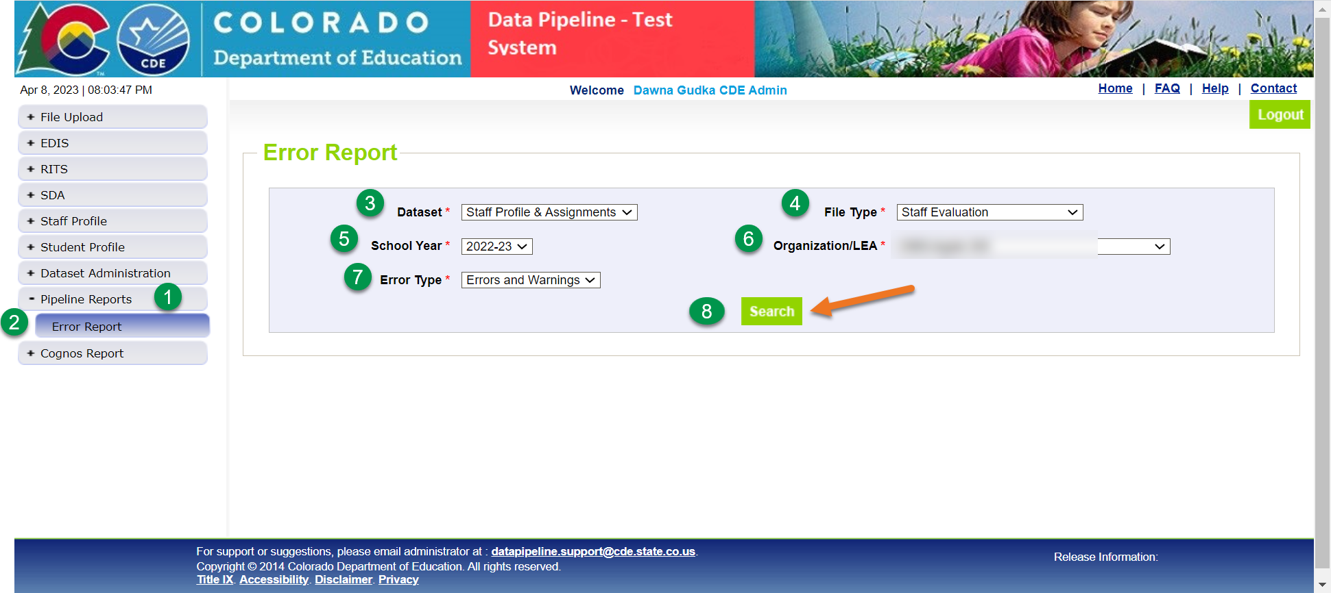
Checking Snapshot Errors

Slide 21
Collection recommendations
Start NOW by uploading updated Staff Profile and Staff Assignment File
May 1st upload Staff Evaluation file
Create Staff Evaluation Snapshot
Get your Staff Evaluation Data Submitted before 2023-2024 School Year rolls around

Slide 22
Office Hours & Training
OFFICE HOURS
April 12th 9-10am TODAY
April 19th 1-2pm
Microsoft Teams meeting Click here to join the meeting
COLLECTION TRAINING
April 26th 9-10am
Microsoft Teams meeting Click here to join the meeting
Townhall
Every Thursday 9-10am
Microsoft Teams meeting
Join on your computer or mobile app
Click here to join the meeting
Or call in (audio only)
+1 929-341-4269,,760274086# United States, New York City
Phone Conference ID: 760 274 086#
Find a local number | Reset PIN
Learn More | Meeting options

Slide 23
Questions & Resources
Dawna Gudka
Any questions, please reach out:
(303) 598-7901
Gudka_d@cde.state.co.us

