Slide 1
AEC Collections Webinar:
Collection Window 1 Overview
2/2/2025
Accountability Analytics Unit

Slide 2
Agenda
Collection Window 1 Overview
  Collections & Timeline
  Collections Checklist
  Pipeline Basics
Renewal/Application Collection
  Collection Basics
  Resources
  Submitting Your Data
  Reports
  Error Logic
  Collection Opt Out
  Sign Off Sheets
Planned Measures For 2025 Collection
  Update on Accountability Pause
  Collection Basics
  Resources
  Submitting Your Data
  Error Logic
  Collection Opt Out
Resources, Trainings & Contacts

Slide 3
Collection Window 1 Overview
Collections & Timeline
Collection Checklist
Pipeline Basics

Slide 4
Collections and Timeline
Timeline:
January:
Notify B Sanders/April Thompson of new schools seeking AEC designation by 1/31/2024
March:
Renewal/Application collection opens 3/19/2025
Planned measures for 2025 SPF collection opens 3/19/2025
Office Hours Available
April
Renewal/Application collection closes 4/25/2025
May
Actual measures for 2025 AEC SPF collection opens 5/14/2025
Office hours for Selection of Measures
June
Planned measures for 2025 AEC SPF collection closes 6/27/2025
Actual measures for 2024 AEC SPF collection closes 6/27/2025
Office hours for Selection of Measures

Slide 5
Collections Checklist
Collections Checklist
Review the file layout and definitions document and other resource documents
Decide how you will submit your data OR decide if you will opt out of data collection
Download your submission sign off form
Complete your data submission OR opt out of data collection
Gather necessary signatures
If data is submitted check submission for errors
Finalize data submission using the Status Dashboard in Pipeline
Email completed sign off form(s) to B Sanders
Submissions process is complete when all steps are complete

Slide 6
Collections Checklist for Renewal/Application Collection
In Collection Window 1, you only need to do this for the Renewal/Application Collection.
Collections Checklist
Review the file layout and definitions document and other resource documents
Decide how you will submit your data OR decide if you will opt out of data collection
Download your submission sign off form
Complete your data submission OR opt out of data collection
Gather necessary signatures
If data is submitted check submission for errors
Finalize data submission using the Status Dashboard in Pipeline
Email completed sign off form(s) to B Sanders

Slide 7
Pipeline Basics
Accessing Data Pipeline
  If you are managing the AEC Collections for your district/BOCES – in part or in whole – then you will need to work with your local area manager (LAM) to receive data pipeline permissions
Role for collections: AEC~LEAAPPROVER
  Grants ability to sign into Alternative Education tab in Data Pipeline and the ability to submit data to CDE for these collections
  Ability to download/upload extracts to AEC collections
  Ability to edit records for Renewal/Application Collection
  Ability to add and edit records for Planned Measures for 2024 AEC SPF Collection
  Ability to opt out of AEC collections
You cannot participate in the AEC Collections unless your LAM has assigned you to the AEC~LEAAPPROVER role!

Slide 8
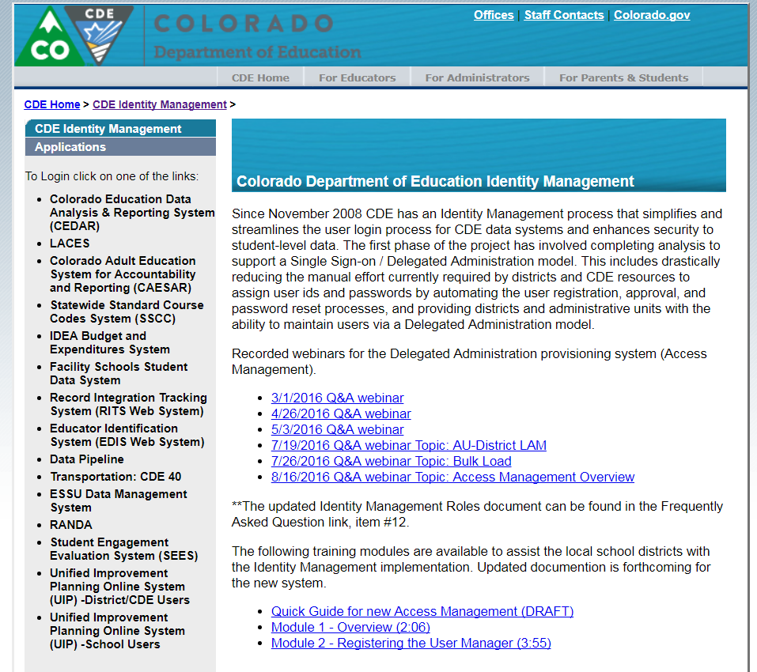
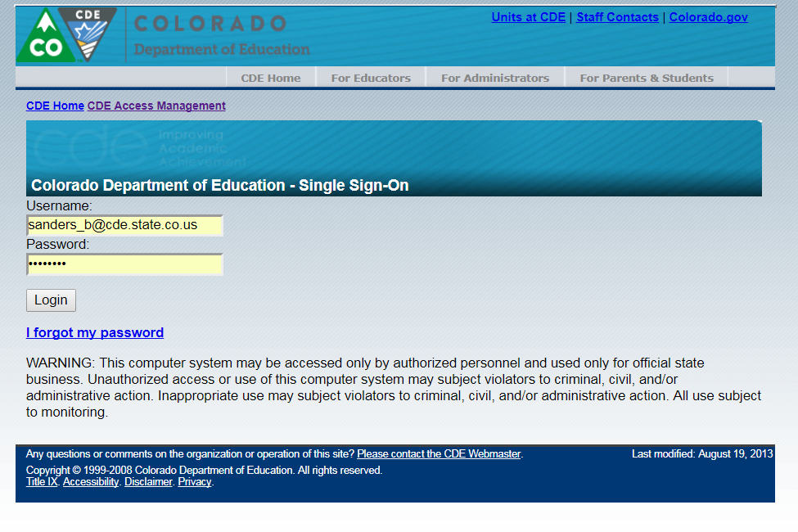
Data Pipeline Access
http://cdeapps.cde.state.co.us/index.html

Slide 9
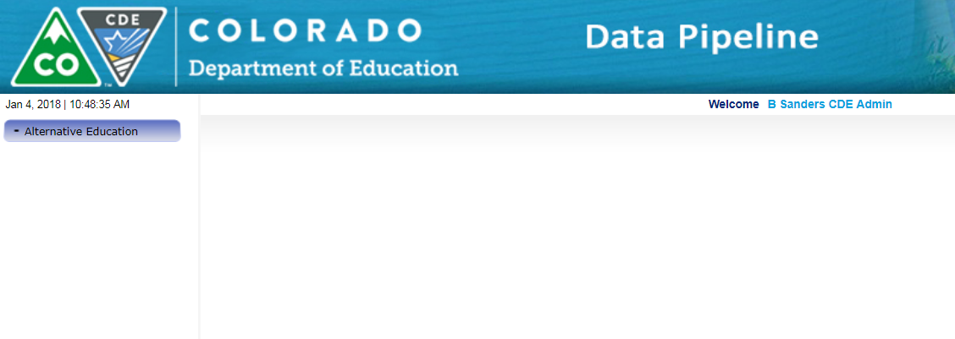
Data Pipeline- LEA Approver Role
If you have permissions to the AEC LEA Approver role, then you should see Alternative Education on the left-hand side of the menu when you log into Data Pipeline.
If you do not see this option, contact your LAM and confirm your role permissions.

Slide 10
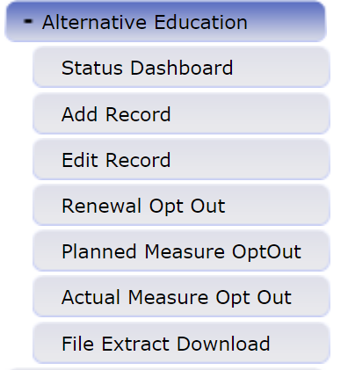
Data Pipeline – Alternative Education Tab
This is where you will start for all AEC Collections.
Use this to formally submit your completed data submission to CDE. You can also use this to check errors in your data submission before finalizing it.
Add records for the Planned Measures for 2024 Collection.
Use for both the Renewal/Application and Planned Measures for current year collections.
Opt a school, or schools, out of either collection.
Download file extracts for each collection.

Slide 11
Pipeline Basics - Errors
Errors in Data Pipeline:
Invalid codes
  Missing data in required fields
  Incorrect codes in a given field
Data that breaks a logic rule in a given field
Data errors will need to be resolved before submitted data can be finalized.

Slide 12
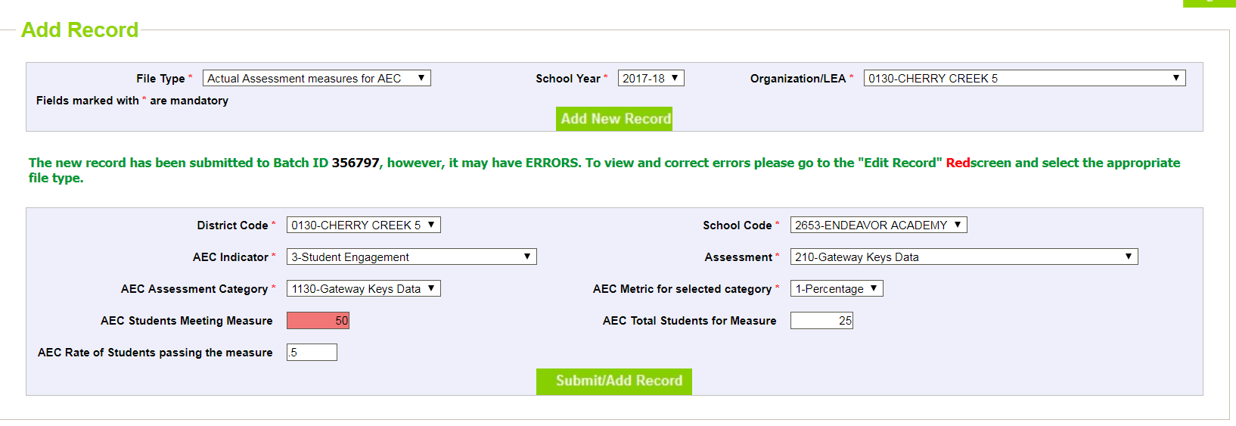
Data Pipeline – Error Flags
2023-24
Records added with errors will still be submitted to the Data Pipeline system, but you will receive a notice that they are an error, and they will be flagged in RED. They will be flagged this same way in the Edit records screen.

Slide 13
Renewal/Application Collection
Collection Basics
Resources
Submitting Your Data
Finalizing Your Data
Reports
Error Logic
Collection Opt Outs
Sign Off Sheets

Slide 14
Renewal/Application Collection Basics
AEC Renewal/Application Collection
  REQUIRED for any school that wishes to receive Alternative Education Campus (AEC) designation from the state
  This designation allows for the school to be accredited using the AEC School Performance Framework (SPF)
  Collection is student level and uses personally identifiable information (PII)
    No high risk designation data from this collection is used in any subsequent reporting
  Threshold for designation is still 90% high-risk as of the school’s 2025-26 October Count population
    Data is pre-populated from October Count, Student End of Year, Student December, and previous year AEC Renewal/Application submissions for students who have re-enrolled at the same AEC for multiple October Counts (for these students, we carry forward district designated high risk categories)

Slide 15
Renewal/Application Collection - Explanation
Renewal Schools: Schools that received AEC designation for the 2024-2025 school year and are re-applying for the 2025-2026 school year
  Full list of schools with 2024-2025 AEC designation
Applicant Schools: Schools applying for AEC designation for the 2025-2026 school year that did not have AEC designation in the 2024-2025 school year
  Schools applying for AEC designation for the first time
  Schools re-applying for AEC designation after a lapse in designation

Slide 16
Renewal/Application - Sites Visits and Monitoring
Routine Monitoring Site Visits: These visits are opportunities for school and district staff to meet with CDE staff. In these visits, CDE staff provide clarification on AEC related processes and provide technical support where needed. Monitoring site visits may occur in the following conditions:
  Onboarding Site Visit: All school applying for AEC designation for the first time or applying after a lapse in designation status receive an onboarding site visit.
  Monitoring Site Visit: Schools in districts which have not had a routine site visit or a data audit in the last four years may be selected for a monitoring site visit.
Data Audits: A school in your district may be selected for an in-person audit by CDE personnel for any of the following reasons:
  The district opted out of providing student-level data for the school during the Renewal/Application Collection process
  Data irregularities were found during the Renewal/Application Collection process
  The district has excluded the AEC from the district’s District Performance Framework in a previous accountability cycle

Slide 17
Renewal/Application - Resources
What do you need? | Why do you need it? | Where do you get it?
List of AECs with current AEC designation | Determine if a school is a renewal school or an applicant school | https://www.cde.state.co.us/accountability/sbe_aecdesignees_2023_updatedlogo-0
Renewal/Application File Layout and Definitions | Understand fields needed for data submission | http://www.cde.state.co.us/datapipeline/per-aec
Confirmation that you have access to the AEC Collections in Pipeline | Cannot submit data without access to Data Pipeline | Local Area Manager grants AEC~LEAAPPROVER role permission
Sign off sheets for Renewal/Application Collection downloaded | Data submission is not considered final until sign off sheets are submitted | http://www.cde.state.co.us/datapipeline/per-aec
Documentation requirements for high-risk student identification available for review | If district/BOCES is using district-identified categories, review of documentation requirements is helpful | http://www.cde.state.co.us/datapipeline/per-aec

Slide 18
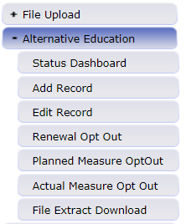
Renewal/Application Submitting Your Data – File Upload
Use File Download/Upload to complete if:
  You have several AECs in your district/BOCES or if you have particularly large AECs in your district/BOCES
  The staff completing the Renewal/Application Collection are comfortable using and working with excel spreadsheets
  Data entry and analysis for the Renewal/Application Collection will likely be shared across individuals
Upload completed files to Data Pipeline for CDE review
Download pre-populated files from Data Pipeline to submit

Slide 19
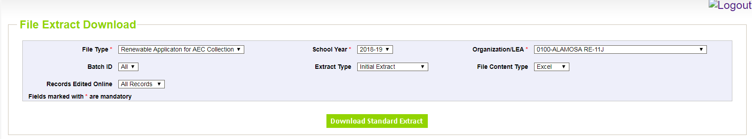
Renewal/Application Submitting Your Data – File Extract
2024-25
Select
File Type: Renewal Application for AEC Collection
Extract Type: Initial Extract
File Content Type: Excel
Your LEA
Hit Download Standard Extract
Gives you only the fields you can update
Helpful Cognos reports:
Students Not Identified As At risk

Slide 20
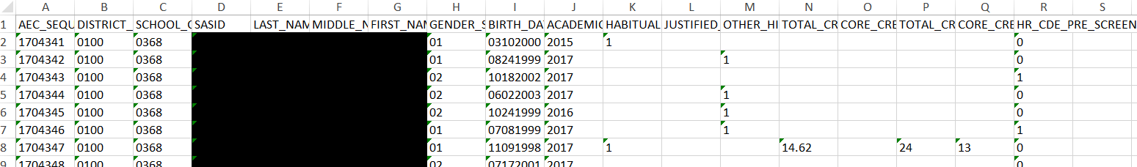
Renewal/Application
Submitting Your Data – Standard Extract
2024-25
Select
File Type: Renewal Application for AEC Collection
Extract Type: Initial Extract
File Content Type: Excel
Your LEA
Hit Download Standard Extract
Complete the following:
Habitually Truant
Justified Expulsion
Other High Risk
Over Age and Under Credited credit information (if desired)

Slide 21
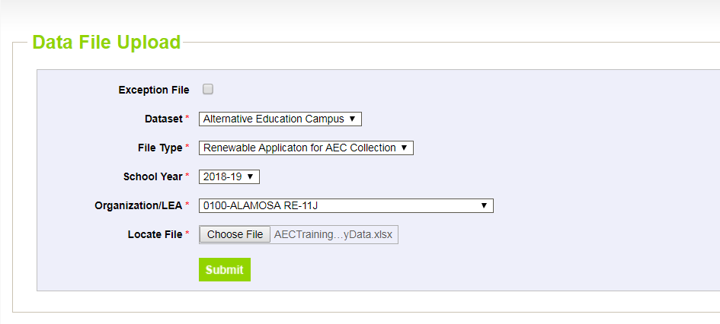
Renewal/Application – Submit to CDE
2024-25
Select
Dataset: Alternative Education Campus
File Type: Renewal Application for AEC Collection
Your LEA
Hit Submit

Slide 22
Renewal/Application Submitting Your Data – Edit Records
Use Edit Records to complete if:
  You have only one or two AECs in your district/BOCES and they have small enrollments
  The staff completing the Renewal/Application Collection feel more comfortable with a web interface than with spreadsheets
  One person will be doing the majority of the data entry and submission for all of the student records
  You will be entering data student by student or high-risk indicator by high-risk indicator

Slide 23
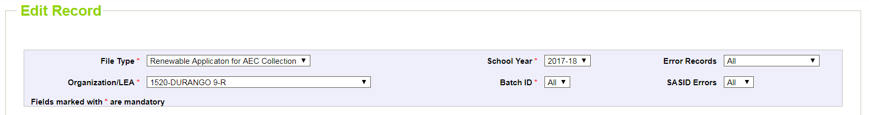
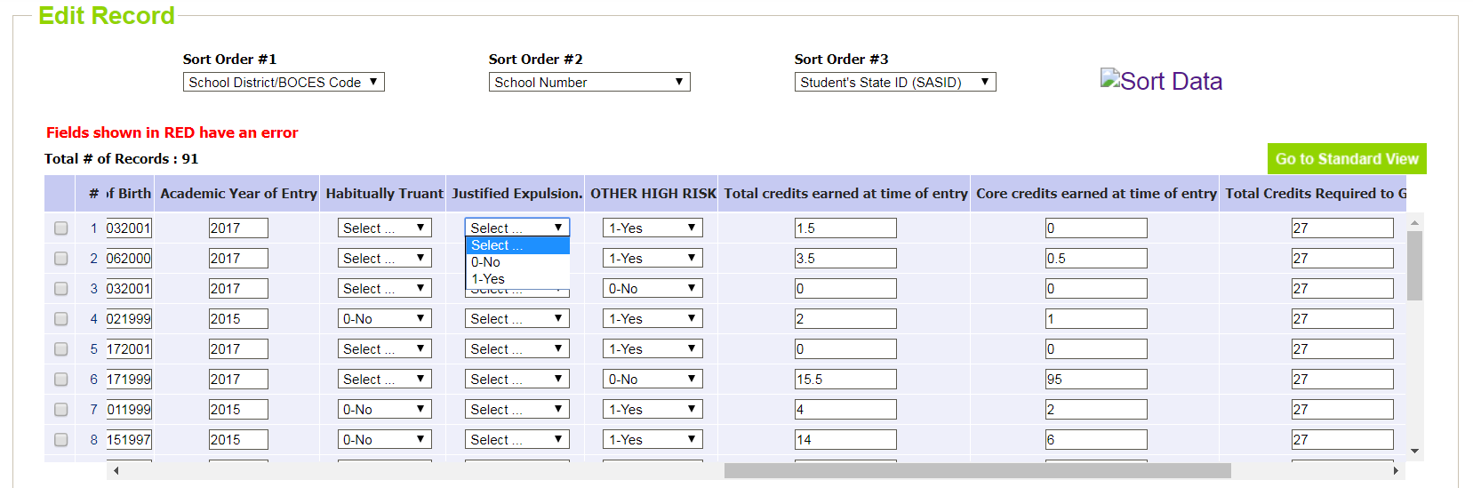
Renewal/Application Collection
Submitting Your Data – Edit Records
2024-25
Select Renewable Application for AEC Collection and your LEA, then hit SEARCH
Use dropdowns to enter yes/no values
Enter over age/under credit data into cells

Slide 24
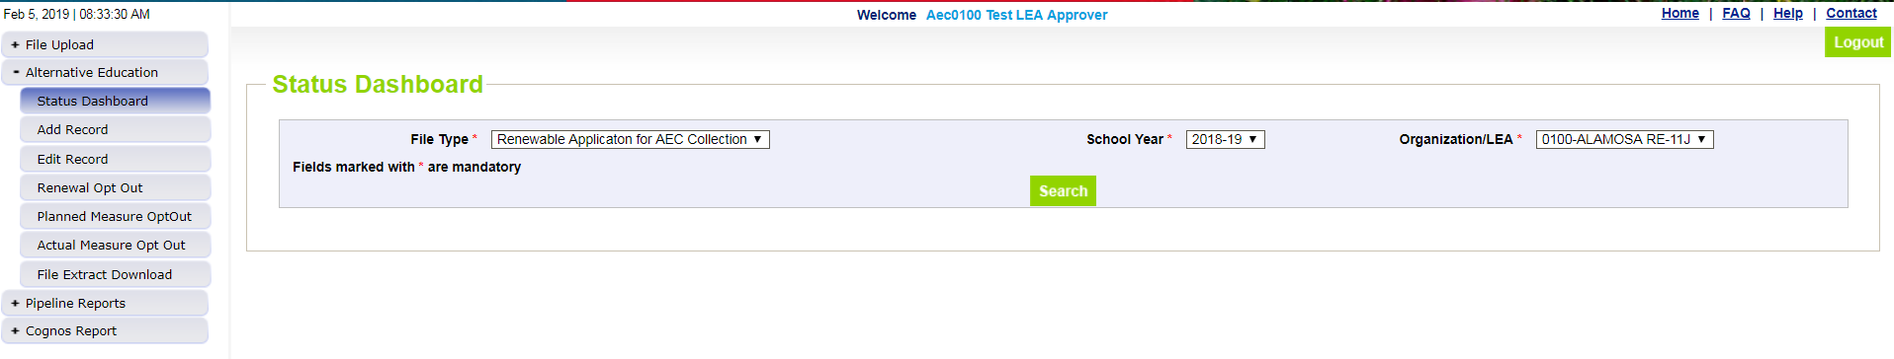
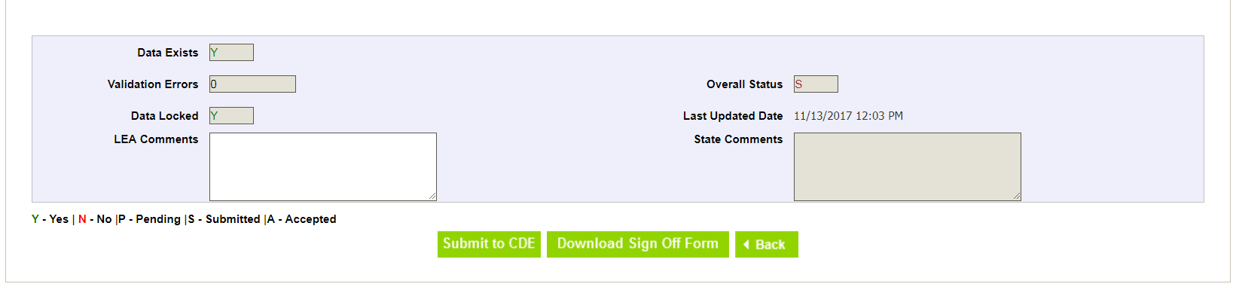
Renewal/Application Finalizing Your Data – Status Dashboard
2024-25
Select
Renewable Application for AEC Collection
Your Organization/LEA
Hit Search
Check your Validation Errors. When Validation Errors are 0, and you have no changes left to make on your data, hit Submit to CDE.
When you hit Submit to CDE, you have submitted your collection data!

Slide 25
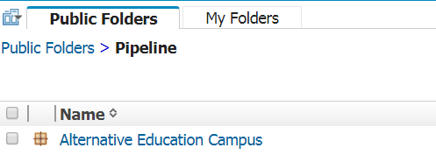
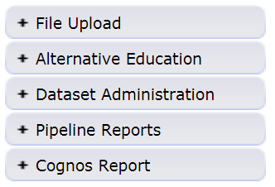

Renewal/Application Cognos Reports
Click on the Alternative Education Campus link
Reports relevant to Renewal/Application Collection

Slide 26
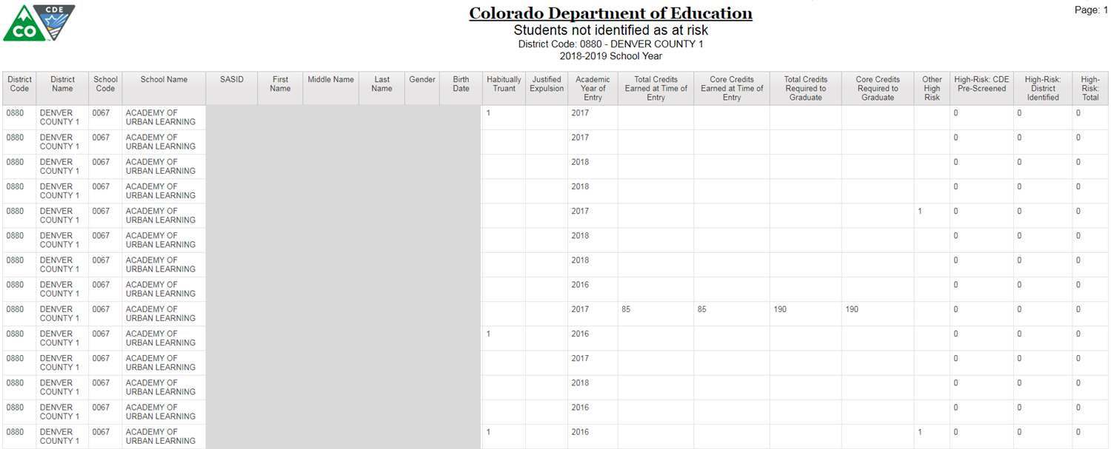
Renewal/Application Cognos Report for Students not Identified At Risk
2024-25
Students Not Identified As At Risk Report:
This report pulls a list of students who do not have a flag in any high risk indicator in the dataset most currently uploaded to Data Pipeline
Can use this report to narrow down on which students need high risk designation before finalizing submission

Slide 27
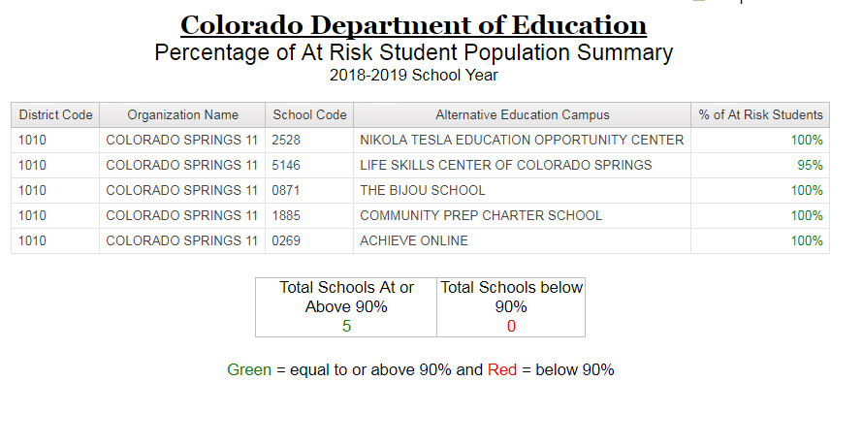
Renewal/Application Cognos Summary Reports
2024-25
Percentage of At Risk Student Population Summary Report:
Shows the percentage of students with flagged with at least one high risk indicator in the current data set uploaded to pipeline for each school in a given district/BOCES
Updates after submission finalization through status dashboard

Slide 28
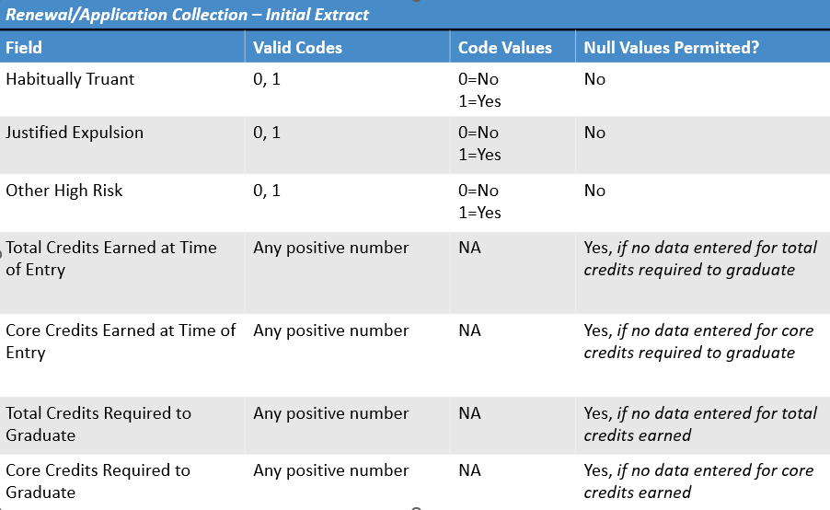
Renewal/Application Collection
Error Logic

Slide 29
Renewal/Application Collection
Error Logic – Over Age and Under Credit
Error Logic | Reason
Data is entered for Total Credits Earned but not for Total Credits Required | Cannot determine if (OAUC) without credits required threshold
Data is entered for Core Credits Earned but not for Core Credits Required | Cannot determine if (OAUC) without credits required threshold
Core Credits Required is equal to or larger than Total Credits Required | Likely an error; would suggest no possibility of elective credits
Total Credits Earned is equal to or larger than Total Credits Required | Likely an error; Total Credits Required should be cumulative, not number left
Core Credits Earned is equal to or larger than Core Credits Required | Likely an error; Core Credits Required should be cumulative, not number left

Slide 30
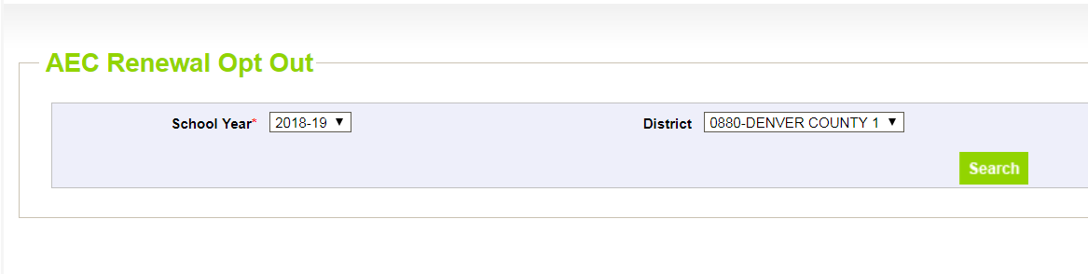
Renewal/Application Collection
Opt Out
2024-25
Select the relevant year. For Renewal/Application, only 2024-25 should be available.
Select the your district/BOCES. You should only be able to select your own district/BOCES.
Then hit Search.
Opting Out:
  Choosing not to submit data in a specific AEC data collection and alerting CDE to that decision through a simple process.

Slide 31
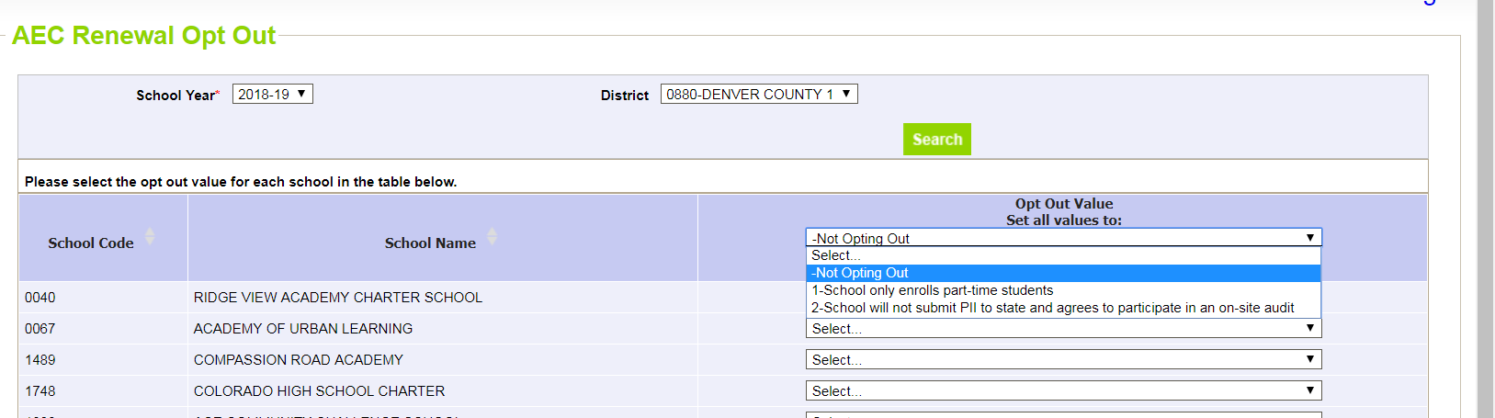
Renewal/Application Collection
Opt Out Entry
2024-25
Decide if you’re choosing an opt-out value for all schools or only a subset of schools
Notes on opt-out values:
  1 – schools only enrolls part-time students: all students at school must be primarily enrolled at another school
  2 – school will not submit PII: selecting this option flags school and district for a potential in-person audit with CDE personnel
  3 – School is not opting out
  4 – School is closing or withdrawing AEC application
Remember to hit SAVE when you are done!

Slide 32
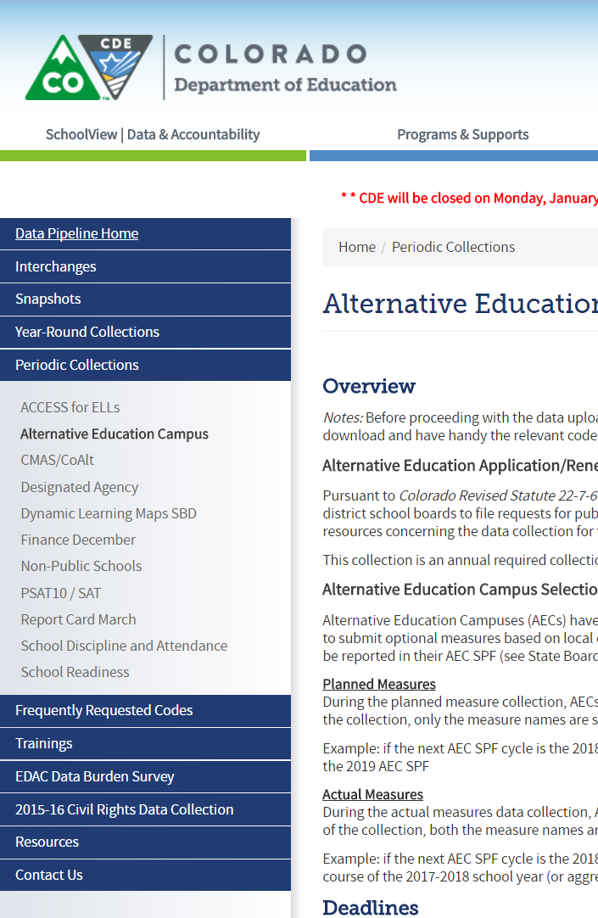
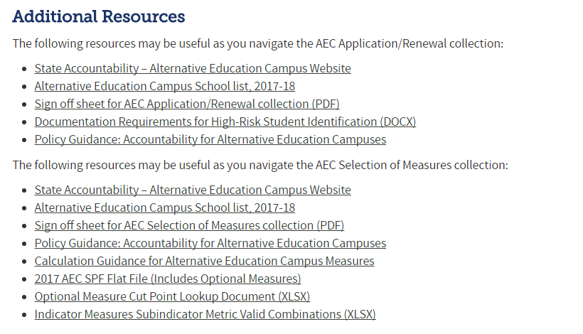
Renewal/Application Collection
Sign Off Sheet
http://www.cde.state.co.us/datapipeline/per-aec
Scroll down to this section:

Slide 33
Renewal/Application Collection
Sign Off Sheet – Send to CDE
Download sign off form
Complete sign off form
Email signed form to B Sanders
By 6/28/2024
Print form
Add necessary information
Gather needed signatures
Scan completed form
Email signed form to April Thompson(Thompson_april@cde.state.co.us)
Your AEC Collection data is not considered complete and final until we receive your sign off form!

Slide 34
Planned Measures for the 2025 SPF
Update on Accountability Pause
Collection Basics
Resources
Submitting Your Data
Finalizing Your Data
Error Logic
Collection Opt Outs

Slide 35
Planned Measures for the 2025 AEC SPF
Collection Basics
Planned Measures for 2025 AEC SPF Collection
  VOLUNTARY for any school that has received or is planning to receive AEC designation
  Information submitted in this collection is to tell CDE the measures that the school intends to include on the 2025 AEC SPF
    The actual data for these measures will be collected in Collection Window 2; no data is collected here
  May opt out of collection, but should do so formally using the opt out feature
Planned Measures: Measures that you are expecting to use for an upcoming AEC SPF cycle
  These are a forecast of what you’re using
  No data is included, only the measure names
No changes to this collection this year!

Slide 36
Planned Measures for the 2025 AEC SPF
Collection Access
What do you need? | Why do you need it? | Where do you get it?
File Layout and Definitions (Planned) | Understand fields needed for data submission | http://www.cde.state.co.us/datapipeline/per-aec
Confirmation that you have access to the AEC Collections in Pipeline | Cannot submit data without access to Data Pipeline | Local Area Manager grants AEC~LEAAPPROVER role permission
Previous year’s AEC SPF if available | Historical context for optional measures the AEC has submitted and had approved | https://www.cde.state.co.us/schoolview/performance

Slide 37
Planned Measures for the 2025 AEC SPF - Submitting a New Measure
Field | Code | Label
AEC Indicator | 1 | Academic Achievement
AEC Indicator | 2 | Academic Growth
AEC Indicator | 3 | Student Engagement
AEC Indicator | 4 | Post-Secondary and Workforce Readiness
AEC Sub Indicator | 999 | New Subindicator
AEC Sub Indicator Category | 9999 | New Category
AEC Subindicator Category Metric | 1 | Percentage
AEC Subindicator Category Metric | 2 | Percentile Rank
AEC Subindicator Category Metric | 3 | Growth Score
AEC Subindicator Category Metric | 4 | MGP
AEC Subindicator Category Metric | 6 | Mean Score
To propose a measure that has not been previously approved, choose the indicator you believe it should fall into, New Subindicator and New Category, and whichever metric seems most appropriate.
B Sanders will reach out for specifics about the Subindicator and Category once submitted; negotiations will open between the district/BOCES and CDE

Slide 38
Planned Measures for the 2025 AEC SPF - Submitting Your Data – File Upload
Use File Download/Upload to complete if:
  You have several AECs in your district/BOCES, and you are planning to submit many optional measures for each
  The staff completing the Planned Measures Collection are comfortable using and working with excel spreadsheets
  You have reviewed and have on hand all the additional resources you need for working with the file extracts
    http://www.cde.state.co.us/datapipeline/per-aec
Upload completed files to Data Pipeline for CDE review
Download blank files from Data Pipeline to submit

Slide 39
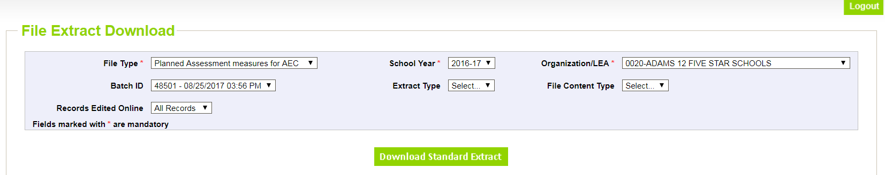
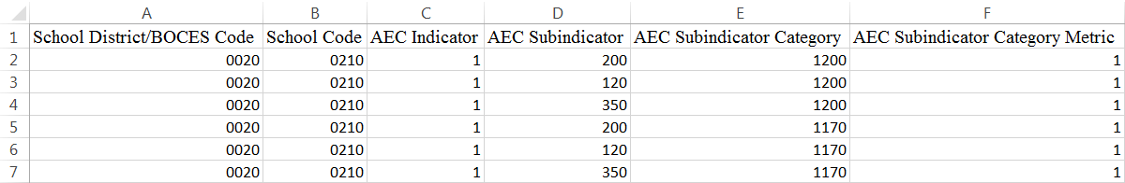
Planned Measures for the 2025 AEC SPF - File Extract Download
2023-24
Select
Planned Assessment Measures for AEC
2025-26
Preferred File Content Type (rec: Excel)
Hit Search
Add in the codes for:
AEC Indicator
AEC Subindicator
AEC Subindicator Category
AEC Subindicator Category Metric

Slide 40
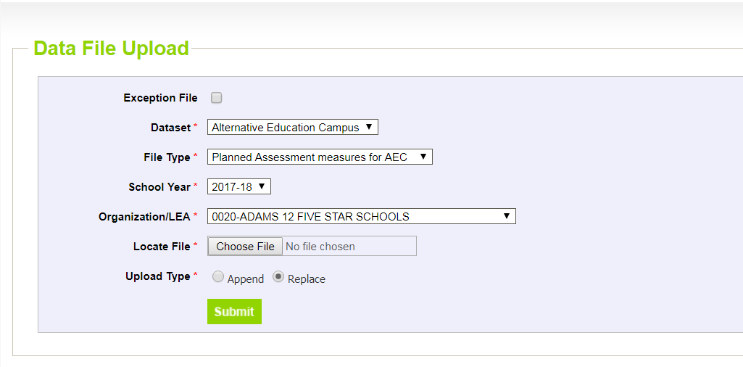
Planned Measures for the 2025 AEC SPF – Data File Upload
2023-24
Select
Alternative Education Campus in Dataset
Planned Assessment Measures for AEC in File Type
2025-26 in School Year
Your LEA
Choose your file
Replace in Upload Type

Slide 41
Planned Measures for the 2025 AEC SPF - Add/Edit Records
Use Add/Edit Records to complete if:
  You do not want to map numeric codes to indicator, subindicator, category, and metric names
  You do not want to reference a separate document to track which subindicators match which categories and which subindicators match which indicators
  One person will be doing the majority of the data entry and submission for all of the measure records
  You will be entering data measure by measure

Slide 42
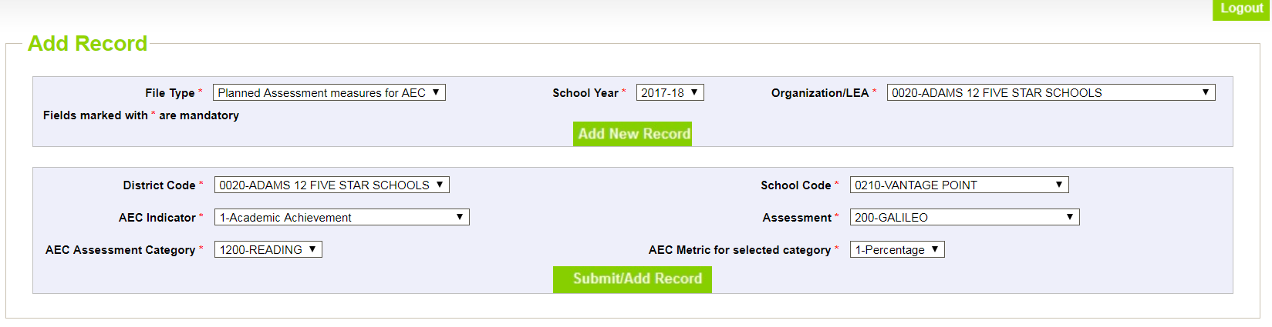
Planned Measures for the 2025 AEC SPF – Adding New Records
2023-24
Select
Planned Assessment Measures for AEC
2025-26
Your LEA
Hit Add New Record
Select
School Code
Choose Measure Details from dropdowns
  AEC Indicator
  Assessment
  Category
  Metric
Hit Submit/Add Record

Slide 43
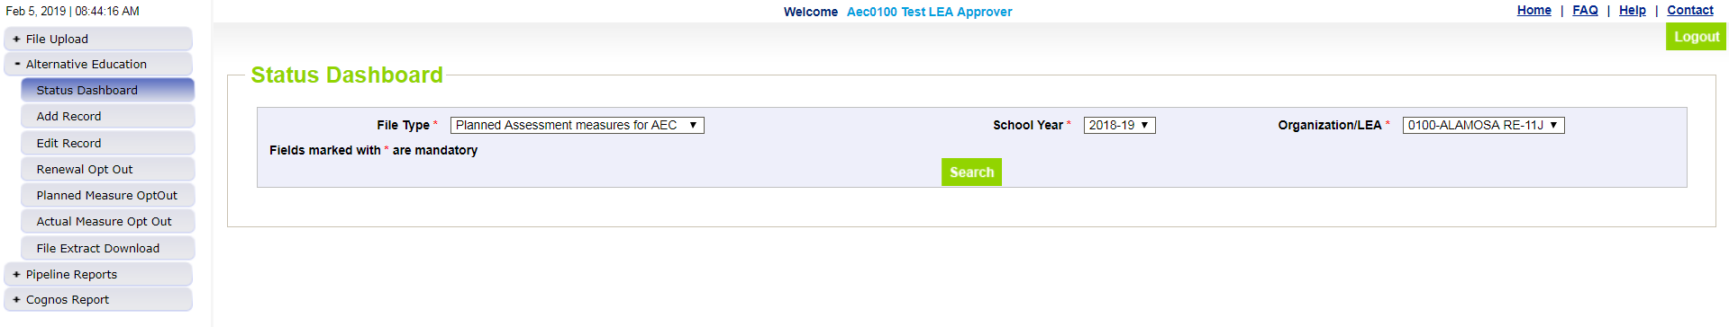
Planned Measures for the 2025 AEC SPF - Finalizing Your Data
2023-24
Check your Validation Errors. When Validation Errors are 0, and you have no changes left to make on your data, hit Submit to CDE.
When you hit Submit to CDE, you have submitted your collection data!
Select
Planned Measures for AEC
Your Organization/LEA
Hit Search

Slide 44
Planned Measures for the 2025 AEC SPF - Error Logic
Field | Code or Data? | Null Values Permitted?
AEC Indicator | Code | No
AEC Subindicator | Code | No
AEC Subindicator Category | Code | No
AEC Subindicator Category Metric | Code | No
Error logic: submitted data must conform to valid combinations between indicator, subindicator, category, and metric

Slide 45
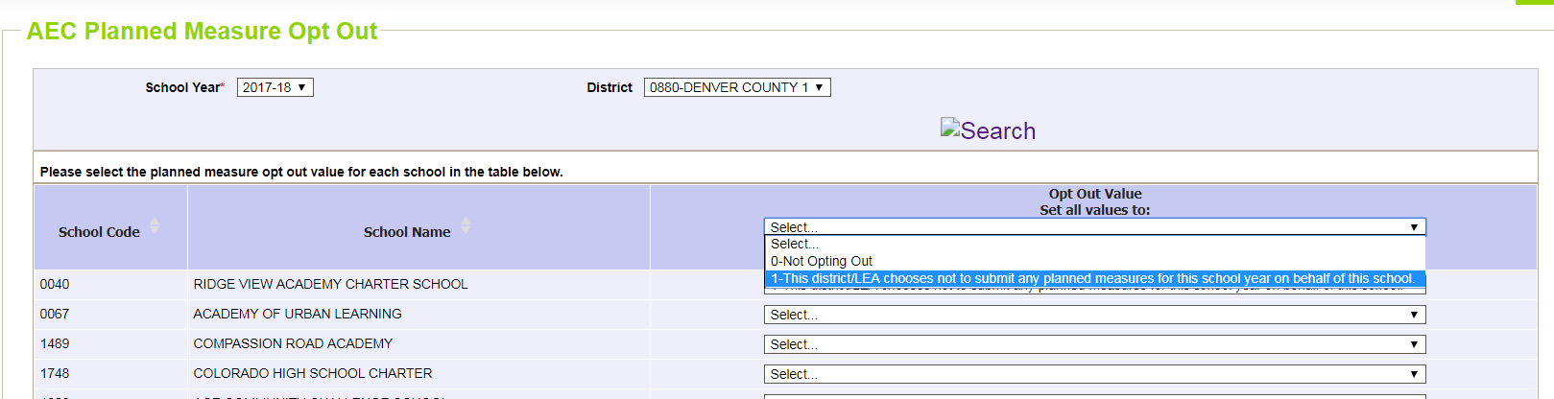
Planned Measures for the 2025 AEC SPF - Collection Opt Out
2023-24
Mark option 1 for any school not submitting planned measures.
Remember to hit SAVE when you are done!

Slide 46
Planned Measures for the 2025 AEC SPF - No sign off form!
No sign off form for Planned Measures!
  Informal planning collection
  Sign off sheets only required for Renewal/Application and Actual Measures and Data collections
You are done when you:
  Submit data and finalize your submission, or
  Opt out of the collection

Slide 47
Resources, Trainings, and Contact Information

Slide 48
Resources
AEC Collections Information Page
http://www.cde.state.co.us/datapipeline/per-aec
AEC Accountability Resource Page
https://www.cde.state.co.us/Accountability/StateAccountabilityAECs

Slide 49
Trainings
AEC Collections Website:
http://www.cde.state.co.us/datapipeline/per-aec
  AEC Collections materials posted on website; last year’s training materials also posted
AEC Collections Office Hours:
Weekly office hours on Thursday afternoons. You can sign up for a half hour slot to chat with B Sanders/April Thompson about any questions you may have about the AEC collections here: https://www.signupgenius.com/go/10C084DAEAA28A4F9C61-46489917-aecoffice

Slide 50
Contacts
AEC Collection Questions
B Sanders, AEC and Accountability Principal Consultant
  Sanders_b@cde.state.co.us
April Thompson, AEC Consultant & ACI Program Coordinator
  Thompson_April@cde.state.co.us
  303-358-7363
Identity Management Questions
Rich Morris, Systems Administrator
  Morris_r@cde.state.co.us
  303.866.6713

