Slide 1
We are about to get started!
Housekeeping notes:
Please mute your phones.
If you have questions, type them into the chat box.
If you would like to view the narration transcript, click the NOTES tab on the sidebar to the right.
Notes:
Hi everyone! We are about to get started. Please note that in order to make this webinar as accessible as possible, we request that you do the following: mute your phones if you have called in. If you have a question, please type your question into the chat box rather than asking it out loud. I will answer all questions at the end of the webinar via the chat box. Please be patient; all questions will be answered. If you require a transcript of the webinar while it is ongoing, click the notes tab on the sidebar to the right, and the narration script I am using will be visible on-screen.

Slide 2
AEC Collections Webinar 3:
Collection Window 2 Overview
April 12, 2018
Accountability & Data Analysis
Notes:
Good afternoon, and welcome to the third and final AEC Data Collections webinar for this school year. My name is B Sanders, and I am the AEC and Accountability Senior Analyst at CDE. This webinar will provide a detailed overview of the second collection window for the AEC Pipeline collections. Collection Window 2 for Alternative Education Campuses includes the Actual Measures and Data Collection for the 2018 AEC SPF and the Planned Measures Collection for 2019 AEC SPF.

Slide 3
Agenda
Collection Window 2 Overview
Collections & Timeline
About the Collections
Collections Checklist
Pipeline Basics
Actual Measures & Data for 2018 AEC SPF Collection
Collection Basics
Resources
Submitting Your Data
Error Logic
Status Dashboards
Collection Opt Out
Sign Off Sheets
Planned Measures For 2019 AEC SPF Collection
Collection Basics
Resources
Submitting Your Data
Error Logic
Status Dashboards
Collection Opt Out
Resources, Trainings & Contacts
Questions
Notes:
Here’s what we’re covering in today’s webinar. If you’ve participated in the AEC Collections in previous years, some of this information will be familiar to you. We’ll cover general information that will be useful to both collections occurring in this window first. Then, we’ll dig into the nuts and bolts of the Actual Measures and Data Collection. We’ll also talk about the details for the Planned Measures for 2019 Collection. Before we close out today’s webinar, I’ll also cover some helpful resources, additional training opportunities, and useful contacts. Finally, we have time allotted at the end for questions. Remember to type your questions into the chat box, and I will answer them there.

Slide 4
Collection Window 2 Overview
Collections & Timeline
About the Collections
Collection Checklist
Pipeline Basics
Notes:
First, I’m going to give a general overview of what’s expected of districts and BOCES during the Collection Window 2. I’ll talk through which collections will be live during this window, and the timeline for this window. I’ll also cover some Data Pipeline basics that are relevant to both the Actual Measures and Data Collection and the Planned Measures for 2019 collection.

Slide 5
Collection Window 2 Overview Collections & Timeline
Timeline:
Month | Renewal/Application Designation Collection | Selection of Measures Collection (Planned and Actual)
January | Training – webinar 1 (1/18/18) Notify B Sanders of new schools seeking AEC designation by 1/31/2018 | Training - office hours
February | Training – webinar 2 (2/15/18) Training – office hours | Training – office hours
March | Renewal/Application collection opens 3/1/2018 Office hours for Renewal/Application collection will be available | Planned measures for 2018 AEC SPF collection opens 3/1/2018 Office hours for Selection of Measures
April | Renewal/Application collection closes 5/4/2018 | Planned measures for AEC SPF closes 5/4/2018 Training – webinar 3 (4/12/18)
May |  | Planned measures for 2019 AEC SPF collection opens 5/7/2018 Actual measures for 2018 AEC SPF collection opens 5/7/2018 Office hours for Selection of Measures
June |  | Planned measures for 2019 AEC SPF collection closes 6/29/2018 Actual measures for 2018 AEC SPF collection closes 6/29/2018 Office hours for Selection of Measures
Notes:
AEC Collection Window 2 opens on May 7th, 2018, and closes on June 29th, 2018. There are two AEC related collections to complete during Collection Window 2: the Actual Measures and Data for the 2018 AEC SPF Collection, and the Planned Measures for the 2019 AEC SPF collection. While Collection Window 2 is ongoing, I will still be hosting weekly office hours. Feel free to sign up for those if you need help with either the Actual Measures Collection or the Planned Measures for 2019 Collection! We will discuss how to sign up for office hours later in this webinar.

Slide 6
Collection Window 2 Overview About the Collections
Actual Measures and Data
Voluntary
2018 AEC SPF
Submitting measures and data
Cannot propose new measures through this collection window
Requires a sign off form
Notes:
Before we dig into the collections in depth, let’s take a step back and talk through both collections that are happening in this window, and how they are different from each other. Unlike in collection window 1, where the two collections happening were fairly distinct from one another, the two collections happening in this window are related. Let’s start with the Actual Measures and Data collection. In this voluntary collection, you will have the opportunity to provide optional measure data for Alternative Education Campuses served in your district or BOCES for the 2018 AEC School Performance Framework, or SPF. Please note that you will not have the ability to submit a new measure for the 2018 AEC SPF at this time; new measures need to be submitted as part of the Planned Measures for 2018 collection which closes on May 4th. Please also note that since data is submitted as part of this collection, you are required to submit a sign off form in order for this collection to be considered complete and final.

Slide 7
Collection Window 2 Overview About the Collections
Actual Measures and Data
Voluntary
2018 AEC SPF
Submitting measures and data
Cannot propose new measures through this collection window
Requires a sign off form
Planned Measures – 2019
Voluntary
2019 AEC SPF
Submitting measures only (no data)
Use this collection to propose a new measure to CDE and begin measure negotiations
Does not require a sign off form
Notes:
Now, let’s talk about the Planned Measures for the 2019 AEC SPF Collection, which is also open during this collection window. The Planned Measures for 2019 is also voluntary. As with the Planned Measures for 2018, this collection only allows you to submit measure names. No data can be entered for this collection. This collection is forward looking—you will be submitting potential measures for the 2019 AEC SPF. This collection is especially useful if you are planning to begin negotiations with us at CDE for a brand new measure or assessment. Because no data is submitted through the Planned Measures for 2019 collection, this collection does not require a sign off form.

Slide 8
Collection Window 2 Overview Collections Checklist
Collections Checklist
Review the file layout and definitions document and other resource documents
Decide how you will submit your data OR decide if you will opt out of data collection
Download your submission sign off form
Complete your data submission OR opt out of data collection
Gather necessary signatures
If data is submitted check submission for errors
Finalize data submission
Email completed sign off form to B Sanders (sanders_b@cde.state.co.us)
Notes:
This is a general checklist that will help you think through all the steps involved in any of the AEC Pipeline Collections. If you have not already done so, you should consider scheduling time to review the relevant documentation on our AEC Collections website for each of the collections you will be supporting during this window. You should also give some thought as to how to submit your data using the pipeline system—is the edit records web interface going to be most useful to you, or will you find the file download/upload method easier? For those AEC Collections which require a sign off form from multiple people in your district, downloading the sign off forms ahead of time is a good step. Once you’ve thought through all of this, you can begin the data submission process. Before you finalize your data, remember to check for errors flagged by Data Pipeline, and remember to submit your sign off forms.

Slide 9
Collection Window 2 Overview Pipeline Basics
Accessing Data Pipeline: https://cdeapps.cde.state.co.us/index.html
If you are managing the AEC Collections for your district/BOCES – in part or in whole – then you will need to work with your local area manager (LAM) to receive data pipeline permissions
Role for collections: AEC~LEAAPPROVER
Grants ability to sign into Alternative Education tab in Data Pipeline
Ability to download/upload extracts to AEC collections
Ability to edit records for Renewal/Application Collection
Ability to add and edit records for Planned Measures for 2018 AEC SPF Collection
Ability to opt out of AEC collections
You cannot participate in the AEC Collections unless your LAM has assigned you to the AEC~LEAAPPROVER role!
Notes:
Remember, if you cannot access Data Pipeline, you can’t submit your data. If you sign into the Data Pipeline system, and you do not see the Alternative Education tab on the left hand menu on the side of the screen, then please contact your LAM and request that you be assigned the AEC~LEAAPPROVER role. The simplest way to check to see if you have this role assigned to you is by signing in to Data Pipeline and looking at your permissions there.

Slide 10
Collection Window 2 Overview Pipeline Basics
This is where you will start for all AEC Collections.
When all errors are resolved, use this to submit your data to CDE for review.
Add records for both collections in this window.
Edit records for both collections in this window.
Opt a school, or schools, out of either collection in this window.
Download file extracts for each collection.
Notes:
The image on the left is the navigation menu you will see if you have AEC~LEAAPPROVER role permissions properly assigned to you. To do anything with the AEC Collections, you will start by clicking on the Alternative Education button. Clicking on this button will display all of the buttons below it. The buttons below allow you to pull and modify the data in Data Pipeline associated with a given collection. We’ll go through how to use all of these functions for each collection a little later in this presentation. Before we talk about that, let’s cover how data errors are defined and flagged in Data Pipeline, since this is one thing you’ll need to check for before finalizing your data submission.

Slide 11
Collection Window 2 Overview Pipeline Basics
Errors in Data Pipeline:
Invalid codes
Missing data in required fields
Incorrect codes in a given field
Data that breaks a logic rule in a given field
Data errors will need to be resolved before submitted data can be finalized.
Notes:
The reason you need to understand that errors exist, and the kinds of errors there are, is because you must resolve all the errors in your data before your data submission can be finalized. In Data Pipeline, an error is either data that is an invalid code in a given field, or data that breaks the logic rule assigned to a given field. I’ll talk in detail about what the logic rules are for each collection in this collection window later in this webinar, but regardless of collection the errors will be flagged the same way. Now, let’s look at how the Data Pipeline system flags errors for you to see.

Slide 12
Collection Window 2 Overview Pipeline Basics
Records added with errors will still be submitted to the Data Pipeline system, but you will receive a notice that they are an error, and they will be flagged in RED.
Notes:
If you are trying to add a record, and you add a record in a way that results in an error, the Data Pipeline system will flag it for you as displayed on this slide. If an error is entered, the error will enter the Data Pipeline system, but will be flagged in red, as shown here.

Slide 13
Collection Window 2 Overview Pipeline Basics
When you load an edit record screen for a given collection, any errors will be flagged in RED.
Notes:
You can also use the edit record screen to find errors in your existing Data Pipeline data. Any fields with red shading, as shown here, are flagged as errors. You can make changes to these fields in order to correct errors in this screen. If you do so, remember to hit the save button at the bottom of the screen.

Slide 14
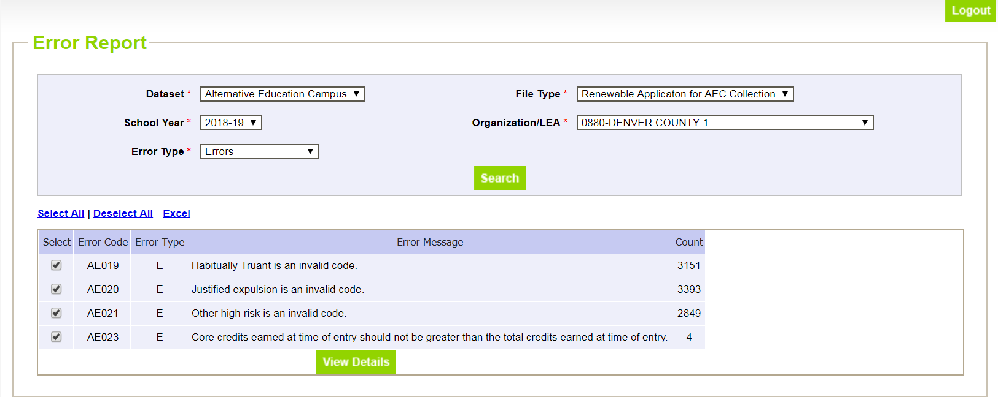
Collection Window 2 Overview Pipeline Basics
The Pipeline Error Report is useful for file downloads/uploads. This will tell you how many errors and what types of errors an uploaded file contains. The View Details button will take you to those specific rows and let you edit them with the Edit Record screen.
Notes:
Finally, there is also an error report function in the Data Pipeline system. This is a useful way to find errors in any of the AEC Collections, no matter how you go about completing and uploading the AEC Collection data. If you are downloading and uploading file extracts, this is the best way to check any potential errors, and should be done once you’ve uploaded your file. The error reports will also work if you’re adding and editing records through the pipeline web interface.

Slide 15
Actual Measures & Data for 2018 AEC SPF Collection
Collection Basics
Resources
Submitting Your Data
Error Logic
Status Dashboard
Collection Opt Outs
Sign Off Sheets
Notes:
Now that we’ve covered some general information, let’s dive into each collection separately. In these sections, I’ll tell you how to use Data Pipeline to complete your submission and go through information specific to each collection. Let’s start with the Actual Measures and Data for the 2018 AEC SPF Collection.

Slide 16
Actual Measures & Data for 2018 Collection Collection Basics
Actual Measures: Measures submitted with the intent of inclusion in the next AEC SPF cycle (2018 AEC SPF)
VOLUNTARY for any school that has received or is planning to receive AEC designation
Collection data is aggregated; not student level
Data is included here, otherwise the measures are unable to be incorporated into the AEC SPF
Can only choose from previously approved measures, or new measures which were negotiated during the Planned Measures – 2018 collection (ends May 4th)
May opt out of collection, but must do so formally using the opt out feature
Notes:
The Selection of Measures collection is voluntary for Alternative Education Campuses. Since optional measures are optional, no district must submit measures for use on the AEC SPF. That said, we highly recommend that you participate in this collection. The use of optional measures on the AEC SPF generally improves performance on the AEC SPF and goes a long way towards contextualizing the state-required measures that will appear on the AEC SPF. Please note that this collection uses aggregated data, not student level information.

Slide 17
Actual Measures & Data for 2018 Collection Resources
What do you need? | Why do you need it? | Where do you get it?
File Layout and Definitions (Actual) | Understand fields needed for data submission | http://www.cde.state.co.us/datapipeline/aec-application-renewal-filelayout-1819
Confirmation that you have access to the AEC Collections in Pipeline | Cannot submit data without access to Data Pipeline | Local Area Manager grants AEC~LEAAPPROVER role permission
Sign off sheets for Actual Measures Collection downloaded | Data submission is not considered final until sign off sheets are submitted | http://www.cde.state.co.us/datapipeline/aec-selection-measures-signoff
Calculation Guidance for AEC Measures | Can provide ideas for the kinds of optional measures to submit and standard calculation procedures | http://www.cde.state.co.us/accountability/calculation_guidance_for_aec_measures_4_24_17
Optional Measures Cut Point Lookup Document | Can look up optional measure cut points and measure rating bands for previously approved measures | http://www.cde.state.co.us/datapipeline/aec-cutpoint-lookup
Indicator Measures Valid Combination Sheet | Able to see what measures are associated with which indicators and metrics | http://www.cde.state.co.us/datapipeline/aec-indicators-valid-combinations
Notes:
This table shows you what you’ll need to have on hand as you start the Actual Measures and Data for the 2018 AEC SPF Collection, why you’ll need each document, and where to find it. You will first need to familiarize yourself with the file layout and definitions document for this collection. Doing so will make the data submissions process easier and simpler since you will know which fields to complete and how to complete them. Before the window opens, it is a good idea to check to make sure that you have your AEC~LEAAPPROVER permissions correctly set for Data Pipeline. You may also want to download the required sign off sheet and make the requisite number of copies needed since sometimes gathering those signatures takes longer than anticipated. You may consider reviewing some of the resources CDE has created for optional measure. Specifically, the Calculation Guidance for AEC Measures will be useful in helping you determine which measures have been previously approved and how to calculate them. The Optional Measures Cut Point Lookup Document allows you to see at a glance what the norms and cut points were for any optional measure submitted and approved for the 2017 AEC SPF. The Indicator Measures Valid Combinations Sheet will show you how to cross-reference indicators, subindicators, categories, and metrics for this collection. Now, let’s talk about how you can submit your completed data.

Slide 18
Actual Measures & Data for 2018 Collection Submitting Your Data – Add/Edit Records
Use Add/Edit Records to complete if:
You do not want to map numeric codes to indicator, subindicator, category, and metric names
You do not want to reference a separate document to track which subindicators match which categories and which subindicators match which indicators
One person will be doing the majority of the data entry and submission for all of the measure records
You will be entering data measure by measure
Notes:
The add/edit records method is generally a good fit for the Actual Measures and Data collection. Using this method takes some of the nitpicking out of this data submission. You will not need to map the numeric codes for the indicator, subindicator, category, or metric you select when you enter a given measure. You will also not need to remember or look up the valid combinations between the indicators, subindicators, categories, and metrics as you enter your measures.

Slide 19
Actual Measures & Data for 2018 Collection Submitting Your Data – Add/Edit Records
Select
File Type: Actual Assessment Measure for AEC
School Year: 2017-18
Organization/LEA: Your District/BOCES
Hit Add New Record
Notes:
CDE does not pre-populate data for the Actual Measures and Data collection. In order to complete this data submission using the web interface tools, you will need to first add records, and then edit them as you like. When you click on Add Record on the navigation menu on the left hand screen while in Data Pipeline, you will be taken to a screen which looks like this. You will need to select your file type, school year, and LEA. You should only be able to select your own LEA. Once you have selected the file type, school year, and LEA, hit Add New Record.

Slide 20
Actual Measures & Data for 2018 Collection Submitting Your Data – Add/Edit Records
Select
File Type: Actual Assessment Measure for AEC
School Year: 2017-18
Organization/LEA: Your District/BOCES
Hit Add New Record
Select
School Code
Choose Measure Details from dropdowns
AEC Indicator
Assessment
Category
Metric
Enter data
Students meeting measure (numerator)
Total students (denominator)
Rate (final value)
Hit Submit/Add Record
Notes:
After hitting Add New Record, you will be given the options at the bottom of the screen. To add a measure you plan to submit for consideration for the 2018 AEC SPF, choose the relevant information from the dropdown menus. Since the information in the dropdowns are dependent on each other, it makes the most sense to work through the dropdown menus in the following order: AEC Indicator, Assessment, AEC Assessment Category, then AEC Metric for selected category. When I say the choices in the dropdowns are dependent on each other, what I mean if you select Academic Achievement in the AEC Indicator, you will see a different list of assessments than if you select Student Engagement. Likewise, ACT to ACT growth has a different set of AEC Assessment Categories to choose from than NWEA MAP. Once you have made all your choices, add in your measurement data to the following fields: AEC Students Meeting Measure, AEC Total Students for Measure, and AEC Rate of Students Passing the Measure. When you are through making your choices and adding your data, hit Submit/Add Record. Repeat this process as many times as necessary until you have added all of your actual measures and data for the 2018 AEC SPF for each of the AECs in your district or BOCES.

Slide 21
Actual Measures & Data for 2018 Collection Submitting Your Data – Add/Edit Records
Select
Actual Assessment Measures for AEC
2017-18
Your LEA
Hit Search
Notes:
If you realize that you have made a mistake, and you need to edit or delete one of the measure you have added, you can use the Edit Records function. Click the Edit Record button on the navigation menu on the left hand side of the screen, and you will be taken to this screen. You will need to choose the appropriate file type and school year from the menu. Then, hit Search.

Slide 22
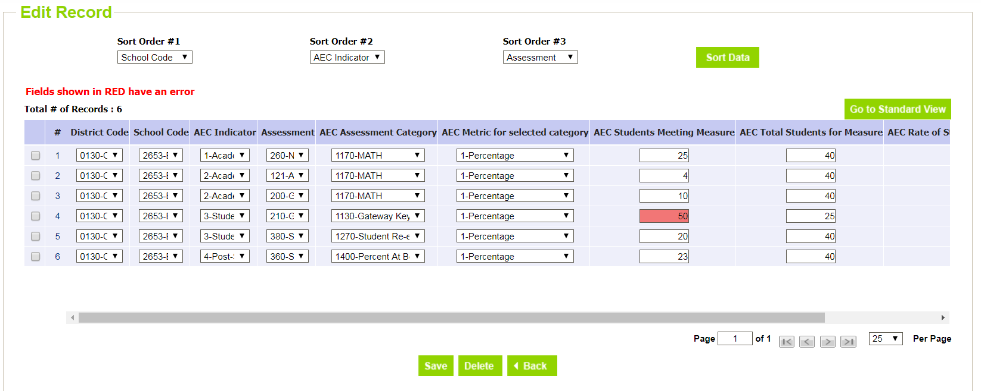
Actual Measures & Data for 2018 Collection Submitting Your Data – Add/Edit Records
Select
Actual Assessment Measures for AEC
2017-18
Your LEA
Hit Search
You can delete or modify any of these records in this screen. You can edit multiple records at once, then SAVE.
Notes:
When you hit Search, you will see this screen, and you will be able to edit records that exist in Data Pipeline for the Actual Measures and Data collection. Note that you can delete or modify records using this function, and that you can modify multiple records at once. When you hit the save button at the bottom of the screen, your changes will be passed through to the Data Pipeline system.

Slide 23
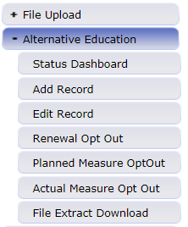
Actual Measures & Data for 2018 Collection Submitting Your Data – File Upload
Use File Download/Upload to complete if:
You have several AECs in your district/BOCES, and you are planning to submit several optional measures for each
The staff completing the Actual Measures Collection are comfortable using and working with excel spreadsheets
You have reviewed and have on hand all the additional resources you need for working with the file extracts
http://www.cde.state.co.us/datapipeline/per-aec
Upload completed files to Data Pipeline for CDE review
Download blank files from Data Pipeline to submit
Notes:
You could also use the file download/upload method if you have several AECs in your district or BOCES, and each one is submitting quite a few optional measures for consideration. If you use this method, make sure to review the file layout and definitions documents for these collections and look through the additional resources available for these collections. These resources are listed on the AEC Collections pipeline website at the link on the slide.

Slide 24
Actual Measures & Data for 2018 Collection Submitting Your Data – File Upload
Select
Actual Assessment Measures for AEC
2017-18
Preferred File Content Type (rec: Excel)
Hit Download Standard Extract
Notes:
When you click on the File Extract Download button, you will see this screen. You will need to select the following from the dropdown menus: a file type, a school year, your district or BOCES, and a file content type. The file type determines which AEC Collection you are working on. Note that the extract for the Actual Measures and Data collection will be a blank template. You will also need to choose a file type. We recommend choosing excel. When you have made your choices, hit the Download Standard Extract button.

Slide 25
Actual Measures & Data for 2018 Collection Submitting Your Data – File Upload
Select
Actual Assessment Measures for AEC
2017-18
Preferred File Content Type (rec: Excel)
Hit Download Standard Extract
Add in the codes for:
AEC Indicator
AEC Subindicator
AEC Subindicator Category
AEC Subindicator Category Metric
Add in the data for:
Students meeting measure (numerator)
Total students for measure (denominator)
Rate/final value
Notes:
Your Actual Measures and Data file will be a template with only the headers in the screenshot below. You will need to enter the numeric codes for your desired optional measures in the collection fields, along with your district or BOCES and school codes as I have done in this example. The numeric codes that crosswalk to AEC Indicators, AEC Subindicators, AEC Subindicator Categories, and AEC Subindicator Category Metrics can all be found in the file layouts and definitions document. The specific valid combinations between these fields are available in the Indicator Measures Valid Combinations Sheet document. Note that if any field is blank, or if any field uses an invalid code, or if any row uses an invalid combination of numeric codes, then your data will be flagged with errors.

Slide 26
Actual Measures & Data for 2018 Collection Submitting Your Data – File Upload
Select
Alternative Education Campus in Dataset
Actual Assessment Measures for AEC in File Type
2017-18 in School Year
Your LEA
Choose your file
Replace/Append in Upload Type depends on data you’re submitting
Notes:
When you click on the File Upload button in Data Pipeline, you will see this screen. You will need to select the Alternative Education Campus dataset and the appropriate file type from the dropdown menus. You will also need to select the relevant school year and your district or BOCES. Finally, choose replace or append in the upload type section. Choose replace if your file includes all AECs in your district or BOCES. Choose append if you are uploading your data school by school. Finally, choose the file you want to upload and hit the submit button.

Slide 27
Actual Measures & Data for 2018 Collection Error Logic – Fields to Complete
Field | Code or Data? | Null Values Permitted?
AEC Indicator | Code | No
AEC Subindicator | Code | No
AEC Subindicator Category | Code | No
AEC Subindicator Category Metric | Code | No
AEC Students Meeting Subindicator | Data | Yes, if metric is not percentage or growth score
AEC Total Students for Subindicator | Data | No
AEC Final Subindicator Value | Data | No
Notes:
This table outlines what fields in the Actual Measures and Data Collection you will need to complete, and how they will need to be completed. Each of these fields use the numeric codes outlined in the reference documents we just went over, but if you’re using the add or edit record screens you will be able to choose names from dropdown menus. No null values are permitted for these fields. The last three fields require you to enter data points for your measures. These fields have embedded logic based on the relationships between the fields and what kind of metric is chosen. We’ll go over that now.

Slide 28
Actual Measures & Data for 2018 Collection Error Logic – Embedded Field Logic
Error Logic | Reason
If AEC Indicator is Academic Achievement, Postsecondary and Workforce Readiness, or Student Engagement, then AEC Total Students for Subindicator cannot be less than 16 | N of 16 is minimum for these indicators
If AEC Indicator is Academic Growth, then AEC Total Students for Subindicator cannot be less than 20 | N of 20 is minimum for this indicator
If AEC Subindicator Category Metric is Percentage or Growth Score, then the AEC Final Subindicator Value cannot be greater than 1 | Rate-based metrics must be entered as a decimal (ex: .50)
If AEC Subindicator Category Metric is Percentage or Growth Score, then AEC Student Meeting Subindicator cannot be null | Rate-based metrics must include both denominator and numerator
If AEC Subindicator Category Metric is MGP or Percentile Rank, then AEC Final Subindicator Value must be between 1 and 99 | MGP and Percentile Rank valid values are only between 1 and 99
If AEC Students Meeting Subindicator is not null, then this value cannot be greater than AEC Total Students for Subindicator | Likely an error; cannot have more students in numerator than denominator
Notes:
Your actual measures collection data will be flagged with errors if any of the logic rules on this slide are broken. This slide shows the logic rule on the left, and the reasoning behind that logic rule on the right. Please feel free to reach out to me, B Sanders, if you have any questions about these logic rules.

Slide 29
Actual Measures & Data Collection Status Dashboard
Select
Actual Assessment Measures for AEC
2017-18
Your Organization/LEA
Hit Search
Notes:
Once all of your measures have been selected, all of your data has been entered, and all errors have been resolved, it’s time to submit your data to CDE. You can do this by going to the status dashboard. This is available by clicking on the Alternative Education Campus button on the navigation menu on the left hand side of the screen, and then clicking on the status dashboard button, which is just beneath the Alternative Education Campus button. When you click on the Status Dashboard button, you will be taken to this screen. To submit your Actual Measures and Data collection data to CDE, select Actual Assessment Measures for AEC under file type, 2017-18 under school year, and your district or BOCES under Organization. Then press Search.

Slide 30
Actual Measures & Data Collection Status Dashboard
Select
Actual Assessment Measures for AEC
2017-18
Your Organization/LEA
Hit Search
Check your Validation Errors. When Validation Errors are 0, and you have no changes left to make on your data, hit Submit to CDE.
When you hit Submit to CDE, you have submitted your collection data!
Notes:
When you have zero validation errors in your data set, you can send CDE your data by pressing the Submit to CDE button. If you have comments you would like to send along with your data, you can enter them in the LEA Comments box here. When you submit your data to CDE, the system will notify CDE that you have done so. We will review your data. If we have no questions, and if there is nothing that needs to change, we will accept your data. You should receive and email from Data Pipeline when we accept your data. Once your data is submitted to us, it is locked. You cannot change it unless we unlock it for you.

Slide 31
Actual Measures & Data for 2018 Collection Collection Opt Out
Mark option 1 for any school not submitting actual measures and data.
Remember to hit SAVE when you are done!
Notes:
The last thing to talk about is how to opt out of the Actual Measures and Data collection. There is only 1 option for schools opting out of the Actual Measures and Data collection, and it is simply that the district is not submitting optional measures on the school’s behalf. We have instituted this process to make sure that no schools are over looked and that a lack of submitted data is intentional. Please remember that submitting optional measures through Data Pipeline during this collection window is the only way to submit optional measures to CDE for the 2018 AEC SPF. If you decide to opt an AEC out of this collection, there is no other way to submit optional measures for consideration for the 2018 AEC SPF.

Slide 32
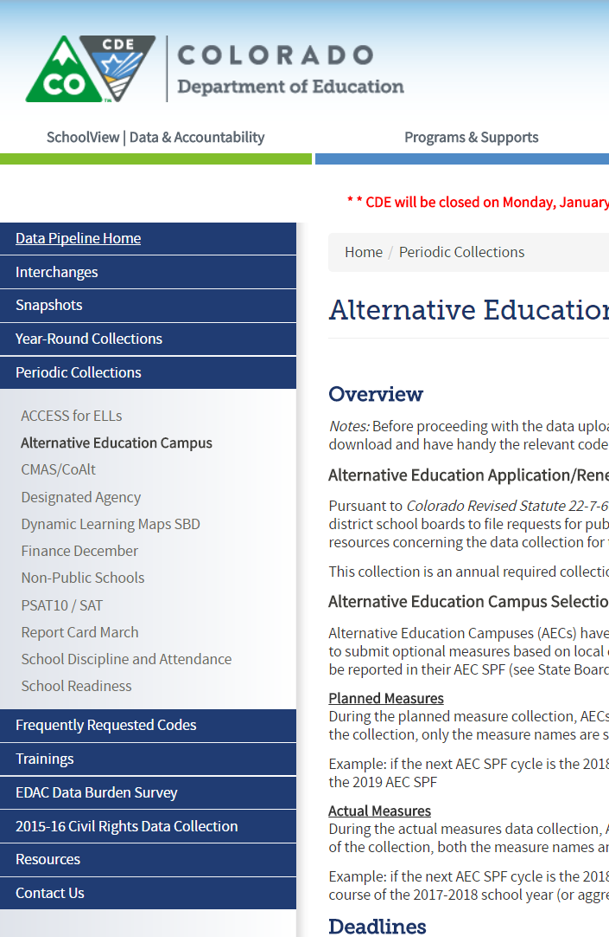
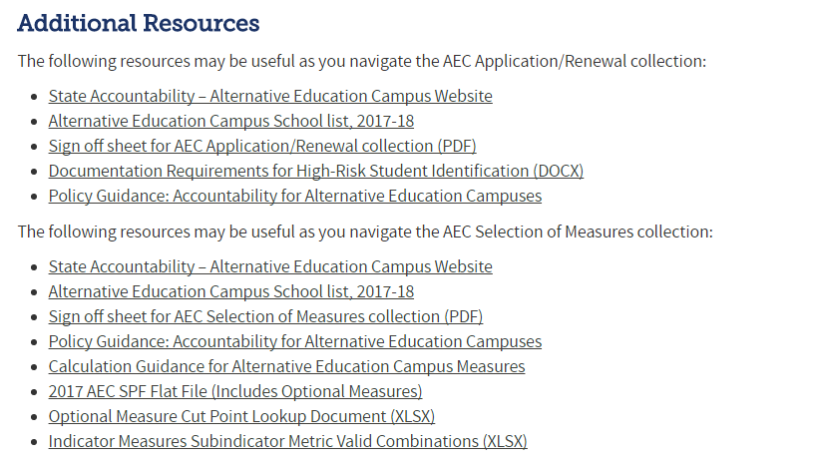
Actual Measures & Data for 2018 Collection Sign Off Sheet
http://www.cde.state.co.us/datapipeline/per-aec
Scroll down to this section:
Notes:
The last step in the Actual Measures and Data Collection is sending CDE your completed sign off sheets. These are required for each AEC participating in the collection which have submitted data. AECs which have opted out of the submission do not need to provide sign off sheets. This slide demonstrates where to find the sign off sheet for the Actual Measures and Data collection. Using the link on the top of this slide, navigate to the AEC Collections website. Once there, scroll down to the Additional Resources section, which is near the very bottom of the page. The Actual Measures and Data Collection sign off sheet PDF can be downloaded directly to your machine by clicking on the link.

Slide 33
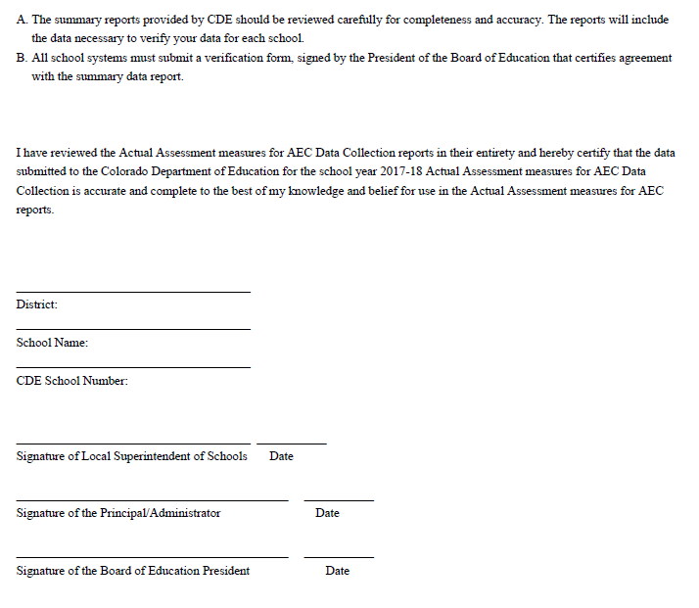
Actual Measures & Data for 2018 Collection Sign Off Sheet
Complete all fields. Please print legibly.
All signatures are needed
Notes:
The sign off sheet for the Actual Measures and Data collection is only one page long, and it simply requires that you complete the district name, school name, CDE school number, and then gather the necessary signatures. The signatures needed for this collection are the school’s principal, the district or BOCES superintendent, and the district or BOCES Board of Education president.

Slide 34
Actual Measures & Data for 2018 Collection Sign Off Sheet
Download sign off form
Complete sign off form
Email signed form to B Sanders
Print form
Add necessary information
Gather needed signatures
Scan completed form
Email signed form to B Sanders (sanders_b@cde.state.co.us)
Your AEC Collection data is not considered complete and final until we receive your sign off form!
Notes:
Please remember that CDE cannot consider your submitted data complete or finalized until we have all sign off forms from schools with submitted data. Again, no sign off forms are required for schools which have opted out of submitting optional measures. Please also remember that since the data included in the sign off sheets is unique to each school—specifically the school name and the principal sign off—you will need to complete one sign off sheet for each school which is submitting optional measures for consideration. When your forms are complete, email the signed and scanned forms to me, B Sanders.

Slide 35
Planned Measures for the 2019 AEC SPF Collection
Collection Basics
Resources
Submitting Your Data
Error Logic
Status Dashboard
Collection Opt Outs
Notes:
Now that we’ve covered the specifics of the Actual Measures and Data Collection, let’s switch gears and talk about the Planned Measures for the 2019 SPF Collection. We’ll cover the basics of the collection, useful resources you should review before getting started, the nuts and bolts of how to submit error-free data, and how to opt out of this collection if that’s what you choose to do.

Slide 36
Planned Measures for the 2019 AEC SPF Collection Basics
Planned Measures: Measures that you are expecting to use for an upcoming AEC SPF cycle (2019 AEC SPF)
VOLUNTARY for any school that has received or is planning to receive AEC designation
No data is included, only the measure names
Information submitted in this collection is to tell CDE the measures that the school intends to include on the 2019 AEC SPF
May opt out of collection, but must do so formally using the opt out feature
Notes:
Like the Actual Measures and Data collection, the Planned Measures for the 2018 AEC SPF collection is voluntary for Alternative Education Campuses. Since optional measures are optional, no district must submit measures for use on the AEC SPF. That said, we highly recommend that you participate in this collection, especially if you are considering submitting any brand new measures for the 2019 AEC SPF. Submitting measures which have not been previously approved in advance will give both you and CDE ample time to work through negotiations for those measures.

Slide 37
Planned Measures for the 2019 AEC SPF Collection Basics
What do you need? | Why do you need it? | Where do you get it?
File Layout and Definitions (Planned) | Understand fields needed for data submission | http://www.cde.state.co.us/datapipeline/aec-application-renewal-filelayout-1819
Confirmation that you have access to the AEC Collections in Pipeline | Cannot submit data without access to Data Pipeline | Local Area Manager grants AEC~LEAAPPROVER role permission
Calculation Guidance for AEC Measures | Can provide ideas for the kinds of optional measures to submit and standard calculation procedures | http://www.cde.state.co.us/accountability/calculation_guidance_for_aec_measures_4_24_17
Indicator Measures Valid Combination Sheet | Able to see what measures are associated with which indicators and metrics | http://www.cde.state.co.us/datapipeline/aec-indicators-valid-combinations
Notes:
This table shows you what you’ll need to have on hand as you start the Planned Measures for the 2019 AEC SPF Collection, why you’ll need each document, and where to find it. You’ll need to first familiarize yourself with the Planned Measures file layout and definitions document. Doing so will make the data submissions process easier and simpler since you will know which fields to complete and how to complete them. Before the window opens, it is a good idea to check to make sure that you have your AEC~LEAAPPROVER permissions correctly set for Data Pipeline. If you’re not sure where to start with optional measures, reviewing the Calculation Guidance for AEC Measures will be helpful. This document contains a set of pre-approved optional measures and some standard ways to calculate them for each indicator on the AEC SPF. The Indicator Measures Valid Combinations Sheet may also be useful; this spreadsheet outlines which assessments have been previously approved for which indicators, and can help you map out ahead of time what you want to submit. Finally, if your AEC has submitted optional measures in the past, referring back to previous AEC SPFs is helpful to understand what that school has had approved by CDE.

Slide 38
Planned Measures for the 2019 AEC SPF Collection Basics
How to submit a new measure for consideration:
Field | Code | Label
AEC Indicator | 1 | Academic Achievement
 | 2 | Academic Growth
 | 3 | Student Engagement
 | 4 | Post-Secondary and Workforce Readiness
AEC Subindicator | 999 | New Subindicator
AEC Subindicator Category | 9999 | New Category
AEC Subindicator Category Metric | 1 | Percentage
 | 2 | Percentile Rank
 | 3 | Growth Score
 | 4 | MGP
 | 6 | Mean Score
To propose a measure that has not been previously approved, choose the indicator you believe it should fall into, New Subindicator and New Category, and whichever metric seems most appropriate.
B Sanders will reach out for specifics about the Subindicator and Category once submitted; negotiations will open between the district/BOCES and CDE
Notes:
The Planned Measures collection is the ideal time to propose a new measure for consideration to CDE since this allows enough time for negotiation of new methodology and assessments for approval for the AEC SPF. If you have local data that you would like to see on your AEC SPF, but it has not been previously approved by CDE, then indicate that you would like to open negotiations for a new measure by submitting a planned measure with the codes 999 and 9999. You can see what local data has been previously approved by CDE by looking at the file layouts and definitions document.

Slide 39
Planned Measures for the 2019 AEC SPF Submitting Your Data – Add/Edit Records
Select
Planned Assessment Measures for AEC
2018-19
Your LEA
Hit Add New Record
Select
School Code
Choose Measure Details from dropdowns
AEC Indicator
Assessment
Category
Metric
Hit Submit/Add Record
Notes:
CDE does not pre-populate data for the Planned Measures collection. In order to complete this data submission using the web interface tools, you will need to first add records, and then edit them as you like. When you click on Add Record on the navigation menu on the left hand screen while in Data Pipeline, you will be taken to a screen that looks like this. You will need to select your file type, school year, and LEA. You should only be able to select your own LEA. Once you have selected the file type, school year, and LEA, hit Add New Record.
After hitting Add New Record, you will be given the options at the bottom of the screen. To add a measure you plan to submit for consideration for the 2019 AEC SPF, choose the relevant information from the dropdown menus. Since the information in the dropdowns are dependent on each other, it makes the most sense to work through the dropdown menus in the following order: AEC Indicator, Assessment, AEC Assessment Category, then AEC Metric for selected category. When you are through making your choices, hit Submit/Add Record. Repeat this process as many times as necessary until you have added all of your planned measures for the 2019 AEC SPF for each of your AECs in your district or BOCES.

Slide 40
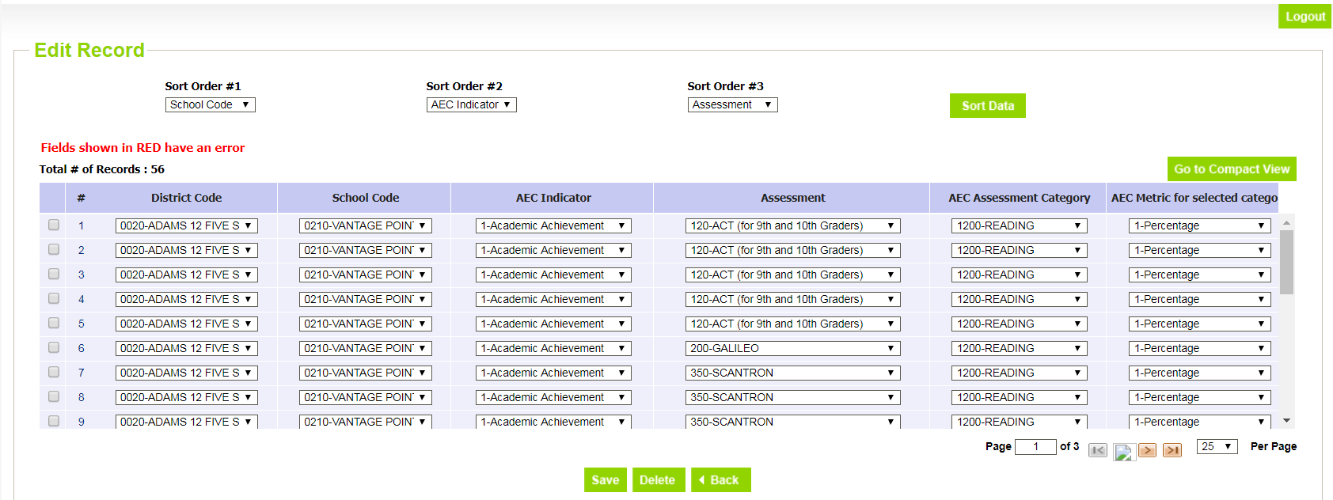
Planned Measures for the 2018 AEC SPF Submitting Your Data – Add/Edit Records
Select
Planned Assessment Measures for AEC
2018-19
Your LEA
Hit Search
You can delete or modify any of these records in this screen. You can edit multiple records at once, then SAVE.
Notes:
If you realize that you have made a mistake, and you need to edit or delete one of the measure you have added, you can use the Edit Records function. Click the Edit Record button on the navigation menu on the left hand side of the screen, and you will be taken to this screen. You will need to choose the appropriate file type and school year from the menu, and hit Search.
When you hit Search, you will see this screen, and you will be able to edit records that exist in Data Pipeline for the Planned Measures collection. Note that you can delete or modify records using this function, and that you can modify multiple records at once. When you hit the save button at the bottom of the screen, your changes will be passed through to the Data Pipeline system.

Slide 41
Planned Measures for the 2019 AEC SPF Submitting Your Data – File Upload
Select
Planned Assessment Measures for AEC
2018-19
Preferred File Content Type (rec: Excel)
Hit Search
Add in the codes for:
AEC Indicator
AEC Subindicator
AEC Subindicator Category
AEC Subindicator Category Metric
Notes:
When you click on the File Extract Download button, you will see this screen. You will need to select the following from the dropdown menus: a file type, a school year, your district or BOCES, and a file content type. Note that the extract for the Planned Measures collection will be a blank template. When you have made your choices, hit the Download Standard Extract button.
Your Planned Measures file will be a template with only the headers in the screenshot below. You will need to enter the numeric codes for your desired planned measures in the collection fields, along with your district or BOCES and school codes as I have done in this example. The numeric codes that crosswalk to AEC Indicators, AEC Subindicators, AEC Subindicator Categories, and AEC Subindicator Category Metrics can all be found in the file layouts and definitions document. The specific valid combinations between these fields are available in the Indicator Measures Valid Combinations Sheet document. Note that if any field is blank, or if any field uses an invalid code, or if any row uses an invalid combination of numeric codes, then your data will be flagged with errors.

Slide 42
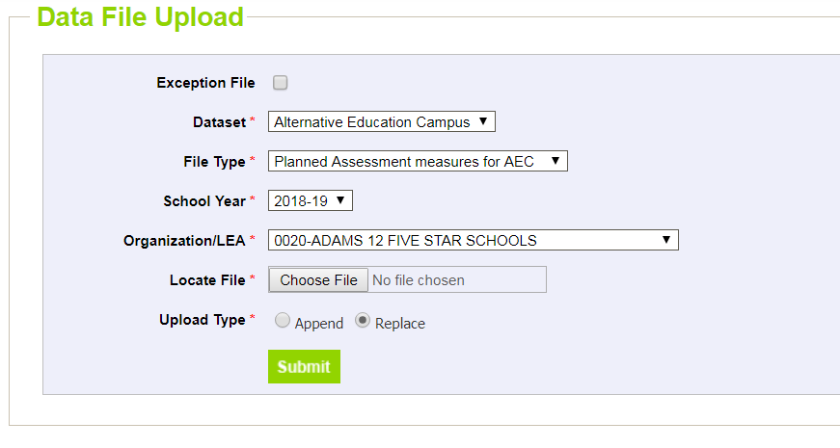
Planned Measures for the 2019 AEC SPF Submitting Your Data – File Upload
Select
Alternative Education Campus in Dataset
Planned Assessment Measures for AEC in File Type
2018-19 in School Year
Your LEA
Choose your file
Replace/Append in Upload Type as needed
Notes:
When you click on the File Upload button in Data Pipeline, you will see this screen. You will need to select the Alternative Education Campus dataset, the appropriate file type, and the school year from the dropdown menus. Choose replace if your file includes all AECs in your district or BOCES. Choose append if you are uploading your data school by school. Finally, choose the file you want to upload and hit the submit button.

Slide 43
Planned Measures for the 2019 AEC SPF Error Logic
Field | Code or Data? | Null Values Permitted?
AEC Indicator | Code | No
AEC Subindicator | Code | No
AEC Subindicator Category | Code | No
AEC Subindicator Category Metric | Code | No
Error logic: submitted data must conform to valid combinations between indicator, subindicator, category, and metric
Notes:
This table outlines the fields in the Planned Measures Collection which you need to complete, and how they will need to be completed. Each of the fields in the Planned Measures collection use the numeric codes outlined in the file layouts and definitions document, but if you’re using the add or edit record screens you will be able to choose names from dropdown menus. No null values are permitted for these fields. The only error logic applied in this collection is that any submitted data must adhere to the valid combinations between the fields. You can verify that your data adheres to valid combinations using the Indicator Measures Valid Combinations Sheet document available on the AEC Collections home page.

Slide 44
Actual Measures & Data Collection Status Dashboard
Select
Planned Assessment Measures for AEC
2018-19
Your Organization/LEA
Hit Search
Check your Validation Errors. When Validation Errors are 0, and you have no changes left to make on your data, hit Submit to CDE.
When you hit Submit to CDE, you have submitted your collection data!
Notes:
Once all of your measures have been selected, all of your data has been entered, and all errors have been resolved, it’s time to submit your data to CDE. You can do this by going to the status dashboard. This is available by clicking on the Alternative Education Campus button on the navigation menu on the left hand side of the screen, and then clicking on the status dashboard button, which is just beneath the Alternative Education Campus button. When you click on the Status Dashboard button, you will be taken to this screen. To submit your Planned Measures collection data to CDE, select Planned Assessment measures for AEC under file type, 2018-19 under school year, and your district or BOCES under Organization. Then press Search.
When you have zero validation errors in your data set, you can send CDE your data by pressing the Submit to CDE button. If you have comments you would like to send along with your data, you can enter them in the LEA Comments box here. When you submit your data to CDE, the system will notify CDE that you have done so. We will review your data. If we have no questions, and if there is nothing that needs to change, we will accept your data. You should receive and email from Data Pipeline when we accept your data. Once your data is submitted to us, it is locked. You cannot change it unless we unlock it for you.

Slide 45
Planned Measures for the 2019 AEC SPF Collection Opt Out
Mark option 1 for any school not submitting planned measures.
Remember to hit SAVE when you are done!
Notes:
The last thing to talk about is how to opt out of the Planned Measures collection. Please remember that if you are planning to submit measures which have not been previously approved, that you should complete this collection. Compared to the renewal/application opt out, the opt out values for the planned measures is simpler. There is only 1 option for schools opting out of the planned measures, and it is simply that the district is not submitting planned measures on the school’s behalf. We have instituted this process to make sure that no schools are over looked and that a lack of submitted data is intentional.

Slide 46
Planned Measures for the 2019 AEC SPF No sign off form!
No sign off form for Planned Measures!
Informal planning collection
Sign off sheets only required for Renewal/Application and Actual Measures and Data collections
You are done when you:
Upload data and submit your data to CDE, or
Opt out of the collection
Notes:
Remember, there is no sign off sheet for the planned measures collection. This is because this collection is an informational collection. We encourage you to use it for informational purpose, and to engage with use for the negotiation of new local measures. But since no data is submitted to us, either student level or aggregated, we do not need your formal sign off. This collection is complete once you finalize your submission or when you opt an AEC school out of this collection.

Slide 47
Resources, Trainings, and Contacts
Notes:
As we close out today’s webinar, I’ll go over some useful resources, let you know about upcoming trainings, and tell you about helpful contacts.

Slide 48
Resources
AEC Collections Information Page
http://www.cde.state.co.us/datapipeline/per-aec
AEC Accountability Resource Page
https://www.cde.state.co.us/Accountability/StateAccountabilityAECs
Notes:
General information about the AEC Pipeline Collections, and about AEC accountability in general, can be found at the two links on this slide. The AEC Collections Information Page has a wealth of resources documents created specifically to guide you through these Collections. A recording of this webinar, along with its chat transcript, will be posted there, too.

Slide 49
Trainings
AEC Collections Webinar Schedule:
FOR REFERENCE:
Webinar 1: Collections Overview
deck and chat transcript
Webinar 2: Collection Window 1 Details
Deck, chat transcript, recording
AEC Collections Office Hours:
Weekly office hours on Tuesday afternoons from 1pm to 3 pm are available. You can sign up for a half hour phone slot to chat with B Sanders about any questions you may have about the AEC collections here: http://www.signupgenius.com/go/5080c4ca5af2eabf94-aeccollections
Notes:
The materials from our last webinar have been posted to the AEC Collections home page and are available for your reference. If you have further questions about the AEC Collections, feel free to sign up for office hours! The link on this slide will take you to a sign-up page where you can sign up for weekly office hour slots with me, B Sanders, to get your questions answered about AEC Collections and AEC Accountability.

Slide 50
Modules
In order to view the narration while the video is playing, click on the Notes tab in the sidebar in the player.
Video Module 1 – Overview & Timelines (9:59): https://enetlearning.adobeconnect.com/pi1md74k0rhw
Video Module 2 – Access to Pipeline (5:30): https://enetlearning.adobeconnect.com/pds83bvi0bka
Video Module 3 – Opting Out of Collections (7:21): https://enetlearning.adobeconnect.com/p4akh8y057nt
Video Module 4 – Sign Off Sheets (11:10): https://enetlearning.adobeconnect.com/p7lcn4j7j302
Video Module 5 – Resources (10:30): https://enetlearning.adobeconnect.com/paii0l5a6d2h
Video Module 6 – Edit Records vs File Upload (12:24): https://enetlearning.adobeconnect.com/pjxifyl076br
Video Module 7 – Errors (9:12): https://enetlearning.adobeconnect.com/pqbkrtgu2l70
Notes:
We also have a set of video modules to help you navigate the AEC Collections! In these seven modules, we cover everything from timelines to the pros and cons of using the edit records function. If you get stuck on something, like why Data Pipeline is flagging your data as an error, these modules are a great place to find the answer.

Slide 51
Contacts
AEC Collection Questions
B Sanders, AEC and Accountability Senior Consultant
Sanders_b@cde.state.co.us
303.866.2685
Jessica Watson, Accountability and Policy Principal Consultant
Watson_J@cde.state.co.us
303.866.6778
Identity Management Questions
Rich Morris, Systems Administrator
Morris_r@cde.state.co.us
303.866.6713
Notes:
Finally, if you have questions about the AEC Collections, reach out to me, B Sanders, or my colleague, Jessica Watson. We can probably answer your question, and if we can’t, we’ll get you in contact with someone who can. If you have questions about the identity management system, such as permissions related to your local area manager or the AEC~LEAAPPROVER role, reach out to Rich Morris.

Slide 52
Reminder: Please use chat box to ask questions and keep phone muted.
Notes:
Now, I’ll go back through the chat box and address any questions that have been asked there during the webinar presentation. I’ll be typing my answers so that they will be recorded in the webinar chat log. I will answer all questions that come through, so now is the time to throw out any questions that you have! I’ll stick around until 3:00pm, as scheduled. Please keep your phone muted. I will be turning off my microphone now, but I will keep the video recording on until questions stop coming through. Thank you all for attending today!

