Slide 1
We are about to get started!
Housekeeping notes:
Please mute your phones.
If you have questions, type them into the chat box
If you would like to view the narration transcript, click the NOTES tab on the sidebar to the right
Notes:
Hi everyone! We are about to get started. Please note that in order to make this webinar as accessible as possible, we request that you do the following: mute your phones if you have called in. If you have a question, please type your question into the chat box rather than asking it out loud. I will answer the question at the end of the webinar via the chat box. Please be patient; all questions will be answered. If you require a transcript of the webinar while it is ongoing, click the notes tab on the sidebar to the right, and the narration script I am using will be visible on-screen.

Slide 2
AEC Collections Webinar 2:
Collection Window 1 Overview
February 15, 2018
Accountability & Data Analysis
Notes:
Good afternoon, and welcome to the second AEC Data Collections webinar. My name is B Sanders, and I am the AEC and Accountability Senior Analyst at CDE. This webinar will provide a detailed overview of the first collection window for the AEC Pipeline collections. Collection Window 1 for Alternative Education Campuses includes the AEC Renewal/Application Collection and the Planned Measures for 2018 AEC SPF Collection.

Slide 3
Agenda
Collection Window 1 Overview
Collections & Timeline
Collections Checklist
Pipeline Basics
Renewal/Application Collection
Collection Basics
Resources
Submitting Your Data
Reports
Error Logic
Collection Opt Out
Sign Off Sheets
Planned Measures For 2018 Collection
Collection Basics
Resources
Submitting Your Data
Error Logic
Collection Opt Out
Resources, Trainings & Contacts
Questions
Notes:
Here’s what we’re covering in today’s webinar. If you’ve participated in the AEC Collections in previous years, some of this information will be familiar to you. We’ll cover general information that will be useful to both collections occurring in this window first. Then, we’ll dig into the nuts and bolts of the AEC Renewal/Application Collection. We’ll also talk about the details for the Planned Measures for the 2018 Collection. Before we close out today’s webinar, I’ll also cover some helpful resources, additional training opportunities, and useful contacts. Finally, we have time allotted at the end for questions. Remember to type your questions into the chat box, and I will answer them there.

Slide 4
Collection Window 1 Overview
Collections & Timeline
Collection Checklist
Pipeline Basics
Notes:
First, I’m going to give a general overview of what’s expected of districts and BOCES during the Collection Window 1. I’ll talk through which collections will be live during this window, and the timeline for this window. I’ll also cover some Data Pipeline basics that are relevant to both the AEC Renewal/Application Collection and the Planned Measures for 2018 AEC SPF collection.

Slide 5
Collection Window 1 Overview Collections & Timeline
Timeline:
Month | Renewal/Application Designation Collection | Selection of Measures Collection (Planned and Actual)
January | Training – webinar 1 (1/18/18) Notify B Sanders of new schools seeking AEC designation by 1/31/2018 | Training - office hours
February | Training – webinar 2 (2/15/18) Training – office hours | Training – office hours
March | Renewal/Application collection opens 3/1/2018 Office hours for Renewal/Application collection will be available | Planned measures for 2018 AEC SPF collection opens 3/1/2018 Office hours for Selection of Measures
April | Renewal/Application collection closes 4/27/2018 | Planned measures for AEC SPF closes 4/27/2018 Training – webinar 3 (4/12/18)
May |  | Planned measures for 2019 AEC SPF collection opens 5/1/2018 Actual measures for 2018 AEC SPF collection opens 5/1/2018 Office hours for Selection of Measures
June |  | Planned measures for 2019 AEC SPF collection closes 6/29/2018 Actual measures for 2018 AEC SPF collection closes 6/29/2018 Office hours for Selection of Measures
Notes:
AEC Collection Window 1 opens on March 1st, 2018, and closes on April 27th, 2018. There are two AEC related collections to complete during Collection Window 1: the AEC Renewal/Application Collection, and the Planned Measures for the 2018 AEC SPF collection. While Collection Window 1 is ongoing, I will still be hosting weekly office hours. Feel free to sign up for those if you need help with either the Renewal/Application Collection or the Planned Measures for the 2018 AEC SPF Collection! We will discuss how to sign up for office hours later in this webinar. Also note that on April 12th, 2018, there will be the third and final AEC Collections webinar. This webinar is meant to prepare you for Collections Window 2.

Slide 6
Collection Window 1 Overview Collections Checklist
Collections Checklist
Review the file layout and definitions document and other resource documents
Decide how you will submit your data OR decide if you will opt out of data collection
Download your submission sign off form
Complete your data submission OR opt out of data collection
Gather necessary signatures
If data is submitted check submission for errors
Finalize data submission
Email completed sign off form to B Sanders
Notes:
This is a general checklist that will help you think through all the steps involved in any of the AEC Pipeline Collections. If you have not already done so, you should consider scheduling time to review the relevant documentation on our AEC Collections website for each of the collections you will be supporting during this window. You should also give some thought as to how to submit your data using the pipeline system—is the edit records web interface going to be most useful to you, or will you find the file download/upload method easier? For those AEC Collections which require a sign off form from multiple people in your district, downloading the sign off forms ahead of time is a good step. Once you’ve thought through all of this, you can begin the data submission process. Before you finalize your data, remember to check for errors flagged by Data Pipeline, and remember to submit your sign off forms.

Slide 7
Collection Window 1 Overview Collections Checklist
Collections Checklist
Review the file layout and definitions document and other resource documents
Decide how you will submit your data OR decide if you will opt out of data collection
Download your submission sign off form
Complete your data submission OR opt out of data collection
Gather necessary signatures
If data is submitted check submission for errors
Finalize data submission
Email completed sign off form to B Sanders
Submissions process is complete when all steps are complete
Notes:
It’s important to lay out all of the steps necessary in the AEC Collections so that you understand what the collection entails, and what is required in order for your data to be considered finalized and complete. Submitted data with errors in it will be returned back to your district or BOCES for further checking and resubmission. And submissions without supporting sign off forms will not be considered finalized or complete.

Slide 8
Collection Window 1 Overview Collections Checklist
Collections Checklist
Review the file layout and definitions document and other resource documents
Decide how you will submit your data OR decide if you will opt out of data collection
Download your submission sign off form
Complete your data submission OR opt out of data collection
Gather necessary signatures
If data is submitted check submission for errors
Finalize data submission
Email completed sign off form to B Sanders
In Collection Window 1, you only need to do this for the Renewal/Application Collection.
Notes:
A quick note: in Collection Window 1, the only collection which requires a sign off sheet from your district or BOCES staff is the AEC Renewal/Application Collection. There is no sign off form for the Planned Measures collections. Now that we’ve talked through what the AEC Collections generally require, let’s switch gears and talk about the basics of the Data Pipeline system.

Slide 9
Collection Window 1 Overview Pipeline Basics
Accessing Data Pipeline
If you are managing the AEC Collections for your district/BOCES – in part or in whole – then you will need to work with your local area manager (LAM) to receive data pipeline permissions
Role for collections: AEC~LEAAPPROVER
Grants ability to sign into Alternative Education tab in Data Pipeline
Ability to download/upload extracts to AEC collections
Ability to edit records for Renewal/Application Collection
Ability to add and edit records for Planned Measures for 2018 AEC SPF Collection
Ability to opt out of AEC collections
You cannot participate in the AEC Collections unless your LAM has assigned you to the AEC~LEAAPPROVER role!
Notes:
We’ll start first by talking about how to access Data Pipeline. Remember, if you cannot access Data Pipeline, you can’t submit your data. If you sign into the Data Pipeline system, and you do not see the Alternative Education tab on the left hand menu on the side of the screen, then please contact your LAM and request that you be assigned the AEC~LEAAPPROVER role. The simplest way to check to see if you have this role assigned to you is by signing in to Data Pipeline and looking at your permissions there.

Slide 10
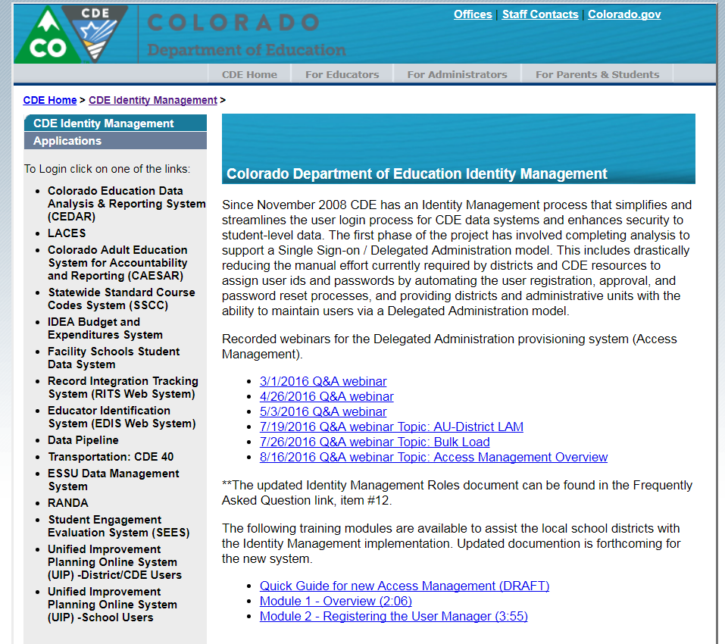
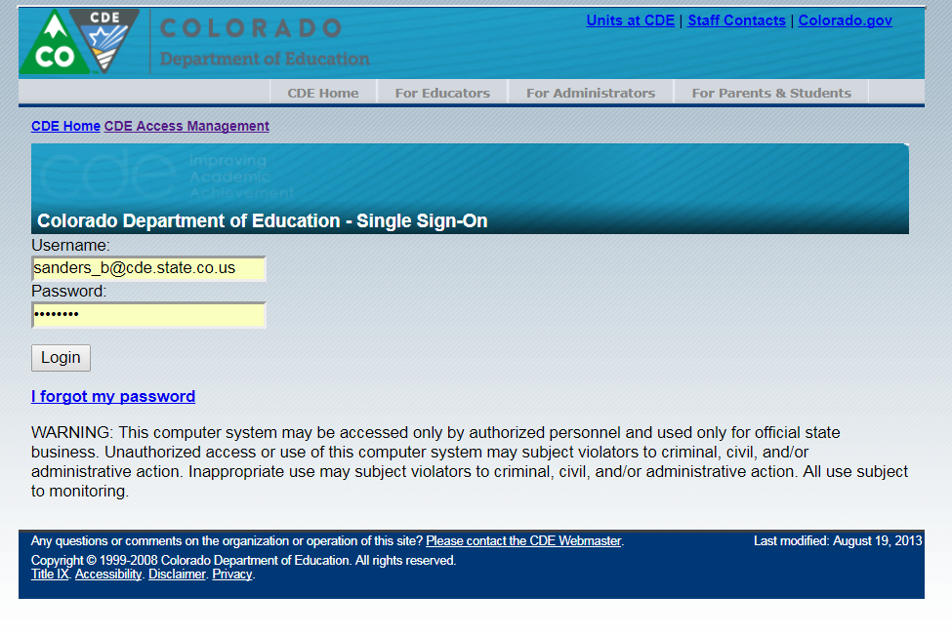
Collection Window 1 Overview Pipeline Basics
http://cdeapps.cde.state.co.us/index.html
Notes:
The link at the top of this slide will take you to page which allows you to navigate to any of the online applications managed by CDE’s single sign on system, which includes Data Pipeline. When you click on the link for Data Pipeline, you will be taken to a login page which looks like this. You will need to enter the username and password information you set up when your LAM assigned you the AEC~LEAAPPROVER role. If you were already in the identity management system, you will use your existing username and password. The AEC~LEAAPPROVER role will be added to your current permissions.

Slide 11
Collection Window 1 Overview Pipeline Basics
If you have permissions to the AEC LEA Approver role, then when you sign into Data Pipeline you should see Alternative Education on the left-hand side of the menu.
If you do not see this option, contact your LAM and confirm your role permissions.
Notes:
When you click login, you’ll be taken to the Data Pipeline home screen, which looks like this. You should see an Alternative Education tab on the left hand side of the screen. If you do, then your permissions to interact with and participate in the AEC Collections are correctly set up. If you do not see Alternative Education on the left hand side of the screen, or if you receive an error message, you may not have the AEC~LEAAPPROVER role assigned to you. Your next step is to contact your local area manager and confirm your role permissions. Make sure to check this before March 1st, 2018, when Collection Window 1 opens. Now, I’ll walk you through what you’ll see in Data Pipeline and how you can use Data Pipeline to complete your data submission.

Slide 12
Collection Window 1 Overview Pipeline Basics
This is where you will start for all AEC Collections.
Use this to see what errors/warnings still need to be resolved in your district/BOCES by collection.
Add records for the Planned Measures for 2018 Collection.
Use for both the Renewal/Application and Planned Measures for 2018 Collections.
Opt a school, or schools, out of either collection.
Download file extracts for each collection.
Notes:
The image on the left is the navigation menu you will see if you have AEC~LEAAPPROVER role permissions properly assigned to you. To do anything with the AEC Collections, you will start by clicking on the Alternative Education button. Clicking on this button will display all of the buttons below it. The buttons below allow you to pull and modify the data in Data Pipeline associated with a given collection. We’ll go through how to use all of these functions for each collection a little later in this presentation. Before we talk about that, let’s cover how data errors are defined and flagged in Data Pipeline, since this is one thing you’ll need to check for before finalizing your data submission.

Slide 13
Collection Window 1 Overview Pipeline Basics
Errors in Data Pipeline:
Invalid codes
Missing data in required fields
Incorrect codes in a given field
Data that breaks a logic rule in a given field
Data errors will need to be resolved before submitted data can be finalized.
Notes:
The reason you need to understand that errors exist, and the kinds of errors there are, is because you must resolve all the errors in your data before your data submission can be finalized. If errors are still present in your data when the collection window closes, I will need to reach back out to you to ask you to resubmit with the errors cleaned out. In Data Pipeline, an error is either data that is an invalid code in a given field, or data that breaks the logic rule assigned to a given field. I’ll talk in detail about what the logic rules are for each collection in Collection Window 1 later in this webinar, but regardless of collection the errors will be flagged the same way. Now, let’s look at how the Data Pipeline system flags errors for you to see.

Slide 14
Collection Window 1 Overview Pipeline Basics
Records added with errors will still be submitted to the Data Pipeline system, but you will receive a notice that they are an error, and they will be flagged in RED.
Notes:
If you are trying to add a record, and you add a record in a way that results in an error, the Data Pipeline system will flag it for you as displayed on this slide. If an error is entered, the error will enter the Data Pipeline system, but will be flagged in red, as shown here.

Slide 15
Collection Window 1 Overview Pipeline Basics
When you load an edit record screen for a given collection, any errors will be flagged in RED.
Notes:
You can also use the edit record screen to find errors in your existing Data Pipeline data. Any fields with red shading, as shown here, are flagged as errors. You can make changes to these fields in order to correct errors in this screen. If you do so, remember to hit the save button at the bottom of the screen.

Slide 16
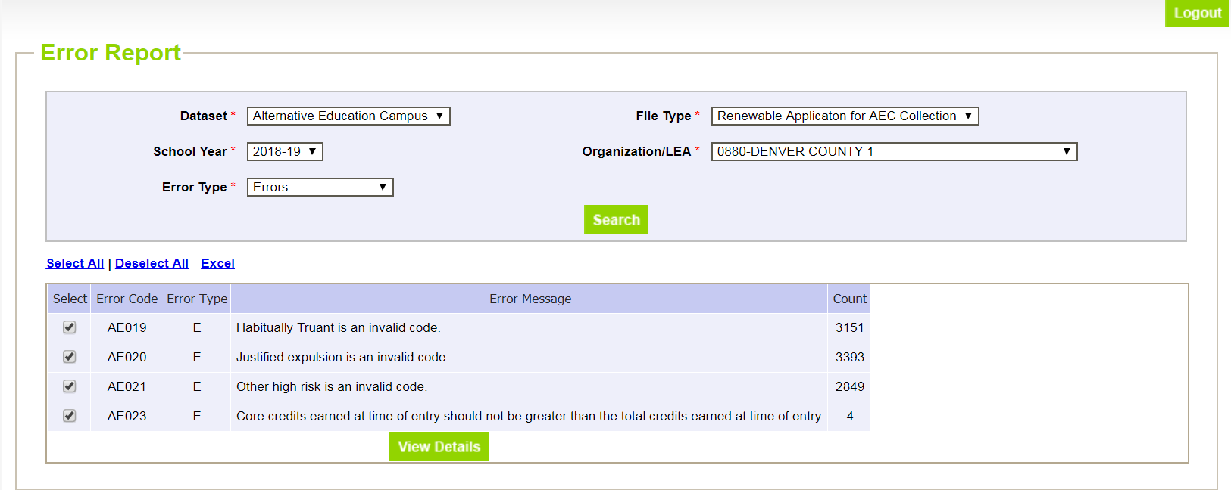
Collection Window 1 Overview Pipeline Basics
The Pipeline Error Report is useful for file downloads/uploads. This will tell you how many errors and what types of errors an uploaded file contains. The View Details button will take you to those specific rows and let you edit them with the Edit Record screen.
Notes:
Finally, there is also an error report function in the Data Pipeline system. This is a useful way to find errors in any of the AEC Collections, no matter how you go about completing and uploading the AEC Collection data. If you are downloading and uploading file extracts, this is the best way to check any potential errors, and should be done once you’ve uploaded your file. The error reports will also work if you’re adding and editing records through the pipeline web interface.

Slide 17
Renewal/Application Collection
Collection Basics
Resources
Submitting Your Data
Reports
Error Logic
Collection Opt Outs
Sign Off Sheets
Notes:
Now that we’ve covered some general information, let’s dive into each collection separately. In these sections, I’ll tell you how to use Data Pipeline to complete your submission and go through information specific to each collection. Let’s start with the Renewal/Application Collection.

Slide 18
Renewal/Application Collection Collection Basics
AEC Renewal/Application Collection
REQUIRED for any school that wishes to receive Alternative Education Campus (AEC) designation from the state
This designation allows for the school to be accredited using the AEC School Performance Framework (SPF)
Collection is student level and uses personally identifiable information (PII)
No high risk designation data from this collection is used in any subsequent reporting
Threshold for designation is still 90% high-risk as of the school’s 2017 October Count population
Notes:
As you may know, the AEC Renewal/Application collection is required in order for a school to be designated as an Alternative Education Campus. There are two main things to know about this collection: first, that all AECs must complete this collection annually in order to receive or maintain their AEC designation. Second, that receiving AEC designation allows for accreditation using the specialized AEC School Performance Framework. Though this collection has moved to the Data Pipeline this year, it is still the same as it was last year. The collection requires districts to determine the high-risk status of students at their AEC schools based on the population of students that were there as of October Count. None of the risk factor definitions have changed since last year.

Slide 19
Renewal/Application Collection Collection Basics
Renewal Schools: Schools that received AEC designation for the 2017-2018 school year and are re-applying for the 2018-2019 school year
Full list of schools with 2017-2018 AEC designation is available here: https://www.cde.state.co.us/accountability/applications_for_aec_status_17_18
Applicant Schools: Schools applying for AEC designation for the 2018-2019 school year that did not have AEC designation in the 2017-2018 school year
Schools applying for AEC designation for the first time
Schools re-applying for AEC designation after a lapse in designation
Notes:
The Renewal/Application Collection includes both renewal schools and applicant schools. Renewal schools are those which go into the collection with their AEC designation from the previous year already in place. The link on the slide goes to a list of the schools which received State Board of Education approval for AEC designation in August 2017—any schools from this list which apply in the upcoming collection window will be considered renewal schools. A school not on that list will be considered an applicant school. Applicant schools are those which are applying for AEC designation for the first time, or schools which may have received AEC designation, but not in the preceding year.

Slide 20
Renewal/Application Collection Collection Basics
In-Person Audits: A school in your district may be selected for an in-person audit by CDE personnel for any of the following reasons:
The school is applying for AEC designation for the first time
The school is re-applying for AEC designation after a lapse in designation status
The district opted out of providing student-level data for the school during the Renewal/Application Collection process
Data irregularities were found during the Renewal/Application Collection process
The district has excluded the AEC from the district’s District Performance Framework in a previous accountability cycle
Random selection
Notes:
As some of you know, CDE audits a handful of schools after the Renewal/Application collection window closes. The audits are a way for us to contextualize the data we receive from you and to answer questions you may have for us. We want you to be aware that there is a possibility you may be selected for an audit at the end of the data collection period. Applicant schools are nearly always selected for audits because we want to see and talk through your intake processes and record keeping processes. We also randomly select schools to audit because we try to visit and audit every district with an AEC once every four years on a rotating basis. Now that we’ve discussed the content and purpose of the AEC Renewal/Application Collection, let’s talk about what you’ll need to complete your data submission.

Slide 21
Renewal/Application Collection Resources
What do you need? | Why do you need it? | Where do you get it?
List of AECs with current AEC designation | Determine if a school is a renewal school or an applicant school | http://www.cde.state.co.us/accountability/applications_for_aec_status_17_18
Renewal/Application File Layout and Definitions | Understand fields needed for data submission | http://www.cde.state.co.us/datapipeline/aec-application-renewal-filelayout-1819
Confirmation that you have access to the AEC Collections in Pipeline | Cannot submit data without access to Data Pipeline | Local Area Manager grants AEC~LEAAPPROVER role permission
Sign off sheets for Renewal/Application Collection downloaded | Data submission is not considered final until sign off sheets are submitted | http://www.cde.state.co.us/datapipeline/aec-renewal-application-signoff
Documentation requirements for high-risk student identification available for review | If district/BOCES is using district-identified categories, review of documentation requirements is helpful | http://www.cde.state.co.us/datapipeline/aec-documenation-assurance
Notes:
This table shows you what you’ll need to have on hand as you start the Renewal/Application Collection, why you’ll need each document, and where to find it. You’ll need to first check to see if the schools you are working with are renewal or applicant schools. While nothing is different in the actual submission process, as previously discussed, applicant schools are more likely to receive an audit from CDE staff at the close of the collection. CDE also will need to be notified that applicant schools wish to seek AEC designation so that we can prepopulate the data in Data Pipeline for you. If you have an applicant school which is seeking AEC designation, and you have not yet notified CDE of this, please do so immediately. You will also need to familiarize yourself with the Renewal/Application file layout and definitions document. Doing so will make the data submissions process easier and simpler since you will know which fields to complete, which to leave alone, and how to complete them. This document also provides error logic for your reference. Before the window opens, it is a good idea to check to make sure that you have your AEC~LEAAPPROVER permissions correctly set for Data Pipeline. You may also want to download the required sign off sheet and make the requisite number of copies needed since sometimes gathering those signatures takes longer than anticipated. Finally, please review the documentation requirements for high-risk students. When you submit and sign off on the data provided, you are doing so with the understanding that any district identified categories have the required documentation to back up that identification, so it is worthwhile to understand what those documentation requirements are. Now, let’s talk about how you can submit your completed data.

Slide 22
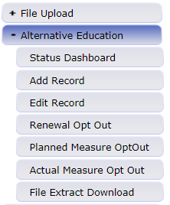
Renewal/Application Collection Submitting Your Data – File Upload
Use File Download/Upload to complete if:
You have several AECs in your district/BOCES or if you have particularly large AECs in your district/BOCES
The staff completing the Renewal/Application Collection are comfortable using and working with excel spreadsheets
Data entry and analysis for the Renewal/Application Collection will likely be shared across individuals
Upload completed files to Data Pipeline for CDE review
Download pre-populated files from Data Pipeline to submit
Notes:
The file download/upload method for the Renewal/Application Collection works best when a district or BOCES is completing this collection for multiple AECs, or when there are particularly large AECs in the collection. If the staff at the district or BOCES are already used to completing this collection using spreadsheets, and are comfortable using formulae and filters, then this continues to make sense. Additionally, if part of the analysis and modification for this collection will be done by some individuals, for example, school staff, and then completed or verified by others, say district staff, then the download/upload method may prove useful. To access the pre-populated data file CDE has crated for you, use the File Extract Download button on the navigation menu on the left hand side of the screen when in Data Pipeline. To upload your completed data, you will use the File Upload button. We’ll go through each screen next in greater detail.

Slide 23
Renewal/Application Collection Submitting Your Data – File Upload
Select
File Type: Renewal Application for AEC Collection
Extract Type: Initial Extract
File Content Type: Excel
Your LEA
Hit Download Standard Extract
Gives you only the fields you can update
Helpful Cognos reports:
Students Not Identified As At risk
Notes:
When you click on the File Extract Download button, you will see this screen. You will need to select the following from the dropdown menus: a file type, a school year, your district or BOCES, and a file content type. The file type determines which AEC Collection you are working on. You can download extracts for any of the AEC Collections, but a pre-populated extract will only be available for the Renewal/Application Collection. You will also need to choose a file type. We recommend choosing excel. When you have made your choices, hit the Download Standard Extract button. There are two types of extracts available for download for the Renewal/Application Collection: the AEC full initial extract, and the Initial extract. We recommend that you choose the initial extract, as listed here. This file type will give you only those fields that you should update. The AEC full initial extract will give you all fields, including calculated fields and non-updateable fields, which can be confusing in the submission process. Another thing you should be aware of for this portion of the submission process is a helpful Cognos report call the Students Not Identified At Risk report, which will flag for you any student in your district at an AEC who is not currently flagged in a high risk category. If you’re not sure where to start with the designation process, this report, combined with the initial extract download, can help you focus your efforts.

Slide 24
Renewal/Application Collection Submitting Your Data – File Upload
Select
File Type: Renewal Application for AEC Collection
Extract Type: Initial Extract
File Content Type: Excel
Your LEA
Hit Download Standard Extract
Complete the following:
Habitually Truant
Justified Expulsion
Other High Risk
Over Age and Under Credited credit information (if desired)
Notes:
Your Renewal/Application file will look like the screenshot below. The cells which are blacked out contain personally identifiable information; in your file, these will be viewable. You must enter data for all students into the district identified fields. Those fields are Habitually Truant, Justified Expulsion, and Other High Risk. The fields used to calculate Over Age and Under Credit—Total Credits Earned at Time of Entry, Total Credits Required to Graduate, Core Credits Earned at Time Of Entry, and Core Credits Required to Graduate—can be left blank. Please note that this file will display all AECs in your district or BOCES, but that your data will be sorted first by school, then by SASID within each school. If you are planning to send the data to schools to complete, you may need to separate each school’s data into separate sheets before sending it out, then compile the complete data into one master sheet again before uploading.

Slide 25
Renewal/Application Collection Submitting Your Data – File Upload
Select
Dataset: Alternative Education Campus
File Type: Renewal Application for AEC Collection
Your LEA
Hit Submit
Notes:
When you click on the File Upload button in Data Pipeline, you will see this screen. You will need to select the Alternative Education Campus dataset and the appropriate file type from the dropdown menus. You will also need to select the relevant school year and your district or BOCES. Finally, choose the file you want to upload and hit the submit button.

Slide 26
Renewal/Application Collection Submitting Your Data – Edit Records
Use Edit Records to complete if:
You have only one or two AECs in your district/BOCES and they have small enrollments
The staff completing the Renewal/Application Collection feel more comfortable with a web interface than with spreadsheets
One person will be doing the majority of the data entry and submission for all of the student records
You will be entering data student by student or high-risk indicator by high-risk indicator
Notes:
The nice thing about using the Data Pipeline system for these collections is that it’s flexible. We recommend using the file download/upload method for the Renewal/Application collection, but you could also complete this collection by using the edit records function in Data Pipeline. The edit records method will be useful if you have a relatively small number of student records to modify or analyze. The edit records method is also a good fit for the Renewal/Application Collection if a single staff member is completing the entire collection, and if that staff member feels more comfortable doing data entry in a web interface than managing spreadsheets, especially spreadsheets with filters and formulae. The edit records method may also be a good approach if someone is completing the collection in a particularly thorough way, such as by going student by student and indicator by indicator.

Slide 27
Renewal/Application Collection Submitting Your Data – Edit Records
Select Renewable Application for AEC Collection and your LEA, then hit SEARCH
Notes:
When you click the Edit Record button on the navigation menu on the left hand side of the screen in Data Pipeline, you will see a screen that looks like this. You will need to select a file type and your district or BOCES. For file type, select Renewable Application for AEC Collection. If you are editing records for submission, select All where it says Error Records. If you are checking for errors, you can use that filter to display only records with errors. Then hit Search.

Slide 28
Renewal/Application Collection Submitting Your Data – Edit Records
Select Renewable Application for AEC Collection and your LEA, then hit SEARCH
Use dropdowns to enter yes/no values
Enter over age/under credit data into cells
Notes:
When you hit search, you will see all the data which CDE has pre-populated for you for the Renewal/Application Collection. Again, the data you need to enter as the district are the fields which the district can identify: Habitually Truant, Justified Expulsion, Other High Risk, and the data necessary to calculate if a student is Over Age and Under Credit. For Habitually Truant, Justified Expulsion, and Other High Risk, you can simply choose yes or no from a dropdown menu. Note that each student must have a yes or no value in each of these fields in order for your collection to be error-free. For the credit-based fields, data can be entered directly into the cells. Since we’ve covered how to submit your data, let’s talk about how to make sure your Renewal/Application data is error-free. Note that when using the edit records function for the Renewal/Application collection that you can neither add or delete records. The universe of students which you need to analyze for high-risk status is fixed and reflects the 2017 October Count population that was at a given AEC. Also note that this will display all AECs in your district or BOCES, but that your data will be sorted first by school, then by SASID within each school.

Slide 29
Renewal/Application Collection Cognos Reports
CDE generated reports which pull out specific populations in the data or aggregate the data you submit
Notes:
Let’s talk for a moment about the available Cognos reports that will be useful as you go through the Renewal/Application Collection. To access the Cognos reports associated with the AEC Data Pipeline Collections, hit the Cognos Report button on the navigation menu on the left hand side of the screen.

Slide 30
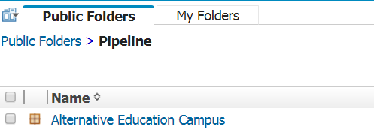
Renewal/Application Collection Cognos Reports
Click on the Alternative Education Campus link
Notes:
When you click on the Cognos Report button, you will be taken to a screen that looks like this. Depending on the identity management role permissions you have assigned to you by your district, you may have access to several different kinds of reports. To access the reports related to the AEC Data Pipeline collections, click on the link labeled Alternative Education Campus.

Slide 31
Renewal/Application Collection Cognos Reports
Click on the Alternative Education Campus link
Reports relevant to Renewal/Application Collection
Notes:
This will take you to a screen where you will see all the available reports associated with the AEC Data Pipeline collections. I encourage you to check through all of these reports, since they might be useful to you! I want to bring your attention to three specific reports right now, which are designed to help you through the Renewal/Application Collection specifically. These are the Percentage of At Risk Student Population Detail report, the Percentage of At Risk Student Population Summary report, and the Students Not Identified As At Risk report. I’ll talk about what to look for in each and what each is useful for.

Slide 32
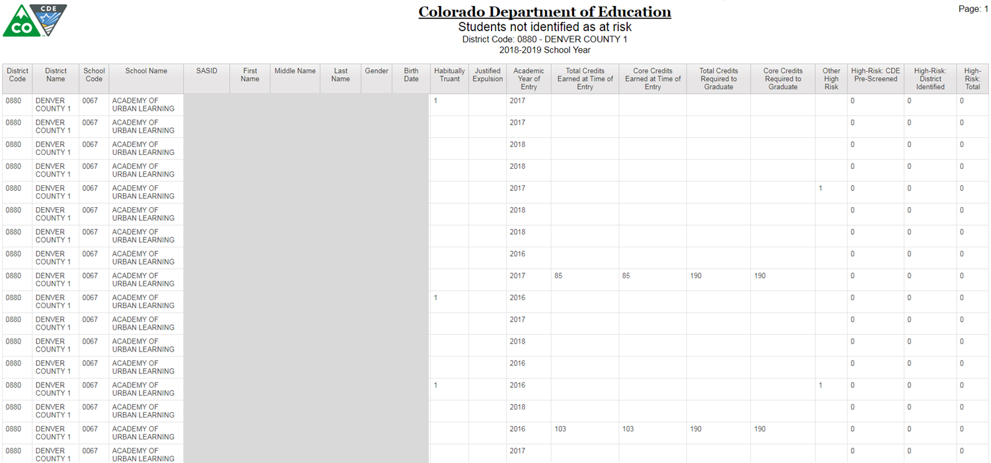
Renewal/Application Collection Cognos Reports
Students Not Identified As At Risk Report:
This report pulls a list of students who do not have a flag in any high risk indicator in the dataset most currently uploaded to Data Pipeline
Can use this report to narrow down on which students need high risk designation
Notes:
Let’s start with the Students Not Identified As At Risk Report. The reason to talk about this report first is because you would want to look at this report early and often, well before the end of the collection process. What this report shows you is a list of students in your district or BOCES who are not currently identified in any of the high risk categories. Since this report shows everything that’s in the data extract for the Renewal/Application Collection, I’ve blocked out the personally identifiable information here. Those fields will be viewable in your report. If you take a targeted approach towards this collection, then this report will help you zero in on students who are not identified, and you can use this list to check against your own records to look for identifications for these specific students. It’s worth noting that if you upload a file, or if you make changes using the edit records feature, you can refresh this report to see changes in this list.

Slide 33
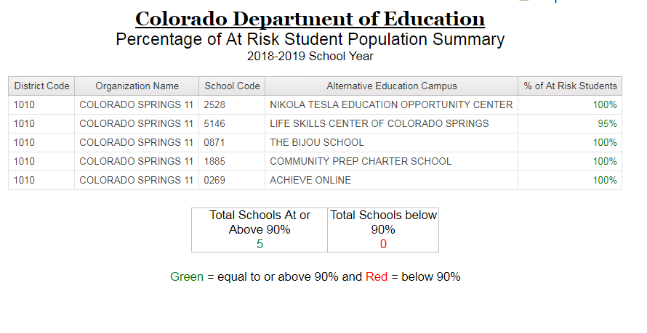
Renewal/Application Collection Cognos Reports
Percentage of At Risk Student Population Summary Report:
Shows the percentage of students with flagged with at least one high risk indicator in the current data set uploaded to pipeline for each school in a given district/BOCES
Notes:
At the end of the identification process, you will want to see if the AECs your district or BOCES serves met or exceeded the 90% high risk threshold needed to receive or maintain AEC designation. The Percentage of At Risk Student Population Summary Report can give you that information. This report gives you a list of all of the AECs in your district or BOCES and the percentage of students with at least one high risk flag. Again, you can use this report to monitor your progress through the collection. If you make changes by uploading a file or by using the edit records feature, you can refresh this report to see changes in this list.

Slide 34
Renewal/Application Collection Cognos Reports
Percentage of At Risk Student Population Detail Report:
Shows the number of students in each high risk category and the percentage of students flagged in at least one high risk category in a specific school
This can be used to fill out the table on page 3 of the sign off sheet
Page down to see each school in a given district/BOCES (displayed one by one)
Notes:
The last report you should know about for the Renewal/Application Collection is the Percentage of At Risk Student Population Detail Report. This report shows you counts of how many students are in each high risk category and the total percentage of students with at least one high risk flag. The screen displays information for only one school at a time, so if your district or BOCES serves multiple AECs, you will need to use the page down and page up buttons at the bottom of the screen to navigate from school to school. Remember, you can use this report to monitor your progress through the collection. If you make changes by uploading a file or by using the edit records feature, you can refresh this report to see changes in this list.

Slide 35
Renewal/Application Collection Error Logic
Renewal/Application Collection – Initial Extract
Field | Valid Codes | Code Values | Null Values Permitted?
Habitually Truant | 0, 1 | 0=No 1=Yes | No
Justified Expulsion | 0, 1 | 0=No 1=Yes | No
Other High Risk | 0, 1 | 0=No 1=Yes | No
Total Credits Earned at Time of Entry | Any positive number | NA | Yes, if no data entered for total credits required to graduate
Core Credits Earned at Time of Entry | Any positive number | NA | Yes, if no data entered for core credits required to graduate
Total Credits Required to Graduate | Any positive number | NA | Yes, if no data entered for total credits earned
Core Credits Required to Graduate | Any positive number | NA | Yes, if no data entered for core credits earned
Notes:
This table outlines what fields in the Renewal/Application Collection you will need to complete, and how they will need to be completed. For the first three fields, only a value of 0 or 1 is permitted, where 0 represents “No” and where 1 represents “Yes”. No null values are permitted in these fields. For the last four fields, which are all related to over age and under credited designation, null values are permitted in some circumstances, and positive numbers are fine to enter. Once in the system, calculations are run on the over age and under credited fields to determine that designation based on the credit totals.

Slide 36
Renewal/Application Collection Error Logic – Over Age and Under Credit
Error Logic | Reason
Data is entered for Total Credits Earned but not for Total Credits Required | Cannot determine if (OAUC) without credits required threshold
Data is entered for Core Credits Earned but not for Core Credits Required | Cannot determine if (OAUC) without credits required threshold
Core Credits Required is equal to or larger than Total Credits Required | Likely an error; would suggest no possibility of elective credits
Total Credits Earned is equal to or larger than Total Credits Required | Likely an error; Total Credits Required should be cumulative, not number left
Core Credits Earned is equal to or larger than Core Credits Required | Likely an error; Core Credits Required should be cumulative, not number left
Notes:
Since there is additional layers of embedded logic for the over age and under credited designation, you should be aware of the logic rules that are in place. Your data will be flagged with errors if any of the logic rules on this slide are broken. This slide shows the logic rule on the left, and the reasoning behind that logic rule on the right. Please feel free to reach out to me, B Sanders, if you have any questions about these logic rules. Remember that there are multiple ways to check your data for errors once it’s submitted. You can pull an error report, or you can pull a list of student records with error flags using the Edit Record function. Now, everything we have covered so far assumes that you are going to submit student level data to CDE as part of the Renewal/Application collection. Most of you will! But some of you will opt out of the student level data collection. Let’s walk through that process now.

Slide 37
Renewal/Application Collection Collection Opt Out
Select the relevant year. For Renewal/Application, only 2018-19 should be available.
Select the your district/BOCES. You should only be able to select your own district/BOCES.
Then hit Search.
Opting Out:
Choosing not to submit data in a specific AEC data collection and alerting CDE to that decision through a simple process.
Notes:
To clarify, opting out of the Renewal/Application collection does not mean that a given school is not participating in this collection. Instead, the opt out process for the Renewal/Application Collection is a way of informing CDE that you are not going to provide us with the student level information relevant to this collection. If you choose to pursue this route, click on the Renewal Opt Out button on the left-hand side of the Data Pipeline menu. Then, you will be taken to a screen that looks like this. You will only be able to select the relevant designation year, 2018-19, and your own district. Then, hit search.

Slide 38
Renewal/Application Collection Collection Opt Out
Opting Out:
Choosing not to submit data in a specific AEC data collection and alerting CDE to that decision through a simple process.
Decide if you’re choosing an opt-out value for all schools or only a subset of schools
Remember to hit SAVE when you are done!
Notes:
On this screen, you will be able to choose whether you are opting out a single AEC in your district or BOCES from the Renewal/Application collection, or all of your AECs from the Renewal/Application collection. To opt a single AEC out of the collection, choose an opt out value in that school’s row. To opt all AECs in your district or BOCES out of the collection, choose a value from the top row, the header row in darker purple, and it will populate your selected opt out value for all AECs in your district or BOCES. Then, hit save.

Slide 39
Renewal/Application Collection Collection Opt Out
Opting Out:
Choosing not to submit data in a specific AEC data collection and alerting CDE to that decision through a simple process.
Notes on opt-out values:
1 – schools only enrolls part-time students: all students at school must be primarily enrolled at another school
2 – school will not submit PII: selecting this option flags school and district for a potential in-person audit with CDE personnel
Remember to hit SAVE when you are done!
Notes:
Now, let’s talk about the reasons why you would consider opting an AEC out of the Renewal/Application collection, and what the potential consequences are for doing so. As you can see on this slide, there are two potential opt out values which are available for this collection. First, schools which enroll exclusively part-time students, that is schools where their entire student body are secondarily enrolled at that school, do not have to demonstrate that their student population is 90% high risk. Therefore, the student level analysis that this collection is based on is not relevant to these schools; the fact that all their students are part-time enrollments de facto qualifies them as AECs. These schools can and should signal that they serve this distinct population by using the opt out value marked 1. Second, there are districts and BOCES who have expressed reservations about supplying CDE with high risk student data. We recognize this, and appreciate these LEA’s desire for data privacy. Opt out value 2 is reserved for districts and BOCES who wish to designate AECs which fall into the categories requiring student level analysis of high risk status, but which do not want to provide student level data to CDE. If your district or BOCES falls into this category, assign your AECs to this category. However, CDE is still required to verify student level information and practices at your district or BOCES. By choosing to provide aggregate counts only, you are agreeing to allow CDE staff to come to your district or BOCES for an audit of your student records to ensure that your AECs do indeed meet the 90% high risk threshold.

Slide 40
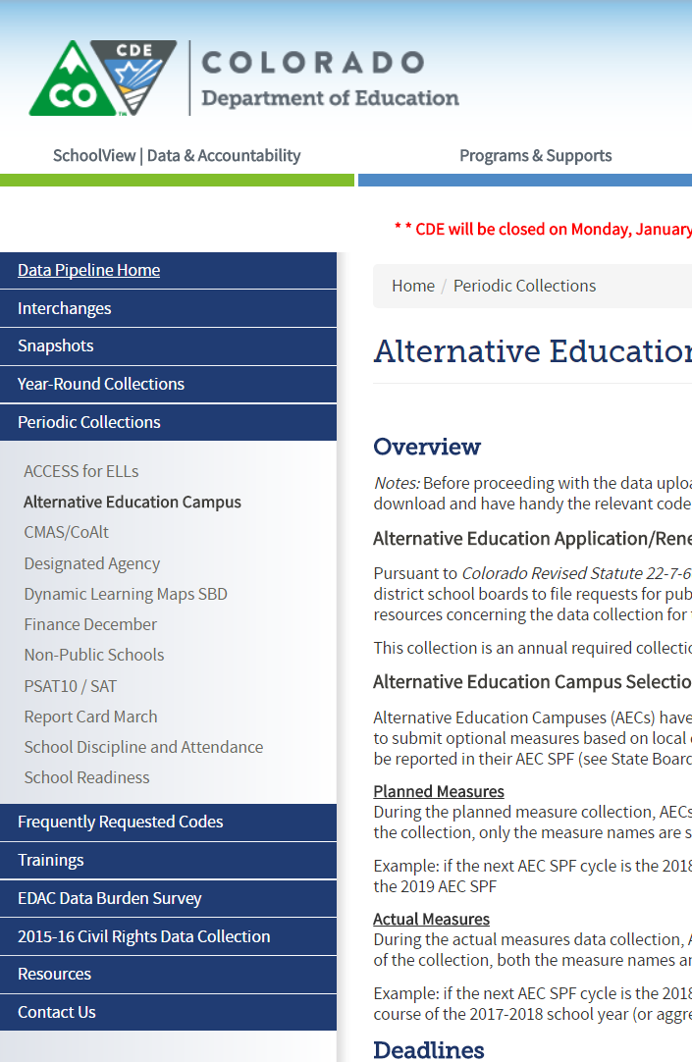
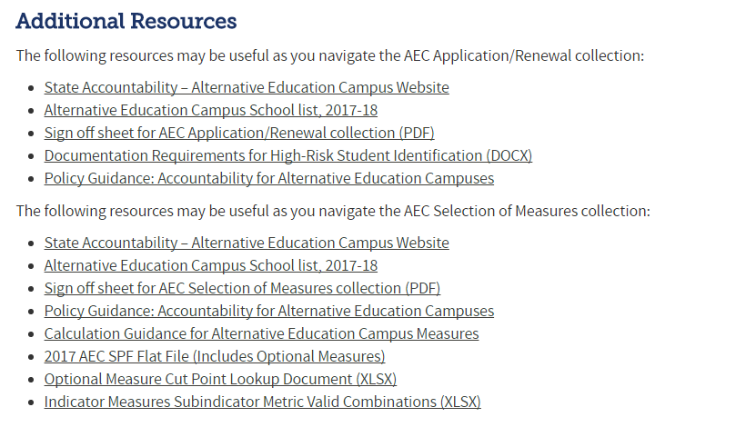
Renewal/Application Collection Sign Off Sheet
http://www.cde.state.co.us/datapipeline/per-aec
Scroll down to this section:
Notes:
The last step in the Renewal/Application Collection is sending CDE your completed sign off sheets. These are required for each AEC participating in the collection, even those that have opted out of the student level data submission. This slide demonstrates where to find the sign off sheet for the Renewal/Application collection. Using the link on the top of this slide, navigate to the AEC Collections website. Once there, scroll down to the Additional Resources section, which is near the very bottom of the page. The Renewal/Application Collection sign off sheet PDF can be downloaded directly to your machine by clicking on the link.

Slide 41
Renewal/Application Collection Sign Off Sheet – Page 1
Complete all fields. Please print legibly.
This section are the statutory requirements for an AEC:
Place check marks beside all of these criteria.
Select only the description of the student population that describes this school.
Notes:
The sign off form for the AEC Renewal/Application Collection is four pages long. I recommend printing it one-sided, since that will make it simpler to scan at the end of the process. This is page one. Everything noted in red needs to be completed by your district or BOCES. Things noted in blue are for informational purposes. On page one, you will need to complete a section noting your school name and CDE school number, and your district name. You will also need to complete a section regarding the statutory requirements regarding the definition of an Alternative Education Campus.

Slide 42
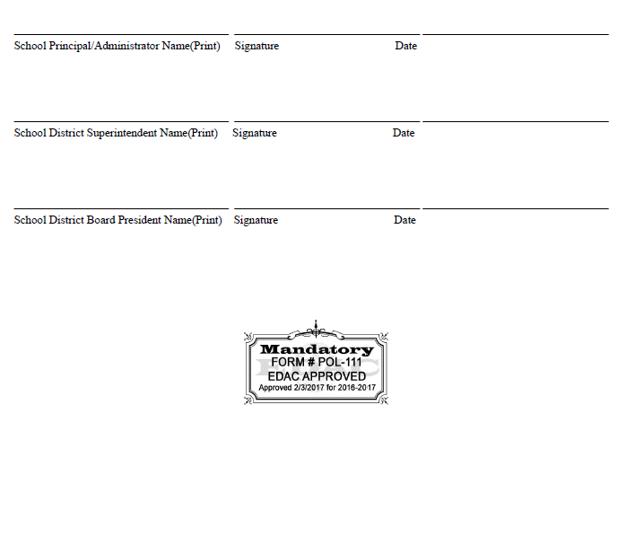
Renewal/Application Collection Sign Off Sheet – Page 2
All signatures are needed
EDAC approval stamp
Notes:
Page 2 of the AEC Renewal/Application sign off sheet is where the principal, superintendent, and Board of Education president signatures go. Note that this sign off sheet has been approved by Educational Data Advisory Committee, or EDAC.

Slide 43
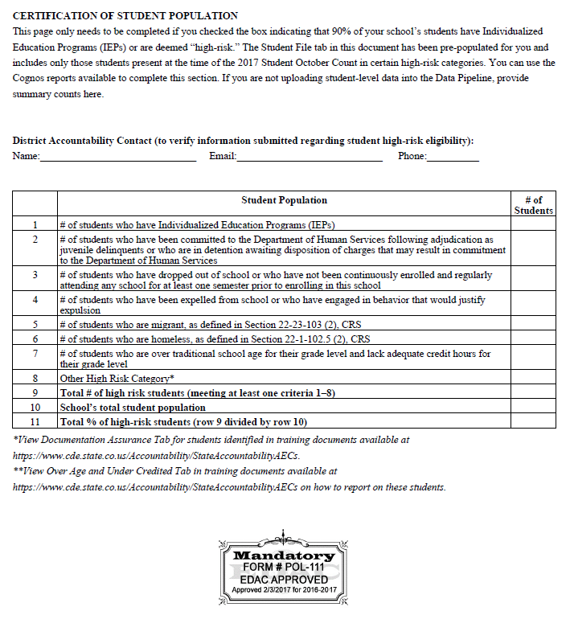
Renewal/Application Collection Sign Off Sheet – Page 3
Note that schools enrolling 100% part-time enrollments do not need to complete the data collection.
Complete District Accountability Contact information
If district/BOCES is not submitting student level information, this section must be completed. You can use the Percentage of At Risk Population Detail report to gather this information.
If student level information is entered into Data Pipeline, this section can be skipped.
Notes:
Page 3 of the sign off form also has areas for you to complete. Please read the note called out in blue at the top carefully, because depending on the population your AEC serves, you may not need to complete the AEC data collection and may be able to opt out instead. The data table provided below is intended for completion by schools and districts who prefer to provide summary counts instead of student level information through Data Pipeline due to PII concerns. Remember that providing these summary counts instead of student level data will flag your AEC for an in-person audit with CDE staff.

Slide 44
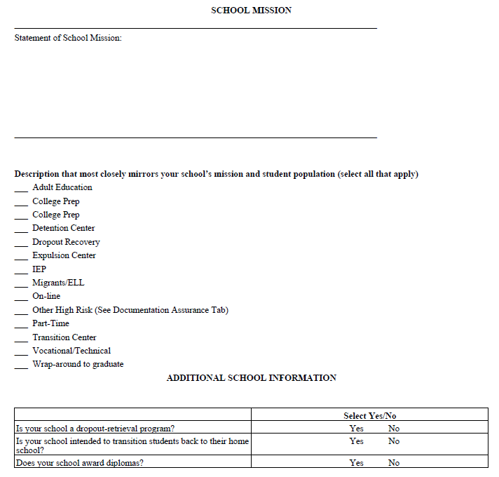
Renewal/Application Collection Sign Off Sheet – Page 4
This section must be completed. Please print legibly.
Add checkmarks to any description that fits your school.
Feel free to reach out if you are unsure if a given term fits your school.
Circle YES or NO as appropriate for each question.
Notes:
Page four is the last page of the sign off sheet for the AEC Renewal/Application Collection. All school must complete a school mission statement and should complete the section with descriptors of their program. Circle yes or no as appropriate for the final three questions in the Additional School Information section. Reach out to me, B Sanders, with any questions you may have regarding terminology on this page, and I am happy to clarify!

Slide 45
Renewal/Application Collection Sign Off Sheet – Send to CDE
Download sign off form
Complete sign off form
Email signed form to B Sanders
Print form
Add necessary information
Gather needed signatures
Scan completed form
Email signed form to B Sanders (sanders_b@cde.state.co.us)
Your AEC Collection data is not considered complete and final until we receive your sign off form!
Notes:
Please remember that CDE cannot consider your submitted data complete or finalized until we have all of your sign off forms. Please also remember that since the data included in the sign off sheets is unique to each school—specifically the school mission statement, the school characteristics, and the principal sign off—you will need to complete one sign off sheet for each school for which you are seeking AEC designation. When your forms are complete, email the signed and scanned forms to me, B Sanders.

Slide 46
Planned Measures for the 2018 SPF
Collection Basics
Resources
Submitting Your Data
Error Logic
Collection Opt Outs
Notes:
Now that we’ve covered the specifics of the Renewal/Application Collection, let’s switch gears and talk about the Planned Measures for the 2018 SPF Collection. We’ll cover the basics of the collection, useful resources you should review before getting started, the nuts and bolts of how to submit error-free data, and how to opt out of this collection if that’s what you choose to do.

Slide 47
Planned Measures for the 2018 AEC SPF Collection Basics
Planned Measures for 2018 AEC SPF Collection
VOLUNTARY for any school that has received or is planning to receive AEC designation
Information submitted in this collection is to tell CDE the measures that the school intends to include on the 2018 AEC SPF
The actual data for these measures will be collected in Collection Window 2; no data is collected here
May opt out of collection, but must do so formally using the opt out feature
Planned Measures: Measures that you are expecting to use for an upcoming AEC SPF cycle
These are a forecast of what you’re using
No data is included, only the measure names
Notes:
Unlike the Renewal/Application Collection, which is required for schools seeking AEC designation, the Planned Measures for the 2018 AEC SPF collection is voluntary for Alternative Education Campuses. Since optional measures are optional, no district must submit measures for use on the AEC SPF. That said, we highly recommend that you participate in this collection. The use of optional measures on the AEC SPF generally improves performance on the AEC SPF and goes a long way towards contextualizing the state-required measures that will appear on the AEC SPF. Please note that this collection asks for measures you expect to submit for consideration on the 2018 AEC SPF, and as such, only asks for the name of the measures, and does not require you to provide any data.

Slide 48
Planned Measures for the 2018 AEC SPF Collection Basics
What do you need? | Why do you need it? | Where do you get it?
File Layout and Definitions (Planned) | Understand fields needed for data submission | http://www.cde.state.co.us/datapipeline/aec-application-renewal-filelayout-1819
Confirmation that you have access to the AEC Collections in Pipeline | Cannot submit data without access to Data Pipeline | Local Area Manager grants AEC~LEAAPPROVER role permission
Calculation Guidance for AEC Measures | Can provide ideas for the kinds of optional measures to submit and standard calculation procedures | http://www.cde.state.co.us/accountability/calculation_guidance_for_aec_measures_4_24_17
Indicator Measures Valid Combination Sheet | Able to see what measures are associated with which indicators and metrics | http://www.cde.state.co.us/datapipeline/aec-indicators-valid-combinations
Previous year’s AEC SPF if available | Historical context for optional measures the AEC has submitted and had approved | https://www.cde.state.co.us/schoolview/performance
Notes:
This table shows you what you’ll need to have on hand as you start the Planned Measures for the 2018 AEC SPF Collection, why you’ll need each document, and where to find it. You’ll need to first familiarize yourself with the Planned Measures file layout and definitions document. Doing so will make the data submissions process easier and simpler since you will know which fields to complete and how to complete them. Before the window opens, it is a good idea to check to make sure that you have your AEC~LEAAPPROVER permissions correctly set for Data Pipeline. If you’re not sure where to start with optional measures, reviewing the Calculation Guidance for AEC Measures will be helpful. This document contains a set of pre-approved optional measures and some standard ways to calculate them for each indicator on the AEC SPF. The Indicator Measures Valid Combinations Sheet may also be useful; this spreadsheet outlines which assessments have been previously approved for which indicators, and can help you map out ahead of time what you want to submit. Finally, if your AEC has submitted optional measures in the past, referring back to previous AEC SPFs is helpful to understand what that school has had approved by CDE.

Slide 49
Planned Measures for the 2018 AEC SPF Collection Basics
How to submit a new measure for consideration:
Field | Code | Label
AEC Indicator | 1 | Academic Achievement
 | 2 | Academic Growth
 | 3 | Student Engagement
 | 4 | Post-Secondary and Workforce Readiness
AEC Subindicator | 999 | New Subindicator
AEC Subindicator Category | 9999 | New Category
AEC Subindicator Category Metric | 1 | Percentage
 | 2 | Percentile Rank
 | 3 | Growth Score
 | 4 | MGP
 | 6 | Mean Score
To propose a measure that has not been previously approved, choose the indicator you believe it should fall into, New Subindicator and New Category, and whichever metric seems most appropriate.
B Sanders will reach out for specifics about the Subindicator and Category once submitted; negotiations will open between the district/BOCES and CDE
Notes:
The Planned Measures collection is the ideal time to propose a new measure for consideration to CDE since this allows enough time for negotiation of new methodology and assessments for approval for the AEC SPF. If you have local data that you would like to see on your AEC SPF, but it has not been previously approved by CDE, then indicate that you would like to open negotiations for a new measure by submitting a planned measure with the codes 999 and 9999. You can see what local data has been previously approved by CDE by looking at the file layouts and definitions document. Please note that there is no option to submit a new subindicator or category in the actual measures and data collection, so if you would like to propose a new measure for the 2018 AEC SPF, you must do so through the Planned Measures collection in window 1.

Slide 50
Planned Measures for the 2018 AEC SPF Submitting Your Data – Add/Edit Records
Use Add/Edit Records to complete if:
You do not want to map numeric codes to indicator, subindicator, category, and metric names
You do not want to reference a separate document to track which subindicators match which categories and which subindicators match which indicators
One person will be doing the majority of the data entry and submission for all of the measure records
You will be entering data measure by measure
Notes:
The add/edit records method is generally a good fit for the planned measures collection. Using this method takes some of the nitpicking out of this data submission. You will not need to map the numeric codes for the indicator, subindicator, category, or metric you select when you enter a given measure. You will also not need to remember or look up the valid combinations between the indicators, subindicators, categories, and metrics as you enter your measures.

Slide 51
Planned Measures for the 2018 AEC SPF Submitting Your Data – Add/Edit Records
Select
Planned Assessment Measures for AEC
2017-18
Your LEA
Hit Add New Record
Notes:
Unlike with the Renewal/Application collection, CDE does not pre-populate data for the Planned Measures collection. In order to complete this data submission using the web interface tools, you will need to first add records, and then edit them if needed. When you click on Add Record on the navigation menu on the left hand screen while in Data Pipeline, you will be taken to a screen that looks like this. You will need to select your file type, school year, and LEA. You should only be able to select your own LEA. Once you have selected the file type, school year, and LEA, hit Add New Record.

Slide 52
Planned Measures for the 2018 AEC SPF Submitting Your Data – Add/Edit Records
Select
Planned Assessment Measures for AEC
2017-18
Your LEA
Hit Add New Record
Select
School Code
Choose Measure Details from dropdowns
AEC Indicator
Assessment
Category
Metric
Hit Submit/Add Record
Notes:
After hitting Add New Record, you will be given the options at the bottom of the screen. To add a measure you plan to submit for consideration for the 2018 AEC SPF, choose the relevant information from the dropdown menus. Since the information in the dropdowns are dependent on each other, it makes the most sense to work through the dropdown menus in the following order: AEC Indicator, Assessment, AEC Assessment Category, then AEC Metric for selected category. When I say the choices in the dropdowns are dependent on each other, what I mean if you select Academic Achievement, you will see a different list of assessments than if you select Student Engagement in the AEC Indicator. Likewise, ACT to ACT growth has a different set of AEC Assessment Categories to choose from than NWEA MAP. When you are through making your choices, hit Submit/Add Record. Repeat this process as many times as necessary until you have added all of your planned measures for the 2018 AEC SPF for each of your AECs in your district or BOCES.

Slide 53
Planned Measures for the 2018 AEC SPF Submitting Your Data – Add/Edit Records
Select
Planned Assessment Measures for AEC
2017-18
Your LEA
Hit Search
Notes:
If you realize that you have made a mistake, and you need to edit or delete one of the measure you have added, you can use the Edit Records function. Click the Edit Record button on the navigation menu on the left hand side of the screen, and you will be taken to this screen. You will need to choose the appropriate file type and school year from the menu, and hit Search.

Slide 54
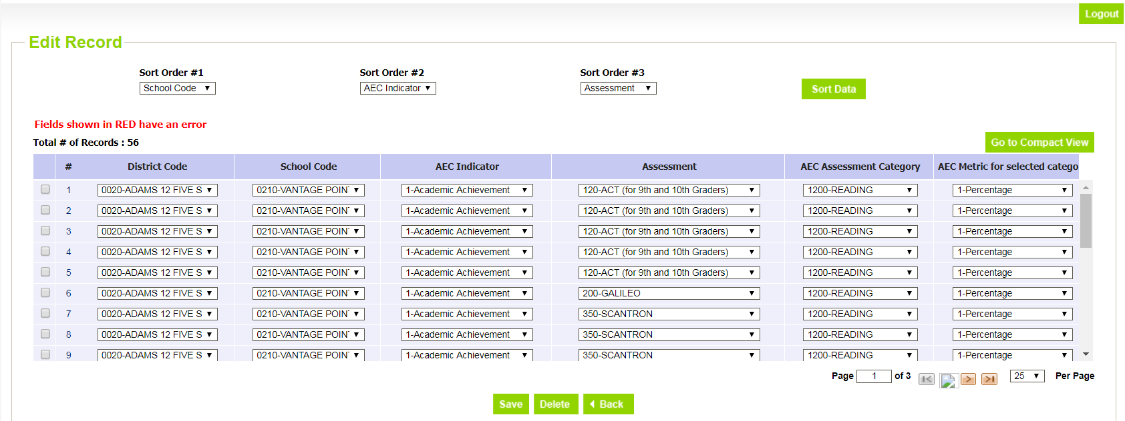
Planned Measures for the 2018 AEC SPF Submitting Your Data – Add/Edit Records
You can delete or modify any of these records in this screen. You can edit multiple records at once, then SAVE.
Select
Planned Assessment Measures for AEC
2017-18
Your LEA
Hit Search
Notes:
When you hit Search, you will see this screen, and you will be able to edit records that exist in Data Pipeline for the Planned Measures collection. Note that you can delete or modify records using this function, and that you can modify multiple records at once. When you hit the save button at the bottom of the screen, your changes will be passed through to the Data Pipeline system.

Slide 55
Planned Measures for the 2018 AEC SPF Submitting Your Data – File Upload
Use File Download/Upload to complete if:
You have several AECs in your district/BOCES, and you are planning to submit many optional measures for each
The staff completing the Planned Measures Collection are comfortable using and working with excel spreadsheets
You have reviewed and have on hand all the additional resources you need for working with the file extracts
http://www.cde.state.co.us/datapipeline/per-aec
Upload completed files to Data Pipeline for CDE review
Download blank files from Data Pipeline to submit
Notes:
You could also use the file download/upload method if you have several AECs in your district or BOCES and each one is submitting quite a few optional measures for consideration. If you use this method, make sure to review the file layout and definitions documents for these collections and look through the additional resources available for these collections. These resources are listed on the AEC Collections pipeline website at the link on the slide.

Slide 56
Planned Measures for the 2018 AEC SPF Submitting Your Data – File Upload
2017-18
Select
Planned Assessment Measures for AEC
2017-18
Preferred File Content Type (rec: Excel)
Hit Search
Notes:
When you click on the File Extract Download button, you will see this screen. You will need to select the following from the dropdown menus: a file type, a school year, your district or BOCES, and a file content type. The file type determines which AEC Collection you are working on. Note that the extract for the Planned Measures collection will be a blank template. You will also need to choose a file type. We recommend choosing excel. When you have made your choices, hit the Download Standard Extract button.

Slide 57
Planned Measures for the 2018 AEC SPF Submitting Your Data – File Upload
2017-18
Select
Planned Assessment Measures for AEC
2017-18
Preferred File Content Type (rec: Excel)
Hit Search
Add in the codes for:
AEC Indicator
AEC Subindicator
AEC Subindicator Category
AEC Subindicator Category Metric
Notes:
Your Planned Measures file will be a template with only the headers in the screenshot below. You will need to enter the numeric codes for your desired planned measures in the collection fields, along with your district or BOCES and school codes as I have done in this example. The numeric codes that crosswalk to AEC Indicators, AEC Subindicators, AEC Subindicator Categories, and AEC Subindicator Cateogry Metrics can all be found in the file layouts and definitions document. The specific valid combinations between these fields are available in the Indicator Measures Valid Combinations Sheet document. Note that if any field is blank, or if any field uses an invalid code, or if any row uses an invalid combination of numeric codes, then your data will be flagged with errors.

Slide 58
Planned Measures for the 2018 AEC SPF Submitting Your Data – File Upload
Select
Alternative Education Campus in Dataset
Planned Assessment Measures for AEC in File Type
2017-18 in School Year
Your LEA
Choose your file
Replace in Upload Type
Notes:
When you click on the File Upload button in Data Pipeline, you will see this screen. You will need to select the Alternative Education Campus dataset, the appropriate file type, and the school year from the dropdown menus. You will also need to select the relevant school year and your district or BOCES. Finally, choose replace in the upload type section. Then choose the file you want to upload and hit the submit button.

Slide 59
Planned Measures for the 2018 AEC SPF Error Logic
Field | Code or Data? | Null Values Permitted?
AEC Indicator | Code | No
AEC Subindicator | Code | No
AEC Subindicator Category | Code | No
AEC Subindicator Category Metric | Code | No
Error logic: submitted data must conform to valid combinations between indicator, subindicator, category, and metric
Notes:
This table outlines the fields in the Planned Measures Collection which you need to complete, and how they will need to be completed. Each of the fields in the Planned Measures collection use the numeric codes outlined in the file layouts and definitions document, but if you’re using the add or edit record screens you will be able to choose names from dropdown menus. No null values are permitted for these fields. The only error logic applied in this collection is that any submitted data must adhere to the valid combinations between the fields. You can check your submitted data using the error report functions in Data Pipeline, but you can also verify that your data adheres to valid combinations using the Indicator Measures Valid Combinations Sheet document available on the AEC Collections home page.

Slide 60
Planned Measures for the 2018 AEC SPF Collection Opt Out
2017-18
Select 2017-18
Mark option 1 for any school not submitting planned measures.
Remember to hit SAVE when you are done!
Notes:
The last thing to talk about is how to opt out of the Planned Measures collection. Please remember that if you are planning to submit measures which have not been previously approved, that you should complete this collection. Compared to the renewal/application opt out, the opt out values for the planned measures is simpler. There is only 1 option for schools opting out of the planned measures, and it is simply that the district is not submitting planned measures on the school’s behalf. We have instituted this process to make sure that no schools are over looked and that a lack of submitted data is intentional.

Slide 61
Planned Measures for the 2018 AEC SPF No sign off form!
No sign off form for Planned Measures!
Informal planning collection
Sign off sheets only required for Renewal/Application and Actual Measures and Data collections
You are done when you:
Submit data and finalize your submission, or
Opt out of the collection
Notes:
Remember, there is no sign off sheet for the planned measures collection. This is because this collection is an informational collection. We encourage you to use it for informational purpose, and to engage with use for the negotiation of new local measures. But since no data is submitted to us, either student level or aggregated, we do not need your formal sign off. This collection is complete once you finalize your submission or when you opt an AEC school out of this collection.

Slide 62
Resources, Trainings, and Contacts
Notes:
As we close out today’s webinar, I’ll go over some useful resources, let you know about upcoming trainings, and tell you about helpful contacts.

Slide 63
Resources
AEC Collections Information Page
http://www.cde.state.co.us/datapipeline/per-aec
AEC Accountability Resource Page
https://www.cde.state.co.us/Accountability/StateAccountabilityAECs
Notes:
General information about the AEC Pipeline Collections, and about AEC accountability in general, can be found at the two links on this slide. The AEC Collections Information Page has a wealth of resources documents created specifically to guide you through these Collections. A recording of this webinar, along with its transcript, will be posted there, too.

Slide 64
Trainings
AEC Collections Webinar Schedule:
FOR REFERENCE: AEC Collections Overview materials posted on website
UPCOMING: 4/12/18 - Collection Window 2 Overview (Actual Measures for 2018 and Planned Measures for 2019)
AEC Collections Office Hours:
Weekly office hours on Tuesday afternoons from 1pm to 3 pm are available. You can sign up for a half hour phone slot to chat with B Sanders about any questions you may have about the AEC collections here: http://www.signupgenius.com/go/5080c4ca5af2eabf94-aeccollections
Notes:
The materials from our last webinar have been posted to the AEC Collections home page and are available for your reference. We have another webinar coming up in a few weeks, and this one will outline everything you need to know for Collection Window 2. If you have further questions about the Renewal/Application collection or the Planned Measures collection, or if you have questions about Collection Window 2 prior to the upcoming webinar, feel free to sign up for office hours! The link on this slide will take you to a sign-up page where you can sign up for weekly office hour slots with me, B Sanders, to get your questions answered about AEC Collections and AEC Accountability.

Slide 65
Modules
In order to view the narration while the video is playing, click on the Notes tab in the sidebar in the player.
Video Module 1 – Overview & Timelines (9:59): https://enetlearning.adobeconnect.com/pi1md74k0rhw
Video Module 2 – Access to Pipeline (5:30): https://enetlearning.adobeconnect.com/pds83bvi0bka
Video Module 3 – Opting Out of Collections (7:21): https://enetlearning.adobeconnect.com/p4akh8y057nt
Video Module 4 – Sign Off Sheets (11:10): https://enetlearning.adobeconnect.com/p7lcn4j7j302
Video Module 5 – Resources (10:30): https://enetlearning.adobeconnect.com/paii0l5a6d2h
Video Module 6 – Edit Records vs File Upload (12:24): https://enetlearning.adobeconnect.com/pjxifyl076br
Video Module 7 – Errors (9:12): https://enetlearning.adobeconnect.com/pqbkrtgu2l70
Notes:
We also have a set of video modules to help you navigate the AEC Collections! In these seven modules, we cover everything from timelines to the pros and cons of using the edit records function. If you get stuck on something, like why Data Pipeline is flagging your data as an error, these modules are a great place to find the answer.

Slide 66
Contacts
AEC Collection Questions
B Sanders, AEC and Accountability Senior Consultant
Sanders_b@cde.state.co.us
303.866.2685
Jessica Watson, Accountability and Policy Principal Consultant
Watson_J@cde.state.co.us
303.866.6778
Identity Management Questions
Rich Morris, Systems Administrator
Morris_r@cde.state.co.us
303.866.6713
Notes:
Finally, if you have questions about the AEC Collections, reach out to me, B Sanders, or my colleague, Jessica Watson. We can probably answer your question, and if we can’t, we’ll get you in contact with someone who can. If you have questions about the identity management system, such as permissions related to your local area manager or the AEC~LEAAPPROVER role, reach out to Rich Morris.

Slide 67
Webinar 3: Collection Window 2 – 4/12/2018
Planned Measures for 2019 AEC SPF
Actual Measures & Data for 2018 AEC SPF
Notes:
Before we close out, I wanted to remind you that we have another webinar scheduled for April 12th. In that webinar, we’ll talk specifically about the nuts and bolts of the Actual Measures and Data for the 2018 AEC SPF Collection and the Planned Measures for the 2019 AEC SPF Collection. I hope you’ll join me again for that webinar! If not, no worries—like this one, it will be recorded and posted along with a transcript.

Slide 68
Webinar 3: Collection Window 2 – 4/12/2018
Planned Measures for 2019 AEC SPF
Actual Measures & Data for 2018 AEC SPF
Reminder: Please use chat box to ask questions and keep phone muted.
Notes:
Now, I’ll go back through the chat box and address any questions that have landed there during the webinar presentation. I’ll be typing my answers so that they will be recorded in the webinar chat log. I will answer all questions that come through, so now is the time to throw out any questions that you have! I’ll stick around until 3:00pm, as scheduled. Please keep your phone muted. I will be turning off my microphone now, but I will keep the video recording on until questions stop coming through. Thank you all for attending today!

