Slide 1
WIDA ACCESS
Student Biographical Data (SBD) Collection
Training for 2025-2026
CDE Assessment and Accountability Analytics

Slide 2
Welcome!
Welcome
As we are getting started:
  Please mute your microphones.
  Cameras have been turned off for participants for privacy reasons.
  These slides will be posted on the WIDA ACCESS SBD webpage

Slide 3
Training Webinar Roadmap
Training Webinar Roadmap
Presentation Outline:
General Information
  Purpose
  Collection Timeline
  Role Assignments in Identity Management (IdM)
SBD Step-by-Step Guide
Deeper Dive into ACCESS SBD:
  Background Information
  Changes for 2025-26
  Specific Fields
Time for Questions

Slide 4
SBD: Purpose
SBD Purpose
The Student Biographical Data (SBD) Review Process provides districts with an opportunity to verify the accuracy of student data after testing but prior to reporting and accountability calculations.
This process is completed for the following assessment:
  WIDA ACCESS Assessment
(The process will be different beginning this year for the others)
  CMAS Assessments – In PearsonACCESS^{Next}
      -ELA/Math (including CSLA) and Science
      -CoAlt Science
  CO PSAT/SAT and CoAlt Dynamic Learning Maps (DLM)) – Student Interchange Snapshot

Slide 5
WIDA ACCESS SBD: General Process
SBD: General Process
Data used in the SBD review process comes from the vendor system after testing.
The SBD review process can be used to validate/update student information that is not in the vendor portal. One example is SASID validation.
The SBD review process is not required BUT is highly recommended because inaccurate data can impact accountability.

Slide 6
SBD: Collection Timeline and Snapshot Timelines
SBD: Collection Timeline
 | Assessment | Dates | Data Pipeline Group Name
1 | WIDA ACCESS SBD | March 16 – 24, 2026 | ACC
2 | SBD Snapshot for SAT/DLM | April 6 to May 8, 2026 | SBD
3 | CMAS clean in PAN | April 12 to May 8 (May 1 – May 8 District Only) | N/A

Slide 7
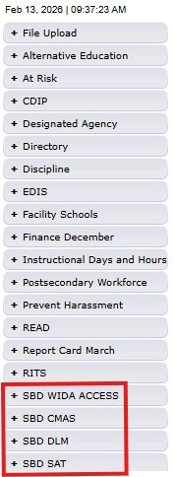
SBD: Group Role Assignments
SBD: Group Role Assignments
You can learn whether you have access to the WIDA ACCESS by logging into Data Pipeline and reviewing the gray boxes on the left-hand side.
If you do not have access, please reach out to your district’s local access manager (LAM). Please ensure that the LEA APPROVER role is assigned to someone who is available during SBD.
CDE cannot provide access for district users.

Slide 8
SBD Support Email and Phone Number (For identity support info for login problems and user rights, please see the slide that follows).
SBD Support Email and Phone Number
SBD support is available by phone or email
  CDE has a team that responds to emails and to phone calls. Please use the SBD Support phone number and email address. Do not contact a specific person at CDE or the general CDE Helpdesk!
  This provides a single point of contact for all collections.
  Remember not to send student PII by email!
Phone Number: 720-696-0185
Email address: sbdsupport@cde.state.co.us

Slide 9
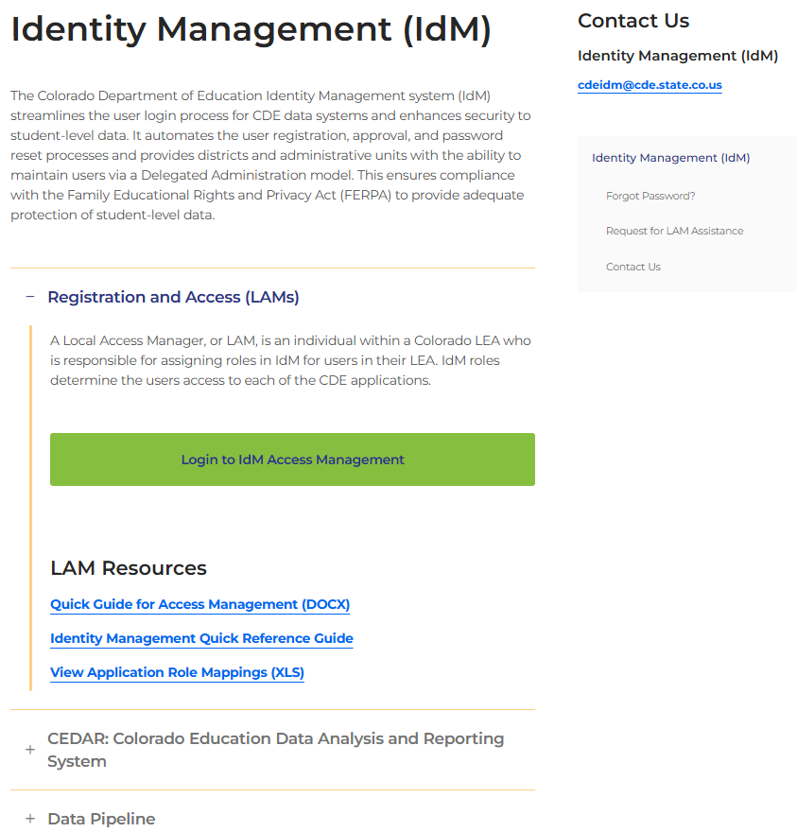
Colorado Department of Education
Identity Management (IdM)
Identity Management Site *NEW*
Links to CDE Applications
  Pipeline, CEDAR/COGNOS, RITS, EDIS, Etc.
Resources on IdM Site
  Frequently Asked Questions
  Application Role Mappings
  LAM Quick Guide
Important: Users are not automatically removed from IdM when their email address is no longer active in your district. The LAM must deactivate their IdM account to ensure only designated staff can access CDE’s data reporting system.
Support:
  Michael Threlkeld
  Forgot Password
  Request LAM Assistance
Notes:
A couple of quick reminders. The CDE Identity management system is what gets you access to all the different data collections. Each district has Local Access Managers who can assign you access to the different systems that you need for your collections. LAMS – Users are not automatically removed from IdM so please make sure you are checking your system making sure that only active users have access. NEXT SLIDE

Slide 10

What is PII?
Student Personally Identifiable Information (PII) is defined by state and federal laws as information that, alone or in combination, personally identifies an individual
  This includes direct identifiers
  (i.e. student and staff names, SASID, EDID, etc.)
  Includes information that when combined is identifiable
Colorado’s Student Data Transparency and Security Act outlines requirements for how Student PII is collected, used and shared
See the Data Privacy and Security website for prepared guidance on how to comply with this and other privacy laws.
Notes:
A quick reminder about PII? PII is personally identifiable information, such as SASIDS, Names, Date of birth, or Social Security Numbers - anything that would allow someone to identify the student with reasonable certainty.

Slide 11

Sharing Data
Use secure methods to transfer any PII to CDE
  CDE Assessment has a Syncplicity folder
    DACs have automatic access and data respondents can be given access to the SBD 2026 subfolder as needed
  Avoid sending PII via email or in voicemail messages
Check local policies for restrictions, requirements, etc. regarding PII
  Do not use PII in trainings, presentations, etc.
  Do not share PII with unauthorized individuals
  Do not share passwords
  Follow local policies when transmitting PII to any third party
Notes:
We want to make sure that PII is not being sent through email, it needs to be sent in a secure manner. At CDE we use Syncplicity, so if you have a need to communicate PII please make sure you email the collection lead you are working with and we will make sure you are setup in Syncplicity. If you do upload a file, please let your collection lead know as we do not get automatic notifications when a file is uploaded.

Slide 12
SBD Review: Step-by-Step Guide

Slide 13
Step 1: Download the SBD Manual and Collection Specific Information
Step 1 SBD Manual
Please download the SBD Manual and collection specific information.
  Link for Manual: SBD Manual 2025-26 (update link)
    The manual provides a detailed, step-by-step process with screenshots on how to complete the WIDA ACCESS SBD collection
    Link for collection specific information: Data Pipeline Collections Website
    Please download and review:
      WIDA ACCESS SBD File Layout (includes specific instructions for each field)
      Business Rules (includes how to resolve errors)
      Training materials (including the SBD Manual)

Slide 14
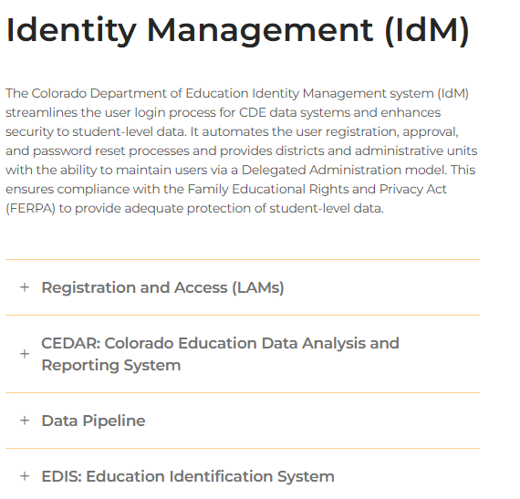
Step 2: Log in to Data Pipeline
Step 2: Login to Data Pipeline
On the Identity Management website, select “Data Pipeline” under Applications on the left side of the screen.
Enter your username and password
Check:
  Your user role is correct
  The collection you are working on appears on the left side of the screen
Most log-in issues must be handled by your LAM.

Slide 15
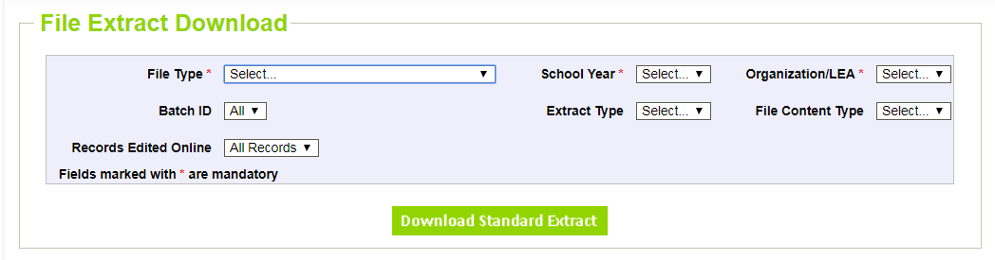
Step 3: Download a Vendor SBD Extract
Step 3: Download Vendor Extract
Navigate to the collection tab along the left-hand side.
Select “File Extract Download” for the appropriate assessment.
Make the following selections:
File Type: Vendor File
Extract Type:
            SBD Extract – Vendor demographic data
            SBD Extract using Student Interchange demographics
            File Content Type
            Excel: If you are using Excel to review data use this version
            CSV: comma delimited – Do not use this if you plan to work in Excel
            Text: Fixed Format

Slide 16
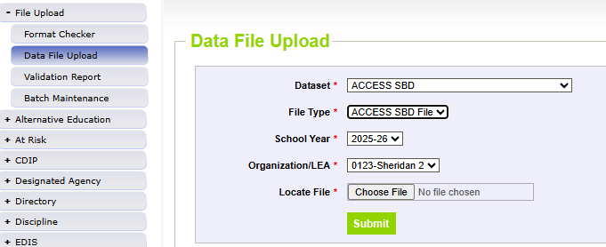
Step 4: Upload Vendor SBD Data Extract
Step 4: Upload Vendor SBD Data Extract
Upload back into Data Pipeline prior to editing the file
  Allows access to COGNOS reports
    Error Summary
    Error Detail
  The number of errors found can help guide data clean up and give a sense of how much work needs to be done on the file
  Activates the Edit Records screen
This is done by:
  Select “File Upload” tab -> Data File Upload
  Choose file and submit
  Emails:
    Submission Notification
    File Upload Summary

Slide 17
Step 5: Review Errors and Warnings
Step 5: Review Errors and Warnings
The number of errors and warnings are available in two places:
  Error Report under “Pipeline Reports” along the left-hand side
  COGNOS Error Summary Report under “Cognos Reports”
Identifying specific records with errors can be done in three places:
  COGNOS Error Detail Report
    Download as an Excel file to review
  Pipeline Report – View Details
    Same layout as the Error Detail Report
  Edit Records Page
    Choose records with errors and warnings
    Fields with errors will be red; warnings will be yellow

Slide 18
Step 6: Correct Data Errors
Step 6: Correct Data Errors
Method 1: Correcting errors using the Vendor SBD Extract File
  Open the vendor file in your chosen program
  Update data in records with errors
    Start with SASID errors
    Use the Data File Layout with field definitions and the Business Rules documents to figure out how to correct the data
      Business rules will explain errors. For example, “Date First Enrolled US” cannot be blank.
  Upload the file periodically to check your progress
    Once you are down to just a few errors, it may be faster to use the Edit Records screen

Slide 19
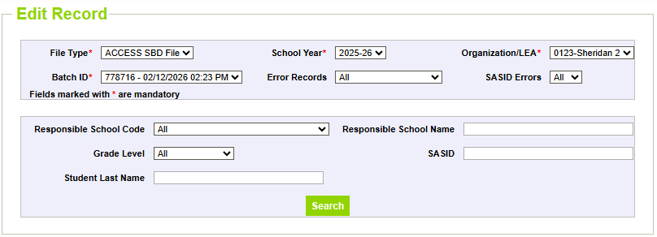
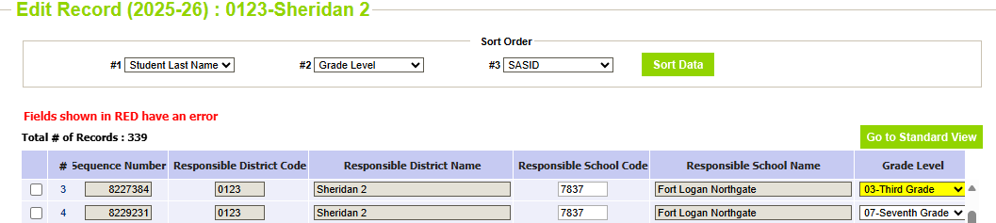
Step 6: Correct Data Errors (Continued)
Step 6: Correct Data Errors (Continued)
Method 2: Correcting errors using the Edit Records page
  On the Edit Records page, select the appropriate drop downs
  Check the box next to record you would like to edit
  Correct the data in the fields highlighted in red. (Fields highlighted in yellow are warnings).
  Make sure that the box along the left-hand side is checked, and then click “Save” to save the edits

Slide 20
Step 7: Data Validation
Step 7: Data Validation
Data Pipeline can only check for certain types of errors
  It cannot check that your demographic data is accurate (i.e., a student is actually Hispanic or not)
  It cannot validate that students have the correct invalidation
    The Data File Layout will have instructions for how to select the appropriate invalidation
Do not change/make up data just to clear errors!
  If you have a lot of missing data, check a different extract
    Maybe the interchange data or vendor data is better
  Making up data can cause issues with reporting and accountability
  If you have an error that cannot be cleared but the data is correct, contact SBD Support.
Warnings
  Warnings are used to inform users of situations that may indicate errors but not necessarily (more than 10% Native American)
  Warnings do not prevent data submission

Slide 21
Step 7: Data Validation (Continued)
Step 7: Data Validation (Continued)
Download the COGNOS SBD Summary Report
  Compare your district summary numbers to last year’s final data
    Large changes in the number of students in a category could indicate a coding error or incorrect data submitted to the Interchange or vendor system
  Review Reasons Not Tested and Invalidation codes
    Check for students who have not tested, or invalidation codes entered but who may have scores
      ACCESS has 6 Reason Not Tested codes or 1 invalidation code (INV)

Slide 22
Step 8: Submit SBD Data
Step 8: Submit SBD Data
Download your final SBD extract for your records through the File Extract Download option
  This is especially important if you use the Edit Records screen
Select “Status Dashboard” under the appropriate assessment collection
Review the data on the Status Dashboard to make sure you are ready to submit
  Validation Errors and RITS Errors must be zero unless SBD Support has ignored errors
  If errors are ignored, you must submit without making any additional changes or uploading a new file, or it will reset the ignore errors status
Click “Submit to CDE” and “Yes” in the pop-up window
If you need to make additional changes after submission, SBD Support can unlock your data until the end of the window

Slide 23
Troubleshooting
Troubleshooting
See the SBD Manual (update link) for common issues and trouble shooting techniques
Users generally have issues at three different points in the SBD process:
  Logging in to Data Pipeline
    Generally, these issues must be resolved by the district LAM.
    CDE cannot change or grant user permissions.
  Uploading a Data file
    This is usually an issue with the file format. See the manual for common issues and how to identify them.
  Clearing Errors
    Usually, the Data File Layout and Definitions and Business Rules documents are enough to identify why an error is occurring.
    If you think an error is triggering incorrectly, contact SBD Support.

Slide 24
Deeper Dive into ACCESS SBD:
Background Information

Slide 25
Deeper Dive into WIDA ACCESS: Background Information
Background Information
WIDA ACCESS is the English Language Proficiency assessment.
Students classified as Non-English Proficient (NEP) or Limited English Proficient (LEP) are required to take WIDA ACCESS. No other students take this assessment.
The assessment is offered in all grades, K-12.
There is an alternate version (Alt-ACCESS) used for students with significant cognitive disabilities.
The testing window starts in January, so the data clean up is earlier than other state assessments.

Slide 26
Deeper Dive into WIDA ACCESS: Collection Documentation (Slide 1 of 2)
Collection Documentation (Slide 1 of 2)
All documentation can be found on the WIDA ACCESS SBD webpage (update links on web page)
Available Documentation:
  File Layout and Definitions Section:
    The 2025-26 file layout is updated and posted for this collection year.
    This document provides all fields, as well as their position, length, and valid values, for the collection.
    This document also provides whether the field is updateable.
  Business Rules Section:
    List of active business rules for 2025-2026 and their error messages
  Link to the SBD Manual:
    This links to the manual for WIDA ACCESS SBD

Slide 27
Deeper Dive into WIDA ACCESS: Collection Documentation (Slide 2 of 2)
Collection Documentation (Slide 2 of 2)
Failsafe Templates:
  The District Transfers Failsafe Form: This is the document used to move students between districts. This should only be used for students who are in your district’s SBD file but moved out of your district before or during the testing window and DID NOT TEST in your district. Do not use the Failsafe form to report any students who tested in your district and moved afterward. If they moved after testing, the student data should remain in the district where the student tested.
Training information and documentation
  This PowerPoint will be posted to the website as soon as it is available. ( or is posted if available now)

Slide 28
Deeper Dive into ACCESS SBD:
Specific Fields and Rules

Slide 29
Deeper Dive into WIDA ACCESS SBD: Vendor Variables
Vendor Variables
DRC Student ID
  This is an ID created by DRC for their internal system.
  It is included because it helps SBD Support find records in the vendor file to answer questions or complete Failsafe requests.
Assessment Type
  This field indicates whether a student took the General or Alternate version of WIDA ACCESS.
Reported Record
  This field indicates if a record is being considered a duplicate or primary by DRC and can help resolve duplicates or missing domain issues.

Slide 30
Deeper Dive into WIDA ACCESS SBD: Language Fields
Language Fields
WIDA ACCESS is intended for multilingual learners only. The values for the “Language” fields must be correct, or the record will be invalidated.
Language Proficiency
  Only 1 (NEP) or 2 (LEP) are valid values.
Language Background
  This field cannot be ENG (English).
  Use only 3-character alpha codes that are used in the Student Interchange
Language Program
  Students must be in a program if they are NEP or LEP.
  If a student is a multilingual learner but has been opted out of a Language Instruction Program by a parent, use ’98’.
  Using the code of 00 or blank will trigger an error.

Slide 31
Deeper Dive into WIDA ACCESS SBD: Test Cluster
Test Cluster
WIDA ACCESS tests are based on grade clusters rather than specific grade levels.
Each test domain (Reading, Speaking, Writing, Listening) has a grade cluster field, which indicates the grade cluster the student took for that domain.
The values for grade cluster are provided by WIDA based on the actual test taken by the student for that domain. The cluster CANNOT be changed during the SBD review process. If a student took any domain of the test in the incorrect grade cluster, contact SBD Support so we can invalidate that domain.
If one of the cluster fields is blank, it means that the student did not complete that domain, or the student’s information has been split across multiple records.
    If the student did not complete one or more domains, he/she will not receive an overall score.
In some cases, domains may be split across multiple records for the student. Instructions for how multiple records for a student can be merged are provided later in this presentation.

Slide 32
Deeper Dive into ACCESS SBD: Test Clusters by Grade
Test Clusters by Grade
 | General Assessment | General Assessment | Alternate Assessment
Student’s Grade | Paper – Valid Cluster | Online – Valid Cluster | Paper (Online Not Available) – Valid Cluster
Kindergarten | 0 | N/A (Online not available for Kindergarten) | 0
Grade 1 | 1 | 1 | 0
Grade 2 | 2 | 2 | 0
Grade 3 | 3 | 2 | 3
Grades 4-5 | 4 | 4 | 3
Grades 6-8 | 6 | 6 | 6
Grades 9-12 | 9 | 9 | 9
Notes:
This table is in the file layout for reference if you get a mismatch.

Slide 33
Deeper Dive into ACCESS SBD: Do Not Score and Not Tested Reason Codes
Do Not Score and Not Tested Reason Codes
Students who are registered in WIDA AMS, but do not take the WIDA ACCESS assessment are added to the SBD file
  These records do not have a DRC Record ID and all clusters will be blank
The Not Tested Reason field was added in 23-24 to allow districts to add an explanation for why the student did not test
WIDA ACCESS does not have a state accountability participation component; none of the Do Not Score or Not Tested Reason codes are classified as “exempt” or “not exempt.” Parent opt-out is not legally allowed for WIDA ACCESS.
Do Not Score codes are used to prevent DRC from creating a score for the student for that domain. Instances where the Do Not Score code are applicable should have been reported to CDE during assessment administration.
  Students who tested incorrectly or were reported for plagiarism will already be given an INV code prior to the SBD collection based on discussions with CDE

Slide 34
Deeper Dive into ACCESS SBD: Do Not Score and Not Tested Reason Codes Listed and Explained
Do Not Score and Not Tested Reason Codes
Not Tested Reason Codes:
  00 – Absent: Used only for students who were absent for the entire testing window but did not withdraw from the school
  03 – Withdrew Before Testing: The student left the district before they started testing.
  04 – Student Refusal: The student refused to begin testing all domains when the opportunity was provided.
  07 – Medical Exemption
  08 – Part-time Home School Student: New for 24-25, CDE was instructed to include home options school students
  10 – Did Not Attend: The student was not absent but did not attend a scheduled/rescheduled test session for any domain
  11 – Data Error: There was an error in the data submitted at October Count and the student is not NEP or LEP.
  Codes 00, 03, 04, 07 and 08 are same as other assessments. Codes 10 and 11 are unique to Access.
Do Not Score Code:
  Invalidation (INV)
  Used if the student completed some of the test but the test session was not valid and should not be scored
  This will be applied by CDE prior to loading the vendor file to Pipeline.
  These fields are non-updateable and are there for your reference.

Slide 35
Troubleshooting: More than One Record for a Student
More than One Record for a Student
  Multiple records for a single student are created when identifying fields bubbled on the paper materials do not match an existing student record in WIDA AMS. In this situation, WIDA will create a new record from the information provided on the paper test.
    In grades 1-3, all writing test responses are on paper even if the other domains are administered online, so the majority of split records occur for students in these grades.
    CDE will attempt to remove any not tested records with a duplicate tested record caused by paper tests, but if the identifying information on the paper test has an incorrect SASID this may not be possible to catch
  Duplicates can also be created if a student tests a domain multiple times when moving across districts
    These can be merged by moving both records to the same district
    CDE will attempt to fix these prior to SBD, if our resolution puts them in the incorrect district
    use the Failsafe procedure or a Not Tested Code ’03’ and we will move the student after SBD
    Do not try to merge multiple records yourself – this must be done by DRC after the SBD review process ends. Errors will trigger if records with the same SASID do not match on the other necessary fields for merging.

Slide 36
Time for Questions
Questions
Questions?
Please feel free to unmute or use the chat box.

Slide 37
Contact Information
Contact Information
Please contact SBD Support with any questions:
Email: sbdsupport@cde.state.co.us
Phone: 720.696.0185
Website:
https://www.cde.state.co.us/datapipeline/per_access-ell

