Slide 1
2025-2026 Summer EBT Data Pipeline Training
Collin Slutzky s-ebt@cde.state.co.us
Notes:
This is a quick overview of data pipeline. There will be another training this week for new respondents that covers more specifics of Student October

Slide 2
Data Collection Timeline
Date | Event | Event Description
01/28/2026 | Training Event | Summer EBT Data Pipeline Overview 1-2 p.m
02/02/2026 | Open | Districts may begin uploading Summer EBT files
02/06/2026 | Interim Deadline | Upload Summer EBT file and review errors
02/20/2026 | Interim Deadline | Upload error-free Summer EBT file
02/25/2025 | Report Review | Review Summer EBT file to ensure Free/Reduced Lunch reporting is correct
02/27/2025, 12:00 p.m. | State Deadline | Submit Summer EBT data

Slide 3
Corrections Phase Timeline
Date​ | Event​ | Event Description​
05/18/2026 | Open | Corrections period opens for submissions
07/17/2026 | Other Date | Upload error-free Corrections file
07/24/2026 | Deadline​ | Final Deadline for S-EBT Correction files
The corrections period is optional, but highly recommended for larger districts
Districts should use the corrections period for:
Capturing newly eligible students for 2025-26 after February
Correct FRL status for students reported incorrectly in February

Slide 4
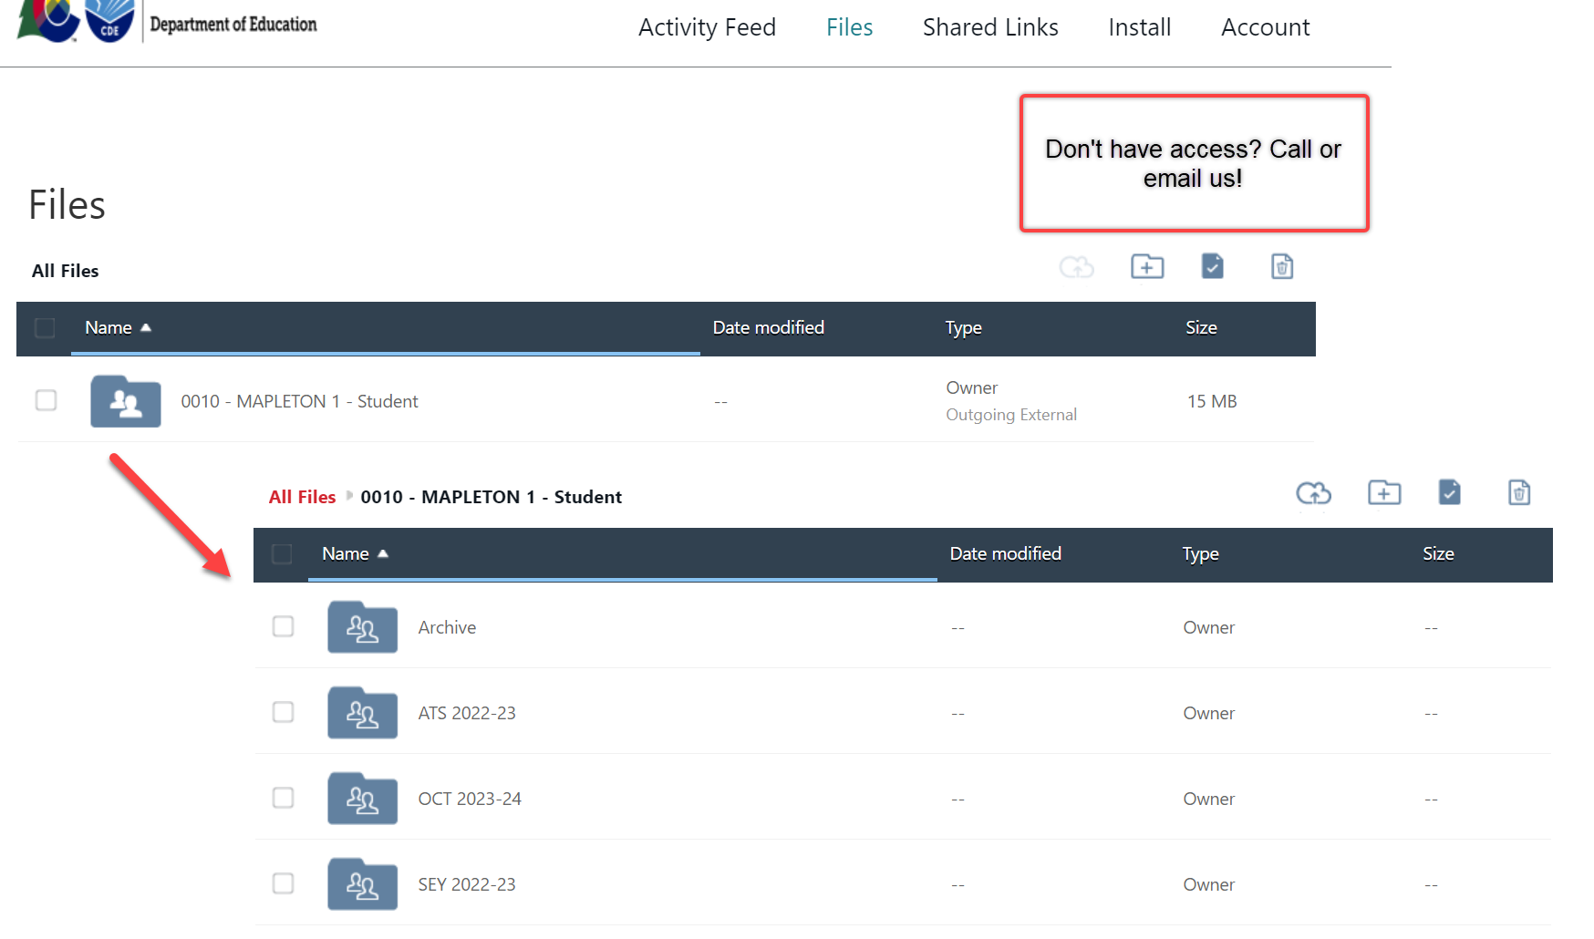
Syncplicity and Town Hall
Syncplicity – CDE’s secure file sharing service of choice
Town Hall – Review various Data Pipeline Collection information/updates
Weekly on Thursdays from 9 – 10 am (Summer has a biweekly schedule)
Email to subscribe: DATASERVICES-subscribe-request@cdelist.cde.state.co.us

Slide 5
CDE Application Login
Identity Management (IdM) is the single login shared by most CDE applications including Data Pipeline and RITS
Bookmark the IdM page to quickly access applications needed for data collections
Below are the different IdM roles for Summer EBT
Note that the roles for S-EBT are labeled “PBT” in IdM
Application | Collection | Role | Access Level
Pipeline | Summer EBT | LEA User | Upload and Edit Records for the Summer EBT collection
Pipeline | Summer EBT | LEA Approver | Upload and Edit Records, submit to CDE
Pipeline | Any | LEA Viewer | View Cognos reports – cannot edit
IdM Website
Notes:
This is our Identity Management System (commonly called IDM). IDM is a one stop shop to all CDE applications including Data Pipeline which you will ultimately use to upload the Student Interchange files as well as other collection data. Please get this webpage book marked, saved or whatever you need to do to remember this site! The IDM page also has a link to RITS (Record Integration Tracking System) which is our system used to track SASIDs for students as well as CEDAR (Colorado Education Data Analysis and Reporting System) commonly called Cognos which creates reports based on the data provided in Data Pipeline to validate data. Reports within this system have many purposes depending on the collection you are working through. There is also a link to Access Management (which we also call Identity Management) which is how you will get registered for these various applications and how you be able to log into Data Pipeline.

Slide 6
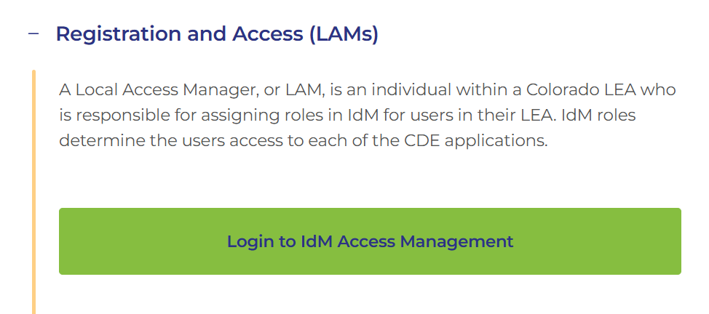
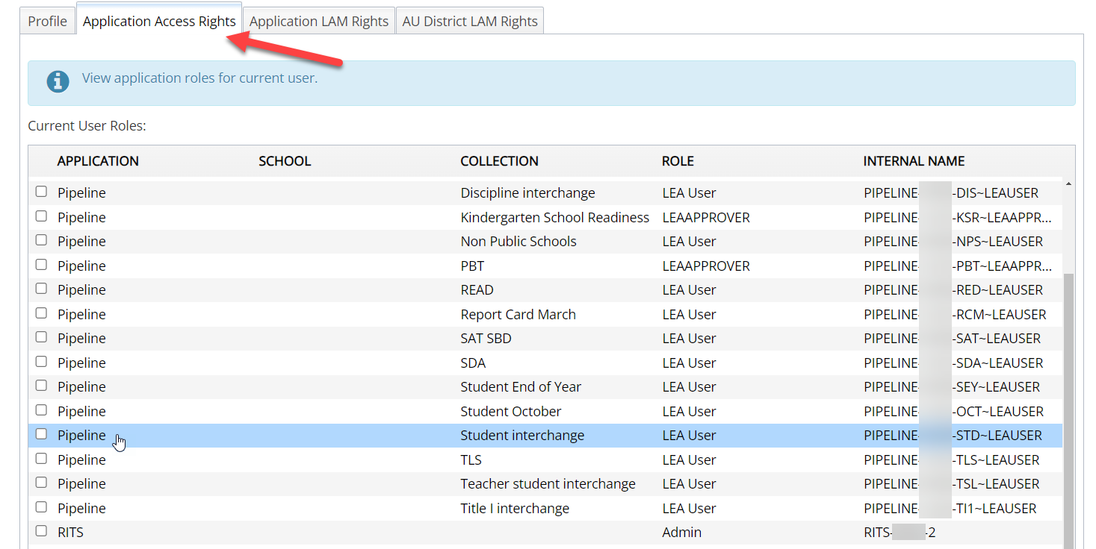
CDE Identity Management
Don’t have access?
Talk to your District’s Local Access Manager (LAM)!
Note: Different roles for different collections

Slide 7
Student Information System (SIS) Extracts
Download reports (files) from your Student Information System
Save each file in an accessible location with naming convention
Upload file to Data Pipeline (steps shown later)
Summer EBT (.xlsx is recommended format) – files could be named differently in SIS
Do not open file!
Example: 0110_SEBT_10112024.xls (No spaces in file name are allowed)
Keep filing system organized

Slide 8
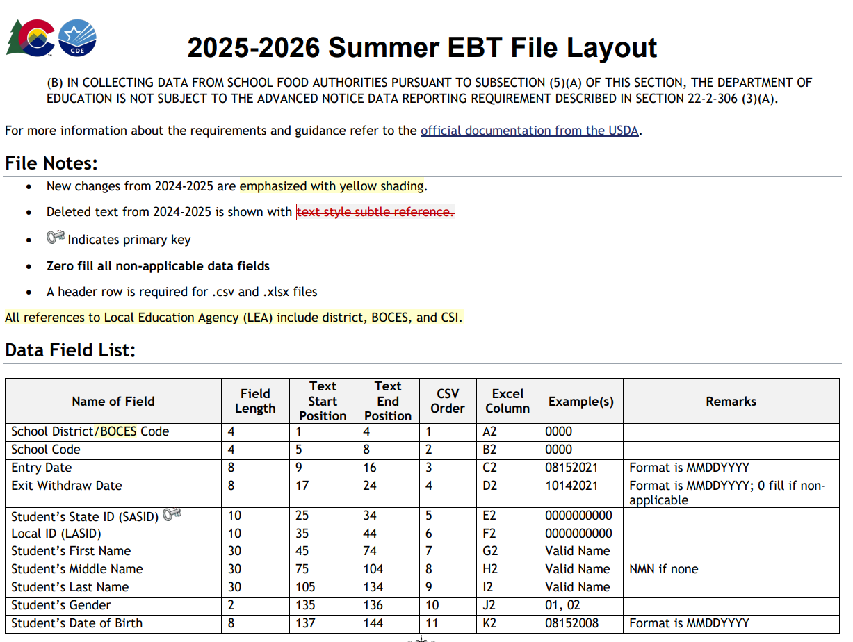
Summer EBT File Layout
2025-2026 Summer EBT File Layout
Student demographic fields
Parent contact information
Free/Reduced Price Lunch Status

Slide 9
S-EBT Pipeline Process
Upload extracted file into Data Pipeline
Wait for a Confirmation Email from the Pipeline System
The email will show you the number of errors in your upload
Resolve ALL errors in your S-EBT file
Check your error reports
Update your Interchange files to address the errors
Update in SIS → Extract → Upload to Pipeline
Edit Record Tool (Data Pipeline)

Slide 10
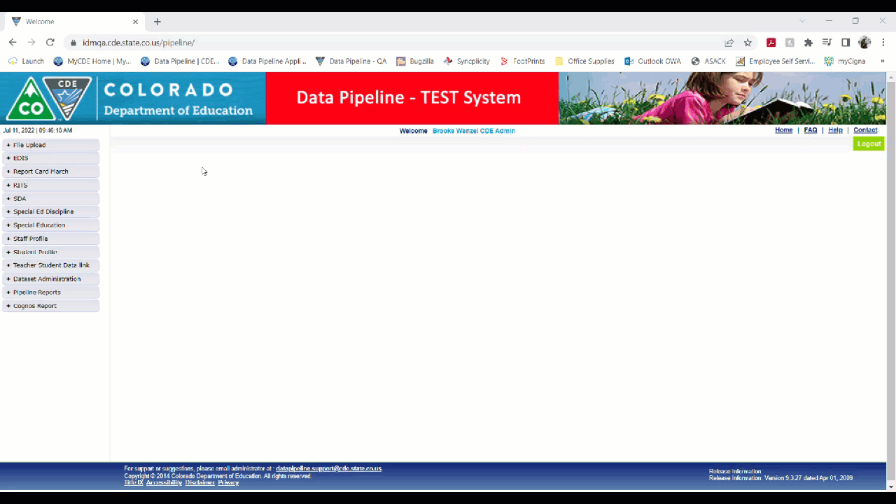
Data Pipeline Demonstration
Dataset: Summer Student EBT
File Type: Summer Student EBT School Year: 2025-26
Organization/LEA: Will autofill to yours
Locate File: Find location of saved extracted file
Upload Type: Replace (will take file and replace everything in Data Pipeline)

Slide 11
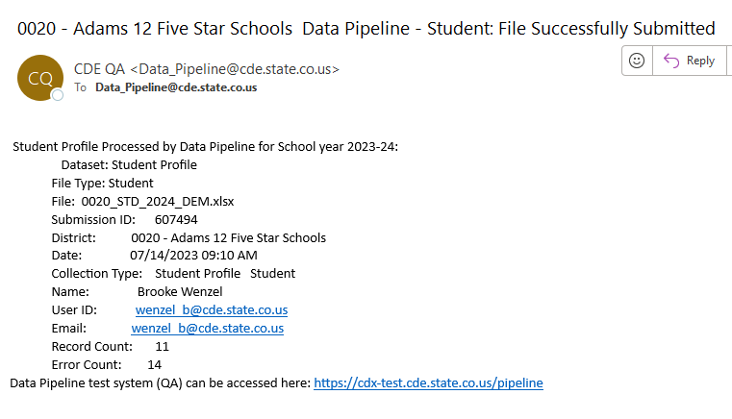
Automated Emails
After submitting a file to Data Pipeline you will receive an automated email with your record count and errors
These emails occasionally fail to send or get caught by spam filters
If the email shows zero records, check your file’s formatting

Slide 12
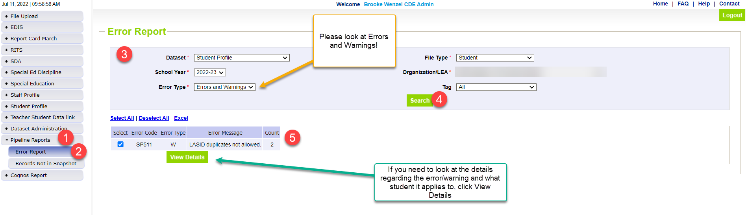
Pipeline Error Report
Errors
Warnings
Must be addressed
Update data fields to clear
Request errors be ignored if student data is accurate but does not follow the typical coding pattern as indicated by the error message
Data cannot be submitted if there are any errors
Indicate possible data inconsistencies/coding issues
Data can be submitted even if warnings are present
Pro Tip: Review warnings to look for patterns/areas where district data could be documented in a more accurate manner

Slide 13
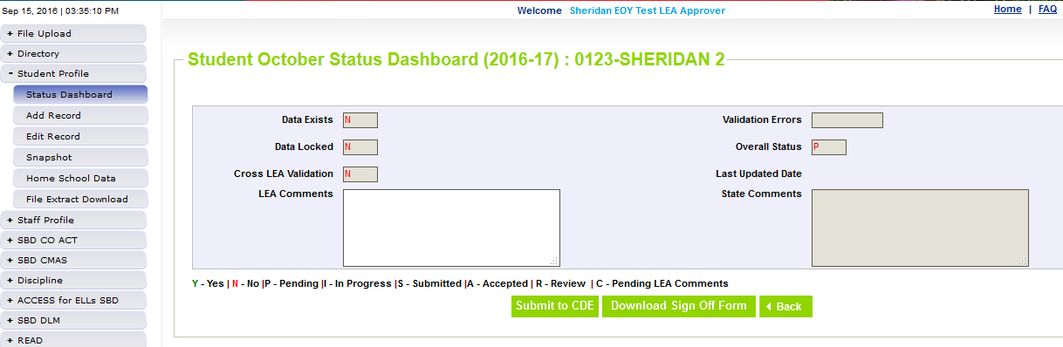
Ready to Submit
Once you have verified the data, submit your file to CDE. Go to:
Summer EBT -> Status Dashboard and click ‘Submit to CDE’
Must have LEAAPPROVER role in IDM to complete this step
Once data is submitted it will be locked, must request unlock to make changes (email or call me to request)

Slide 14
Thank you for attending!
720-760-3569
s-ebt@cde.state.co.us
S-EBT Data Pipeline Website
CDHS S-EBT Website
Identity Management/Data Pipeline

