Slide 1
Student End of Year (SEY) Snapshot Introduction
March 14, 2022

Slide 2
Agenda
SEY Snapshot Overview
SEY Collection Cycle & Timeline
SEY Changes 2021-2022
SEY Collection Key Topics
Interchange Files
Snapshot
Status Dashboard
Adequate Documentation
Errors & Warnings
Adjustment File
Reporting Exceptions
Pipeline Reports
COGNOS (CEDAR) Reports
Rates & Reporting: Overview
Resources, Contacts, & Glossary

Slide 3
SEY Snapshot Overview

Slide 4
What is a Snapshot?
A data snapshot begins with uploading the corresponding interchange files. These interchange files become the source of information, or source file for specific data fields on a snapshot.
Source File A
Contains multiple columns of data/information as outlined on the file layout for this source file.
Source File B
Contains multiple columns of data/information as outlined on the file layout for this source file.
File A: Element 1
File A: Element 2
File B: Element 1
File B: Element 2
File A: Element 4
File A: Element 5
File B: Element 3
File B: Element 4
File A: Element 3

Slide 5
What is a Snapshot?
When a snapshot is triggered, it pulls needed information from the source (interchange) files into a new file called the snapshot.
Source File A
Source File B
File A: Element 1
File A: Element 4
File B: Element 1
File B: Element 4
File A: Element 3
File A: Element 5
File A: Element 2
File B: Element 2
File B: Element 3
Snapshot

Slide 6
What is a Snapshot?
Snapshots typically won’t use every data element on a source file.
Snapshots often pull in information called “internal flags.” These are calculated pieces of data from information provided on the interchange files or from other internal data in data pipeline.
Source File A
Source File B
Internal Flags
File A: Element 2
File A: Element 5
File B: Element 3
Internal Flag: 1
Internal Flag: 2
Snapshot
File A: Element 1
File B: Element 1
File A: Element 3
File A: Element 4
File B: Element 2
File B: Element 4

Slide 7
What is a Snapshot?
How do I know what data needs to be on the interchange (source) file?
Every snapshot layout will tell you which interchange files are needed on the first page under the section dependencies.
The file layout for the specific interchange (source) file will tell you the information needed for that file.
How do I know where data comes from on the snapshot?
The file layout for a snapshot will list the source interchange file for each data element.
If the data element is from an internal flag, it will list that as well.

Slide 8
SEY Snapshot Dependencies
Student has been assigned a SASID and updated in the RITS system
Student has a record in the student interchange for:
Student Demographics
Student School Association (may have multiple records)
Graduation Guidelines (only required for graduating students)
Adjustment File (only required if adjusting prior year data)
Student has a record in the Title 1 interchange if:
Student has received Targeted Assisted Services/Funding (as of Oct. 1)
Student has a record in the IEP interchange if:
Student is a special education student
Internal Flag
Internal Flag

Slide 9
Which students are reported in the SEY Snapshot?
All students in grades PK-12 counted in membership at any time between July 1 and June 30 of the reported school year
Including those that left your school/district during that time
Student School Association File:
Pupil Attendance Information Codes 01-08
Pupils attending an education program operated by the reporting district
Primary School Flag = 1 (yes)
This includes students who are attending BOCES programs (non-school program ’03’) for whom you are their home district/school.

Slide 10
Purpose and use of SEY snapshot information
Summarize annual educational history for students throughout the school year
Derive graduation, completion, dropout, mobility, and stability rates
Inform state and federal policy
Public information; used in official reports and news articles
School and District Accountability measures
Accuracy is ESSENTIAL!

Slide 11
Ensuring Accuracy
Review, review, review!
Talk to subject matter experts
Utilize COGNOS reports
Error free ≠ Accurate

Slide 12
SEY Collection Cycle & Timeline

Slide 13
Collection Cycle Overview
Regular Phase
Cross LEA Phase
Post Cross LEA Phase
Final Data Review
Public Data Release
Soft Open
September 22nd – October 13th
March 14th – May 4th
October 20th – November 17th
November 28th – December 1st
January 10, 2023
May 5th – September 8th
Primary data collection phase
First post-collection phase
Second post-collection phase

Slide 14
Key Dates: Regular Phase
 | Date | Event
Data Collection and Cleanup Phase (Regular Phase) | Monday 03/14/2022 | Snapshot Soft Open
 | Thursday 05/05/2022 | Snapshot Official Open
 | Thursday 06/02/2022 | Target: Create first End of Year Snapshot
 | Thursday 06/23/2022 | Target: Error free Student Interchange Uploads
 | Thursday 07/21/2022 | Target: Error free Student End of Year Snapshot
 | Thursday 09/01/2022 | Soft Deadline: Submit Student End of Year Snapshot
 | Thursday 09/08/2022 | Deadline: Submit Student End of Year Snapshot Approve initial data summary reports Deadline is mandated under Colorado Administrative Rules

Slide 15
Key Dates: Cross LEA Phase
 | Date | Event
Cross LEA Validation (Phase A) | Thursday 9/22/2022 | Cross LEA Validation begins: Snapshots reopen
 | Thursday 10/06/2022 | Target: Error free Student End of Year Snapshot
 | Thursday 10/13/2022 | Deadline: Resubmit data to CDE

Slide 16
Key Dates: Post-Cross LEA Phase
 | Date | Event
Post-Cross LEA Validation (Phase B) | Thursday 10/20/2022 | Post-Cross LEA Validation begins
 | Thursday 11/10/2022 | Target: Error free Student End of Year Snapshot
 | Thursday 11/17/2022 | Deadline: End of Post-Cross LEA validation phase

Slide 17
Key Dates: Final Dates
 | Date | Event
Final Dates | Monday 11/28/2022 | Begin final review of graduation and dropout rates after the AYG reconciliation Any changes will require a new sign-off page
 | Thursday 12/01/2022 | Deadline: Superintendents must approve final Data Summary Reports (collection closes)
 | Tuesday 01/10/2023 | Official/final data and rates posted on the CDE website and released to the public

Slide 18
SEY Changes 2021-2022

Slide 19
SEY 2021-22 Changes Overview
Removed Field
New Fields
Graduation Guidelines (GG)
Extended Evidence Outcome Status
Alternate Assessment Participation
Required for graduating students as of 2020-21
Local Measure option removed 2021-22 and beyond per State Board of Education
Postsecondary Program Enrollment
Cause of Housing Crisis
Additional Cause of Housing Crisis
Non School Program
Non-School Program
ward_r@cde.state.co.us

Slide 20
SEY Collection Key Topics

Slide 21
Identity Management

Slide 22
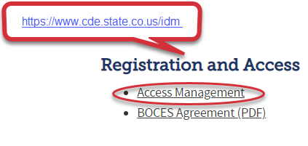
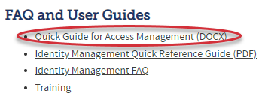
CDE Identity Management
District Local Access Manager (LAM) assigns account/privileges to the SEY Data Respondent
SEY Data Respondents roles:
Questions?
Use the password reset form, or for other questions, please contact:
CDE Identity Manager: CDEIdM@cde.state.co.us
1
2
Application | Collection | Role | Internal Name
Pipeline | Student Interchange | LEA USER OR APPROVER | -STD~LEAUSER -STD~LEAAPPROVER
Pipeline | Student End of Year | LEA USER OR APPROVER | -SEY~LEAUSER -SEY~LEAAPPROVER
3

Slide 23
CDE Identity Management
Application | Collection | Role | Access Level
Pipeline | Student Interchange | LEA User | Upload and Edit Records for the Student Demographic, School Association, and Graduation Guidelines files
Pipeline | Student End of Year | LEA User | Create Snapshot - cannot submit
Pipeline | Student End of Year | LEAAPPROVER | Create Snapshot and submit
Pipeline | Any | LEA Viewer | View Cognos reports – cannot edit
Pipeline | Title I Interchange | LEA User | Upload and Edit Records
You can only have one role for each Collection.
An LEAAPPROVER can do all the things an LEA User can do.
Link: Quick Guide to Access Management

Slide 24
Interchange Files

Slide 25
Student Interchange Preparation
Get SASIDs for your new students
Through RITS or Data Pipeline
Resources on getting SASIDs can be found here:
http://www.cde.state.co.us/datapipeline/yr_rits
Create Extracts from your Student Information System
Pull data for the Student Demographic/Profile file and Student School Association
Data Pipeline accepts .csv, .xls, .xlsx formats
.xls is the recommended format
If opening file in Excel, please make sure you don’t lose leading zeros
CDE has a guide to keeping leading zeros on Student Interchange website
CDE recommends using a file naming convention:
Example: 0110_DEM_EOY_10112016.xls
Spaces in the file name are not allowed

Slide 26
Student Interchange Preparation
Upload interchange files
Wait for a Confirmation Email from the Pipeline System
The email will show you the number of errors in your upload
Resolve ALL errors in your interchange files
Check your error reports
Update your Interchange files to address the errors
Update in SIS → Extract → Upload to Pipeline
Edit Record Tool (Data Pipeline)
Upload Student Demographic File
Upload Student School Association File
Upload Graduation Guidelines File

Slide 27
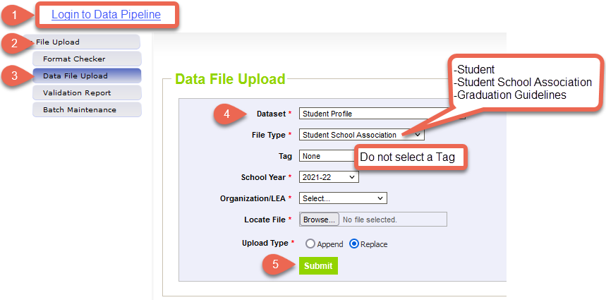
Data File Upload
Data pipeline will send you an email indicating the status of your upload.
Use the Pipeline/COGNOS reports to review errors

Slide 28
Snapshot

Slide 29
Snapshot Process
Create/update
Create/update snapshot
Review
Review errors and warnings
Update
Update student records on corresponding student interchange files
New file upload
Manual update in data pipeline with the ‘edit record’ screen
Create/update
Create/update snapshot
Review
Review errors and warnings
Repeat
Repeat until error free
Validate
Validate data with COGNOS reports
Submit
Submit data to CDE
Regular Phase Deadline: September 8th

Slide 30
Create/Update Snapshot
The message “Snapshot creation triggered and processing. A notification email will be sent upon completion” will appear at the top of the screen after you press the confirm snapshot creation button.
Creating a new snapshot will replace the records from your previous snapshot.
Note: During the Post-Cross LEA phase snapshots can only be updated.
Button changes to update exit types
Only records with SE900 level errors can be updated
In some instances, other records can be updated using the exception process

Slide 31
Business Rules
Business Rules are the list of errors and warnings that are checked when a snapshot is created.
Available on the SEY Website
Note: Business Rules will continue to be updated through the official open on May 5th.
Kinds of information checked:
Demographic information (some fields typically do not change from Student October to Student End of Year)
Valid student entry/exit types, internally and across districts
Graduating/completing/dropout student coding to ensure accuracy of reporting
Cohort groups
Student movement between districts
Students retained (academic, postsecondary programs, transition programs)
Identify dropouts from prior years showing up in other districts
Identify students for whom an HSED certificate has been reported

Slide 32
Entry and Exit Types
Entry/Exit types and corresponding dates are used to track an overview of a student’s enrollment history throughout the year
Reported on the SSA file (file layout on student interchange website)
For students in grades 7-12, exit types are used to determine if a student is part of your cohort for dropout/ graduation/completion rates
Adequate documentation is needed for some exit types
See the SEY website for a list of exit types that comprise the graduation cohort base for a given AYG

Slide 33
Common Entry/Exit Types
Entry Types
Exit Types
02 – Continuous in same school (beginning of the year)
11 – Transfer from school in the same district (includes matriculating students)
13 – Transfer from another public school in a CO district
14 – Transfer from a different state
16 – Transfer from home-based education
40 – Re-entry after dropping out from same school district in a previous year
00 – Student did not exit (completed the school year)
11 – Transfer to a school in the same district
13 – Transfer to another public school in a CO district
14 – Transfer to another state
40 – Dropped Out
90 – Graduated with Regular Diploma
District | SASID | Entry Date | Entry Type | Exit Date | Exit Type
1234 | 1234567890 | 08162021 | 02 | 10022021 | 13
1234 | 1234567890 | 01062022 | 13 | 00000000 | 00
Notes:
Example:
Student returns from prior year (Entry Type 02)
Student exits to transfer to another district (Exit Type 13)
Later in the year student comes back from another district (Entry Type 13)
Student exits for the summer (Exit Type 00)

Slide 34
One Day Records
Students who exit in a previous year with ’00 – student did not exit’ need to have a record in the current SEY snapshot
If missing a record, SE404 error will trigger
Sometimes students leave over the summer and do not attend during the current year
Report a one-day record to show how this student exited your district
Example:
2020-2021 a 10th grade student completed the school year
This student moved out of state over the summer
2021-2022 one day record
District Code | SASID | Entry Date | Entry Type | Entry Grade Level | Exit Date | Exit Type
1234 | 1234567890 | 08022021 | 02 | 110 | 08022021 | 14

Slide 35
Status Dashboard

Slide 36
Status Dashboard
Allows you to review the status of a submitted interchange file or snapshot
Quantity of errors
Data Exists ‘Y’ means successful snapshot creation
Data Locked ‘Y’ means snapshot creation is not available
Post-Cross LEA updates can be completed in this status
Overall Status
‘P’ Pending
‘S’ Submitted
Used to submit snapshot to CDE
Used to download the superintendent verification (sign-off) form during the final phase of data collection

Slide 37
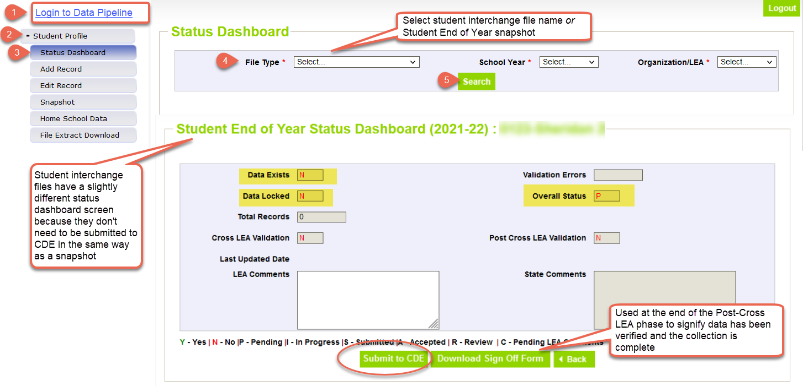
Status Dashboard Screen

Slide 38
Adequate Documentation

Slide 39
Adequate Documentation Overview
Districts must maintain adequate documentation when coding students as transferring out of their district to avoid incorrectly coding students as dropouts.
Find more information on the SEY Adequate Documentation site
Post-Cross LEA phase may require a district to submit a copy of adequate documentation when resolving SE903 errors.
Types of documentation
Written records request
Confirmation of enrollment and attendance
Certificate of enrollment
Signed parent/guardian letter
Written confirmation from school administrator
Note: Different exit types require different types of documentation. View the complete list here.

Slide 40
Exit 13 – Transfer to a public school in a different CO District
Documentation Required: Confirmation of enrollment and attendance
Provided by receiving district when student has begun attending the receiving school
Must include date of enrollment and date of attendance
No other documentation is accepted
RITS system is not adequate because a student may have enrolled but never attended
Sending district should request this form if they lack documentation
Districts must respond to records requests within two weeks
Records requests for out of home placements must be responded to within 5 days

Slide 41
Errors & Warnings

Slide 42
Errors/Warnings: Overview
Errors
Warnings
Must be addressed
Update data fields to clear
Request reporting exception if student data is accurate but does not follow the typical coding pattern as indicated by the error message
Snapshot cannot be submitted if there are any errors
Indicate possible data inconsistencies/coding issues
Some SEY warnings indicate issues that will turn into errors in the post collection phases if not addressed
Snapshot can be submitted even if warnings are present
Pro Tip: Review warnings to look for patterns/areas where district data could be documented in a more accurate manner

Slide 43
Errors/Warnings: Interchange vs Snapshot
Interchange
Snapshot
Typically address data inconsistencies that apply to multiple data collections (snapshots)
Errors on the student demographics and student school association interchange files prevent the student from being included on the SEY snapshot
Errors on the graduation guidelines file prevent that measure from being associated with a graduating student’s SASID
Business Rules: Student Interchange Website
Address data inconsistencies that apply to SEY data collection specifically
Focused on the student’s educational history to ensuring accuracy when deriving graduation, dropout, mobility, and stability rates
Business Rules: Student End of Year Website

Slide 44
Addressing Errors/Warnings
Data fields must be updated on the corresponding student interchange file
Upload a new interchange file or manually edit the interchange file in data pipeline
Must create a new snapshot to clear snapshot level errors
Snapshot creation causes pipeline to run the data through the business rules again

Slide 45
Adjustment File

Slide 46
Adjustment File Use
Used to provide additional information about students who were previously enrolled in a district and did not enroll in the current school year.
Used for 7th-12th grade students only
Modify records from prior years for students reported as dropouts, expulsions, and HSED transfers that completed their education through another agency
Adjust cohort membership bases for graduation/completion rates
Typically used during the Cross LEA phase, but can be used at any time during the collection
Cross LEA phase will have errors that are cleared using the adjustment file

Slide 47
Adjustment Record Methods
Adjustment File Upload
Add Record Screen
Best when multiple adjustment records need to be entered
Functions like a student interchange upload
File layout and business rules posted on SEY website
Best when few adjustment records need to be entered
Uses same adjustment justification codes as a file upload
See the Cross LEA Validation Phase steps for step-by-step directions
File layout and business rules posted on SEY website

Slide 48
Reporting Exceptions

Slide 49
When are reporting exceptions needed?
Sometimes a student’s records will have accurate information, but their educational history will not follow the anticipated coding patterns outlined in the business rules for an interchange file or snapshot
These are unique circumstances and apply to few students
Reporting exceptions are used to clear the errors associated with a student’s record without changing the data
Data respondents must work with the data collection lead for a given file/snapshot to request an exception be granted

Slide 50
Reporting Exception Process
Complete exception request template
Upload exception request template to your district’s Syncplicity student folder
Folder: 1234 – DISTRICT NAME – Student
Notify the SEY collection lead (ward_r@cde.state.co.us) that you’ve uploaded a document for review
Subfolder: SEY 2021-22
Collection lead will review your request and notify you of the outcome
Approved requests – reupload interchange file and/or create a new SEY snapshot
Denied requests – collection lead will provide next steps for clearing the error
Additional information needed – collection lead will request information
Available on SEY Website
Pro Tip: Include the date in name of your exception request file as you may upload more than one exception during the collection cycle

Slide 51
What types of exceptions might need additional information?
If the reason given for the exception doesn’t make sense with the coding pattern, clarification may be requested
SASID merge situations
Work with the RITS coordinator (puccetti_d@cde.state.co.us) to resolve
English Learners whose status changed mid-year
Often a body of evidence supporting a mid-year redesignation is requested, including most recent ACCESS scores for review by the CLDE department
Post-Cross LEA SE903 errors
Adequate documentation required for student to remain coded as Exit 13 (transfer to a public school in another CO district)
Missing graduation guidelines records for a graduating student
SE301 Exception Request Supporting Documentation

Slide 52
Pipeline Reports

Slide 53
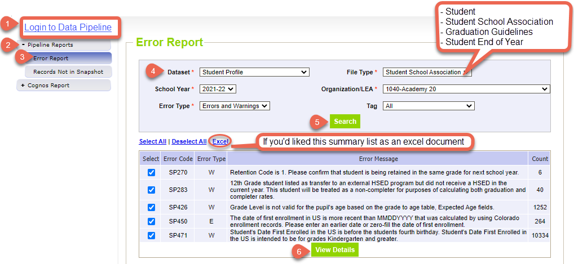
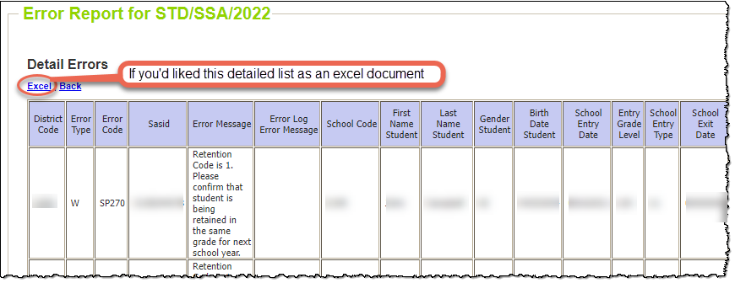
Pipeline Error Report
Summary
Details

Slide 54
COGNOS (CEDAR) Reports

Slide 55
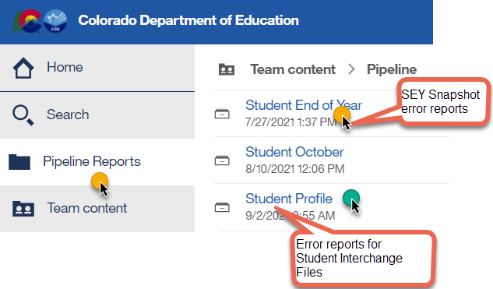
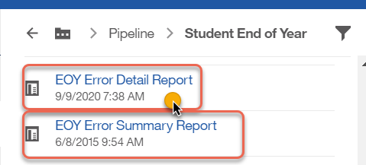
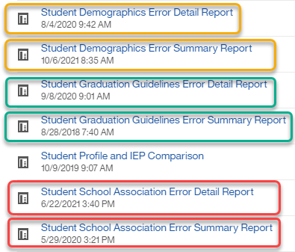
COGNOS (CEDAR) Error Reports
Login to COGNOS/CEDAR using the link in Data Pipeline or from the IdM website.

Slide 56
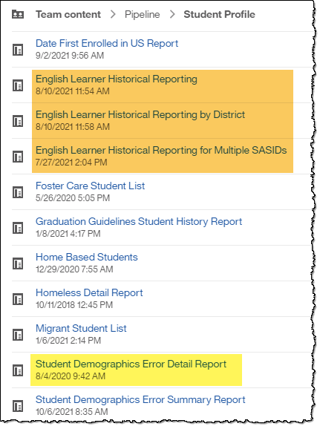
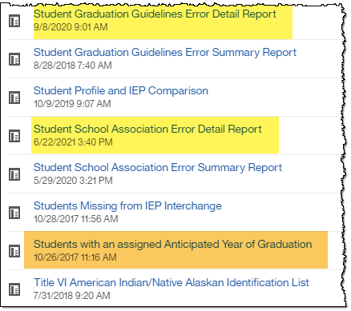
COGNOS (CEDAR) Student Profile Reports
These reports are connected to the student interchange files.
Coming Soon:
Graduation Guidelines Student Completion List
Graduation Guidelines Student Summary List

Slide 57
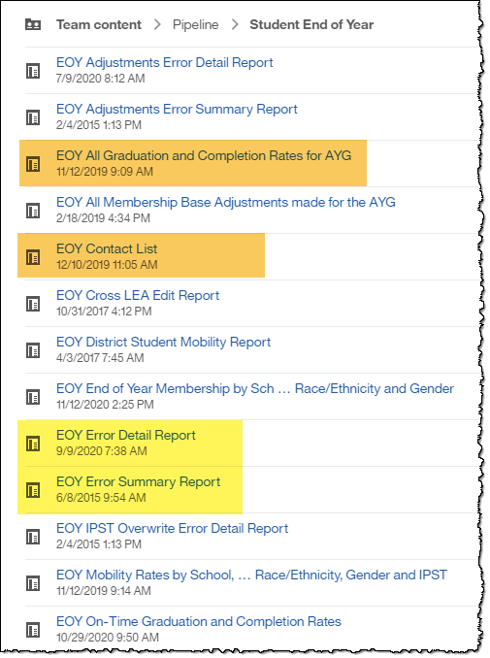
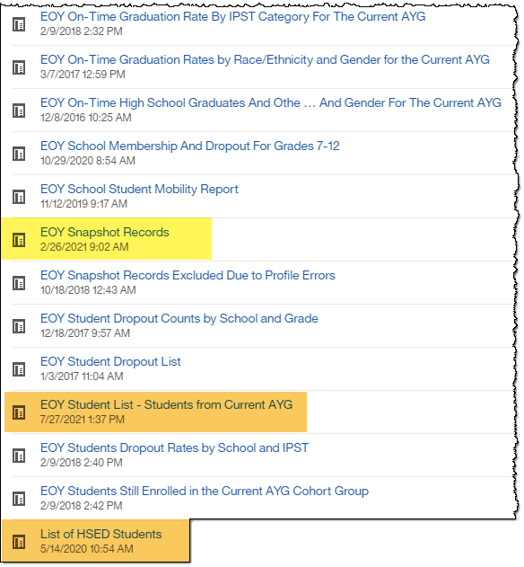
COGNOS Student End of Year Reports
These reports are based upon SEY snapshot records or are specific to the SEY collection

Slide 58
Rates & Reporting: Overview

Slide 59
End of Year Data Online
Used for school, district and state rates
Graduation & Completion Rates
Dropout Rates
Mobility / Stability Rates
Districts can view early versions of these rates through COGNOS/CEDAR reports.

Slide 60
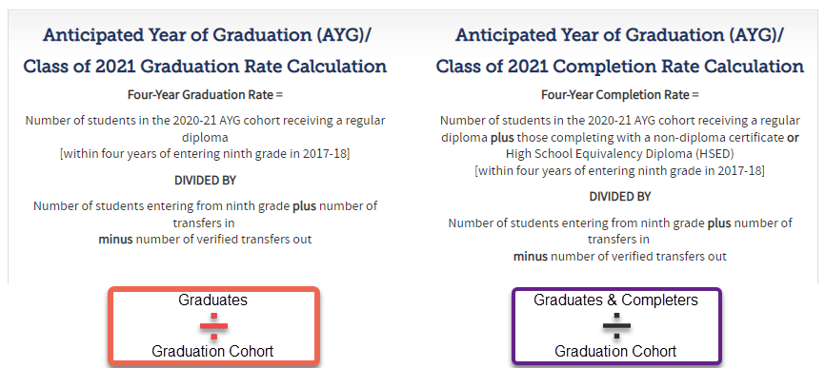
Calculating Graduation Rates
Exit Types that Comprise the Graduation Cohort (PDF)

Slide 61
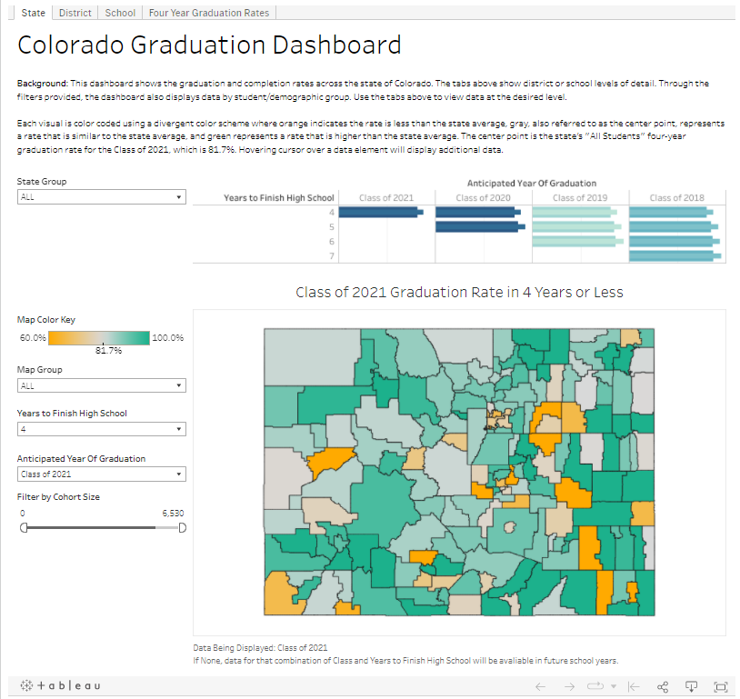
Graduation Statistics: Colorado Graduation Dashboard

Slide 62
Calculating Dropout Rates
Students considered dropouts
Exit 40 – Dropped Out
Exit 01 – Reached maximum age for services
Note: Students exiting to an HSED program are not counted as dropouts in the dropout rate

Slide 63
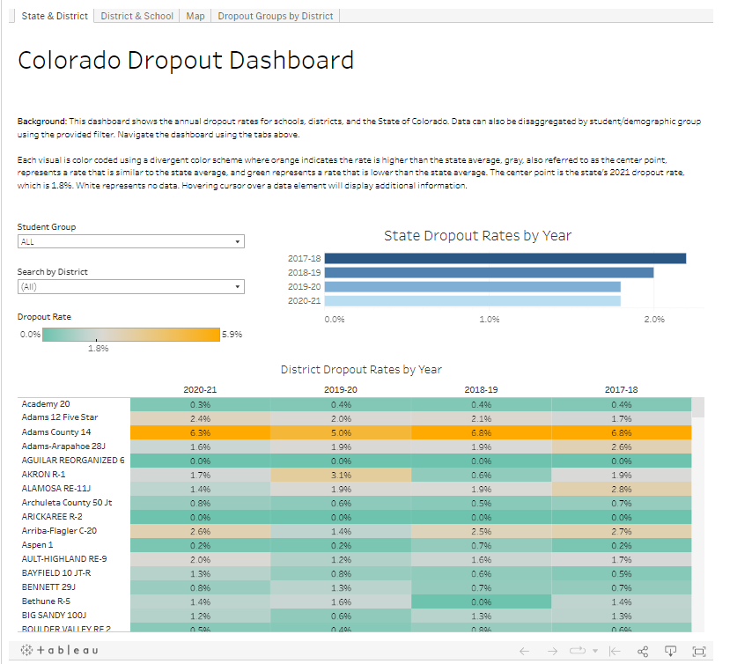
Dropout Statistics: Colorado Dropout Dashboard

Slide 64
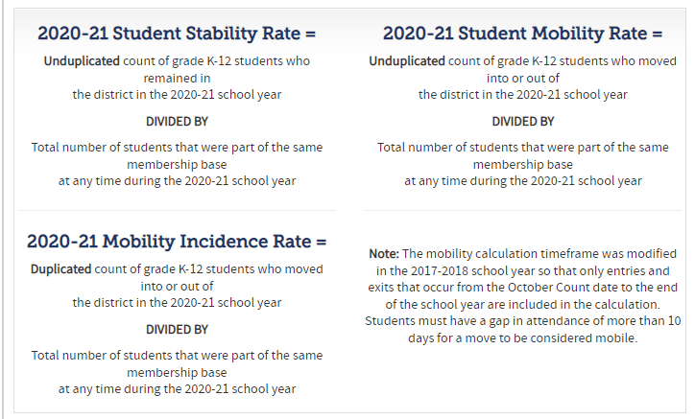
Calculating Mobility/Stability Rates

Slide 65
Resources, Contacts, & Glossary

Slide 66
Resources
Student End of Year
Timeline
File layouts (SEY & Adjustment)
Business rules (SEY & Adjustment)
Trainings/schedule (SEY & GG)
Step by step instructions
Additional Resources
Student Interchange
File Layouts (DEM, SSA, GG)
Business Rules (DEM, SSA, GG)
Graduation Guidelines
Menu of Options
Background/History
FAQ

Slide 67
Contacts
Name | Area of Expertise | Contact Info
Reagan Ward | Student End of Year Graduation Guidelines | ward_r@cde.state.co.us
Brooke Wenzel | October Count Student Interchange | wenzel_b@cde.state.co.us
Robin Russel | Graduation Guidelines | russel_r@cde.state.co.us
Debbie Puccetti | RITS/EDIS Consultant | ruccetti_d@cde.state.co.us
Michelle Romero | Postsecondary Programs | romero_m@cde.state.co.us
Erica Ryan | Postsecondary Programs | ryan_e@cde.state.co.us
Ashley Idrees | Dropout Prevention | idrees_a@cde.state.co.us
Paula Gumina | McKinney Vento Homeless Education | gumina_p@cde.state.co.us
Doris Nguyen | EL Students | nguyen_d@cde.state.co.us

Slide 68
Glossary
AYG: Anticipated Year of Graduation (4 years after entering 9th grade)
IPST: Instructional program service type (Free and Reduced Lunch, Title 1, Migrant, etc.)
Cohort: Group of students with the same AYG and/or same IPST category
Graduate: Student receiving a High School diploma
Completer: Student receiving HSED, certificate of completion
SPF: School Performance Framework
DPF: District Performance Framework
Summer Dropout: Student who leaves 8th grade and is not reported at a public school in Colorado the following year

