Slide 1
2021-2022 Student End of Year (SEY) Training: Regular Phase
April 27, 2022
Reagan Ward ward_r@cde.state.co.us

Slide 2
Agenda
SEY Collection Cycle & Timeline
Regular Phase Process
Student Interchange Files
File Uploads
Checking Errors/Warnings
Common Interchange File Errors
Student End of Year Snapshot
Creating a snapshot
Checking Errors/Warnings
SEY Snapshot Errors/Warnings
Snapshot Submission
Reporting Exceptions
Frequently Asked Questions
CEDAR/COGNOS Reports
Looking Ahead
Resources & Contact Information

Slide 3
SEY Collection Cycle & Timeline

Slide 4
Collection Cycle Overview
Regular Phase
Cross LEA Phase
Post Cross LEA Phase
Final Data Review
Public Data Release
Soft Open
September 22nd – October 13th
March 14th – May 4th
October 20th – November 17th
November 28th – December 1st
January 10, 2023
May 5th – September 8th
Primary data collection phase
First post-collection phase
Second post-collection phase

Slide 5
Key Dates: Regular Phase
 | Date | Event
Data Collection and Cleanup Phase (Regular Phase) | Monday 03/14/2022 | Snapshot Soft Open
 | Thursday 05/05/2022 | Snapshot Official Open
 | Thursday 06/02/2022 | Target: Create first End of Year Snapshot
 | Thursday 06/23/2022 | Target: Error free Student Interchange Uploads
 | Thursday 07/21/2022 | Target: Error free Student End of Year Snapshot
 | Thursday 09/01/2022 | Soft Deadline: Submit Student End of Year Snapshot
 | Thursday 09/08/2022 | Deadline: Submit Student End of Year Snapshot Approve initial data summary reports Deadline is mandated under Colorado Administrative Rules

Slide 6
Regular Phase Process

Slide 7
Regular Phase Process
Resolve Interchange Errors
Resolve SEY Snapshot Errors
Review Warnings
Repeat
Repeat interchange file updates & SEY snapshot updates until error free
Validate
Validate data with COGNOS/CEDAR reports
Submit
Submit data to CDE
Regular Phase Deadline: September 8th
Upload Interchange Files
Student Demographic, Student School Association, Graduation Guidelines
Create SEY Snapshot
Review Warnings
Reupload Interchange Files
Update data as needed

Slide 8
Student Interchange Files

Slide 9
Student Interchange Files
Student (Demographic)
One record per student
Types of Information:
Race/Ethnicity
Free/Reduced Lunch
English Learners
Special Education status
Homeless
Postsecondary Program
Military Connected or Enlisted
Graduation Guidelines
Required for graduating students
At least one English
At least one Math
Student School Association
One or more records per student (depends on enrollment)
Types of Information:
Grade Level
School Entry
School Exit
Retention
Primary School
Home Based Education
Non School Program
Gifted & Talented
Title I Interchange
Title 1 status for students receiving targeted assistance
SPED Interchange
SPED status for students with disabilities
Notes:
Title 1 and SPED Status are internal flags for the SEY snapshot. This information is pulled from the corresponding interchanges for qualifying students and is automatically indicated as ‘0’ or No for students who do not have records on these interchanges. Title 1 status for students attending a school-wide title 1 program are also automatically indicated as Title 1 = Yes on the SEY snapshot.

Slide 10
Student Interchange Preparation
Get SASIDs for your new students
Through RITS or Data Pipeline
Resources on getting SASIDs can be found here:
http://www.cde.state.co.us/datapipeline/yr_rits
Create Extracts from your Student Information System
Pull data for the Student Demographic/Profile file and Student School Association
Data Pipeline accepts .csv, .xls, .xlsx formats
.xls is the recommended format
If opening file in Excel, please make sure you don’t lose leading zeros
CDE has a guide to keeping leading zeros on Student Interchange website
CDE recommends using a file naming convention:
Example: 0110_DEM_EOY_10112016.xls
Spaces in the file name are not allowed

Slide 11
File Uploads

Slide 12
Student Interchange Preparation
Upload interchange files
Wait for a Confirmation Email from the Pipeline System
The email will show you the number of errors in your upload
Resolve ALL errors in your interchange files
Check your error reports
Update your Interchange files to address the errors
Update in SIS → Extract → Upload to Pipeline
Edit Record Tool (Data Pipeline)
Student Demographic File
Student School Association File
Graduation Guidelines File

Slide 13
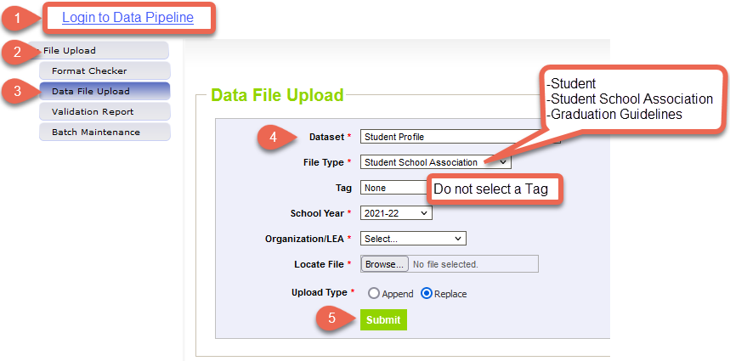
Data File Upload
Data pipeline will send you an email indicating the status of your upload.

Slide 14
Checking Errors/Warnings

Slide 15
Interchange Business Rules
Errors
Warnings
Must be addressed
Prevent a record from being included in the SEY snapshot
Indicate possible data inconsistencies/coding issues.
Review to ensure data accurately reflects a student’s educational history
Reupload interchange files to trigger the data pipeline system to check file for errors/warnings after a change has been made.

Slide 16
Pipeline Error Report
Student
Student School Association
Graduation Guidelines
To view specific student records that are triggering an error/warning, select View Details at the bottom of the screen.

Slide 17
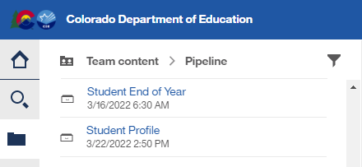
COGNOS/CEDAR Error Reports
Login to CEDAR/COGNOS
Select Pipeline Reports
Select the Student Profile reports category
Select the Error Detail or Error Summary report for the desired interchange file.
Complete the drop-down menu selections.
Select Finish to view the report.
More Information: SEY COGNOS/CEDAR Guide

Slide 18
Common Interchange File Errors

Slide 19
Student Demographic: Language Proficiency
Language Proficiency – A student's English language proficiency is described by his or her ability to speak, listen, read, and write in English.
Expected Value: Student should have the same language proficiency as coded in Student October
Non-EL students must be coded as (0) NA or (4) PHOLTE Primary or Home Language Other Than English
Former English Learners are coded as (5) FELL- Former EL
(1) NEP
(2) LEP
(6) FEP Monitor Year 1
(7) FEP Monitor Year 2
(8) FEP Exited Year 1
(9) FEP Exited Year 2
(5) FELL

Slide 20
Student School Association: Date First Enrolled in the U.S.
Districts may zero-fill this field and CDE will calculate the date of first enrollment based upon the date a student first had an entry date in a CDE student interchange data collection.
Student’s date of first enrollment will be calculated based on the earliest entry date in Kindergarten and greater.
Students with Entry Type 14 (Entry from another state) may not be zero filled.
If a date has been entered for a student, CDE will not override that field with a calculated value, though the entered value may not be more recent than the date CDE calculates.
Schools on US military bases count as US schools
Home School does not count as a ‘public or non-public school’

Slide 21
Student School Association: Attendance Fields
Attendance data fields can be zero filled for the SEY snapshot.
TOTAL DAYS ATTENDED
TOTAL DAYS EXCUSED
TOTAL DAYS UNEXCUSED
TOTAL POSSIBLE ATTENDANCE DAYS
HABITUALLY TRUANT STATUS
TOTAL DAYS MISSED DUE TO OUT OF SCHOOL SUSPENSIONS
Most of these data fields require a decimal.
Example: TOTAL DAYS ATTENDED = 0.0 or 175.3
Note: Attendance and SEY snapshots use untagged SSA files; it may be simpler to ensure these fields are up-to-date through the close of the Attendance snapshot in August.

Slide 22
Graduation Guidelines: Guideline Score
Do not use leading zeros for this data field
Must be a numeric value, no alpha values
Accepted score values change based upon the GUIDELINE_NAME
Guideline Name and Description | Guideline Name Code | Accepted Guideline Score Values | Benchmark Scores
SAT | SAT | 200-800 | Benchmark English: 470 Benchmark Math: 500
ACT | ACT | 1-36 | Benchmark English: 18 Benchmark Math: 19
District Capstone | CAP | 0 – non passing per district 1 – passing per district | Benchmark English: District Policy Benchmark Math: District Policy

Slide 23
Graduation Guidelines: Guideline Name
Must be the alpha name code that matches the desired guideline
Some codes are dependent on the GUIDELINE_TYPE (English or Math)
i.e. if GUIDELINE_NAME is QAS, GUIDELINE_TYPE must be 1 (math)
Local Measure (LM) was removed from the menu of options for 2021-2022 and beyond

Slide 24
Graduation Guidelines: School Code & District of Completion
School Code
Required field
Cannot be zero filled
If student has exited your district, use the school code for the last school of attendance in your district
District of Completion
Can be zero filled (0000)
Options:
Report your district code for measures completed while student attended a school in your district
Report another district code if the student completed the measure elsewhere
Report 0000 if the measure was completed while student attended a school out of state, out of country, non-public, or home-based education
Based on your district’s policy for determining if acceptance of these scores

Slide 25
Student End of Year (SEY) Snapshot

Slide 26
Purpose and use of SEY snapshot information
Summarize annual educational history for students throughout the school year
Derive graduation, completion, dropout, mobility, and stability rates
Inform state and federal policy
Public information; used in official reports and news articles
School and District Accountability measures

Slide 27
Which students are reported in the SEY Snapshot?
All students in grades PK-12 counted in membership at any time between July 1 and June 30 of the reported school year
Including those that left your school/district during that time
This includes students who are attending BOCES programs (non-school program ’03’) for whom you are their home district/school
Criteria:
Error free records from Student School Association File where
Pupil Attendance Information Codes 01-08 (Pupils attending an education program operated by the reporting district)
Primary School Flag = 1 (yes)
Valid public school code
Matched to data fields from
Student Demographic (SASID, District Code, School Year)
Graduation Guidelines (SASID)
Other internal data sources such as Title 1 interchange and SPED interchange

Slide 28
Creating a Snapshot

Slide 29
Creating a Snapshot
Do not create a snapshot until you have error free interchange files (SSA, DEM, GG)
Students with errors in SSA or DEM will not be included in snapshot
SE401: A PK-12 grade student has errors at the interchange level (SSA).
SE405: A PK-12 grade student has errors at the interchange level (DEM).
Records with errors on the GG file will not be associated with a SASID.
SE301 errors could occur due to GG file errors
Each time a snapshot is created, the old one is deleted
When a snapshot is created it will check against the business rules
Errors/warnings may clear upon snapshot creation
New errors/warnings may arise after snapshot creation

Slide 30
Data Pipeline: Create snapshot
A message will display across the top of the screen indicating a snapshot creation has been triggered and is processing. You will receive a notification email from Data Pipeline once the snapshot has completed processing. If a snapshot creation is already in progress, you will receive a message to ask you to try again later.

Slide 31
Checking Errors/Warnings

Slide 32
Business Rules
Business Rules are the list of errors and warnings that are checked when a snapshot is created.
Available on the SEY Website
Kinds of information checked:
Demographic information (some fields typically do not change from Student October to Student End of Year)
Valid student entry/exit types, internally and across districts
Graduating/completing/dropout student coding to ensure accuracy of reporting
Cohort groups
Student movement between districts
Students retained (academic, postsecondary programs, transition programs)
Identify dropouts from prior years showing up in other districts
Identify students for whom an HSED certificate has been reported

Slide 33
Pipeline Error Report
To view specific student records that are triggering an error/warning, select View Details at the bottom of the screen.

Slide 34
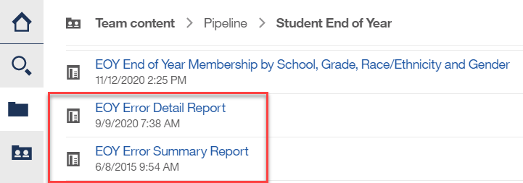
COGNOS/CEDAR Error Reports
Login to CEDAR/COGNOS
Select Pipeline Reports
Select the Student Profile reports category
Select the EOY Error Detail or EOY Error Summary report.
Complete the drop-down menu selections.
Workflow Step = Snapshot Edits
Select Finish to view the report.
More Information: SEY COGNOS/CEDAR Guide

Slide 35
SEY Snapshot Errors/Warnings

Slide 36
Entry and Exit Types
Entry/Exit types and corresponding dates are used to track an overview of a student’s enrollment history throughout the year
Reported on the SSA file (file layout on student interchange website)
For students in grades 7-12, exit types are used to determine if a student is part of your cohort for dropout/ graduation/completion rates
Adequate documentation is needed for some exit types
See the SEY website for a list of exit types that comprise the graduation cohort base for a given AYG

Slide 37
Common Entry/Exit Types
Entry Types
Exit Types
02 – Continuous in same school (beginning of the year)
11 – Transfer from school in the same district (includes matriculating students)
13 – Transfer from another public school in a CO district
14 – Transfer from a different state
16 – Transfer from home-based education
40 – Re-entry after dropping out from same school district in a previous year
00 – Student did not exit (completed the school year)
11 – Transfer to a school in the same district
13 – Transfer to another public school in a CO district
14 – Transfer to another state
40 – Dropped Out
90 – Graduated with Regular Diploma
District | SASID | Entry Date | Entry Type | Exit Date | Exit Type
1234 | 1234567890 | 08162021 | 02 | 10022021 | 13
1234 | 1234567890 | 01062022 | 13 | 00000000 | 00
Notes:
Example:
Student returns from prior year (Entry Type 02)
Student exits to transfer to another district (Exit Type 13)
Later in the year student comes back from another district (Entry Type 13)
Student exits for the summer (Exit Type 00)

Slide 38
One Day Records
Students who exit in a previous year with ’00 – student did not exit’ need to have a record in the current SEY snapshot
If missing a record, SE404 error will trigger
Sometimes students leave over the summer and do not attend during the current year
Report a one-day record to show how this student exited your district
Example:
2020-2021 a 10th grade student completed the school year
This student moved out of state over the summer
2021-2022 one day record
District Code | SASID | Entry Date | Entry Type | Entry Grade Level | Exit Date | Exit Type
1234 | 1234567890 | 08022021 | 02 | 110 | 08022021 | 14

Slide 39
Common Warnings
Warning Code | Warning Message
SE163 | Warning: This student was previously identified as Gifted and Talented in one or more domains and should still be identified as such. Please correct this student’s Gifted and Talented codes on your SSA file. Note: A student may be indicated as Gifted and Talented in multiple domains.
SE137 | WARNING: If 7th - 12th grade students have exit type code 13 (transfer to another Colorado public school district) and exit date after May 1 of the reported year. If the student does not physically attend classes in the receiving school district before the end of the currently reported school year, you will receive an error during the Post-Cross LEA Phase. Consider changing the student's exit type to 00 and exit date to 00000000 and wait until next year's EOY to report the student as transferring to another district.
SE211 | ___ % of students age 17 or older were reported as enlisting in the military. Military enlistment is included in the school performance frameworks (SPF) and district performance frameworks (DPF) at the high school level as part of the Postsecondary Workforce Readiness (PWR) Indicator.
SE224 | Warning: Student's Postsecondary Program Enrollment code has changed since Student October. Please verify the student's postsecondary program enrollment status.
SE722 | These students are currently coded as transferring to another Colorado public school district (Exit/Withdrawal Type Code = 13), but their SASID was not reported in the current Student End of Year collection by any other district after the exit date reported by your district. Please verify the educational status of these students after exiting your district and change their Exit/Withdrawal Type Code if appropriate. If you have confirmation of enrollment and attendance, please contact the receiving district to have them include the student in their end of year submission prior to the Post Cross LEA process.
Notes:
SE211 is an example of a snapshot level warning. These types of warnings reflect information based upon the entire snapshot collection, not a specific student’s record.

Slide 40
Common Errors
Error Code | Error Message
SE049 | If a student was reported in Student October in grade K-12 with Attendance Code 01-08 they must have at least 1 record in EOY. Note: Pre-K students who did not complete the school year in your district do not have to be reported on the Student End of Year.
SE060 | The EOY data you submitted shows an enrollment history through October 1, however, these students were either not included in Student October for the current year or reported at a different school for October Count. Please confirm the student's attendance and submit an exception if the student was incorrectly reported in October.
SE061 | This student was reported as receiving a HSED in the current year however their Exit Type in the last detail record is not 93 or 94 or 13. REQUIRED ACTION: Change the exit type of this record to reflect the student's HSED completion status (93 or 94). If you believe this HSED status is an error, please request an exception.
SE091 | Students with Exit Type Code 11 should be followed by record with Entry Type Code 11 or 12.
SE102 | Entry Type may be 02 (Continuous in same school with no interruption of schooling) for the first detail record only if the student was reported in the prior year as finishing at the same School Building Code with Exit Type Code = 00.
SE104 | If a grade K-12 student was reported last year with Exit Type=00 in the last detail record, their first detail record must be reported with an Entry Type = 02, 03, 11, 90, 91 or 00. Please update the entry type in your School Association file.
SE117 | For students entering Grades 8-12, Entry Grade Level for the first detail record must be the same as prior year's Entry Grade Level, if the last record from the prior year had Exit Type Code=00 and Retention Code=1.
SE400s | SE400s are related to records not getting into snapshot. The primary school flag must be set to 1 for the student to appear Check to see if the record is in error in student interchange file Validate the pupil's attendance code is correct

Slide 41
SE301 Error Logic Graduation Guidelines + Student End of Year
If student’s exit type indicates graduate (exit 90, 95, 96)
And student’s AYG is >= 2021
Search for matching Graduation Guidelines records in data pipeline, matched on SASID
At least one matching English at/above minimum benchmark
At least one matching Math at/above minimum benchmark
Corresponding GG records found; no error triggered
Missing a GG record for English and/or Math; error triggered

Slide 42
Student End of Year: SE301 Errors
Error Message: “This student was reported with an exit type of 90 (graduating with a regular diploma) or 95 or 96. However, this student does not have a record of meeting graduation guidelines in English and/or math in the Graduation Guidelines file (GG). Please add this student to your Graduation Guidelines file or change the school exit type.”
Resolutions:
Add missing GG record(s) for this student to your GG interchange file
Change the student’s exit type to something other than a graduate (Exits 90, 95, 96)
Contact SEY data collection lead for possible reporting exception
Notes:
Exit 90 = graduated with regular diploma
Exit 95 = graduated with regular diploma in current year after being reported as a HSED recipient by the reporting district in a prior year
Exit 96 = graduated and completed a postsecondary program

Slide 43
Snapshot Submission

Slide 44
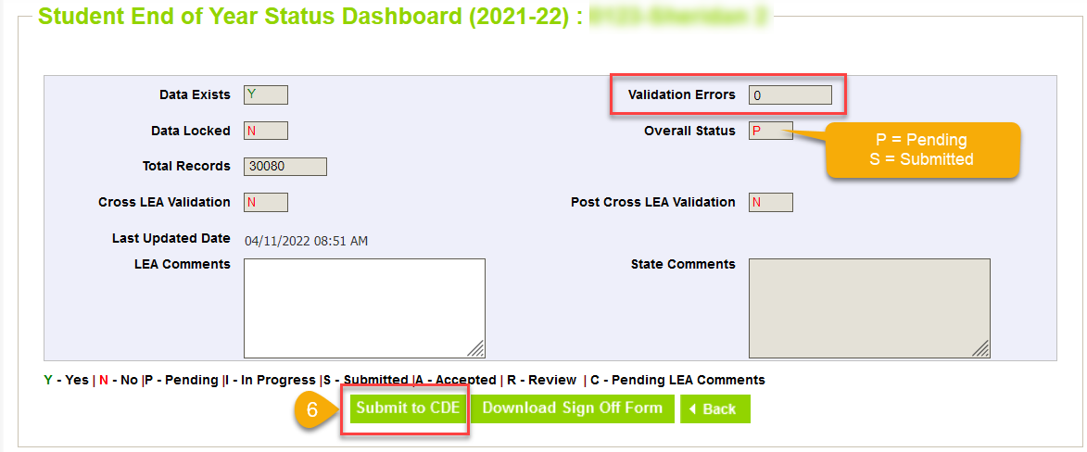
Submitting the SEY snapshot
All snapshot errors must be resolved before submitting.
Deadline: Thursday, September 8, 2022

Slide 45
Reporting Exceptions

Slide 46
When are reporting exceptions needed?
Sometimes a student’s records will have accurate information, but their educational history will not follow the anticipated coding patterns outlined in the business rules for an interchange file or snapshot
These are unique circumstances and apply to few students
Reporting exceptions are used to clear the errors associated with a student’s record without changing the data
Student Demographic
Student School Association
Student End of Year
Data respondents must work with the data collection lead for a given file/snapshot to request an exception be granted
SEY Website: How to Request an Exception

Slide 47
Reporting Exception Process
Complete exception request template
Upload exception request template to your district’s Syncplicity student folder
Folder: 1234 – DISTRICT NAME – Student
Notify the SEY collection lead (ward_r@cde.state.co.us) that you’ve uploaded a document for review
Subfolder: SEY 2021-22
Collection lead will review your request and notify you of the outcome
Approved requests – reupload interchange file and/or create a new SEY snapshot
Denied requests – collection lead will provide next steps for clearing the error
Additional information needed – collection lead will request information
Available on SEY Website
Pro Tip: Include the date in name of your exception request file as you may upload more than one exception during the collection cycle

Slide 48
What types of exceptions might need additional information?
If the reason given for the exception doesn’t make sense with the coding pattern, clarification may be requested
SASID merge situations
Work with the RITS coordinator (puccetti_d@cde.state.co.us) to resolve
English Learners whose status changed mid-year
Often a body of evidence supporting a mid-year redesignation is requested, including most recent ACCESS scores for review by the CLDE department
Post-Cross LEA SE903 errors
Adequate documentation required for student to remain coded as Exit 13 (transfer to a public school in another CO district)
Missing graduation guidelines records for a graduating student
SE301 Exception Request Supporting Documentation
Notes:
SE301 Supporting Documentation
Reason for Request: “Please provide detail regarding extenuating circumstances that have led to this request. Please include your districts’ process for making this decision.”

Slide 49
Frequently Asked Questions

Slide 50
Student End of Year FAQs
Review the full FAQ document here
When should I use exit type code ‘00’? How does CDE define this exit code?
Exit Type Code ‘00’ indicates that the student completed the school year in a given grade and school within your district. Exit Type ‘00’ should be used for every student who completes the school year in your district – regardless of his or her anticipated enrollment status at the beginning of the next year. The students described in each of the following scenarios would be assigned an exit code of ‘00’:
“Jimmy finished the school year with us, but I know for certain his family is moving to California over the summer.”
“Kate finished middle school this year and will be starting at our high school next year.”
“Tom is a high school senior who will need to repeat 12th grade next year.” (retention code should be ‘1’)

Slide 51
Student End of Year FAQs
What is considered ‘finishing’ the school year when using exit type code ‘00’?
Per the Colorado Code of Regulations (1-CCR-301-1), “students shall be counted as completing (finishing) the school year if they leave school within three weeks of the last day of school or have completed all coursework early, meaning they have completed the locally defined requirements for the current grade and will be promoted to the next higher grade the following school year.” These students use Exit Type Code ‘00’ with an Exit Date of ‘00000000’ – regardless of his or her anticipated enrollment status at the beginning of the next year.
Why do I have to code a student as returning in the current year even though the student never attended a school in our district in the current year? What is a one-day record?
Students who were reported in the prior year with an exit type ‘00’ are required to have a record in the current year. CDE requires this record in order to see the student’s progression into the next school year. The enrollment record can have an entry date any date after July 1st for the school year and the exit type needs to indicate where the student went after leaving your district. This is often referred to as a ‘one-day’ record because it shows the student entering and exiting the district on the same day.

Slide 52
Student End of Year FAQs
What happens when an 8th grade student drops out over the summer? Are they included in a cohort graduation rate?
In this case, you need to code the student as a summer district drop out. These students should be entered in the next school year SEY as follows:
Then, the student will only be attributed as a district summer dropout. The student will NOT be included in any graduation cohorts.
NOTE: Districts that code a student to the school they were anticipated to attend, but never did, will be included in that school’s rate information. CDE allows the above coding as to not penalize the anticipated school.
Summer District dropout
Pupil Attendance Code | School Code | School Entry Date | School Entry Type | Entry Grade Level | School Exit Date | School Exit Type
03 | 0000 | 00000000 | 00 | 090 | 00000000 | 40

Slide 53
Student End of Year FAQs
What happens if a 7th, or 9th-12th grade student drops out over the summer?
These students should have a one-day record showing they dropped out from their last school of attendance.
These students are attributed to their last school of attendance and will be part of the corresponding dropout and
Summer School dropout
School Code | School Entry Date | School Entry Type | Entry Grade Level | School Exit Date | School Exit Type
a school code | an entry date | an entry type | prior year + 1 | an exit date | 40

Slide 54
Student End of Year FAQs
What retention code do I need for ____?
Retention Code = 1
Used when a student is retained for academic purposes.
This may be used with students in any grade level.
Student’s exit type should be ’00’
Retention Code = 2
Used for 12th grade students who will return to participate in an approved postsecondary program in the following year (ASCENT, PTECH, TREP)
Student’s exit type may be ’90’ or ’00’
Retention Code = 3
Used for 12th grade students who will return to participate in a transition program in the following year.
Student’s exit type may be ’00’, ’90’, or ’27’

Slide 55
COGNOS/CEDAR Reports

Slide 56
CEDAR/COGNOS Reports Overview
The Colorado Education Data Analysis and Reporting system (CEDAR) is a private, secure system which provides student level data to authorized users. Access to student-level data is limited to educators who have need for such data.
Reports in CEDAR/COGNOS have multiple purposes. Some are used as operational reports to assist data respondents in looking up specific information on students, file/snapshot errors, and students missing from a snapshot due to profile errors. Other reports are used to validate data when finalizing a data collection. Many reports also provide districts with a preview of data that will be published based upon specific data collections. (i.e., graduation statistics)
SEY CEDAR/COGNOS Reports Guide
Notes:
Often CEDAR is referred to as COGNOS since COGNOS is the software currently powering the Colorado Education Data Analysis and Reporting system (CEDAR).

Slide 57
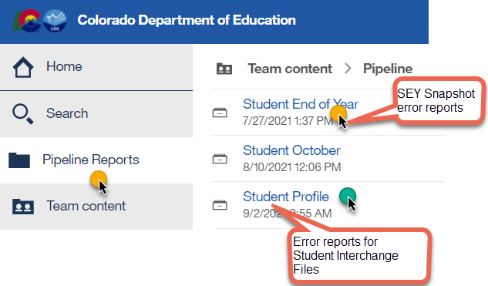
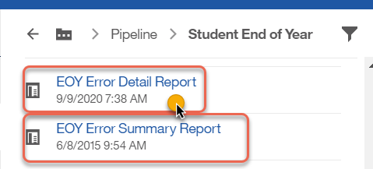
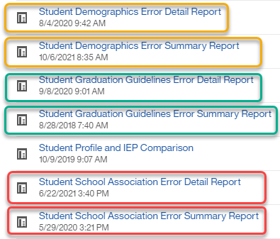
COGNOS (CEDAR) Error Reports
Login to COGNOS/CEDAR using the link in Data Pipeline or from the IdM website.

Slide 58
Graduation Guidelines: Student Completion List
Student Profile
List of any completed measures for all students in district
If the student does not have any reported measures, they are excluded from the list
Student list based upon current SSA file
Graduation Guidelines measures based upon any reported measures (all years/districts) found in data pipeline
Matched on SASID
Includes ‘Met Benchmark Y/N’ field
Can be exported to excel

Slide 59
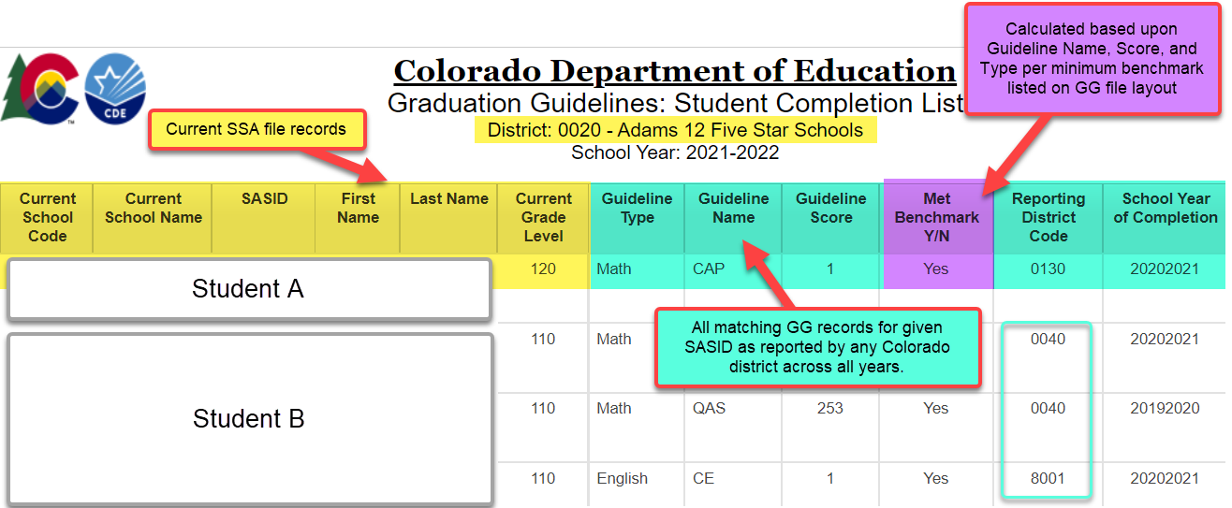
Graduation Guidelines: Student Completion List
Student Profile
Notes:
Report updates with SSA file upload and GG file upload
Only reflects reported measures. A student may have completed a measure in a prior district that has not been reported to CDE.

Slide 60
Looking Ahead

Slide 61
SEY Post-Collection Phases
 | Date | Event
Cross LEA Validation | Thursday 9/22/2022 | Cross LEA Validation begins: Snapshots reopen
 | Thursday 10/06/2022 | Target: Error free Student End of Year Snapshot
 | Thursday 10/13/2022 | Deadline: Resubmit data to CDE
 | Date | Event
Post-Cross LEA Validation | Thursday 10/20/2022 | Post-Cross LEA Validation begins
 | Thursday 11/10/2022 | Target: Error free Student End of Year Snapshot
 | Thursday 11/17/2022 | Deadline: End of Post-Cross LEA validation phase
 | Date | Event
Final Dates | Monday 11/28/2022 | Begin final review of graduation and dropout rates after the AYG reconciliation Any changes will require a new sign-off page
 | Thursday 12/01/2022 | Deadline: Superintendents must approve final Data Summary Reports (collection closes)
 | Tuesday 01/10/2023 | Official/final data and rates posted on the CDE website and released to the public

Slide 62
Resources & Contact Information

Slide 63
Resources
Student End of Year
Timeline
File layouts & Business Rules (SEY & Adjustment)
Trainings (SEY & GG)
Regular Phase Resources
SEY Overview & Checklist
Regular Phase
FAQs
SEY COGNOS/CEDAR Report Guide
Additional Resources
Student Interchange
File Layouts (DEM, SSA, GG)
Business Rules (DEM, SSA, GG)
Graduation Guidelines
Menu of Options
Background/History
FAQ

Slide 64
Contacts
Name | Area of Expertise | Contact Info
Reagan Ward | Student End of Year Graduation Guidelines | ward_r@cde.state.co.us
Brooke Wenzel | October Count Student Interchange | wenzel_b@cde.state.co.us
Robin Russel | Graduation Guidelines | russel_r@cde.state.co.us
Debbie Puccetti | RITS/EDIS Consultant | ruccetti_d@cde.state.co.us
Michelle Romero | Postsecondary Programs | romero_m@cde.state.co.us
Erica Ryan | Postsecondary Programs | ryan_e@cde.state.co.us
Ashley Idrees | Dropout Prevention | idrees_a@cde.state.co.us
Paula Gumina | McKinney Vento Homeless Education | gumina_p@cde.state.co.us
Doris Nguyen | EL Students | nguyen_d@cde.state.co.us

