Slide 1
2017-18 Staff Interchange

Slide 2
Agenda
Staff Interchange Overview
Timeline
Staff File Updates
Additional Information
Data Pipeline Steps

Slide 3
Staff Interchange Overview

Slide 4
Interchange Process
Create/Update Data Files
Upload files in Data File Upload
Review Batch Maintenance
Review Error Reports in Cognos
Correct Data Files in Source System
Upload files in Format Checker
Once No Errors in All Files Needed -> Create Snapshot

Slide 5
Staff Interchange Files
Staff Profile
General information per staff
Only 1 record per staff
Must be uploaded first
Staff Assignment
Provides specifics to actual duties and locations
Multiple records per staff allowed

Slide 6
Staff Interchange Uses
Staff Interchange files are used in the following snapshots:
Human Resources
Special Education December Count
Teacher Student Data Link Snapshot
Staff Interchange files may be updated throughout the year
December Count and HR will pull records that are employed on December 1st
TSDL will reference all records (looks to see if the teachers reported in TSDL were also reported in the staff interchange file)

Slide 7
Human Resources – Use of Data
EDFacts – federal reports
SchoolView.org/Data Center
Performance Reports – staff statistics
ESSA In-Field Reporting
Media and external data requests
Colorado Department of Labor and Employment
Colorado Department of Higher Education

Slide 8
Special Education December Count– Use of Data
EDFacts – federal reports
Report on educator effectiveness
Medicaid
Draw random samples for parent survey
Compliance record review
Monitoring
Provide information regarding the fiscal impacts of the numbers
Indicator reporting – Significant Disproportionality
Public reporting
Legislature requests
Research requests
Consultant analysis to support technical assistance needs in the state

Slide 9
Teacher Student Data Link – Uses of Data
EDFacts
Civil Rights Data Collection (CRDC) report for the Office of Civil Rights
Colorado Department of Higher Education
Updating the Staff interchange files for TSDL after HR and Dec Count snapshots have closed DOES NOT impact either the HR or Dec Count Snapshots

Slide 10
Timeline

Slide 11
Staff Interchange Timeline
Staff Interchange opened September 6th
Remains open throughout year

Slide 12
Human Resources Timeline
November 1st | Snapshot Opens
November 16th | Must have both interchange files uploaded at least once
December 1st | Official Count Date
December 14th | Must create snapshot at least once
December 21st | Interchange files error free
January 18th | Snapshot newly recreated (to update Special Ed Report)
Jan 18th- 25th | Review Special Education Report
February 8th | All errors resolved (interchange and snapshot)
Feb 8th – 15th | Review reports for accuracy
February 15th | Snapshot must be finalized

Slide 13
Special Education December Count Timeline
November 1st | Snapshot Opens
November 16th | Must have all interchange files uploaded at least once
December 1st | Official Count Date
December 14th | Must create snapshot at least once
December 21st | Interchange files error free
January 18th | All errors resolved (interchange and snapshot)
Jan 19th – 25th | Review Staff and Student Reports
January 25th | Validity Certification Reports due
Jan 26th – Feb 8th | Student Duplication Process
February 15th | Snapshot must be finalized

Slide 14
Timeline – Highlights from both snapshots
Start early! Staff Interchange is open and files can be uploaded multiple times throughout process
November 16th – Upload Interchange files at least once
December 21st – Interchange files error free
January 19th – 25th – Review week
Districts MUST REVIEW Special Education Staff Report (Cognos)
Districts and AUs must collaborate to ensure Special Education Staff data is reported accurately and complete
AUs review reports in detail and make any data corrections deemed necessary during this window

Slide 15
Timeline - Resources
Please reference detailed timelines online- much more information provided
Human Resources Timeline: https://www.cde.state.co.us/datapipeline/2016-2017humanresourcestimeline
Special Education December Count Timeline: https://www.cde.state.co.us/datapipeline/2017-2018specialeducationdecembercounttimeline

Slide 16
2017-18 File Updates and Review

Slide 17
Staff Profile Updates
Removed fields:
“Years of Prior PreK-12 Teaching Experience Out of State”
“Years of Prior PreK-12 Education Experience Out of State”
“Subject Area of Degree 4”
“Subject Area of Degree 5”
Updated fields:
“Years of Prior PreK-12 Teaching Experience In State” to include Teaching Experience In State AND Out of State. Field Name is now “Years of Prior PreK-12 Teaching Experience”
“Years of Prior PreK-12 Education Experience In State” to include Education Experience In State AND Out of State. Field Name is now “Years of Prior PreK-12 Education Experience”

Slide 18
Overall Performance and Quality Standard Ratings (Review)
All Teachers and Specialized Service Providers (SSPs) must have rating reported for the following job class codes:
All Principals and Assistant Principals must have rating reported for these job class codes:
105 – Principal
106 – Assistant Principals
If Overall Rating is provided with a valid code other than ‘Not Rated’ then the Quality Standard Ratings are also required to be reported
201 – General Ed Teacher
202 – Special Ed Teacher
206 – Title I Teacher
222 – Reading Interventionist
223 – Math Interventionist
216 – Librarian
211 – Counselor
231 – Audiologist
233 – Registered Nurse
234 – Occupational Therapist
235 – Physical Therapist
236 – Psychologist
237 – Social Worker

Slide 19
Staff Assignment Updates
Removed fields:
“Passed Colorado State Board of Education Approved Elementary Or Early Childhood Core Content Test”
“24 Semester Hours of Secondary Core Content Coursework”
“Passed Colorado State Board of Education Approved Secondary Core Content Test In Teaching Area”
Added fields:
“Demonstrates In-Field Status 1”
“Demonstrates In-Field Status 2”

Slide 20
Demonstrates In-Field Status 1
Report the best option for each teacher:
Report 00 (N/A) for all non-teaching staff
Code | Description
01 | Subject Area Endorsement on Teaching License
02 | Degree (BA or higher) in subject area
03 | 36 semester credit hours in subject area
04 | Passed State Board of Education approved content exam in subject area
06 | Highly Qualified via 24 semester hours in subject area
05 | None (teacher is out of field)
best

Slide 21
Demonstrates In-Field Status 2
Report the next best option for teachers:
Report 00 (N/A) again for all non-teaching staff
Code | Description
00 | N/A – no other method applicable
12 | Degree (BA or higher) in subject area
13 | 36 semester credit hours in subject area
14 | Passed State Board of Education approved content exam in subject area
16 | Highly Qualified via 24 semester hours in subject area
15 | None (teacher is out of field)

Slide 22
Reporting Combinations
Demonstrates In-Field Status 1 | Demonstrates In-Field Status 2
01 (Subject Area Endorsement on Teaching License) | 00 (N/A), 12 (Degree), 13 (36 Semester Hours), 14 (Passed Exam) or 16 (HQ via 24 Semester Hours)
02 (Degree, BA or higher) | 00 (N/A), 13 (36 Semester Hours), 14 (Passed Exam) or 16 (HQ via 24 Semester Hours)
03 (36 Semester Hours in Subject Area) | 00 (N/A), 14 (Passed Exam) or 16 (HQ via 24 Semester Hours)
04 (Passed Exam in Content Area) | 00 (N/A) or 16 (HQ via 24 Semester Hours)
06 (Highly Qualified) via 24 semester hours in subject area) | 00 (N/A)
05 (None (teacher is out of field)) | 00 (N/A)

Slide 23
ESSA In-Field Crosswalk
Provides allowed endorsements for each teaching subject area code
Provides Subject Area of Degree code for each teaching subject area code
Reference list for Human Resources at: https://www.cde.state.co.us/datapipeline/hr-essa-infield-crosswalk
List for Special Education specific teaching subject areas expected soon

Slide 24
Additional Resources
Staff Interchange information:
http://www.cde.state.co.us/datapipeline/inter_staff
Annette Severson: severson_a@cde.state.co.us (also HR)
Kristi Gleason: gleason_k@cde.state.co.us (also Dec Count)
Human Resources Snapshot information:
http://www.cde.state.co.us/datapipeline/snap_hr
Special Education December Count Snapshot information:
http://www.cde.state.co.us/datapipeline/snap_sped-december
Additional Contacts:
Lindsey Heitman: heitman_l@cde.state.co.us and
Orla Bolger: bolger_o@cde.state.co.us

Slide 25
Next Up: Data Pipeline Steps
We realize the Staff Interchange/HR Snapshot/Dec Count Snapshot can all take considerable effort & time, just remember…
Staff Interchange/Human Resources Snapshot: Severson_a@cde.state.co.us or (303)866-6824
Special Education Dec Count Snapshot: Gleason_k@cde.state.co.us or (303) 866-4620

Slide 26
Data Pipeline Steps

Slide 27
Identity Management Roles
Staff Interchange Roles:
STF~ LEAUSER – upload and modify staff interchange files OR
STF~LEAVIEWER – view (only) staff interchange data
Human Resources Snapshot Roles:
HRD~LEAAPPROVER – Approves, creates, views Snapshot OR
HRD~LEAUSER - creates, views Snapshot OR
HRD~LEAVIEWER- views snapshot
Special Education December Count Snapshot Roles:
DEC~LEAAPPROVER – Approves, creates, views Snapshot OR
DEC~LEAUSER - creates, views Snapshot OR
DEC~LEAVIEWER- views snapshot

Slide 28
More about the roles
Preferred Options:
A respondent with the STF role associated with the 5 digit admin unit code can only report Special Education Staff (flag=1)
A respondent with the STF role associated with the 4 digit district code may report ALL staff, regular and special education, for the district.
If you are reporting all staff be sure to be available to make changes to special education data in accordance with the timeline.
Not recommended. Check with CDE
A respondent with the STF role associated with the 4 digit BOCES code may report all staff associated with the Administrative Unit, BOCES, and Districts
Check with CDE on the logistics of this.

Slide 29
Authoritative Source
Prior to reporting staff data be sure the structure for reporting has been established and the appropriate roles have been assigned. Determined by the Superintendent along with LAMs and Special Education Directors.
Here is a good resource for determining the Authoritative Source for staff http://www.cde.state.co.us/datapipeline/authoritativesourceforstaff
Often the reporting comes down to personnel options who is reporting the data.

Slide 30
Create Files
Excel, CSV or Text File all accepted
Need to create 2 separate files:
Staff Profile – demographic and educational background info
Staff Assignment File – specifics for location and duties
1st record of data must be field names/titles
File layouts, definitions and codes all found at: http://www.cde.state.co.us/datapipeline/inter_staff

Slide 31
Creating Staff File/Assignment – Helpful Tips
First Record = Headings or Titles
can be labeled to make the most sense to you
Pipeline system ignores these headers-essentially skips it to the 2nd row with actual data
Codes must match codes within file layout
Include leading zeros
Blanks are not allowed – zero fill if N/A
Templates available if needed at: http://www.cde.state.co.us/datapipeline/inter_staff

Slide 32
Referencing/Using Last Year’s Data File
You may download last year’s data file as a starting point if needed
File layout will be in prior year (2016-2017) file layout, so updates would be required prior to re-uploading
Data Pipeline -> Staff Profile -> File Extract Download
This may also be used to download recent files uploaded into pipeline
Includes any updates made in ‘Edit Record Screen’
Includes all data records from all files uploaded

Slide 33
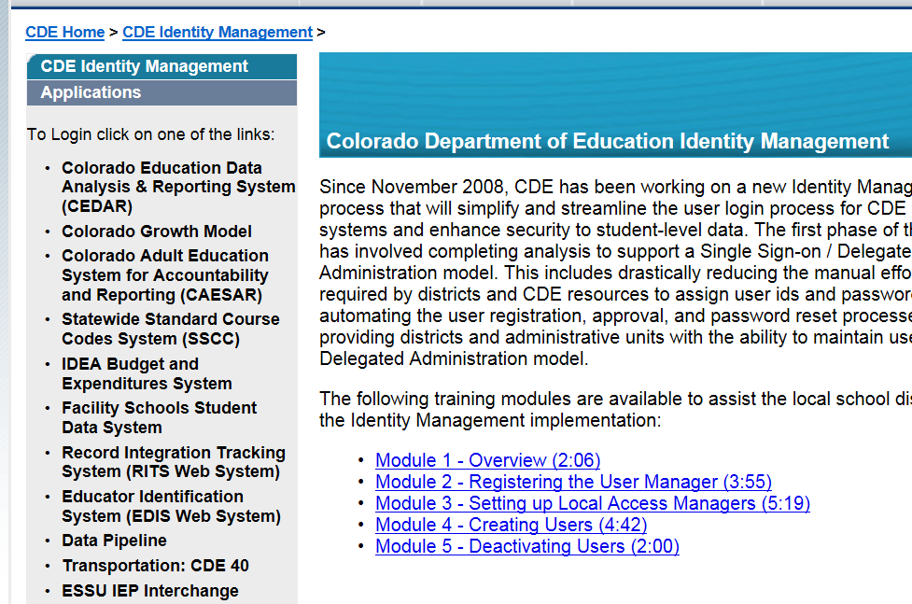
Accessing Data Pipeline
https://cdeapps.cde.state.co.us/index.html
Data Pipeline

Slide 34
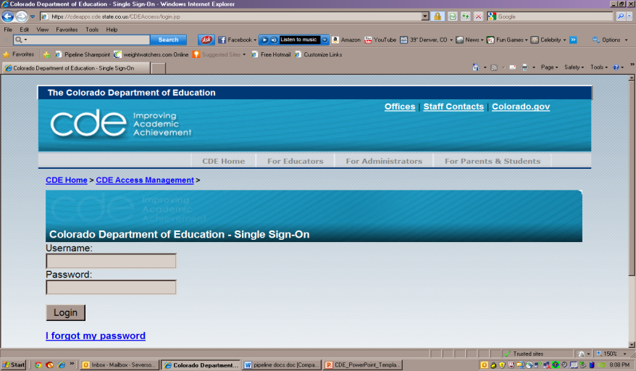
Pipeline Log-In Screen
Your Email Address
Password is set by you – use I forgot my password to reset

Slide 35
Pipeline Website Review
Batch Maintenance, Format Checker and Data File Upload
Based on your Identity Management Roles
Error reports and other validation reports

Slide 36
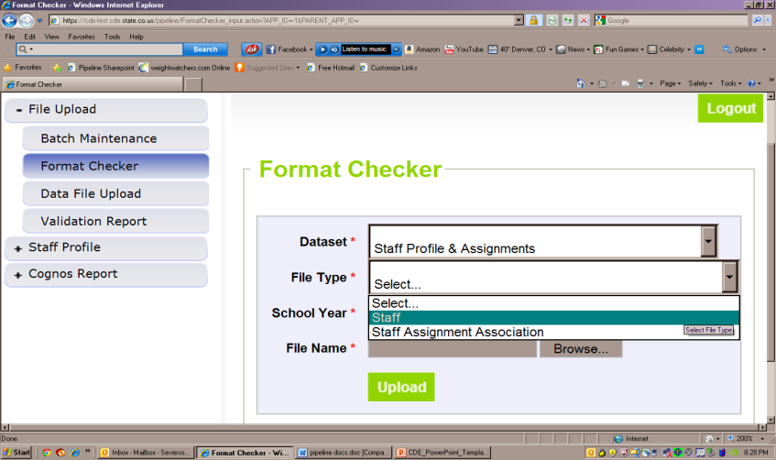
File Upload – Format Checker

Slide 37
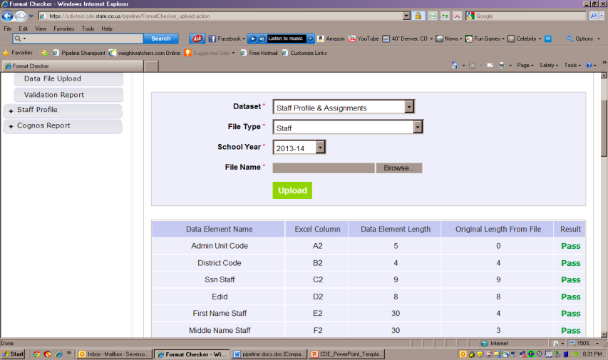
Format Checker – Upload Results

Slide 38
Format Checker Notes
Format Checker will only review the 2nd row in your file
Passing format checker Does Not Equal file will process
Green ‘Pass’ for each field is desired result
Red ‘Fail’ for a field indicates file is not in the correct format- please refer to the 2017-18 file layout on web

Slide 39
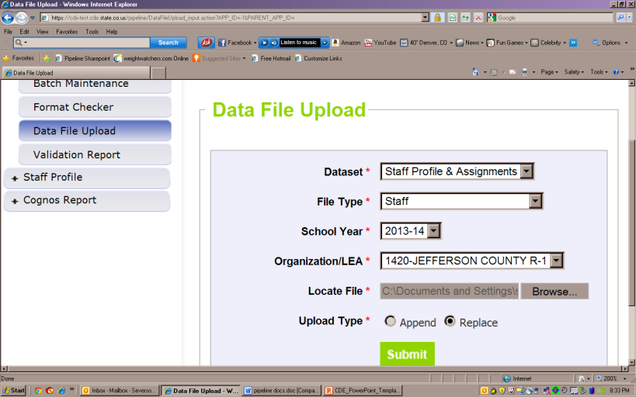
Data File Upload

Slide 40
Data File Upload Notes
Upload Staff Profile file first
Upload staff assignment file second
Staff profile does not have to be error free, just uploaded before staff assignment file is uploaded.
Upload Types:
Append = adds file to existing file, all records from both files included
Can be tricky with fixing errors
Replace = deletes any prior data file and replaces it with the file being uploaded
RECOMMENDED

Slide 41
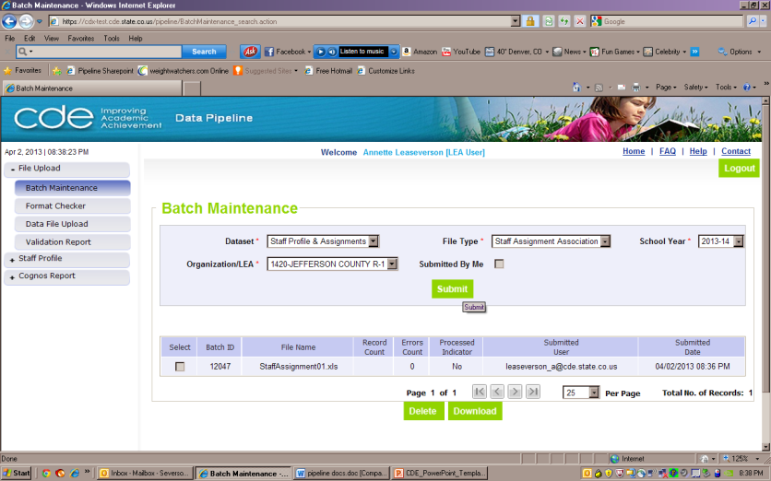
Batch Maintenance Screen

Slide 42
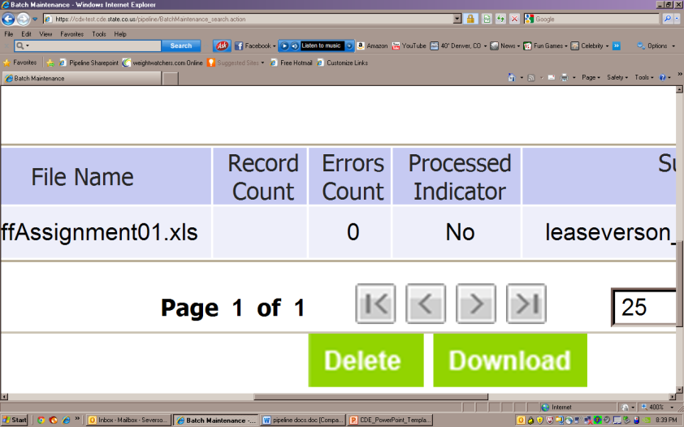
Batch Maintenance – Not Processed

Slide 43
File Not Processed – Next Steps
Ensure file has all green ‘pass’ in format checker
YES?
Open file and review all records are formatted the same as the 2nd row
Be sure all codes and dates have leading zeros included
NO?
Review file layout posted online and re-format the file
For further assistance, contact Annette Severson or Kristi Gleason
DO NOT INCLUDE THE FILE IN ANY EMAILS

Slide 44
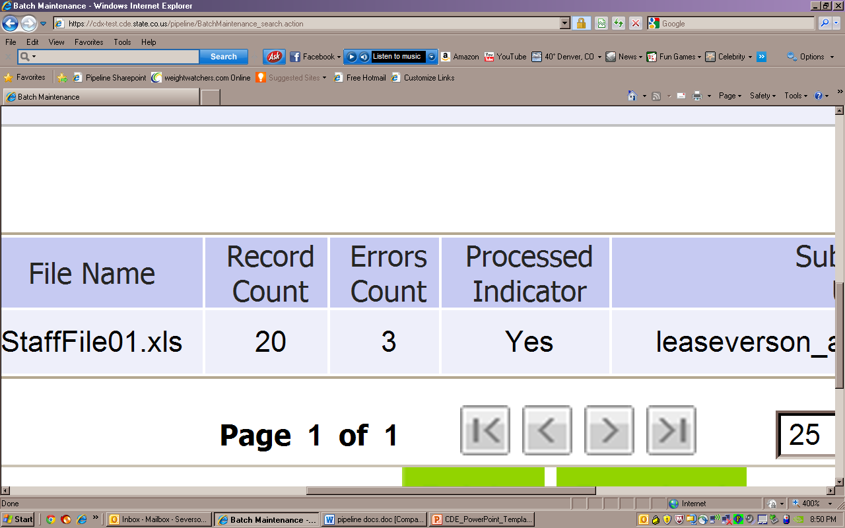
Batch Maintenance – File Processed

Slide 45
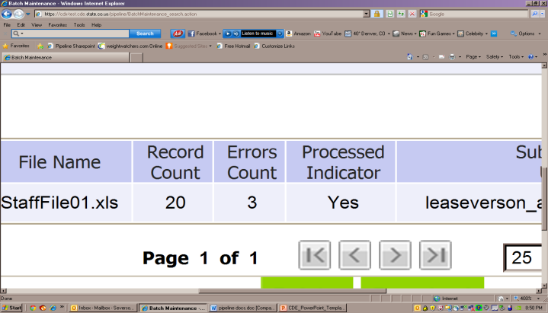
File Processed – Next Steps
Use same screen to see the Number of Errors:

Slide 46
Review Errors in Detail
2 methods available:
Data Pipeline Reports -> Error Reports
Cognos Reports – > Staff Profile
All Business rules (errors and warnings) can be found at:
http://www.cde.state.co.us/datapipeline/inter_staff
Cognos Reports -> Baseline -> Business Rules

Slide 47
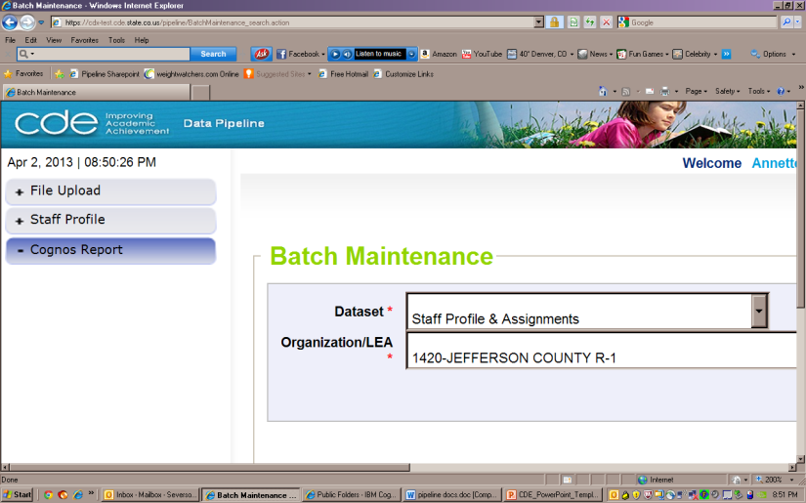
Cognos Reports

Slide 48
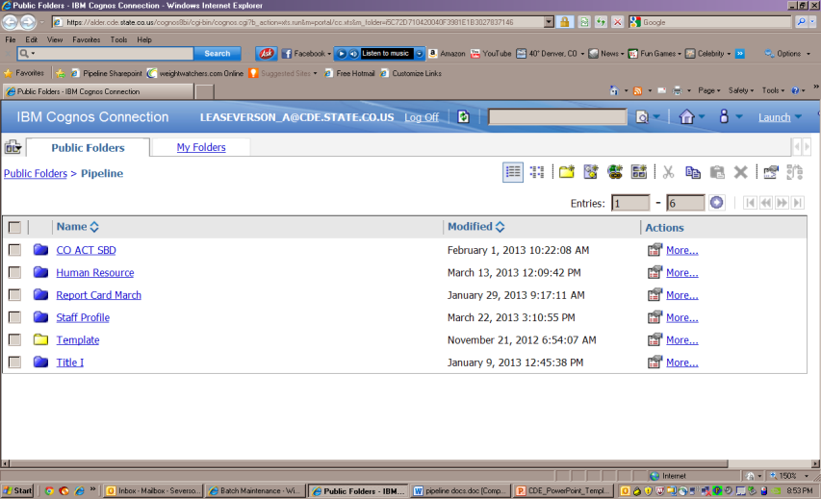
Clicking on Cognos Reports- Opens in a new Screen

Slide 49
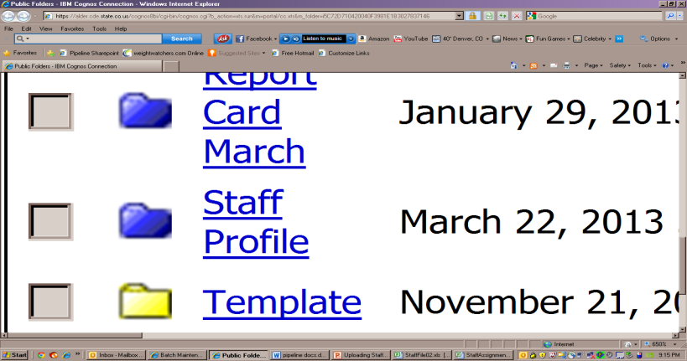
Select the Staff Profile

Slide 50
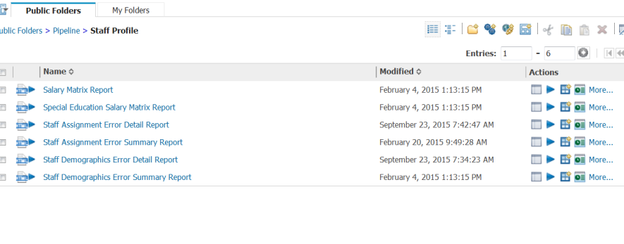
Staff Interchange Errors
Detail Reports – provides detailed records with descriptions of error
Summary Reports – provides a count of records by type of error
*Do Not Send Error reports via email to CDE for assistance

Slide 51
Error Reports
Error Detail Report
Provides specific records causing the error with the error description
Can select to View ALL error records or 1 type of error at a time
Error Summary Report
Provides a count of errors generated per error type and description
Resubmit either file as needed for corrections for all data errors to be resolved
Be sure to update source file with corrections as well

Slide 52
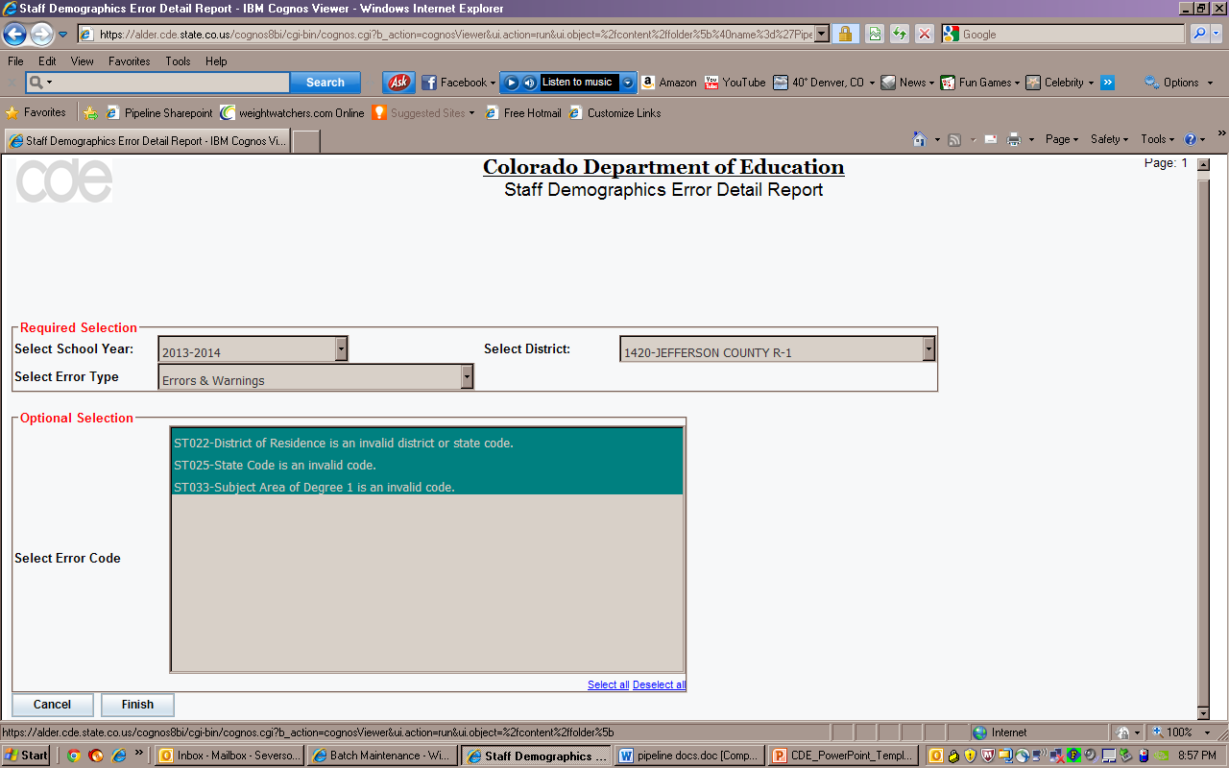
Error Detail Report

Slide 53
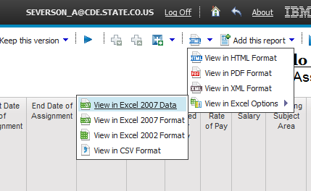
Error Detail Report- Excel
All cognos reports can be downloaded into excel
Choose ‘Excel Format’ when making selection

Slide 54
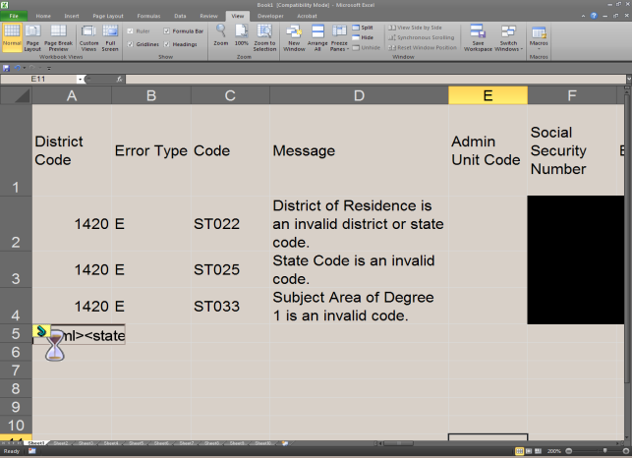
Example of Error Report – in Excel

Slide 55
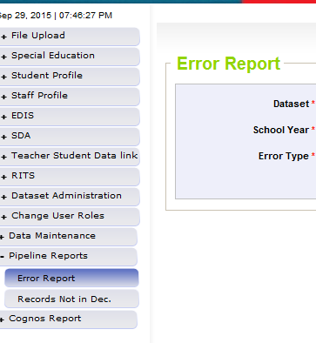
Pipeline Reports
Search:
Dataset = Staff Profile and Assignments
School Year = 2015-16
Error type = Errors and Warnings
File Type: Staff/Staff Assignment
Org/LEA = Code
Click ‘Search’

Slide 56
Pipeline Error Reports – Viewing Details
Summary of Errors in File are next provide
Click on ‘View Details’ to view each record with the error
Choose ‘Excel’ to download error report in Excel – recommended

Slide 57
Correcting Errors
Correct the errors in the file:
May have to fix errors in both Staff Profile and Staff Assignment files
Keep file versions – in case updated file causes even more errors, you can re-start using a prior file version
Resubmit your data records using the same process and replacing your existing data file using the Data File Upload tool
All errors must be corrected, all warnings should be reviewed

Slide 58
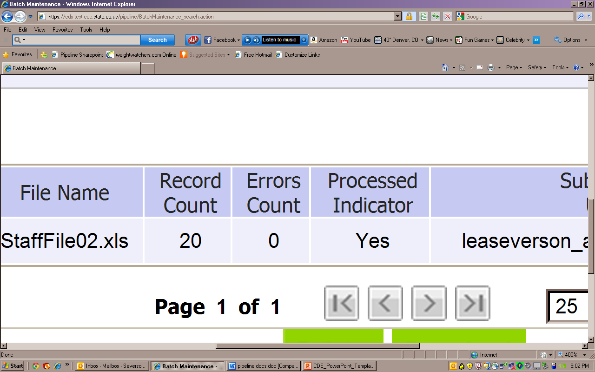
Batch Maintenance: No Errors

Slide 59
Next Steps – Staff
Staff Profile = Processed and Zero Error Count
Staff Assignment File = Processed and Zero Error Count
Create Snapshot
Districts/BOCES create Human Resources Snapshot
Administrative Units create Special Education December Count Snapshot

Slide 60
Resources
Staff Interchange information:
http://www.cde.state.co.us/datapipeline/inter_staff
Annette Severson: severson_a@cde.state.co.us (also HR)
Kristi Gleason: gleason_k@cde.state.co.us (also Dec Count)
Human Resources Snapshot information:
http://www.cde.state.co.us/datapipeline/snap_hr
Special Education December Count Snapshot information:
http://www.cde.state.co.us/datapipeline/snap_sped-december
Additional Contacts: Lindsey Heitman: heitman_l@cde.state.co.us and Orla Bolger: bolger_o@cde.state.co.us

Slide 61
Thank you for joining us!
Questions?
Annette Severson: Severson_a@cde.state.co.us
Kristi Gleason: Gleason_k@cde.state.co.us

