Slide 1
2016-17 School Discipline and Attendance (SDA) Data Collection
Annette Severson – severson_a@cde.state.co.us

Slide 2
Agenda
General info on SDA
  Why is data collected?
  How is data reported?
  What is the data used for?
Collection Timeline & 2016-17 File Layout Updates
SDA Data Overview
Collection Process
  Updating No Reportable Incidents tab
  Uploading and correcting data files
  Review reports for accuracy and Finalize
Available Resources
In-Depth Documentation Review

Slide 3
General Information

Slide 4
SDA data is Required by Statute:
22-11-503 (3)(c): The information shall be consistent for each type of report and, at a minimum, shall include the occurrence of each of the following types of incidents, expressed as a number and as a percentage of the total occurrences of all of the incidents:
    Substance abuse-drugs; Substance abuse- alcohol; Substance abuse- tobacco; Felony assaults; Fights; Possession of dangerous weapons; and Other violations of the code of conduct at the public school
22-32-109.1(2)(b)(IV): The number of conduct and discipline code violations…only in the most serious category that is applicable to that violation including to specific information on the number of and the action taken with respect to the following types of incidents:
    Dangerous Weapon; Destruction of Property; Alcohol; Tobacco; Drug; Robbery; Disobedient/Defiant; Detrimental Behavior; 1st, 2nd or Vehicular Assault; 3rd degree Assault/Disorderly Conduct

Slide 5


Data is Reported to CDE via Data Pipeline Process
Schools
Track data throughout school year
Districts
Combine data from schools
Report data to CDE
Data Pipeline
Provide data to districts
Verify accuracy of reports
Determines the appropriate category for every incident
Correct and Approve data
Checks data for accuracy
Collects data from districts
Rejects data if not accurate-districts must resubmit
Verify accuracy with schools
CDE
Reports data as required
Aligns data with law
Reviews Data

Slide 6
CDE Uses of Data
School View Data Center –
  all data is published by school for the public to review
Provided to the U.S. Department of Education
Provided for various data requests – media, researchers, legislatures and advocates

Slide 7
Public Uses of Data
Advocacy groups:
  Campaigning to end the “school-to-prison pipeline” rely on accurate discipline numbers to define the problem
  Data helps as school discipline policies become more of a focal point for education reform advocates who say punitive discipline erodes students’ motivation and negatively impacts their attitudes toward their school.
Media: Reporting and analysis for the public review of the safety and attendance of their local schools. Quote from a recent report:
  “These aren’t just numbers. These are students’ lives. These are the conditions they walk into every day at school. This is the environment of their school. That’s what these numbers reflect.”

Slide 8
Collection Timeline
&
2016-17 File Layout Updates

Slide 9
2016-17 Timeline
Date | Event
May 3rd (Wednesday) | Collection Opens
May 9th (Tuesday) | Webinar Training
May 15th (Monday) | Webinar Training
May 23rd (Tuesday) | Online Attendance Webinar Training
June 2nd (Friday) | Suggested Date for having No Reportable Incidents tab updated
June 9th (Friday) | Suggested Date for having at least 1 file uploaded
June 16th (Friday) | Suggested Date for having all files uploaded
June 23rd (Friday) | Suggested Date for having all files error free
June 30th (Friday) | Suggested Date to have SDA data finalized
July 12th (Wednesday) | Deadline for SDA to be finalized

Slide 10
2016-17 File Layout Changes
Discipline by Action:
  No Updates
Discipline by Student Demographics File:
  No Updates
Firearm (GFSA) Discipline File:
  New weapon code of 04 for Multiple Firearms
Attendance Data File – Added fields:
  Ethnicity/Race
  Gender
  IDEA/Special Education
  Section 504 Status
  ELL Status
  Homeless
  Number of Students with Chronic Absenteeism

Slide 11
SDA Data Overview

Slide 12
What must be Reported?
All students disciplined during the school year
All student attendance info- count of days and partial days
Include the student and incident:
  If the student is disciplined with a Classroom Suspension, In-School Suspension, Out of School Suspension, Expelled, or Referred to Law Enforcement regardless of behavior code
    OR
  If the incident would fit a behavior code other than code 12- Other Violation of Code of Conduct

Slide 13

SDA Consists of 4 separate files:
Discipline by Action
Discipline by Student Demographic
Firearm (GFSA) Discipline
Attendance Data
1
2
3
4

Slide 14
Discipline by Action File
Count of Behaviors per school is reported in file
  Most severe action taken per behavior
  Only 1 action taken/incident reported
  Referrals to Law Enforcement reported in addition to most severe action taken if applicable
Only report those behaviors which occurred in school during school year
Each Behavior has a code associated with it
  A record will be reported per behavior and school
Discipline by Action

Slide 15
Discipline by Action File: Behaviors Reported
Code | Behavior Type
01 | Drug Violation
02 | Alcohol Violation
03 | Tobacco Violation
04 | 1st, 2nd Degree or Vehicular Assault
05 | Dangerous Weapons
06 | Robbery
07 | Other Felony
08 | Disobedience/Defiant or Repeated Interference
09 | Detrimental Behavior
10 | Destruction of School Property
12 | Other Violation of Code of Conduct
13 | 3rd Degree Assault/Disorderly Conduct
14 | Marijuana Violation
15 | Sexual Violence/Battery (other than Rape)
16 | Rape or Attempted Rape
Discipline by Action

Slide 16
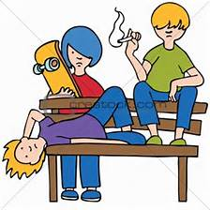
Reporting Incident Example 1
Discipline by Action File
1 Incident of tobacco violation
1 In-School Suspension
Discipline by Student Demographic File
1 White, Male, 7th grader, Non IDEA, Non 504, Non ELL Student with In School Suspension and Referred to Law Enforcement
1 Asian, Female, 7th grader, Non IDEA, Non 504, Non ELL Student with In School Suspension and Referred to Law Enforcement
1 White, Male, 8th grader, Non IDEA, Non 504, Non ELL Student with In School Suspension and Referred to Law Enforcement
1 Referral to Law Enforcement
3 students receive in-school suspensions and are referred to law enforcement for tobacco use (1 incident)
Discipline by Action

Slide 17
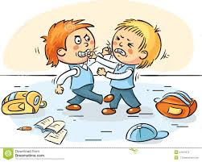
Reporting Incident Example 2
2 students fight and are suspended
(1 out of school and the other in school)
Discipline by Action File
1 Incident of 3rd Degree Assault with Out of School Suspension
Discipline by Student Demographic File
1 White, Male, 10th grader, Non IDEA, Non 504, Non ELL Student, Only 1 Out-of-School Suspended
1 White, Male, 9th grader, Non IDEA, Non 504, Non ELL Student, 1 In-School Suspended
Discipline by Action

Slide 18
Discipline by Student Demographic File
One record per subset of students disciplined by school
Detailed information on students disciplined:
  Ethnicity/Race
  Gender
  Grade Level
  IDEA/Special Education status
  Section 504 Status
  ELL Status
Counts of students by action taken
Discipline by Demographics

Slide 19
Out of School Suspensions – 3 fields
Received Only One Out-of-School Suspension – The total number of students (not incidents) received an out-of-school suspension only once during the school year.
Received More than One Out-of-School Suspension – The total number of students (not incidents) received an out-of-school suspension more than once during the school year.
Total Out-of-School Suspensions – The total number of students (not incidents) which received an out-of-school suspension. If a student received multiple out-of-school suspensions, each time is included in this count.

Slide 20
Discipline by Student Demographic File: FAQs
Unduplicated count of the students:
  If 1 student receives 3 in-school suspensions and expelled with services once (all for different incidents), he/she would be reported as:
    3 in the in-school suspensions
    1 in the expulsions with educational services
    1 in the unduplicated count of students disciplined
Discipline by Demographics

Slide 21
Reporting Incident Example 1
Discipline by Action File
1 Incident of tobacco violation
1 In-School Suspension
Discipline by Student Demographic File
1 White, Male, 7th grader, Non IDEA, Non 504, Non ELL Student with In School Suspension and Referred to Law Enforcement
1 Asian, Female, 7th grader, Non IDEA, Non 504, Non ELL Student with In School Suspension and Referred to Law Enforcement
1 White, Male, 8th grader, Non IDEA, Non 504, Non ELL Student with In School Suspension and Referred to Law Enforcement
1 Referral to Law Enforcement
3 students receive in-school suspensions and are referred to law enforcement for tobacco use (1 incident)
Discipline by Demographics

Slide 22
Reporting Incident Example 2
2 students fight and suspended
(1 out of school and the other in school)
Discipline by Action File
1 Incident of 3rd Degree Assault, Out of School Suspension
Discipline by Student Demographic File
1 White, Male, 10th grader, Non IDEA, Non 504, Non ELL Student, Only 1 Out-of-School Suspended
1 White, Male, 9th grader, Non IDEA, Non 504, Non ELL Student, 1 In-School Suspended
Discipline by Demographics

Slide 23

Reporting Incident Example 3: Out of School Suspension Focus
Student ‘Z’ receives 3 separate out of school suspensions during the school year at school A
Discipline by Demographics File
Counted as 1 in the ‘Received More than One Out-of-School Suspension’ field
Counted as 3 in the ‘Total Out of School Suspensions’ field
Counted as 0 in the ‘Received Only One Out-of-School Suspension’ field
Discipline by Demographics

Slide 24
Reporting Incident Example 4: Out of School Suspension Focus
Student ‘G’ receives 1 Out of School Suspension during the year at school B
Discipline by Demographics File
Counted as 1 in the ‘Received Only One Out-of-School Suspension’ field
Counted as 1 in the ‘Total Out of School Suspensions’ field
Counted as 0 in the ‘Received More than One Out-of-School Suspension’ field
Discipline by Demographics

Slide 25

Reporting Incident Example 5: Unduplicated Count Focus
Provide an unduplicated count of students involved reported incidents.
Regardless of how many times a student is counted for any category within the Discipline by Student Demographics file, only count the student once in the unduplicated count of students disciplined.
1
Same Student, counted multiple times in Discipline by Student Demographics File
Same Student, counted once in the Unduplicated Count of Students Disciplined field
Discipline by Demographics

Slide 26

Important Note to Remember
Discipline by Student Demographic
>
or
=
Discipline by Action
Count of Students Disciplined
Count of Incidents
Multiple Students may be disciplined for 1 incident
2 students
disciplined
>
1 fight

Slide 27
Firearm (GFSA) Discipline File
One record per school and firearm weapon with counts of actions taken.
If there are no firearms to report for a school, no record will be needed in file (based on No Reportable Incidents screen)
4 types of Firearms reported
  Handgun - Rifle/Shotgun - Other Firearm - Multiple Firearms
Expulsions reported are a subset of Dangerous Weapon Expulsions reported
Firearm (GFSA) Discipline
Firearm (GFSA) Discipline

Slide 28
Firearm (GFSA) Discipline File Flowchart
(A) Brought or Possessed at School
(B1) Expelled
(B2) Other Discipline Action (suspensions, etc)
(B3) Remove Other (death, incarcerated, etc)
(B4) No Action Taken
(C1) Less Than Mandatory One Calendar Year
(C2) Full Mandatory One Calendar Year
(D2) Referred to Alternative School/Program
(D1) Referred to Alternative School/Program
Firearm (GFSA) Discipline

Slide 29
Attendance Data File
First, Data is categorized and reported by Student Demographic information:
  Ethnicity/Race
  Gender
  IDEA/Special Education
  Section 504 Status
  ELL Status
  Homeless
Attendance Data
Attendance

Slide 30
Attendance Data
Second, each subgroup of students would have reported the following:
  Total Days Attended
  Total Days Excused
  Total Days Unexcused
  Total Days Possible Attendance
  Number of students habitually truant four or more days in a month
  Number of students habitually truant ten or more days in a school year
  Number of students habitually truant for both conditions listed above
  Number of Students with Chronic Absenteeism
Attendance

Slide 31
Attendance Data File: Relationship Equation
Student Total Days Attended
Student Total Days Unexcused Absent
Student Total Days Possible
Student Total Days Excused Absent
Decimal point is implied for all of these values.
Example: Student Total Days Attended reported as 5005 is reflected as 500.5 days.
Attendance

Slide 32
Habitually Truant Definition
22-33-107(3)(I): A child who has attained the age of six years on or before August 1 of the year in question and is under the age of seventeen years and who has four unexcused absences from public school in any one month or ten unexcused absences from public school during any school year. Absences due to suspension or expulsion of a child are considered excused absences for purposes of this subsection.
Attendance

Slide 33
Habitually Truant Counts
3 fields capture this required data:
  Truancy: Four or more days in any one calendar month
  Truancy: Ten or more days in one school year
  Truancy: Met both conditions
Students are to be reported in only 1 category per school as applicable
Attendance

Slide 34

Reporting Habitually Truancy Example
1 count of Truancy: 4 or more Days in one calendar month
Unexcused Absences for Sally in March. (Total Unexcused Absences in the School year is less than 10)
Attendance

Slide 35
Reporting Habitually Truancy Example
Month | # Unexcused Absences for Shirley
Aug | 0
Sept | 1
Oct | 1
Nov | 0
Dec | 1
Jan | 1
Feb | 0
March | 2
April | 0
May | 4
TOTAL | 10
1 count of Truancy: Met Both Conditions
Attendance

Slide 36
Chronically Absent Definition
The unduplicated count of students absent 10% or more of the days enrolled in the public school year during the school year. A student is absent if he or she is not physically on school grounds and is not participating in instruction or instruction –related activities at an approved off-grounds location for the school day. Chronically absent students include students who are absent for any reason (e.g., illness, suspension, the need to care for a family member), regardless of whether absences are excused or unexcused. This count would include students in grades K-12.
Attendance

Slide 37
Examples of Calculating Chronically Absent Status
Student | # Days Possible (enrolled) | # Days Attended | # Days Excused Absent | # Days Unexcused Absent | Total Days Absent | Total Days Absent/ Days Possible | Chronically Absent?
Alligator | 176 | 135 | 24 | 17 | 41 | 23.30% | Y
Bear | 123 | 111 | 9 | 3 | 12 | 9.76% | N
Cat | 54 | 44 | 10 | 0 | 10 | 18.52% | Y
Dog | 118 | 117 | 0 | 1 | 1 | 0.85% | N
Elephant | 97 | 92 | 3 | 2 | 5 | 5.15% | N
Frog | 145 | 101 | 38 | 6 | 44 | 30.34% | Y
Giraffe | 167 | 128 | 33 | 6 | 39 | 23.35% | Y
Horse | 175 | 168 | 4 | 3 | 7 | 4.00% | N
Iguana | 177 | 164 | 11 | 2 | 13 | 7.34% | N
Attendance

Slide 38
Additional Information - Attendance
Students may be counted as BOTH Habitually Truant AND Chronically Absent or as either/or
Habitually Truant fields refers to students with UNEXCUSED absences
Chronically Absent field refers to students with EXCUSED and UNEXCUSED absences

Slide 39
Business Rule Updates
Data counts are being compared between the three files:
  Discipline by Action
  Discipline by Student Demographics and
  Firearm (GFSA) Discipline
The Total Number of Incidents must be greater than 0
  If the Total Number of Incidents is 0 for that behavior code, then no record is required for the behavior code
Attendance data fields are all required and cannot be left blank
  If the appropriate response is ‘0’ then report ‘0’

Slide 40
Comparison Business Rules Review

Slide 41
Comparison of Incidents Reported and Students Disciplined (Cognos Report)
Provides the total counts of incidents reported per school
Provides the total count of students disciplined reported by school
These numbers will assist with any comparison error(s) in your data file and to verify accuracy of both reports
Recall, the count of students disciplined should be either more than or equal to the count of incidents reported.

Slide 42
Comparison Business Rule: SR090
(error will be in Demographic File Error Report)
Discipline by Student Demographic
Discipline by Action
Count of Students Disciplined
Count of Incidents
The Sum by School:
  Classroom Suspensions +
  In School Suspensions +
  Total Out of School Suspensions +
  Expulsions without Services +
  Expulsions with services +
  Referred to Law Enforcement +
  School Related Arrests +
  Other Action Taken
Total Number of Incidents per School
>
or
=
Note: > means “Greater Than”
= means “Equals”

Slide 43
Comparison Business Rules
(errors will be in Demographic File Error Report)
Discipline by Student Demographic
Discipline by Action
Count of Students Disciplined
Count of Incidents
Total Number of Classroom Removals by School
Total Number of In School Suspensions by School
Number of Out of School Suspensions by School
(SR091) The Sum by School of Classroom Removals
(SR092) The Sum by School of In School Suspensions
(SR093) The Sum by School
of Total Out of School Suspensions
>
or
=
>
or
=
>
or
=
Note: < means “Less Than”
= means “Equals”

Slide 44
More Comparison Business Rules
(errors will be in Demographic File Error Report)
Discipline by Student Demographic
Discipline by Action
Count of Students Disciplined
Count of Incidents
Total Number of Expulsions by School
Total Number of Referrals to Law Enforcement by School
Number of Other Action Taken by School
(SR094) The Sum by School Expulsions without Services and Expulsions with Services
(SR095) The Sum by School of Referrals to Law Enforcement
(SR096) The Sum by School of Other Action Taken
>
or
=
>
or
=
>
or
=
Note: < means “Less Than”
= means “Equals”

Slide 45
Important Note to Remember
Discipline by Student Demographic
>
or
=
Discipline by Action
Count of Students Disciplined
Count of Incidents
Multiple Students may be disciplined for 1 incident
2 students
disciplined
>
1 fight
Note: < means “Less Than”
= means “Equals”

Slide 46
Comparison Business Rule: SF076
(error will be in Firearm(GFSA) Discipline File Error Report)
Firearm (GFSA) Discipline
Discipline by Action
Count of Students Disciplined for Firearms
Count of Incidents
Total Number of Expulsions by School
The Sum of Students Expelled for firearm possessions by School
<
or
=
Note: < means “Less Than”
= means “Equals”

Slide 47

Next up – overall pipeline process
Questions/Answers

Slide 48
Collection Process

Slide 49
Identity Management Roles
To have access to the SDA periodic collection, one of the following 3 roles would need to be assigned to you by your Local Access Manager:
If you plan to ‘do it all’ – you will want the SDA~LEA Approver Role
IdM Role | Enables User to:
SDA~LEAAPPROVER | Finalize, Submit, Modify and View Data
SDA~LEAUSER | Submit, Modify and View Data
SDA~LEAVIEWER | View Data

Slide 50
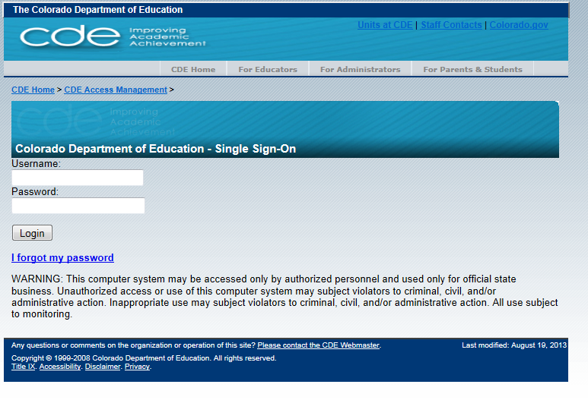
Login to Data Pipeline
https://cdx.cde.state.co.us/pipeline
Username = email address
Password = determined by you. Use the ‘I forgot my password’ if needed.

Slide 51
Quick Review of Process
Update ‘No Reportable Incidents’ Tab
Upload Data files in order (if applicable):
  Discipline by Action File
  Discipline by Student Demographic File
  Firearm (GFSA) Discipline File
  Attendance File
Review error reports, correct data and re-upload files as needed
Review data reports for accuracy
Finalize data files

Slide 52

Updating
No Reportable Incidents tab
Reportable
Incidents

Slide 53
No Reportable Incidents
A separate tab in Data Pipeline, under “SDA”
Option to use when a school has no incidents to report to CDE; either
  No Disciplinary Incidents and/or
  No Firearms to report
Can be updated throughout the SDA process.
  If marked as “No” initially, this can be updated to “Yes” for a school if needed and vice versa, until the data is finalized.
Must update each page or select ‘all’ per page to update all schools in one screen

Slide 54
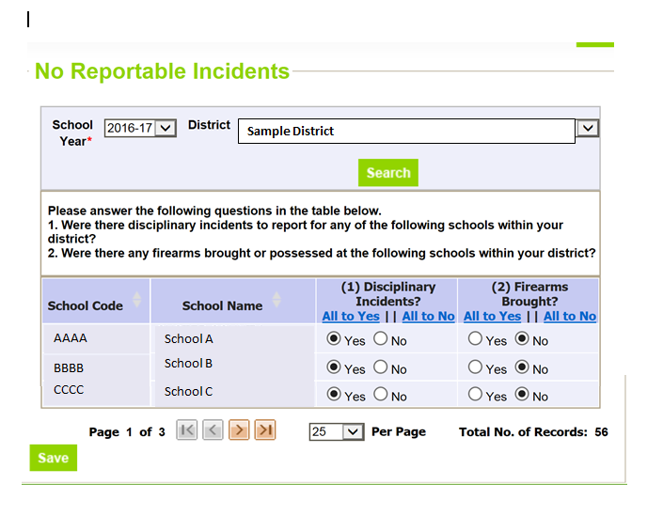
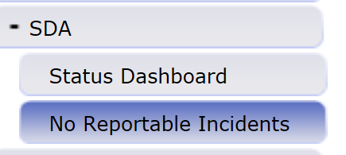
No Reportable Incidents Screenshot
After logging into Data Pipeline:
*If there are multiple pages, please be sure to list ‘All’ per page OR save each page after updating the status indicators

Slide 55
No Reportable Incidents – Disciplinary Incidents
Disciplinary Incidents column:
  “Yes” indicates:
    the school is included in the Discipline by Action file AND
    The school is included in the Discipline by Student Demographic file
  “No” indicates:
    The school is not included in the Discipline by Action file AND
    The school is not included in the Discipline by Student Demographic file
    If all schools are marked as “No”, then the LEA will not upload either the Discipline by Action file or the Discipline by Student Demographic file.

Slide 56
No Reportable Incidents – Firearm Incidents
Firearms brought column:
  “Yes” indicates:
    The school is included in the Firearm (GFSA) data file uploaded
  “No” indicates:
    The school is not included in the Firearm (GFSA) data file uploaded.
    If all schools in the district have this indication, then the LEA will not upload the Firearm (GFSA) data file.

Slide 57
Uploading and Correcting Data Files
(must be uploaded in order)

Slide 58
Uploading Data Files Order
(based on No Reportable Incidents tab)
If 1 or more school(s) have “Yes” indicated for Incidents in the Disciplinary column and “Yes” in the Firearm column:
    Discipline by Action File
    Discipline by Student Demographic File
    Firearm (GFSA) Discipline File
    Attendance File
If 1 or more school(s) have “Yes” indicated for Incidents in the Disciplinary column and “No” in the Firearm column:
    Discipline by Action File
    Discipline by Student Demographic File
    Attendance File
If ALL schools have “No” indicated for Incidents in the Disciplinary and Firearm columns:
    Attendance File

Slide 59
Uploading Data File Process
Upload data file in Pipeline
Check Batch Maintenance for process indicator
Check Status Dashboard for error count
Review errors and warnings (Pipeline Error Report or Cognos Error Reports)
Correct data file
Upload corrected data file in Pipeline
Continue until all errors resolved
Review Cognos Data Reports for data accuracy
Re-upload corrected files if needed
Finalize once ALL applicable SDA files are uploaded, error-free, reviewed and accurate

Slide 60
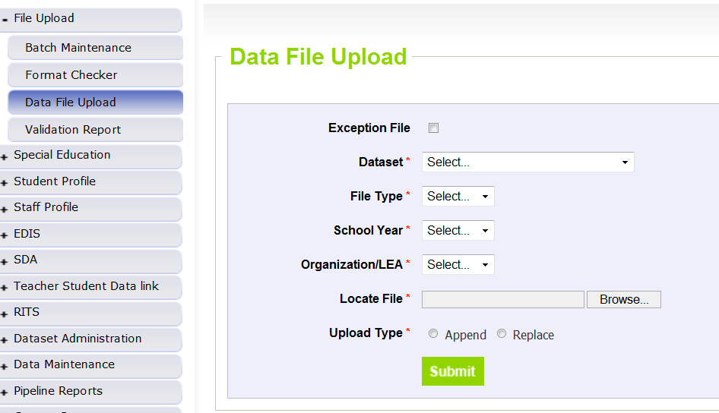
Uploading File Screenshot
Dataset | School Discipline Attendance
File Type | Discipline by Action THEN Discipline by Student Demo THEN Firearm Discipline THEN Attendance Data
School Year | 2015-2016
Organization/LEA | Select your District/BOCES
Locate File | Browser and select file to upload
Upload Type | Replace if your file is complete within the one file upload
 | Append if you are adding additional data to what has been previously uploaded
Click “Submit” for each file

Slide 61
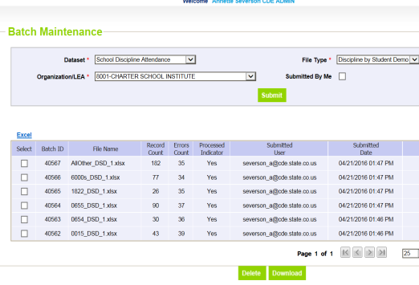
Batch Maintenance Screenshot
Displays status for files
If using ‘Append’ functionality, error count is incorrect for all except the last file uploaded.

Slide 62
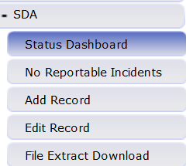
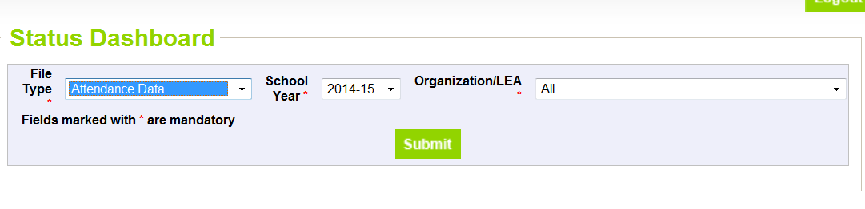
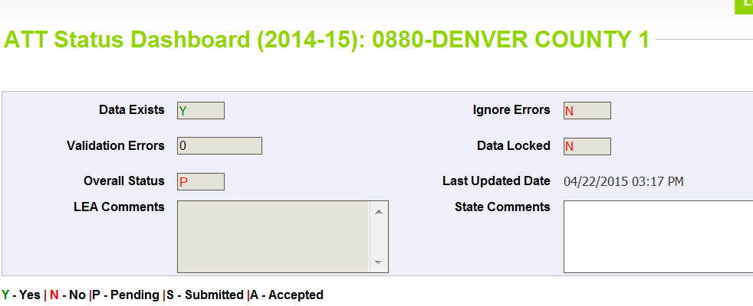
Status Dashboard
Confirms file processed and provides the error count in the file
Data Exists = Y (data processed) or N (data not processed)
Validation Errors = # (# of errors in file)
Overall Status = P (Pending) or N (No data)
Last updated date = last date of upload

Slide 63
Review Errors and Warnings
Two options:
  Using Cognos
  Using Pipeline Error Reports
You may use either option exclusively or both throughout

Slide 64


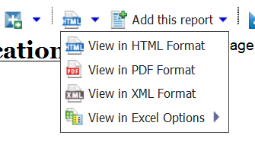
Using Cognos (Errors and Warnings)
Select the appropriate Error Report to view:
  For Attendance data errors: “Attendance Error Detail Report”
  For Discipline by Student Demographic data errors: “Demographics Error Detail Report”
  For Discipline by Action data errors: “Discipline Action Error Detail Report”
  For Firearm Incident data errors: “Firearm Error Detail Report”
If there are no errors for your district for the file OR the file was not processed for your district yet, there will be no error report available
Error reports can be downloaded into excel

Slide 65
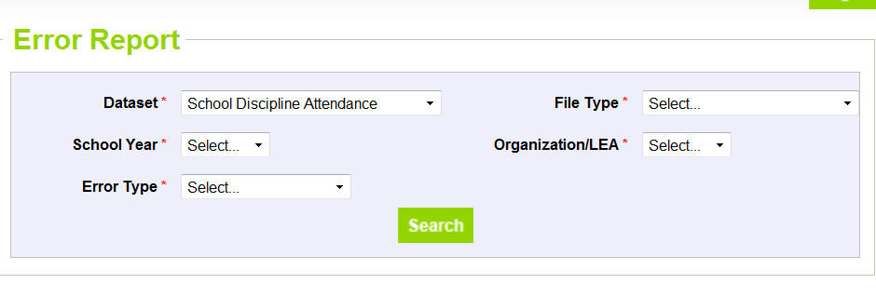
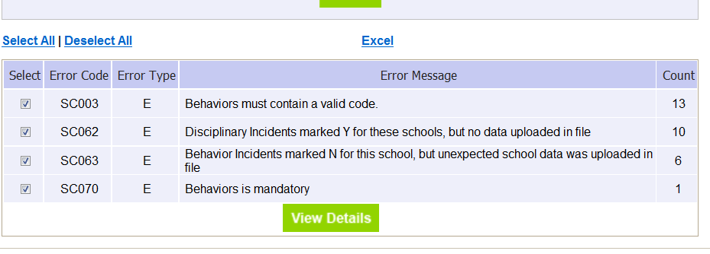
Using Data Pipeline (Errors and Warnings)
Select file type, year, LEA and Errors and Warnings – then select “Search”
Select Excel to view report

Slide 66
Correct Data
Update data in data files based on errors/warnings and re-upload files as needed.
Repeat steps until all errors in file are resolved
Repeat for all applicable files for SDA

Slide 67
Review Reports for Accuracy and Finalize

Slide 68
Review Reports

Slide 69
Discipline by Action Reports Available
Summary of Behavior by Action
  Provides the Type of Behavior (code and description)
  Provides the totals as reported for each Type of Behavior by School:
    Number of Incidents
    Classroom Removals
    In-School Suspensions
    Out-of-School Suspensions
    Expulsions
    Law Enforcement Referrals
    Other Action Taken

Slide 70
Discipline by Student Demographic Reports Available
Summary of Disciplinary Actions by Federal Race/Ethnicity
  Total of each disciplinary action reported by Federal Race/Ethnicity for each School
Summary of Disciplinary Actions by Gender
  Total of each disciplinary action reported by Gender for each School
Summary of Disciplinary Actions by Grade
  Total of each disciplinary action reported by Grade for each School
Summary of Discipline by Demographic File
  Total of each disciplinary action reported by Federal Race/Ethnicity, Gender, Grade, Special Education, 504, and ELL status for each School

Slide 71
Comparison of Incidents Report
Compares data reported in Discipline by Action and Discipline by Student Demographic files for each School
  Provides total counts of incidents as reported in the Discipline by Action file
  Provides total number of students disciplined as reported in the Discipline by Student Demographic File
Counts of Students Disciplined must be equal or greater than the Count of Incidents for each school
Report will assist with comparison business rules and validating data reported prior to finalizing

Slide 72
Firearm (GFSA) Reports Available
  Firearm (GFSA) Discipline Summary Report (NEW)
  Provides data only if Firearm file was uploaded
  Provides Firearm data by School, Grade Level and Firearm Weapon Code/Description

Slide 73
Attendance Reports Available
Attendance and Truancy Data
  Attendance and Truancy Rates by School
  Habitually Truant Student Counts by School
  Number of Students with Chronic Absenteeism by School (NEW)
  Average Daily Attendance (ADA) by School (NEW)
    Calculated by taking Total Number of Days Attended divided by Length of School Year
  Attendance by Race/Ethnicity (NEW)
  Provides same data as Attendance and Truancy Data Report; including the Race/Ethnicity and Gender of the students by School

Slide 74
Finalize Data
Attendance File is only file needed to be “Submitted to CDE”
All files must be uploaded and error free or indicated as “No” for all schools in No Reportable Incidents tab prior to finalizing
By finalizing the Attendance data file, the other 3 files are also finalized
Download sign off form will indicate which schools have data reported

Slide 75
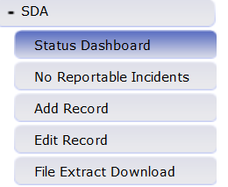
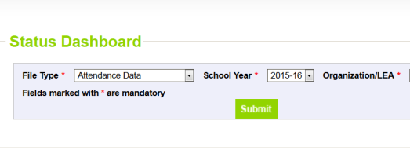
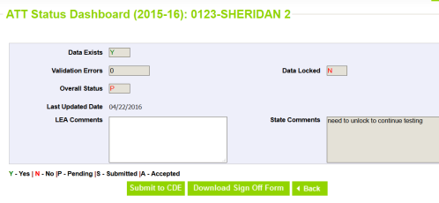
Finalize Data Steps
Only the LEAAPPROVER role can perform this step

Slide 76

Available Resources
All resources made available at: http://www.cde.state.co.us/datapipeline/schooldisciplineattendance

Slide 77
Data Pipeline Website http://www.cde.state.co.us/datapipeline
Periodic Collections -> School Discipline and Attendance
  Overview
  Deadlines
  File Layouts
  Business Rules
  Templates
  Trainings
  Additional Resources
Direct Link: http://www.cde.state.co.us/datapipeline/schooldisciplineattendance

Slide 78
Additional Resources
Calculating Attendance in Online Schools SDA Business Rule Additional Guidance
SDA Frequently Asked Questions SDA Process Document
Behavior Statutes and Clarifications
Guide for Determining Most Serious Incidents
2016-17 Summary of Updates
2017-2018 Summary of Updates
2017-2018 School Discipline and Attendance Review of Updates (PPTX)

Slide 79
Contact Information
Annette Severson
  Severson_a@cde.state.co.us
  (303) 866-6824

Slide 80
In-Depth Documentation Review:
Behavior Statutes and Clarifications
&
Guide for Determining “Most Serious” Incident

Slide 81
Behavior Codes
Code | Behavior Type
01 | Drug Violation
02 | Alcohol Violation
03 | Tobacco Violation
04 | 1st, 2nd Degree or Vehicular Assault
05 | Dangerous Weapons
06 | Robbery
07 | Other Felony
08 | Disobedience/Defiant or Repeated Interference
09 | Detrimental Behavior
10 | Destruction of School Property
12 | Other Violation of Code of Conduct
13 | 3rd Degree Assault/Disorderly Conduct
14 | Marijuana Violation
15 | Sexual Violence/Battery (other than Rape)
16 | Rape or Attempted Rape

Slide 82
Behavior Statutes and Clarifications
Drug Violations (code 01): Use, possession, or sale of a drug or controlled substance, other than marijuana, on school grounds, in a school vehicle, or at a school activity or sanctioned event.
Alcohol Violations (code 02): Use or possession of alcohol on school grounds, in a school vehicle, or at a school activity or sanctioned event.
Marijuana Violations (code 14): The unlawful use, possession, or sale of marijuana on school grounds, in a school vehicle, or at a school activity or sanctioned event.

Slide 83
Behavior Statutes and Clarifications
Tobacco Violations (code 03): Use or possession of a tobacco product on school grounds, in a school vehicle, or at a school activity or sanctioned event.
C.R.S. 18-13-121 (5) Tobacco Product; “Tobacco Product” means:
  Any product that contains nicotine or tobacco or is derived from tobacco and is intended to be ingested or inhaled by or applied to the skin of an individual; or
  Any device that can be used to deliver tobacco or nicotine to the person inhaling from the device, including an electronic cigarette, cigar, cigarillo, or pipe.

Slide 84
Behavior Statutes and Clarifications
Dangerous Weapons (code 05): Possessing a dangerous weapon on school grounds, in a school vehicle, or at a school activity or sanctioned event without the authorization of the school or the school district.
22-33-102(4) Dangerous Weapon; A firearm defined as:
  Any pellet or BB gun or other device, whether operational or not, designed to propel projectiles by spring action or compressed air;
  A fixed-blade knife with a blade that exceeds three inches in length
  A spring-loaded knife or a pocket knife with a blade exceeding three and one-half inches in length
  Any object, device, instrument, material, or substance, whether animate or inanimate, that is used or intended to be used to inflict death or serious bodily injury.

Slide 85
Behavior Statutes and Clarifications
Robbery (code 06): Commission of an act on school grounds, in a school vehicle, or at a school activity or sanctioned event that, if committed by an adult, would be considered robbery.
Clarifications: Robbery is a class four felony.
  Example: A 12-year old student approaches another student on the playground and in a very threatening manner demands the younger student’s lunch money. When the student refuses to hand over the money, the older student pushes the younger student to the ground and forcefully takes the money from his shirt pocket. This would be considered a robbery because a thing of value (the lunch money) was taken from the person (his shirt pocket) by the use of force (pushing to the ground.)

Slide 86
Behavior Statutes and Clarifications
1st, 2nd Degree or Vehicular Assault (code 04): Commission of an act on school grounds, in a school vehicle, or at a school activity or sanctioned event that, if committed by an adult, would be considered first degree assault, second degree assault, or vehicular assault.
Clarifications: In keeping with the requirements, this category includes acts considered first and second degree assault, as defined by state statutes or municipal ordinances, but does not include acts considered third degree assault. Fights and other third degree assaults in violation to the local code of conduct should be reported in the "3rd Degree Assaults/Disorderly Conduct" category.

Slide 87
Behavior Statutes and Clarifications
3rd Degree Assault/Disorderly Conduct (code 13): Commission of an act on school grounds, in a school vehicle, or at a school activity or sanctioned event that, if committed by an adult would be considered third degree assault, as described in section 18-3-204, C.R.S., or disorderly conduct, as described in section 18-9-106 (1) (d), C.R.S.

Slide 88
Behavior Statutes and Clarifications
Sexual Violence/Battery (other than Rape) (code 15): The number of acts of sexual violence on school grounds, in a school vehicle, or at a school activity or sanctioned event. “Sexual violence” means a physical sexual act perpetrated against a person’s will or where a person is incapable of giving consent.
Clarification: An incident that includes threatened rape, fondling, indecent liberties, child molestation, or sodomy. Both male and female students can be victims of sexual battery. Classification of these incidents should take into consideration the age and developmentally appropriate behavior of the offender(s).

Slide 89
Behavior Statutes and Clarifications
Rape or Attempted Rape (code 16): Incidents of rape or attempted rape on school grounds, in a school vehicle, or at a school activity or sanctioned event. Rape refers to forced sexual intercourse (vaginal, anal, or oral penetration). This includes penetration from a foreign object. Both male and female students can be victims of rape. Rape is not defined as a physical attack or fight.

Slide 90
Behavior Statutes and Clarifications
Other Felony (code 07): Commission of an act on school grounds, in a school vehicle, or at a school activity or sanctioned event that, if committed by an adult, would be considered a felony.
Clarification: Any incident for which a student is disciplined which would be considered a felony if committed by an adult, shall be reported in the "other felonies" category except those related to, and already reported under, substance abuse, assault, sexual violence/battery, rape or attempted rape, dangerous weapons or robbery.

Slide 91
Behavior Statutes and Clarifications
Disobedience/Defiant or Repeated Interference (code 08): Being willfully disobedient or openly and persistently defiant or repeatedly interfering with the schools ability to provide educational opportunities to and a safe environment for, other students.
Destruction of School Property (code 10): Willful destruction or defacement of school property.

Slide 92
Behavior Statutes and Clarifications
Detrimental Behavior (code 09): Behavior on school grounds, in a school vehicle, or at a school activity or sanctioned event that is detrimental to the welfare or safety of other students or of school personnel, including but not limited to incidents of bullying and other behavior that creates a threat of physical harm to the student or to other students.
“Bullying” means any written or verbal expression, or physical or electronic act or gesture, or a pattern thereof, that is intended to coerce, intimidate, or cause any physical, mental, or emotional harm to any student.

Slide 93
Behavior Statutes and Clarifications
Other Violations of Code of Conduct (code 12): Other violations of the code of conduct and discipline that resulted in documentation of the conduct in a student’s record.
  Include only if the student received a Suspension (classroom, in school or out of school), Expelled, or Referred to Law Enforcement in relation to this ‘Other Violation of Code of Conduct’
Reminder, the full documentation with statutes and clarifications found at: http://www.cde.state.co.us/datapipeline/sdabehaviorstatutesclarification

Slide 94
Guide for Determining “Most Serious” Incident
The Safe School Act; 22-32-109.1( 2) ( b) , C.R.S. requires …to report…. The number of conduct and discipline code violations, each of which violations shall be reported only in the most serious category that is applicable to that violation
Therefore, if a situation includes more than one violation, school officials must determine which among the violations they deem to be “most serious” for the purposes of reporting the incident only once

Slide 95
Additional Information
At times it may be difficult to conclude which among two or more serious incidents and/or behaviors within one incident should be considered the most serious of all.
Although CDE offers the following guidance for a school’s consideration, it must be understood that the discretion for determining seriousness rests with the local school and school district.
Important: The guidance applies only to when a situation includes more than one violation. Incidents considered to be only one violation will be reported as that particular violation.

Slide 96
Guidance – in general
In general; Behaviors that rise to the level of violating the criminal code are considered more serious than those that do not, and:
  crimes against persons are considered by law to be more serious than crimes against property,
  crimes classified as felonies are considered to be more serious than misdemeanors

Slide 97
Guidance – Other Felony
Incidents given its own reporting category that may be a felony are to be reported per the incident ’ s category . “Other Felonies” refer only to those felonies that don’t have their own separate category. For example, the “willful destruction or defacement of school property” may be a felony if the cost of the damage is quite high. It would be reported under the defacement -related category and not the “other felony” category.

Slide 98
Example 1
Fights and Assaults:
  According to state statues, 1st and 2nd degree assaults and vehicular assault are felonies. 3rd degree assault and disorderly conduct are misdemeanors. Disorderly conduct for SDA purposes is defined as “fights with another in a public place except in an amateur or professional contest of athletic skill”. If a fight resulted in the commission of a 1st or 2nd degree assault, then it would be reported as an assault instead of a 3rd degree assault/disorderly conduct.

Slide 99
Example 2
Dangerous Weapons:
  A dangerous weapon in and of itself should be reported as a dangerous weapon. If the weapon was used to inflict death or serious bodily injury it would be reported in the 1st and 2nd degree/vehicular assault category.

Slide 100
Example 3
Alcohol, Fights, Weapons:
  If a student scuffled with another student in the parking lot which was considered to be a fight, then pulled out a knife (measuring longer than 3”)and threatened but did not harm the other student, and was found to have a six-pack of beer in his car, the student has committed three violations. The school official would weigh the harm and potential harm caused by the student and determines the appropriate action for one or more of the violations. The potential for the knife to cause death would most likely be considered the most dangerous of the behaviors so it would be reported in the dangerous weapons category. (This may also be considered a felony menacing crime reportable as “Other Felony”.)

Slide 101
Example 4
Tobacco, Defiance:
  A student becomes confrontational with a teacher during class, frightens other students in the meantime and walks out. The student has a pack of cigarettes in his/her shirt pocket. He/she is suspended for defiance and possession of tobacco because they had been caught and warned several times before about the tobacco. The school considered the “willful disobedience and openly defiant” the more serious of the violations because it involved a person-to-person confrontation as well as involving other students by disrupting the entire class.

Slide 102
Ranking – Guidance Only
This ranking is intended as guidance only. Incidents can vary in seriousness on a case-by-case bas is that would deviate from the order listed.
    1.1st, 2nd Degree or Vehicular Assaults
    2.Rape or Attempted Rape
    3.Dangerous Weapons -Unless used to inflict death or serious bodily injury
    4.Sexual Violence/Battery (other than Rape)
    5.3rd Degree Assaults /Disorderly Conduct
    6.Robbery
    7.Other Felony (not reported in another descriptive category)
    8.Detrimental Behavior
    9.Drug Violations
    10.Marijuana Violations
    11.Alcohol Violations
    12.Destruction of School Property
    13.Disobedient/Defiant or Repeated Interference
    14.Tobacco Violations
    15.Other Violations of Code of Conduct

Slide 103

Annette Severson
Severson_a@cde.state.co.us Phone: 303-866-6824

