Slide 1
COLORADO COMPREHENSIVE QUALITY PHYSICAL EDUCATION INSTRUCTION PILOT PROGRAM
PURSUANT TO: Health and Wellness Through Comprehensive
Quality Physical Education Instruction Pilot Program (C.R.S 22-99-101)
Application Webinar
October 2019

Slide 2
Introduction
The Colorado Health and Wellness Through Comprehensive Quality Physical Education Instruction Pilot Program Legislative declaration 22-99-11 states that while ensuring cognitive development and strong academic outcomes for Colorado’s students is of paramount importance, focus must also be placed on the whole student including their physical, psychological, and social health and development.
It is important to the health and well-being of Colorado’s children and youth to ensure competent and comprehensive quality physical education instruction based in the model physical education policy.

Slide 3
Purpose
The intent of the funding is to address the barriers to implement comprehensive quality physical education instruction programs based in the model physical education policy. The purpose is to develop a pilot program and funding to schools or districts to implement model policies.

Slide 4
Definitions
The statutory definition of "comprehensive quality physical education" means the program of comprehensive quality physical education instruction described in section 22-99-103 (5) C.R.S.
Examples of comprehensive quality physical education are defined here:
  PE For All Colorado Coalition (www.peforallcolorado.org)
  CDC’s Physical Education Curriculum Analysis Tool (PECAT) (www.cdc.gov/healthyschools/pecat)

Slide 5
Grant Focus Area
Local Education Providers awarded a pilot program grant shall use the grant to implement a comprehensive quality physical education instruction program that includes, at a minimum, all of the following components:
  Thirty minutes daily or one hundred fifty minutes per week of physical education instruction for all students in kindergarten through fifth grade, not including recess time or physical activity breaks;
  Forty-five minutes daily or two hundred twenty-five minutes per week for all students in sixth through eighth grade, not including recess time or physical activity breaks;
  A class size for physical education instruction that is comparable to the class size for academic subjects;
  Safe, clean, and well-maintained indoor and outdoor spaces for physical education instruction and physical activity, and equipment and facilities that support physical education instruction;
  Curriculum that meets Colorado’s physical education standards at each covered grade level;
  Moderate to vigorous physical activity for at least half of the physical education class time;
  Regular assessment of physical education learning objectives, including formative and summative assessments and a measure for student growth;
  Student progress monitoring, including student surveys of physical activity, nutrition, sleep habits, and perceptions of physical education instruction;
  Physical education instructor and classroom teacher surveys of student outcomes or changes in student behavior attributed to the pilot program;
  A prohibition against removal of a student from the physical education program for academic reasons or as a form of punishment; and
  A prohibition against exempting students from physical education instruction; except that a parent or guardian may excuse a student from participation for a limited period of time or limited portion of the instruction for religious observances or due to religious prohibitions. A student may be excused from the physical activity component of the instruction if the student is injured or has a physical or emotional condition that prevents participation. In those circumstances, modified physical activities may be provided. In accordance with the federal "individuals with disabilities education improvement act", 42 U.S.C. sec. 1400, et. Seq., as amended, all students shall receive equal-quality physical education.

Slide 6
Grant Focus Area (continued)
In addition, Local Education Providers will be expected to:
  Have licensed educators with a physical education endorsement, or, if employed by a school that does not require teacher licensing for employment, a program of professional development that enables the physical education instructor to become proficient in teaching comprehensive quality physical education in accordance with the pilot program requirements and physical education endorsement standards;
  Implement a mandatory professional development program for instructors that includes at least fifteen hours of instruction each year, which instruction must address appropriate practices in providing comprehensive quality physical education, including emerging technologies, model physical education programs, and improvement in physical education teaching methods; and
  Each school awarded a pilot program grant and each school district awarded a pilot program grant shall prepare a three-year comprehensive quality physical education instruction action plan that includes class schedules, physical education curriculum, physical education teacher qualifications, a professional development plan, and sample physical education assessments and assessment rubrics.

Slide 7
Eligible Applicants
Local Education Providers (LEPs) are eligible to apply for this opportunity. An eligible LEP is:
  A School District;
  A School (Elementary or middle school or the elementary and middle school of a school district);
  A school operated by a Board of Cooperative Services
  Charter Schools authorized by a School District; or
  Charter Schools authorized by the Charter School Institute.
Note: Schools and charter schools may submit individual applications but the authorizer (school district or CSI) must be notified. If funded, the school’s authorizer will serve as the fiscal agent.

Slide 8
Priority Considerations
Priority Consideration: At least 30% of the grants will be awarded to eligible LEPs receiving federal money for programs under title I, Part A. Priority considerations will be given equally to rural, urban, and suburban schools, as well as elementary and middle schools.

Slide 9
Available Funds
Local Education Providers may request up to $80,000 per year of the three-year grant. Up to 15 applications may be approved for funding for the three-year grant term contingent on available funds. Funding is contingent upon approval of appropriations from the State Legislature and funding in subsequent years for grantees is contingent upon continued appropriations and upon grantees meeting all grant, fiscal and reporting requirements.

Slide 10
Allowable Use of Funds
Funding for developing and implementing local comprehensive quality physical education programs may include, but are not limited to:
  Staff salary and benefits to support comprehensive quality physical education for all students.
  Purchase of curriculum, resources, equipment, and materials, to support implementation of a comprehensive quality physical education program for all students.
  Stipends, substitute pay, salary, materials and resources needed to effectively align existing curricular resources with 2020 Physical Education Standards or curriculum mapping to identify gaps and strengths in existing curricula.
  Support professional development for physical education teachers or other staff members to support implementation of a comprehensive quality physical education program.
  Funds to travel for two, two-day meetings and other professional development opportunities.
  Purchase of technology (e.g., heart rate monitors, pedometers, classroom projector, iPad, cords, etc.) (must be approved by CDE).
Note: Funding may not be used for capital needs, and/or supplant any activities that currently support a comprehensive quality physical education program.

Slide 11
Duration of Grant
Grants will be awarded for a three-year term , with Year 1 beginning July 1, 2020, through June 30, 2021. Additional grant funding for subsequent years will be contingent upon annual appropriations by the State Legislature as well as completion of all evaluation and reporting requirements (see Evaluation and Reporting section). Year 1 funds must be expended by June 30, 2021.

Slide 12
Evaluation and Reporting
Each Education Provider that receives a Comprehensive Quality Physical Education grant is required to report, at a minimum, the following information to the Department:
  Annual mid-year progress report on work plan and objectives (January 29, 2021);
  Annual mid-year progress budget report (January 29, 2021);
  End-of-year progress report regarding work plan (June 30, 2021);
  End-of-year progress report regarding budget (June 30, 2021);
  New work plan for the following fiscal year 2020-2021 (June 30, 2021);
  New budget for the following fiscal year 2020-2021 (June 30, 2021);
  Success Story (June 30, 2021); and
  An annual financial report (AFR) (September 30, 2021).
As part of these reports each school awarded a pilot program grant and each school district awarded a pilot program grant shall prepare a three-year comprehensive quality physical education instruction action plan that includes class schedules, physical education curriculum, physical education teacher qualifications, a professional development plan, and sample physical education assessments and assessment rubrics.
See Attachment C for the Mid-Year Progress Report Questions, and Attachment D for the End-of Year Program Report Questions.

Slide 13
Evaluation and Reporting (continued)
To assess the pilot program impacts, schools and districts may be asked to include demonstration of changes in student disciplinary referrals, attendance, and academic achievement. Other objective measures of student health and well-being may be collected to demonstrate changes in levels of physical fitness, mental health, and substance use. Schools will be encouraged to use statewide tools to track changes in student behavior as well as changes in policies and practices.
An outside evaluator will be identified to support and conduct student and instructor perception survey and interviews to determine the value of the pilot program experience to students, physical education instructors and classroom instructors. The evaluators shall review formative and summative assessment data to determine the impact of the pilot program. The evaluators will work with grantees to identify and determine collection practices for necessary data.
Necessary data collected by pilot program participants must include, but not limited to, student demographics, measures of student poverty, and English Language Learners Status. The program evaluator, school, or district will not release any identifying information and shall comply with state and federal law related to student data privacy.

Slide 14
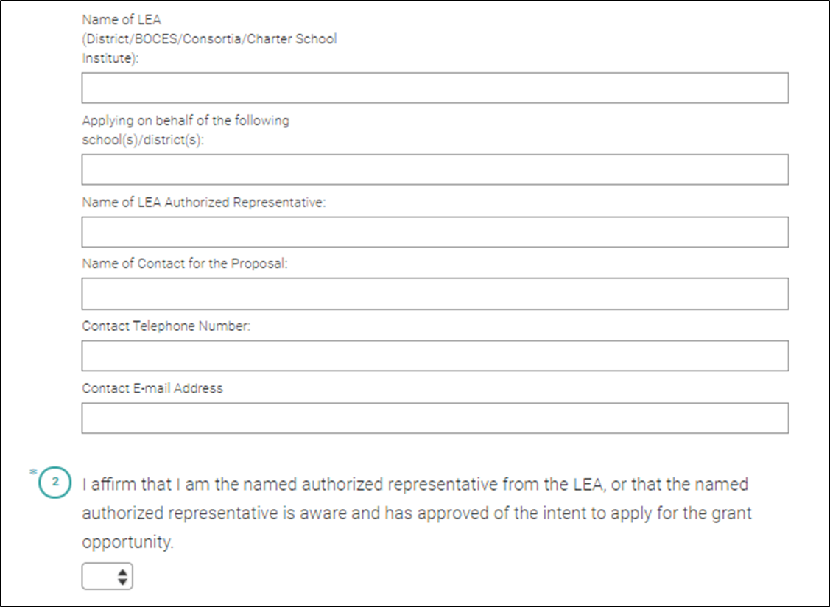
Intent to Apply
The Letter of Intent to apply
for the Comprehensive
Quality Physical Education
Pilot is due Friday, October 25, 2019 at 11:59 pm
This is an optional portion of
the application process and
will not be used in the review
or scoring. Please submit
online via SurveyMonkey at
https://www.surveymonkey.com/r/cqpepilot_loi

Slide 15
Review Process and Timeline
Applications will be reviewed by CDE staff and peer reviewers to ensure they contain all required components. Applicants will be notified of final award status no later than Friday, February 28, 2020.
Note: This is a competitive process – applicants must score at least 80 points out of the 113 possible points to be approved for funding.
  Applications that score below 80 points may be asked to submit revisions that would bring the application up to a fundable level.
  There is no guarantee that submitting an application will result in funding or funding at the requested level.
  All award decisions are final.
  Applicants that do not meet the qualifications may reapply for future grant opportunities.

Slide 16
Submission Process and Deadline
An electronic copy of the application (in PDF format) and electronic budget (in Excel format) must be submitted to CompetitiveGrants@cde.state.co.us by Sunday, December 1, 2019, by 11:59 pm.
  The electronic version should include all required components of the application as one document.
  Please attach the electronic budget workbook in Excel format as a separate document.
  Faxes will not be accepted.
  Incomplete or late applications will not be considered.

Slide 17
Application Format
The total narrative (Sections A-B) of the application cannot exceed 10 pages. Please see below for the required elements of the application.
  Note: Applications that exceed 10 pages will not be reviewed.
Section C: Project Objectives and Work Plan (Attachment A) of the narrative does not have a page limit.
All pages must be standard letter size, 8-1/2” x 11”, using 12-point font, and single-spaced with 1-inch margins and numbered pages.
The signature page must include original signatures of the lead organization/fiscal agent.

Slide 18
Required Application Elements
The format outlined below must be followed in order to assure consistent application of the evaluation criteria. See evaluation rubric for specific selection criteria needed in Part II.
  Part I: Application Introduction
    Part IA: Cover Page - Applicant Information
    Part IB: Recipient Schools Information
    Part IC: Program Assurances Form
  Part II: Narrative
    Section A: Needs Assessment and Plan for Addressing Gaps
    Section B: Additional Narrative for Districts and BOCES
    Section C: Project Objectives and Work Plan (includes Attachment A)
    Section D: Commitment Letter of Support
    Section E: Budget Narrative and Electronic Budget (Excel Document)

Slide 19
Application Scoring and Evaluation Rubric

Slide 20
Application Scoring
Part I: Application Introduction (No Points)
  Cover Pages and Assurances
  Complete applicant information and program assurances and include as the first pages of the application.
Part II: Narrative (113 Points)
  The following criteria will be used by reviewers to evaluate the application as a whole. In order for the application to be recommended for funding, it must receive at least 80 points out of the 113 possible points and all required elements must be addressed. An application that receives a score of zero on any required elements will not be funded.

Slide 21
Scoring Definitions
The following criteria will be used by reviewers to evaluate the application as a whole:
  Scoring Definitions
    Minimally Addressed or Does Not Meet Criteria - Information not provided
    Met Some but Not All Identified Criteria - Requires additional clarification or development
    Addressed Criteria but Did Not Provide Thorough Detail - Adequate response, but not thoroughly developed or high-quality response
    Met All Criteria with High Quality - Clear, concise, and well thought out response

Slide 22
Section A: Needs Assessment and Plan for Addressing Gaps
Section A: Needs Assessment and Plan for Addressing Gaps | Minimally Addressed or Does Not Meet Criteria (information not provided) | Met Some but Not All Identified Criteria (requires additional clarification) | Addressed Criteria but Did Not Provide Thorough Detail (adequate response, but not thoroughly developed or high-quality response) | Met All Criteria with High Quality (clear, concise, and well thought out response) | Total
1) Describe your school’s demographics, and the communities that it serves (e.g., Free and Reduced Lunch Rates, Race and Ethnicity, Healthy Kids Colorado behavioral data, obesity, or BMI rates). | 0 | 2 | 4 | 6
2) Provide a specific and comprehensive description of your current physical education program. Describe the current extent that you are addressing the core components and grant focus areas (see page 3 in the application) based on Senate Bill 19-246, Section 22-19-103 (5a) Note: This is not scored based on the extent that these practices are in place only that they are thoroughly described. | 0 | 2 | 4 | 6
3) Provide a full and clear description of gaps and barriers to the development and implementation of comprehensive quality physical education program. | 0 | 2 | 4 | 6
4) Thoroughly describe your current infrastructure and readiness to support implementation of Comprehensive Quality Physical Education (e.g., staffing, facilities, administrative support, equipment, scheduling, support of school staff etc..) | 0 | 3 | 6 | 9
5) Briefly describe your approach to addressing the barriers and gaps that you have identified. | 0 | 2 | 4 | 6
Reviewer Comments:
Total |  |  |  |  | /33

Slide 23
Section B: Additional Narrative for Districts and BOCES (Not Scored)
Section B: Additional Narrative for Districts and BOCES (Not Scored)
1) If you are applying as a district or BOCES: describe how you will identify specific schools that will be implementing the grant requirements.
Reviewer Comments:

Slide 24
Section C: Project Objectives and Work Plan
Work plan(s) (Attachment A) is not included in the 10-page limit.
Section C: Project Objectives and Work Plan Work plan(s) (Attachment A) is not included in the 10-page limit. | Minimally Addressed or Does Not Meet Criteria (information not provided) | Met Some but Not All Identified Criteria (requires additional clarification) | Addressed Criteria but Did Not Provide Thorough Detail (adequate response, but not thoroughly developed or high-quality response) | Met All Criteria with High Quality (clear, concise, and well thought out response) | Total | Total
1) Based on the responses in Section A: NEEDS ASSESSMENT, identify the goals (SMART Objectives*) of the eligible school or school district that align with the components of a comprehensive quality physical education instruction program. | 0 | 2 | 4 | 6
2) Provide a preliminary three-year comprehensive quality physical education instruction action plan for the eligible school or school district. Refer to grant focus areas (see page 3 in application) based on SENATE BILL 19-246, Section 22-19-103 (6) for a list of components that are required, as a minimum, to be included in the action plan. To receive full points, applicants must include the following in their response: The following items must be included in the action plan: Complete a work plan using Attachment A template. Align activities with the identified goals (SMART Objectives*) to build a comprehensive quality physical education instruction program. Identify benchmarks on how the eligible school or school district will meet the identified activity. *SMART Objectives are: Specific: Concrete, detailed, and well defined so that you know where you are going and what to expect when you arrive Measureable: Numbers and quantities provide means of measurement and comparison Achievable: feasible and easy to put into action Realistic: Considers constraints such as resources, personnel, cost, and time frame Time-Bound: A time frame helps to set boundaries around the objective www.cdc.gov/phcommunities/‌‌resourcekit/ evaluate/smart_objectives.html | 0 | 5 | 10 | 15
3) Provide an expected timeline, including intermediate milestones, to implement the three-year comprehensive quality physical education instruction action plan. The timeline and responsibilities are clear, sequential, and aligned with activities and benchmarks. | 0 | 2 | 4 | 6
Reviewer Comments:
Total |  |  |  |  | /27

Slide 25
Attachment A

Slide 26
Section D: Commitment Letter of Support
(Not Included in 10-page limit)
Section D: Commitment Letter of Support (Not Included in 10-page limit) | Minimally Addressed or Does Not Meet Criteria (information not provided) | Met Some but Not All Identified Criteria (requires additional clarification) | Addressed Criteria but Did Not Provide Thorough Detail (adequate response, but not thoroughly developed or high-quality response) | Met All Criteria with High Quality (clear, concise, and well thought out response) | Total
1) The eligible school or school district administrator must provide a letter of commitment to support the implementation of a comprehensive quality physical education instruction action plan. Information regarding the infrastructure to support the implementation of the grant should be included in the letter. | 0 | 5 | 10 | 15
2) Briefly describe parent and community support for the grant and share how you see them being involved. | 0 | 2 | 4 | 6
Reviewer Comments:
Total |  |  |  |  | 33/21

Slide 27
Section E: Budget Narrative and Electronic Budget
Section E: Budget Narrative and Electronic Budget | Minimally Addressed or Does Not Meet Criteria (information not provided) | Met Some but Not All Identified Criteria (requires additional clarification) | Addressed Criteria but Did Not Provide Thorough Detail (adequate response, but not thoroughly developed or high-quality response) | Met All Criteria with High Quality (clear, concise, and well thought out response) | Total | Total
Submit an electronic budget/budget narrative, in compliance with CDE’s standard fiscal rules. The budget/budget narrative spreadsheet is not included in the 10-page limit, but must address the following criteria.
Electronic Budget (Budget Spreadsheet - Excel File) 1) Complete and attach the Budget Spreadsheet (Excel file) to the application. List costs of the proposed project as presented that are reasonable, necessary, and clearly aligned to the project activities provided in the Program Description in Section C. All costs are calculated to show how amounts are determined. The budget should be sufficient in relation to the objectives, design, scope, and sustainability of project activities. Demonstrate appropriate in-kind contributions directly related to components of a quality physical education program. | 0 | 4 | 8 | 12
Budget Narrative (Within Budget Spreadsheet - Excel File) 2) Provide an explanation that addresses the following criteria: Provide an explanation that summarizes the proposed uses of grant funds by budget category and is tied to the project description, work plan and budget. Costs are clearly explained and justified in narrative form. Costs should be clearly aligned to the plan provided in Section C. Include the cost of the instructional and student support program that the applicant plans to implement using the grant funds. Item Explanation: Cost: .X FTE for [role or title] at $xxxxx per [hour or month or year] times [x per hours or months or year] Explanation: Staff support of implementation of standards PK-12. Cost: Sub pay for X participants @ = $ZZZ.ZZ Explanation: Training for X middle school, Y Elementary School teachers on W 2020 standards and district resources. | 0 | 5 | 10 | 15
3) Costs are reasonable and sufficient in relation to the measurable objectives, design, scope, sustainability, and duration of project activities. Use of funds are connected to grant goals and activities and supplement and not supplant current activities in a Comprehensive Quality Physical Education Program. To receive maximum points, the budget and budget narrative should provide justification for activities referenced in Sections A-C. | 0 | 1 | 3 | 5
Reviewer Comments:
Total |  |  |  |  | /32

Slide 28
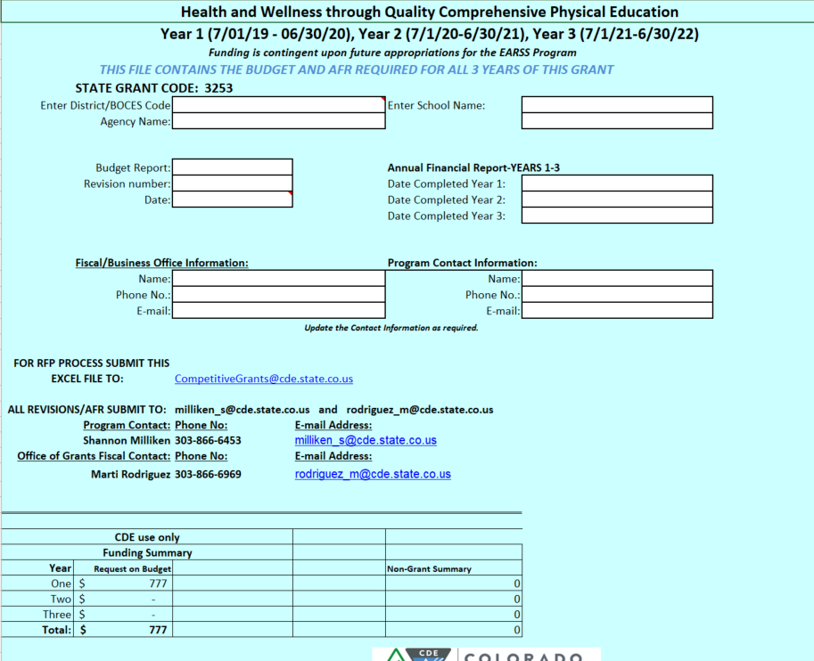
Section E. Budget

Slide 29
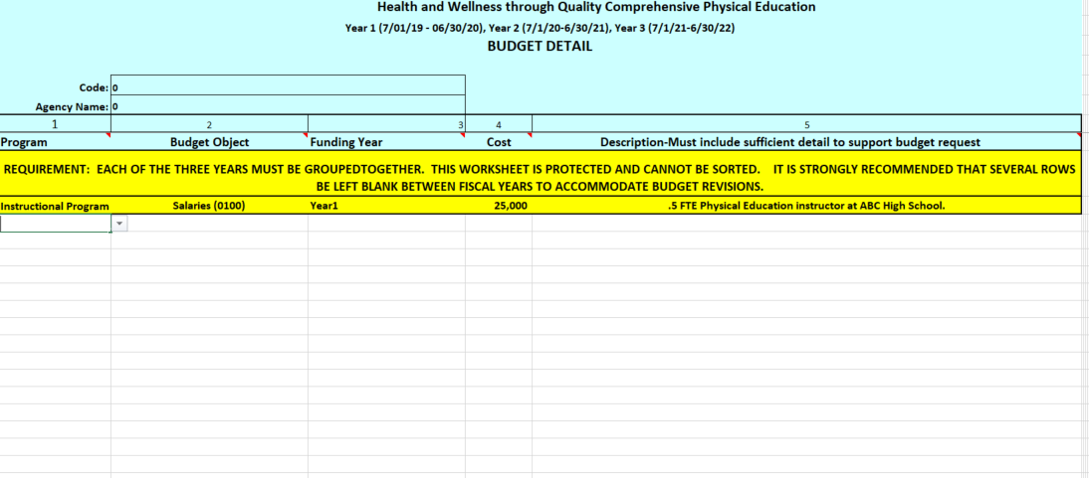
Section E. Budget
Complete the first four columns be sure to indicate the Program (Instructional or Support Program), the budget category, the year and the requested budget amount. Leave blank rows between years for revisions.

Slide 30
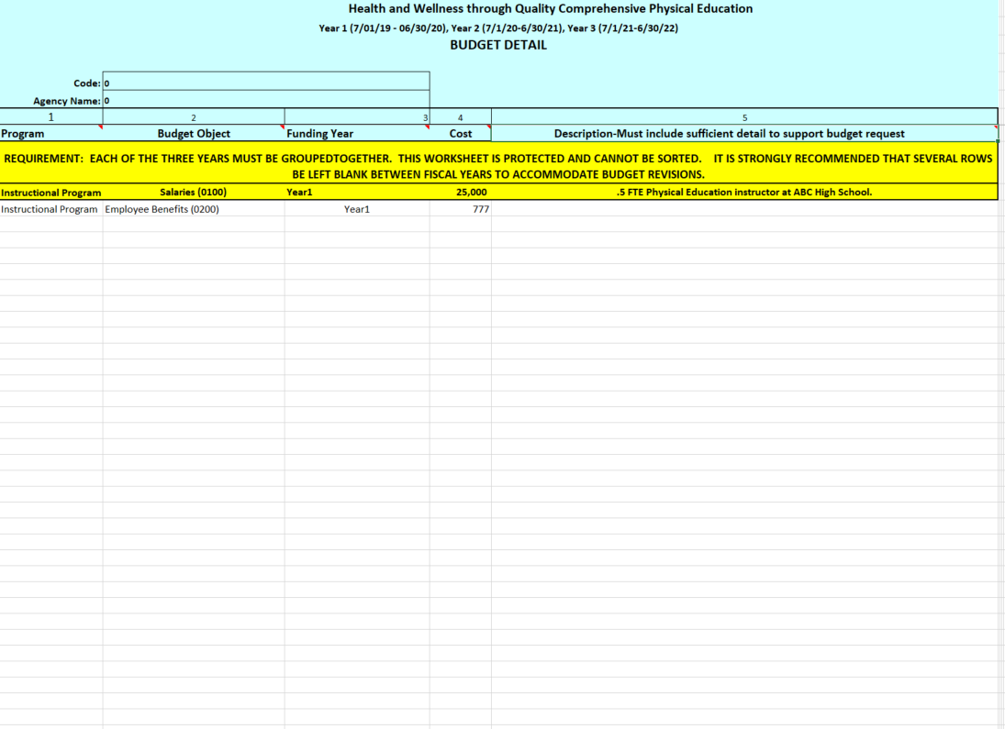
Section E. Budget Narrative (Found in the Excel)
Complete the budget narrative in the last column of the sheet.

Slide 31
Questions

Slide 32
For More Information
Program Questions:
Shannon Milliken, Health and Wellness Unit
303-866-6453| Milliken_S@cde.state.co.us
Budget/Fiscal Questions:
Marti Rodriguez, Office of Grants Fiscal
303-866-6769 | Rodriguez_M@cde.state.co.us
Application Questions:
Mandy Christensen, Competitive Grants and Awards
303-866-6250 | Christensen_A@cde.state.co.us

