Slide 1
READ Act Teacher Training Office Hours
Thursday, May 12, 2022
Notes:
Include timeline information & information about submitting to COOL

Slide 2
Introductions
Anji Gallanos
Director, Preschool through 3rd Grade Office
Whitney Hutton
Literacy Business Analyst, Preschool through 3rd Grade Office
READ Act Teacher Training Updates Office Hours
Scheduled Dates and Times
November 16, 2021: 3-4PM
December 9, 2021: 3-4PM
January 20, 2022: 3-4 PM
February 17, 2022: 3-4PM
March 17, 2022: 3-4PM
April 14, 2022: 3-4PM
May 12, 2022: 3-4PM
Notes:
Speaker Notes:

Slide 3
Webinar Logistics Q&A During the Webinar
Organized by topic
As we complete discussion of each topic, there will be designated time for participants to enter questions in the Q&A feature that are related to that specific topics.
Some questions will be answered during the webinar and others will be captured for further consideration.
Additionally:
For general questions about the CDE-Provided Teacher Training options email: ReadActTraining@cde.state.co.us
For all other questions related to the READ Act email: ReadAct@cde.state.co.us

Slide 4
Session Objectives:
Share information on district reporting requirements
Notes:
Image:
Image from: http://www.picpedia.org/highway-signs/a/agenda.html

Slide 5
Colorado READ Act K-3 Teacher Training Deadlines
By the beginning of the 2022-23 school year, each district that receives READ funding must ensure that K–3 teachers complete evidence-based training in teaching reading and pass an end of course assessment.
Deadlines for K-3rd grade teachers hired on or before June 1, 2022:
August 1, 2022: Evidence-based training in teaching reading must be completed
August 15, 2022: Documentation should be submitted to the Colorado Online Licensing (COOL) system
K-3rd grade teachers hired after June 1, 2022, will need to register for a training as soon as they receive their district email address and have it completed soon after.
Teachers must be prepared to show evidence that they are enrolled and progressing in a CDE approved training.
Notes:
All K-3rd grade teachers, as defined by the READ Act and Rule, hired on or before June 1, 2022, must have completed and have evidence of completing the evidence-based training in teaching reading as required by the READ Act.
Teachers should have documentation of meeting the READ Act Teacher training requirement submitted to the Colorado Online Licensing system (COOL) no later than Aug. 15, 2022
All K-3rd grade teachers hired after June 1, 2022, that have not met the READ Act teacher training requirement, will need to register for a training as soon as they receive their district email address and have it completed soon after.
These teachers must be prepared to show evidence that they are enrolled and progressing in a CDE approved training.
It is important to note that this requirement is not required for license renewal; however, it is a requirement for all K-3rd grade teachers as defined by the READ Act and Rule.

Slide 6
District Teacher Training Reporting Submitting Teacher Training Completion in Data Pipeline

Slide 7
District Teacher Training Reporting Timeline
District Teacher Training Completion reporting window opens August 1, 2022 and closes August 31, 2022.
Timeline:
March – July 2022: Districts continue to encourage teachers to submit documentation to the Colorado Online Licensing (COOL) system
August 1, 2022: Evidence-based training in teaching reading must be completed by teachers & district reporting window opens
August 15, 2022: Documentation must be submitted to the COOL system by teachers
August 31, 2022: District must have error free and locked Teacher Training Completion data file in the Status Dashboard

Slide 8
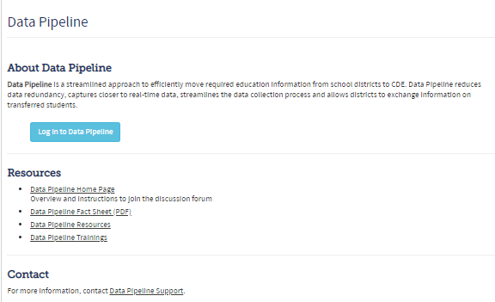
District Teacher Training Reporting Data Pipeline
Data Pipeline is a streamlined approach to efficiently move required education information from school districts to CDE

Slide 9
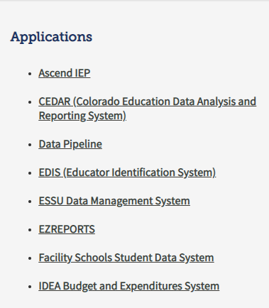
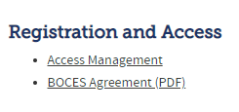
District Teacher Training Reporting Identity Management System
Identity Management System - Before logging into Data Pipeline, data respondent will request the REDLEAAPPROVER role in the IdM System from their Local Access Manager (LAM)
LAMs can view the IdM FAQ website for additional information on how to administer user accounts
Please contact the CDE Identity Manager for any questions related to Idm: CDEIdM@cde.state.co.us
Access Management - https://www.cde.state.co.us/idm

Slide 10
District Teacher Training Reporting Data Elements
The Teacher Training Completion data file will include the following data elements. * indicates required
Teacher Demographic Data*: District and school code, EDID, first name, last name, gender, DOB and primary K-3 grade level
Teacher Training Status Code*: Which training option the individual teacher completed Districts are not required to report the individual pathway of completion. Instead, districts are required to indicate if the training was completed and where evidence of completion was submitted.
Teacher Training Not Complete Narrative: Only required if teacher has not completed the training. District will provide a narrative explanation for why the teacher has not completed the required training (250-character limit). Narrative explanation will be reviewed by CDE.
K-3rd grade teachers hired after June 1, 2022, are not required to complete the training by August 1, 2022

Slide 11
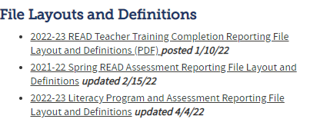
District Teacher Training Reporting Data Collection Website
READ Data Collection Website –
http://www.cde.state.co.us/coloradoliteracy/readdatapipeline

Slide 12
District Teacher Training Reporting Data Elements
READ Teacher Training Reporting File Layout & Definitions Doc –
http://www.cde.state.co.us/coloradoliteracy/202223teacher-trainingfilelayoutanddefinitions
Please be aware that when code 13 is used, a narrative explanation is required and will not be reviewed by CDE until after the close of the collection which could delay funding

Slide 13
District Teacher Training Reporting READ Training Export Report
READ Training Export Report Will:
Provide data respondents a starting point for the collection will provide an alternative source of READ Act designation data in a way that is familiar to LEA data respondents
Pull the latest available READ designation data from COOL and the latest available HR Snapshot data (21-22) and Special Education December Count at report runtime
Include teachers assigned to grades K-3 and other educators identified in roles (via Job Classifications) likely to be involved with teaching reading
READ Training Export Report Will Not:
Be an extensive list of teachers required to complete the training. Data respondents will need to modify the list to exclude teachers who are no longer employed by the district and/or add teachers that are not on the list before uploading into Data Pipeline

Slide 14
District Teacher Training Reporting READ Training Export Elements
Data Fields and Sources
Data Element | Source
District Code School Code School Name EDID Staff First Name Staff Last Name Staff Gender Staff Date of Birth Staff Primary K-3 Grade Level Subject Area Code Job Code | HR Snapshot/Special Education December Count
READ Training Status Pathway Code Pathway Description READ Training Completion Date | COOL/Licensure Data
Subject Area Description Job Description | Data Pipeline

Slide 15
District Teacher Training Reporting READ Training Export Report
Step 1
Step 2
Run this report for the current school year (2021-22) and download into Excel
Step 3
Districts can use this data to determine who has completed the training and has their designation in COOL and who does not. You can also use this as your file template that you will load into Data Pipeline
Step 4
If using as file template, remove columns M-S before loading into Data Pipeline
In Data Pipeline, click on Cognos then “Pipeline Reports” and select the “READ Training Extract” report

Slide 16
District Teacher Training Reporting COOL Reports
Districts will be able to access reports from the Colorado Online Licensing system (COOL) that include information on which staff members have met the READ Act teacher training requirements.
Instructions for Pulling Reports in COOL
The READ Act report:
Based on the 2020 HR collection at this time and includes the names of any educator in the district that has obtained the READ Act teacher training designation.
This report has not been updated with 21-22 HR data yet
Individual educator search in COOL
Districts can do an individual educator search in COOL.
Individual educator reports show whether the educator has or has not obtained the READ Act teacher training designation.
This report does not include a designation code, or the pathway selected by the teacher to meet the READ Act teacher training requirement.

Slide 17
District Teacher Training Reporting District Reporting Collection
Non-Licensed Teachers:
Non-licensed teachers are required to complete the training
Teachers without a license will need to complete this Google form to receive more information on how to submit documentation directly to CDE via Secure Transfer
After the Google form is submitted, non-licensed teacher will receive an email at the email provided in the form with instructions on how to:
Provide required information (teacher demographic data)
Attach evidence of completion
First batch of emails will be sent next week and weekly after that
Finally, CDE will combine the data submitted by non-licensed teachers to the data in Data Pipeline to build the complete set of teachers that will be used to drive compliance reports
Licensed Teachers without COOL designation:
District required to submit evidence of completion and demographic info via Secure Transfer directly to CDE for review, which could delay funding

Slide 18
District Teacher Training Reporting Evidence of Training Completion
Please continue to encourage teachers to submit their documentation of meeting the READ Act teacher training requirement to COOL.
Teacher Benefits:
Through COOL, teachers are able to submit documentation, and the system enables the documentation and designation to remain with the teacher's license
District Benefits:
Most efficient way to complete reporting
District leaders will be able to easily check the status of teacher completion and create a report for that can be used for Data Pipeline reporting.
If a teacher does not submit evidence of completion through COOL, then the district will be required to submit evidence of completion on the teacher's behalf directly to CDE through a Secure Transfer process.

Slide 19
Questions

Slide 20
Helpful Links
READ Act Main Page:
http://www.cde.state.co.us/coloradoliteracy
READ Act Designation Pathway Options:
http://www.cde.state.co.us/coloradoliteracy/teacher-training
Submitting Documentation for READ Act Designation:
http://www.cde.state.co.us/coloradoliteracy/readactdesignation
CDE Approved Professional Development:
http://www.cde.state.co.us/coloradoliteracy/option-advisorylistofpd
Webinar/Office Hours Information:
https://www.cde.state.co.us/coloradoliteracy/readactdesignation
READ Act Statute and State Board Rules:
http://www.cde.state.co.us/coloradoliteracy/readactstatuteandstateboardrules

