Slide 1



Using
STAR Early Learning
for the READ Act
R57921

Slide 2
Agenda
STAR Early Learning
STAR Early Literacy
  New default benchmarks
  Transitioning to STAR Reading
STAR Early Literacy Diagnostic Report
  Skills profile—case study (fall, winter, spring)
  Understanding skill set scores
Resources

Slide 3


STAR Early Learning

Slide 4

STAR Early Literacy Benchmarks
New default benchmarks for STAR Early Literacy

Slide 5
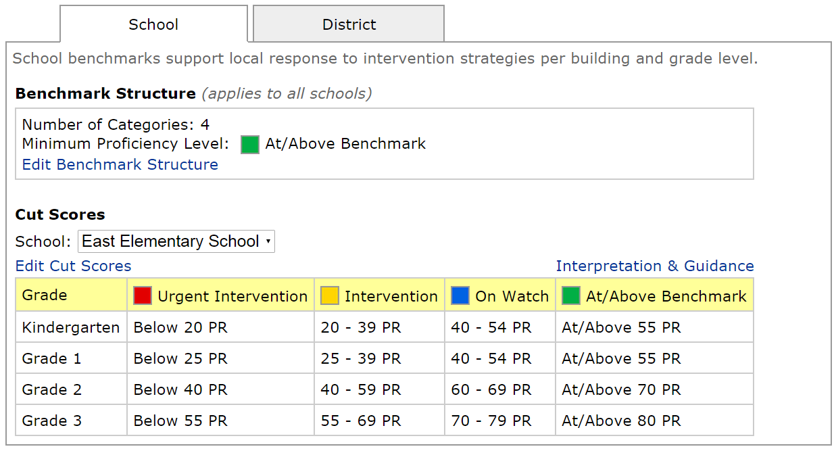
Default benchmarks in the software

Slide 6

Benefits of new benchmarks
Mirror state trends toward higher standards for academic achievement
More accurate identification of students needing intervention
More accurate insight about struggling readers

Slide 7
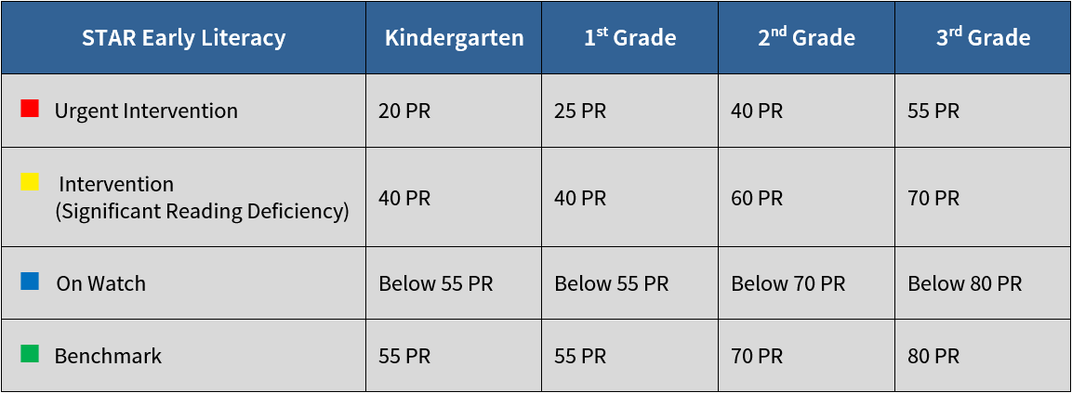
STAR Early Literacy Benchmarks

Slide 8
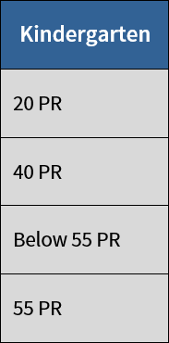
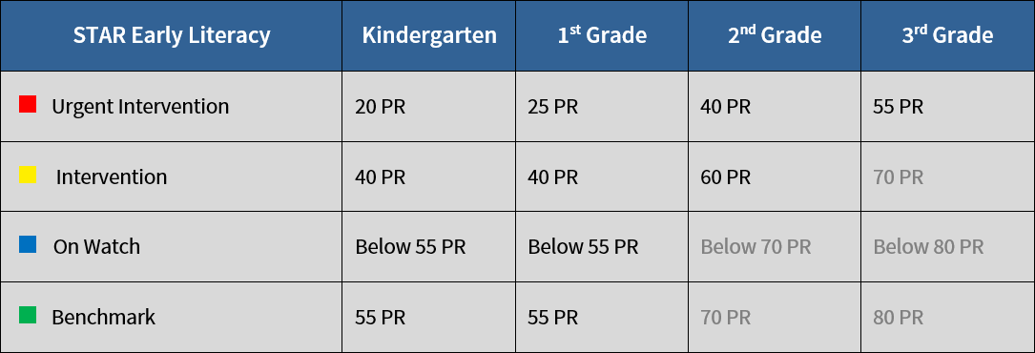


Kindergarten
Fall: 55 PR = 530 SS
Kindergarten Literacy Readiness Indicator

Slide 9
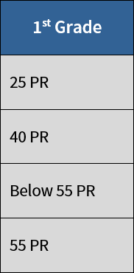
1st Grade

Slide 10
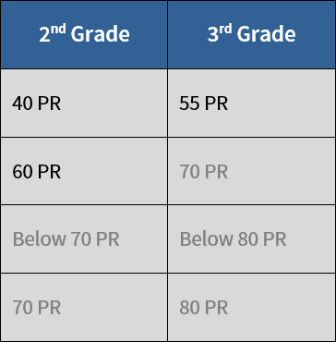
2nd and 3rd Grade

Slide 11

57 PR
Current Default Benchmarks
Intervention
Previous Benchmarks
Above Benchmark
2nd Grade

Slide 12
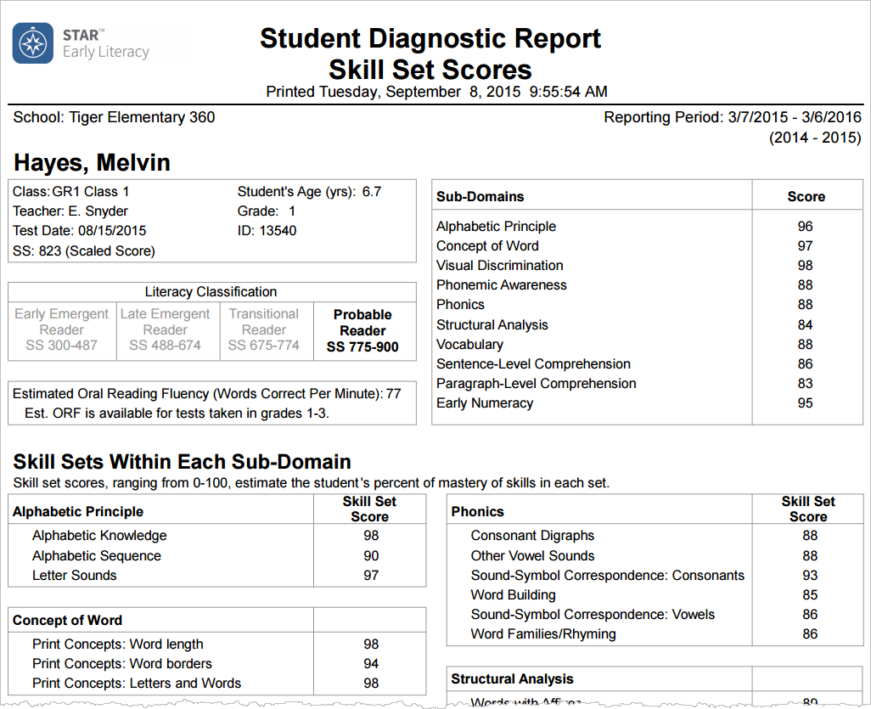
When to transition to STAR Reading
775 SS
Probable Reader
775 SS
Probable Reader

Slide 13
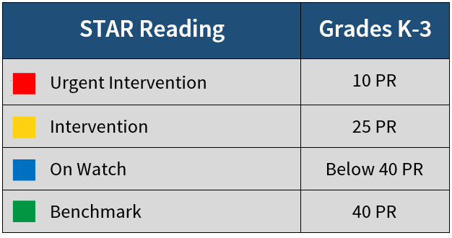

Slide 14
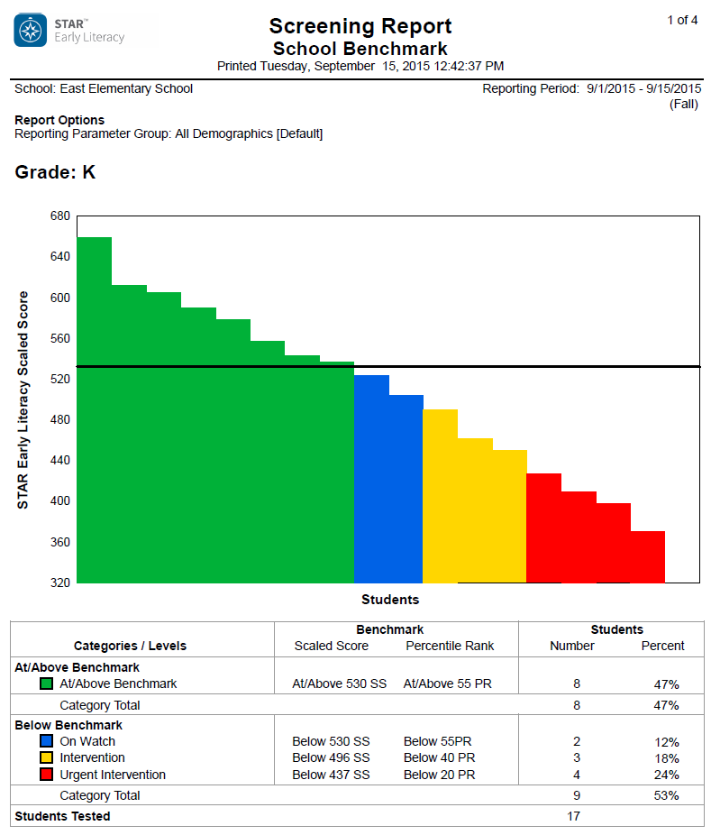
Meeting student needs
Identify available resources
  What kind of support can we provide with the resources we have?
Create transition plan
  What additional resources do we need in order to meet the needs of our students?

Slide 15

STAR Early Literacy Diagnostic Report

Slide 16

How do you make meaning of the scaled score?

Slide 17
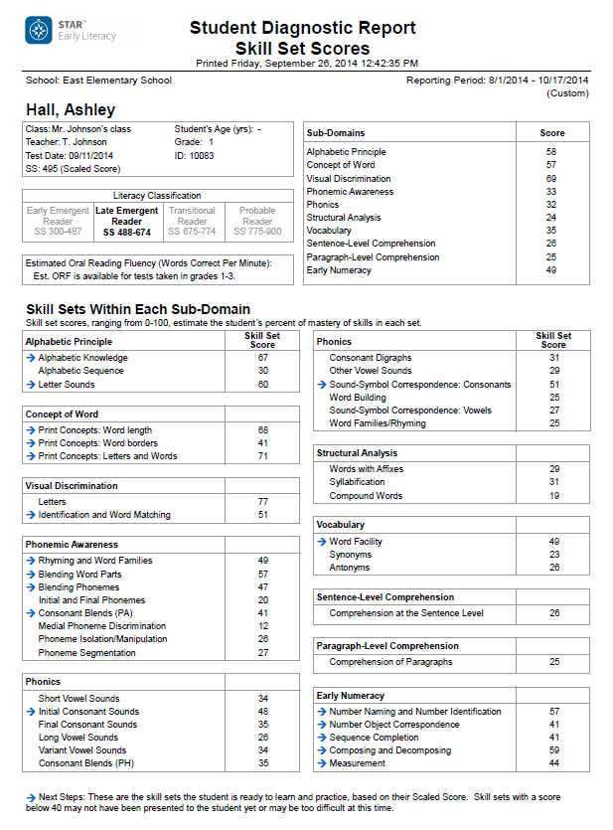


Slide 18
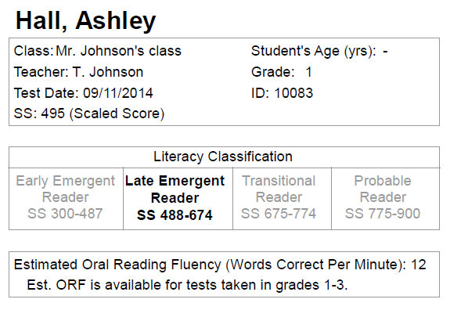
First Grade—Fall
525
525 SS

Slide 19
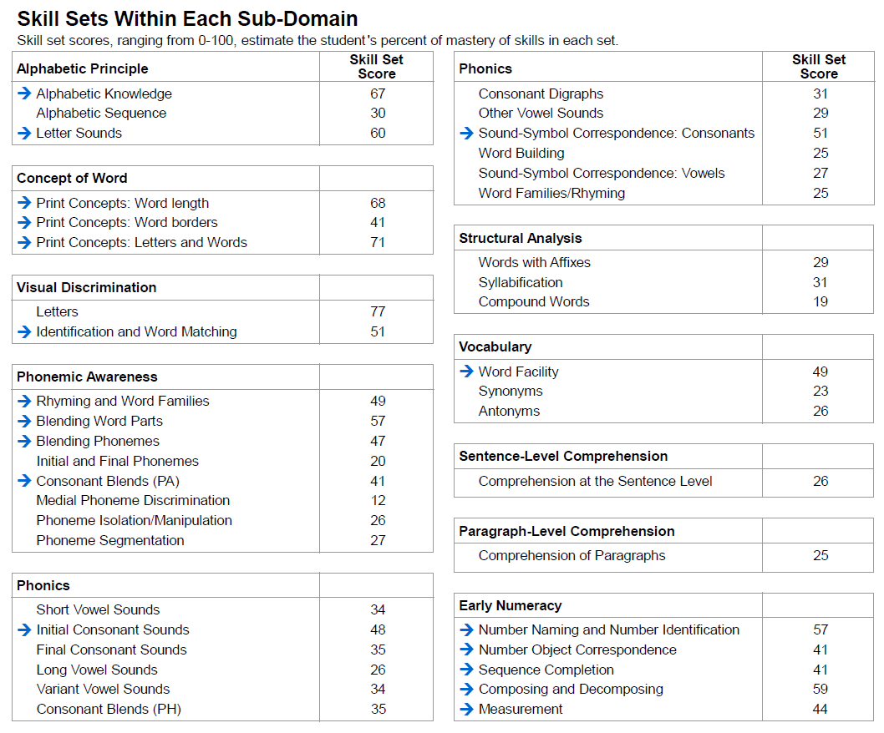

Slide 20
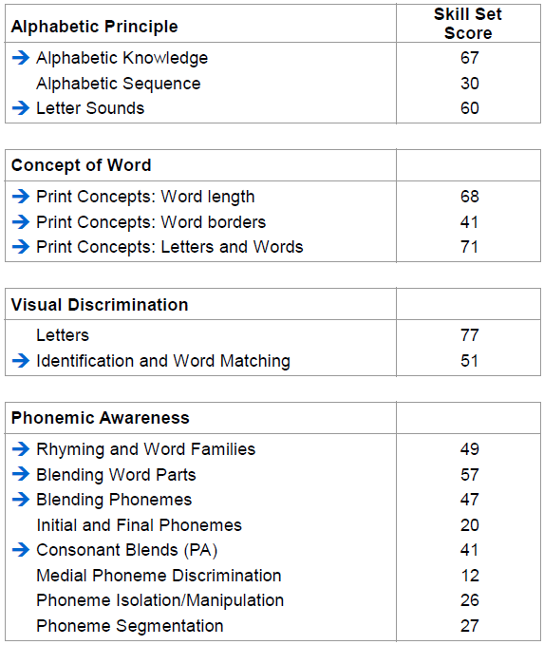
First Grade—Fall
Below 40—Frustration
40 – 55—Intervention
56 – 75—Instruction
Above 75—Mastery

Slide 21
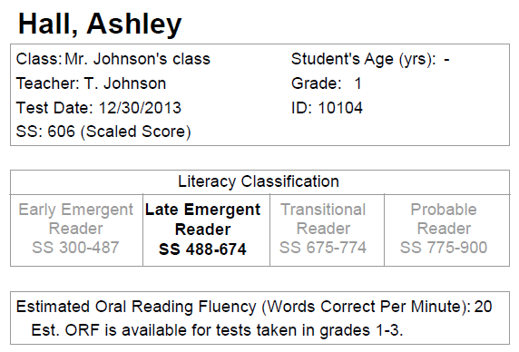
First Grade—Winter
634
Fall
634 SS

Slide 22
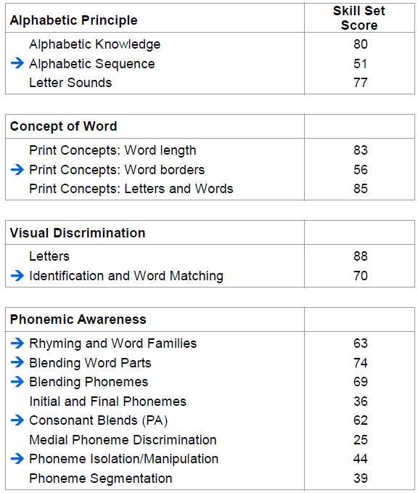
Fall
Winter

Slide 23
First Grade—Winter
Below 40—Frustration
40 – 55—Intervention
56 – 75—Instruction
Above 75—Mastery

Slide 24
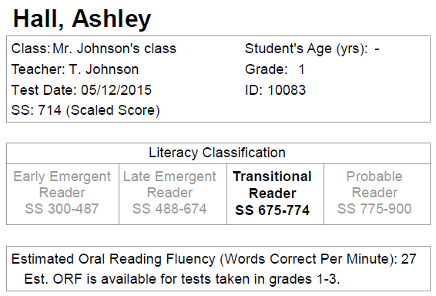
First Grade—Spring
737
Fall
Winter
737 SS

Slide 25
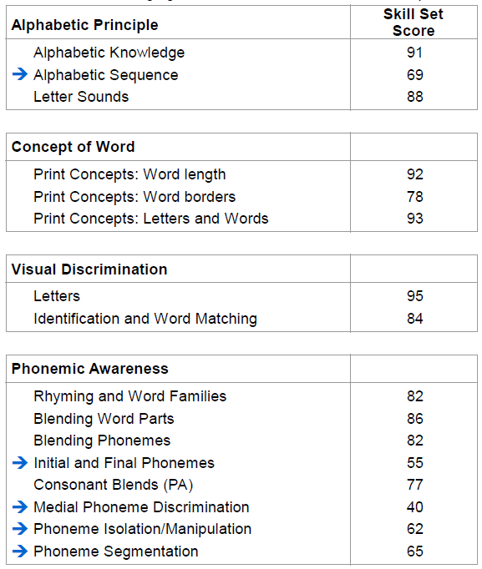
First Grade—Spring
Below 40—Frustration
40 – 55—Intervention
56 – 75—Instruction
Above 75—Mastery

Slide 26
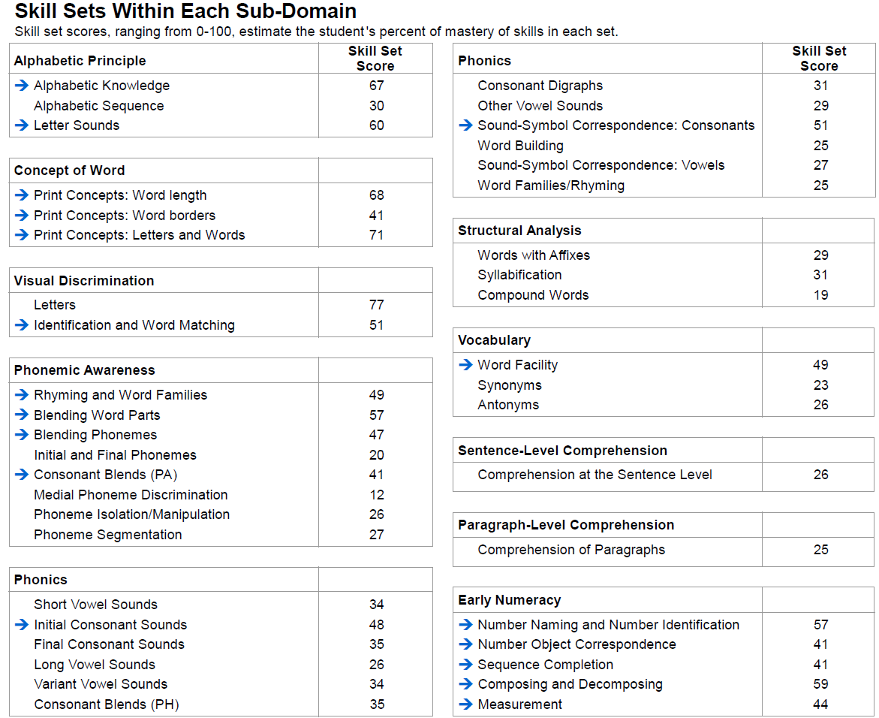
Fall

Slide 27
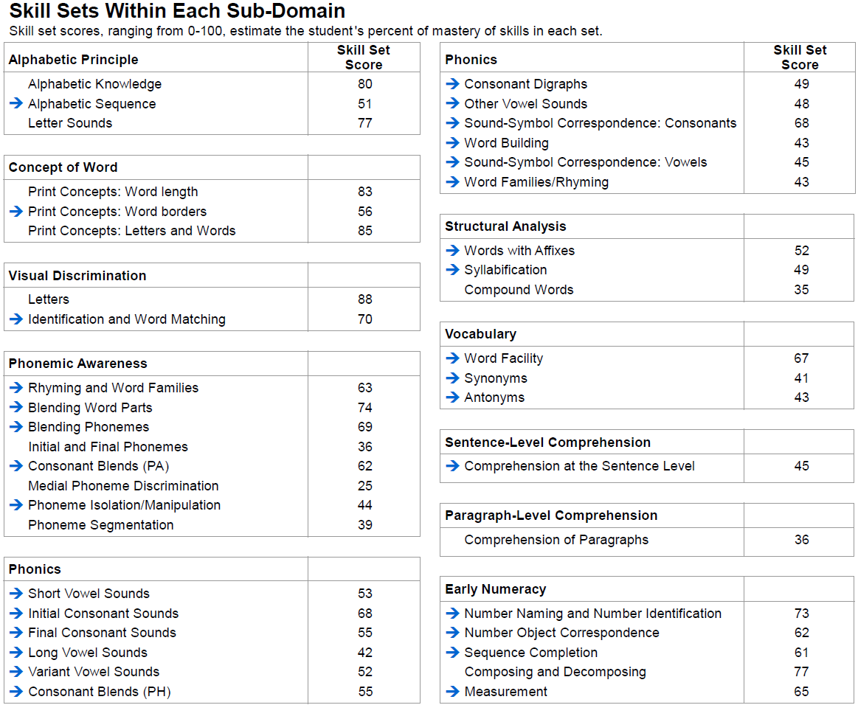
Winter

Slide 28
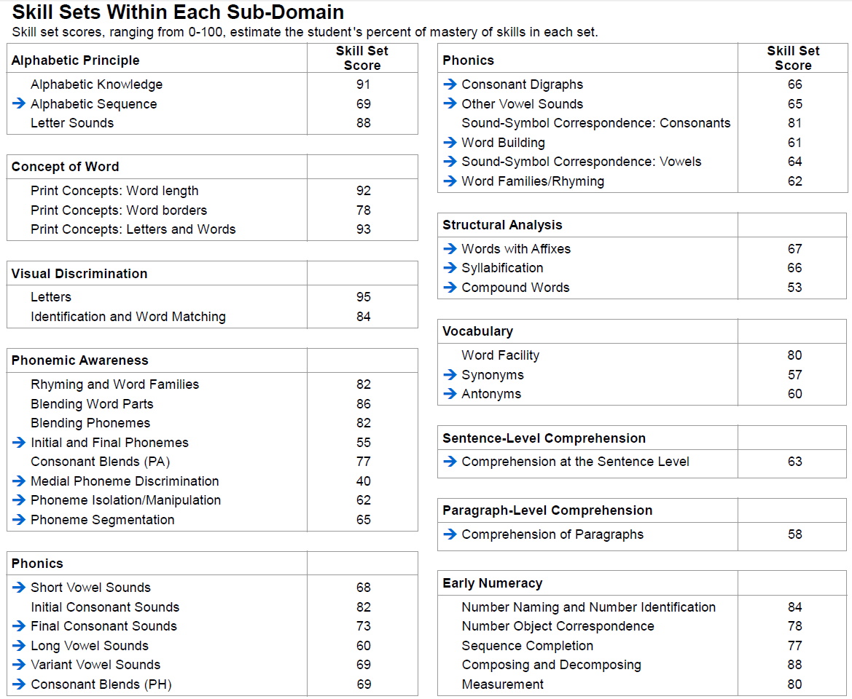
Spring

Slide 29

Get set up for success
Envision the future
Resources

Slide 30
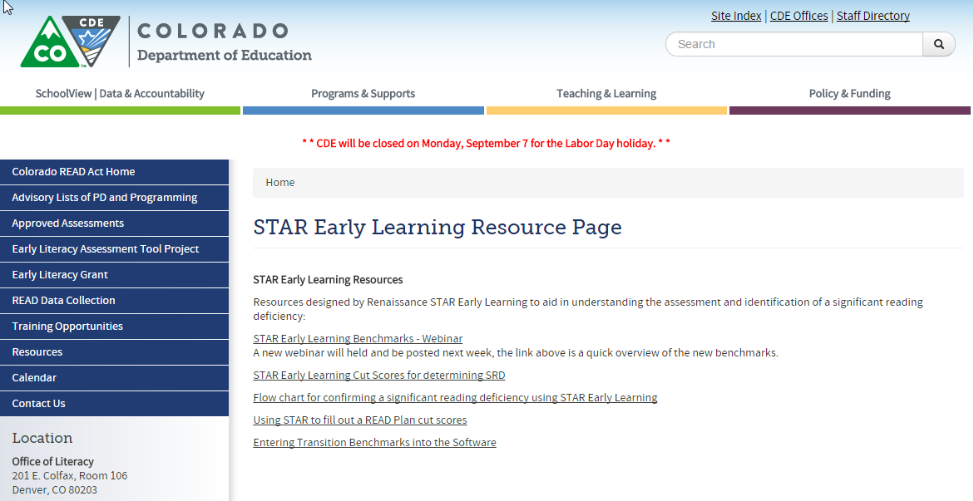
STAR Early Learning Resources Page

Slide 31

Contact Renaissance Learning to convert scores
Spring 2016
unifiedscore@Renaissance.com

Slide 32



Renaissance Learning resources and support
Renaissance Place
  Live Chat (technical support)
  Help menu
  STAR Early Literacy Technical Manual
Email: answers@renaissance.com
Phone: 1-800-338-4204

Slide 33

© 2015 Renaissance Learning, Inc. All rights reserved.
All logos, designs, and brand names for Renaissance Learning’s products and services, including but not limited to Accelerated Math, Accelerated Reader, AccelScan, AccelTest, AR, ATOS, Core Progress, English in a Flash, Learnalytics, Progress Pulse, Renaissance Home Connect, Renaissance Learning, Renaissance Place, Renaissance-U,STAR, STAR 360, STAR Custom, STAR Early Literacy, STAR Math, STAR Reading, STAR Reading Spanish, and Subtext, are trademarks of Renaissance Learning, Inc., and its subsidiaries, registered, common law, or pending registration in the United States and other countries. All other product and company names should be considered the property of their respective companies and organizations.

