Slide 1
Resources needed for this presentation (Keep this slide hidden)
A way to project the PowerPoint
  Note for presenters: For accessibility, you must read the words on the slides. The words bolded in the notes are the words from the slide.
Adequate audio for playing videos (test audio and video before presentation)
  Classroom Example: Fluency Practice: Reading Phrases with Short 'i' and Short 'e'
  Video 1: Echo Reading
  Video 2: Reading Together
  Video 3: Practice Reading Out Loud
Writing utensils
Print these documents:
  Provide blank paper for participants to take notes for discussion
  Handout 1: Practice Reading Out Loud Bookmark
  Handout 2: Practice Reading Out Loud with Alternated Reading Bookmark
  Handout 3: Fluency for Parents handout
Approximate time for:
  Estimated time of presentation: 60 minutes
  Content: 30 minutes
  Optional Classroom Example Videos: 5 minutes
  Parent Activities: 25 minutes

Slide 2


Reading Fluency
The Colorado READ Act and
the Science of Reading for Families
Notes:
Welcome and thank you all for joining us today.
This is a presentation within the Colorado READ Act and the Science of Reading for Families series developed to support parents with ways to help their children build reading skills in partnership with their child’s school. ​
The READ Act encourages local education providers to provide parent opportunities to participate in parent reading workshops throughout the school year to assist parents in developing their own reading skills and in developing the skills necessary to assist their children in reading. We hope this series will be helpful to you as parents (CRS 22-7-1208 (4)).
The Colorado READ Act statute defines the term “parent’ as a student’s biological or adoptive parent, stepparent, foster parent, or legal guardian(CRS 22-7-1203 (8)(a)).
For brevity purposes, we have adopted this definition throughout the presentation. When we use “Parent” during the presentation we mean family or caregiver aligned with the language of the law.
During this presentation, we will be focusing on Fluency.
For more information or additional resources, please visit the READ Act Parent Resources page found within the CDE website. (QR Code on the slide)​

Slide 3
Welcome | Fluency
First Name Last Name, Title
Organization
Contact Information
Notes:
Welcome, we are glad you are here.
Share your name, title and contact details
If time, share a bit about your journey as an educator and/or parent that would be relevant to this session.
Logistics: Share the following points that match your circumstance
This presentation includes active captions.
Presenters will be using a microphone.
We ask that audience members use a microphone when asking questions.
Presenters will be reading the content on each slide to ensure that it is accessible for ALL participants.
Note for presenters: For accessibility, you must read the words on the slides. The words bolded in the notes are the words from the slide.

Slide 4
Outcomes | Fluency
What is fluency?
Why is fluency important?
What does fluency look like at school?
How can you support fluency at home?
Notes:
By the end of this presentation the outcomes are for you to be able to answer these questions.
What is fluency?
Why is fluency important?
What does fluency look like at school?
How can you support fluency at home?
​Take a moment to think about which agenda question(s) you are interested in learning more about today. (Provide 1-2 minutes of think time.)
(If presenting in-person): We have provided writing utensils and paper at each table.
(If presenting virtually, start here) Please feel free to take notes. Later in the session, we will be talking in partners about what we have heard and learned around these questions.

Slide 5
Norms | Fluency
Active listening is appreciated
Active participation is welcomed
Take care of your own needs
Silence your cell phone as a courtesy to all
Notes:
We hope this will be an engaging and informative time for everyone here tonight. Please work to follow these norms:
Active listening is appreciated
Active participation is welcomed
Please take care of your own needs
If in-person, share where the restrooms and water stations are located, as needed.
If presenting virtually, you might consider asking participants to leave cameras on as they are able.
Silence your cell phone as a courtesy to all
Are there any other items you think we should add to this list that will support all of us?

Slide 6
Warm-Up | Fluency
Like Me
Move chairs back from the table so it is easy for you to stand up.
A category will be named.
Stand if you match the category.
Look around to see who else is also in the category.
Notes:
We are going to start with a Warm-up activity called (CLICK) Like Me (Adjust the mobility section of the activity according to the abilities of the participants in the room).
We are doing this activity because:
We want to begin to turn this room of individuals into a group that works together
You will begin to understand who you are in relation to others in the group
I will read all of the steps, ask for questions and then we will begin to activity.
(CLICK) Move chairs back from the table so it is easy for you to stand up. (Adjust the mobility section of the activity according to the abilities of the participants in the room. If presenting virtually, ask participants to stand in front of their camera or use the thumb's up reaction button).
(CLICK) A category will be named.
(CLICK) Stand if you match the category.
(CLICK) Look around to see who else is also in the category.
FACILITATOR NOTES:
Read the activity steps.
Ask if participants have questions.
Start activity at step 1.
Name some (5-10) of the following categories (or create your own to match your community) and give time for people to stand: (facilitators should also participate by standing or staying seated):
I am a parent
I have a child in kindergarten, 1st, 2nd, or 3rd grade.
I have more than one child in elementary school.
I have a middle or high schooler in addition to my elementary student or students.
I live within walking distance of the school.
I work in this community.
I attended this school (or another school in this district).
I grew up in this town/city.
I am new to this community within the last 2 years.
I speak more than one language at home.
I enjoy attending school or community events with my family.
I share family stories, traditions, or sayings with my child or children.
My child or children enjoy playing word games or singing silly songs.
I have noticed my child sounding out letters or words.
I have listened to my child or children read the same book more than once.
I believe reading will help my child or children in future.
Have the parents go around the room and share: (if group is large, make small groups for this activity)
Name
Grade of Child(ren)

Slide 7
Simple View of Reading (SVR)
Word
Recognition
Language
Comprehension
=
Reading
Comprehension
X
(Gough & Tunmer, 1986)
Notes:
Several decades of reading research has given us a clear understanding of how students best learn to read. One way to conceptualize reading is through the Simple View of Reading (SVR) model. This model developed by Gough and Tunmer organizes the skills needed to become a proficient and successful reader into two categories: (CLICK) word recognition and (CLICK) language comprehension. The Simple View of Reading is a basic formula for (CLICK) reading comprehension.
It says this: reading comprehension is the product of word recognition skills and language comprehension skills.
We need both sides of the equation for students to become skilled, proficient readers.
(CLICK) Students need efficient word recognition or decoding skills where they are accurately and automatically reading the words on the page without aid of context clues or pictures.
(CLICK) They also need fully developed language comprehension skills which references the ability to understand language.
In order for a student to understand text, they need to decode the words on the page and then make meaning of the words, sentences, and overall text.
(https://www.cde.state.co.us/coloradoliteracy/scienceofreadingresources)

Slide 8
Simple View of Reading (SVR) | The 5 Components of Reading
Word
Recognition
Language
Comprehension
=
Reading
Comprehension
X
Phonological Awareness
Phonics
Vocabulary
Language- based skills and strategies
Literacy knowledge and skills
Fluency
Oral Language
(Gough & Tunmer, 1986; NRP, 2000)
Notes:
We can use the Simple View of Reading to organize the Five Essential Components of Reading.
(CLICK) Word recognition skills require phonological awareness (attention to the sounds in our language) and phonics (the ability to connect sounds to the letters that represent them).
(CLICK) Language comprehension is supported by vocabulary knowledge (knowing and understanding the meanings of words). In addition, vocabulary knowledge can also support word recognition, particularly as students encounter more complex or irregular words that require familiarity with word parts (morphemes) or context to decode and understand.
Readers also need a variety of language-based skills and strategies such as inferencing, understanding syntax and sentence structure, and utilizing background knowledge. To comprehend text, we must also acquire literacy knowledge and skills, such as understanding text structure and literary genres.
(CLICK) Reading Fluency acts like a bridge that connects word recognition and language comprehension to support understanding when reading (Sedita, 2019).
(CLICK) Oral language is the foundation for skilled reading and literacy development and needs to be integrated throughout all components.
As we become better readers, our reading skills, in turn, help us develop more complex thinking, communication, and language skills (Kamhi & Catts, 1989; Lonigan & Shanahan, 2012).
Each component acts as a piece of the larger whole, similar to a puzzle. Effective reading instruction is not complete without ensuring that all five components, and oral language, are taught.

Slide 9


Simple View of Reading (SVR) | The 5 Components of Reading 2
Word
Recognition
Language
Comprehension
=
Reading
Comprehension
X
Phonological Awareness
Phonics
Vocabulary
Language- based skills and strategies
Literacy knowledge and skills
Fluency
Oral Language
(Gough & Tunmer, 1986; NRP, 2000)
Notes:
Today we are going to explore the Simple View of Reading (SVR) and Fluency in more detail.
Fluency is the bridge connecting Word Recognition and Language Comprehension.
Fluency is not a single skill strand, it is the result of accurate, automatic word recognition and language comprehension working together.
Fluency is the result of early reading skills and subskills being explicitly taught with lots of practice.
If readers do not develop sufficient levels of fluency, they can become stuck in the middle of the bridge- able to decode words, but with insufficient automaticity to lead to comprehension.
In the seminal report of the National Reading Panel (2000), the panel highlighted fluency as one of these top five components, which finally led to long-needed attention from publishers, researchers, teacher educators, and schools. These findings were the basis for the panel's recommending fluency-building practices throughout the elementary years-and even for older students whose reading gets stalled in the first-through sixth-grade range.

Slide 10
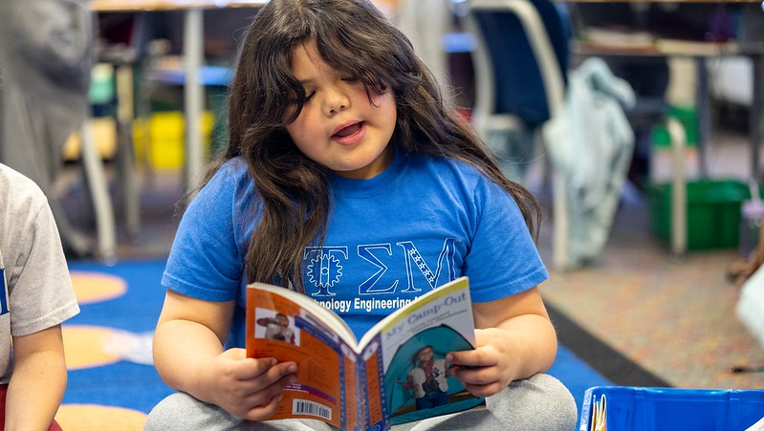

What is Fluency?
Notes:
What is Fluency?

Slide 11
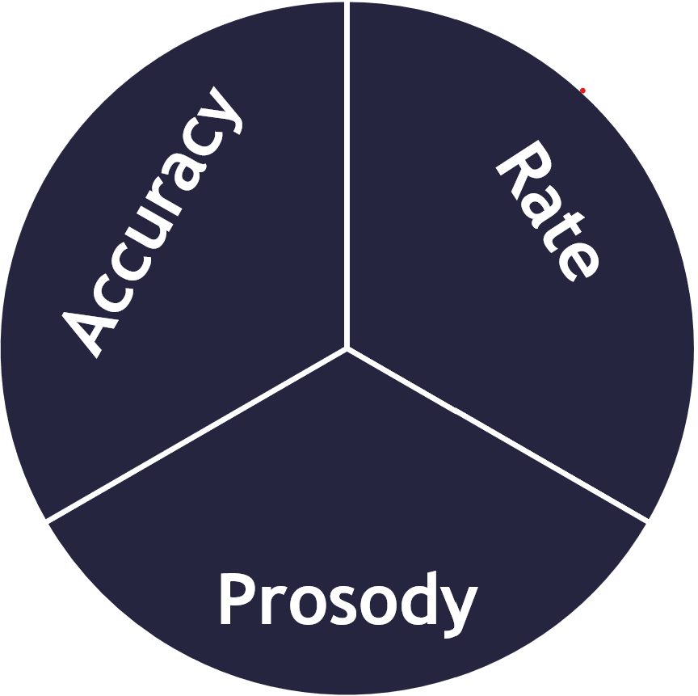



Fluency
The capacity to read words in connected text with sufficient accuracy, rate, and prosody to comprehend what is read.
(Birsh & Carreker, 2018)
Notes:
Fluency is the capacity, or the ability, to read words in connected text with sufficient accuracy, rate, and prosody to comprehend what is read.
Fluency develops in progressions: Accuracy then automaticity at the letter, letter-pattern, then at the word, phrase, and sentence level.
Actually, though, to perform fluently, even at an early level of a complex skill, requires lots of effort and practice. To gain more advanced performance takes yet more attention to many new sub-skills, often weakening overall performance until-with a lot more practice-the newly learned skills integrate with the well-practiced.
Let’s define each of these terms: accuracy, rate, and prosody

Slide 12

Accuracy
The ability to read words correctly
(Birsh & Carreker, 2018)
Notes:
Accuracy is the ability to read words correctly (Birsh & Carreker, 2018).
Accuracy is the first focus and most important component of fluency development.
Accuracy allows access to comprehension. Comprehension is limited by inaccurate reading because a child cannot make sense of a text if he or she does not read the words correctly.
In other words, a reader needs sufficient word-level accuracy to move beyond inefficient, slow, laborious reading and into automatic reading that sounds like speech.
Many children can read words accurately but still are not fluent readers. If correctly reading the words takes a lot of effort, it will likely be inefficient, slow and labored. Dedicating all this attention to decoding words might lead to accurate reading, but it distracts from reading comprehension.

Slide 13
Automaticity
The ability to read letters or words automatically without having to think about it
Letter
Recognition
Sound/Spelling
Correspondence
Regular &
Irregular Words
Multisyllabic
Words
Notes:
Automaticity refers to the ability to read letters or words automatically without having to think about it.
It is the result of moving beyond inefficient, slow, laborious reading.
Reading fluency depends on the development of many underlying processes that must be so well learned that they can be carried out automatically. This process is similar to learning to drive or playing an instrument.
Automaticity is needed in order for readers to be able to dedicate most of their attention to prosody and comprehension.
Automaticity becomes an instructional priority after children become accurate readers. Skills should be practiced to automaticity at each of the following stages:
Letter Recognition
Sound/Spelling Correspondence
Regular & Irregular Words
Multisyllabic Words

Slide 14

Rate
The speed at which a reader reads text
(Hasbrouck, 2020)
Notes:
Rate is the speed at which a reader reads text. When assessing rate, we measure the number of words a student reads correctly per minute, so accurate reading plays an important role in how we measure rate (Hasbrouck, 2020).
Improved reading rate is the result of accuracy and automaticity. As readers become more accurate at sounding-out words, automaticity improves and they can read words more quickly. As reading begins to sound more like natural speech, students can keep pace with comprehending what they are reading.

Slide 15
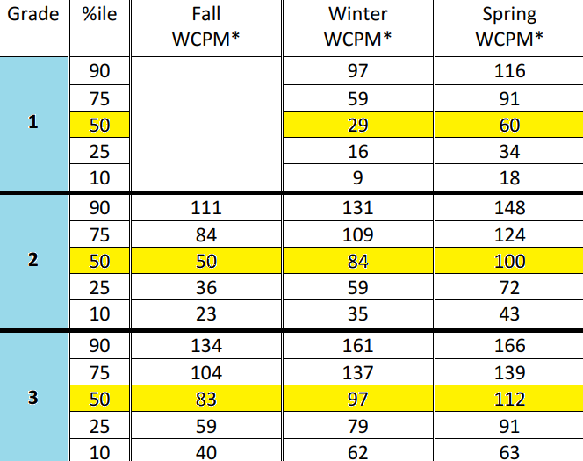
Hasbrouck and Tindal
Fluency Norms (2017)
Notes:
It is important to emphasize: Increasingly fast reading is not the goal. The goal should be to read at a reasonable, appropriate rate that demonstrates comprehension (Garnett, 2018).
Focusing on speed can have dangerous consequences. Much like driving, reading rate picks up with proper learning and sufficient practice. Nobody promotes dangerous driving, and prioritizing reading speed over comprehension is just as dangerous.
In 2006, Jan Hasbrouck and Gene Tindal conducted and extensive study of oral reading fluency which resulted in establishing fluency norms for grades 1-6. These norms were updated in 2017. (Hasbrouck, J. & Tindal, G. (2017). An update to compiled ORF norms (Technical Report No. 1702). Eugene, OR, Behavioral Research and Teaching, University of Oregon.)
The fluency norms give us guidelines for the rate at which a student can accurately read, measured in words correct per minute, at in the fall, winter, and spring of each grade level.
Typically, students who are reading at a rate close to or above the 50th percentile at their grade level are considered to be making expected progress.
Once a student reaches the 50th percentile or above consistently, additional efforts to increase fluency rates are not considered beneficial.
.

Slide 16

Prosody
The ability to read with expression, including volume, pitch, tone, emphasis, and phrasing
PROS
OD(E)Y
toward
song
(Stahl & Kuhn, 2002)
Notes:
Prosody is the ability to read with expression, including volume, pitch, tone, emphasis, and phrasing. Fluent reading should sound like speech (Stahl & Kuhn, 2002).
Reading with expression involves prosody. The word is created from two Greek words: pros (toward) and ode (song).
Reading expression is the primary outcome of comprehension, rather than contributing to comprehension.
It is difficult to show prosody if you don’t know what the words mean.
Reading with expression shows that you understand what you are reading.
For example, you change your voice to be excited when a character is excited.
When children read fluently, they can focus their attention on understanding what they read, rather than trying to figure out how to read the words.

Slide 17
1. Progression of Fluency Skills
LESS COMPLEX
MORE COMPLEX
Connected Texts
Sentences
Phrases
Word Parts
Words
Letter Sounds
Letter Names
(Wolf & Katzir-Cohen, 2001)
Notes:
The progression of fluency skills begins with letter names and letter sounds, then words, word parts, phrases, sentences, and, finally with connected text.
Fluency is the outcome of a progression of mastered skills and subskills.
Fluency is a critical part of complex skill development. Reading-like playing an instrument or driving a car is a complex skill made of many sub-skills that require much practice to come naturally.
Most of us forget how much time, effort, and repeated practice and experience it took to develop fluent driving (or reading) and what it was like along the way because now it just seems natural.
On the early road to becoming fluent, beginning readers dedicate most of their attention to the sub-skills.
Automaticity is needed in order for readers to be able to dedicate most of their attention to prosody and comprehension.
Attention is focused on lower level sub-skills, leaving little room for higher level processing.
When word-level reading is fluent, the reader’s attention and working memory can focus on the meaning of what is being read, moving beyond inefficient, slow, laborious reading

Slide 18
2. Progression of Fluency Skills
LESS COMPLEX
MORE COMPLEX
Connected Texts
Sentences
Phrases
Word Parts
Words
Letter Sounds
The frog jumped /
into the pond. /
Letter Names
(Wolf & Katzir-Cohen, 2001)
Notes:
As a child becomes increasingly automatic with letter and word recognition level skills, fluency practice can be provided with connected text moving from the phrase to sentence level.
At the phrase skill level, fluency includes reading commonly used phrases and breaking parts of sentences into meaningful chunks.
For example: The frog jumped (PAUSE) into the pond (PAUSE).

Slide 19
3. Progression of Fluency Skills
LESS COMPLEX
MORE COMPLEX
Connected Texts
Sentences
Phrases
Word Parts
Words
Letter Sounds
The frog jumped into the pond. /
Letter Names
(Wolf & Katzir-Cohen, 2001)
Notes:
As children develop automaticity with phrases, sentence skill level fluency includes attending to the beginning and ending of a new sentence, word part and word meaning, and the order of words in sentences.
For example: The frog jumped into the pond (PAUSE).

Slide 20
4. Progression of Fluency Skills
LESS COMPLEX
MORE COMPLEX
Connected Texts
Sentences
Phrases
Word Parts
Words
Letter Sounds
The frog jumped into the pond.
It made a huge splash! /
Letter Names
(Wolf & Katzir-Cohen, 2001)
Notes:
Finally, practicing connected text provides multiple opportunities to play with prosody and rate once children are adequately accurate with grade-level text.
For example: The frog jumped into the pond. It made a huge splash!
As you can see, fluency is not a "level" but an ongoing process that affects reading across a range of levels. This means that fluency is something of a moving target (Rasinski, 2017; Rasinski & Nageldinger, 2016). A child is fluent at reading text with certain complexities but is not fluent with others.

Slide 21




Sight Word Recognition
Sight word recognition is foundational to fluent reading
Creating a sight word involves forming permanent connections between a word’s letters, its pronunciation, and its meaning in memory
The orthographic mapping process is the only way to turn unfamiliar words into instantly recognizable sight words
The goal is that ALL words become sight words
f r o g
/f/ /r/ /o/ /g/
frog
Notes:
Our sight word memory is also referred to as our orthographic lexicon, which includes all the words we can read accurately and effortlessly. Literate adults have a sight word memory of 30,000 to 70,000 words. Sight word recognition is foundational to fluent reading.
Creating a sight word involves forming permanent connections between a word’s letters, its pronunciation, and its meaning in memory (Perfetti, 1992; Rack, Hulme, Snowling, & Wightman, 1994). This process is termed “ORTHOGRAPHIC MAPPING.”
The orthographic mapping process is the only way to turn unfamiliar words into instantly recognizable sight words.
In the process we combine new information with known information. What we know is the pronouncing and the meaning of many spoken words from listening and speaking.
When we see a printed word, like the word frog:
Our brain uses letter sound relationships PLUS our knowledge of phonemes to identify each sound in the word, /f/ /r/ /o/ /g/
and then blends the sounds together to read the word, frog,
With multiple exposures and practice our brains map the letter sequence to long term memory.
The orthographic mapping process (Ehri, 2014; Kilpatrick, 2015) is literally the “glue” that bonds words in memory.
The goal is that ALL words to become sight words.
Remember we are not simply remembering what a word looks like in visual memory. We are storing the sounds connected to the letters and meaning in a different part of the brain.
Once a child has strong mapping skills, the process of turning a new word into a sight word is faster and typically occurs after exposures to a words from 1 to 4 times. This allows us to build a large library of words that we recognize instantly (Kilpatrick, 2015; Reitsma, 1983).
Starting in 3rd grade, it is estimated that skilled readers anchor 10-15 new words a day into their sight word memories.
Remember we are not simply remembering what a word looks like in visual memory. We are storing the sounds connected to the letters and meaning.

Slide 22
Sight Recognition (of Familiar Words) & High Frequency Words
Regular/
Decodable
Words
Irregular
Words
High
Frequency
Words
have
it
if
could
and
had
said
Notes:
High-frequency words, as the name implies, are the words most commonly used in text. Because high-frequency words are essential to learning how to read even simple text, many children in primary grades learn some high-frequency words as sight words at the same time they are being taught how to use phonics to sound out words.
Sight Words are words stored in memory, whether they are Regular (Decodable) Words or Irregular Words.
A sight word is any word that you can read instantly and recognize without having to think about it.
Many words are regularly spelled and use predictable letter sound correspondences. These are words like "if," "and“, "it“, and "had,” but also words with more complex but predictable spelling patterns that are taught over time.
Other words have irregular spellings, like ”could”, “have”, and “said.” This means that at least one part of the word contains a pattern that is not a predictable sound/spelling pattern. Irregular words are learned through multiple exposures. Children may need more exposures to learn irregular words than regular, decodable words.
Once these students are able to orthographically map, they will start to store high-frequency words as sight words on their own. Integrating high-frequency words with phonics instruction allows students to make sense of spelling patterns for these words.
For readers to become fluent, they need to recognize both regularly spelled and irregularly spelled high-frequency words.

Slide 23
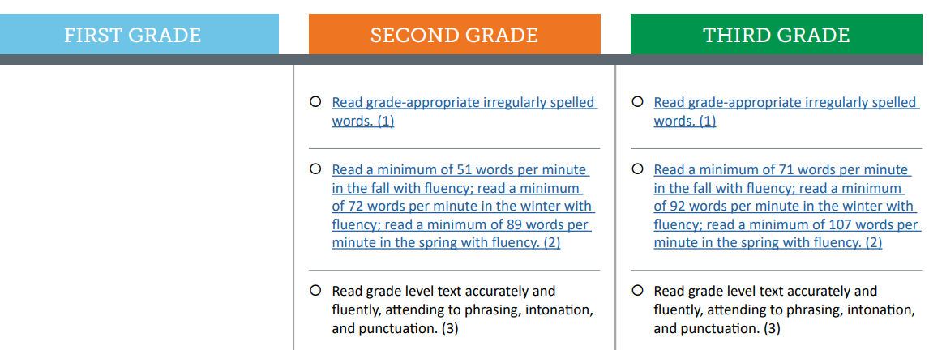
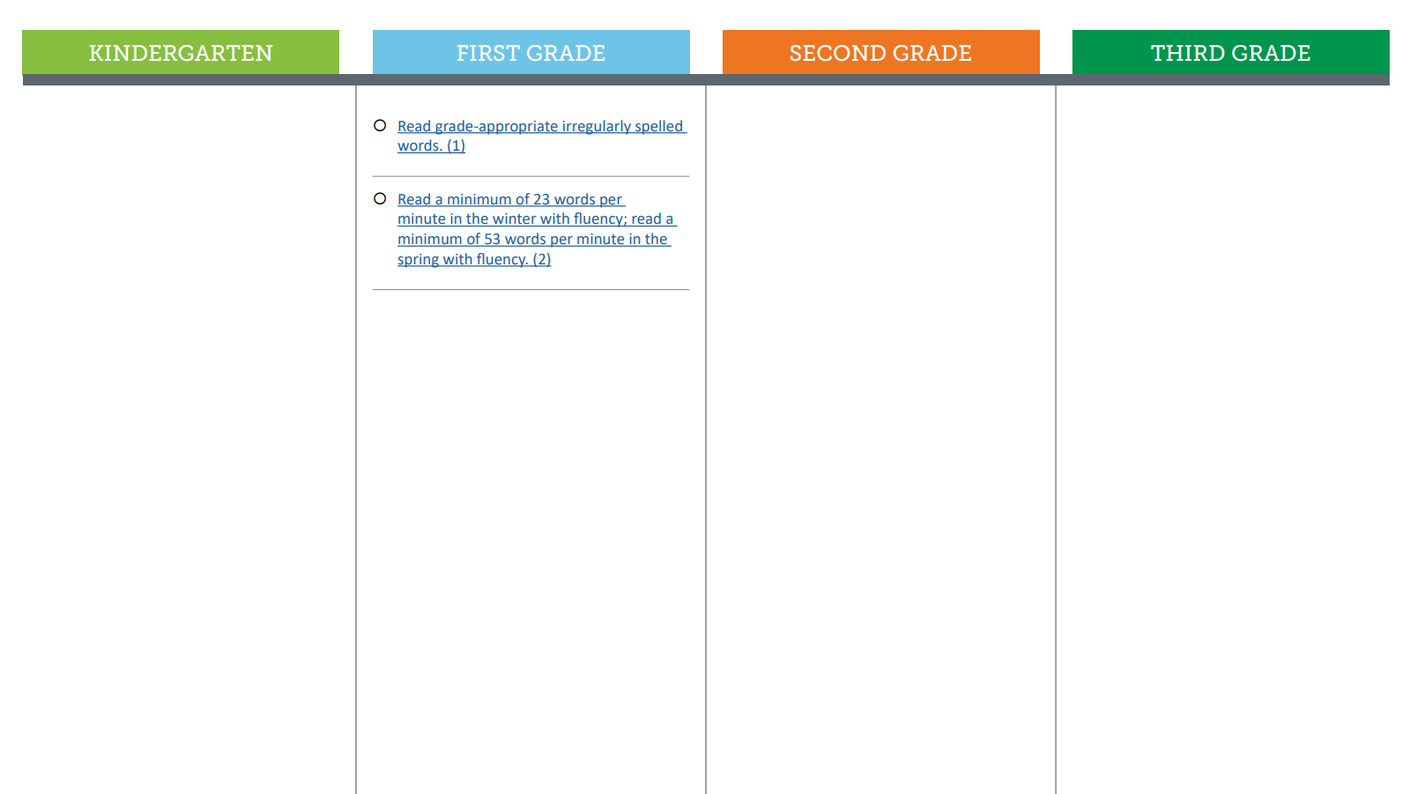


CO Minimum Reading Competency Skills for Fluency
Fluency rates align to Hasbrouck and Tindal fluency norms
First measured in first grade
Grade-appropriate irregularly spelled words
In 2nd and 3rd grades, attention to prosody is expected
Notes:
The Colorado READ Act outlines minimum reading competency skills for fluency that students must master to become proficient readers by third grade. These minimum competencies are assessed by the approved READ Act interim assessment measures and are also part of the Colorado Academic Standards.
The Colorado Minimum Reading Competency Skills Matrix is an interactive document that outlines the progression of fluency skills for kindergarten through third grades.
Expectations for grade level fluency rates at different points throughout the school year align to the Hasbrouck and Tindal Fluency Norms mentioned earlier in this presentation.
Note that reading fluency skills are first measured by a minimum of words correct per minute in winter of first grade.
At every grade, students are expected to read grade-appropriate irregularly spelled words.
In second and third grades, reading fluency with attention to prosody is expected when reading grade level text.

Slide 24
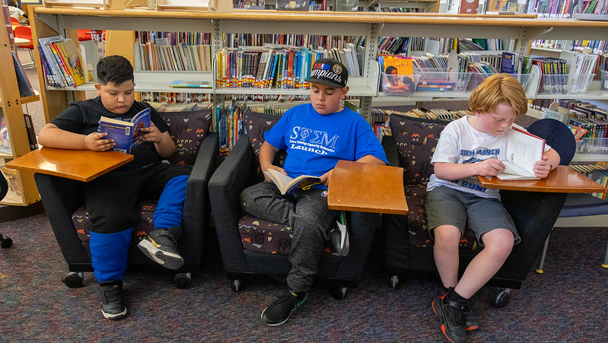
Why is Fluency Important?
Notes:
Why is Fluency Important?

Slide 25
Why is Fluency Important?
1 of 5 essential components of reading
Critical for skilled reading
Essential for reading comprehension and motivation
Supports academic success
In short, fluency is the supersonic highway that takes readers very effortlessly from reading words to understanding and comprehension.
(Vaughn, n.d.)
Notes:
Why is Fluency Important?
It is One of five essential components of reading
As we learned when exploring the Simple View of Reading model, fluency is a key skill to becoming a proficient reader because it is the bridge connecting word recognition and language comprehension.
Fluency results largely from the mastery of underlying reading skills.
Fluency is Critical for skilled reading
A reader who does not attain automaticity in word recognition is said to be “glued” to the print and must focus all their attention on sounding out words (Chall,1983).
Skilled readers do not depend primarily on context to identify new words. When proficient readers come to an unknown word, they decode the word, name it, and then attach meaning. The context of the passage helps a reader get the meaning of a word once a word has been deciphered, not the other way around.
Essential for reading comprehension and motivation
Fluent readers do not need to focus on figuring out the words, they can focus their attention on understanding the text and making connections between the ideas in the text and their background knowledge.
Fluent readers are also more likely to feel successful and motivated with regards to their reading abilities. And it’s a virtuous cycle: As their confidence grows, they’re more likely to engage in and enjoy reading—and continue to improve.
It comes as no surprise that children who’s reading is not fluent don’t enjoy reading because it is difficult and less likely to read, which often leads to an even further decline in their reading skills.
Fluency supports academic success by helping students read to learn.
Fluent reader help children be more prepared for the demands of the upper grades.
As students advance through school, fluency becomes increasingly important for comprehension and analysis of more advanced and content-rich texts.
Children in the upper grades are often expected to do a lot of independent reading for their classes. Even if they can read accurately, if they are not fluent, it will take them longer to complete classwork.
The important thing to remember is that fluent readers recognize words and comprehend at the same time. On the other hand, less fluent readers need to focus their attention on figuring out the words, leaving them little attention for understanding the text.
In short, fluency is the supersonic highway that takes readers very effortlessly from reading words to understanding and comprehension (Vaughn, n.d).

Slide 26
Fluent Readers vs. Dysfluent Readers
Fluent Readers | Dysfluent Readers
Mental energy spent on comprehension | Mental energy spent on decoding
Able to comprehend more | Minimal comprehension
Greater motivation to read | Less motivation to read
Increased amount of time reading | Decreased amount of time reading
Larger vocabulary | Smaller vocabulary
(Moats, 2007)
Notes:
Louisa Moats (2007) noted that consequences of not becoming a fluent reader can be devastating.
​
To compare, fluent readers are able to spend mental energy on comprehending the text and will comprehend more, whereas dysfluent readers spend most of their mental energy on decoding the text which leads to minimal comprehension of what they read.
Fluent readers develop a greater motivation to read because they are able to understand what they are reading while dysfluent readers tend to become less motivated to read due to time and energy spent decoding.
As a result, fluent readers spend an increased amount of time reading and develop a larger vocabulary and dysfluent readers spend less time reading and accumulate a smaller vocabulary.
​

Slide 27

Oral Reading as a Thermometer
A measure of reading health
Oral reading assessments provide quick checkpoints
A low score on an oral reading fluency (ORF) assessment indicates a problem
Additional diagnostic assessments are needed to identify the root causes
(Hasbrouck, 2020)
Notes:
Oral reading fluency is often referred to as the educator’s thermometer. Like a thermometer provides a trustworthy and useful measure temperature and information about health, oral reading measures provide a valid and reliable tool to measure children’s reading health. Over 30 years of research show that oral reading fluency is a reasonable indicator of how well a reader is likely to comprehend text (Hasbrouck, 2020).
Oral reading assessments, like a thermometer, are designed to provide quick checkpoints into a student’s reading skills. In just one to two minutes, educators can use oral reading fluency assessments to collect valuable information without taking too much time from instruction.
Oral reading assessments provide a numeric score based on the correct number of words a child reads aloud correctly per minute that can be compared to grade-level benchmarks. This is like the way we use a thermometer to compare body temperature to the normal range of 98.6 degrees.
If a number is far from the normal range, it indicates there might be a problem, and we need to investigate more.
Similarly, a low score on an oral reading fluency assessment indicates a problem in a child’s reading, but it does not tell us why he or she might be struggling. Additional diagnostic assessments are needed to identify root causes so that treatment addresses the appropriate skill deficits.

Slide 28
Paired Verbal Fluency I Fluency
What is fluency?
Why is it important for reading development?
Write down thoughts and ideas you could share with a partner.
We will create partners A and B and take turns talking about the questions above.
At a signal, one will speak, and one will listen.
At a signal, the other will speak while the first speaker listens.
Each time, no one is allowed to repeat anything that was said by the other.
Notes:
We are going to do an activity called Paired Verbal Fluency
We want to give you time to think about the information presented and share your understanding with a partner about what oral language and vocabulary development are and why they are important for literacy. (If presenting virtually, say that you will be creating breakout rooms for this discussion to take place).
Here is how this activity will work:
First, you will think about these two questions:
What is fluency?
Why is it important for reading development?
Next, we will follow these steps:
Write down thoughts and ideas you could share with a partner (2-3 minutes).
We will create partners A and B and take turns talking about the questions above.
At a signal, one will speak, and one will listen.
At a signal, the other will speak while the first speaker listens.
Each time, no one is allowed to repeat anything that was said by the other.
Does anyone have any questions? (Clarify as needed).
Note to Presenter:
Start at #1 (2-3 minutes to write down ideas or think about notes taken)
Create partners:
Same kind of shoes, sitting next to each other, child in same grade, etc.
Have partners decide or assign A and B
First round (60 seconds)
A speaks, B listens
Second round (40 seconds)
B speaks, A listens
If time, Third Round (20 seconds)
A speaks, B listens
*If presenting virtually, read all the directions and have participants discuss on their own in breakout rooms. Create breakout rooms ahead of time.
Ask if anyone has any questions or comments to share before moving on.

Slide 29
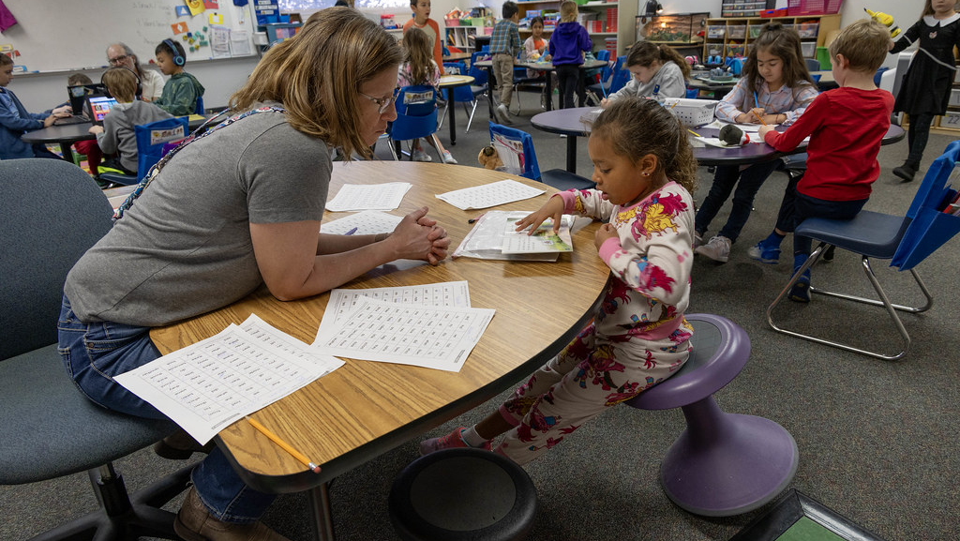
What Does Fluency
Look Like at School?
Notes:
What Does Fluency Look Like at School?

Slide 30


Colorado Academic Standards (CAS) I Fluency
Expectations for Second Grade
Reading for All Purposes: read fluently (with proper speed, accuracy, and expression) by using skills and strategies to help them understand books, stories, poems and informational books (“how to” books, instructions)
You May Find Students
Using phonics and knowledge of words (spelling patterns, root words, prefixes, and suffixes) to read fluently (with appropriate speed, accuracy, and expression)
Using decoding skills (sound out and pronounce) to read and understand stories, informational books, and opinion pieces
(CDE, 2020)
Notes:
Let’s explore how fluency is reflected in the Colorado Academic Standards (CAS).
Created by Coloradans for Colorado children, the Colorado Academic Standards provide a grade-by-grade road map to help ensure children are successful in college, careers, and life. The standards aim to improve what children learn and how they learn in 12 content areas while emphasizing critical thinking, creativity, problem solving, collaboration, and communication as essential skills for life in the 21st century.​
To support families, communities, and teachers in realizing the goals of the Colorado Academic Standards (CAS), the Colorado Family and Community Guides provide overviews of the learning expectations for children. ​
These guides offer some learning experiences children may engage in at school that may also be supported at home.​
As always, the best place to learn about what your child is learning is from your child's teacher.​
Expectations for Second Grade
Reading for All Purposes: read fluently (with proper speed, accuracy, and expression, what we defined as prosody earlier in the presentation, by using skills and strategies to help them understand books, stories, poems and informational books (“how to” books, instructions).
You May Find Students sections. ​
Using phonics and knowledge of words (spelling patterns, root words, prefixes, and suffixes) to read fluently (with appropriate speed, accuracy, and expression)
Using decoding skills (sound out and pronounce) to read and understand stories, informational books, and opinion pieces
The bit.ly is attached for parents to save the link to the Family and Community Guides to the Colorado Academic Standards

Slide 31
2CO Minimum Reading Competency Skills for Fluency
Fluency rates align to Hasbrouck and Tindal fluency norms
First measured in first grade
Grade-appropriate irregularly spelled words
In 2nd and 3rd grades, attention to prosody is expected
Notes:
As we reviewed earlier in the presentation, the READ Act contains minimum reading competency skills for reading fluency in grades 1-3, which are part of the Colorado Academic Standards for Reading and Writing.
As a reminder, fluency rate expectations align to Hasbrouck and Tindal fluency norms, are first measured in first grade, include grade appropriate irregularly spelled words and in 2nd and third grades, attention to prosody is expected

Slide 32
What Does Fluency Instruction Look Like?
Explicit & Direct
  I do, We do, You
Systematic & Sequential
  Simple → Complex
Practice, Practice, Practice
Notes:
Fluency is best taught direct, explicitly, and systematically, and then practiced until skills become automatic so children can shift their attention to comprehend what they read.
Fluency continues to develop along a continuum of increasing complexity.
Explicit and direct means that the teacher explains and illustrates a new concept directly, without relying on students to discover it themselves or pick it up from some incidental examples. Children do not learn that print represents speech simply from exposure to books or print.
Instruction includes planned practice and application to meaningful reading and writing using a gradual release of responsibility. This is an instructional model in which:
The teacher models the skill first (I do it),
Then the teacher and students practice the skill together (We do it),
and finally, the students practice and apply the skills independently (You do it).
Although explicit instruction works for all children, it is particularly critical to for children who are struggling readers.
Systematic and sequential means that concepts are presented within a defined scope and sequence in which more complex ideas or patterns build up from more simple skills to more complex skills.
Fluency skills should be integrated to facilitate deep understanding of the text.
Practice, Practice, Practice
Fluency develops slowly over time and with lots of practice reading words, phrases and sentences, and connected texts.
Fluency is not achieved at one point in time. Rather, it keeps developing-with practice-over a long span.
Research shows that the number of repetitions needed to reach reliable word reading accuracy for average young readers is 4-14 repetitions and more than 40 repetitions for students with reading difficulties (Reitsma,1983a, 1983b).

Slide 33
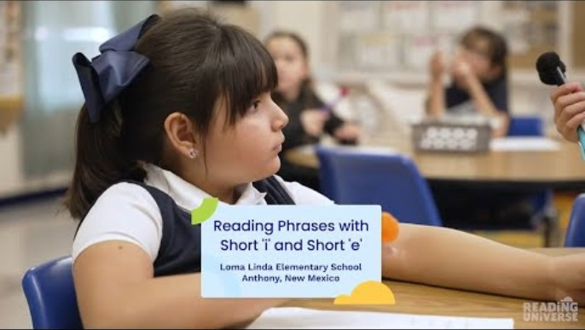
Classroom Example: Phrase Reading
Key Points About the Video:
Third grade teacher guides students through oral reading phrase reading practice with short i and short e vowel sounds
Teacher emphasizes accuracy first, and then automaticity with three different reads
Phrase reading supports accuracy and builds fluency
(Reading Universe)
Notes:
Optional classroom example. Video length: 2:12 minutes
Keep this slide hidden if unused.
Let’s watch a short video on what explicit, direct, and systematic reading fluency instruction might look like in the classroom.
In this classroom example, the teacher guides third grade students through oral reading phrase reading practice with short i and short e vowel sounds. This practice directly connects to previously taught material in the lesson and supports accuracy and builds fluency.
The teacher emphasizes in the first read students are going to focus on accuracy– reading the words correctly. Then in the second and third reads, students are going to focus on building automaticity.
FACILITATOR NOTES:
Before watching the video, read the Key Points About the Video so participants know what to focus on.
Watch Video: Fluency Practice: Reading Phrases with Short 'i' and Short 'e’ (Closed captioning is available. Enable by clicking on the black CC box at the bottom of the video.)

Slide 34

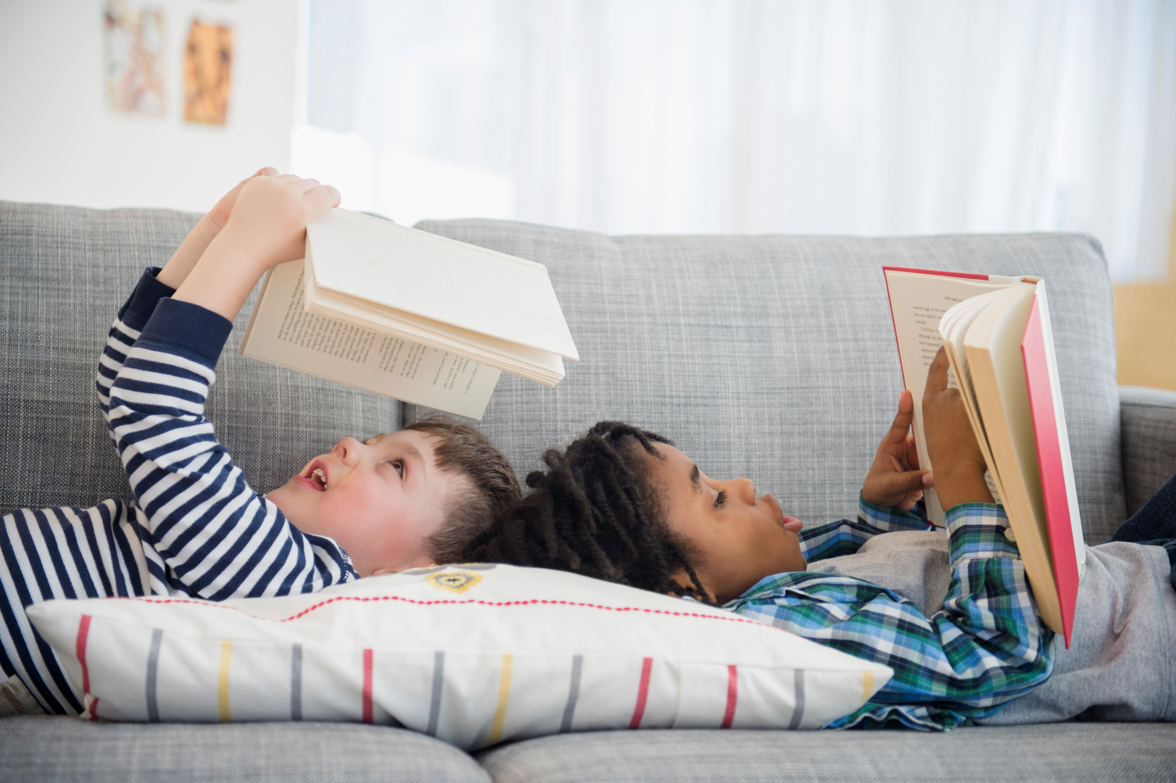

Progression of Fluency Skills I K-3
Kindergarten
Focus on accuracy with decoding
Fluency practice with letter naming, letter sounds, word reading
First Grade
Focus is still primarily on accuracy with decoding
Fluency practice with letter sounds, word reading, connected text
Second/Third Grades
Focus shifts to include all aspects of fluency; accuracy, rate, and prosody
Fluency practice in connected text
Notes:
This is a general progression of fluency skills from kindergarten to third grade:
In Kindergarten, instruction focuses on accuracy with decoding and practice with letter naming, letter sounds, and word reading.
Some practice may extend to connected decodable text with patterns that were explicitly taught. Typically, these activities are done in whole group or one on with the teacher.
In first grade, instruction still primarily focuses on accuracy with decoding and practice with letter sounds, word reading, and connected text.
Once children are accurate, teachers may provide additional practice to increase rate with word reading and connected text.
In second and third grades, instruction shifts focus to includes all aspects of fluency; accuracy, rate, and prosody, and use structured partner practice with letter sounds, words and phrase reading, and connected.
Typically, in the upper grades partner practice is with connected text.
It is important to note: This is a continuum; teachers may go back to skills based on individual student needs.

Slide 35

How Can You Support Fluency at Home?
Notes:
How Can You Support Fluency at Home?

Slide 36
1.How Can You Support Fluency at Home?
Practice 1: Echo Reading
Practice 2: Reading Together
Practice 3: Alternated Reading & Reading Together
Notes:
Let’s explore three example practices you can use to support fluency at home.
Practice 1: Echo Reading
Practice 2: Reading Together
Practice 3: Alternated Reading & Reading Together
FACILATORS NOTE:
All the practice videos use connected text or book reading. For parents of younger students (e.g. Kindergarten and first grade), you may want to expand on what fluency practice can look like at home using letters, sounds, words, phrases, or sentences. You may also want to re-emphasize the best place to learn about what their children are learning and how to support fluency practice at home is from their children’s teacher.

Slide 37
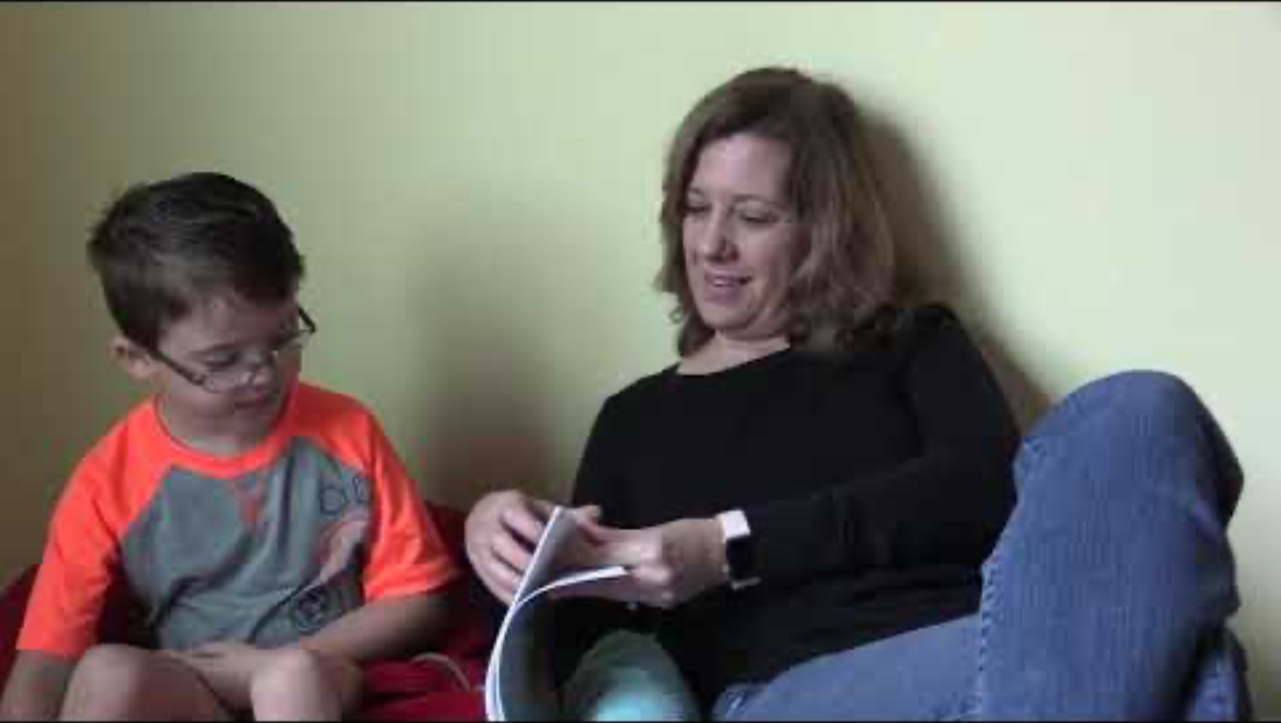
Practice 1: Echo Reading
Key Points About the Video:
Parent reads at a conversational pace and with expression to model fluent reading.
Parent encourages child to point to the words as he reads and reviews words (leap, tug, shrug, heap) to make sure he understands what they are reading.
Parent tells child she is proud of him for practicing reading.
Practice Reading Out Loud Bookmark
(Institute of Education Sciences, n.d.)
Notes:
Practice 1 is oral reading practice called echo reading using the book Sheep in a Jeep.
Oral reading practice is when children read out loud. As children read out loud, it is important to have a more proficient reader that listens and offers help when needed. As children read out loud, they get better at reading words correctly, quickly, and with the right expression (fluently). The more children practice reading out loud with support, the better readers they will become.
There are many ways to support your child in oral reading practice. You can echo read and read together.
Echo reading means the more proficient reader reads part of a book out loud and then the child reads the same part out loud. Thus, the child echoes what you read. As you echo read with your child, make sure that he or she follows along while you read by looking at the words as you read them. Your child should point to the words as he or she reads the same thing you read. This is to make sure your child is paying attention to the words and not just repeating what you say.
Key Points About the Video:
Parent reads at a conversational pace and with expression to model fluent reading.
Parent encourages child to point to the words as he reads and reviews words (leap, tug, shrug, heap) to make sure he understands what they are reading.
Parent tells child she is proud of him for practicing reading.
FACILITATOR NOTES:
Before watching the video, read the Key Points About the Video so participants know what to focus on.
Watch Video 1: Echo Reading (Closed captioning is available. Enable by clicking on the black CC box at the bottom of the video.)
After watching the video, give participants time to practice the linked activities with their paired verbal fluency partner(s).
The encouragement and support children receive as they read out loud will help them become more fluent and confident readers. Be patient as children learn to read and remind them often of how proud you are of them for practicing reading.

Slide 38
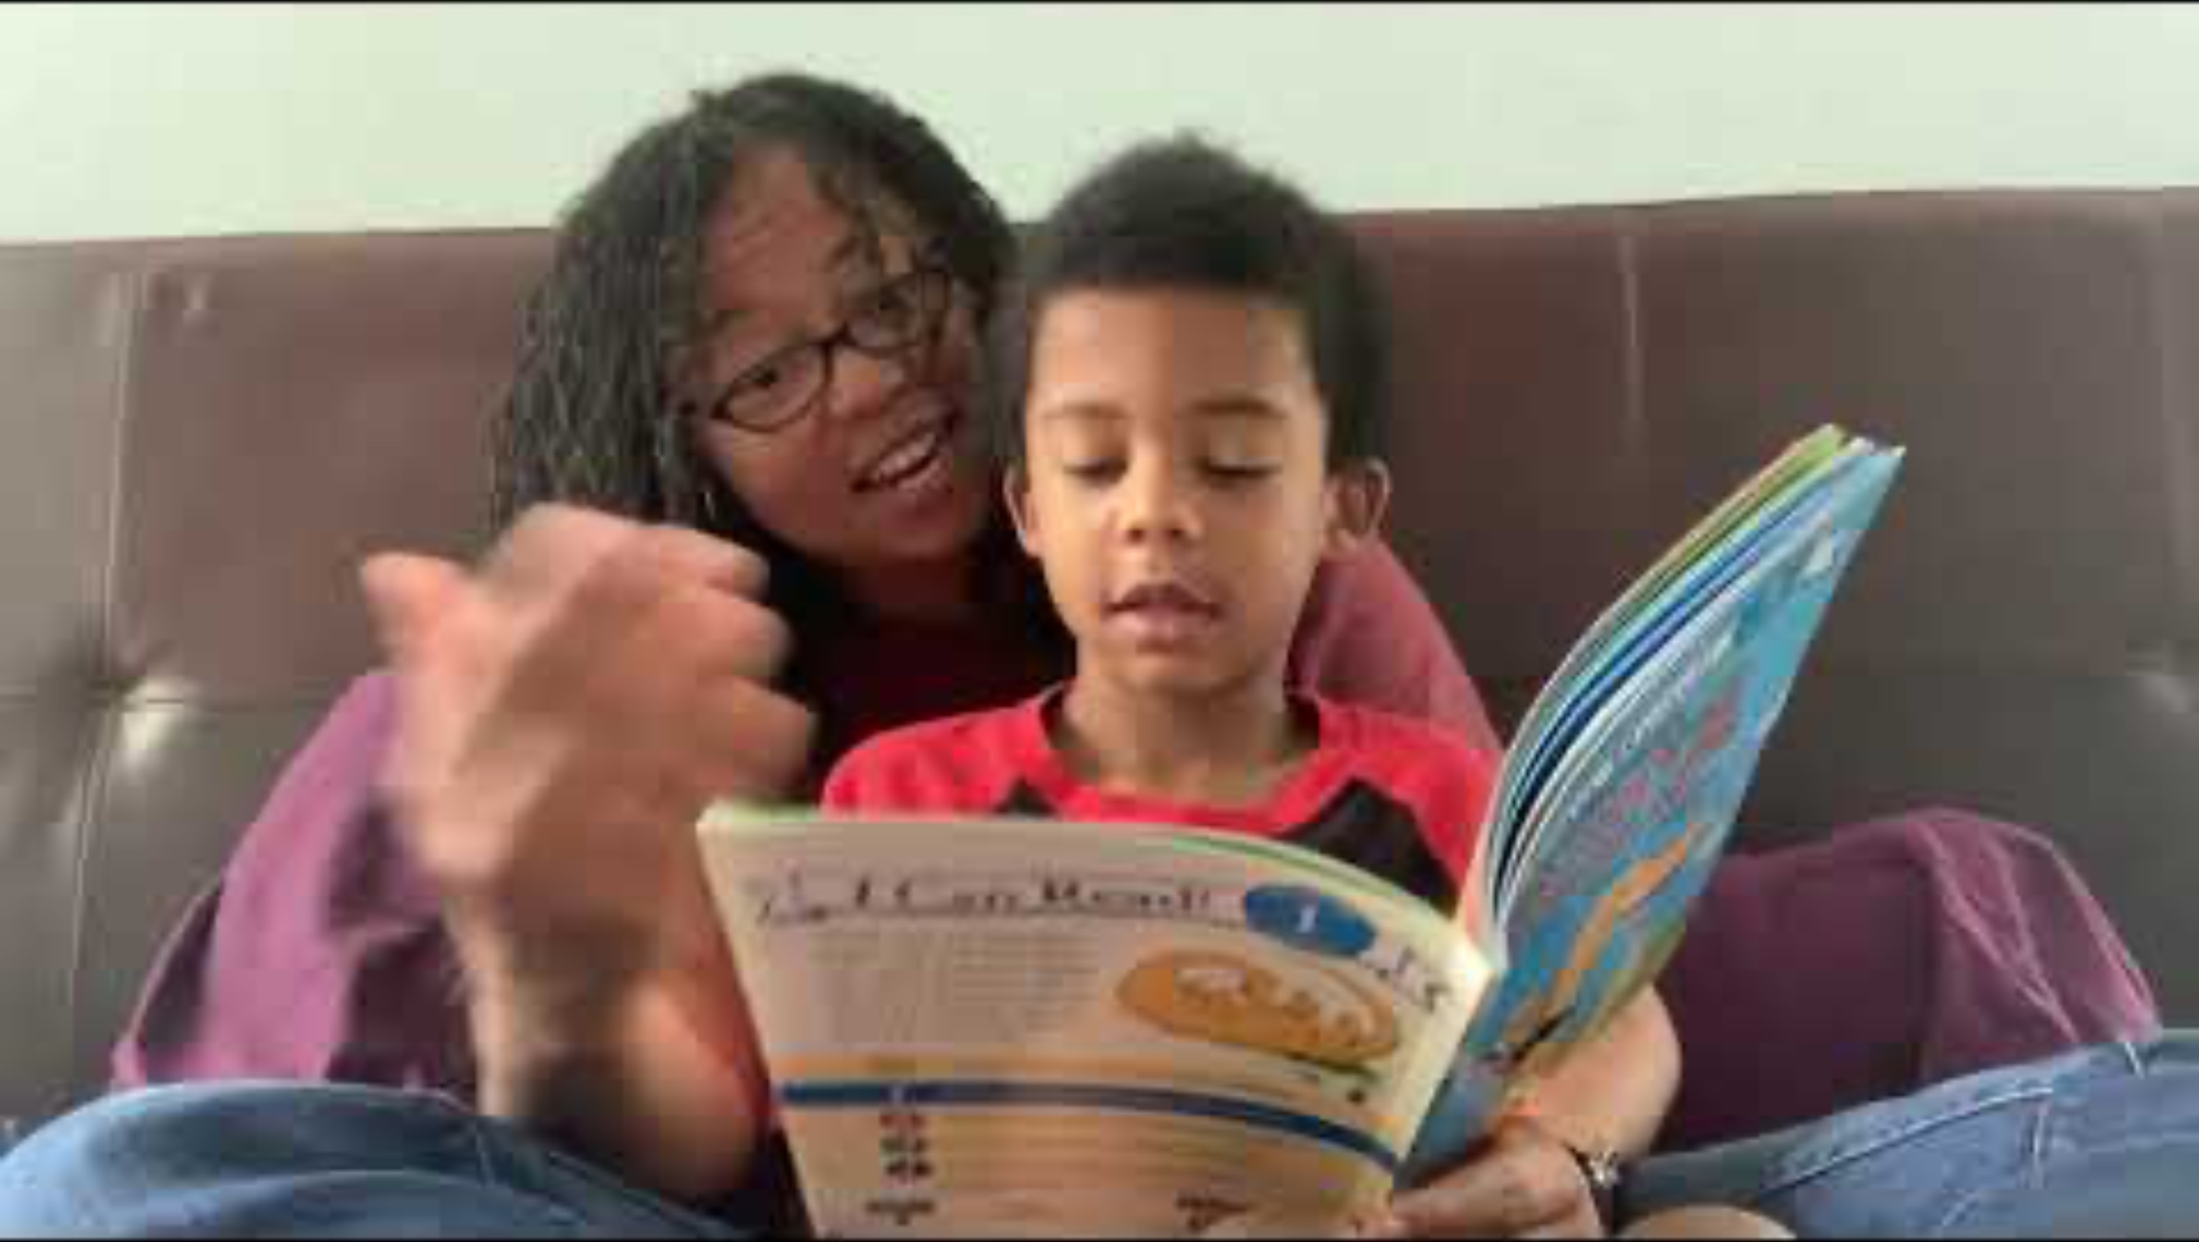
Practice 2: Reading Together
Key Points About the Video:
Parent slows her pace of reading a little so they can read at the same time.
Parent uses her finger to point to the words as they read together.
Parent reads with expression, an important part of reading fluently.
The child in this video has sufficient decoding skills to read along with the parent.
Practice Reading Out Loud Bookmark
(Institute of Education Sciences, n.d.)
Notes:
Practice 2 is another oral reading practice called reading together using the book Danny and the Dinosaur and the New Puppy.
Reading together means you and your child read the same thing out loud at the same time. When you read at the same time, make sure your child follows along by pointing to each word. You can slow your pace of reading down a little when you read at the same time. Always offer positive encouragement and let your child know how proud you are because he or she is practicing reading.
As a reminder: Automaticity should only be the instructional priority after children become accurate readers. The child in this video has sufficient decoding skills to read along with the parent. Non-automatic readers should not be encouraged to read faster and faster.
Key Points About the Video:
Parent slows her pace of reading a little so they can read at the same time.
Parent uses her finger to point to the words as they read together.
Parent reads with expression, an important part of reading fluently.
The child in this video has sufficient decoding skills to read along with the parent.
The encouragement and support children receive as they read out loud will help them become more fluent and confident readers. Be patient as children learn to read and remind them often of how proud you are of them for practicing reading
FACILITATOR NOTES:
Before watching the video, read the Key Points About the Video so participants know what to focus on.
Watch Video 2: Reading Together (Closed captioning is available. Enable by clicking on the black CC box at the bottom of the video.)
After watching the video, give participants time to practice the linked activities with their paired verbal fluency partner(s).
Tell parents to use the bookmark as a reminder of the importance of reading every day with children. One side of the bookmark describes Echo Reading and the other side describes Reading Together.

Slide 39
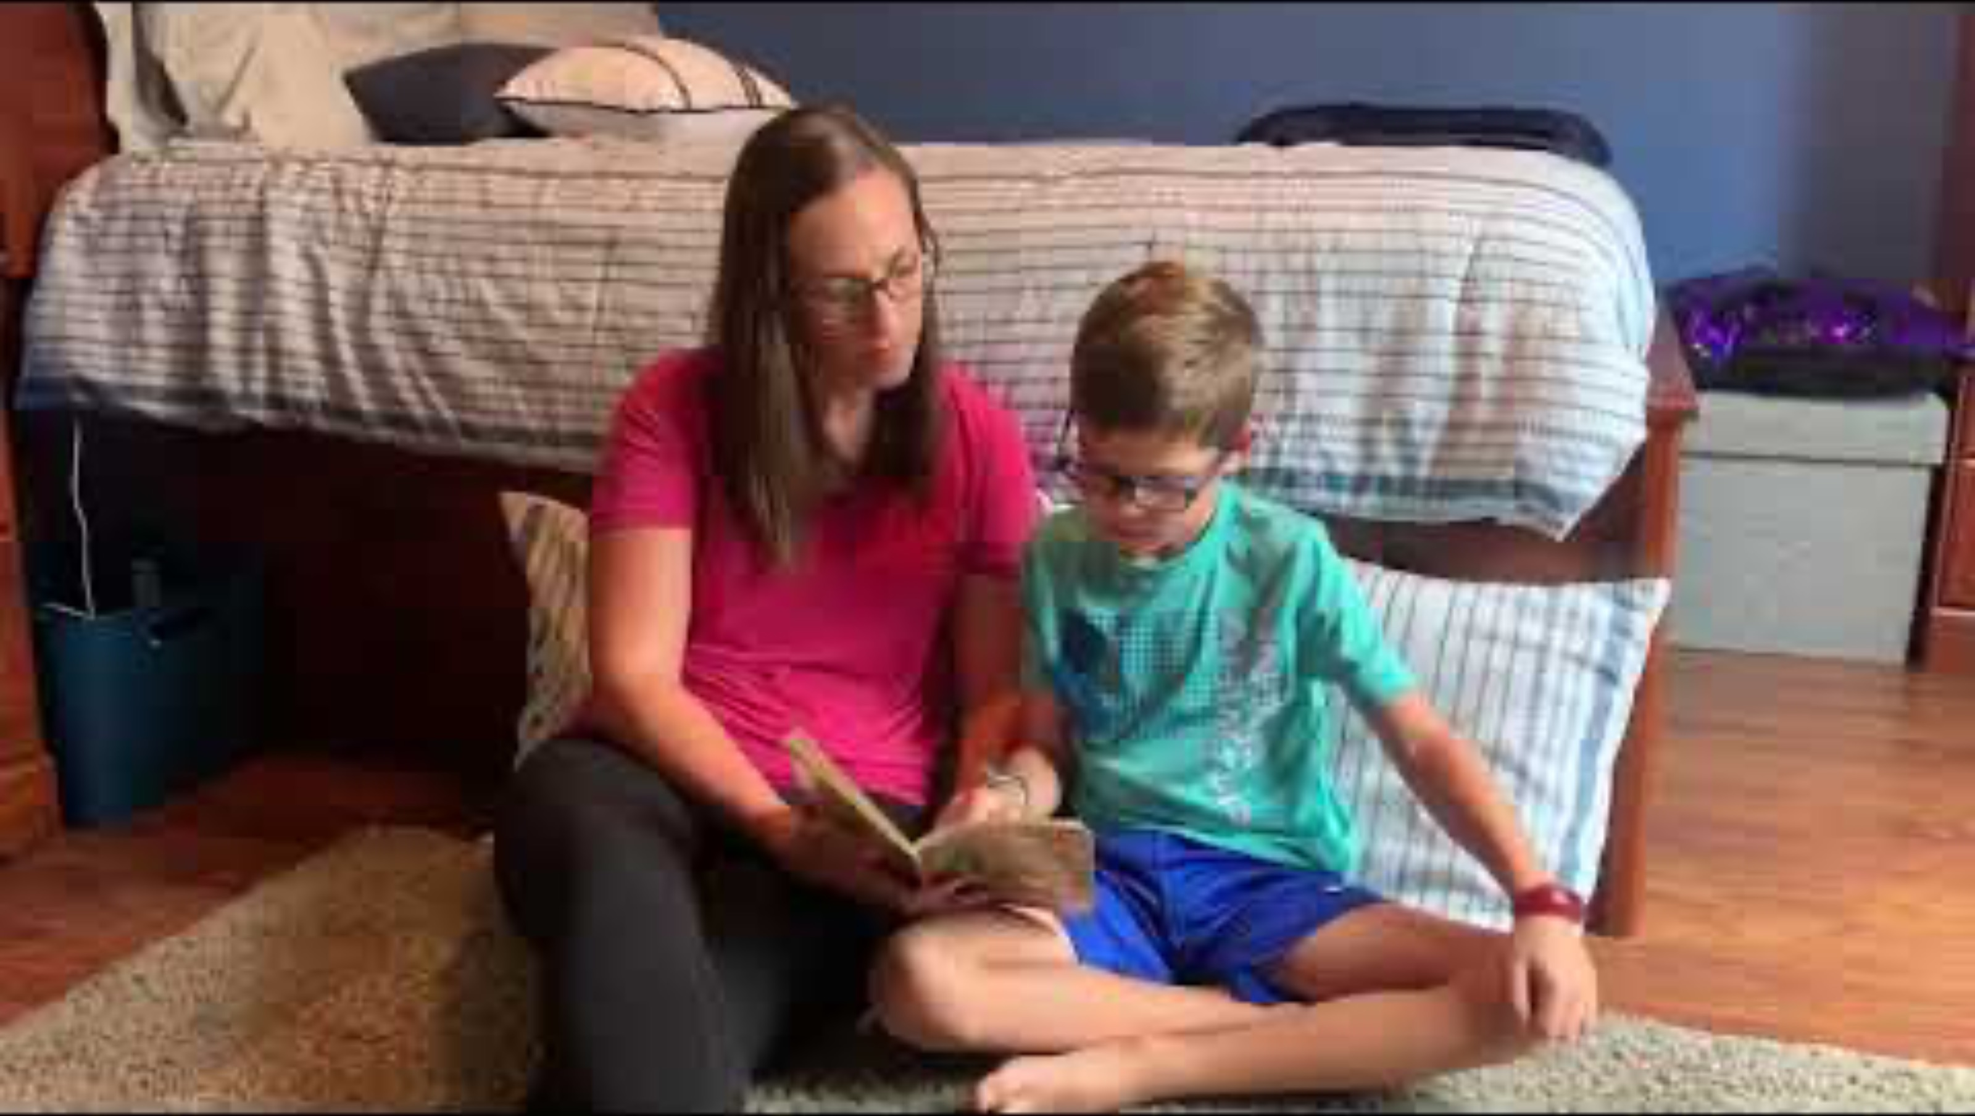
Practice 3: Alternated Reading & Reading Together
Key Points About the Video:
Parent explains what a prologue is (an introduction to the book that tells what happened before chapter 1).
Parent and child take turns reading so parent can model fluent reading.
Parent provides child tips on how to read with expression by reminding him what to do at punctuation marks.
Practice Reading Out Loud with Alternated Reading Bookmark
(Institute of Education Sciences, n.d.)
Notes:
Practice 3 can be use with older students and combines two practices: alternated reading and reading together.
Oral reading practice is when children read out loud. It is very important that children in third grade have many opportunities for oral reading practice with a proficient reader that listens and offers help when needed.
Alternated reading is when you and your child take turns reading a paragraph, page, or chapter out loud. You child continues reading, picking up where you left off.
Reading together means you and your child read the same thing out loud at the same time. When you read at the same time, make sure your child follows along by pointing to each word. You can slow your pace of reading down a little when you read at the same time. Always offer positive encouragement and let your child know how proud you are because he or she is practicing reading.
Key Points About the Video:
Parent explains what a prologue is (an introduction to the book that tells what happened before chapter 1).
Parent and child take turns reading so parent can model fluent reading (reading correctly, at a conversational pace, and with expression).
Parent provides child tips on how to read with expression by reminding him what to do at periods, question marks, and explanation marks.
FACILITATOR NOTES:
Before watching the video, read the Key Points About the Video so participants know what to focus on.
Watch Video 1: Alternated Practice & Reading Together (Closed captioning is available. Enable by clicking on the black CC box at the bottom of the video.)
After watching the video, give participants time to practice the linked activities with their paired verbal fluency partner(s).
Tell parents to use the bookmark as a reminder of the importance of reading every day with children. One side of the bookmark describes Alternated Reading Echo Reading and the other side describes Reading Together

Slide 40
Key Takeaways | Fluency
Fluency is the ability to read words with sufficient accuracy, rate, and prosody to comprehend what is read
Fluency is the bridge connecting Word Recognition and Language Comprehension
Fluency gradually builds over time through instruction and practice
Oral reading practice supports fluency development
Notes:
Let’s wrap up the presentation by revisiting some Key Takeaways about Fluency.
Fluency is the ability to read words with sufficient accuracy, rate, and prosody to comprehend what is read.
Fluent readers recognize words automatically, allowing them to dedicate cognitive resources to more complex processes.
Fluency is the bridge connecting Word Recognition and Language Comprehension.
Fluency enables comprehension and supports motivation. Children who read fluently are more likely to read, build vocabulary, and understand more).
Fluency gradually builds over time through explicit, systematic instruction and practice.
Developing reading fluency is a gradual process that requires consistent practice and exposure to different types of texts.
Oral reading practice supports fluency development.
When children read aloud simultaneously with a more fluent reader, either at school or at home, they practice their own skills while also hearing someone else make meaning of the same text. This can also take the form of echo reading. Reading together allows children to practice prosody in a supportive and collaborative environment. This regular practice helps boost the confidence and motivation that assists children in developing fluency.
Share Handout 3: Fluency for Parents handout

Slide 41
Torgeson Quote.
“There is no comprehension strategy that compensates for difficulty reading words accurately and fluently.”
(Torgesen, 2010)
Notes:
There is no comprehension strategy that compensates for difficulty reading words accurately and fluently.
In other words, fluency is not just reading fast. And it goes beyond simply sounding out words, to developing a deep understanding of what they’re trying to say. Fluency allows readers to connect ideas, recognize patterns, and infer meanings. Fluency connects readers not just to words, but to emotions and expressions, characters and connotations. And it’s also where reading starts to foster joy.

Slide 42
Do You Want to Learn More?
Visit the CDE Parent Resources Website
Notes:
Do You Want to Learn More?
There are more resources for parents on the CDE Parent Resources Website including videos of activities you can do at home.

Slide 43
References 1
Adams, M. J., Foorman, B. R., Lundberg, I., & Beeler, T. (1998). Phonemic awareness in young children: A classroom curriculum. Brookes Publishing.
Birsh, J. R. & Carreker, S. (2018). Multisensory teaching of basic language skills (4th ed.). Brookes Publishing.
Boulton, D. (2003). Children of the code [Documentary series]. Learning Stewards.
Cassar, M., Treiman, R., Moats, L., Pollo, T. C., & Kessler, B. (2005). How do the spellings of children with dyslexia compare with those of nondyslexic children? Reading and Writing, 18(1), 27–49.
Colorado State Board of Education. Rules for the Administration of the Colorado Reading to Ensure Academic Development Act (READ act). 1 CCR 301-92, March, 2020.
Ehri, L. C., Nunes, S. R., Stahl, S. A., & Willows, D. M. (2001). Systematic phonics instruction helps children learn to read: Evidence from the National Reading Panel's meta-analysis. Review of Educational Research, 71(3), 393–447.
Garnett, K. (2018). Fluency in learning to read: Conceptions, misconceptions, learning disabilities, and instructional moves. In J. R. Birsh & S. Carreker (Eds.), Multisensory teaching of basic language skills (4th ed., pp. 467–481). Brookes Publishing.
Gillon, G. T. (2004). Phonological awareness: From research to practice. Guilford Press.
Gough, P. B. & Tunmer, W.E. (1986). Decoding, reading, and reading disability. Remedial and Special Education, 7(1).
Hanna, P. R., Hanna, J. S., Hodges, R. E., & Rudorf, E. H. (1966). Phoneme–grapheme correspondences as cues to spelling improvement. Washington, DC: U.S. Department of Health, Education, and Welfare.

Slide 44
References 2
Hasbrouck, J. (2020). An update to the National Reading Panel Report: What we know about fluency in 2020. The Reading League Journal, 1(3), 29-31.
Hasbrouck, J. & Tindal, G. (2017). An update to compiled ORF norms (Technical Report No. 1702). Eugene, OR, Behavioral Research and Teaching, University of Oregon
Institute of Education Sciences. (n.d.). [YouTube channel]. YouTube. https://www.youtube.com/@InstituteofEducationSciences
Kamhi, A. G., & Catts, H. W. (1989). Reading disabilities: A developmental language perspective. Allyn & Bacon.
Kemeny, L. (2023). 7 mighty moves: Research-backed, classroom-tested strategies to ensure K-to-3 reading success. Scholastic Professional.
Kilpatrick, D. A. (2015). Essentials of assessing, preventing, and overcoming reading difficulties. Wiley.
Kuhn, M. R., Schwanenflugel, P. J., Meisinger, E. B., & Levy, B. A., & Rasinski, T. V. (Eds.). (2010). Aligning theory and assessment of reading fluency: Automaticity, prosody, and definitions of fluency. Reading Research Quarterly, 45(2), 230–251.
Lane, H. B., & Pullen, P. C. (2004). Phonological awareness assessment and instruction: A sound beginning. Allyn & Bacon.
Lonigan, C. J., & Shanahan, T. (2008). Executive summary of the report of the National Early Literacy Panel. Developing early literacy: Report of the National Early Literacy Panel, 1–8. National Center for Family Literacy.
Moats, L.C. (2020). Speech to Print Workbook: Language Exercises for Teachers (3rd ed.). Brookes Publishing.
Moats, L. C. (2020). Teaching reading is rocket science (2nd ed.). In L. Diamond & L. Thorsnes (Eds.), Teaching reading sourcebook (3rd ed., pp. 9–30). Arena Press.

Slide 45
References 3
National Early Literacy Panel. (2008). Developing early literacy: Report of the National Early Literacy Panel. National Center for Family Literacy.
National Reading Panel. (2000). Teaching children to read: An evidence-based assessment of the scientific research literature on reading and its implications for reading instruction (NIH Publications No. 00-4769) Washington, DC: National Institutes of Child Health and Human Development.
National Institute of Child Health and Human Development. (2000). Report of the National Reading Panel: Teaching children to read: An evidence-based assessment of the scientific research literature on reading and its implications for reading instruction (NIH Publication No. 00-4769). U.S. Government Printing Office.
Reading Rockets. (n.d.). Reading 101: A guide for parents. https://www.readingrockets.org/literacy-home/reading-101-guide-parents.
Reading Universe. (n.d.). Word recognition. Reading Universe. https://readinguniverse.org/explore-teaching-topics/word-recognition
Reitsma, P. (1983a). Printed word learning in beginning readers. Journal of Experimental Child Psychology, 36, 321-339.
Reitsma, P. (1983b). Word-specific knowledge in beginning reading. Journal of Research in Reading, 6, 41-56.
Rules for the Administration of the Colorado Reading to Ensure Academic Development Act, 1 Colo. Code Regs. 301-92, (2017).
Scarborough, H. S. (2001). Connecting early language and literacy to later reading (dis)abilities: Evidence, theory, and practice. In S. Neuman & D. Dickinson (Eds.), Handbook for research in early literacy. New York: Guilford Press.
Sedita, J. (2021). The keys to beginning reading [Professional development materials]. Keys to Literacy.
Stahl, S. A., & Kuhn, M. R. (2002). Making it sound like language: Developing fluency. The Reading Teacher, 55(6), 582–584.
The Reading League. (2022). Science of Reading: Defining guide (2nd ed.). The Reading League.

Slide 46
References 4
Torgesen, J. K. (1998). Catch them before they fall: Identifying and helping children with reading difficulties in early grades. American Educator, 22(1–2), 32–39.
Torgesen, J. K. (2004). Lessons learned from research on interventions for children who have difficulty learning to read. In P. McCardle & V. Chhabra (Eds.), The voice of evidence in reading research (pp. 355–382). Paul H. Brookes Publishing.
Wolf, M. & Katzir-Cohen, T. (2001). Reading fluency and its interventions, Scientific Studies of Reading, 5, 211-239.
Yopp, H. K., & Yopp, R. H. (2009). Phonological awareness is child's play! Young Children, 64(1), 12–17.

