Slide 1
Resources needed for this presentation (Keep this slide hidden)
A way to project the PowerPoint
  Note for presenters: For accessibility, you must read the words on the slides. The words bolded in the notes are the words from the slide.
Adequate audio for playing videos (test audio and video before presentation)​
  Classroom Example: How to Introduce a New Letter
  Small Group Example: Blending Sounds to Read Words
  Practice 1: Consonants and Short Vowel Practice Using Junk Mail
  Practice 2: Let’s Read Words and Sentences
Writing utensils
Print these documents:
  Provide blank paper for participants to take notes for discussion
  Handout 1: Consonant and Short Vowel Practice
  Handout 2: Let’s Read Words and Sentences
  Handout 3: Phonics for Parents Handout
Estimated time of presentation: 78 minutes
  Content: 40 minutes
  Optional Classroom Example Videos: 18 minutes (slides 39, 40,43, 44)
  Parent Activities: 20 minutes

Slide 2
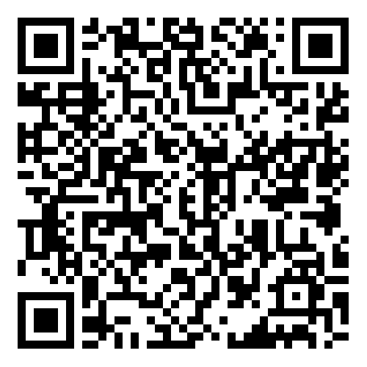

Phonics
The Colorado READ Act and
the Science of Reading for Families
Notes:
Welcome and thank you all for joining us today.
This is a presentation within the Colorado READ Act and the Science of Reading for Families series developed to support parents with ways to help their children build reading skills in partnership with their child’s school. ​
During this presentation, we will be focusing on Phonics
For more information or additional resources, please visit the READ Act Parent Resources page found within the CDE website. (QR Code on the slide)
Background for presenters:
The READ Act encourages local education providers to provide parent opportunities to participate in parent reading workshops throughout the school year to assist parents in developing their own reading skills and in developing the skills necessary to assist their children in reading. We hope this series will be helpful to you as parents (CRS 22-7-1208 (4)).
The Colorado READ Act statute defines the term “parent’ as a student’s biological or adoptive parent, stepparent, foster parent, or legal guardian(CRS 22-7-1203 (8)(a)).
For brevity purposes, we have adopted this definition throughout the presentation. When we use “Parent” during the presentation we mean family or caregiver aligned with the language of the law.

Slide 3
Welcome | Phonics
First Name Last Name, Title
Organization
Contact Information
Notes:
Welcome, we are glad you are here.
Share your name, title and contact details
If time, share a bit about your journey as an educator and/or parent that would be relevant to this session.
Logistics: Share the following points that match your circumstance
This presentation includes active captions.
Presenters will be using a microphone.
We ask that audience members use a microphone when asking questions.
If on zoom: Please keep your microphone on mute unless you are sharing with the group.
Presenters will be reading the content on each slide to ensure that it is accessible for ALL participants.
FACILITATOR NOTES:
For accessibility, you must read the words on the slides. The words bolded in the notes are the words from the slide.

Slide 4
Outcomes | Phonics
What is phonics?
Why is phonics important?
What does phonics look like at school?
How can you support phonics at home?
Notes:
By the end of this presentation the outcome is for you to be able to answer these questions.
What is phonics?
Why is phonics important?
What does phonics look like at school?
How can you support phonics and decoding at home?
Take a moment to think about which agenda question(s) you are very interested in learning about in our time together (Give 1 minute of think time).
We have provided writing utensils and paper at each table.
Later in the session, we will be talking in partners about what we have heard and learned about these questions.

Slide 5
Norms | Phonics
Active listening is appreciated
Active participation is welcomed
Take care of your own needs
Silence your cell phone as a courtesy to all
Notes:
We hope this will be an engaging and informative time for everyone participating. Please work to follow these norms:
Active listening is appreciated
Active participation is welcomed
Please take care of your own needs
If in-person, share where the restrooms and water stations are located, as needed.
If presenting virtually, you might consider asking participants to leave cameras on as they are able.
Silence your cell phone as a courtesy to all
Are there any other items you think we should add to this list that will support all of us?

Slide 6
Warm-Up | Phonics
Like Me
Move chairs back from the table so it is easy for you to stand up.
A category will be named.
Stand if you match the category.
Look around to see who else is also in the category.
Introduce yourself
Notes:
We are going to start with a Warm-up activity called (CLICK) Like Me (Adjust the mobility section of the activity according to the abilities of the participants in the room).
We are doing this activity because:
We want to begin to turn this room of individuals into a group that works together
This activity focuses the energy into this room and out of your day or previous activities, so you feel ready to participate
You will begin to understand who you are in relation to others in the group
Here is how this activity will work. I will read all of the steps, ask for questions and then we will begin the activity.
(CLICK) Move chairs back from the table so it is easy for you to stand up. (Adjust the mobility section of the activity according to the abilities of the participants in the room. If presenting virtually, ask participants to stand in front of their camera or use the thumb's up reaction button).
(CLICK) A category will be named.
(CLICK) Stand if you match the category.
(CLICK) Look around to see who else is also in the category.
(CLICK) Introduce yourself
FACILITATOR NOTES:
Read the activity steps.
Ask if participants have questions.
Start activity at step 1.
Name some (5-10) of the following categories (or create your own to match your community) and give time for people to stand: (facilitators should also participate by standing or staying seated):
I am a parent
I have a child in kindergarten, 1st, 2nd, or 3rd grade.
I have more than one child in elementary school.
I have a middle or high schooler in addition to my elementary student or students.
I live within walking distance of the school.
I work in this community.
I attended this school (or another school in this district).
I grew up in this town/city.
I am new to this community within the last 2 years.
I speak more than one language at home.
I enjoy attending school or community events with my family.
I share family stories, traditions, or sayings with my child or children.
My child or children enjoy playing word games or singing silly songs.
I have noticed my child sounding out letters or words.
I have listened to my child or children read the same book more than once.
I believe reading will help my child or children in future.
Have the parents go around the room and share: (if group is large, make small groups for this activity)
Name
Grade of Child(ren)

Slide 7
Simple View of Reading (SVR)
Word
Recognition
Language
Comprehension
=
Reading
Comprehension
X
(Gough & Tunmer, 1986)
Notes:
Several decades of reading research has given us a clear understanding of how students best learn to read. One way to conceptualize reading is through the Simple View of Reading (SVR) model. This model developed by Gough and Tunmer organizes the skills needed to become a proficient and successful reader into two categories: (CLICK) word recognition and (CLICK) language comprehension. The Simple View of Reading is a basic formula for (CLCK) reading comprehension.
It says this: reading comprehension is the product of word recognition skills and language comprehension skills.
We need both sides of the equation for students to become skilled, proficient readers. (CLICK)
Students need efficient word recognition or decoding skills where they are accurately and automatically reading the words on the page without aid of context clues or pictures. (CLICK)
They also need fully developed language comprehension skills which references the ability to understand language.
In order for a student to understand text, they need to decode the words on the page and then make meaning of the words, sentences, and overall text.
(https://www.cde.state.co.us/coloradoliteracy/scienceofreadingresources)

Slide 8
Simple View of Reading (SVR) | The 5 Components of Reading
Word
Recognition
Language
Comprehension
=
Reading
Comprehension
X
Phonological Awareness
Phonics
Vocabulary
Language- based skills and strategies
Literacy knowledge and skills
Fluency
Oral Language
(Gough & Tunmer, 1986; NRP, 2000)
Notes:
We can use the Simple View of Reading to organize the Five Essential Components of Reading.
(CLICK) Word recognition skills require phonological awareness (attention to the sounds in our language) and phonics (the ability to connect sounds to the letters that represent them).
(CLICK) Language comprehension is supported by vocabulary knowledge (knowing and understanding the meanings of words). In addition, vocabulary knowledge can also support word recognition, particularly as students encounter more complex or irregular words that require familiarity with word parts (morphemes) or context to decode and understand.
Readers also need a variety of language-based skills and strategies such as inferencing, understanding syntax and sentence structure, and utilizing background knowledge. To comprehend text, we must also acquire literacy knowledge and skills, such as understanding text structure and literary genres.
(CLICK) Reading Fluency acts like a bridge that connects word recognition and language comprehension to support understanding when reading (Sedita, 2019).
(CLICK) Oral language is the foundation for skilled reading and literacy development and needs to be integrated throughout all components.
As we become better readers, our reading skills, in turn, help us develop more complex thinking, communication, and language skills (Kamhi & Catts, 1989; Lonigan & Shanahan, 2012).
Each component acts as a piece of the larger whole, similar to a puzzle. Effective reading instruction is not complete without ensuring that all five components, and oral language, are taught.

Slide 9
Simple View of Reading (SVR) | The 5 Components of Reading 2
Word
Recognition
Language
Comprehension
=
Reading
Comprehension
X
Phonological Awareness
Phonics
Vocabulary
Language- based skills and strategies
Literacy knowledge and skills
Fluency
Oral Language
(Gough & Tunmer, 1986; NRP, 2000)
Notes:
Let’s explore the Simple View of Reading (SVR) and Phonics in more detail.

Slide 10


What is Phonics?
Notes:
What is Phonics?
Over time, there have been many approaches to teaching reading. Decades of scientific research have proven that phonics is an elemental component of early literacy instruction.

Slide 11
1What is Phonics?
Phonics is the study of the relationships between the letters and the sounds they represent.
Phonics instruction is a method of teaching people to read by explicitly teaching sound-symbol correspondences.
(Birsh & Carreker, 2018)
Notes:
What is phonics?
Phonics is the study of the relationships between the letters and the sounds they represent.
Phonics instruction is a method of teaching people to read by explicitly teaching sound-symbol correspondences.

Slide 12



Phoneme vs. Grapheme
SPEECH
SOUND
Letter or letters that represent a speech sound
m
Phoneme
Grapheme
Notes:
There are special terms we use when talking about speech sounds and the letters that represent those sounds.
A phoneme is a speech sound. It’s the smallest unit of sound. English has approximately 44 speech sounds.
We use letters to represent, or stand for, speech sounds. A grapheme is the term for the letter or letters that represent a speech sound. In English, a speech sound can be represented by a single letter, or it can be represented by a combination of letters. This is why the term grapheme is more precise than the term “letter.”
CLICK = For example, one phoneme is /m/, the first sound in ‘moon.’
CLICK = We represent this sound with the grapheme ‘m’.
Phonics instruction involves teaching students to connect the individual phonemes in words to the graphemes we use to represent those sounds in print.

Slide 13

It Starts with Sounds
/k/
/a/
/t/
Notes:
Before we begin phonics instruction with students, it starts with sounds. It is important that they can attend to the individual speech sounds in words. This is called “phonemic awareness.” For example, there are three phonemes in the word cat: /k/ /a/ /t/.
Phonemic awareness typically begins with the ability to isolate the first sound in a spoken word (CLICK).
Once a child can accurately identify the beginning sound, we can then focus on isolating the ending sound (CLICK).
Isolation of the middle sound in a three-phoneme word comes last (CLICK).
A student who can isolate beginning, middle and ending sounds is ready to blend and segment simple words in print.

Slide 14

The Alphabetic Principle
The concept that letters and letter patterns represent the sounds of a spoken language
26 letters in the English alphabet combine in many ways to spell the 44 spoken sounds in the English language
Students identify alphabet letters by form, letter name, and the sound each letter represents.
Notes:
At the same time, students are gaining knowledge of the alphabetic principle, the concept that letters and letter patterns represent the sounds of a spoken language .
There are 26 letters in the English alphabet that combine in many ways to spell the 44 sounds in the English language.
Students learn to identify the letters of the alphabet by their form, both uppercase and lowercase, by the letter name, and by the sound each letter represents.

Slide 15
Matching Sounds to Print
/k/ /a/ /t/
/k/ /a/ /t/
c
a
t
Notes:
Once students can pull apart the individual speech sounds in words and understand that we use letters to represent these sounds, we can begin to teach how to match the sounds we hear in spoken words to the letters that represent those sounds in print.
For example, when a child can segment the sounds /k/ /a/ /t/ in the spoken word ‘cat,’ they are ready to start matching the letters to the sounds: C – A – T. This is phonics!

Slide 16
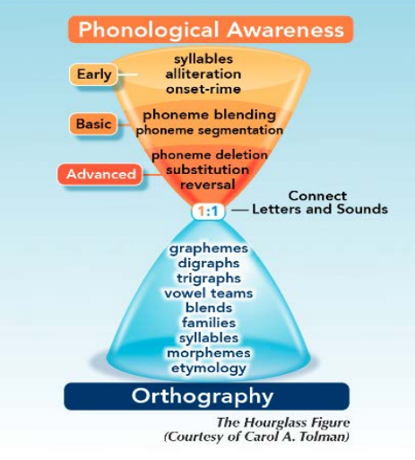
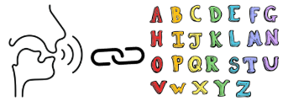

Tolman’s Hourglass
Notes:
Dr. Carol Tolman designed an excellent graphic that shows the progression of learning as we teach students to match sounds to print. The Hourglass figure shows that we begin by teaching students to pay attention to the sounds of our language, until they can pull apart and work with individual speech sounds in words.
(CLICK) Then, as we see in the center of the hourglass, students can connect these sounds to individual letters in the alphabet.
(CLICK) Once students understand this connection, they can begin to work with more complex sound/symbol correspondences, such as digraphs (two letters that make one speech sound), like the letters sh representing the /sh/ sound; trigraphs (three letters that make one speech sound), like –tch for /ch/ in the word patch; and vowel teams (more than one letter that represents a vowel sound), like ‘oa’ for the long /o/ sound in boat, and ‘oi’ for the /oy/ sound in coin. As students progress, they will learn about the six basic syllable types to support reading and spelling longer words, and about word parts that affect meaning, such as prefixes, suffixes and root words.
Facilitator Note:
Long-form caption for The Hourglass Figure image included in Appendix A on slide 51

Slide 17


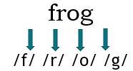
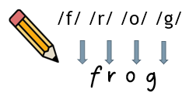
Decoding & Encoding
Decoding
Process of Reading
Encoding
Process of Spelling
“frog”
Notes:
During phonics instruction, we teach students how to DECODE and to ENCODE.
Decoding is the process of reading, which involves sounding out a written word and blending those sounds together to read the word. For example, when a student sees the word frog in print, they identify the sounds of each letter, /f/, /r/ /o/ /g/, and then blend the sounds together to read the word: FROG.
Encoding is the process of spelling, which involves thinking of a word, breaking the word into sounds, and writing the letter or letters that represent each sound. So when a student wants to write the word frog, they must think about each sound in the word, /f/ /r/ /o/ /g/, and then write down the letters that represent those sounds, f-r-o-g.
Encoding is much more difficult because you have to recall the letter patterns in your mind in order to write them. Early spelling is often not accurate because young readers are in the initial stages of learning how English spelling works. This is developmentally appropriate and follows a predictable progression.
Spelling reinforces decoding and decoding reinforces spelling. Phonics is not just for teaching reading; it is equally important for teaching spelling.

Slide 18




Early Phonics – Syllable Types
Closed | Open | Silent E | Vowel Team | R-Controlled | Final Stable
ro·bot
to·ma·to
note·book
mar·ble
Notes:
Early phonics instruction also includes learning about the six basic syllable types in English.
A syllable is a word or word part that includes a vowel or a vowel sound.
Six written syllable-spelling conventions are used in English spelling. These conventions help teachers and students organize phonics patterns and know when to use short, long, or variant vowel sounds when decoding words. The six basic syllable types are called closed, open, silent E, Vowel Teams, R-Controlled vowels, and Final Stable Syllables,
Learning the six syllable patterns in the English language provides a reliable strategy for reading approximately 96% of words.
Typically, students begin learning closed and open syllables in kindergarten, and most of the remaining syllable types by the end of first grade.
Open and Closed syllables make up almost 75% of syllables in English words.
Knowledge of the syllable types provides a foundation for reading longer, multisyllabic words.
For example: (CLICK) Robot is a word made up of an open syllable (ro) and a closed syllable (bot).
The word notebook is made up of a silent e syllable (note), and a vowel team syllable (book).
The word marble is made up of an r-controlled (or bossy r)syllable (mar) and a final stable syllable(-ble).
Finally, the word tomato is made up of three open syllables – to-ma-to.

Slide 19
Advanced Word Study - Morphology
Morphology is the study of meaningful units of language, called morphemes, and how they are combined in forming words.
Knowledge of word parts, including prefixes, suffixes, and roots, increases children’s ability to determine the meaning of unknown words.
Inflectional endings are often the beginning of morphology instruction. (e.g. –ed/-ing;-s/-es; -er/est)
About 60% of word meanings can be predicted through their morphemes.
dog + more than one
dogs
jump + already happened
jumped
(Nagy & Anderson, 1984)
Notes:
Finally, once students have learned the most useful sound/syllable correspondences, phonics instruction advances to more complex word study and shifts to a focus on morphology.
Morphology is the study of meaningful units of language, called morphemes, and how they are combined in forming words.
Knowledge of word parts, including prefixes, suffixes, and roots, increases children’s ability to determine the meaning of unknown words.
- Students begin to understand and use basic morphological knowledge in reading and writing as early as kindergarten and first grade. Inflectional endings - suffixes that change number, tense or degree – are often the beginning of morphology instruction. Examples include the endings –ed/ –ing, the plural marker –s/-es and –er/-est .
For example, to show more than one dog, we can add an s at the end of the word. (CLICK)
Another example, to show an event already happened, we can add an –ed at the end of the word, so the word jump becomes jumped.
About 60% of word meanings can be predicted through their morphemes. (Nagy & Anderson, 1984)
As students learn about adding prefixes and suffixes to base words or root words, they are also learning predictable spelling rules that help them internalize conventional spelling patterns for words.

Slide 20
What is Phonics Instruction?
Effective phonics instruction is instruction that explicitly teaches the sound-symbol correspondences.
There is a logical order to teaching phonics skills that goes from simple to more complex letter patterns.
As each new skill is learned, students practice in text that is controlled to include patterns they have already learned (decodable text).
Notes:
Effective phonics instruction is instruction that explicitly teaches the sound-symbol correspondences in the language.
There is a logical order to teaching phonics skills that goes from simple to more complex letter patterns.
As each new skill is learned, students are provided ample practice in text that is controlled to include patterns they have already learned. This is called decodable text.
When students are able to automatically decode words, children can shift their attention to comprehending what they read.

Slide 21
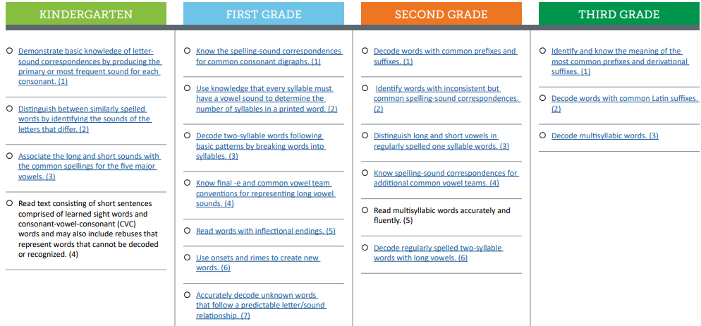
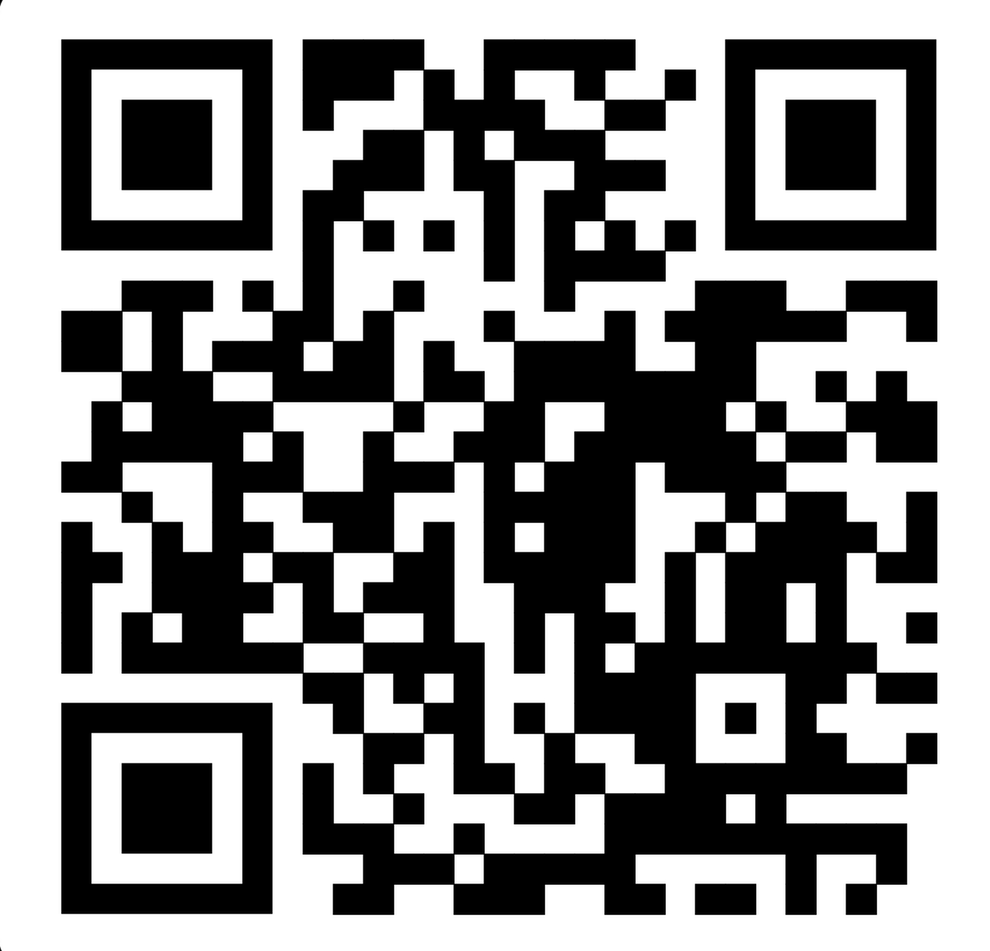

CO Minimum Reading Competency Skills for Phonics
Basic letter/sound correspondences → complex spelling patterns
Includes syllable types, morphology, and multisyllabic word reading
Progresses in complexity over time
Through all instruction, students should be practicing new skills in decodable text
Notes:
The Colorado READ Act contains Minimum Reading Competency Skills for Phonics. These minimum competencies are outlined in a kindergarten through third grade progression in the Minimum Reading Competency Skills Matrix and align to the READ Act approved interim reading assessments for these grades. QR code to access the skills matrix is on this slide.
In kindergarten, students begin phonics instruction by learning letter names and letter formation as they are developing phonemic awareness. Students begin by basic letter/sound correspondences and progress through increasingly complex phonic spelling patterns until they reach more advanced word study skills by third grade.
The phonics skill progressions includes instruction in syllable types, morphology, and multisyllabic word reading.
The scope and sequence of phonics skill instruction progresses in complexity over time.
Through all instruction in the early grades, students should be practicing new skills in decodable text, which means text that contains the patterns they have been previously taught.

Slide 22
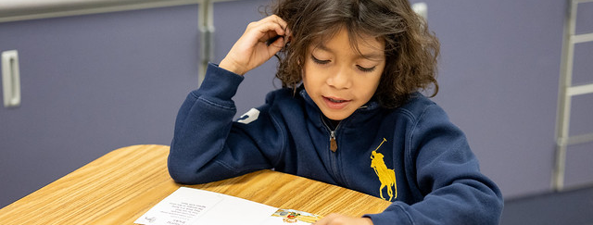
Why is Phonics Important?
Notes:
Why is Phonics Important?

Slide 23


English Orthography is Complex
Spanish
23 phonemes
18 consonants
5 vowels
Regular sound/symbol correspondences
“transparent”
Meaning structures that affect spelling and pronunciation
    44 phonemes
    25 consonants
    19 vowels
English
Less direct sound/symbol correspondences
“opaque”
Notes:
“Orthography” is the formal term for the conventional spelling system of a language.
Many of the world’s languages have what is termed a “transparent” orthography, or spelling system. These languages tend to have fewer individual speech sounds, including a limited number of vowel sounds, and very regular sound/symbol correspondences. For example, Spanish contains only 23 phonemes with just 18 consonants and 5 vowel sounds. The letters or graphemes that represent the speech sounds are highly regular and predictable; in most cases a single letter represents a single sound. As an example, the grapheme ‘o’ in Spanish always represents a single sound.
In contrast, languages with “opaque” orthographies, like English, tend to have more phonemes and often a variety of ways to spell the sounds. English has 44 phonemes with 25 consonant sounds and 19 vowel sounds and has around 250 ways to spell the 44 phonemes! Therefore, the sound/symbol correspondences are less direct. Sometimes two, three, or four letters are combined to represent one speech sound.
English also has meaning structures that affect spelling and pronunciation of words. We say that English is a morphophonemic language, relying both on speech sound and meaning structures. This makes English much more complex to learn to read, and requires a structured, systematic approach to teaching.

Slide 24
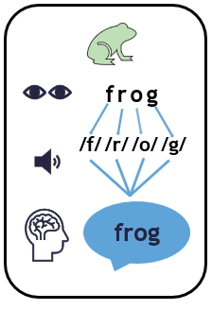
The Process of Orthographic Mapping
Notes:
Orthographic mapping is the term Dr. Linnea Ehri popularized to label the process that happens in the brain that allows us to turn an unfamiliar word in print into a word we recognize automatically, without having to sound them out each time. Contrary to common belief, we do not memorize words by the way they look or as a whole unit.
Here’s how it works: while we may think that we can look at a word and instantly know it as a whole word, our brain is actually paying attention to every letter and connecting what we know about the sound/symbol correspondences.
When we are reading an unfamiliar word for the first time, we must break the word apart and attach what we know about the sound each letter or group of letters makes, then blend the sounds together to make the word.
Once we have used this process a few times, the brain gets more efficient at instantly recognizing the sound/symbol relationships, until it can process the word instantly. For most people, this process takes from one to four exposures to the word. For people who struggle with learning to read, more exposures to the word might be necessary before the word is known “by sight.”
Since English is a more complex language and has hundreds of spelling patterns, explicitly teaching the most common patterns supports the process of orthographic mapping by helping readers make the connections between sounds and spelling more efficiently.
Phonics is important for supporting orthographic mapping. Proficiency in sound/symbol correspondences and understanding the “code” of the English language is essential for students to become automatic and fluent readers.

Slide 25
Phonics - Ways to Spell Long /e/ Sound
Spelling | Word
ee | meet
Notes:
Take the next minute to brainstorm different ways to spell the long /e/ sound.
For example, one way to spell the long /e/ sound is ee, as in the word meet.

Slide 26
2Phonics - Ways to Spell Long /e/ Sound
Spelling | Word
ee | meet, free
ea | eat, peach
ie | chief
y | funny
e | me
i | variation
Spelling | Word
ey | key
ei | receive
eo | people
oe | amoeba
ae | archaeologist
ix | Grand Prix
Notes:
The left side lists the more common spellings for the long /e/ sound with /ee/ being the most common, in words such as meet, and free.
We also have
-ea, as in eat, and peach
-ie as in the word ‘chief’
-y that end the word “funny”
e, like in the open syllable me
And ‘I’, like in the word variation ( a spelling change when an ending is added)
Directly teaching the most common spelling patterns gives students a road map to tackle the majority of words they will encounter, especially in the early years of reading.
The right side lists less common spellings, which do occur, but with much less frequency. Even though this example may seem like there is an overwhelming variety of ways to spell in English, in truth, it is much more regular and predictable than it may appear.

Slide 27
Phonics - The English Language
ALL students benefit from phonics instruction—it leads to better
fluency, comprehension, spelling and writing.
50% of English words are completely regular (predictable sound/symbol correspondences)
34% of remaining words contain only one irregularity
About 12% more are predictable if origin, meaning, etc. are considered
ONLY 4% of English words are truly irregular
(Moats & Tolman, 2009)
Notes:
Because of its complexity, the English language is often regarded as one of the most difficult to master. The English language (like all languages) has predictable patterns, but also because of the nature of its development has many exceptions to common patterns. But English is fairly predictable in its orthography.
About 50% of English words are completely regular – they have predictable sound/symbol correspondences.
34% of the remaining words contain only one irregularity
About 12% more are predictable if things like language of origin and meaning are considered
ONLY 4% of English words are truly irregular.
This means that all students benefits from explicit, systematic phonics instruction. Quality instruction in phonics leads to better fluency, comprehension, spelling and writing.

Slide 28

5 Principles of Word Instruction
English words are spelled by:
Phoneme/Grapheme Correspondences
    sat, chin, meet
Predictable Letter Patterns
    safe, me, table
Position of a Sound in a Word
    crack, edge
Meaning
    nature → natural
Language of Origin
    archaeologist
(Moats, 2005)
Notes:
Having an understanding of why English words are spelled the way they are can help students learn them more readily, and strong phonics instruction and advanced word study are designed around these 5 principles of English spelling.
English words are spelled by: Sound/Symbol correspondences – the words sat, chin, and meet are examples of words spelled by matching phonemes to known grapheme correspondences
They are also spelled by predictable Letter patterns – Syllable type instruction helps students learn the most common spelling patterns to spell the vast majority of English words
We also spell by the position of a sound in a word. Some letter patterns are only used in certain positions in words, for example the ‘ck’ spelling like in the word crack only occurs at the end of a word. The letter “j” never ends a word in English, so we use -ge or–dge as in ‘edge’.
We also spell by meaning. The word “nature” is the root of the word “natural,” so the spelling remains, even though the words sound different.
And finally, we spell by language of origin. Many English words come from other languages, and so their spellings are often preserved. It is why the /k/ sound in “archaeologist” is spelled CH; because that is how the sound is spelled in its language of origin, Greek.
Moats, Louisa C. (2005). How Spelling Supports Reading. American Educator, Winter 2005/06, 12-43.

Slide 29
Importance of Phonics Instruction
Learning that there are predictable relationships between sounds and letters allows students to apply these concepts and read both familiar and unfamiliar words.
Decoding (reading) and encoding (spelling) activities are equally important in building these skills.
Through phonics instruction students learn the predictable patterns in English that includes the six syllable types and syllable division patterns.
Notes:
Learning that there are predictable relationships between sounds and letters allows students to apply these concepts and read both familiar and unfamiliar words.
Decoding and encoding activities are equally important in building these skills, and both should be included in daily lessons.
Through phonics instruction, students learn the predictable patterns in English. Predictable patterns are learned through the introduction of and lesson application in the six syllable types and syllable division patterns.
All of this supports students in more efficiently adding to their sight word bank, or words that they have processed enough times to recognize instantly.

Slide 30
Myth Buster - Phonics
MYTH
Phonics instruction is boring and unnecessary. Sounding out words slows down reading.
FACT
Phonics instruction can be fun! Sounding out words supports the development of fluent word reading.
Notes:
Over the past 50 years, educators have used lots of approaches to teach children to read.
The interdisciplinary body of scientifically based research, also referred to as the science of reading, helps us understand the skills and processes needed to read, and it also provides us with knowledge on how to teach students those skills effectively. (CLICK)
One myth left from the reading wars in in the 1990’s is phonics instruction is boring and unnecessary. Sounding out words slows down reading. (CLICK)
The fact is, phonics instruction can be fun! Sounding out words supports the development of fluent word reading.
Yes, sounding out words does slow reading down at first, but it is a necessary step on the journey to becoming automatic. Children need to do the hard work of sounding out words first.
Background for presenters:
Question: What is the alternative to using phonics for learning to read words?
The alternative is memorizing every word—not an efficient strategy, or
guessing words based on pictures and context– which only get children so far.

Slide 31
Paired Verbal Fluency I Phonics
What is phonics?
Why is it important for reading development?
Write down thoughts and ideas you could shared with a partner.
We will create partners A and B and take turns talking about the questions above.
At a signal, one will speak, and one will listen.
At a signal, the other will speak while the first speaker listens.
Each time, no one is allowed to repeat anything that was said by the other.
Notes:
To help us think about the information presented, we are going to use a conversation protocol called Paired Verbal Fluency to share with your partner about what phonics is and why it is important for reading development.
Write down thoughts and ideas you could shared with a partner.
We will create partners A and B and take turns talking about the questions above.
At a signal, one will speak, and one will listen.
At a signal, the other will speak while the first speaker listens.
Each time, no one is allowed to repeat anything that was said by the other.
FACILITATOR NOTES:
Read all of the protocol directions.
Ask if participants have questions.
Start at #1: Give participants 2-3 minutes to write down thoughts and ideas they could share with a partner.
Create partners
Determine who’s A and B.
Round 1: 60 seconds
Partner A speaks, Partner B listens
Round 2: 40 seconds
Partner B speaks, Partner A listens
Round 3: 20 seconds (Time permitting)
Partner A speaks, Partner B listens
Ask participants if there are any questions or comments before continuing presentation.

Slide 32
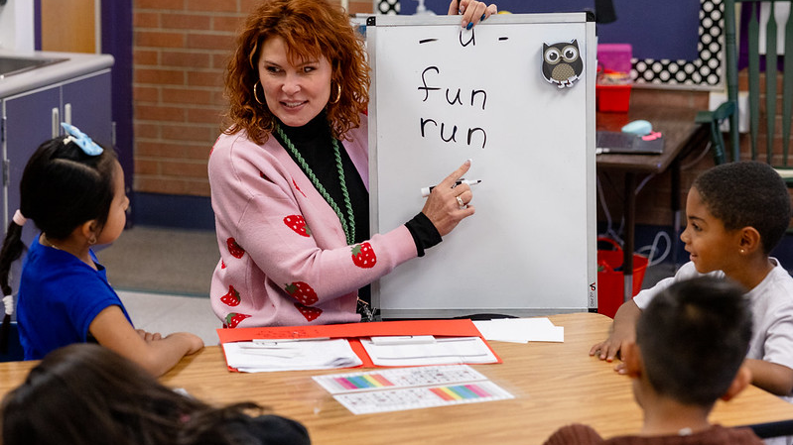
What Does Phonics
Look Like at School?
What Does Phonics Look Like at School?
Notes:
What Does Phonics Look Like at School?

Slide 33
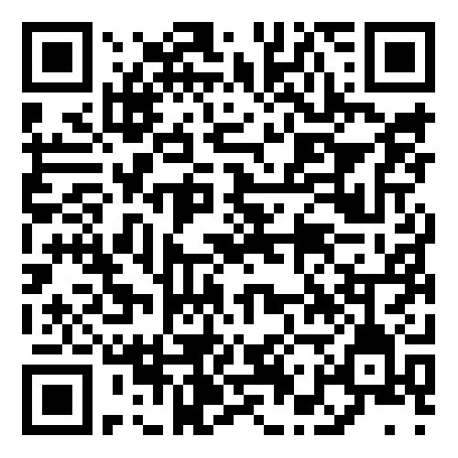

Colorado Academic Standards (CAS) I Phonics
Expectations for First Grade
Apply letter sounds (short and long vowels) and letter combinations to decode words (sound out and pronounce)
Understand word structure (how words are put together)
You May Find Students
Applying phonics rules (sounds of letters) to decode (sound out and pronounce) one- and two-syllable words
(CDE, 2020)
Notes:
Let’s explore how phonics is reflected in the Colorado Academic Standards (CAS).
This is an example of the expectations for first grade
Appling letter sounds (short and long vowels) and letter combinations to decode words (sound out and pronounce)
Understand word structure (how words are put together)
You May Find Students:
Applying phonics rules (sounds of letters) to decode (sound out and pronounce) one- and two-syllable words
Phonics is a critical skill needed for reading and is focused on heavily in the early school years
The bit.ly is attached for parents to save the link to the Family and Community Guides to the Colorado Academic Standards
Background for presenter:
Created by Coloradans for Colorado children, the Colorado Academic Standards provide a grade-by-grade road map to help ensure children are successful in college, careers, and life. The standards aim to improve what children learn and how they learn in 12 content areas while emphasizing critical thinking, creativity, problem solving, collaboration, and communication as essential skills for life in the 21st century.​
To support families, communities, and teachers in realizing the goals of the Colorado Academic Standards (CAS), the Colorado Family and Community Guides provide overviews of the learning expectations for children. ​
These guides offer some learning experiences children may engage in at school that may also be supported at home.​
As always, the best place to learn about what your child is learning is from your child's teacher.​
You can use the QR code to access the Family and Community Guides to the Colorado Academic Standards

Slide 34
2CO Minimum Reading Competency Skills for Phonics
Basic letter/sound correspondences → advanced word study
Includes syllable types, morphology, and multisyllabic word reading
Progresses in complexity over time
Through all instruction, students should be practicing new skills in controlled text
Notes:
As we reviewed earlier, The Colorado READ Act contains Minimum Reading Competency Skills for Phonics that are a part of the Colorado Academic Standards for phonics.
As a reminder, Students begin by basic letter/sound correspondences and progress through increasingly complex phonic spelling patterns until they reach more advanced word study skills by third grade.
The phonics skill progressions includes instruction in syllable types, morphology, and multisyllabic word reading.
The scope and sequence of phonics skill instruction progresses in complexity over time.
And, Through all instruction in the early grades, students should be practicing new skills in decodable text, which means text that contains the patterns they have been previously taught.

Slide 35
Effective Phonics Instruction
Systematic: Lessons are taught in a structured, predictable format, with many opportunities for feedback and cumulative practice.
Explicit: Important concepts and skills are taught very clearly and directly by the teacher. Children are not expected to infer these concepts and skills just from exposure alone.
Sequential: Lessons are taught in a logical order, from simple to more complex. Skills build on each other over time.
(IDA, 2020)
Notes:
Effective Phonics Instruction is systematic. Lessons are taught in a structured, predictable format, with many opportunities for feedback and cumulative practice.
Effective phonics instruction is explicit: Important concepts and skills are taught very clearly and directly by the teacher. Children are not expected to infer these concepts and skills just from exposure alone.
And, effective phonics instruction is sequential: Lessons are taught in a logical order, from simple to more complex. Skills build on each other over time.
This is HOW phonics instruction should be delivered. Now let’s take a look at WHAT types of activities you may see in a well-designed phonics lesson.

Slide 36


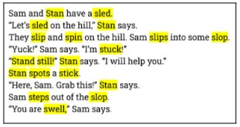

Early Phonics Instruction
Blending & Segmenting Words
Phoneme Grapheme Mapping
b a t
Practice with Decodable Text
Irregular Word Routine
Notes:
This slide shows a few examples of things you might see in your child’s classroom during early phonics instruction.
The teacher may be guiding students in blending and segmenting words by pointing to each letter in the word, having the students say the sounds, and then blending the sounds together to read the word. This is done during whole group and small group instruction to model decoding.
You might also see an activity called phoneme grapheme mapping, which is used to help students learn to encode, or spell, using a newly learned phonics pattern. This process teaches a student to break a word into individual phonemes and match the sound they hear to the grapheme that represents the sound. Each phoneme has its own box, or line, to help students connect the way a sound is spelled to the number of phonemes they hear in the word. For example, the word ‘desk’ has four phonemes, /d/ /e/ /s/ /k/, so there are four boxes to match the phoneme to the grapheme.
Students should also be provided practice with decodable text that includes the spelling pattern they are learning as well as spelling patterns they have already been taught. The example shown here clearly shows many examples of words with s-blends and would be used to allow students to practice reading words with s-blends after they have had instruction with this skill.
You also may see students practicing words that are hard to decode using an irregular word routine. These words are often called Heart Words, Tricky Words, or Rule Breakers. Students learn that some words don’t follow the usual rules, and they must learn the parts of the word that are irregular so that they can remember the word for reading and spelling. This routine helps students learn some of the high frequency words they need for early reading that don’t follow common spelling rules.

Slide 37



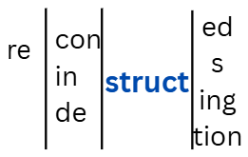
Advanced Word Study
Syllable Division
Spelling Rules
Multisyllabic Word Reading Routine
Morphology Instruction
Notes:
As students progress from early phonics into more advanced word study, usually in second and third grades, you may see them practicing syllable division generalizations to accurately read and spell longer words, as in the example word “fan tas tic.”
They also begin to learn generalized spelling rules, such as changing an end Y to I before adding a vowel suffix like –er, as in the example word “happier.”
You might see students utilizing a multisyllabic word reading routine where they circle any prefixes or suffixes before breaking down what is left of a word for reading, as we see here with the example word “unhappily.”
And finally, students may be practicing building words using meaningful parts like root words and expanding their knowledge about the meanings of common prefixes and suffixes through morphology instruction. Word matrices, similar to the image shown here, are one way teachers can scaffold word building with meaningful parts with students.

Slide 38
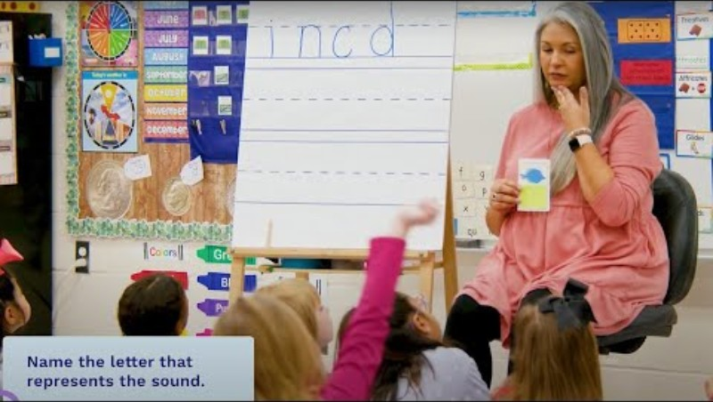
Classroom Example: How to Introduce a New Letter
Key Points About the Video:
This kindergarten teacher introduces a new letter and guides students through steps that will be repeated every time a new letter is introduced.
The narrator provides context about each step in the lesson.
How to Introduce a New Letter
(Reading Universe, n.d.)
Notes:
Optional classroom example. Video length: 4.32 minutes
We are going to watch a short video where a teacher is modeling
How to Introduce a New Letter – Kindergarten
Key Points About the Video:
This kindergarten teacher introduces a new letter and guides students through steps that will be repeated every time a new letter is introduced.
The narrator provides context about each step in the lesson.
(Play the video-subtitles are included within the video; Video length: 4:32 minutes)
FACILITATOR NOTES:
Before watching the video, read the Key Points About the Video so participants know what to focus on.
Watch Classroom Example: How to Introduce a New Letter

Slide 39
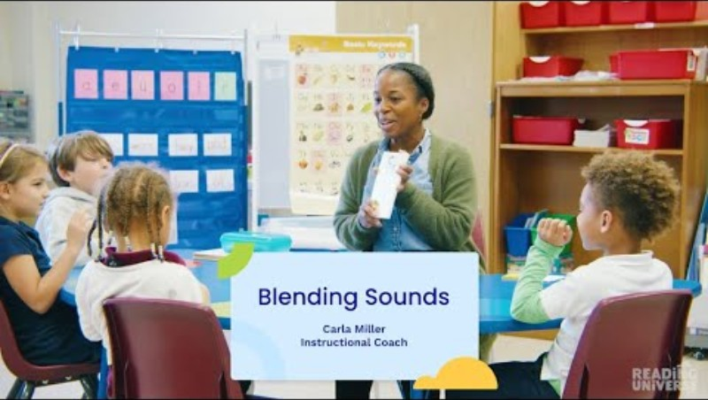
Small Group Example: Blending Sounds to Read Words
Key Points About the Video:
This instructional coach models and practices with her students the process for blending sounds into words.
Students have the chance to read words with short vowels both as a group and individually.
Blending Sounds to Read Words
(Reading Universe, n.d.)
Notes:
Optional classroom example. Video length: 5.45 minutes
We are going to watch a short video where a teacher is working with a
Small Group Blending Sounds to Read Words
Key Points About the Video:
This instructional coach models and practices with her students the process for blending sounds into words.
Students have the chance to read words with short vowels both as a group and individually.
(Play the video-subtitles are included within the video; Video length: 5.45 minutes)
FACILITATOR NOTES:
Before watching the video, read the Key Points About the Video so participants know what to focus on.
Watch Small Group Example: Blending Sounds to Read Words with Short Vowels

Slide 40

How Can You Support Phonics at Home?
Notes:
How Can You Support Phonics at Home?

Slide 41
How Can You Support Phonics at Home?
Practice 1: Letter-Sound Practice Using Junk Mail
Practice 2: Reading Words & Sentences
Notes:
Let’s explore two example practices you can use to support phonics at home.
Practice 1: Letter Sound Practice Using Junk Mail
Practice 2: Reading Words & Sentences

Slide 42
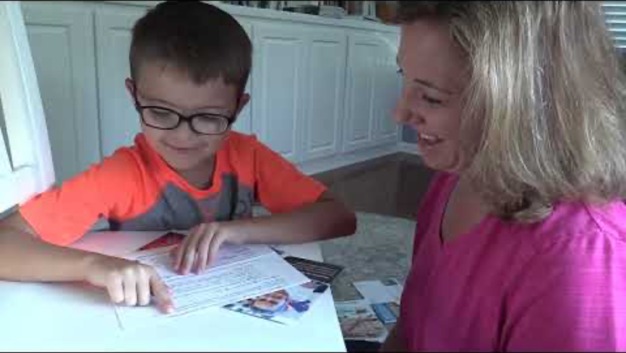
Practice 1: Letter-Sound Practice Using Junk Mail
Key Points About the Video:
Parent explains the activity and provides an example for child by saying the letter name and the letter–sound.
Parent and child laugh and have fun with the activity.
Consonant & Short Vowel Practice
(Institute of Education Sciences, n.d.)
Notes:
Optional classroom example. Video length: 2.07 minutes
Practice 1 is called Letter-Sound Practice Using Junk Mail.
It is important for children to know letter names and letter sounds. Letter name knowledge is recognizing and naming letters. An example of recognizing letters is when you show a child the letters N, A, and S and ask which letter is S, the child points to the S. An example of naming letters is when a child looks at the letter M and orally names that letter.
Letter sound knowledge is demonstrated when a child can look at a letter in print and tell you the sound it represents.
For example, if you point to the letter F and ask, "What sound does this letter make?" The child will say, /f/
Key Points About the Video:
Parent explains the activity and provides an example for child by saying the letter name and the letter–sound.
Parent and child laugh and have fun with the activity.
(Play the video-subtitles are included within the video; Video length: 2.07 minutes)
FACILITATOR NOTES:
Before watching the video, read the Key Points About the Video so participants know what to focus on.
Watch Video 1: Rhyme Time
After watching the video, give participants time to practice the linked activities with their paired verbal fluency partner(s).
Consonant & Short Vowel Practice

Slide 43
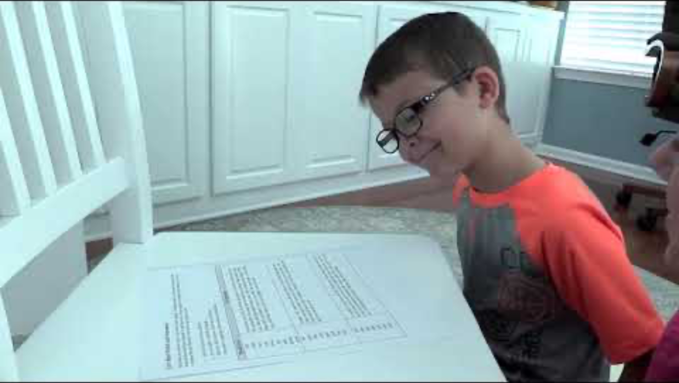
Practice 2: Reading Words & Sentences
Key Points About the Video:
Parent encourages child to point to the words as he reads.
When child has difficulty with a word, parent points to the sound-spelling, reminds him what is says, asks him to read the word, and then read the whole sentence (oi, /oi/, noise; o, /o/, slop).
Parent reminds child to pause a little longer when he sees a period, so the words don't all run together.
Let’s Read Words & Sentences
(Institute of Education Sciences, n.d.)
Notes:
Optional classroom example. Video length: 4:27 minutes
Practice 2 is called Reading Words and Sentences.
Once children know letter sounds, like the letter s says /s/, and how to blend, they can read many words! Blending is the ability to put sounds together to read a word.
For example, when children see the word soil, they are able to say, "/s/, /oi/, /l/, soil.”
There are many ways to support your child in reading words.
For example, provide opportunities for your child to practice reading words in a list or on flashcards. It is also important for children to practice reading words in sentences and stories.
Key Points About the Video:
Parent encourages child to point to the words as he reads.
When child has difficulty with a word, parent points to the sound-spelling, reminds him what is says, asks him to read the word, and then read the whole sentence (oi, /oi/, noise; o, /o/, slop).
Parent reminds child to pause a little longer when he sees a period, so the words don't all run together.
Parents questions after each paragraph to make sure child understood what he read.
(Play the video-subtitles are included within the video; Video length: 4.27 minutes)
FACILITATOR NOTES:
Before watching the video, read the Key Points About the Video so participants know what to focus on
Watch Video 2: Reading Words & Sentences
After watching the video, give participants time to practice the linked activities with their paired verbal fluency partner(s).
Let’s Read Words & Sentences

Slide 44

Reading With Your Child at Home
Look at the letters.
Sound it out.
Does that make sense?
Notes:
When reading with your child at home, this simple guidance to support them as they read is most effective and keeps the focus on decoding accurately.
When reading a word, ask your child to:
Look at the letters
Sound it out.
Once a word has been decoded, then we can ask…Does that make sense?

Slide 45
Key Takeaways | Phonics
Phonics is the study of the relationships between the letters and the sounds they represent.
Phonics is a critical component of reading instruction
The alphabetic principle and phonics skills are critical in helping children become accurate, automatic, fluent readers.
Effective phonics instruction is explicit and direct, systematic and sequential, cumulative, multi-modal, and diagnostic.
Notes:
Let’s wrap up the presentation by revisiting some Key Takeaways about Phonics.
Phonics is the study of the relationships between the letters and the sounds they represent.
Phonics is a critical component of reading instruction
The alphabetic principle and phonics skills are critical in helping children become accurate, automatic, fluent readers.
Effective phonics instruction is explicit and direct, systematic and sequential, cumulative, multi-modal, and diagnostic.
Share Handout 3: Phonics for Parents Handout

Slide 46
A Relevant Quote
“If a child memorizes ten words, the child can read only ten words, but if the child learns the sounds of ten letters,,
the child will be able to read
350 three-sound words,
4,320 four-sound words, and
21,650 five-sound words.”
(Kozloff, 2022)
Notes:
Words are built from sounds and our written language is a code for those sounds.
If a child memorizes ten words, the child can read only ten words, but if the child learns the sounds of ten letters, the child will be able to read 350 three-sound words, 4,320 four-sound words, and 21,650 five-sound words.
Memorizing is not an efficient reading strategy. Guessing is not an efficient reading strategy. Learning how to decode words is both effective and necessary.

Slide 47
Do You Want to Learn More?
Visit the CDE Parent Resources Website
Notes:
Do You Want to Learn More?
There are more resources for parents on the CDE Parent Resources Website including videos of activities you can do at home.

Slide 48
References 1
Adams, M. J., Foorman, B. R., Lundberg, I., & Beeler, T. (1998). Phonemic awareness in young children: A classroom curriculum. Paul H. Brookes Publishing.
Birsh, J. R. & Carreker, S. (2018). Multisensory teaching of basic language skills (4th ed.). Baltimore, MD: Brookes.
Boulton, D. (2003). Children of the code [Documentary series]. Learning Stewards.
Cassar, M., Treiman, R., Moats, L., Pollo, T. C., & Kessler, B. (2005). How do the spellings of children with dyslexia compare with those of nondyslexic children? Reading and Writing, 18(1), 27–49.
Cárdenas-Hagan, E. (2020). Literacy foundations for English learners: a comprehensive guide to evidence-based instruction. Baltimore, MD: Paul H. Brookes Publishing Co.
Colorado Reading to Ensure Academic Development Act, Colo. Rev. Stat. §§ 22-7-1201-1214, (2019).
Dehaene, S. (2009). Reading in the brain. New York, NY: Penguin Viking.
Ehri, L. C., Nunes, S. R., Stahl, S. A., & Willows, D. M. (2001). Systematic phonics instruction helps children learn to read: Evidence from the National Reading Panel's meta-analysis. Review of Educational Research, 71(3), 393–447.
Gillon, G. T. (2004). Phonological awareness: From research to practice. Guilford Press.
Goldberg, M. (2022). Seeing the good in balanced literacy... and moving on. Reading Rockets Blog.
Gough, P. B. & Tunmer, W.E. (1986). Decoding, reading, and reading disability. Remedial and Special Education, 7(1).
Hanna, P. R., Hanna, J. S., Hodges, R. E., & Rudorf, E. H. (1966). Phoneme–grapheme correspondences as cues to spelling improvement. Washington, DC: U.S. Department of Health, Education, and Welfare.
Institute of Education Sciences. (n.d.). [YouTube channel]. YouTube. https://www.youtube.com/@InstituteofEducationSciences
International Dyslexia Association. (2020). Structured literacy: Effective instruction for students with dyslexia and related reading difficulties. https://dyslexiaida.org/effective-reading-instruction/
Kamhi, A. G., & Catts, H. W. (1989). Reading disabilities: A developmental language perspective. Allyn & Bacon.
Kemeny, L. (2023). 7 mighty moves: Research-backed, classroom-tested strategies to ensure K-to-3 reading success. Scholastic Professional.
Kilpatrick, D. A. (2015). Essentials of assessing, preventing, and overcoming reading difficulties. Wiley.
Kozloff, M. A. (2002). Sufficient Scaffolding, Organizing and Activating Knowledge, and Sustaining High Engaged Time.
Lane, H. B., & Pullen, P. C. (2004). Phonological awareness assessment and instruction: A sound beginning. Allyn & Bacon.

Slide 49
References 2
Lonigan, C. J., & Shanahan, T. (2008). Executive summary of the report of the National Early Literacy Panel. Developing early literacy: Report of the National Early Literacy Panel, 1–8. National Center for Family Literacy.
National Early Literacy Panel. (2008). Developing early literacy: Report of the National Early Literacy Panel. National Center for Family Literacy.
Moats, Louisa C. (2005). How Spelling Supports Reading. American Educator, Winter 2005/06, 12-43.
Moats, L. C. (2020). Speech to print: Language essentials for teachers (3rd ed.). Baltimore, MD: Brookes
Moats, L. C. (2020). Teaching reading is rocket science (2nd ed.). In L. Diamond & L. Thorsnes (Eds.), Teaching reading sourcebook (3rd ed., pp. 9–30). Arena Press.
Moats, L., & Tolman, C. A. (2009). The speech sounds of English: Phonetics, phonology, and phoneme awareness (Module 2). In Language Essentials for Teachers of Reading and Spelling (LETRS). Boston, MA: Sopris West.
National Reading Panel. (2000). Teaching children to read: An evidence-based assessment of the scientific research literature on reading and its implications for reading instruction (NIH Publications No. 00-4769) Washington, DC: National Institutes of Child Health and Human Development.
National Institute of Child Health and Human Development. (2000). Report of the National Reading Panel: Teaching children to read: An evidence-based assessment of the scientific research literature on reading and its implications for reading instruction (NIH Publication No. 00-4769). U.S. Government Printing Office.
Reading Rockets. (n.d.). Reading 101: A guide for parents. https://www.readingrockets.org/literacy-home/reading-101-guide-parents.
Reading Universe. (n.d.). Word recognition. Reading Universe. https://readinguniverse.org/explore-teaching-topics/word-recognition
Scarborough, H. S. (2001). Connecting early language and literacy to later reading disabilities: Evidence, theory, and practice. In S.B. Neuman and D.K. Dickinson (Eds.), Handbook of early literacy research (p. 98) New York, NY: Guilford Press.
Sedita, J. (2021). The keys to beginning reading [Professional development materials]. Keys to Literacy.
Sullivan, A. (2023). A Parent’s Guide to Phonics: Understanding How to Help Your Child with Reading and Spelling (47 pp.). Ann Sullivan.
The Reading League. (2022). Science of Reading: Defining guide (2nd ed.). The Reading League.
Tolman, C. (2018). Introduction to the Tolman hourglass figure. Dr. Carol Tolman Blog. https://drcaroltolman.com/introduction-to-the-tolman-hourglass-figure/
Torgesen, J. K. (1998). Catch them before they fall: Identifying and helping children with reading difficulties in early grades. American Educator, 22(1–2), 32–39.

Slide 50
References 3
Uhry, J. K. (2011). Phonemic awareness and letter-sound knowledge: Their impact on spelling. In R. L. Treiman & B. E. Berninger (Eds.), Spelling development and disability: Theoretical, empirical, and practical perspectives (pp. 147–164). Routledge.
Yopp, H. K., & Yopp, R. H. (2009). Phonological awareness is child's play! Young Children, 64(1), 12–17.

Slide 51
Appendix A: Detailed Explanation of The Hourglass Figure
The image depicts an hourglass-shaped diagram illustrating the different levels of phonological awareness and orthography. The top of the hourglass, colored in orange, represents "Phonological Awareness" and includes three levels: "Early," "Basic," and "Advanced." Each level consists of specific phonological skills. The "Early" level includes syllables, alliteration, and onset-rime. The "Basic" level focuses on phoneme blending and phoneme segmentation, while the "Advanced" level involves phoneme deletion and substitution. Connecting these skills to "Letters and Sounds" is represented by a narrow, blue funnel labeled "1:1." The bottom of the hourglass, shaded in blue, represents "Orthography," including skills such as digraphs, trigraphs, vowel teams, blends, word families, syllables, morphemes, and etymology. The overall background is light blue with a gradient effect.
Notes:
Long-form caption for image included on slide 16

Slide 52
Appendix B: Detailed Explanation of Orthographic Mapping Process Image
The image features a diagram on a white background with a black border. At the top is a small green silhouette of a frog. Below it is the word "frog" in lowercase letters. Beneath the word "frog," phonetic symbols "/f/ /r/ /o/ /g/" are displayed with blue lines connecting each phoneme to a blue speech bubble at the bottom containing the word "frog." On the left side of the diagram, three icons are arranged vertically. The top icon shows a pair of stylized eyes, representing visual perception. The middle icon depicts a speaker, signifying auditory input. The bottom icon is an outline of a human head with a brain, symbolizing cognitive processing.
Notes:
Long-form caption for image included on slide 25

