Slide 1
Resources needed for this presentation (Keep this slide hidden)
A way to project the PowerPoint
Note for presenters: For accessibility, you must read the words on the slides. The words bolded in the notes are the words from the slide.
Adequate audio for playing videos (test audio and video before presentation)​
Video 1: Phonemic Awareness: Big 5 in Under 5
Small Group Example: Segmenting Phonemes
Practice 1: Rhyme Time
Practice 2: Syllable Sort
Practice 3: Saying Individual Sounds in Words
Writing utensils
Print these documents:
Provide blank paper for participants to take notes for discussion
Handout 1: Rhyme Time
Handout 2: Nursery Rhyme Time
Handout 3: Syllable Sort
Handout 4: Clap Word Parts
Handout 5: What’s the First Sound? Song & Add a Sound to Make a New Word
Handout 6: Phonological Awareness for Parents handout
Estimated time of presentation: 75 minutes
Content: 40 minutes
Optional Classroom Example Videos: 15 minutes (slides: 26, 34, 38, 39,40)
Parent Activities: 20 minutes

Slide 2


The Colorado READ Act and the Science of Reading for Families
Phonological Awareness
Notes:
Welcome and thank you all for joining us today.
This is a presentation within the Colorado READ Act and the Science of Reading for Families series developed to support parents with ways to help their children build reading skills in partnership with their child’s school. ​
During this presentation, we will be focusing on Phonological Awareness
For more information or additional resources, please visit the READ Act Parent Resources page found within the CDE website. (QR Code on the slide)
Background for presenters:
The READ Act encourages local education providers to provide parent opportunities to participate in parent reading workshops throughout the school year to assist parents in developing their own reading skills and in developing the skills necessary to assist their children in reading. We hope this series will be helpful to you as parents (CRS 22-7-1208 (4)).
The Colorado READ Act statute defines the term “parent’ as a student’s biological or adoptive parent, stepparent, foster parent, or legal guardian(CRS 22-7-1203 (8)(a)).
For brevity purposes, we have adopted this definition throughout the presentation. When we use “Parent” during the presentation we mean family or caregiver aligned with the language of the law.
Sources​
CRS 22-2-1203 (8)(a) Colorado READ Act Legislative Declaration​
CRS 22-2-1208 (4) Colorado READ Act Legislative Declaration​

Slide 3
Welcome | Phonological Awareness
First Name Last Name, Title
Organization
Contact Information
Notes:
Welcome, we are glad you are here.
Share your name, title and contact details
If time, share a bit about your journey as an educator and/or parent that would be relevant to this session.
Logistics: Share the following points that match your circumstance
This presentation includes active captions.
Presenters will be using a microphone.
We ask that audience members use a microphone when asking questions.
If on zoom: Please keep your microphone on mute unless you are sharing with the group.
Presenters will be reading the content on each slide to ensure that it is accessible for ALL participants.
Note for presenters: For accessibility, you must read the words on the slides. The words bolded in the notes are the words from the slide.

Slide 4
Outcomes | Phonological Awareness
What is phonological awareness?
Why is phonological awareness important?
What does phonological awareness look like at school?
How can you support phonological awareness at home?
Notes:
By the end of this presentation the outcome is for you to be able to answer these questions.
What is phonological awareness?
Why is phonological awareness important?
What does phonological awareness look like at school?
How can you support phonological awareness at home?
​Take a moment to think about which agenda question(s) you are interested to know more about today. (Provide 1-2 minutes for participants to think).
We have provided writing utensils and paper at each table.
(If presenting virtually, start here) Please feel free to take notes. Later in the session, we will be talking in partners about what we have heard and learned around these questions.

Slide 5
Norms | Phonological Awareness
Active listening is appreciated
Active participation is welcomed
Take care of your own needs
Silence your cell phone as a courtesy to all
Notes:
We hope this will be an engaging and informative time for everyone here tonight. Please work to follow these norms:
Active listening is appreciated
Active participation is welcomed
Please take care of your own needs
If in-person, share where the restrooms and water stations are located, as needed.
If presenting virtually, you might consider asking participants to leave cameras on as they are able.
Silence your cell phone as a courtesy to all
Are there any other items you think we should add to this list that will support all of us?

Slide 6
Warm-Up | Phonological Awareness
Like Me
Move chairs back from the table so it is easy for you to stand up
A category will be named
Stand if you match the category
Look around to see who else is also in the category
Introduce yourself
Notes:
We are going to start with a Warm-up activity called (CLICK) Like Me (Adjust the mobility section of the activity according to the abilities of the participants in the room).
We are doing this activity because:
This activity focuses the energy into this room and out of your day or previous activities, so you feel ready to participate
You will begin to understand who you are in relation to others in the group
Here is how this activity will work. I will read all of the steps, ask for questions and then we will begin the activity.
(CLICK) Move chairs back from the table so it is easy for you to stand up. (Adjust the mobility section of the activity according to the abilities of the participants in the room. If presenting virtually, ask participants to stand in front of their camera or use the thumb's up reaction button).
(CLICK) A category will be named.
(CLICK) Stand if you match the category.
(CLICK) Look around to see who else is also in the category.
(CLICK) Introduce yourself
FACILITATOR NOTES:
Read the activity steps.
Ask if participants have questions.
Start activity at step 1.
Name some (5-10) of the following categories (or create your own to match your community) and give time for people to stand: (facilitators should also participate by standing or staying seated):
I am a parent
I have a child in kindergarten, 1st, 2nd, or 3rd grade.
I have more than one child in elementary school.
I have a middle or high schooler in addition to my elementary student or students.
I live within walking distance of the school.
I work in this community.
I attended this school (or another school in this district).
I grew up in this town/city.
I am new to this community within the last 2 years.
I speak more than one language at home.
I enjoy attending school or community events with my family.
I share family stories, traditions, or sayings with my child or children.
My child or children enjoy playing word games or singing silly songs.
I have noticed my child sounding out letters or words.
I have listened to my child or children read the same book more than once.
I believe reading will help my child or children in the future.
Have the parents go around the room and share: (if group is large, make small groups for this activity)
Name
Grade of Child(ren)

Slide 7
Simple View of Reading (SVR)
Word
Recognition
Language
Comprehension
=
Reading
Comprehension
X
(Gough & Tunmer, 1986)
Notes:
Several decades of reading research has given us a clear understanding of how students best learn to read. One way to conceptualize reading is through the Simple View of Reading (SVR) model. This model developed by Gough and Tunmer organizes the skills needed to become a proficient and successful reader into two categories: (CLICK) word recognition and (CLICK) language comprehension. The Simple View of Reading is a basic formula for (CLICK) reading comprehension.
It says this: reading comprehension is the product of word recognition skills and language comprehension skills.
We need both sides of the equation for students to become skilled, proficient readers.
(CLICK) Students need efficient word recognition or decoding skills where they are accurately and automatically reading the words on the page without aid of context clues or pictures.
(CLICK) They also need fully developed language comprehension skills which references the ability to understand language.
In order for a student to understand text, they need to decode the words on the page and then make meaning of the words, sentences, and overall text.
(https://www.cde.state.co.us/coloradoliteracy/scienceofreadingresources)

Slide 8
Simple View of Reading (SVR) | The 5 Components of Reading
Word
Recognition
Language
Comprehension
=
Reading
Comprehension
X
Phonological Awareness
Phonics
Vocabulary
Language- based skills and strategies
Literacy knowledge and skills
Fluency
Oral Language
(Gough & Tunmer, 1986; NRP, 2000)
Notes:
We can use the Simple View of Reading to organize the Five Essential Components of Reading.
(CLICK) Word recognition skills require phonological awareness (attention to the sounds in our language) and phonics (the ability to connect sounds to the letters that represent them).
(CLICK) Language comprehension is supported by vocabulary knowledge (knowing and understanding the meanings of words). In addition, vocabulary knowledge can also support word recognition, particularly as students encounter more complex or irregular words that require familiarity with word parts (morphemes) or context to decode and understand.
Readers also need a variety of language-based skills and strategies such as inferencing, understanding syntax and sentence structure, and utilizing background knowledge. To comprehend text, we must also acquire literacy knowledge and skills, such as understanding text structure and literary genres.
(CLICK) Reading Fluency acts like a bridge that connects word recognition and language comprehension to support understanding when reading (Sedita, 2019).
(CLICK) Oral language is the foundation for skilled reading and literacy development and needs to be integrated throughout all components.
As we become better readers, our reading skills, in turn, help us develop more complex thinking, communication, and language skills (Kamhi & Catts, 1989; Lonigan & Shanahan, 2012).
Each component acts as a piece of the larger whole, similar to a puzzle. Effective reading instruction is not complete without ensuring that all five components, and oral language, are taught.

Slide 9
Simple View of Reading (SVR) | The 5 Components of Reading 2
Word
Recognition
Language
Comprehension
=
Reading
Comprehension
X
Phonological Awareness
Phonics
Vocabulary
Language- based skills and strategies
Literacy knowledge and skills
Fluency
Oral Language
(Gough & Tunmer, 1986; NRP, 2000)
Notes:
Let’s explore the Simple View of Reading (SVR) and Phonological Awareness in more detail.
Under the umbrella of phonological awareness, phonemic awareness is a required foundation for phonics, spelling, vocabulary, fluency, and ultimately reading comprehension and writing composition.
In the seminal report of the National Reading Panel (2000), phonemic awareness was well-established as a required component in the process of learning to read. It is first in the list of the big five components of reading, followed by phonics, vocabulary, fluency, and comprehension (NICHD, 2000). These components are highly interrelated, and phonemic awareness ability contributes to growth and competency in each of them.

Slide 10
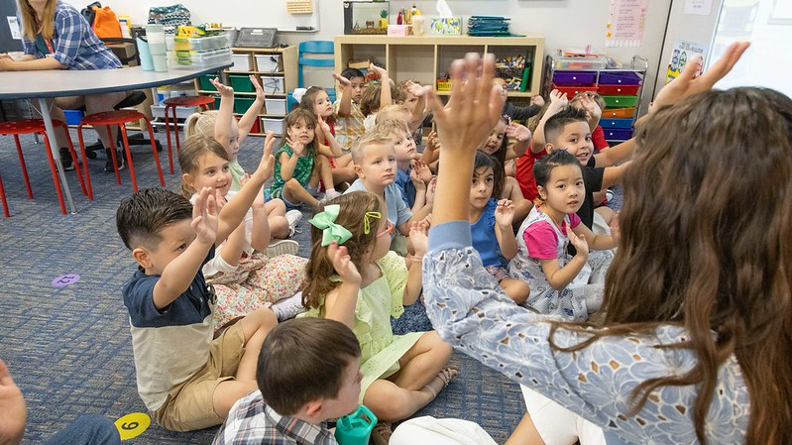

What is Phonological Awareness?
Notes:
What is Phonological Awareness?

Slide 11
The "PHON" Words
Phonology
Phonological
Awareness
Phoneme
Phonemic Awareness
Phonics
oral language
written language
(Adapted from Sedita, 2021)
Notes:
The "PHON" Words
What do these words have in common? They all include the Greek root word phon which means sound. It is easy to confuse these words as they relate to teaching beginning reading in the primary grades.
Phonology is the study of speech sounds in a language.
Phonological Awareness is a larger “umbrella” term for the awareness of units of speech
A Phoneme is a single speech sound; words are formed by combining phonemes.
Phonemic Awareness is awareness of individual speech sounds (phonemes), including the ability to isolate, identify, blend, segment, and manipulate sounds in words; it focuses only on individual sounds. Phonemic awareness is the most sophisticated level of phonological awareness.
Phonics involves print and speech sounds; it is about the connections between sounds (phonemes) and letters (graphemes); phonics knowledge is necessary to turn print into speech.
Let’s explore two of these “phon” words, phonological awareness and phonemic awareness, in more detail.
Background for presenter:
The English alphabet has 26 letters that are used to represent approximately 44 individual speech sounds, or phonemes.
Phonemic has ONE inside of the word. One speech sound

Slide 12


Phonological Awareness
The ability to identify and manipulate sounds in spoken language
(all sizes of sounds)
Phonological Awareness
Phonemic Awareness
Word Awareness
Rhyming & Alliteration
Identifying
Syllables
Onsets & Rimes
Blending
Segmenting
Manipulating
(Birch & Carreker, 2018; National Reading Panel, 2000; The Reading League, 2022)
Notes:
Phonological Awareness is the ability to identify and manipulate sounds in spoken language (all sizes of sounds).
Phonological awareness is the umbrella term for the knowledge of sounds in spoken language, including the largest parts of sounds, such as words and syllables, and the smallest units of sounds, called phonemes.
This includes
Word awareness
Rhyming and Alliteration
Syllables
Onsets and Rimes

Slide 13
Phonological Awareness Skills
LESS COMPLEX
MORE COMPLEX
Phonemic Awareness
Onsets & Rimes
f – un
p – art
cl – ock
sh – ip
dr - ink
– own
Syllables
pho-no-lo-gi-cal
cup – cake
ba –na– na
moose
Rhyming & Alliteration
ban → can → fan → man → pan → ran
Peter piper picked a pack of pickled peppers.
Word
Awareness
The_dog_ate
my _homework.
(Birch & Carreker, 2018; NRP, 2000; TRL, 2022)
Notes:
Phonological Awareness Skills
Phonological awareness skills exist on a continuum from less complex to more complex, beginning at the word level and progressing to the phonemic level and onto more complex skills.
Although instruction should generally progress from larger to smaller units of sound, children do not need to master one step before being exposed to other levels of phonological awareness (Yopp & Yopp, 2009).
First, we will look at the skills that are in the early phonological awareness category, when learners are developing a sensitivity to the larger sound parts in spoken language.
Word Awareness
Word Awareness is the least complex skill and focuses on determining word boundaries, where they begin and end, within the flow of speech. It is the ability to separate words in a spoken sentence. ​
For example, how many words are in the sentence: The dog ate my homework. (5)
Word awareness can be developed in young children before they even start school.
The remaining skills are related but don’t necessarily follow a set progression:
Rhyming and Alliteration
Rhyming and alliteration are the next skills on the continuum.
Rhyming is the ability to recognize words that end with the same sounds, usually starting with the vowel sound and continuing to the end of the word. For example, ban, can, fan, man, pan, ran
Rhyme awareness begins to develop across the toddler and preschool years.
Alliteration is the occurrence of the same sound at the beginning of adjacent or closely connected words. For example, Peter piper picked a pack of pickled peppers.
Neither of these skills are related to knowing letters.
Syllables
The next skill on the continuum involves attending to syllable parts in words.
Syllables are the part of words that have a vowel sounds.
Place your hands under your chin and say the word pho-no-lo-gi-cal​. Notice how your chin moves down for every syllable as you say the word​. Your chin drops slightly five times because your mouth opens when you make a vowel sound.
This skill begins with the ability to segment compound words into parts (e.g., cup-cake, hot-dog, snow - man), then identify the number of syllables in multisyllabic words (e.g., ba-na-na, Sep-tem-ber. kan- ga-roo, mo-tor-cy-cle), and identify that some words have one syllable (e.g., moose, chair, run).
Onsets and Rimes
The next skill in the continuum is onset-rime, with a focus on beginning sounds in words.
Onset is the sounds that come before the vowel in a syllable
Rime is the vowel plus the consonants that follow in a syllable.
Every word has a rime, but not every word has an onset.
These words are divided by onset-rime: f- un, p-art, cl - ock, sh – ip, dr- ink, - own
Onset and rime awareness occurs when children recognize that rhyming is done by blending a new onset to an old rime. Sorting by sound is an important skill for developing phonemic awareness (Uhry, 2011).​
The most complex phonological skill is phonemic awareness and is the skill that most impacts reading and spelling development.
Background for presenter:
Word Awareness:
Understanding of word boundaries affects the ability to learn another language. Listening to an unfamiliar language often sounds quite fast because you are not yet familiar with the word boundaries within the flow of speech. More practice and experience learning the new language would help you determine the word boundaries.
For example, how many words are in the sentence: The dog ate my homework. (5)
As their vocabulary grows and they begin saying longer words, children need to become sensitive to differences in word pronunciations to distinguish similar sounding words (Birch & Carreker, 2018).
Rhyming
Rhyme awareness begins to develop across the toddler and preschool years, with detection of words that rhyme, and progresses into the early elementary grades, with the ability to produce words that rhyme (Birch & Carreker, 2018).
Syllables
Many activities designed for young children focus on syllables. Singing songs and saying nursery rhymes have a rhythmic component and an element of playing with the syllable structures of words. For example, in singing the song "Twinkle, Twinkle Little Star," children naturally segment the words' syllables saying, "Twin - kle, twin - kle, li - ttle star” (Birch & Carreker, 2018).
More familiar words are often easier to manipulate than less familiar ones. A preschooler may be able to blend the syllables in familiar words such as rhinoceros or hippopotamus more easily than in words such as multiplication or geography (Birch & Carreker, 2018).

Slide 14
Phonemic Awareness
The ability to identify and manipulate INDIVIDUAL sounds in spoken WORDS.
Phonological Awareness
Phonemic Awareness
Word Awareness
Rhyming & Alliteration
Identifying
Syllables
Onsets & Rimes
Blending
Segmenting
Manipulating
(Birch & Carreker, 2018; NRP, 2000; TRL, 2022)
Notes:
Phonemic Awareness
Is the ability to identify and manipulate, or play with, INDIVIDUAL sounds in spoken WORDS.
Phonemic awareness falls under the umbrella of phonological awareness and refers to the specific ability to identify, blend, segment, and manipulate the individual sounds, or phonemes, in spoken words.
Phonemes combine to form syllables and words. For example, the word cat has three phonemes: /c/, /a/, and /t/.

Slide 15

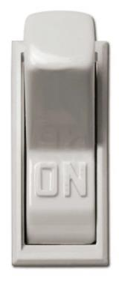
Phonological Awareness vs Phonics
Phonological Awareness
Phonics
sounds
&
letters
sounds
Lights Off
Lights On
(Adapted from Sedita, 2021)
Notes:
Phonological Awareness vs Phonics
It is important to distinguish phonemic awareness from phonics.
Phonological awareness tasks can be done “in the dark with the lights off” because they do not require using letters.
The focus is on the sounds of words, whether they are syllables or phonemes (individual sounds).
Phonics activities need to be done with the “lights on” because phonics includes letters that need to be seen.
The focus is on the relationship between the sounds, or phonemes, and the graphemes, or letters in written language.
Instruction in phonological awareness and phonics often overlap.
There is a reciprocal relationship between phonemic awareness and phonics. Phonemic awareness instruction improves phonics skills and phonics instruction improves phonemic awareness (Lane & Pullen, 2004).
In short, phonological awareness involves sounds only, and phonics involves sounds plus print.

Slide 16
44 English Phonemes
25 Consonant Sounds | 19 Vowel Sounds
/b/ /k/ /s/ /ch/ | /ā/ /ă/ /o͞o/ /ar/
/d/ /l/ /t/ /sh/ | /ē/ /ĕ/ /o͝o/ /er/
/f/ /m/ /v/ /zh/ | /ī/ /ĭ/ /oi/ /or/
/g/ /n/ /w/ /th/ | /ō/ /ŏ/ /ou/ /Ə/
/h/ /p/ /y/ /th/ | /ū/ /ŭ/ /aw/
/j/ /r/ /z/ /hw/
/ng/
sounds
Macron – long sound​
​
Breve – short sound
Lights Off
Notes:
˘The English language has approximately 44 sounds, 26 letters, and over 200 ways to arrange the letters to spell the 44 sounds.
There are 25 consonant sounds and 19 vowel sounds, including the unaccented schwa vowel.
The diacritical marks above some of the vowel sounds are added to denote if the vowel is “long” (macron) or ‘short” (breve).
It is important to know that English contains phonemes that don’t occur in other languages, so multilingual learners may need extra focus on identifying and producing certain phonemes in English.

Slide 17
Counting Phonemes
Notes:
Counting Phonemes
Let’s practice identifying the number of phonemes in some words.
For this activity:
First I’m going to say the word out loud,
Then you will use your fingers to show the number of phonemes in that word
Finally, we review the word and the number of phonemes together.
The first word is at.

Slide 18
1.Counting Phonemes
at | → | /a/ /t/ | → | 2
Notes:
The word at has 2 phonemes: /a/, /t/.
The slanted lines on the slide are called virgules. Virgules are used to indicate the sound and not the letters.
The next word is mop.

Slide 19
2.Counting Phonemes
at | → | /a/ /t/ | → | 2
mop | → | /m/ /o/ /p/ | → | 3
Notes:
The word mop has 3 phonemes: /m/, /o/, /p/.
The next work is clip.

Slide 20
3.Counting Phonemes
at | → | /a/ /t/ | → | 2
mop | → | /m/ /o/ /p/ | → | 3
clip | → | /c/ /l/ /i/ /p/ | → | 4
Notes:
The word clip has 4 phonemes: /c/, /l/, /i/, /p/.
The next word is splash

Slide 21
4.Counting Phonemes
at | → | /a/ /t/ | → | 2
mop | → | /m/ /o/ /p/ | → | 3
clip | → | /c/ /l/ /i/ /p/ | → | 4
splash | → | /s/ /p/ /l/ /a/ /sh/ | → | 5
Notes:
The word splash has 5 phonemes: /s/, /p/, /l/, /a/, /sh/. The /sh/ sound is a diagraph which means two graphemes, or letters, represent one phoneme, or sound.
The last word is a little tricky. The word is fox.

Slide 22
5.Counting Phonemes
at | → | /a/ /t/ | → | 2
mop | → | /m/ /o/ /p/ | → | 3
clip | → | /c/ /l/ /i/ /p/ | → | 4
splash | → | /s/ /p/ /l/ /a/ /sh/ | → | 5
fox | → | /f/ /o/ /k/ /s/ | → | 4
Notes:
The word fox has 4 phonemes: /f/, /o/, /k/, /s/. The letter x is two sounds /k/ and /s/.
Note that the number of letters often does not indicate the number of phonemes. This is because in English, we often have 2, 3, or 4-letter combinations that represent a single unit of sound. These letter or letters are called graphemes and are discussed in the phonics and decoding presentation of this series.

Slide 23
Identifying, Blending & Segmenting Phonemes
Isolating
Isolating beginning, middle, or ending sounds in words.
/k/ /a/ /t/
/d/ /o/ /g/
/f/ /i/ /sh/
Segmenting and blending abilities are more predictive of later reading achievement than rhyming abilities.
Blending
Blending, or combining, the separate sounds in a word to say the word
/c/ /a/ /t/ = cat
/d/ /o/ /g/ = dog
/f/ /i/ /sh/ = fish
Segmenting
Segmenting, or breaking, a word into its separate sounds
cat = /c/ /a/ /t/
dog = /d/ /o/ /g/
fish = /f/ /i/ /sh/
(Birch & Carreker, 2018; NRP, 2000; TRL, 2022)
Notes:
Next, we will look at three important phonemic awareness skills: isolating, blending, and segmenting phonemes.
Mastery of these skills is important for reading and writing words. Even adults may benefit from them when they encounter unfamiliar words. In fact, blending and segmenting skills contribute more to learning to read and spell well than any of the other activities under the phonological awareness umbrella (NRP, 2000).
Isolating
The first skill is phoneme isolating. This includes the ability to isolate beginning, middle, or ending sounds in words.
For example, the beginning sound of cat is /k/, the ending sound of dog is /g/ and the middle sound in fish is /i/. It is also important to know that when isolating phonemes, the skill builds in difficulty from beginning phonemes, ending phonemes, and then middle phonemes being the most difficult isolation skill.
Blending
The next skill is phoneme blending. This includes the ability to blend, or combine, the separate sounds, or phonemes, in a word to say the word.
Let's use the same three words for examples: The sounds /k/ /a/ /t/ blend to make the word cat, the sounds /d/ /o/ /g/ blend to make the word dog, and the sounds /f/ /i/ /sh/ blend to make the word fish.
Segmenting
Finally, the last skill is phoneme segmenting. This is the ability to segment, or break, a whole word into it’s individual sounds, or phonemes.
It is especially important in developing phonemic awareness for reading and writing. With this task, children break, or segment a whole word into its individual phonemes.
Again, let's use the same three words for examples: the sounds in the word cat are /k/ /a/ /t/, the sounds in the word dog are /d/ /o/ /g/, and the sounds in the word fish are /f/ /i/ /sh/.
Segmenting and blending abilities are better at predicting later reading achievement than rhyming abilities (Hatcher & Hulme, 1999; Hatcher et al., 2004; Muter et al., 1998; Nation & Hulme, 1997).
For some children, rhyming seems to develop fairly naturally, and for others, it is a difficult task that continues to be challenging in the elementary grades.
Background for presenter:
Of note, identifying and segmenting phonemes in words may be challenging for adults because the reading process has become so automatic that identifying the phonemes in words does not need to be a conscious task (Ehri, 2014).

Slide 24
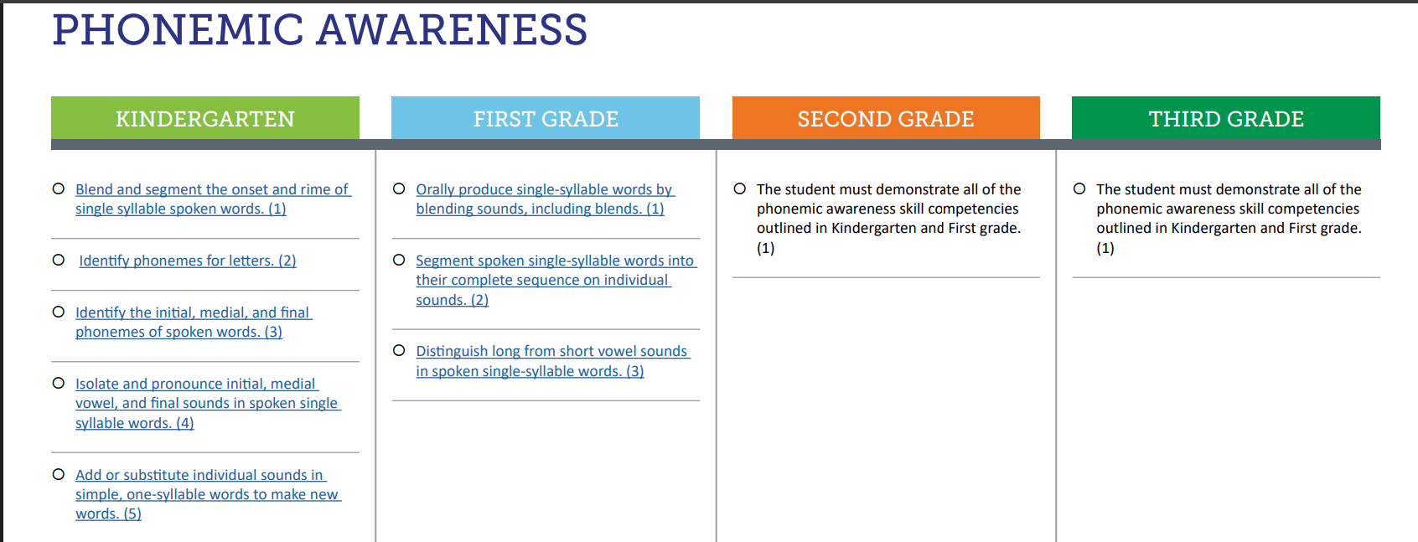

1.CO Minimum Reading Competency Skills for Phonemic Awareness
PA skills focused on primarily in kindergarten and 1st Grades
Begins with identifying and isolating phonemes
Progresses to more advanced PA skills
Notes:
The Colorado Read Act outlines Minimum Reading Skill Competencies for Phonemic Awareness that students need to master to support the development of proficient reading skills.
These minimum competencies are outlined in a kindergarten through third grade progression in the Minimum Reading Competency Skills Matrix. A QR code to access the skills matrix is on this slide.
Phonological and phonemic awareness skills are focused on primarily in kindergarten and first grade, as students are in the beginning stages of early literacy instruction.
Instruction begins with simple skills like identifying and isolating individual phonemes, then progresses to blending and segmenting and more advanced phonemic awareness skills.

Slide 25
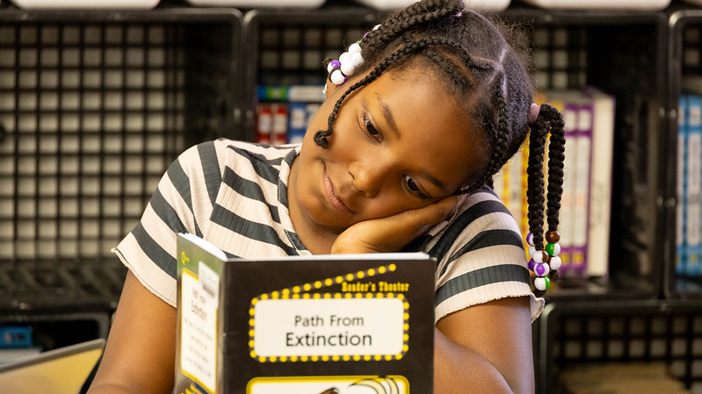
Why is Phonological Awareness Important?
Notes:
Why is Phonological Awareness Important?

Slide 26
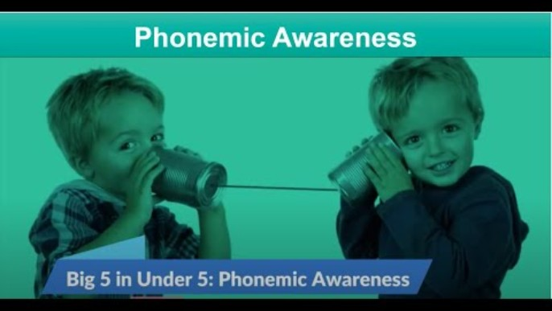
Phonemic Awareness: Big 5 in Under 5
Key Points About the Video:
Essential for learning to read in an alphabetic writing system
Strong predictor of early reading success
Once children can blend and segment sounds easily, use letters as a transition to phonics
Phonemic awareness helps children get ready for reading and writing
(National Center on Improving Literacy)
Notes:
Optional classroom example. Video length: 4:53 minutes
To help summarize what we have learned about phonemic awareness, we are going to watch a short video from the National Center on Improving Literacy (NCIL) called Phonemic Awareness: Big 5 in Under 5.
Some key Points in the video include:
Phonemic awareness is:
Essential for learning to read in an alphabetic writing system
Strong predictor of early reading success
If a child can do phonemic awareness tasks, they will most likely be a good reader. One of the common differences between readers who struggle and those who don’t, is strong phonemic awareness.
Once children can blend and segment sounds easily, use letters as a transition to phonics
Seeing the letters help children associate which sounds go with which letters.
Phonemic awareness helps children get ready for reading and writing
It helps them sound out words as they read and write.
(Play the video-subtitles are included within the video; Video length: 4:53 minutes)
Background for presenter:
Phonological awareness is like an umbrella under which phonemic awareness exists with other levels of phonological awareness.”
First graders who cannot blend sounds into words, or segment words into sounds are likely in need of phonemic awareness intervention. Some students will also need word-level and spelling instruction to explicitly link sounds to print.
FACILITATOR NOTES:
Before watching the video, read the Key Points About the Video so participants know what to focus on
Watch Video (Closed captioning is available. Enable by clicking on the black CC box at the bottom of the video.)
After watching the video, give participants time to ask questions or share comments.

Slide 27
Building Readiness for Phonics
Phonological awareness is essential in the development of foundational reading skills.
Most struggling readers and writers have weakness in phonological awareness
Instruction in phoneme awareness is beneficial for beginning readers and spellers
Phonological awareness interacts with and facilitates the development of vocabulary and word awareness.
Phoneme awareness predicts later outcomes in reading and spelling
(Adams et al., 1998; Cassar et al., 2005; Gillon, 2004; Lonigan & Shanahan, 2008; NICHD, 2000; Rath, 2001; Torgesen, 1998, 2004)
Notes:
Phonological awareness helps children in building readiness for phonics.
Phonological awareness is essential in the development of foundational reading skills. It is critical for learning the alphabetic code and building readiness for phonics.
Most struggling readers and writers have weakness in phonological awareness
Research has repeatedly shown that poor readers as a group do relatively less well on phoneme awareness tasks than on other cognitive tasks. In addition, at least 80 percent of all poor readers are estimated to demonstrate a weakness in phonological awareness and/or phonological memory.
Instruction in phoneme awareness is beneficial for novice readers and spellers
Instruction reduces and alleviates reading and spelling difficulties (Adams et al., 1998; Gillon, 2004; NICHD, 2000; Rath, 2001). Teaching speech sounds explicitly and directly also accelerates learning of the alphabetic code.
Phonological awareness interacts with and facilitates the development of vocabulary and word consciousness
This argument is made much less commonly than the first four points. Phonological awareness and memory are involved in these activities of word learning
Attending to unfamiliar words and comparing them with known words
Repeating and pronouncing words correctly
Remembering (encoding) words accurately so that they can be retrieved and used
Differentiating words that sound similar so their meanings can be contrasted
Phoneme awareness predicts later outcomes in reading and spelling
Phoneme awareness supports growth in printed word recognition. Even before children learn to read, we can predict with a high level of accuracy whether that student will be a good reader or a poor reader by the end of third grade and beyond (Torgesen, 1998, 2004).
For example, at the transition between pre-kindergarten and kindergarten, a student's ability to isolate and identify the beginning sounds in words is a strong predictive indicator of how well that student should be reading at the end of second grade (Lonigan & Shanahan, 2008; NICHD, 2000).
Background for presenter:
Phonological awareness is highly predictive of later outcomes in reading and spelling.
Readers with phonological processing weaknesses also tend to be the poorest spellers (Cassar et al., 2005).
classroom instruction for beginning readers should include phoneme awareness activities.

Slide 28

Progression of Skills in Isolating Phonemes
/k/
/a/
/t/
Notes:
As a reminder, phonemic awareness typically begins with the ability to isolate the first sound in a spoken word. Once a child can accurately identify the beginning phoneme, we then can focus on isolating the ending phoneme. Isolation of the middle sound in a three-phoneme word comes last.
A student who can isolate beginning, middle and ending sounds is ready to blend and segment CVC words.

Slide 29
Isolating Phonemes & Decoding
/k/ /a/ /t/
/k/ /a/ /t/
c
a
t
Notes:
Blending and segmenting phonemes in CVC words is an important precursor to phonics. When children can pull apart the individual phonemes in a word, they can then attach the corresponding letters, called graphemes, to begin early decoding and encoding of words in print.
Students are considered to have full phoneme awareness when they can segment and blend five phonemes, which for a typically developing reader happens around the fall of first grade.

Slide 30
Paired Verbal Fluency I Phonological Awareness
What is phonological awareness?
Why is it important for reading development?
Write down thoughts and ideas you could shared with a partner.
We will create partners A and B and take turns talking about the questions above.
At a signal, one will speak, and one will listen.
At a signal, the other will speak while the first speaker listens.
Each time, no one is allowed to repeat anything that was said by the other.
Notes:
We are going to do an activity called Paired Verbal Fluency
We want to give you time to think about the information presented and share your understanding with a partner about what the Phonological Awareness is and why it is important for literacy. (If presenting virtually, say that you will be creating breakout rooms for this discussion to take place).
Here is how this activity will work:
First, you will think about these two questions:
What is phonological awareness?
Why is it important for reading development?
Next, we will follow these steps:
Write down thoughts and ideas you could share with a partner (2-3 minutes).
We will create partners A and B and take turns talking about the questions above.
At a signal, one will speak, and one will listen.
At a signal, the other will speak while the first speaker listens.
Each time, no one is allowed to repeat anything that was said by the other.
Does anyone have any questions? (Clarify as needed).
Note to Presenter:
Start at #1 (2-3 minutes to write down ideas or think about notes taken)
Create partners:
Same kind of shoes, sitting next to each other, child in same grade, etc…
Have partners decide or assign A and B
First round (60 seconds)
A speaks, B listens
Second round (40 seconds)
B speaks, A listens
If time, Third Round (20 seconds)
A speaks, B listens
*If presenting virtually, read all the directions and have participants discuss on their own in breakout rooms. Create breakout rooms ahead of time.
Ask if anyone has any questions or comments to share before moving on.

Slide 31
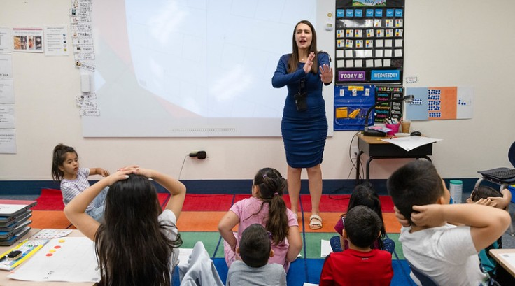
What Does Phonological Awareness Look Like at School?
Notes:
What Does Phonological Awareness Look Like at School?

Slide 32


Colorado Academic Standards (CAS) I Phonological Awareness
Expectations for Kindergarten
Use their voice to show phonemic awareness (knowledge of the sounds of language, such as long and short vowel sounds, consonants)
Show how vocal sounds produce words (the word “cat” has three sounds – /k/-/a/-/t/)
You May Find Students
Blending and segmenting oral sounds in simple words
(CDE, 2020)
Notes:
Let’s explore how phonological awareness is reflected in the Colorado Academic Standards (CAS).
This is an example of Expectations for Kindergarten
Use their voice to show phonemic awareness (knowledge of the sounds of language, such as long and short vowel sounds, consonants)
Show how vocal sounds produce words (the word “cat” has three sounds – /k/-/a/-/t/)
You May Find Students
Blending and segmenting oral sounds in simple words
Phonological awareness is a critical skill needed for reading and is focused on heavily in the early school years. As you can see from the standards, it builds readiness for phonics.
By grade 2, phonemic awareness continues to develop, but as part of phonics instruction, with letters added.​
More complex phonemic awareness skills continue to develop in typical readers until about third or fourth grade and level off by fifth grade.
However, some children may need supplemental instruction for basic phonological awareness and phonemic awareness blending and segmenting.
Background for presenter:
Created by Coloradans for Colorado children, the Colorado Academic Standards provide a grade-by-grade road map to help ensure children are successful in college, careers, and life. The standards aim to improve what children learn and how they learn in 12 content areas while emphasizing critical thinking, creativity, problem solving, collaboration, and communication as essential skills for life in the 21st century.​
To support families, communities, and teachers in realizing the goals of the Colorado Academic Standards (CAS), the Colorado Family and Community Guides provide overviews of the learning expectations for children. ​
These guides offer some learning experiences children may engage in at school that may also be supported at home.​
As always, the best place to learn about what your child is learning is from your child's teacher.​
You can use the QR code to access the Family and Community Guides to the Colorado Academic Standards

Slide 33
2.CO Minimum Reading Competency Skills for Phonemic Awareness
PA skills focused on primarily in kindergarten and 1st Grades
Begins with identifying and isolating phonemes
Progresses to more advanced PA skills
Notes:
As we reviewed earlier in the presentation, the READ Act contains minimum reading competency skills for phonemic awareness, which are part of the Colorado Academic Standards for Reading and Writing.
As a reminder, the minimum competencies show the progression of phonemic awareness skills from kindergarten through third grade, which are focused on primarily in kindergarten and first grades. Instruction begins with identifying and isolating phonemes and progresses to more advanced phonemic awareness skills over time.

Slide 34
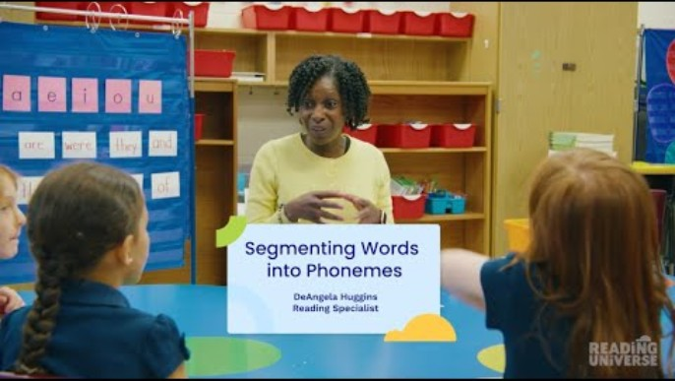
Small Group Example: Segmenting Phonemes
Key Points About the Video:
First grade students segment words into phonemes by tapping out the sounds in each word with their fingers.
Students use their fingers to show the teacher the number of sounds in each word.
Teacher gives students increasingly difficult words to segment with digraphs and consonant blends
Segmenting Phonemes
(Reading Universe, n.d.)
Notes:
Optional classroom example. Video length: 2:39 minutes
Small Group Example: Segmenting Phonemes
Now we are going to watch a quick video of a teacher providing instruction in phonological awareness.
Key Points About the Video:
The teacher works with first grade students on segmenting words into phonemes by tapping out the sounds in each word with their fingers.
The students use their fingers to show the teacher the number of sounds in each word.
The teacher gives students increasingly difficult words to segment with digraphs (e.g., the /ch/ sound in the word chart) and consonant blends (e.g., the /s/ and /m/ at the beginning of the word smart).
(Play the video-subtitles are included within the video; Video length: 2:39 minutes)
FACILITATOR NOTES:
Before watching the video, read the Key Points About the Video so participants know what to focus on.
Watch Small Group Example: Segmenting Phonemes (Closed captioning is available. Enable by clicking on the black CC box at the bottom of the video.)

Slide 35

Phonological Awareness Instruction
Prioritizes phoneme-level skills
Focuses on blending and segmenting
Brief (but precise) and frequent practice
Practices with or without letters
Integrates phonemic awareness with phonics skills
(Kilpatrick, 2015; NELP, 2008; NRP, 2000)
Notes:
Teaching phonemic awareness helps all children improve their reading ability.
Educators will want to prioritizes phoneme-level skills and focus on blending and segmenting
While early phonological awareness tasks can provide valuable insight about a student’s phonological awareness, it is not necessary for children to master all early phonological skills. Phonemic awareness, the ability to identify and manipulate, or play with, INDIVIDUAL sounds in spoken WORDS, is a critical skill for learning to read and spell.
Educators will want to make sure instruction is brief (but precise) and allows for frequent practice
Phonemic awareness is best taught in short and frequent sessions.
Practices with or without letters is also important
The National Reading Panel found that manipulating letters during phonemic awareness instruction is more powerful for improving reading than strictly oral-only instruction.
Integrates phonemic awareness with phonics skills
While phonemic awareness improves phonics skills, phonics can improve phonemic awareness skills. The relationship is reciprocal.
Background for presenters:
When we are teaching phonemic awareness, we want to: include those who have typically developing skills, those who are at risk of experiencing literacy difficulties, those who are diagnosed with a learning disability with impacts on reading and writing, and those learning English as another language, no matter the socioeconomic level (Kilpatrick, 2015).
If children cannot understand that words are made up of individual sounds, they are going to have a hard time connecting letters to the sounds.
The National Reading Panel found that focusing on one or two phonemic awareness tasks at a time is more effective than three or more
Once children are working with letters, they are better served by focusing on phonemic awareness practice that includes letters (NELP, 2008; NRP, 2000).
Another way to say this is: once children know some sound-letter relationships, they should mostly be working with letters and sounds together.

Slide 36

How Can You Support Phonological Awareness at Home?
Notes:
How Can You Support Phonological Awareness at Home?

Slide 37
How Can You Support Phonological Awareness at Home?
Practice 1: Rhyme Time
Practice 2: Syllable Sort
Practice 3: Saying Individual Sounds in Words
Notes:
Developing your child’s phonological awareness is an important part of developing your child as a reader. There are lots of ways families can work to develop a child’s phonological skills. Most activities require no paper or pencil, which makes them perfect for those times when you’re stuck waiting. All you need is a little bit of silliness and a willingness to play with sounds.
Let’s explore three example practices you can use to support phonological awareness at home.
How Can You Support Phonological Awareness at Home?
Practice 1: Rhyme Time
Practice 2: Syllable Sort
Practice 3: Saying Individual Sounds in Words

Slide 38
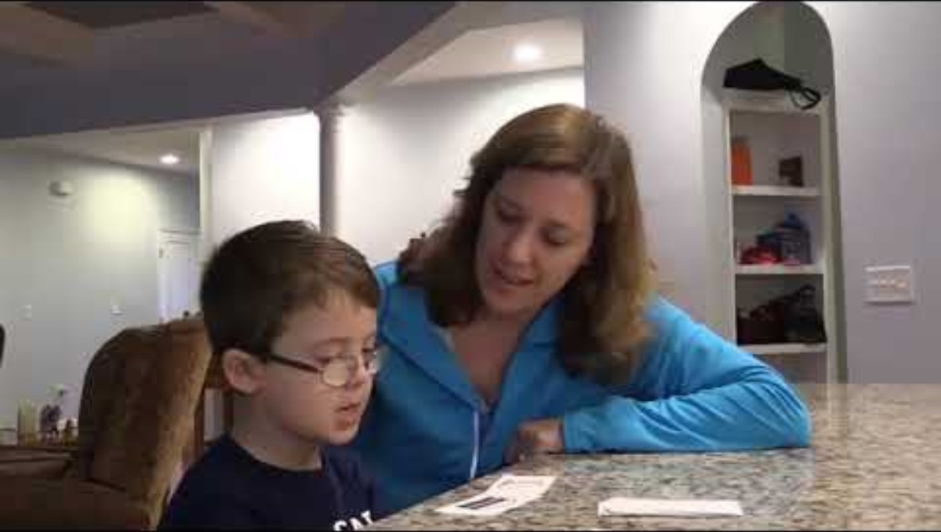
Practice 1: Rhyme Time
Key Points About the Video:
At the beginning, parent describes what a rhyme is and shows child how to play the game.
Throughout the game, parent describes the meanings of words, like random and pot.
Rhyme Time Activity
Nursery Rhyme Time Activity
(Institute of Education Sciences, n.d.)
Notes:
Optional classroom example. Video length: 2:49 minutes
Practice 1 is called Rhyme Time.
There are many different types of sounds in words. For example, rhyming words represent a type of sound relationship between words. Children need to have the ability to recognize when words rhyme. Words rhyme when they have the same ending sound. For example, blue and shoe rhyme and moon and spoon rhyme. When children recognize words that rhyme and can say a word that rhymes with a word they are given, they can use known words to read new words—for example, they can use the known word fall to help read the unfamiliar word wall.
This activity is an example of a less complex phonological awareness skill. We are going to watch a video and then practice the activities.
Key Points About the Video:
At the beginning, parent describes what a rhyme is and shows child how to play the game.
Throughout the game, parent describes the meanings of words, like random and pot.
(Play the video-subtitles are included within the video; Video length: 2:49 minutes)
FACILITATOR NOTES:
Before watching the video, read the Key Points About the Video so participants know what to focus on.
Watch Video 1: Rhyme Time (Closed captioning is available. Enable by clicking on the black CC box at the bottom of the video.)
After watching the video, give participants time to practice the linked activities with their paired verbal fluency partner(s).
Rhyme Time Activity
Nursery Rhyme Time Activity

Slide 39
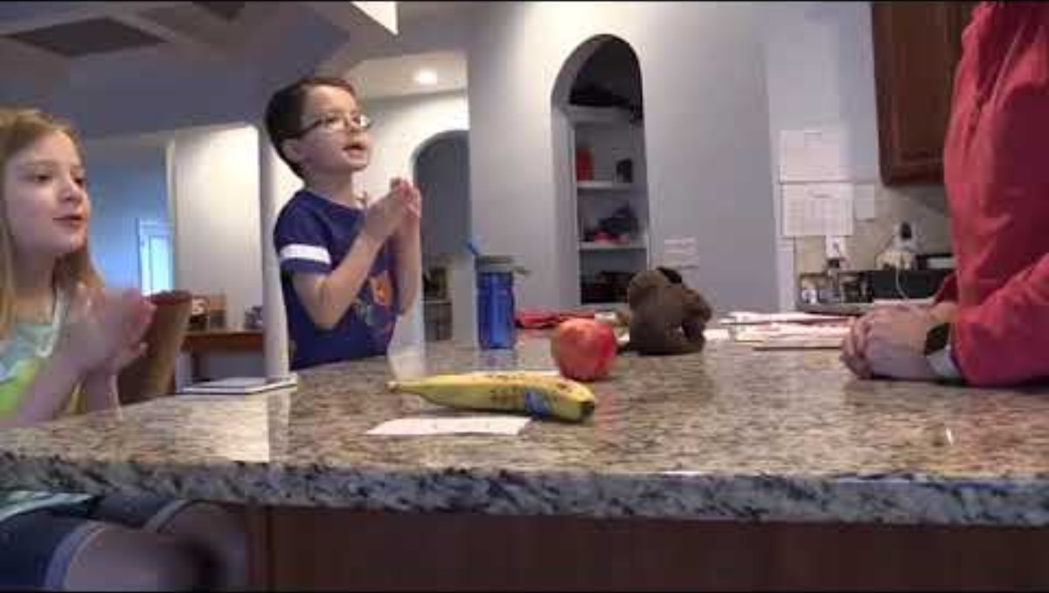
Practice 2: Syllable Sort
Key Points About the Video:
Parents explains that a syllable is a word part and provides an example.
Parent shows child how to play the game by providing examples.
Parent encourages child to clap the word parts when he isn't sure of how many syllables are in the word banana.
Syllable Sort Activity
Clap Word Parts Activity
(Institute of Education Sciences, n.d.)
Notes:
Optional classroom example. Video length: 2:17 minutes
Practice 2 is called Syllable Sort
There are many types of different sounds in words. For example, one skill is being able to separate words into syllables, or parts, like knowing that the word folder has two syllables, or parts: fold-er. And the word computer has three syllables or parts: com-pu-ter. Being able to separate words into syllables will help children break a word into parts in order to read or spell the word.
We are going to watch a video and then practice the activity.
Key Points About the Video:
Parent explains that a syllable is a word part and provides an example.
Parent shows child how to play the game by providing examples.
Parent encourages child to clap the word parts when he isn't sure of how many syllables are in the word banana.
(Play the video-subtitles are included within the video; Video length: 2:17 minutes)
FACILITATOR NOTES:
Before watching the video, read the Key Points About the Video so participants know what to focus on
Watch Video 2: Syllable Sort (Closed captioning is available. Enable by clicking on the black CC box at the bottom of the video.)
After watching the video, give participants time to practice the linked activities with their paired verbal fluency partner(s).
Syllable Sort Activity
Clap Word Parts Activity

Slide 40
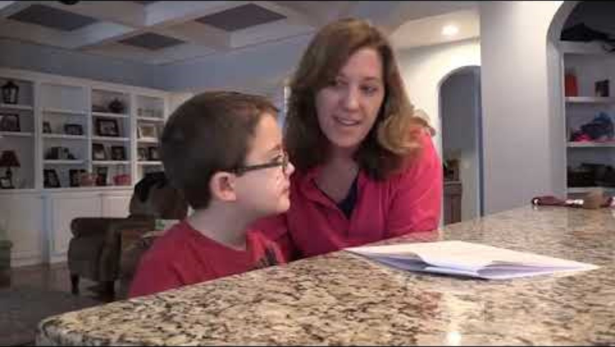
Practice 3: Saying Individual Sounds in Words
Key Points About the Video:
Parent explains how to play the game and is enthusiastic.
This is a listening activity, so the child does not look at any letters or words.
When the child says the letter name, c, instead of the letter sound, /k/, parent tells him that he would be right if he were spelling the word, but for now, they are just listening to the sounds in words.
What's the First Sound? Song
Add a Sound to Make a New Word Activity
(Institute of Education Sciences, n.d.)
Notes:
Optional classroom example. Video length: 2:05 minutes
Practice 3 is called Saying Individual Sounds in Words
Help your child link sounds in speech to letters in print. Although speaking and listening may not seem related to learning to read, being aware of sounds in words is very important to reading. This awareness allows children to break apart words orally and use sounds to learn to read and write words. Children first need to become aware of sounds in words without relating those sounds to print. They demonstrate their knowledge using their speaking and listening skills.
This activity is an example of an important complex phonemic awareness skills. We are going to watch a video and then practice the activity.
Key Points About the Video:
Parent explains how to play the game and is enthusiastic.
This is a listening activity, so the child does not look at any letters or words.
When the child says the letter name, C, instead of the letter sound, /k/, parent tells him that he would be right if he were spelling the word, but for now, they are just listening to the sounds in words.
(Play the video-subtitles are included within the video; Video length: 2:05 minutes)
FACILITATOR NOTES:
Before watching the video, read the Key Points About the Video so participants know what to focus on
Watch Video 3: Saying Individual Sounds in Words (Closed captioning is available. Enable by clicking on the black CC box at the bottom of the video.)
After watching the video, give participants time to practice the linked activities their paired verbal fluency partner(s).
What’s the First Sound? Song
Add A Sound to Make a New Word Activity

Slide 41



More Practice
Rhyme Time
Word Families
Tongue Twisters
Syllable Shopping
I Spy First Sounds
Sound Scavenger Hunt
(Reading Rockets, n.d.)
Notes:
Parents can make a big difference in helping their children become readers by practicing pre-reading oral skills at home, in the car, or even in the grocery store. Here are some more practice ideas from Reading Rockets:
Rhyme Time
“I am thinking of an animal that rhymes with big. What’s the animal?” Answer: pig. What else rhymes with big? (dig, fig, wig)
While you’re out driving in the car, spot something out the window and ask your child, “what rhymes with tree or car or shop?” Then switch roles and have your child spot something and ask you for a rhyme. This can turn into a game of nonsense rhymes (“What rhymes with tree stump?”) but that’s great for practicing sounds, too!
Word Families
Word families are sets of words that rhyme. Start to build your word family by giving your child the first word, for example, cat. Then ask your child to name all the “kids” in the cat family, such as: bat, fat, sat, rat, pat, mat, hat, flat. This will help your child hear patterns in words.
Tongue Twisters
Alliteration or “tongue ticklers” — where the sound you’re focusing on is repeated over and over again — can be a fun way to provide practice with a speech sound. Try these:
For M: Miss Mouse makes marvelous meatballs!
For F: Freddy finds fireflies with a flashlight.
For S: Silly Sally sings songs about snakes and snails.
Sing songs and say silly tongue twisters. These help your child become sensitive to the sounds in words.
Syllable Shopping
While at the grocery store, have your child tell you the syllables in different food names. Have them hold up a finger for each word part. Eggplant = egg-plant, two syllables. Pineapple = pine-ap-ple, three syllables. Show your child the sign for each and ask her to say the word.
I Spy First Sounds
Practice beginning sounds with this simple “I spy” game at home, on a walk, or at the grocery store. Choose words with distinctive, easy-to-hear beginning sounds. For example, if you’re in the bathroom you can say, “I spy something red that starts with the “s” ssss sound (soap).”
Sound Scavenger Hunt
Choose a letter sound, then have your child find things around your house that start with the same sound. “Can you find something in our house that starts with the letter “p” pppppp sound? Picture, pencil, pear”

Slide 42
Key Takeaways | Phonological Awareness
Phonological awareness is the umbrella term for the knowledge of sounds in spoken language
Phonemic awareness is the ability to identify and manipulate individual sounds in spoken words
Phonemic awareness is a critical component of reading instruction
Blending and segmenting are the most critical phonemic awareness skills
Phoneme awareness predicts later outcomes in reading and spelling
Notes:
Let’s wrap up the presentation by revisiting some Key Takeaways about Phonological Awareness.
Phonological awareness is the umbrella term for the knowledge of sounds in spoken language
Phonemic awareness falls under the umbrella of phonological awareness and refers to the specific ability to identify, blend, segment, and manipulate the individual sounds, or phonemes, in spoken words.
Phonemic awareness is a critical component of reading instruction
Blending and segmenting are the most critical phonemic awareness skills
Phoneme awareness predicts later outcomes in reading and spelling
Share Handout 6: Phonological Awareness for Parents handout

Slide 43
Do You Want to Learn More?
Visit the CDE Parent Resources Website
Notes:
Do You Want to Learn More?
There are more resources for parents on the CDE Parent Resources Website including videos of activities you can do at home.

Slide 44
References 1
Adams, M. J., Foorman, B. R., Lundberg, I., & Beeler, T. (1998). Phonemic awareness in young children: A classroom curriculum. Paul H. Brookes Publishing.
Birsh, J. R. & Carreker, S. (2018). Multisensory teaching of basic language skills (4th ed.). Baltimore, MD: Brookes.
Boulton, D. (2003). Children of the code [Documentary series]. Learning Stewards.
Cassar, M., Treiman, R., Moats, L., Pollo, T. C., & Kessler, B. (2005). How do the spellings of children with dyslexia compare with those of nondyslexic children? Reading and Writing, 18(1), 27–49.
Colorado Reading to Ensure Academic Development Act, Colo. Rev. Stat. §§ 22-7-1201-1214, (2019).
Ehri, L. C. (2014). Orthographic mapping in the acquisition of sight word reading, spelling memory, and vocabulary learning. Scientific Studies of Reading, 18(1), 5–21.
Ehri, L. C., Nunes, S. R., Stahl, S. A., & Willows, D. M. (2001). Systematic phonics instruction helps children learn to read: Evidence from the National Reading Panel's meta-analysis. Review of Educational Research, 71(3), 393–447.
Gillon, G. T. (2004). Phonological awareness: From research to practice. Guilford Press.
Gough, P. B. & Tunmer, W.E. (1986). Decoding, reading, and reading disability. Remedial and Special Education, 7(1).
Hatcher, P. J., & Hulme, C. (1999). Phonemes, rhymes, and intelligence as predictors of children’s responsiveness to remedial reading instruction. Journal of Experimental Child Psychology, 72(2), 130–153.
Hatcher, P. J., Hulme, C., & Snowling, M. J. (2004). Explicit phoneme training combined with phonic reading instruction helps young children at risk of reading failure. Journal of Child Psychology and Psychiatry, 45(2), 338–358.
Notes:
References | Phonological Awareness

Slide 45
References 2
Institute of Education Sciences. (n.d.). [YouTube channel]. YouTube. https://www.youtube.com/@InstituteofEducationSciences
Kamhi, A. G., & Catts, H. W. (1989). Reading disabilities: A developmental language perspective. Allyn & Bacon.
Kemeny, L. (2023). 7 mighty moves: Research-backed, classroom-tested strategies to ensure K-to-3 reading success. Scholastic Professional.
Kilpatrick, D. A. (2015). Essentials of assessing, preventing, and overcoming reading difficulties. Wiley.
Lane, H. B., & Pullen, P. C. (2004). Phonological awareness assessment and instruction: A sound beginning. Allyn & Bacon.
Lonigan, C. J., & Shanahan, T. (2008). Executive summary of the report of the National Early Literacy Panel. Developing early literacy: Report of the National Early Literacy Panel, 1–8. National Center for Family Literacy.
Muter, V., & Snowling, M. J. (1998). Concurrent and longitudinal predictors of reading: The role of metalinguistic and short-term memory skills. Reading Research Quarterly, 33(3), 320–337.
Nation, K., & Hulme, C. (1997). Phonemic segmentation, not onset–rime segmentation, predicts early reading and spelling skills. Reading Research Quarterly, 32(2), 154–167.
National Center on Improving Literacy. (n.d.). Retrieved from https://www.improvingliteracy.org/
National Early Literacy Panel. (2008). Developing early literacy: Report of the National Early Literacy Panel. National Center for Family Literacy.
National Reading Panel. (2000). Teaching children to read: An evidence-based assessment of the scientific research literature on reading and its implications for reading instruction (NIH Publications No. 00-4769) Washington, DC: National Institutes of Child Health and Human Development.
Notes:
References | Phonological Awareness

Slide 46
References 3
National Institute of Child Health and Human Development. (2000). Report of the National Reading Panel: Teaching children to read: An evidence-based assessment of the scientific research literature on reading and its implications for reading instruction (NIH Publication No. 00-4769). U.S. Government Printing Office.
Rath, L. K. (2001). Phonemic awareness: Segmenting and blending the sounds of language. In S. Brody (Ed.), Teaching reading: Language, letters, and thought (2nd ed.). LARC Publishing.
Reading Rockets. (n.d.). Reading 101: A guide for parents. https://www.readingrockets.org/literacy-home/reading-101-guide-parents.
Reading Universe. (n.d.). Word recognition. Reading Universe. https://readinguniverse.org/explore-teaching-topics/word-recognition
Sedita, J. (2021). The keys to beginning reading [Professional development materials]. Keys to Literacy.
The Reading League. (2022). Science of Reading: Defining guide (2nd ed.). The Reading League.
Torgesen, J. K. (1998). Catch them before they fall: Identifying and helping children with reading difficulties in early grades. American Educator, 22(1–2), 32–39.
Torgesen, J. K. (2004). Lessons learned from research on interventions for children who have difficulty learning to read. In P. McCardle & V. Chhabra (Eds.), The voice of evidence in reading research (pp. 355–382). Paul H. Brookes Publishing.
Uhry, J. K. (2011). Phonemic awareness and letter-sound knowledge: Their impact on spelling. In R. L. Treiman & B. E. Berninger (Eds.), Spelling development and disability: Theoretical, empirical, and practical perspectives (pp. 147–164). Routledge.
Yopp, H. K., & Yopp, R. H. (2009). Phonological awareness is child's play! Young Children, 64(1), 12–17.
Notes:
References | Phonological Awareness

