Slide 1
Resources needed for this presentation (Keep this slide hidden) | 1
A way to project the PowerPoint
Note for presenters: For accessibility, you must read the words on the slides. The words bolded in the notes are the words from the slide.
Adequate audio for playing videos (test audio and video before presentation)
Video 1: Second Grade Vocabulary Instruction-enable CC for accessibility
Video 2: Kindergarten Read Aloud-enable CC for accessibility
Video 3: Dinner Table Talk-subtitles are embedded
Video 4: Talking While You Read-subtitles are embedded
Writing utensils and blank paper for participants to take notes for discussion
Review facilitator directions for the 2 Practices:
Practice 1: Dinner Table Talk p. K|1|8 - K|1|12
Practice 2: Talking While You Read p. 1|1|3 – 1|1|7

Slide 2
Resources needed for this presentation (Keep this slide hidden) | 2
If in a virtual setting, prepare to make breakout rooms for partners to talk.
Printed copies of these documents:
Practice 1:
Dinner Table Talk
Print p. K|1|10 one-sided for families to post on their refrigerator
Print pp. K|1|11 one-sided to fold for grocery shopping
Learning Language Every Day
Print the languages needed by your participants/community
Practice 2:
Talking While You Read | PEER
Print p. 1|1|6, the tri-fold
A variety of picture books for the practice section
Print out this document with QR codes for audio books for parents if they prefer.

Slide 3


The Colorado READ Act and the Science of Reading for Families
Oral Language and Vocabulary Development
Notes:
Welcome and thank you all for being here today.
This is a presentation within the Colorado READ Act and the Science of Reading for Families series developed to support parents with ways to help their children build reading skills in partnership with their school. ​
The READ Act encourages local education providers to provide parent opportunities to participate in parent reading workshops throughout the school year to assist parents in developing their own reading skills and in developing the skills necessary to assist their children in reading. We hope this series will be helpful to you as parents (CRS 22-7-1208 (4)).
The Colorado READ Act statute defines the term “parent’ as a student’s biological or adoptive parent, stepparent, foster parent, or legal guardian(CRS 22-7-1203 (8)(a)).
For brevity purposes, we have adopted this definition throughout the presentation. When we use “Parent” during the presentation we mean family or caregiver aligned with the language of the law.
During this presentation, we will be focusing on Oral Language and Vocabulary Development​
For more information or additional resources, please visit the READ Act Parent Resources page found within the CDE website. (QR Code on the slide)

Slide 4
Welcome | Oral Language & Vocabulary
First Name Last Name, Title or Position
Office or school/district
Email/contact information
Notes:
Welcome, we are glad you are here.
Share your name, title and contact details
If time, share a bit about your journey as an educator and/or parent that would be relevant to this session.
Logistics: Share the following points that match your circumstance
This presentation includes active captions.
Presenters will be using a microphone.
We ask that audience members use a microphone when asking questions.
Presenters will be reading the content on each slide to ensure that it is accessible for ALL participants.
Note for presenters: For accessibility, you must read the words on the slides. The words bolded in the notes are the words from the slide.

Slide 5
Outcomes| Oral Language & Vocabulary
What are oral language and vocabulary development?
Why are oral language and vocabulary important?
What do oral language and vocabulary look like at school?
How can you support oral language and vocabulary at home?
Notes:
By the end of this presentation the outcomes are for you to be able to answer these questions.
What are oral language and vocabulary development?
Why are oral language and vocabulary important?
What do oral language and vocabulary look like at school?
How can you support oral language and vocabulary at home?
Take a moment to think about which question(s) you are very interested in learning about in our time together (Give 1-2 minutes of think time).
(If presenting in-person): We have provided writing utensils and paper at each table.
(If presenting virtually, start here) Please feel free to take notes. Later in the session, we will be talking in partners about what we have heard and learned around these questions.

Slide 6
Norms | Oral Language & Vocabulary
Active listening is appreciated
Active participation is welcomed
Take care of your own needs
Silence your cell phone as a courtesy to all
Notes:
We hope this will be an engaging and informative time for everyone here tonight. Please work to follow these norms:
Active listening is appreciated
Active participation is welcomed
Please take care of your own needs
If in-person, share where the restrooms and water stations are located, as needed.
If presenting virtually, you might consider asking participants to leave cameras on as they are able.
Silence your cell phone as a courtesy to all
Are there any other items you think we should add to this list that will support all of us?

Slide 7

Warm-Up | Oral Language & Vocabulary
Like Me
Move chairs back from the table so it is easy for you to stand up
A category will be named
Stand if you match the category
Look around to see who else is also in the category
Introduce yourself
Notes:
We are going to start with a Warm-up activity called (click) Like Me (Adjust the mobility section of the activity according to the abilities of the participants in the room).
We are doing this activity because:
We want to begin to turn this room of individuals into a group that works together
This activity focuses the energy into this room and out of your day or previous activities, so you feel ready to participate
You will begin to understand who you are in relation to others in the group and have a chance to introduce yourself
Here is how this activity will work. I will read all of the steps, ask for questions and then we will begin to activity.
(click) Move chairs back from the table so it is easy for you to stand up. (Adjust the mobility section of the activity according to the abilities of the participants in the room. If presenting virtually, ask participants to stand in front of their camera or use the thumb's up reaction button).
(click) A category will be named.
(click) Stand if you match the category.
(click) Look around to see who else is also in the category.
(click) Introduce yourself
Check for understanding -Does anyone have any questions?
Then, start the activity at step 1.
Name some of the following categories (or create your own to match your community) and give time for people to stand: (facilitators should also participate by standing or staying seated)
I am a parent
My child or children can become super interested in one topic for weeks at a time. (Have them share the topics, if time allows).
My child or children notices interesting words and points them out to me!
We tell jokes at home. (Share jokes, if time).
My child or children love to talk!
Other: If you have not had the opportunity to stand yet, please stand now and share something about yourself.
Have the parents go around the room and share: (if group is large, make small groups for this activity)
Name
Grade of Child(ren)

Slide 8
Simple View of Reading (SVR)
Word
Recognition
Language
Comprehension
=
Reading
Comprehension
X
(Gough & Tunmer, 1986)
Notes:
Several decades of reading research has given us a clear understanding of how students best learn to read. One way to conceptualize reading is through the Simple View of Reading (SVR) model. This model developed by Gough and Tunmer organizes the skills needed to become a proficient and successful reader into two categories: (click) word recognition and (click) language comprehension. The Simple View of Reading is a basic formula for (click) reading comprehension.
It says this: reading comprehension is the product of word recognition skills and language comprehension skills.
We need both sides of the equation for students to become skilled, proficient readers.
(click) Students need efficient word recognition or decoding skills where they are accurately and automatically reading the words on the page without aid of context clues or pictures.
(click) They also need fully developed language comprehension skills which references the ability to understand language.
In order for a student to understand text, they need to decode the words on the page and then make meaning of the words, sentences, and overall text.
(https://www.cde.state.co.us/coloradoliteracy/scienceofreadingresources).

Slide 9
Simple View of Reading (SVR) | The 5 Components of Reading
Word
Recognition
Language
Comprehension
=
Reading
Comprehension
X
Phonological Awareness
Phonics
Vocabulary
Language- based skills and strategies
Literacy knowledge and skills
Fluency
Oral Language
(Gough & Tunmer, 1986; NRP, 2000)
Notes:
We can use the Simple View of Reading to organize the Five Essential Components of Reading.
(CLICK) Word recognition skills require phonological awareness (attention to the sounds in our language) and phonics (the ability to connect sounds to the letters that represent them).
(CLICK) Language comprehension is supported by vocabulary knowledge (knowing and understanding the meanings of words). In addition, vocabulary knowledge can also support word recognition, particularly as students encounter more complex or irregular words that require familiarity with word parts (morphemes) or context to decode and understand.
Readers also need a variety of language-based skills and strategies such as inferencing, understanding syntax and sentence structure, and utilizing background knowledge. To comprehend text, we must also acquire literacy knowledge and skills, such as understanding text structure and literary genres.
(CLICK) Reading Fluency acts like a bridge that connects word recognition and language comprehension to support understanding when reading (Sedita, 2019).
(CLICK) Oral language is the foundation for skilled reading and literacy development and needs to be integrated throughout all components.
As we become better readers, our reading skills, in turn, help us develop more complex thinking, communication, and language skills (Kamhi & Catts, 1989; Lonigan & Shanahan, 2012).
Each component acts as a piece of the larger whole, similar to a puzzle. Effective reading instruction is not complete without ensuring that all five components, and oral language, are taught.

Slide 10
Simple View of Reading (SVR) | The 5 Components of Reading 2
Word
Recognition
Language
Comprehension
=
Reading
Comprehension
X
Phonological Awareness
Phonics
Vocabulary
Language- based skills and strategies
Literacy knowledge and skills
Fluency
Oral Language
(Gough & Tunmer, 1986; NRP, 2000)
Notes:
Let’s look closer at the Simple View of Reading (SVR) with Oral Language and Vocabulary Development

Slide 11
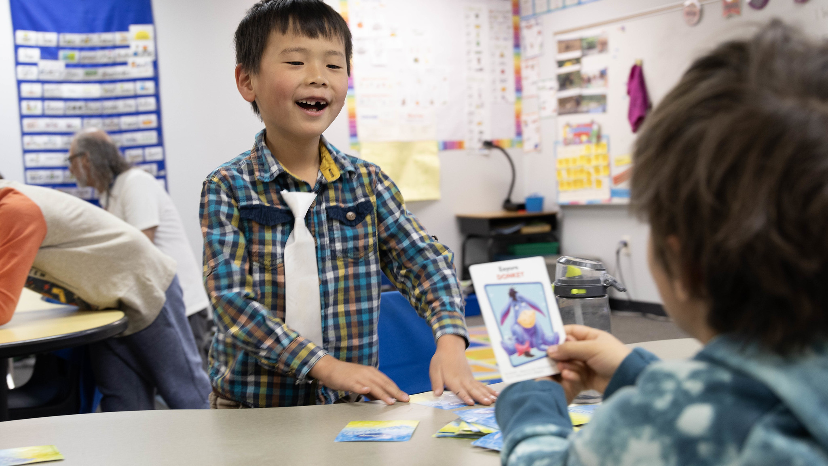

What are Oral Language and Vocabulary Development?
Notes:
What are Oral Language and Vocabulary Development?

Slide 12

Oral Language
The ability to produce and comprehend spoken language, including vocabulary and grammar.
Listening
Speaking
Conversations
Vocabulary Development
(CCR 301-92, 2.23; NELP, 2008)
Notes:
The Colorado READ Act defines Oral language as the ability to produce and comprehend spoken language, including vocabulary and grammar (CCR 301-92, 2.23).
Oral language is sometimes called spoken language, and it includes listening, speaking, conversations, and vocabulary development (Gillis, 2020; NELP, 2008)
Oral language skills begin at birth, through interactions at home and in the community (Cardenas-Hagan, 2020).
Oral language skills are then extended through interactions at school (Cardenas-Hagan, 2020; Snow, 2020).
Oral language provides the foundation for all other literacy skills (Gillis, 2020; Honig et al, 2018; Sedita, 2019; Soifer as cited by Birsh & Carreker, 2018).

Slide 13
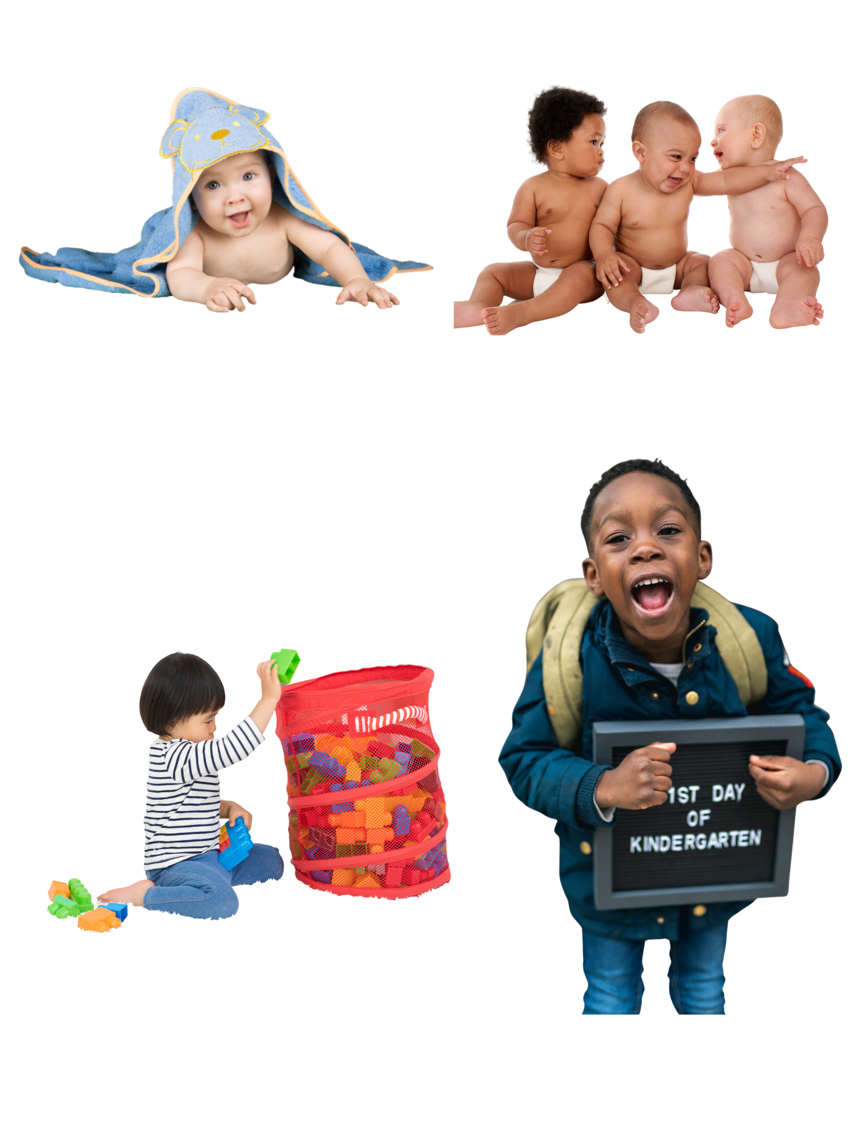

Oral Language Development
Unlike reading, oral language development is a natural process for humans and a basic skill necessary for higher forms of language.
birth to 5 months | 5 months to 18 months | 18 months to 3 years | 3 years and beyond
Link to speech and language milestones
(Birsh & Carreker, 2018; Cardenas-Hagan, 2020; Snow, 2020)
Notes:
Oral Language Development
Unlike reading, oral language development is a natural process for humans and a basic skill necessary for higher forms of language (Birsh & Carreker, 2018; Cardenas-Hagan, 2020).
“… most children are not taught to use language but rather discover the rules that govern language in the context of social interaction as they strive to understand and convey meaning.” (Soifer as cited by Birsh & Carreker, 2018). However, it is important to note that while oral language development is a natural process and needed to learn to read, learning to read is NOT a natural process. It is a skill that is developed over time with direct instruction and opportunity to practice.
Oral language development typically following this process (Cardenas-Hagan, 2020; Snow, 2020):
From birth to around 5 months, a child typically reacts to loud noises, turns their head toward sounds, watches the speaker’s face, vocalizes both pleasure and displeasure, and makes noise in response to speech.
Between 5 to 18 months, babies begin to understand simple words like “no-no,” babble, use gestures to communicate, and try to mimic sounds. As they approach 18 months, they can follow simple directions, answer questions nonverbally, point to familiar objects or people, attend to activities briefly, and say or imitate simple words.
Between 18 months and 3 years, children begin recognizing patterns in language and significantly expand their vocabulary, knowing around 50 words by age two. They enjoy being read to, follow simple commands, and start forming short phrases like “more milk.” Their speech becomes more accurate, though strangers may still have difficulty understanding them, and they begin to ask questions and answer simple ones.
From age 3 and beyond, children rapidly expand their language skills. They follow multi-step directions, answer “why” questions, describe and categorize objects, and begin using more complex sentences. Speech becomes clearer to strangers, and they actively engage in conversations, storytelling, and playful use of language like rhymes and imaginative narratives.
Oral language skills develop before reading skills, and they continue to develop beyond the first 5 years and for a lifetime (Snow, 2020).
If you would more information, please use the QR code to open a link to speech and language milestones.

Slide 14
Vocabulary
Knowledge of words and word meanings and includes words that a person understands and uses in language. Vocabulary is essential for both learning to read and comprehending text.
Never heard the word
Heard the word with some sense of meaning
Know the word in specific context
Not able to use the word in appropriate situations
“Own” the word
(1 CRR 301-92; Beck et al., 2013)
Notes:
The Colorado READ Act states that Vocabulary is the knowledge of words and word meanings and includes words that a person understands and uses in language. Vocabulary is essential for both learning to read and comprehending text (1 CRR 301-92, 2.40).
As discussed in the previous slides, individuals are literally surrounded by words from birth onward. The understanding of word meaning allows humans to communicate (Hennessy as cited by Birsh & Carreker, 2018).
When we think about vocabulary development, which is a subcomponent of oral language, it helps to understand that word learning happens along a continuum. A continuum is something that keeps going, changing slowly over time. So, at different times we are learning words at different places along this continuum (Beck et al., 2013).
(click) Here are the stages of the continuum of word learning:
Never heard the word
Heard the word and have some sense of its meaning
Know the word in specific context
Have knowledge but not able to use the word in appropriate situations
“Own” the word and use the word correctly and flexibly across multiple contexts
Important Points:
There are many levels of “knowing” a word, from hearing it for the first time, all the way to knowing it deeply and being able to use it flexibly.
Our level of knowledge about an individual word is personal and unique.
We have greater knowledge about some words than others.
Word learning is not finite; we continue to build our knowledge throughout our life.
We grow our word knowledge with exposure, instruction, and use.

Slide 15
Connections Across Languages
For bilingual children (learning two languages) developmental milestones align with those of monolingual children (learning one language) regarding early language development.
Oral language proficiency in the home language affects performance in the second language.
Languages have commonalities such as sounds, letters and word meaning.
Speaking your home language supports your child’s oral language and literacy development.
(August & Shanahan, 2008; Birsh & Carreker, 2018; Cardenas-Hagan, 2020; Petitto & Kovelman, 2003)
Notes:
Now let’s consider Connections Across Languages
(click) For bilingual children (learning two languages) developmental milestones align with those of monolingual children (learning one language) regarding early language development (Petitto & Kovelman, 2003).
In simpler terms, oral language skills develop in a similar way across languages (Cardenas-Hagan, 2020).
(click) Oral language proficiency in the home language affects performance in the second language (Cardenas-Hagan, 2020).
A child who has a stronger foundation of oral language is likely to be able to respond well to learning a second language (August & Shanahan, 2008).
(click) Languages have commonalities such as sounds, letters and word meaning. These transfer from a home language to learning a new language (Cardenas-Hagan, 2020)
(click) Speaking to your child in your home or preferred language supports their oral language and literacy development (Birsh & Carreker, 2018; Cardenas-Hagan, 2020)
​Why is this important?
The language that students are exposed to at home and in school influences language development.
Language proficiency depends on how much language exposure and what types of language exposure they have had, regardless of the language they speak.

Slide 16
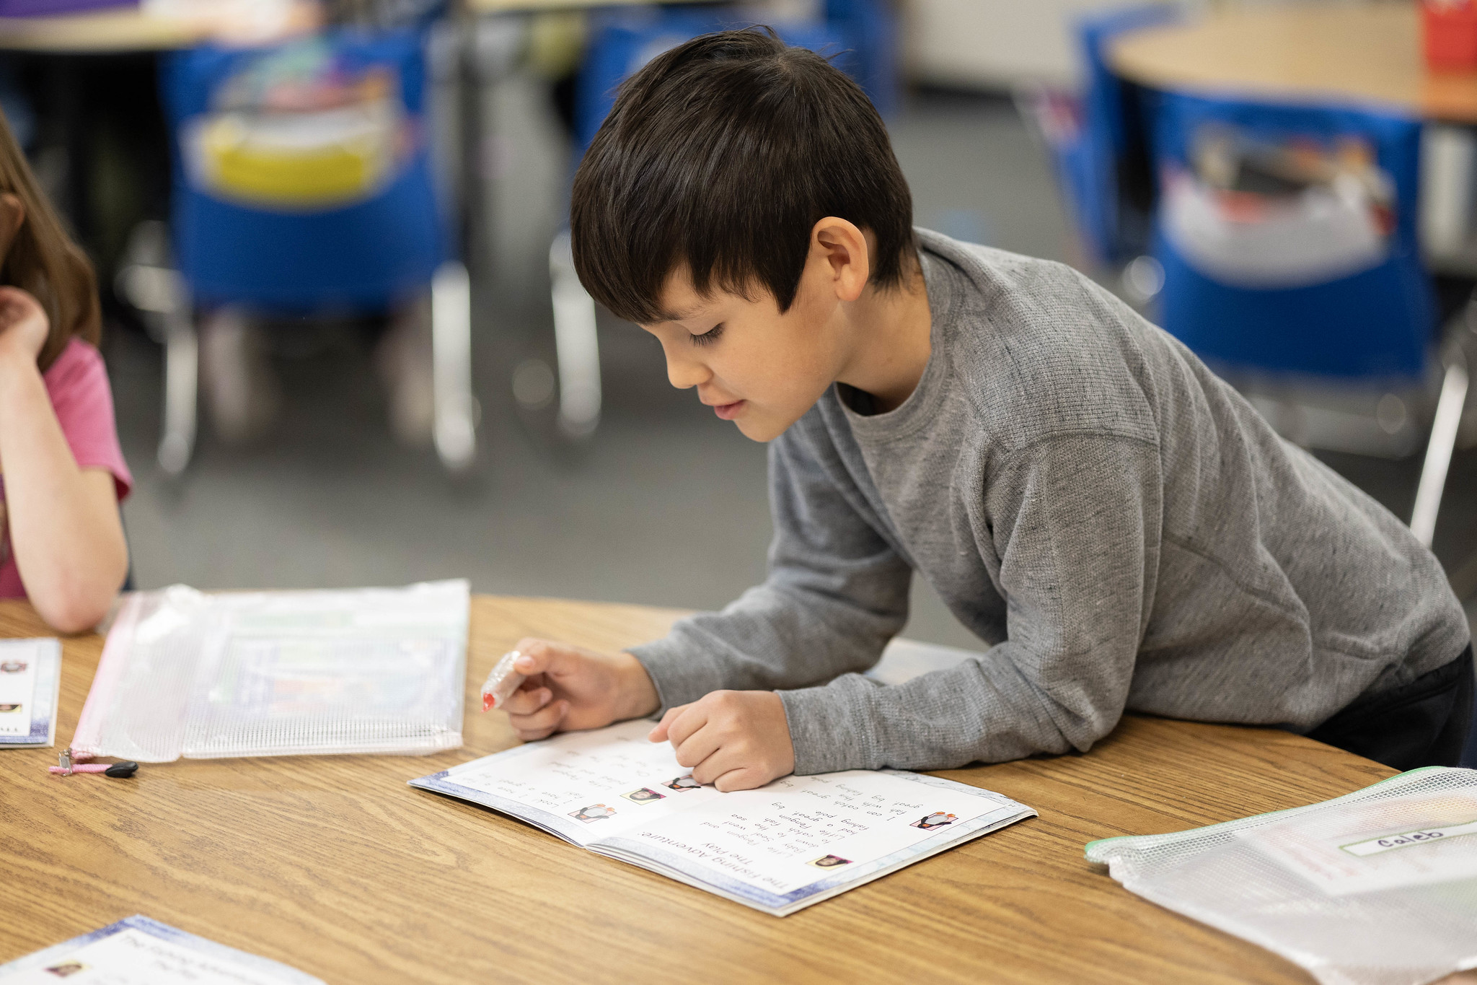
Why are Oral Language & Vocabulary Important?
Notes:
Why are Oral Language and Vocabulary Important?

Slide 17




The Building Blocks of Literacy
Oral Language
Written Language
Listening Vocabulary:
The words we need to know to understand what we hear
Reading Vocabulary:
The words we need to know to understand what we read
Speaking Vocabulary:
The words we use when we speak
Writing Vocabulary:
The words we use when we write
(Honig et al., 2018; NCIL, 2023; NELP, 2008; Snow, 2020; WIDA, 2020)
Notes:
Oral Language & Vocabulary are The Building Blocks of Literacy
Oral Language development comes first and is the foundation for written language development. In other words, oral language is learned first and written language builds on it (Honig et al., 2018; Snow, 2020). Children’s speaking and listening skills are one factor in helping them learn to read, and then reading helps them grow their language skills as they get older (Kahmi & Catts, 1989).
There are different forms of language.
(click) Listening vocabulary, which is oral language, are the words we need to know to understand what we hear.
(click) Reading vocabulary, which is written language, and are the words we need to know to understand what we read.
Both listening and reading are receptive-this is language that is received and processed internally.
(click) Speaking vocabulary, which is oral language, are the words we use when we speak.
(click) Writing vocabulary, which is written language, and are the words we use when we write.
Both speaking and writing are expressive-these are words expressed outwardly, to others. Expressive skills, pushing words outward, are more challenging than receptive skills, taking words in (Soifer as cited by Birsh & Carreker, 2018).
Important Points:
Listening and speaking are natural process while reading and writing must be taught. Not all humans learn this with ease (Soifer as cited by Birsh & Carreker, 2018)
In early readers, oral vocabularies are larger than written or print vocabularies
As students advance, written or printed language plays a larger role (Honig et al., 2018).
You must be able to understand language at an oral level in order understand it at the written level (Gillis, 2020).

Slide 18
Language & Literacy Work Together
Oral language is the underlying foundation for written language.
Oral language, vocabulary and reading grow together, each one helps the other improve.
Children with strong oral language skills and large vocabularies typically become strong readers when they receive explicit phonics instruction.
Speaking to your child in your home language supports literacy development.
Oral Language & Vocabulary
Reading
Writing
(Birsh & Carreker, 2018; Cardenas-Hagan, 2020; Honig et al., 2018; Kahmi & Catts, 1989; Lonigan & Shanahan, 2012)
Notes:
Language and literacy work together
(click) Oral language is the underlying foundation for written language (Honig et al, 2018; Soifer as cited by Birsh & Carreker, 2018). You must be able to understand language at an oral level to understand it at a written level (Gillis, 2020)
(click) Oral language, vocabulary and reading grow together, each one helps the other improve (Kamhi & Catts, 1989; Lonigan & Shanahan, 2012). It is one factor that leads to Reading Comprehension.
(click) Children with strong oral language skills and large vocabularies typically become strong readers when they receive explicit phonics instruction in decoding and word recognition (Hennessey as cited in Birsh & Carreker, 2018; Kosavovich et al., 2020).
(click) Speaking to your child in your home or preferred language supports their oral language and literacy development (Soifer as cited by Birsh & Carreker, 2018; Cardenas-Hagan, 2020)

Slide 19
Paired Verbal Fluency | Oral Language & Vocabulary
What are oral language and vocabulary development?
Why are they important?
Write down thoughts and ideas you could share with a partner (2-3 minutes).
We will create partners A and B and take turns talking about the questions above.
At a signal, one will speak, and one will listen.
At a signal, the other will speak while the first speaker listens.
Each time, no one is allowed to repeat anything that was said by the other.
Notes:
We are going to do an activity called Paired Verbal Fluency
We want to give you time to think about the information presented and share your understanding with a partner about what oral language and vocabulary development are and why they are important for literacy. (If presenting virtually, say that you will be creating breakout rooms for this discussion to take place).
Here is how this activity will work:
First, you will think about these two questions:
What are oral language and vocabulary development?
Why are they important?
Next, we will follow these steps:
Write down thoughts and ideas you could share with a partner (2-3 minutes).
We will create partners A and B and take turns talking about the questions above.
At a signal, one will speak, and one will listen.
At a signal, the other will speak while the first speaker listens.
Each time, no one is allowed to repeat anything that was said by the other.
Does anyone have any questions? (Clarify as needed).
Note to Presenter:
Start at #1 (2-3 minutes to write down ideas or think about notes taken)
Create partners:
Same kind of shoes, sitting next to each other, child in same grade, etc…
Have partners decide or assign A and B
First round (60 seconds)
A speaks, B listens
Second round (40 seconds)
B speaks, A listens
If time, Third Round (20 seconds)
A speaks, B listens
*If presenting virtually, read all the directions and have participants discuss on their own in breakout rooms. Create breakout rooms ahead of time.
Ask if anyone has any questions or comments to share before moving on.

Slide 20
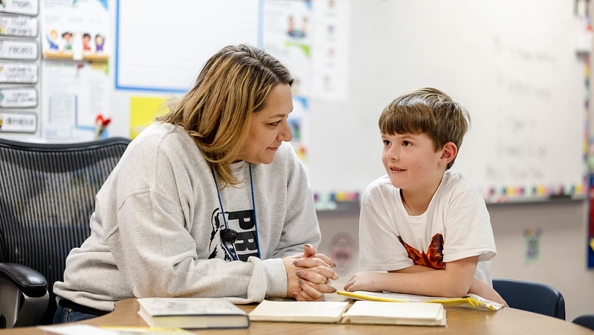
What Do Oral Language & Vocabulary Look Like at School?
Notes:
What Do Oral Language & Vocabulary Look Like at School?

Slide 21


Colorado Academic Standards (CAS) | Oral Language & Vocabulary
Expectations for 1st Grade:
Expand their spoken vocabulary
Demonstrate how words, gestures, and actions are used to give and receive information.
You May Find Students:
Working with fellow students to discuss different readings and topics
Responding to the ideas of others by asking/answering questions
Actively listening by making eye contact and demonstrating positive body posture.
(CDE, 2020)
Notes:
Created by Coloradans for Colorado students, the Colorado Academic Standards (CAS) provide a grade-by-grade road map to help ensure students are successful in college, careers, and life. The standards aim to improve what students learn and how they learn in 12 content areas while emphasizing critical thinking, creativity, problem solving, collaboration, and communication as essential skills for life in the 21st century.
To support families, communities, and teachers in realizing the goals of the Colorado Academic Standards (CAS), the Colorado Family and Community Guides provide overviews of the learning expectations for students.
These guides offer some learning experiences students may engage in at school that may also be supported at home.
As always, the best place to know about what your child is learning is from your child's teacher.
Standards for Oral Language and Vocabulary Development are found in all grade-levels (Sedita, 2019).
You can use the QR code to access the Family and Community Guides to the Colorado Academic Standards.
Here is an example of Expectations for 1st Grade.
Expand their spoken vocabulary
Demonstrate how words, gestures, and actions are used to give and receive information.
Give and receive information refers to receptive and expressive language that we have previously discussed.
You May Find 1st Grade Students:
Working with fellow students to discuss different readings and topics
Responding to the ideas of others by asking/answering questions
Actively listening by making eye contact and demonstrating positive body posture.

Slide 22
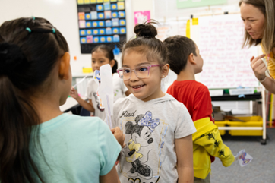
Language-Rich Environments
Embed oral language development into lessons and across the day
Model academic language
Provide multiple opportunities to communicate with others
Direct and indirect vocabulary instruction
Encourage word consciousness
(Honig er al., 2018; Lonigan & Shanahan, 2012; NRP, 2000)
Notes:
Schools build Language-Rich Environments:
(click) Teachers embed oral language development into lessons across the day so students are surrounded by talk
They explicitly Teach Listening & Discussion Skills aligned to the Colorado Academic Standards
Explicit instruction on how to communicate ideas is one that becomes more advanced over time. When students are first learning this skill, teachers are facilitators in providing students with the tools and language they need to share their ideas across varied audiences in small and large-group settings (Gillis, 2020).
The teacher models recasting, rephrasing, or repeating what students say to enrich oral language exchanges. Or provides sentence stems for scaffolding oral language.
(click) They model academic language
Academic language is the language of the classroom and written texts or books (Gillis, 2020).
Teachers are conscious of the language they use, how they use it, and how to create an environment in which academic language and precision are modeled.
(click) Teachers intentionally plan for classrooms’ where students have multiple opportunities to communicate with others (Lonigan & Shanahan, 2012).
The plan time within lessons dedicated to students hearing and using academic vocabulary
The time the teacher talks is minimized to allow for student response and conversation within a lesson.
(click) Direct and indirect vocabulary instruction occurs.
The National Reading Panel (2000) found no one specific way to teach vocabulary. A variety of methods are recommended.
Teachers will incorporate vocabulary instruction into lessons as well as model and emphasize language in how they speak to the class (Lonigan & Shanahan, 2012).
(click) Teachers encourage word consciousness by helping children become interested in words; both how they think about words and how they feel about words (Anderson & Nagy, 1992 as cited in Honig et al., 2018).
They might do this through building background knowledge on a topic, playing word games and teaching how words relate to each other.

Slide 23
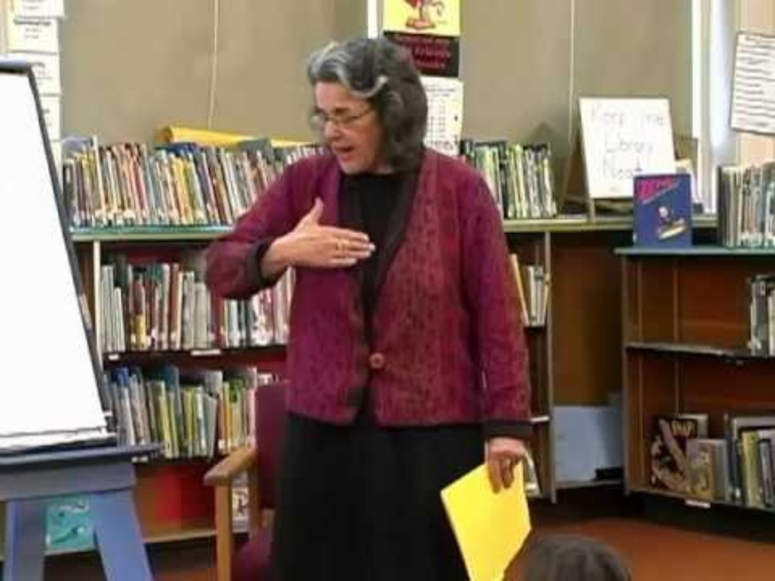
Language Rich Environment | Example
Key Points About the Video:
Introduces the word by parts
Shares child-friendly explanation and examples
Students restate the word and actively use the word
Checks the children’s understanding of the word.
Models ways to use the new words.
(Archer, 2013)
Notes:
Facilitator: This is an optional video if time allows. Video length: 4:17
Keep this slide hidden if unused.
This video demonstrates a direct vocabulary lesson in a second-grade classroom. It is an example of one component of a Language Rich Environment.
Please watch for these Key Points about the Video:
The teacher:
Introduces the word by parts
Shares child-friendly explanation and examples
Has the Students restate the word and actively use the word
Checks the children’s understanding of the word.
Models ways to use the new words.
(Play the video-Click the CC to start subtitles for accessibility)
Would anyone like to share something they noticed or thought about during the video? Discuss as appropriate.

Slide 24

Read Aloud or Shared Book Reading
Develops oral language
Improves listening skills
Introduces students to new concepts and ideas
Boosts vocabulary
Cultivates a love of reading
(Birsh & Carreker, 2018; Cardenas-Hagan, 2020; Kemeny, 2023)
Notes:
Teachers Read Aloud to students, also known as Shared Book Reading, when they are reading, talking about and looking at books with the children (Soifer as cited in Birsh & Carreker, 2018; Cardenas-Hagan, 2020).
“When adults engage in purposeful and high-quality conversation with children, children develop larger vocabularies” (Hart & Risely, 1999; Hoff & Naigles, 2002, as cited in Birsh & Carreker, 2018).
Reading aloud to students (Kemeny, 2023):
(click) Develops oral language
(click) Improves listening skills
(click) Introduces students to new concepts and ideas
(click) Boosts vocabulary
(click) Cultivates a love of reading
Children who have been read to as preschoolers find the process of learning to read an easier experience (Soifer as cited by Birsh & Carreker, 2018) when they also receive systematic and explicit instruction in all the components of reading with opportunities to practice.

Slide 25
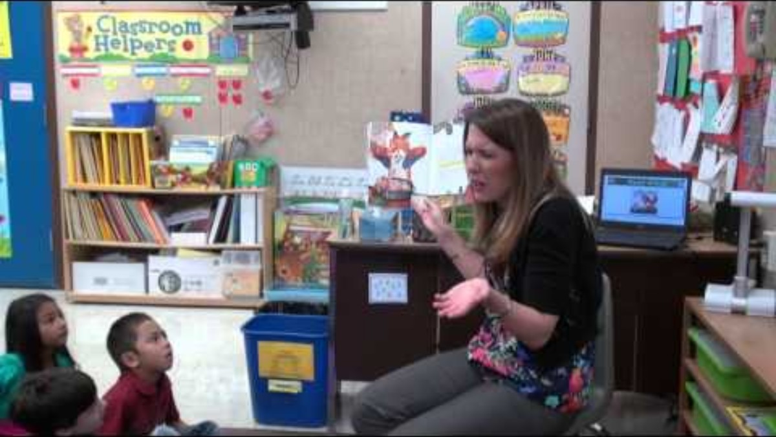
Read Aloud or Shared Book Reading | Example
Key Points About the Video:
Stops and explains vocabulary words
Turn and talk to make predictions
Sentence stem to help start a sentence
Asks the children questions about the book to show their understanding
(Stevens, 2013)
Notes:
Facilitator: This is an optional video if time allows. Video length: 6:25.
Keep this slide hidden if unused.
This video demonstrates a Read Aloud or Shared Book Reading Example in a kindergarten classroom.
Please watch for these Key Points about the Video:
The teacher stops and explains vocabulary words important to the story to boost vocabulary learning.
The teacher uses child-friendly explanations.
To develop oral language:
The students turn and talk to make predictions about what happens next to develop their oral language.
The teacher gives them a sentence stem to help them start a sentence.
The teacher asks the children questions about the book to show their understanding of concepts and ideas in the book.
(Play the video-Click the CC to start subtitles for accessibility)
Would anyone like to share something they noticed or thought about during the video? Discuss as appropriate.

Slide 26

How Can You Support Oral Language & Vocabulary at Home?
Notes:
How can you support oral language and vocabulary at home?
Read! Talk! Listen!
Adults have countless formal and informal opportunities to support oral language and vocabulary development but might be unaware of when and how they can provide support (Hennessy as cited in Birsh & Carreker, 2018).

Slide 27
How Can You Support Oral Language and Vocabulary at Home?
Practice 1: Model and Expand Language
Practice 2: Talking While You Read
Notes:
We will consider two practices around How can you support oral language and vocabulary at home.
Practice 1: Model and Expand Language
Practice 2: Talking While You Read
These practices mirror or align with how oral language and vocabulary are developed in the classroom.

Slide 28
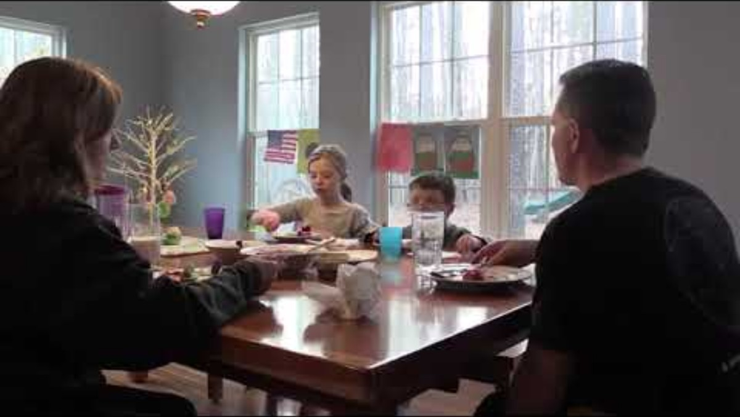
Practice 1: Model and Expand Language
Key Points in the Video:
Adults listen and ask open-ended questions to extend the conversation.
Adults correct the children, as needed, to model and encourage complete sentences.
Dinner Table Talk
Learning Language Every Day
(Kosanovich et al., 2020; WIDA, 2025)
Notes:
“Vocabulary acquisition begins in the home, where children have opportunities to acquire and use their developing oral language abilities through conversations with their parents and siblings who can scaffold and extend their responses as they learn to talk about the world around them” (Cardenas-Hagan, 2020).
While “Vocabulary knowledge serves as a critical component in all … language development and plays an important role in development of conceptual knowledge growth, which strengthens and builds background knowledge essentials for comprehension of text materials” (Cardenas-Hagan, 2020, p. 121).
Practice 1 is Model and Expand Language
Asking open-ended questions to encourage conversation where you can model and expand on the language is a great strategy (Cavazos, 2024). Remember, speaking to your child in your home or preferred language supports their oral language and literacy development (Soifer as cited by Birsh & Carreker, 2018; Cardenas-Hagan, 2020).
Be intentional with the words you use
Instead of happy, use joyful
Provide meaning to the words you use
“I am exhausted, meaning I am very tired from my day.”
Use language as a model in everyday tasks
“Please concentrate on getting dressed.”
We are going to watch a video and then practice activities that model and expand language for you to use at home.
Please watch for these key points in the video as you listen to how these adults help the children build their oral language and vocabulary:
Adults listen and ask open-ended questions to extend the conversation.
Adults correct the children, as needed, to model and encourage complete sentences.
(Play the video-subtitles are included within the video)
Would anyone like to share something they noticed or thought about during the video? Discuss as appropriate.
I have some resources I am going to handout.
Let’s look at this Dinner Table Talk, the Grocery Shop Talk and the Learning Languages Every Day Handouts.
The Dinner Table Talk is designed to hang on your refrigerator or a noticeable place at home.
The Grocery Shop Talk is designed for you to create a grocery list together and gives suggestions around ways to talk at the grocery store to build language.
The Learning Language Every Day handout can be used to start conversations with your children about many topics. There is no right or wrong way to use these activities. You can share them with your friends and family members.
Please read through each handout making note of any questions you might have (give participants 5-7 minutes)
Are there any questions as you read about these activities? (Clarify as needed).
We are going to watch a video and then practice the activities.
(Consult the IES Facilitator Guide Practice 1: Dinner Table Talk (p. K|1|8) for additional directions or ideas

Slide 29
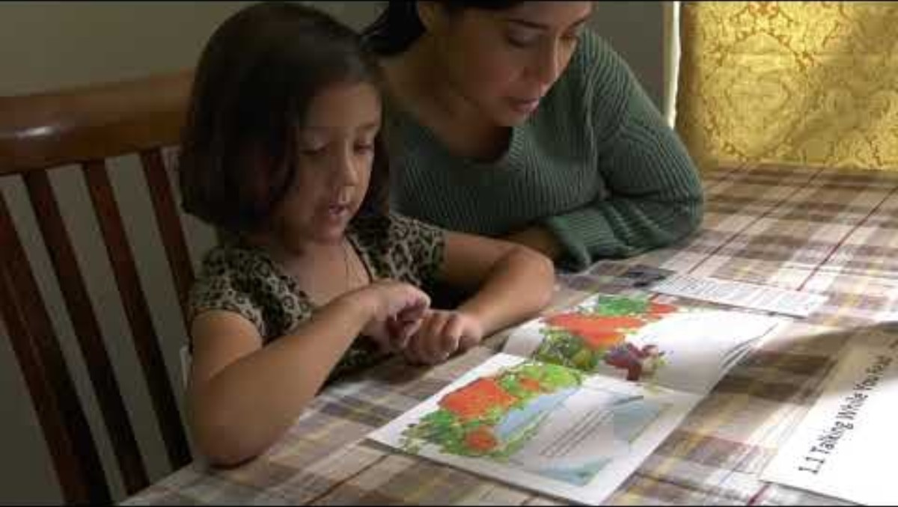
Practice 2: Talking While You Read
Key Points About the Video:
Mom keeps using the word round to help build her daughter’s vocabulary
Mom restates her daughter’s answers in complete sentences to model oral language skills
Mom uses the Talking While You Read Bookmark to decide what questions to ask
Talking While You Read | PEER
(Kosanovich et al., 2020; Kosanovich et al., 2021)
Notes:
Practice 2 is Talking While You Read (Kosanovich et al., 2020)
Talking with your child when you read is an important way to develop vocabulary and knowledge about the topic of the book.
Tip: It is ok to read a book multiple times or to read multiple books on the same topic. This builds a child’s vocabulary and background knowledge around a topic (Cardenas-Hagan, 2020). You could also choose books that match topics your child is learning about at school to maximize learning and build knowledge! Ask your child’s teacher for topics.
We are going to watch a video and then practice activities that model and expand language for you to use at home.
Please watch for these key points in the video as you listen to how this adult helps build oral language and vocabulary skills:
Mom keeps using the word round to help build her daughter’s vocabulary
Mom restates her daughter’s answers in complete sentences to model oral language skills
Mom uses the Talking While You Read Bookmark to decide what questions to ask
(Play the video-subtitles are included within the video)
Would anyone like to share something they noticed or thought about during the video? Discuss as appropriate.
Let’s look at this trifold handout: Talking While You Read using PEER that the mom in the video was using. This is something you can have next to you while you read with your child.
I am going to go through each steps for using this strategy found on the handout. (These steps follow with what is written on the trifold. Point this out to parents as needed).
Choose a book with detailed pictures and of interest to your child.
First, read the entire book to your child.
Next, read the book again, stopping on every page or every other page to have a conversation using PEER:
Prompt your child to say something about the book by asking a question. Ask wh questions (who? what? when? where? why? how?).
Evaluate your child’s response.
Expand your child’s response by rephrasing and adding information to it.
Repeat the prompt.
You can use PEER with any book!
At each of your tables, I have placed a number of books you could read aloud to your child. I also have papers with QR codes where you can access audio books if you prefer to read in this way with your child. If presenting in a virtual setting, say “We will review The Tortoise and the Hare example on the trifold together).
On your own or with a partner, choose a book from your table (printed or audio) to read and think about question you might ask, use PEER to help you. I will walk around to answer questions as you try this out.
Give 7-10 minutes
Would anyone like to share a question they could ask about a book? (Take 1-3 answers).
(Consult the IES Facilitator Guide Grade 1: Talking While You Read (p. 1|1|3 – 1|1|7) for additional directions or ideas)

Slide 30

Foundations of Literacy
“Language skills and literacy achievement are highly correlated; research consistently demonstrates that the more children know about language, the better equipped they are to succeed in reading and writing.”
(Sedita, 2019)
Notes:
I hope you have seen that language skills are the foundations of literacy.
“Language skills and literacy achievement are highly correlated; research consistently demonstrates that the more children know about language, the better equipped they are to succeed in reading and writing” (Sedita, 2019).
You can influence your child’s success at learning to read by supporting their oral language and vocabulary development at home.

Slide 31
Do You Want to Learn More?
Visit the CDE Parent Resources Website
Notes:
Do you want to learn more?
There are more resources on the CDE Parent Resources Website including:
A list of guiding questions you could use to discuss your child’s reading with their teacher or school
Videos of activities you can do at home
Links to get additional books for use at home
You can also look up your local library for the resources they have to share!

Slide 32
References Slide 1
Archer, A. (2013, February 18). Vocabulary Instruction [Video]. YouTube. https://www.youtube.com/watch?v=fr7yRYegjb8
August, D., & Shanahan, T. (2006). Executive summary. Developing Literacy in Second-Language Learners: A Report of the National Literacy Panel on Language Minority Children and Youth. Mahwah, NJ: Lawrence Erlbaum Associates, Inc.
Beck, I. L., McKeown, M. G., & Kucan, L. (2013). Bringing words to life: Robust vocabulary instruction.​ New York, NY: Guilford Press. ​
Birsh, J. R. & Carreker, S. (2018). Multisensory teaching of basic language skills (4th ed.). Baltimore, MD: Brookes.
Cardenas-Hagan, E. (2020). Literacy foundations for English learners: A comprehensive guide to evidence-based instruction. Paul H Brookes Publishing.
Cavazos, L. & Goldenberg, C. (2024). Reading Rope for Multilingual Learners.
Colorado Department of Education. (2020). Family and community guides to the Colorado academic standards.
https://www.cde.state.co.us/standardsandinstruction/guidestostandards
Gillis, M. (2020). Oral language. Literacy How. https://literacyhow.org/oral-language/
Gough, P. B. & Tunmer, W.E. (1986). Decoding, reading, and reading disability. Remedial and Special Education, 7(1).
Honig, B., Diamond, L., & Gutlohn, L. (2018). Teaching reading sourcebook. Academic Therapy Publications.

Slide 33
References Slide 2
Kahmi, A.G., & Catts, H.W. (1989). Language and reading: Convergences, divergences and development. In A.G. Kamhi & H.W. Catts (Eds.), Language and reading disabilities (3rd ed.) Boston, MA: Pearson.
Kemeny, L. (2023). 7 mighty moves: Research-backed, classroom-tested strategies to ensure K-to-3 reading success. Scholastic Professional.
Kosanovich, M., Lee, L. & Foorman, B. (2020). A First-Grade Teacher’s Guide to Supporting Family Involvement in Foundational Reading Skills (REL 2021-042). Washington, DC: U.S. Department of Education, Institute of Education Sciences, National Center for Education Evaluation and Regional Assistance, Regional Educational Laboratory Southeast. Retrieved from http://ies.ed.gov/ncee/edlabs.
Kosanovich, M., Lee, L. & Foorman, B. (2021). A Second-Grade Teacher’s Guide to Supporting Family Involvement in Foundational Reading Skills (REL 2021-053). Washington, DC: U.S. Department of Education, Institute of Education Sciences, National Center for Education Evaluation and Regional Assistance, Regional Educational Laboratory Southeast. Retrieved from http://ies.ed.gov/ncee/edlabs.
Lonigan, C. & Shanahan, T. (2012, October 9). The role of early oral language in literacy development. Language Magazine. https://languagemagazine.com/5100-2/
National Center on Improving Literacy. (2023). Activities to build your child's vocabulary at home. Washington, DC: U.S. Department of Education, Office of Elementary and Secondary Education, Office of Special Education Programs, National Center on Improving Literacy. Retrieved from https://www.improvingliteracy.org/post/activities-to-build-your-childs-vocabulary-at-home.
National Early Literacy Panel (2008). Developing Early Literacy: Report of the National Early Literacy Panel. Washington, DC: National Institute for Literacy. Retrieved from https://lincs.ed.gov/publications/pdf/NELPReport09.pdf

Slide 34
References Slide 3
National Reading Panel. (2000). Teaching children to read-An evidence-based assessment of the scientific research literature on reading and its implications for reading instruction (NIH Publications No. 00-4769) Washington, DC: National Institutes of Child Health and Human Development.
Petitto, L. A. & Kovelman, I. (2003). The Bilingual Paradox: How signing-speaking bilingual children help us to resolve it and teach us about the brain’s mechanisms underlying all language acquisition. Learning Languages, Spring Vol.8, No.3, pages 5-18.​
Rules for the Administration of the Colorado Reading to Ensure Academic Development Act, 1 Colo. Code Regs. 301-92 (2017).
Sedita, Joan. (2019). Keys to beginning reading teacher training manual. Rowley, MA: Keys to Literacy.
Snow, P. C. (2020). SOLAR: The science of language and reading. Child Language Teaching and Therapy, 37(3), 222-233. https://doi.org/10.1177/0265659020947817
Stevens, R. (2013, July 9). Repeated interactive read-aloud in kindergarten [Video]. YouTube. https://www.youtube.com/watch?v=ZoaqX_-J-fs
WIDA. (2020). WIDA English language development standards framework, 2020 edition: Kindergarten–grade 12. Board of Regents of the University of
Wisconsin System.​
WIDA. (2025). Family Resources. Retrieved May 22, 2025, from https://wida.wisc.edu/resources?keys=%22activities+for+families%22

