Slide 1
Resources needed for this presentation (Keep this slide hidden)
A way to project the PowerPoint
  Note for presenters: For accessibility, you must read the words on the slides. The words bolded in the notes are the words from the slide.
Writing utensils
Provide blank paper for participants to take notes for discussion
If in a virtual setting, prepare to make breakout rooms for partners to talk.
Approximate time for:
  Presentation: 30 minutes

Slide 2
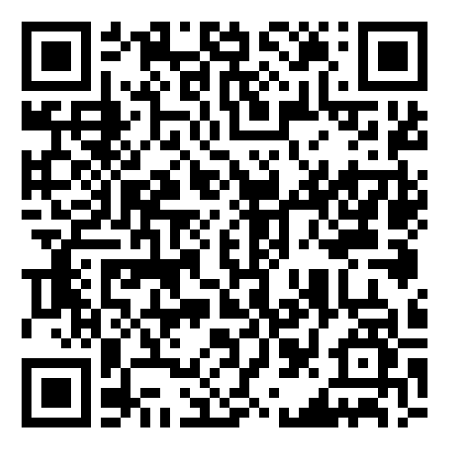

The Colorado READ Act and the Science of Reading for Families
The Colorado READ Act Overview
Notes:
Thank you all for being here today.​
This is the first presentation in the Colorado READ Act and the Science of Reading for Families series developed to support parents with ways to help their children build reading skills in partnership with their school. ​
The READ Act encourages local education providers to provide parent opportunities to participate in parent reading workshops throughout the school year to assist parents in developing their own reading skills and in developing the skills necessary to assist their children in reading (CRS 22-7-1208 (4)). We hope this series will be helpful to you.
The Colorado READ Act statute defines the term “parent’ as a student’s biological or adoptive parent, stepparent, foster parent, or legal guardian (CRS 22-7-1203 (8)(a)).
For brevity purposes, we have adopted this definition throughout the presentation. When we use “Parent” during the presentation we mean family or caregiver aligned with the language of the law.
During this presentation, we will be focusing on a Colorado READ Act Overview​.
For more information or additional resources, please visit the READ Act Parent Resources page found within the CDE website. (QR Code on the slide)

Slide 3
Welcome | The Colorado READ Act
First Name Last Name, Title/Position
Office or school/District
Email/contact information
Notes:
Welcome, we are glad you are here.
Share your name, title and contact details
If time, share a bit about your journey as an educator and/or parent that would be relevant to this session.
Logistics: Share the following points that match your circumstance
This presentation includes active captions.
Presenters will be using a microphone.
We ask that audience members use a microphone when asking questions.
If on zoom: Please keep your microphone on muted unless you are sharing with the group.
Presenters will be reading the content on each slide to ensure that it is accessible for ALL participants.
Note for presenters: For accessibility, you must read the words on the slides. The words bolded in the notes are the words from the slide.

Slide 4
Outcomes | The Colorado READ Act
What is the Colorado READ Act?
Why is the Colorado READ Act important?
What does the Colorado READ Act look like at school?
How can you support your child’s reading at home?
Notes:
By the end of this presentation the outcomes are for you to be able to answer these questions.
What is the Colorado READ Act?
Why is the Colorado READ Act important?
What does the Colorado READ Act look like at school?
How can you support your child’s reading at home?
Take a moment to think about which question(s) you are very interested in learning about in our time together (Give 1-2 minutes of think time).
(If presenting in-person:) We have provided writing utensils and paper at each table. (If presenting virtually, start here) Please feel free to take notes. Later in the session, we will be talking in partners about what we have heard and learned around these questions.

Slide 5
Norms | The Colorado READ Act
Active listening is appreciated
Active participation is welcomed
Take care of your own needs
Silence your cell phone as a courtesy to all
Notes:
We hope this will be an engaging and informative time for everyone here tonight. Please work to follow these norms:
Active listening is appreciated
Active participation is welcomed
Please take care of your own needs
If in-person, share where the restrooms and water stations are located, as needed.
If presenting virtually, you might consider asking participants to leave cameras on as they are able.
Silence your cell phone as a courtesy to all
Are there any other items you think we should add to this list that will support all of us?

Slide 6

Warm-Up | The Colorado READ Act
Like Me
Move chairs back from the table so it is easy for you to stand up
A category will be named
Stand if you match the category
Look around to see who else is also in the category
Introduce yourself
Notes:
We are going to start with a Warm-up activity called (click) Like Me (Adjust the mobility section of the activity according to the abilities of the participants in the room).
We are doing this activity because:
We want to begin to turn this room of individuals into a group that works together
This activity focuses the energy into this room and out of your day or previous activities, so you feel ready to participate
You will begin to understand who you are in relation to others in the group
Here is how this activity will work. I will read all of the steps, check for questions, and then we will begin the activity.
(click) Move chairs back from the table so it is easy for you to stand up. (Adjust the mobility section of the activity according to the abilities of the participants in the room. If presenting virtually, ask participants to stand in front of their camera or use the thumb's up reaction button).
(click) A category will be named.
(click) Stand if you match the category.
(click) Look around to see who else is also in the category.
(click) Introduce yourself
Check for understanding -Does anyone have any questions?
Then, start the activity at step 1.
Name some of the following categories (or create your own to match your community) and give time for people to stand: (facilitators should also participate by standing or staying seated)
I am a parent
My first child is in this school
I have multiple children in this school
I attended this school as a child
Our family is new to this community
My favorite level of schooling was elementary
My favorite level of schooling was secondary/high school
Other: If you have not had the opportunity to stand yet, please stand now and share something about yourself.
Have the parents go around the room and share: (if group is large, make small groups for this activity)
Name
Grade of Child(ren)

Slide 7


What is The Colorado READ Act?
What is the Colorado READ Act?
Notes:
What is the Colorado READ Act?

Slide 8

Reading to Ensure Academic Development (READ) Act
Passed by the Colorado Legislature in 2012
Focuses on K-3 literacy and is preventative in nature
Includes specific guidance around literacy assessment and individual student intervention plans, including screening for indicators of dyslexia (2025)
Contains requirements for parent communication and involvement
Provides funding to support interventions and outreach
Requires K-3 teachers, 4th-12th reading interventionists and K-3 administrators to be trained in the science of reading
Notes:
The official name of the statute, or law, is the Reading to Ensure Academic Development Act. The acronym READ is commonly used.
Passed by the Colorado Legislature in 2012
It is designed to be a comprehensive, or broad, approach to early literacy education to improve student achievement (CRS 22-7-1202​(d)).
The READ Act focuses on K-3 literacy and is preventative in nature
It promotes early identification of reading difficulties and effective intervention to quickly close reading gaps (CRS 22-7-1202, CRS 22-7-1204) as it is more cost-effective to invest in effective early literacy education than pay for later remediation or extra support for students (CRS 22-7-1202 (c)​). ​
It Includes specific guidance regarding literacy assessment and individual intervention plans, including screening for indicators of dyslexia (which was passed in 2025 and will be enacted in the 2027-2028 school year).
The READ Act ensures all Colorado students can demonstrate competency, or the knowledge, skills, abilities and behaviors, in reading necessary to achieve success in school (CRS 22-7-1202(2), 22-7-1205 (I)).
It contains requirements for parent communication and involvement
The READ Act requires that schools ensure parents understand what parts of reading their child is struggling with, create the child’s READ Plan together and that schools share information on how parents can support their child with reading (CRS 22-7-1205(2)(a).
The greatest impact for ensuring student success lies in a productive collaboration among parents, teachers, and schools in providing a child's education (CRS 22-7-1202(f)​)​.
The READ Act provides funding to support interventions and outreach
All students can succeed in school if they have the foundational skills necessary for academic success (CRS 22-7-1202(a)​).
It also requires K-3rd teachers, 4th-12th grade reading interventionists and K-3rd administrators to be trained in the science of reading (CRS 22-7-1208 (6)(a), (6.5)(a), (6.7)(a)).

Slide 9
A Brief History | Part 1
2012
2015
2019
HB 12-1238
The Colorado READ Act repealed the Colorado Basic Literacy Act.
HB 15-1323
More specific requirements for schools on screening for reading difficulties and assessments
SB 19-199
New requirements set for schools for funding, reporting, and scientifically based and evidence-based training for K-3 teachers.​
Notes:
The READ Act has been updated to help improve reading outcomes in Colorado. ​
And, in this next section, we will briefly summarize how the Colorado Read Act has changed over time. ​
A Brief History Part 1
In 2012, House Bill 12-1238 The Colorado READ Act repealed the Colorado Basic Literacy Act to become the new law.
​
In 2015, House Bill 15-1323 included more specific requirements for schools on screening for reading difficulties and assessments (CRS 22-7-1205).
This included guidance for schools on the process of determining which students are at-risk of or have a significant reading deficiency. ​
​
In 2019, Senate Bill 19-199 strengthened the Colorado READ Act with new requirements set for schools for funding, reporting, and scientifically based and evidence-based training for K-3 teachers (CRS 22-7-1210, 22-7-1213, 22-7-1208 (6)(a)).​
​It requires that each teacher employed to teach kindergarten or any of grades one through three has successfully completed evidence-based training in teaching reading (22-7-1208 (6)(a)). ​

Slide 10
A Brief History | Part 2
2021
2022
2025
SB 21-151
Literacy Curriculum Transparency Act was passed, setting requirements on what information schools must publicly post on their websites.​
SB 22-004
Amended and added to the READ Act, including scientifically based and evidenced-based training for more school personnel.​​
SB 25-200
New requirements for screening around characteristics of dyslexia to go into effect in the 2027-2028 school year.
Notes:
A Brief History Part 2
In 2021, Senate Bill 21-151 or The Literacy Curriculum Transparency Act was passed, setting requirements on what information schools must publicly post on their websites (CRS 22-7-1204, 22-7-1208 (5)(a)(I)(II), (8)(a)(I)(II)(III), (8)(b)).
In 2022, Senate Bill 22-004 amended and added to the Colorado Read Act, including scientifically based and evidenced-based training for more school personnel (CRS 22-7-1208 (6.5)(a), (6.7)(a)).​
It extended requirements to ensure K-3 principals and administrators as well as 4th grade -12th grade reading interventionists are trained in scientifically based and evidence-based reading instruction.​ (CRS 22-7-1208 (6.5)(a), (6.7)(a)).​
The bill also requires the department to provide free, evidence-based science of reading training to public librarians upon request of library directors (CRS 22-7-1208(7), 22-7-1209(7). ​
In 2025, Senate Bill 25-200 passed with new requirements for screening around characteristics of dyslexia to go into effect in the 2027-2028 school year.

Slide 11

Why is the Colorado READ Act Important?
Notes:
Why is the Colorado READ Act Important?

Slide 12

The State of Colorado’s Goal
By the end of third grade, all students can read at grade level.
Regardless of demographics and learning needs, all students meet or exceed state academic standards.
CDE Performance Plan
Notes:
The State of Colorado’s goal is By the end of third grade, all students can read at grade level
Regardless of demographics and learning needs, all students meet or exceed state academic standards (http://www.cde.state.co.us/cdecomm/cdeperformanceplan)
Which will support all children in Colorado to graduate from high school having attained skill levels that adequately prepare them for postsecondary studies [college] or for the workforce (CRS 22-7-1205 (I)).

Slide 13
A Sense of Urgency
6 out of 10 students struggle with reading at grade-level in Colorado
Researchers estimate 95% of students can be taught to read through scientifically based and evidence-based instruction.
100% of Colorado K-3 students in public schools are screened for early signs of reading difficulty because of the Colorado READ Act.
READ Act Annual Legislative Reports
Notes:
There is A Sense of Urgency because:
(click) Recent data indicates nearly 6 out of 10 students struggle with reading at grade-level in Colorado (http://www.cde.state.co.us/cdecomm/cdeperformanceplan)
Of all students in grades K-3 assessed for reading competency in 2023-24, almost 21% were identified as reading well below grade level. 2024 Colorado READ Act Report (linked on slide)
We know that a students’ reading abilities at the end of their first-grade year largely predict their learning outcomes in later grades.
We also know that scientifically based and evidence-based literacy instruction is most effective in teaching students how to read.
(click) The good news is that researchers estimate 95% of students can be taught to read through scientifically based and evidence-based instruction (Moats, 2020).
(click) In addition, 100% of Colorado kindergarten through 3rd grade students in public schools are screened for early signs of reading difficulty because of the Colorado READ Act (CRS 22-7-1205).

Slide 14

Strong Foundations
“By focusing on support for our youngest students and their educators, the department can ensure more students are reading at grade level by the end of third grade and build a strong foundation for continued success in school.”
Notes:
Strong Foundations
Research shows that proficiency in reading by the end of third grade enables students to shift from learning how to read to using reading skills to master more complex subjects in fourth grade and beyond.
“By focusing on support for our youngest students and their teachers, the department can ensure more students are reading at grade level by the end of third grade and build a strong foundation for continued success in school” (http://www.cde.state.co.us/cdecomm/cdeperformanceplan).

Slide 15
Paired Verbal Fluency | The Colorado READ Act
What is the Colorado READ Act? Why is it important?
Write down thoughts and ideas you could shared with a partner (2-3 minutes).
We will create partners A and B and take turns talking about the questions above.
At a signal, one will speak, and one will listen.
At a signal, the other will speak while the first speaker listens.
Each time, no one is allowed to repeat anything that was said by the other.
Notes:
We are going to do an activity called Paired Verbal Fluency
We want to give you time to think about the information presented and share your understanding with a partner about what the Colorado READ Act is and why it is important for literacy. (If presenting virtually, say that you will be creating breakout rooms for this discussion to take place).
Here is how this activity will work:
First, you will think about these two questions:
What is the Colorado READ Act?
Why is it important?
Next, we will follow these steps:
Write down thoughts and ideas you could share with a partner (2-3 minutes).
We will create partners A and B and take turns talking about the questions above.
At a signal, one will speak, and one will listen.
At a signal, the other will speak while the first speaker listens.
Each time, no one is allowed to repeat anything that was said by the other.
Does anyone have any questions? (Clarify as needed).
Note to Presenter:
Start at #1 (2-3 minutes to write down ideas or think about notes taken)
Create partners:
Same kind of shoes, sitting next to each other, child in same grade, etc.
Have partners decide or assign A and B
First round (60 seconds)
A speaks, B listens
Second round (40 seconds)
B speaks, A listens
If time, Third Round (20 seconds)
A speaks, B listens
*If presenting virtually, read all the directions and have participants discuss on their own in breakout rooms. Create breakout rooms ahead of time.
Ask if anyone has any questions or comments to share before moving on.

Slide 16
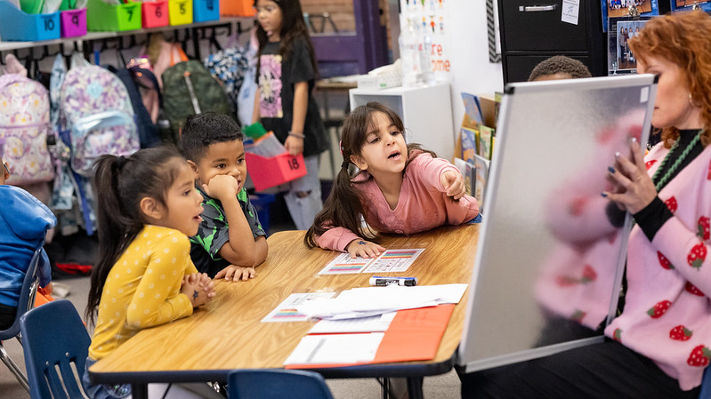
What Does the Colorado READ Act
Look Like at School?
Notes:
What does the Colorado READ Act look like at school?

Slide 17

Access to Effective Evidence-based Instruction
Focused on the foundational reading skills
  Phonemic awareness
  Phonics
  Vocabulary development
  Reading fluency including oral skills
  Reading comprehension
Scientifically Based
  Rigorous, systematic, and objective procedures to obtain valid knowledge that is relevant to reading development, reading instruction, and reading difficulties
Evidence-based
  Reliable, trustworthy, and valid evidence and has demonstrated a record of success in adequately increasing students’ reading competency
Notes:
The READ Act ensures that each child has access to effective evidence-based instruction (CRS 22-7-1202(b)).
​
(click) Research shows that reading instruction that is focused on the foundational reading skills of phonemic awareness, phonics, vocabulary development, reading fluency including oral skills, and reading comprehension is highly effective in teaching young children to read.” (CRS 22-7-1202 (II)). These are also known as the 5 components of reading (NRP, 2000).
Scientifically based and evidence-based instruction are both defined and embedded in all of the requirements in the READ Act.
(click) Scientifically based means:
The instruction or item described is based on research that applies rigorous, systematic, and objective procedures to obtain valid knowledge that is relevant to reading development, reading instruction, and reading difficulties (CRS 22-7-1203(14)).
(click) Evidence-based means:
The instruction or item described is based on reliable, trustworthy, and valid evidence and has demonstrated a record of success in adequately increasing students’ reading competency in the areas of phonemic awareness, phonics, vocabulary development, reading fluency, including oral skills, and reading comprehension (CRS 22-7-1203(4)).
This means that the instruction children should receive is based on solid research and is backed by strong evidence in helping children become better readers.

Slide 18
Attributes of Effective Instruction
Universal: All classroom students
Intervention: Small group of students
Addresses all 5 components of reading
Guided by student data
Minimum of 90 minutes per day of instruction
Scope and sequence that is delivered explicitly
Driven by the Colorado Academic Standards
Addresses one or more of the 5 components of reading
Focused on identified area(s) of need
Delivered with sufficient intensity, frequency, urgency and duration
Scope and sequence that is delivered explicitly
Directed by an effective teacher in the teaching of reading
Notes:
Attributes (or features) of Effective Instruction
Within a multi-tiered system of support there are layers of effective instruction. Rules for the Administration of the Colorado READ Act identify attributes of effective universal instruction and effective targeted and intensive instructional intervention. This slide provides a summary of these attributes or features.​ While there are many similarities, there are also key differences.
Universal instruction is delivered to all the classroom students, while intervention is delivered to a small group of students as identified by assessment data.
Universal instruction addresses all five components of reading, while intervention addresses one or more of the 5 components of reading as identified by data
Universal instruction is guided by students’ data from the board-approved interim assessments, and so is intervention, but it specifically focuses on identified area(s) of need for the students in the small group.
Universal instruction is delivered a minimum of 90 minutes per day, while intervention is delivered with sufficient intensity, frequency, urgency, and duration as detailed by student data and need.
Both utilize a scope and sequence that is delivered explicitly, allowing for active and engaged students and to connect instruction between the two.
Universal instruction is driven by the grade-level Colorado Academic Standards
Intervention is directed by an effective teacher in the teaching of reading, which might be the classroom teacher or another qualified educator, and is provided in addition to universal instruction.
(1CCR301-92 6.00, 6.01, 7.00, 7.01)

Slide 19

Approved Curriculum & Programming
Evidence-based and scientifically based curriculum and programming
All students in kindergarten through 3rd grade
Focused on the 5 components of reading
Literacy Curriculum Transparency Act
Literacy Curriculum Transparency Icon
Senate Bill 21-151 (PDF)
Notes:
Approved Curriculum & Programming
The READ Act mandates that all local education providers offer
evidence-based and scientifically based curriculum and programming
for all students in kindergarten through 3rd grade.
These programs must focus on developing reading competency, focused on the 5 components of reading which are phonemic awareness, phonics, vocabulary development, reading fluency (including oral skills), and reading comprehension (CRS 22-7-1204).
With the passage of Senate Bill 21-151 (PDF), the General Assembly enacted the Literacy Curriculum Transparency Act which requires each local education provider (LEP) to submit information around the targeted, evidence-based or scientifically based core and supplemental reading instructional programs and intervention reading instruction, services, and other supports used at each of their schools.
The Colorado Department of Education is required to post this information on its website.
The Literacy Curriculum Transparency icon is an easily identifiable image representing student literacy and the Colorado READ Act.
Your child’s school must include this icon and a link to the Literacy Curriculum Transparency webpage on their website.
​(CRS 22-7-1204, 22-7-1208 (5)(a)(I)(II), (8)(a)(I)(II)(III), (8)(b), https://www.cde.state.co.us/coloradoliteracy/literacycurriculumtransparency)

Slide 20
Identify Risk and Instructional Needs
All K-3 students are screened at the beginning of the school year for Significant Reading Deficiencies (SRD).
All K-3 students are given an approved READ Act interim assessment at the beginning of each school year.
1
2
If the interim assessment data indicates a student is at-risk of having an SRD, a state approved READ Act diagnostic assessment is administered.
School personnel collect a body of evidence (interim assessment, diagnostic assessment, and other data from the classroom) to determine if the child has an SRD.
3
4
A READ plan that is specific to the child’s learning needs is developed with key stakeholders including teachers, other school personnel, and parents.
4
READ Plan implemented.
Notes:
The READ Act ensures that teachers measure each student’s reading competency yearly which will identify risk and instructional needs (CRS 22-7-1205(1)(a)).
The READ Act ensures that (click) All K-3 Students are screened at the beginning of the school year for Significant Reading Deficiencies, commonly known as SRD, as determined by assessments and a body of evidence (CRS 22-7-1205(1)(a)(a.5)).
(click) All K-3 students are given an approved READ Act interim assessment at the beginning of each school year (CRS 22-7-1205(1)(a)(a.5), 1 CCR 302-92 3.00-4.00).
All School districts must administer an approved interim assessment to all kindergarten through third grade students at the beginning of the school year (CRS 22-7-1205(1)(a)).
The board approved interim assessment functions as a first alert to those students who may need additional support with literacy and is the first step in the process.
The interim assessment is administered in the first 30 calendar days for grades one through three, and within the first 90 calendar days for kindergartners (CRS 22-7-1205(1)(a.5)).
The local education provider has the authority to determine the language in which a student who is an English learner takes a state board approved interim reading assessment in kindergarten through third grade. The list of state board approved interim reading assessments currently includes options in English and Spanish (CRS 22-7-1205(a.7)(I)(II), READ Act Handbook, p. 16).
(click) If the interim assessment data indicates a student is at-risk of having an SRD, a state approved diagnostic assessment is administered (CRS 22-7-1205(1)(b), 1 CCR 302-92 3.00-4.00).
This helps pinpoint what students are struggling with.​
The approved diagnostic assessment must be administered within 60 calendar days from the interim assessment, and it must assess and provide in-depth information to pinpoint the student’s specific reading skill deficits.
The Colorado READ Act requires that a body of evidence be collected when determining an SRD (1 CCR 302-92 3.00-4.00).
(click) School personnel collect a body of evidence that includes, at minimum, data from the interim assessment, the diagnostic assessment, and other data or observations from the classroom to determine if the child has an SRD.
In addition to data from these assessments, the body of evidence, which may include formal and informal data and should include all components of reading, plus oral language, will help inform goal development and instruction.
With exceptions for English Language Learners, the body of evidence cannot be used to override findings from the interim and diagnostic assessments. Rather, each of these pieces are compiled to form a complete picture of the students’ skills and instructional needs.
Once it is determined that a student has a significant reading deficiency, (click) a READ plan that is specific to the child’s learning needs is developed with key stakeholders including teachers, other school personnel, and parents (CRS 22-7-1206, 1 CCR 302-92 3.00-4.00).
Parents are encouraged to help create the READ plan with the teacher and any other skilled school professionals (CRS 22-7-1206 (1)(a)).
It is the school district’s responsibility to ensure that a (click) READ Plan is developed and implemented (CRS 22-7-1208).
In our second presentation in this series, we will go into further detail about how an SRD is determined and the essential components of a READ Plan.

Slide 21


Evidence-Based Training Requirements
All schools that receive per-pupil funding ensure their K-3 reading teachers and 4th-12th grade reading interventionists have successfully completed evidence-based training in teaching reading.
K-3 principals and administrators complete training that assists them in coaching and evaluating educators and implementing schoolwide literacy programming that is scientifically based and evidence-based.
Notes:
Another way the READ Act helps ensure effective instruction is by outlining evidence-based training requirements for educators.
All schools that receive per-pupil funding ensure their K-3 reading teachers (CRS 22-7-1208 11-403 (6)(a),(b),(c)) and 4th-12th grade reading interventionists have successfully completed evidence-based training in teaching reading (CRS 22-7-1208 11-403 (6.7)(a),(b),(c)).
In addition, the Read Act requires K-3 principals and administrators complete training that assists them in coaching and evaluating educators and implementing schoolwide literacy programming that is scientifically based and evidence-based (CRS 22-7-1208 11-403 (6.5)(a),(b),(c)).
There are different pathways educators can take to meet this requirement.
The Colorado Department of Education provides, at no cost, evidence-based training.
Educators must successfully pass an approved end-of-course assessment to demonstrate their knowledge of scientifically based and evidence-based reading instruction.
Districts are required to submit evidence to the Colorado Department of Education that each of their K-3 teachers, 4th-12th reading interventionists and K-3 administrators have met this requirement.

Slide 22
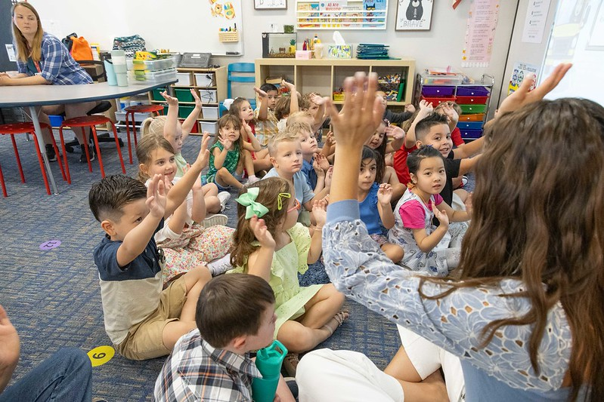
Colorado Department of Education (CDE) Advisory Lists
The first step in improving literacy outcomes for Colorado K-3 students is ensuring all levels of literacy programming are scientifically based and evidence-based, and that instruction is delivered by a knowledgeable teacher.
Notes:
The Colorado Department of Education or CDE creates and maintains Advisory Lists for district use (CRS 22-7-1209).
The first step in improving literacy outcomes for Colorado K-3 students is ensuring all levels of literacy programming are scientifically based and evidence-based, and that instruction is delivered by a knowledgeable teacher.
The Colorado READ Act details rules and duties for the Colorado Department of Education (CDE). Among these, the department is charged with reviewing and recommending reading assessments, instructional programming, and professional development programs to be included in approved advisory lists.
The purpose of the advisory lists is to support districts in selecting assessments, instructional programming and professional development that are scientifically based and evidence-based and to ensure schools are providing all students with the best opportunity to learn.

Slide 23

How Can You Support
Your Child’s Reading at Home?
Notes:
How can you support Your Child’s Reading at Home?

Slide 24

Supporting your Child’s Reading
“An important partnership between a parent and child begins before the child enters kindergarten, when the parent helps the child develop rich linguistic experiences, including listening comprehension and speaking, that help form the foundation for reading and writing…"
Be an advocate
Talk often
Read together
Be an example
Visit the library
Learn more
Notes:
Supporting your Child’s Reading
“An important partnership between a parent and child begins before the child enters kindergarten, when the parent helps the child develop rich linguistic experiences, including listening comprehension and speaking, that help form the foundation for reading and writing“ (CRS 22-7-1202 (e)).​
​
Schools cannot do it alone and there are many different strategies parents and caregivers can use that act as an extension of the classroom instruction.​
​
Some ways to support the instruction your child receives at school are to:​
Be an advocate: Keep informed about your child’s reading. Ask your child’s teacher about ways to help at home.​ Attend additional presentations like this one around the READ Act and the Science of Reading!
Talk often: The more words children hear, the better they will be at reading.​ “Vocabulary acquisition begins in the home, where children have opportunities to acquire and use their developing oral language abilities through conversations with their parents and siblings who can scaffold and extend their responses as they learn to talk about the world around them” (Cardenas-Hagan, 2020, p. 122). This builds knowledge for them to use in all the books they will read.
Read together: Read books together, spend time talking about stories, and listen to audio books. ​
Be an example: Children learn from the habits of those around them. They benefit from seeing you read, write and model literacy routines.​
Visit the library: Other exciting opportunities and activities await the entire family at your local library. ​
Learn more: There are additional presentations in this series around the READ Act and the Science of Reading.
​

Slide 25
Do You Want to Learn More?
Visit the CDE Parent Resources Website
Notes:
Do you want to learn more?
There are more resources on the CDE Parent Resources Website including:
A list of guiding questions you could use to discuss your child’s reading with their teacher or school
Videos of activities you can do at home
Links to get additional books for use at home
You can also look up your local library for the resources they have to share!

Slide 26
References
Colorado Department of Education. (2024, January). Strategic Plan. https://www.cde.state.co.us/cdecomm/cdeperformanceplan
Colorado Department of Education. (2024, January 19). Literacy curriculum transparency. https://www.cde.state.co.us/coloradoliteracy/literacycurriculumtransparency
Colorado Department of Education. (2024, October). READ act handbook. https://www.cde.state.co.us/coloradoliteracy/readplans#readacthandbook
Colorado Reading to Ensure Academic Development Act, Colo. Rev. Stat. §§ 22-7-1201-1214, (2019).​
Cardenas-Hagan, E. (2020). Literacy foundations for English learners: A comprehensive guide to evidence-based instruction. Paul H Brookes Publishing.
Moats, L. C. (2020). Teaching reading is Rocket Science: What expert teachers of reading should know and be able to do. Washington, DC: American Federation of Teachers.
National Reading Panel. (2000). Teaching children to read-An evidence-based assessment of the scientific research literature on reading and its implications for reading instruction (NIH Publication No. 00-4769) Washington, DC: National Institutes of Child Health and Human Development.
Rules for the Administration of the Colorado Reading to Ensure Academic Development Act, 1 Colo. Code Regs. 301-92 (2017).

