Slide 1
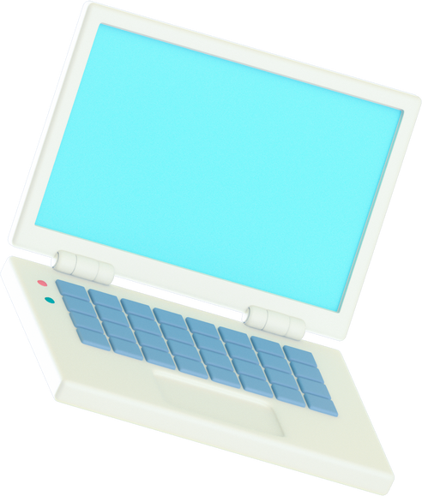







Instructional
Programs
& Tools
Notes:
Welcome. In working toward READ Act goals and student reading success, having common understanding of definitions, expectations and key components of the READ Act is critical. In this training we will discuss the differences between core programming, supplemental programming, and intervention. This training on Instructional Programs and Tools is presented to you by Colorado Department of Education’s Literacy Team.

Slide 2



Types of Instruction
Core Instruction
Supplemental Instruction
Intervention
Notes:
The READ Act requires the use of evidence-based instructional programs for kindergarten through third grade literacy instruction. Also required by the Act is the identification of programs that are scientifically and evidence based by the Colorado Department of Education. In this training we will cover the difference between core programming, supplemental programming, and intervention programming and approved programs in each of these categories.

Slide 3
Core Instruction
All students
Comprehensive reading program
Whole class and small group
Differentiated according to student needs
Notes:
Let’s begin with core programming. Core Instruction is instruction provided to all students, and is typically guided by a comprehensive core reading program. Part of core instruction is provided to the class as a whole, and part is provided during the small group, differentiated instruction period. Although instruction is differentiated by student need during the small group period, materials and lesson procedures from the core program can be used to provide reteaching, or additional teaching to students according to their needs.

Slide 4


Approved Core Programming
Approved K-3
CKLA (2017)
Benchmark Workshop (2021)
Approved K-2
Benchmark Advance (2021)
Approved 1-3
Arriba la Lectura (2020)
Into Reading (2020)
Maravillas (2020)
Open Court Reading (2016)
Wonders (2020)
Writing Road to Reading (2003)
Collaborative Literacy (2016)
LearnZillion EL Education (2017)
Open Up Resources EL Education (2021)
SuperKids (2017)
Maravillas (2017)
Notes:
The list of approved Core Instructional Programs can be found on the CDE website on the webpage entitled 2020 Advisory List of Instructional Programming. The programs found on this list were reviewed by CDE staff and volunteer reviewers. The list was updated in March 2021 and is considered complete.
When reviewing the list, please note the publication year of the curricula because changes are often made from edition to updated edition. Additionally, the review rubrics for approved programs are posted for scoring and review transparency.

Slide 5

Supplemental Instruction
Beyond what is provided in the core program
In a key area of need
Used to strengthen core instruction
Notes:
Next we have supplemental programming. Supplemental Instruction is instruction that goes beyond that provided by the core program because the core program does not provide enough instruction or enough practice in a key area to meet the needs of students in a particular classroom or school. For example, teachers in a school may observe that their comprehensive core program does not provide enough instruction in vocabulary or phonics to adequately meet the needs of the majority of their students. They could then select a supplemental program in these areas to strengthen the initial instruction and practice provided to all students.

Slide 6
Approved Supplemental Programming
Phonological Awareness
mClass Amplify Reading (K-1)
Mondo Bookshop Phonics (K-2)
Spell-Links (2-3)
Waterford Reading Academy (K-1)
Writing Road to Reading (K-1)
Being a Reader 2016 (K-2)
Blast (1)
Core 5 (K-1)
Countdown (K)
iReady (K-3)
istation (K-1)
Heggerty (K-3)
Fundations (K-1)
Open Court (K-3)
Yoshimo Orton Gillingham (K-1)
SuperKids Foundational Skills Kit (K-1)
Notes:
Supplemental programs are approved by grade level and by component of reading. For example this slide shows programs which have been approved specifically to strengthen instruction in the area of phonological and phonemic awareness.

Slide 7

Intervention
Beyond what is provided in the core program
Students who are below proficient
In a key area of need
More time, more targeted instruction, smaller group size
Notes:
The third type of instructional programming we are looking at is intervention programming. Intervention is the practice of providing scientifically-based, high-quality instruction and progress monitoring to students who are below proficient in reading. Intervention is provided with intensity that is matched to student need. This involves more time daily, above and beyond 90+ minutes of universal core instruction, which is focused on the specific needs of the student as identified by a diagnostic measure. Instruction can be intensified in three ways: (1) more time, (2) more targeted instruction, and (3) smaller group size.

Slide 8
Approved Intervention
Programs & Tools
All Components & Grades
95% Group
Reach Into Phonics
iStation Espanol Lectura Temprana
SiPPS
Wonder Works
Blast
Esperanza
Notes:
As you go through the intervention programming list, you will see the programs and tools have been approved by grade level and by specific literacy component. In the list, you will find things like screeners, kits, and programs which are a combination of a teacher directed component paired with an online component. This slide shows some of the tools and curricula that have been approved for all grade levels for the component of focus or for all components and grade levels. Additional information for each can be found in the review rubrics.

Slide 9



Coming Up Next!
Completed rubrics for any reviewed program will be made available upon request. Please email the READ Act Email, readact@cde.state.co.us, with all rubric requests and questions related to instructional program review.​
Notes:
To learn more about selecting a scientifically and evidence-based reading program stay tuned for the next training linked on this page. The Selecting an Instructional Program training covers high level information on what scientifically and evidence based reading instruction looks like and walks through the use of two tools that can help in this decision-making process.
Completed rubrics for any reviewed program will be made available upon request. Please email the READ Act Email, readact@cde.state.co.us, with all rubric requests and questions related to instructional program review.

