Slide 1
CDE Science of Reading Literacy Series
Inference

Slide 2

Objectives
Understand the role of inference in supporting text comprehension
Introduce instructional strategies for making local and global coherence inferences
Analyze current curriculum and materials
Understand how inference involves connections between parts of the text as well as relationships between the text and background knowledge
Notes:
The objectives of this session are to:
Understand the role of inference in supporting text comprehension
Understand how inference involves connections between part of the text as well al relationships between text and background knowledge
Introduce instructional strategies for making local and global coherence inferences
Analyze current curriculum and materials

Slide 3
Setting the Foundation
Notes:
First, we will cover foundational knowledge related to inference and comprehension.

Slide 4

Reading Comprehension Quote
"Reading comprehension is not a single entity that can be explained by a unified cognitive model. Instead, it is the orchestrated product of a set of linguistic and cognitive processes operating on text and interacting with background knowledge, features of the text, and the purpose and goals of the reading situation.“
- Castles, Rastle, and Nation (2018, p. 28)
Notes:
Consider this quote by Castles, Rastle, and Nation:
"Reading comprehension is not a single entity that can be explained by a unified cognitive model. Instead, it is the orchestrated product of a set of linguistic and cognitive processes operating on text and interacting with background knowledge, features of the text, and the purpose and goals of the reading situation.“

Slide 5
Simple View of Reading (SVR)
Word
Recognition
Language Comprehension
Reading Comprehension
Phonological/Phonemic Awareness
Phonics/Decoding
Sight Words
Background Knowledge
Vocabulary
Syntactic/Semantic Knowledge
Verbal Reasoning
Literacy Knowledge
Gough, P. B. & Tunmer, W.E. (1986). Decoding, reading, and reading disability. Remedial and Special Education, 7(1).
Notes:
Speaker Notes:
Several decades of reading research has given us a clear understanding of how students best learn to read. One way to conceptualize reading is through the Simple View of Reading model. This model, developed by Gough and Tunmer, organizes the skills needed to become a proficient and successful reader into two categories: word recognition and language comprehension. The Simple View of Reading is a basic formula for reading comprehension. It says this: reading comprehension is the product of word recognition skills and language comprehension skills. We need both variables on the left side of the equation for students to become skilled, proficient readers.

Slide 6
Key Terminology
Inference – the identification of meaningful relations between the various parts of the text, and between those parts and reader’s background knowledge (Kendeou, et.al, 2008, p. 259)
Coherence – the way in which text elements, including words, phrases, sentences, and the paragraph or passage as a whole, work together and contribute to constructing meaning
Cohesive ties –words or phrases used to connect ideas between different parts of text
Connectives – words or phrases, including conjunctions and adverbs, that signal logical relationships between parts of sentences
Notes:
The following terminology relates to the topic of inference.
Inference - the identification of meaningful relations between the various parts of the text, and between those parts and reader’s background knowledge
Coherence – the way in which text elements, including words, phrases, sentences, and the paragraph or passage as a whole, work together and contribute to constructing meaning
Cohesive ties –words or phrases used to connect ideas between different parts of text
Connectives – words or phrases, including conjunctions and adverbs, that signal logical relationships between parts of sentences
We will cover these terms in more depth later in the session.

Slide 7
Levels of Understanding
Level 1
Understanding the Surface Code
Level 2
Making Meaning from the Text Base
Level 3
Constructing a Situation or Mental Model of the Text
(Kintsch & Rawson, 2005)
Notes:
There are several components that we have to consider before we can get to the depth of understanding where inference lies.
The first component that we have to think about is the text itself. This is the surface level of a text. These are the words and sentences that are on the page.
The second part is the text base, which means the underlying meanings behind the words and sentences on the page. This is where vocabulary and context lie. We can also add our background knowledge to this level.
These components lead to what is referred to as the situation or mental model of the text. This is the deep level understanding of the text. Inference lies in this deep level of the text.

Slide 8
Level 1: Understanding the Surface Code
Level 1: Understanding the Surface Code
Level 1
Surface Code
Level 2
Text Base
Level 3
Mental Model
Exact words and syntax of the author
What readers immediately recall
Example: Answering literal questions with direct text evidence
Notes:
When readers are interacting with the surface code of the text, they are making sense of the exact words and syntax of the author. Typically, the surface code is what readers immediately recall. In the classroom, this could be answering literal questions with direct text evidence.

Slide 9
Level 2: Making Sense from the Text Base
Level 2: Making Meaning from the Text Base
Beyond words and sentences on the page
Requires understanding of the author’s intended meaning, including word meanings and how words work in combination to communicate the meaning of the text
Example: Making connections and accessing background knowledge
Level 1
Surface Code
Level 2
Text Base
Level 3
Mental Model
Notes:
To make sense of the text base, readers must go beyond the words and sentences on the page. This requires understanding of the author’s intended meaning, including word meanings and how words work in combination to communicate the meaning of the text. For example, utilizing the text base is demonstrated by making connections and accessing background knowledge.

Slide 10
Level 3: Constructing a Situation or Mental Model of the Text
Level 3: Constructing a Situation or Mental Model of the Text
Using language and cognitive processes, including inference, to integrate units of meaning
Information that is explicitly stated as well as implied
Example: Constructing an overall understanding of the situation in the text
Level 1
Surface Code
Level 2
Text Base
Level 3
Mental Model
Notes:
Finally, to construct a situation or mental model of the text, readers must use language and cognitive processes, including inference, to integrate units of meaning. This includes information that is explicitly stated as well as information that is implied. When readers can successfully construct a mental model, they have an overall understanding of the situation in the text.

Slide 11
Levels of Language Processing
Words and Phrases
Academic vocabulary (breadth and depth)
Sentences
Density
Background Knowledge
Schema
Coherent Representation of Text
Length
Structure
Cohesive ties and connectives
Text structure
Inference
Local
Global
Level 1: Understanding the Surface Code
Level 2: Making Meaning from the Text Base
Level 3: Constructing a Situation or Mental Model of the Text
(Hennessy, 2021; Cain & Oakhill, 2007)
Notes:
This graphic, adapted from Nancy Hennessy, illustrates the levels of language processing a reader experiences when interacting with text.
The reader first attends to the words and phrases, including academic vocabulary. The reader must also make sense of the sentences, including the syntactic structure. Next, the reader uses cohesive devices within the sentences to connect to their background knowledge. This includes their mental schema as well as specific knowledge around how text is structured. This all lends to the process of making inferences through local and global coherence, as we will discuss later in this presentation. By integrating all these components and skills, the reader forms a coherent representation of the text.
Notice there is a reciprocal relationship between each of these components, and that language skills in each of these areas are needed for readers to develop a mental model and form a coherent representation and understanding of the text.

Slide 12
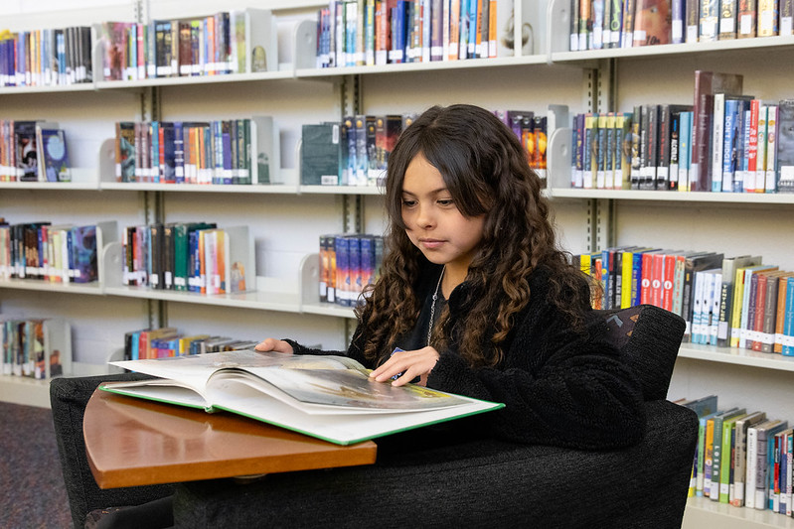
Inference Involves:
Inference involves:
Connections between parts of the text
Relationships between the text and background knowledge
Inference is an integrative and constructive process.
(Hennessy, 2021; Cain & Oakhill, 2007)
Notes:
Inference involves:
Connections between parts of the text
Relationships between the text and background knowledge
Inference is an integrative and constructive process

Slide 13
Practice & Reflect
“Make a wish!” Calvin’s mother said excitedly. Calvin closed his eyes for a moment, took a deep breath, and blew out all seven of the tiny flames.
“I want a corner piece!” exclaimed Claire.
“Calvin gets to choose first,” their mother replied as she slid the knife through the brightly colored frosting. The table full of children squealed in anticipation.
Notes:
Read the passage on the slide. Next, we will reflect upon the way in we make inferences and how those inferences contribute to our overall understanding of the text.
“Make a wish!” said Calvin’s mother. Calvin closed his eyes for a moment, took a deep breath, and blew out all seven of the tiny flames.
“I want a corner piece!” exclaimed Claire.
“Calvin gets to choose first,” their mother replied as she slid the knife through the brightly colored frosting. The table full of children squealed in anticipation.
What is happening? (Calvin is having a birthday party. He is seven. His sister is Claire.)
What information did you have to infer? (Making a wish, candles, cake)
How did you know it was cake? (candles, knife, brightly colored frosting, excited children)
What specific words in the text helped you make your inference? (Blew out tiny flames, brightly colored frosting, corner piece)
What background knowledge outside of the text did you draw upon? (birthday party traditions that include candles, cake, making wishes)

Slide 14
Preparing for Instruction
Notes:
In the next section, we will dive deeper into inference, including instructional strategies to support students.

Slide 15
Warm Up
How would you describe the connection between inference and comprehension?
Notes:
Before we continue, please take a moment to reflect and/or share about the following question:
How would you describe the connection between inference and comprehension?
Talking points:
Comprehension requires contributions from the reader
“Reading between the lines”
Inference plays a role in comprehension at the sentence, paragraph, and text level (Hennessy, 2021)
Inference involves making meaningful connections between text and background knowledge
Integrating information

Slide 16
Types of Inference
Local Coherence
Information is provided within the sentence(s) by words and syntax
Text based
Link ideas and concepts
Necessary and often automatic
Global Coherence
Explicit information in sentence(s) is supplemented by background knowledge in the long-term memory
Knowledge based
Fill in gaps to understand text
Make connections in text to form mental model
Notes:
Inference can be divided into two categories: local coherence and global coherence.
Local coherence inferences are made when the information is provided within the sentence or sentences through the understanding of words and syntax. This type of inference is text-based, links ideas and concepts within the text, and is necessary and often automatic.
Global coherence inferences are by supplementing the text with background knowledge from the reader’s long-term memory. In this respect, global coherence inferences are knowledge-based. The reader uses this access to background knowledge to fill in gaps and better understand the text. Connections within the text are made, and the reader is able to form a mental model.

Slide 17


Local Coherence vs. Global Coherence
Local coherence, also known as text-based inference, involves looking at words and clues within the text.
Global coherence, also known as knowledge-based inference, involves supplementing with knowledge beyond what is in the text.
Notes:
When comparing local coherence verse global coherence, we can also think of it this way:
Local coherence, also known as text-based inference, involves looking at words and clues within the text. Global coherence, also known as knowledge-based inference, involves supplementing with knowledge beyond what is in the text. This is one reason why building students’ background knowledge is important for inference and comprehension.

Slide 18
Local Coherence Inference
Cohesive Devices
Local coherence inference includes making meaning of individual sentences, as well as how sentences combine to make sense.
Cohesive ties
Words or phrases used to connect ideas between different parts of text
Connectives – conjunctions and adverbs
Words or phrases that signal logical relationships between parts of sentences
Notes:
Local coherence includes making meaning of individual sentences, as well as how sentences combine to make sense. This is done through the use of words and phrases called cohesive devices. There are two types of cohesive devices: cohesive ties and connectives. Cohesive ties are words or phrases used to connect ideas between different types of text. Connectives are words or phrases that signal logical relationships between the parts of sentences. We will look at examples of these types of cohesive devices on the following slide.

Slide 19
Local Coherence Inference
Cohesive Ties
Cohesive ties are words or phrases used to connect ideas between different parts of text. There are three main types of cohesive devices.
Type | Example
Pronoun referent | One afternoon, when Bruno came home from school, he was surprised to find Maria, the family’s maid — who always kept her head bowed and never looked up from the carpet — standing in his bedroom, pulling all his belongings out of the wardrobe and packing them in four large wooden crates, even the things he’d hidden at the back that belonged to him and were nobody else’s business.
Repetition of a noun or phrase | ‘It’s a very important job,’ said Mother, hesitating for a moment. ‘A job that needs a very special man to do it. You can understand that, can’t you?’ ‘And we all have to go too?’ asked Bruno. ‘Of course we do,’ said Mother. ‘You wouldn’t want Father to go to his new job on his own and be lonely there, would you?’
Substitution or synonym | ‘Yes, of course,’ said Bruno, nodding his head, because there were always so many visitors to the house — men in fantastic uniforms, women with typewriters that he had to keep his mucky hands off — and they were always very polite to Father and told each other that he was a man to watch and that the Fury had big things in mind for him.
Notes:
Cohesive ties are words or phrases used to connect ideas between different parts of text.
The excerpts one this slide are from “The Boy in the Striped Pyjamas,” a historical fiction novel by John Boyne written from the perspective of a young German boy whose father is a Nazi officer placed in charge of Auschwitz concentration camp.
Referents are pronouns that refer to previously stated nouns in the text.
Example: One afternoon, when Bruno came home from school, he was surprised to find Maria, the family’s maid — who always kept her head bowed and never looked up from the carpet — standing in his bedroom, pulling all his belongings out of the wardrobe and packing them in four large wooden crates, even the things he’d hidden at the back that belonged to him and were nobody else’s business.
In this example, the pronouns he, his, and him all refer to the character Bruno.
Repetitions connect text by simply repeating the same or similar words and phrases.
Example: ‘It’s a very important job,’ said Mother, hesitating for a moment. ‘A job that needs a very special man to do it. You can understand that, can’t you?’
‘And we all have to go too?’ asked Bruno.
‘Of course we do,’ said Mother. ‘You wouldn’t want Father to go to his new job on his own and be lonely there, would you?’
In this example, the author uses different words and phrases to describe a job: a very important job, and new job, which all refer to the same job.
Substitutions are synonyms that refer back to a previously stated noun.
Example: ‘Yes, of course,’ said Bruno, nodding his head, because there were always so many visitors to the house — men in fantastic uniforms, women with typewriters that he had to keep his mucky hands off — and they were always very polite to Father and told each other that he was a man to watch and that the Fury had big things in mind for him.
In this example, the author names visitors. The words, men, women, and man all refer to the visitors.

Slide 20
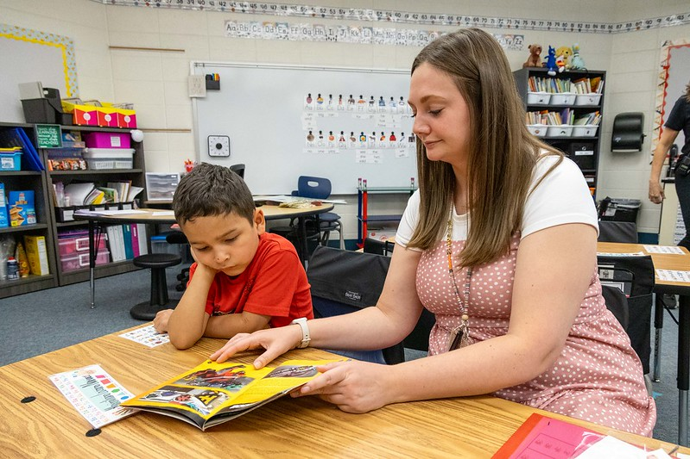
Instructional Strategies
Cohesive Ties
Identify targeted words and phrases in the text
Frame a question or task
Search for clues or connections
Make the connections visually or verbally
Notes:
To support students in making inferences, the following strategy can be used with cohesive ties:
Identify targeted words and phrases in the text
Frame a question or task
Search for clues or connections
Make the connections visually or verbally
We will look at a scripted example on the following slide.

Slide 21
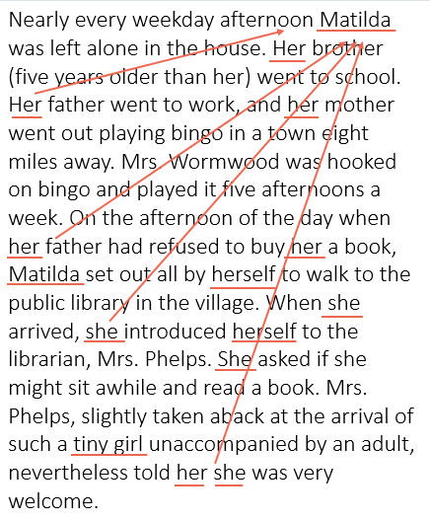
Instructional Strategies
Cohesive Ties
Scripted Example:
Identify targeted words and phrases in the text: Matilda
Frame a question or task: Matilda is an important character in the story. Instead of using the character’s name over and over, the author used other words to stand in for Matilda. We are going to search for these words, called pronouns.
Search for clues or connections. Teacher models a think aloud: I need to find all the pronouns that are standing in for Matilda. We see the word her before brother and father. Her is talking about Matilda. I also see the words tiny girl that refer to Matilda.
Make the connections visually or verbally. Let’s find all the words that stand for Matilda and underline them.
Notes:
This scripted example of an instructional strategy for cohesive ties uses a passage from the R. Dahl book Matilda.
Step 1 is to identify the targeted words and phrases in the text. In this passage the who or the what is the name Matilda.
Step 2 is to frame a question or task: Matilda is an important character in the story. Instead of using the character’s name over and over, the author used other words to stand in for Matilda. We are going to search for these words, called pronouns.
Step 3 prompts students to search for clues or connections. The teacher models a think aloud: I need to find all the pronouns that are standing in for Matilda. We see the word her before brother and father. Her is talking about Matilda. I also see the words tiny girl that refer to Matilda.
Finally, in step 4, make the connections visually or verbally. Let’s find all the words that stand for Matilda and underline them.

Slide 22
Local Coherence Inference
Connectives
Connectives are words or phrases, including conjunctions and adverbs, that signal logical relationships between parts of sentences.
Types | Examples
Additive | and, in addition, furthermore
Temporal | before, after, as, while, during
Causal | because, as a result, consequently, so
Adversative (contrast) | instead, but, alternatively, although, even though
Conditionality | unless, if, if-then
Instructional Strategy:
Explicitly and systematically teach conjunctions and adverbs that serve as connectives in text
Prompt students to identify connectives and analyze how the words contribute to meaning
Notes:
In addition to cohesive ties, another type of local coherence inference involves the use of words or phrases called connectives. Connectives can be conjunctions and adverbs and signal logical relationships between parts of sentences.
The table on the slide shows different types of connectives and examples for each. Take a moment to review them.
To support students in using connectives to make inferences, an instructional strategy includes:
Explicitly and systematically teach conjunctions and adverbs that serve as connectives in text, and
Prompt students to identify connectives and analyze how the words contribute to meaning
Understanding connectives and how they influence the meaning of the text are critical for making inferences and comprehending text. If students do not understand the meaning of the connective word or phrase or how it changes the overall meaning of the sentence, in will impede their ability to form a coherent understanding. This is why explicit teaching of connectives is important for making inferences and forming a mental model.

Slide 23
Instructional Strategies
Connectives
Explicitly and systematically teach conjunctions and adverbs that serve as connectives in text
Prompt students to identify connectives and analyze how the words contribute to meaning
Laura Ingalls Wilder, The Long Winter
Its round eyes were shining like beads, and its tongue was flickering so fast that it looked like a tiny jet of steam. The whole bright-striped snake had a gentle look. Laura knew that garter snakes will not harm anyone, and they are good to have on a farm because they eat the insects that spoil crops.
It stretched its neck low again and, making a perfectly square turn in itself because it could not climb over Laura, it went flowing around her and away in the grass.
Practice how you would prompt students to identify connectives and analyze how the words contribute to meaning in this passage.
Notes:
To support students in using connectives to support inference and comprehension, consider the following strategies:
Explicitly and systematically teach conjunctions and adverbs that serve as connectives in text, and
Prompt students to identify connectives and analyze how the words contribute to meaning
Practice how you would prompt students to identify connectives and analyze how the words contribute to meaning in this passage.
Draw students’ attention to the connective words in the passage:
and is additive that indicates there is more detail on the same topic,
because is causal – Why is it good to have snakes? (because they eat insects) Why did the snake turn? (because it could not climb over Laura)

Slide 24
Global Coherence Inference
Readers use global coherence inference to:
Understand the cause of events
Predict future actions
Identify setting
Identify characters’ motives, beliefs, and traits
Understand character relationships
Draw conclusions
Understand the author’s view and/or biases
Global coherence inference includes the reader’s ability to gain access to semantic knowledge networks and use their knowledge base to fill in the details with text and identify what is not stated
(Hennessy, 2021; Westby, 2011)
Notes:
While local coherence requires readers to look at words within the sentence or sentences, global coherence involves drawing upon background knowledge and long-term memory. Global coherence inference includes the reader’s ability to gain access to activities semantic knowledge networks and use their knowledge base to fill in the details with text and identify what is not stated.
Readers use global coherence inference to:
Understand the cause of events
Predict future actions
Identify setting
Identify characters’ motives, beliefs, and traits
Understand character relationships
Draw conclusions
Understand the author’s view and/or biases

Slide 25
Instructional Strategies
Global Cohesive Inference
Teacher and student steps for global inference
Teacher | Student
Identifies and prepares the text | Reads the text
Frames inferential questions/prompts | Reads and uses the questions/prompts
Models identification of clues and integration of background knowledge | Finds clues and connects to background knowledge
Models response to questions/prompts | Responds to the questions/prompts
(Hennessy, 2021)
Notes:
Teachers can guide students in making meaningful connections to background knowledge using the following strategies:
First, the teacher identifies and prepares the text, and the students read the text. The teacher frames inferential questions and prompts for the students to read and use. Next, the teacher models the identification of clues and the integration of background knowledge so that the students can find clues and connect to their background knowledge. Finally, the teacher models the response to the questions or prompts, and the students respond.

Slide 26
Instructional Strategies
Global Coherence
Natalie Babbitt, Tuck Everlasting
The first week of August hangs at the very top of the summer, the top of the live-long year, like the highest seat of a Ferris wheel when it pauses in its turning. The weeks that come before are only a climb from balmy spring, and those that follow a drop to the chill of autumn, but the first week of August is motionless, and hot. It is curiously silent, too, with blank white dawns and glaring noons, and sunsets smeared with too much color. Often at night there is lightning, but it quivers all alone. There is no thunder, no relieving rain. These are strange and breathless days, the dog days, when people are led to do things they are sure to be sorry for after.
Connect to Background Knowledge:
Identify and prepare the text
Frame inferential questions/prompts
Model identification of clues and integration of background knowledge
Model response to questions/prompts
Practice how you would prompt students to connect to background knowledge in this passage using the steps above.
Notes:
Let’s take another opportunity to practice how we can support students with global coherence and connecting to background knowledge. Using the excerpt from Natalie Babbitt’s novel,Tuck Everlasting, practice how you would prepare the text, frame inferential prompts and questions, model identification of clues and integration of background knowledge, and model questions and prompts.
Connect to Background Knowledge:
Identify and prepare the text
Frames inferential questions/prompts
What does the author mean about the first week of August hanging at the very top of summer like the highest seat of a Ferris Wheel?
Why does the author compare the first week of August to a Ferris wheel?
What do you think the author means about people being led to do things they are sure to be sorry for after?
Model identification of clues and integration of background knowledge
Have any of you ever been on a Ferris wheel before? What words does the author use to compare the passing of time to the movement of a Ferris wheel?
What do we need to know about the seasons and summer weather to understand the text better?
What does “dog days” mean? What clues in the text can be used to help fill in the gaps?
Model response to questions/prompts
The author uses the Ferris wheel analogy to explain how the first week of August is the peak of summer when the days are hot, still, quiet, and the midpoint between spring and fall. The author also foreshadows by mentioning the dog days, “when people are lead to do things they are sure to be sorry for after.”

Slide 27




Instructional Strategy
Global Cohesive Inference
Graphic organizers can be used to prompt connections between text and knowledge to support the reader in making inferences.
The Question | What does it say in the text? | What do I know? | So, I think…
Things I have heard the caterpillar say… | Things the caterpillar has done…
Things I know about the caterpillar… | I think the caterpillar is…
Notes:
Graphic organizers can be used to support students with global cohesive inference by prompting connections between text and knowledge. The examples on the slide are simple graphic organizers that could be adapted for a variety of texts and should be used across content areas to help support inference, background knowledge, and comprehension.

Slide 28
Instructional Strategy
E.B. White, Charlotte’s Web
The crickets sang in the grasses. They sang the song of summer’s ending, a sad monotonous song. “Summer is over and gone, over and gone, over and gone. Summer is dying, dying.” A little maple tree heard the cricket song and turned bright red with anxiety.
The crickets felt it was their duty to warn everybody that summertime cannot last forever. Even on the most beautiful days in the whole year — the days when summer is changing into fall the crickets spread the rumor of sadness and change.
Everybody heard the song of the crickets. Avery and Fern Arable heard it as they walked the dusty road. They knew that school would soon begin again. The young geese heard it and knew that they would never be little goslings again. Charlotte heard it and knew that she hadn’t much time left. Mrs. Zuckerman, at work in the kitchen, heard the crickets, and a sadness came over her, too. “Another summer gone,” she sighed. Lurvy, at work building a crate for Wilbur, heard the song and knew it was time to dig potatoes.
“Summer is over and gone,” repeated the crickets. “How many nights till frost?” sang the crickets. “Good-bye, summer, good-bye, good-bye!”
Global Cohesive Inference
The Question | What does it say in the text? | What do I know? | So, I think…
How do the animals feel about the end of summer? | The animals sang a sad song, crickets spread rumor of sadness, “dying,”, Mrs. Zuckerman was sad | Some plants and animals die at the end of summer, animals get slaughtered on farms | The animals are sad about the end of summer.
Notes:
Let’s take a moment to review the passage from Charlotte’s Web and the corresponding graphic organizer used to support with forming a global inference.
Read:
The crickets sang in the grasses. They sang the song of summer’s ending, a sad monotonous song. “Summer is over and gone, over and gone, over and gone. Summer is dying, dying.” A little maple tree heard the cricket song and turned bright red with anxiety.
The crickets felt it was their duty to warn everybody that summertime cannot last forever. Even on the most beautiful days in the whole year — the days when summer is changing into fall the crickets spread the rumor of sadness and change.
Everybody heard the song of the crickets. Avery and Fern Arable heard it as they walked the dusty road. They knew that school would soon begin again. The young geese heard it and knew that they would never be little goslings again. Charlotte heard it and knew that she hadn’t much time left. Mrs. Zuckerman, at work in the kitchen, heard the crickets, and a sadness came over her, too. “Another summer gone,” she sighed. Lurvy, at work building a crate for Wilbur, heard the song and knew it was time to dig potatoes.
“Summer is over and gone,” repeated the crickets. “How many nights till frost?” sang the crickets. “Good-bye, summer, good-bye, good-bye!”
When using this graphic organizer, we’ll begin with the question: How do the animals feel about the end of summer?
Next, the graphic organizer directs us to look for evidence in the text. The text tells us that the animals sang a sad sone, crickets spread rumors of sadness, we can see the word “dying,” and the text also states that Mrs. Zuckerman was sad.
The next column in the graphic organizer directs us to draw upon our background knowledge. We might note that we know that some plants and animals die at the end of summer. Since the setting of this story is a farm, the reader may also know that this is the time of year when animals are often slaughtered or sold.
Finally, the far-right column is used to state what we think the animals think about the end of summer: The animals are sad.

Slide 29
Let’s Practice
Local Coherence
Global Coherence
What cohesive ties and connectives could be identified to help better understand the text?
What background knowledge do you need to have to understand this text?
Just as they rounded the corner to the next block, a cottontail darted across the sidewalk and off into the grass. The leash slipped out of Casey’s hand as the furry pair bounded through the yard. “Polly! Come back here!” Casey shouted.
What can you infer from the passage?
What are the characters doing? How do you know?
Who is Polly? How do you know?
Why does Casey want Polly to come back?
Notes:
Just as they rounded the corner to the next block, a cottontail darted across the sidewalk and off into the grass. The leash slipped out of Casey’s hand as the furry pair bounded through the yard. “Polly! Come back here!” Casey shouted.
What can you infer from this passage?
What are the characters doing? How do you know?
Who is Polly? How do you know?
Why does Casey want Polly to come back?
Local Coherence
What cohesive ties and connectives could be identified to help better understand the text?
Cohesive ties: they, cottontail, furry pair
Connectives: as, and
Global Coherence
What background knowledge do you need to have to understand this text?
A cottontail is a rabbit.
You need to know something about dogs and leashes.
“Rounded the corner” could be an unfamiliar phrase.
Block has multiple meanings.

Slide 30
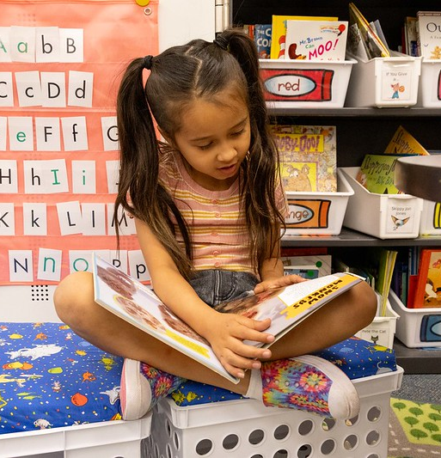
The Importance of Developing Inference Skills
Students with higher levels of inference skills, both at the elementary and secondary levels, perform at higher levels on reading comprehension tests.
(Cain, Oakhill, & Bryant, 2004; Kendeou, BohnGettler, White, & van den Broek, 2008)
Factors That Can Influence a Reader’s Ability to Make Inferences:
Access to vocabulary and knowledge
Student’s standards of coherence
Working memory
Notes:
Access to vocabulary and knowledge
While students may possess the knowledge, teachers should use practices to support students in accessing and applying relevant background knowledge to make inferences.
Student’s standards of coherence
A reader's criteria or general sense of the importance of forming a coherent representation, especially of how different parts of a text are related to one another” (Magliano et al, in McNamara, 2007, p. 121).
Working memory
Weaknesses in working memory can impact a student’s ability to make inferences and monitor comprehension (Oakhill et al., 2014).

Slide 31
Curriculum Check
Notes:
Now let’s turn our attention to your existing curriculum and instructional practices. We are going to use the next couple of slides to guide a critical analysis of your current instructional materials.

Slide 32
Does your curriculum…
Provide opportunities for students to interact at all levels of text understanding to build toward a situation or mental model?
Incorporate the various components of language comprehension needed for skilled reading?
Explicitly and systematically teach conjunctions and adverbs that serve as connectives in text?
Prompt students to identify connectives and analyze how the words contribute to meaning?
Provide graphic organizers to prompt connections between text and knowledge to support the reader in making inferences?
Notes:
Before we conclude, we will take some time to reflect upon the following questions as they relate to inference and your curricular resources.
Does your curriculum…
Provide opportunities for students to interact at all levels of text understanding to build toward a situation or mental model?
Incorporate the various components of language comprehension needed for skilled reading?
Explicitly and systematically teach conjunctions and adverbs that serve as connectives in text?
Prompt students to identify connectives and analyze how the words contribute to meaning?
Provide graphic organizers to prompt connections between text and knowledge to support the reader in making inferences?
Facilitator notes:
These questions can be used to guide teachers in finding resources within their instructional materials, reflect and write, or discuss in groups.

Slide 33
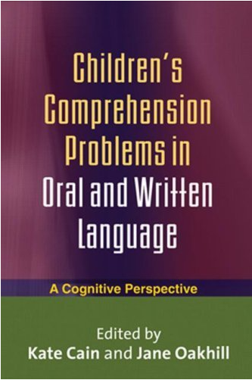
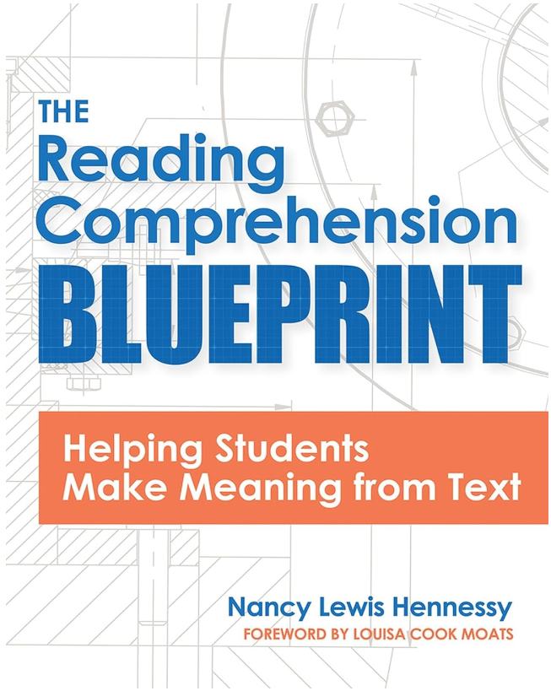
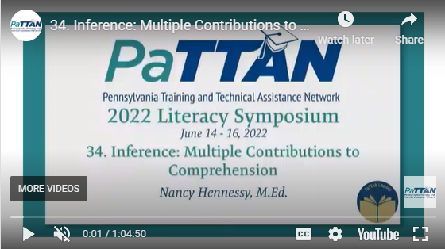
Learn More
Read:
Cain, K, & Oakhill, J. (2007). Children’s comprehension problems in oral and written language: A cognitive perspective. New York, NY. Guildford Press.
Hennessy, N. (2021). The reading comprehension blueprint: Helping students make meaning from text. Paul H. Brookes Publishing Co., Inc.
Watch:
Inference: Multiple Contributions to Comprehension | 2022 Literacy Symposium (PaTTAN)
Speaking: Nancy Hennessy, M.Ed.
7/22/2022
https://youtu.be/ERgWJwLTQXE?si=zClB6k_EmrZEKSX9
Notes:
To learn more about inference, we recommend the following books:
Children’s comprehension problems in oral and written language: A cognitive perspective, by Kate Cain & Jane Oakhill
The reading comprehension blueprint: Helping students make meaning from text, by Nancy Hennessy
We also recommend Nancy Hennessy’s webinar: Inference: Multiple Contributions to Comprehension, from the 2022 PaTTAN Literacy Symposium, available on YouTube.
https://www.youtube.com/watch?v=ERgWJwLTQXE

Slide 34
Resources

Slide 35
References
Boyne, J. (2006). Chapter One: Bruno Makes a Discovery. In The Boy in the Striped Pyjamas (pp. 1–4). Random House Group Ltd.
Babbitt, N. (2010). Prologue. In Tuck Everlasting (pp.1). St Martin's Press.
Cain, K, & Oakhill, J. (2007). Children’s comprehension problems in oral and written language: A cognitive perspective. New York, NY. Guildford Press.
Castles, A., Rastle, K., & Nation, K. (2018). Ending the reading wars: Reading acquisition from novice to expert. Psychological Science in the Public Interest, 19, 5–51.
Dahl, R. (2016). Chapter One: The Reader of Books. In Matilda (pp. 8–9). Puffin Books.
Gough, P. B. & Tunmer, W.E. (1986). Decoding, reading, and reading disability. Remedial and Special Education, 7(1).
Hennessy, N. (2021). The reading comprehension blueprint: Helping students make meaning from text. Paul H. Brookes Publishing Co., Inc.
Ingalls Wilder, L. (2008). Chapter One: Make Hay While the Sun Shines. In The Long Winter (p. 2). HarperCollins.
Kendeou, P., Bohn-Gettler, C., White, M., & van den Broek, P. (2008). Children’s inference generation across different media. Journal of Research in Reading, 31, 259–272.

Slide 36
References
Kintsch, W., & Rawson, K.A. (2005). Comprehension. In M.J. Snowling & C. Hulme (Eds.), The science of reading: A handbook (pp. 209-226). Oxford, England: Blackwell.
PaTTAN. (2022, June). Inference: Multiple Contributions to Comprehension, Nancy Hennessy, M. Ed. YouTube. https://youtu.be/ERgWJwLTQXE?si=zClB6k_EmrZEKSX9
Scarborough, H. S. (2001). Connecting early language and literacy to later reading (dis)abilities: Evidence, theory, and practice. In S. Neuman & D. Dickinson (Eds.), Handbook for research in early literacy. New York: Guilford Press.
Westby, C. (2011). Reading between the lines: Making inferences. Retrieved from https://speechpathology.com/articles/oelig-eading-between -lines-making-1526
White, E. B. 1., & Williams, G. (1952). Chapter 15: The Crickets. In Charlotte's web. First edition. (pp.113-114) Harper & Brothers.

