Slide 1
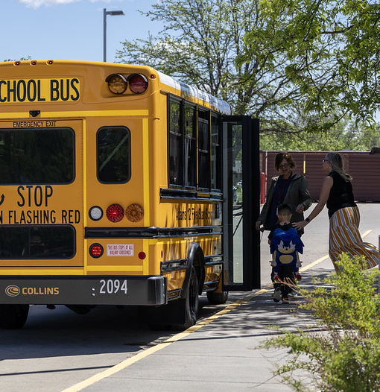

CLSD Grant Meeting
Local Literacy Plans
October 2025
1
Notes:
CLSD Grantee Meeting – 2025 Grantees
Focus on Local Literacy Plans

Slide 2

CLSD Updates
Amended GALs with full year 1 amount sent out
Budget revisions can be made via GAINS
Reminder to submit fund requests quarterly, but can submit more frequently
Local Literacy Plan resources:
  Birth – Kinder Entry Toolkit
  K-12 Toolkit
  BOCES Toolkit
2
Notes:
Amended grant award letters with your full year 1 award amounts were sent out October 15th
If budget revisions are needed for your project plans those can be made via GAINS.
As a reminder, fund requests should be submitted at a minimum quarterly but can be submitted more frequently. Those are also submitted in the GAINS system.
Today we will be covering, the local literacy plan toolkits which have been added to the CLSD webpage.
Three version of these toolkits have been added: birth to kinder entry toolkit, K-12 toolkit, and BOCES toolkit.

Slide 3

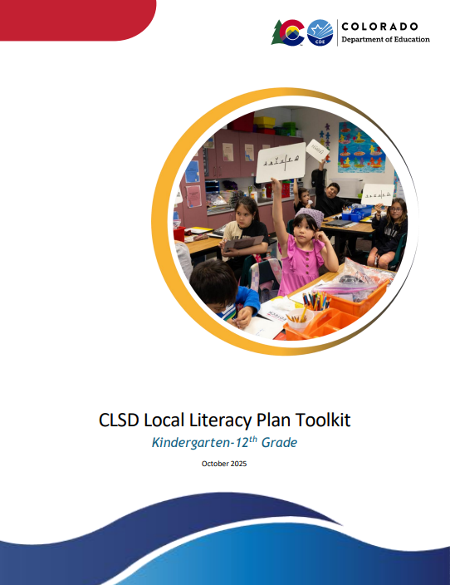
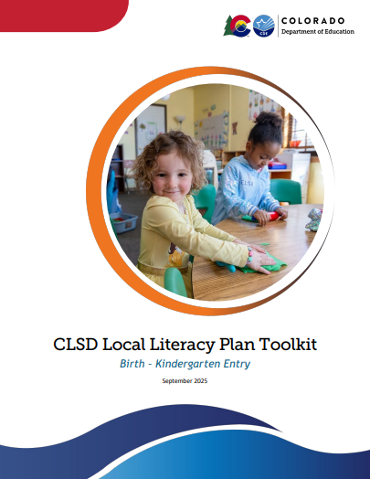
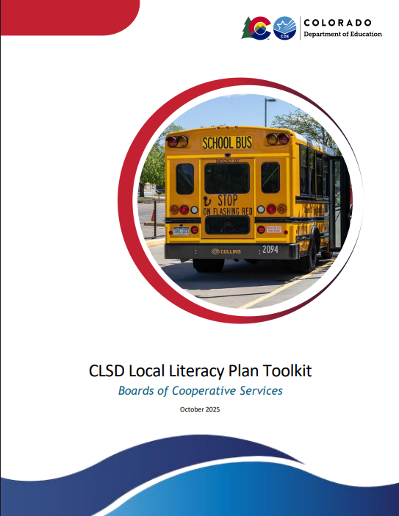
Local Literacy Plans
3
Notes:
These are the three literacy toolkits linked here: https://www.cde.state.co.us/early/comprehensive-state-literacy-development-grant

Slide 4

What is a Local Literacy Plan?
A local literacy plan sets the vision for an organization’s literacy programming and serves as a roadmap to guide implementation and achieve performance goals.
A comprehensive literacy plan should:
Be informed by a needs assessment
Align with the Statewide Comprehensive Literacy Plan
Include age bands served
Include specific goals
Include instruction and practices supported by evidence
Include a plan for professional learning
Be data-driven, with appropriate collection and use of data
Reflect leadership, educator, partner, and family voice and communication
4
Notes:
Creating a literacy plan is part of the CLSD grant commitments at the state and local/district level.
This can be found in the Federal Register and state CLSD RFA documents.
https://www.federalregister.gov/documents/2024/04/23/2024-08578/applications-for-new-awards-comprehensive-literacy-state-development
https://www.cde.state.co.us/coloradoliteracy/2025clsd_rfa

Slide 5

Parts of a Literacy Plan
Each section is designed to be created piece by piece, and together they will build a comprehensive literacy plan for your district or organization.
❖ Introduction
❖ Literacy Team
❖ Literacy Vision
❖ Needs Assessment
❖ Goals
❖ Literacy Instruction
❖ Use of Data
❖ Leadership
❖ Professional Development
❖ Family Involvement
❖ Partnerships
5
Notes:
These are the essentials parts of the literacy plan that should be included. Your organization may choose to add additional sections or structure the plan in a different manner that meets your needs. There are examples linked throughout the toolkits to give you an idea of how you might organize your plan.

Slide 6
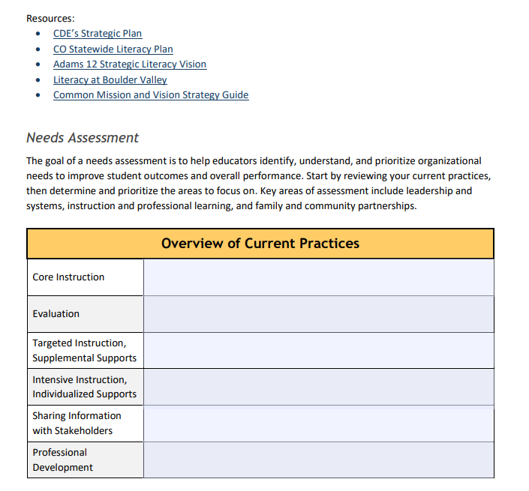
Inside the Toolkit
Each toolkit serves as a guide to the essential components of a local literacy plan, offering step-by-step guidance, suggestions, resources, and examples to reference.
Fillable boxes are included throughout to help you draft, organize, and refine your plan as you work through the process.
Notes:
These toolkits include guidance, suggestions, links to resources, and examples for each section.
I tried to find examples from Colorado but also included out-of-state examples for more variety of what different plans might look like.
The toolkits also include fillable boxes that you can use to help draft, organize, or jot down ideas as you meet with your literacy teams.
The toolkits can also be thought of as a first draft and be modified/added to based on your feedback.

Slide 7

Introduction, Literacy Team, Literacy Vision
7
Notes:
The first three sections outlined in the toolkit are the introduction, literacy team, and literacy vision.

Slide 8
Intro, Literacy Team, Vision
Introduction
Literacy Team
Document the members of the literacy team
Literacy Vision
When the plan was created
Who was involved in its development
Why it’s important to have a documented literacy plan
Should include individuals with key positions at various levels of the organization
A brief overview of your district/organization and current literacy practices
Vision and mission statements that articulate your commitment to literacy
Priorities related to vision and mission
Connection to long-term goals for student outcomes and system improvement
Notes:
Introduction
The introduction sets the purpose of the literacy plan. It explains why the plan exists, what it aims to accomplish, and how it will guide literacy work across the district or organization. Although the introduction is listed first, your team may complete it last. Most teams will begin by setting the direction and purpose of the plan by developing a literacy mission or vision statement.
In this section, you might include: • When the plan was created • Who was involved in its development • Why it is important to have a documented literacy plan
The three toolkits all link to the same resources as examples literacy plan introductions: Cherry Creek, North Harrison in Missouri, Naugatuck Public School in Connecticut
Literacy Team
This is the section of the plan to document the organization’s literacy leadership team and who has helped contribute to the literacy plan
It’s important to include members at various levels within the organization and have all stakeholders represented
A fillable form is included
Literacy Vision
Set the direction and purpose of your literacy plan by creating a mission and vision that reflect your local needs and context. These statements will ground your work and help ensure alignment across your schools, programs, and partners.
When drafting this section, you might include: • A brief overview of your district/organization and current literacy practices • Vision and mission statements that articulate your commitment to literacy • Priorities related to vision and mission • Connection to long-term goals for student outcomes and system improvement
Resources in this section vary by toolkit but may include statewide resources such as the Statewide Literacy Plan and the Universal Preschool Emergent and Early Literacy Alignment, as well as examples of district literacy vision statements and a Mission and Vision Strategy Guide.

Slide 9

Needs Assessment
9
Notes:
The goal of a needs assessment is to help educators identify, understand, and prioritize organizational needs to improve student outcomes and overall performance. Start by reviewing your current practices, then determine and prioritize the areas to focus on. Key areas of assessment include leadership and systems, instruction and professional learning, and family and community partnerships.

Slide 10
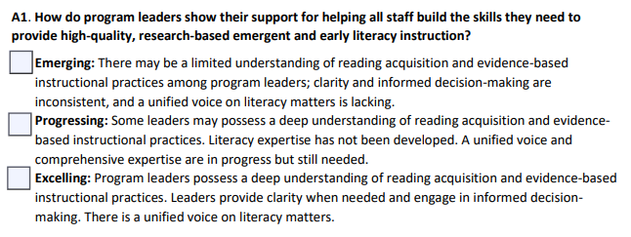
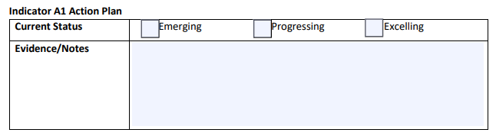
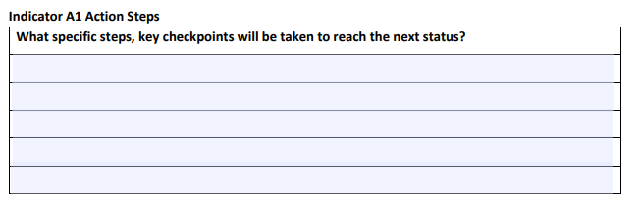
Needs Assessment Example
Notes:
The questions for the Needs Assessment will vary slightly depending on the toolkit you are using
You will rate yourself using the indicators provided for emerging, progressing, or excelling.
The toolkit then has space to provide evidence or notes for your rating and then actions step to be taken to improve.

Slide 11

Goals, Literacy Instruction, Use of Data
Notes:
The next sections are the sections to create literacy goals, outline instructional practices, and explain how the organization uses of data to guide instruction and make decisions.

Slide 12
Goals, Instruction, Data
Goals
  Each goal is designed to be specific, measurable, ambitious, realistic, and time-bound
  Reflects priorities identified through the needs assessment, including self-assessment results
  May focus on student outcomes, educator and staff development, program-level improvements, or addressing factors that contribute to literacy underachievement
Instruction
  This section describes how the organization uses evidence-based practices and interventions to help learners build essential literacy skills that prepare them to become successful readers and writers
  Includes guiding questions to frame the description and highlight key practices
Data
  This section explains how the organization uses data to guide instruction and decision-making
  It highlights how the organization/district builds capacity to interpret data, identify trends, and apply findings to strengthen instruction
  Includes guiding questions to frame the description and highlight key practices
Notes:
Goals
This section presents the goals that guide the literacy plan. Each goal is designed to be Specific, Measurable, Ambitious, Realistic, and Time-bound (SMART) and reflects priorities identified through the needs assessment process, including self-assessment results.
Plan goals may focus on student outcomes, educator and staff development, program-level improvements, or addressing factors that contribute to literacy underachievement– the BOCES plan will have more of a focus on goals around supporting and guiding member districts to improve student outcomes and sustain progress over time
Each of the toolkits includes a few links to examples of district literacy goals
Instruction

Slide 13

Leadership & Professional Development
Notes:
The next sections outline how leaders and professional development support strong literacy instruction in the organization.

Slide 14
Leadership & PD
Leadership
Professional Development
The professional development section describes how staff and educators will be supported to implement high-quality, evidence-based literacy instruction.
It ensures that professional learning is purposeful, ongoing, and aligned with the district or organization’s literacy goals.
This section describes how district or organizational leaders support, guide, and sustain high-quality literacy instruction.
It emphasizes that leadership is intentional, coordinated, and accountable for literacy outcomes.
Notes:
Leadership
This section describes how district or organizational leaders support, guide, and sustain high-quality literacy instruction.
The section might include:
clear roles and responsibilities for leaders, coaches, and staff involved in literacy initiatives
decision-making and policy alignment that ensures resources, staffing, and procedures support literacy goals
data-informed leadership to monitor implementation, guide instruction, and adjust supports as needed
professional learning and support strategies for educators and staff, including coaching, mentoring, and ongoing pd
Resources in this section include examples of leadership roles from Edina, MN, Cherry Creek’s description of Literacy Leadership, and a Leadership goal and with indicators of success from Naugatuck Public Schools in CT.
Professional Development
The professional development section describes how staff and educators will be supported to implement high-quality, evidence-based literacy instruction.
Key elements may include:
clear connection between professional learning and the district or organization’s literacy vision, goals, and instructional priorities
alignment with evidence-based literacy practices and state literacy standards
identification of staff or roles who will receive training
topics covered, delivery methods, structures for ongoing support
opportunities for feedback, systems for monitoring, use of data

Slide 15

Family Involvement & Partnerships
Notes:
The final sections in the literacy plan are the family involvement section and the partnerships section.

Slide 16
Family Involvement and Partnerships
Family Involvement
This section outlines how families are actively involved in literacy initiatives
Effective family involvement includes clear communication, accessible resources, and opportunities for collaboration with educators and community partners
Partnerships
Effective partnerships leverage resources, expertise, and networks to enhance instruction, provide additional learning opportunities, and engage families and the broader community in literacy efforts
This section outlines how the district or organization collaborates with community organizations, local businesses, higher education institutions, libraries, and other stakeholders
Notes:
Family Involvement
This section outlines how families are actively involved in literacy initiatives, how they are informed and empowered to support learning at home, and how their perspectives help shape literacy programming.
Effective family involvement includes clear communication, accessible resources, and opportunities for collaboration with educators and community partners.
Key elements may include:
Clear communication with families about literacy goals, expectations, and student progress.
Providing accessible resources and guidance for supporting literacy at home.
Opportunities for families to participate in school- or organization-based literacy events and activities.
Mechanisms for families to share input and feedback on literacy programs and initiatives.
Strategies to engage families from diverse linguistic, cultural, and socioeconomic backgrounds.
And more…
Resources in this section vary by toolkit but include a Family-School-Community Strategy Guide, Read, Lead, Learn, Colorado, and the Head Start Parent, Family, and Community Engagement Framework.
Partnerships
This section outlines how the district or organization collaborates with community organizations, local businesses, higher education institutions, libraries, and other stakeholders to support literacy development.
Effective partnerships leverage resources, expertise, and networks to enhance instruction, provide additional learning opportunities, and engage families and the broader community in literacy efforts.
Key elements may include:
Identifying community organizations, agencies, and institutions that can support literacy goals
Clear roles and responsibilities for each partner in supporting instruction, programs, or events
Collaboration on programs, tutoring, mentoring, or enrichment opportunities for students
Sharing resources, expertise, or facilities to strengthen literacy initiatives
And more…
The resource shared in this section is the Family-School-Community Partnerships Strategy Guide– this section can be built out with suggestions

Slide 17
Literacy Plan Questions/Updates
First draft due at end of school year
Plan should be for all of the grade levels that your organization serves
If you have an existing literacy plan, you can build upon that
Should align with UIPs
17
Notes:
Will update slide during meeting based on questions and comments

