Slide 1
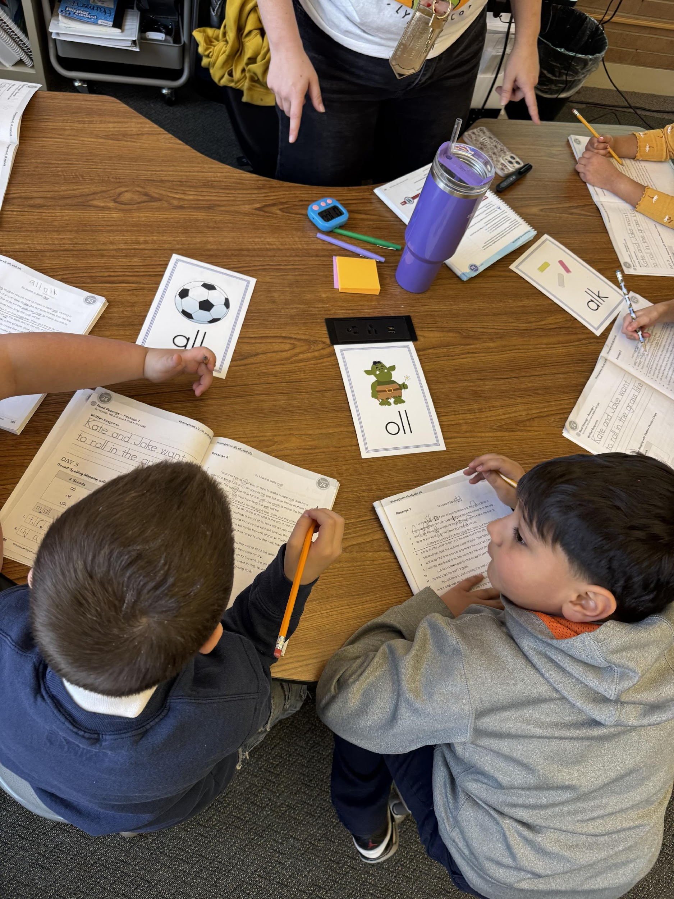
Comprehensive State Literacy Development (CSLD) Grant
2025 Welcome Meeting

Slide 2
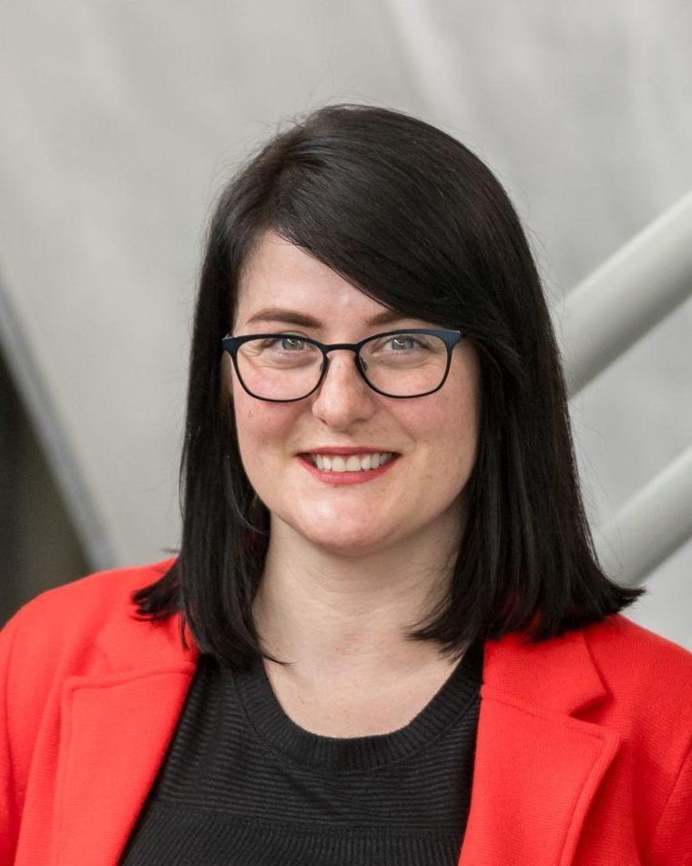
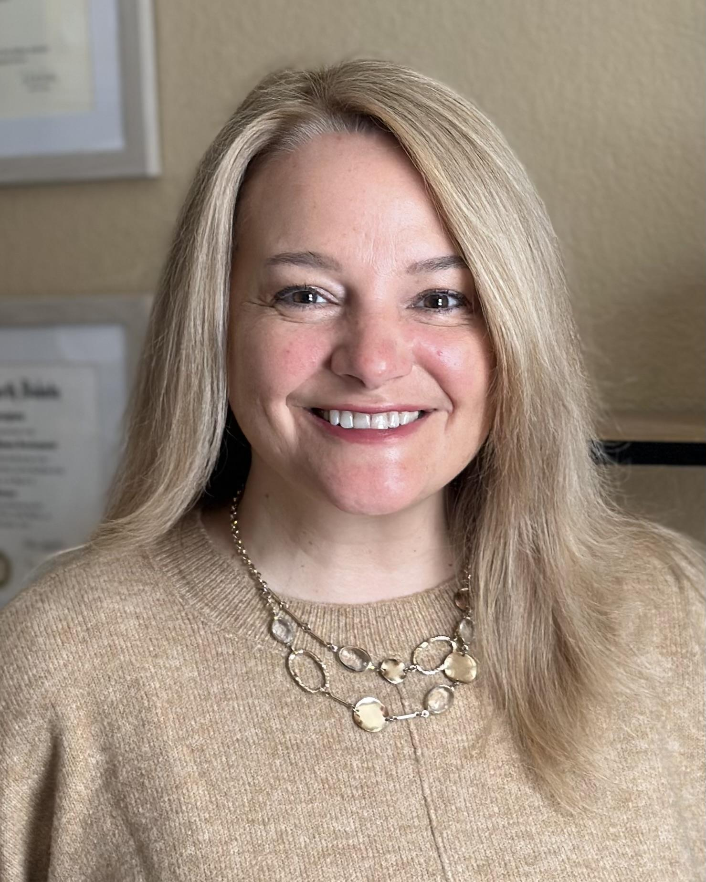
Welcome!
Laura Lay
CLSD Grant Program Manager
Colorado Department of Early Childhood
Heather Craiglow
Head Start Collaboration Office Director
Colorado Department of Early Childhood

Slide 3
CLSD Overview- National Level
Colorado is one of 23 awardees of the federal CLSD Grant
Five-year grant cycle with the following goals:
  Increase district capacity and infrastructure in implementing high-quality, evidence-based instructional practices and literacy activities at all grade levels.
  Increase the number of disadvantaged students with access to high-quality instructional opportunities and staff trained in the science of reading.
  Increase literacy outcomes for all students served by subgrantee schools.

Slide 4
Performance Measures
  Increase oral language skills for 4-year-olds.
  The % of children prepared for kindergarten ready to read increases 25%.
  The % of students in grades K-3 identified as having an SRD decreases 10%.
  The % of students in grades 4-5 achieving proficiency increases 20%.
  The % of students in grades 6-8 achieving proficiency increases 20%.
  The % of students in grades 9-11 meeting expectations increases 20%.

Slide 5
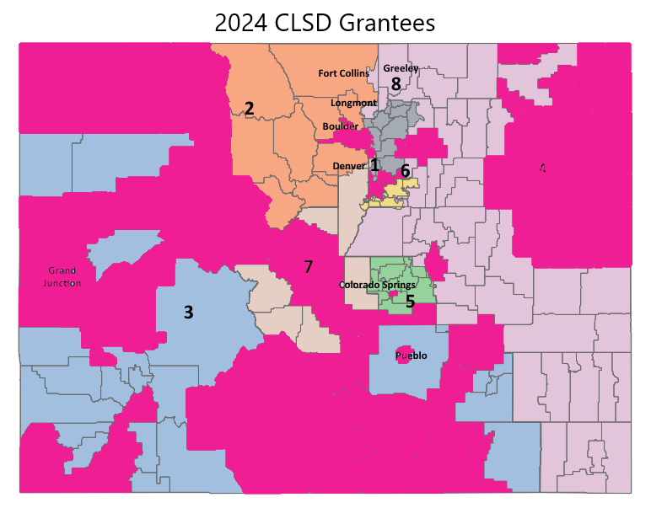
CLSD Overview- State Level
Highly competitive application process
33 grantees: 25 rural, 8 non-rural
4-year grant cycle

Slide 6
Grant Project Focus
High-leverage, evidence-based literacy practices:
  Implement structured literacy approaches grounded in reading research
  Utilize high-quality curricula to reduce teacher workload, allowing teachers to focus on effective instruction
  Focus on practices found to have moderate or strong evidence in IES Practice Guides
  Use data-driven instruction and progress monitoring to inform teaching strategies
Local Needs Alignment:
  Address literacy gaps through local needs
  Provide professional development for educators based on district-specific challenges
  Support English Language Learners and students with reading disabilities
  Engage families and communities to support reading in and out of school

Slide 7

Supports for Your Project
Marketplace - Transitions During the Early Years
Expanding Quality in Infant Toddler Initiative | Colorado Department of Early Childhood
Professional Development Information System (PDIS)
Individualized Professional Development (iPD) Portfolio | HeadStart.gov
Course Catalog | HeadStart.gov
Imagination Library of Colorado
Early Childhood Council Leadership Alliance
Early Learning & Development Guidelines & PLAYbook
Notes:
Consider CDEC’s resources that support coaching,

Slide 8
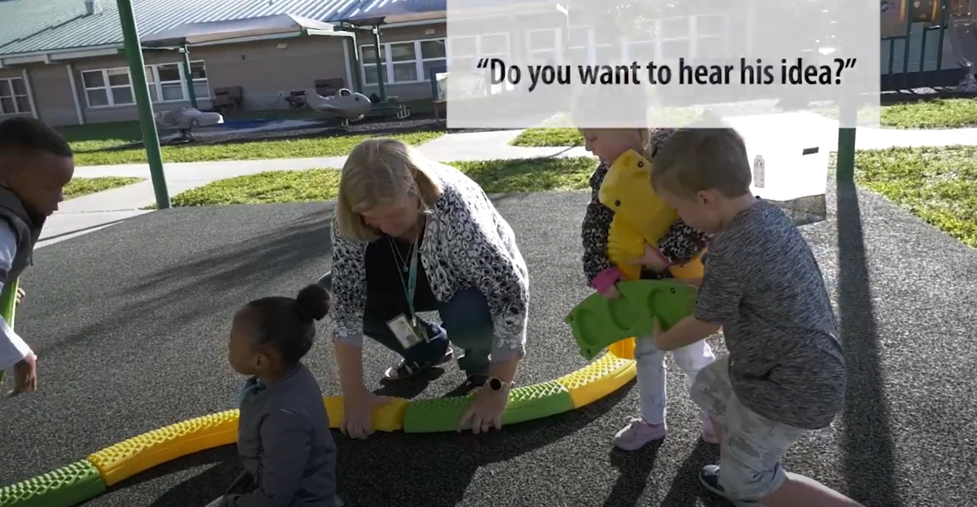
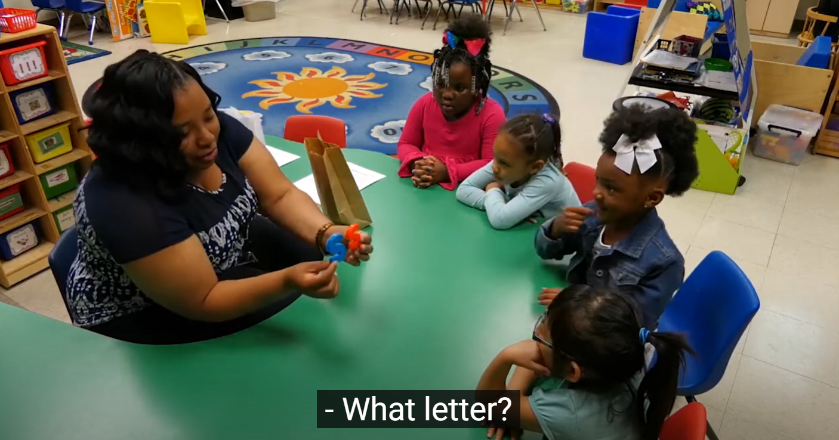
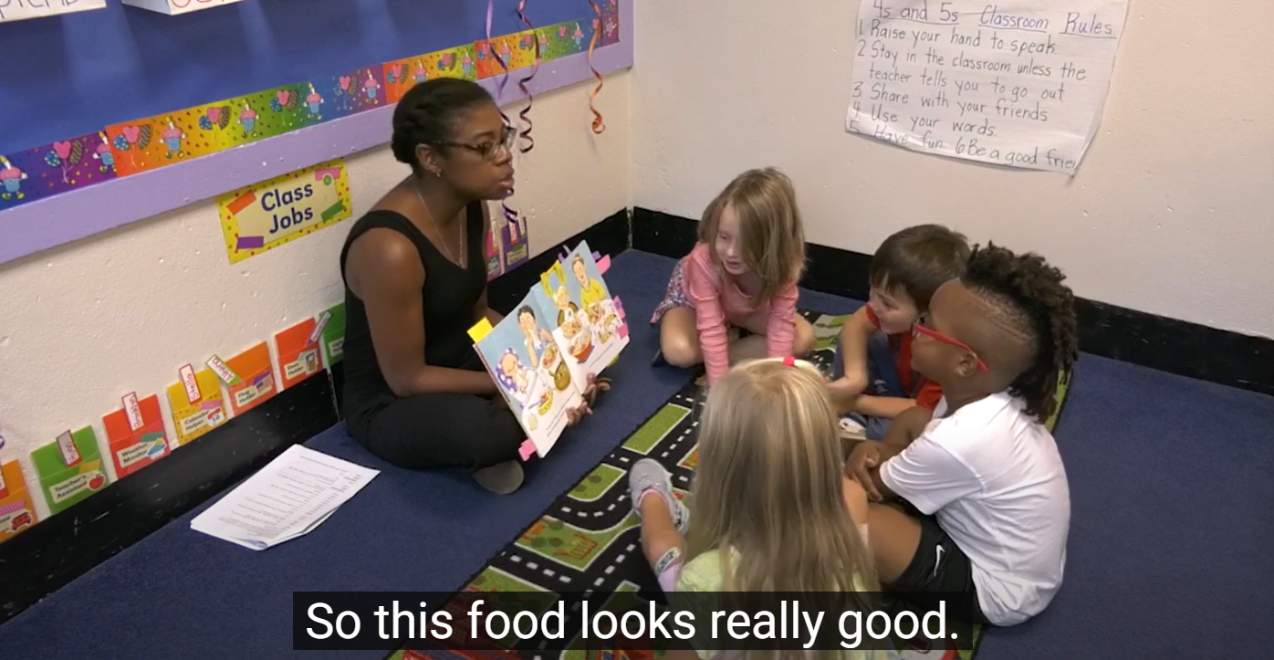
Effective Practices – Birth – PK
Intentionally plan activities to build children’s vocabulary and language.
Build children’s knowledge of letters and sounds.
Use shared book reading to develop children’s language, knowledge of print features, and knowledge of the world.
Preparing Young Children for School

Slide 9
Managing Your Grant – Program Requirements
Annual grant performance monitoring is required. Grant Partnership Meetings will be held virtually or in person and scheduled in advance.
Participation in data collection surveys to evaluate progress and the effectiveness of CLSD activities is expected.
Grantees serving the birth-kindergarten entry age band are required to submit four-year-old language data to CDE.
A local literacy plan must be developed and submitted by the end of Year 1 of the grant.

Slide 10
Managing Your Grant – Budgets
Budgets are submitted in GAINS each year in June for approval of the following school year's planned costs.
Revisions must be submitted for approval if changes need to occur.
    Any time revisions are made, it goes through the same approval process in GAINS: Draft completed > LEA Fiscal Representative Approved > LEA Authorized Representative Approved > CDE

Slide 11
Managing Your Grant – Fiscal Requirements
Programs must draw down funds at a minimum of every 4 months and no more than once a month.
All funds for each grant year (Years 1-4) must be expended between July 1 and June 30.
The final day to submit reimbursement requests is August 15.
    A Final Expenditure Report (FER) will be due September 30 each year via GAINS.

Slide 12
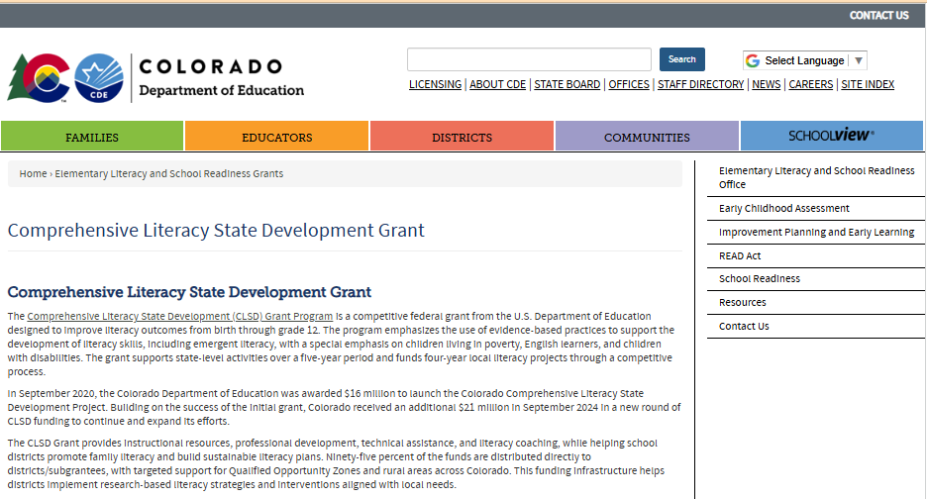

www.cde.state.co.us/early/comprehensive-state-literacy-development-grant

Slide 13
Project Goals
Develop two or three clear project goals
Connected to UIP and documented accordingly when appropriate
Should be measurable
  Linked to student outcomes or
  Tied another key project focus area
We will discuss these goals
during individual meetings
  If you included goals in your application or existing district UIP, we can review and modify them as needed.

Slide 14
Communication Plan
Can't be just another new thing or all top-down
Multidirectional communication strategy that actively involves and empowers teachers, parents, and other key stakeholders
Develop key messages
Choose communication channels
Provide clear channels for feedback, questions, and concerns from all stakeholders
Notes:
For Teachers:
Highlight the benefits of the grant for professional growth and student success.
Explain how the grant will provide new resources and opportunities.
Provide clear steps for accessing training and resources.
For Parents:
Emphasize how the grant will improve students' learning experiences and academic performance.
Explain opportunities for parents to get involved and support their children's education.
Address potential concerns and provide reassuring information.
For Stakeholders:
Highlight the grant's positive impact on the school district and community.
Showcase how the grant aligns with existing initiatives and strategic plans.
Demonstrate the responsible use of funds and measurable outcomes

Slide 15
District/Local Literacy Plan
A document that outlines how a school district or organization will improve literacy skills for all students.
Local literacy plan due at the end of the school year.
Ensures Year 2 starts with alignment to the new local literacy plan.
Should not be a static document but should evolve to meet the needs of your students, educators, and local needs.

Slide 16
Topic Specific Meetings
Age Band Specific Meetings
Developing a Literacy Plan
Staff Transition Plans
Grant Management: Reporting, Progress Reports, GAINS, etc.

Slide 17
Important Dates
July 1: Beginning of each performance period
June 30: End of performance period
August 15: Last day to submit reimbursement requests
September 30: Final Expenditure Report due
Year 1: July 1, 2025 – June 30, 2026
Year 2: July 1, 2026 – June 30, 2027
Year 3: July 1, 2027 – June 30, 2028
Year 4: July 1, 2028 – June 30, 2029
**Pending continued funding from the US Department of Education

Slide 18
Next Steps
Schedule a meeting with me through Bookings (I will email you the link)
Review the Grant Award Letter (GAL) and Exhibit A upon receipt
Complete email survey about technical assistance & literacy leadership at the state level
Develop grant project goals
Start on a communication plan
Begin a plan for a literacy leadership team for your district/local literacy plan

Slide 19
Birth - Kindergarten Grantees
Adams County 14
LENA Grow, parent academy nights, vertical alignment/transitions to K-12
Canon City RE-1
Colorado Shines PD cohort, PK Heggerty, Kindergarten launch program
Delta County 50(J)
TS GOLD PD, coaching support, vertical alignment
Durango 9-R
Coaching and implementation support, literacy strategic plan, parent support resources
Eagle County RE 50
Transitions to K-3, consistent MTSS framework, coaching early literacy skills in English & Spanish
Eagle Valley Child Care Association
Professional development, literacy kits, bilingual family engagement materials
Early Childhood Council for Yuma, Washington, and Kit Carson Counties
Bilingual/language services, LENA Grow, Imagination Library, Motheread/Fatheread
First Impressions of Routt County
Professional development, LENA Grow
Garfield RE-2
Coaching and mentoring, Raising a Reader, extended learning opportunities
Mesa County Valley 51
Instructional programming, dialogic reading, transition to kindergarten, community partnerships
Montrose County RE-1J
Literacy First, professional development
Mountain Valley Developmental
Services, Inc.
Family literacy kits, Creative Curriculum, coaching, Ready Rosie, LENA Grow
San Luis Valley BOCES
Professional development, comprehensive needs assessment
St Vrain Valley RE1J
Heggerty, Fundations training, LENA Grow
Westminster Public Schools
Literacy task force, new ECE core resource, consultant support

Slide 20
Got Questions…
General CLSD Grant Questions:
Laura Lay, lay_l@cde.state.co.us
Early Childhood & Preschool Programming and Best Practice Questions:
Heather Craiglow, heather.craiglow@state.co.us
Kristen Lang, kristen.lang@state.co.us
Grant Finance Questions:
Gloria Kochan, kochan g@cde.state.co.us
GAINS Questions:
Megan Allen Winicki, allen_m@cde.state.co.us
Notes:
If we needed a contact slide-
heather.craiglow@state.co.us
kristen.lang@state.co.us

