Slide 1
Background Knowledge
CDE Science of Reading Literacy Series

Slide 2
Introduction

Slide 3

Objectives
Understand the role of background knowledge in supporting text comprehension
Analyze instructional resources to determine how background knowledge is addressed and what additional supports may be needed
Determine personalized next steps for implementation
Identify ways to activate, build and make connections to student’s background knowledge to support comprehension
Notes:
During this session, participants will
Understand the role of background knowledge in supporting text comprehension
Identify ways to activate, build and make connections to student’s background knowledge to support comprehension
Analyze instructional resources to determine how background knowledge is addressed and what additional supports may be needed
Determine personalized next steps for implementation

Slide 4

Key Terminology
Mental model: The overall representation of the meaning of a text.
Schema: The mental web of ideas and facts about a specific topic that are automatically activated when reading.
Background knowledge: Information a person has on a particular topic, acquired through indirect and direct experience and held in long- term memory.

Slide 5
Simple View of Reading (SVR)
FLUENCY
Word
Recognition
Language Comprehension
Reading Comprehension
Phonological/Phonemic Awareness
Phonics/Decoding
Sight Words
Background Knowledge
Vocabulary
Syntactic/Semantic Knowledge
Verbal Reasoning
Literacy Knowledge
Gough, P. B. & Tunmer, W.E. (1986). Decoding, reading, and reading disability. Remedial and Special Education, 7(1).
Notes:
Several decades of reading research has given us a clear understanding of how students best learn to read. One way to conceptualize reading is through the Simple View of Reading model. This model, developed by Gough and Tunmer, organizes the skills needed to become a proficient and successful reader into two categories: word recognition and language comprehension. The Simple View of Reading is a basic formula for reading comprehension. It says this: reading comprehension is the product of word recognition skills and language comprehension skills. We need both variables on the left side of the equation for students to become skilled, proficient readers.
Source: https://www.cde.state.co.us/coloradoliteracy/scienceofreadingresources

Slide 6
Reading Comprehension Quote
"Reading comprehension is not a single entity that can be explained by a unified cognitive model. Instead, it is the orchestrated product of a set of linguistic and cognitive processes operating on text and interacting with background knowledge, features of the text, and the purpose and goals of the reading situation.“
- Castles, Rastle, and Nation (2018, p. 28)
Notes:
Consider this quote by Castles, Rastle, and Nation:
"Reading comprehension is not a single entity that can be explained by a unified cognitive model. Instead, it is the orchestrated product of a set of linguistic and cognitive processes operating on text and interacting with background knowledge, features of the text, and the purpose and goals of the reading situation.“

Slide 7
Levels of Understanding
Level 1
Understanding the Surface Code
Level 2
Making Meaning from the Text Base
Level 3
Constructing a Situation or Mental Model of the Text
(Kintsch & Rawson, 2005)​
Notes:
There are several components that we have to consider before we can get to the depth of understanding where inference lies.
The first component that we have to think about is the text itself. This is the surface level of a text. These are the words and sentences that are on the page.
The second part is the text base which means the underlying meanings behind the words and sentences on the page. This is where vocabulary and context lie. We can also add our background knowledge to this level.
These components lead to what is referred to as the situation or mental model of the text. This is the deep level understanding of the text. Inference lies in this deep level of the text.

Slide 8
Level 1: Understanding the Surface Code
Level 1: Understanding the Surface Code
Level 1
Surface Code
Level 2
Text Base
Level 3
Mental Model
Exact words and syntax of the author
What readers immediately recall
Example: Answering literal questions with direct text evidence
Notes:
When readers are interacting with the surface code of the text, they are making sense of the exact words and syntax of the author. Typically, the surface code is what readers immediately recall. In the classroom, this could be answering literal questions with direct text evidence.

Slide 9
Level 2: Making Meaning from the Text Base
Level 2: Making Meaning from the Text Base
Beyond words and sentences on the page
Requires understanding of the author’s intended meaning, including word meanings and how words work in combination to communicate the meaning of the text
Example: Making connections and accessing background knowledge
Level 1
Surface Code
Level 2
Text Base
Level 3
Mental Model
Notes:
To make sense of the text base, readers must go beyond the words and sentences on the page. This requires understanding of the author’s intended meaning, including word meanings and how words work in combination to communicate the meaning of the text. For example, utilizing the text base is demonstrated by making connections and accessing background knowledge.

Slide 10
Level 3: Mental Model
Level 3: Constructing a Situation or Mental Model of the Text
Using language and cognitive processes, including inference, to integrate units of meaning
Information that is explicitly stated as well as implied
Example: Constructing an overall understanding of the situation in the text
Level 1
Surface Code
Level 2
Text Base
Level 3
Mental Model
Notes:
Finally, to construct a situation or mental model of the text, readers must use language and cognitive processes, including inference, to integrate units of meaning. This includes information that is explicitly stated as well as information that is implied. When readers can successfully construct a mental model, they have an overall understanding of the situation in the text.

Slide 11
Levels of Language Processing
Words and Phrases
Academic vocabulary (breadth and depth)
Sentences
Density
Background Knowledge
Schema
Coherent Representation of Text
Length
Structure
Cohesive ties and connectives
Text structure
Inference
Local
Global
Level 1: Understanding the Surface Code
Level 2: Making Meaning from the Text Base
Level 3: Constructing a Situation or Mental Model of the Text
(Hennessy, 2021; Cain & Oakhill, 2007)
Notes:
This graphic, adapted from Nancy Hennessy, illustrates the levels of language processing a reader experiences when interacting with text.
The reader first attends to the words and phrases, including academic vocabulary. The reader must also make sense of the sentences, including the syntactic structure. Next, the reader uses cohesive devices within the sentences to connect to their background knowledge. This includes their mental schema as well as specific knowledge around how text is structured. This all lends to the process of making inferences through local and global coherence, as we will discuss later in this presentation. By integrating all these components and skills, the reader forms a coherent representation of the text.
Notice there is a reciprocal relationship between each of these components, and that language skills in each of these areas are needed for readers to develop a mental model and form a coherent representation and understanding of the text.

Slide 12



Level 1 Text Example
Moving from London to Phoenix in mid-July was quite an adjustment for Judy. Both the climate and the culture were different from her hometown in England, not to mention the initial jetlag she experienced when she first arrived.
Exact words and syntax of the author
What readers immediately recall
Who moved?
Where did she move?
When did she move?
What was different?
Notes:
Let’s take a look at how the mental model develops when reading a specific passage of text.
(Read aloud or have participants read silently the short text in the middle of the slide.)
At the first level of understanding, the surface code, readers must be able to decode and connect the exact words and syntax the author uses. At this level, readers can answer literal or “right there” questions in which the answers can be found directly in the text. In this case, we should easily be able to answer these questions:
Who moved? (Judy moved)
Where did she move? (to Phoenix, or, from London to Phoenix)
When did she move? (in mid-July)
What was different? (the climate and culture were different)

Slide 13
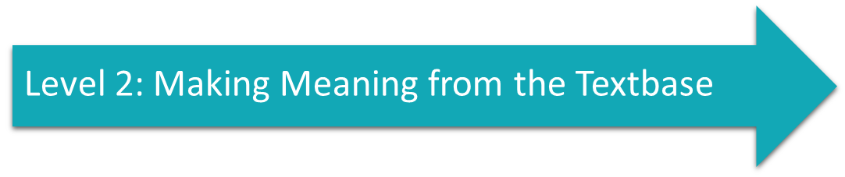

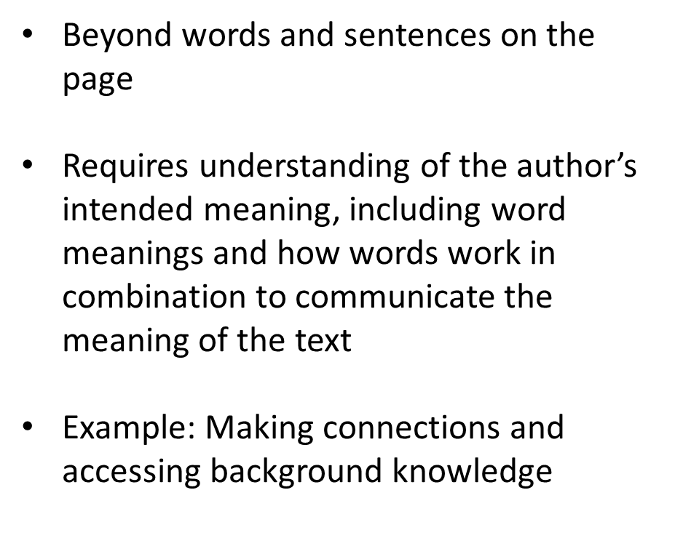

Level 2 Text Example
Moving from London to Phoenix in mid-July was quite an adjustment for Judy. Both the climate and the culture were different from her hometown in England, not to mention the initial jetlag she experienced when she first arrived.
London is in England.
Phoenix is in Arizona, which is in the United States.
England is another country thousands of miles away in Europe, which is in a different time zone.
Traveling through multiple time zones can cause sleep/wake patterns to be disrupted, resulting in feeling exhausted (“jetlag”).
Different countries have different ways of doing things. (Culture)
Climate is the weather pattern in an area:
  England has a temperate climate; July is warm and humid.
  Arizona has an arid climate; July is very hot and dry.
Notes:
In order to make meaning from the text base, the next level of understanding, the reader must have some underlying knowledge that goes deeper than the words and sentences on the page.
For example, the reader could draw from many different pieces of general knowledge, each of which better enables them to better understand what the author intends in these few sentences. The reader has to have at least a basic understanding of what the terms climate, culture, and jetlag mean. Geographical knowledge is also critical to making meaning, because the reader has to understand that the locations mentioned in the passage are in very different geographical regions as well as being in different countries. The reader also must have a general understanding that different countries have different ways of doing things that could impact one’s perspective and experience.

Slide 14



Cohesive Ties
Moving from London to Phoenix in mid-July was quite an adjustment for Judy. Both the climate and the culture were different from her hometown in England, not to mention the initial jetlag she experienced when she first arrived.
Cohesive ties:
“Both” refers to two things: climate and culture.
“Her hometown in England” is London
“She” and “her” refer to Judy
The different climate and culture and her experience with jetlag all contributed to the move being an adjustment for Judy
Notes:
In addition to assumed knowledge, readers must also grapple with the way a text is structured and be able to understand how words, sentences, and paragraphs are connected throughout the text. Even in a short passages such as this, there are a variety of cohesive ties, words or phrases used to connect ideas between different parts of the text, that the author assumes readers will accurately connect to make meaning from the text. For example, the reader must understand that the word “both” in the second sentence is referring to two things that follow in the sentence: climate and culture. The reader must also make the connection across sentences that the pronouns “she” and “her” are used as referents to Judy. One must make the connection that “her hometown in England” is referring to London. And, the reader has to understand that there were several things that made the move to Phoenix an adjustment for Judy: the different climate, the different culture, and the jetlag she experienced.

Slide 15
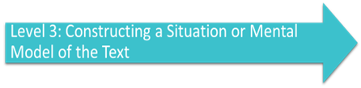

Level 3 Text Example
Moving from London to Phoenix in mid-July was quite an adjustment for Judy. Both the climate and the culture were different from her hometown in England, not to mention the initial jetlag she experienced when she first arrived.
Using language and cognitive processes, including inference, to integrate units of meaning
Information that is explicitly stated as well as implied
Judy moved from London, England, to Phoenix, Arizona (US) in the middle of summer, and it was difficult for her. The hot, dry temperature in Arizona was very different from what summer was like in England, and at the same time, she had to adjust to societal norms and etiquette, social interactions, and cultural expectations in America that were different than what she was used to in England. Feeling tired and out of sorts from the time change between locations also impacted her experience. I know that feeling exhausted can make a person more emotional, and big changes can be uncomfortable, so I infer that Judy may have been feeling overwhelmed and homesick at first.
Notes:
If reader can accurately decode and decipher the surface code, has some understanding of the vocabulary, has some background knowledge about geography and travel, and also understands how the text is structured using cohesive devices, a complete mental model of the passage can be formed. This includes integrating all of these units of meaning to make important inferences.
(READ the example on the slide of the mental model formed from this excerpt).

Slide 16
Preparing for Instruction
Notes:
In this section, we will focus on importance of background knowledge to reading comprehension and ways to target background knowledge through careful preparation for instruction.

Slide 17
What is background knowledge?
Background Knowledge
Facts and references
Word meanings
Academic concepts
Personal experiences
Political, social and historical contexts
Moats & Hennessy (2010, p. 25)
Notes:
Background knowledge is the Information a person has on a particular topic, acquired through indirect and direct experience and held in long- term memory. Just like with vocabulary knowledge, both breadth and depth of background knowledge matters for students to comprehend complex texts they are presented in academic contexts. Background knowledge to support comprehension on a given topic includes facts and references, an understanding of word meanings, academic concepts, related personal experiences, and an understanding of political, social, and historical contexts.

Slide 18

Schema
“A mental web of facts and idea on a specific topic that is automatically activated as we read or that is constructed as we read”
May be sparse or elaborate
May be true, partially true, or false. May contain misunderstandings or misconceptions.
Constantly changing as information is added
(Moats & Hennessy, 2010)
Notes:
When we read about a topic, a mental model of all the things we know, perceive, or think about that topic is activated. This mental model is called schema. When we have a lot of background knowledge about a topic, the schema is rich and allows us to build upon that schema with new information that is added. However, when a schema is weak or poorly developed, or there are many misconceptions or faulty understandings, it may be more difficult to efficiently add new information to the model. A person’s mental schema may be sparse or elaborate, may be true, partially true, or false, and may contain misunderstandings or misconceptions. As information is added, our schema on a topic changes to accommodate the new learning.

Slide 19

“Mental Velcro”
“…knowledge about the topic at hand is like mental Velcro. The relevant knowledge gives the words of the text places to stick and make sense, thereby supporting comprehension and propelling the reading process forward.”
Adams, 2015
Notes:
Having knowledge about a topic allows for a more richly developed schema, which in turn makes it easier to add new information to the model efficiently. Marilyn Adams explained that “…knowledge about the topic at hand is like mental Velcro. The relevant knowledge gives the words of the text places to stick and make sense, thereby supporting comprehension and propelling the reading process forward.”

Slide 20

Inference Requires Background Knowledge
Notes:
It is also important to make the connection between background knowledge and inference. It is very difficult to make accurate inferences without sufficient background knowledge available. For example, a young child reaching for a hot iron would not be able to infer that touching the iron would result in a painful burn if the child had no prior experience to work from, such as being told the iron is hot, having a parent react in alarm when the child reached for the iron before, or even having an unfortunate direct experience with the iron.
When we have a student who has difficulty making inferences when reading or discussing text, it is very possible that the student does not have sufficient background knowledge to allow the development of an inference.

Slide 21




The Matthew Effect
Notes:
Most of us are familiar at this point with the term “The Matthew Effect.” First coined by sociologist Robert K. Merton in 1968 and later elaborated by Kieth Stanovich (1986), “The Matthew Effect” explains the impact of early experiences on achievement later on. In short, “the rich get richer, and the poor get poorer.” Like other skills and knowledge students bring to the table, rich background knowledge and more robust schema support students literacy development and allow them to make stronger gains over time, particularly with vocabulary and reading comprehension. Students who lack background knowledge are often at a disadvantage, particularly when we as educators do not thoughtfully plan to bridge the gap for these students.

Slide 22
Boy in the Striped Pyjamas Excerpt
“Gretel looked at her little brother and found herself agreeing with him for once. ‘I know what you mean,’ she said. ‘Its not very nice, is it?’
‘It’s horrible,’ Said Bruno.
‘Well, yes,’ said Gretel, acknowledging that. ‘Its horrible right now. But once the house is smartened up a bit it probably won’t seem so bad. I heard Father say that whoever lived here at Out-With before us lost their job very quickly and didn’t have time to make the place nice for us.’
‘Out-With?’” asked Bruno. ‘What’s an Out-With?’
‘It’s not an Out-With, Bruno,’ said Gretel with a sigh. ‘It’s just Out-With.’
‘Well, what’s Out-With then? He repeated. Out with what?’
‘That’s the name of the house, explained Gretel. ‘Out-With.’
Boyne (2006, p. 23)
Notes:
This excerpt is from “The Boy in the Striped Pyjamas,” a historical fiction novel by John Boyne written from the perspective of a young German boy whose father is a Nazi officer placed in charge of Auschwitz concentration camp. This text provides an excellent example of both the type of reasoning that can occur when a lack of background knowledge is present (in this case, demonstrated by the characters’ questions and inferences), and an example of text that requires the reader to have a level of topical background knowledge sufficient to make appropriate inferences to construct a complete mental model. Take a moment to read the excerpt to yourself.
Discuss:
How does the text demonstrate the lack of background knowledge the characters have and how that is evident in the inferences made or conclusions drawn? How do the gaps in prior knowledge affect the character’s mental model or schema?
What must the reader bring to the table in terms of background knowledge in order to fully comprehend what the characters are discussing? What might the outcome be for the reader if they have lack of relevant background knowledge when reading this?
In this case, the reader must have enough understanding of the topic of Holocaust to infer that Gretel is referring to Auschwitz (“Out-With”), a concentration camp, and that the character does not have a clear understanding of what the name is referring to (thinking it is the name of the house they are living in and not the surrounding camp). The reader may need to have a sense of why the children think it is “not very nice” or “horrible,” and that they are likely not referring to just the house they are in but the surrounding area as well. Without this background knowledge, the conversation between the characters could be very confusing to the reader, and a misinterpretation of the text could result.

Slide 23
The ABC’s of Background Knowledge
Activate and Assess
What relevant knowledge do student’s already have?
What misconceptions might get in the way?
Build
What do I need to teach students to ensure the “velcro” is in place for new learning?
How do I focus on the key information needed without overteaching?
Hennessy, 2021
Connect
How do I ensure students are making connections between their existing knowledge and new learning?
Notes:
In order to ensure that student’s have the background knowledge necessary to adequately comprehend text and build upon their existing schema in a way that supports learning, it is important to directly target knowledge during instruction. Nancy Hennessy has identified the ABCs of Background Knowledge to support teachers in ensuring knowledge is addressed before, during, and after reading a text.
The “A” stands for Activate and Assess background knowledge. What relevant knowledge do students already have? What misconceptions might get in the way of learning? And how should I focus my instruction to fill the gaps?
“B” stands for Build. This means intentionally focusing on key information and explicitly teaching necessary content that will support students’ comprehension of a text. WE need to ask “What do I need to teach students to ensure the “Velcro” is in place for new learning? How do I focus on the key information without over teaching the content?
Finally, the “C” stands for Connect. How do I ensure students are making connections between their existing knowledge and new learning?

Slide 24
Activating and Assessing Background Knowledge
Anticipation guides
Concept Sorts
Questions or prompts
Webs, charts, diagrams
Visual Images
Notes:
Activating background knowledge and assessing what students are bringing to the table is an important step before instruction on a topic begins. This can be done in various ways, including the use of anticipation guides, concept sorts, questions or prompts, webs, charts and diagrams, and incorporating visual images.
We will focus on each of these tools in the upcoming slides.

Slide 25
Anticipation Guides
Before Reading
After Reading
Agree | Disagree | Statement | Agree | Disagree
 |  | Propaganda is an effective and powerful way to promote specific ideas and influence public opinion.
 |  | When facing pressure from a group, people will act in ways they would not if they were alone.
Notes:
Anticipation guides can be used before reading or engaging with a text or topic to activate and assess student’s background knowledge. The guide also supports setting a purpose for reading and allows an avenue for identifying any preconceived ideas students have about the topic.
In this example, students would be asked to read each statement listed in the anticipation guide and decide whether they agree or disagree with the statement prior to instruction on the topic. After instruction and reading the targeted text, students would then revisit the same statements to see if their opinions changed.
RESOURCE: https://www.readingrockets.org/classroom/classroom-strategies/anticipation-guide

Slide 26
Concept Sorts
gas chambers
persecution
Nazi
antisemitism
swastika
concentration camp
ghetto
Fuhrer
genocide
The Third Reich
deportation
Judaism
barracks
propaganda
Gestapo
Gather words, objects, or images
dehumanization
Sort into groups
Discuss groupings
Notes:
Concept sorts can be used to activate background knowledge and identify what students know about a topic in advance of a reading or unit of study. It can also allow for discussion that draws out misconceptions or misinformation students have about the topic. Frequently, concept sorts focus on introducing vocabulary words students will encounter, but a sort can also be doing using objects or images. The idea of a concept sort is for students to use what they know about the items presented in the sort to group items into categories and be able to have a discussion around the way each student or small group chose to organize their terms or items.
The teacher can provide the categories for a closed sort, or leave the students to determine the categories for an open sort.
After the students sort the items into groups, it is important to discuss how items were sorted and allow students to rationalize their decisions.
A concept sort can be a great too in helping students to activate what they already know as well as find out what students don’t know before a unit of study.

Slide 27

Questions or Prompts
What do you know about the Holocaust?
What do you think it would be like to be a Jew living in Nazi Germany?
Do you know what it is like to be discriminated against?
Notes:
We know from research that questioning is a key strategy to support comprehension, and it is also an excellent way to activate student’s existing background knowledge about the content they will encounter in the selected text. Questions or prompts can be used for oral discussions or written response to activate existing knowledge and to gather information about what students already know and what they will need to know to comprehend the text.

Slide 28
Webs, Charts, Diagrams
KWL Chart
Before Reading
During/After Reading
What do you KNOW about Nazi concentration camps? | What do you WANT to know? | What have you LEARNED?
Notes:
KWL charts have been a common tool in classroom instruction for decades, with good reason. Webs, diagrams and charts that help students recall what they already know about a topic are a great way to activate background knowledge. A KWL chart (and acronym for Know, Want to know, and Learned) also asks students to generate questions about the topic that they want answers for before they begin to read the text, which helps to provide a context for reading. The chart can then be used during and after reading the text to record what students have learned as they are reading.

Slide 29

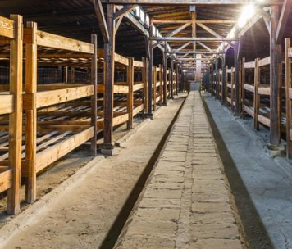
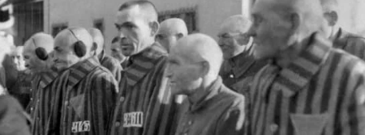
Visual Images
Notes:
Visual images are a powerful way to activate background knowledge, particularly when paired with questioning that engages students in thinking about the topic they will be reading about in the selected text.
For example, the images on this slide can be used to give students a visual understanding of what a Nazi concentration camp looked like, so that when they begin reading they have visual supports to “stick” descriptions to.
Questions that could be asked are:
What do you notice in these photographs?
How do these photographs help you understand what Nazi concentration camps were like?

Slide 30

Building Background Knowledge
Notes:
Once we have introduced a topic through activities that activate and assess students’ existing knowledge about a topic, we have information that helps define the critical instruction that must occur to build background knowledge students will need to set the stage for comprehension.

Slide 31
Building Background Knowledge
Multiple texts on a topic
Virtual or Real-time Experiences
Authentic Artifacts
Vocabulary connections
Notes:
Teachers can be targeted in their teaching to purposefully build students’ knowledge before, during, and after reading.
While it is important to note that it is possible to spend too much time building background knowledge, which not only wastes instructional time but also can potentially take away from a student’s ability to make critical connections on their own. So, it is important to focus on building enough knowledge on key content critical for understanding the text and support students as they read with additional details and support in making critical connections.
When focusing on building background knowledge about a topic, it is important to provide students with multiple texts on a topic, virtual or real time experiences and authentic artifacts to explore, and vocabulary connections that help students develop their schema.
We will discuss each of these areas in the slides to follow.

Slide 32
Multiple Texts on a Topic
Articles
The Holocaust – National WWII Museum New Orleans
Auschwitz Camp Complex – Holocaust Encyclopedia, USHMM
Additional texts (NF or F)
Night by Elie Weisel
Letters
Primary Sources
Treaties or legal documents
The Diary of Anne Frank
Newspaper articles from the time
Auschwitz by Laurence Rees
Notes:
Providing students the opportunity to read multiple texts on a topic is a powerful way to build background knowledge through reading. This can include articles and short stories, additional nonfiction or fiction texts that provide deepened exposure and multiple perspectives, and primary text sources related to the topic.
For example, if the main text for the unit of study was The Boy in the Striped Pyjamas, background knowledge on the topics critical to understanding the text deeply might include articles about the holocaust and its causes, or articles that describe and explain the creation and operation of Auschwitz. Primary sources such as personal letters, treaties or legal documents, or newspaper articles from the time develop knowledge that support understanding of the events and historical context described in the novel. Reading additional fiction or nonfiction texts related to the topic allow students to make connections and deepen schema while comparing and contrasting the experiences of the characters or real people and events portrayed in the texts.

Slide 33





Virtual or Real-Time Experiences
Guest speaker
News stories/related videos
Virtual tour (camps, museums)
Online scavenger hunt
Field trips
Notes:
Real-time or virtual experiences are an excellent way to build background knowledge outside of just reading about a topic. These experiences also provide an interactive and exploratory element that students often find engaging and impactful.
These experiences can include a real-time or virtual opportunity to listen to a guest speaker who has personal experience or academic knowledge about the topic they can share with students. For example, the Mizel Museum in Denver offers a guest speaker experience called “Eyewitness to History,” in which students can hear the real-life experience of a Holocaust survivor.
While it used to be impossible to experience a museum or historical site unless you were located nearby, the virtual world now allows for students to experience tours of these locations through online platforms. A virtual tour of Auschwitz is easily accessible through remember.org that allows visitors to experience the layout of the camp and what it might be like to walk through the grounds.
An online scavenger hunt, with targeted questions and specific sites or webpages for students to visit, can be an engaging way to help students gain specific knowledge while getting to know resources that can support their learning. The United States Holocaust Memorial Museum website has vast amounts of educational resources that are excellent for this purpose.
News articles and related videos can be helpful in not only learning about the topic, but making connections to current events in real time. Current events highlighting antisemitism can be explored by reading or watching news coverage and making connections with students. (For example, the House passed the Antisemitism Awareness Act in 2024).
Finally, when possible, field trips are not only a fun and refreshing way to explore a topic, but also provide an opportunity to students they may not ever get outside of school. The Mizel Museum in Denver provides exhibits and programs for students to learn more about the Holocaust through in-person museum visits.

Slide 34


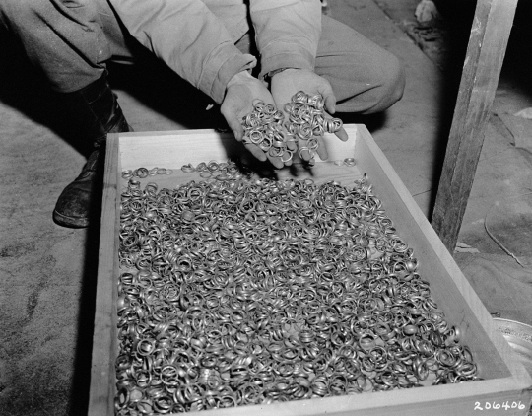
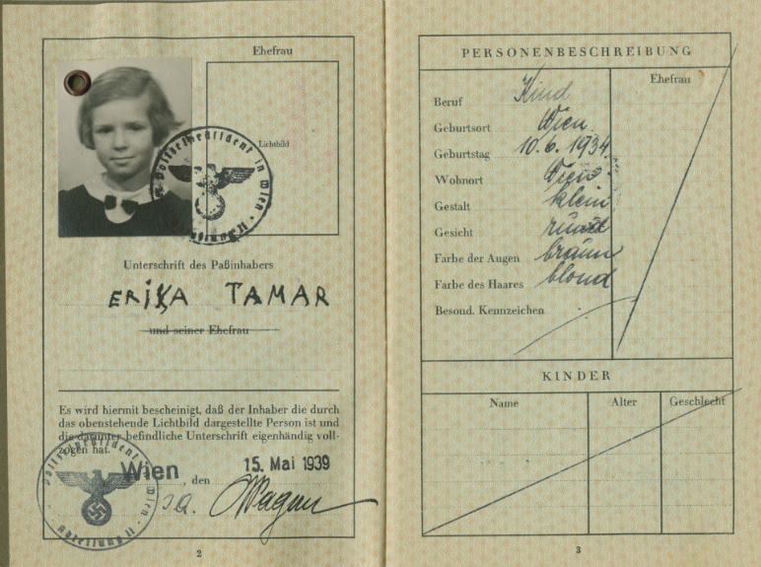
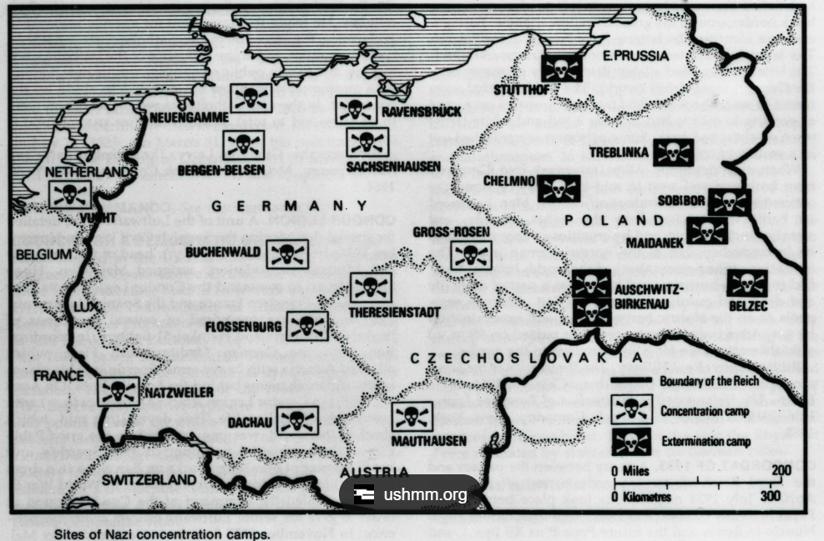
Authentic Artifacts
United States Holocaust Memorial Museum Collection, Gift of Steven Zabin
US Holocaust Memorial Museum, courtesy of National Archives and Records Administration, College Park
United State Holocaust Memorial Museum
US Holocaust Memorial Museum, courtesy of Liz Perle
United State Holocaust Memorial Museum
Notes:
Authentic artifacts can be a powerful way to make a topic, especially a historical or scientific topic, come to life and feel “real” to students. The examples shown here from the U.S. Holocaust Memorial Museum provide students with a glimpse into the time but also provides key visual support to “stick” to critical vocabulary. For example, the poster on the left of the slide can help students better understand what was being used as propaganda at the time, and the Star of David patch in the upper right corner provides a clear visual of how Jewish citizens were marked and segregated. Artifacts such as these can be powerful in helping students better understand content and make connections as they are reading complex text on a topic.

Slide 35


Vocabulary Connections
propaganda
persecution
racism
scapegoat
segregation
antisemitism
hatred
stereotypes
discrimination
boycott
exclusion
Notes:
Finally, supporting students in making connections between vocabulary words students have learned helps to strengthen comprehension and further develop the mental schema around a topic. In this example, students can be asked to make connections between each of these words and specifically how each relates to the overarching topic of antisemitism.
(CLICK to circle selected words)
Students can be asked to select two words and explain how they are connected. For example, after learning these words/concepts, a student might select the words “propaganda” and “stereotypes” (Connect and explain that propaganda used by the Nazis on posters and publications often emphasized negative stereotypes about Jews, which in turn encouraged antisemitic sentiments in the German public).

Slide 36
Connecting Background Knowledge to New Learning
Notes:
Finally, when teachers have a focus on building background knowledge about a topic to support text comprehension, it is important to connect that activated and developed knowledge to the new learning that occurs through the text itself.

Slide 37

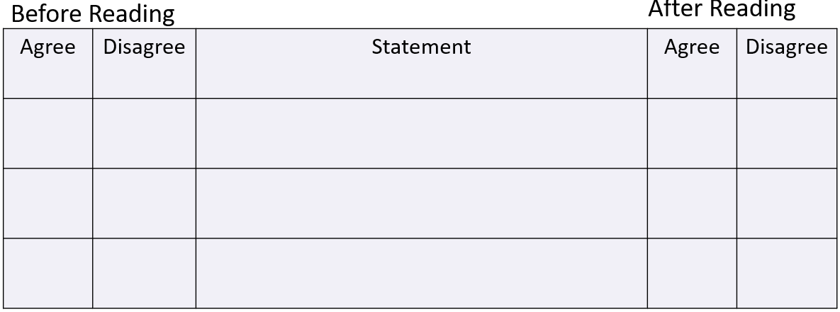
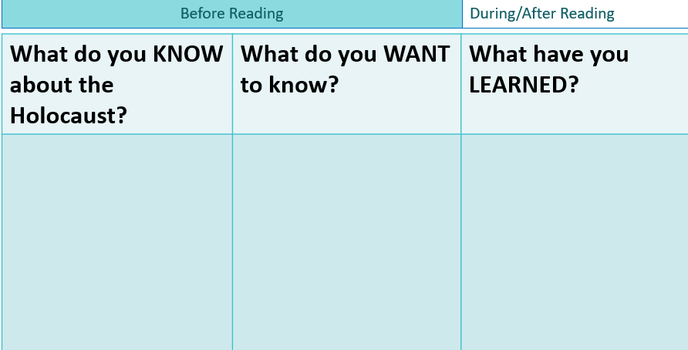
Anticipation Guides
Notes:
Connecting background knowledge to new learning requires that teachers take time to revisit anticipations guides, charts or webs and questions and prompts that were used to activate existing background knowledge and use them to make connections to the new learning students gleaned from the text. This allows teachers to intentionally support students in adding to their existing schema and helps them reflect on what they have learned and consolidate their knowledge.
For example, students can again be presented with the anticipation guide to reflect upon the same statements they were asked before reading the text(s). Did their answers change? Can they explain their thinking?
The KWL chart can also be revisited to add to the “Learned” column and also to see if their “want to know” questions were answered. They may also be able to reflect on what was originally listed in the “know” column to see if there are any misconceptions or misunderstandings that they have now revised after reading the text.

Slide 38
Questions or Prompts
What conditions in Germany made the Holocaust possible?
How did perpetrators and bystanders each contribute to the outcome of the Holocaust?
What current events in the world can you link to the types of behaviors, ideas, and movements that caused the Holocaust to occur?
Notes:
We know from research that questioning is a key strategy to support comprehension, and it is also an excellent way to activate student’s existing background knowledge about the content they will encounter in the selected text. Questions or prompts can be used for oral discussions or written response to activate existing knowledge and to gather information about what students already know and what they will need to know to comprehend the text.

Slide 39
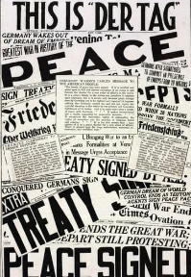

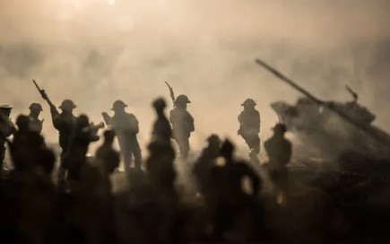
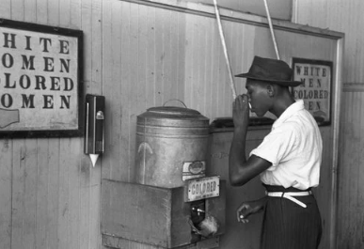



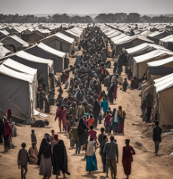

Application to other readings
Notes:
Supporting students to apply what they have learned to additional readings helps solidify their knowledge and be able to use and maintain the background knowledge they have built. A well-designed curriculum asks students to use what they have learned to better understand related content or events that align to the topic. In the example we are using, students could apply their understanding of Nazi concentration camps to make comparisons to the Japanese internment camps that were built in North America during the resulting war (WWII), how the events in Europe led to multiple nations getting involved, and the development of peace treaties and war tribunals followed.
Just as important, helping students apply their knowledge to other world events in which key concepts can be applied in a variety of contexts helps expand their understanding and build webs of connection that deepens their schema about interrelated topics. Finally, knowledge can be carefully connected to current events, news, and broadcasts that students read and watch to help them think critically about topics and events they encounter today.

Slide 40
Curriculum Check
Notes:
Now that we have explored the ways that background knowledge can be targeted in planning and instruction, it is time to take a thoughtful look at the current literacy curriculum to analyze how well background knowledge is addressed. Understanding where a curriculum has strengths and weaknesses is important for understanding what gaps must be filled to ensure background knowledge is addressed adequately.

Slide 41
What does our curriculum already do?
Is our curriculum structured so that students read multiple texts on a topic?
Are visual supports, artifacts or audio/video resources provided with the curriculum?
Are anticipation guides or visual organizers provided to support activating and connecting background knowledge?
Are activities or supports included that help to connect vocabulary important to understanding and expanding knowledge about key concepts in the text(s)?
Are cultural considerations that may impact background knowledge addressed within the curriculum?
Notes:
Take a few moments to look at your curricular resources, either hard copies you brought with you or through online access to your materials.
Think about each of these questions and identify areas that are fully addressed, somewhat addressed, or minimally addressed to support background knowledge.
Is our curriculum structured so that students read multiple texts on a topic?
Are visual supports, artifacts or audio/video resources provided with the curriculum?
Are anticipation guides or visual organizers provided to support activating and connecting background knowledge?
Are activities or supports included that help to connect vocabulary important to understanding and expanding knowledge about key concepts in the text(s)?
Are cultural considerations that may impact background knowledge addressed within the curriculum?

Slide 42
Planning for Instruction
What is necessary for understanding the critical topics and understandings represented in this text?
What did the author assume readers would bring to the text?
What are my students bringing to the text?
What are the connections students can make to other readings/content?
How will I activate or gain access to my students’ knowledge?
Given what my students know, what else might my students need to know?
How will I facilitate the building of necessary knowledge?
How will I prompt students’ integration of background knowledge with the text?
(Hennessy, 2021)
Notes:
Finally, here is a list of questions a teacher should consider when planning for instruction with a particular text. Regardless of how well the curriculum addresses background knowledge, these questions can help a teacher analyze what are the needs of the particular group of students who will be reading the text, and better prepare the teacher to deliver engaging and impactful instruction.

Slide 43
References
Adams, M (2015). Knowledge for literacy: Literacy ladders. Retrieved from https://www.shankerinstitute.org/resource/literacy-ladders
Boyne, J. (2007). The boy in the striped pajamas. Black Swan Books.
Cain, K., & Oakhill, J. (2007). Children’s comprehension problems in oral and written language: A cognitive perspective. New York, NY. Guildford Press. ​
Castles, A., Rastle, K., & Nation, K. (2018). Ending the reading wars: Reading acquisition from novice to expert. Psychological Science in the Public Interest, 19, 5–51.
Gough, P. B. & Tunmer, W.E. (1986). Decoding, reading, and reading disability. Remedial and Special Education, 7(1).
Hennessy, N. (2021). The reading comprehension blueprint: Helping students make meaning from text. Paul H. Brookes Publishing Co., Inc.
Kintsch, W., & Rawson, K.A. (2005). Comprehension. In M.J. Snowling & C. Hulme (Eds.), The science of reading: A handbook (pp. 209-226). Oxford, England: Blackwell.
Moats, L.C., & Hennessy, N. (2010). Digging for meaning: Teaching text comprehension (2nd Edition). Sopris West.
Oakhill, J., Cain, K., & Elbro, C. (2015). Understanding and teaching reading comprehension. Routledge.
Stanovich, K.E. (1986). Matthew effects in reading: Some consequences of individual differences in the acquisition of literacy. Reading Research Quarterly, 22, 360-407.

