Slide 1

READ Act Regional Meeting
Friday, September 12, 2025
Office of Elementary Literacy and School Readiness

Slide 2
Agenda
9:00 – 9:55 | READ Act Implementation Basics The Process of Determining Reading Risk Significant Reading Deficiency (SRD) Determination READ Plan Essentials
10:00 – 11:00 | Literacy Updates and Collaboration Regional Consultant Support Literacy Evaluation Tool SB25-200 Legislative Updates West Ed Report Breakout Rooms Parent Communication Professional Development Updates: Science of Reading Literacy Series Biliteracy Series New Series for Families Coming Soon!
Note: Both sections of today’s meeting will be held on the same Zoom link.

Slide 3

Objectives
Review READ Act implementation topics, including the assessment timeline, process for determining significant reading deficiency (SRD), and READ Plan essentials
Share literacy and legislation updates from CDE and the Office of Elementary Literacy and School Readiness
Collaborate and discuss READ Act implementation and parent communication with the support of CDE staff
Notes:
Today’s meeting objectives are to:
Share literacy and legislation updates from CDE and the Office of Elementary Literacy and School Readiness
Provide READ Act implementation reminders and READ plan guidance for the year ahead
Review READ Data collection requirements and overview of collection process
Collaborate and discuss READ Act implementation with the support of CDE staff

Slide 4


READ Act Implementation Basics

Slide 5

Colorado READ Act
The Colorado READ Act
Passed by the Colorado legislature in 2012
Focuses on early literacy development for all students in kindergarten through 3rd grade
Preventative in nature
  Scientifically and evidence-based reading instruction
  Assessment
  READ plans
  Parent communication monitoring
Ensure every student in Colorado reaches reading proficiency by the end of 3rd grade
Notes:
The Colorado Reading to Ensure Academic Development Act (READ Act), was passed by the Colorado legislature in 2012
The READ Act focuses on literacy development for kindergarten through third grade - especially for students at risk for not reading at grade level by the end of third grade.
The READ Act is preventative in nature:
The READ Act requires that all school districts ensure that students in K-3rd grade receive scientifically and evidence-based reading instruction
The READ Act requires teachers to assess the literacy development of K-3rd grade students in the areas of phonemic awareness; phonics; vocabulary development; and reading fluency, which includes mastery of oral skills and reading comprehension.
By assessing students early, teachers are able to identify students who struggle or may struggle with learning to read.
The READ Act also requires the development and implementation of individual intervention plans (READ Plans) for students who are identified as having a significant reading deficiency.
Parent communication is also a part of the READ Act. Under the READ Act, parents and school personnel should make decisions collaboratively throughout the READ Plan implementation process.
Again, the READ Act is about prevention.

Slide 6
Identify Risk and Instructional Needs | Development of a READ Plan
All K-3 students are tested at the beginning of the school year for Significant Reading Deficiencies (SRD).
All K-3 students are given an approved READ Act interim assessment at the beginning of each school year.
1
2
If the interim assessment data indicates a student is at-risk of having an SRD, a state approved READ Act diagnostic assessment is administered.
School personnel collect a body of evidence (interim assessment, diagnostic assessment, and other data from the classroom) to determine if the child has an SRD.
3
4
A READ plan that is specific to the child’s learning needs is developed with key stakeholders including teachers, other school personnel, and parents.
4
READ Plan implemented.
Notes:
This slide provides a brief overview of the process of determining reading risk as defined by the Colorado READ Act. (Animated)
School districts must administer an approved interim assessment to all kindergarten through third grade students at the beginning of the school year. The board approved interim assessment functions as a first alert to those students who may need additional support with literacy, and it is the first step in the process.
When interim assessments indicate a student is at-risk of having an SRD, a state-approved diagnostic assessment is then administered to pinpoint the student’s specific reading skill deficits. For some assessments, diagnostic reports are included in the interim assessment, and additional diagnostic assessments are not required. Please refer to your specific assessment and vendor if you have questions about your diagnostic assessment options.
Next, the Colorado READ Act requires a body of evidence in determining an SRD. Data from the interim assessment and the diagnostic assessment are included within the body of evidence.
Upon finding that a student has a significant reading deficiency, the school district ensures that a READ plan is developed for the student.

Slide 7
READ Interim Assessment Timeline
1st - 3rd grades:
Within 30 calendar days of enrollment
Kindergarten:
Within 90 days of first day of school, OR
Within 60 days of first day of school, to use interim data for literacy component of KSR plan
ELAT participating schools
Kindergarten students must be assessed within the first 60 days of school
READ Act Assessment Timeline
Notes:
CCR 3.02; 3.03; C.R.S. 22-7-1205(a.5)
ALL students in grades 1-3 must be assessed using an approved interim reading assessment within the first 30 calendar days of enrollment.
Kindergarten students must be assessed within the first 90 (calendar) days of school, or within the first 60 days if the data from the assessment will be used to inform the literacy component of the kindergarten school readiness plan. (Note: The kindergarten readiness plan is required for ALL kindergarten students)
Schools that participate in ELAT must assess kindergarten students within the first 60 days of school; this is a requirement of the project.
READ Act Assessment Timeline

Slide 8

A Plan for Assessment
Students who were SRD at EOY and students not SRD but continuing on READ plans – Assess first!
Students at or above grade level at EOY
– assess last.
Students below grade level but not SRD at EOY – assess next…
Notes:
Let’s consider a plan for assessment.
When considering your plan for assessment, it is important to assess students who were SRD at the end of the year and students not SRD but continuing READ plans first.
Then assess students below grade level but not SRD at the EOY
Assess students at or above grade level last.

Slide 9

Students Continuing on READ Plans
It is important to start the school year prepared to begin interventions aligned to their specific skill deficits as quickly as possible when the new school year begins.
The interim assessment administered within the first 30 days of school is used to:
Obtain the most recent data about student needs to inform the READ plan
Compare interim assessment data to previous data
Write strong goals and objectives
Ensure the appropriate interventions are in place
Diagnostic assessments may be used to gather additional information to inform the interventions, but for these students, there is no longer a 60-day window.
Notes:
It is important to start the school year prepared to begin interventions aligned to their specific skill deficits as quickly as possible when the new school year begins.
In this case, the interim assessment administered within the first 30 days of school is used not for screening for risk because we already know they are at risk, but to
obtain the most recent data about what the student needs to inform the READ plan
Compare interim assessment data to previous data
Write strong goals and objectives
Ensure the appropriate interventions are in place
Diagnostic assessments may be used to gather additional information to inform the interventions, but for these students, there is no longer a 60-day window.

Slide 10
Assessment Considerations
READ Act Approved
INTERIM ASSESSMENT
The READ Act details requirements for assessing English Learners, including the option to determine whether a student is assessed in Spanish or English.
Alternate approved assessment pathways are also outlined for students with disabilities.
READ Act Approved DIAGNOSTIC ASSESSMENT
Collection of a
BODY of EVIDENCE
Notes:
The READ Act includes detailed requirements for assessing English Learners, including the option to determine whether a student is assessed in Spanish or English. We’ll talk a little bit more about this on the next slide.
Additional assessment pathways are detailed in the READ Act for students with disabilities. Local Education Providers are given three pathways to choose from in order to select the most appropriate interim screener for their exceptional students to ensure accessibility and valid, reliable results.
Drop link in chat: https://www.cde.state.co.us/coloradoliteracy/readanddisabilities

Slide 11



Assessing English Learners
The Local Education provider has the authority to determine:
The language of assessment for K-3 students whose home language is Spanish and who have not yet reached partial proficiency in English.
The level of English proficiency at which the student demonstrates partial proficiency or higher in English and must take at least one of the state board-approved interim reading assessments in English.
Students who receive instruction in both English and Spanish may take the approved interim reading assessment in Spanish to determine whether the student has a significant reading deficiency. An assessment in English must be administered at least annually.
Notes:
As we mentioned in the previous slide, the local education provider has the authority to determine the language of assessment for a student who is an English learner. A student whose home language is Spanish and who has not yet reached partial proficiency in English may take the approved interim assessment in Spanish.
The LEP also has the authority to determine the level of English proficiency at which the student demonstrates partial proficiency or higher in English and must take at least one of the state board-approved interim reading assessments in English.
For students in a Dual Language Immersion Program, students who receive instruction in both English and Spanish may take the approved interim reading assessment in Spanish to determine whether the student has a significant reading deficiency. An assessment in English must be administered at least annually.

Slide 12

Significant Reading Deficiency (SRD)
The Colorado READ Act states that a significant reading deficiency (SRD) is determined when a student does not meet the minimum skill levels for reading competency in the areas of phonemic awareness, phonics, vocabulary development, reading fluency, including oral skills, and reading comprehension established by the state board for the student’s grade level.
(C.R.S. 22-7-1203)
Notes:
The Colorado READ Act states that a significant reading deficiency is determined when a student does not meet the minimum skill levels for reading competency in the areas of phonemic awareness, phonics, vocabulary development, reading fluency, including oral skills, and reading comprehension established by the state board for the student’s grade level.
Determination of an SRD is based on a state board-approved interim assessment score, results from a state board-approved diagnostic assessment, and additional data collected to form a body of evidence.
Data collected throughout the determination process is used to drive instructional decision-making that best supports the instructional needs of students, regardless of whether they are determined to have a significant reading deficiency.
Next, we will provide a high-level overview of the process of screening students for risk of significant reading deficiency.

Slide 13
1. Significant Reading Deficiency (SRD) Determination
READ Act Approved
INTERIM ASSESSMENT
READ Act Approved DIAGNOSTIC ASSESSMENT
Collection of a
BODY of EVIDENCE
Universal screener administered to all students
Administered within the first 30 calendar days for grades 1-3
Administered within the first 90 calendar days for kindergartners
If administered within the first 60 days for kindergartners, the LEP is not required to administer the literacy component of the school readiness assessment.
Notes:
Let’s review the process of determining an SRD, including the testing windows for each step in the process.
The interim assessment is a universal screener used to identify students who may be at risk for reading challenges within the timelines we covered on the previous slide, also listed again here. Data from the interim assessment is used to identify any student who is at risk for reading difficulties while concurrently informing reading instruction for each learner.
Grade-level cut scores are defined by the state board approved interim assessments. For students’ whose score on the interim assessment falls below the cut score indicating a possible significant reading deficiency, the next step is to administer an approved diagnostic assessment.

Slide 14
2. Significant Reading Deficiency (SRD) Determination
READ Act Approved
INTERIM ASSESSMENT
READ Act Approved DIAGNOSTIC ASSESSMENT
Collection of a
BODY of EVIDENCE
Administer the diagnostic assessment within 60 calendar days from when the interim assessment was administered
During the 60-day window, the LEP ensures students are receiving scientifically based and evidence-based core instruction and intervention
Used to pinpoint the specific skill deficiencies within phonemic awareness, phonics, vocabulary development, reading fluency including oral skills and reading comprehension.
Notes:
Diagnostic assessments are administered to students who score below the cut-score for a significant reading deficiency on the interim assessment within 60 calendars days from when the interim assessment was given. As previously stated, some assessments include diagnostic reports as part of the interim assessment, and additional diagnostic assessments are not required. Please refer to your specific assessment and vendor if you have questions about your diagnostic assessment options.
During the 60-day window, the LEP is responsible for ensuring students are receiving scientifically based and evidence-based core instruction and intervention.
The diagnostic is used to pinpoint at minimum, the specific skill deficiencies within phonemic awareness, phonics, vocabulary development, reading fluency including oral skills and reading comprehension the student is struggling with. These results inform the larger body of evidence used to determine if the student has a significant reading deficiency.

Slide 15
3. Significant Reading Deficiency (SRD) Determination
READ Act Approved
INTERIM ASSESSMENT
READ Act Approved DIAGNOSTIC ASSESSMENT
Collection of a
BODY of EVIDENCE
Used to determine if a student has a Significant Reading Deficiency (SRD)
Includes information from the interim and diagnostic assessments
May include additional information such as classroom work, other assessments, English language proficiency
Concurrently used to inform the READ plan and instruction
Notes:
A body of evidence is used to determine if a student is at significant risk for reading deficiency. This collection of information includes scores from the interim and diagnostic assessments and may include classroom work and additional assessments that measure the students’ literacy skills and English proficiency. If a student is determined to have an SRD, a READ Plan is developed and implemented.
It is critical to note that scientifically based and evidence-based reading instruction is being delivered to all students immediately, layered by the process of determining significant reading deficiencies and informed by data that is concurrently collected.
This includes universal instruction and any additional targeted, intensive intervention that focuses on reading competency in the five components of reading and oral language skills. Instruction and/or intervention should also address any needs unique to the learner, such as oral language support for English Language Learners.

Slide 16
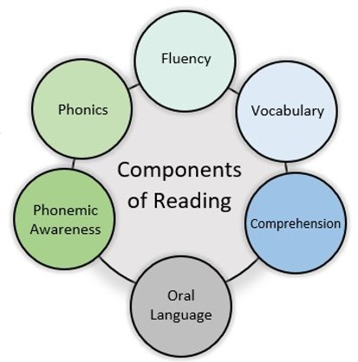
Body of Evidence
The Colorado READ Act defines a body of evidence as a collection of information about a student’s academic performance which, when considered in its entirety, documents the level of a student’s academic performance. A body of evidence, at a minimum, shall include scores on formative or interim assessments and work that a student independently produces in a classroom, including but not limited to the school readiness assessments adopted pursuant to section 22-7-1004(2)(a), C.R.S. A body of evidence may include scores on summative assessments if a local education provider decides that summative assessments are appropriate and useful in measuring students’ literacy skills (C.R.S. 22-7-1203).​
Considers all components of reading plus oral language​
Includes the interim assessment and diagnostic assessment
Forms a complete picture of students’ literacy skills to support instruction and document progress toward reading competency
http://www.cde.state.co.us/coloradoliteracy/readactstatuteandstateboardrules​
Notes:
A key component in determining a significant reading deficiency or SRD is the body of evidence. While sometimes overlooked in the process, it is important to note that the READ Act requires a body of evidence as the final piece in determining an SRD.
When diagnostic assessments indicate a skill deficit, multiple data points for that skill and/or associated skills should be compiled within the body of evidence. Additional qualitative and quantitative data in the body of evidence may include but are not limited to school readiness assessments, summative assessments, observations, and samples of classroom work. Information about students’ language proficiency, family history, and other factors that influence academic performance may also be gathered. If the interim and diagnostic assessments are combined, it may be particularly beneficial for LEPs to utilize the body of evidence in order to identify specific student skill strengths and deficits for instruction.
A complete body of evidence for students’ literacy skills may include formal and informal data and should include all components of reading plus oral language. When selecting materials to include in the body of evidence, teachers should ensure the data accurately measures the skills and areas of need identified in the interim and diagnostic assessments.

Slide 17

A Body of Evidence Includes:
Approved interim and diagnostic assessments
Informal and formal assessment information
Qualitative and quantitative data
Language proficiency data and home language assessment data
Any information about factors that influence academic performance
Data that addresses all components of literacy plus oral language
Notes:
A complete body of evidence for students’ literacy skills includes multiple data points and sources of information.
This includes interim and diagnostic assessments, informal and formal assessment information, qualitative and quantitative data, language proficiency data, and home language assessment data.
Information about other factors that influence academic performance should also be included.
A complete body of evidence documents students’ literacy skills and informs instructional needs by addressing all components of literacy and oral language.

Slide 18

Purpose of a READ Plan
Identify specific reading skill deficits (or challenges) and create a plan of action
Document services being provided
Monitor progress toward targeted goals
A student remains on a READ plan until achieving grade-level competency in reading.
Notes:
The purpose of a READ plan is to:
Identify specific reading skill deficits (or challenges) and create a plan of action.
READ plans also document services being provided
And should serve as a documentation of:
the data that supports the student’s reading progress,
the services that the student is receiving
who is providing the instruction the student is receiving
A READ Plan is also designed to monitor a student’s progress toward targeted goals and determine how well the services are supporting the student throughout the year.
A student remains on a READ plan until achieving grade-level competency in reading (CRS 22-7-1206(6)).
A READ Plan is created as soon as possible after a student is confirmed as having a Significant Reading Deficiency.​​

Slide 19
A Tool for Success!
Early Identification
Intentional Planning
Family and School Engagement
Timely assessments and data analysis support the identification of risk factors and create opportunities for intervention and prevention.
Differentiated learning that considers the developmental and academic needs of each child as a prevention strategy.
School Success
Families engaged in the process to build collaboration, communication and support for students.
Documentation of student data, supports, and outcomes creates opportunities for collaboration between a child’s teachers over time.
Notes:
The READ plan is a tool for success.
By identifying a student at risk for reading difficulty early in the process, we can provide support that will close the gap quickly instead of using a wait-to-fail model.
Furthermore, READ plans can also provide a way to intentionally plan for family and school engagement in order for students to be more successful in school.
Early Identification – Timely assessments and data analysis support the identification of risk factors and create opportunities for intervention and prevention.
Intentional Planning – Differentiated learning that considers the developmental and academic needs of each child as a prevention strategy.
Family and School Engagement – Families engaged in the process to build collaboration, communication and support for students.
School Success – Documentation of student data, supports, and outcomes creates opportunities for collaboration between a child’s teachers over time.

Slide 20

A Strong READ Plan is a “Living Document”
The READ plan should be updated as services and data change to reflect the needs of the student and the supports the student is receiving.
READ plans should serve as a documentation of:
Data that supports the student’s reading progress
Services that the student is receiving
Who is providing the instruction and support
How well those services are supporting the student throughout the year
Notes:
A strong READ plan is a “living” document.
This means that the READ plan should be updated as services and data change to reflect the needs of the student and the supports the student is receiving.
READ plans should serve as a documentation of:
the data that supports the student’s reading progress,
the services that the student is receiving
Who is providing the instruction and support the student is receiving, and
how well those services are supporting the student throughout the year
A plan is not written at the beginning of the year and put away. It is used to guide instruction and determine when adjustments are needed, and successes are celebrated.

Slide 21

Who develops the READ plan?
A teacher or other skilled school professional that the local education provider may choose to select
Parent or guardian
Additional support staff if needed (e.g., ELL teachers, mental health provider, etc.)
Notes:
A READ Plan is created as soon as a student is confirmed as having a Significant Reading Deficiency.
A teacher, or other skilled school professional that the local education provider selects, is responsible for developing the READ Plan in collaboration with the student’s parents/guardians, if possible.
A READ plan is intended to be a collaborative effort between school professionals and the student’s parent(s) or guardians, so every effort needs to be made to have them involved.
Additional support staff may also attend if needed, such as an English Language Learner teacher or mental health providers.

Slide 22
Required Components
Each READ plan must include, at a minimum:
The student’s specific, diagnosed reading skill deficiencies
Goals and objectives for the student’s targeted growth
The type(s) of additional instructional services and interventions the student will receive in reading
The scientifically and evidence-based reading instructional programming the teacher will use for reading instruction and interventions
How the child’s progress will be monitored and evaluated
Strategies parents are encouraged to use to assist
Any additional services the teacher deems available and appropriate to accelerate the student’s reading skill development
Notes:
The READ Act includes several elements that must be included in a READ plan.
Each READ plan must include, at a minimum:
The student’s specific, diagnosed reading skill deficiencies that need to be remediated in order for the student to attain reading competency;
The goals and objectives for student growth in attaining reading competency;
The type of additional instructional services and interventions the student will receive in reading. At a minimum, the local education provider shall ensure the student receives educational services in a daily literacy block for the length of time identified as effective in research relating to best practices in teaching reading.
The scientifically based or evidence-based reading instructional programming the teacher will use to provide daily reading approaches, strategies, interventions, and instruction, which programs at a minimum shall address the areas of phonemic awareness, phonics, vocabulary development, reading fluency, including oral skills, and reading comprehension.
How the student’s progress will be evaluated and monitored;
The strategies parents are encouraged to use that are designed to supplement the programming
Any additional services the teacher deems available and appropriate to accelerate the student’s reading skill development
22-7-1206 (5) a-g
READ plans are specific to each student. The READ Act details additional components to include in READ Plans for English Language learners. The READ Act also includes additional READ Plan considerations for students who may have an Individualized Educational Plan.
READ Plan CHECKLIST link: http://www.cde.state.co.us/coloradoliteracy/readplanchecklist

Slide 23
READ Plan Process
1. Identify specific skill deficits
2. Write goals and objectives
3. Match intervention to skill deficits; implement with fidelity
4. Select and administer progress monitoring assessment
6. Determine effectiveness of instruction; adjust as needed
5. Analyze PM data
These should directly address the specific skill deficits
This should happen at regular intervals (e.g., every 6 weeks)
Notes:
The graphic shown on the slide represents what the READ Plan Process would look like:
When a student is identified as having an SRD, a READ plan will be put in place:
Identify specific skill deficits
Write goals and objectives
Match intervention to skill deficits; implement with fidelity
Select and administer progress monitoring assessment
Analyze progress monitoring data
Determine effectiveness of instruction; adjust as needed
Ongoing, regular updates to parents occur throughout the READ Plan process

Slide 24

Considerations for Students with Disabilities
May be identified as having an SRD
Could have a READ plan in addition to an Individualized Education Plan (IEP)
District decision on how these two plans work together to best support a child
Notes:
There are also considerations for student with disabilities
A child with a disability may be identified as having an SRD
And could have a READ plan in addition to an Individualized Education Program, or IEP (CRS 22-7-1206(3)).
It is a district decision on how these how these two plans work together to best support a child (CRS 22-7-1206(3); https://www.cde.state.co.us/cdesped/idea_colorados_read_act_guidance).
Note that not all students with a disability who have a significant reading deficiency will have an IEP and that these determinations are also made at the local level and are unique to the learner.

Slide 25

Considerations for Multilingual Learners
The READ Plan Should Include:
Reading goals and selected interventions should be developed with a student's English language proficiency level in mind
The necessary instructional scaffolds to ensure language considerations are addressed while providing the intervention
Information about a student’s home language literacy skills, if available, to help inform instruction
Notes:
When writing a READ Plan for an English Learner, the process for analyzing data, determining specific skill deficits, and writing goals and objectives is the same.
However, it is also important that the READ plan incorporates information about the student’s English language development.
When creating a READ plan for an English Learner:
The READ plan should include
Reading goals that address the student's specific skill deficits while taking into account the student's English language proficiency level.
Any interventions included in a READ plan for English Learners must be appropriately scaffolded to address English language development needs and
should incorporate a student’s home language literacy knowledge whenever possible.
Following these principles, schools can develop READ Plans that reflect the unique strengths and needs of English Learners to set them on a trajectory toward proficiency in both literacy and English language development.

Slide 26
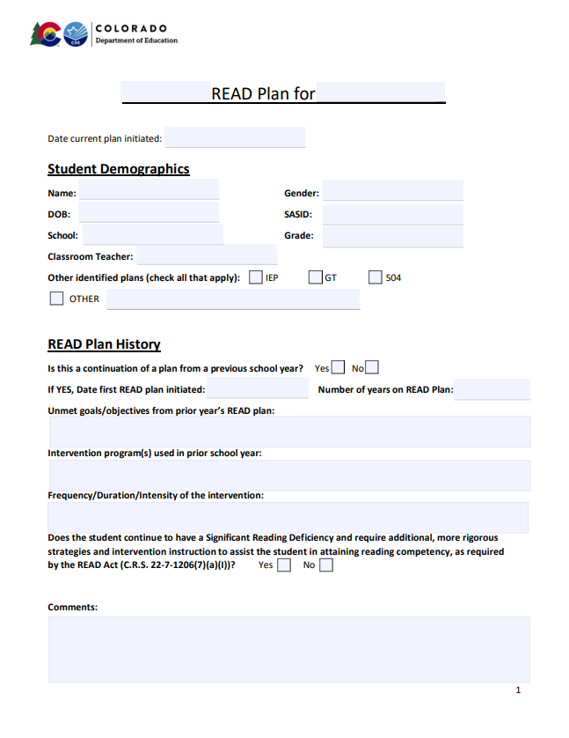
READ Plan Templates
READ Plan Template https://www.cde.state.co.us/coloradoliteracy/readplanexample
Multilingual Learners READ Plan Template:
https://www.cde.state.co.us/coloradoliteracy/mlreadplantemplate
Notes:
Last summer, our office completed a revision of the READ plan templates posted on our website to provide districts with an updated model to guide the way READ plans are written, revised, and implemented across the state. Understanding the need to differentiate documentation for diverse needs, a new template specifically designed for multilingual learners was developed as well.
Both templates are in PDF format and available to download on our website at the links provided here (and are also linked to the agenda you received this week).
We will be referring to these templates in upcoming slides as we go over each section of the new format and connect it to READ Act requirements and guidance for implementation that helps to explain how each section is formatted to ensure a well-written READ plan is a living document and reflects the key information about a student’s pathway and progress over time.

Slide 27
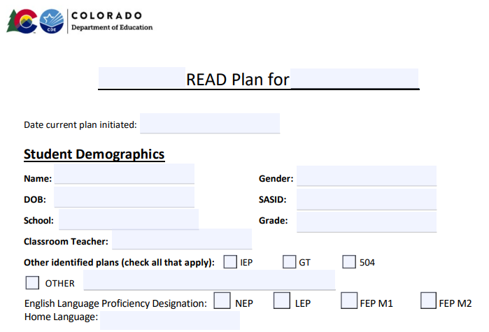
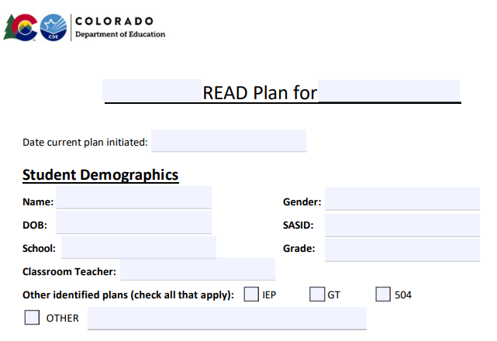
Student Demographics
Notes:
The student demographic section on both templates includes basic demographic information as well as a place to indicate whether a child has additional educational plans.
One change is clearer wording and a prominent location for the date the current plan is initiated, which differentiates it from previous versions of the READ plan a student may have.
The READ plan template for MLs includes additions specific to the needs of multilingual learners who also need intensive reading support.
While the template is formatted similarly to the general READ plan template, there are a few differences to note.
In the student demographic section, there is a place to document a student’s home language as well as their English Language Proficiency designation.

Slide 28
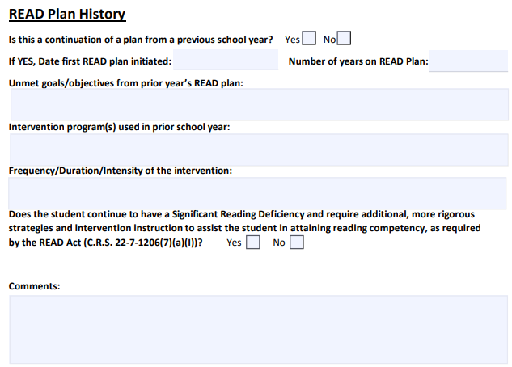
READ Plan History
Notes:
The READ plan history section is a new addition to the template. This section provides a place to record whether the READ plan is being continued from a prior school year.
If a plan is being continued, there is a place to document when the READ plan was first initiated and the number of years the student has been on a READ plan.
The additional information in this section is intended to help the teacher who is updating the plan revisit the prior year’s plan to determine what goals were unmet previously, what intervention program was used, and what was the frequency, duration, and intensity of the previously implemented intervention.
Recording this information in the current READ plan allows more direct transfer of information from year to year and provides information to the current teacher to make thoughtful decisions about how a plan is intensified for a student who continues to have an SRD from one year to the next.

Slide 29
READ Plans | Second or Subsequent School Year
The teacher must revise the READ plan to include additional, more rigorous strategies and interventions, including increased daily reading instruction.
The principal ensures that the student receives reading instruction supported through the other subjects during the school day.
The student receives reading instruction from a teacher who is identified as effective or highly effective and has expertise in teaching reading.
With the approval of the child’s parent the school may provide mental health support
Notes:
​When a student continues on a READ plan for a second or subsequent consecutive school year, the school or district ensures that in the next school year (CRS 22-7-1206(7)(a)):
The student’s teacher must revise the READ plan to include additional, more rigorous strategies and interventions, including increased daily time in school for reading instruction (CRS 22-7-1206(I).
There are different ways educators can ensure a student receives more rigorous strategies and interventions: (READ Plans from Year to Year https://www.cde.state.co.us/node/67190/)
Increase the amount of intervention time and/or frequency the student receives
Decrease the number of students for a smaller instructional group
Adjust the time of day for instruction that best fits the student’s needs
Use specialty programs that are scientifically based and evidence-based from the CDE approved list of programming
Increase progress monitoring frequency to pinpoint and drive effective targeted instruction
The principal of the school in which the student is enrolled ensures that the student receives reading instruction in conjunction with and supported through the other subjects in which the student receives instruction during the school day (CRS 22-7-1206(II));
And, if possible, the student receives reading instruction from a teacher who is identified as effective or highly effective in their most recent performance evaluation and has expertise in teaching reading (CRS 22-7-1206(III)).
In addition, with the approval of the student's parent, the local education provider (or school) may provide to the student mental health support from the school psychologist, school social worker, or school counselor (CRS 22-7-1206(7)(b)).

Slide 30
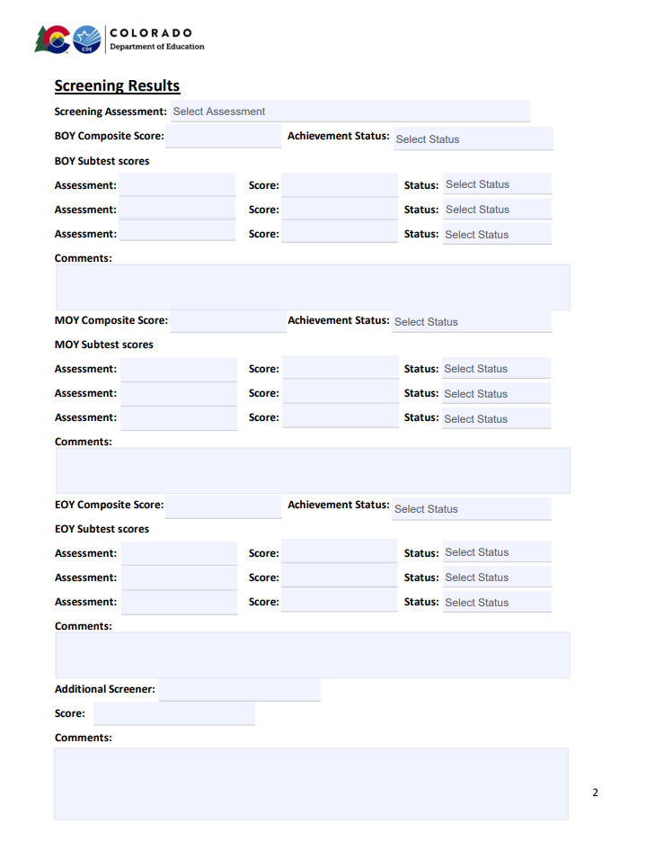
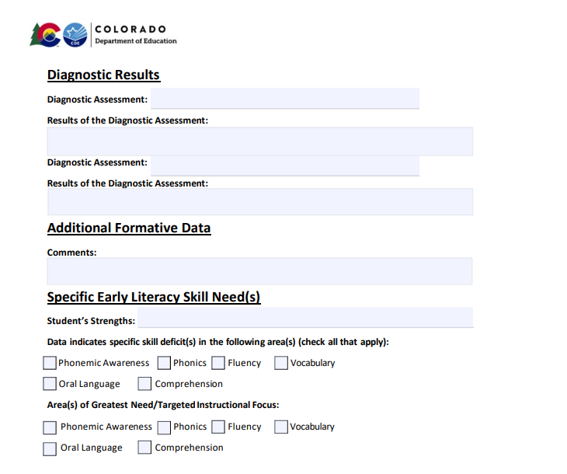

Assessment Results
Notes:
The READ plan contains a section for recording student assessment data and identifying specific skills deficits that should be targeted through instruction.
The updates to this section include the ability to record data throughout the year, at BOY, MOY, and EOY, as well as to record specific subtest scores at each benchmark window.
A drop-down menu also allows the teacher to record the status of each benchmark assessment and each subtest. (Well below, below, at/above).
This helps provide a clearer picture over time of student assessment data and performance, rather than having to interpret solely numerical scores or composite scores only.
There is also a separate location to record the diagnostic assessment and results of the assessment in narrative form.

Slide 31
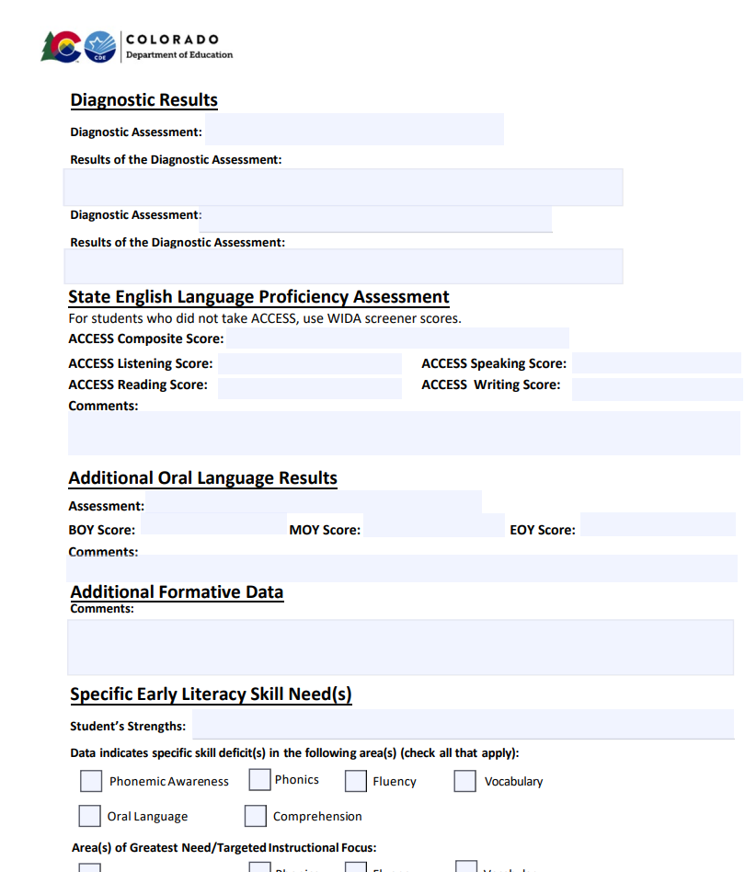
READ Plan Additions for Multilingual Learners
Notes:
In the assessment section, there is a more complete section for recording a student’s ACCESS scores, including subtest scores, as well as a place to record additional oral language results and additional formative data.

Slide 32
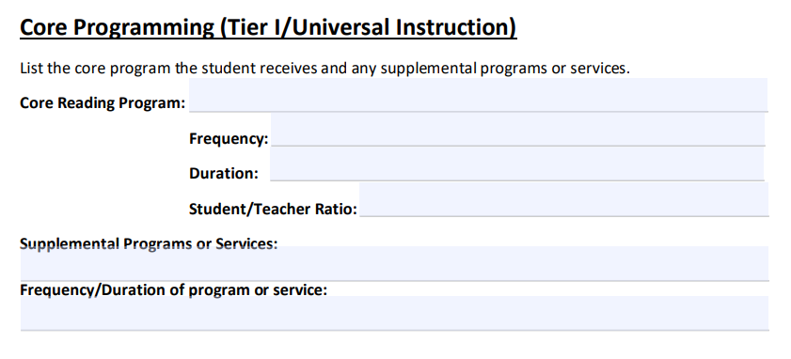
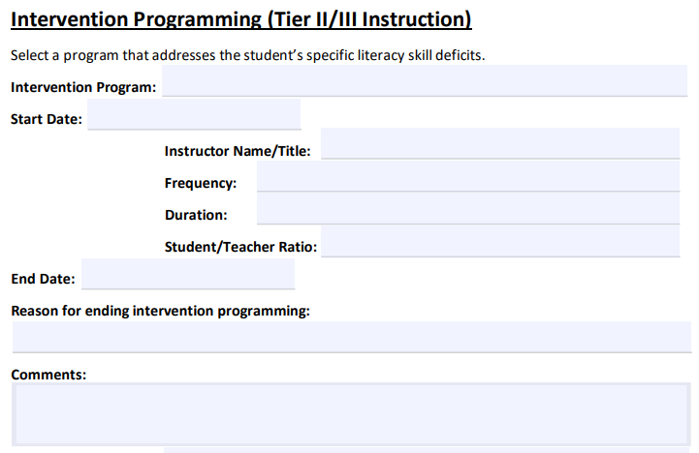
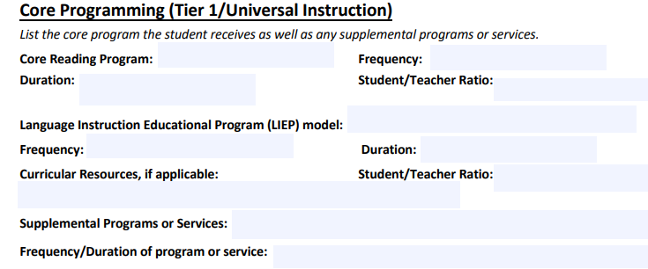
Instruction and Programming
Notes:
The next section of the revised READ plan template addresses instruction and programming. Updates to this section include spaces to record the frequency, duration, and student/teacher ratio for both core and intervention programming the student receives. The intervention section was expanded to include start and end dates for intervention programs, knowing that in some cases a student may either complete a program or require a shift to a different intervention within the school year. This also allows teachers to record reasoning for ending an intervention and an additional space for comments about the intervention program and the student’s response to it.
On the multilingual learner template, there is space to record a student’s Language Instructional Education Program model, including the frequency, duration and student/teacher ratio, as well as curricular resources used.

Slide 33
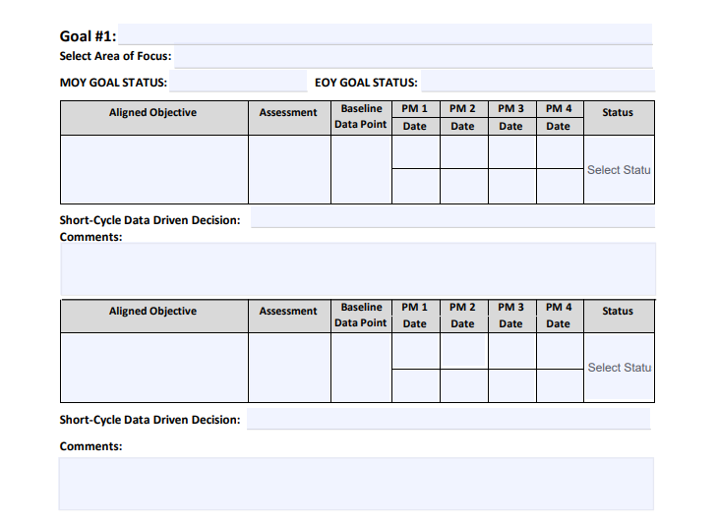
READ Plan Goal(s), Objectives, & Progress Monitoring
Goals should clearly identify the skill being targeted, the time frame for achieving the goal, and the assessment used to measure it.
Goals should be specific, ambitious yet attainable, realistic, and timely.
Consider referencing the CDE minimum competencies standards and Colorado Academic Standards when creating goals.
List the goals in order of priority and align objectives for progress monitoring to the outlined goals
Notes:
This section includes within the template a bulleted list of helpful tips to support with better goal writing and identifying targeted objectives. This section was streamlined to include up to three long term goals and spaces for three short-term objectives under each goal.
Each goal includes a line to record the area of focus (e.g. phonemic awareness, phonics) and spaces to record a students’ status towards the goal at MOY and EOY.
The table for each objective provides cells to record the assessment used for progress monitoring, cells to record progress monitoring data over several assessment windows, and a drop-down menu to record whether additional support is needed, whether the student is making progress and should continue with the objective, or whether the objective has been met.
An open line is provided for teachers to determine a short-cycle data driven decision.
In order to use this section in the way it is intended, it is important to focus on strong goals and objectives from the start.

Slide 34
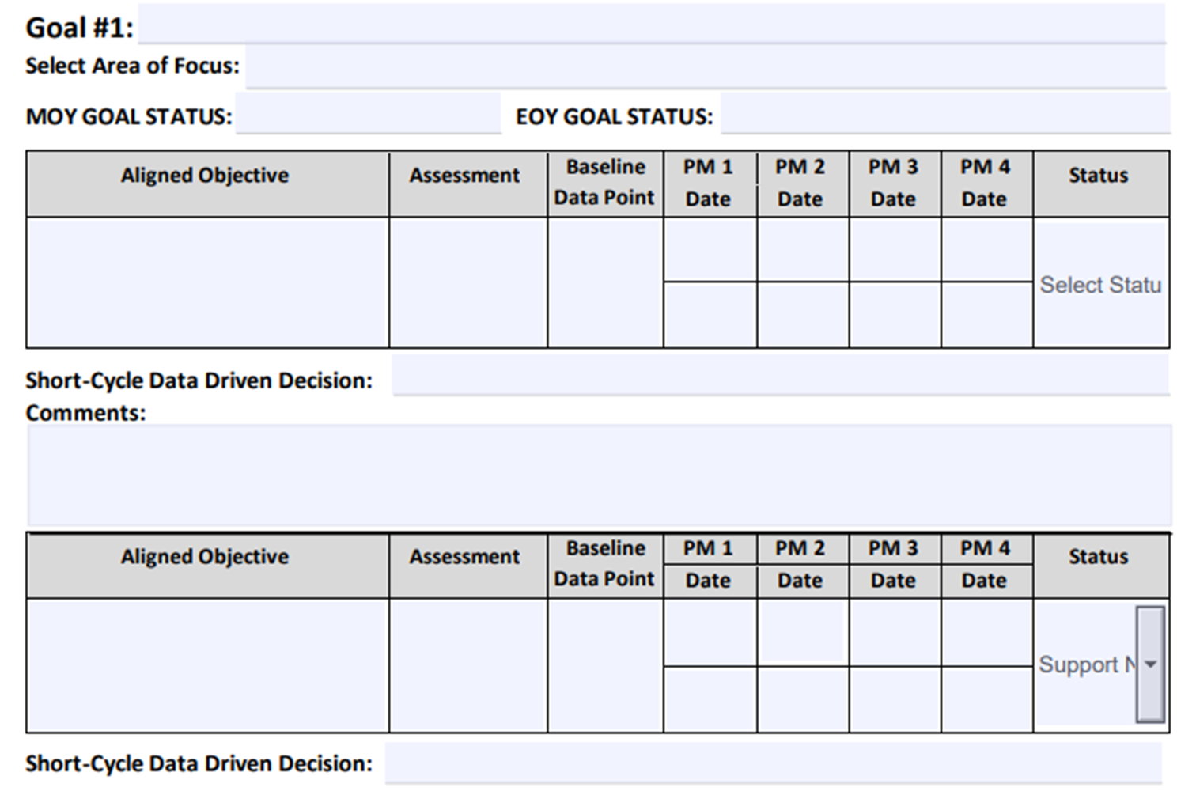
Goals and Objectives Example
By EOY, Sam will read 35 nonsense words per minute on the DIBELS 8 NWF assessment.
phonics
Identify all letter sound correspondences with 100% accuracy.
Identify each letter sound in a CVC word accurately.
Notes:
This is just an example of how the goal and its corresponding objectives would appear in the format provided by the updated template.

Slide 35
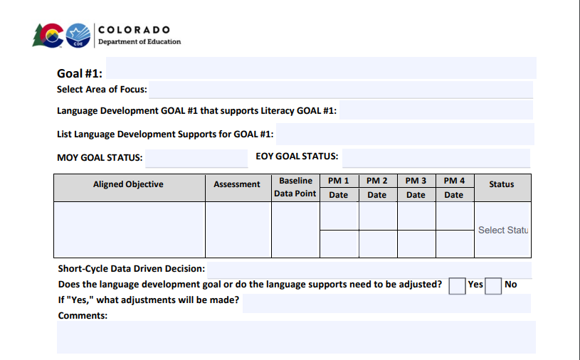
Goals Section of ML Template
Notes:
The goals section of the template is customized as well, providing a section for a language development goal that supports the literacy goal, as well as for listing language development supports for the goal. Language development goals are also tied to the decision-making process for determining next steps throughout the year.

Slide 36
Language Development Supports
• Include “wait time” so that students can process information.
• Incorporate gestures and use visual supports.
• Use recasting to model and expand language.
• Develop oral language throughout all content areas.
• Incorporate language objectives to give students access to the content.
• Plan collaborative talk structures (e.g., Think-Pair-Share).
• Use graphic organizers.
• Provide differentiated sentence frames.
• Make direct cross-linguistic connections.
• Provide multiple opportunities for practice and accurate repetition.
• Adjust the rate of speech and complexity of language to meet the needs of the learners.
• Activate and build upon prior knowledge.
• Break down multi-step directions or tasks.
• Dedicate time for verbal reasoning/rehearsal.
• Incorporate translanguaging.
Notes:
When planning for intervention instruction for multilingual students, it is important that teachers carefully consider the types of language development supports students will need in order for the intervention to be effective in remediating their reading skill deficits as well as support their language development goals.
The new Multilingual Learner READ Plan template includes suggested instructional supports for language development to help teachers identify the right supports for their students.
These support options include: (Read bulleted list)

Slide 37
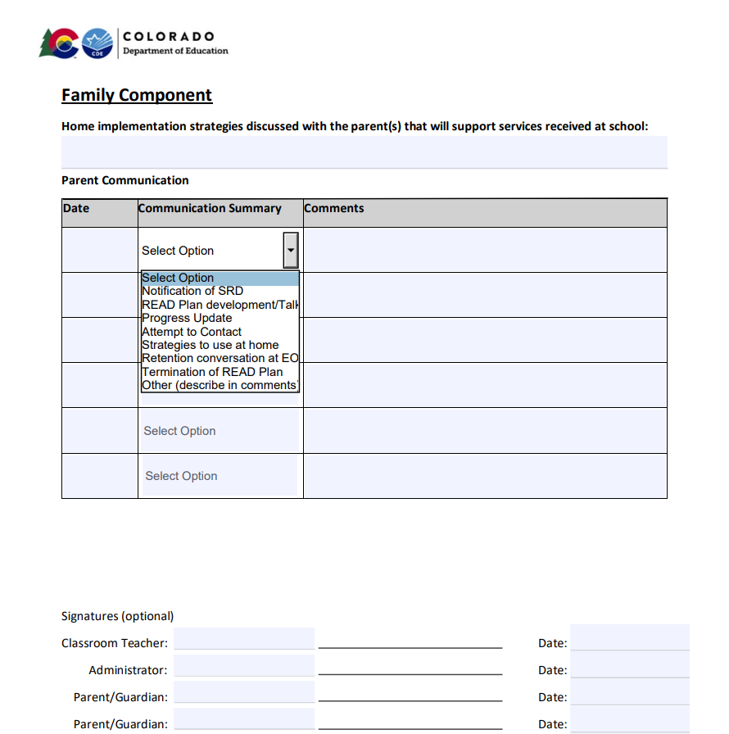
Family Component
Template includes dropdown menus to document various and ongoing communication with families
Notes:
The READ Plan template also has some new additions for documenting communication with families. In addition to fields for the date and comments, there is now a dropdown menu for the communication survey including the following options: notification of SRD, READ plan development/talk, progress update, attempt to contact, strategies to use at home, retention conversation at EOY, termination of READ Plan, or other.

Slide 38
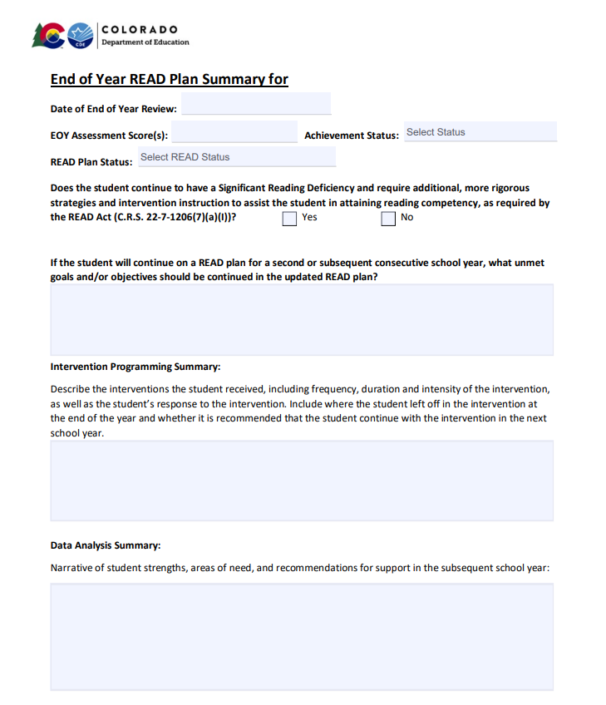
End of Year READ Plan Summary
Notes:
The final section of the READ Plan template is the End of Year Summary. This section includes EOY assessment results and READ Plan status, SRD status, explanation of unmet goals, intervention programming summary, and a data analysis summary.
Once the READ plan template has been in place through a school year, with the READ plan history at the beginning and the End of Year summary at the end, these sections will provide the information needed to transfer a plan from one year to the next for a student who continues on a READ plan into a second year, OR can provide key information to the next year’s teacher to support a student from the start who is no longer on a READ plan so that they don’t regress in the next school year.

Slide 39

Ideal READ Plan Pathway by EOY
Updates have occurred regularly
Includes adjustments or changes to the intervention
Includes progress towards objectives and/or goals
Progress monitoring data is well documented
Ideally, also includes HOW the intervention was implemented, including:
  FREQUENCY
  DURATION
  INTENSITY
  GROUP SIZE
Notes:
By the time we get to the end of the school year in which a child has been identified with an SRD and placed on a READ plan, ideally, we have used the steps in the READ plan process through several cycles and have updated the plan regularly.
This means the documentation should include clear descriptions of the intervention programming the student has received and when that has been changed or adjusted. It should also include progress toward identified objectives and when those objectives are met, development of new objectives when needed, and an indication of any goals met along the way. Documentation of assessment data should be clearly listed as evidence of progress.
Ideally, the READ plan should also include information on HOW the intervention was implemented, such as frequency, duration, intensity, and group size.
This allows teachers to pull “instructional levers” to adjust instruction if a student is not responding well to an intervention.

Slide 40
Exiting a READ Plan
Schools monitor the ongoing reading progress, collecting a body of evidence.
A body of evidence demonstrates the student has achieved grade level competency in reading and parents are notified.
The READ plan is updated and exit date is recorded. READ plan is no longer active.
Notes:
Finally, let’s briefly review the process for students to exit a READ plan.
Each district shall ensure that a teacher continues to revise and implement a student’s READ plan until the student attains reading competency, regardless of the student’s grade level (22-7-1206(6)).
Schools monitor the ongoing reading progress of the students determined to have an SRD through progress monitoring and collecting a body of evidence.
A body of evidence demonstrates the student has achieved the Minimum Reading Competency Skills and is demonstrating grade level competency in reading and parents are notified.
In alignment with the requirements of the READ Act, schools should:
Document the assessment scores and the body of evidence that supports the student has demonstrated grade level reading competency.
Ensure the READ plan has supporting documentation for the plan and the body of evidence that demonstrates the student has reached grade level reading competency is included in the permanent academic record (22-7-1206(1)(b))
Schools must also communicate with the student’s parents that the student has reached grade level competency in reading and will be removed from the READ Plan. (22-7-1205(4)).
The READ Plan is updated and exit date is recorded. The READ Plan is no longer active.

Slide 41
READ Plan Reflection
Questions:
What do your READ Plans look like now? Have high-quality goals and objectives been a part of your READ Plans?
How is parent communication for students on READ Plans addressed in your district? What improvements could be made?
How are READ plans for Multilingual Learners handled in your district?
What plans can you make now to improve the quality of READ Plans and ensure teachers are prepared to write them?
Notes:
Questions:
What do your READ Plans look like now? Have high-quality goals and objectives been a part of your READ Plans?
How is parent communication for students on READ Plans addressed in your district? What improvements could be made?
How are READ plans for Multilingual Learners handled in your district?
What plans can you make now to improve the quality of READ Plans and ensure teachers are prepared to write them?

Slide 42

READ Act Implementation Questions

Slide 43
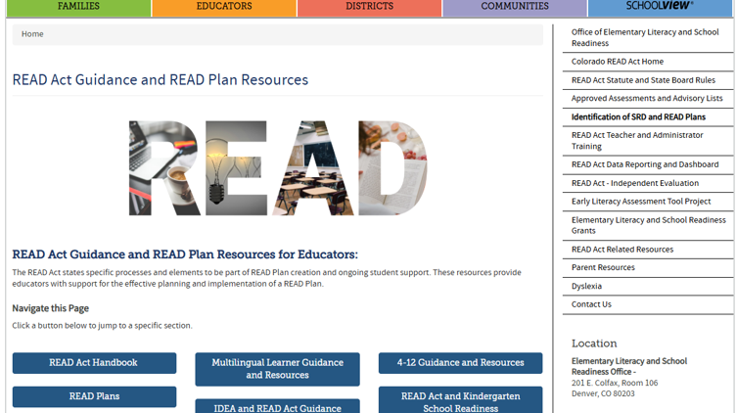
READ Plan Resources
Notes:
On the CDE website, we have a page of READ Act Guidance and READ Plan Resources for you to refer to as you continue the school year.
The READ Act Handbook is a compilation of all the guidance documents and resources we have created to support READ Leads set up in a chronological order for the school year. We also have the guidance documents and templates linked separately if you need to access one at a time.
This page includes current information about the READ Act statute, assessments, SRD identification, initiating a READ Plan, collecting a body of evidence, support for READ plans throughout the year, guidance for READ plans in subsequent years, including 4th grade and beyond, parent communication, exiting students from a READ plan, and the fillable READ plan templates.
https://www.cde.state.co.us/coloradoliteracy/readplans

Slide 44

Break:
We will resume on this link at 10:00.

Slide 45

Literacy Updates and Collaboration

Slide 46
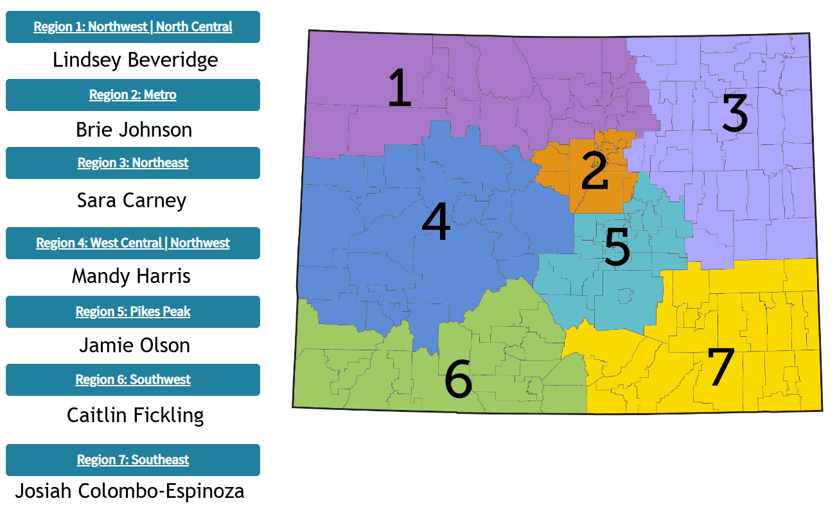

ELSR Support Region Information
https://www.cde.state.co.us/early/elsrregionalsupport
Notes:
The CDE website has been updated to show our new regional support map. On this webpage, you can find information about the consultant for your district, resources we can provide, and a link to a request for support form. The regions now align more closely with Field Services, and we have two new Senior Literacy Consultants who are supporting regions 3 and 7.
Elementary Literacy and School Readiness (ELSR) Regional Support | CDE (state.co.us)

Slide 47
ELSR
Regional Consultant
Support
Data analysis
SRD identification
READ Act implementation
Professional development
Planning for developing processes and procedures required by the READ Act
Notes:
There are many ways in which the ELSR Regional Consultants can provide support
Districts or BOCES can reach out to their ELSR regional consultant and request support with:
Developing a process to select programs that align with the science of reading and evidence-based practices
Selecting programs/instructional materials
Developing a process for implementation of newly selected programs
Provide guidance on SRD identification, READ plan development and READ Act implementation
They can support with data analysis and for developing processes and procedures required by the READ Act

Slide 48
About the Literacy Evaluation Tool (LET)
Notes:
For this meeting, we will be reviewing the Literacy Evaluation Tool as a way to assess your current systems and track progress with providing quality literacy instruction on your campus throughout the school year.

Slide 49
Literacy Evaluation Tool (LET)
Developed to help guide schools through systems evaluation and improvement
Aligned with READ Act requirements and scientifically and evidence-based practices
Provides a baseline for CDE to evaluate grantee progression and grant effectiveness
Designed in Microsoft Excel or GoogleSchools participating in the Comprehensive
Early Literacy Grant (ELG) Program are required to use the LET
Notes:
Read slide.
Add: Because of this, the LET is not intended for customization or alterations. We need this document to stay as-is when using so we have somewhat of a standardized view for comparisons of schools. We ask that implementation consultants, principals, and others using this tool not change or alter it.

Slide 50
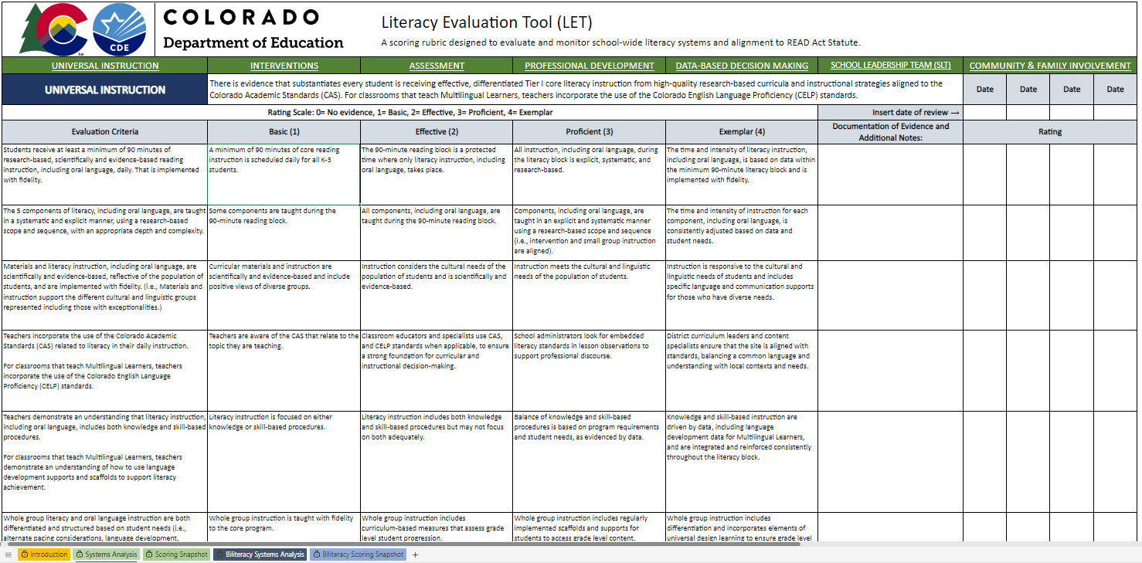
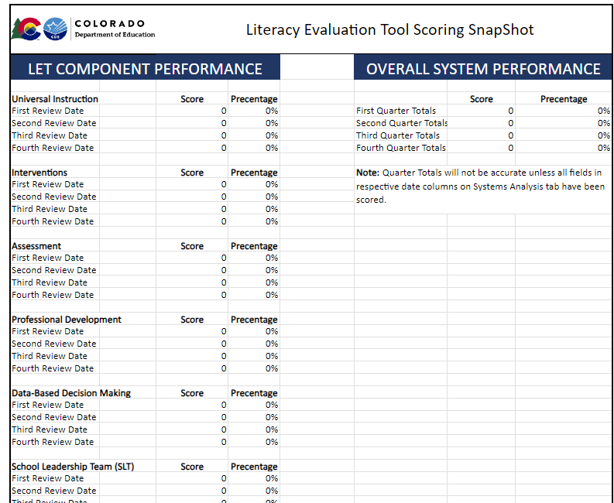

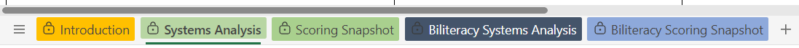
Literacy Evaluation Tool Features
Navigation Basics
Color-Coded Tabs
      Hyperlinked Section Headers
      Auto-Formatted Date Fields
Auto-Scoring Fields
Scoring Snapshot (For ELG Reporting)
Notes:
Before we delve further into the content, we wanted to just provide some visuals and definitions of language we’ll be using throughout the presentation. The updated LET includes several new navigation features for an improved user-end experience.
Tabs: Click
Introduction Tab: First, we’ve added an introduction tab with directions to the tool. While our ELG grantees are typically guided on how to use this tool, it is used by other schools across the state. We also wanted to provide some basic guidelines for using the LET for our grantees. The introduction tab includes more details on the LET features, purpose, the scoring snapshot, and guidance on which tabs to use for schools with different program models.
Another big update for the LET is that schools may now select from the green set of tabs (system analysis and scoring snapshot) or the blue set of tabs (biliteracy systems analysis/scoring). It is important to note that schools should select from either the green or the blue and should not incorporate both sets. The biliteracy tabs include everything the green tabs offer but have added language that supports different biliteracy programming. On the blue Biliteracy Systems Analysis tab, the additional language is colored in a dark purple for easy comparison to the green tabs. The introduction tab also includes more guidance on selecting which tabs are best for different program models.
Green Headers
The LET includes 7 Key Systems that schools will be analyzing. These systems are listed across the top of each section. The green headers serve as hyperlinks so users can quickly jump to the respective section within the tool. The blue title underneath the green navigation bar tells you which key system you are analyzing and provides a brief rationale and description of the system.
Auto-Formatting
Date fields auto-format, so be mindful that the data populates accurately after you enter it. It is best if you can score a complete section on the same day. If you cannot, choose the most recent date when that section was completed.
Scoring fields will accept numbers 0 -4. The scores will auto-populate at the bottom of each section and will carry over to the scoring snapshot tab.
Scoring Snapshot
The scoring snapshot is designed to print on a single page and to be converted to a PDF for ELG Grant reporting. It shows a quick view of progress over each key element and the entire system. We will discuss its features more in depth later in this presentation.

Slide 51
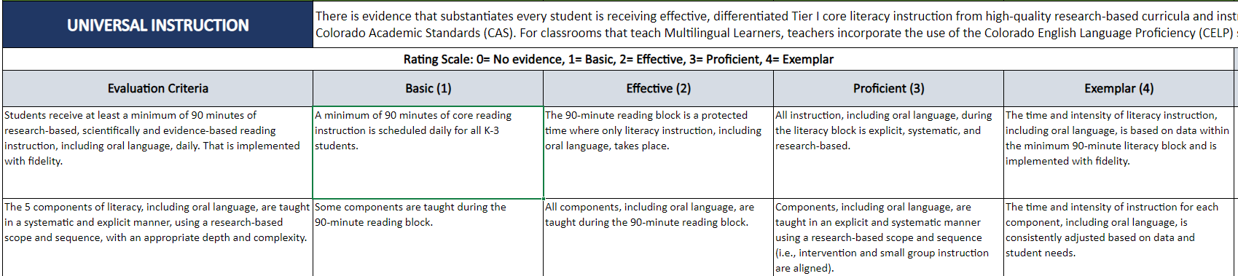
Literacy Evaluation Tool Scoring
Evaluation Criteria
Descriptors
Documentation of evidence
Rating Scale
0 - 4 scores auto populate
Designed to input ongoing review of criterion
Notes:
For each key system schools evaluate, there is a set of evaluation criteria and corresponding descriptors. While those of you who have used the former LET will note a similar resemblance to the former version, we’ve updated the language in the evaluation criteria and in the rating descriptors. These updates helped reduce redundancies throughout the tool, provide more flexibility for school schedules and systems, and better aligned the ratings to the evaluation criteria. Language updates also ensure that oral language development is included in evaluation of systems and that basic and effective ratings include the minimum required related elements within the READ Act. Another notable change is that we added descriptors to the community and family involvement section, pulling language from the READ Act on community and family involvement and respective CDE offices to better align with their guidance.
Descriptors serve as guides to evaluate your systems into quantifiable data
Space is provided to document evidence of meeting evaluation criterion for qualitative data
A rating of 0 – 4 is applied within the excel sheet that auto populates and scores each system.
Ratings are set on a scale of 0-4 with:
0 = No evidence
1 = Basic
2 = Effective
3 = Proficient
4 = Exemplar
When rating evaluation criteria, it is important to note that all the prior checks in the descriptors below the selected score have been met. For example, if the SLT believes they meet the proficient, or 3 criteria, they should also ensure that they meet all criteria in the basic (1) and effective (2) boxes. Similarly, if a school meets the criteria in the effective (2) category but does not meet the criteria in the basic (1) box, they should assign themselves a score of 0.

Slide 52

Literacy Evaluation Key Systems
Key Systems
Universal Instruction
Interventions
Assessment
Professional Development
Data-Based Decision Making
School Leadership Team
Community and Family Involvement
Notes:
The Literacy Evaluation Tool identifies 7 key elements to evaluate.
Universal Instruction
Interventions
Assessment
Professional Development
Data-Based Decision Making
School Leadership Team
Community and Family Involvement
Evaluating the entire LET can be time consuming, and we recommend planning accordingly at the beginning and end of the school year, at minimum. The LET is designed to analyze each system quarterly.

Slide 53
Literacy Evaluation Tool Questions

Slide 54

SB25-200
Notes:
Next, we will provide updates to the SB25-200 legislation that began on July 1st, 2025.

Slide 55
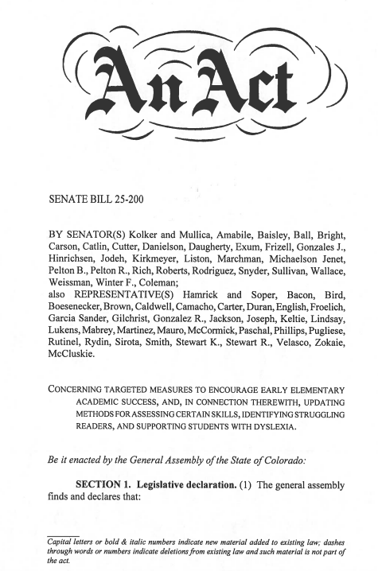
SB25-200 Review
Dyslexia Screening and READ Act Requirements
Creates a definition of dyslexia in the READ Act.
Expands criteria for identifying Significant Reading Deficiencies (SRD) using a broader body of evidence.
Requires teachers to review dyslexia indicators and engage families early.
Includes universal screening for characteristics of dyslexia in K-3rd grade
Passed with strong bipartisan backing (Senate: 32–0, House: 60–4)
https://www.cde.state.co.us/coloradoliteracy/readactstatuteandstateboardrules
Notes:
https://leg.colorado.gov/bills/sb25-200
Senate Bill 25-200 Dyslexia Screening and READ Act Requirements was introduced during the 2025 legislative session.​
This bill ​creates a definition of dyslexia in the READ Act​.
expands the criteria for identifying SRD using a broader body of evidence,
requires teachers to review dyslexia indicators and engage in conversations with families early about dyslexia,
and includes universal screening for characteristics of dyslexia for students in kindergarten through 3rd grade​.
The bill passed with strong bipartisan backing in both the Senate and the House.
We will not be answering questions at this time. This is an opportunity to see the legislation and ground ourselves in these upcoming changes to the READ Act.
We will take your thoughts and questions into consideration as we work over the next few months to take what will be provided in rule and create guidance for implementation.

Slide 56
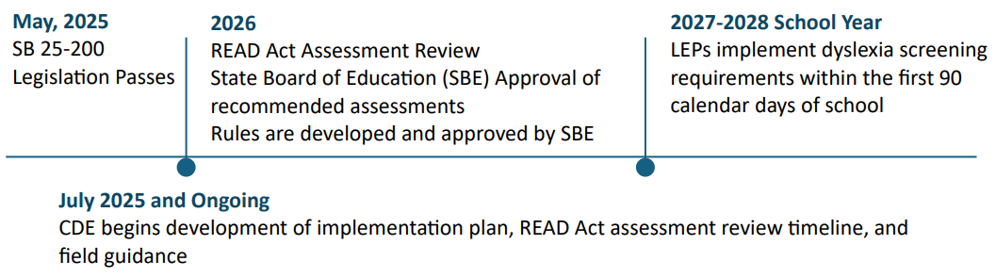
SB25-200 Timeline for Implementation
Dyslexia Screening and READ Act Requirements
Notes:
The governor signed the bill on May 23rd, 2025
All new legislation began on July 1, 2025
CDE is currently developing an implementation plan that is shared with the legislature and the State Board of Education
READ Act assessments are reviewed every 4 years. The next review is scheduled for 2026. CDE will develop the assessment review timeline.
After assessments are reviewed, the State Board of Education must approve the assessments and adopt the list in Rule.
Rules for the READ Act will be developed and approved. Based on information in the bill, this will include definitions of terms and lists of approved assessments.
Districts implement dyslexia screening requirements by the beginning of the 2027-28 school year.
https://www.cde.state.co.us/coloradoliteracy/sb-25-200-summary-of-dyslexia-read-act-requirements
Fact Sheet:
https://www.cde.state.co.us/coloradoliteracy/dyslexia

Slide 57

Family Engagement
Notes:
Next, let’s turn our attention to our regional collaboration topic for today, family engagement.

Slide 58

Communication with Families
The READ Act requires schools to:
Collaborate with parents to create READ plan together
Discuss the student’s specific reading needs
Communicate ongoing, regular progress updates for parents
Ensure parent understanding of information
Share the READ plan interventions that address the child’s needs
Discuss how parents play a central support role
Notes:
The READ Act details several requirements about the information schools need to share with parents and what schools need to do to involve the community and parents.
The READ Act requires schools to:
Discuss the student’s specific reading needs
Collaborate with parents to create READ plans together
Communicate ongoing, regular progress updates for parents
Ensure parents understand the information being presented (this includes presenting the information in a language the parents understand whenever possible)
Share the READ plan interventions that address the child’s needs and to
Discuss how parents play a central supportive role

Slide 59
Key Takeaways from West Ed Report
Family Engagement with READ Act Communication and READ Plan Involvement
Parents expressed frustration over:
SRD identification process and practices
READ Plans
Ongoing student supports
General lack of communication about their child’s reading progress
Year 4 Summary Report
Notes:
In 2019, the Colorado Legislature revised the READ Act to include an annual independent evaluation to identify and assess strategies that the state, local districts, and schools have taken to support Colorado students in achieving proficiency in reading (pursuant to C.R.S. 22-7-1208 (8)). Last year’s evaluation focused on gathering feedback from parents and families.
Although parents did give positive feedback about their experiences, parents who provided written feedback and participated in focus groups expressed frustration over identification practices, READ Plans, ongoing student supports, and a general lack of communication.
• Parents reported frustrations related to the SRD identification process, including the lack of inclusion of dyslexia, issues with specific testing, and failures to involve parents.
• Of the 271 parents who provided written responses on the inventory, over 70% expressed frustration with a lack of communication.
• Approximately one-third of parents providing written responses to the inventory felt their child was not currently receiving adequate support.
As a result, West Ed has recommended that CDE should provide guidance and support to districts and schools to better serve families impacted by the READ Act. Our office will continue to provide and highlight resources during these regional meetings.

Slide 60
READ Act | Parent Communication
Each Local Education Provider shall adopt procedures to comply with the requirements of the READ Act.
This includes procedures for “effectively communicating with parents concerning the creation, contents, and implementation of READ Plans”
The READ Act requires a meeting with parents at the time a READ plan is initiated and a meeting at the end of any school year prior to fourth grade in which a student continues to have a significant reading deficiency.
The LEP should ensure that the parent of a student on a READ plan receives ongoing, regular updates from the student’s teacher
Notes:
Going back to what is required by the READ Act, let’s reflect and consider how we can improve upon communication with parents.
The READ Act states that Each Local Education Provider shall adopt procedures to comply with the requirements of the READ Act.
This includes procedures for “effectively communicating with parents concerning the creation, contents, and implementation of READ Plans”
Two specific parent/teacher meetings are spelled out within the READ Act. The READ Act requires a meeting with parents at the time a READ plan is initiated and a meeting at the end of any school year prior to fourth grade in which a student continues to have a significant reading deficiency. Schools should have procedures in place to ensure these meetings are scheduled and held and that the purpose and talking points are clear for all.
Finally, it is important for the LEP to ensure that the parent of a student on a READ plan receives ongoing, regular updates from the student’s teacher.
A clear policy and procedure should be in place so that all teachers know the expectations and are providing updates to parents in a transparent, consistent, and predictable manner.
Also, the READ Act requires that, to the extent practicable, communication with parents is provided in a language the parent understands.
In a few slides, you will have the opportunity to discuss your current processes for parent communication and possible improvements in breakout rooms.

Slide 61
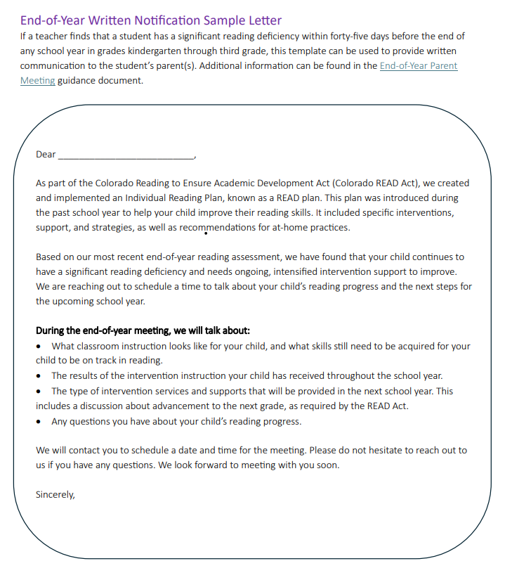
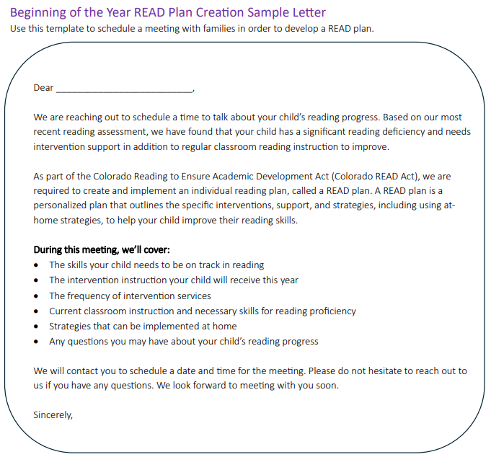
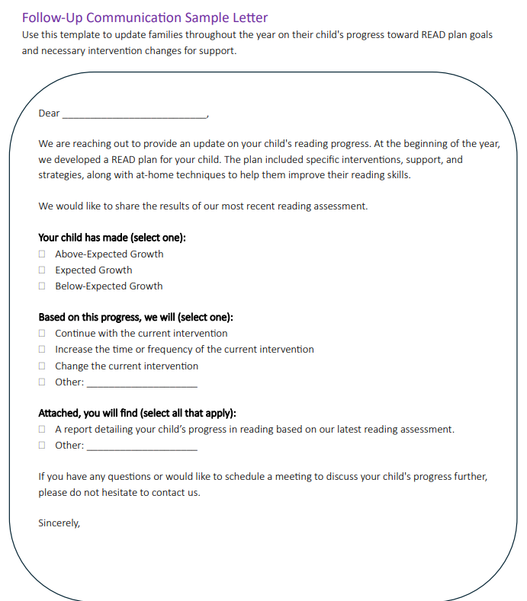
Family Letter Templates
https://www.cde.state.co.us/coloradoliteracy/familylettertemplatesreadact
Notes:
To support you with parent communication, our office has created sample family letter templates for the beginning of the year READ plan creation, a follow up letter to update families on student progress, and an end-of-year letter template.
https://www.cde.state.co.us/coloradoliteracy/familylettertemplatesreadact

Slide 62

Regional Collaboration

Slide 63
Parent Communication Reflection
Review current procedures for parent communication: are they aligned with statute requirements?
Are expectations and timelines communicated clearly with staff?
Are resources available to teachers to make parent communication easier?
Notes:
In most instances, there is always room for improving communication with parents related to student progress and READ plan implementation. This is a great time of year to revisit how transparent, efficient, and consistent policies and procedures are around communicating with families.
Consider reviewing current procedures for parent communication: are they aligned with statute requirements, such as ensuring meetings are held when required, talking points are discussed and parents are receiving the information they need to support their child. This is also a great time to review form letters for tone, clear and inviting, and collaborative messaging.
Also, take time to look at internal messaging: are expectations and timelines around parent communication communicated clearly with staff? Does everyone know what to do and have access to the information they need? Do they know what they should be updated parents about to ensure messaging is clear and gives parents an understanding of their child’s progress throughout the year?
Finally, consider resources, including forms, schedules, and time. Are resources available to teachers to make parent communication easier so that they are more likely to make it a regular part of their habit?

Slide 64
Breakout Rooms
Guiding Questions:
How are your current policies and procedures around parent communication working?
What could be improved upon?
What is working well and could be valuable to share?
What resources or supports could help ensure consistency across schools and/or your district in relation to communication around READ plans and student progress?

Slide 65
ELSR Professional Development Updates

Slide 66
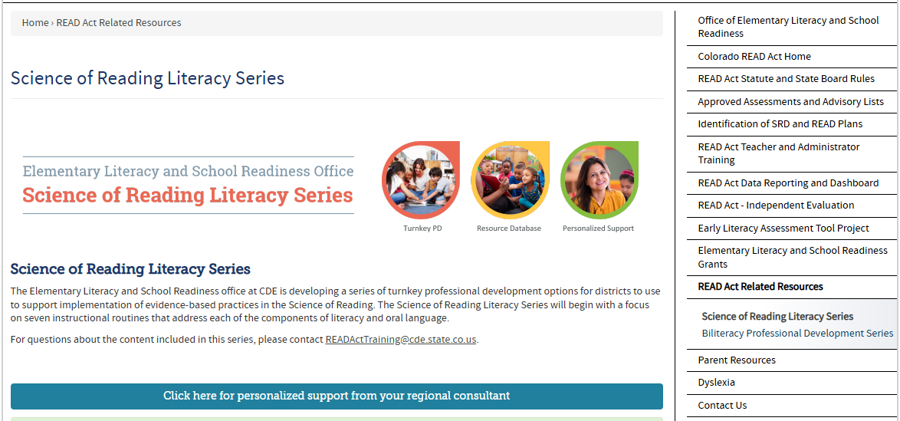
CDE Science of Reading Literacy Series
https://www.cde.state.co.us/coloradoliteracy/sorliteracyseries
Notes:
As a reminder, the Science of Reading Literacy Series is available on the CDE website.
This is a collection of turn-key professional development products to support districts with the implementation of evidence-based instructional routines aligned to the Science of Reading.
These slide decks and resources were developed in alignment with the 45-hour teacher training to revisit the research base, review the steps in the instructional routines, provide a model for the routine, and allow opportunities for practice and planning.
The series also includes resources for administrators or literacy coaches to track and provide feedback on the implementation of the routines in their buildings.
https://www.cde.state.co.us/coloradoliteracy/sorliteracyseries

Slide 67

Biliteracy Guidance for MLs
This guide supports literacy and biliteracy instruction for Multilingual Learners (MLs) in bilingual education programs.
Key topics covered include oral language development, oracy, translanguaging, cross-linguistic connections, and holistic assessment.
http://www.cde.state.co.us/coloradoliteracy/biliteracy-professional-development-series-0
Notes:
In addition to the Science of Reading Literacy Series, we are also excited to remind you about another great resource from CDE, the Biliteracy Professional Development Series.
This is a four-part course comprised of an Introduction and three Modules. This course is designed to provide participants with evidence-based strategies for teaching students in English and Spanish while working towards bilingualism and biliteracy.
It is an open-source format designed to be accessible to anyone interested in learning more about best practices for providing biliteracy instruction in Spanish and English.
Additionally, you will find support documents and websites to further your learning. You may take this course at your own pace. If you choose to take the quiz at the end of the course, you will be eligible for two hours of professional development.

Slide 68
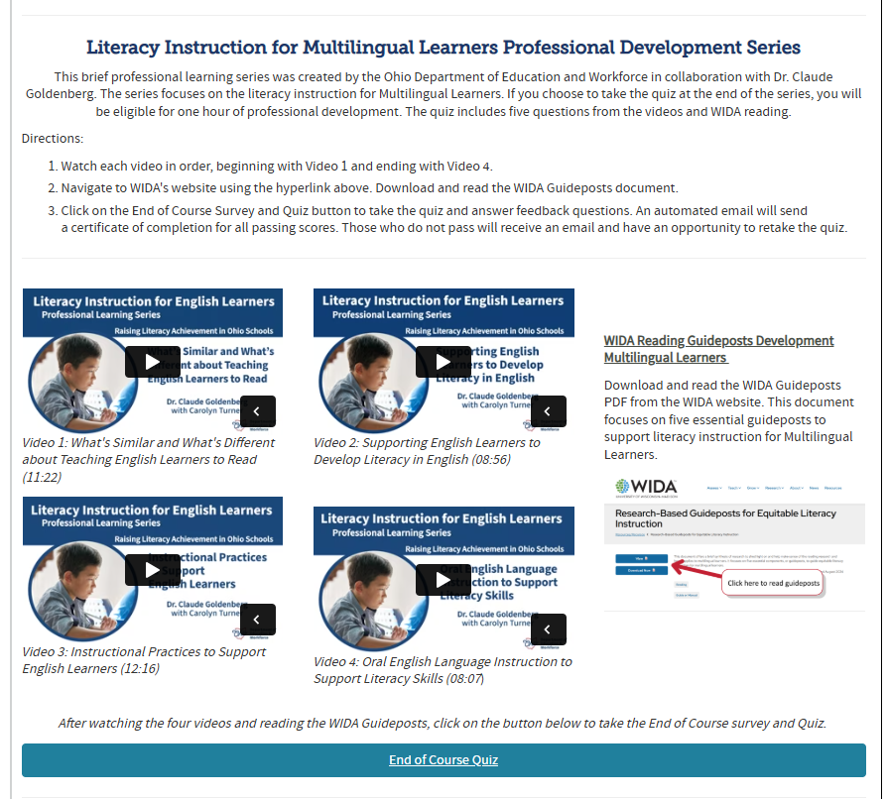
Literacy Instruction for MLs Professional Development Series
The series focuses on the literacy instruction for Multilingual Learners.
If you choose to take the quiz at the end of the series, you will be eligible for one hour of professional development.
https://www.cde.state.co.us/coloradoliteracy/readandel

Slide 69

Family Awareness Resources
Informational Sessions: First Semester
Tuesday, October 28, 2025: 3:30PM-4:30PM
REGISTER HERE
Friday, October 31, 2025: 10:00AM-11:00AM
REGISTER HERE
Informational Sessions: Second Semester
Tuesday, January 20, 2026: 3:30PM-4:30PM
REGISTER HERE
Friday, January 23, 2026: 10:00AM-11:00AM
REGISTER HERE
https://www.cde.state.co.us/coloradoliteracy/readactandsorforfamilies
Notes:
The Elementary Literacy and School Readiness (ELSR) office at CDE has created a series of turnkey resources for districts and schools to use to support family awareness of the Colorado READ Act, READ plans, and the science of reading for families. An email will be sent to all READ Leads when the content is available on the website in September.
Live informational sessions are being held to support administrators and educators with understanding and explore the resource components.
Note: All sessions have the same content. Please choose the date that works best for you.
Informational Sessions: First Semester
Tuesday, October 28, 2025: 3:30PM-4:30PM
REGISTER HERE
Friday, October 31, 2025: 10:00AM-11:00AM
REGISTER HERE
Informational Sessions: Second Semester
Tuesday, January 20, 2026: 3:30PM-4:30PM
REGISTER HERE
Friday, January 23, 2026: 10:00AM-11:00AM
REGISTER HERE
Please reach out to your ELSR Regional Consultant with any questions.
https://www.cde.state.co.us/coloradoliteracy/readactandsorforfamilies

Slide 70

Early Literacy Assessment Tool Project
Professional Development
Professional development on the assessment tool and data is available at no cost to participating schools and districts.
For more information, visit https://amplify.com/elat-pd
2026-2027 Letters of Intent
Letters of Intent to Apply for SY26-27 will be available on October 1, 2025.
This link will be shared directly with current participants and through the READ Act listserv.
ELAT Project Questions: elat@cde.state.co.us

Slide 71
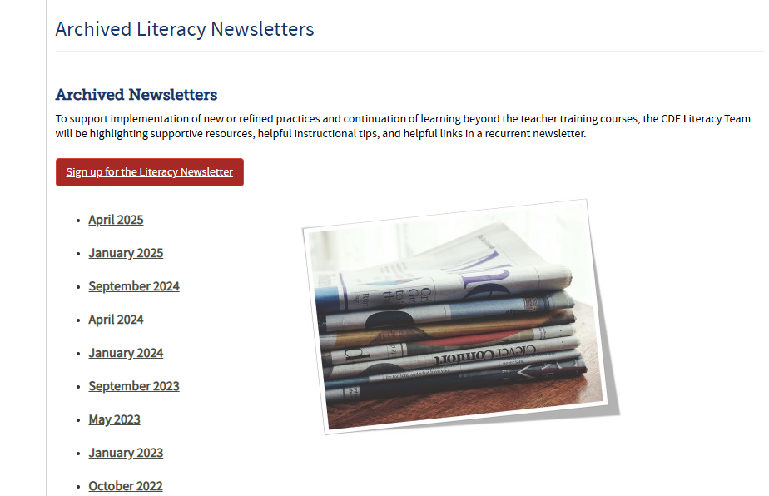
Literacy Newsletter
http://www.cde.state.co.us/coloradoliteracy/archivedliteracynews
Sign Up for the Literacy Newsletter
Notes:
We also want to provide a quick reminder that our office has a monthly literacy newsletter to provide supportive resources and helpful instructional tips. If you have not done so already, you can sign up to receive this monthly newsletter via the link on the slide or in the chat.
Newsletter Signup Link:
https://docs.google.com/forms/d/e/1FAIpQLSdGZlID5hfWJP02U13pyZXIVzNEmAV8BkTiqwPtJGWk2dE3Yg/viewform

Slide 72

Thank you!
Archived Meeting Materials available at https://www.cde.state.co.us/coloradoliteracy/readactregionalmeetings
Notes:
Welcome back. We hope this time to meet with other leaders has been beneficial for you. Before you go on with the rest of your morning, our team would greatly appreciate your feedback about today’s collaboration session and future READ Act meetings. Link provided for participants who attended the live meeting.

