Slide 1
READ Act Regional Meeting
Literacy Updates and Collaboration
Office of Elementary Literacy and School Readiness
Friday, September 6, 2024
Notes:
Thank you for joining us this morning for the first READ Act Regional Meeting of the 2024-2025 school year. In this part of today’s meetings, we will be going over literacy updates from CDE and providing time to collaborate with other district leaders in your part of the state.

Slide 2
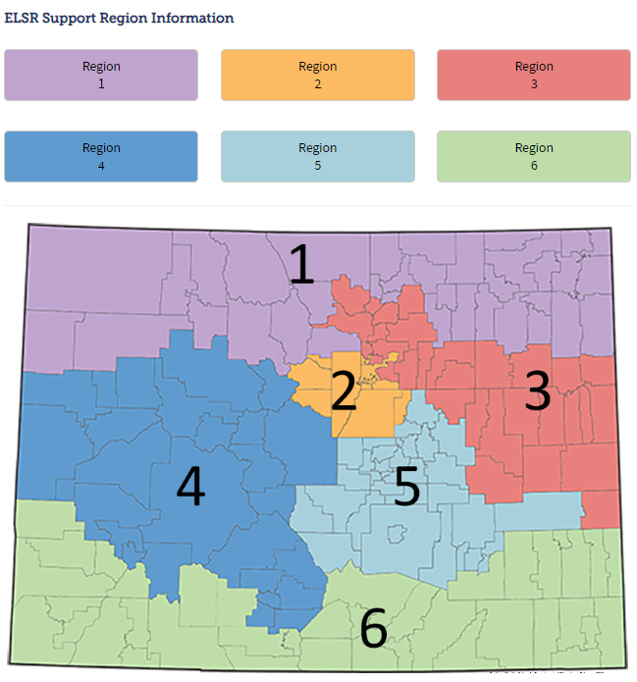
Region 1: Lindsey Beveridge
Beveridge_l@cde.state.co.us
Region 2 and EL Consultant:
Brie Johnson
Johnson_b@cde.state.co.us
Region 3: Karen Ingalls
Ingalls_k@cde.state.co.us
Region 4: Mandy Harris
Harris_a@cde.state.co.us
Region 5: Jamie Olson
Olson_j@cde.state.co.us
Region 6: Caitlin Fickling
Fickling_c@cde.state.co.us
Elementary Literacy and School Readiness (ELSR) Regional Support
Literacy Program Supervisor: Melissa Ahlstrand
Ahlstrand_m@cde.state.co.us
Notes:
On the CDE website, we have a webpage that includes information about the ELSR regional support.
On this webpage, you can find information about the which consultant may be supporting your district, supports we can provide, and a link to a request for support form.
Elementary Literacy and School Readiness (ELSR) Regional Support | CDE (state.co.us)

Slide 3

ELSR Regional Consultant
Support
Data analysis
SRD identification
READ Act implementation
Professional development
Planning for developing processes and procedures required by the READ Act
Notes:
There are many ways in which the ELSR Regional Consultants can provide support
Districts or BOCES can reach out to their ELSR regional consultant and request support with:
Developing a process to select programs that align with the science of reading and evidence-based practices
Selecting programs/instructional materials
Developing a process for implementation of newly selected programs
Provide guidance on SRD identification, READ plan development and READ Act implementation
They can support with data analysis and for developing processes and procedures required by the READ Act

Slide 4

Quarterly Meeting Objectives:
Provide updates on literacy guidance and resources, including the newly updated READ Plan templates
Provide opportunities for district leaders to connect and collaborate with other leaders in their region and their CDE Senior Literacy Consultant
Notes:
Our Meeting Objectives today are to:
Provide updates on literacy guidance and resources, including the newly updated READ Plan templates
Provide opportunities for district leaders to connect and collaborate with other leaders in their region and their CDE Senior Literacy Consultant

Slide 5
Meeting Agenda
Future Dates:
January 17, 2025
April 4, 2025
AGENDA ITEM
Welcome and Introductions
Updated READ Plan Template
READ Plans in Subsequent Years
Goals and Objectives
READ Plan Template for Multilingual Learners
ELSR Updates: Science of Reading Professional Development Series, Regional Consultant Support
Feedback
Notes:
As we mentioned in our previous communication, we have made some adjustments to the format of the regional meetings. The first hour this morning focused on READ Act implementation basics with the intended audience being new READ Leads or those who would benefit from additional review. This part of the meeting will center around literacy updates from CDE and time to collaborate with other district leaders in your part of the state. The topics we will be covering are:
Updated READ Plan Template
READ Plans in Subsequent Years
Goals and Objectives
READ Plan Template for Multilingual Learners
ELSR Updates: Science of Reading Professional Development Series, Regional Consultant Support
Finally, we will be gathering feedback about the meeting and gathering interest about opportunities for future district spotlights.

Slide 6


Icebreaker
New York City
or
Los Angeles?
In your breakout rooms, introduce yourself with your name, district, role, and reason for the city of your choice.
Notes:
We’re going to start out with a quick icebreaker activity. You will be put in a breakout room with others for this activity. Please take turns introducing yourself with your name, district, role, and answer to the question: New York City or Los Angeles, including a brief explanation of why you would choose that city. You will have 10 minutes for this activity. In a moment, you should see a box pop up with an invitation to join the breakout room.

Slide 7

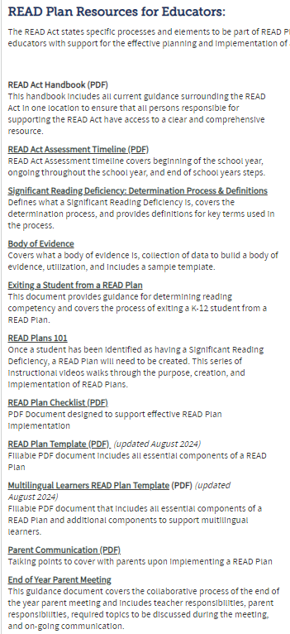

READ Act Handbook
https://www.cde.state.co.us/coloradoliteracy/readplans
Notes:
The READ Act Handbook is a compilation of all the guidance documents and resources we have created to support READ Leads set up in a chronological order for the school year.
This handbook includes current information about the READ Act statute, assessments, SRD identification, initiating a READ Plan, collecting a body of evidence, support for READ plans throughout the year, guidance for READ plans in subsequent years including 4th grade and beyond, parent communication, exiting students from a READ plan, and fillable READ plan templates.
This will serve as an onboarding guide, and we will use this handbook as a foundation for future professional development.
The handbook is located on the CDE Read Plans web page and is the first linked document under the title READ Plan Resources for Educators.
https://www.cde.state.co.us/coloradoliteracy/readplans

Slide 8
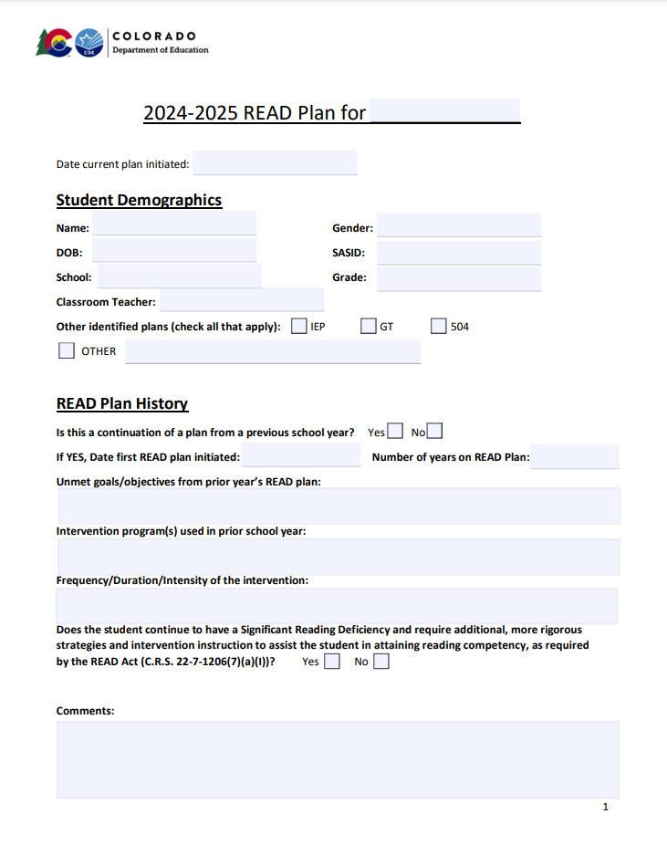

New READ Plan Templates
(Updated August 2024)
READ Plan Template https://www.cde.state.co.us/coloradoliteracy/readplanexample
Multilingual Learners READ Plan Template:
https://www.cde.state.co.us/coloradoliteracy/mlreadplantemplate
Notes:
This summer, our office completed a revision of the READ plan templates posted on our website to provide districts with an updated model to guide the way READ plans are written, revised, and implemented across the state. Understanding the need to differentiate documentation for diverse needs, a new template specifically designed for students who are multilingual learners was developed as well. Both of the templates are in PDF format and available to download on our website at the links provided here (and are also linked to the agenda you received this week).
We will be spending some time in the upcoming slides going over each section of the new format and connecting it to READ Act requirements and guidance for implementation that helps to explain how each section is formatted to ensure a well-written READ plan is a living document and reflects the key information about a student’s pathway and progress over time.

Slide 9

READ Plan Essentials
Notes:
A Reading to Ensure Academic Development Plan, or READ Plan, is an intervention plan created to ensure the student receives the intervention programming needed to remediate their significant reading deficiency, in order to demonstrate grade level competency in reading .

Slide 10

Purpose
The purpose of a READ plan is to identify specific reading skill deficits and to create a plan of action.
READ plans also document services and a student’s progress toward their targeted goals. They are living documents and are updated to meet the student’s needs.
A student remains on a READ plan until achieving grade-level proficiency in reading.
Notes:
“The purpose of a READ plan is to identify specific reading skill deficits and to create a plan of action. READ plans also document services and a student’s progress toward their targeted goals. A student remains on a READ plan until achieving grade-level proficiency in reading. “
A READ Plan is created as soon as possible after a student is confirmed as having a Significant Reading Deficiency.​​
A strong READ plan is a “living” document. This means that The READ plan should be updated as services and data change to reflect the needs of the student and the supports the student is receiving.
READ plans should serve as a documentation of:
the data that supports the student’s reading progress,
the services that the student is receiving
Who is providing the instruction and support the student is receiving, and
how well those services are supporting the student throughout the year

Slide 11

Who Develops the READ plan?
A teacher or other skilled school professional that the local education provider may choose to select
Parent or guardian
Additional support staff if needed (e.g., ELL teachers, mental health provider, etc.)
Notes:
A READ Plan is created as soon as a student is confirmed as having a Significant Reading Deficiency.
A teacher, or other skilled school professional that the local education provider selects, is responsible for developing the READ Plan in collaboration with the student’s parents/guardians, if possible.
A READ plan is intended to be a collaborative effort between school professionals and the student’s parent(s) or guardians, so every effort needs to be made to have them involved.
Additional support staff may also attend if needed such as an English Language Learner teacher or mental health providers.

Slide 12
READ Plan Process
Identify specific skill deficits
Write goals and objectives
Match intervention to skill deficits; implement with fidelity
Select and administer progress monitoring assessment
Analyze PM data
Determine effectiveness of instruction; adjust as needed
When a student is identified as having an SRD and a READ plan will be put in place:
This should happen at regular intervals (e.g., every 6 weeks)
These should directly address the specific skill deficits
Notes:
Again, a strong READ plan is a “living” document, and should document the following:
Identifying the possible significant reading deficiency starting with assessments and building a body of evidence
Identifying the specific skill deficiency
Developing the READ plan including identifying the intervention being used to meet the needs of the SRD, creating goals and objectives and what assessments will be used to progress monitor
Implementing the interventions that the student is receiving
Monitoring the student’s progress
and evaluating how effective the intervention is in developing the student’s skill.
By identifying the components of the process, the goal is for teachers to see the power of a well-written READ plan and how it can support the improvement of reading skills for students.

Slide 13
Required Components
Each READ plan must include, at a minimum:
The student’s specific, diagnosed reading skill deficiencies
Goals and objectives for the student’s targeted growth
The type(s) of additional instructional services and interventions the student will receive in reading
The scientifically and evidence-based reading instructional programming the teacher will use for reading instruction and interventions
How the child’s progress will be monitored and evaluated
Strategies parents are encouraged to use to assist
Any additional services the teacher deems available and appropriate to accelerate the student’s reading skill development
Notes:
The READ Act includes several elements that must be included in a READ plan.
Each READ plan must include, at a minimum:
The student’s specific, diagnosed reading skill deficiencies that need to be remediated in order for the student to attain reading competency;
The goals and objectives for student growth in attaining reading competency;
The type of additional instructional services and interventions the student will receive in reading. At a minimum, the local education provider shall ensure the student receives educational services in a daily literacy block for the length of time identified as effective in research relating to best practices in teaching reading.
The scientifically based or evidence-based reading instructional programming the teacher will use to provide daily reading approaches, strategies, interventions, and instruction, which programs at a minimum shall address the areas of phonemic awareness, phonics, vocabulary development, reading fluency, including oral skills, and reading comprehension.
How the student’s progress will be evaluated and monitored;
The strategies parents are encouraged to use that are designed to supplement the programming
Any additional services the teacher deems available and appropriate to accelerate the student’s reading skill development
22-7-1206 (5) a-g
READ plans are specific to each student. The READ Act details additional components to include in READ Plans for English Language learners. The READ Act also includes additional READ Plan considerations for students who may have an Individualized Educational Plan.
READ Plan CHECKLIST link: http://www.cde.state.co.us/coloradoliteracy/readplanchecklist

Slide 14
READ Plan Template Updates
Fully accessible format
Dropdown menus for some fields
Additional section for READ Plan history
Redesigned to be more user-friendly for ongoing updates
End of year summary
Alternate template for multilingual learners
Notes:
Updates made to the READ plan template include:
A fully accessible format
Dropdown menus for some fields
An additional section for READ Plan history
Redesigned to be more user-friendly for ongoing updates
End of year summary
Alternate template for multilingual learners
We will be reviewing each section of the template to show how the format supports best practices in documenting planning and progress over time.

Slide 15
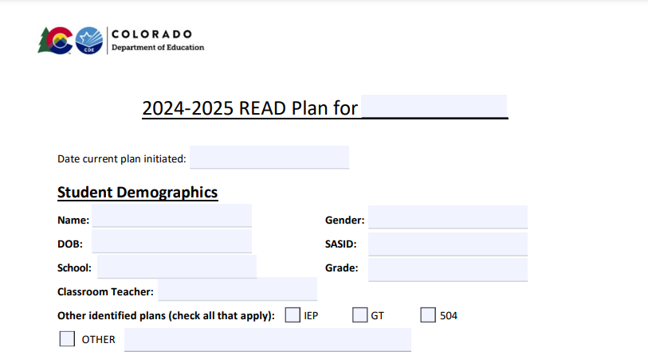
Student Demographics
Notes:
The student demographic section remains very similar to the original template format, including basic demographic information as well as a place to indicate whether a child has additional educational plans. One change is clearer wording and a prominent location for the date the current plan is initiated, which differentiates it from previous versions of the READ plan a student may have.

Slide 16
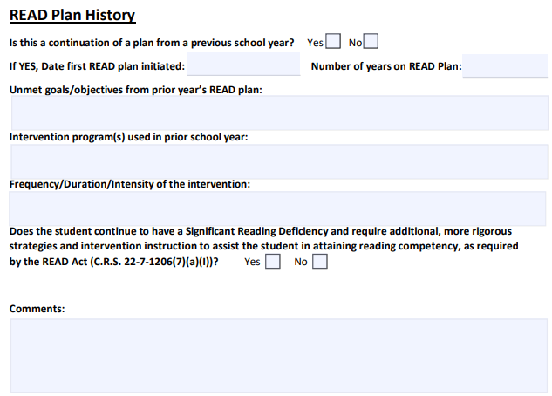
READ Plan History
Notes:
The READ plan history section is a new addition to the template. This section provides a place to record whether the READ plan is being continued from a prior school year. If a plan is being continued, there is a place to document when the READ plan was first initiated and the number of years the student has been on a READ plan. The additional information in this section is intended to help the teacher who is updating the plan revisit the prior year’s plan to determine what goals were unmet previously, what intervention program was used, and what was the frequency, duration, and intensity of the previously implemented intervention.
Recording this information in the current READ plan allows more direct transfer of information from year to year and also provides information to the current teacher to make thoughtful decisions about how a plan is intensified for a student who continues to have an SRD from one year to the next.

Slide 17
Students continuing on READ Plans
Notes:
Because the continuation of a READ plan from one school year to the next is often a place where lack of communication or clear documentation can create gaps in services for students who need intervention the most, we are going to spend a little time today reviewing READ Act requirements and best practices for students who remain on a READ plan from one year to the next.

Slide 18


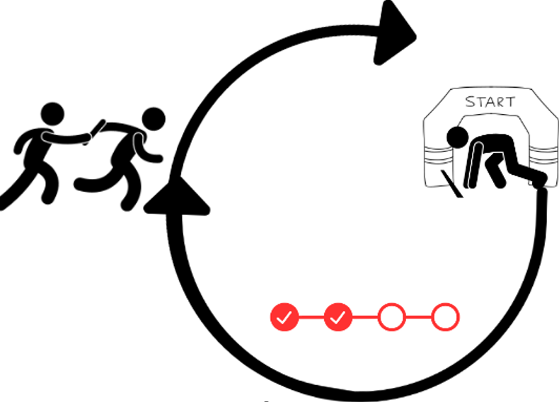

READ Plans in Subsequent Years
Notes:
A mistake than many schools make at the beginning of a new school year for students continuing on READ plans is to begin the process intended for SRD identification all over again.
(CLICK) We waste precious time making that mistake.
Remember that for students who will continue on a READ plan for a second or subsequent year, it is important to start the school year prepared to begin interventions aligned to their specific skill deficits as quickly as possible when the new school year begins.
In this case, the interim assessment administered within the first 30 days of school is used not for screening for risk (we already know they are at risk), but for obtaining the most recent data about what the student needs to inform the READ plan, comparing it to previous data, writing strong goals and objectives, and ensuring the appropriate interventions are in place.
Diagnostic assessments may be used to gather additional information to inform the interventions, but for these students, there is no longer a 60-day window.
The body of evidence that was hopefully well documented in the previous version of the student’s READ plan, along with any additional data from the beginning of the year assessments, should help teachers quickly and easily revise the READ plan for the new year. This is where revisiting the previous READ plan and aligning to the current version is critically important.

Slide 19
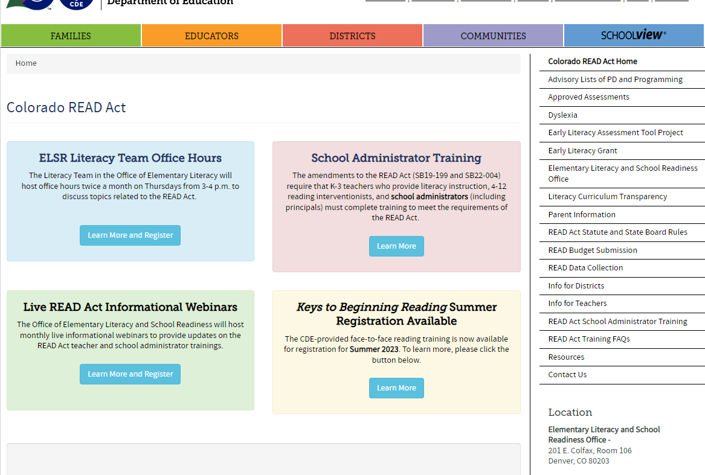
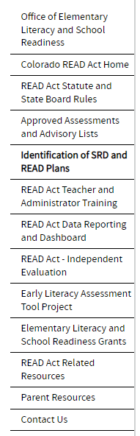
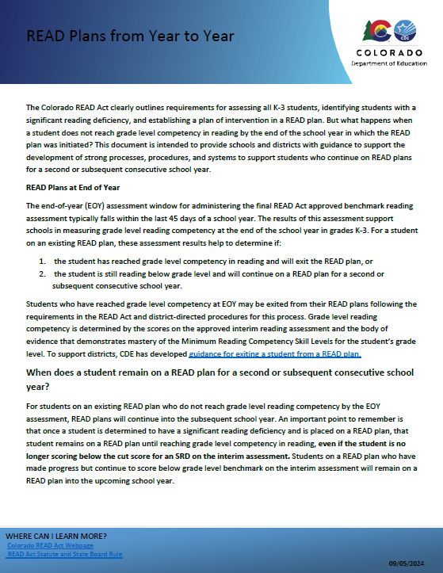
READ Plans from Year to Year
https://www.cde.state.co.us/coloradoliteracy/readplansfromyeartoyear
Notes:
The guidance document that aligns with this presentation is located on the CDE website in the section titled “Identification of SRD and READ Plans”. The direct link to this document is on the slide.
Direct link: https://www.cde.state.co.us/coloradoliteracy/readplansfromyeartoyear
Website link: https://www.cde.state.co.us/coloradoliteracy/readplans

Slide 20


EOY READ Act Requirements – Existing READ Plans
STUDENT REMAINS ON READ PLAN
No longer SRD but below Grade Level
Continues to have an SRD
READ plan revised with additional, more rigorous strategies and intervention, including increased daily time
Reading instruction from effective/highly effective teacher
Principal ensures support throughout the day
Update READ plan
Parent communication
Notes:
For students who are on existing READ plans there are three possible outcomes at the end of year assessment window (typically within the last 45 days of the school year).
Students can continue to have an SRD, they can no longer score below the cut score for an SRD but remain below grade level, or they may reach grade level reading competency. For students who reach grade level reading competency and have a body of evidence to show they have mastered the minimum skill competencies, exiting the READ plan is possible.
CLICK_For students who remain below grade level, EVEN IF THEY ARE NO LONGER SRD, a READ plan must be continued for a second or subsequent consecutive year. Students who are no longer SRD will need to have their READ plan updated (in the manner we will be discussing shortly), and their parents should receive communication about their progress in the manner your school chooses (meeting, phone call, email, progress report, etc).
Stu
A student’s READ plan should be updated with specific changes detailed in the READ Act that include steps teachers, principals, and districts need to take to prepare the READ plan and services that will be provided when a student continues on a READ plan for a second or subsequent consecutive school year.
In the following school year:
The student’s teacher will revise the READ plan to include additional, more rigorous strategies and interventions, including increased daily time in school for reading instruction.
The principal of the school ensures the reading instruction the student will receive is in conjunction with, and is supported through other subjects during the school day.
And, if practicable, the student receives reading instruction from a teacher who is identified as effective or highly effective in their most recent performance evaluation and has expertise in teaching reading.
22-7-1206 (7) (a) (I) (II) (III)
dents who continue to have an SRD and must remain on a READ plan have some additional requirements outlined in the READ Act.

Slide 21

More Rigorous Strategies and Intervention
• Increase the amount of intervention time and/or frequency the student receives the intervention
• Decrease the number of students in the instructional group for a smaller teacher/student ratio
• Optimize the best time of day for student learning
• Utilize specialty programs that are scientifically and evidence-based from the CDE approved list of programming
• Place student with a highly effective educator who is skilled in reading instruction
• Increase progress monitoring frequency to pinpoint and drive effective targeted instruction
Notes:
There are different ways educators can ensure a student receives more rigorous strategies and interventions.

Slide 22
Planning for the Year Ahead:
Statute to Practice
Additional, more rigorous strategies and intervention instruction
Change in interventions/teachers (Tier I, Tier II, Tier III)
Increased daily time in school for reading instruction
Increased weekly frequency
Increased reading intervention supports across content
Smaller Group Ratios
Increased frequency of progress monitoring/data analysis
More targeted, pinpointed intervention
Increased duration
Reading instruction is supported across content within the school day
Small group instruction
Push-in support
Increased accommodations/modifications
Notes:
For students who did not reach grade level competency in reading and will remain on a READ Plan in the subsequent school year, READ Act statute designates that students receive intensified instructional efforts.
First, students should receive additional and more rigorous strategies and intervention. This could be a change in interventions and/or teachers, smaller group ratios, more targeted intervention, and/or increased frequency of progress monitoring. Next, an increase in daily reading instruction can be achieved through increased weekly frequency, increased duration for lessons, and increased support across content. Finally, reading instruction should be supported across content in the instructional day, including small group instruction, push-in support, and increased accommodations or modifications.

Slide 23
Leaders – Planning at BOY
Identify which students at each grade will need intensified intervention and align schedule and highly effective teachers to support
Outline expectations for assessing students that prioritizes assessing students continuing on READ plans early.
Ensure teachers have time to review existing READ plans and communicate with teachers from previous years.
Support planning for flexible grouping that can begin quickly
Provide training or mentoring for new teachers around READ plans
Notes:
Leaders can also begin to plan thoughtfully to make the transition into the new school year seamless.
Leaders can:
Identify which students at each grade will need intensified intervention and align schedule and highly effective teachers to support
Outline expectations for assessing students that prioritizes assessing students continuing on READ plans early.
Ensure teachers have time to review existing READ plans and communicate with teachers from previous years.
Support planning for flexible grouping that can begin quickly
Provide training or mentoring for new teachers around READ plans

Slide 24

As Soon As Possible When the School Year Begins
Assess with urgency
Compare EOY to BOY assessment data: does anything new emerge?
Align goals and objectives continuing from previous update and write for current school year
Ensure intervention aligns to identified skill deficits and is appropriate intensity, duration, frequency
Ensure instruction is intensified for students who are SRD
Begin cycle of progress monitoring and adjusting instruction
Notes:
For all students in grades 1-3, the READ Act requires the interim assessment be administered within the first 30 days of the school year. So as soon as possible, students continuing on READ plans should be assessed so that the new data can be analyzed and compared to the data from the EOY assessment.
Any goals and objectives that were not met in the previous school year should also be reviewed, and aligned to goals and objectives written in the update with adjustments and additions as needed.
Staff should review the intervention that was previously provided to the student, and he intervention selected for the student for the current plan should align to the identified skill deficits and should be of appropriate intensity, duration, and frequency.
For any student who continues to have an SRD, instruction must be appropriately intensified, which includes a highly qualified teacher when possible.
Finally, the cycle of implementing intervention, progress monitoring, analyzing data and adjusting instruction should begin as soon as the plan is designed.

Slide 25
Discussion:
READ Plans in Subsequent Years
Questions:
What processes and structures does your district have in place for transitioning READ Plans from one grade level and teacher to the next?
Do your district processes and procedures align with READ Act statute requirements? If not, what changes can you make to be more in alignment?
How could the addition of a section for READ plan history in a READ plan impact planning and communication for students continuing on READ plans?
Notes:
Now we have covered how to support students on READ plans in subsequent years, we are going into breakout rooms for ~10 minutes to discuss the questions on this slide.

Slide 26
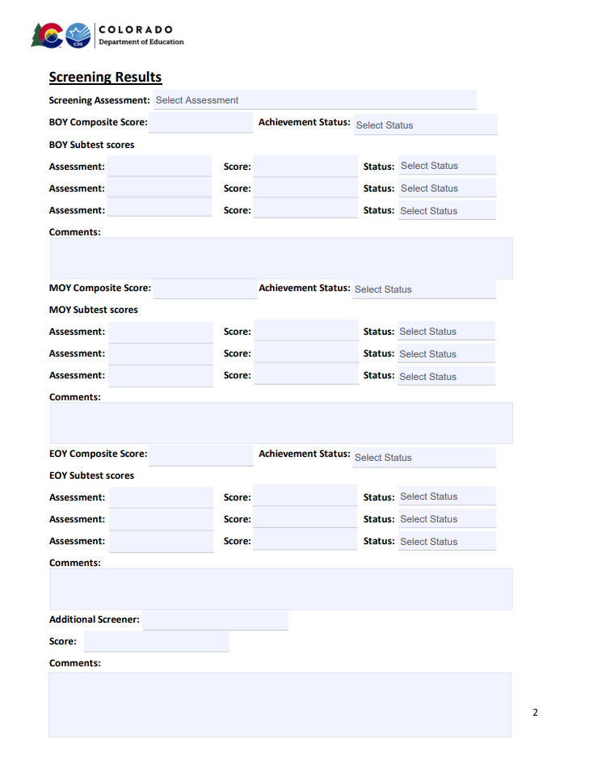
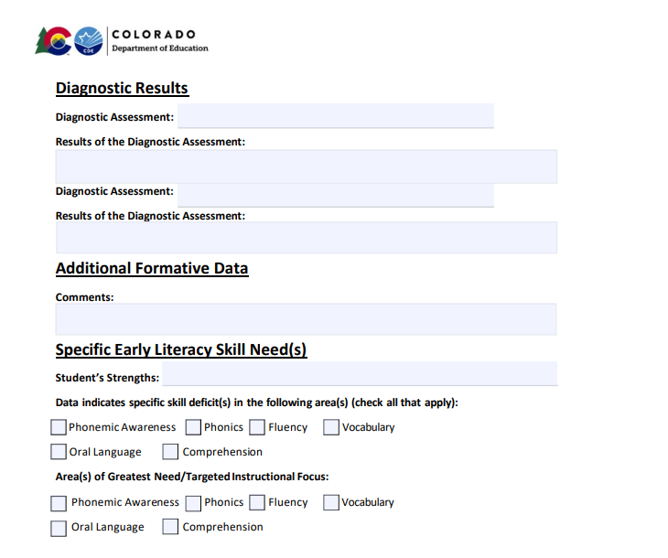
Assessment Results
Notes:
As always, the READ plan contains a section for recording student assessment data and identifying specific skills deficits that should be targeted through instruction. The updates to this section include the ability to record data throughout the year, at BOY, MOY, and EOY, as well as to record specific subtest scores at each benchmark window. A drop down menu also allows the teacher to record the status of each benchmark assessment and each subtest. (Well below, below, at/above). This helps provide a clearer picture over time of student assessment data and performance, rather than having to interpret solely numerical scores or composite scores only.
There also remains a separate location to record the diagnostic assessment and results of the assessment in narrative form.

Slide 27
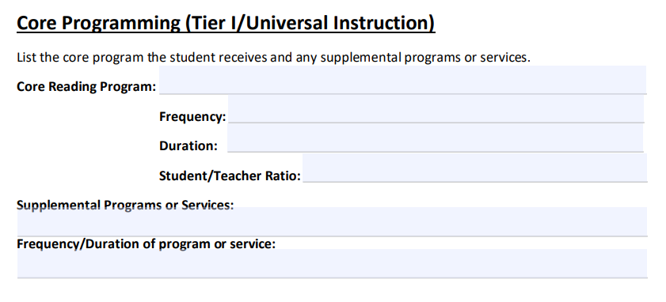
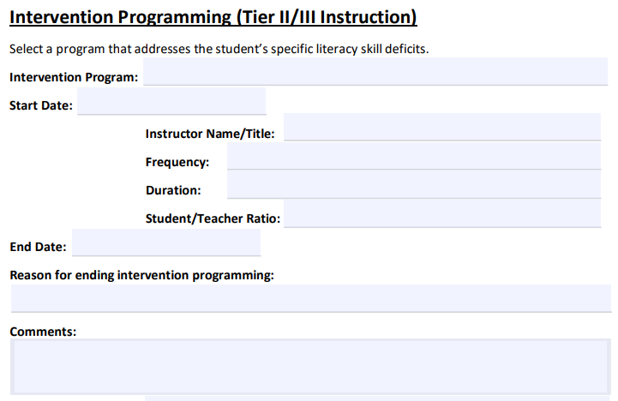
Instruction and Programming
Notes:
The next section of the revised READ plan template addresses instruction and programming. Updates to this section include spaces to record the frequency, duration, and student/teacher ratio for both core and intervention programming the student receives. The intervention section was expanded to include start and end dates for intervention programs, knowing that in some cases a student may either complete a program or require a shift to a different intervention within the school year. This also allows teachers to record reasoning for ending an intervention and an additional space for comments about the intervention program and the student’s response to it.

Slide 28
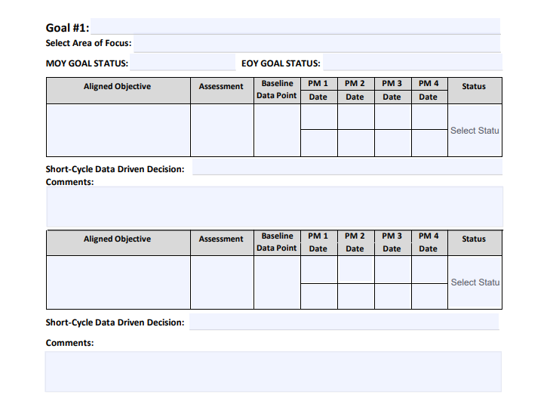
READ Plan Goal(s), Objectives, & Progress Monitoring
Goals should clearly identify the skill being targeted, the time frame for achieving the goal, and the assessment used to measure it.
Goals should be specific, ambitious yet attainable, realistic, and timely.
Consider referencing the CDE minimum competencies standards and Colorado Academic Standards when creating goals.
List the goals in order of priority and align objectives for progress monitoring to the outlined goals
Notes:
Updates have also been made to the goals and objectives section of the template. This section includes within the template a bulleted list of helpful tips to support with better goal writing and identifying targeted objectives. This section was streamlined to include up to three long term goals and spaces for three short-term objectives under each goal.
Each goal includes a line to record the area of focus (e.g. phonemic awareness, phonics) and spaces to record a students’ status towards the goal at MOY and EOY.
The table for each objective provides cells to record the assessment used for progress monitoring, cells to record progress monitoring data over several assessment windows, and a drop-down menu to record whether additional support is needed, whether the student is making progress and should continue with the objective, or whether the objective has been met.
An open line is provided for teachers to determine a short-cycle data driven decision.
In order to use this section in the way it is intended, it is important to focus on strong goals and objectives from the start.
We’ll review goals and objectives in the next section of slides.

Slide 29

Setting the Plan
Why is it happening?
What is the root cause?
Define the skill deficit.
What needs to happen?
What are the SMART Goals?
What are the objectives?
What is happening?
What does the data say?
What will I do if it’s not happening?
What changes need to be made?
How often will we make changes?
How will it happen?
What is the intervention that will address the skills deficits?
Who will deliver it?
How frequently?
How will I know it is happening?
What will I use to PM?
How often?
When will we analyze the data?
Notes:
As we talk about and practice with goal setting today, let’s think about how we break down goal setting into relatable parts.
(go through steps on slide)

Slide 30
Use Data to Determine the Goal
Phoneme awareness
Other Long Vowel Patterns
Onset Rime
Long-Vowel- Silent e
Long-Vowel Sounds in Open Syllables
Syllable Awareness
Easier skill More complex
“Floss” Rule
Rhyming
Ng and nk
Consonant Blends
Word awareness
Digraphs
Digraphs
CVC, CCVC, CCVCC
CVC, CCVC, CCVCC
Alphabetic principle
Alphabetic principle
Sedita, 2019
Notes:
We have shown this example in the past, but it is worth revisiting how we use data to determine the goal.
As an example, let’s say a first-grade student’s diagnostic assessment indicated that although he had sufficient phonemic awareness to blend and segment the sounds in simple words, he struggled with words that contained more than three phonemes, particularly with segmenting words with beginning or end blends. (CLICK TO CIRCLE PHONEME AWARENESS)
Further, the diagnostic revealed several specific sound/letter correspondences that the student did not identify accurately in isolation. In addition, the student struggled to accurately identify these letters sounds in CVC words and was not consistently able to blend CVC words with accuracy or automaticity. (CLICK TO CIRCLE Alphabetic Principle).
At this point, the assessment has given us specific skill deficits that indicate a clear starting point for planning. The data from these assessments can now be used to pinpoint targeted goals and objectives needed to progress toward reading proficiency.

Slide 31

READ Plan Goals
SMART: Specific, measurable, achievable, realistic, timely
Broad, year long
Aligned with the identified area of need
Notes:
When writing goals for a READ plan
Having identified the most important skill deficit, we can begin working on goals. We typically want 2-3 goals at most.
If we have the highest leverage goals, with appropriate evidence-based interventions, we will begin to move towards grade-level reading proficiency.
Goals should be SMART goals which means they should be: specific, measurable, achievable, realistic and timely.
Goals typically last all year, so should be based on the end of year benchmark for a particular skill. This may mean you are off-grade level progress monitoring for foundational skills that are not adequately measured by a student’s grade level assessments.

Slide 32

Crafting a Meaningful Goal
Specific
What, When, How
Realistic
Consider all factors
Measurable
Aligned to valid and reliable assessment
Timely
Clearly defined start and end for measuring progress
Achievable
Yet ambitious. More than a year’s growth.
Notes:
Once we have identified the specific skill deficit using the student’s assessment data, we use this information to craft a meaningful goal using the SMART goal format. A strong goal should be:
Specific: The goal should very clearly identify what skill is being targeted, the time frame for achieving the goal, the assessment that will measure the goal; What, when, how
Measureable: We must be able to objectively measure the goal and identify whether or not the goal was met in the time frame indicated. This is best measured by a valid and reliable literacy assessment, your READ Act approved assessment.
Ambitious yet attainable: when a student is well below grade level, the goal we set must be ambitious and require the student to make more than a year’s growth in order to make up the deficit. In DIBELS 8, this would mean the students makes above average to well above average growth on the skill measured by the assessment that is measuring the skill.
Realistic: While a goal should be ambitious, it must also be realistic. This might mean, particularly for older students, that the goal set for the school year, even if met, does not allow them to reach grade level competency and exit a READ plan. However, it SHOULD allow the student to make significant progress out of the intensive category of risk and into a more strategic need for intervention. A realistic goal should also take into account the intensity of the intervention, the number of intervention minutes a student will receive, alignment of programs, and quality of Tier 1 instruction.
Timely:. The goal should have a clearly defined start and end date for measuring progress. The goal should address the students needs according to current literacy data and should begin to be addressed through intervention NOW; the clock start ticking the moment the goal is set!

Slide 33






Why does the goal matter?
“Finish my Master’s”
“Run a marathon”
“Lose 10 pounds”
“Write a book”
“Declutter the house”
“Get an A in Algebra”
Notes:
It is easy to think “let’s just put these goals in and get this done” when it comes to READ plans. However, if the goal isn’t well thought out, doesn’t target the right skills or causes, is too overly broad or is vaguely described, it is unlikely that the sense of urgency, instructional focus, or measures of progress will be clearly defined enough to move efficiently in the direction of the goal.
Think about some of the goals people often set that fall into this category of being over-general or unspecific. How often do we name goals but not accomplish them?

Slide 34

Getting Real with Goal Setting
What does the data say?
What factors need to be considered?
What is the timeline to accomplish this goal?
What are the specifics of the goal?
How will I measure success?
Notes:
What does the data say? What factors need to be considered? If my goal is to run a marathon four months from now, but I have literally never owned a pair of running shoes and get winded walking to the mailbox, it may not be a realistic or achievable goal within that timeframe. Experts say that, in general, people who want to complete a marathon in a typical timeline for training (about 16 weeks) should have been running for at least a year. In that case, I might need to adjust my targeted goal to something more realistic, like running a 10K, for the current goal, knowing that will allow me to make significant gains toward the longer-term goal of running a marathon in the future.
If I am already a runner, the goal of running a marathon in four months is probably realistic, but I will need to consider what resources I have for training, how much time I can allocate to prepare, and at what intensity I need to train to meet the goal.
What is the timeline to accomplish this goal?
The timeline for the goal is important because it establishes the intensity of the work toward the goal, how realistic the goal is, and whether the goal is achievable. If we don’t give enough time, the goal is not realistic or achievable. If we give too much time, we may lose focus or not work with the appropriate intensity.
What are the specifics of the goal? How will I measure success? If I set a goal to run a marathon, I need to get specific about what that looks like. Do I want to complete the marathon within the alotted time for finishing? This can vary according to individual marathons and their rules (some cut off at, say 6 hours, while others are up to 12 hours). Do I want to set a specific time for completion, say, under 5 hours? Am I looking for a finish time that will allow me to qualify for more competitive marathons? Being specific allows me to understand how intense my training will need to be and specifically how I will be measuring success at the end of the time frame I have established.
In any case, TIME will be the measurement since it is a determining factor in whether the goal is achieved.

Slide 35
Getting Real with Goal Setting
Established runner
10 to 11-minute mile average
20 Weeks to train
No prior marathon experience
“I will complete the Denver Colfax Marathon in under six hours on May 18, 2024.”
Notes:
We have taken the time to review the data and the factors involved in setting a goal that is specific, measureable, achievable, realistic and timely.
Since the person setting this goal is already a runner, a 20-week time-frame for training should be sufficient for meeting the goal.
Because the person has never run a marathon before, simply completing the marathon is a realistic. A little research shows the Denver Colfax Marathon has a cut off time of 6 hours, which means the runner will have to average 13:44 pace per mile to complete the Marathon. This seem achievable based on the runner’s current data.
Finally, this goal is easily measurable, since marathons are a timed event and the runner will know he did not meet his goal if he gets pulled off the course for running too slowly.

Slide 36
Setting Strong Goals
“Finish a Master’s degree”
“Lose 10 pounds”
What factors need to be considered/what data would you need to have?
What is the timeline to accomplish the goal?
What are the specifics of the goal?
How will you measure success?
“Declutter the house”
“Write a book”
“Get an A in Algebra”
Notes:
We used the example of a marathon to write a goal that is specific, measurable, attainable, realistic, and timely.
If you were going to set a strong goal for any of these over general topics, think about:
What factors need to be considered or what data would you need to have?
What is the timeline to accomplish the goal?
What are the specifics of the goal?
How will you measure success?

Slide 37

EOY SMART Goal Example
Goal 1: By the EOY assessment, (student name) will achieve a score of (identify target) or higher on the DIBELS 8 Phoneme Segmentation Fluency (PSF) assessment.
Goal 2: By the EOY assessment, (student name) will be able to correctly recode (identify target) nonsense words per minute on the DIBELS 8 NWF assessment.
Notes:
As stated before, the goal(s) should match the student’s identified area(s) of need. This will be the first step to move the student towards becoming a proficient reader. For instance, if a student does not know all their letter sounds, focusing on this precedes a focus on oral reading fluency. This is how we can create an attainable goal by focusing on the appropriate deficit with our goals and objectives.
Ideally you want to have a goal that is as close to being proficient as possible for that skill for that specific grade, which may not be the same as the student’s actual grade level. The objectives identified are what needs to occur prior to the student being able to achieve the overall goal.
They should also be evaluated short term, to show progress. Our example goals are that by the end of year assessment, the student will achieve a specific score or higher on the PSF assessment, and that by the EOY assessment, the student will be able to read a specific number of nonsense words per minute on a nonsense word fluency assessment.

Slide 38
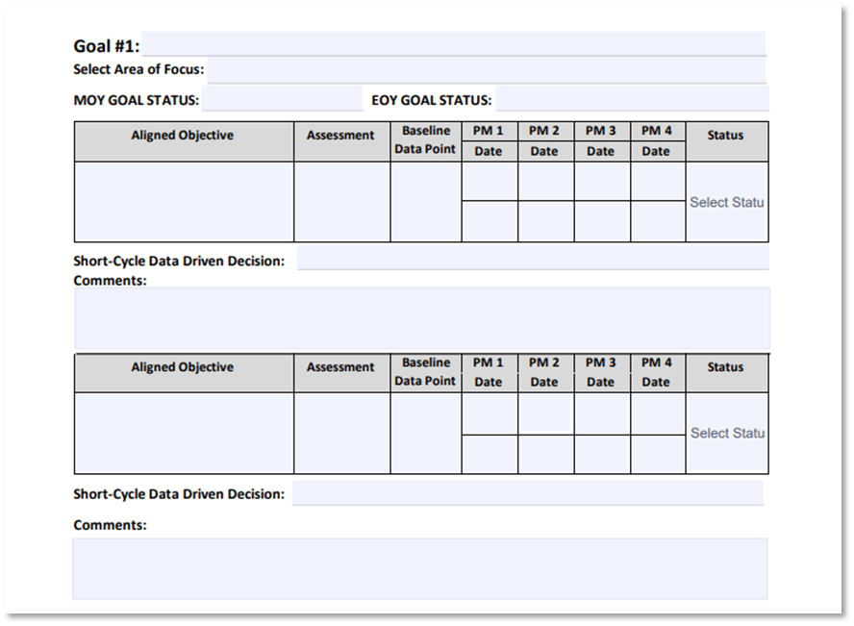
What is an objective?
“Stepping stone” to the goal
Targeted, specific, measurable
Skill-based
What skills does the student have to master to achieve the goal on the READ plan?
Notes:
Objectives are subcomponents of the overarching goal and should contribute towards the achievement of it. The objectives would be for a smaller portion of time and can vary on the amount needed based on student’s needs. On the READ plan, you would document when you started the goal, as well as the objective. When progress monitoring, a student’s ability to meet the objectives helps us see if the student is making overall progress toward the achievement of the goal.
Ideally, if your goal is specific, measurable, attainable, realistic and timely, the objectives should break the goal down into the skills needed to accomplish that goal. When identifying appropriate objectives, we have to ask ourselves, “What skills does the student have to master to achieve the goal on the READ plan?”

Slide 39



Goal Setting Example
GOAL:
“I will complete the Denver Colfax Marathon in under six hours on May 18, 2024.”
20- mile Run
Objectives
10-mile continuous run
5-mile continuous run
3-mile continuous run
Each run under 13:44/mile pace!
Notes:
Let’s go back to our example goal of running a marathon.
We know, typically speaking, very few people will be successful just saying they want to run a marathon and then go run one successfully.
And someone who is a casual runner is probably not going to continue their everyday running routine and be successful either.
To ensure success, training programs are specifically designed to increase fitness, stamina and pace over the time allotted for training so that by race day, finishing the race is likely.
So, as training occurs, we will want to ensure the skills we need are in place so that we can measure progress towards the goal in shorter term increments and makes adjustments early if we are not meeting those targets.
This is of course very simplified (as I myself am not a distance runner), but if I know that during my training schedule I am working toward shorter term, specific and targeted objectives, I am more likely to be able to course correct if I am not meeting the objectives, to be able to identify where specifically I am struggling, to accelerate if I find I am not challenged, or even to adjust my goal if I encounter setbacks.
Objectives are also critical in analyzing whether the training program is appropriate for me and my current needs.

Slide 40
Setting Targeted Objectives
“Finish a Master’s degree”
“Lose 10 pounds”
What steps would need to be taken between now and the goal date?
What skills might need to be mastered or addressed?
How will you know if you are making progress?
“Declutter the house”
“Write a book”
“Get an A in Algebra”
Notes:
Thinking again about one of these topics, take a moment to think through how we might set targeted objectives:
What steps would need to be taken between now and the goal date?
What skills might need to be mastered or addressed?
How will you know if you are making progress?
Share objectives. (5 min)

Slide 41


Aligning Targeted Objectives
Goal: By the EOY assessment, (student name) will achieve a score of (identify target) or higher on the DIBELS 8 Phoneme Segmentation Fluency (PSF) assessment.
Blend and segment phonemes in 4 phoneme words with blends*
  Isolate initial, final and medial phonemes in 3 phoneme words*
Blend and segment phonemes in 3 phoneme words*
* With 85% or better accuracy
Notes:
Ideally you want to have a goal that is as close to being proficient as possible for that skill for that specific grade, which may not be the same as the student’s actual grade level. The objectives identified are what needs to occur prior to the student being able to achieve the overall goal.
They should also be evaluated short term, to show progress.
Our example goal is that by the end of year, the student will achieve a defined score or higher on the DIBELS 8 PSF assessment. In this case, our first objective is that the student will need Isolate initial, final and medial phonemes in 3 phoneme words. We know if students can accomplish this, they will be more likely to be able to blend and segment phonemes in three phoneme words, which is the next objective. Finally, the student would be able to blend and segment phonemes in 4 phoneme words with blends. All of these skills would be measured for 85% accuracy or better to ensure mastery.
Progress toward these objectives and mastery of them could be monitored using the same assessment that we are using to monitor the goal.

Slide 42
Aligning Targeted Objectives
Goal: By the EOY assessment, (student name) will be able to correctly recode (identify target) nonsense words per minute on the DIBELS 8 NWF assessment.
Blend CVC words with 90% accuracy.
  Accurately identify all letter/sound correspondences.
Identify each letter sound in a CVC word with 90% accuracy.
Notes:
Our second example goal is that by the end of year, the student will be able to read a specific number of nonsense words per minute on a nonsense word fluency assessment. In this case, our first objective is that the student will need to accurately identify all letter correspondences. We know if students can accomplish this, they will be more likely to be able to blend words. Next we would work on identifying each letter sound in a CVC word accurately.
We know that students will isolate correct letters sounds first before they will be able to fluently and automatically blend letters together to form words.
Last, we would have the student working on blending CVC words with 90% accuracy. We will determine if the student has automaticity with each of these skills by assessing them with a nonsense word fluency assessment. By breaking down this end of year goal into objectives, we will be able to see the progress being made and shift our practice if the student is not making adequate growth at a reasonable rate.

Slide 43

Simplifying Objectives
Utilize minimum skill competencies
Align to intervention skill progression that addresses the skill deficit
Consider groups of students with similar deficits and align objectives
Make your list once; revise as needed
minimumcompetencylinkedmatrix (state.co.us)
Notes:
Utilize minimum skill competencies
Align to intervention skill progression that addresses the skill deficit
Consider groups of students with similar deficits and align objectives
Make your list once; revise as needed

Slide 44
EOY SMART Goals and Objective Example
Goal 1: By end of year, (student name) will be able to read (identify target)
nonsense words per minute on the (test name) NWF assessment.
Objective(s):
  Identify all letter sound correspondences with 100% accuracy.
  Identify each letter sound in a CVC word accurately.
  Blend CVC words with 90% accuracy.
Notes:
To review, a strong goal should target the skills a student would be able to demonstrate by the end of the school year, while the objectives are measurable steps that lead to the achievement of the goal.
Our example goal is that by the end of year, the student will be able to read a specific number of nonsense words per minute on a nonsense word fluency assessment. In this case, our first objective is that the student will need to accurately identify all letter correspondences. We know if students can accomplish this, they will be more likely to be able to blend words. Next, we would work on identifying each letter sound in a CVC word accurately.
We know that students will isolate correct letters sounds first before they will be able to fluently and automatically blend letters together to form words. Last, we would have the student working on blending CVC words with 90% accuracy. We will determine if the student has automaticity with each of these skills by assessing them with a nonsense word fluency assessment. By breaking down this end of year goal into objectives, we will be able to see the progress being made and shift our practice if the student is not making adequate growth at a reasonable rate.

Slide 45
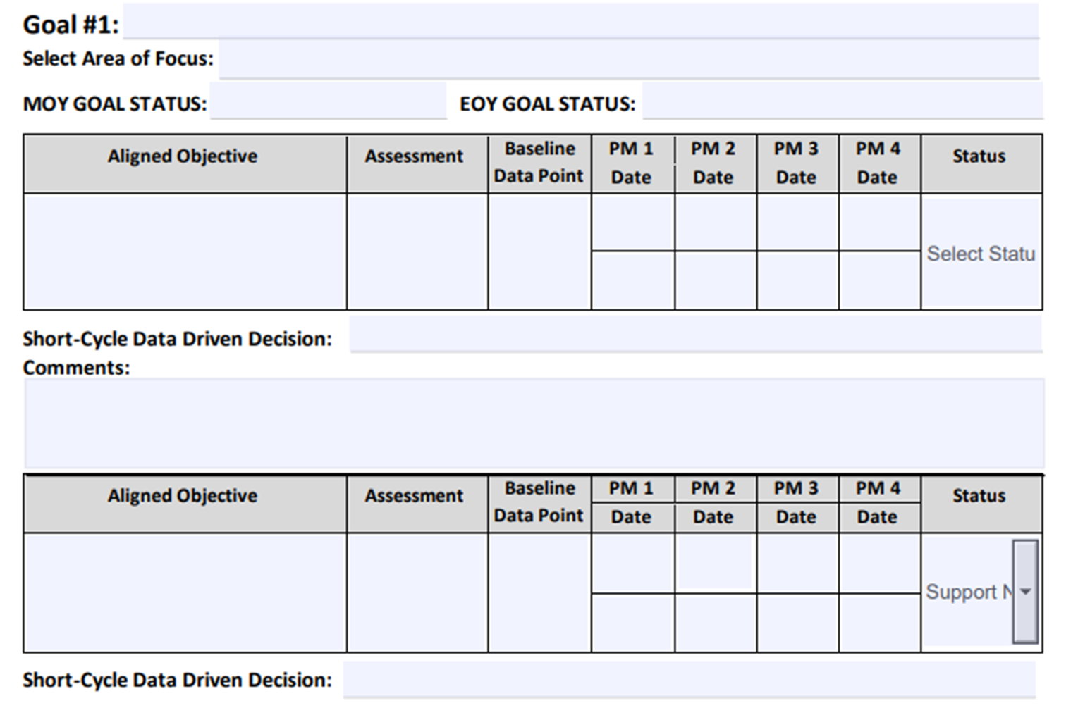
Goals and Objectives Example
By EOY, Sam will read 35 nonsense words per minute on the DIBELS 8 NWF assessment.
phonics
Identify all letter sound correspondences with 100% accuracy.
Identify each letter sound in a CVC word accurately.
Notes:
This is just an example of how the goal and its corresponding objectives would appear in the format provided by the updated template.

Slide 46
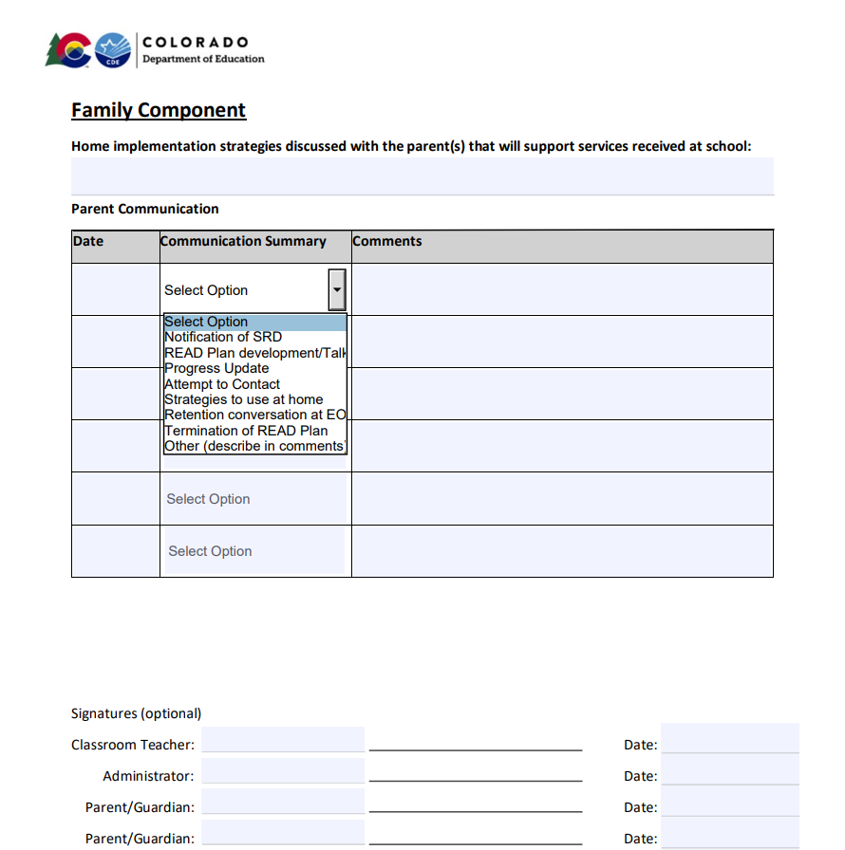
Family Component
New template includes dropdown menus to document various and ongoing communication with families
Notes:
The updated READ Plan template also has some new additions for documenting communication with families. In addition to fields for the date and comments, there is now a dropdown menu for the communication survey including the following options: notification of SRD, READ plan development/talk, progress update, attempt to contact, strategies to use at home, retention conversation at EOY, termination of READ Plan, or other.

Slide 47
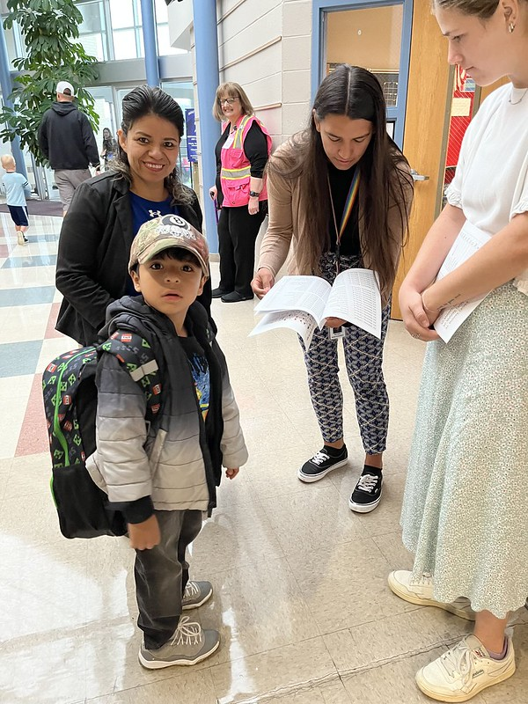
Communication with Families
School Responsibilities
The READ Act requires schools to:
Collaborate with parents to create READ plan together
Discuss the student’s specific reading needs
Ensure parent understanding of information
Share the READ plan interventions that address the child’s needs
Discuss how parents play a central support role
Communicate ongoing, regular progress updates for parents
Notes:
The READ Act details several requirements about the information schools need to share with parents and what schools need to do to involve the community and parents.
The READ Act requires schools to:
Discuss the student’s specific reading needs
Collaborate with parents to create READ plans together
Ensure parents understand the information being presented (this includes presenting the information in a language the parents understand whenever possible)
Share the READ plan interventions that address the child’s needs and to
Discuss how parents play a central supportive role
Communicate ongoing, regular progress updates for parents

Slide 48
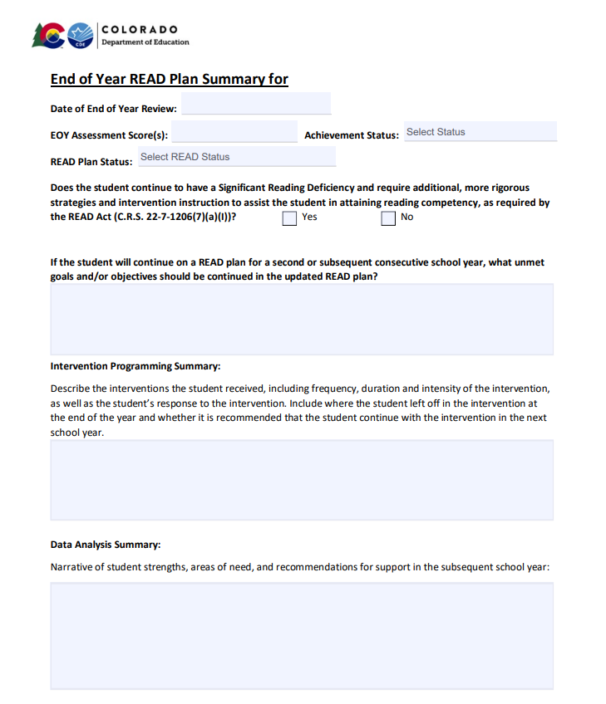
End of Year READ Plan Summary
Notes:
The final change to the updated READ Plan template is the End of Year Summary. We wanted to briefly highlight this addition as we walk through the template, and we will go over this section in more detail at our April meeting. This section includes EOY assessment results and READ Plan status, SRD status, explanation of unmet goals, intervention programming summary, and a data analysis summary.
Once the READ plan template has been in place through a school year, with the READ plan history at the beginning and the End of Year summary at the end, these sections will provide the information needed to transfer a plan from one year to the next for a student who continues on a READ plan into a second year, OR can provide key information to the next year’s teacher to support a student from the start who is no longer on a READ plan so that they don’t regress in the next school year.

Slide 49

Ideal READ Plan Pathway by EOY
Updates have occurred regularly
Includes adjustments or changes to intervention
Includes progress towards objectives and/or goals
Progress monitoring data is well documented
Ideally, also includes HOW the intervention was implemented, including:
  FREQUENCY
  DURATION
  INTENSITY
  GROUP SIZE
Notes:
By the time we get to the end of the school year in which a child has been identified with an SRD and placed on a READ plan, ideally we have used the steps in the READ plan process through several cycles and have updated the plan regularly.
This means the documentation should include clear descriptions of the intervention programming the student has received and when that has been changed or adjusted. It should also include progress toward identified objectives and when those objectives are met, development of new objectives when needed, and an indication of any goals met along the way. Documentation of assessment data should be clearly listed as evidence of progress.
Ideally, the READ plan should also include information on HOW the intervention was implemented, such as frequency, duration, intensity, and group size.
This allows teachers to pull “instructional levers” to adjust instruction if a student is not responding well to an intervention.

Slide 50

EOY READ Plan Updates-
What will teachers need to know?
End-of-year benchmark assessment data
Which goals and objectives were met and not met, and which should be continued or revised in the upcoming year
Which specific skill focus should be addressed in the upcoming school year, as supported by the body of evidence
A narrative synopsis of the frequency, duration, and intensity of intervention instruction that was provided in the current school year and the effectiveness of the intervention(s).
Based on the end-of-year results, include a recommendation for the upcoming year
Notes:
The End of Year Summary is a way to provide the next year’s teacher with the critical information they need to make strong decisions for their student from the start.
What information would be needed the following year to provide increased instruction and/or start the year running?
End-of-year benchmark assessment data
Which goals and objectives were met and not met, and which should be continued or revised in the upcoming year
Which specific skill focus should be addressed in the upcoming school year, as supported by the body of evidence
A narrative synopsis of the frequency, duration, and intensity of intervention instruction that was provided in the current school year and the effectiveness of the intervention(s).
Based on the end-of-year results, include a recommendation for the upcoming year
All of these considerations have been addressed in the End-of Year summary section of the new template to support transfer from one year to the next.

Slide 51
READ Plans for
Multilingual Learners
Notes:
In addition to a revised basic READ plan template, CDE has developed at new template specifically for students on READ plans who are multilingual learners.

Slide 52

Considerations for English Language Learners
The READ Plan Should Include:
Reading goals and selected interventions should be developed using the Proficiency Level Descriptors (PLDs)
The necessary instructional scaffolds to ensure language considerations are addressed while providing the intervention
Information about a student’s home or preferred language
Notes:
When writing a READ Plan for an English Learner, the process for analyzing data, determining specific skill deficits, and writing goals and objectives is the same.
However, it is also important that the READ plan incorporates information about the student’s English language development. When creating a READ plan for an English Learner:
The READ Plan Should Include:
Reading goals and selected interventions should be developed using the Proficiency Level Descriptors (PLDs)
The necessary instructional scaffolds to ensure language considerations are addressed while providing the intervention
Information about a student’s home or preferred language
The new template provides structure to include these elements in the plan.

Slide 53
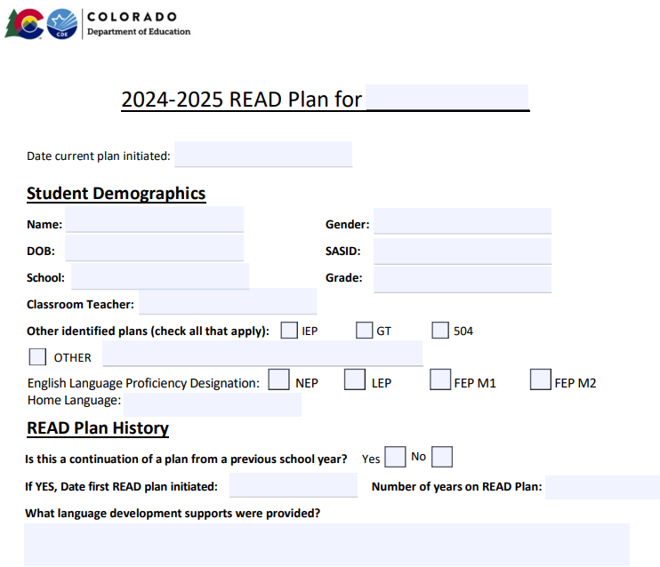
READ Plans for Multilingual Learners
Notes:
The new READ plan template for MLs includes additions specific to the needs of multilingual learners who also need intensive reading support. While the template is formatted similarly to the general READ plan template, there are a few differences to note.
In the student demographic section, there is a place to document a student’s home language as well as their English Language Proficiency designation.

Slide 54
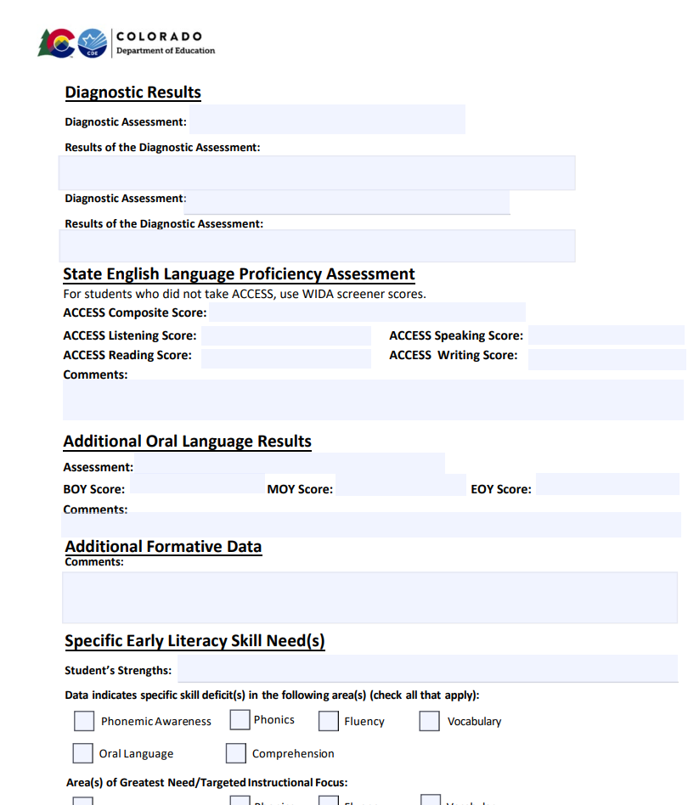
READ Plan Additions for Multilingual Learners
Notes:
In the assessment section, there is a more complete section for recording a student’s ACCESS scores, including subtest scores, as well as a place to record additional oral language results and additional formative data.

Slide 55
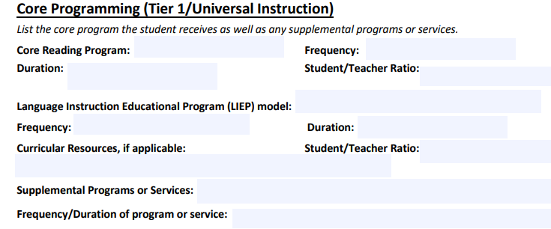
Core Programming
Notes:
In the core programming section of the template, there is space to record a student’s Language Instructional Education Program model, including the frequency, duration and student/teacher ratio, as well as curricular resources used.

Slide 56
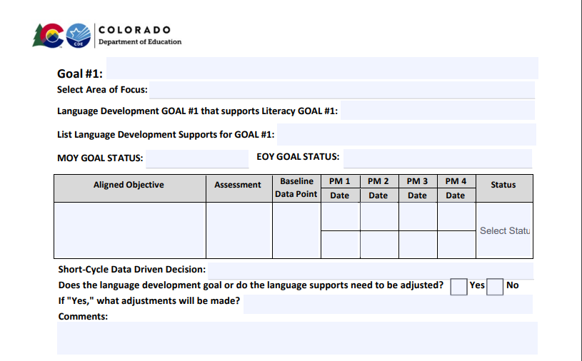
Goals
Notes:
The goals section of the template is customized as well, providing a section for a language development goal that supports the literacy goal, as well as for listing language development supports for the goal. And language development goals are also tied to the decision-making process for determining next steps throughout the year.

Slide 57
Language Development Supports
Language Development Supports
• Include “wait time” so that students can process information.
• Incorporate gestures and use visual supports.
• Use recasting to model and expand language.
• Develop oral language throughout all content areas.
• Incorporate language objectives to give students access to the content.
• Plan collaborative talk structures (e.g., Think-Pair-Share).
• Use graphic organizers.
• Provide differentiated sentence frames.
• Make direct cross-linguistic connections.
• Provide multiple opportunities for practice and accurate repetition.
• Adjust the rate of speech and complexity of language to meet the needs of the learners.
• Activate and build upon prior knowledge.
• Break down multi-step directions or tasks.
• Dedicate time for verbal reasoning/rehearsal.
• Incorporate translanguaging.
Notes:
When planning for intervention instruction for multilingual students, it is important that teachers carefully consider the types of language development supports students will need in order for the intervention to be effective in remediating their reading skill deficits as well as support their language development goals.
The new Multilingual Learner READ Plan template includes suggested instructional supports for language development to help teachers identify the right supports for their students.
These support options include: (Read bulleted list)

Slide 58
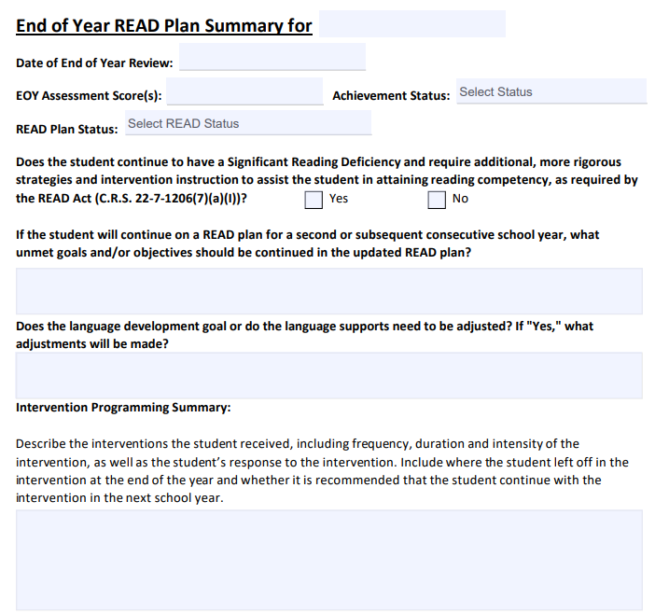
End of Year READ Plan Summary
Notes:
And finally, the end of year READ plan summary for multilingual learners also includes reflection on the language development goal in addition to reading goals and intervention recommendations.

Slide 59

Review Your READ Plan Sample
Take a moment to review the READ plan sample that you brought from your district.
Does the READ plan sample include detailed information in a readable format about the student’s assessment results, core and intervention programming, and history?
Does the READ plan include targeted SMART goals and clear, aligned objectives? Has the plan been updated at regular intervals to document progress?
    Is there enough information recorded in the READ plan for a subsequent year’s teacher or instructional team to understand what a student accomplished in the previous school year?
For students with an SRD continuing on a READ plan from a prior year, is there enough information to ensure that intervention is intensified appropriately?
Does the READ plan document parent communication consistently?
Are there customized options in your current READ plans to meet the needs of Multilingual learners?
Notes:
Take a moment to review the READ plan sample that you brought from your district.
Does the READ plan sample include detailed information in a readable format about the student’s assessment results, core and intervention programming, and history?
Does the READ plan include targeted SMART goals and clear, aligned objectives? Has the plan been updated at regular intervals to document progress?
Is there enough information recorded in the READ plan for a subsequent year’s teacher or instructional team to understand what a student accomplished in the previous school year?
For students with an SRD who will continue on a READ plan from a prior year, is there enough information to ensure that intervention is intensified appropriately?
Does the READ plan document parent communication consistently?
Are there customized options in your current READ plans to meet the needs of Multilingual learners?

Slide 60
Discussion:
READ Plan Reflection
Questions:
What do your READ Plans look like now? Have high quality goals and objectives been a part of your READ Plans?
How is parent communication for students on READ Plans addressed in your district? What improvements could be made?
How are READ plans for Multilingual Learners handled in your district?
What plans can you make now to improve the quality of READ Plans and ensure teachers are prepared to write them?
Topics:
The READ Plan process
SMART Goals for READ plans
Aligned READ plan objectives
Parent Communication Policies
Notes:
Now that you’ve had some time to review your READ plan goals and objectives, we are going into breakout rooms for ~10 minutes to discuss the questions on this slide.

Slide 61

CDE Science of Reading Literacy Series
Notes:
Next, we will turn our attention to the CDE Science of Reading Literacy series. This is an optional series of trainings that you can use to enhance your systems and structures in key areas of literacy instruction.

Slide 62
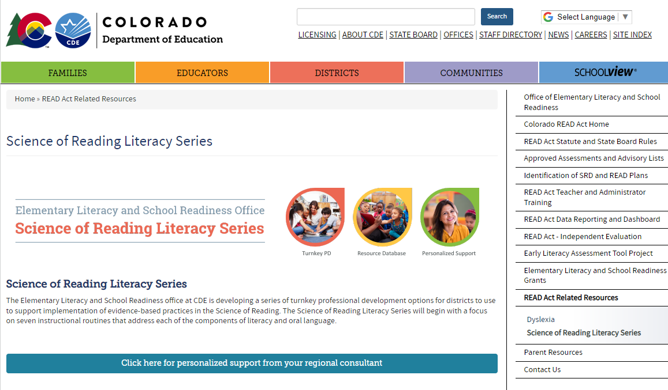
CDE Science of Reading Literacy Series
https://www.cde.state.co.us/coloradoliteracy/sorliteracyseries
Notes:
https://www.cde.state.co.us/coloradoliteracy/sorliteracyseries
Starting in the Fall of 2023, the ELSR office began releasing a series of turn-key professional development products to support districts with implementation of evidence-based instructional routines aligned to the Science of Reading. The series can be found on the READ Act website by navigating to the side menu, clicking Read Act Related Resources, and then on Science of Reading Literacy Series in the drop-down menu. These Powerpoint decks and resources were developed in alignment with the 45-hour teacher training to revisit the research base, review the steps in the instructional routines, provide a model for the routine, and allow opportunities for practice and planning. The series also includes resources for administrators to be able to track and provide feedback on implementation of the routines in their buildings.

Slide 63

Series Highlights
Fully scripted slides
Digital handouts
Companion overview video for background knowledge
Focuses on key areas of literacy instruction
Provides an effective routine
Interactive format
Incorporates time to practice, collaborate, and plan
Supports building wide implementation
Notes:
This series includes fully scripted slides, digital handouts, companion overview videos for each topic, an effective routine, and interactive format. This series focuses on key areas of literacy instruction, incorporates time to practice, collaborate, and plan, and supports building wide implementation.

Slide 64
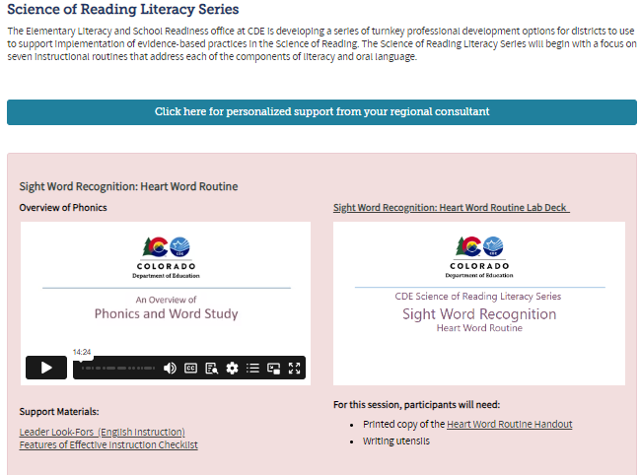
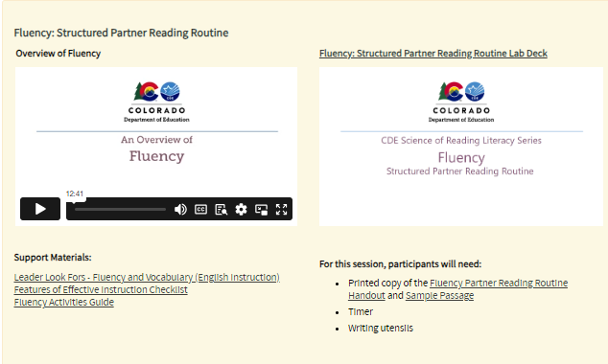
Science of Reading Literacy Series
Notes:
We started by releasing three routines in September 2023 for phonemic awareness blending and segmenting, phonics blending and segmenting, and phoneme grapheme mapping. We released four additional topics in December 2023, including a Heart Word routine, and routines for introducing new vocabulary and partner reading for fluency, as well as a Turn and Talk routine for supporting oral language. Along with the release of the materials on our website, we also offered Training of Trainer sessions for leaders to go through the training materials and provide opportunities for questions and discussion. Each TOT was offered two times. The website also includes a link to request support from regional consultants should leaders have additional questions or need support with implementation.

Slide 65
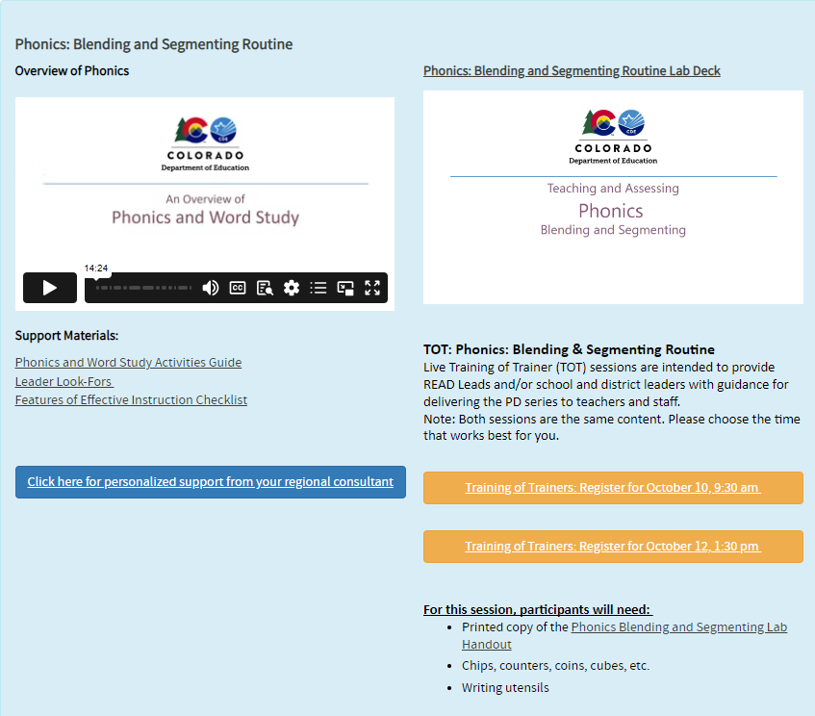
Leader Look Fors Observation Tool
Notes:
An important component of the CDE Science of Reading Literacy Series is the intentional integration of resources that provide both teachers and school leaders specific criteria for determining whether the routines are being implemented effectively. The Leader Look Fors observation tool is located under “Support Materials” for each of the trainings.

Slide 66

Coming Soon
Notes:
For the 2024-25 school year, the ELSR office is rolling out 3 additional topics in the Science of Reading Literacy Series that align with language comprehension. These fully scripted slide decks will not have a specific instructional routine but will have extensive content to support foundational knowledge for each topic and opportunities to analyze your current curriculum in these areas. We will send a follow up email when these decks are available on the website.

Slide 67
Regional Consultant Support
At the top of the Literacy Series page, there is a button to click for personalized support.
This will take you to the regional support map and allow you to contact your regional consultant.
Notes:
At the top of this webpage, there is a button to click for personalized support.
This will take you to the regional support map and allow you to contact your regional consultant. There are buttons on the webpage to choose a 30 minute or 1 hour session with your consultant. When you email your regional consultant, we will also share our booking links with you.

Slide 68
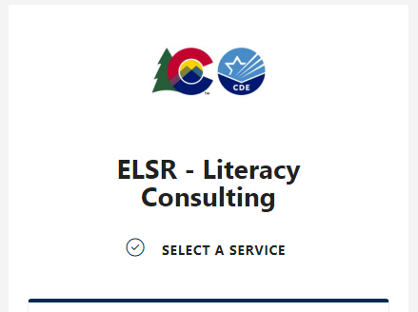
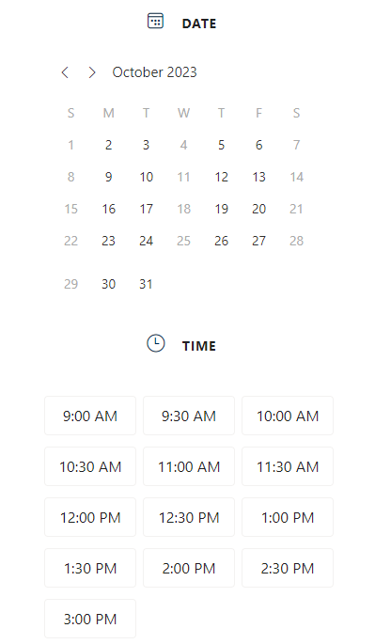
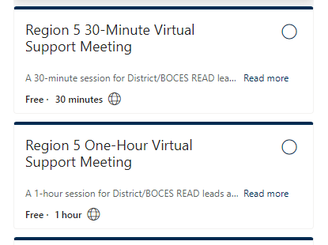
Schedule a Meeting with Bookings
Notes:
When you click the button on the webpage or email your regional consultant, you will receive a link to schedule a virtual meeting through Bookings.
Depending on your needs, we have 30 minute and 1-hour sessions available to book.
Once you click on a service for your region, you will see the available dates and times to meet with your consultant.

Slide 69
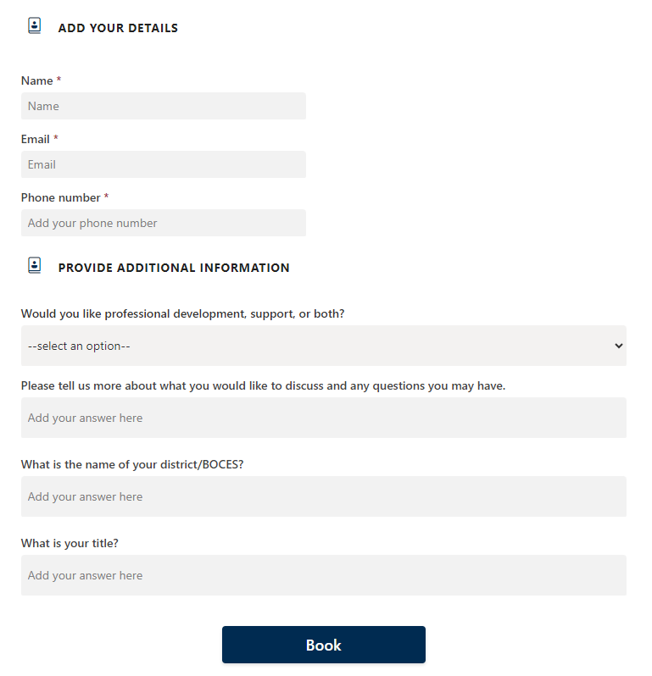
Bookings Form
Notes:
Once you select a time that works for you, there will be additional details to add to your booking. When you are filling out this form, please make sure to add all necessary details in the additional information section. You can write notes and questions in the section where it says, “Please tell us more about what you would like to discuss and any questions you may have”.
We rely on that section to ensure that our time together is intentional and supportive of your specific needs.
If you need to cancel or reschedule a meeting, please go back to the original email you were sent from Bookings when you made the appointment. If it is within 48 hours, please email your consultant directly to cancel and we will send you the link to reschedule.

Slide 70
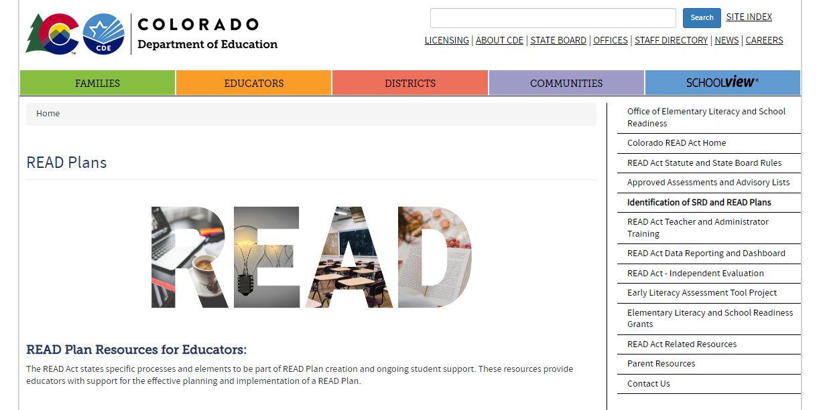
READ Act Website –
Updates and Resources
http://www.cde.state.co.us/coloradoliteracy

Slide 71

Questions?
Notes:
This concludes the information covered in today’s meeting. Before we continue to the survey, are there any remaining questions about the topics we discussed this morning?

Slide 72
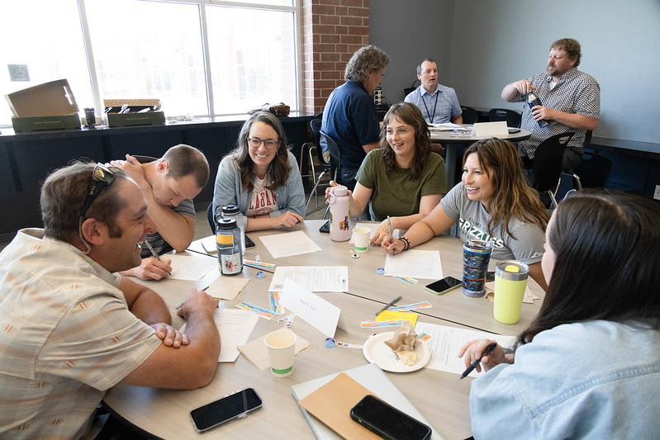
Future Meetings and Collaboration
Multi-Tiered Systems of Support
Culturally and Linguistically Diverse Education
Exceptional Student Services Unit
Transformation Network (formerly Turnaround Network)
Standards and Instructional Support
Comprehensive Literacy State Development Grant
Early Literacy Grant
READ Act Principal/Administrator Training
Notes:
Future READ meetings in the coming year will include collaboration with other CDE offices, units, and information about literacy grants and resources from CDE. This includes:
Multi-Tiered Systems of Support
Culturally and Linguistically Diverse Education
Exceptional Student Services Unit
Transformation Network (formerly Turnaround Network)
Standards and Instructional Support
Comprehensive Literacy State Development Grant
Early Literacy Grant
READ Act Principal/Administrator Training

Slide 73

District Spotlights
Evidence-based instructional practices
Supporting READ Plans with strong MTSS systems
Efficient data protocols
Aligning practices with assessment results
Ongoing professional development
Innovative parent communication and family involvement practices
Notes:
Finally, our office is interested in spotlighting literacy work happening in districts around the state. For districts who are interested in sharing their work, there will be possible opportunities to invite CDE staff for site visits and share some of this work with others at our regional meetings. Topics we are interested in spotlighting are:
Evidence-based instructional practices
Supporting READ Plans with strong MTSS systems
Efficient data protocols
Aligning practices with assessment results
Ongoing professional development
Innovative parent communication and family involvement practices
If you believe your district has work that you would be interested in sharing with CDE and other districts, please indicate that on the feedback survey at the end of today’s meeting.

Slide 74

Feedback Survey
We value your feedback!
Please take a few moments to fill out this form to help inform future meetings.
https://forms.gle/uUnrcWNZWF52FcFT7
Notes:
We value your feedback!
Please take a few moments to fill out this form to help inform future meetings.
Drop link in the chat:
Feedback Form: https://forms.gle/uUnrcWNZWF52FcFT7

Slide 75
Contact Information
For general questions about the CDE-Provided Teacher or Administrator Training options: ReadActTraining@cde.state.co.us
For READ Act Data inquires: READActData@cde.state.co.us
For all other questions related to the READ Act: ReadAct@cde.state.co.us
Notes:
We are always here to support you with questions.
If you have general questions about the CDE-Provided Teacher or Administrator Training options email: ReadActTraining@cde.state.co.us
For READ Act Data inquires email READActData@cde.state.co.us
For all other questions related to the READ Act email: ReadAct@cde.state.co.us

Slide 76
Helpful Links
READ Act Main Page:
http://www.cde.state.co.us/coloradoliteracy
Webinar/Office Hours Information: https://www.cde.state.co.us/coloradoliteracy/elsrliteracyteam-officehours
READ Act Statute and Rules: http://www.cde.state.co.us/coloradoliteracy/readactstatuteandstateboardrules
READ Plans:
https://www.cde.state.co.us/coloradoliteracy/readplans
READ and English Learners:
https://www.cde.state.co.us/coloradoliteracy/readandel
Science of Reading Resources: https://www.cde.state.co.us/coloradoliteracy/scienceofreadingresources
Educator Resources: https://www.cde.state.co.us/coloradoliteracy/readacteducatorresources
Body of Evidence: Webinar and Guidance Document:
http://www.cde.state.co.us/coloradoliteracy/readplans
Notes:
Here are some helpful links from the CDE website.
READ Act Main Page:
http://www.cde.state.co.us/coloradoliteracy
Webinar/Office Hours Information: https://www.cde.state.co.us/coloradoliteracy/elsrliteracyteam-officehours
READ Act Statute and Rules: http://www.cde.state.co.us/coloradoliteracy/readactstatuteandstateboardrules
READ Plans:
https://www.cde.state.co.us/coloradoliteracy/readplans
READ and English Learners:
https://www.cde.state.co.us/coloradoliteracy/readandel
Science of Reading Resources: https://www.cde.state.co.us/coloradoliteracy/scienceofreadingresources
Educator Resources: https://www.cde.state.co.us/coloradoliteracy/readacteducatorresources
Body of Evidence: Webinar and Guidance Document:
http://www.cde.state.co.us/coloradoliteracy/readplans

Slide 77

Thank You!
Notes:
Thank you for attending today. We very much value your time and continued partnerships. The Elementary Literacy and School Readiness office is here to support the work you do.

Slide 78
References
Colorado Department of Education. (2022). Body of evidence: Data to measure literacy skills and inform instruction. http://www.cde.state.co.us/coloradoliteracy/bodyofevidence
Colorado Department of Education. (2022). Exiting a student from a READ Plan: Determining reading competency in kindergarten through third grade. http://www.cde.state.co.us/coloradoliteracy/exitingareadplan
Colorado Department of Education. (2017). READ Act minimum reading competency skills matrix. http://www.cde.state.co.us/coloradoliteracy/minimumcompetencylinkedmatrix
Colorado Reading to Ensure Academic Development Act, Colo. Rev. Stat. §§ 22-7-1201-1214, (2019).
Gough, P. B. & Tunmer, W.E. (1986). Decoding, reading, and reading disability. Remedial and Special Education, 7(1).
Moats, L.C. (2009). Getting up to speed: Developing fluency, 2nd edition. Boston, MA: Sopris West.
National Reading Panel. (2000). Teaching children to read-An evidence-based assessment of the scientific research literature on reading and its implications for reading instruction (NIH Publication No. 00-4769) Washington, DC: National Institutes of Child Health and Human Development.
Rules for the Administration of the Colorado Reading to Ensure Academic Development Act, 1 Colo. Code Regs. 301-92 (2017).
Scarborough, H. S. (2001). Connecting early language and literacy to later reading (dis)abilities: Evidence, theory, and practice.
Stahl, S. A., & Nagy, W. E. (2006). Teaching word meanings. Mahwah, NJ: Erlbaum.

