Slide 1

READ Act Regional Meeting
READ Act and Students with Disabilities
Friday, April 4, 2025
Office of Elementary Literacy and School Readiness and the Exceptional Student Services Unit
Notes:
Welcome, and thank you for attending our spring READ Act Regional Meeting. Today we are thrilled to be partnering with the Exceptional Student Services Unit at CDE to share more information about the READ Act and students with disabilities.

Slide 2

Welcome
Lindsey Beveridge, Senior Literacy Consultant
Office of Elementary Literacy and School Readiness
Beveridge_L@cde.state.co.us
Caitlin Fickling, Senior Literacy Consultant
Office of Elementary Literacy and School Readiness
Fickling_C@cde.state.co.us
Jamie Olson, Senior Literacy Consultant
Office of Elementary Literacy and School Readiness
Olson_J@cde.state.co.us
Notes:
Introductions

Slide 3

Introductions: Office of Special Education
Emily Ottinger, Specific Learning Disabilities Specialist
Exceptional Student Services Unit / Office of Special Education
Ottinger_E@cde.state.co.us
Notes:
We would also like to introduce our guest presenter today, Emily Ottinger, Specific Learning Disabilities Specialist from the Office of Special Education.

Slide 4
Agenda
9:00 – 9:55 | READ Act and Students with Disabilities * In collaboration with the Exceptional Student Services Unit
10:00 – 11:00 | Literacy Updates and Collaboration Students with Disabilities Q&A READ Act FAQs and Breakout Discussions: Students with Disabilities Multilingual Learners MTSS and Tiers of Literacy Instruction EOY READ Act Reminders CDE Literacy Updates
Note: Both sections of today’s meeting will be held on the same Zoom link.
Notes:
This is the brief agenda for this morning. In the first hour, we will have a presentation about the READ Act and Students with Disabilities in collaboration with the Exceptional Student Services Unit. We will take a brief break and reconvene at 10:00 for a Q&A time about students with disabilities, READ Act FAQs and breakout discussions for students with disabilities, multilingual learners, and MTSS, with CDE staff from both offices in each breakout room. Finally, our meeting will end with EOY READ Act reminders and CDE literacy updates.
Please note: Both sections of today’s meeting will be held on the same link. We’re glad to connect faces from across our state and department this morning.

Slide 5
Senate Bill 25-200
Current Status:
Under Consideration
Information can be found on the Colorado General Assembly web page:
https://leg.colorado.gov/bills/sb25-200
If you have questions about active or potential legislation, please feel free to reach out directly to the CDE Policy Team: policyteam@cde.state.co.us
Notes:
We understand that many of you are aware of the recent Senate Bill 25-200 and have questions about potential impacts should there be changes to the READ Act. This bill is currently under consideration in the state legislature. We at CDE are not able to discuss SB 25-200 at this stage in the legislative process, nor will be discussing it or answering questions about it during today’s meeting. If changes are made to the READ Act, our office will release guidance as soon as possible.
If you would like to read more about the bill, information can be found on the Colorado General Assembly web page: https://leg.colorado.gov/bills/sb25-200
If you have questions about active or potential legislation, please feel free to reach out directly to the CDE Policy Team: policyteam@cde.state.co.us

Slide 6

Objectives
Explore how the READ Act and IDEA intersect and how both are used to support student needs
Collaborate and discuss READ Act implementation with the support of CDE staff
Provide EOY READ Act implementation reminders and guidance
Share literacy updates from CDE and the Office of Elementary Literacy and School Readiness
Notes:
Today’s meeting objectives are to:
Explore how the READ Act and IDEA intersect and how both are used to support student needs
Collaborate and discuss READ Act implementation with the support of CDE staff
Provide EOY READ Act implementation reminders and guidance
Share literacy updates from CDE and the Office of Elementary Literacy and School Readiness

Slide 7

Key Takeaways for Today
Students with disabilities are general education students first. The focus of today is students with disabilities on IEPS or 504 Plans.
READ Act requirements apply to all students.
All staff who provide support to students should share in assessment responsibilities, participate in data analysis, and collaborate to provide aligned, accessible instruction and assessment.
Notes:
Today we would also like to emphasize a few key takeaways:
First, students with disabilities are general education students first. The focus of today is students with disabilities on IEPS or 504 Plans.
Next, READ Act requirements apply to all students.
Finally, all staff – general education teachers, special education teachers, specials teachers, administration, etc. - who provide support to students should share in assessment responsibilities, participate in data analysis, and collaborate to provide aligned, accessible instruction and assessment.

Slide 8

Literacy Is a Fundamental Right
48% of American adults are not proficient readers
The READ Act was written to ensure that reading is an area of focus for all students
With the right instruction, "all but 2-5 percent of students can learn basic reading skills in first grade, even in populations where the incidence of poor reading is very high." (Mathes et. al., 2005, as cited in Moats & Tolman, 2019).
Notes:
We also want to stay focused on the importance of literacy as a fundamental right.
48% of American adults are not proficient readers
The READ Act was written to ensure that reading is an area of focus for all students
With the right instruction, "all but 2-5 percent of students can learn basic reading skills in first grade, even in populations where the incidence of poor reading is very high."

Slide 9


Legislation
Notes:
In the first section of our presentation about the READ Act and students with disabilities, we will cover the legislation from both IDEA and the READ Act.

Slide 10
IDEA and the READ Act
IDEA requires that all children with disabilities be included in all general State and district-wide assessment programs. When participating in general assessments, children with disabilities must be provided with accommodations and alternate assessments, if any, described in their IEP. 34 C.F.R. § 300.160 (a).
The READ Act requires that all children, kindergarten through third grade (K-3), be tested for their reading skills. 22-7-1205, C.R.S.
Together, state and federal law require that children with disabilities be tested for reading skills using an approved assessment along with all K-3 children.
Notes:
IDEA, federal legislation, requires that all children with disabilities be included in all general State and district-wide assessment programs. When participating in general assessments, children with disabilities must be provided with accommodations and alternate assessments, if any, described in their IEP.
The READ Act, Colorado state legislation, requires that all children, kindergarten through third grade (K-3), be tested for their reading skills.
Together, state and federal law require that children with disabilities be tested for reading skills using an approved assessment along with all K-3 children.

Slide 11
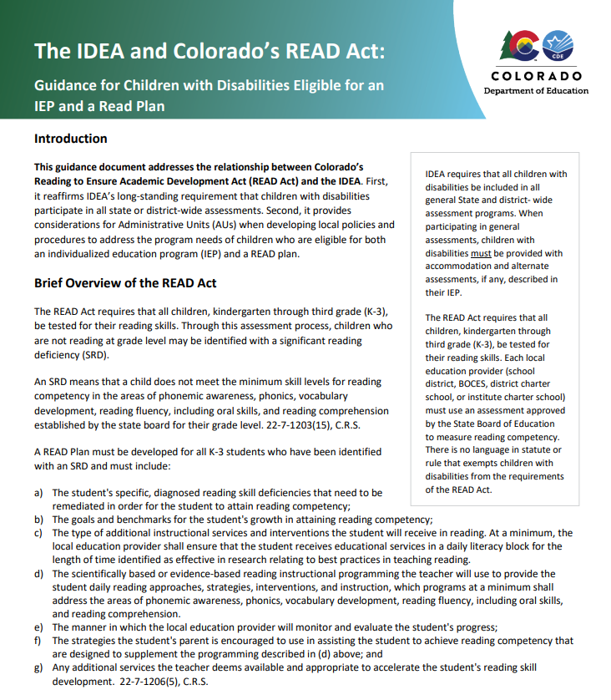
IDEA and the READ Act Guidance
Children with disabilities may not be exempted from assessments conducted in accordance with the READ Act.
https://www.cde.state.co.us/cdesped/idea_colorados_read_act_guidance
Notes:
CDE has a guidance document available about IDEA and Colorado’s READ Act, specifically guidance for students who are eligible for an IEP and a READ Plan.
The most important point to remember is that children with disabilities may not be exempted from assessments in accordance with the READ Act. We will cover the topics within this document over the next hour.

Slide 12

Assessments
Notes:
In the next section, we will first cover assessment elements of the READ Act as they may relate to students with disabilities.

Slide 13
How do you identify an SRD in a student with a disability?
The READ Act requires that all children, kindergarten through third grade (K-3), be tested for their reading skills. Through this assessment process, children who are not reading at grade level may be identified with a significant reading deficiency (SRD).
An SRD means that a child does not meet the minimum skill levels for reading competency in the areas of phonemic awareness, phonics, vocabulary development, reading fluency, including oral skills, and reading comprehension established by the state board for their grade level. 22-7-1203(15), C.R.S.
Notes:
First, this is a common question we receive at CDE: How do you identify an SRD in a student with a disability. Put simply, the process is the same, although different assessment pathway options may be used.
The READ Act requires that all children, kindergarten through third grade (K-3), be tested for their reading skills. Through this assessment process, children who are not reading at grade level may be identified with a significant reading deficiency (SRD).
An SRD means that a child does not meet the minimum skill levels for reading competency in the areas of phonemic awareness, phonics, vocabulary development, reading fluency, including oral skills, and reading comprehension established by the state board for their grade level. 22-7-1203(15), C.R.S.

Slide 14

Differentiated Pathways for Students with Disabilities
To meet the legal mandate that ALL students in grades K-3 be screened for an SRD, a Differentiated Pathways process was developed.
The Differentiated Pathways have been designed to include all students.
Notes:
Beginning in the 2015-2016 school, students previously exempted or excluded from participation requirements of the READ ACT, including those with disabilities, will be assessed for a significant reading deficiency (SRD) and reported in the Spring, 2016 READ Act data collection.
In order to meet the legal mandate that ALL students in grades K-3 be screened for an SRD, the Exceptional Student Services Unit, in collaboration with the Office of Literacy, has developed a Differentiated Pathways process.
The Differentiated Pathways have been designed to include all students, even those who previously could not be assessed using one of the State-Approved READ Act interim assessments.

Slide 15
Pathway #1
Select a State-approved READ Act interim assessment to screen students in grades Kindergarten through the third grade for a Significant Reading Deficiency.
For more information: Office of Elementary Literacy and School Readiness, READ Act
^{Approved Interim Assessments:}
^{Acadience Reading K-6}
mCLASS with DIBELS 8th Ed., mCLASS Lectura
^{i-Ready Assessment for Reading}
^{ISIP Reading, ISIP Lectura}
Star Early Learning, Star Early Learning (Spanish)
^{March 2025}
Notes:
https://www.cde.state.co.us/coloradoliteracy/readactassessments#interim

Slide 16
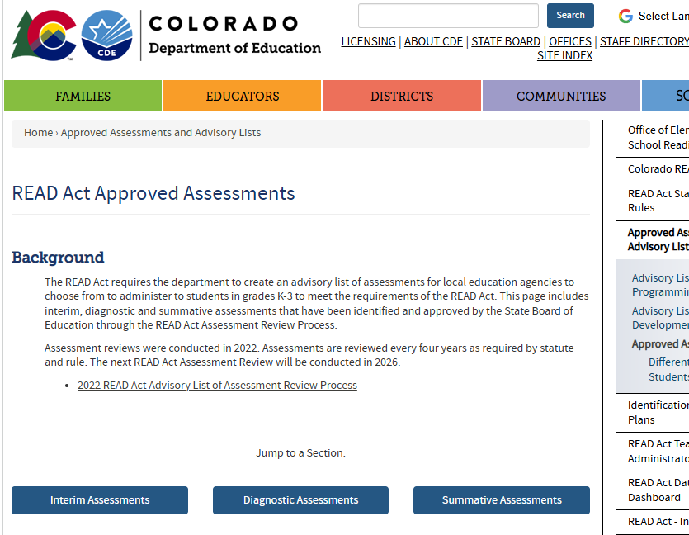
Pathway #2
Students who cannot be assessed with the interim assessment typically used in Pathway #1, as a result of an accessibility issue, are assessed using one of the other State-approved interim assessments that will yield a valid score.
Read Act Approved Assessments
Notes:
https://www.cde.state.co.us/coloradoliteracy/readactassessments#interim

Slide 17
Pathway #3
For small populations of students with disabilities who are unable to access the approved interim assessments.
Pathway 3 options are specific to students who are braille learners, students with minimal or no auditory access, and/or with the most significant cognitive disability.
Braille
Deaf and Hard of Hearing
Colorado Emergent Literacy Scales (CELS)
Notes:
Overview
Beginning in the 2015-2016 school, students previously exempted or excluded from participation requirements of the READ ACT, including those with disabilities, will be assessed for a significant reading deficiency (SRD) and reported in the Spring, 2016 READ Act data collection. In order to meet the legal mandate that ALL students in grades K-3 be screened for an SRD, the Exceptional Student Services Unit, in collaboration with the Office of Literacy, has developed a Differentiated Pathways process. The Differentiated Pathways have been designed to include all students, even those who previously could not be assessed using one of the State-Approved READ Act interim assessments.
General READ Act information
READ Data Collection
Differentiated Pathways Regional Training PowerPoint

Slide 18

Pathway #3: Braille
This pathway is reserved for students who are braille readers. It is likely that many of these learners will be in the process of learning the Unified English Braille code.
The child's Teacher of Students with Visual Impairments (TVI) should assist with brailling appropriate assessment content and shared assessment administration, interpretation of results, and documentation for the READ Plan, if one is needed. Not all assessment tools will be appropriate for a child who is a braille reader.
For more information, contact Tanni Anthony at anthony_t@cde.state.co.us or (303) 503 4647.

Slide 19

Pathway #3: Deaf and Hard of Hearing
For Deaf and Hard of Hearing (DHH) students with limited or no auditory access, standard READ Act assessments may not be suitable.
Teachers of the Deaf should support a "Body of Evidence" approach to assess if the student has a Significant Reading Deficiency (SRD). This involves collecting data from various sources, such as observations, work samples, alternative assessments, and progress monitoring, to form a complete picture of the student's literacy abilities and needs.
For more information contact Shauna Moden @ Moden_s@cde.state.co.us
Notes:
https://app.smartsheet.com/b/form/f6ac280a433643e7902010fbed8c9dc5
https://www.cde.state.co.us/cdesped/read-act-guide-deaf-hard-hearing
https://docs.google.com/spreadsheets/d/17e49NNHzhXwWcIw5BVhTPwnPUJb4AnbtYC4Vv_u75Xc/edit?gid=531459488#gid=531459488
All or nothing is not the thing
WJ letter ID and Comprehension: old way to measure for deaf/hoh
Many people are still using, NOT AN OPTION
differentiated pathway is CASE BY CASE
Document from Shauna: in Teams Chat
looking at auditory access
computer, paper pencil live voice, then go to pathway
BOE approach to differentiated pathway, form to fill out
document is on website, going down this path: contact Shauna for training
orally or through sign (videos in google sheet)
"language through the air" vs. "oral language"
rhyming looks different in sign but the concept still exists
one or two high risk scores, STOP
High Risk- more than a year delay
Some- less than year
sheet auto fills with areas that will get intervention
data collection because not documented
not an allowable accommodation, but we just need a starting point, don't care about percentile
97-98% stay on READ Plan
June 4-5 training: free, wrote READ Act class, Robert Frantom Allen at the Marriot in Golden, some open spots for reimbursement for over 100 miles

Slide 20

Pathway #3: Colorado Emergent Literacy Scales (CELS)
For students with the most significant cognitive disability and receive their instruction on the alternate academic achievement standards or the Extended Evidence Outcomes (EEO).
This framework is designed to collect information through a structured portfolio process.
Everything needed to use this process can be found on the CDE Website – Literacy and Students with Disabilities.
For more information contact Gina Herrera at herrera_g@cde.state.co.us

Slide 21

Goals & Intervention

Slide 22
READ Plans & IEPs
The READ plan is a general education plan that includes tiered instruction /intervention to be provided within a student’s general education program.
The READ plan and the IEP must work together to provide a holistic approach to improving the child’s reading performance.
If the READ plan is part of the IEP, it must meet all the minimum requirements of the READ Act.
              The choice to combine plans is a district decision made at the district leadership level.
Notes:
Notes:
The choice to combine plans is a district decision. CDE recommends that districts consider speaking with their legal team to ensure both state and federal mandates are met.
The goals and objectives in the READ plan and IEP should align if the student has reading goals in the IEP.

Slide 23
Aligning Instruction and Intervention
Students should have accessible, explicit, aligned instruction and multiple opportunities to practice skills throughout the day.
Ongoing collaboration between general and special education teachers is crucial to ensure alignment in addressing skill deficits.
All staff providing instruction should work together to ensure consistency with language, multisensory cues, terminology, key words, etc. used for literacy instruction.

Slide 24

Accommodations: IEPs and 504 Plans
Ensure that required accommodations are provided to students and reflected within the READ Plan
Teams should review for allowable accommodations on approved assessments
Accommodations documented in IEPs and 504 Plans should be aligned and reflected in the READ Plan
Notes:
Some students may have a disability that does not require specially designed instruction and an IEP, although the student may have necessary accommodations in a 504 Plan (e.g. some students who are hard of hearing)

Slide 25
Accommodations
Changes HOW
When the student needs some change to the presentation, response, timing or scheduling of assignments in order to provide access to content information and how they demonstrate their learning.
Accommodations do not substantially change expectation, instructional rigor, content, performance criteria - just delivery of information and/or modes of participation.
Instructional Accommodations and Assessment Accommodations

Slide 26

Extended Evidence Outcomes
Standards developed for a very small (approx. 1%) and specific group of students, those who have been identified with the most significant cognitive disability.
A process is in place to assist special educational teams with this decision. The process and documents are available on the Instructional Standards and Adaptations for Students with a Disability webpage.
https://www.cde.state.co.us/coextendedeo
Notes:
https://www.cde.state.co.us/coextendedeo
When EEOs are used for a student, they can be used to formulate appropriate goals on the READ plan for these students.

Slide 27

Progress Monitoring

Slide 28

Data Analysis & Instructional Changes
Review data and READ Plan/IEP goals frequently.
Adjust instruction as needed.
Ensure all staff who provide instruction to students are sharing assessment responsibilities, participate in data analysis, and collaborate to provide aligned, accessible instruction and assessment
Notes:
Regular progress monitoring is a critical component of any intervention cycle and data-based decision making.
Using an appropriate assessment tool to measure progress, teachers must regularly review progress monitoring data and the progress towards students READ Plan and IEP goals.
When progress is not adequate, adjustments to instruction may be needed.
It is important that all staff who provide instruction to students are involved in assessing, analyzing data, and collaborating to provide aligned, accessible instruction.

Slide 29

Dyslexia
Notes:
In this final section, we are going to spend a few minutes discussing dyslexia, one of the more common learning disabilities that affects students' ability to learn to read on pace with their peers.

Slide 30
Dyslexia Definition
“Dyslexia is a specific learning disability that is neurobiological in origin. It is characterized by difficulties with accurate and/or fluent word recognition and by poor spelling and decoding abilities. These difficulties typically result from a deficit in the phonological component of language that is often unexpected in relation to other cognitive abilities and the provision of effective classroom instruction. Secondary consequences may include problems in reading comprehension and reduced reading experience that can impede growth of vocabulary and background knowledge.”
(International Dyslexia Association, 2002)
https://dyslexiaida.org/definition-of-dyslexia/
Notes:
The International Dyslexia Association defines dyslexia as...(READ DEFINITION ON SLIDE)

Slide 31
Quadrant Model for the Simple View of Reading
Language Comprehension (STRONG)
Dyslexic Reader
Reader with Specific Word Recognition Difficulties
Typical Reader
Word Recognition (WEAK)
Word Recognition (STRONG)
Reader with Mixed Reading Difficulties
Reader with Specific Comprehension Difficulties
Hyperlexic Reader
Language Comprehension (WEAK)
Notes:
The quadrant Model for the Simple View of Reading can help us understand common characteristics of dyslexia and how these characteristics compare to other types of reading disabilities as well as characteristics of typical reading development.
In the model, the horizontal arrow represents the spectrum of word recognition skills from weak (left) to strong(right).
The vertical arrow represents language comprehension skills from weak (bottom) to strong(top). These perpendicular arrows create four quadrants of reading ability.
As you can see, a typically developing reader, would fall in the upper right quadrant of the model, demonstrating both strong word recognition skills and strong language comprehension.
The top left quadrant of the model represents the classic characteristics of a dyslexic reader. These students typically display weak word recognition skills that are in contrast to relative strength in language comprehension skills.
https://www.markweaklandliteracy.com/blog/what-are-reading-difficulties-part-2
https://www.youtube.com/watch?v=0nqygB7Yeaw

Slide 32
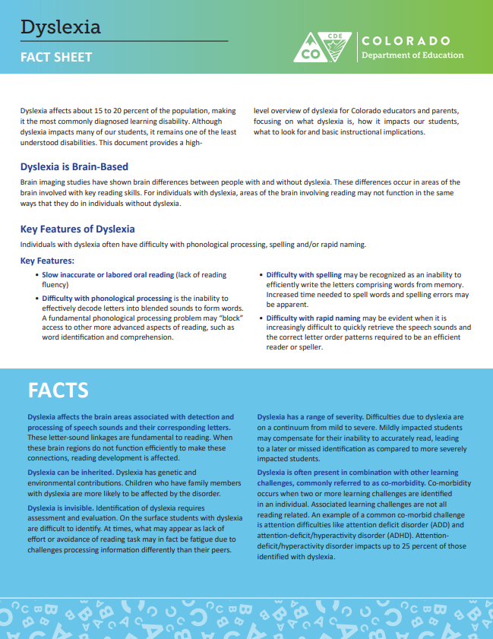
Dyslexia Facts
Dyslexia is brain-based.
Features of Dyslexia:
Slow, inaccurate, or labored oral reading
Difficulty with phonological processing
Difficulty with spelling
Difficulty with rapid naming
Notes:
It is important for all teachers and school staff to be familiar with the characteristics of dyslexia so as to best identify the correct supports for students who display these characteristics, whether or not they have been formally diagnosed.
Dyslexia is a brain-based reading disability.
Features of dyslexia include:
(Read Bullets on Slide)
The CDE has produced a fact sheet on dyslexia that may be helpful for staff and parents. It can be located at this link:
https://www.cde.state.co.us/communications/dyslexia-factsheet

Slide 33

Dyslexia Facts, More
Dyslexia falls within the definition of a specific learning disability (SLD). However, not all students with dyslexia will qualify for special education services because they do not require specially designed instruction to access grade level standards.
Dyslexia affects about 15-20% of the population.
Notes:
Dyslexia falls within the definition of a Specific Learning Disability (SLD) and is not separately diagnosed in the school setting.
Not all students with dyslexia will qualify for special education services, because not all students require specially designed instruction to access grade level standards.
Some students may receive required accommodations for dyslexia under a 504 plan.
It is important to note that dyslexia affects approximately 15-20% of the population, so even without a diagnosis, schools should be prepared to identify characteristics of dyslexia and provide appropriate intervention with urgency.

Slide 34

Dyslexia Screening
Dyslexia screeners are available in READ Act approved assessments but are currently not required.
No single assessment can diagnose dyslexia. Dyslexia screeners can be used to identify characteristics of dyslexia.
A strong MTSS framework supports all students, including students with dyslexia.
Notes:
Approved READ Act assessments include dyslexia screening tools. These tools are available for schools to utilize but are not currently required.
Dyslexia screeners can not diagnose dyslexia. They can be used to identify characteristics of dyslexia that can help inform decision making for a student.
A strong MTSS framework is a key component of supporting all students, including students with dyslexia, to ensure the right supports are provided to all students who need them.

Slide 35

Dyslexia Resources
Dyslexia Fact Sheet
Dyslexia Handbook (Colorado Department of Education)
International Dyslexia Association
Dyslexia Screening for Multilingual Learners
Notes:
Listed on this slide are some resources that can help schools, teachers, and parents learn more about dyslexia:
https://www.cde.state.co.us/communications/dyslexia-factsheet
https://www.cde.state.co.us/cdesped/codyslexiahandbook
https://dyslexiaida.org/
https://ies.ed.gov/learn/blog/youve-got-dyslexia-screening-multilingual-learners

Slide 36

Planning for the Year Ahead
Notes:
This is the time of year when schools can take inventory of instructional practices, planning protocols and systems that are in place to ensure a smooth transition for students as a school year comes to an end.
We will review a few reminders related to the READ Act requirements to support your year-end planning now, and then we will address additional reminders at the end of the second hour today.

Slide 37




EOY READ Act Requirements – Existing READ Plans
STUDENT REMAINS ON READ PLAN
Reaches Grade Level Competency
No longer SRD but below Grade Level
Continues to have an SRD
Update READ plan
Parent communication
Notes:
For students who are on existing READ plans there are three possible outcomes at the end of year assessment window (typically within the last 45 days of the school year).
Students can continue to have an SRD, they can no longer score below the cut score for an SRD but remain below grade level, or they may reach grade level reading competency. For students who reach grade level reading competency and have a body of evidence to show they have mastered the minimum skill competencies, exiting the READ plan is possible. (We will review that process in the next hour of this meeting)
CLICK For students who remain below grade level, EVEN IF THEY ARE NO LONGER SRD, a READ plan must be continued for a second or subsequent consecutive year. Students who are no longer SRD will need to have their READ plan updated, and their parents should receive communication about their progress in the manner your school chooses (meeting, phone call, email, progress report, etc.).
Students who continue to have an SRD and must remain on a READ plan have some additional requirements outlined in the READ Act.

Slide 38
Students Continuing with an SRD at EOY
The READ Act requires that, for students who continue to have an SRD and will remain on a READ plan for a second or subsequent consecutive school year, the READ plan includes more rigorous strategies and interventions, including increased daily time in school for reading instruction, than were provided in the previous year (C.R.S 22-7- 1206 (7)(a)(I-III)(b).
When a student continues to have an SRD:
READ plan revised with additional, more rigorous strategies and intervention, including increased daily time
Reading instruction from effective/highly effective teacher
Principal ensures support throughout the day
Notes:
When a student continues to have an SRD at the end of the school year and will enter the upcoming school year continuing on the READ plan, the READ Act requires that more rigorous strategies and intervention, which includes increased daily time, are included in the READ plan revision.
This intensification includes reading instruction from an effective or highly effective teacher. It is the principal's responsibility to ensure that support in provided throughout the school day.
For students who have both an IEP and a READ plan, it is important to carefully review and align the IEP goals and the READ plan goals to ensure that the student's instructional programming for the upcoming year is coordinated and includes the appropriate accomodations. All staff who support the student should be involved in the planning to ensure the supports the student needs are aligned as soon as the new school year begins.

Slide 39
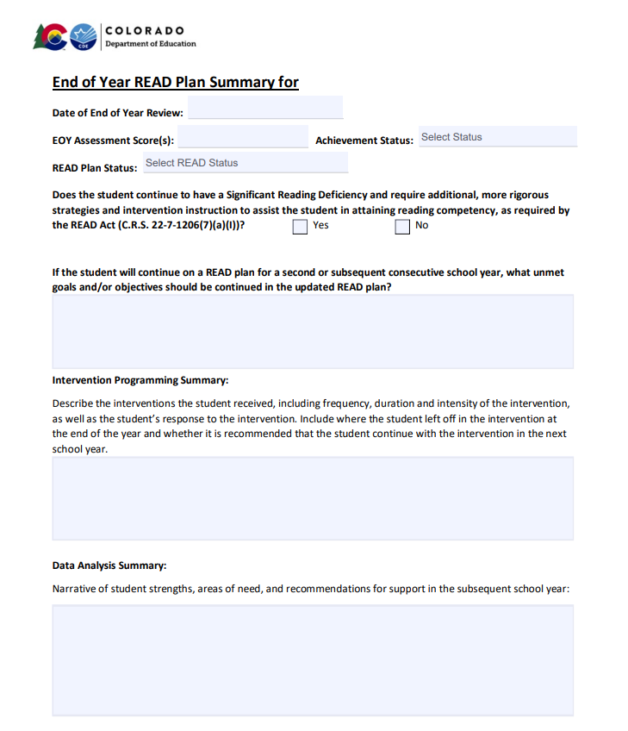

End of Year READ Plan Summary
Narrative of student strengths, areas of need, and recommendations for support in the subsequent school year
Notes:
As a reminder, the literacy team at CDE published a new READ plan template in 2024 that includes an End of Year Summary page. This summary page includes EOY assessment results and READ Plan status, SRD status, explanation of unmet goals, intervention programming summary, and a data analysis summary. In the open text sections, teachers can also include narratives about a student's IEP if needed.
Once the READ plan template has been in place through a school year, with the READ plan history at the beginning and the End of Year summary at the end, these sections will provide the information needed to transfer a plan from one year to the next for a student who continues on a READ plan into a second year, OR can provide key information to the next year’s teacher to support a student from the start who is no longer on a READ plan so that they don’t regress in the next school year.

Slide 40
Planning for the Year Ahead: Statute to Practice
Additional, more rigorous strategies and intervention instruction
Change in interventions/teachers (Tier I, Tier II, Tier III)
Increased daily time in school for reading instruction
Increased weekly frequency
Increased reading intervention supports across content
Smaller Group Ratios
Increased frequency of progress monitoring/data analysis
More targeted, pinpointed intervention
Increased duration
Reading instruction is supported across content within the school day
Literacy focused content area instruction
Push-in support
Increased accommodations/modifications
Small group instruction
Notes:
For students who continue to have a significant reading deficiency and will remain on a READ Plan in the subsequent school year, READ Act statute designates that students receive intensified instructional efforts. Careful and thoughtful planning NOW can ensure that systems and supports are in place for the upcoming school year.
For students who require them, additional and more rigorous strategies and intervention could be a change in interventions and/or teachers, smaller group ratios, more targeted intervention, and/or increased frequency of progress monitoring.
Next, an increase in daily reading instruction can be achieved through increased weekly frequency, increased duration for lessons, and increased support across content.
Finally, reading instruction should be supported across content in the instructional day, and can include literacy-focused content area instruction, planning for more small group instruction, push-in support, and increased accommodations or modifications.

Slide 41
Essential Questions for Leaders at EOY – Planning for the Year Ahead
How many students will need increased intervention support in the upcoming school year based on EOY data?
What should staffing look like for the upcoming year to ensure students with an ongoing READ plan are placed with a highly effective teacher?
How will the schedule accommodate the number and size of intervention groups?
What additional resources may be needed to support the instructional needs of students on READ plans?
Notes:
Some essential questions to consider as a leader at the end of the year include:
How many students will need increased intervention support in the upcoming school year based on EOY data?
What should staffing look like for the upcoming year to ensure students with an ongoing READ plan are placed with a highly effective teacher?
How will the schedule accommodate the number and size of intervention groups?
What additional resources may be needed to support the instructional needs of students on READ plans?

Slide 42
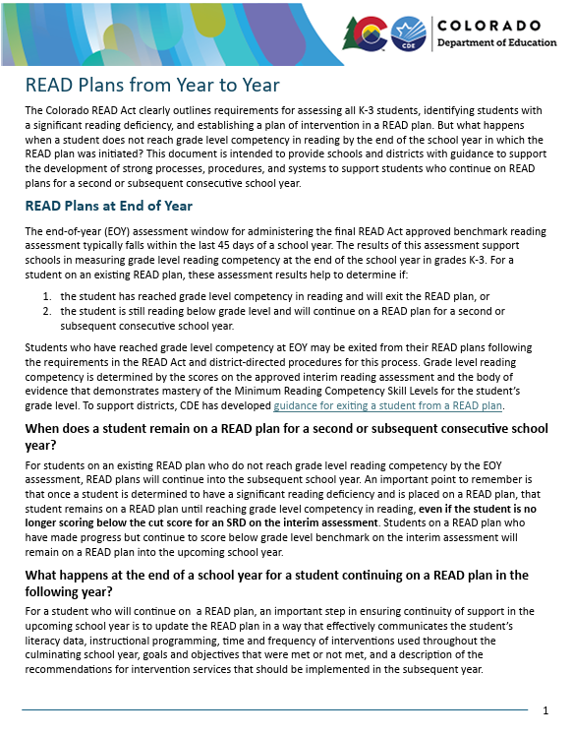
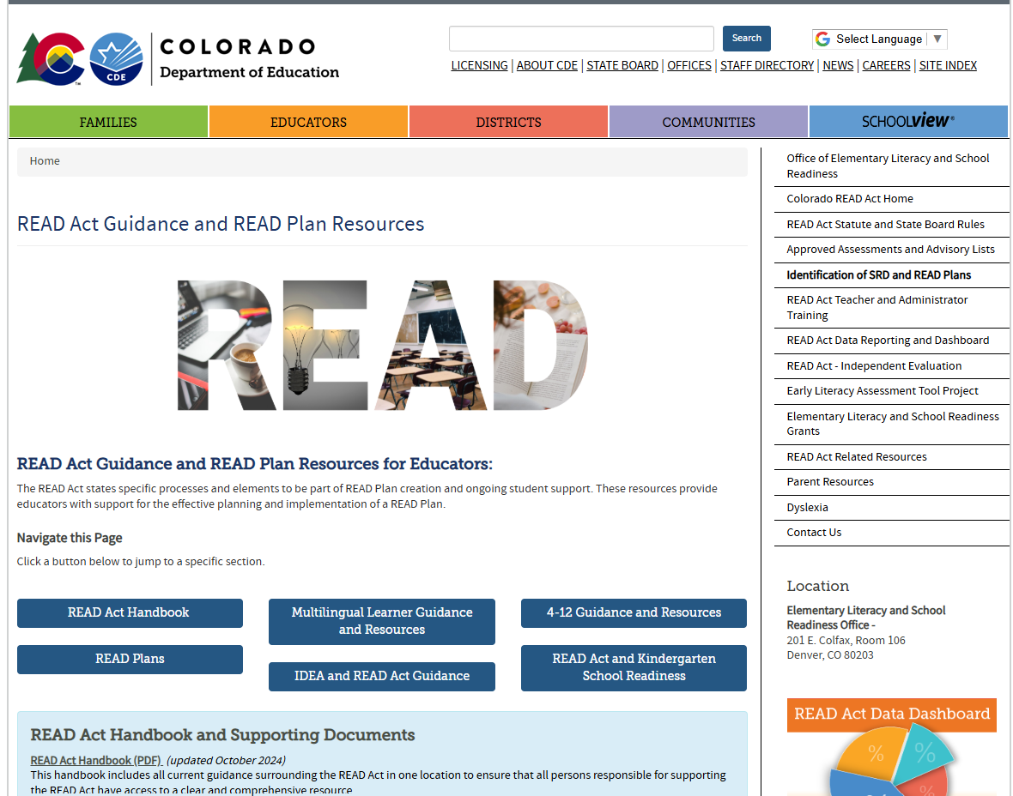
READ Plans from Year to Year
Planning for the Year Ahead
Notes:
https://www.cde.state.co.us/coloradoliteracy/readplans

Slide 43

Break:
We will resume on this link at 10:00.

Slide 44
References
Eide, D. (2012). Uncovering the logic of English: a common-sense approach to reading, spelling, and literacy. 2nd ed. pbk. Pedia Learning Inc.

