Slide 1
Break: We will resume on this link at 10:00.
Notes:
Welcome back and thank you for joining us for the second half of this morning’s meeting.

Slide 2
Agenda
10:00 – 11:00 | Literacy Updates and Collaboration Students with Disabilities Q&A READ Act FAQs and Breakout Discussions: Students with Disabilities Multilingual Learners MTSS and Tiers of Literacy Instruction EOY READ Act Reminders CDE Literacy Updates
Note: Both sections of today’s meeting will be held on the same Zoom link.
Notes:
In case you are just joining us, in the next hour we will have a Q&A time about students with disabilities, READ Act FAQs and breakout discussions for students with disabilities, multilingual learners, and MTSS, with CDE staff from both offices in each breakout room. Finally, our meeting will end with EOY READ Act reminders and CDE literacy updates.

Slide 3
Senate Bill 25-200
Current Status:
Under Consideration
Information can be found on the Colorado General Assembly web page:
https://leg.colorado.gov/bills/sb25-200
If you have questions about active or potential legislation, please feel free to reach out directly to the CDE Policy Team: policyteam@cde.state.co.us
Notes:
We understand that many of you are aware of the recent Senate Bill 25-200 and have questions about potential impacts should there be changes to the READ Act. This bill is currently under consideration in the state legislature. We at CDE are not able to discuss SB 25-200 at this stage in the legislative process, nor will be discussing it or answering questions about it during today’s meeting. If changes are made to the READ Act, our office will release guidance as soon as possible.
If you would like to read more about the bill, information can be found on the Colorado General Assembly web page: https://leg.colorado.gov/bills/sb25-200
If you have questions about active or potential legislation, please feel free to reach out directly to the CDE Policy Team: policyteam@cde.state.co.us

Slide 4
READ Act and Students with Disabilities
Notes:
If you were able to join us in the first hour, you know that today we are pleased to be partnering with the Exceptional Student Services Unit and the Office of Special Education today to be providing information about the READ Act and Students with Disabilities.

Slide 5
Key Takeaways for Today
Students with disabilities are general education students first. The focus of today is students with disabilities on IEPS or 504 Plans.
READ Act requirements apply to all students.
All staff who provide support to students should share in assessment responsibilities, participate in data analysis, and collaborate to provide aligned, accessible instruction and assessment.
Notes:
Before we move into our Q&A and breakout discussions, we’d like to reiterate the key takeaways for today:
First, students with disabilities are general education students first. The focus of today is students with disabilities on IEPS or 504 Plans.
Next, READ Act requirements apply to all students.
Finally, all staff – general education teachers, special education teachers, specials teachers, administration, etc. - who provide support to students should share in assessment responsibilities, participate in data analysis, and collaborate to provide aligned, accessible instruction and assessment.

Slide 6
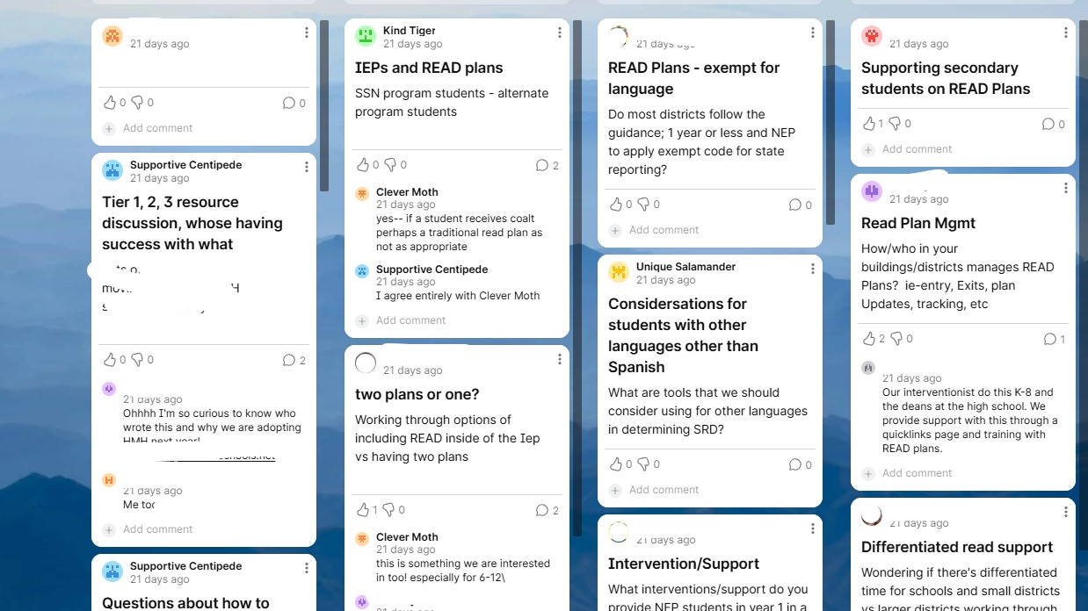
READ Act FAQs
Notes:
In the next part of today’s meeting, we will be covering READ Act FAQs. If you have attended Regional Meetings and collaboration sessions in the past, you know that we gather feedback through a google survey at the end of each meeting. In February, we also used a Padlet to capture FAQs from different categories. We’ve used those questions, in collaboration with the offices of special education and MTSS, to prepare today’s meeting content and breakout discussions.

Slide 7
Students with Disabilities: Questions
Tanni Anthony, Director / State Consultant on Blindness
Exceptional Student Services Unit / Office of Special Education
Anthony_T@cde.state.co.us
Emily Ottinger, Specific Learning Disabilities Specialist
Exceptional Student Services Unit / Office of Special Education
Ottinger_E@cde.state.co.us
Notes:
In staying with the topic of the READ Act and Students with Disabilities, we’re first going to reintroduce Emily Ottinger, Specific Learning Disabilities Specialist, to spend about 10 minutes answering questions about students with disabilities and this morning’s presentation. We do ask that you use this time for general questions for the good of the group. If you have more questions about students with disabilities at the end of this Q&A time, we invite you to join Emily in one of the breakout rooms later in the meeting. As always, if you have individual questions, we encourage you to reach out to your regional consultant.
* Pass to Emily and allow 10 minutes for questions.

Slide 8
Students with Disabilities Questions
More specific guidance around READ identification, implementation and alignment for students who are served through Special Education
Clarification on SRD and who receives a READ plan
If a student has an IEP for reading, do they also need a READ Plan?
Notes:
SLD PD Support - https://www.cde.state.co.us/cdesped/sd-sld_resources_literacy

Slide 9
Multilingual Learner: Questions
Brie Johnson, Senior Literacy Consultant
Elementary Literacy and School Readiness
Johnson_B@cde.state.co.us
Notes:
Introductions

Slide 10
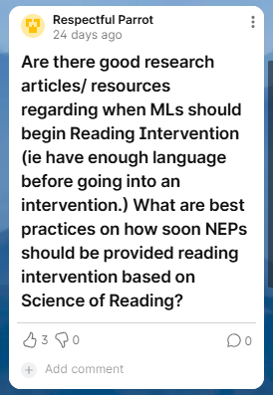
Multilingual Learner Question 1
Multilingual Learners require both literacy and language instruction. It is crucial that we do not wait for students to reach a specific level of language proficiency before providing them with core or intervention instruction.
Best practices for Multilingual Learners:
Linguistically Responsive Data Based Instructional Decision Making for MLs
Multitiered Systems of Supports for ELs
Project Lee
English Learners / Emergent Bilinguals and the Science of Reading
Notes:
What are the best practice on how soon students identified as Multilingual Learners who are Non-English Proficient or NEP should be provided reading intervention based on the SoR?
Multilingual learners require both literacy and language instruction. It is crucial that we do not wait for students to reach a specific level of language proficiency before providing them with core or intervention instruction. A key best practice is ensuring that your school or district has a culturally and linguistically responsive approach within a multi-tiered system of supports for multilingual learners.
(Drop the links to resources provided on the slide.)
https://www.cde.state.co.us/cdesped/linguistically-responsive-data-based-instructional-decision-making
https://mtss4els.org//resources/briefs (this resource includes guidance on tier 2 intervention for MLs)
https://www.projectlee.org/
https://www.thereadingleague.org/compass/english-learners-emergent-bilinguals-and-the-science-of-reading/#the-reading-league-summit-joint-statement-and-report
When a significant number of Multilingual Learners need additional support, educators should first evaluate the core curriculum and LIEP (Language Instruction Education Program)
Does the instruction connect with Multilingual Learners' cultural and linguistic backgrounds?
Are new concepts linked to students’ background knowledge, lived experiences, language, and prior learning?
Are linguistic supports and scaffolds provided to ensure access to grade-level literacy content?
Is oral language is developed across all content areas?
Are students receiving targeted English Language Development (ELD) instruction that is research-based and independent from literacy instruction?
Colorado MTSS is designed to enrich the learning environment for every student. Just remember that Tier 1 instruction for MLs should be delivered in general education classrooms by teachers knowledgeable in second or additional language acquisition (Hill & Flynn, 2006). The process of identifying student needs and supporting them should be a fluid process; we label the supports provided, not the students. A student or group of students may receive Targeted or Tier 2 supports in one area while the rest of their needs are addressed effectively in the universal/Tier 1 core.

Slide 11
Multilingual Learner Question 2
Multilingual Learners receive language and literacy instruction tied to their cultural and linguistic backgrounds.
Additionally, students need targeted, research-based English Language Development (ELD) instruction through a district-approved Language Instruction Educational Program (LIEP), and not in place of, core literacy instruction or any additional literacy interventions provided.
If additional instructional time is needed, can phonics instruction be moved to the English Language Development (ELD) block?
Notes:
Multilingual Learners receive language and literacy instruction tied to their cultural and linguistic backgrounds. This includes connecting new concepts to their prior experiences, developing oral language, and providing linguistic supports to ensure access to grade-level content.
Additionally, students need targeted, research-based English Language Development (ELD) instruction through a district-approved Language Instruction Educational Program (LIEP), and not in place of, core literacy instruction or any additional literacy interventions provided. ELD instruction includes carefully structured interactive activities among students, as well as explicit, corrective feedback from the teacher on language use.
If needed: Additional information on LIEP Plans: https://www.cde.state.co.us/cde_english/languageinstructioneducationalprogramplan (examples: bilingual, transitional TNLI, heritage language, ESL, pull-out ESL, newcomer centers)
Key Points of Providing LIEPs from the U.S. Department of Education Office for Civil Rights’ (OCR) and the U.S. Department of Justice’s (DOJ):
ML instruction and programs must be educationally sound in theory and effective in practice (Castañeda Standard)
ML programs must be designed to enable MLs to attain both English proficiency and parity of participation in the standard instructional program within a reasonable length of time
Districts must offer ML instruction and programs, until MLs are proficient in English and can participate meaningfully in educational programs without ML support
Additionally, districts must provide appropriate special education services to MLs with disabilities who are found to be eligible for special education and related services

Slide 12
What ELD is…
What ELD is…
•Explicit language instruction
•Differentiated based on the language proficiency levels of the students
•Dedicated and targeted time
•Reflected in master schedule
•The objective of each lesson is centered around English language skills and development
•Aligned to CELP Standards
What ELD isn’t…
Literacy intervention
Translated texts in content classes
An additional phonics class
Full-day program separate from non-ML peers
An elective
A class that takes the place of core curriculum
A class outside of the regularly scheduled school day
Notes:
What ELD is…
•Explicit language instruction
•Differentiated based on the language proficiency levels of the students
•Dedicated and targeted time
•Reflected in master schedule
•The objective of each lesson is centered around English language skills and development
•Aligned to CELP Standards
What ELD isn’t…
Literacy intervention
Translated texts in content classes
Additional phonics class
Full-day program separate from non-ML peers
An elective
A class that takes the place of core curriculum
A class outside of the regularly scheduled school day

Slide 13
COMTSS: Questions
​
Christina Kirchhof, Multi-Tiered Systems of Support (MTSS) Specialist​
Office of Learning Supports​
Kirchhof_C@cde.state.co.us​
​
Evan Daldegan, Multi-Tiered Systems of Support (MTSS) Specialist​
Office of Learning Supports​
Daldegan_E@cde.state.co.us
Notes:
Introductions

Slide 14
MTSS Questions
How are we monitoring MTSS tiers and success with reading instruction?
Questions about kicking off MTSS and providing structures for the schools
Struggles working as a small school to build the systems
Ideas about scheduling and resources
Using MTSS to support 6-12 READ Plans
SMART goals/objectives for both READ and MTSS plans to make writing plans more efficient

Slide 15
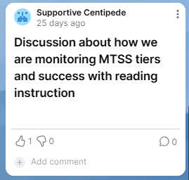
MTSS Question
Use effective universal screening practices and effective progress monitoring practices that are outlined in the Colorado Multi-Tiered System of Supports practice profiles, and the Recorded School Level Training Series videos. Universal Screening and Progress monitoring systems should be in place to help guide tiered considerations for targeting skill-based deficits for students.
Notes:
Question: How are we monitoring MTSS tiers and success with reading instruction?
Use effective universal screening practices and effective progress monitoring practices that are outlined in the Colorado Multi-Tiered System of Supports practice profiles, and the Recorded School Level Training Series videos. Universal Screening and Progress monitoring systems should be in place to help guide tiered considerations for targeting skill-based deficits for students.
Resources (drop in chat):
DBPSDM page
CSAS page
Modules: LearnWorlds
Comprehensive Screening and Assessment System - An introduction
Data-Based Problem Solving and Decision Making - An introduction

Slide 16
Breakout Rooms
Notes:
The next portion of this morning’s meeting will be our breakout rooms. Breakout rooms will be 15 minutes, and you will have the choice of which topic you discuss.

Slide 17
Breakout Room Topics
Multilingual Learners,
Office Culturally and Linguistically Diverse Education (CLDE)
MTSS and Tiers of Instruction,
Colorado Multi-Tiered Systems of Support (COMTSS)
Students with Disabilities,
Exceptional Student Services Unit / Office of Special Education (ESSU)
Notes:
We have three breakout rooms for you to choose from this morning:
Multilingual Learners, with Brie Johnson
MTSS and Tiers of Instruction, with Christina and Evan from COMTSS
Students with Disabilities, with Emily from ESSU
We understand you may wish we could do multiple breakout rooms, but with all of today’s content, we only have time for one. We wanted to come full circle with all of the year’s content and guests, so please choose the room that is most beneficial for you. We will also be gathering feedback at the end of the meeting, so please let us know if more time for breakout discussions is something you’d like.
In just a moment, you will see a box pop up, inviting you to join one of the three breakout rooms. If at any point you’d like to leave the room, come back to the main room, and move into another room, you may do that. Please select a room, and then we will see everyone back here in 15 minutes.

Slide 18
End-of-Year (EOY) READ Act Reminders
Notes:
Next, we will briefly go over some end-of-year READ Act Reminders.

Slide 19
End-of-Year (EOY) READ Act Resources
READ Act Handbook
READ Plans from Year to Year
End-of-Year Parent Meeting
Exiting Students from a READ Plan
Notes:
CDE has several READ Act guidance documents within the READ Act handbook or listed by topic on our website. These can be located on the right-hand side menu on our webpage under the tab Identification of SRD and READ plans.
These topics include READ plans from Year to Year with guidance on ways to ensure students continuing on READ plans get the support they need, specific guidance on the End of Year Parent Meeting and guidance on Exiting students from a READ plan

Slide 20
Exiting Students from a READ Plan
Notes:
Throughout the next section we will briefly review some of the statute requirements that apply to the end of year assessment window, and considerations for leaders as they prepare to exit students from READ plans.

Slide 21
Exiting a READ Plan: READ Act Statute and Rule
Statute
22-7-1206 (6) Each local education provider shall ensure that a teacher continues to revise and implement a student's READ plan until the student attains reading competency, regardless of the student's grade level and regardless of whether the student was enrolled with the local education provider when the READ plan was originally created or the student transferred enrollment to the local education provider after the READ plan was created.
Rule
4.01(B) The LEP shall monitor the ongoing progress of students determined to have a significant reading deficiency by administering the selected state board approved interim assessment periodically throughout the school year and by collecting a body of evidence demonstrating student progress toward the Minimum Reading Competency Skill Levels described below. Once a student demonstrates grade level competency, he or she may be removed from a READ plan.
Notes:
The Colorado READ Act has specific sections that address READ plans. Section 22-7-1206 states that “each local education provider shall ensure that a teacher continues to revise and implement a student’s READ plan until the student attains reading competency, regardless of the student’s grade level and regardless of whether the student was enrolled with the local education provider when the READ plan was originally created.
Section 4.01B in rules requires progress monitoring of students with an SRD, documenting progress toward the minimum reading competency skill levels and states that once a student demonstrates grade level competency, they may be removed from the READ plan.

Slide 22
Determining Reading Competency
Reading competency is determined by:
Scores on the approved interim reading assessment
AND
A body of evidence that demonstrates mastery of the Minimum Reading Competency Skill Levels for the student’s grade level
Classroom work and assessments
Adopted school readiness assessments
Additional formative or summative assessments
ACCESS for ELLs; native language reading assessment data
http://www.cde.state.co.us/coloradoliteracy/minimumcompetencylinkedmatrix
Notes:
Reading competency is determined by scores on the approved interim reading assessment AND a body of evidence that demonstrates mastery of the Minimum Reading Competency Skill Levels for the student’s grade level. The body of evidence may include:
Classroom work and assessments
Adopted school readiness assessments
Additional formative or summative assessments
ACCESS for ELLs; native language reading assessment data
http://www.cde.state.co.us/coloradoliteracy/minimumcompetencylinkedmatrix

Slide 23
Considerations When Exiting Students from a READ Plan
Has the student demonstrated mastery of the minimum competencies consistently, over multiple measures?
Does the student demonstrate reading competency in all subskills measured by the assessment?
Do the assessment data align with the additional body of evidence?
Is the student able to maintain grade level competency through Tier 1 instruction alone?
If the student is an English Learner, are adequate language supports provided to ensure continued progress in reading?
Notes:
When exiting a student from a READ Plan, the following should be considered:
Has the student demonstrated mastery of the minimum competencies consistently, over multiple measures?
Does the student demonstrate reading competency in all subskills measured by the assessment?
Do the assessment data align with the additional body of evidence?
Is the student able to maintain grade level competency through Tier 1 instruction alone?
If the student is an English Learner, are adequate language supports provided through Tier 1 programming, including English Language Development instruction to ensure continued progress in reading?

Slide 24
Steps for Exiting a Student from a READ Plan
Document
Document on the READ plan the assessment scores and the body of evidence that supports the student has demonstrated grade level reading competency.
Ensure
Ensure the READ plan, supporting documentation for the plan, and the body of evidence that demonstrates the student has reached grade level reading competency are included in the permanent academic record.
Communicate
Communicate with the student’s parent or guardian that the student has reached grade level competency in reading and will be removed from the READ plan.
Notes:
If the decision to exit a student from a READ Plan is made, the following steps are required:
Document on the READ plan the assessment scores and the body of evidence that supports the student has demonstrated grade level reading competency.
Ensure the READ plan, supporting documentation for the plan, and the body of evidence that demonstrates the student has reached grade level reading competency are included in the permanent academic record.
Communicate with the student’s parent or guardian that the student has reached grade level competency in reading and will be removed from the READ plan.

Slide 25
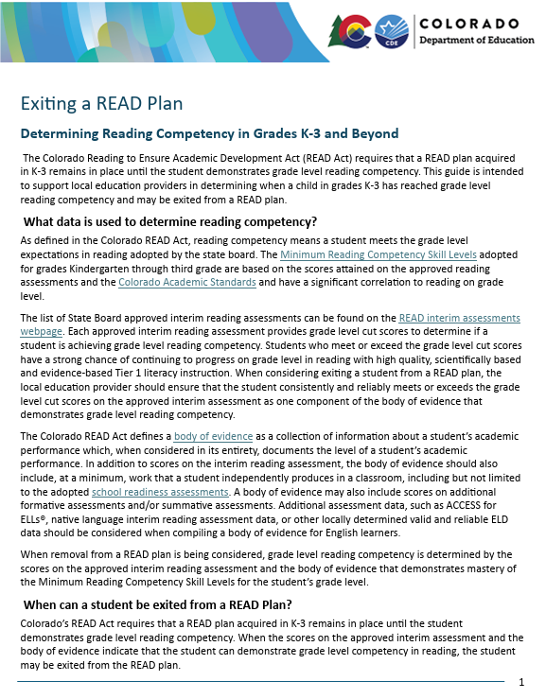
Exiting a READ Plan Guidance Document
Topics included in the guidance document:
Data are used to determine reading competency
Criteria for exiting a student from a READ Plan
Process for exiting students from a READ Plan
Exiting a READ Plan beyond third grade
Considerations when exiting a student for a READ Plan
https://www.cde.state.co.us/coloradoliteracy/exitingareadplan
Notes:
The guidance document titled “Exiting a Student from a READ Plan” can be found on the READ Act webpage by clicking on “Resources” and then “READ Plans in the drop down menu. This will take you to a page of READ plan resources, including the Exiting a Student from a READ plan document we are highlighting today.
Put link in chat:

Slide 26
End-of-Year Parent Meeting
Notes:
In this next section, we will go over a summary of the guidance for the end of year parent meeting for students on who continue to have an SRD at EOY.

Slide 27
Parent Meeting For Students with an SRD at the End of the School Year
If, within forty-five days before the end of any school year prior to a student's fourth-grade year, a teacher finds that a student has a significant reading deficiency, the LEP shall provide to the student's parent written notice that includes, at a minimum:
There are serious implications to a student entering fourth grade with an SRD and, therefore, under state law, the parent, the student's teacher, and other personnel of the local education provider are required to meet and consider retention as an intervention strategy and determine whether the student, despite having an SRD, is able to maintain adequate academic progress at the next grade level
Personnel of the student's school will work with the parent to schedule a date, time, and place for the meeting
If the parent does not attend the meeting, the teacher and personnel of the local education provider will decide whether the student will advance to the next grade level in the next school year. C.R.S. 22-7-1207(2)(a-c)
Notes:
The READ Act states that if, within forty-five days before the end of any school year prior to a student's fourth-grade year, a teacher finds that a student has a significant reading deficiency, the LEP shall provide to the student's parent written notice that includes, at a minimum:
There are serious implications to a student entering fourth grade with an SRD and, therefore, under state law, the parent, the student's teacher, and other personnel of the local education provider are required to meet and consider retention as an intervention strategy and determine whether the student, despite having an SRD, is able to maintain adequate academic progress at the next grade level
Personnel of the student's school will work with the parent to schedule a date, time, and place for the meeting
If the parent does not attend the meeting, the teacher and personnel of the local education provider will decide whether the student will advance to the next grade level in the next school year.

Slide 28
Parent Meeting For Students with an SRD at the End of the School Year continued…
These provisions do not apply if:
(a) The student is a student with a disability who is eligible to take the alternative statewide assessment, or the student is identified as having a disability that substantially impacts the student's progress in developing reading skills, resulting in the student's significant reading deficiency
(b) The student is an English language learner and the student's significant reading deficiency is due primarily to the student's language skills
(c) The student is completing the second school year at the same grade level.
C.R.S. 22-7-1207(1)(a-c)
Notes:
These provisions do not apply if:
(a) The student is a student with a disability who is eligible to take the alternative statewide assessment, or the student is identified as having a disability that substantially impacts the student's progress in developing reading skills, resulting in the student's significant reading deficiency
(b) The student is an English language learner and the student's significant reading deficiency is due primarily to the student's language skills (so these would be your students who are SRD but have not been placed on a READ plan because it has been determined their language skills are the primary factor)
(c) The student is completing the second school year at the same grade level.
C.R.S. 22-7-1207(1)(a-c)

Slide 29
Decisions on Advancement
The parent, the teacher, and the other personnel shall decide whether the student will advance to the next grade level in the next school year.
If the parent, teacher, and other personnel are not in agreement, the parent shall decide whether the student will advance to the next grade level (unless otherwise specified in the policy adopted by the local education provider). C.R.S. 22-7-1207(4)(b)
For students completing 3rd grade, the decision to advance the student is subject to approval of:
the school district superintendent if the student is enrolled in a public school of a school district that is not a charter school
or the school principal, if the student is enrolled in a district charter school, an institute charter school, or a public school operated by a board of cooperative services.
If the superintendent or the principal, whichever is applicable, does not approve the decision to advance the student, the student shall not advance to fourth grade in the next school year. C.R.S. 22-7-1207(6)
Notes:
Just as when a READ plan is initiated, the READ Act places importance on parent involvement in the continued academic plan for a student with an SRD. The parent, the teacher, and the other personnel shall decide whether the student will advance to the next grade level in the next school year.
If the parent, teacher, and other personnel are not in agreement, the parent shall decide whether the student will advance to the next grade level (unless otherwise specified in the policy adopted by the local education provider).
C.R.S. 22-7-1207(4)(b)
For students completing 3rd grade, the decision to advance the student is subject to approval of:
the school district superintendent if the student is enrolled in a public school of a school district that is not a charter school
or the school principal, if the student is enrolled in a district charter school, an institute charter school, or a public school operated by a board of cooperative services.
If the superintendent or the principal, whichever is applicable, does not approve the decision to advance the student, the student shall not advance to fourth grade in the next school year.

Slide 30
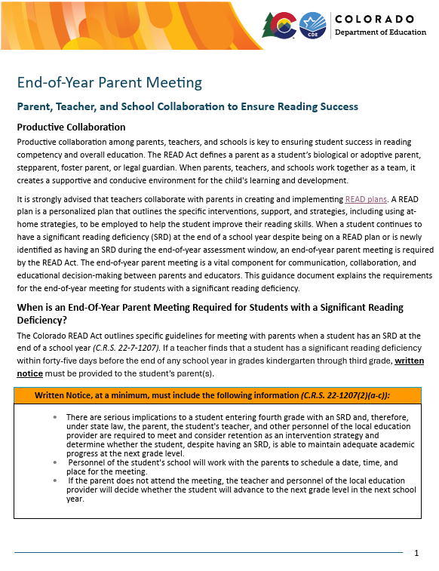
End-of-Year Parent Meeting Guidance Document
Topics addressed in the guidance document:
Requirements for written notice and an end-of-year meeting when students have an SRD at end-of-year
Topics to discuss at the end-of-year meeting
Teacher/School and parent responsibilities after the end-of-year meeting
Students newly identified with SRD at end-of-year
https://www.cde.state.co.us/coloradoliteracy/endofyearparentmeeting
Notes:
https://www.cde.state.co.us/coloradoliteracy/endofyearparentmeeting

Slide 31
CDE Literacy Updates
Notes:
Finally, we have a few quick updates from our office.

Slide 32
Coming Soon: CDE Online Training Updates
Updates to the CDE-Provided online training: Building a Strong Foundation for Lifelong Literacy Success:
Updates will be made to the PCG Pepper platform in June 2025
CDE and PCG will be sharing regular communication about these platform updates via the website, Spark, Scoop, READ Act Listserv and through scheduled webinars and office hours.
These updates will make the CDE provided online courses fully accessible, and it will be more intuitive for the user.
Notes:
Updates to the CDE-Provided online training: Building a Strong Foundation for Lifelong Literacy Success:
Updates will be made to the PCG Pepper platform in June 2025
CDE and PCG will be sharing regular communication about these platform updates via the website, Spark, Scoop, READ Act Listserv and through scheduled webinars and office hours.
These updates will make the CDE provided online courses fully accessible, and it will be more intuitive for the user.

Slide 33
Regional Consultants
New Senior Literacy Consultants:
Josiah Colombo-Espinoza
Sara Carney
Office of Elementary Literacy and School Readiness
More information about updated regions and consultants coming soon!
Notes:
Finally, we want to let you all know that we have 2 new consultants on our team at CDE. To best utilize our team’s support across the state, we will be making a few small changes to regions and consultants. We will be sharing this information and introducing you to the new consultants in the coming months.

Slide 34
Thank you!
Next READ Act Regional Meeting:
Thursday, June 5, 2025
9:00 – 11:00 AM
Register Here
We appreciate your time in completing this brief feedback survey:
https://forms.gle/DHdVnwiijhdWUvqa6
Notes:
Welcome back. We hope this time to meet with other leaders has been beneficial for you. Before you go on with the rest of your morning, our team would greatly appreciate your feedback about today’s collaboration session and future READ Act meetings. I will drop the link to the Google survey:
Feedback Survey
https://forms.gle/DHdVnwiijhdWUvqa6
Register for the June 5th READ Act Regional Meeting:
https://us06web.zoom.us/meeting/register/Z6KVtoSSTBSWLneNDm3KzQ

