Slide 1

READ Act Regional Meeting
Friday, January 16, 2026 Office of Elementary Literacy and School Readiness

Slide 2
Agenda
9:00 – 9:55 | READ Act Implementation READ Act Budgets MOY READ Act Implementation Reminders New CDE Website
10:00 – 11:00 | Literacy Updates and Collaboration Regional Consultant Support Professional Development Updates Data-Based Decision Making at MOY Breakout Rooms MOY Progress Professional Development Links: The Colorado READ Act and Science of Reading for Families Series Science of Reading Literacy Series Biliteracy Professional Development Series
Note: Both sections of today’s meeting will be held on the same Zoom link.

Slide 3

Objectives
Review READ Act budget requirements and overview of the budget review process
Provide MOY READ Act implementation reminders and guidance
Share literacy updates from CDE and the Office of Elementary Literacy and School Readiness, including new website navigation
Collaborate and discuss READ Act implementation and data-based decision making at MOY with the support of CDE staff
Notes:
Today’s meeting objectives are to:
Review READ Act budget requirements and overview of collection process
Provide MOY READ Act implementation reminders and guidance
Share literacy updates from CDE and the Office of Elementary Literacy and School Readiness, including new CDE website navigation
Collaborate and discuss READ Act implementation and data-based decision making at MOY with the support of CDE staff

Slide 4

READ Act Budgets

Slide 5
How Allocations are Calculated
SRD collection open spring-late summer (Pipeline)​
SRD numbers are confirmed by LEAs​
​
School Finance calculates the PPR and the allocation amount per district​
-$26,000,000/total SRD amount in Colorado= PPR​
-PPR x # of SRD in district = LEA allocation​
​
*SRD is different than READ plan​

Slide 6
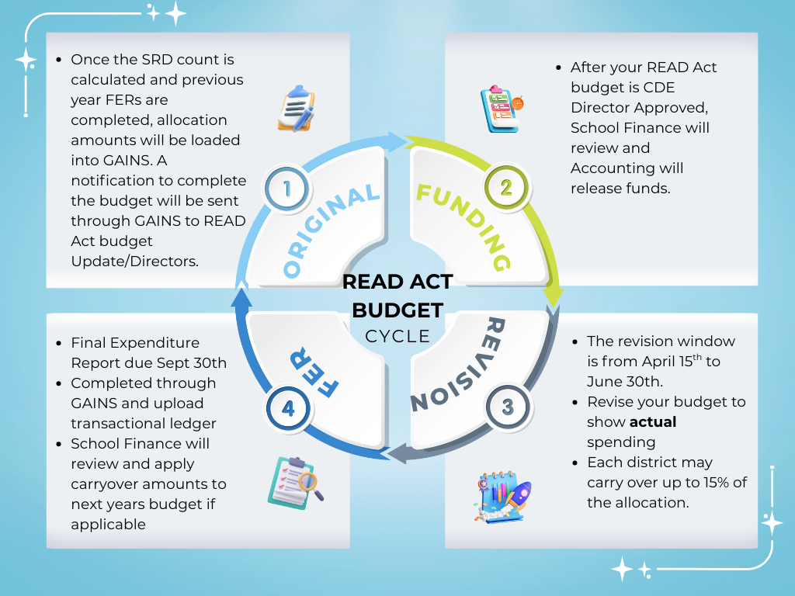
Life Cycle of a READ Act Budget

Slide 7
Allowable Expenses
Operate a summer school literacy program
Purchase core reading instructional programs that are included on the READ Act advisory list of instructional programming
Purchase and/or provide approve targeted, evidence-based or scientifically based intervention services to students which may include services provided by a reading interventionist
Purchase tutoring services focused on increasing students’ foundational reading skills
Provide technology, including software that is on the advisory list of instructional programming; may include professional development for use of technology
Purchase from a BOCES the services of a reading specialist or reading interventionist
Provide professional development programming to support K-3 educators in teaching reading

Slide 8
READ Act Budget Info
READ Act Budgets are completed in GAINS
must be "LEA Authorized Representative Approved"
Final Expenditure Reports must be completed for READ Act Budgets
due Sept 30th
Funding is released when all requirements are met:
SRD reporting complete
Teacher Training
Literacy Curriculum Transparency Reported
FER completed
Budget CDE Director Approved
No provisional budget to complete in the spring.

Slide 9
Unreported Carryover
LEAs are required to report any unspent funds/carryover at the end of each fiscal year.
If your district has remaining READ Act funds, in excess of what is shown on the 25/26 budget in GAINS:
-Complete the READ Act Carry over Reporting Form (due Feb 27, 2026)
-​Carryover amounts will be updated in the 25/26 budget in GAINS
-All districts will revise budgets based on actual spending in the spring
(April 15- June 30)
READ Act Carryover Reporting Form
Notes:
READ Act Carryover Reporting Form

Slide 10
Contacts
Nancy Taylor- ELSR- READ Act budgets (Taylor_N@cde.state.co.us)
David Miller- School Finance- FERs (Miller_D@cde.state.co.us)
Michelle Prael- Grants Program Administration- GAINS (Prael_M@cde.state.co.us)
READ Budget Submissions - Colorado Department of Education
Advisory List of Instructional Programming - Colorado Department of Education
READ Act Final Expenditure Report Training | CDE
Notes:
READ Budget Submissions - Colorado Department of Education
Advisory List of Instructional Programming - Colorado Department of Education
READ Act Final Expenditure Report Training | CDE

Slide 11
MOY READ Act Reminders
Notes:
Next, we will briefly review middle of year READ Act implementation reminders.

Slide 12

Purpose of MOY Assessment Data
Analyze the health of the system
Provide evidence to support continued implementation or needed changes within a system
Predict the likelihood of students meeting End of Year (EOY) benchmark goals
Notes:
The Colorado READ Act requires that each local education provider that enrolls students in kindergarten or first, second, or third grade shall ensure that teachers measure each student's reading competency using interim reading assessments throughout the school year.
Approved interim reading assessments are structured to include a middle of year (MOY) benchmark data collection window.
MOY data provides an opportunity to measure collective student progress across a district or school
The purpose of MOY data is for:
analyzing the health of the system throughout each school, and also at individual grade and classroom levels
providing evidence to support continued implementation or needed changes within a system
predicting the likelihood of students' meeting End of Year (EOY) benchmark goals based on current performance
22-7-1205 (1)(a) Each local education provider that enrolls students in kindergarten or first, second, or third grade shall ensure that teachers measure each student's reading competency using interim reading assessments at least once during the spring semester of the 2012-13 school year and throughout the year in subsequent school years.

Slide 13

A Strong READ Plan is a “Living Document”
The READ plan should be updated as services and data change to reflect the needs of the student and the supports the student is receiving.
READ plans should serve as a documentation of:
Data that supports the student’s reading progress
Services that the student is receiving
Who is providing the instruction and support
How well those services are supporting the student throughout the year
Notes:
A strong READ plan is a “living” document.
This means that the READ plan should be updated as services and data change to reflect the needs of the student and the supports the student is receiving.
READ plans should serve as a documentation of:
the data that supports the student’s reading progress,
the services that the student is receiving
Who is providing the instruction and support the student is receiving, and
how well those services are supporting the student throughout the year
A plan is not written at the beginning of the year and put away. It is used to guide instruction and determine when adjustments are needed, and successes are celebrated.

Slide 14

Initiating a READ Plan at MOY
22-7-1205 (1)(b) If a teacher finds, based on a student's scores on the approved reading assessments, that the student may have a significant reading deficiency, the teacher shall administer to the student one or more diagnostic assessments within sixty days after the previous assessment to determine the student's specific reading skill deficiencies.
22-7-1205(2) (a) Beginning no later than the 2013-14 school year, upon finding that a student has a significant reading deficiency, the local education provider shall ensure that the student receives a READ plan.
Notes:
Some students who previously tested above the cut score for an SRD may score below the cut score at MOY, and in this case, the same procedure is required that we follow at BOY and initiate a READ Plan at MOY
Students who are NEWLY IDENTIFIED at MOY for a possible significant reading deficiency based on their scores on the interim assessment should be administered a diagnostic assessment within sixty days,
and upon finding the student has an SRD, a READ plan must be initiated.

Slide 15
Required Components
Each READ plan must include, at a minimum:
The student’s specific, diagnosed reading skill deficiencies
Goals and objectives for the student’s targeted growth
The type(s) of additional instructional services and interventions the student will receive in reading
The scientifically and evidence-based reading instructional programming the teacher will use for reading instruction and interventions
How the child’s progress will be monitored and evaluated
Strategies parents are encouraged to use
Any additional services the teacher deems available and appropriate to accelerate the student’s reading skill development
Notes:
The READ Act includes several elements that must be included in a READ plan.
Each READ plan must include, at a minimum:
The student’s specific, diagnosed reading skill deficiencies that need to be remediated in order for the student to attain reading competency;
The goals and objectives for student growth in attaining reading competency;
The type of additional instructional services and interventions the student will receive in reading. At a minimum, the local education provider shall ensure the student receives educational services in a daily literacy block for the length of time identified as effective in research relating to best practices in teaching reading.
The scientifically based or evidence-based reading instructional programming the teacher will use to provide daily reading approaches, strategies, interventions, and instruction, which programs at a minimum shall address the areas of phonemic awareness, phonics, vocabulary development, reading fluency, including oral skills, and reading comprehension.
How the student’s progress will be evaluated and monitored;
The strategies parents are encouraged to use that are designed to supplement the programming
Any additional services the teacher deems available and appropriate to accelerate the student’s reading skill development
22-7-1206 (5) a-g
READ plans are specific to each student. The READ Act details additional components to include in READ Plans for English Language learners. The READ Act also includes additional READ Plan considerations for students who may have an Individualized Educational Plan.
Drop link:
READ Plan Checklist link: http://www.cde.state.co.us/coloradoliteracy/readplanchecklist

Slide 16
READ Plan Process
1. Identify specific skill deficits
2. Write goals and objectives
3. Match intervention to skill deficits; implement with fidelity
4. Select and administer progress monitoring assessment
6. Determine effectiveness of instruction; adjust as needed
5. Analyze PM data
These should directly address the specific skill deficits
This should happen at regular intervals (e.g., every 6 weeks)
Notes:
The graphic shown on the slide represents what the READ Plan Process would look like:
When a student is identified as having an SRD, a READ plan will be put in place:
Identify specific skill deficits
Write goals and objectives (These should directly address the specific skill deficits)
Match intervention to skill deficits; implement with fidelity
Select and administer progress monitoring assessment
Analyze progress monitoring data (This should happen at regular intervals, for example, every 6 weeks)
This helps Determine effectiveness of instruction; adjust as needed and celebrate student success!
Ongoing, regular updates to parents occur throughout the READ Plan process

Slide 17

Considerations for Students with Disabilities
May be identified as having an SRD
Could have a READ plan in addition to an Individualized Education Plan (IEP)
District decision on how these two plans work together to best support a child
Notes:
As mentioned before, There are considerations for student with disabilities
A child with a disability may be identified as having an SRD
And could have a READ plan in addition to an Individualized Education Program, or IEP (CRS 22-7-1206(3)).
It is a district decision on how these how these two plans work together to best support a child (CRS 22-7-1206(3); https://www.cde.state.co.us/cdesped/idea_colorados_read_act_guidance).
Note that not all students with a disability who have a significant reading deficiency will have an IEP and that these determinations are also made at the local level and are unique to the learner.
The IDEA and Colorado’s READ Act Guidance Document: https://www.cde.state.co.us/cdesped/idea_colorados_read_act_guidance

Slide 18

Considerations for Multilingual Learners
The READ Plan should include:
Reading goals and selected interventions should be developed with a student's English language proficiency level in mind
The necessary instructional scaffolds to ensure language considerations are addressed while providing the intervention
Information about a student’s home language literacy skills, if available, to help inform instruction
Notes:
When writing a READ Plan for a Multilingual Learner, the process for analyzing data, determining specific skill deficits, and writing goals and objectives is the same.
However, It is important that the READ plan incorporates information about the student’s English language development.
When creating a READ plan for Multilingual Learners, The READ plan should include:
Reading goals and selected interventions developed with a student's English language proficiency level in mind
The necessary instructional scaffolds to ensure language considerations are addressed while providing the intervention
Information about a student’s home language literacy skills, if available, as an asset to help inform instruction
Following these principles, schools can develop READ Plans that reflect the unique strengths and needs of MLs to set them on a trajectory toward proficiency in both literacy and English language development.

Slide 19
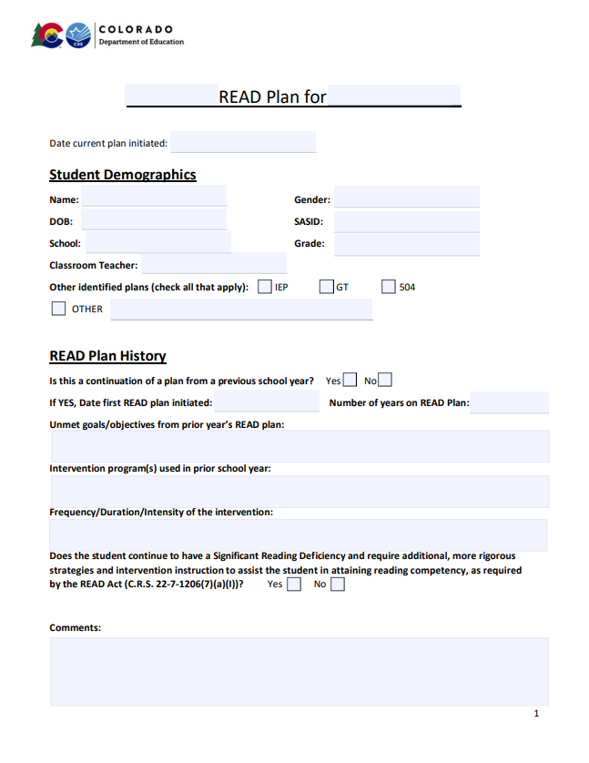
READ Plan Templates
READ Plan Template https://www.cde.state.co.us/coloradoliteracy/readplanexample
Multilingual Learners READ Plan Template:
https://www.cde.state.co.us/coloradoliteracy/mlreadplantemplate
Notes:
Our office completed revisions of the READ plan templates and posted them on our website to provide districts with an updated model to guide the way READ plans are written, revised, and implemented across the state.
Understanding the need to differentiate documentation for diverse needs, a new template specifically designed for multilingual learners was developed as well.
Both of the templates are in a fillable PDF format and available to download on our website at the links provided on this slide and we will also dropped them in the chat.
Drop in chat:
READ Plan Template
https://www.cde.state.co.us/coloradoliteracy/readplanexample
Multilingual Learners READ Plan Template:
https://www.cde.state.co.us/coloradoliteracy/mlreadplantemplate

Slide 20
Exiting a READ Plan
Schools monitor the ongoing reading progress, collecting a body of evidence.
A body of evidence demonstrates the student has achieved grade level competency in reading and parents are notified.
The READ plan is updated and exit date is recorded. READ plan is no longer active.
Notes:
Finally, let’s briefly review the process for students to exit a READ plan.
Each district shall ensure that a teacher continues to revise and implement a student’s READ plan until the student attains reading competency, regardless of the student’s grade level (22-7-1206(6)).
Schools monitor the ongoing reading progress of the students determined to have an SRD through progress monitoring and collecting a body of evidence.
A body of evidence demonstrates the student has achieved the Minimum Reading Competency Skills and is demonstrating grade level competency in reading and parents are notified.
In alignment with the requirements of the READ Act, schools should:
Document the assessment scores and the body of evidence that supports the student has demonstrated grade level reading competency.
Ensure the READ plan has supporting documentation for the plan and the body of evidence that demonstrates the student has reached grade level reading competency is included in the permanent academic record (22-7-1206(1)(b))
Schools must also communicate with the student’s parents that the student has reached grade level competency in reading and will be removed from the READ Plan. (22-7-1205(4)).
The READ Plan is updated and exit date is recorded. The READ Plan is no longer active.

Slide 21
Considerations When Exiting a Student From a READ Plan at MOY
Has the student demonstrated mastery of the minimum competencies consistently, over multiple measures?
Does the student demonstrate reading competency in all subskills measured by the assessment?
Do the assessment data align with the additional body of evidence?
Is the student able to maintain grade level competency through Tier 1 instruction alone, or does the student require additional supports through Tier II or Tier III interventions in order to maintain grade level competency?
If the student is a Multilingual Learner, are adequate language supports provided through Tier 1 programming, including English Language Development instruction, to ensure continued progress in reading?
Notes:
There are several considerations schools should take into account when making the decision to exit a student from a READ plan:
• Has the student demonstrated mastery of the minimum competencies consistently, over multiple measures?
• Does the student demonstrate reading competency in all subskills measured by the assessment?
• Do the assessment data align with the additional body of evidence?
• Is the student able to maintain grade level competency through Tier 1 instruction alone, or does the student require additional supports through Tier II or Tier III interventions in order to maintain grade level competency?
• If the student is a Multilingual Learner, are adequate language supports provided through Tier 1 programming, including English Language Development instruction, to ensure continued progress in reading?
Drop in Chat
https://www.cde.state.co.us/coloradoliteracy/exitingareadplan

Slide 22
Parent Communication
Does your district have procedures in place that support communication with parents?
Are there barriers to communication that need to be addressed at a district or school leader level?
Notes:
The READ Act contains specific language pertaining to parent communication. The LEP is responsible for ensuring that parents of students on a READ plan receive ongoing, regular updates from the student’s teacher concerning the results of the intervention instruction and the student’s progress.
The student's teacher is encouraged to communicate with the parent concerning the parent's progress in implementing the home reading strategies identified in the student's READ plan. To the extent practicable, the teacher shall communicate with the parent in a language the parent understands.
MOY is a good time to reflect on the quality of communication between teachers and parents in relation to READ plans. Questions to consider:
Does your district have procedures in place that support communication with parents?
Are there barriers to communication that need to be addressed at a district or school leader level?
There is one other note we would like to make about parent communication and we have shared in other regional meetings.
One finding in the 2024 READ Act Report from WestEd, although with a smaller sample size from across the state, was that a majority of parents surveyed (over 70%) expressed frustration with lack of communication from their student’s school regarding READ Plans. This provides a reminder to us to ensure strong communication is in place to ensure parents feel informed about their child’s literacy development.
22-7-1205 (4) The local education provider shall ensure that the parent of each student who has a READ plan receives ongoing, regular updates from the student's teacher, which may occur through existing methods of communication, concerning the results of the intervention instruction described in the plan and the student's progress in achieving reading competency.

Slide 23
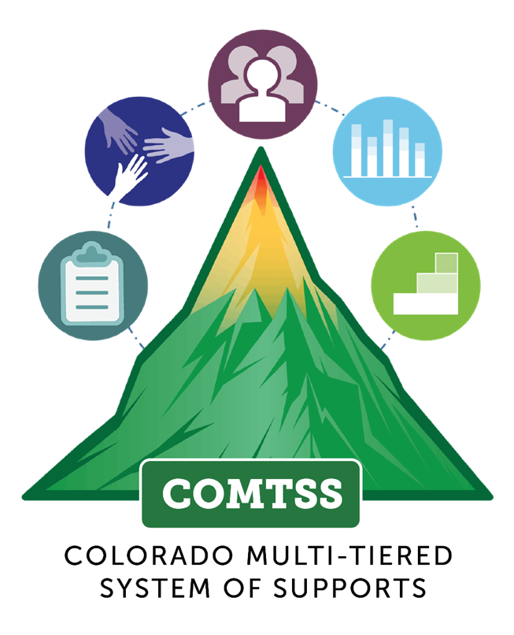
By MOY Data Collection:
Multiple data cycles
Robust progress monitoring
Flexible groupings
Data driven response, all tiers
Notes:
By the time the middle of year assessment is administered, a well-functioning system would ideally include multiple data cycles, in which teachers have been able to monitor how students are responding to instruction. This means a robust system for progress monitoring student progress is in place. A strong system would also have students placed flexibly into intervention groups, so that changes can be made in response to how students are responding to intervention. Also, hopefully data is being used to support all tiers of instruction, including making adjustments to Tier 1 instruction when necessary.
It is always important to keep in mind the general numbers associated with tiers of instruction when anticipating data outcomes at any point in the year. Ideally, in a healthy system the vast majority of students (around 80%) will score at or above the benchmark cut scores for their grade level when provided with high-quality tier 1 instruction, around 15% will require additional supports from tier 2 instruction, and around 5% will need more intensive interventions (tier 3).
We know the reality is that there are many factors that keep this balance from happening in our data, so looking not only at over all school or district-wide data but more deeply at individual subtests, demographic trends, and other more granular data can support us in finding root causes for what keeps schools from reaching their reading goals.

Slide 24
Revisit SMART Goals and Objectives
What progress have students made moving through objectives between BOY and MOY?
Do READ plans accurately reflect what is being done to target goals and objectives? Are there adjustments that need to be made?
If teachers have not been writing clear goals or targeted objectives, is MOY a time that can be revisited to improve alignment between goals and the instruction students are receiving?
Notes:
Finally, the middle of year data collection is the perfect time to be reflective about and strategically plan to revisit READ plan goals and corresponding objectives.
What progress have students made moving through objectives between BOY and MOY?
Do READ plans accurately reflect what is being done to target goals and objectives? Are there adjustments that need to be made?
If teachers have not been writing clear goals or targeted objectives, is MOY a time that can be revisited to improve alignment between goals and the instruction students are receiving?

Slide 25
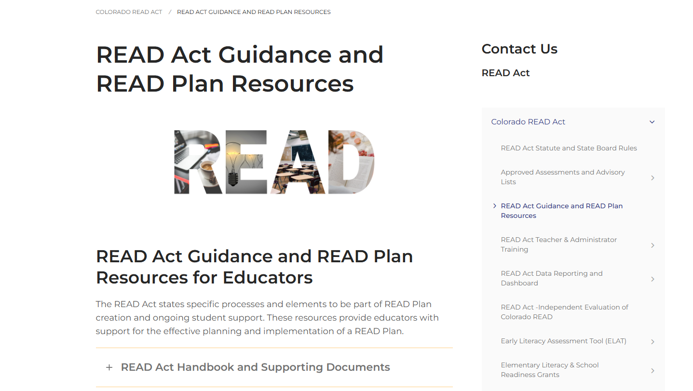
READ Plan Resources
https://ed.cde.state.co.us/coloradoliteracy/readplans
Notes:
On the CDE website, we have a page of READ Act Guidance and READ Plan Resources for you to refer to as you continue the school year. This is where the links we have been sharing live.
The READ Act Handbook, a good starting point, is a compilation of all the guidance documents and resources we have created to support READ Leads set up in a chronological order for the school year.
We also have the guidance documents and templates linked separately if you need to access one at a time.
This page includes current information about the READ Act statute, assessments, SRD identification, initiating a READ Plan, collecting a body of evidence, support for READ plans throughout the year, guidance for READ plans in subsequent years, including 4th grade and beyond, parent communication, exiting students from a READ plan, and the fillable READ plan templates.
https://ed.cde.state.co.us/coloradoliteracy/readplans

Slide 26

Updates to the CDE Website

Slide 27
New CDE Website
CDE has recently switched to a new website platform: ed.cde.state.co.us.
Most of the web pages and links from the old website have been moved to this platform or have redirect links.
This update is meant to be more accessible with your mobile devices.
The department is working on streamlining navigation from the main CDE page to each office, as well as click paths for relevant topics.
Please bookmark this page for content related to the ELSR office, early literacy grants, and READ Act implementation. https://ed.cde.state.co.us/coloradoliteracy
Notes:
CDE has recently switched to a new website platform: ed.cde.state.co.us. Most of the web pages and links from the old website have been moved to this platform or have redirect links.
This update is meant to be more accessible with your mobile devices.
The department is still working on streamlining navigation from the main CDE page to each office, as well as click paths for relevant topics.
Please bookmark this page for content related to the ELSR office, early literacy grants, and READ Act implementation. https://ed.cde.state.co.us/coloradoliteracy

Slide 28

Navigation to READ Act
Notes:
Currently, you can navigate to READ Act content from the main CDE page by hovering over the “Family Resources” tab. This will take you to the READ Act parent resources page, from which you can navigate to all ELSR content via the right-side menu.

Slide 29

READ Act Website Content
READ Act Approved Assessments and Advisory Lists
READ Act Handbook
READ Guidance Documents
READ Plan Templates
READ Act Teacher and Administrator Training Info
Data Dashboard
READ Budget Submissions
Literacy Curriculum Transparency
ELAT, ELG, CLSD Info
SOR Literacy PD Series
CDE Biliteracy PD Series
READ Act & SOR for Families PD Series
SB25-200 Updates
Dyslexia Working Group
Notes:
Following the navigation from the CDE main page mentioned on the previous slide, you will see this READ Act Parent Resources page. The right-side menu includes all the READ content, and the first link on the menu will take you to that READ Act page you bookmarked.
The right-side menu includes links to statute, approved assessments, advisory lists, READ Act Guidance and READ Plan resources, data dashboard, ELAT, elementary literacy & school readiness grants (CLSD and ELG), and READ Act related resources.

Slide 30


Data-Based Decision Making at MOY

Slide 31

Analyzing Tier 1 Instruction
Is the core curriculum instruction resulting in 75 to 80 percent of students reaching grade-level benchmarks?
If not, what considerations need to be made to improve student outcomes?
Notes:
As referenced earlier with MTSS and tiers of instruction, data analysis should first focus on the efficacy of universal tier 1 instruction. The following questions can be considered:
Is the core curriculum instruction resulting in 75 to 80 percent of students reaching grade-level benchmarks?
If not, what considerations need to be made to improve student outcomes?
https://www.pattan.net/getmedia/612dbbd1-2152-4cef-a884-1f0c8dbc1fdf/TDR_Data_Teams0415

Slide 32
Improving Tier 1 Instruction
Is Tier 1 instruction differentiated and scaffolded to meet the needs of students?
Is assessment data being used to determine the efficacy of instruction and planning?
How is staff being used during instructional time?
How is programming being utilized?
Are instructional routines and language consistent within the building and among staff?
Are there opportunities for collaboration and communication among all staff who provide instruction and intervention to students?
Are there connections to Tier 2 and Tier 3 instruction?
Notes:
Guiding questions to consider:
Is Tier 1 instruction differentiated and scaffolded to meet the needs of students?
Is assessment data being used to determine the efficacy of instruction and planning?
How is staff being used during instructional time?
How is programming being utilized?
Are instructional routines and language consistent within the building and among staff?
Are there opportunities for collaboration and communication among all staff who provide instruction and intervention to students?
Are there connections to Tier 2 and Tier 3 instruction?

Slide 33

Layered Continuum of Supports
Ensure that every student receives equitable whole-child supports that are evidenced based, culturally responsive, matched to need, and developmentally appropriate through layered supports.
Every student = Universal
Some = Universal + Targeted
Few = Universal + Targeted + Intensive
Notes:
When considering layers of support and intervention, it is also important to consider the layered continuum of supports in the MTSS framework.
In the COMTSS Framework, layered continuum of supports is:
A Prevention based framework that is proactive as opposed to reactive
Used for students but also adults: How do teachers’ needs differ? Parent needs? Admin needs? What additional supports do these groups need?
Students at all levels continue to receive high quality and evidence-based tier 1 universal supports, regardless of their level of intervention.

Slide 34
Key Aspects of Data-Based Problem Solving and Decision-Making
Make decisions based on data and evidence, not assumptions.
Don’t jump to solution without understanding what the root problem is and why it’s happening.
Develop an action plan:
-Who will do what, and by when?
-How will we know it was done and that it worked?
Spend time determining if your plan worked.
-How do you know?
Notes:
Key aspects of data-based problem solving and decision-making, defined by Colorado MTSS, include:
Making decisions based on data and evidence and not assumptions
Don’t jump to solution without understanding what the root problem is and why it’s happening,
Develop an action plan: Who will do what by when? How will we know it was done and that it worked?),
Spend time determining if your plan worked. How do you know?

Slide 35
Flow Chart Adapted With Permission from Burns, M., 2024
Assess Comprehension and Vocabulary
Proficient
Core Instruction
Low
Assess Fluency
Fluent
Intervene for Comprehension
Low
Assess Phonics
Can Decode
Intervene for Fluency
Low
Assess Phonemic Awareness (PA)
Has PA
Intervene for Decoding
Low
Intervene for Phonemic Awareness
Adapted with permission from Burns, M., 2024
Notes:
This diagram, adapted with permission from Dr. Matt Burns, provides guidance on how diagnostic data can be used to determine a student’s level and needs for literacy intervention.
On the left side of the chart are the components of reading. After providing initial assessments and determining a students individual skill level, the chart can be used to determine the area in which the student most likely needs interventions. For example, if phonics assessments determine that a student can decode, intervention should focus on fluency. If phonics assessments reveal low decoding skills, we would dig deeper by assessing the student’s phonemic awareness. If those skills are in place, interventions should focus on basic phonics and decoding.

Slide 36
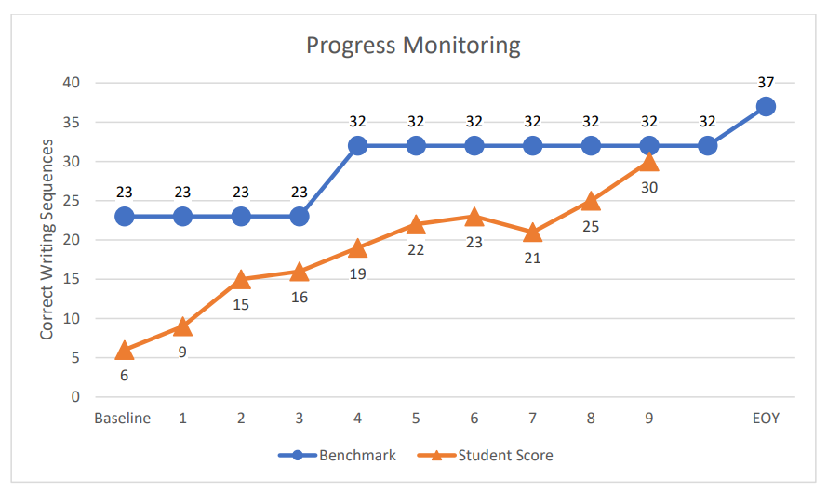
Positive Response to Intervention
Significant improvement is evidenced by a change in the slope of the progress line that indicates the student is making adequate progress toward the benchmark within acceptable time limits. The achievement gap is closing at an acceptable rate.
Notes:
The graph on the slide shows an example of a student demonstrating a positive response to intervention. Significant improvement is evidenced by a change in the slope of the progress line that indicates the student is making adequate progress toward the benchmark within acceptable time limits. The achievement gap is closing at an acceptable rate.

Slide 37
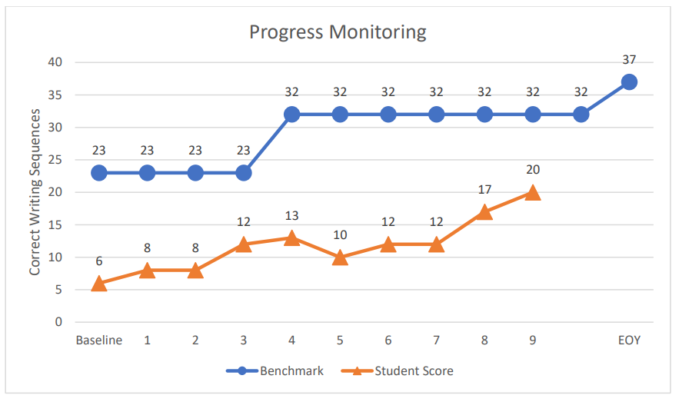
Questionable Rate of Improvement
Improvement is evidenced by a positive change in the slope of the progress line. However, the rate at which this progress is being made is determined to be too slow OR the improvement indicates that the student’s rate of progress is equal to that of peers but that the achievement gap is not narrowing.
Notes:
This graph shows a questionable rate of improvement. Improvement is evidenced by a positive change in the slope of the progress line. However, the rate at which this progress is being made is determined to be too slow OR the improvement indicates that the student’s rate of progress is equal to that of peers but that the achievement gap is not narrowing.

Slide 38
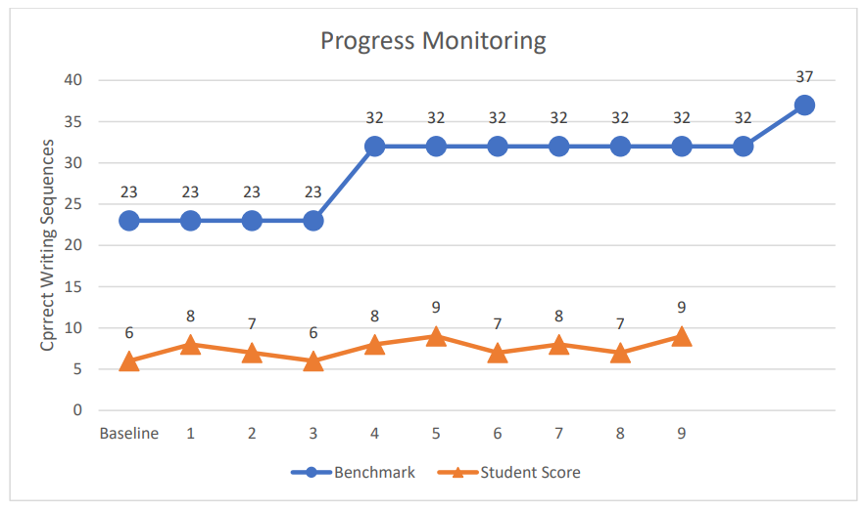
Poor Rate of Improvement
The achievement gap continues to widen.
Notes:
Finally, the graph on this slide shows a poor rate of improvement for the student as the achievement gap continues to widen.

Slide 39
Determine Group or Individual Changes
For students grouped with similar needs, analyze data to determine if most students in the group are responding to the intervention.
If most students in the group are not responding, changes should be made to intensify the intervention for the entire group.
If only a few students are not responding, consider regrouping students to provide more intensified intervention for the lower performing students.
“Adapting the intervention for the group is more efficient than adapting an individual student’s intervention (NCII, 2023).”
Notes:
When making adjustments to intervention, it is important to determine if there needs to be group or individual changes.
For students grouped with similar needs, analyze data to determine if most students in the group are responding to the intervention.
If most students in the group are not responding, changes should be made to intensify the intervention for the entire group.
If only a few students are not responding, consider regrouping students to provide more intensified intervention for the lower performing students.
According to the NCII, “Adapting the intervention for the group is more efficient than adapting an individual student’s intervention (NCII, 2023).”

Slide 40

Regional Collaboration
Notes:
We are about to open up breakout rooms organized by regions, so you have an opportunity to connect with other leaders in your area and your regional consultant.

Slide 41
Breakout Rooms
Guiding Questions:
What structures and processes does your school/district have in place for analyzing midyear data?
How is the data used to inform instructional planning?
What does your data tell you about how your system is serving the needs of students?
What is going well with your data-driven instruction, and what areas could be refined or strengthened?

Slide 42

Literacy Updates and Collaboration

Slide 43
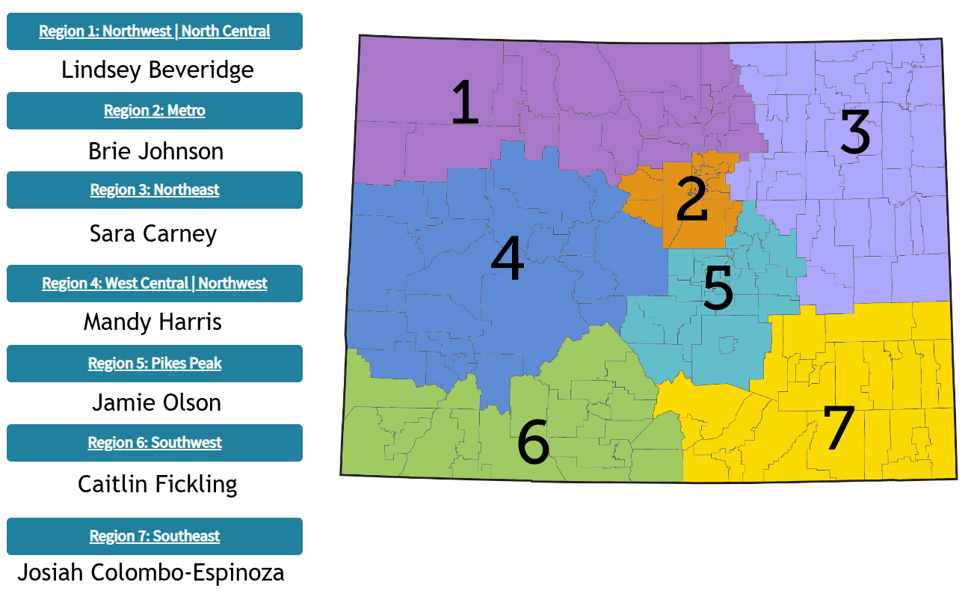

ELSR Regional Support Information
ELSR Regional Support
Notes:
The CDE website has been updated to show our new regional support map. On this webpage, you can find information about the consultant for your district, resources we can provide, and a link to a request for support form.
https://ed.cde.state.co.us/early/elsrregionalsupport

Slide 44
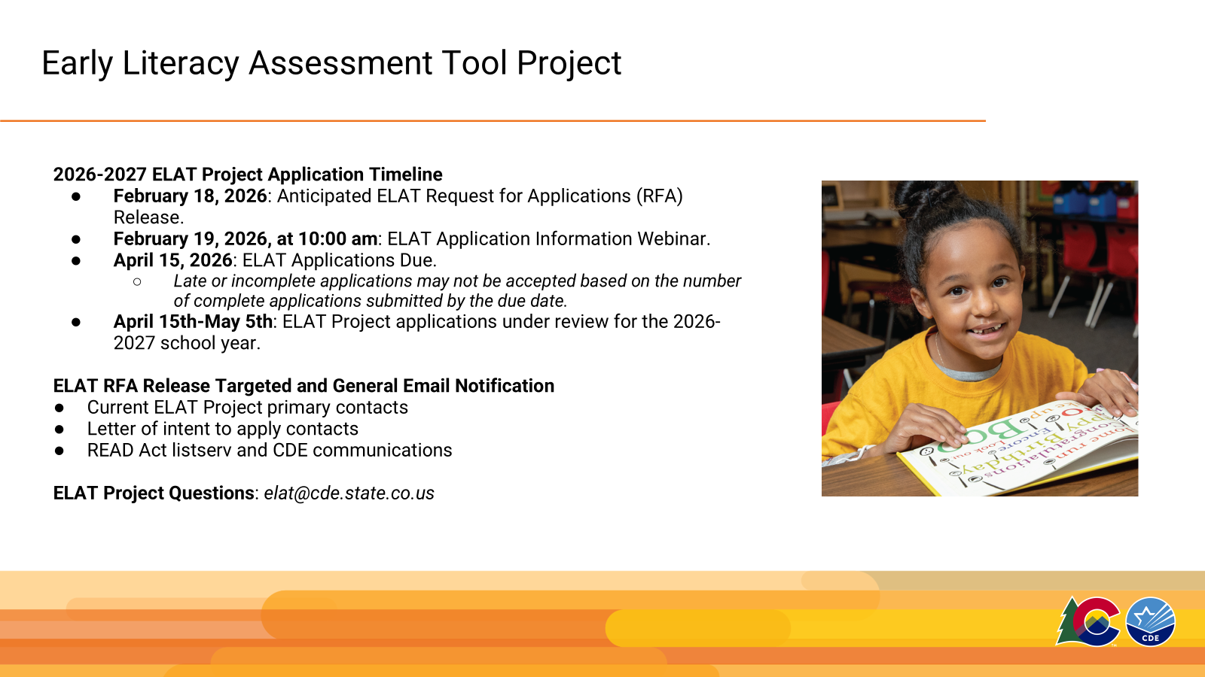
ELSR Regional Consultant Support
Data analysis
SRD identification
READ Act implementation
Professional development
Planning for developing processes and procedures required by the READ Act
Notes:
There are many ways in which the ELSR Regional Consultants can provide support
Districts or BOCES can reach out to their ELSR regional consultant and request support with:
Developing a process to select programs that align with the science of reading and evidence-based practices
Selecting programs/instructional materials
Developing a process for implementation of newly selected programs
Provide guidance on SRD identification, READ plan development and READ Act implementation
They can support with data analysis and for developing processes and procedures required by the READ Act

Slide 45
ELSR Professional Development Updates

Slide 46
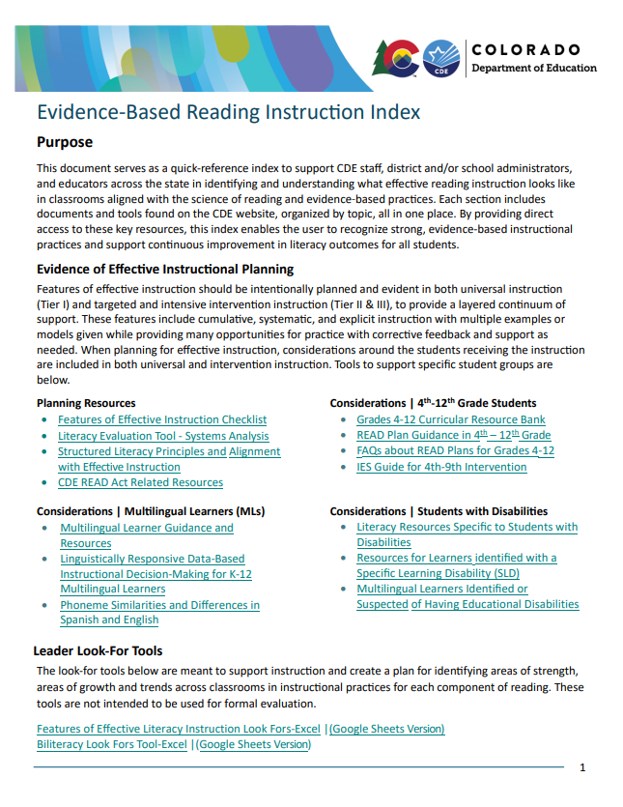
Evidence-Based Reading Instruction Index
Quick-reference index for district/school administrators and educators
Identifies what effective reading instruction looks like in classrooms aligned with the science of reading and evidence-based practices
CDE documents and tools are organized by topic
By providing direct access to these key resources, this index enables the user to recognize strong, evidence-based instructional practices and support continuous improvement in literacy outcomes for all students.
https://www.cde.state.co.us/coloradoliteracy/evidencebasedreadinginstructionindex
Notes:
The Evidence-Based Reading Instruction Index serves as a quick-reference index to support CDE staff, district and/or school administrators, and educators across the state in identifying and understanding what effective reading instruction looks like in classrooms aligned with the science of reading and evidence-based practices. Each section includes documents and tools found on the CDE website, organized by topic, all in one place. By providing direct access to these key resources, this index enables the user to recognize strong, evidence-based instructional practices and support continuous improvement in literacy outcomes for all students.
https://www.cde.state.co.us/coloradoliteracy/evidencebasedreadinginstructionindex

Slide 47
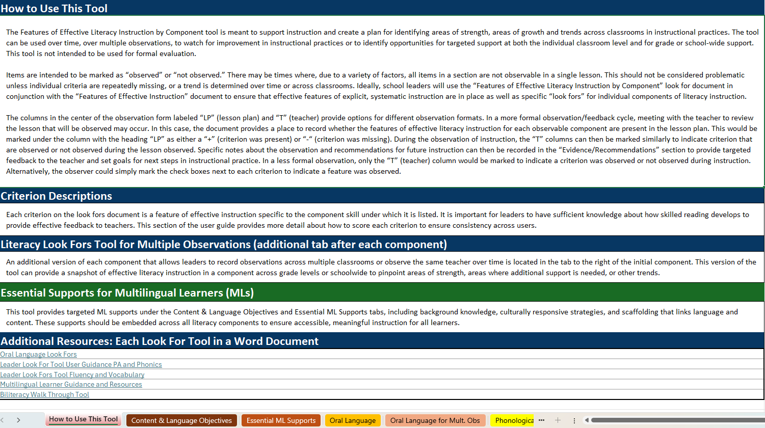
Combined Leader Look-For Tools
Notes:
The look-for tools are meant to support instruction and create a plan for identifying areas of strength, areas of growth, and trends across classrooms in instructional practices for each component of reading. These tools are not intended to be used for formal evaluation.

Slide 48
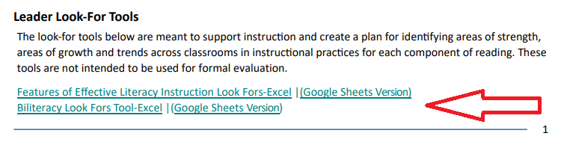
Features of the Look-For Tools
Notes:
The combined leader look-for tools are included at the bottom of the first page of the Evidence-Based Reading Instruction Index.
There is an Excel version and a Google Sheets version for each tool.
We have an English instruction look-for tool and a Biliteracy look-for tool available.

Slide 49
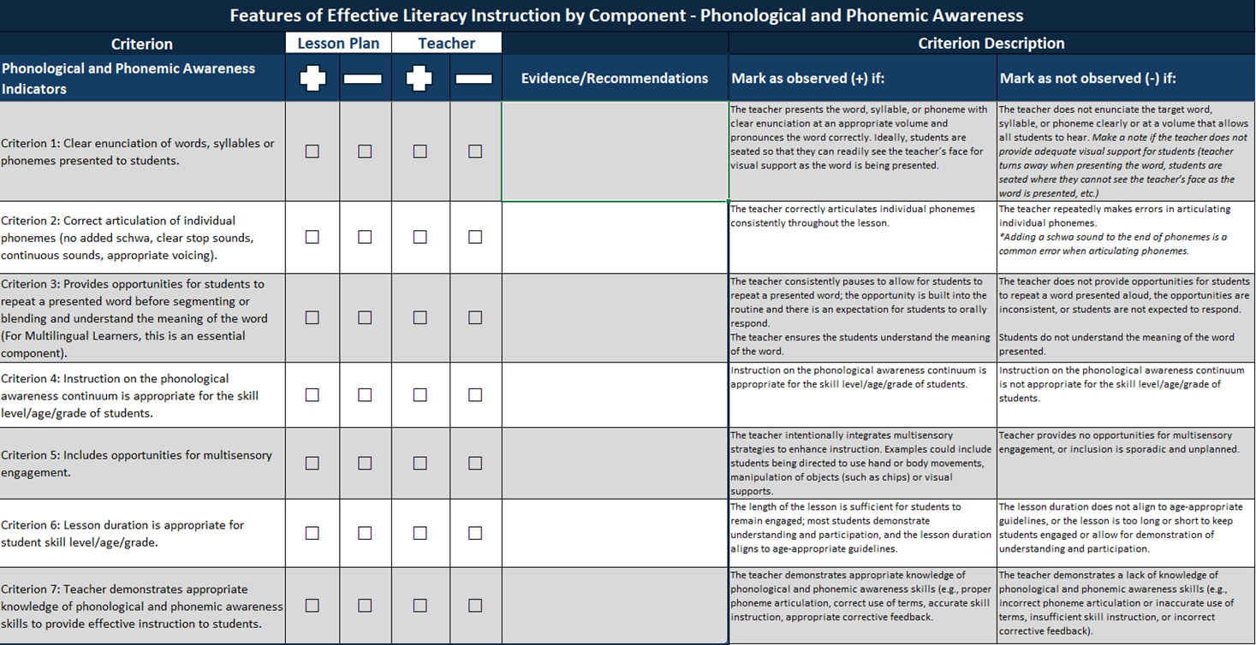

Leader Look For Tool Example
Notes:
This tool is organized by literacy component. The example on this slide is for phonological and phonemic awareness.
Each component has a list of criterion indicators, a place to mark evidence found in the lesson plan and/or during observation, a section to add evidence/recommendations, and then descriptions for each criterion.
There are colored tabs at the bottom of this tool for each component, and to track multiple educators or multiple observations for an educator over time.
Guidance for how to use this tool is located on the first tab of each version of these documents.

Slide 50
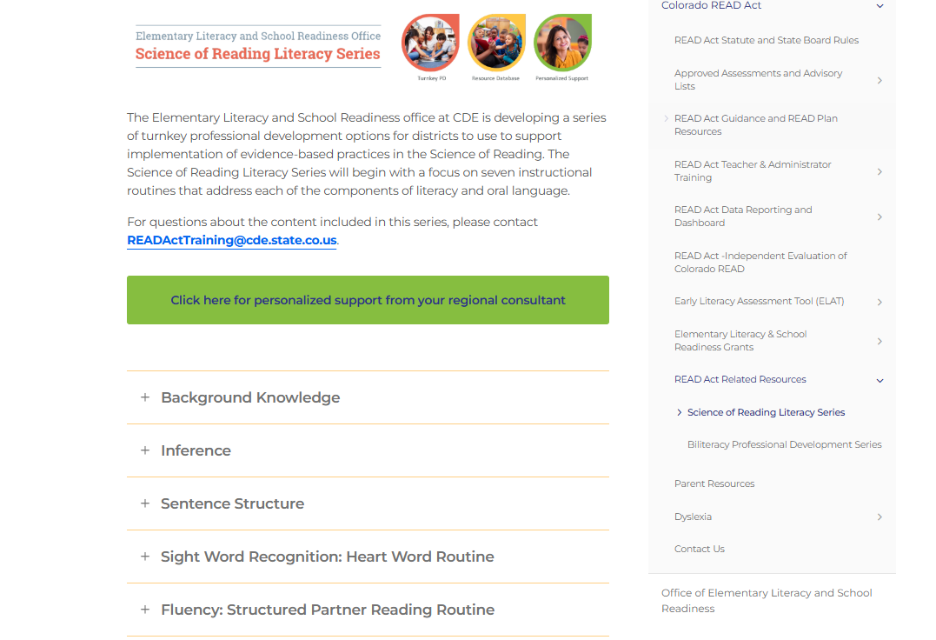
CDE Science of Reading Literacy Series
Notes:
As a reminder, the Science of Reading Literacy Series is available on the CDE website.
This is a collection of turnkey professional development products to support districts with the implementation of evidence-based instructional routines aligned to the Science of Reading.
These slide decks and resources were developed in alignment with the 45-hour teacher training to revisit the research base, review the steps in the instructional routines, provide a model for the routine, and allow opportunities for practice and planning.
The series also includes resources for administrators or literacy coaches to track and provide feedback on the implementation of the routines in their buildings.
https://ed.cde.state.co.us/coloradoliteracy/resources/sorliteracyseries

Slide 51

Biliteracy Guidance for MLs
Available Resources:
Biliteracy Guidance for Multilingual Learners PDF
Biliteracy Walk-Through Tool
Biliteracy Professional Development Series
Notes:
We are also excited to remind you about more great resources from CDE: Biliteracy Guidance for Multilingual Learners, the Biliteracy Walk-Through Tool, and the Biliteracy Professional Development Series.
The Biliteracy Guidance document is a guide to support the literacy and biliteracy instruction of Multilingual Learners (MLs) in bilingual education programs. It includes evidence-based practices that integrate all components of reading while addressing their specific application across languages. Key topics covered include oral language development, oracy, translanguaging, cross-linguistic connections, and holistic assessment.
The Biliteracy Walk-Through Tool helps identify areas of strength and growth in instructional practices. The tool can be used over time, over multiple observations, to watch for improvement in instructional practices or to identify opportunities for targeted support at both the individual classroom level and for grade or school-wide support. It is not intended for formal evaluation. It is available as a forced copy google sheet and excel document.
The Biliteracy Professional Development Series is a four-part course comprised of an Introduction and three Modules. This course is designed to provide participants with evidence-based strategies for teaching students in English and Spanish while working towards bilingualism and biliteracy.
It is an open-source format designed to be accessible to anyone interested in learning more about best practices for providing biliteracy instruction in Spanish and English.
Additionally, you will find support documents and websites to further your learning. You may take this course at your own pace. If you choose to take the quiz at the end of the course, you will be eligible for two hours of professional development.
https://ed.cde.state.co.us/coloradoliteracy/resources/biliteracy-professional-development-series-0

Slide 52
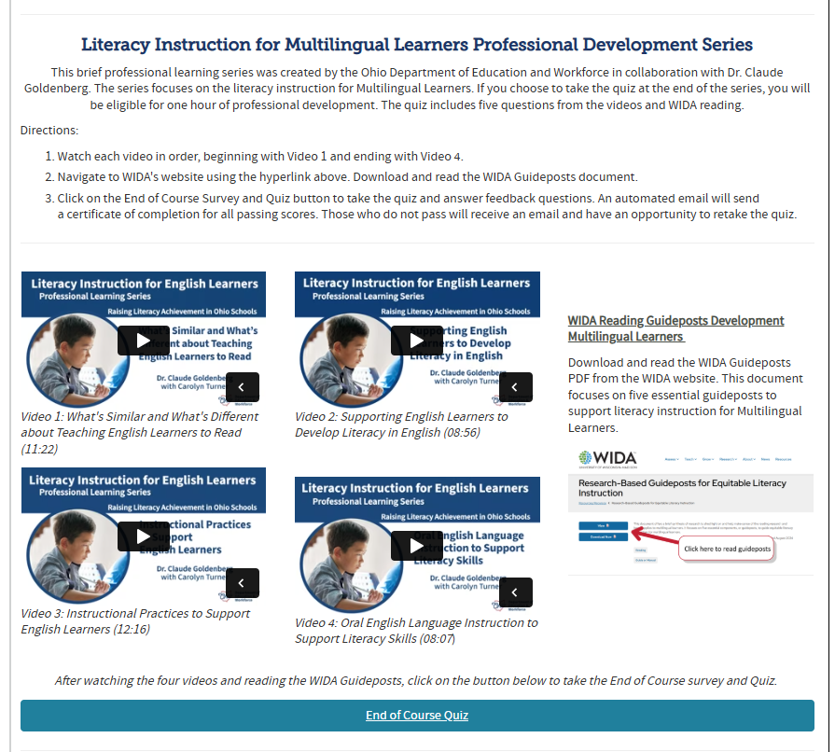
Literacy Instruction for MLs Professional Development Series
The series focuses on the literacy instruction for Multilingual Learners.
If you choose to take the quiz at the end of the series, you will be eligible for one hour of professional development.
https://ed.cde.state.co.us/coloradoliteracy/readandel
Notes:
We have also developed a series that focuses on the literacy instruction for Multilingual Learners.
If you choose to take the quiz at the end of the series, you will be eligible for one hour of professional development.
https://ed.cde.state.co.us/coloradoliteracy/readandel

Slide 53
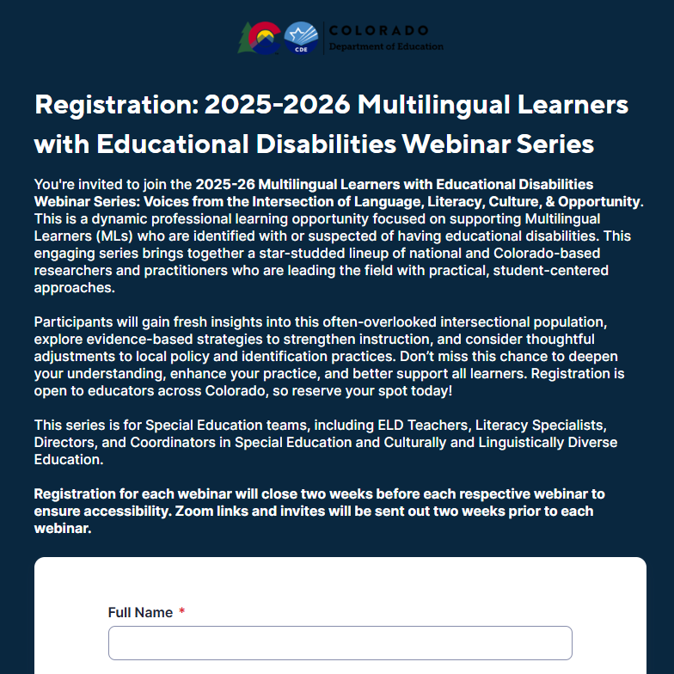
Save the Date!
Upcoming Webinar on February 19, 2026, at 8:30 AM MST
“Translanguaging as a Tool for Equity: Supporting Dually Identified Learners”
Presented by Dra. Tania Hogan & Dra. Deena Gumina
Registration Link
Notes:
February 19, 2026 - “Translanguaging as a Tool for Equity: Supporting Dually Identified Learners”
Presented by Dra. Tania Hogan & Dra. Deena Gumina
Translanguaging is introduced as a pedagogical approach to more equitably serve dually identified students. Participants will explore how to meaningfully incorporate students' home languages into IEP-aligned instruction, challenge monolingual norms, and foster inclusive, asset-based learning environments. Classroom-based examples in reading, writing and oral language instruction will illustrate how translanguaging bridges language development and disability support in meaningful, practical ways.
Here is the registration link: https://app.smartsheet.com/b/form/019833075d957780bbf49d5eb92bf907

Slide 54

Family Awareness Resources
Informational Sessions:
Tuesday, January 20, 2026: 3:30 PM - 4:30 PM
REGISTER HERE
Friday, January 23, 2026: 10:00 AM – 11:00 AM
REGISTER HERE
https://ed.cde.state.co.us/coloradoliteracy/readactandsorforfamilies
Notes:
Our office has also created a series of turnkey resources for districts and schools to use to support family awareness of the Colorado READ Act, READ plans, and the Science of Reading for families.
Live informational sessions are being held to support administrators and educators in understanding and exploring the resource components.
Note: All sessions have the same content. Please choose the date that works best for you.
Informational Sessions: Second Semester
Tuesday, January 20, 2026: 3:30 PM-4:30 PM
REGISTER HERE
Friday, January 23, 2026: 10:00 AM-11:00 AM
REGISTER HERE
Please reach out to your ELSR Regional Consultant with any questions.
https://ed.cde.state.co.us/coloradoliteracy/readactandsorforfamilies

Slide 55

Literacy Newsletter
https://ed.cde.state.co.us/coloradoliteracy/archivedliteracynews
Sign Up for the Literacy Newsletter
Notes:
We also want to provide a quick reminder that our office has a monthly literacy newsletter to provide supportive resources and helpful instructional tips. If you have not done so already, you can sign up to receive this monthly newsletter via the link on the slide or in the chat. By signing up today, you will join the list in time to receive the September 2025 newsletter.
Newsletter Signup Link:
https://docs.google.com/forms/d/e/1FAIpQLSdGZlID5hfWJP02U13pyZXIVzNEmAV8BkTiqwPtJGWk2dE3Yg/viewform

Slide 56

Thank you!
Archived Meeting Materials available at https://ed.cde.state.co.us/coloradoliteracy/readactregionalmeetings

