Slide 1
Mandatory ESSER-Funded Project and Construction Training
March 2024

Slide 2
Purpose
Ensure LEAs understand requirements applicable to federally funded projects
Provide guidance and tools for LEAs to determine exactly what rules apply to their projects
Not all projects are subject to all of the rules
Based on recent U.S. Department of Education (ED) guidance, focus on current/open projects
Areas of noncompliance must be corrected prior to completion of federally funded projects
Provide next steps for LEAs with closed projects that had instances of noncompliance
CDE will be required to report instances of noncompliance to ED

Slide 3
Agenda
Considerations for this Webinar
Davis-Bacon and Related Acts (DBRA)
What is required from LEAs?
Required Contract Provisions
Construction
How do you define it and when is DBRA applicable?
Examples of Projects - Construction or Not
Additional Rules Applicable to Construction
Notice of Federal Interest
Indirect Costs
What if noncompliance occurred on a project?
CDE Construction Questionnaire
Attestation of Completion

Slide 4
Considerations for this Webinar
How did you use your ESSER funds?
Did you have any activities in your application that included contracted work completed by mechanics, plumbers, or other laborers?
Did you have any activities that involved construction, alteration, or repair (including painting and decorating) of public buildings or public works
Are these activities completed or ongoing?
During this webinar, we will discuss the federal regulations and their applicability to various types of projects

Slide 5
Davis-Bacon and Related Acts (DBRA)
May apply to contracts for labor, including but not limited to construction

Slide 6
Davis-Bacon and Related Acts (DBRA)
The Davis-Bacon and Related Acts (DBRA) does not apply to work performed by LEA employees
DBRA applies to contractors and subcontractors performing on contracts that:
Are federally funded (in whole or in part)
Exceed $2,000
Are for the construction, alteration, or repair (including painting and decorating) of public buildings and public works, and
Include employment of laborers or mechanics (work is manual or physical in nature as distinguished from mental or managerial duties)
The four factors listed above are what should be used to determine if a project is subject to DBRA; whether or not the project is considered construction as opposed to minor remodeling is not a factor in determining DBRA applicability.

Slide 7
Davis-Bacon and Related Acts (DBRA) Cont’d
Contracts must include DBRA clauses or provisions detailing the minimum wages (a.k.a. prevailing wages) to be paid to various classes of laborers and mechanics employed under the contract (see subsequent slides for more detail)
Wage determinations (see next slide) must be incorporated in contracts
Davis-Bacon Act (DBA) prevailing wage provisions apply to approximately 60 “Related Acts” or statutes under which federal agencies assist construction projects through grants, loans, loan guarantees, and insurance
Additional information linked here

Slide 8
DBRA Requirements - Wage Determinations, Prevailing Wages and Certified Payrolls
Wage Determinations (WD)
Published by the Department of Labor (DOL), a WDs is a list of locally prevailing hourly wage and fringe benefit rates for each classification of laborer and mechanic by geographic area and by construction type (building, residential, highway, and heavy)
Each WD is assigned a reference number and published on sam.gov
Click here for an overview on how to search sam.gov for WDs applicable to your project or here for additional information about WDs
Prevailing wages and fringe benefits must be paid on a weekly basis
Weekly certified payroll records must be submitted to the LEA
DOL Form WH-347 and Instructions - optional, but the same information and certification language are a required part of the weekly submission
LEAs should at least be spot monitoring submitted certified payrolls
DOL offers a payroll review tutorial with related slides
We recommend LEAs sign and date to show evidence of review
DBRA FAQ page from DOL website linked here

Slide 9
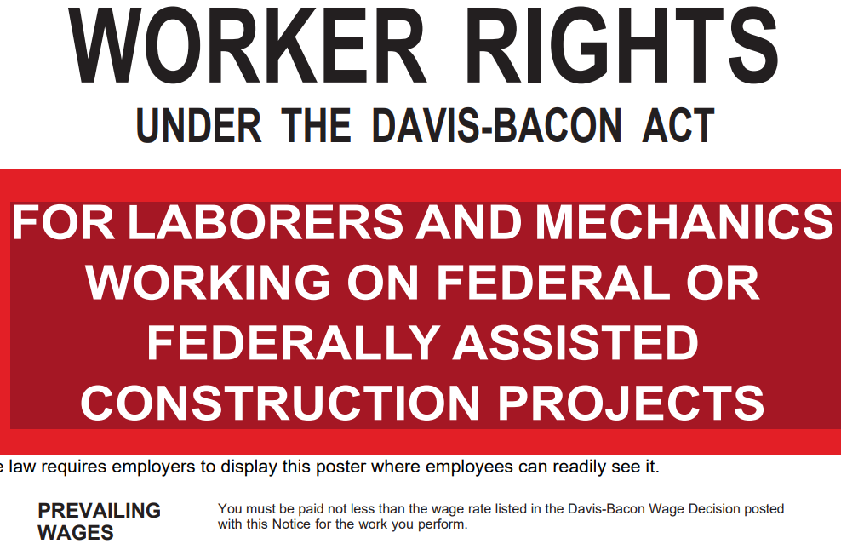
DBRA Requirements - Job Site Postings
Visit the job site to ensure the following are visible:
The applicable DBRA wage determination from sam.gov
WH-1321 poster found here on the DOL website
We recommend taking pictures to document compliance

Slide 10
Contract Provisions and
Other Requirements

Slide 11
Contract Provisions and Other Requirements for Federally Funded Costs or Activities
Work with your attorney to ensure compliance
Determine the need to include:
DBRA provisions from 29 CFR 5.5 - Contract Provisions and Related Matters
Applicable provisions from 2 CFR 200, Appendix II - Contract Provisions for Non-Federal Entity Contracts Under Federal Awards
Insurance coverage on federally funded property must at least be equivalent to coverage on non-federally funded property (2 CFR 200.310)
Follow bonding requirements when applicable (2 CFR 200.326)
Provide for domestic preference for procurement (2 CFR 200.322)
Submit annual real property reports to Colorado Department of Education (Process Coming Soon) (2 CFR 200.330)

Slide 12
Construction

Slide 13
How do we define Construction?
Minor remodeling is not construction
Minor alterations in a previously completed building. The term also includes the extension of utility lines, such as water and electricity, from points beyond the confines of the space in which the minor remodeling is undertaken but within the confines of the previously completed building. The term does not include building construction, structural alterations to buildings, building maintenance, or repairs (34 CFR 77.1).
Remodeling that results in structural changes ≠ minor remodeling
Maintenance and repairs are not construction
Costs incurred for utilities, insurance, security, necessary maintenance, janitorial services, repair, or upkeep of buildings and equipment which neither add to the permanent value of the property nor appreciably prolong its intended life, but keep it in an efficient operating condition (2 CFR 200.452).
Equipment and other Capital Expenditures could be construction
Costs incurred for improvements which add to the permanent value of the buildings and equipment or appreciably prolong their intended life must be treated as capital expenditures (see 2 CFR 200.439 and 200.1).
Project might substantially increase value of a building but not be construction because it is not altering the structure of the building

Slide 14
Is it construction or not?
Construction can be a gray area, case-by-case basis
Proposed changes to Education Department General Administrative Regulations (EDGAR) would provide a definition of construction and also revise the minor remodeling definition to clarify that it is not considered construction
Consider answers to questions such as:
Are you changing existing space? (might not be construction)
Are you creating new space? (likely construction)
Will the project result in structural changes, such as creation of new or alteration of existing load bearing walls? (likely construction)

Slide 15
Project Examples - Construction? DBRA?
NOTE: The following examples may meet the definition of a capital improvement
Change flooring from carpet to tile but no structural changes to the building (typically subject to DBRA but not considered to be construction)
Installation of a marquee sign (typically not construction but subject to DBRA)
Setup of a smartboard (typically not construction nor is it subject to DBRA unless electrical/rewiring work is necessary)
Upgrading wireless with no structural changes (typically not construction but subject to DBRA)
Rewiring (typically minor remodeling (not construction) subject to DBRA)
Upgrading windows (typically minor remodeling subject to DBRA)
Pour concrete pad for modular building (typically construction subject to other construction regulations and DBRA)
Relocate load bearing walls for social distancing (typically construction subject to other construction regulations and DBRA)
Install new/updated HVAC system with no structural changes
(typically minor remodeling subject to DBRA)

Slide 16
IMPORTANT REMINDER!!!
DBRA is often applicable to “non-construction” projects such as minor remodeling, repairs, and maintenance in addition to construction projects.
Remember that DBRA applies to contractors and subcontractors performing on contracts that:
Are federally funded (in whole or in part)
Exceed $2,000
Are for the construction, alteration, or repair (including painting and decorating) of public buildings and public works, and
Include employment of laborers or mechanics
**If your project meets all four criteria above, it is subject to DBRA**

Slide 17
Construction - Some Specific Rules
ESSER-funded projects considered to be construction must meet the rules at 34 CFR 75.600-75.617 (34 CFR 76.600) except for 75.601 (not required, but ED highly encourages compliance) and 75.605
Environmental assessment (75.601)
Historic site preservation (75.602)
Title to site for at least 50 years (75.603)
Cost-sharing availability (75.604)
Approval requirements (75.605)
Timely completion (75.606)
Facility design (75.607)
Cultural activities (75.608)
Health and safety standards (75.609)
Accessibility (75.610)
Flood hazards (75.611)
Supervision and inspection (75.612)
Relocation (75.613)
Operational funds (75.614)
Operation and maintenance (75.615)
Energy conservation (75.616)
Coastal Barriers Resources Act (75.617)

Slide 18
Construction - File a Notice of Federal Interest (NFI)
Required to protect the federal government’s ownership interest in the property created by its participation in funding the construction
See CDE’s Filing A Notice of Federal Interest Guidance Document found here for additional information and examples of completed filings
LEAs should check with their local governmental office to determine what must be provided in order to record property interests

Slide 19
Indirect Costs

Slide 20
Indirect Costs (IDCs) - Has your LEA taken unallowable IDCs?
The indirect cost rate (ICR) cannot be applied against capital expenditures as defined at 2 CFR 200.1, which includes equipment, construction and/or other capitalized items (e.g., software)
For example, no IDCs should be claimed on any HVAC purchase or installation costs that meet the capitalization threshold even if the project only qualifies as minor remodeling
IDCs can only be taken on the first $25,000 of service contracts that go through the procurement process
This limitation generally does not apply to contracts for goods or supplies
These limitations also apply to charter school expenditures and internal services (e.g., objects 0594 and 0851)
Many LEAs did not use the ESSER applications’ manual override feature to correct their overstated IDCs
Recalculate your IDCs and notify CDE of inaccuracies while there is still time to make necessary corrections (ESSER II, III)

Slide 21
Projects That Are Out of Compliance - Next Steps

Slide 22
Current/Open Projects
Consider an accounting adjustment to use non-federal funds to pay for the project
If project will remain federally funded, bring it into compliance in all areas
Amend contracts to include applicable provisions, including DBRA clauses and wage determinations
Ensure prevailing wages were paid from the inception of the project
This will require collection and review of certified payroll records and may require paying additional wages
Perform site visits to view required postings
Possible applicability of 34 CFR 75.600-617
File an NFI if deemed necessary
Update policies and procedures to help ensure future compliance

Slide 23
Closed Projects
If LEAs are identified during monitoring as being out of compliance, CDE is required to notify ED
If still possible, consider an accounting adjustment to use non-federal funds to pay for the project
If LEA did not include DBRA clauses or wage determinations in project contracts, but prevailing wage rates were paid and otherwise sufficiently documented, LEA should contact CDE for assistance in seeking a waiver from the DOL for remaining unmet requirements such as certified payrolls
File an NFI if deemed necessary
Update policies and procedures to help ensure future compliance

Slide 24
CDE Construction Questionnaire

Slide 25
CDE Construction Questionnaire
Developed to facilitate the collection of information from LEAs and serve as a resource and form of technical assistance
Some LEAs have already received it as part of their fiscal monitoring
Sent via email to LEAs with ESSER III projects (construction and non-construction, due to the DBRA and 2 CFR 200, Appendix II requirements)
Similar in format to the Fiscal Monitoring Questionnaire (Google doc)
Download from the link in the format most convenient for you
As you are completing it, if you feel a section does not apply to your LEA based on the specifics of your project (e.g., it does not involve structural changes such as moving load bearing walls), please include that type of information in your responses
Includes a Resources section
Sign the certification page and submit the entire questionnaire in Syncplicity as directed in the instructions

Slide 26
Attestation of Completion

Slide 27
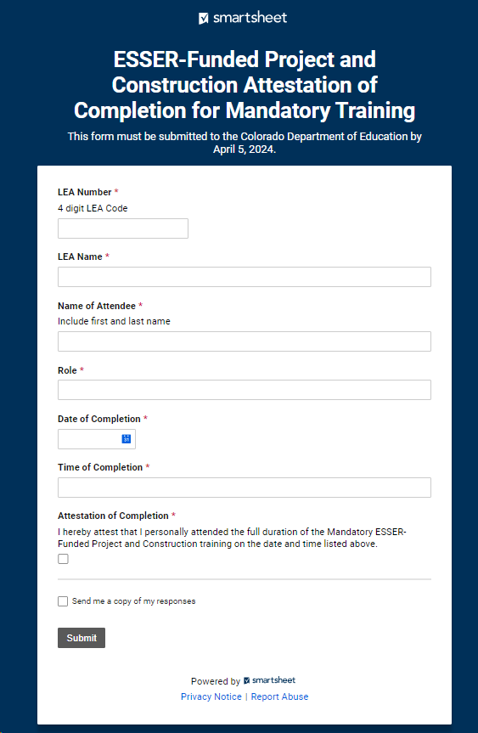
Attestation of Completion
Smartsheet linked here
Used to provide assurance to CDE that LEA personnel watched the available recording or attended Office Hours on March 28, 2024
Individual responses must be submitted
Due by April 5, 2024
Respondents should see a pop-up window as confirmation that CDE received their response
Consider entering your email address and checking the box to get a copy of your response

Slide 28
Resources:
Uniform Grant Guidance (2 CFR §200)
CDE Construction Guidance Document
CDE Filing A Notice of Federal Interest Guidance Document
U.S. Department of Education Office of Elementary and Secondary Education (OESE) Resources
ESSER Resources
Davis-Bacon Overview Document
Links to April 26, 2023, webinar recording and transcript
Links to Davis-Bacon Regulations Updates Office Hours recording and transcript discussing DBRA updates effective October 23, 2023
(NOTE: This is the same link as #3a above. Click on it, expand Webinars & Office Hours, then scroll down to the Davis Bacon Regulations Updates Office Hours (12.07.2023) items.)
U.S. Department of Labor (DOL) Resources
DOL Wage and Hour Division DBRA Webpage
DBA/DBRA Certified Payrolls training and related slides that provide guidance on how to review certified payrolls
Payroll Form WH-347
Instructions for Completing Payroll Form WH-347
Links to prevailing wage webinars and related slides and transcripts
Contract Provisions for Non-Federal Entity Contracts Under Federal Awards (2 CFR §200, Appendix II)

Slide 29

Any Questions?

Slide 30
CDE Contacts
Jennifer Austin
Grants Fiscal Management Director
Office of Grants Fiscal Management
EMAIL: Austin_J@cde.state.co.us
Bill Parsley
ESSER Fiscal Monitoring Supervisor
Office of Grants Fiscal Management
EMAIL: Parsley_b@cde.state.co.us
Hilery Morris
Fiscal Monitoring Specialist
Office of Grants Fiscal Management
Email: Morris_h@cde.state.co.us
Nazie Mohajeri-Nelson
Executive Director
Federal Programs & Supports Unit
EMAIL: Mohajeri-Nelson_n@cde.state.co.us
Tammy Giessinger
Program Monitoring Supervisor
Federal Programs & Supports Unit
EMAIL: Giessinger_T@cde.state.co.us
Kristin Crumley
ESEA/ESSER Monitoring Coordinator
Federal Programs & Supports Unit
EMAIL: Crumley_k@cde.state.co.us

